Slide 1
Grand Canyon
Ecological Forecasting
Mapping and Modeling Juniper Woodland Mortality in Grand Canyon National Park
Scarlet Jackson
Miriam Ritchie
Michael Hitchner
Joe Miotke
Colorado – Fort Collins | Spring 2022
Notes:
Hi everyone! And thanks for joining us in our closeout presentation today. My name is Scarlet Jackson and I am joined by Miriam Ritchie and Michael Hitchner to speak about our mapping and modeling juniper woodland mortality in Grand canyon national park over the last 10 weeks! We learned a lot during this develop term and are excited to share our findings and chat about our project with you all.
------------------------------Image Information Below ------------------------------
•Image Credit: DEVELOP TEAM
•Image Source:

Slide 2
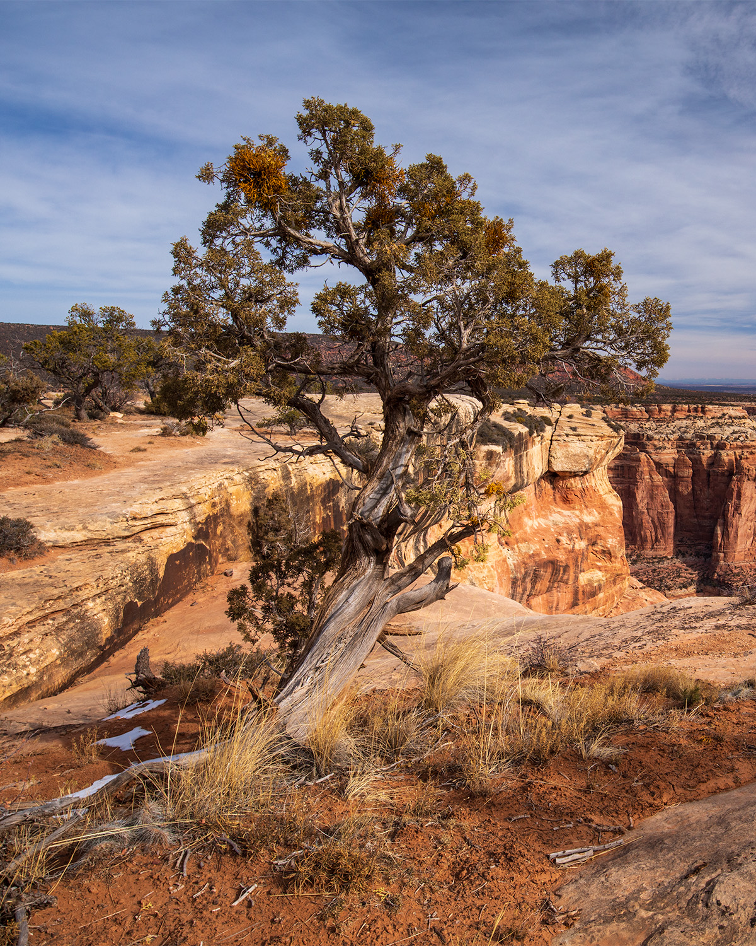
JUNIPER BACKGROUND
Junipers are coniferous trees and shrubs
Mainly occur on the rims of the canyon from elevations between 3 to 8 thousand feet
Known as a drought resistant species
Recording of mass die-off began in 2018
Native to the area
Terrain
Terrain can vary from gentle valleys and plains to rugged and steep rocky terrain
Soils
Soils can range from deep, fine-textures to shallow and rocky soils
Image credit: Mike Hitchner
Notes:
Juniper are coniferous tree and shrub species, and they are native to the southwest
The terrain these juniper woodlands are found in can range from gentle valleys and plains to rugged and steep rocky terrain.
Juniper woodland mainly occur on the rims of the canyon between elevations of 3 to 8 thousand feet.
They have been know as a drought tolerant species BUT
There has been recordings of mass die-off since 2018
------------------------------Image Information Below ------------------------------
•Image Credit: Mike Hitchner
•Image Source: DEVELOP Team

Slide 3
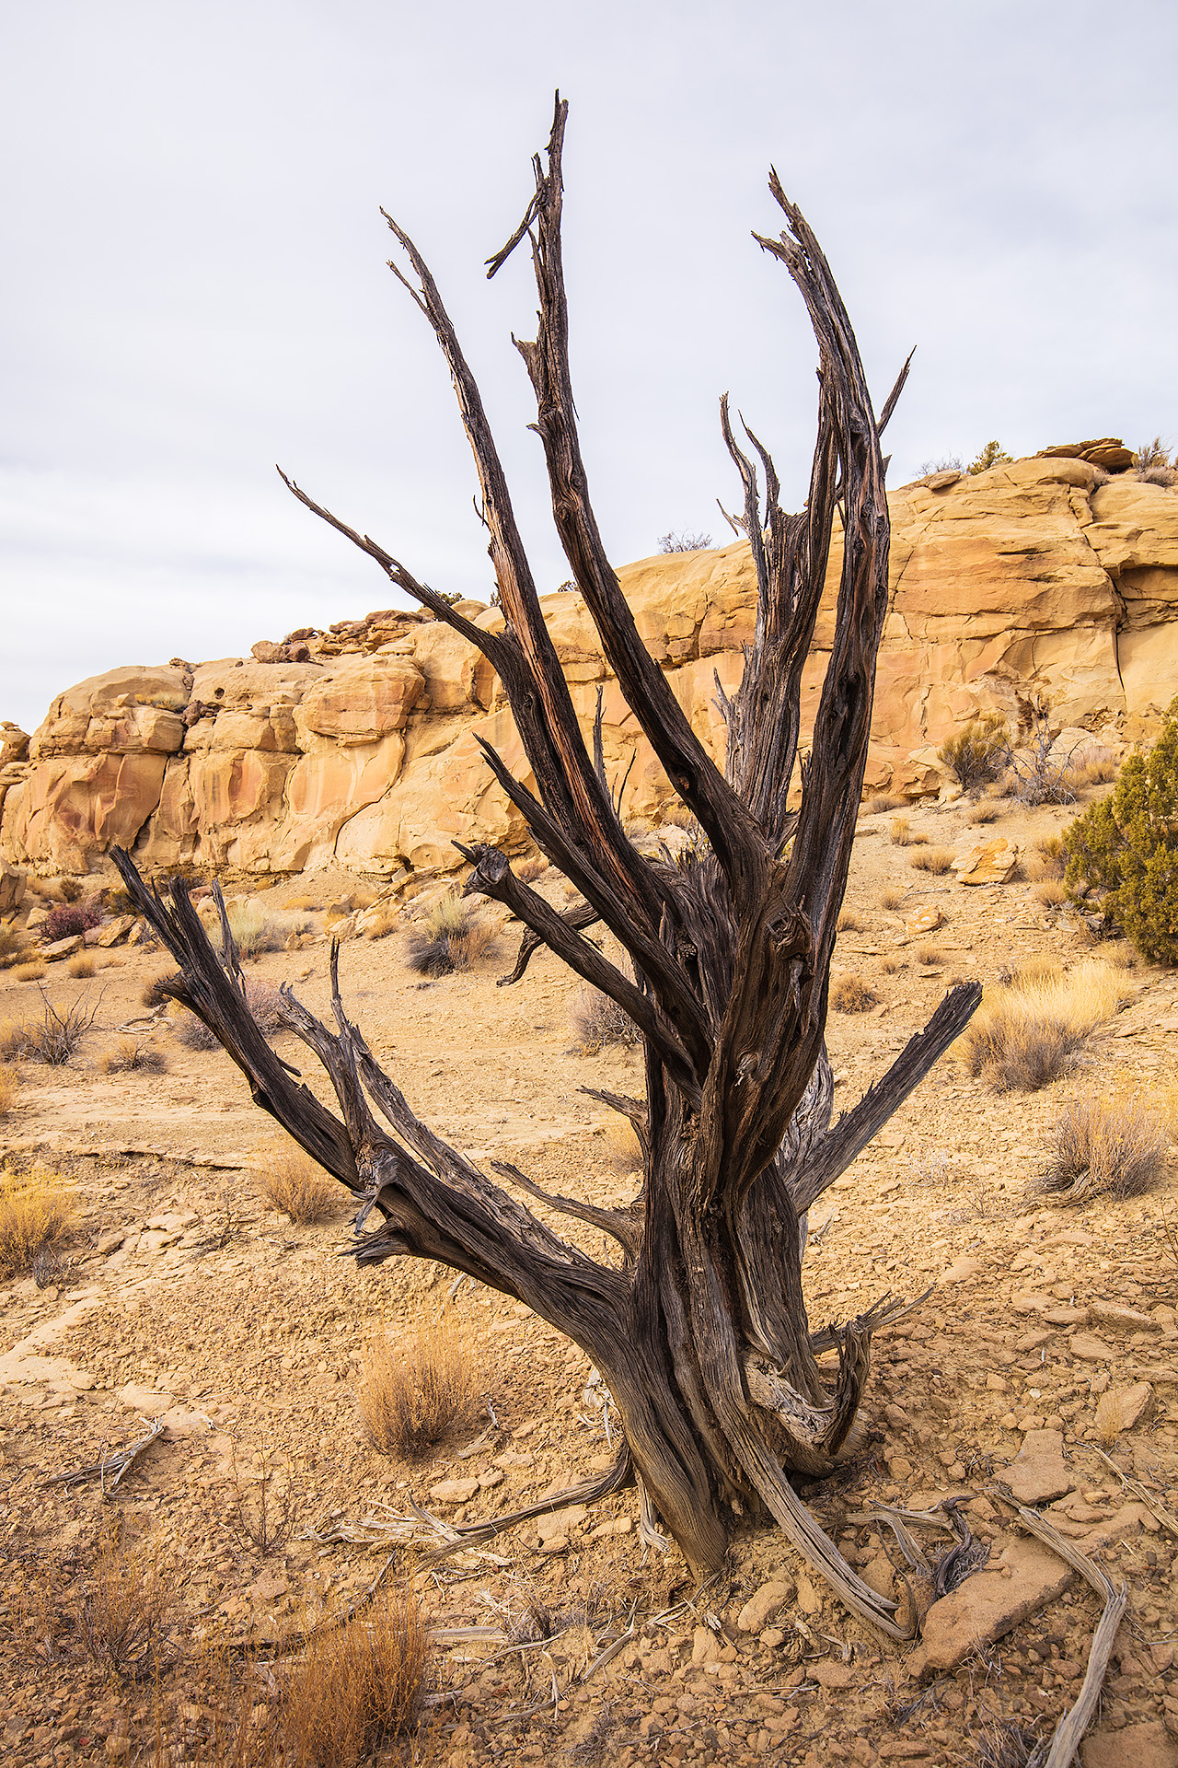
DROUGHT
The North American Southwest has been experiencing a "megadrought" for the last 40 years
Notice of juniper woodland mortality within and around
Grand Canyon National park
Image credit: Mike Hitchner
Notes:
As climate models project rising temperatures and continuous drought, land managers are concerned for the future of juniper woodlands in and around Grand Canyon National Park.
The North American Southwest has been experiencing a "megadrought" for the last 40 years and juniper woodland mortality has been noted within and around Grand Canyon National Park
Especially since 2018 which was a particularly bad drought year
------------------------------Image Information Below ------------------------------
•Image Credit: Mike Hitchner
•Image Source: DEVELOP Team

Slide 4
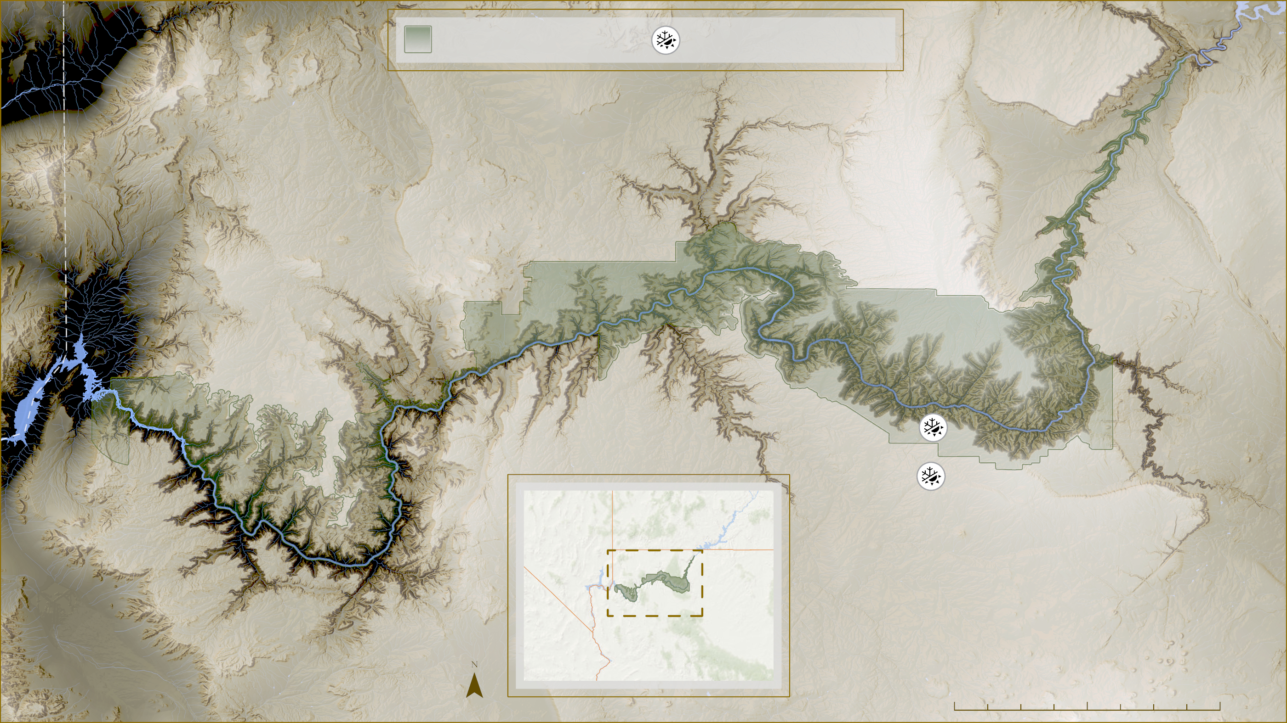
Grand Canyon NP
Weather Station
Nevada
Utah
Arizona
California
0
10
20
40
Notes:
In order to explore the drought we looked at the precipitation history in the Grand Canyon region using NOAA weather station data.
Mapped here are the two NOAA weather stations located near the southwest corner of our project study area
------------------------------Image Information Below ------------------------------
•Map Credit: DEVELOP Team
•Map Data: USGS Digital Elevation Model
•Locator Map Basemap: Esri, GEBCO, DeLorme, NaturalVue

Slide 5
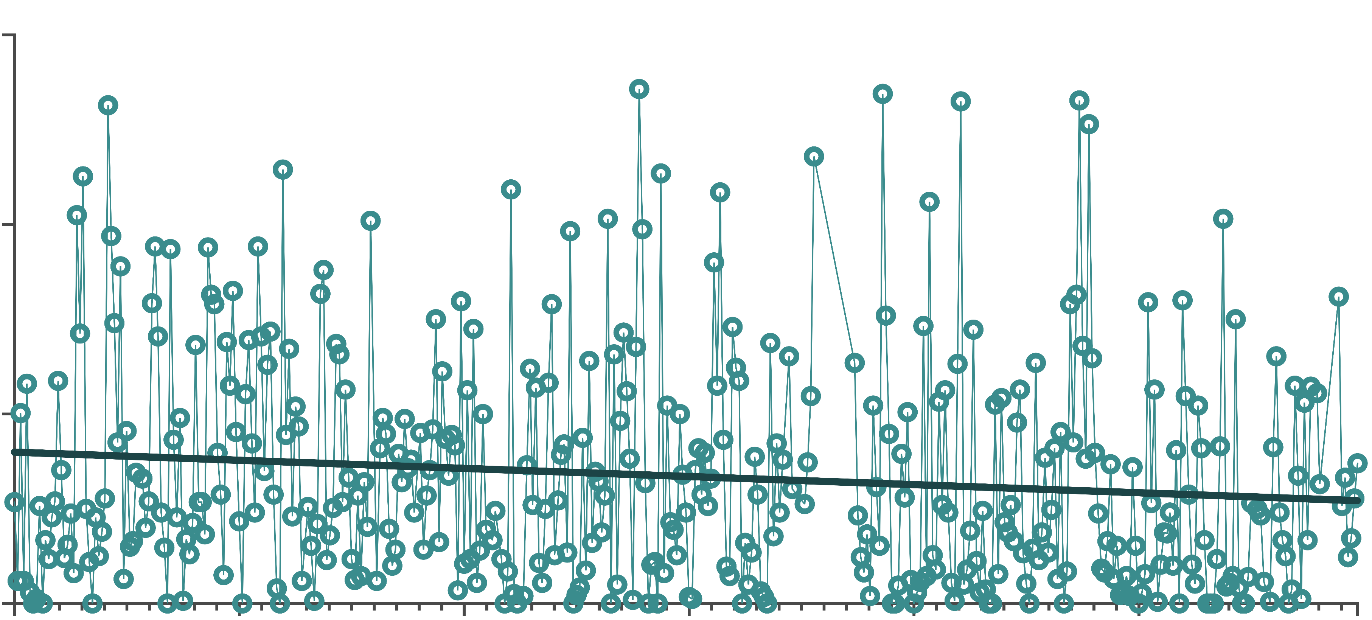
Grand Canyon Precipitation – Station 1 (1976-2012)
6
4
Precipitation (in)
2
0
1976
1982
1988
1994
2000
2006
2012
Time
Notes:
Graphed here is the precipitation for station 1, showing a downward trend line for precipitation since 1980. Monthly average precipitation was around 1.65 inches per month in 1976 and now at the weather stations within the area it is now just below 1 inch per month by 2021.
------------------------------Image Information Below ------------------------------
•Map Credit: DEVELOP Team
•Map Data: NOAA, USGS, Esri, GEBCO, DeLorme,NaturalVue

Slide 6
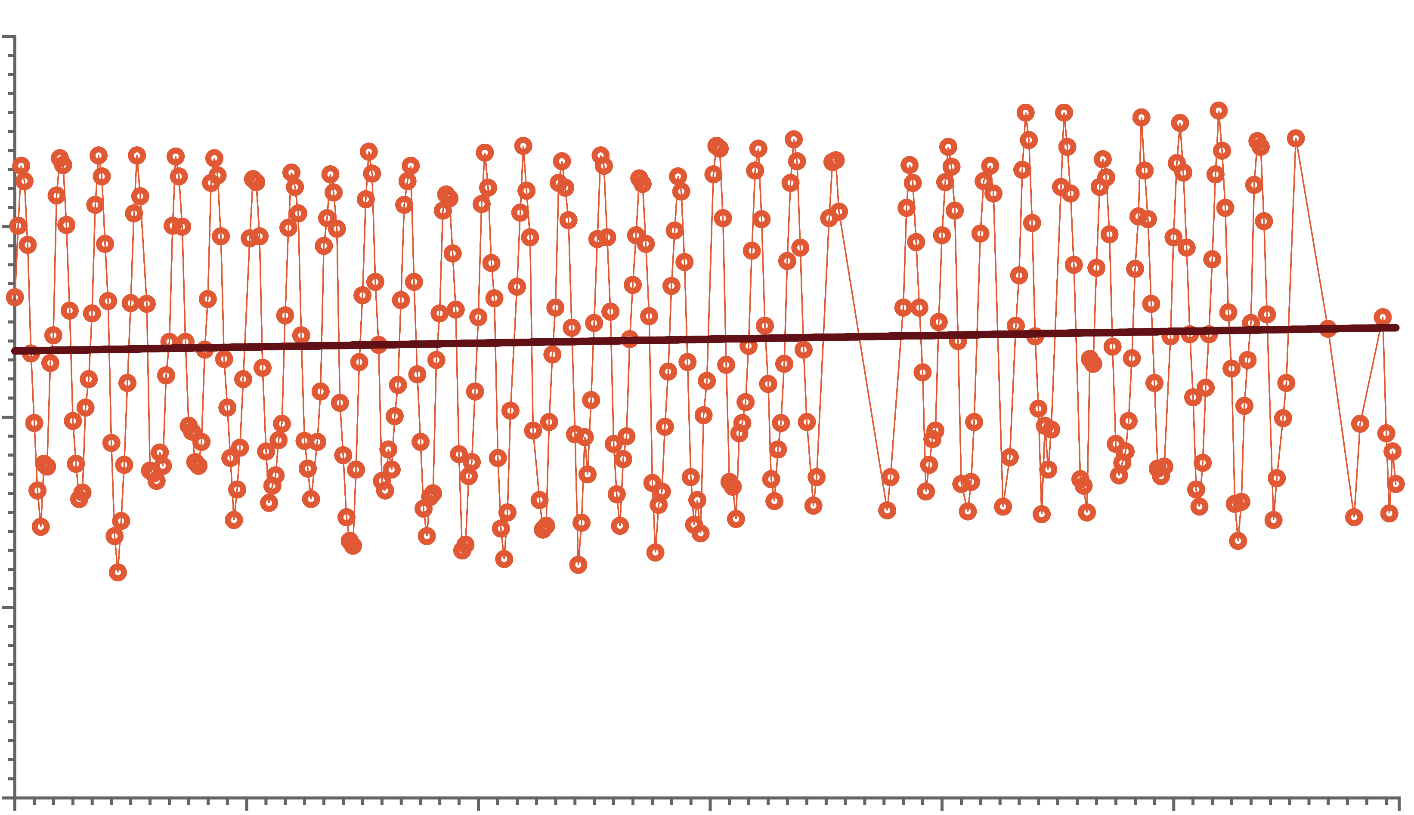
Grand Canyon Temperature – Station 1 (1976-2012)
80
60
40
Temperature (F)
20
0
1976
1982
1988
1994
2000
2006
2012
Time
Notes:
Graphed here is the temperature for a NOAA weather station near our study area, showing an increasing trend line for temperature within the region since 1976.

Slide 7
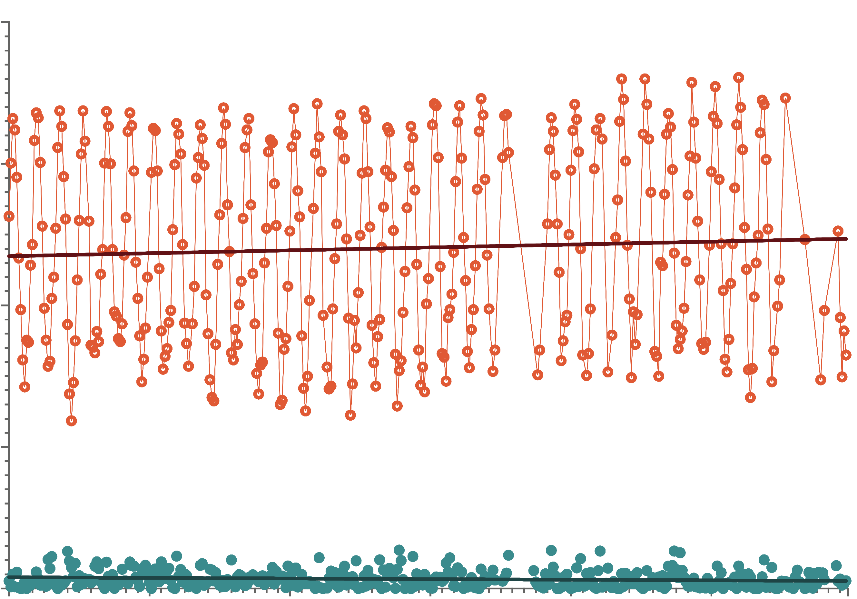
Grand Canyon Temperature and Precipitation – Station 1 (1976-2012)
80
60
Temperature (F)
40
20
Precipitation (in)
0
1976
1982
1988
1994
2000
2006
2012
Time
Notes:
Graphed here are both temperature and precipitation in order to illustrate both trends together.
Since 1976 the monthly average temperature has increased slightly, and the monthly average precipitation has decreased almost 30 percent.
Drought conditions in the west have continued, with years like 2018 having been particularly severe.

Slide 8
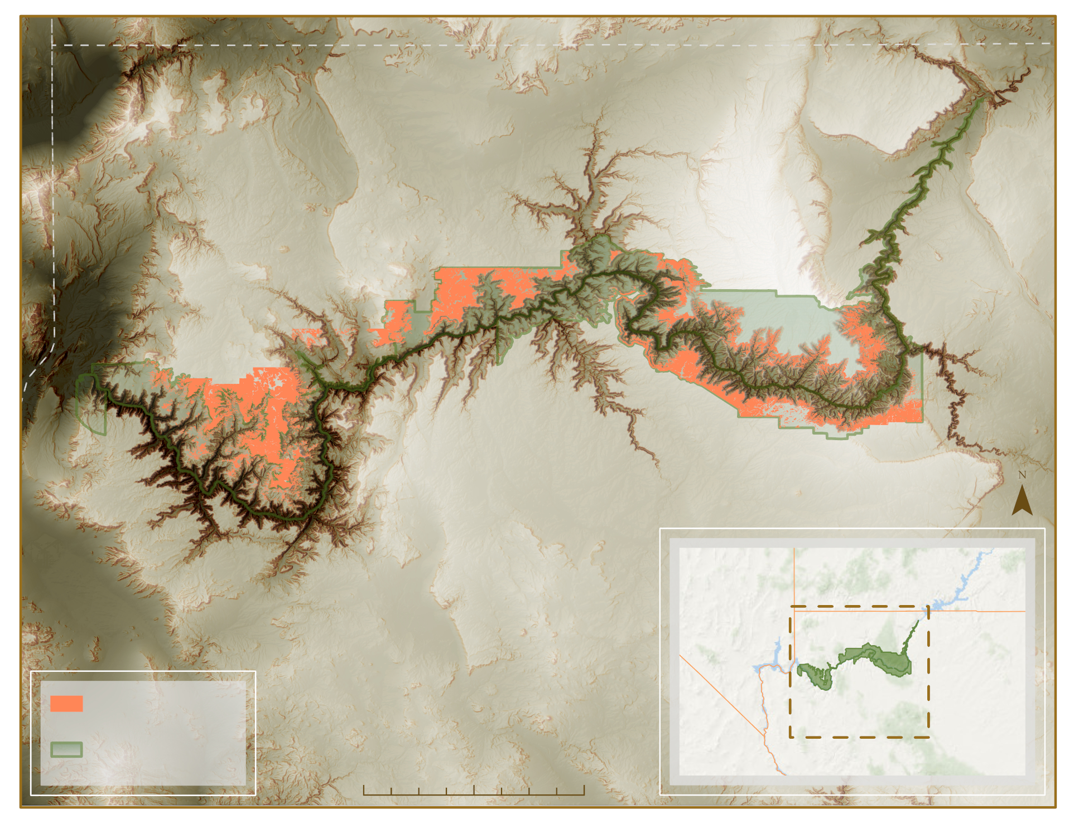
STUDY AREA & PERIOD
Utah
Arizona
Grand Canyon National Park
Falls within areas that have substantial juniper presence
Study period: 2015-2021
Utah
Nevada
Study Area
GCNP
California
Arizona
10
20
40 miles
Map: CO Grand Canyon Eco Team
Notes:
Our study area falls in and around Grand Canyon National Park in northern Arizona.
The study area includes predominantly semi-arid desert landscapes that ranges from 662 meters to 2860 meters in elevation.
The study area is delineated by areas that have a substantial presence of juniper, based on data provided by our partners.
------------------------------Image Information Below ------------------------------
•Map Credit: DEVELOP Team
•Map Data: USGS NED Digital Elevation Model
•Corner Locator Map Data: Esri, GEBCO, DeLorme,NaturalVue

Slide 9
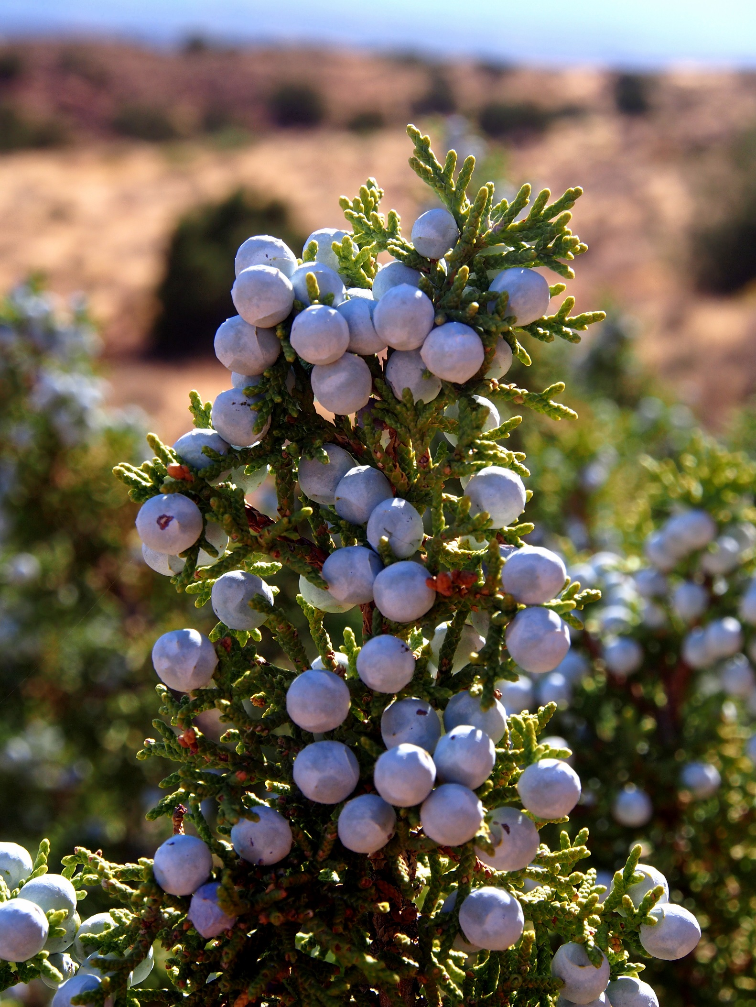
CONCERNS
Ecological Concerns
Food and shelter source to
wildlife in the area
Helps to prevent erosion
Cultural Concerns
Medicinal properties
Wood quality ​
Community Concerns
Fire regime shifts​
Decreases in water availability​
Forest composition + species shifts​
Carbon feedback to atmospheric
and climatic systems​
Image credit: Amy Washuta
Notes:
The loss of Juniper species raises concern in a number of areas.
Junpier trees are a sources of food an shelter to wildlife in Grand Canyon national park such as mule deer, elk, and many bird species,
And they help increase water resources and their well established root help to prevent erosion in soil.
There are also some cultural concerns with the loss of Juniper as the Havasupai tribe utilize Juniper's medicinal properties.
It is also an important source of fire wood.
There are many community concerns with the loss of juniper species as this could mean fire regime shifts with mass amounts of fuel, decreases in water availability, forest composition and species shifts, and carbon feedback to atmospheric and climatic systems.
------------------------------Image Information Below ------------------------------
•Image Credit: Amy Washuta
•Image Source: https://flic.kr/p/2i1A6hg
https://creativecommons.org/licenses/by/2.0/

Slide 10
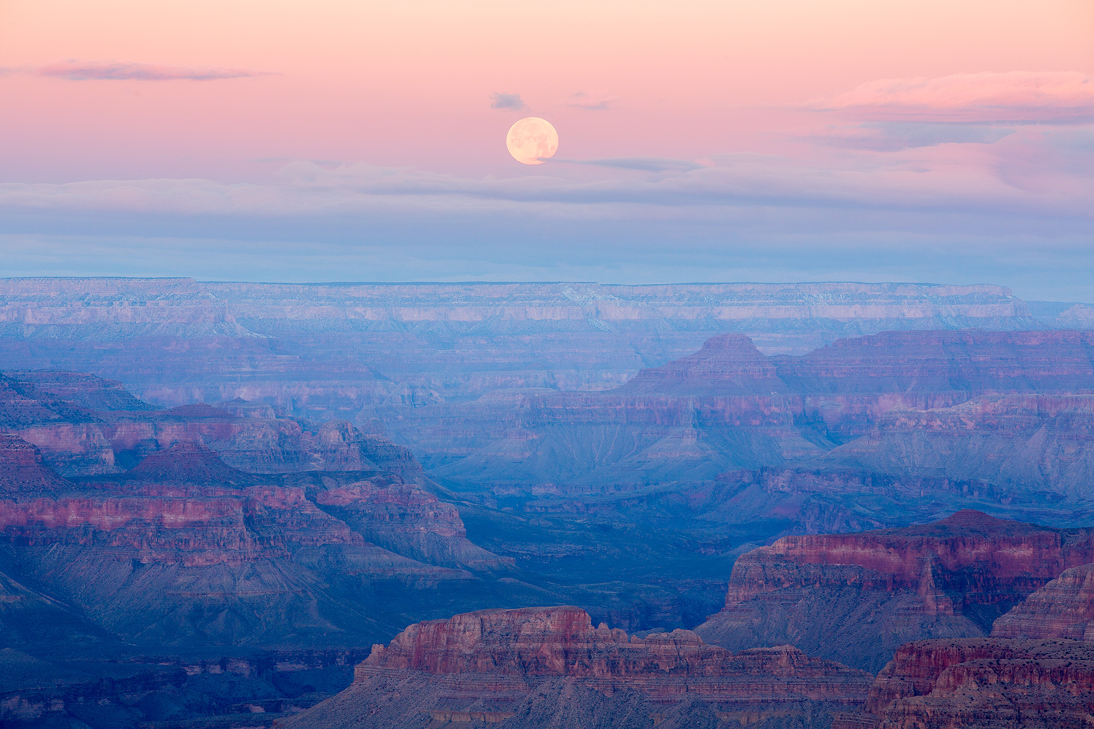
PARTNERS
Grand Canyon
National Park
Science & Resource
Management Division
Image credit: Michael Hitchner, NPS
Notes:
Our partner, Grand Canyon National Park, was interested in exploring the potential causes of juniper die off in and around the park. We hoped to shed light on the cause.
Comment: It's best to just mention this person in the acknowledgements slide since you're partnering with GCNP and not any specific person. @Robert Byles come back to this later?
------------------------------Image Information Below ------------------------------
•Image Credit: NPS Logo (National Park Service)
•Image Source: https://www.nps.gov/articles/parkscience34-1_insert_timeline_hunt_et_al_3883.htm
•Image Credit: Mike Hitchner
•Image Source: DEVELOP Team

Slide 11
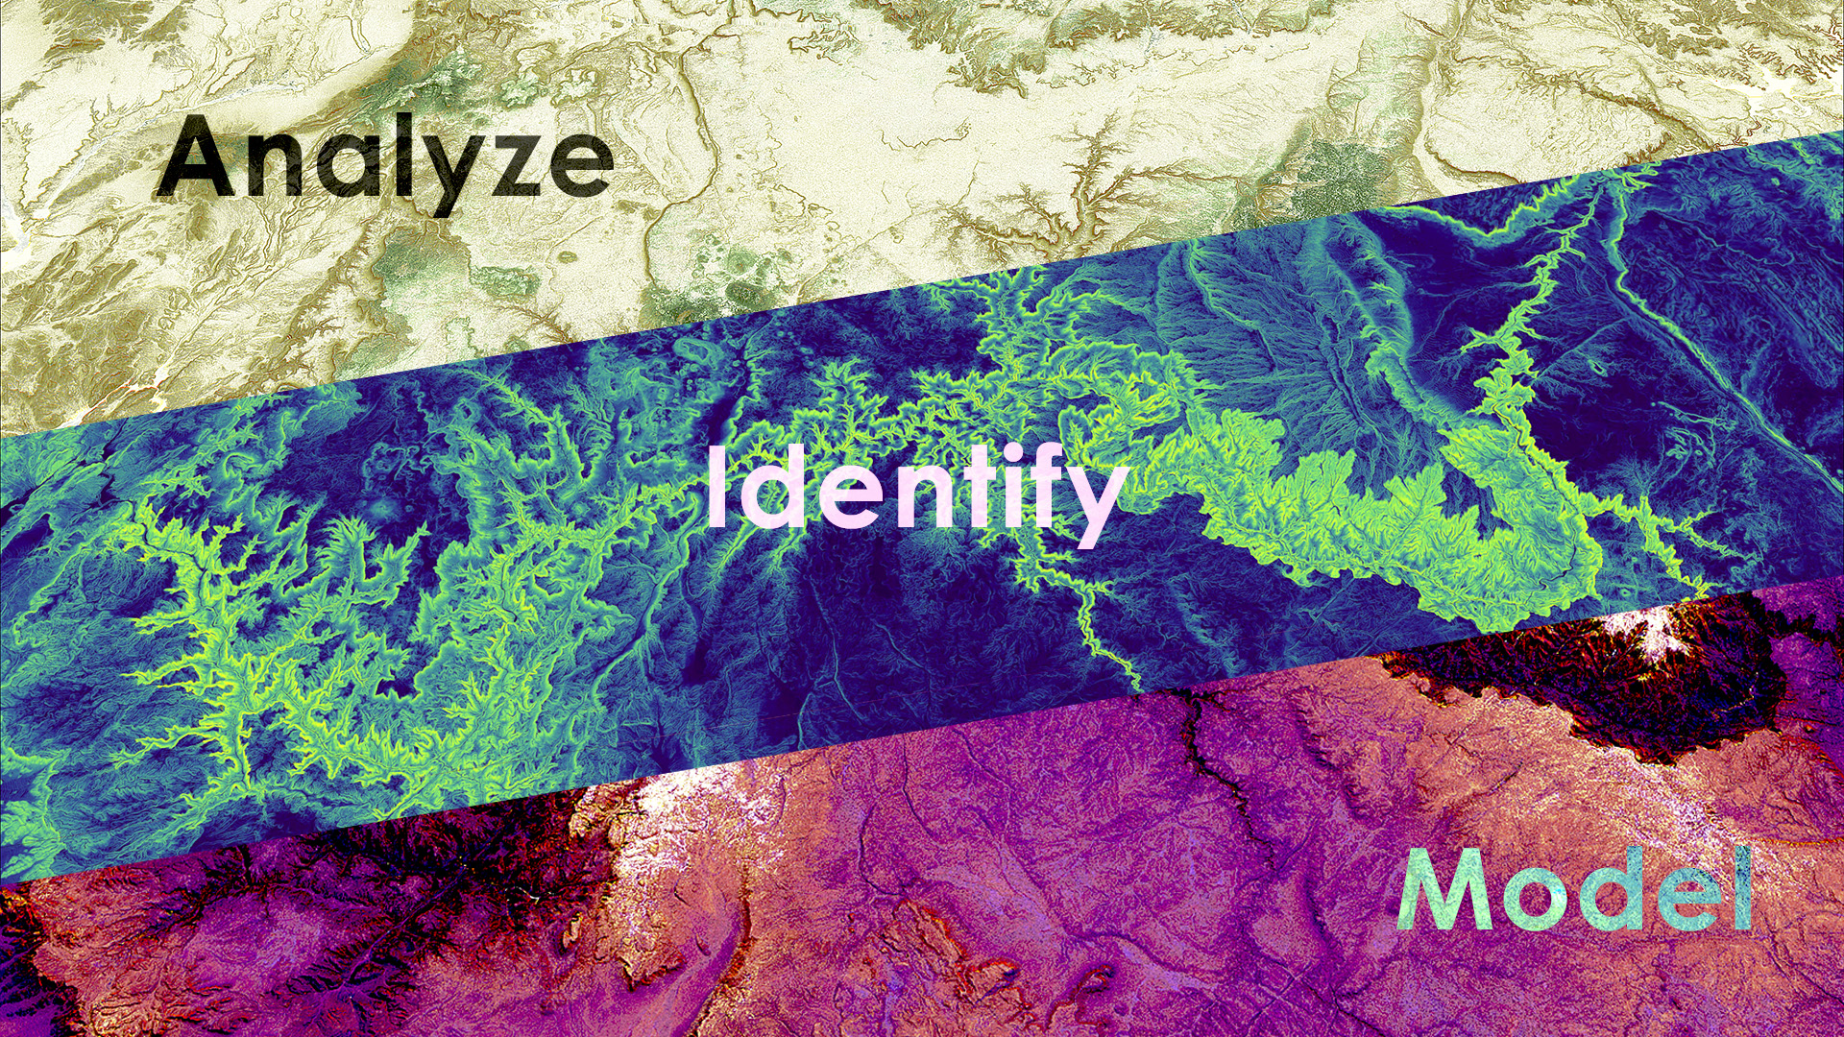
OBJECTIVES
environmental factors associated
with juniper woodland mortality
patterns between characteristics of the landscape and juniper woodland mortality locations
landscape most susceptible to future juniper woodland mortality
Notes:
Our project objectives involved progression through 3 different stages.
Our first step involved analyzing environmental factors associated with juniper woodland mortality.
Second, we worked to identify patterns and characteristics of the landscape and juniper woodland mortality locations.
Third, we planned to model the areas that were most susceptible to potential future juniper woodland mortality.
In order to do so, we utilized several different satellite sensors.
------------------------------Image Information Below ------------------------------
•Image Credit: DEVELOP Team

Slide 12
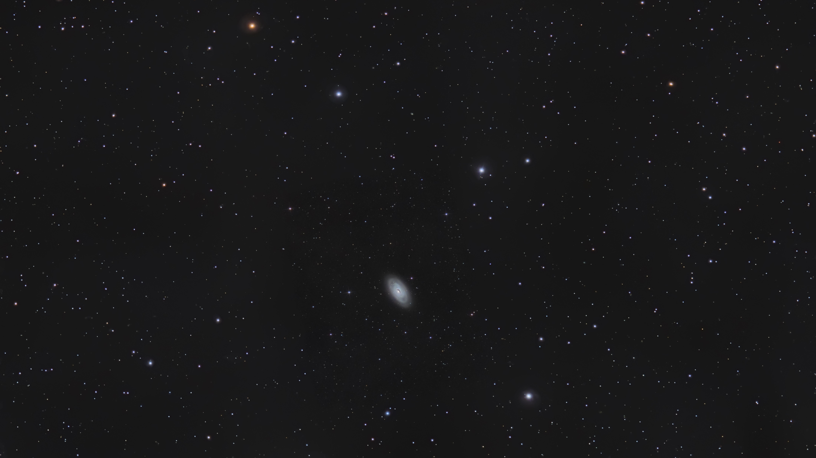
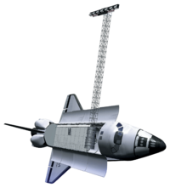
METHODS: SATELLITES AND SENSORS
Landsat 8
Operational Land Imager (OLI)
Shuttle Radar Topography Mission (SRTM)
National Agriculture Imagery Program (NAIP)
Image credits: NASA (satellites), darkSkies (background) USDA (logo)
Notes:
We sourced environmental variables layers, like slope, elevation, and northness and eastness, from SRTM
Indices like NDVI, NBR, and tasseled cap were derived from satellite imagery of Landsat 8.
And we acquired NAIP imagery from USDA for ocular sampling
------------------------------ Image Information Below ------------------------------
Space background image
•Image Credit: darkSkies Astrophotography
•Image Source: https://darkskies.space/portfolio/m64/
•Image license: Attribution-NonCommercial-ShareAlike 4.0 International (CC BY-NC-SA 4.0)
Satellite Images
•Image Credit: DEVELOPedia
•Image Source: DEVELOP National Program (https://www.devpedia.developexchange.com/dp/index.php?title=List_of_Satellite_Pictures)
USDA Logo
•Image Credit: USDA
•Image Source: https://www.usda.gov/themes/usda/img/usda-symbol.svg

Slide 13
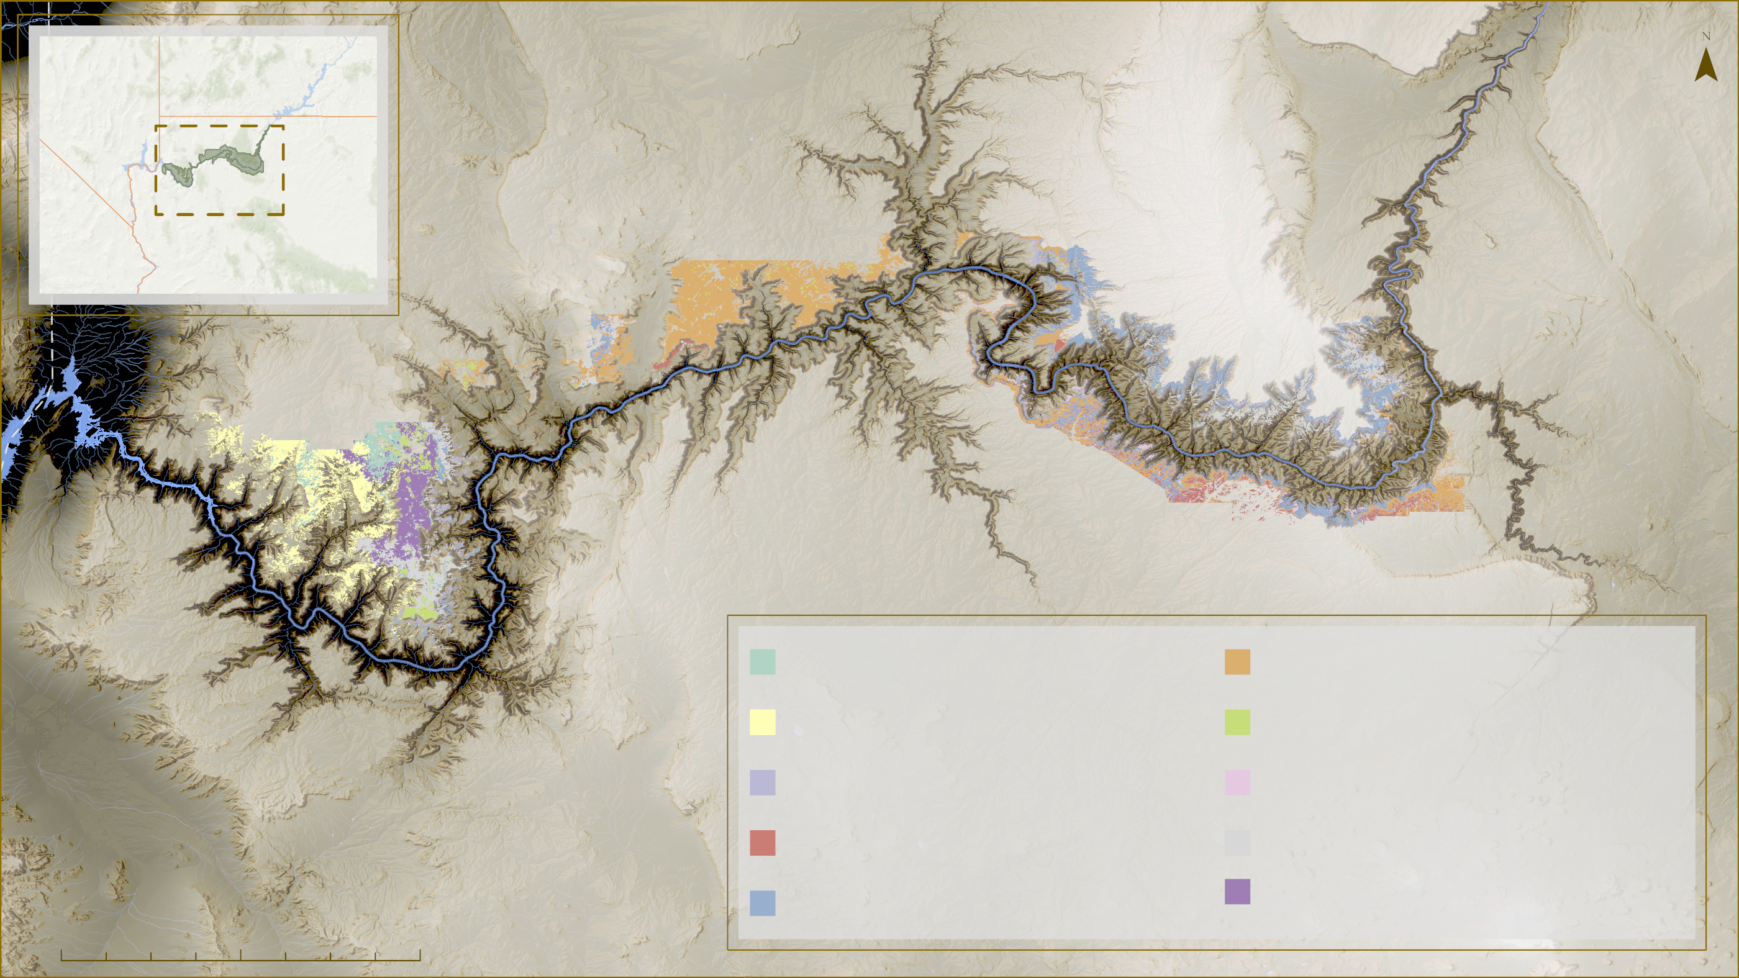
METHODS: ANCILLARY DATASETS
Nevada
Utah
California
Arizona
P + J Grass and Forb
P + J Sagebrush Woodland
P + J Shrub Understory
P + J Sparse Understory
P + J Blackbrush
P + J Talus Canyon
P + J Grass and Forbs
P + J Turbinella Woodland
P + J Oak Woodland
P + J Savannah
0
10
20
40
Notes:
We utilized a couple datasets provided by outside sources. First, we were provided vegetation transects surveyed by the Forest Service to serve as training data for our team.
Although these transects were not within our study area, they helped calibrate our optical sampling methods that we will discuss later.
The second dataset that served as the basis for our study area is a vegetation classification layer provided by the National Park.
The vegetation classes covered areas in and around the park, and we pulled the classifications that included a substantial portion of juniper presence to determine our study area.
The map on this slide shows all 10 vegetation classes that contained juniper and were selected in order to determine this study area.
Once we had determined our study area, we were able to start examining environmental and topographic variables.
------------------------------Image Information Below ------------------------------
•Image Credit: Claude Monet
•Image Source: http://commons.wikimedia.org/wiki/File:Claude_Monet_-_The_Magpie_-_Google_Art_Project.jpg (insert here whether this image is provided by a DEVELOPer/partner, public domain, or the type of creative commons license the image was published under – e.g. CC BY-SA)

Slide 14
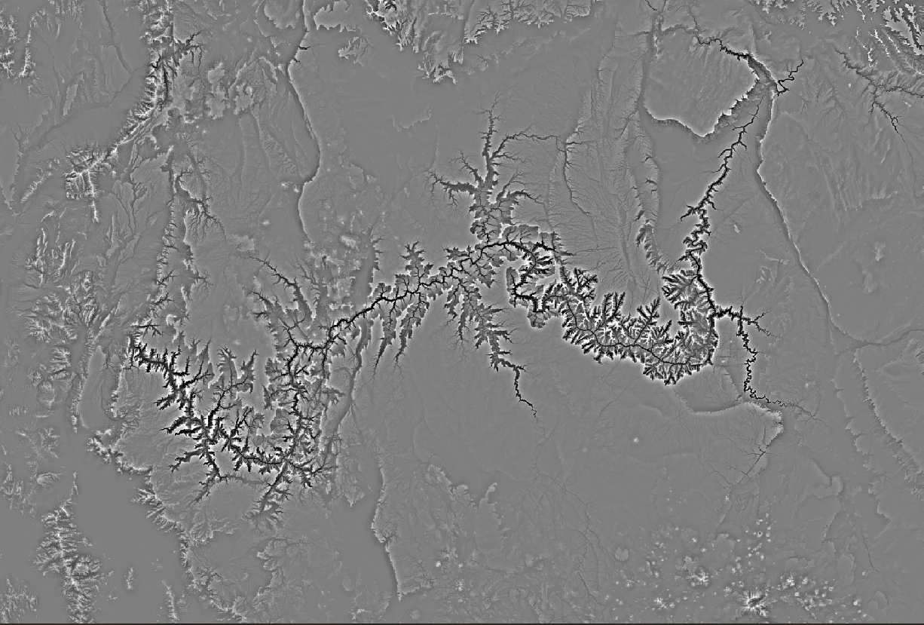
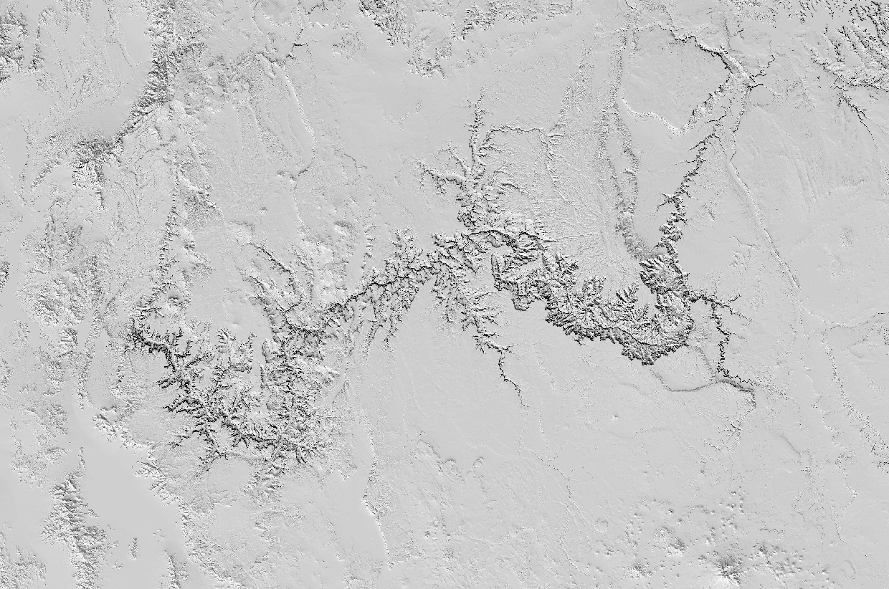
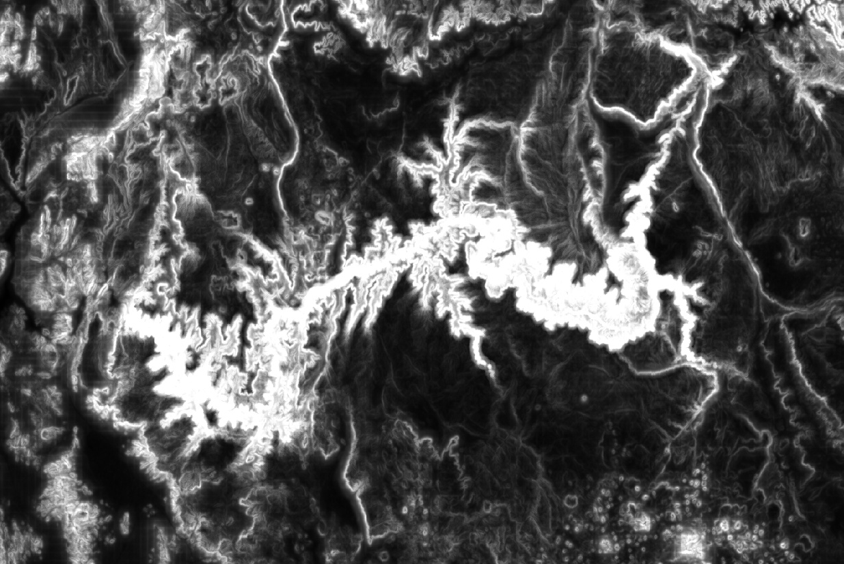
METHODS: Some Environmental Variables
mTPI
Multi-scale Topographic Position Index
CHILI
Continuous Heat Insolation Load Index
Topographic Diversity
Measures topography while including hillslope position to be quantified
Assumes temperatures based on topographic position
Measures the combinations of temperatures and moisture conditions that are occurring
Notes:
Here are a few of the environmental variables that we used
The topographic position index measures topography while allowing hillslope position to be quantified
The CHILI is a heat load index that assumes temperature based on topographic position
And Topographic Diversity is calculated using the mTPI and CHILI to measure combinations of temperatures and moisture conditions that are ocurring
In addition to these we also included slope, elevation, and northness and eastness for our topographic variables
------------------------------Image Information Below ------------------------------
•Images Credit: Theobald, D. M., GEE
•Image Source: https://developers.google.com/earth-engine/datasets/catalog/CSP_ERGo_1_0_US_topoDiversity#description

Slide 15
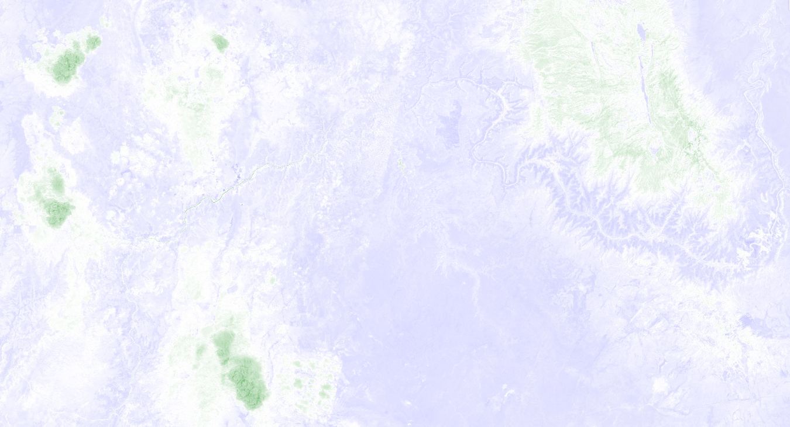
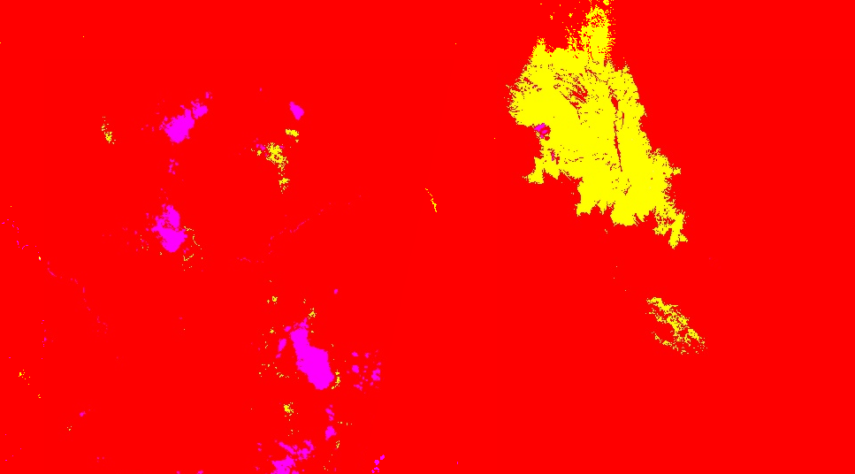
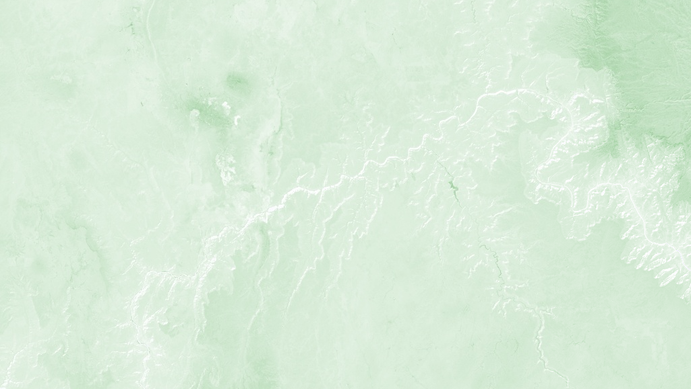
METHODS: Some Derived Indices
NDMI
Normalized Difference Moisture Index
NDVI
Normalized Difference Vegetation Index
Tasseled Cap
NDMI is used to indicate the water content in vegetation.
Tasseled cap index made up of three band images. The three bands represent brightness, greenness, wetness for our area of interest.
NDVI is used to quantify vegetation greenness and is useful in understanding vegetation density and assessing changes in plant health.
Notes:
Some indices we included in analyses were
NDMI to indicate water content in vegetation
Tasseled Cap indices to measure wetness, greeness, and brightness of vegetation
NDVI to quantify vegetation greenness and asses plant health
We also included NBR (Normalized burn ratio) to assess plant health.
These indices were calculate for 2016 and 2021 images and the difference of those indices were included in analysis as well
------------------------------Image Information Below ------------------------------
•Image Credit: Derived in GEE
•Image Source: https://earthengine.google.com/

Slide 16
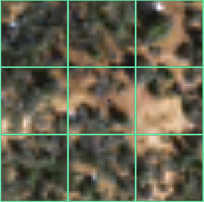
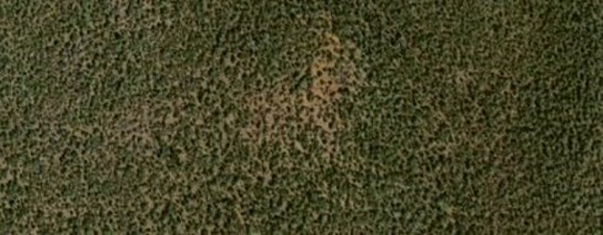
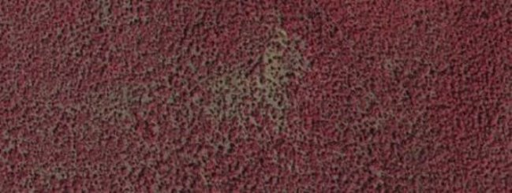
METHODS: OCULAR SAMPLING
270 randomly distributed sample points
Ocularly sampled each point
Estimating the percentage of:
Green
Mortality
Shadow
Other
Percent Green: 10%
Percent Mortality: 30%
Percent Shadow: 5%
Percent Other: 55%
Percent Green: 35%
Percent Mortality: 20%
Percent Shadow: 15%
Percent Other:30%
Percent Green: 20%
Percent Mortality: 20%
Percent Shadow: 10%
Percent Other: 50%
Notes:
Our ocular sampling method involves using high resolution remotely sensed data, in this case, National Agriculture Imaging Program (NAIP) imagery with a resolution of .6 square meters to examine and break down landcover characteristics within our study area.
We utilized both true color and false color imagery to aid with mortality identification.
We randomly distributed 270 sample points in Juniper woodlands within our study area and then visually categorized percentages of green canopy cover and percentage of observed mortality on the landscape at the 20x20m grid cell containing each sample point.
Anything else seen in the images were categorized as a shadow or bare ground and rock were categorized as "Other" class. Any point that was hard to ocular sample due to high percentages of shadow or snow cover was removed from analysis.
Once we had completed the ocular sampling of all 270 points, we had an extensive dataset to conduct analysis with.
------------------------------Image Information Below ------------------------------
•Image Credit: NAIP Imagery
•Image Source: https://www.fsa.usda.gov/programs-and-services/aerial-photography/imagery-programs/naip-imagery/

Slide 17
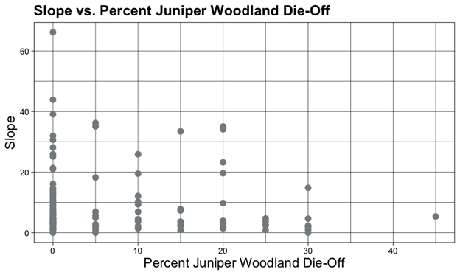
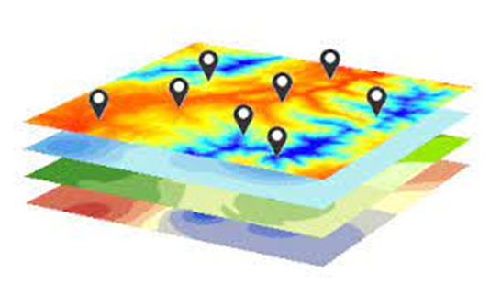
METHODS: DATA ANALYSIS
1. Extracting values at each sample point
2. Plotting values of predictor variables against juniper woodland mortality
3. Running random forest models to assess the feasibility of predicting juniper mortality
Image credit: ESRI
Notes:
We extracted environmental variable values at the points where we had ocularly sampled.
We then plotted these predictor variables against juniper woodland mortality to visualize correlations.
We ran linear models to explore the correlation between the environmental variables we extracted and juniper mortality.
Following this, we ran a regression random forest model to assess the feasibility of predicting juniper mortality
------------------------------Image Information Below ------------------------------
•Image Credit: ESRI
•Image Source: https://www.esri.com/arcgis-blog/products/analytics/analytics/how-to-extract-raster-values-at-point-locations/

Slide 18
METHODS: WORKFLOW
Elevation
Northness/Eastness
Slope
mTPI
CHILI
Satellite Data
Analysis of juniper woodland stress and associated patterns
Topographic Diversity
Linear Model
NDVI, NBR, NDMI
Random Forest
Tasseled Cap Indices
Fire Layers
Locate areas subject to juniper woodland vulnerability
NAIP Imagery
Ocular Sampling
GCNP VegClasses
Notes:
Here is a visual of our workflow, including all of the environmental variables that went into analysis, the modeling steps, and anticipated end goals

Slide 19
RESULTS
There was not a significant correlation between observed mortality and the environmental variables included in the analysis
Notes:
None of the environmental variables included in our analysis were statistically correlated with mortality in the park. Despite our literature review highlighting the potential importance of the variables we explored on juniper mortality, it appears that at least within our study area there are either other factors or variables at play, or data limitations that lead to a lack of correlation between our observed mortality in the ocular sample locations, and the environmental and topographic variables we examined.
Listed here are just a few of those with their R2 values, including difference in summer NDVI, difference in summer NDMI, elevation, and mTPI.
------------------------------Image Information Below ------------------------------
•Image Credit: DEVELOP team
•Image Source:

Slide 20
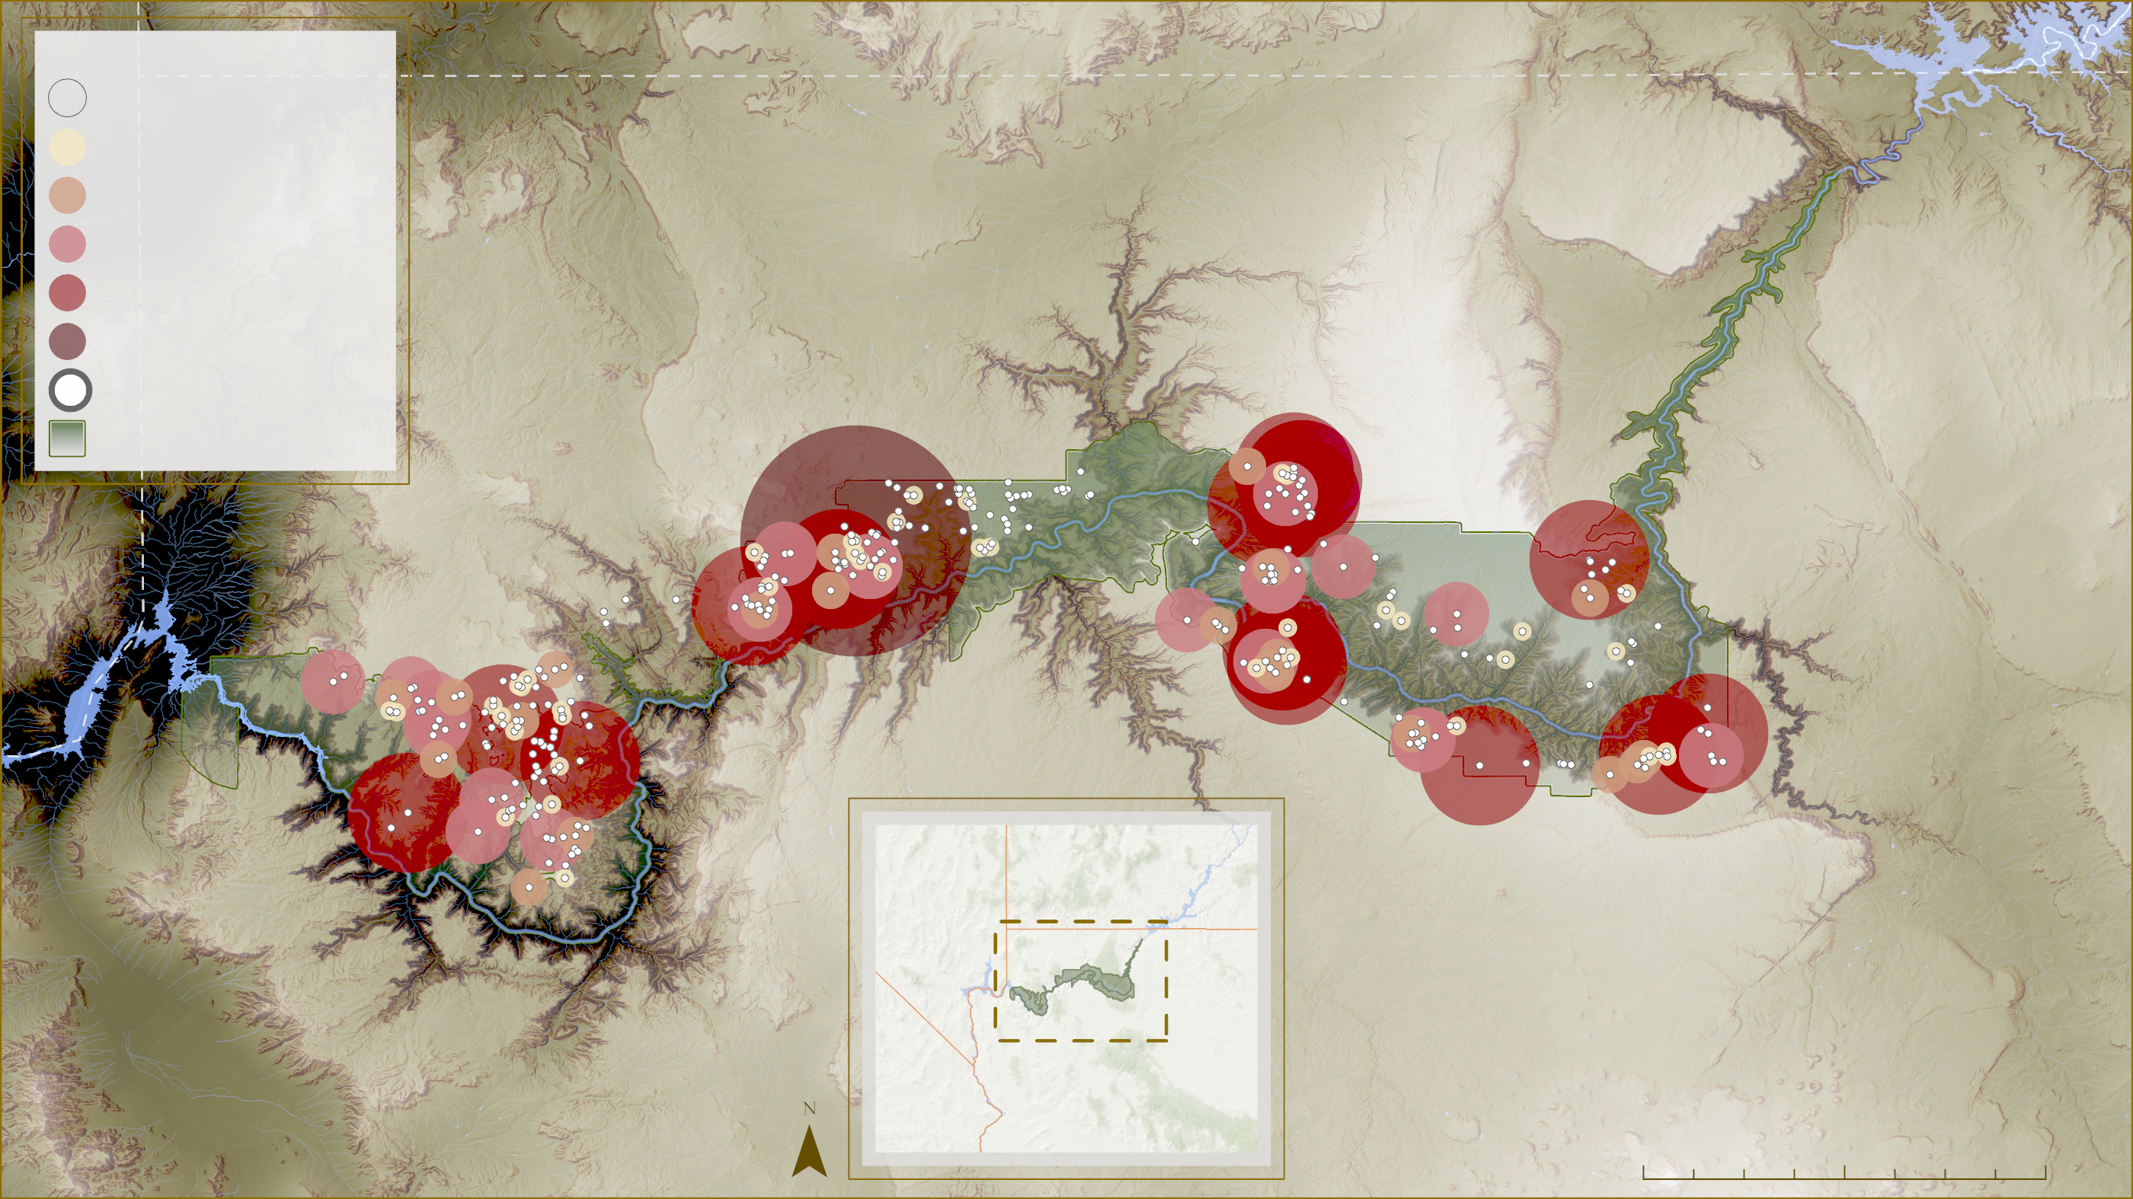
RESULTS
Graduated Symbology - Percent Observed Mortality
0 %
Smaller
1-10 %
11-15 %
16-20 %
21-30 %
31-45 %
Larger
Sample Point
GCNP
Nevada
Utah
California
Arizona
0
10
20
40 mi
Notes:
This map shows a graduated symbology of observed mortality for the ocular sample points within our study area. The largest, darkest red circles have the highest percentage of observed mortality while the smallest circles with no red have the least (0%) mortality.
------------------------------Image Information Below ------------------------------
•Map Credit: DEVELOP Team
•Locator Map Data: Esri, GEBCO, DeLorme, NaturalVue

Slide 21
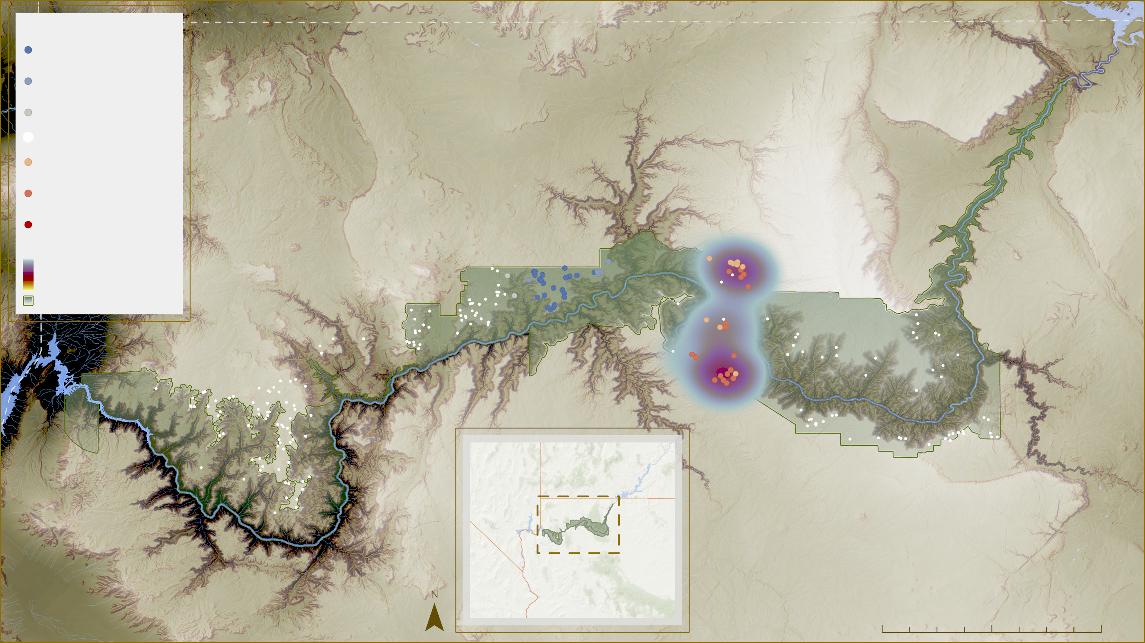
RESULTS
Percent Mortality Optimized Hotspot Analysis and Heat Map
Cold Spot 99%
95%
90%
Insignificant
90%
95%
Hot Spot 99%
Heat Map
GCNP
Nevada
Utah
California
Arizona
0
9
18
36 mi
Notes:
This map displays an optimized hotspot analysis of mortality within our ocular sample locations.
This highlights statistically significant clusters of high or low mortality. The red dots represent clusters of high values of mortality, and the blue dots represent cold spots or clusters or low mortality.
The heat map behind the hot spots also helps draw attention to these clusters of high mortality occurrence.
------------------------------Image Information Below ------------------------------
•Map Credit: DEVELOP Team
•Locator Map Data: Esri, GEBCO, DeLorme, NaturalVue

Slide 22
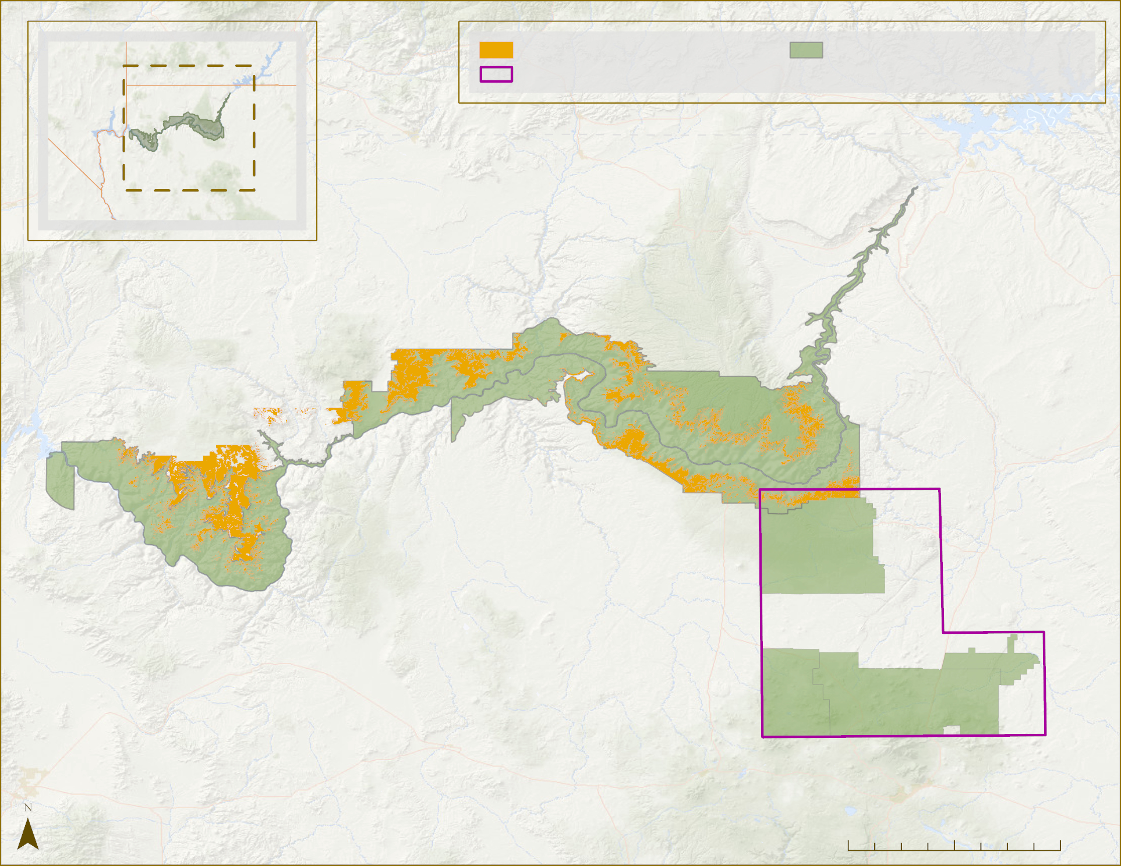
CO Study Area
NPS Managed Lands
RESULTS
Nevada
Utah
GSFC Study Area
Colorado DEVELOP Team - Grand Canyon (Orange)
Approximate study area mortality: 6.60%
Goddard DEVELOP Team - Arizona (Purple)
42.57% Mortality within study area
California
Arizona
Grand Canyon
National Park
Kaibab National
Forest
Wupatki National Monument
Coconino National
Forest
0
10
20
40 mi
Basemap by: Esri, GEBCO, DeLorme, NaturalVue
Notes:
This phenomena is not uniform in occurrence and makes it challenging to study. As shown on the previous slide's map – even within the park there are clusters of higher levels of mortality and areas of lower mortality that do not correlate with any of the environmental or topographic variables that we explored.
For instance – here we have our study area mapped, where we calculates 6% mortality within the landscape.
The Goddard Node working on a similar project this term has a study area just southeast of Grand Canyon National Park in Wupatki National Monument. Here they found 42.75% mortality within the landscape.
While the Goddard node found much more study area mortality, they also found little correlation with the environmental and topographic variables they examined.
------------------------------Image Information Below ------------------------------
•Map Credit: DEVELOP Team
•Basemap Data: Esri, GEBCO, DeLorme, NaturalVue

Slide 23
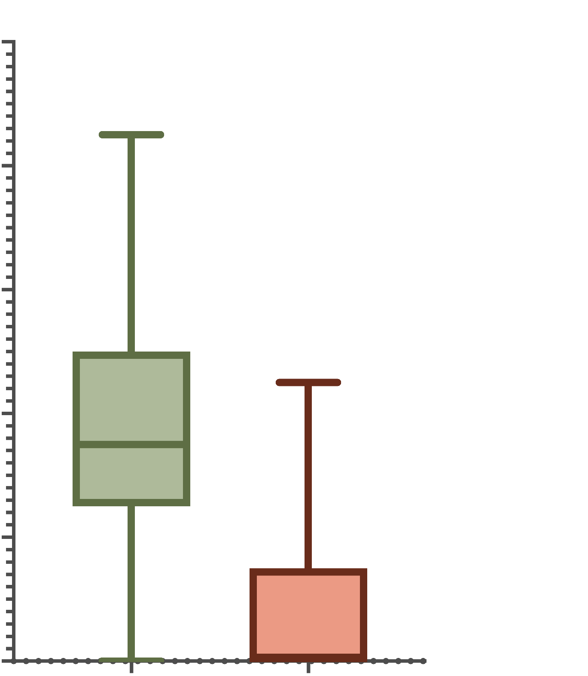
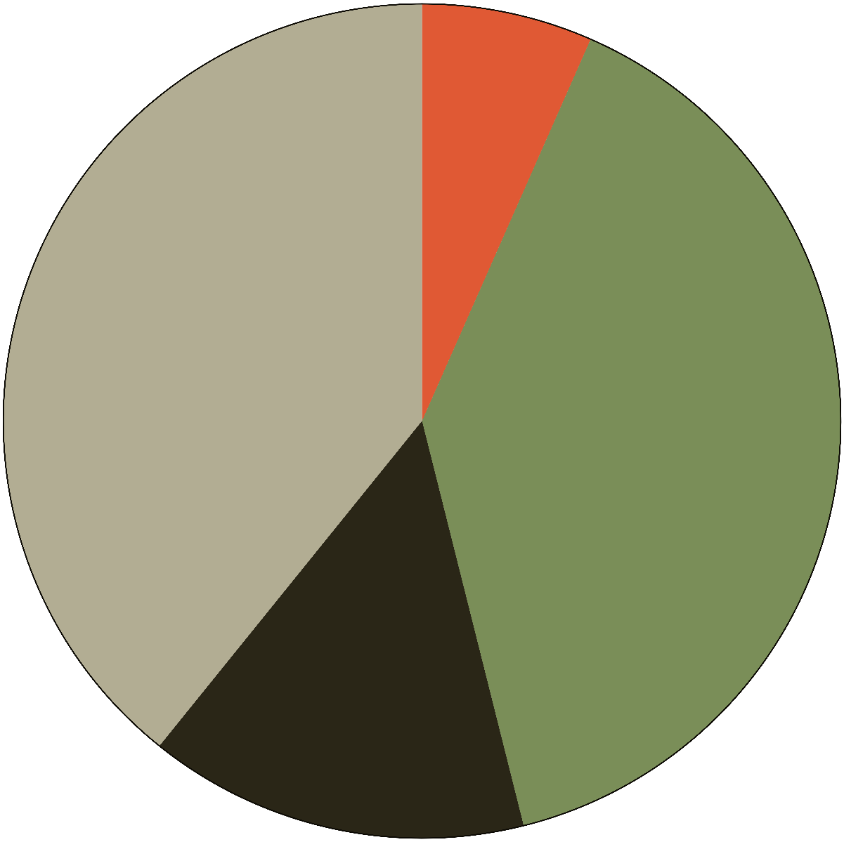
Summary of Ocular Sampling Results
RESULTS
Comparison of Percent Green and Percent Mortality
Cover Type Percent Breakdown
100
Percent Green
80
60
39.5%
Percent Shadow
Percent
14.7%
40
6.6%
20
Percent Mortality
39.2%
Percent Other
0
Percent Green
Percent Mortality
Cover Type
Notes:
These two graphs give a summary of the ocular sampling results. The pie chart on the right shows the total percentages of each type of cover we sampled. 39.5 percent green, 14.7 percent shadow, 6.6 percent mortality, and 39.2 percent other. The plot on the left is an additional visualization comparing the percent green and percent mortality.

Slide 24
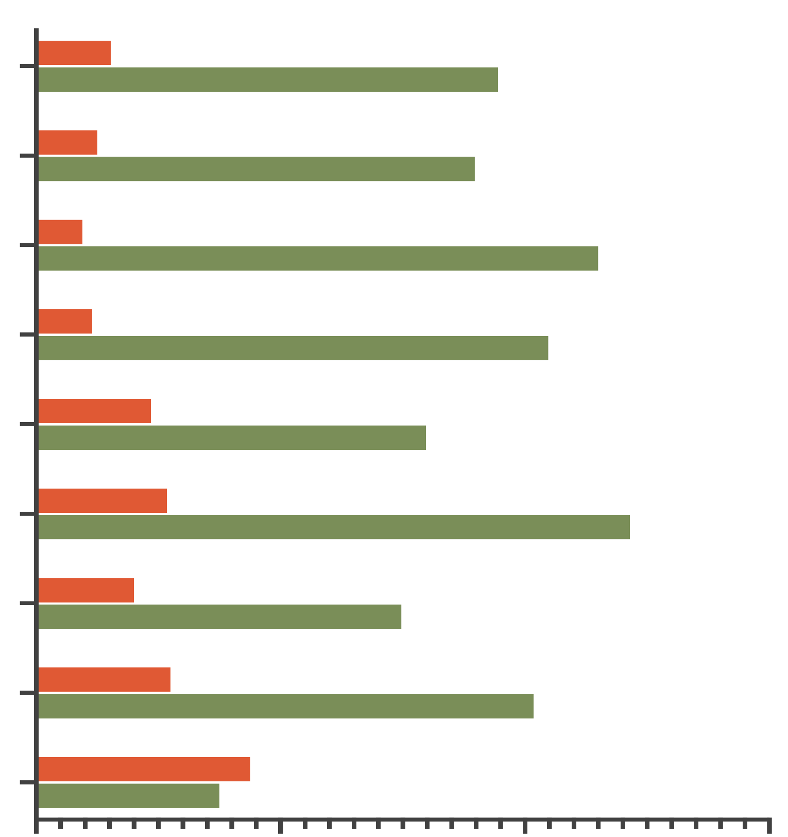
Comparison of Average Percent Green and Average Percent Mortality Across Juniper Woodland Vegetation Classes in the Study Area
RESULTS
Vegetation Class
Two-Needle Pinyon - Utah Juniper / Sagebrush Woodland
Average Green
Two-Needle Pinyon - Utah Juniper / Turbinella Live Oak Woodland
Average Mortality
Utah Juniper Woodlands / Savannahs
Two-Needle Pinyon - Utah Juniper / Sparse Understory Woodland
Singleleaf Pinyon - Utah Juniper / Grass - Forb Understory Woodland
Singleleaf Pinyon - Utah Juniper / Shrub Understory Woodland
Two-Needle Pinyon - Utah Juniper /Mountain Mahogany Oak
Two-Needle Pinyon - Utah Juniper /Grass Forb Understory
Two-Needle Pinyon - Utah Juniper /Blackbrush Woodland
0
20
40
60
Percent Cover
Notes:
The chart above shows a comparison of average percent green and average mortality across the juniper woodland vegetation classes in our study area. As you can see we found the highest average percent mortality in Blackbrush Woodland, and the lowest percent mortality in Savannahs. We additionally found the lowest average percent green in Blackbrush Woodland, and the highest average percent green in Shrub Understory Woodland.

Slide 25
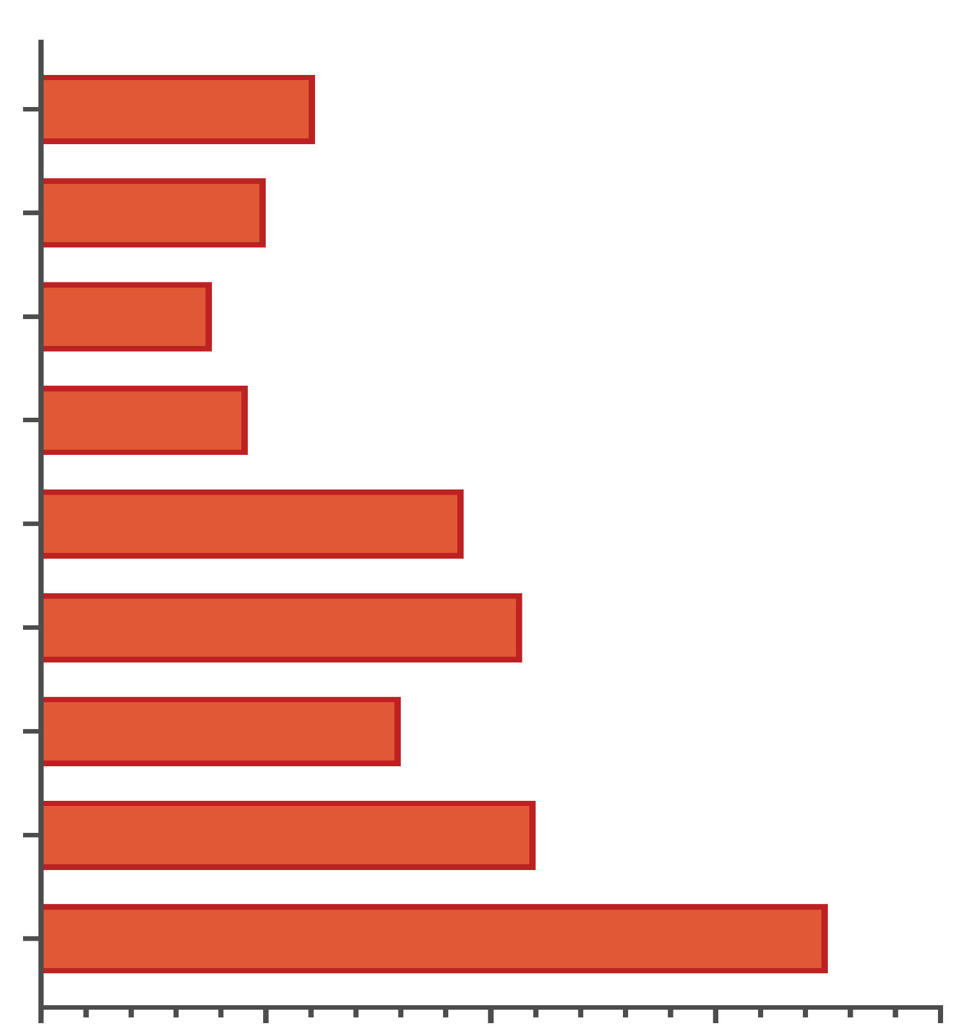
Comparison of Average Mortality Across Juniper Woodland Vegetation Classes
in the Study Area
RESULTS
Vegetation Class
Two-Needle Pinyon - Utah Juniper / Sagebrush Woodland
Two-Needle Pinyon - Utah Juniper / Turbinella Live Oak Woodland
Utah Juniper Woodlands / Savannahs
Two-Needle Pinyon - Utah Juniper / Sparse Understory Woodland
Singleleaf Pinyon - Utah Juniper / Grass - Forb Understory Woodland
Singleleaf Pinyon - Utah Juniper / Shrub Understory Woodland
Two-Needle Pinyon - Utah Juniper /Mountain Mahogany Oak
Two-Needle Pinyon - Utah Juniper /Grass Forb Understory
Two-Needle Pinyon - Utah Juniper /Blackbrush Woodland
0
5
10
15
20
Percent Cover
Notes:
This graph is an additional visualization of the percent stress across vegetation classes. As mentioned in the last slide, in our sampling Blackbrush Woodland had the most average mortality, and Savannahs had the least average mortality.

Slide 26
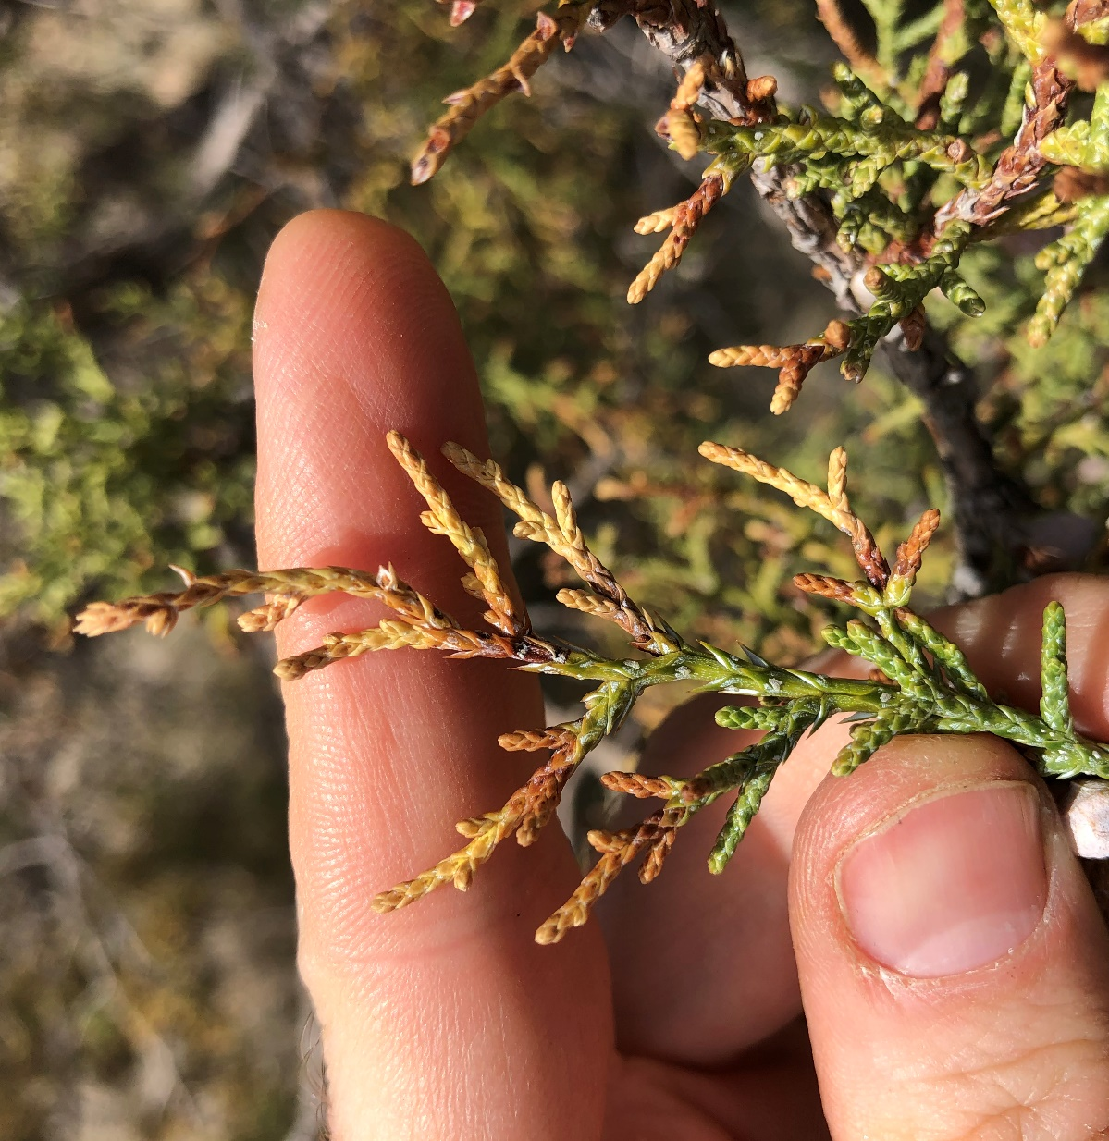
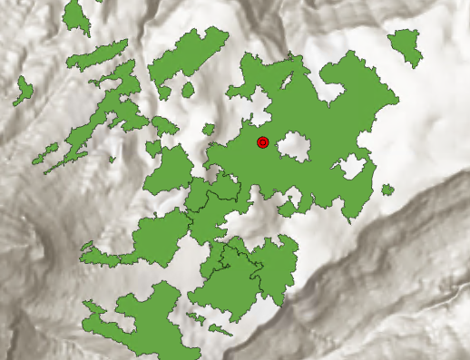
LIMITATIONS / CONCLUSIONS
Ocular sampling may need to be field validated, but it provides targeted direction
Juniper stress and mortality can be difficult to detect using remote sensing
We hope this provides some initial steps in studying this phenomena
Within the park
Targeted locations and vegetation classes
Image credit: USDA
Notes:
Ocular Sampling -
Ocular sampling is not the most effective method of surveying juniper. The resolution of even some of the highest resolution imagery is still not fine enough to occularly detect details in the vegetation. It can also be difficult to tell when the die off occurred
Juniper mortality can be hard to detect using remote sensing. Even though the tree is dead, the foliage can appear green. This can cause both ocular sampling and deriving indices to be uncertain. In this case field surveys would be the most effective for accurately surveying juniper mortality. Being able to feel the dead foliage crumble in your hand is a sure way to evaluate mortality. This can make indices like our vegetation index tasseled cap greenness difficult to be sure of.
We hope this provides some initial steps in studying this phenomena by providing the park with locations where die off is ocurring and vegetation classes that seem to be vulnerable
------------------------------Image Information Below (from left to right) ------------------------------
•Image Credit: Develop Team
•Image Source: NAIP 2021 Imagery
•Image Credit: USDA
•Image Source: https://www.fs.usda.gov/detail/kaibab/news-events/?cid=FSEPRD906836
•Image Credit: Develop Team

Slide 27
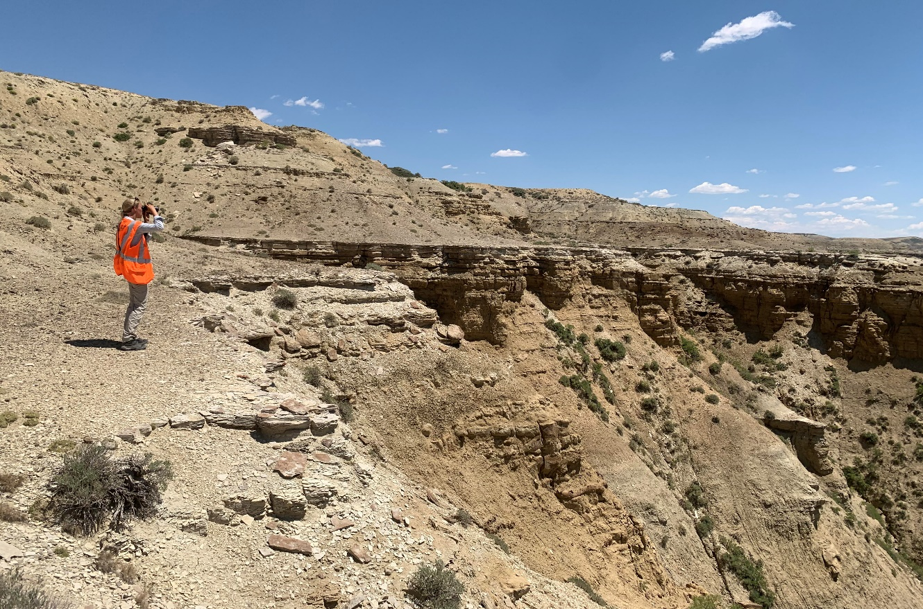
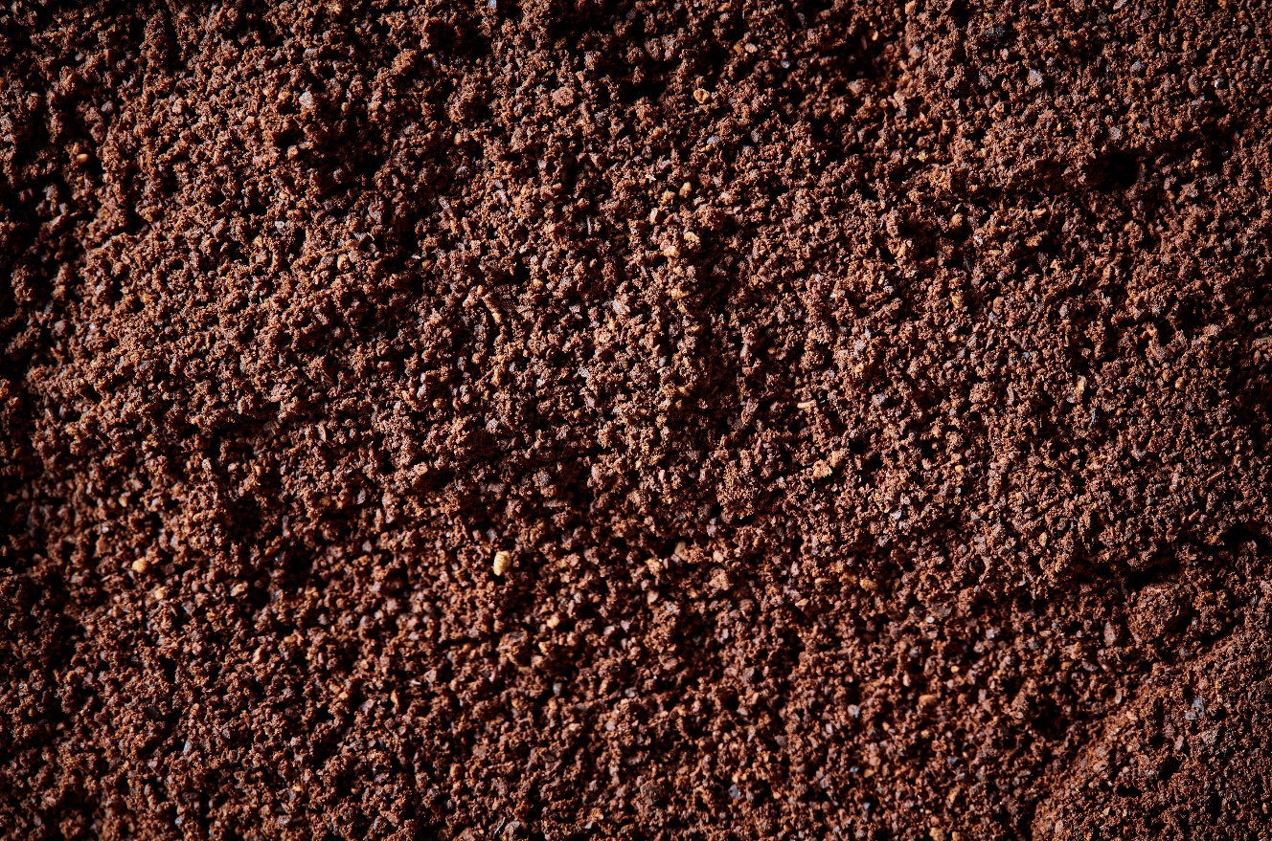
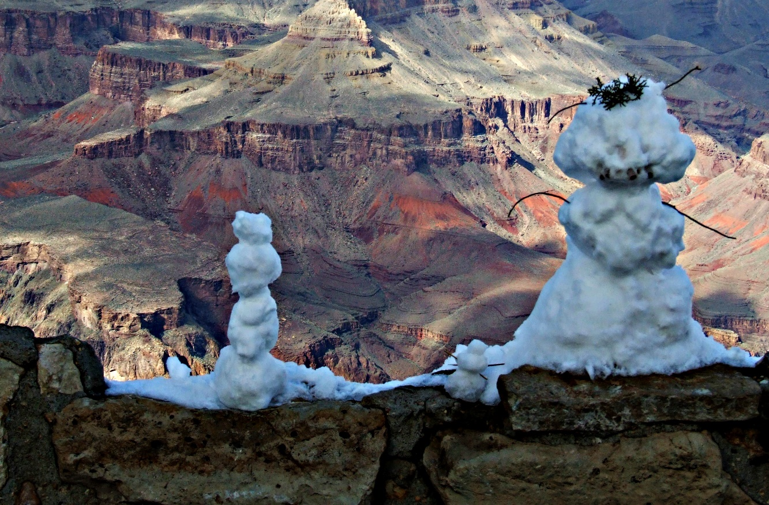
FUTURE WORK
Incorporate historic climate models to study the drought effects in its entirety
Field surveys and sampling within park boundary
Introduce new environmental variables
(such as soils, tree characteristics, etc.)
Incorporate historical imagery into analysis – predating satellite images
Right image credit: JPRoy2101
Notes:
There is a lot that can be built upon this study
There is literature that found die off correlated with tree characteristics, for example it seems like the middle growth class of juniper were experiencing the most die off
Also including additional environmental variables like soil, possible data to collect during field sampling
Our Partner at grand canyon national park intends to hire field biologists to survey and verify our observed points of mortality within the park
Incorporating historic climate models to study the drought in its entirety or the use of change detection algorithms over the longer time period of the drought using LandTrendr with Landsat for example.
And of course, increased resolution of remote sensing data can always help to improve results
------------------------------Image Information Below (from left to right) ------------------------------
•Image Credit: Scarlet Jackson
•Image Source: DEVELOP team
•Image Credit: Stock Images
•Image Source: Microsoft 365
•Image Credit: Wikipedia
•Image Source: https://commons.wikimedia.org/wiki/File:Friendly_Snowmen_at_Grand_Canyon.JPG

Slide 28
The Grand Canyon Ecological Forecasting team is thankful for our project partners and node advisors/mentors for making this project possible:
Partners:
Lonnie Pilkington (Science and Resource Management Division, Grand Canyon National Park - Vegetation Program Manager)
Node advisors & mentors:
Dr. Paul Evangelista (Colorado State University, Natural Resource Ecology Laboratory)
Dr. Catherine Jarnevich (USGS, Fort Collins Science Center)
Peder Engelstad (Colorado State University, Natural Resource Ecology Laboratory)
Dr. Tony Vorster (Colorado State University, Natural Resource Ecology Laboratory)
Nicholas Young (Colorado State University, Natural Resource Ecology Laboratory)
Scott Cunningham (NASA DEVELOP, CO – Fort Collins Fellow)
Maps throughout this document were created using ArcGIS® software by Esri. ArcGIS® and ArcMap™ are the intellectual property of Esri and are used herein under license. Copyright © Esri. All rights reserved. For more information about Esri® software, please visit www.esri.com
Notes:
We would like to thank our project partner Grand Canyon National Park, and specifically Lonnie Pilkington the Vegetation Program Manager. We would additionally like to thank our node advisors, Dr. Paul Evangelista, Dr. Catherine Jarnevich, Peder Engelstad, Dr. Tony Vorster, Nicholas Young, and our Fellow, Scott Cunningham.

