Slide 1
Gulf of Mexico
Health & Air Quality
Mapping Methane Emission Plumes Using Sunglint-configured Imagery for Monitoring Offshore Oil and Gas Activity
Ben Dahan
René Castillo
Melodi Hess
Vanessa Machuca
California – JPL | Fall 2022
Notes:
Hello everyone and thank you for joining us for our Summer Closeout. My name is Ben Dahan, the project lead, and I am joined Rene Castillo, Melodi Hess and Vanessa Machuca. We are the Gulf of Mexico Health and Air Quality Team, and have spent the past 10 weeks identifying, quantifying and mapping methane plumes in the Gulf of Mexico.

Slide 2
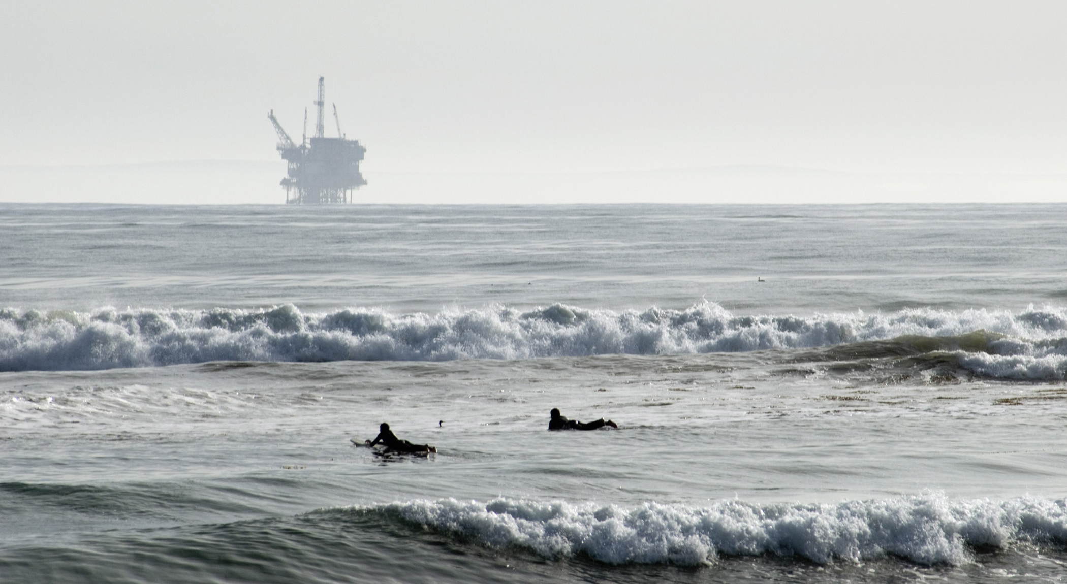
Community Concerns
1/3rd of anthropogenic methane emissions come from oil and natural gas activity
30% of oil and natural gas produced offshore
Methane warms the atmosphere 84x more efficiently than carbon dioxide
Image Credit: Bernardo62
Notes:
Methane is the 2nd largest contributor to global warming, after carbon dioxide.
• one third of anthropogenic methane emissions come from the production and use of oil and natural gas, with other sources including agriculture and land-use, and waste management
• a significant portion of oil and gas production, about 30%, occurs on offshore platforms, where relatively little is known about their greenhouse gas emissions
• This is especially prescient as methane has 84x the warming potential of carbon dioxide over a 10-20 year period. Though it eventually breaks up in the atmosphere, it drives short-term climate change.
------------------------------Image Information Below ------------------------------
•Image Credit: Flickr contributor: Bernardo62 (https://www.flickr.com/people/92819961@N04)
•Image Source: https://commons.wikimedia.org/wiki/File:Offshore_oil_rig.jpg (CC AS-SA)

Slide 3
Project Partners
End Users
Bureau of Ocean Energy Management
Bureau of Safety and Environmental Enforcement
Collaborators
SkyTruth
Notes:
We partnered with the Bureau of Ocean Energy Management (BOEM), Bureau of Safety and Environmental Enforcement (BSEE), and SkyTruth for this project. BOEM creates regulations around U.S. Continental Shelf energy and mineral resources, while BSEE enforces these regulations. Monitoring oil and gas activity is essential to what they do, hence their interest in integrating remote sensing into their work. Within a large subset of the Gulf of Mexico, BOEM has air quality jurisdiction usually reserved for the Environmental Protection Agency. SkyTruth is a non-profit organization that uses satellite imagery to track environmental damage, and is well-known for determining the true extent of the BP Oil Spill in 2010.
------------------------------Image Information Below ------------------------------
BOEM logo
Image Credit: Department of Interior, Bureau of Ocean Energy Management, 2022
Image Source: Department of Interior, Bureau of Ocean Energy Management, 2022
BSEE logo
Image Credit: Department of Interior, Bureau of Safety and Environmental Enforcement, 2022
Image Source: Department of Interior, Bureau of Safety and Environmental Enforcement, 2022

Slide 4
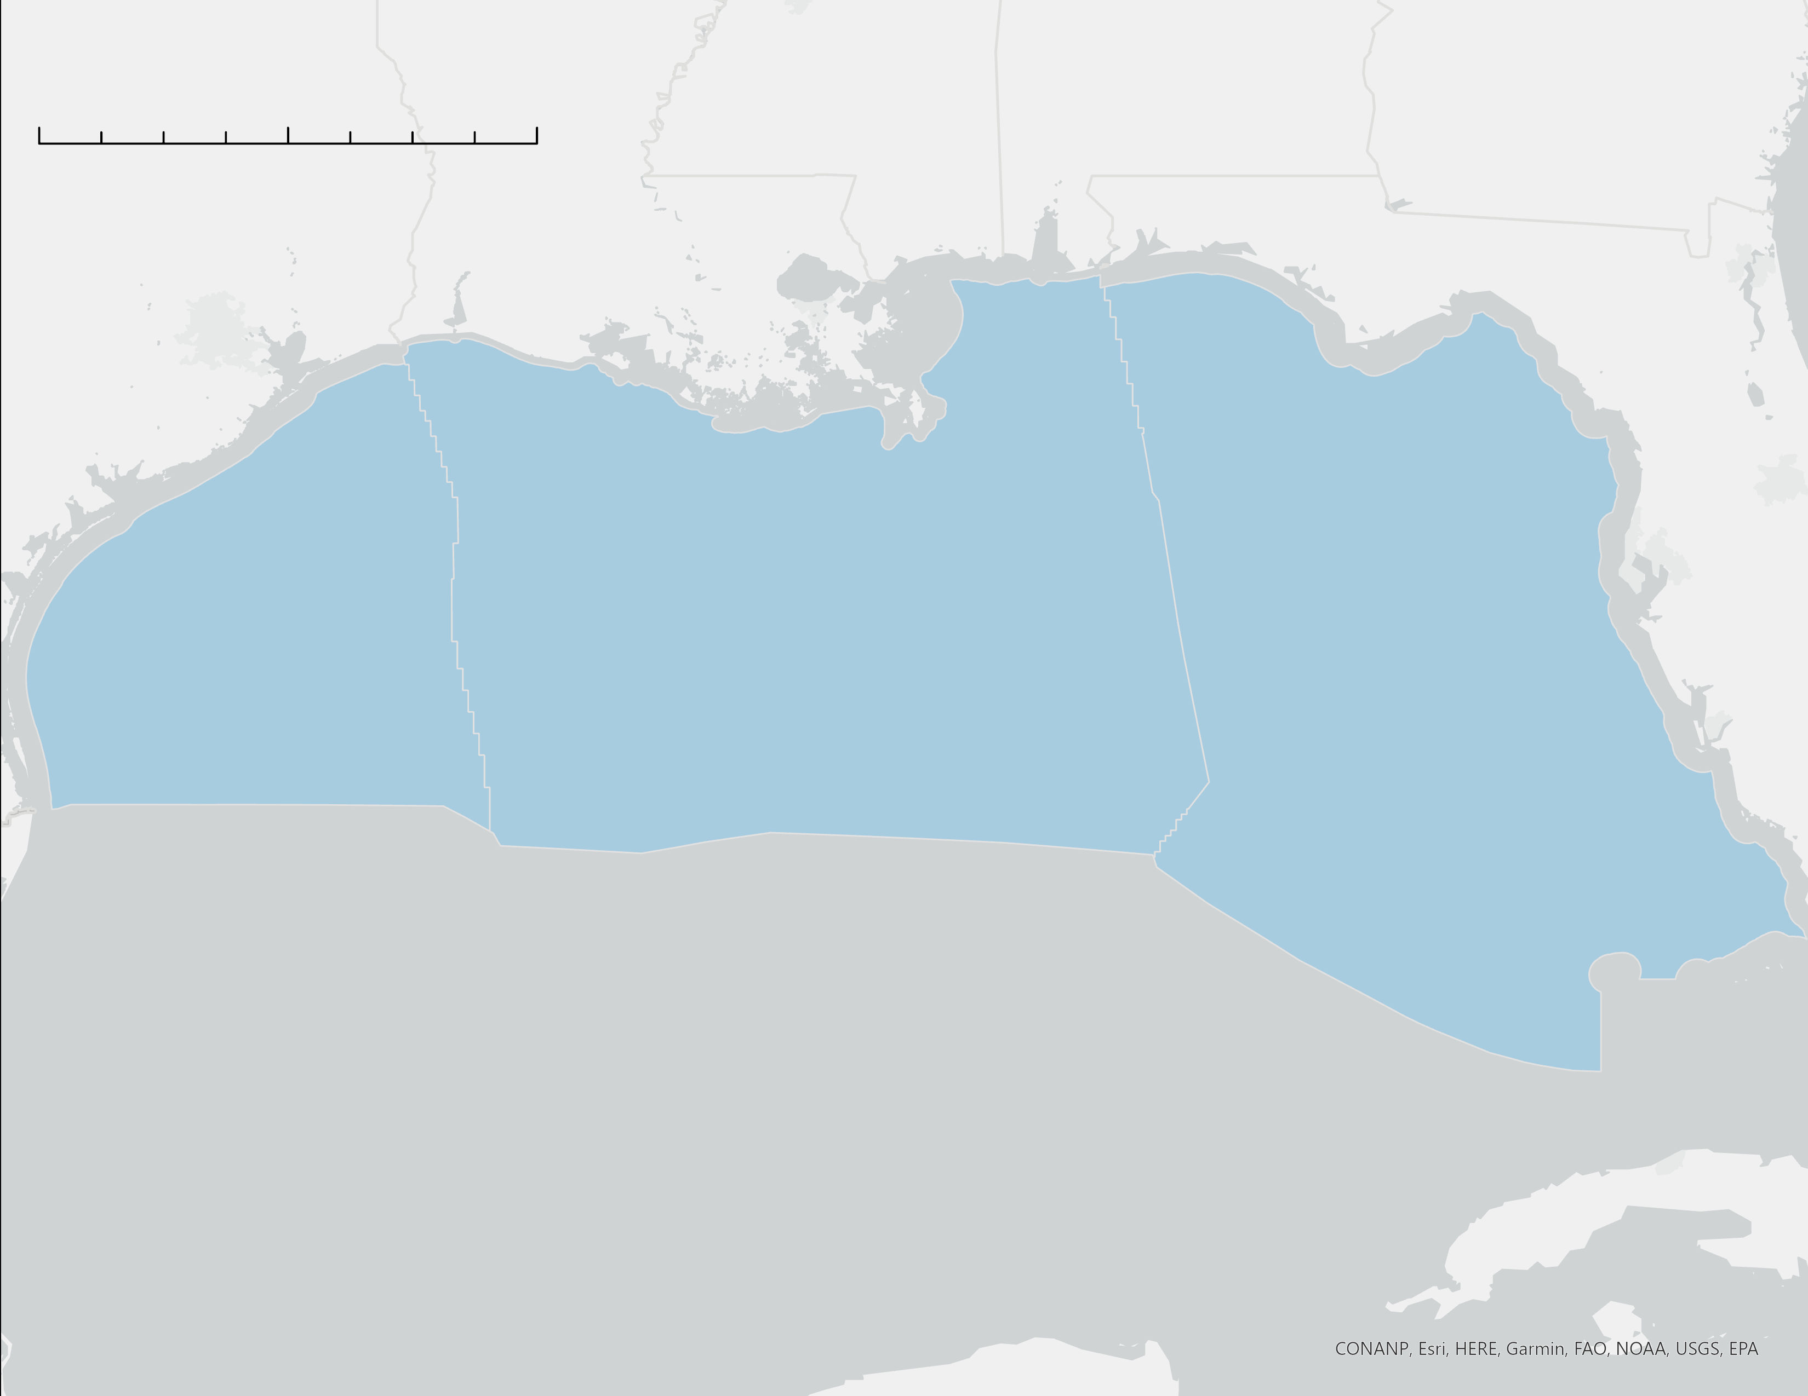
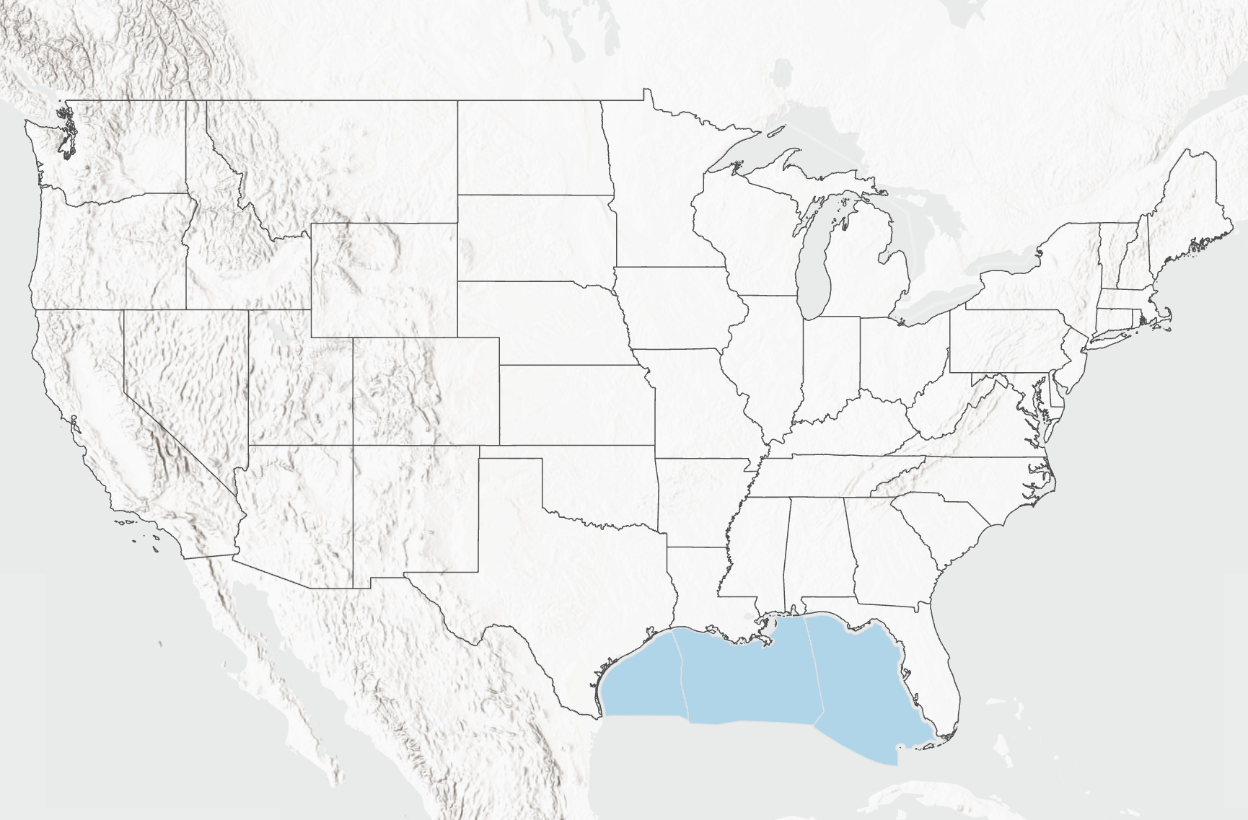
0 250 500 Kilometers
N
Study Area
AL
GA
Map Scale: 1: 6,500,000
MS
LA
Location
Federal waters in the Gulf of Mexico
Study Period
2017-2022
Mostly summertime images
TX
FL
United States
Gulf of Mexico Study Area
Limit of BOEM AQ Jurisdiction
Basemap Credits: CONANP, Esri, HERE, Garmin FAO, NOAA, USGS, EPA
Notes:
This is a map of the primary study area in the Gulf of Mexico. This is the federal zone over which BOEM and BSEE have jurisdiction, broken up by planning area. It does not include state waters closer to the coast.
West of the 87.5 degrees longitude, indicated in the red line, BOEM has air quality jurisdiction as mandated by the Clean Air Act. East of this line, though BOEM still has leasing authority, EPA is responsible for air quality.
We looked at satellite images between 2017 and 2022, mostly during the summertime as that is when cloud cover is lowest.
------------------------------Image Information Below ------------------------------
- Basemap courtesy of City of Tacoma GIS, https://www.arcgis.com/home/item.html?id=89e905fb063a4f2cad2a24aae41e43f4
- Study area shapefile courtesy of BOEM, https://www.data.boem.gov/Main/Mapping.aspx
- US Sates shapefile courtesy of US Census Bureau, https://www.census.gov/geographies/mapping-files/time-series/geo/carto-boundary-file.html

Slide 5
Objectives
Demonstrate how remote sensing can increase methane monitoring capacity
Identify and quantify methane plumes from flaring and venting using sunglint- configured imagery
Increase BOEM and BSEE's understanding of oil and gas methane emissions in the Gulf of Mexico
Notes:
We had three project objectives that we set out to accomplish.
##### CLICK TO ANIMATE #####
The first objective is to demonstrate how remote sensing can complement the current bottom-up methane emission assessments. Currently, quantities of disposed gas vented and flared are self-reported by operators to BOEM and BSEE. Meanwhile, inspections are uncommon, and ground sensors are non-existent. Therefore, remote sensing may be the agencies' best bet in verifying these operator accounts.
##### CLICK TO ANIMATE #####
The second objective is to identify methane plumes in the Gulf of Mexico, Asia, and elsewhere using Sentinel-2, LandSat, and PRISMA images, and then present an estimate of their emission rate. While methane retrievals from oil and gas infrastructure on-shore has been relatively well-documented, doing so on the offshore oil and gas platforms is more difficult, less prevalent, and contingent on the presence of specific conditions.
##### CLICK TO ANIMATE #####
The final objective is to give our partners, BOEM and BSEE, a more robust understanding of methane emissions from oil and gas production in the Gulf of Mexico. This increased knowledge, paired with a demonstration of methane monitoring, is intended to help our partners think about how they can incorporate remote sensing into their monitoring, regulatory and enforcement framework.
------------------------------Image Information Below ------------------------------
Clipart provided by PowerPoint

Slide 6
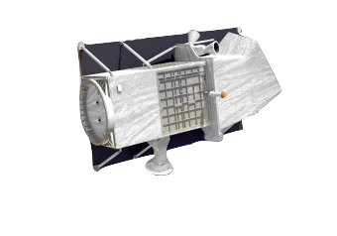
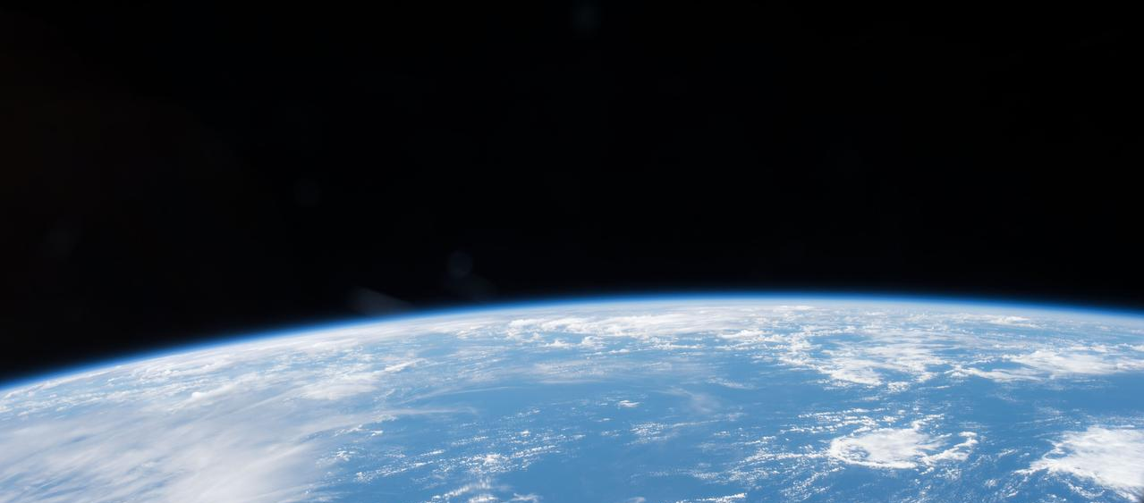
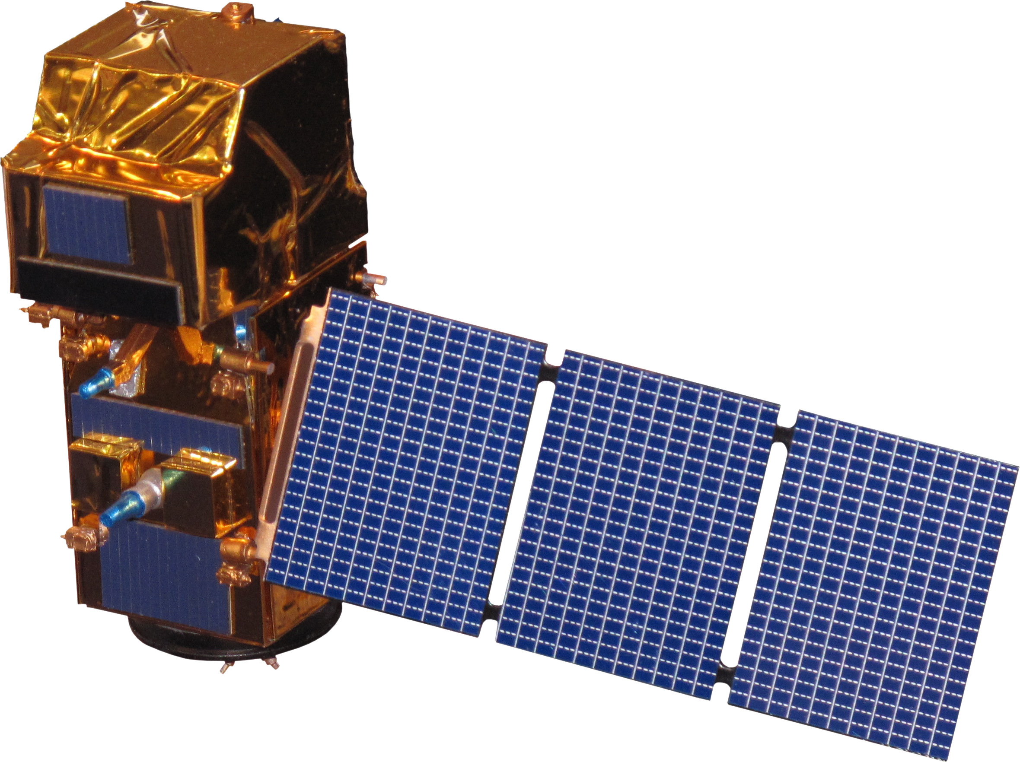
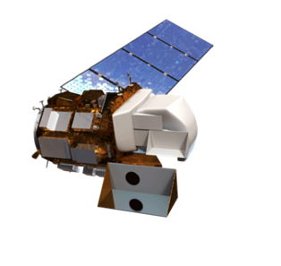
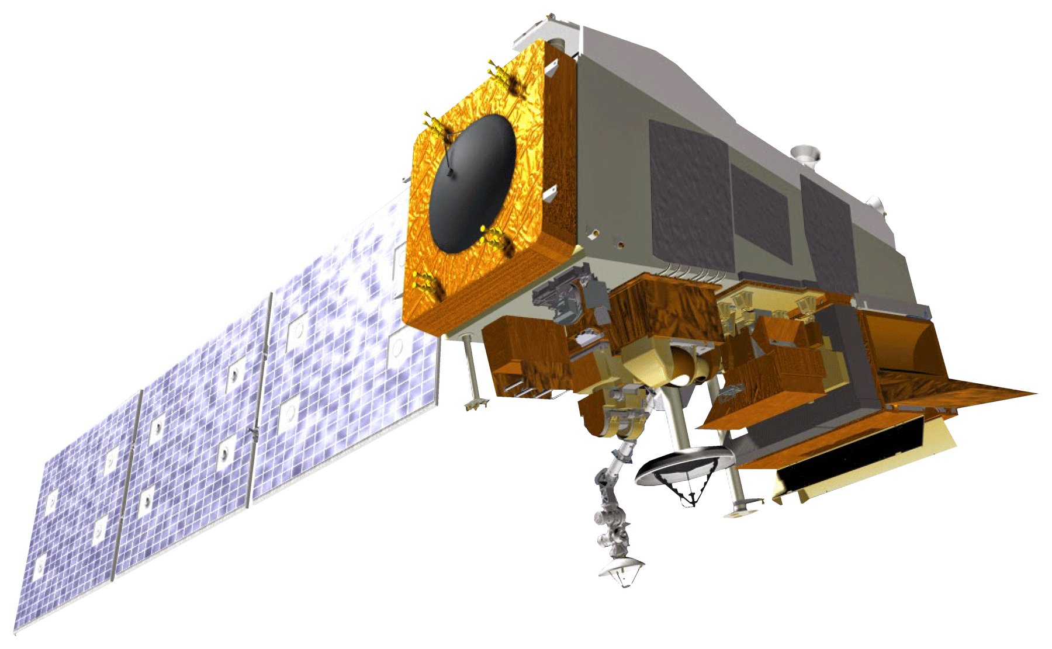
Satellites and Sensors
PRISMA
surface reflectance
Landsat 8 OLI
(Collection 2)​
surface reflectance
Sentinel-2 MSI
surface reflectance
Suomi NPP VIIRS
radiative heat and temperature
Landsat 9 OLI-2
surface reflectance
Image Credits: NASA (background), NASA (Landsat 8 and 9, Suomi NPP), ESA (Sentinel-2), Italian Space Agency (PRISMA)
Notes:
We used a variety of sensors for this project. Surface reflectance measurements from Landsat 8 and 9 Operational Land Imager (OLI); Sentinel-2 Multispectral Instrument (MSI); and PRISMA were used to estimate methane concentrations. We used maps of these concentrations to pinpoint methane plumes in the Gulf of Mexico. The PRISMA satellite has a wider spectral range and a smaller spectral resolution than Sentinel-2 MSI and Landsat 8 and 9 OLI, which makes it potentially useful for finding plumes. Suomi NPP VIIRS radiative heat and temperature measurements were used to locate flare incidents. These were then used to target and validate our methane plume identification.
------------------------------Image Information Below ------------------------------
Background satellite image:
Image Credit: NASA
Image Source: https://images.nasa.gov/details-iss042e013697
Sentinel-2 satellite image:
Image Credit: ESA
Image Source: TBD
Landsat 8 satellite image:
Image credit: NASA/Goddard Space Flight Center Conceptual Image Lab
Image Source: https://www.usgs.gov/media/images/landsat-8
Landsat 9 satellite image:
Image credit:
Image Source:
NPP Suomi satellite image:
Image credit:
Image Source:
PRISMA satellite image:
Image credit:
Image Source: https://www.asi.it/en/earth-science/prisma/

Slide 7
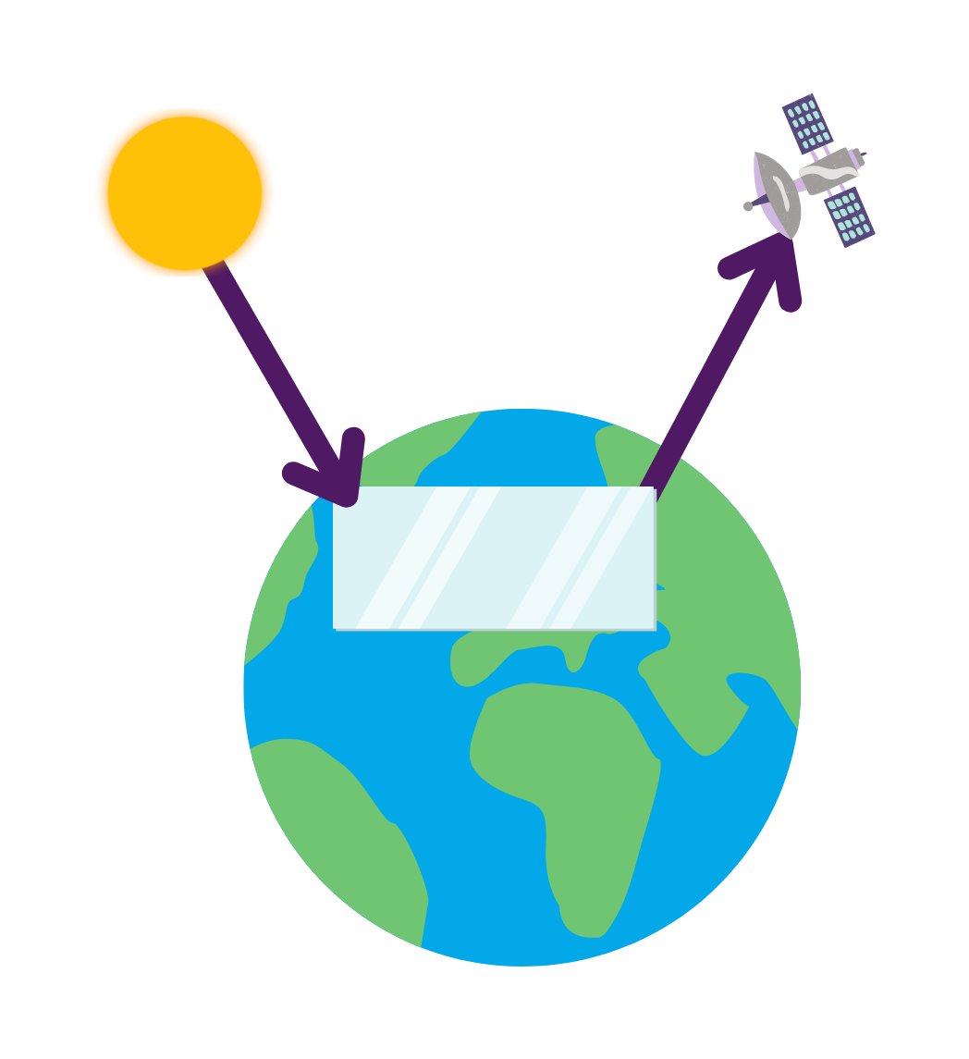
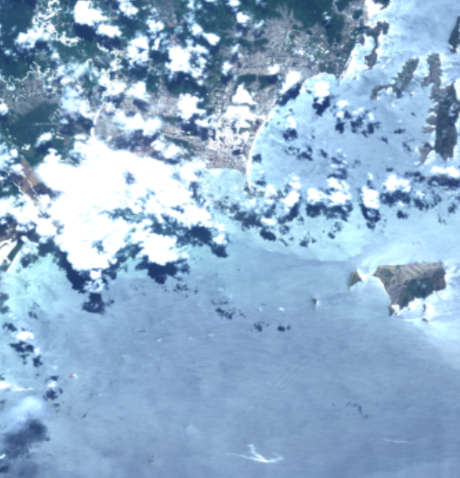
Sunglint-configured Earth Observations
Sunglint occurs when sunlight is reflected off the surface of water at the same angle as the satellite used to view or collect the imagery.
This provides a sufficient reflected radiance to detect a methane signal.
Image Credits: Italian Space Agency (PRISMA)
Notes:
Sunglint is an optical phenomena that occurs when sunlight is reflected off the surface of water at the same angle as the satellite used to view or collect the imagery. It results in a 'mirror-like' reflection of the sunlight off the water that is returned to and received by the satellite. This provides sufficient reflected radiance that offers an opportunity to study methane signals over open water that are otherwise undetectable in non-sunglint conditions.
NOTE: For every image on the slide include an image source in the speaker notes (ex. URL; Name, Affiliation, etc.). ALL images need to be created by a DEVELOPer, in the public domain (federal agency), provided by the partner, or published under a creative commons license (if attributed correctly). See an example citation below:
------------------------------Image Information Below ------------------------------
Image Credit: Dan Cusworth, Italian Space Agency
Image Source: Precursore IperSpettrale della Missione Applicativa (PRISMA)
Diagram Credit: Develop Team using Powerpoint-provided clipart

Slide 8
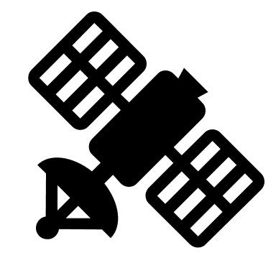
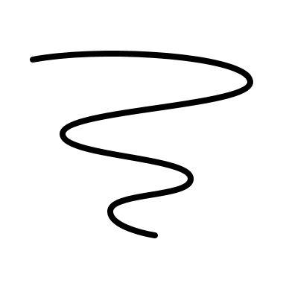
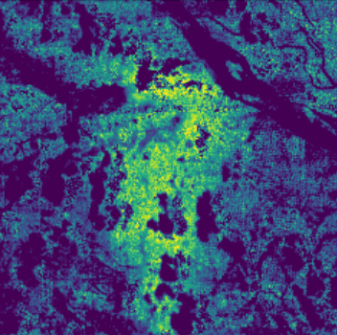
Methods: Multi-band-single-pass (MBSP)
Multi-band-single-pass (MBSP) is a multi-band methane column retrieval method
Band examples: red, green, blue, infrared
Satellite captures images from each band in one pass
Notes:
Multi-band-single-pass (MBSP) is a multi-band methane column retrieval method that estimates methane enhancements from the differences between two different spectral bands (band-11 and band-12 for Sentinel-2 MSI and Landsat 8 and 9 OLI). Methane has a weak absorption in band-11 (~1560-1660 nm) and a strong absorption in band-12 (~2090-2290 nm). A large difference in reflectance between band-11 and band-12 indicates methane column retrieval.
------------------------------Image Information Below ------------------------------
Image Credit: Develop Team
Image Source: PRISMA
Diagram Credit: Develop Team

Slide 9
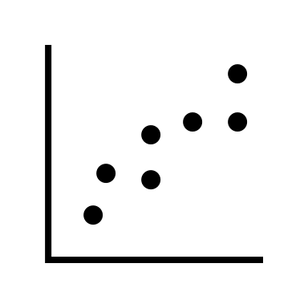
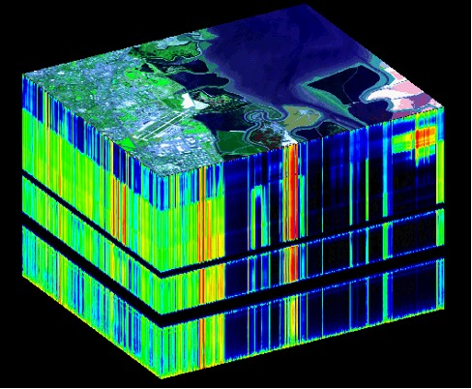
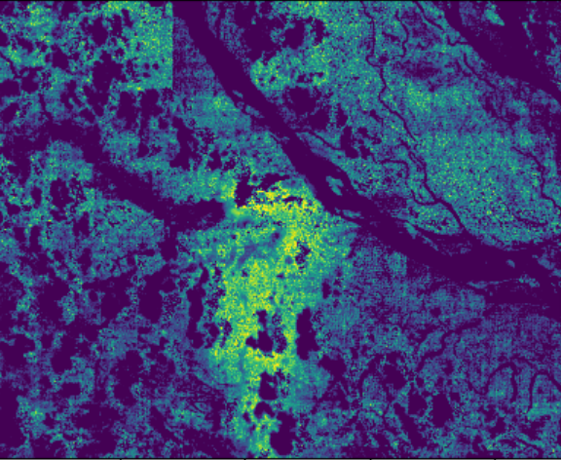
Methods: Statistical Retrieval
PRISMA
Wider spectral range
Smaller spectral resolution
Stitch SWIR and VNIR datasets into a data cube
Use MAG1C tool to identify pixels that deviate from the mean
Use this deviation to calculate methane concentrations
Image Credits: NASA, Italian Space Agency
Notes:
PRISMA, as a hyperspectral satellite, has a wider spectral range and a finer spectral resolution than Sentinel-2 MSI and Landsat 8 and 9 OLI. PRISMA short-wave infrared (SWIR) and visible and near infrared (VNIR) datasets are stitched together into a data cube. Python tool "MAG1C" takes the statistics of all pixels and identifies pixels that deviate from the mean – this reduces error by correcting for sparsity and albedo in the input image. Methane concentrations are mapped across spatial subsets of the image to identify methane concentration hotspots. The example on the right is of the Baghjan natural gas blowout, which occurred in Assam, India in 2020. As a well-documented, high-emissions event, this is where we tested out this method.
------------------------------Image Information Below ------------------------------
Clipart provided by PowerPoint
Data Cube:
Image Credit: NASA
Image Source: https://aviris.jpl.nasa.gov/data/image_cube.html
Methane Map:
Image Credit: Italian Space Agency, processed in Python by DEVELOP Team
Image Source: PRISMA

Slide 10
Methods: Emission Quantification
sum methane concentrations across all pixels in image (kilograms/meter)
Emission Rate Q in Kilograms/Meter
IME
average wind speed over the plume (meters/second)
Q = IME × U
U
L​
calculate methane plume length (meters)
L
Notes:
IME gives the concentration of methane across all pixels in the image which is then multiplied by the windspeed. That value is divided by the length of the plume which gives us the emission *rate*.
Methane emission quantification is done by finding the sum methane concentrations across all pixels in the image multiplied by the average wind speed over the plume, then dividing by the length of the plume in meters. The result is the emission rate (Q) in kilograms per meter.
------------------------------Image Information Below ------------------------------
Clipart provided by PowerPoint

Slide 11
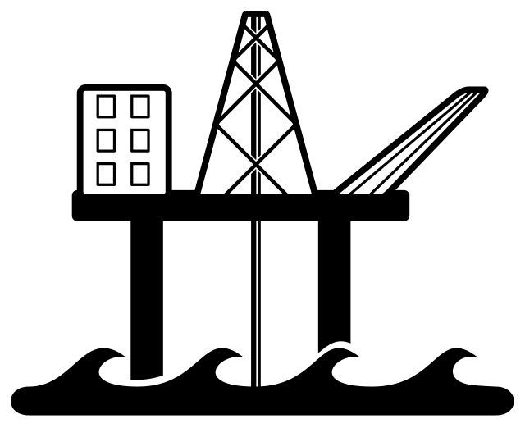
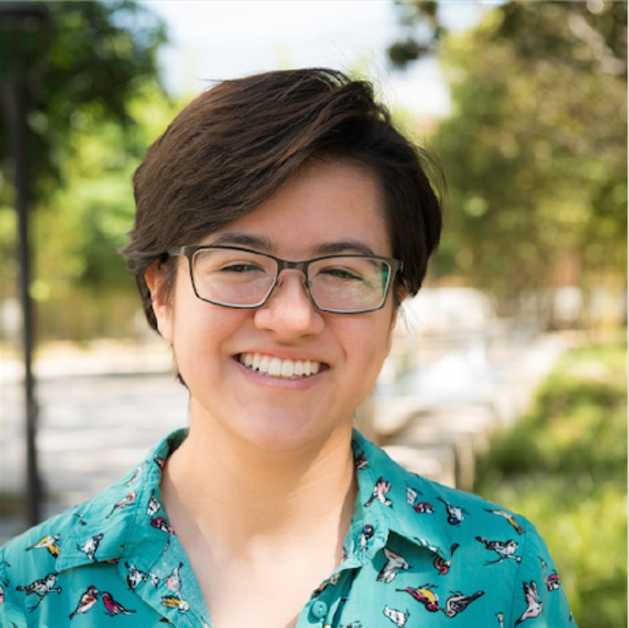
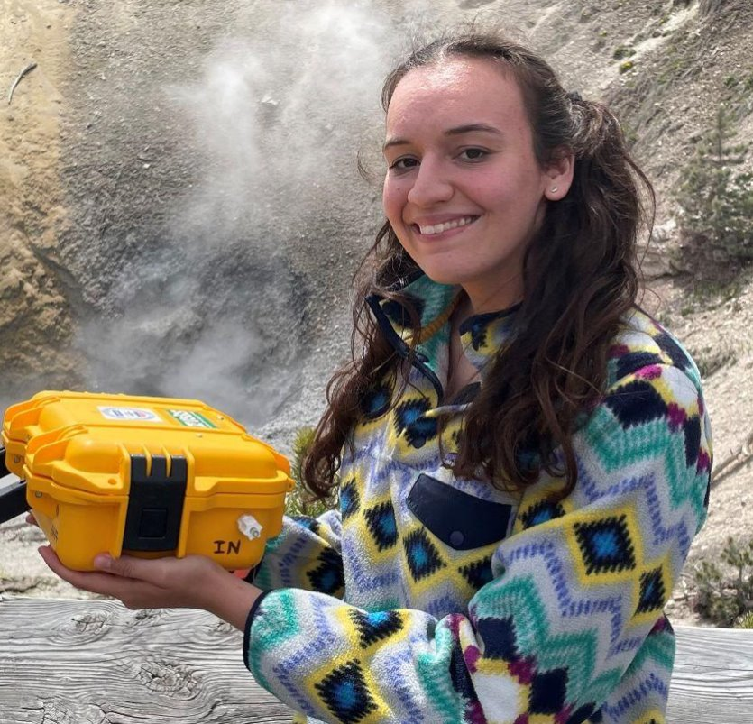
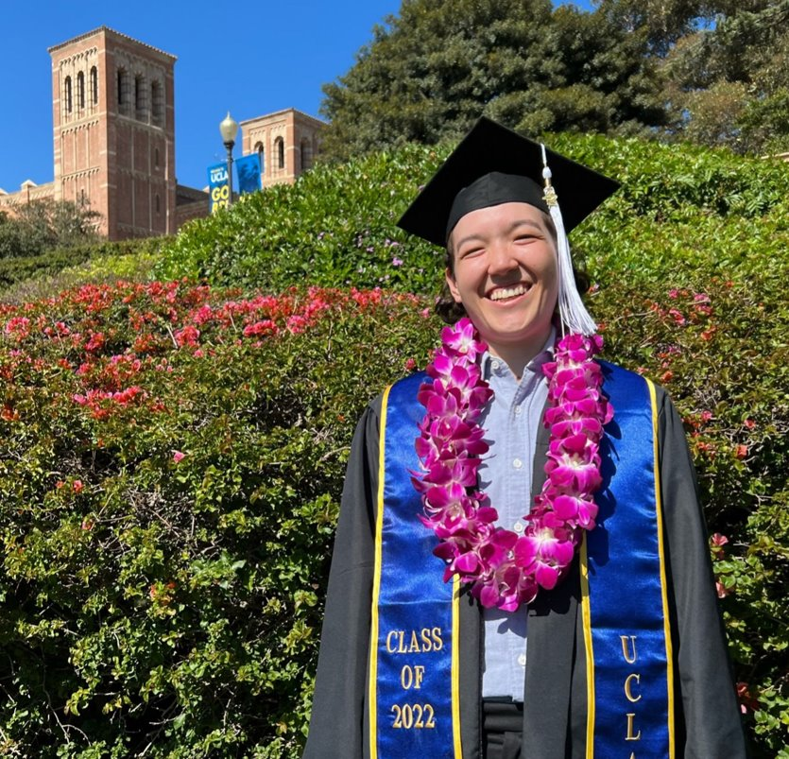
0 250 500 Kilometers
N
Results
AL
GA
Map Scale: 1: 6,500,000
MS
LA
TX
FL
United States
Gulf of Mexico Study Area
Limit of BOEM AQ Jurisdiction
Basemap Credits: CONANP, Esri, HERE, Garmin FAO, NOAA, USGS, EPA
0 250 500 Kilometers
0 250 500 Kilometers
AL
AL
United States
0 250 500 Kilometers
AL
United States
United States
MS
MS
Map Scale: 1: 6,500,000
MS
Map Scale: 1: 6,500,000
Map Scale: 1: 6,500,000
LA
LA
LA
TX
TX
TX
FL
FL
FL
N
N
Gulf of Mexico Study Area
N
Gulf of Mexico Study Area
Gulf of Mexico Study Area
Potential Plume Location
Potential Plume Location
Potential Plume Location
Basemap Credits: CONANP, Esri, HERE, Garmin FAO, NOAA, USGS, EPA
Basemap Credits: CONANP, Esri, HERE, Garmin FAO, NOAA, USGS, EPA
Basemap Credits: CONANP, Esri, HERE, Garmin FAO, NOAA, USGS, EPA
Team Members
Team Members
Ben Dahan
Project Lead
Vanessa Machuca
Rene Castillo
Melodi Hess
Ben Dahan
Project Lead
Vanessa Machuca
Rene Castillo
Melodi Hess
Notes:
Plume 1 (Constitution) was identified by the previous term's team. We were able to identify an additional 3 plumes across the Gulf of Mexico since 2020: Plume 2 (PRD), Plume 3 (Petronius), and Plume 4 (Arena F). Plume 4 was identified using LandSat 9, while the others were captured by Sentinel-2.
------------------------------Image Information Below ------------------------------
Platform Icon: WikiMedia Contributor: Goran tek-en, https://commons.wikimedia.org/wiki/File:Offshore_platform.svg
- Basemap courtesy of City of Tacoma GIS, https://www.arcgis.com/home/item.html?id=89e905fb063a4f2cad2a24aae41e43f4
- Study area shapefile courtesy of BOEM, https://www.data.boem.gov/Main/Mapping.aspx
- US Sates shapefile courtesy of US Census Bureau, https://www.census.gov/geographies/mapping-files/time-series/geo/carto-boundary-file.html

Slide 12
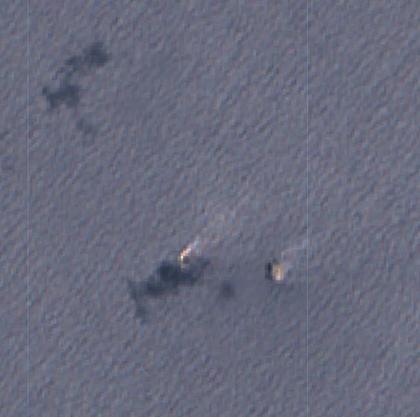
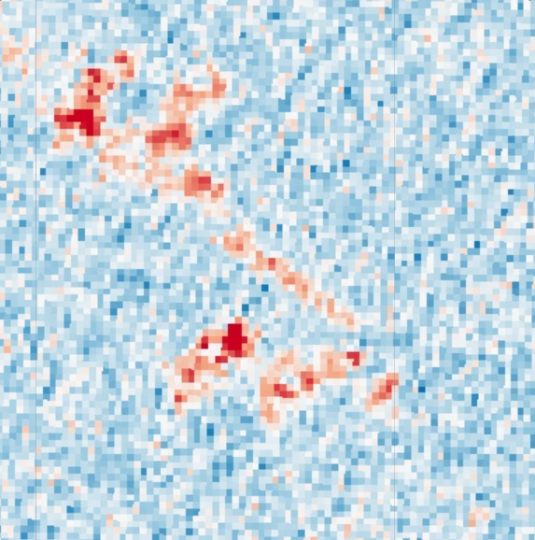
Results: Constitution
620
1240 m
-0.45
-0.009
-0.275
-0.097
MBSP fractional absorption
RGB
emission rate
N
Notes:
Let's start with the plume that last term's team discovered, the July 5, 2017 Constitution plume. In the RGB image on the left, we can see the constitution platform along with nearby cloud shadows. The middle image shows the results of the MBSP calculation. The cloud shadows show up in the MBSP, but so does a trail of red extending from the platform to the northwest. We generated a plume mask in ArcGIS Pro to pick out thus feature, overlayed over a Landsat RGB image in the right-hand image. There are a few pieces of evidence that indicate this to be a methane plume from venting.
1. In a perusal of Planet images, we found that this platform flares from the same location that this potential plume is extending from. That is, the platform likely vents from that location as well.
2. This feature shows up in the MBSP and not in the RGB. It also does not exhibit the same mirroring behavior as the cloud shadow in the MBSP.
Upon establishing that this is a likely a methane plume, we performed the methane concentration retrieval on the MBSP image to determine an emission rate. It comes out to x t/s, which is within the range of plausibility.

Slide 13
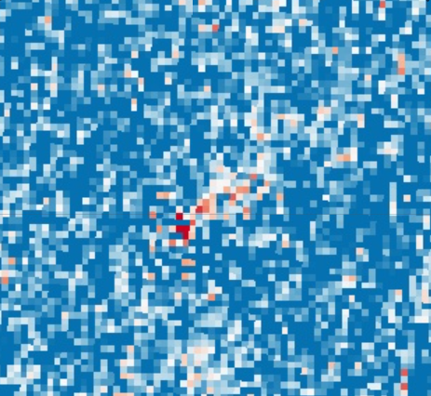
Results: PRD Plume
Wind:
7 MPH
330
660 m
-0.6
0.044
-0.375
-0.339
MBSP fractional absorption
RGB
emission rate
N
Notes:
We move on to the March 16, 2022 PRD platform plume. Again, the potential plume shows up in the MBSP image and not the in RGB, indicating that it is likely not a water or cloud feature. We used the online application Ventusky to determine that the wind was blowing to the northeast near the time this image was captured at 7 miles per hour. This plume is more dispersed than the constitution plume and other potential plumes we found, perhaps owing to the relatively low wind speed.

Slide 14
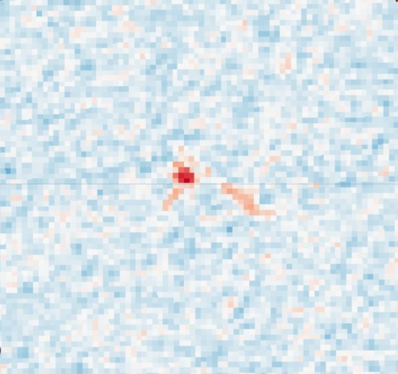
Results: Patronius Plume
Wind:
13 MPH
230
460m
-0.39
-0.041
-0.2
MBSP fractional absorption
-0.105
RGB
emission rate
N
Notes:
Next up is the May 7th, 2021 Patronius plume. We can see in the rightmost image that the plume begins some distance away from the edge of the platform – around 75 meters. Our partners sent a schematic of the Patronius platform, which indicated that the venting boom extends from the northern point of the platform, represented by the black and white triangle in this image. This is quite a ways from the start of the plume! That said, the wind is blowing at 15 mph in the same direction as the plume. It is impossible that the vented methane was blown away from the venting boom, and also that this image was captured after the platform stopped venting. And there are no other features in the RGB that point so some other source of this plume-like feature in the MBSP image.
In any case, this was a great example of stakeholder engagement in how involved our partners were in investigating this potential plume.

Slide 15
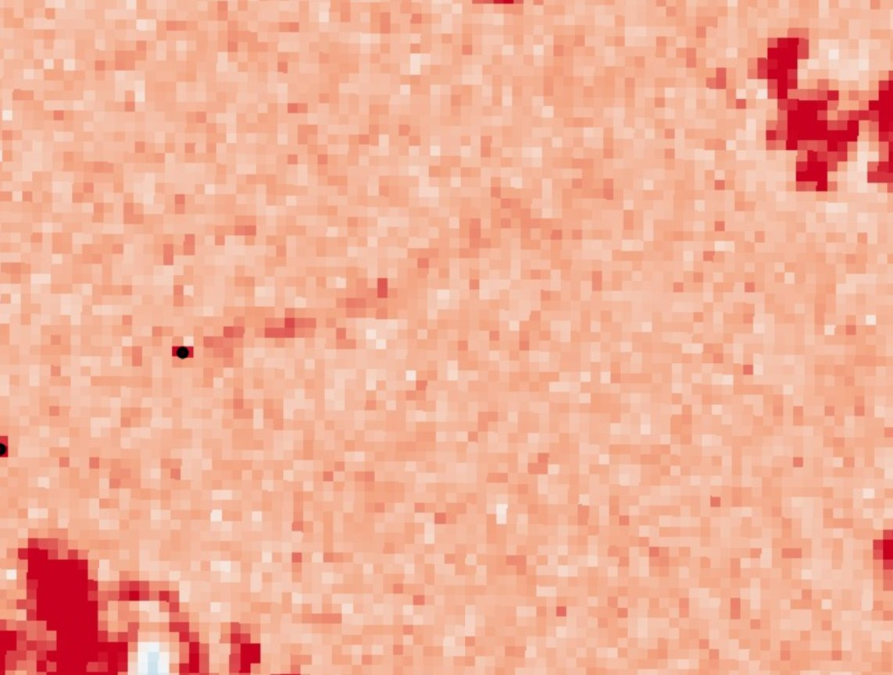
Results: F Plume
Wind:
14MPH
1000
2000 m
-0.42
-0.044
RGB
MBSP fractional absorption
0.025
emission rate
-0.25
N
Notes:
Finally, here is a plume from the F platform found in a Landsat 9 image taken on May 16th, 2022. Like with the previous three plumes, this plume points in the same direction as the wind direction indicated by Ventusky. It is similar to the Constitution plume in how long and thin it is – not as dispersed as the Patronius and PRD plumes.

Slide 16
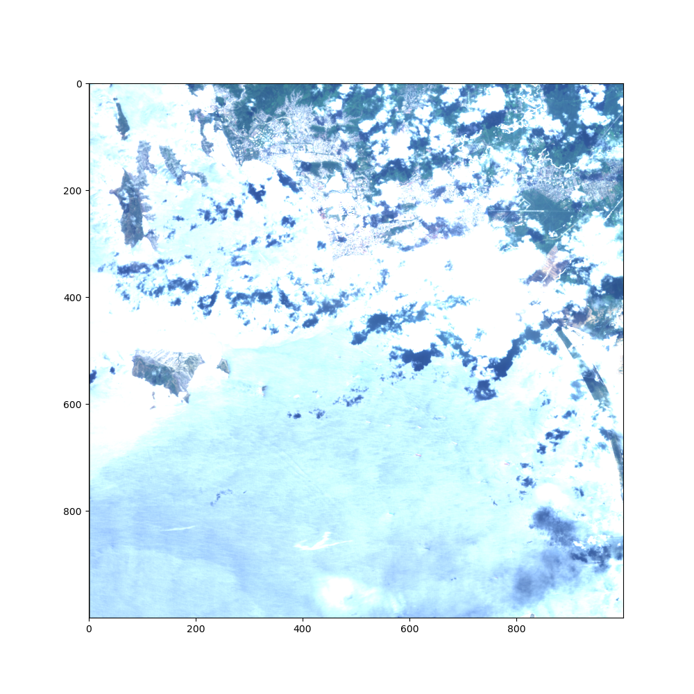
Results: PRISMA
N
20000 nm
5000 nm
Notes:
We also investigated three PRISMA images for methane plumes. We, unfortunately, did not find any methane plumes in these images, but will show one interesting result. The image to the left is an RGB of one of a 2022 image taken off the coast of Argentina and shows a good amount of sun glint. We zoomed into one portion of the image, shown in the top right, and you can clearly make out three boats. These become more apparent in the methane retrieval in the bottom righthand image. This is a good example of what a false positive looks like, similar to the false positives were saw in our MBSP images.

Slide 17
Conclusions
Methane plumes identified and quantified using a sun-glint methodology
Emissions rates were successfully derived from methane enhancement
Notes:
Our project has demonstrated the feasibility of using sunglint-configured imagery to retrieve methane concentrations and quantify emissions from offshore oil and gas platforms. Additionally, we determined the MBSP method to be more effective than statistical retrieval for the PRISMA images. The sunglint methodology for locating and quantifying offshore emissions will help BOEM and BSEE update their platform emission inventories, develop technical procedures for more comprehensive emissions monitoring, and tailor their regulatory requirements within their jurisdiction. The project has shown this methodology can be adapted to employ various multispectral and hyperspectral instruments at different spatial and temporal resolutions.
------------------------------Image Information Below ------------------------------
Image Credit: Python
Image Source: NASA DEVELOP Team

Slide 18
Errors and Uncertainties
Wind speed inaccuracy in emission calculation
Skewed values from clouds and shadows
Potential for irradiance variation
Lack of accurate in-situ activity data
Notes:
We encountered some possible sources of error and uncertainty in our work.
First, we used a modeled wind speed value for our emission rate calculation. Wind speed over the ocean can change drastically through time and also by distance above the water. It is likely, then, that the modeled wind speed we used does not reflect the actual wind speed when and where the methane plume was generated.
Second, the potential for irradiance variation exists with most remote sensing projects, but it is an important source of error to recognize. This could be improved by implementing newly released solar irradiance variability models, however this is out of the scope of our project at this time.
Third, there is a lack of accurate in-situ activity data for off-shore rigs. Since we used what information we did have to target out plume identification efforts, its possible we missed some plumes that lay beyond our scope.
Finally, clouds and cloud shadows may have generated some error. There are no cloud masks for the PRISMA images, which may have skewed the methane concentration calculations. Also, while the Landsat and Sentinel images were cloud masked, the shadows from these clouds and the pieces of cloud that evaded the mask may have obscured some plumes.
------------------------------Image Information Below ------------------------------
Clipart provided by PowerPoint

Slide 19
Future Directions
Develop PRISMA cloud filter for improved retrieval
Improve c scaling factor calculation for MBSP in GEE
Explore NO₂/SO₂ ratio as methane signal
Build a user-friendly tool for MBSP methane monitoring
Notes:
### CLICK TO ANIMATE ###
Develop a PRISMA cloud filter to improve statistical methane retrieval. The presence of clouds may have skewed the PRISMA methane retrieval, and no PRISMA cloud filter yet exists
### CLICK TO ANIMATE ###
Improve c calculation, the scaling factor within the MBSP method formula, in GEE.
This point can be replaced as future directions become clearer in the next 2 weeks.
### CLICK TO ANIMATE ###
Explore no2/so2 ratio as a reliable signal for offshore methane to inform a more robust methane plume detection methodology. Our partners plans to work with TEMPO data once the satellite is launched. It would be great for that project to include a methane detection piece, checking NO2/SO2 ratios against the plumes using spectrally identification in this project.
### CLICK TO ANIMATE ###
Create a tool using sun-glint and NO2/SO2 for methane emissions monitoring. (reference what partners told us at start of term)
------------------------------Image Information Below ------------------------------
Clipart provided by PowerPoint

Slide 20
Partners
Holli D. Ensz, Physical Scientist, BOEM
Jarvis B. Abbott, SPEAR Program Coordinator, BSEE
Ramona Sanders, Senior Environmental Stewardship Coordinator, BSEE
Jay Cho, Program Manager, Engineer, BSEE
Nellie Elguindi, Air Quality Scientist, BOEM
Cholena Ren, Physical Scientist, BOEM
Thomas Kilpatrick, Ocean and Atmospheric Scientist, BOEM
Ross Laidig, Investigations/Incidents, BSEE
Jason Schatz, Chief Technology Officer, SkyTruth
Advisors
Dan Cusworth, Carbon Mapper
Kate Howell, Carbon Mapper
Benjamin Holt, NASA Jet Propulsion Laboratory, California Institute of Technology
NASA DEVELOP
Katie Lange, NASA DEVELOP Fellow
GMHAQ I
Kate Howell, Ashely Fernando, Ephrata Yohannes, J. Kyle Bergerson
This material contains modified Copernicus Sentinel data 2020-2022, processed by ESA.
Notes:
We would like to extend our gratitude to all who made this project possible,
Thank you to our partners at BOEM and BSEE for you invaluable insights and sharing your on-the-ground perspective. Thank you for our advisors at Carbon Mapper and JPL – Dan Cusworth, Kate Howell, and Ben Holt – for being there for us every step of the way, and our collaborators at SkyTruth, especially Jason Schatz, who have also supplied us with their expertise. Thank you to the previous Gulf of Mexico Health and Air Quality team for laying the groundwork. Finally, a big thanks to our fellow, Katie Lange, for making our node such a welcoming place.

