Slide 1
Arizona Health
& Air Quality
Enhancing Extreme Heat Intervention and Preparedness Activities in Maricopa County, AZ
Amy Stuyvesant (Team Lead)
Emma Baghel
Geordi Alm
April Rascon
Rocky Garcia
Bernardo Gracia
Notes:
Good Afternoon. My name is Amy Stuyvesant and I am the team lead for the Arizona Health and Air Quality project where we are looking at enhancing extreme heat intervention and preparedness activities in Maricopa County, AZ.

Slide 2
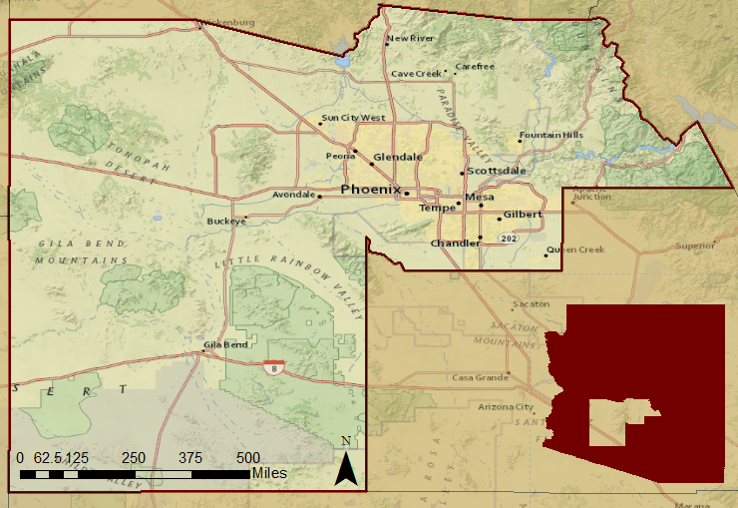
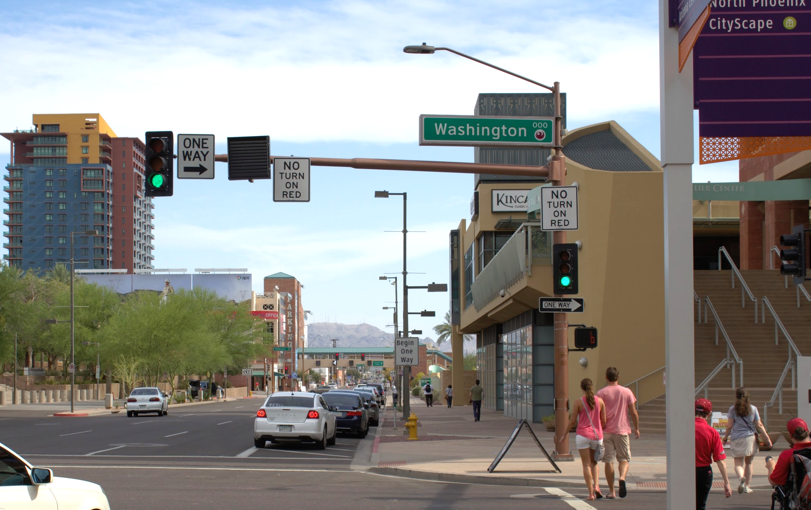
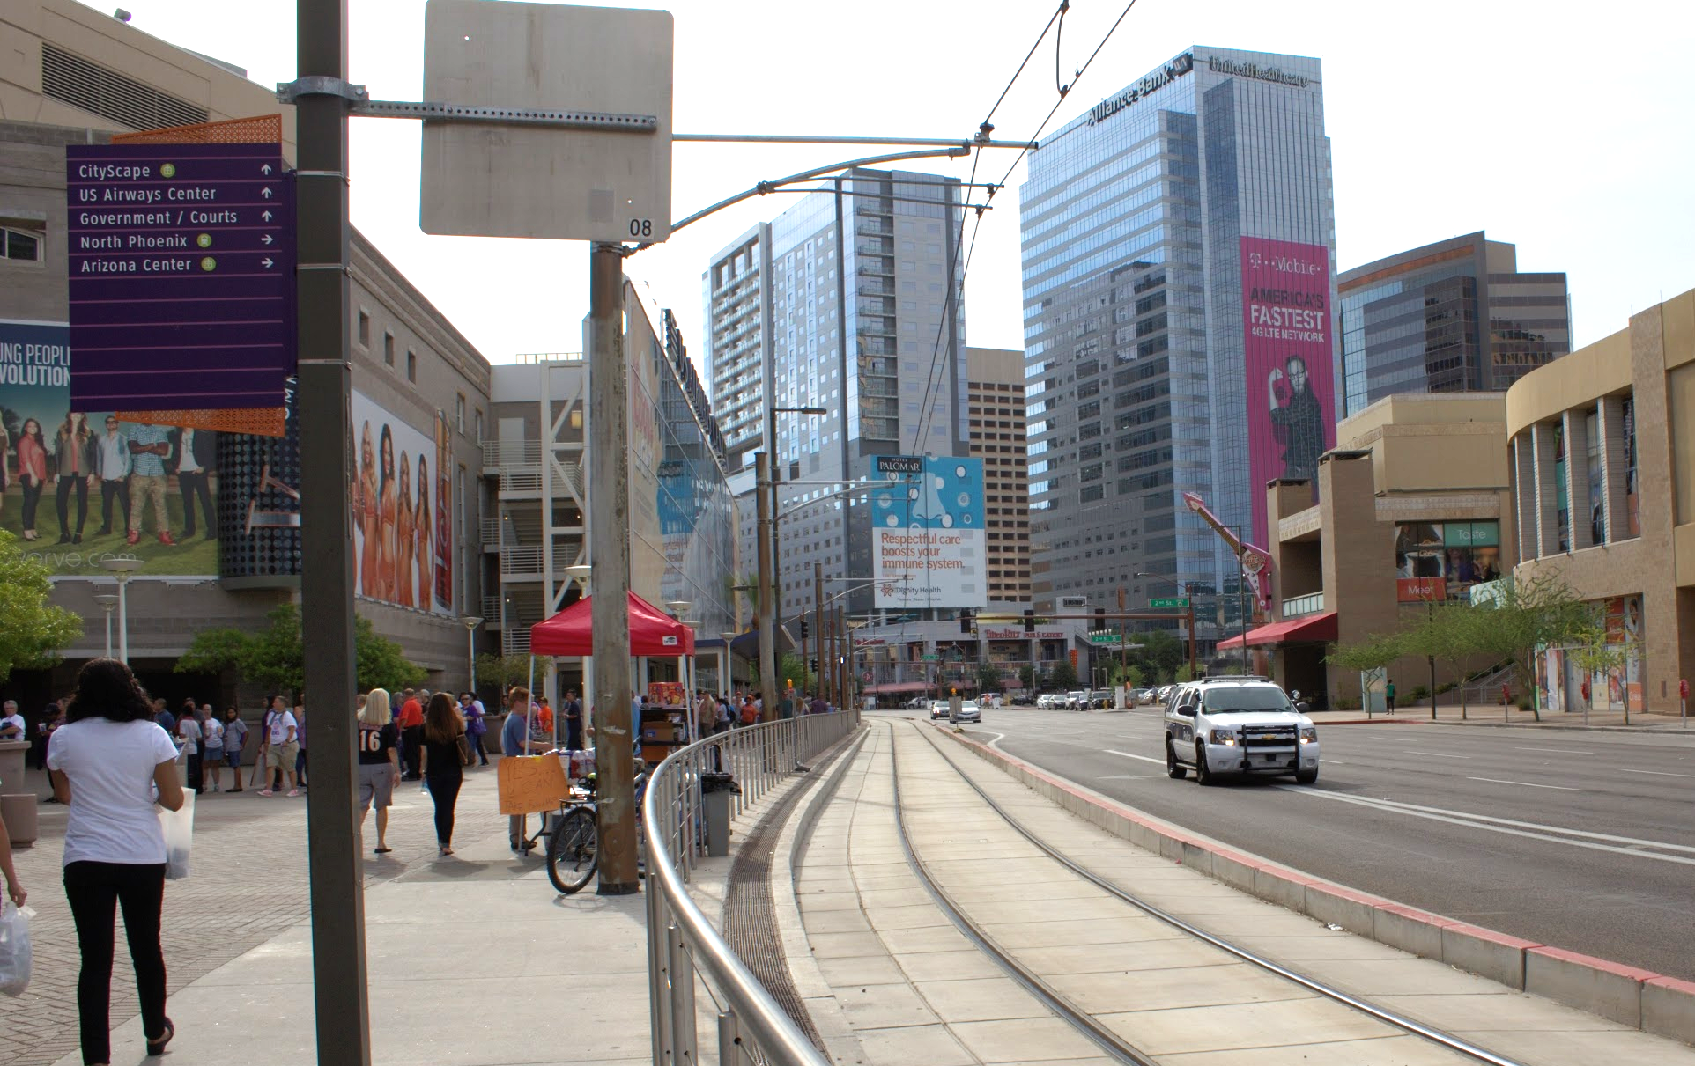
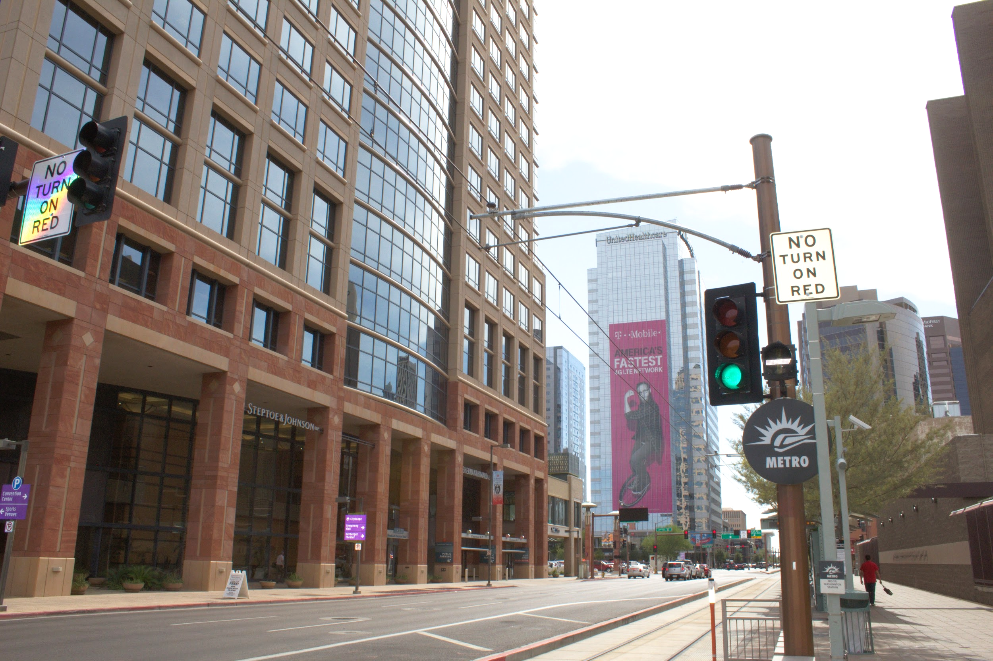
Study Area and Dates
Maricopa County
Arizona
Downtown Phoenix
Photos by Geordi Alm
Study Dates: May - September, 2005 - 2015
Notes:
Basemap: ESRI basemaps
This project brings us to the southwest portion of Arizona to Maricopa County. This includes the major city of Phoenix, one of the leading megapolitan areas in terms of urbanization and population growth, which provides us with interesting data based on its Urban Heat Index effects. Our time period includes the summer months, May - September, for 2005 - 2014.

Slide 3
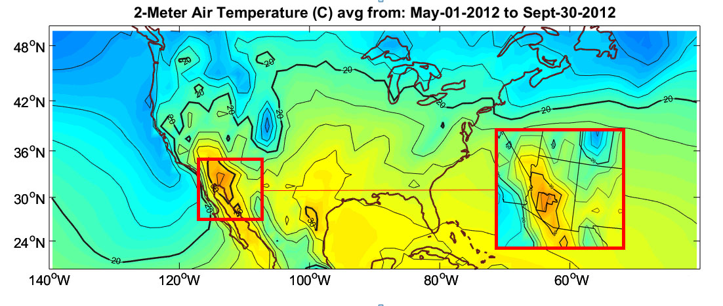
T (C)
Arizona
Community Concern
Extreme heat is a chronic health hazard and is expected to become more dangerous with increased urbanization
Civilians most affected: those without air conditioning, proper insulation, low-income, newcomers, homeless, minorities, and socially isolated
Notes:
(Source authors: Greene et al., 2011, Hartz et al., 2012, and Zhang et al. 2013, MCDPH, 2014, Harlan, 2006, Johnson & Wilson, 2009)
Extreme heat causes heat related and heat caused deaths throughout Maricopa County, where on average 100 people die each year and 1000s more suffer from heat related and heat caused illnesses. With a warming climate and in increase in surfaces like concrete that holds heat in at an unnatural rate, these numbers are projected to increase. These effects are not distributed equally throughout the city or among demographic groups, where some the civilians most affected include those without air conditioning or proper insulation, low-income, newcomers, homeless, minorities, and the socially isolated. While these deaths are tragic, they are preventable. Our partners, the Maricopa Department of Public Health and Arizona Department of Health Services, along with the National Weather Service, do issue warning messages and provide the public with access to cooling centers. Our project is looking to maximize the efficiency of these relief efforts to reach those most in need.

Slide 4
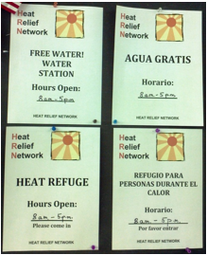
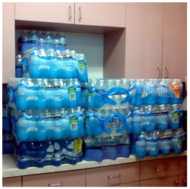
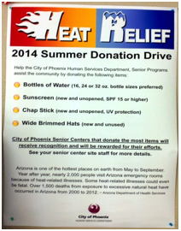
Objectives
Analyze days with extreme heat anomalies
Understand where, how, and why daily variations occur
Establish how users of heat relief resources correlate with socioeconomic vulnerability
Determine where, when, and how relief efforts should intervene
Maricopa County Cooling Center Evaluation Project in Collaboration with ASU and Arizona Department of Health Services
Notes:
We looked at extreme heat anomalies, or days reaching temperatures above 104F, based on literature values in Dr. Sharon Harlan’s research as temperatures that increase health risks. We looked to understand of these heat anomalies, where, how, and why do daily variations within the summer season occur. As you can see in these images, the hottest areas in the county differ by day, where the heat travels towards the populated areas as the season progresses. On top of this, previous studies have used statistical analyses to assume demographic patterns. We have access to surveys deployed by our partner, MCDPH, that will more accurately calculate these demographic trends. Together, we will be able to provide a more detailed look into the UHI variable effect on top of locating communities most at risk so that the MCDPH and AZ Dept of Health Services adaptive capacity may effectively anticipate needs for relief efforts.

Slide 5
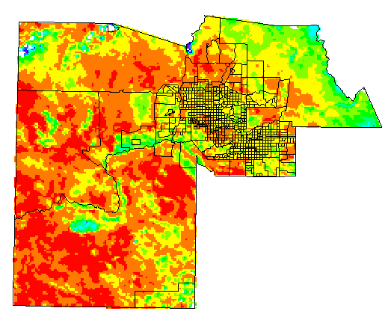
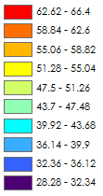
NASA Satellites and Methods
Aqua MODIS
Daily surface temperature data per census tract for statistical comparisons
Landsat 8
Land use classification of the urban environment
Temperature (C)
Terra ASTER
Land use classification of the urban environment
July 10, 2006
MODIS Aqua
Phoenix
Notes:
To answer the how, when, and where questions we used earth observations to gather data on surface temperature. We took each extreme heat day…(click to next slide)

Slide 6
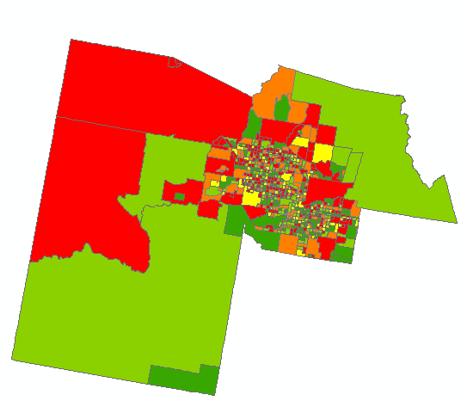
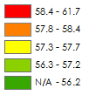
NASA Satellites and Methods
Aqua MODIS
Daily surface temperature data per census tract for statistical comparisons
Landsat 8
Land use classification of the urban environment
Temperature (C)
Terra ASTER
Land use classification of the urban environment
July 10, 2006
MODIS Aqua
Phoenix
Notes:
...and averaged the pixels over census tracts. We further took each extreme heat day and…(click to next slide)

Slide 7
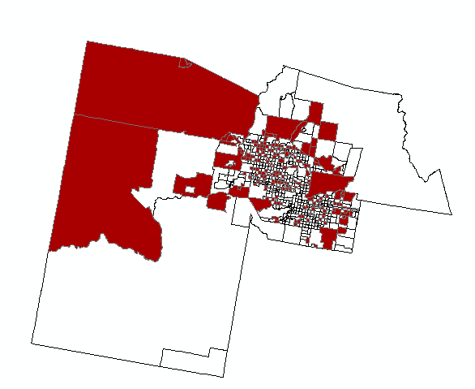
NASA Satellites and Methods
Aqua MODIS
Daily surface temperature data per census tract for statistical comparisons
Landsat 8
Land use classification of the urban environment
Terra ASTER
Land use classification of the urban environment
July 10, 2006
MODIS Aqua
Phoenix
Notes:
...isolated the 30% hottest tracts.

Slide 8
Data Analysis
Census
Bureau
Income
Spatial
Location
Human Concern
CASPER
Survey
Surface Temperature Averages
Spatial Consistency Analysis
Temperature Comparisons
Nuances within UHI
Access to Cooling
Resources
Physical Concern
Notes:
To address the physical concern of the heat, we took these averages and compared them 1) spatially in terms of how consistently a tract occurred in the top 30% throughout the season and 2) in terms of intensity, where we compared the temperature average of the top 30% on extreme heat days to determine if the hottest tracts are always hot in the same magnitude. Additionally, the CASPER survey provided responses with spatial locations which we were we able to pair with census bureau data on income to make conclusions on the access to cooling resources based on where a survey participant lives and the median income level of their census block.

Slide 9
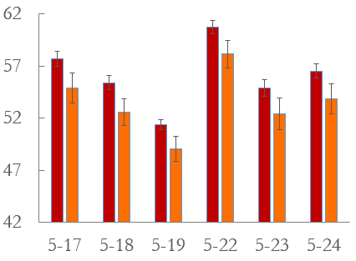
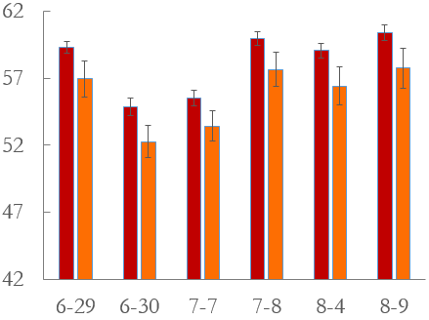
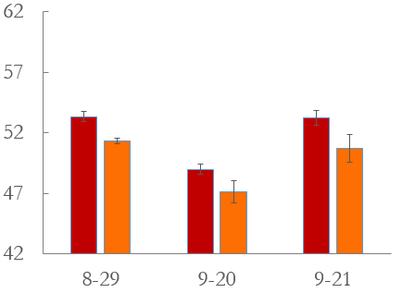
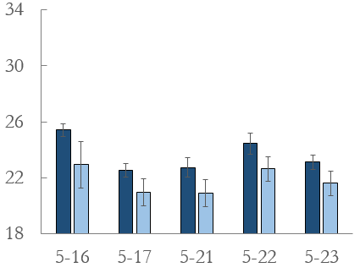
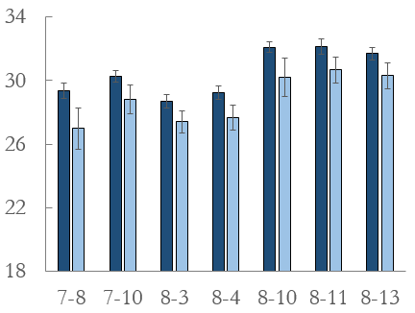
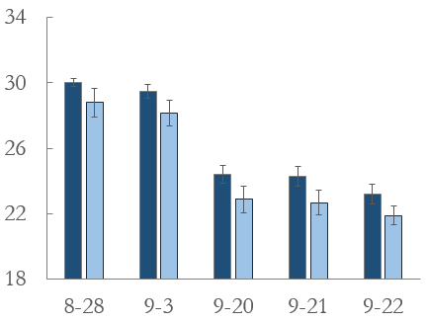
Results and Conclusions
Day - 2012
Early Season
Mid Season
Late Season
Average Surface Temperature (C)
Night - 2012
Date May - September 2012
Notes:
We compared daytime and nighttime temperatures separately and found them to exhibit different trends, exhibited in this diagram for a sample year of 2012. For the daytime temperatures, shown in red, the early season displayed variability with as much as (click animation) 10 degrees Celsius difference between days. This variability demonstrates that our partners relief efforts must be able to anticipate a variable early season and that their warning messages must reflect this to the public so that residents are aware that while on average May is not as warm as July, isolated days may be just as warm, putting them at increased risk. For night, shown in blue, we see a (click for animation) steadily low average temperature early season, rise into the mid season that is sustained, and interestingly there is this (click for animation) lag into the late season not apparent in the day time temperatures. Because the surface is cooling relatively slower than the daytime temperatures, residents are not receiving the relief at night needed to avoid negative health effects. Even though daytime temperatures are starting to decrease into the late season, we suggest the health department and AZ Department of Health Resources relief efforts still focus heavily on this part of the season, as individuals may neglect the severity of these nighttime temperatures, putting their health at unnecessary risk.

Slide 10
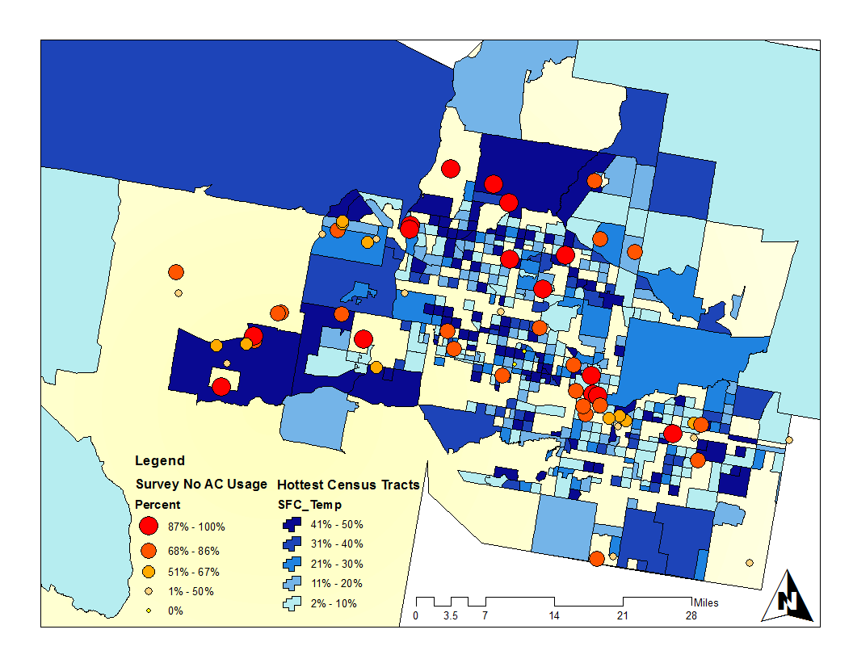
Results and Conclusions
Day - 2012
Notes:
Our spatial analysis of consistency overlaid with survey responses relaying that respondents felt there was something preventing them from using their AC created this hotspot map for 2012. The darker census tracts represent tracts whose daily average surface temperature consistently ranked in the top 30% hottest throughout the whole season and the points represent those who answered ‘yes’ to the question about feeling that something actively prevents them from using AC. We isolated three areas at the most risk throughout the season. This first (click for animation) area represents a suburban neighborhood outside of downtown Phoenix composed of about 22% hispanic. The second (click for animation) area represents a suburban neighborhood with a large amount of elderly individuals living alone or in a retirement home. This last (click for animation) area represents a diverse set of suburban neighborhoods outside the city center. As these areas are at high risk for heat related and heat caused illnesses, whether it is mortality or discomfort, we suggest a heavy emphasis on relief in these areas throughout the entire summer seaosn.

Slide 11
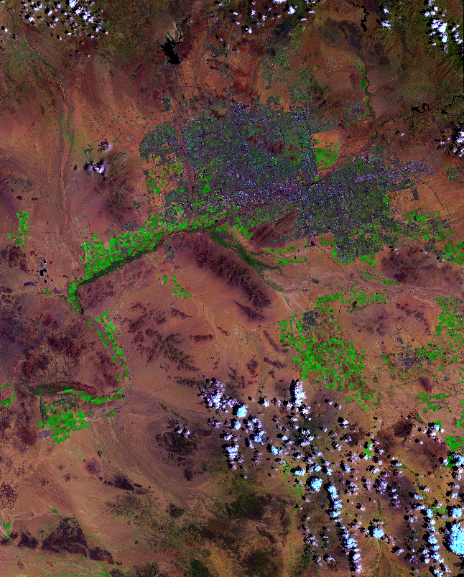
Future Work
Employ land use classification to answer why shifts occur
Synoptic upper air circulation and surface weather type classifications
Suitability analysis for solar panel locations
Incorporating stakeholder knowledge
Landsat 8 Bands 7-5-1 RGB
Notes:
Our project aimed to answer the “how” and “when/where” questions of variations in the UHI effect. Future studies would benefit by increasing this analysis to tackle the “why” questions, such as quantifying surface feature classifications under each heat anomaly to determine any patterns. Our project is also set up to begin tackling larger climatic questions as to why some of these patterns may exist. On top of that, we see potential for this project to continue even further and provide insight into longer term bigger focus solutions that tackle other DEVELOP areas of interest, such as energy and water resources. Over time, we would like to see this information used as a means to provide a suitability analysis for the effective placement of solar panels (or at least to get the conversations heading this way in how solar panels can help save lives in Maricopa) with the idea being that cleaner energy reduces negative climate forcings and solar panels are less water intensive and can inherently cool buildings more efficiently when placed on rooftops by creating an inverse insulation effect. We also look to incorporate stakeholder knowledge for interpretation of results.

Slide 12
Advisors
Dr. David Hondula - Arizona State University:
Geographic Science and Urban Planning
Dr. Kenton Ross - NASA DEVELOP National
Science Advisor
Partners
Maricopa County Department of Public Health
Arizona Department of Health Services
ASU GIS Lab
ASU Center for Policy Informatics
Others
Emily Adams - NASA DEVELOP LaRC Center Lead
Dan Wozniak - NASA DEVELOP LaRC Assistant Center Lead
Jeff Ely - NASA DEVELOP Geoinformatics Scientist
Grant Mercer - NASA DEVELOP LaRC 2015 Summer
Participant
Notes:
A special thanks to all the parties involved that ensured this project moved along in a progressive way.

