Slide 1
DEVELOP National Program – WEEKLY REPORT
Team Location – Center Lead’s Name
Activities and Accomplishments Ending: Friday 06/05/15
Project & Location Activities
Outreach & Conference Activities
Project Milestones
Project A – Accomplishments relating to the project - items completed, etc.
Project B – Other accomplishments
Partner Interaction
Any interaction with partners - calls, emails, meetings, presentations, etc. Make sure to include organization names not just your POC’s name and dates
Include Person’s Name @ Organization Name (spelled out each week)
Ex. Telecon with Tiffani Miller at NASA DEVELOP on 1/5
Science Advisor Interaction
Catalog any meetings/happenings with advisors here.
Ex. Met with Dr. Advisor to discuss (X) and (Y). Outcome: solved issue with (Z).
Meetings & Presentations
These are non-conference presentations and meetings - perhaps at your center to management and whatnot. Also could be telecons, videocons, webinars, etc. These are events and happenings that don’t fit in the other conference/outreach categories. If you presented at the meeting give the title of the presentation and the names of the presenters. Include the nature of the presentation and summarize the audience and who was in attendance.
Event - Date. Nature of event.
Ex. Met with (SO AND SO) to discuss (TOPIC). Outcome: X, Y, Z.
Ex2. Met with (SO AND SO) to discuss (TOPIC), presented (TITLE). Presenters: (NAMES).
Ex3. Attended DEVELOP National Telecon. 01/13/2011.
Issues / Problems
Any project, office, or whatnot issues that have arisen and need to be addressed.
Center Lead Duties
Bulleted list of achievements for the week
Ex. collecting schedules, contracts, maintaining performance metric tracking spreadsheet, application review, interviews, etc.
Conference Attendance
Conference - Location, Date. Title of presentation. Presenting: (NAMES). Attending: (NAMES - only include if different than list of presenting).
Outreach Activities
Recruiting event at (SCHOOL NAME). Brief summary of event and # of students/people in attendance. Date.
Publications & Articles
If your node has a publication, article, interview, journal article, newspaper article, online article, etc. that you/your team have written or were announced in, also include link to article (if accessible online). Provide full citation information if not.
Ex. Langley Research News - feature article on Langley/Wise/Goddard presentation to Pakistani and Indian delegation (www.nasa.gov/centers/langley/news/ researchernews/rn_DEVELOPPaki.html)
Please be sure that if your node is publishing an article, that it has been reviewed by NPO ahead of time. Send a copy of the final article to Tiffani Miller and Lauren Childs-Gleason before submitting. Listing a publication in your quadchart or mentioning it on the national telecon does not count as NPO review.
Future Activities
Focus for the Next Week:
Fall term preparation
Preparation for an upcoming conference/event
Schedule recruiting event for summer term applicants
Spring proposal writing
Upcoming Events & Activities
This is the calendar for upcoming events that have concrete dates. Include what event/activity is, where (if applicable), and date.
DEVELOP Summer Term begins 6/1
Annual Earth Science Applications Showcase – Washington, DC (7/30)
AGU Science Policy Meeting – Washington, DC (6/24-26)

Slide 2
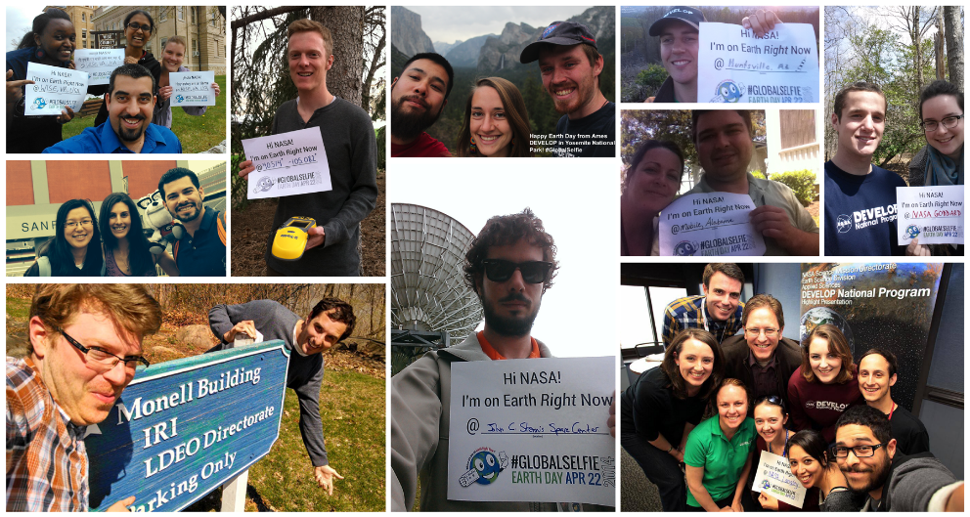
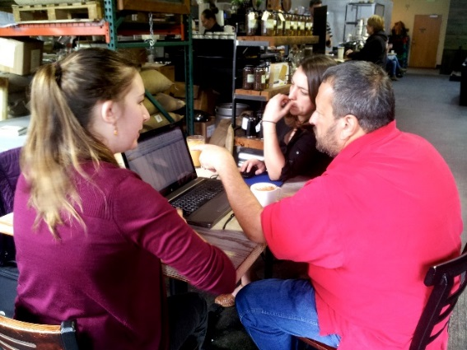
DEVELOP National Program – WEEKLY REPORT
Team Location – Center Lead’s Name
Activities and Accomplishments Ending: Friday 06/05/15
Team Imagery & Photos
Caption describing the picture, be succinct but clear. Make sure no NASA badges are in the picture, that all people have signed a media release who are visible, and that there are no people under the age of 18.
Caption describing the picture, be succinct but clear. Make sure no NASA badges are in the picture, that all people have signed a media release who are visible, and that there are no people under the age of 18.
Ideas of things to put in this section:
Cool imagery from a project (or projects!) at your location
Pictures of DEVELOPers presenting their work
Final products used during or photos of a partner hand-off
Pictures of your location, teams at work, or other everyday scenes at your node
Team building activities (as long as they’re appropriate for Capacity Building/Applied Sciences consumption [read: you’d be comfortable with Nancy Searby seeing it])
Other cool accomplishments or events you take part in!
Things to remember:
Provide a caption or text box for project imagery or photos; explain what’s happening in the photo/being shown in the imagery, and include the names of any individuals in the photos
Make sure you have a signed media release form for anyone appearing in a photo
Feel free to send photos as attachments when submitting your quadchart - we love high-res imagery/photos!

