Slide 1
Georgia Disasters and Water Resources
Utilizing NASA Earth Observations to Monitor Sinkhole Development and Identify Risk Areas in Dougherty County, GA
Matthew Cahalan (Project Lead)
Tunan Hu
Mohamed Amin
Wenjing Xu
Kimberly Berry

Slide 2
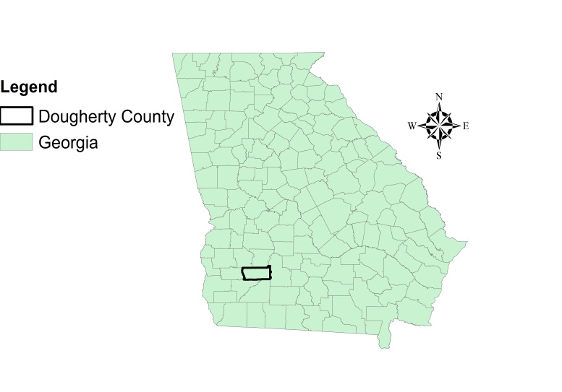
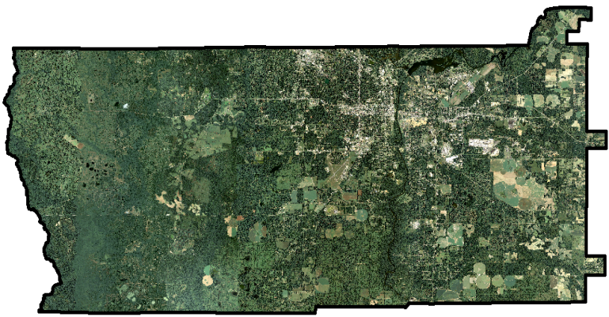
Study Area
Geology- Ocala Limestone and varying
amounts of overburden thickness (0 – 40m)
Hydrology- Flint River and tributaries; Lake
Chewaw; ponds created from sinkhole
depressions
Hydrogeology- Upper Floridan Aquifer
Climate- humid subtropical; 50 inches of annual rainfall
Geomorphology- flat karst terrain characterized by sinkholes, disappearing streams, springs, and cave systems
Human Element- growing populace in agricultural region with increasing demands on groundwater resources for municipalities, agriculture, and industry
Notes:
Our study area for this project is Dougherty County, Georgia, which is located in Southwest Georgia. This area lies within an extensive karst region that experiences sinkhole development on varying spatial and temporal scales. Both large scale cover-subsidence and small-scale cover collapse sinkholes form in this covered karst region, creating significant environmental and engineering hazards. The Upper Floridan Aquifer is a primary source for municipal and agricultural water resource needs. Further, due to its relatively high transmissivities and ability for sinkholes to act as direct conduits to the aquifer, this aquifer is highly susceptible to groundwater contamination. This project aims at mitigating that risk and others posed by sinkhole formation.

Slide 3
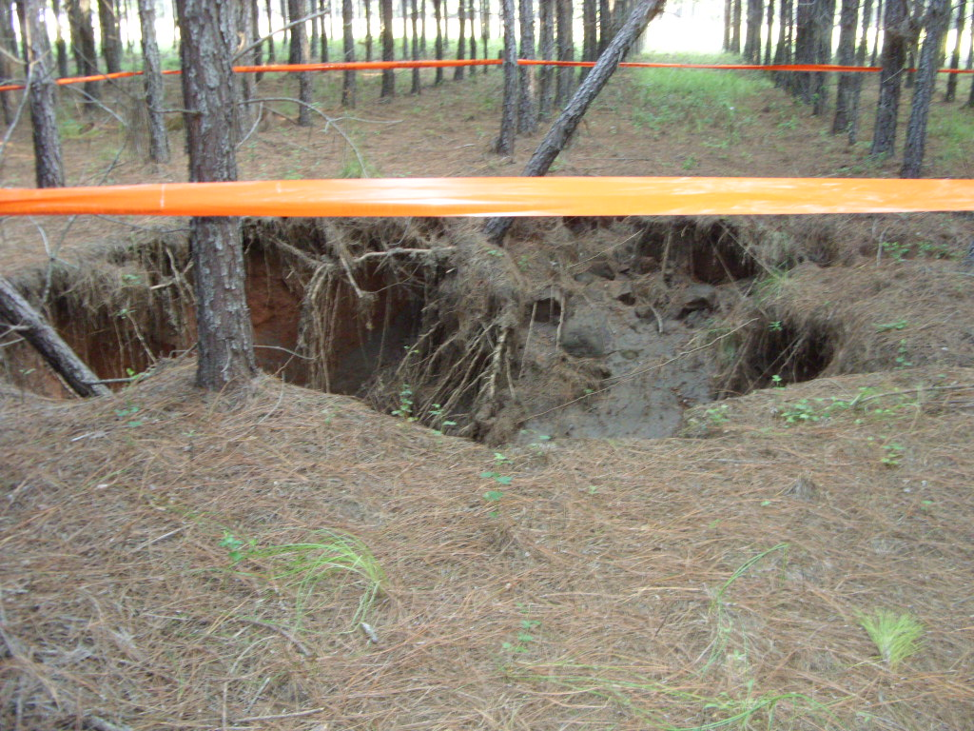
Community Concerns
Sinkholes are a risk to human safety, environmental health, and infrastructure (i.e., roads and buildings) in Dougherty County.
Sinkholes pose a threat to groundwater pollution.
Source: Jim Stolze, Albany Utilities
Notes:
Sinkholes present great difficulties and risk for human safety, land use management, environmental health, and infrastructure damage to roads and buildings. For example, sinkholes can pose a threat to groundwater pollution by introducing contaminants into aquifer systems. Improving the understanding of and predictive capabilities for sinkhole formation is critical to alleviate concerns that groups of people have like farmers, city planners, and water resource managers.

Slide 4
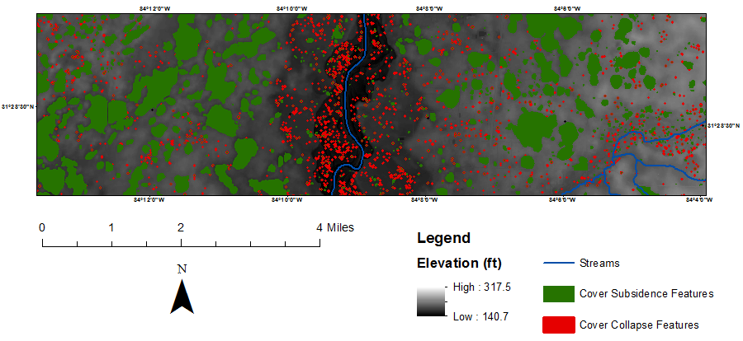
Sinkhole Types
Cover-subsidence- large area and gradual formation
Cover-collapse- small area and abrupt formation
Source: Matthew Cahalan
Notes:
This research strives to understand the formation and distribution of two sinkhole types: cover-collapse and cover-subsidence. Cover-collapse sinkholes are smaller in scale and tend to form over shorter time periods measured in minutes to days. These types of sinkholes tend to form along or near bedrock fractures and within flood plains. Cover-subsidence sinkholes are larger in scale and form over longer time periods measured in months to years. These types of sinkholes are often caused by hydrologic factors such as their proximity to swamps, marsh, rivers and streams. From the image above, the green features denote cover subsidence features while the red features are cover collapse. Cover-collapse sinkholes may form within cover-subsidence sinkholes, but the color-scale of this image does not illustrate this.

Slide 5
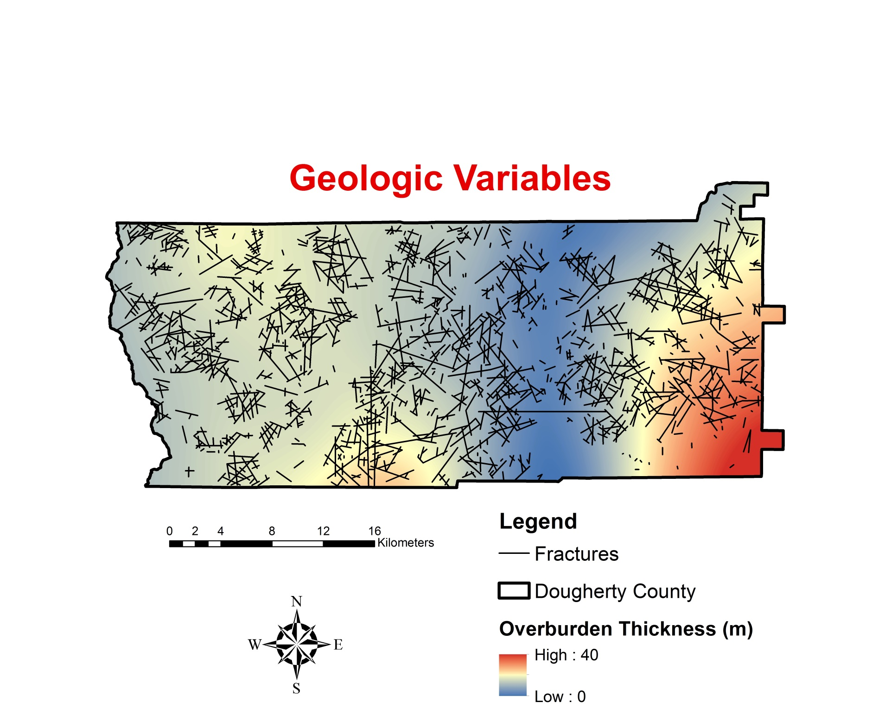
Sinkhole Formation Factors
Notes:
Sinkholes are formed from interactions on the surface and subsurface between multiple factors, one of the important categories being geologic factors. For this project, we looked at geologic factors of overburden thickness from a depth of 0 to 40m, which is represented by the color gradient on the image, and bedrock fractures, which is represented by the black lines that you see. Fracture data was acquired from Brook and Allison, 1983. Overburden thickness data was gathered from the USGS and input into a deterministic interpolator to produce to map.

Slide 6
Sinkhole Formation Factors
Notes:
The next variables we looked into were hydrologic. We took into account various bodies of water such as swamps, marsh, ponds, lakes, and rivers/streams and incorporated them into our analysis. Specifically, we calculated the distances to the various surficial hydrologic features to examine the influence of proximity to these features on sinkhole formation. These data were gathered from the USGS National Hydrography Dataset (NHD).

Slide 7
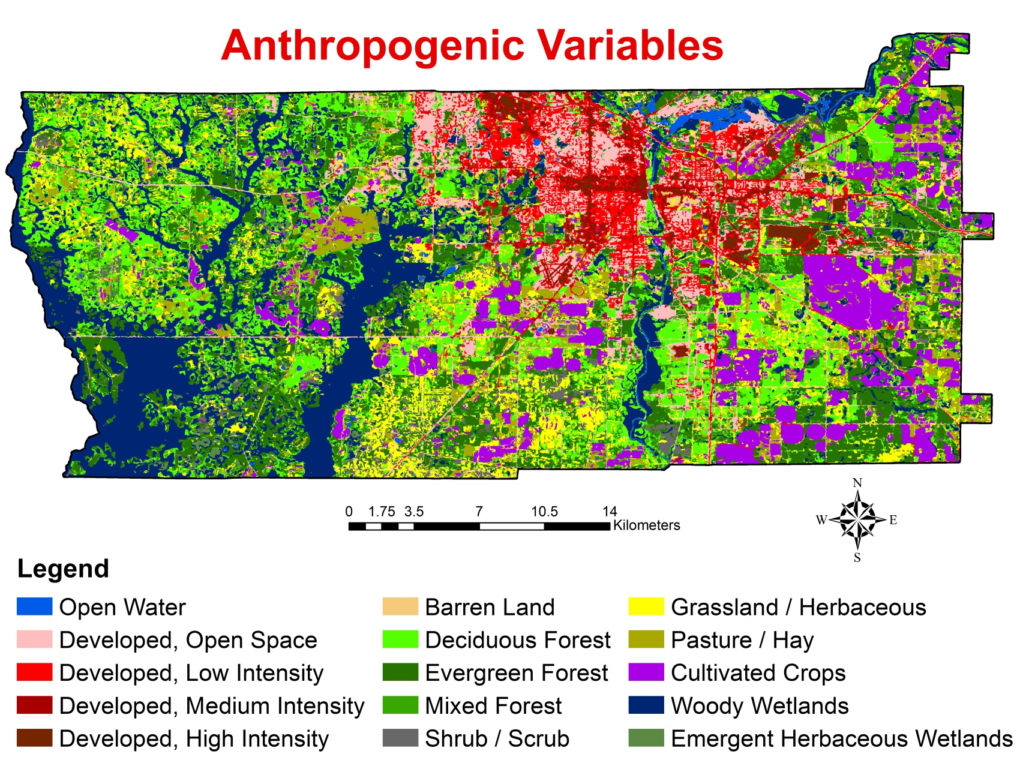
Sinkhole Formation Factors
Notes:
Anthropogenic variables were also included in our analysis. These included land use and land cover change over Dougherty County, according to the National Land Cover Dataset (NLCD).

Slide 8
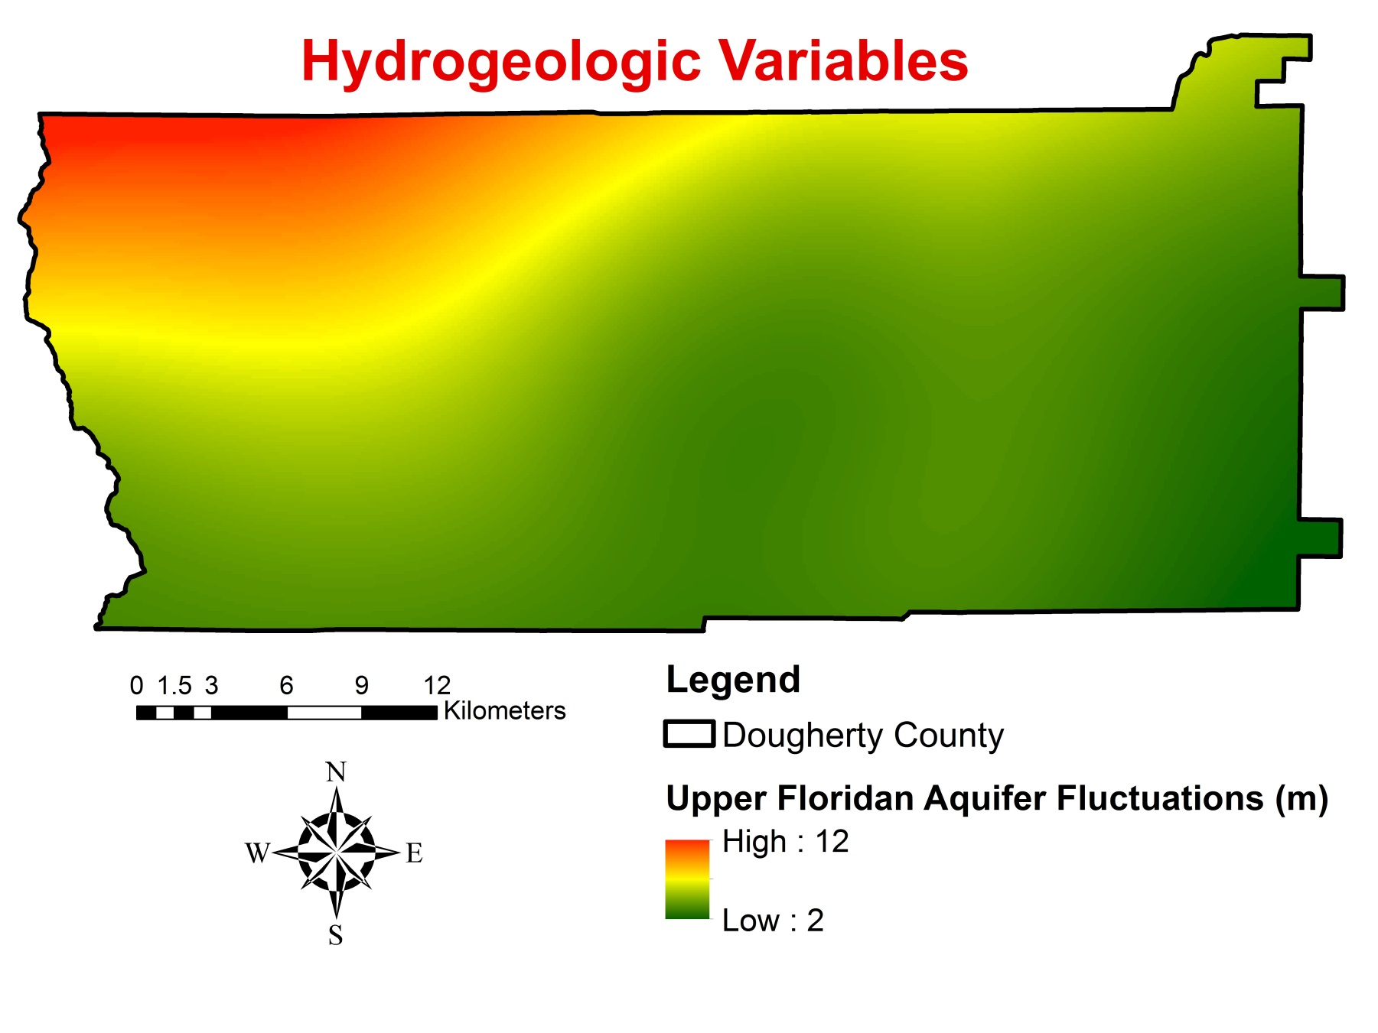
Sinkhole Formation Factors
Notes:
Upper Floridan Aquifer (UFA) fluctuations was our hydrogeologic variable. We took into account fluctuations from a range of 2 to 12 meters. Previous research in this area has correlated UFA fluctuations with sinkhole formation, so inclusion of this variable in our analysis was important. We gathered USGS well data to calculate fluctuations over our study period, and input those values into a deterministic interpolator to produce this map.

Slide 9
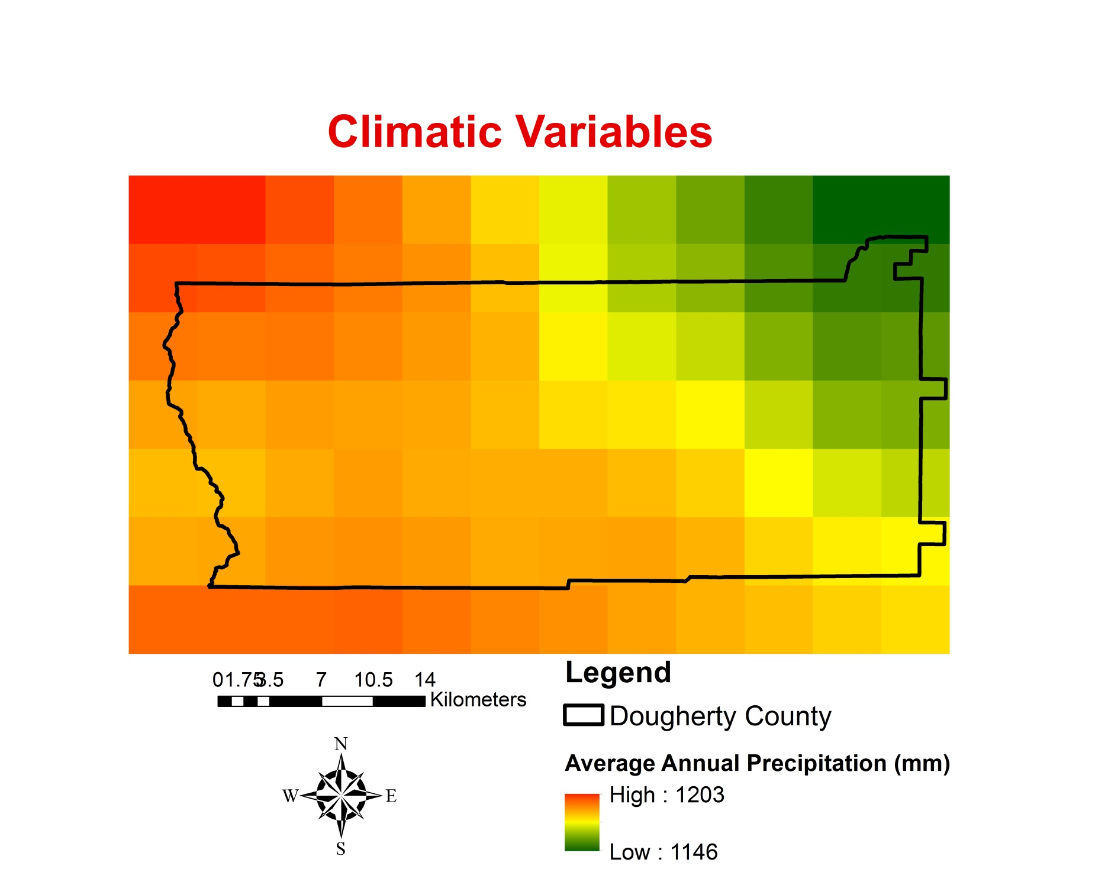
Sinkhole Formation Factors
Notes:
Lastly, the climatic variable taken into account was average annual precipitation, where the gradient of color represents precipitation levels with red being the highest precipitation. This data was gathered from PRISM (Parameter-elevation Relationships on Independent Slopes Model).

Slide 10
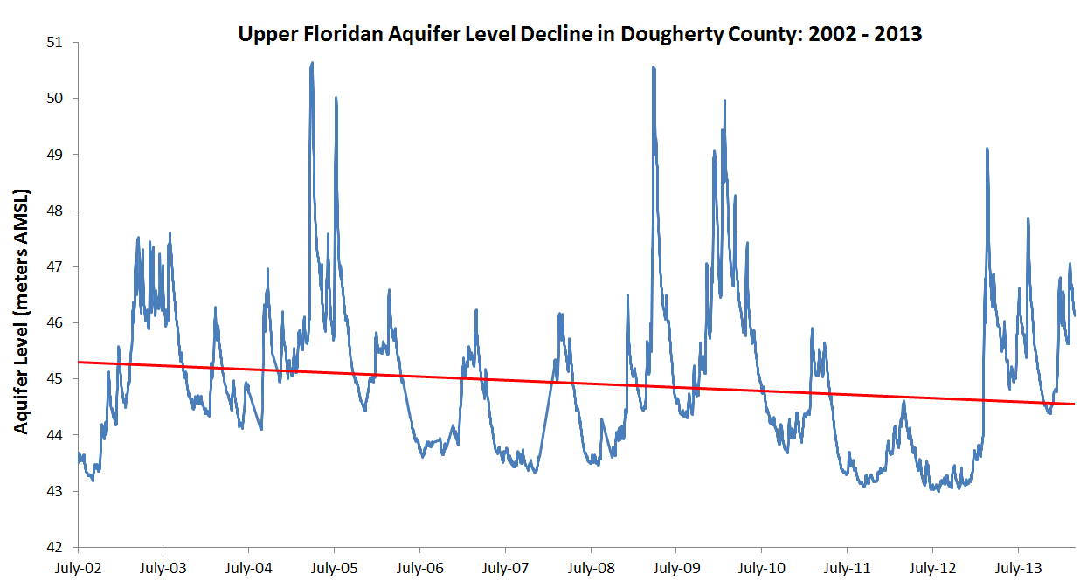
Sinkhole Formation Mechanisms
Flooding- liquefaction
Drought and/or groundwater over extraction - loss of hydrostatic support
Notes:
Sinkholes can form through flooding and drought mechanisms. When flooding occurs, there is increased mass over the surface, which overcomes the underlying support forces (i.e., cohesion of soil particles due to liquefaction). Additionally, drought can lower the aquifer levels, which provide hydrostatic support of overlying materials. From this image, we can see the effects of drought decreasing the aquifer levels over time, which reduces the support of overlying materials. When hydrostatic support is absent, overlying material has a greater chance of eroding into subsurface cavities to form a sinkhole.

Slide 11
Objectives
Develop sinkhole inventory maps for years ranging from 1999 – 2011 utilizing an automated sinkhole mapping algorithm developed by the team
Improve the understanding of and predictive capabilities for sinkhole development by analyzing sinkhole formation factors
Produce sinkhole susceptibility maps for Dougherty County
Notes:
The first objective of this research was to develop sinkhole inventory maps between 1999 and 2011 using a time-series of digital elevation models. An example is shown at the bottom of this slide. The second objective was to improve the understanding of modeling sinkhole development by analyzing factors influencing new sinkhole formations to produce sinkhole susceptibility maps. The team produced two separate sinkhole susceptibility maps for the two different types of sinkholes that form in varying environmental conditions.

Slide 12
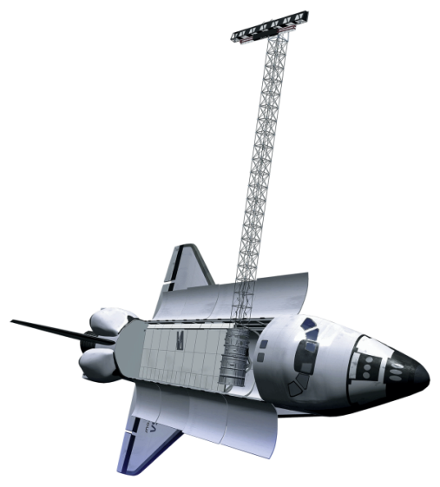
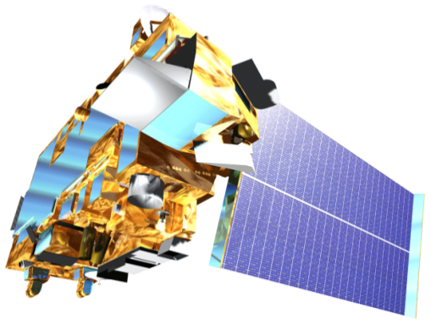
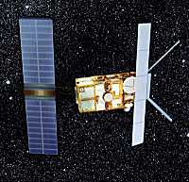
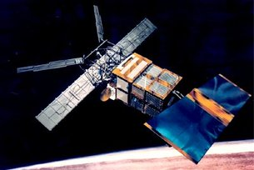
SRTM
Terra (ASTER sensor)
Earth Observations
NASA Satellites
SRTM & Terra (ASTER) DEM
Cover-subsidence sinkhole detection
European Space Agency Satellites
ERS-1 and ERS-2 DEM
Cover-collapse sinkhole detection
Source: NASA DEVELOP National Program Office
ERS-1
ERS-2
Cite image sources on slide and in notes
Source: nasa.gov & esa.int
Notes:
For this project we used a time-series of digital elevation models (DEMs) to complete the first objective of compiling sinkhole inventory maps for the study period of 1999 to 2011. High resolution DEM’s were acquired to analyze the spatiotemporal distribution of cover-subsidence and cover-collapse sinkhole development. DEM data was acquired from four different satellites. SRTM and Terra (ASTER sensor) data were used to detect cover-subsidence sinkhole development, while European Space Agency’s ERS-1 and ERS-2 were used to detect cover-collapse sinkholes. Both SRTM and ASTER had vertical accuracies of 20 meters while ERS-1 and 2 had vertical accuracies of 10 meters. As a result, these accuracy measures presented an uncertainty in our analyses. We approached the differing vertical/horizontal accuracies of the DEMs in two ways. First, we applied error bars around our final sinkhole point values (total number of sinkholes in our study area) for each sinkhole inventory map based on the vertical and horizontal accuracies. Secondly, when identifying newly formed or extended sinkholes within the study period by comparing the sinkhole inventory maps, we used a conservative search radius that took into account the differing horizontal and vertical accuracy measurements. For example, when identifying newly formed or extended sinkholes between the 2000 and 2011 sinkhole inventory maps, any new sinkhole point (in the 2011 map) that was within 20 meters or less than a previously identified sinkhole point (in the 2000 map) was not included in our final temporal difference maps that were used in further analyses.

Slide 13
Methodology
DEM Data download
Sinkhole
Mapping
ArcGIS ModelBuilder Algorithm
NASA SRTM NASA ASTER
ERS-1 and 2
Validation
Temporal Difference Maps
Sinkhole Density Maps
Notes:
30 meter DEM data from 2000 and the 2011 was acquired from NASA’s SRTM and ASTER satellites for analysis on cover-subsidence sinkholes. The spatial and temporal resolutions of these satellite data were appropriate because cover subsidence sinkholes form gradually and over large areas. Next, ERS-1 and 2 satellite aperture radar (SAR) images were used to generate 5 meter resolution DEM’s for cover-collapse sinkhole detection for the years 1999, 2002, 2004, 2005, and 2009. The acquired DEMs, alongside a ArcGIS ModelBuilder algorithm the team created, were used to produce an inventory of sinkhole maps identifying the distribution of past and newly formed sinkholes. We furthered this analysis by human validating the maps to verify sinkhole mapping accuracy and to check for any falsely identified sinkholes.
After the sinkhole inventory maps were produced for each year, temporal difference maps were created by identifying newly formed or enlarged sinkholes through comparative analysis of the sinkhole inventory maps. The cover-subsidence temporal difference map used the 2000 SRTM and 2011 ASTER sinkhole inventory maps for its comparative analyses, while 1999, 2004, and 2009 maps were merged to show cover-collapse sinkhole development. The temporal difference maps were inputs to produce the sinkhole density maps for cover-subsidence and cover-collapse sinkholes.

Slide 14
Methodology
Sinkhole Formation Factor Analysis
Independent Variables:
Precipitation
Aquifer fluctuations
Distance to roads
Distance to streams
Distance to lakes
Distance to fractures
Fracture orientation
Distance to wetlands
Land use
Land cover change
Overburden thickness
Ordinary Least Squares
Geographically Weighted Regression
Sinkhole Susceptibility Map
Notes:
To understand the influential factors behind sinkhole formation, we performed ordinary least square (OLS) regressions. This regression technique takes into account all the independent variables used in this project to recognize which variables were best at explaining the sinkhole distribution that we identified in the sinkhole density maps.
Secondly, geographically weighted regression (GWR) is a robust technique used to model spatially varying relationships. GWR models were constructed to see how all the variables as a whole explain the sinkhole density distribution.
The results of both of these regression analyses were combined to generate the sinkhole susceptibility map, which depicts the probability of future sinkhole formations within the study area.

Slide 15
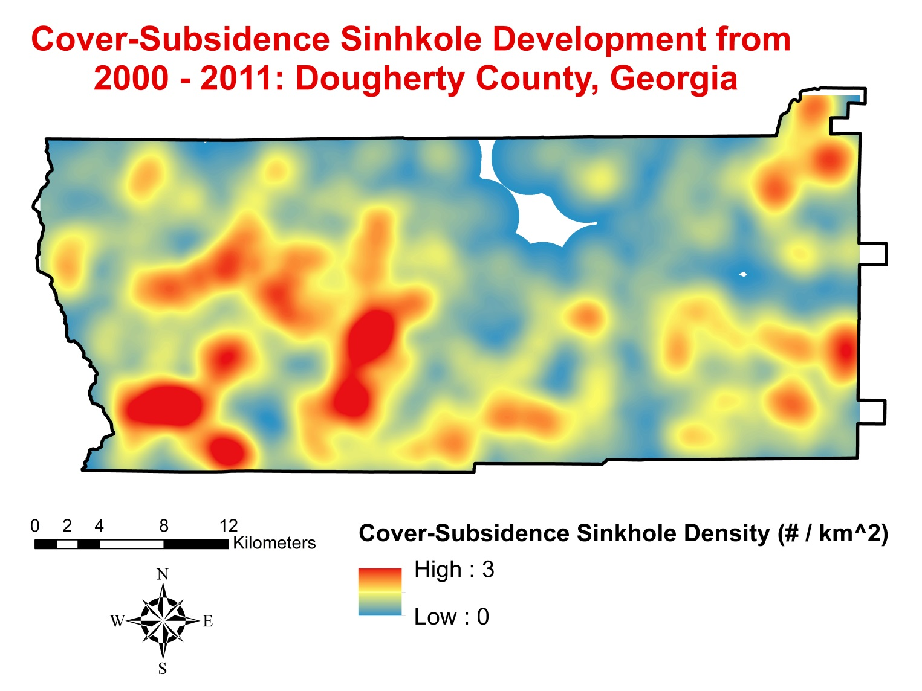
Results
Notes:
The image above depicts cover-subsidence sinkhole development density within the study area between 2000 and 2011. As you can see, a greater density of cover-subsidence sinkholes has developed along the southwest portion of Dougherty County. The input for this map was the cover-subsidence temporal difference map.

Slide 16
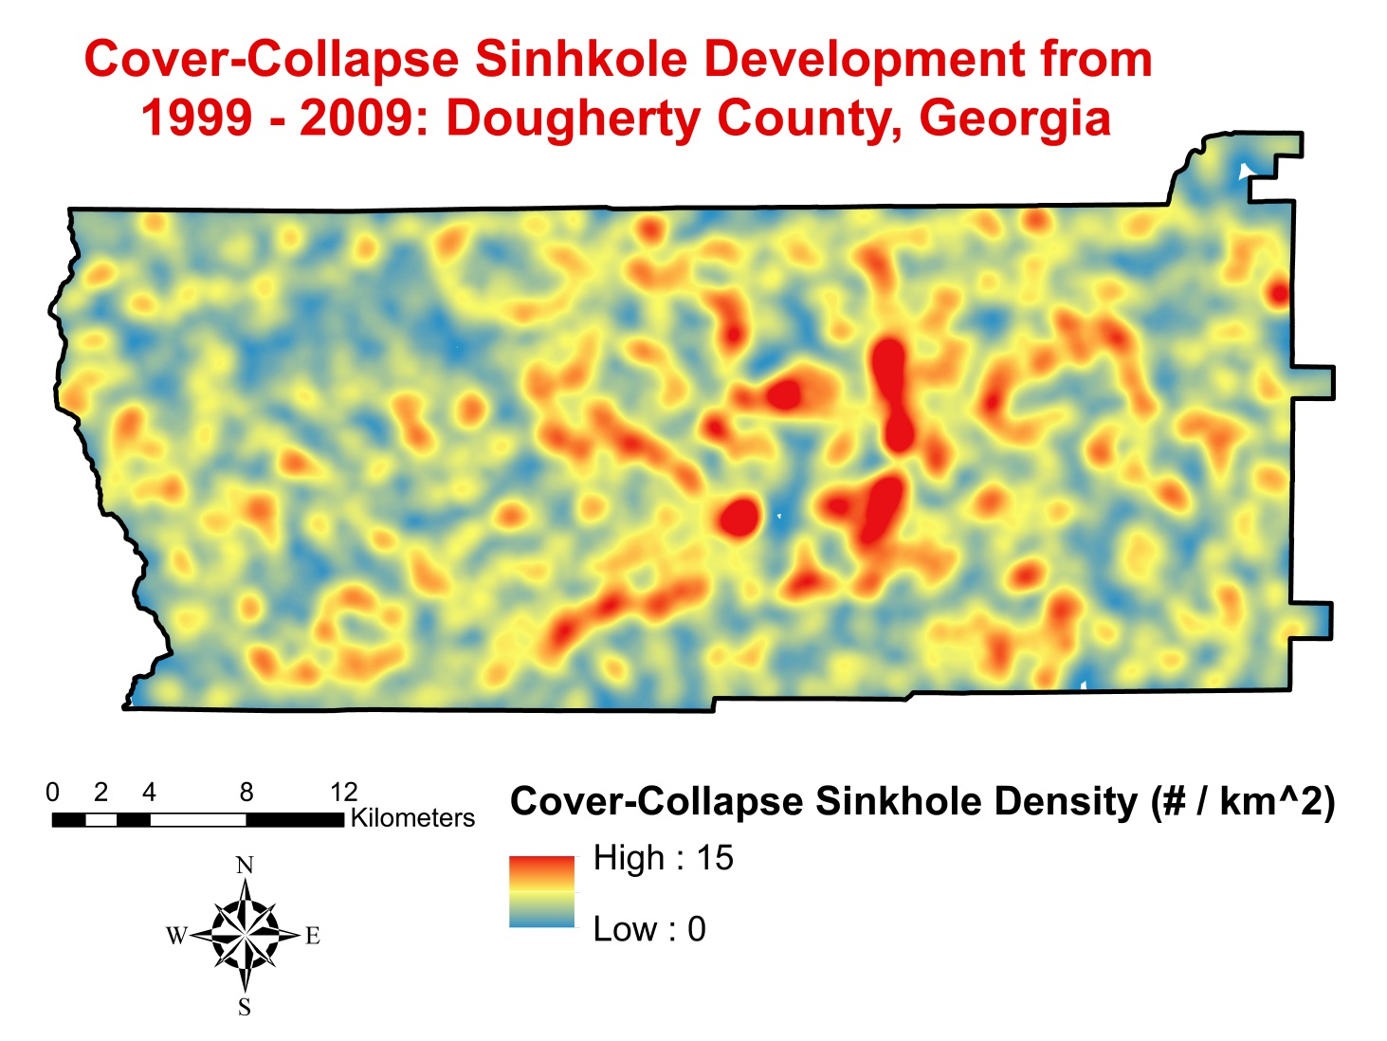
Results
Notes:
The map is of cover-collapse sinkhole development density between 1999 and 2009. Interestingly, a greater density of cover-collapse sinkholes can be seen within the central portion of Dougherty County. The input for this map was the cover-collapse temporal difference map.

Slide 17
Ordinary Least Squares Results
Cover-subsidence sinkhole formation mostly influenced by:
Distance to wetlands
Distance to lakes
Distance to roads
Land use
Aquifer fluctuations
Depth to bedrock
Cover-collapse sinkhole formation most influenced by:
Distance to wetlands
Distance to rivers
Distance to fractures
Shallow overburden thickness
Aquifer fluctuations,
OLS Independent Variables | Cover Subsidence | Cover Collapse
Distance to fractures | 0.179 | 0.000*
Distance to rivers | 0.587 | 0.000*
Distance to wetlands | 0.000* | 0.000*
Distance to roads | 0.018* | 0.115
Distance to lakes | 0.000* | 0.075
Overburden Thickness | 0.000* | 0.000*
Precipitation | 0.253 | 0.112
Land use | 0.010* | 0.407
Land cover change | 0.003* | 0.082
Aquifer Fluctuations | 0.000* | 0.000*
Fracture orientation | 0.456 | 0.572
Notes:
As mentioned before, the OLS regression technique is used to recognize which variables are best at explaining the sinkhole distribution that we measured. From the chart above, you can see that the bolded results depict p-values which show variables that are statistically significant in explaining sinkhole formation. For example, some variables like distance to roads, lakes, and land use were significant in producing cover-subsidence sinkholes (among others), while distance to fractures and overburden thickness were significant in producing cover-collapse sinkholes (among others). Three variables were significant for both types of sinkholes, which were distance to wetlands, overburden thickness, and aquifer fluctuations.

Slide 18
Geographically Weighted Regression Results
The team’s sinkhole models explained 81% and 93% of cover-subsidence and cover-collapse sinkhole formation.
Source: ArcGIS Resources Regression Analysis Basics page
GWR Statistics Summary | Cover Subsidence | Cover Collapse
Number of Observations | 579 | 2,913
R² | 0.81 | 0.93
R² Adjusted | 0.64 | 0.79
Notes:
The GWR method mentioned earlier is a regression technique that shows how well all the variables as a whole explain sinkhole distribution. This technique was chosen because it models spatially varying relationships, and we showed through our mapping results that sinkhole distribution varies spatially. The R-squared value is a measure of how well all the variables within our analyses are able to explain the sinkhole distribution. Based on our R-squared results, our team successfully explained 81% of cover subsidence and 93% of cover collapse sinkhole density variability. The R-squared adjusted accounts for model complexity. Based on the results of R-squared adjusted values, our analyses was able to explain 64% of cover subsidence sinkholes and 79% of cover collapse. The results of our geostatistical analyses (i.e., OLS and GWR) were inputs to produce the sinkhole susceptibility maps.

Slide 19
Results
Notes:
With the combination of our temporal difference maps, sinkhole density maps, and regression results, a final analysis was performed to create susceptibility maps for cover-subsidence and cover-collapse sinkholes. These maps illustrate the areas susceptible to future sinkhole formation across Dougherty County.
For cover-subsidence sinkholes, it makes sense based on our conceptual model of sinkhole formation and measured sinkhole density results to see areas susceptible to cover-subsidence sinkhole formations around the western and eastern portions of Dougherty County because large bodies of water and wetlands are prevalent in those regions while also having intermediate overburden thicknesses of 10 – 20 meters.

Slide 20
Results
Notes:
Based on this results, cover-collapse sinkholes are more susceptible to form around central Dougherty County. Urban land use practices, infrastructure development, and water resource management are ample in this region, accelerating sinkhole formation. Additionally, these results fit our sinkhole formation conceptual model because highly susceptible areas are within close proximity to rivers with shallow overburden thickness of 0 – 10 meters and highly fractured bedrock.

Slide 21
Conclusions
Assessment: the team’s sinkhole mapping algorithm is an effective technique
Analysis: different factors affect the formation of the two types of sinkholes analyzed
Performance: regression models explained 81% and 93% of cover-subsidence and cover-collapse sinkhole formation
Validation: the sinkhole susceptibility prediction surfaces compared well to the measured sinkhole density results
Notes:
In conclusion, we were able to take away four key points of this project. First, the automated sinkhole mapping algorithm developed by the team was effective in identifying both cover-subsidence and cover-collapse sinkholes with DEMs of varying resolutions.
Second, our regression analysis showed different factors affecting the formations of both types of sinkholes. These results can be used to analyze future sinkhole formation mechanisms.
Third, our geographically weighted regression models were able to explain 81% of cover-subsidence and 93% of cover-collapse sinkhole density variations, which made the team confident in the accuracy of the sinkhole susceptibility maps.
Lastly, the sinkhole susceptibility results compared well to the measured sinkhole density results and may be used for land use, water resource, and infrastructure decision making processes.

Slide 22
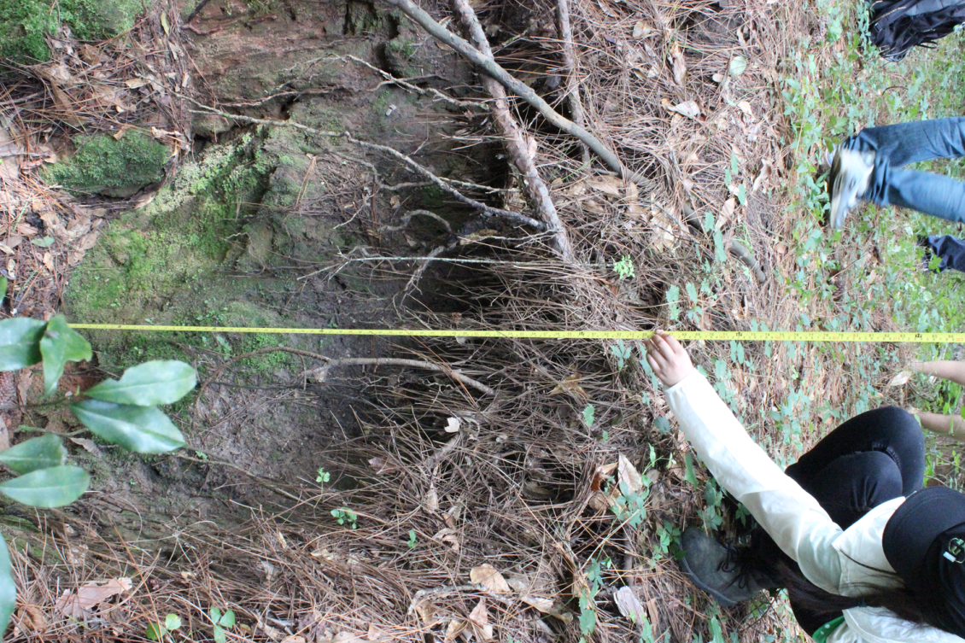
Future Work
Groundwater contamination susceptibility map
Groundwater storage change maps
Presenting results at the 2015 AGU Fall Meeting
Source: Tunan Hu
Notes:
For future work, the Fall 2015 Georgia Water Resources team will further the results and analyses of this project by producing a groundwater contamination susceptibility map and groundwater storage change maps using NASA Earth observations. Additionally, this project was chosen by NASA to present at the 2015 American Geophysical Union Fall Meeting.

Slide 23
Advisors
Dr. Adam Milewski Water Resources and Remote Sensing Laboratory, Department of Geology, University of Georgia
Partners
Paul Forgey City of Albany and Dougherty County Planning and Development Services
Randy Weathersby Southwest Georgia Water Resources Task Force
Jim Stolze Albany Utilities
Others
NASA South Dakota Space Grant Consortium
Notes:
We would like thank NASA DEVELOP and the community for their support of this project and our science advisor, Dr. Adam Milewski for his guidance throughout this term. We would also like to thank Paul Forgey of the City of Albany and Dougherty County Planning and Development Services, Randy Weathersby of the Southwest Georgia Water Resources Task Fore, and Jim Stolze of Albany Utilities for their valuable input as project partners.
Finally, we would like to acknowledge the NASA South Dakota Space Grant Consortium for their grant support of our team member, Kimberly Berry.

Slide 24
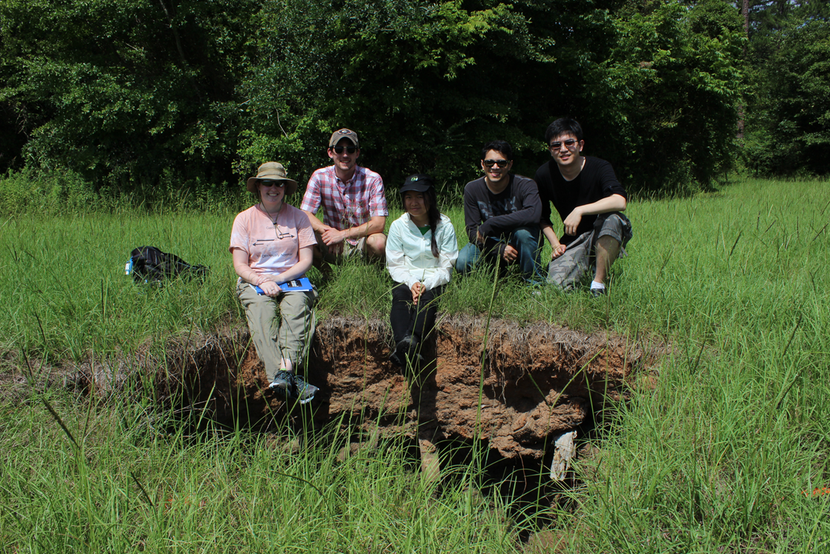
Team Members
From left to right: Kimberly Berry, Matthew Cahalan, Wenjing Xu, Mohamed Amin, and Tunan Hu

