Slide 1
NEVADA WILDLAND FIRES
Mapping Historical Burned Areas and Identifying Drivers of Fuel Load Growth to Inform Desert Tortoise Habitat Management in Southern Nevada
Lucy Hayes
Hunter Davis
Spencer Harman
Colin Jacobs
Maryland – Goddard | Summer 2024
Notes:
Welcome! We are the Nevada Wildland Fires team. Our work mapped historical burned areas and identified drivers of fuel load growth in Southern Nevada. The members of this team include Lucy Hayes, Hunter Davis, Spencer Harman, and Colin Jacobs. This project was completed at the Goddard Space Flight Center in Maryland during the summer 2024 term.

Slide 2
DEVELOP Team
Lucy Hayes Team Lead | Hunter Davis | Spencer Harman | Colin Jacobs
Notes:
The members of our DEVELOP team include the team lead Lucy Hayes, a recent graduate of the University of Maryland, who received a degree in Environmental Science and Technology; Hunter Davis, a current undergrad at Brigham Young University studying Geography; Spencer Harman, a recent graduate from George Mason University receiving a bachelors in Environmental Science; and Colin Jacobs, a current undergrad at the University of Utah studying Atmospheric Sciences.

Slide 3
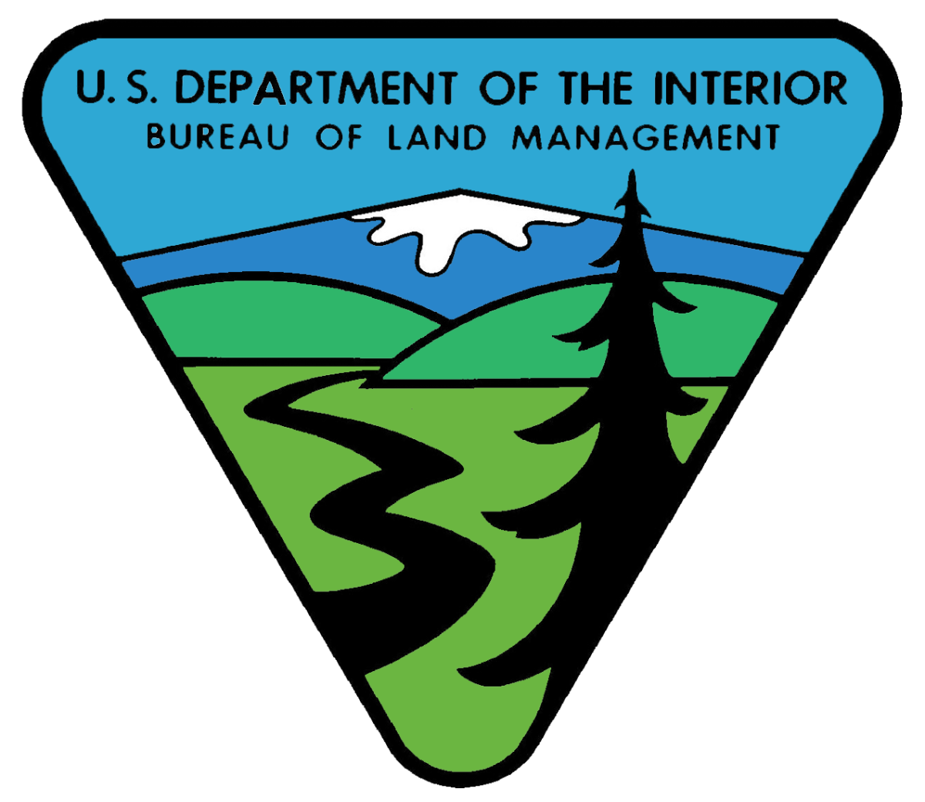
Partners
Bureau of Land Management
Southern Nevada District Office
Forest Service
Rocky Mountain Research Station
Department of Interior
Agricultural Research Service, Arid Lands Ecology Lab
Image Credit: BLM, USFS, DOI
Notes:
We’re happy to work with our partners to complete this project. Our partners include the Bureau of Land Management (BLM), at the Southern Nevada District Office (SNDO); the Forest Service, at the Rocky Mountain Research Station; and the Department of Interior (DOI), at the Agricultural Research Service, Arid Lands Ecology Lab. Throughout this project, we have consulted with them for their advice and desires on the end products we created.
----------Image Information Below----------
Left
Image Credit: BLM
Image Source: https://www.blm.gov
Middle
Image Credit: USFS
Image Source: https://www.fs.usda.gov
Right
Image Credit: DOI
Image Source: https://www.doi.gov

Slide 4
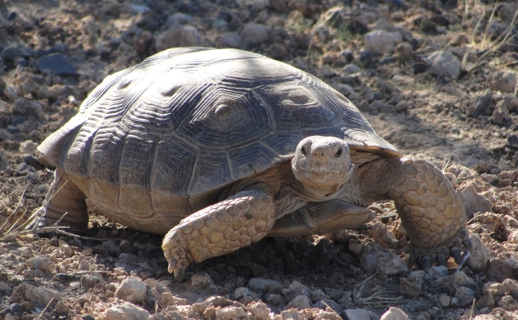
Background – Desert Tortoise (Gopherus agassizii)
Vital to the Mojave Desert ecosystem
Traditionally lives in arid desert land with sparse vegetation
Critically Endangered Status due to increasing fire frequency
Image Credit: Mojave Desert Tortoise - USFWS
Notes:
The Mojave Desert Tortoise is a keystone species that is vital to the Mojave Desert ecosystem. For example, Road Runners, Burrowing Owls, and Gila Monsters rely on the Desert Tortoises’ burrows for shelter (1).
The Desert Tortoise was first recognized as a threatened species by the U.S. Fish and Wildlife Service in the Endangered Species Act of 1973, due to its sharply declining population (2). As of 2020 it was re assessed by the IUCN red list and designated as critically endangered due to continued habitat loss and population decline (4).
The “Mojave population of desert tortoise lives in a variety of habitats from sandy flats to rocky foothills, including alluvial fans, washes and canyons. Desert Arid land with usually sparse vegetation” (3).
----------Image Information Below----------
Mojave Desert Tortoise, USFWS, Public Domain, https://www.fws.gov/banner/mojave-desert-tortoise
Citations:
Importance: Mojave Desert Tortoise Habitat, Threats, and Conservation Facts (nature.org)
Threatened: Listed Species (fws.gov)
Habitat: https://www.fws.gov/species/desert-tortoise-gopherus-agassizii
Updated Listing: https://www.iucnredlist.org/species/97246272/3150871

Slide 5
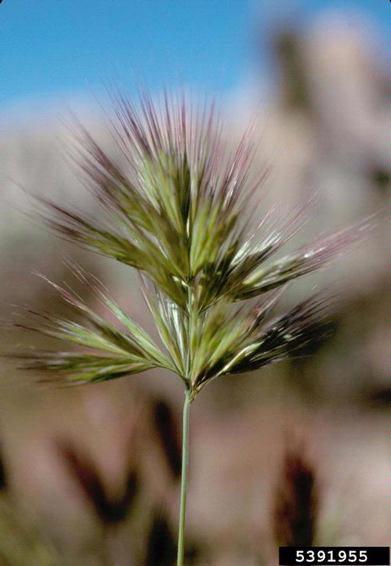
Background – Invasive Grasses
Invasive grasses such as cheatgrass (Bromus tectorum)and red brome (Bromus rubens) are increasing fire activity in Southern Nevada and degrading tortoise habitat.
Fire adapted unlike native plants.
Colonization causes lack of nutritious food for the Desert Tortoise.
Covers interspaces, leading to easier fire spread.
Image Credit: Red Brome - John M. Randall
Notes:
Invasive grasses have taken hold in the American West, and Southern Nevada is no exception. Approximately 3% of Mojave Desert burned in 2005 (2). After this devastating wildfire, the Mojave Desert was colonized by Cheatgrass and Red Brome; Mediterranean grasses that only require half of the amount of water native plants do for their seeds to germinate (1). Generally, they outcompete native plants, who take more time to establish after a fire, and cover important interspaces (usually devoid of vegetation) allowing for easier fire spread (3). Invasive grasses have less protein which meaning when the tortoise eats the invasives they will feel full, but they will not be getting the nutrition they need. 95% of the Desert Tortoise’s diet comes from native vegetation (4).
----------Image Information Below----------
Red Brome
Image Credit: John M. Randall, The Nature Conservancy, Bugwood.org
licensed under a Creative Commons Attribution-Noncommercial 3.0 License.
Image Source: https://www.invasive.org/browse/detail.cfm?imgnum=5391955
Citations:
Cheatgrass less water:
https://www.fs.usda.gov/Internet/FSE_DOCUMENTS/fseprd563040.pdf
Mojave desert burning:
https://www.cambridge.org/core/journals/invasive-plant-science-and-management/article/abs/biophysical-correlates-with-the-distribution-of-the-invasive-annual-red-brome-bromus-rubens-on-a-mojave-desert-landscape/65F5A76167335C4E757C3981BA7373BE?utm_campaign=shareaholic&utm_medium=copy_link&utm_source=bookmark
Interspaces:
https://doi.org/10.1890/09-0398.1
Desert Tortoise diet:
https://doi.org/10.1016/j.jaridenv.2006.09.021

Slide 6
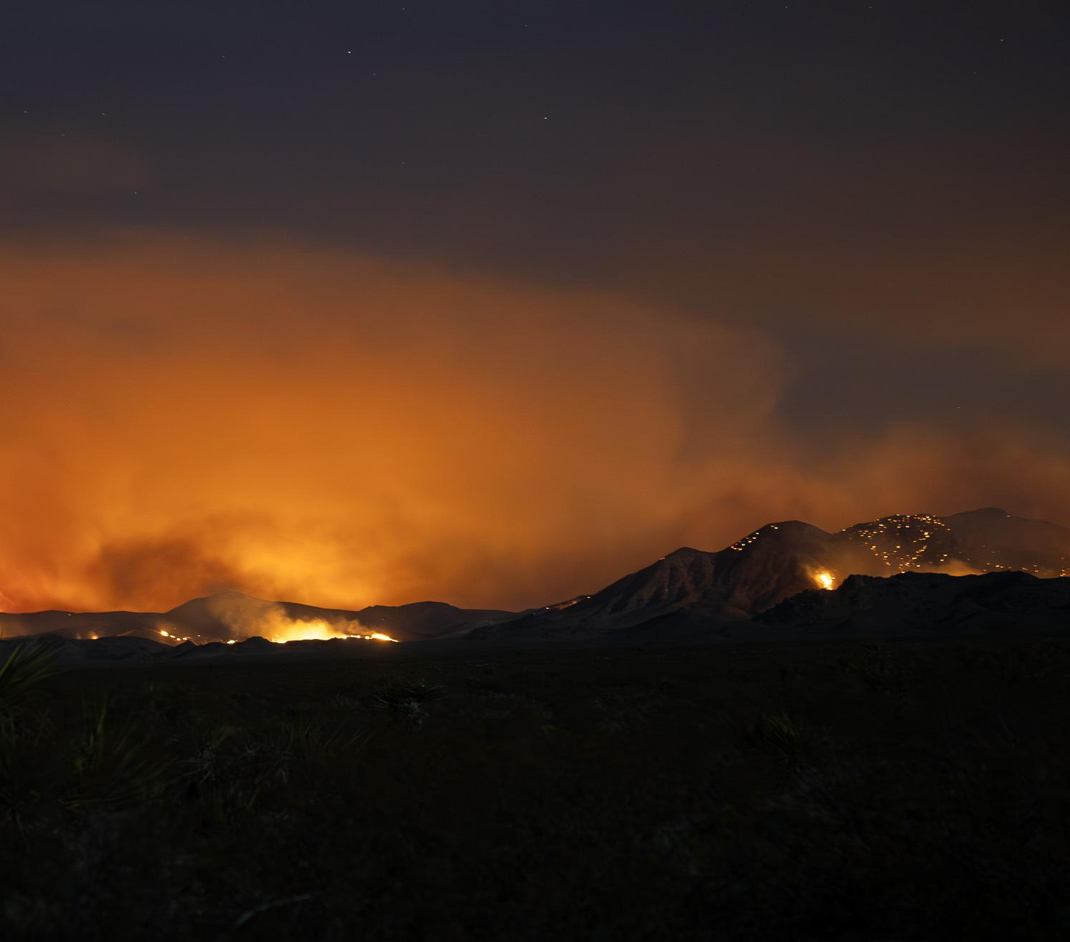
Community Concerns
Increased fire frequency caused by invasive vegetation create community concerts including:
Harm to the Mojave ecosystem which is not fire adapted
Effects tourism to National Parks
Fire effects can pose a threat to human health.
Image Credit: York Fire at Night from Cima Dome - Sierra Willoughby, NPS
Notes:
Increased fire frequency can cause harm to the Mojave ecosystem and the surrounding area, the ecosystem is not adapted to the frequency of fires that invasive vegetation causes.
This can negatively affect tourism to National Parks, economically damaging those areas.
Fire effects can pose a threat to human health, like with smoke inhalation.
----------Image Information Below----------
York Fire at Night from Cima Dome
Image Credit: NPS Photo / Sierra Willoughby, Public Domain
Image Source: https://www.nps.gov/media/photo/gallery-item.htm?pg=7575446&id=0199e477-3dfe-454f-b9ac-39d3707453a1&gid=5BF09DBD-B6EB-4EC6-B7D7-38E989EFA22A

Slide 7
Objectives
Analyze trends in post-fire recovery to protect desert tortoise habitat by mapping 20 years of historic burned areas
Identify drivers of fuel load growth with a focus on invasive vegetation to support partners reducing wildfire risk in desert tortoise habitat
#1
#2
Notes:
Our project has two main objectives. First, to analyze trends in post-fire recovery to protect desert tortoise habitat by mapping 20 years of historic burned areas. Second, we seek to identify drivers of fuel load growth with a focus on invasive vegetation to support partners reducing wildfire risk in desert tortoise habitat.

Slide 8
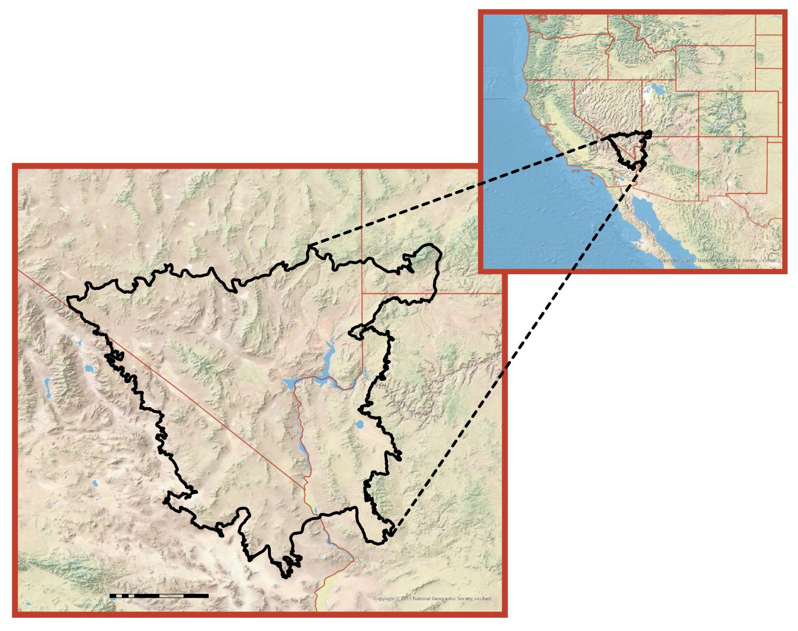
Study Area & Study Period
Study Area
Covers the Mojave Desert (southern Nevada, California, & Arizona)
Includes BLM and Forest Service land
Spans 25,882 square miles
Study Period
2004–2024
Monitoring pre- and post- fire conditions over this 20-year period
Nevada
•
Las Vegas
California
N
Arizona
Map Credits: California State Parks, Esri, TomTom, Garmin, FAO, NOAA, USGS, BLM, EPA, NPS, USFWS, CGIAR, USGS
600
➤
Miles
Map Credit: National Geographic Society, i-cubed
Notes:
As for our study area, we aimed to cover the habitat range of the Desert Tortoise. This included BLM, Forest Service, and SNDO land across southern Nevada and the surrounding Mojave Desert. The area has a high density of Cheatgrass and Red Brome and has been subject to increased fires, making it the right place to focus on.
----------Image Information Below----------
Maps
Map Credit: National Geographic Society, i-cubed

Slide 9
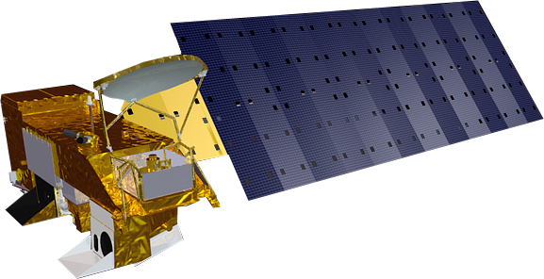
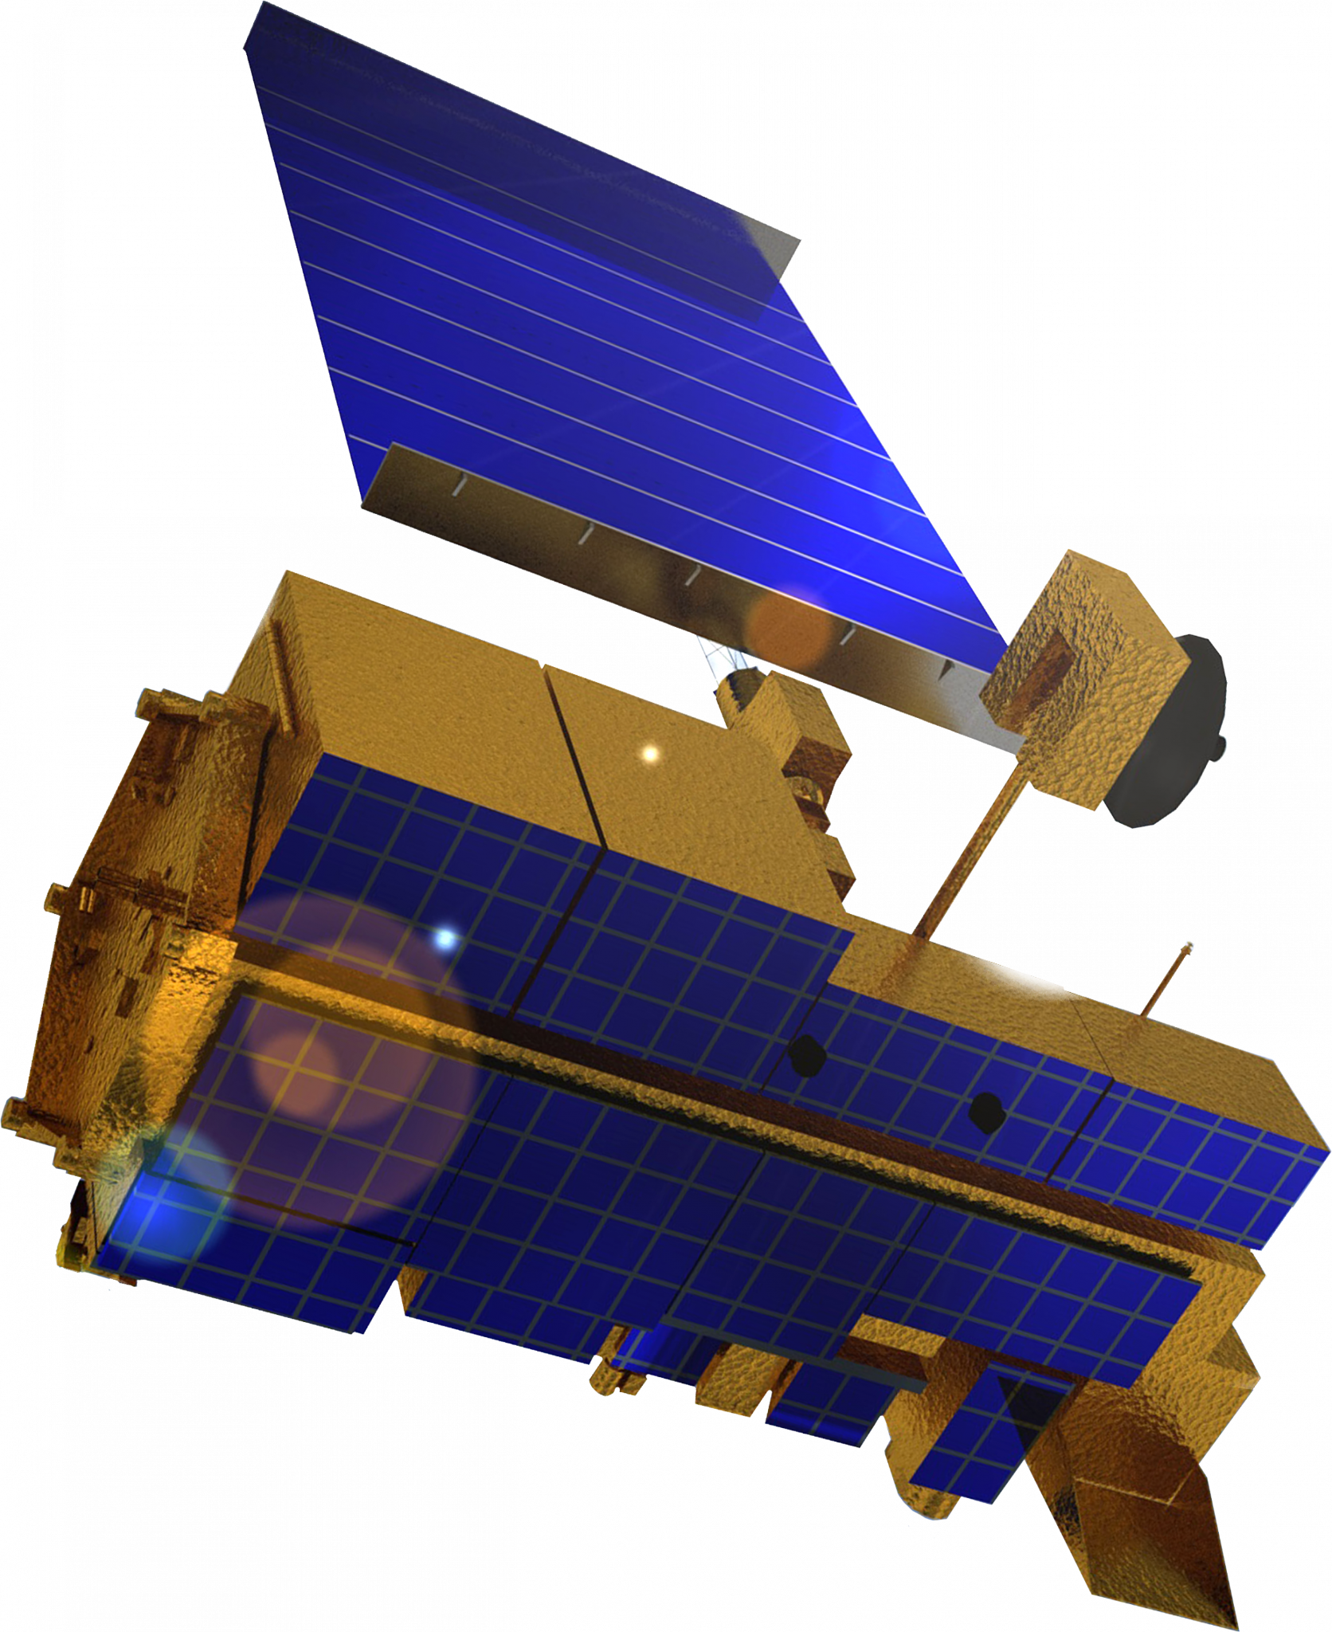
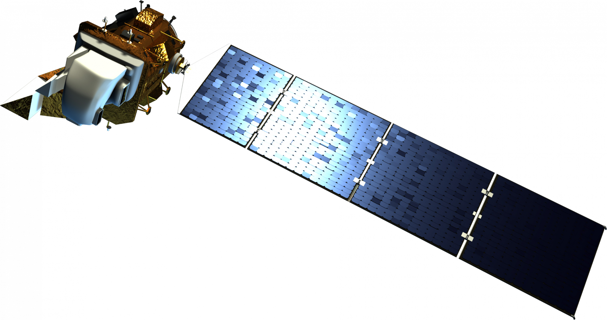
Earth Observations
Aqua
MODIS
250m, 500m, 1km resolutions
Terra
MODIS
250m, 500m, 1km resolutions
Landsat 8
OLI
Landsat 5
TM
30m resolution
30m resolution
Image Credit: NASA
Notes:
For our project, we acquired data from Landsat 5 TM (2004-2013), Landsat 8 OLI (2013-2024), along with Terra MODIS for our pre- and post-fire analyses. Through the use of these satellites, we were able to cover the entire study area and study period. Additionally, we will be using Aqua MODIS to provide climate variables.
----------Image Information Below----------
Terra
Image Credit: NASA
Image Source: Spacecraft Icons - NASA Science
Landsat 5
Image Credit: NASA
Image Source: https://landsat.gsfc.nasa.gov/satellites/landsat-5/
Landsat 8
Image Credit: NASA
Image Source: Spacecraft Icons - NASA Science
Aqua
Image Credit: NASA
Image Source:Spacecraft Icons - NASA Science

Slide 10
Methodology – Historic Burn Maps
Processed precipitation data
Acquired PRISM and CHIRPS precipitation data
Time Series Graphs
Historical Regional Burn Maps
Normalized Difference Vegetation Index (NDVI)
Landsat 5 TM, Landsat 8 OLI
Imagery
Pre- and Post-Fire differenced NBR (dNBR)
Case Studies
Normalized Burn Ratio (NBR) Index
Notes:
Historical Regional Burned Areas Maps: We began by collecting Landsat imagery over our 20-year study period. We then created Normalized Burn Ratio, or NBR, indices and differenced Normalized Burn Ratio, or dNBR index maps, which form the backbone of our historical regional burned areas map and show burn severity for our partners. The output was then dNBR maps across the entire study period of what each fire season looked like. On top of visualizing what each fire season looked like, we wanted to look at an active fire season using both Landsat 5 and Landsat 8. Honing in on specific fire season led to the creation of NDVI and precipitation time-series plots to show conditions leading up to the fire season, and what happened after the fire season.

Slide 11
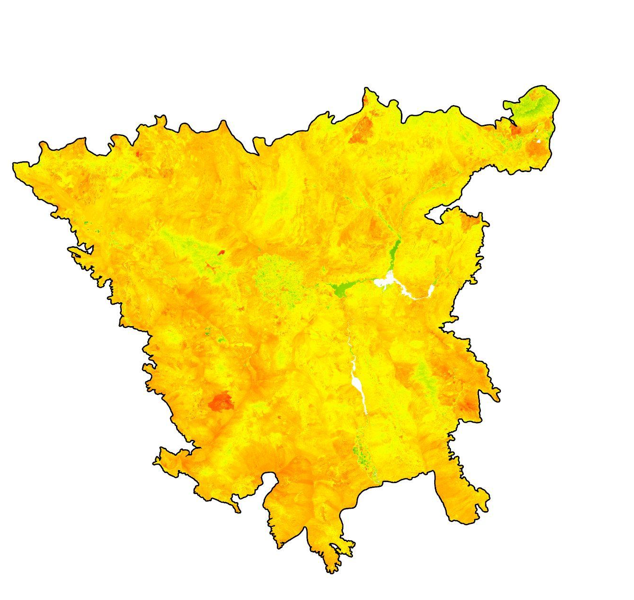
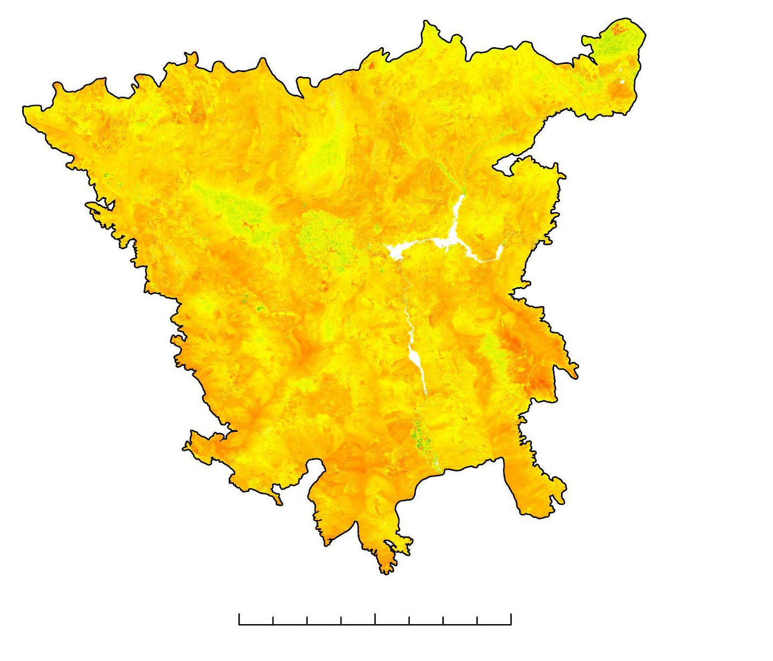
Results – Historic Burn Maps
2020 Pre-Fire NBR
2020 Post-Fire NBR
2020 dNBR
=
-
N
0.5
-0.5
120 Mi
NBR = (NIR - SWIR2)/ (NIR + SWIR2)
Red = Fire Burn Scar (Higher Positive values)
Orange/Yellow = Unburnt Area (~ 0)
Green = Vegetation Regrowth (Negative Values)
Notes:
In order to make the historic burned maps we made median NBR (Normalized Burn Ratio) composites which covered the pre-fire seasons of the Mojave, then subtracted that NBR composite from median post-fire NBR composites. By subtracting the pre-fire NBR from the post-fire NBR that would yield a median dNBR (difference Normalized Burn) composite. dNBR is a good index to evaluate what land changes occurred over a desired period of time in relation to fires, for us that would be the 2020 fire season in this example. The more red the better chances there was a fire, and the more green the better chances there was vegetation regrowth. DNBR is normally measured using range of [-1,1]; however, bare soil caused very few returns above 0.5 or below -0.5. The colors on the NBR maps are also inverted to keep the color scheme consistent.
Point: We need to explain to audience method of creating NBR and dNBR and familiarize them with how maps will look for rest of presentation.
Maps Generated in ArcGIS Pro.

Slide 12
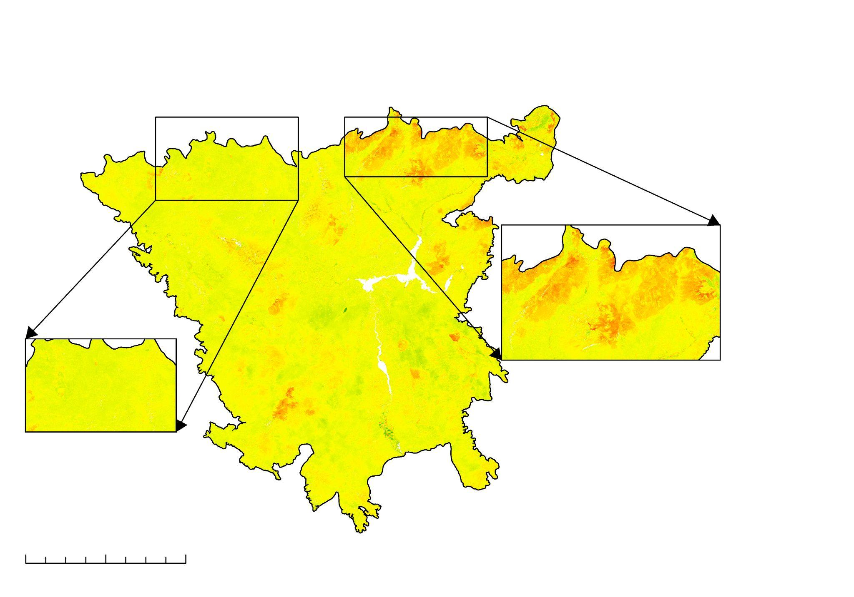
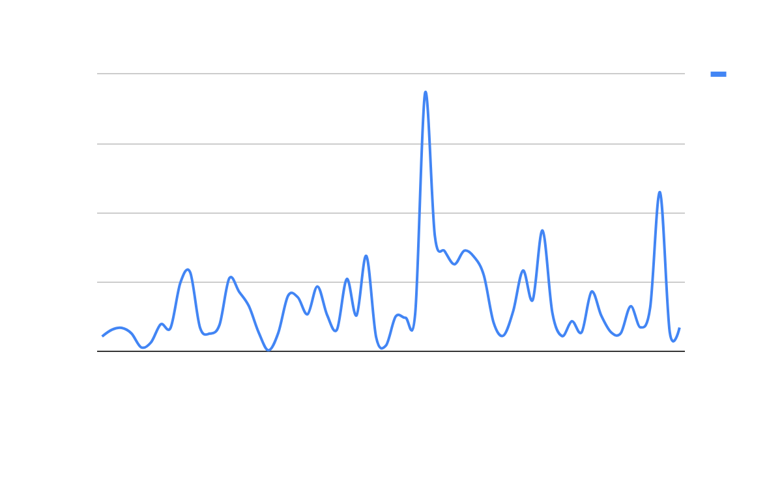
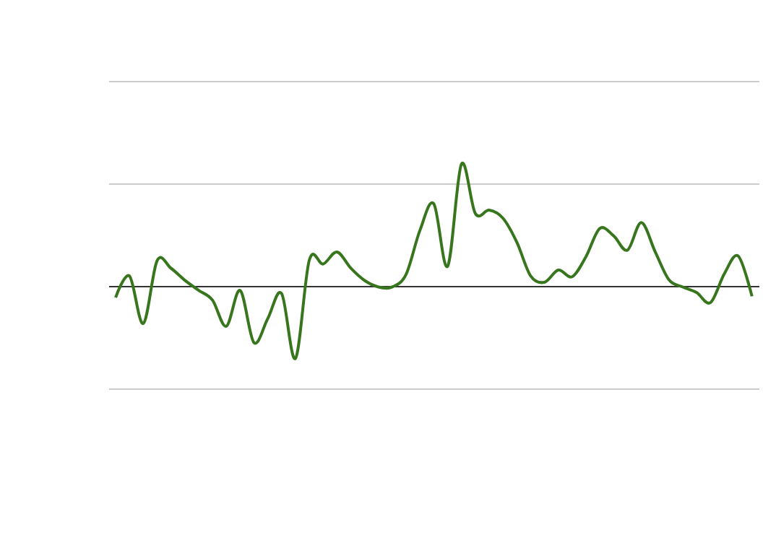
Historic Burn Maps Case Study 2005
40
30
20
10
0
Monthly Precipitation
2005 dNBR
Case Study Plot
Mean Precip. (mm)
0.2
0.1
0
-0.1
Monthly NDVI
0.5
-0.5
Max NDVI Pixels
90
Mi.
2003
2004
2005
2006
Precipitation anomaly led to greening
NDVI rebounds after fire event in 2005
Year
Case Study Fires
Notes:
To compare pre fire and postfire conditions, we selected an area where there was a fire in 2005 (case study) and an area that did not burn (control) Looking at monthly NDVI and Precipitation from 2003 to 2006 we can see that there was a precipitation anomaly that led to a large greening event. Historic data tells us that shortly after this there was a large fire that can be seen in the case study box and is represented by the orange color. There were many different fires that happened this year, within the case study plot there was the Delamar Fire (far left scar), Meadow Valley Fire (middle scar), and the Duzak Fire (biggest burn scar on the right). The arrow on the precipitation graph is pointing to the spike in precipitation and the arrow on the NDVI graph is pointing to the spike in NDVI that came from the precip. The red circle is showing when the first of the fires started in late June of 2005.
Point: We need to explain thoughts behind case study and control plot methods. Next, we need to draw attention to the precipitation spike and NDVI rebound post fire.
Map Generated in ArcGIS Pro.
Graphs made in R Studio.

Slide 13
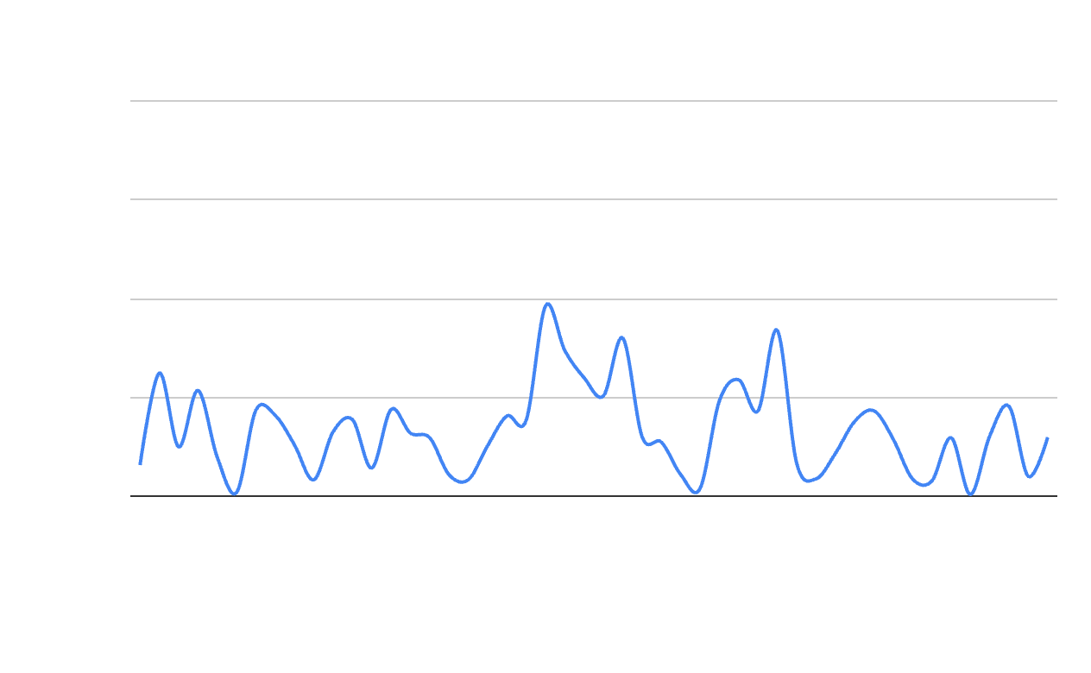
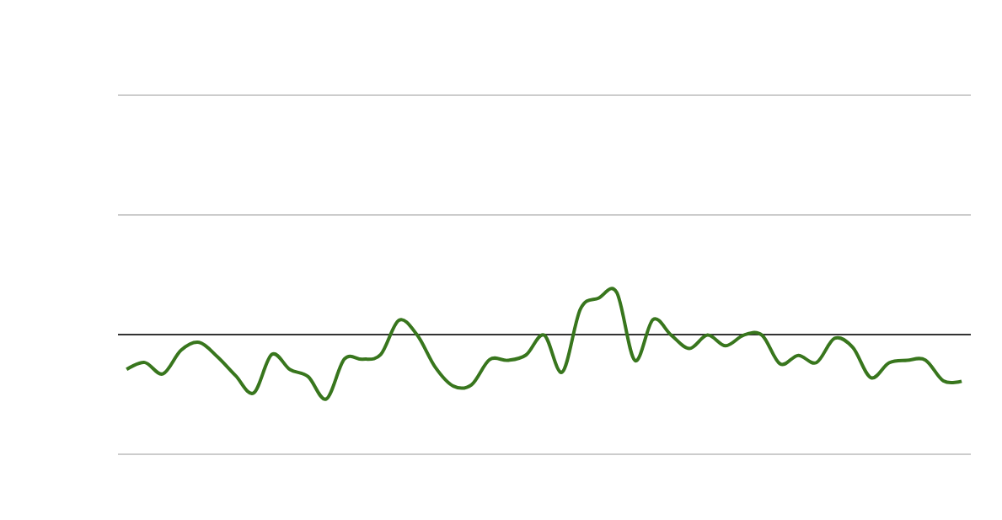
Historic Burn Maps Control 2005
40
30
20
10
0
Monthly Precipitation
2005 dNBR
Control Plot
Mean Precip. (mm)
0.5
-0.5
0.2
0.1
0
-0.1
Monthly NDVI
N
90
Miles
Max NDVI Pixels
Control Plot has a lot less vegetation
2004
2003
2005
2006
Year
Notes:
The control area in 2005 was an area that didn’t see any burned area during the 2005 fire season. Using an area that had no fire and comparing it to an area that had a fire allows us to see what differences there were in NDVI and precipitation in an area with fire vs without. Understanding the differences may be a factor in determining what areas are at most risk for a wildfire to occur.
Point: We need to draw attention to the similarity of the precipitation spike and subsequent NDVI spike. Show how this graph is muted compared to area that burned. We may need to address that the amount of vegetation is different even though the landscape is similar.

Slide 14
Historic Burn Map Time Series 2005- NDVI
0.2
0.1
0
-0.1
40
30
20
10
0
Case Study NDVI
Case Study Precipitation
Case Study fires
Max NDVI Pixels
Monthly Mean Precip. (mm)
40
30
20
10
0
Control Precipitation
Control NDVI
0.2
0.1
0
-0.1
2003
2004
2005
2006
2003
2004
2005
2006
Year
Year
Notes:
Comparing the time series of our case study area (where there was a large fire), and our “control”, an area where there was not a burn. Trying to differences between areas that burned and areas that didn’t burn through seasonality. A spike in NDVI is then noticed a couple months (~3-4 months) after the increased precip. This makes sense because there will be lag time between extra precipitation and higher NDVI signals, since the grasses and shrubs need to green. We see the NDVI have an overall negative trend after the fire which is mostly due to a decrease in precipitation across the region, and the very active fire season of 2005.
Point: We need to compare the NDVI bounce back of the case study plot to the NDVI signal post burn of the control plot. Show that while Precipitation is similar, we can see a slight difference in the NDVI.
All graphs were CSVs exported from GEE and plotted on Google sheets.

Slide 15
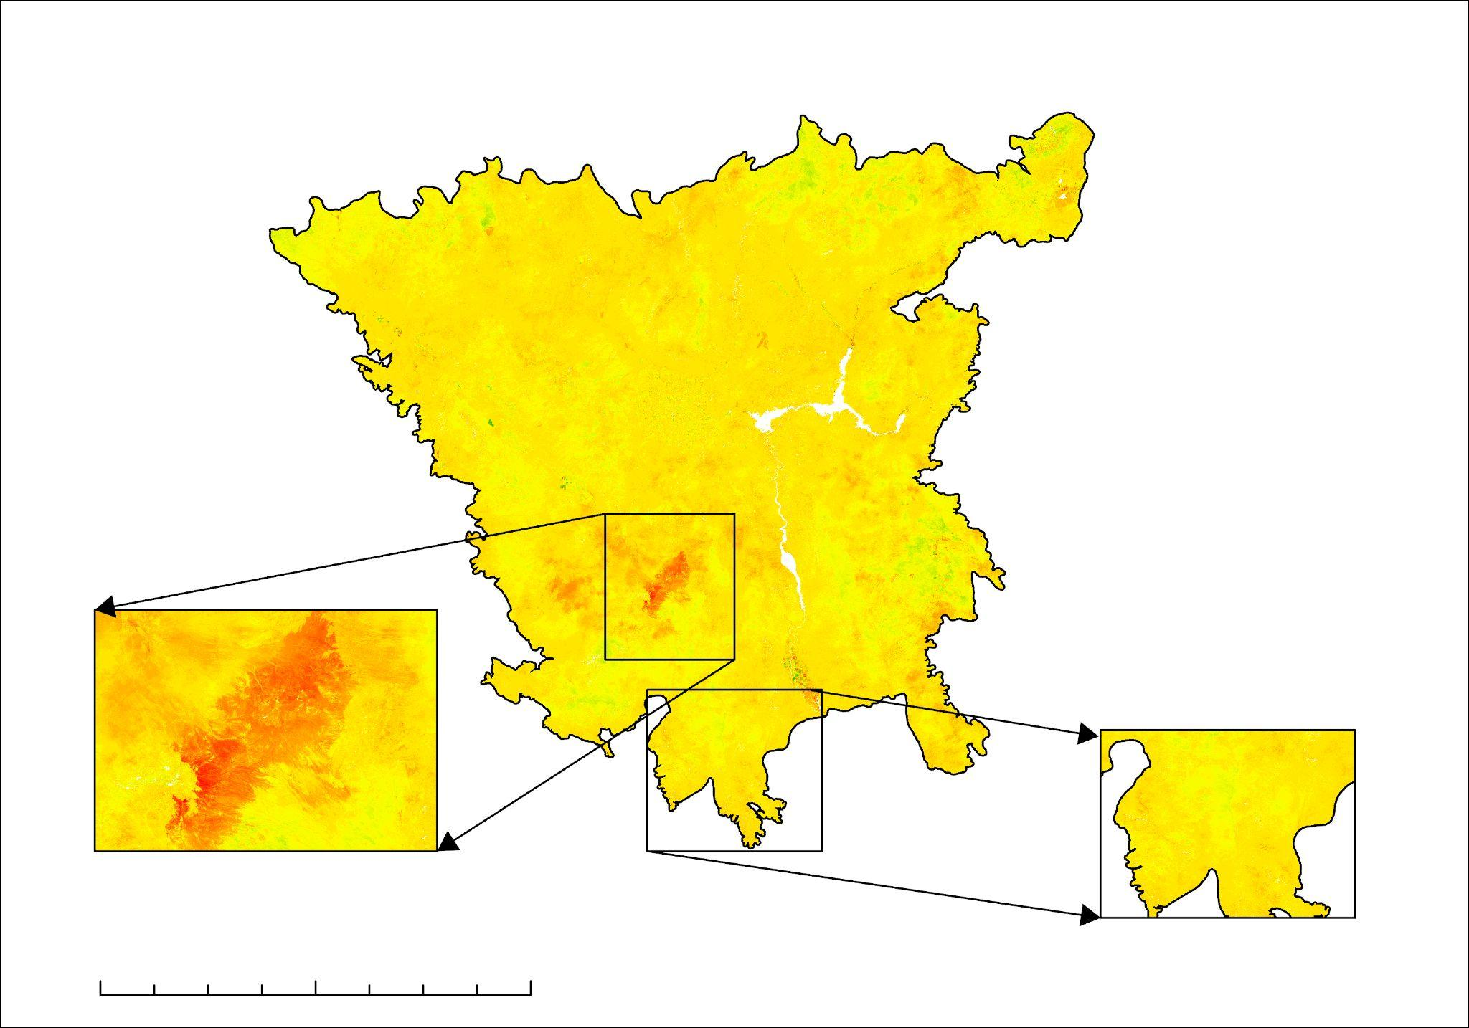
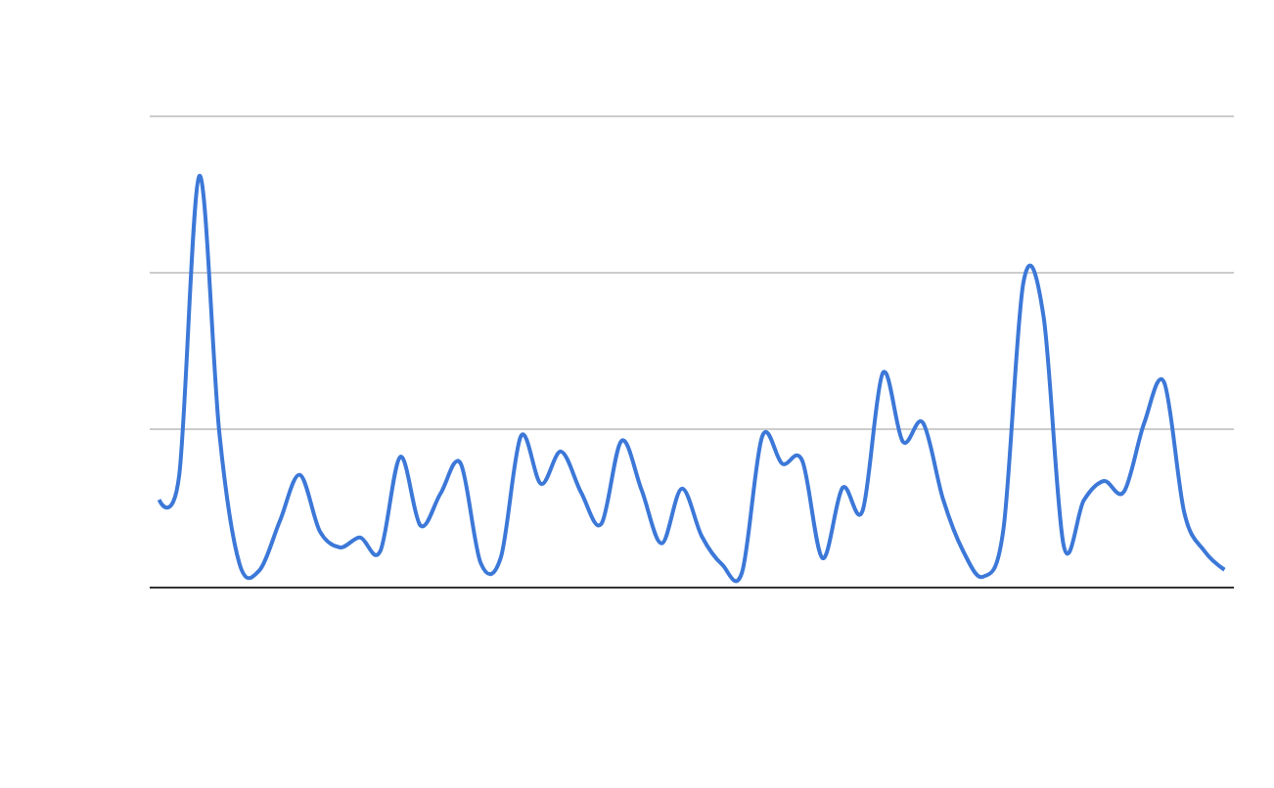
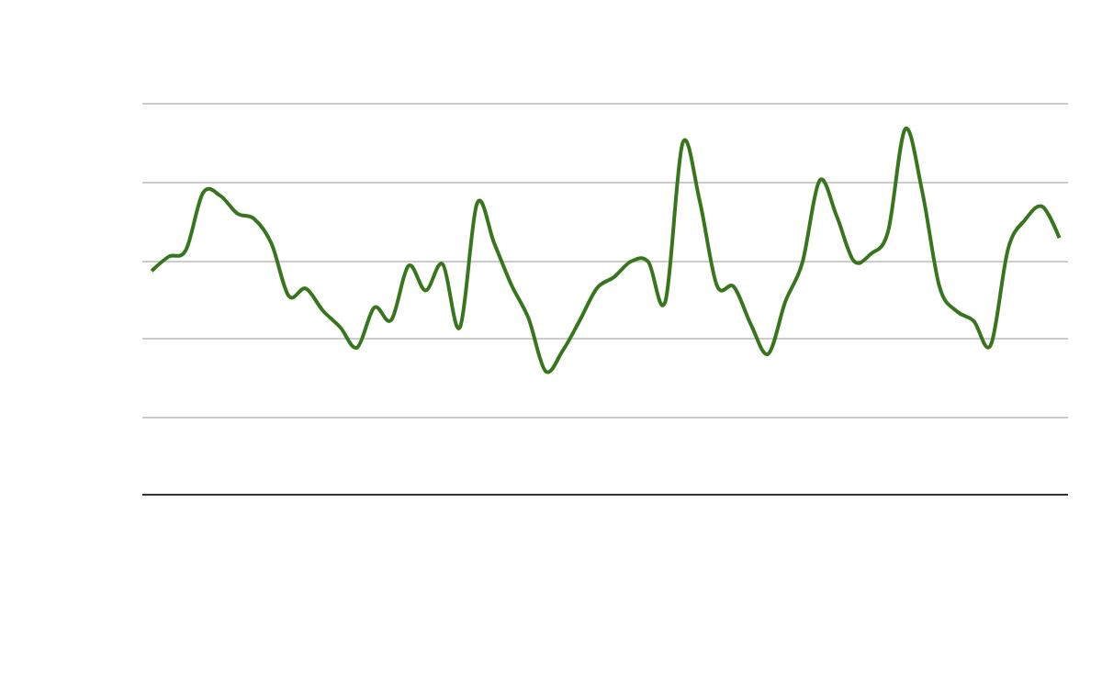
Historic Burn Map Case Study 2023
2023 dNBR
Case Study Plot
Monthly Precipitation
30
20
10
0
Mean Precip. (mm)
N
0.5
-0.5
0.25
0.20
0.15
0.10
0.05
0
Monthly NDVI
York Fire
Max NDVI Pixels
90 Mi.
Precipitation anomaly before the fire
2020
2021
2022
2023
2024
Year
Notes:
We wanted to do a case study into a fire that happened more recently in order to use the more recent Landsat 8 OLI sensor. In 2023 there was the large York fire that took place on the border of Nevada and California. The York fire sparked up on July 28, 2023. We wanted to do a brief analysis on what the precipitation and NDVI looked like before and after. Similar to 2005- we saw a spike in precipitation in late 2022 with minimal precipitation in may/june of 2023.
Point: We repeated the same analysis with Landsat 8 imagery on the 2023 York fire. We need to point out precipitation spike and NDVI spike and regrowth post fire.

Slide 16
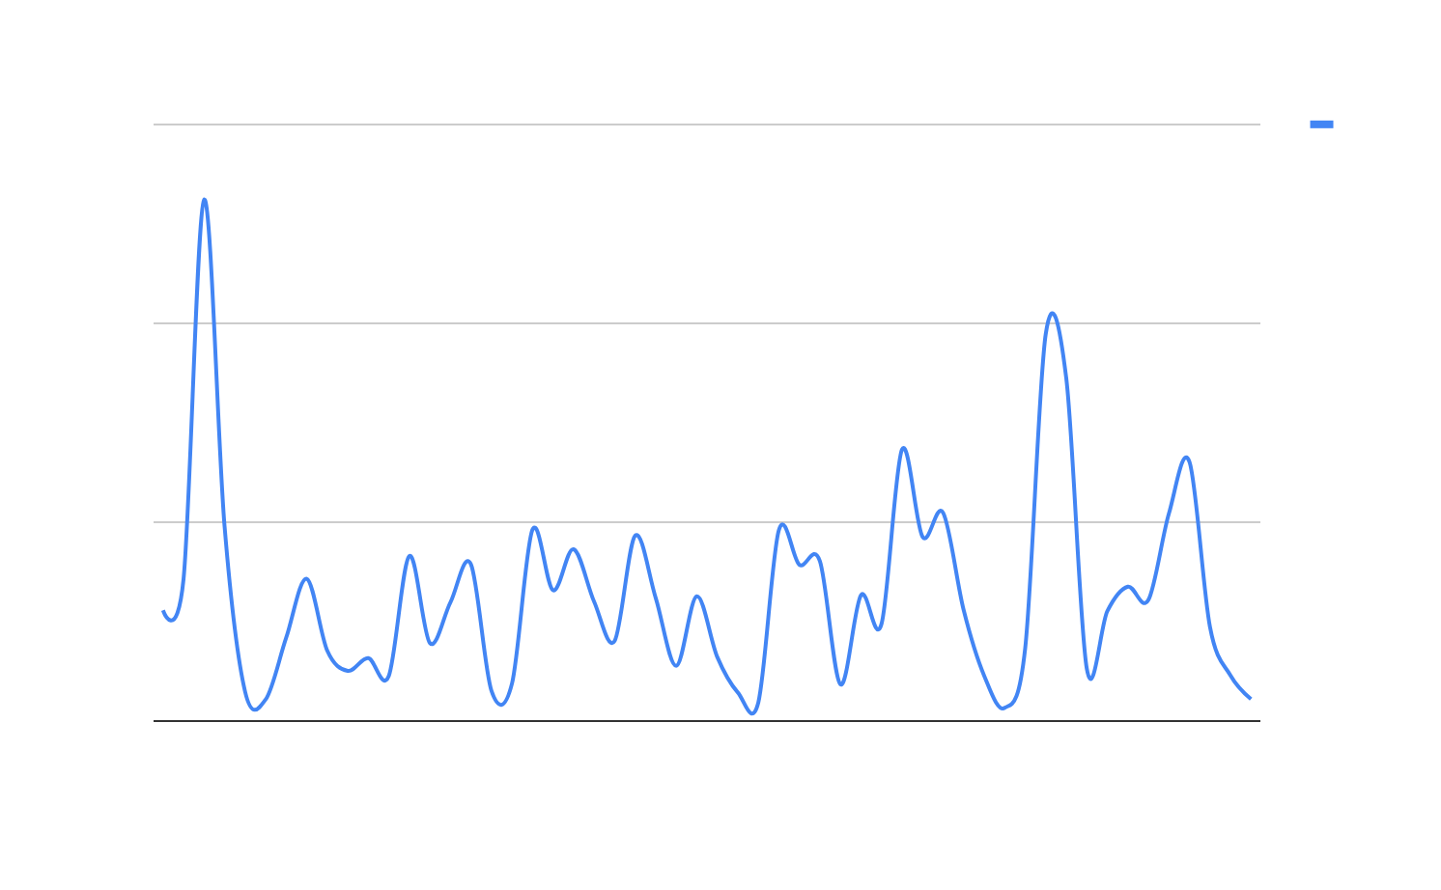
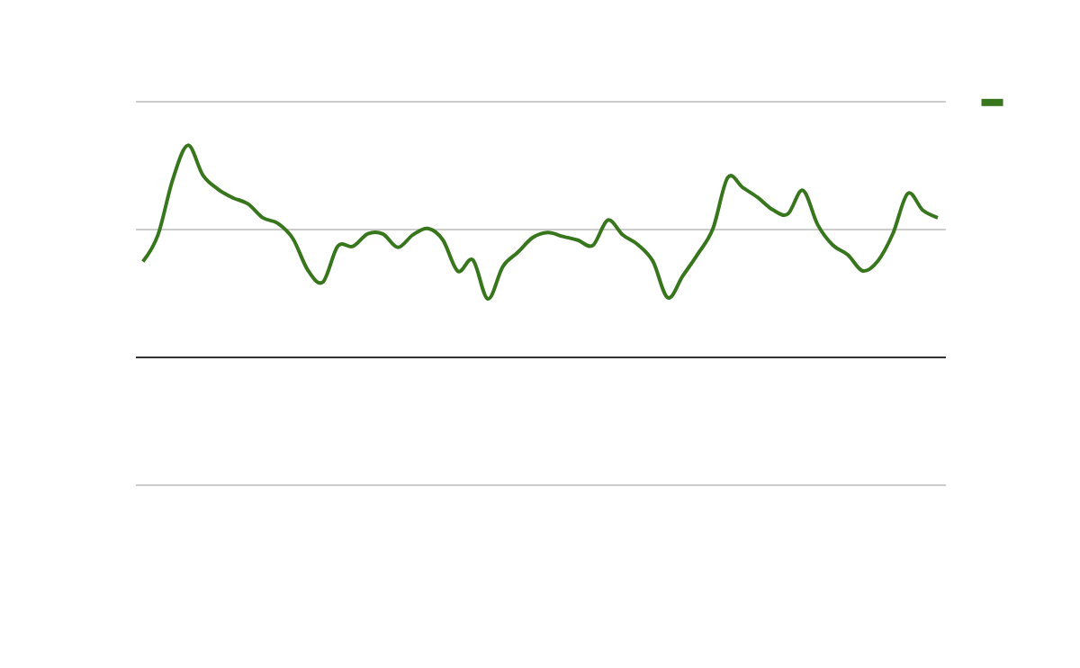
Historic Burn Map Control 2023
Control Plot
Monthly Precipitation
2023 dNBR
30
20
10
0
Mean Precip. (mm)
N
0.5
-0.5
Monthly NDVI
0.2
0.1
0
-0.1
Max NDVI Pixels
90 Mi.
Saw more post fire regrowth compared to 2005
2020
2021
2022
2023
2024
Year
Notes:
We also wanted to look at the precipitation and NDVI values in an area that went unburnt to compare to what happened in the case study area. In 2023 the NDVI and Precipitation were very similar, the main difference has to do with the NDVI halfway through 2023.
Point: We need to point out precipitation spike and NDVI spike. This year also got a lot of rain during and after the fire which helps explain why the NDVI is so strong.

Slide 17
Historic Burn Maps Case Study 2023
Case Study NDVI
Case Study Precipitation
30
20
10
0
0.25
0.20
0.15
0.10
0.05
0.0
York Fire
Max NDVI Pixels
Mean Precip. (mm)
Control Precipitation
Control NDVI
30
20
10
0
0.2
0.1
0
-0.1
2020
2021
2022
2023
2024
2020
2021
2022
2023
2024
Year
Year
Notes:
In the case study area we saw a larger decrease in NDVI values halfway through 2023 which makes sense since there was no fire in the control area. The York fire was very similar to 2005 where there was a precipitation spike in late 2022 which led to a spike in fuels. 2005 saw larger precipitation anomaly. Compared to 2005 the NDVI signals stayed consistent to pre fire signals, and this is most likely because post fire seasons saw an increase in precipitation, and 2023 only having 1 large fire comparative to 2005.

Slide 18
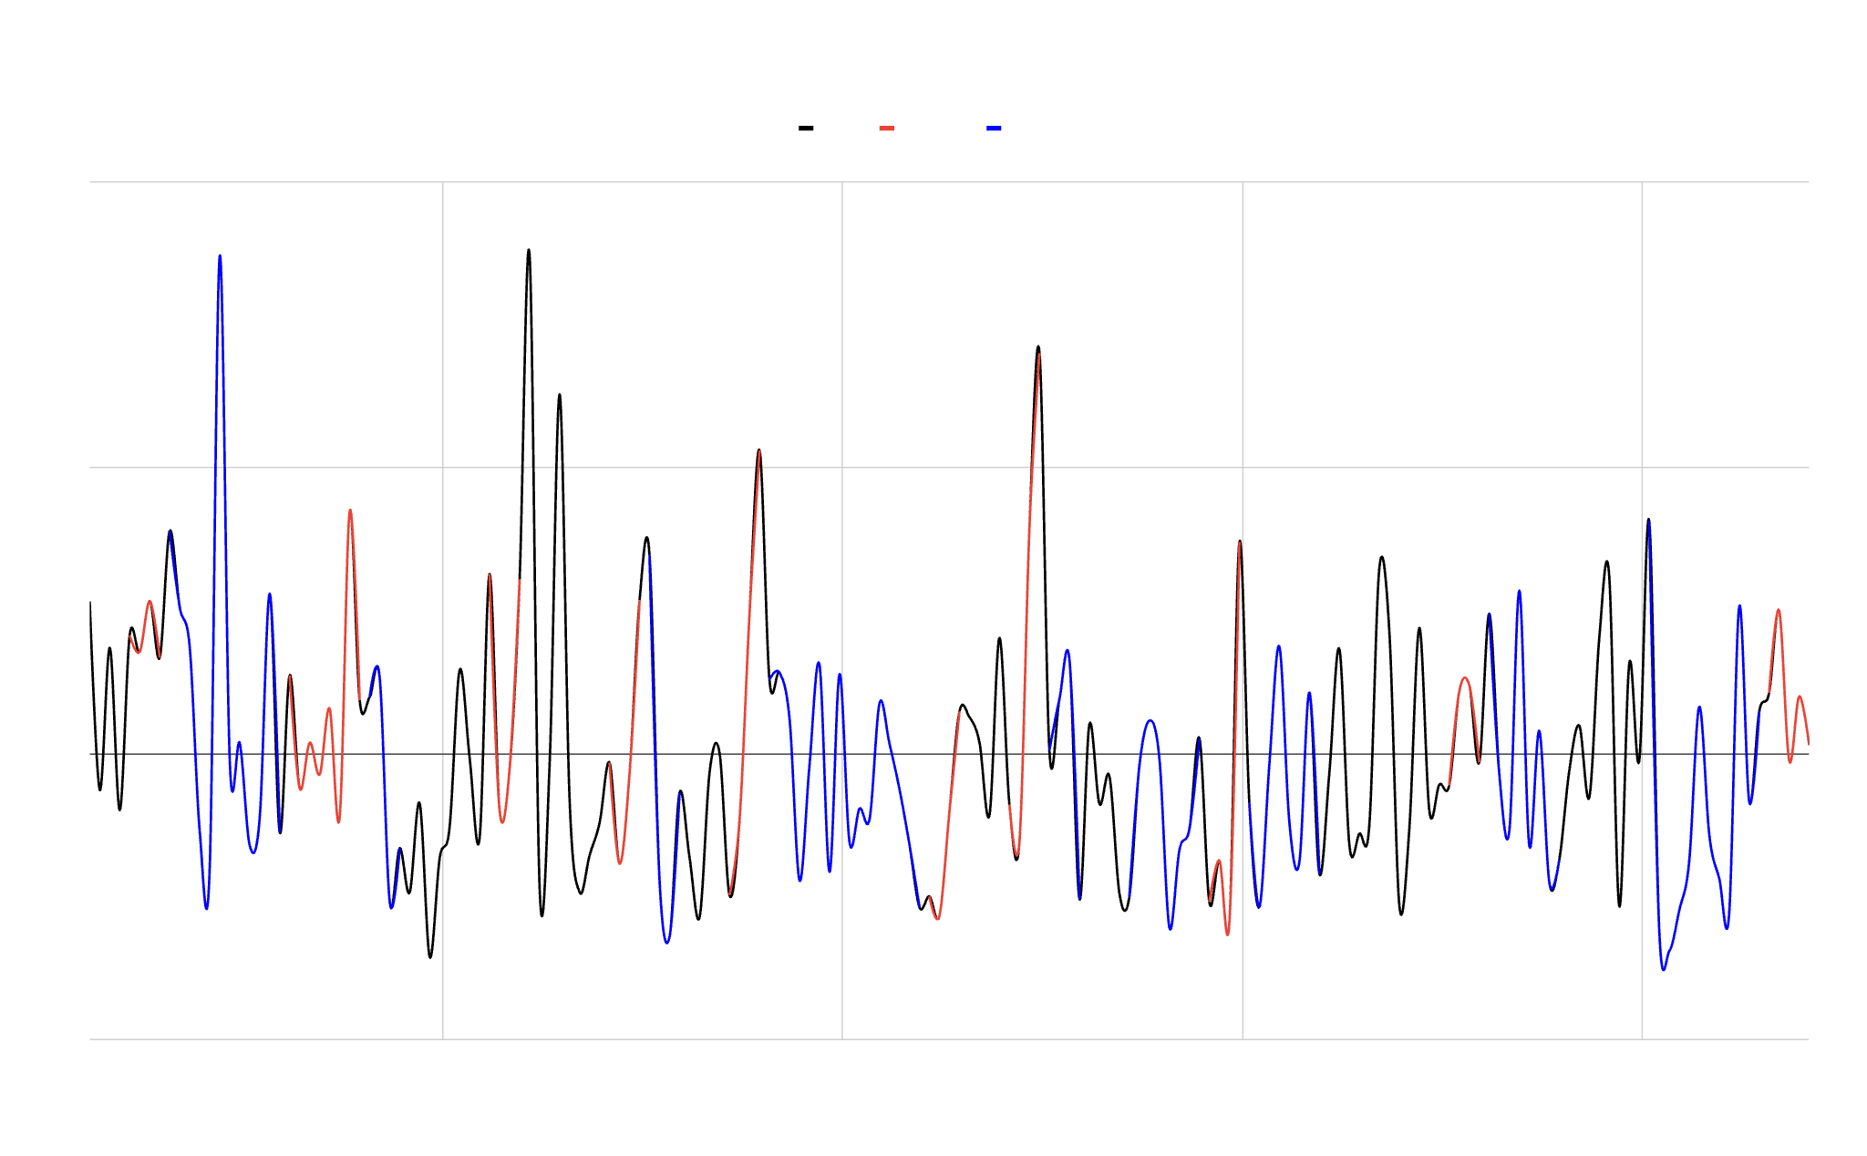
Historic SPI (Standardized Precipitation Index)
El Niño-Southern Oscillation (ENSO) Events and Precipitation
Anomalies1980 to 2024 within Southern Nevada
4
2
0
-2
Moderate
El Niño
La Niña
01/01/1980
01/01/1990
01/01/2000
01/01/2010
01/01/2020
Notes:
This graph represents Precipitation Anomalies measured using the Standardized Precipitation Index and compares them to El NINO Southern Oscillation events. These events refer phenomena that occur because of interactions between the pacific ocean and the atmosphere in tropical regions. Within the Southwestern US, El Nino events are generally associated with increased rainfall and La Nina events are associated with droughts.
A pattern we noticed while looking at the link between precipitation anomalies and fires was that precip anomalies also seemed to be linked to El Nino Years. In El Nino years, there is a higher likelihood of precipitation anomalies, which in turn lead to an increase in fuel load and higher chances of fires in in the dry season.
Years where this pattern is observed include, 1992, 2005, 2010, and 2023 (1). While this is just an observed pattern, it is a natural phenomenon that our end users should be aware of.
Graph is generated from SPI-3 starting in June 2024 to January 1980 using CHIRPS data.
All graphs were CSVs exported from GEE and plotted on Google sheets.
Citation
El Nino: https://ggweather.com/enso/oni.htm

Slide 19
Methods – Fuel Load Growth Analysis
Fuel Load Variable
(Landsat 5 TM, Landsat 8 OLI)
Normalized Difference Vegetation Index (NDVI)
Pearson Correlation
Preliminary Fuel Load Growth Analysis
Final Fuel Load Growth Analysis
Climatic Variables (Terra MODIS)
Resample NDVI to Individual Variable Resolution
Linear Regression Analysis
-Elevation
-Wind Speed
-Soil Moisture
-Total Precipitation
-Mean Temperature
-Max Temperature
-Snowcover, etc.
Notes:
Fuel Load Growth Methodology:
In our fuel load growth analysis, we decided to look at pre- and post-fire fuel loads for notable fire years in our study area (2005, 2020, etc.). To do this, our climatic variables were carefully compiled, taking into consideration the most relevant time period of data needed for what we were looking at. For example, our precipitation variable for a pre-fire fuel load would be a total for the entire germination season. Others stayed the same no matter what time period, like elevation. After we did that, we had to resample the variables to the same resolution, otherwise they wouldn’t be able to be compared in a linear model later.
Once our newly resampled variables were transferred to R, we created a linear regression model with all variables and individual variables. The Max Normalized Difference Vegetation Index (NDVI) for the season was the dependent variable, since it is a good proxy for where vegetation is growing. We tried to see which climatic variable was the most correlated with that NDVI. Once we analyzed that linear regression model, we could see what the drivers of fuel load growth were though our NDVI proxy.
Evapotranspiration imagery from Terra MODIS.

Slide 20
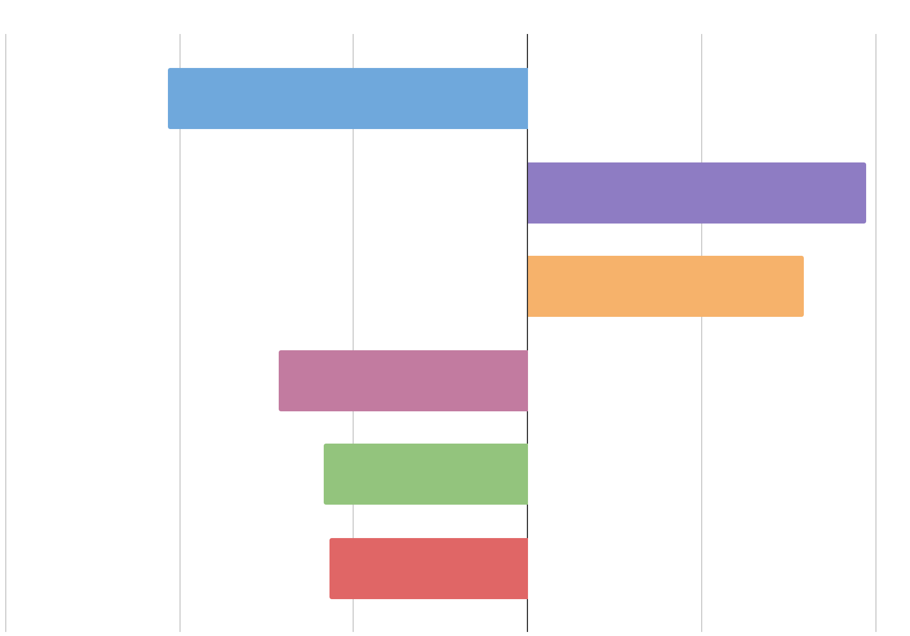
Results - Fuel Load Growth Analysis
NDVI Correlations with fuel load growth variables
Max Evapotranspiration
Pre-fire 2005
(Short Term)
Mean Albedo
Top six most correlated explanatory variables for NDVI using a Pearson Correlation
Values closer to -1 and 1 are most correlated to NDVI,
Near 0 values are least correlated to NDVI.
Soil Water pH
Total Solar Radiation
Soil Organic Carbon Content
Elevation
-.75 -.50 -.25 0 .25 .50
Notes:
For our preliminary fuel load growth analysis, we compared many potential climatic variables using Pearson Correlation to see which had the greatest correlation with the Max NDVI during the Pre-fire 2005 period. We compared both the short term (around 3 months before and after the fire) and the long term (around one year before and after the fire).
Ideally, the most highly correlated variables would have values of -1 or 1 respectively; however, the highest of our correlations hovered at around -0.5 and 0.5. So despite their respective high correlations among the other parameters, these factors are not a perfect predictor of Max NDVI during a Pre-fire season. The five most negatively or positively correlated parameters for the short term pre-fire 2005 period are graphed here, with max evapotranspiration, mean albedo, soil water pH, total solar radiation, soil organic carbon content and elevation being the greatest drivers of NDVI. In contrast, parameters like snowpack, soil clay content, and aspect (among others) seemed to have the least correlation, all having values within +/- 0.1.
That being said, this is just a preliminary analysis. The results would be more powerful if we created individual linear models with each parameter to see which climatic variables were most highly correlated with NDVI using R squared and P values, as detailed in the methods. We are hoping to have that done for the partners by the end of the term.
Graph made in google sheets, data collected from google earth engine.

Slide 21
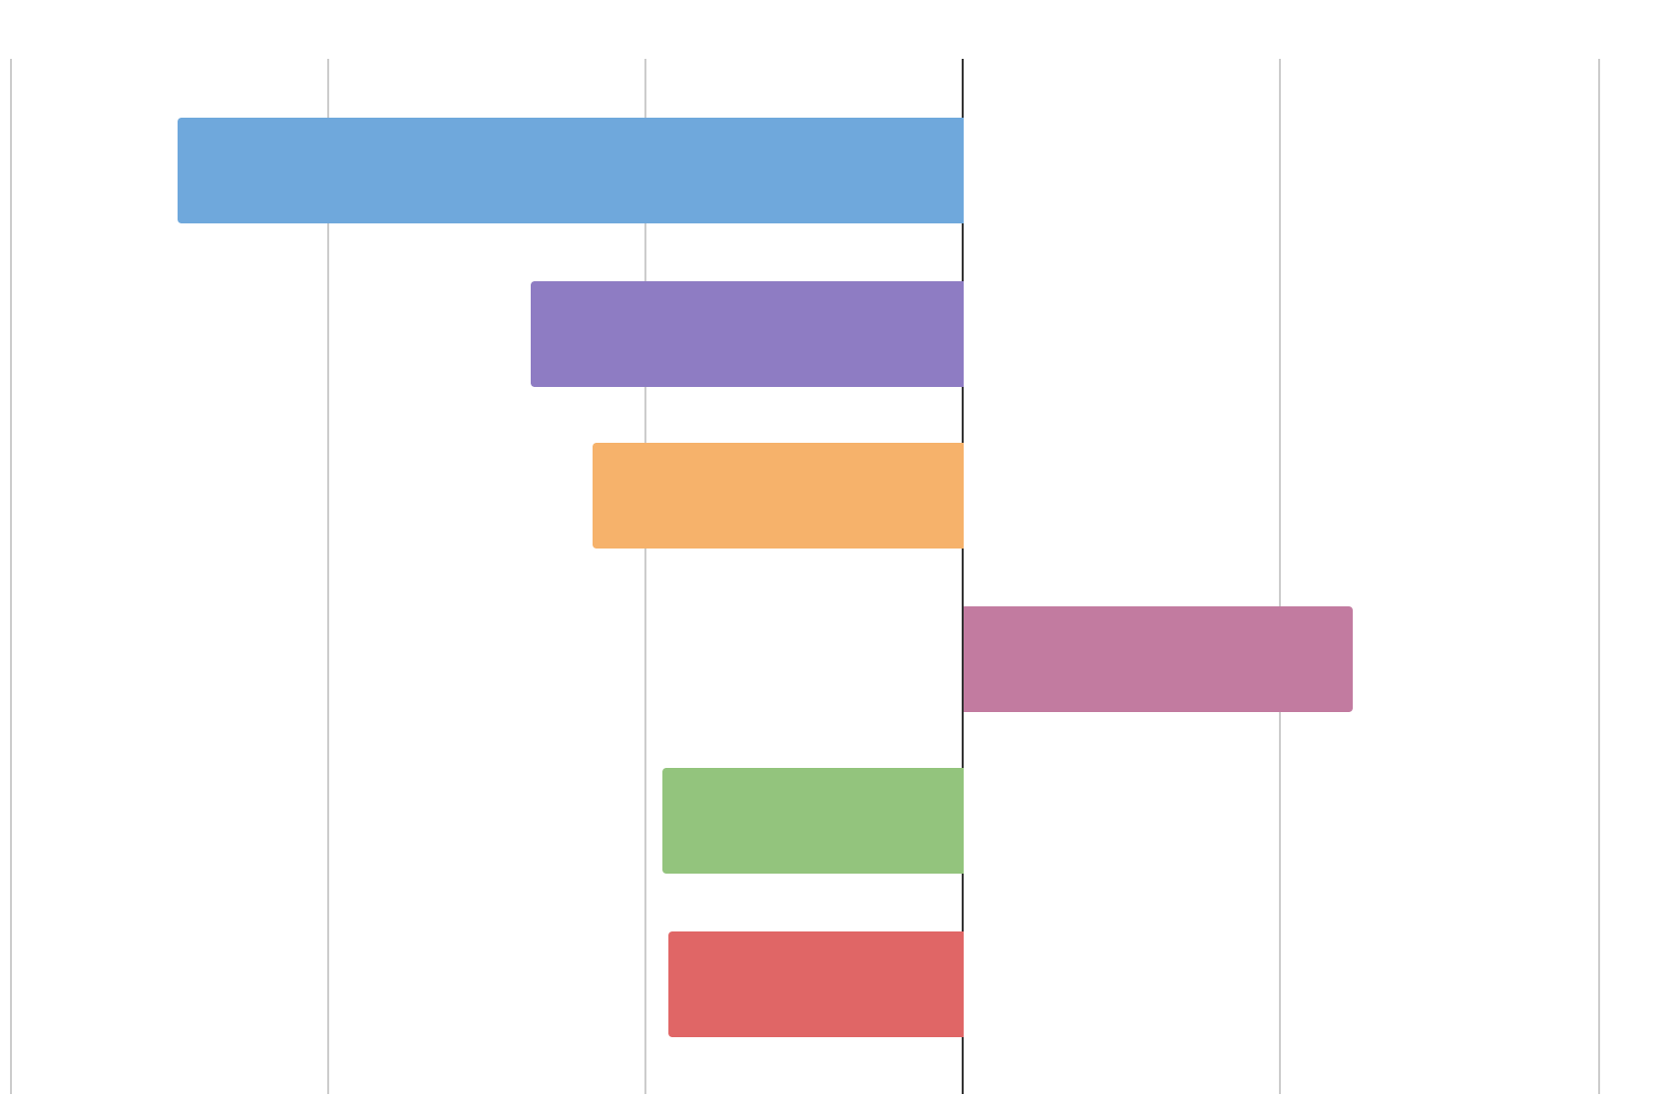
Results - Fuel Load Growth Analysis
NDVI Correlations with fuel load growth variables
Max Evapotranspiration
Pre-fire 2005
(Long Term)
Soil Bulk Density
One year before and after the July 2005 fire.
NDVI is used as a proxy for fuel load growth.
Soil Water PH
Mean Albedo
Total Solar Radiation
Soil Water Content
-.75 -.50 -.25 0 .25 .50
Notes:
In the long term (one year before the fire occurred), it seems like maximum evapotranspiration, soil bulk density, soil water pH, mean albedo, total solar radiation, and soil water content have the greatest Pearson Correlations (positive or negative) with max NDVI. As we can see, the long term pre-fire 2005 period mostly shares parameters with the highest correlation parameters in the short term, except soil water content and bulk density have replaced elevation and soil organic carbon content as some of the highest. The max evapotranspiration correlation is the highest of any time period in 2005, pre- or post-fire, short or long-term.
Graph made in Google sheets, data collected from Google Earth Engine.

Slide 22
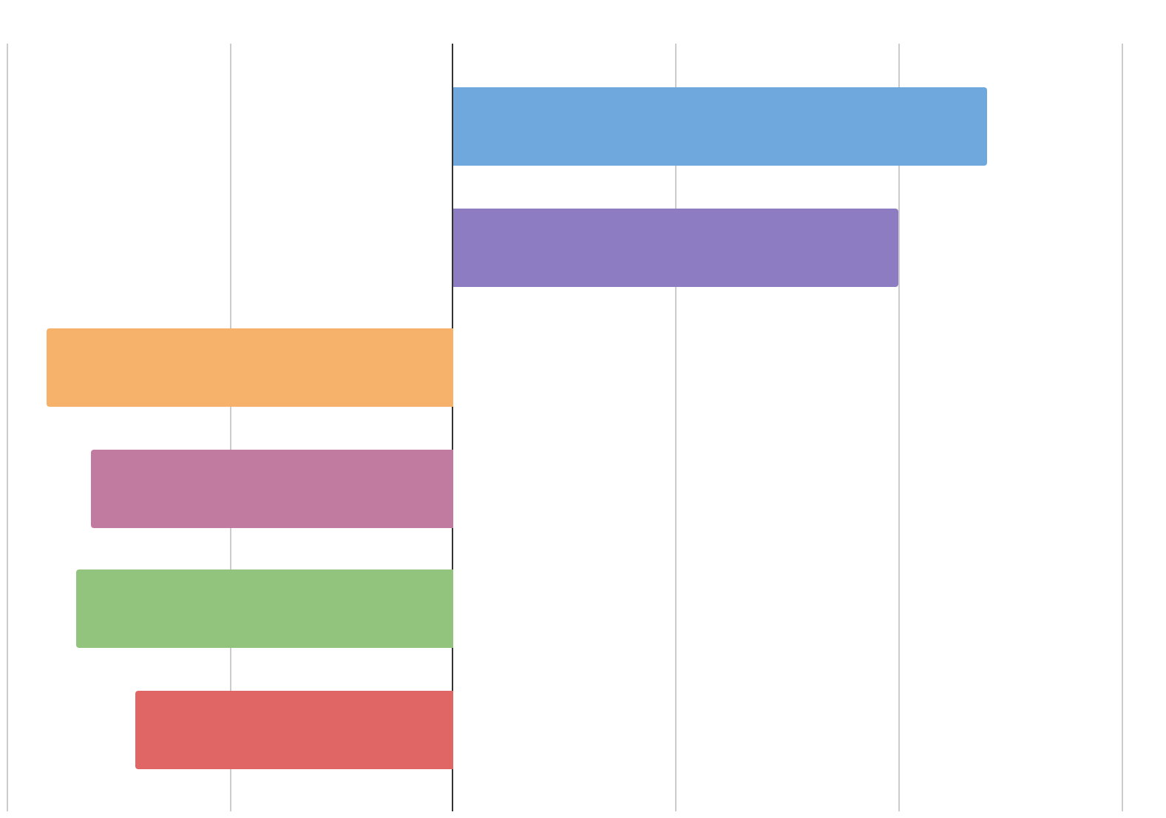
Results - Fuel Load Growth Analysis
NDVI Correlations with fuel load growth variables
Mean Albedo
Post-fire 2005
(Short Term)
Soil Water PH
The short-term periods were taken 3 months before and after the fire.
Max Evapotranspiration
Soil Organic Carbon Content
Total Solar Radiation
Soil Water Content
-.50 -.25 0 .25 .50 .75
Notes:
The post-fire 2005 short-term Pearson Correlation between NDVI and fuel load variables was calculated from data within three months after the July 2005 fire. The mean albedo, soil water pH, max evapotranspiration, soil organic carbon content, total solar radiation, and soil water content were are 6 most correlated variables which we looked at. Soil water pH continues to be a good predictor along with max evapotranspiration, total solar radiation, and soil water content, which seems to indicate that these variables are more closely correlated with NDVI despite the time period. It is notable that max evapotranspiration has dropped a few ranks when looking at post fire, perhaps indicating that it is less useful to look at when assessing fuel load post fire.
Graph made in Google sheets, data collected from Google Earth Engine.

Slide 23
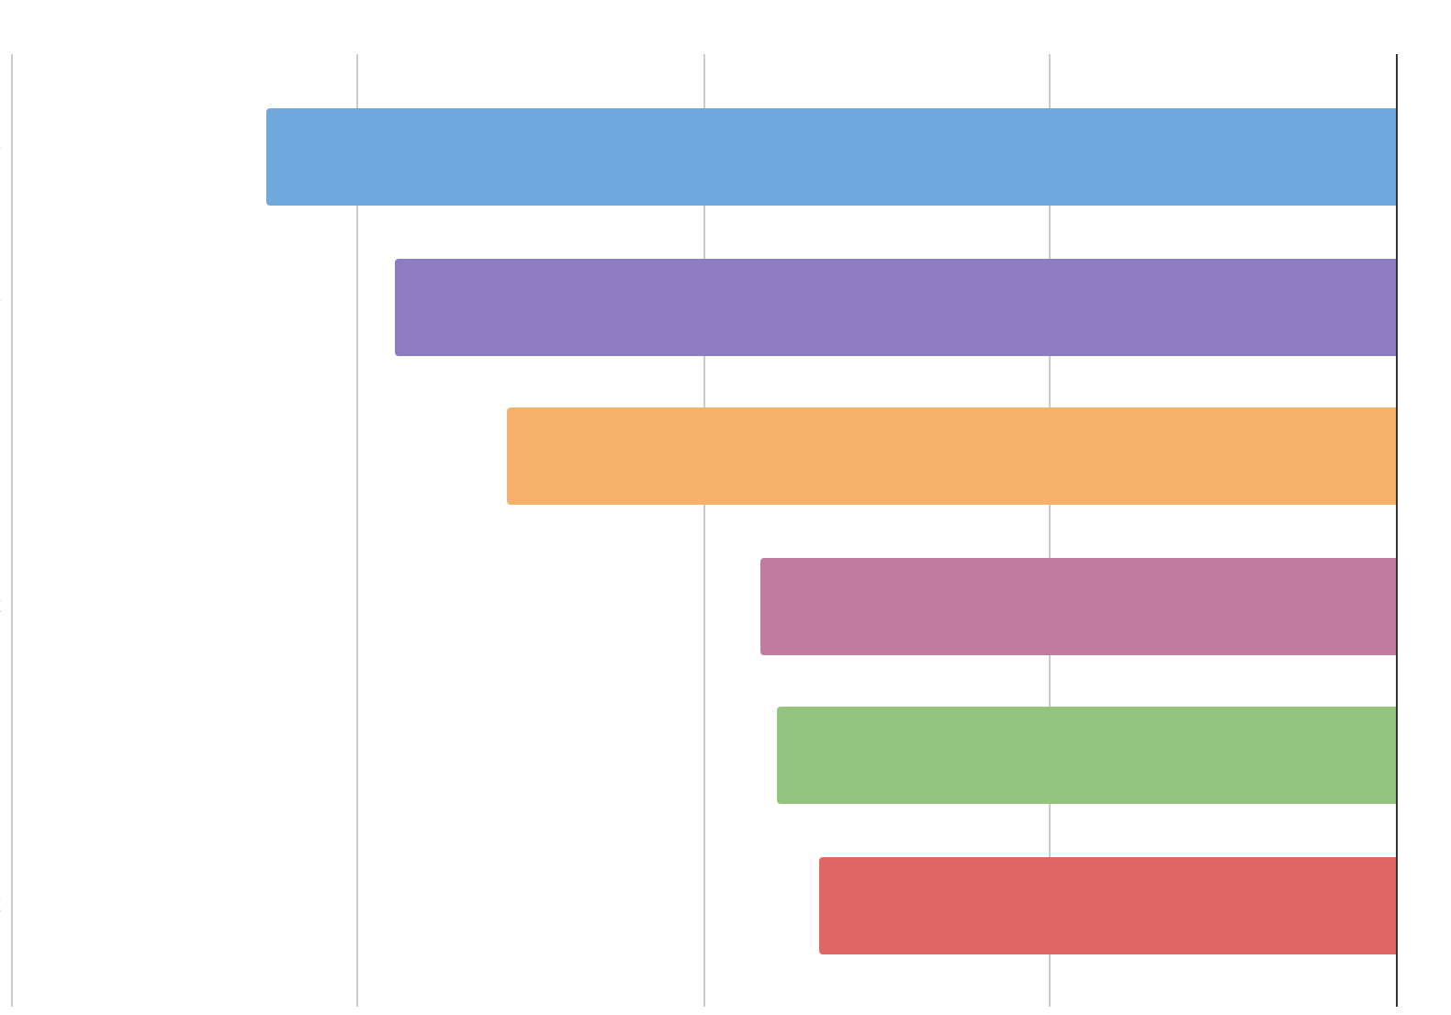
Results - Fuel Load Growth Analysis
NDVI Correlations with fuel load growth variables
Soil Bulk Density
Post-fire 2005
(Long Term)
Max Evapotranspiration
Soil Water PH
Overall Least Correlated Variables:
Min Snowpack
Aspect
Soil Clay content
Temperature
Soil Organic Carbon Content
Total Solar Radiation
Soil Water Content
-.40 -.30 -.20 -.10 0
Notes:
In the long term (one year after the fire occurred), it seems like maximum evapotranspiration, soil bulk density, soil water pH, soil organic carbon, total solar radiation, and soil water content have the greatest Pearson Correlations (positive or negative) with max NDVI. However, there is a lesser correlation than most other time periods (being around -0.3, when other time periods have correlation around +/- 0.5).
Because this is our last fuel load growth analysis slide, we thought it would be good to summarize several variables throughout our analysis that were least correlated (i.e. closest to zero) among all time periods we looked at, which included: min snowpack, aspect, soil clay content, and temperature. Min snowpack can be explained because it is a desert and using min in particular leads to very low correlations, somethings even hitting a perfect zero, meaning there is no correlation. Aspect was most likely not correlated because it is directional data, not really linear, and may have thrown off our results. Soil Clay content makes senses because there is not much clay found in the desert, the area mostly being dominated by sandy soils. Lastly temperature was strange as we thought it would have more of a correlation, this is unexplained. We hope to investigate this more using our linear model, which will likely give us an even better idea of what parameters are most likely driving NDVI (and fuel load growth, as a proxy).
Graph made in Google sheets, data collected from Google Earth Engine.

Slide 24
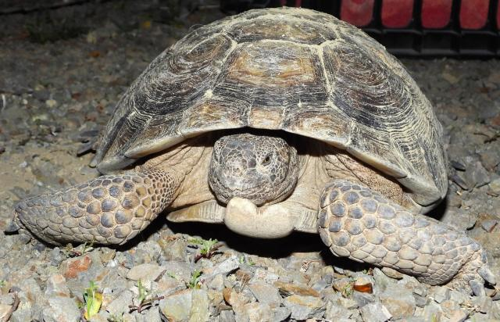
Errors and Uncertainties
South facing mountain slopes
Coarseness with climatic variables
Lack of in-situ data
2012 and 2008 Landsat imagery gaps
Image credit: NASA ARSET, NIFC
Notes:
Landsat data for the years 2012 and 2008 is missing. This is common among other remote sensing projects and should be noted when assessing the historical burn maps. However, since we mainly looked at case studies of large fires over the 20 year period, and 2008 and 2012 did not happen to be years of interest. This did not end up being much of a problem for us, because we did studies on individual years. Another known issue with dNBR historical burn mapping is the fact that south facing mountain slopes tend to give off an inaccurate signal.
There was no invasive grass in-situ data available for our fuel load growth analysis, so we weren’t able to do any prediction of where invasive grasses might appear using a random forest model like we initially thought we could. However, we got around this obstacle by investigating the total fuel load growth explanatory variables (often referred to as “parameters”), for both native and invasive plants using a Pearson Correlation and a linear regression model. For our eventual fuel load growth linear regression model, the lower resolution of climatic variables posed an issue in how we had to resample our NDVI to the lower resolutions of the climatic variables, which lead to the flattening of some data. Unfortunately, data can only be compared in a linear model when it is at the same resolution, but it can lead to inaccurate results to sample coarser data to something artificially finer for analysis. That being said, this presentation only covers the Pearson Correlation we did, which did not have any of these issues.
----------Image Information Below----------
Map Pixel Image
Image Credit: NASA Applied Remote Sensing Training (ARSET)
Image Source: https://www.earthdata.nasa.gov/learn/backgrounders/remote-sensing
Fire Image
Image Credit: NIFC
Image Source: https://www.nifc.gov/
Tortoise Image
Image Credit: BLM
Image Source: Desert tortoise rescued from mineshaft in Newberry Mountains Wilderness | Bureau of Land Management (blm.gov)

Slide 25
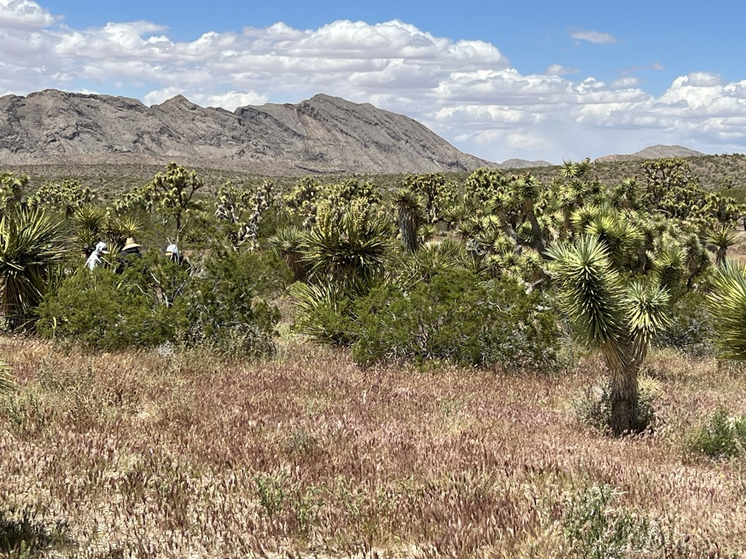
Conclusions
Historic Burn Map
Grassland areas saw fairly substantial regrowth following a fire.
High precipitation during wet season and rapid greening generally lead to larger burns in the dry season
El Niño conditions may lead to an increased interval of fires
Image credit: Beth Newingham - USDA
Notes:
From our work this term, we were able to draw a few conclusions about the study area. Through our historical burn maps, we observed that grassland areas saw fairly substantial regrowth following a fire. Also, high precipitation during the wet season and rapid greening generally lead to larger burns in the dry season. Lastly, precipitation anomalies seem to generally be influenced by the El Niño effect. Therefore we can assume that during El Niño years, there is a higher likelihood that a precipitation anomaly will lead to increased fuel load and a fire.
----------Image Information Below----------
Field with Mountains
Image Credit: Beth Newingham- Partner with USDA, Partner Image
Image Source: beth.newingham@usda.gov

Slide 26
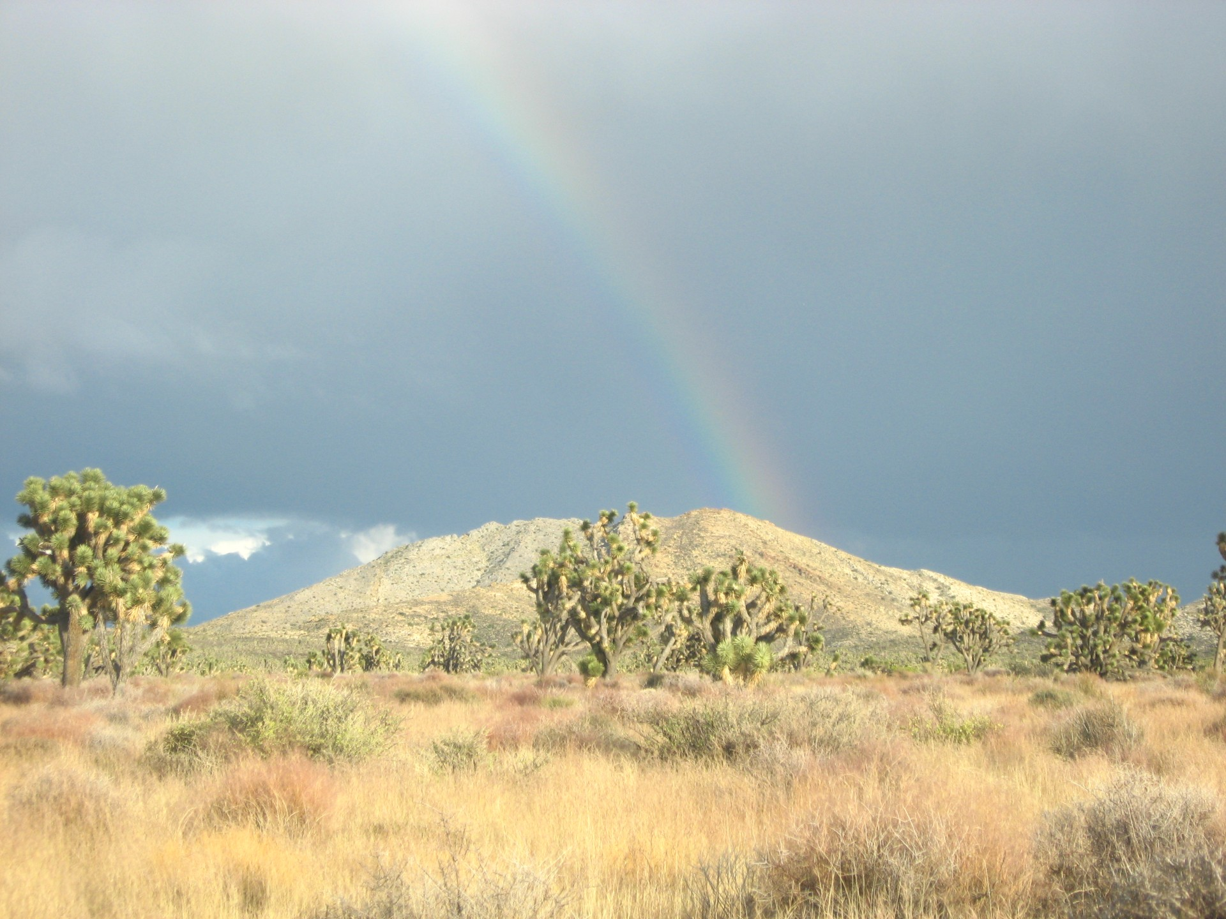
Conclusions
Fuel Load Growth Analysis
Best indicators of fuel load:
Max Evapotranspiration
Soil Water pH
Mean Albedo
Total Solar Radiation
Soil Water Content
Soil Organic Carbon Content
Image credit: Sean McCartney - NASA
Notes:
Our project successfully detected the total fuel load. As for fuel load growth, we found that through all four of our time periods max evapotranspiration, soil water PH, mean albedo, total solar radiation, soil water content, and soil organic carbon content where the best indicators of fuel load (using NDVI as a proxy).
----------Image Information Below----------
Mojave Desert Rainbow
Image credit: Sean McCartney - NASA GSFC
Image Source: sean.mccartney@nasa.gov

Slide 27
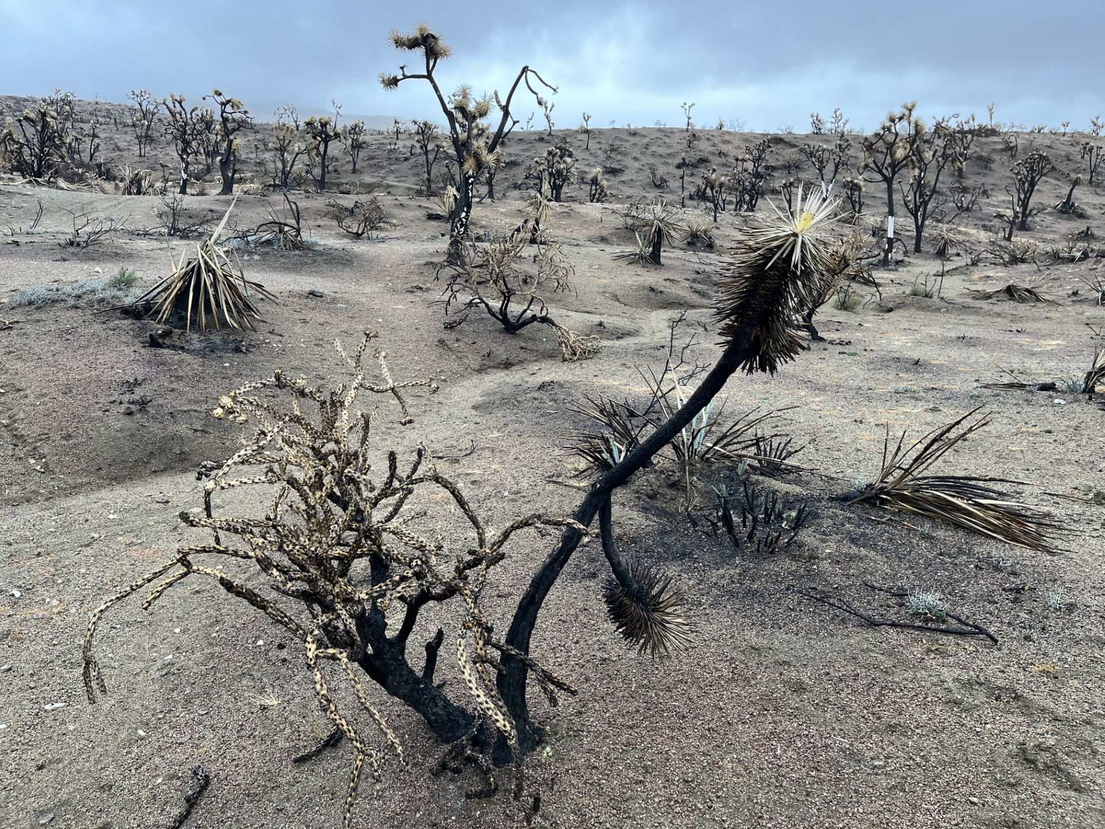
Conclusions
Feasibility
Historic burn maps were feasible
A fuel load analysis was feasible the way we conducted it, but in-situ data is needed for a more complex invasive grass fuel load analysis
Image credit: Tristan Jamieson - BLM
Notes:
Feasibility: Historic burned maps were feasible. The fuel load analysis was feasible the way we conducted it, however a more robust analysis was not feasible with our given data. Our original goal was to identify specific invasive grasses and then apply a fuel load growth analysis to them. A more precise fuel load detection model would be beneficial as opposed to using NDVI as a proxy for fuel load.
----------Image Information Below----------
Post-Fire Mojave
Image credit: Tristan Jamieson - BLM, Partner Image
Image Source: tjamieson@blm.gov

Slide 28
Science Advisors
Dr. Andrew Feldman (NASA Goddard Space Flight Center, UMD)
Sean McCartney (NASA Goddard Space Flight Center, SSAI)
Partners
Lara Kobelt, Natural Resource Specialist (BLM)
Sean McEldery, Fuel Programs Manager (BLM)
Tristan Jamieson, Southern Nevada District Fire Ecologist (BLM)
Dr. Beth Newingham, Research Ecologist (USDA)
Dr. Matt Reeves, Research Ecologist​ (FS)
Center Lead
Isabel Lubitz (NASA Goddard Space Flight Center, AMA)
Additional Assistance
Stephanie Willsey
Notes:
We would like to take a moment to thank those who helped us complete the Nevada Wildland Fires project. We are immensely grateful for their guidance and this opportunity. Thank you to our Science Advisors: Sean McCartney (NASA Goddard Space Flight Center, SSAI), Andrew Feldman (NASA Goddard Space Flight Center, UMD); our Partners: Sean McEldery, Fuel Programs Manager; Lara Kobelt, Natural Resource Specialist; Dr. Beth Newingham, Research Ecologist; Dr. Matt Reeves, Research Ecologist; our Center Lead: Isabel Lubitz; and Stephanie Willsey for her Additional Assistance, along with many more. We couldn’t have done this without you!

