Slide 1
Maldives Climate II
Evaluating the Potential Impacts of Sea Level Rise on Human Development and Coastal Infrastructure
Ben Dahan • Tiffany Hsu • Evan Barrett • Gabriel Halaweh
California — ARC | Spring 2023
Notes:
Our project evaluated the potential impacts of sea level rise on human development and coastal infrastructure
This project was a continuation of the 2022 fall term in which they monitored shoreline change and assessed water quality for select islands in the Maldives between the years of 2016-2022
This term, we focused on analyzing land cover over the past 39 years and projecting shoreline change for the next 17 years
Our team consists of Ben, Tiffany, Evan, and Gabriel

Slide 2
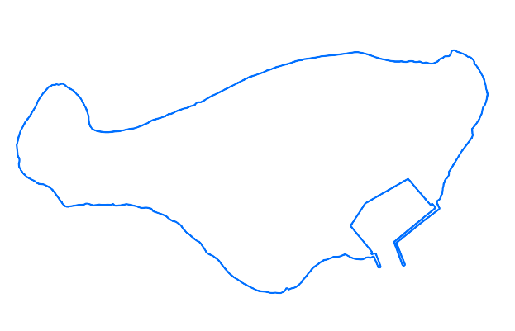
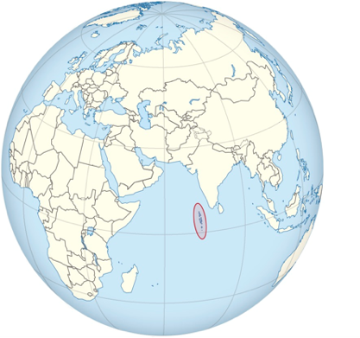
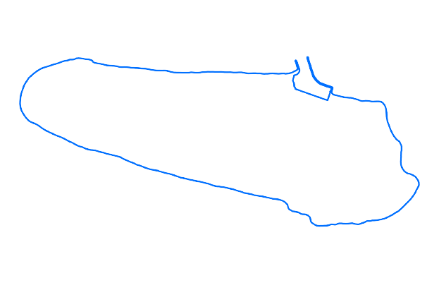
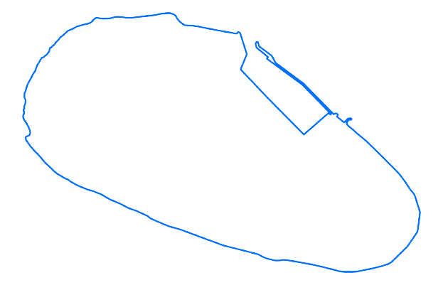
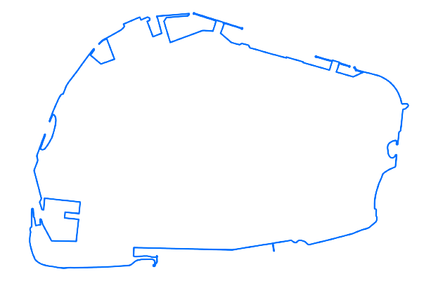
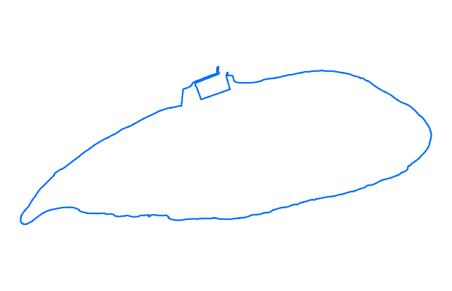
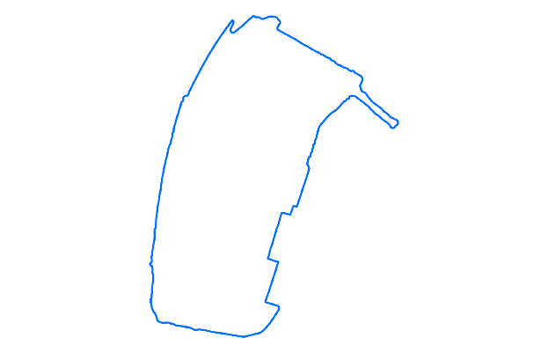
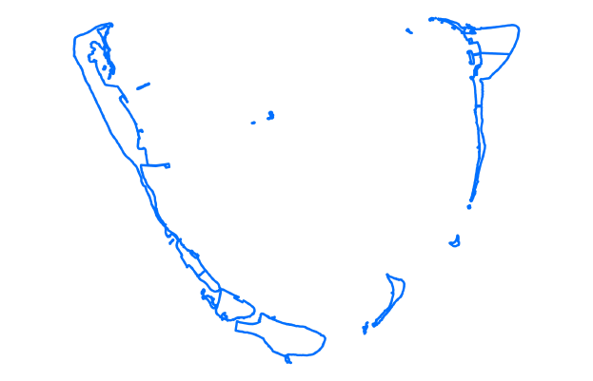
Study Area and Period
Thuraakunu
The Republic of the Maldives
Thuraakunu
Kulhudhuffushi
Eydhafushi
Vandhoo
Malé
Dharanboodhoo
Thinadhoo
Fuvahmulah
Addu Atoll
Kulhudhuffushi
Vandhoo
Eydhafushi
Malé
Dharanboodhoo
Study Period:
2000 – 2100
Land use changes: 2000-2023
Projected shoreline changes: 2023-2100
Thinadhoo
Fuvahmulah
Addu Atoll
Image credits: NASA DEVELOP, TUBS/Wikimedia Commons
Notes:
Our study area is based on the republic of Maldives, focusing specifically on
Thuraakunu
Kulhudhuffushi
Eydhafushi
Vandhoo
Malé
Dharanboodhoo
Thinadhoo
Fuvahmulah
Addu Atollwhich is pictured on the right
We monitored land use changes from 2000 through the present and analyzed projected shoreline changes for up until 2100
NOTE: For every image on the slide include an image source in the speaker notes (ex. URL; Name, Affiliation, etc.). ALL images need to be created by a DEVELOPer, in the public domain (federal agency), provided by the partner, or published under a creative commons license (if attributed correctly). See an example citation below:
------------------------------Image Information Below ------------------------------
•Image Credit: NASA DEVELOP Maldives Climate I Team
•Image Source: Harvey, A., Lopez, D., Chin, D., Porter, M. (2022). Maldives Climate: Monitoring Shoreline Changes and Island Loss in Response to Climate Change [Unpublished manuscript]. NASA DEVELOP National Program, California — Ames Research Center.
Image Credit: TUBS (Wikimedia commons)
Image Source: Image: https://commons.wikimedia.org/wiki/File:Maldives_on_the_globe_(Afro-Eurasia_centered).svg

Slide 3
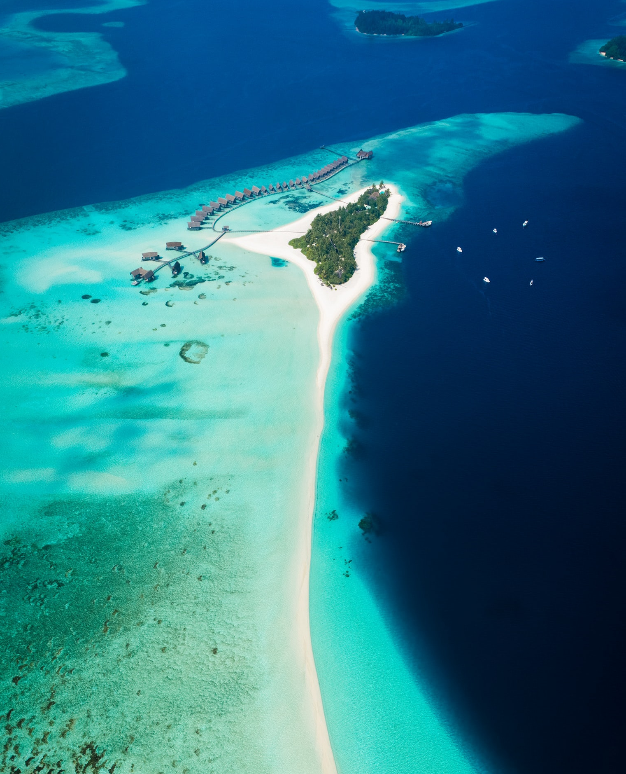
Community Concerns
The people of the Republic of the Maldives are concerned about...
Erosion of islands ​
Sea level rise
Waste management
Climate change ​
​​Future development ​
Image credits: Photo by Shifaaz shamoon on Unsplash
Notes:
The three primary community concerns in the Republic of Maldives are the erosion of islands, waste management, and future development on the islands. Government officials and citizens are concerned about how climate change and sea level rise will affect their way of life and amplify the problems they are facing. These community concerns were communicated to us directly from our project partners in the Maldives and were incorporated into our study and end products.
------------------------------Image Information Below ------------------------------
•Image Credit: Photo by Shifaaz shamoon on Unsplash
•Image Source: https://unsplash.com/photos/AAFH_AADpRg (CC0 license)
Image Credits: Microsoft Icons

Slide 4
Objectives
Determine which coastal areas are most vulnerable to sea level rise over the next few decades.
Projected Shoreline Maps
GEE Tutorial
Landcover Maps
Notes:
- Our project focused on the impact that sea level rise and erosion will have on the Maldives and their ​built environment.
- Throughout our project we worked on three main objectives: the creation of Landcover Maps over time, the implementation of Projected Shoreline Maps, and the creation of a GEE Tutorial.
- We produced a tutorial and landcover map ​that will help inform prevention of climate based damage to the Maldives.
------------------------------Image Information Below ------------------------------
•Image Credit: Microsoft Icons

Slide 5
Partners
U.S. Department of State, Bureau of South and Central Asian Affairs, Office of Bangladesh,
Nepal, Sri Lanka, Maldives, and Bhutan
The Maldives Ministry of Environment, Climate Change, and Technology
U.S. Agency for International Development (USAID), Maldives Office
Image credits: U.S. Department of State; USAID
Notes:
Our project partners were the Maldives Ministry of Environment, Climate Change, and Technology; the U.S. Department of State, Bureau of South and Central Asian Affairs, Office of Bangladesh, Nepal, Sri Lanka, Maldives, and Bhutan; and the U.S. Agency for International Development (USAID), Maldives Office. We worked closely with these offices to discuss their individual needs and what products they would like from the results of the study. They provided valuable input regarding the risk of coastal erosion and continued development in the Maldives.
------------------------------Image Information Below ------------------------------
•Image Credit: U.S. Department of State
•Image Source: https://brand.america.gov/d/WrAFnKrhEEfk/our-brand#/visual-elements/the-seal (Public Domain)
•Image Credit: USAID
•Image Source: https://www.usaid.gov/branding/resources#downloads (Public Domain)

Slide 6
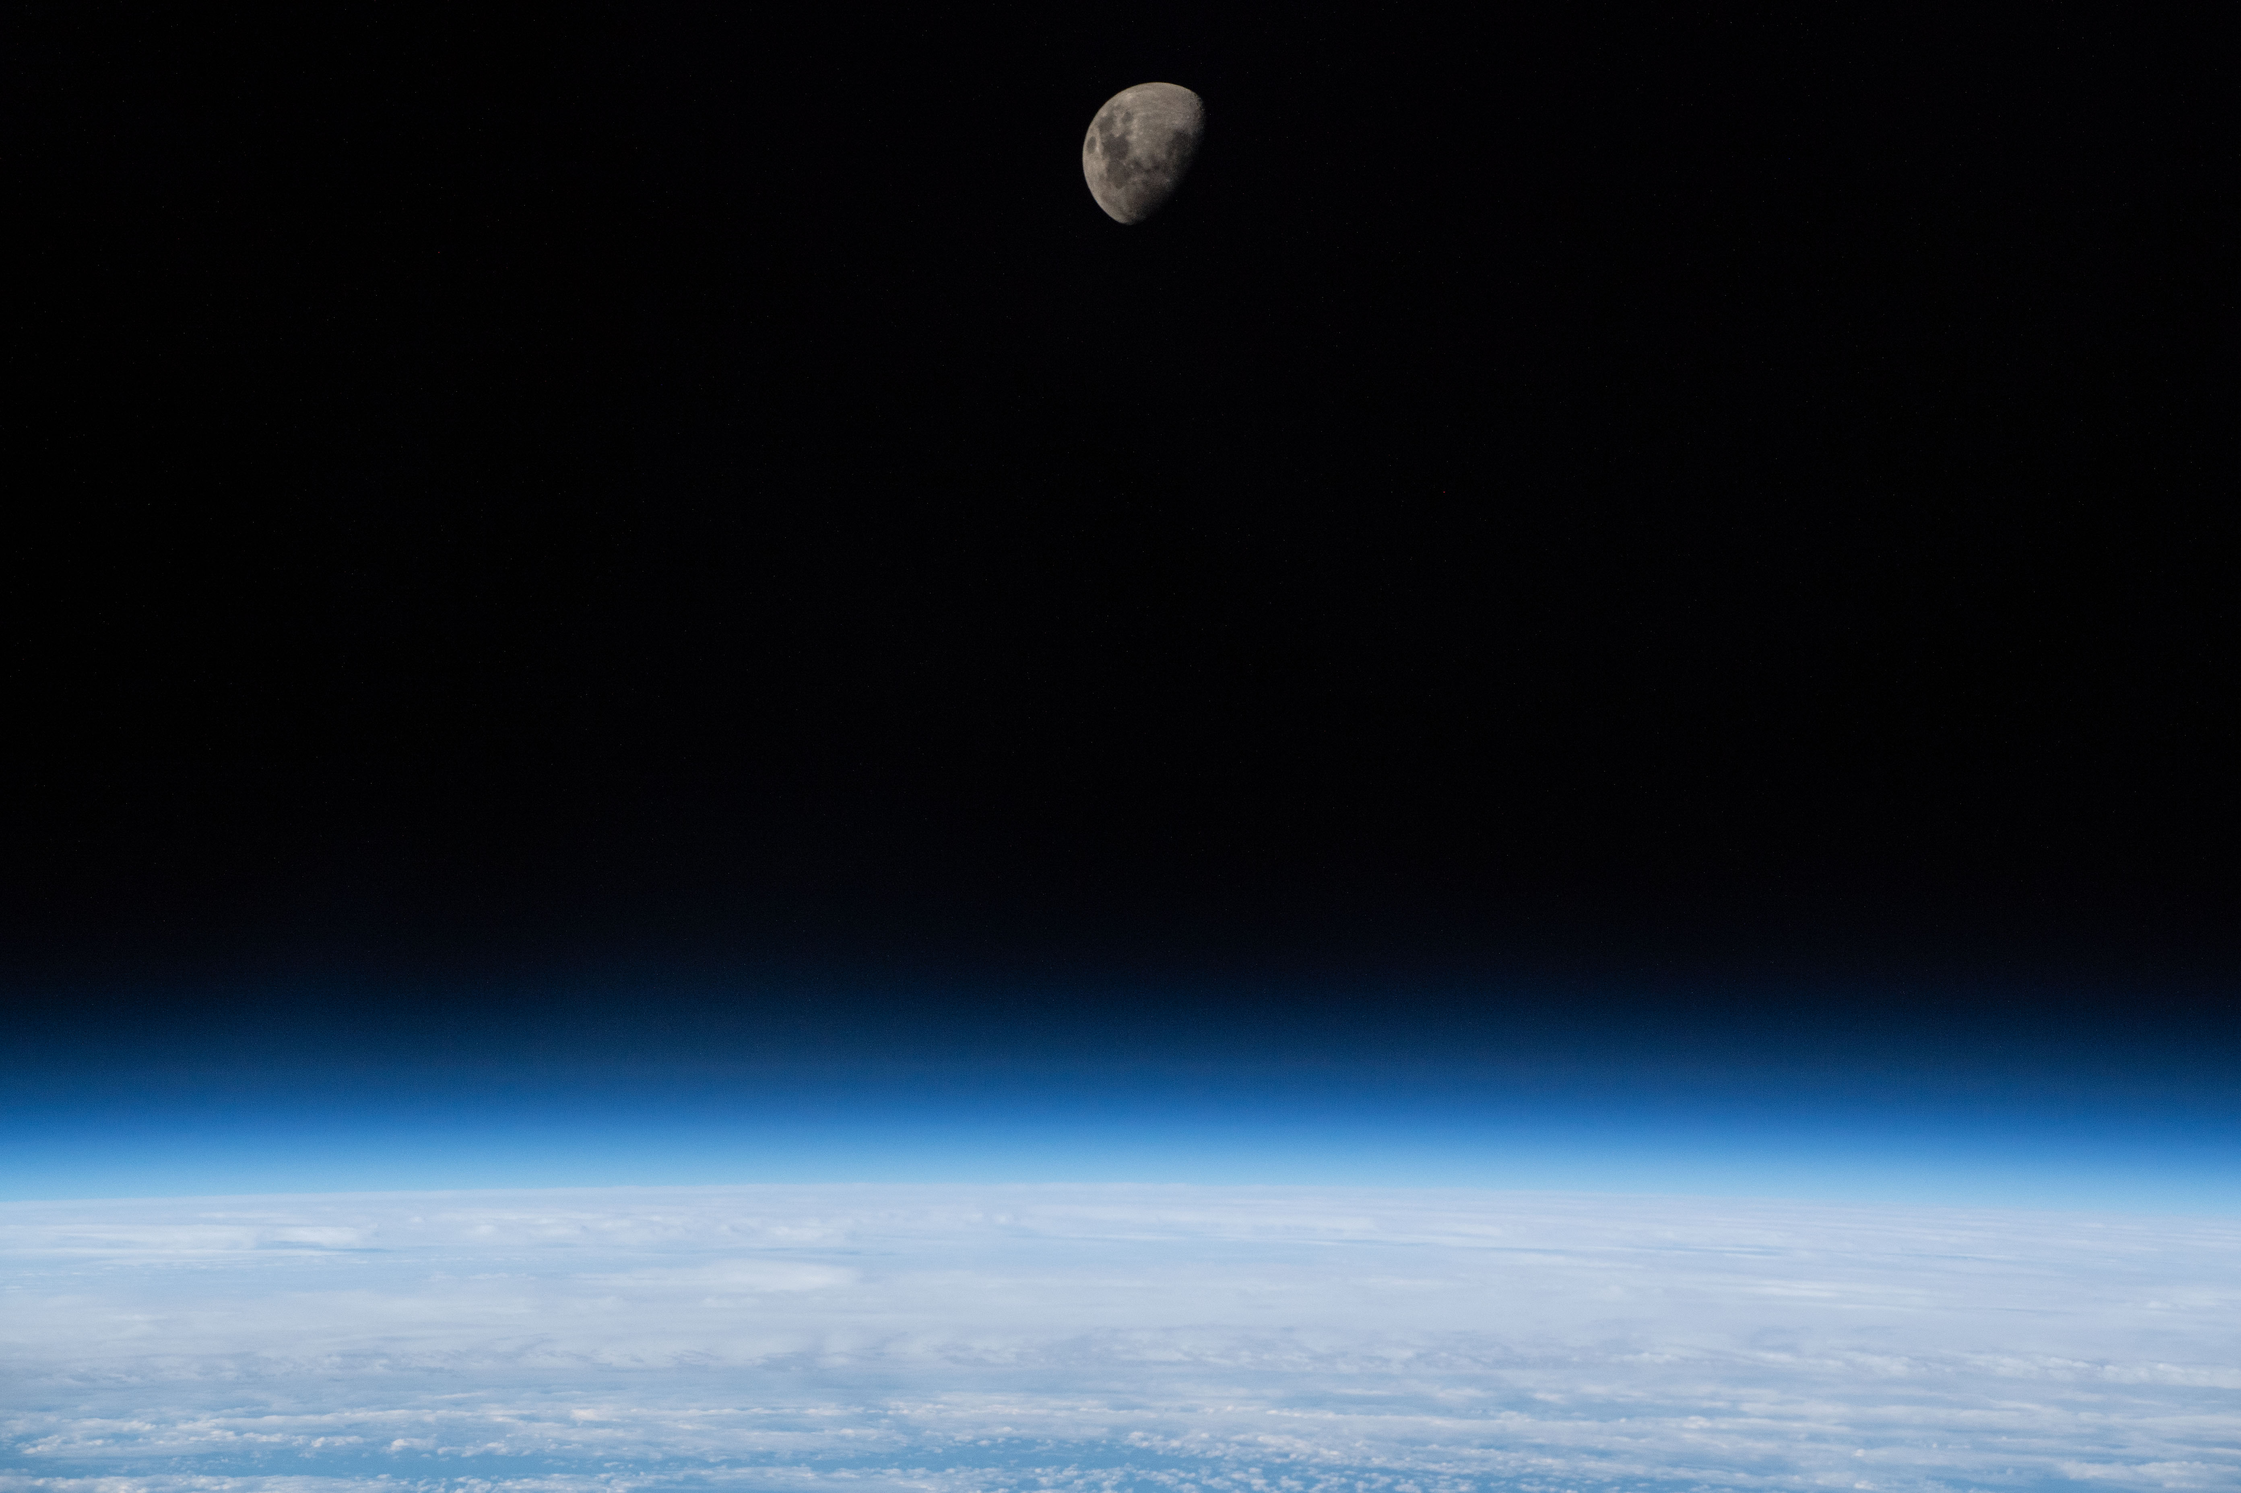
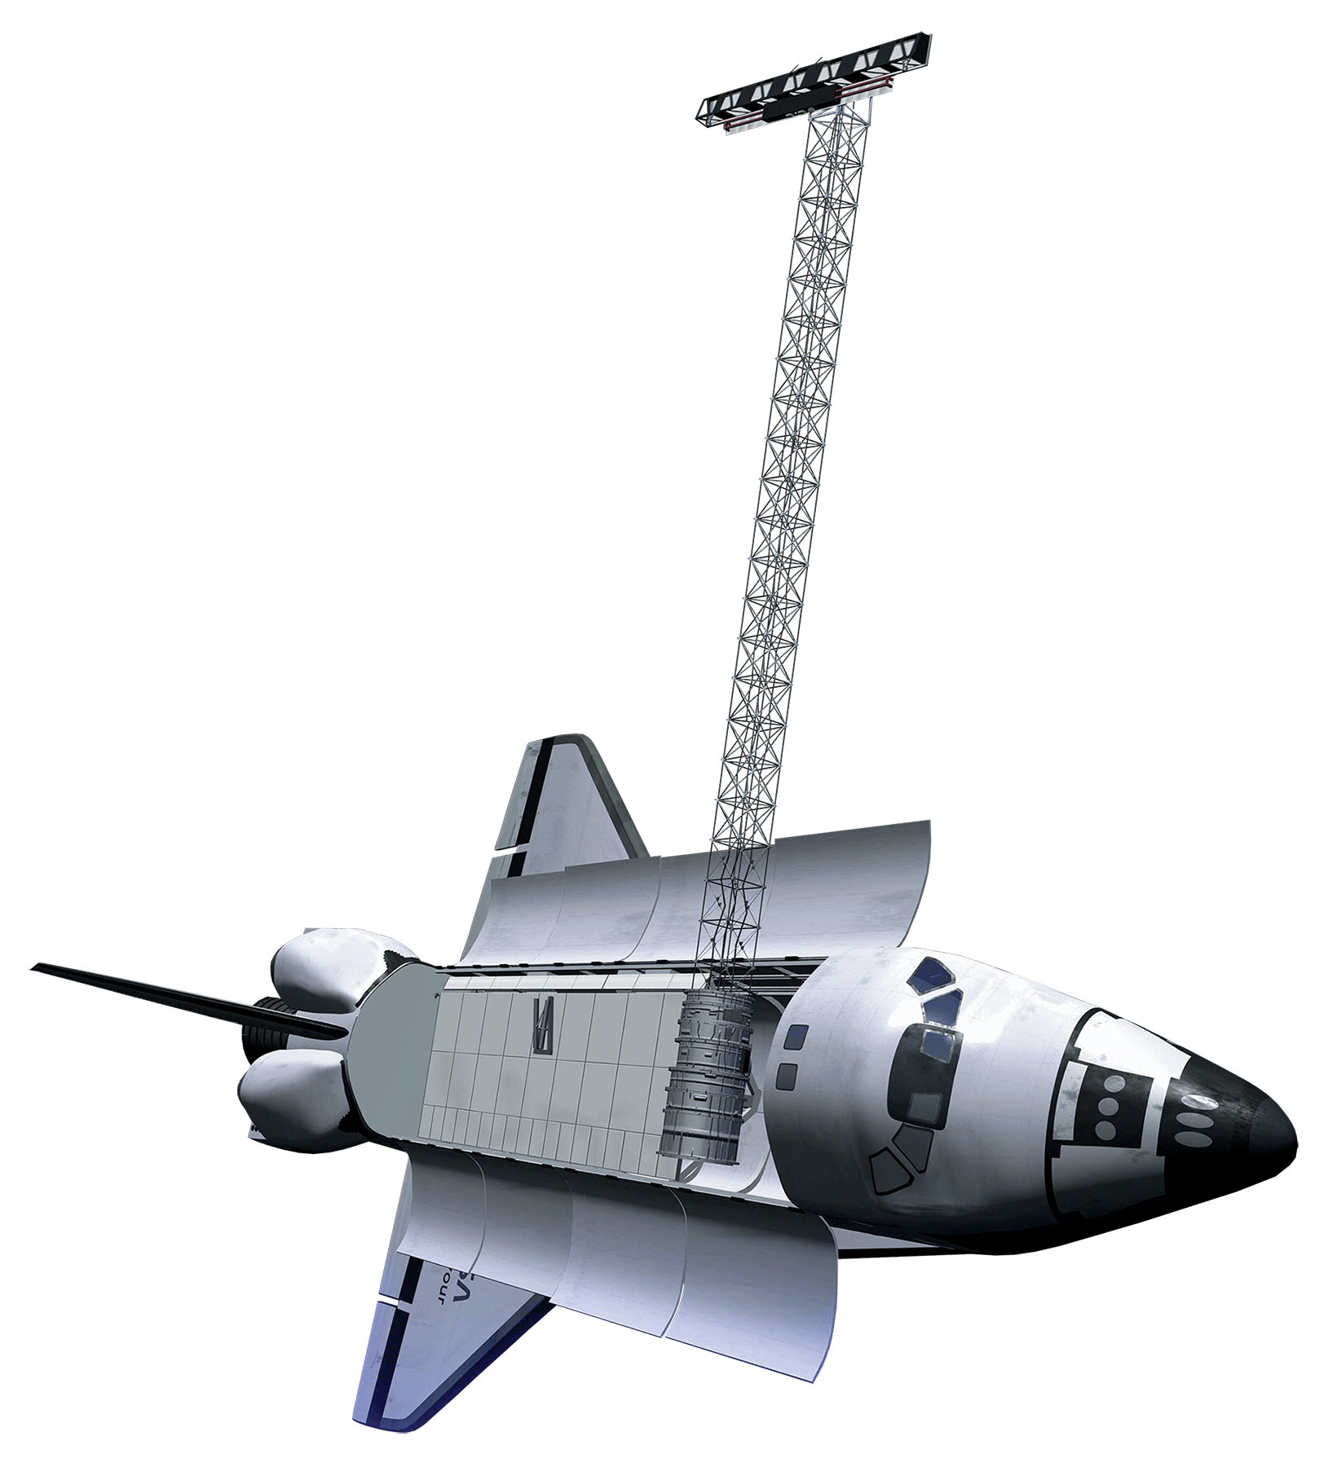
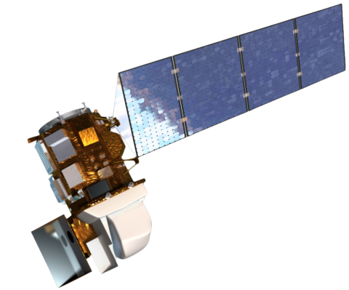
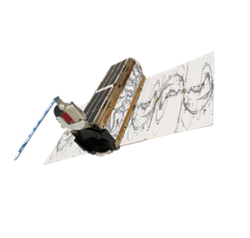
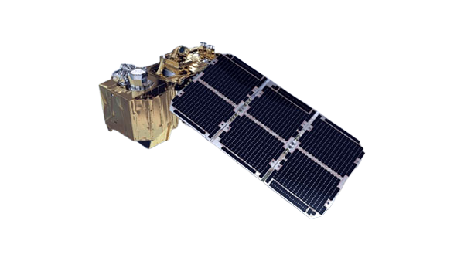
Satellites and Sensors
NASA
Landsat 7 ETM+
SRTM
Landsat 8 OLI-2
1999
2000
2013
2016
2017
Sentinel 2 - MSI
PlanetScope
ESA & Planet
Image credits: NASA, ESA, USGS, Belgian Earth Observation, Planet Labs PBC
Notes:
We used a combination of 5 satellite and sensors for our project. Landsat 7 provided us 30m resolution data from 2000-2013. SRTM provided 30m and 90m resolution elevation data for 2000. Landsat 8 provided 30m resolution data from 2014-2023. Sentinel 2 is 10m resolution from 2016 and is offered through the European Space Agency. We also utilize PlanetScope's SkySat, Dove Classic, Dove R, and SuperDove satellites, which provides near daily imagery from 2017-2023 at 3m resolution.
------------------------------Image Information Below ------------------------------
Landsat 7:
Image Credit: Belgian Earth Observation
Image Source: https://eo.belspo.be/fr/satellites-and-sensors/landsat-7
Landsat 8
Image Credit: USGS
Image Source: https://www.usgs.gov/media/images/landsat-8
Planetscope (SuperDove):
Image Credit: Planet Labs PBC used with Permission
Sentinel 2:
Image Credit: European Space Agency
Image Source: https://sentinels.copernicus.eu/web/sentinel/user-guides/sentinel-2-msi/overview
SRTM:
Image Credit: NASA
Image Source: https://www.devpedia.developexchange.com/dp/index.php?title=List_of_Satellite_Pictures
Background
Image Credit: NASA ISS Image Source: https://www.nasa.gov/feature/high-definition-earth-viewing-payload-reaches-end-of-life-on-station-surpassing-life [CC0]

Slide 7
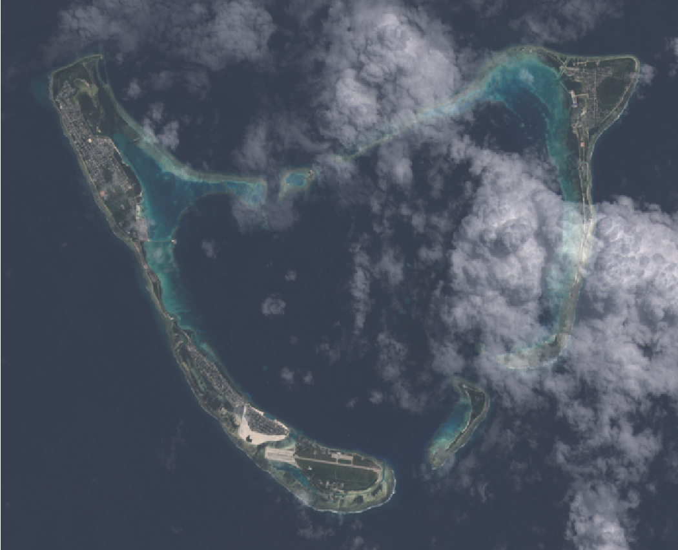
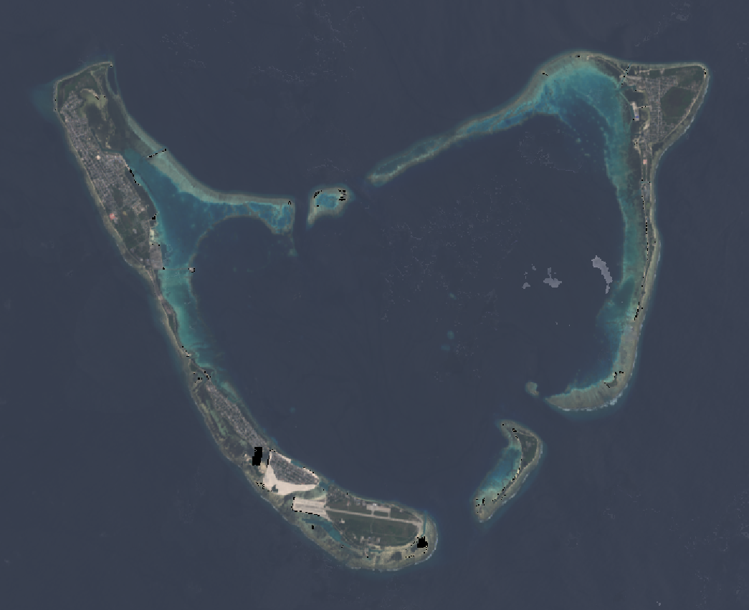
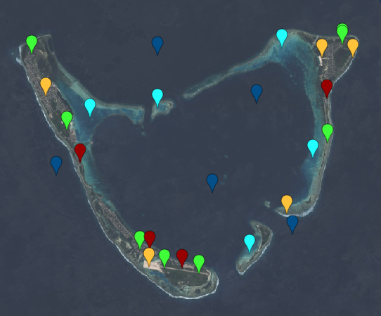
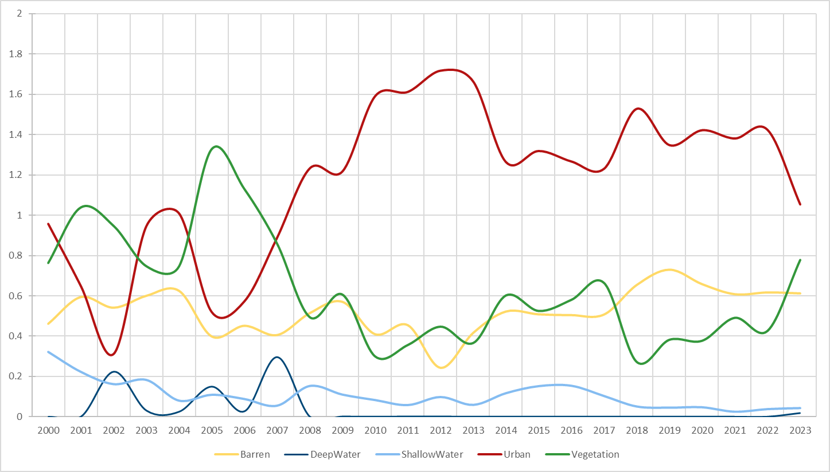
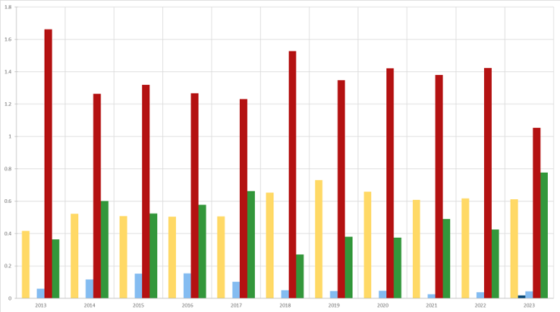
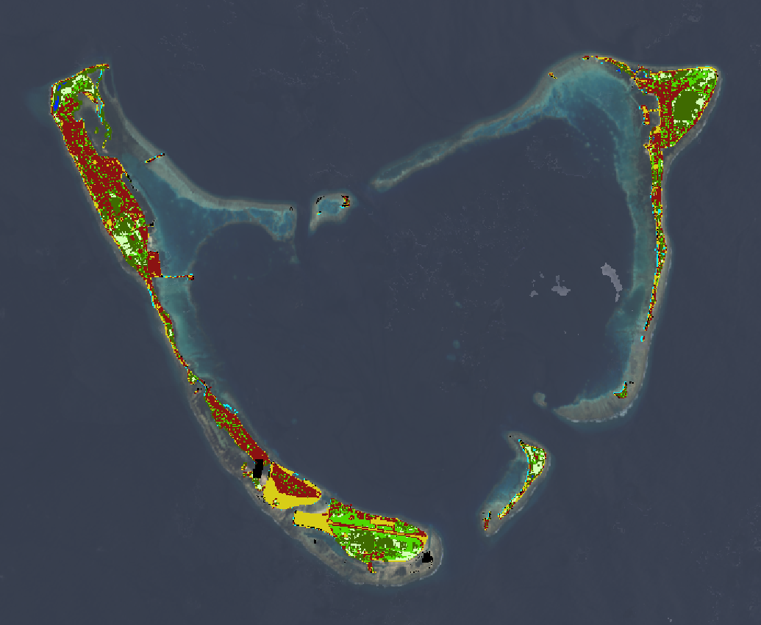
Methodology: Land Use Classification
Create cloud-free composites
Create training points and train a supervised
classifier
Obtain imagery of the region
Analyze data trends and validate results using error analysis
Produce a time series of land use and NDVI changes
Apply the classifier to produce a land use map
Notes:
We conducted all of our land use analyses in Google Earth Engine. We started by obtaining raw imagery and applied spatial and temporal filters to look at our specific region of interest.
------------------------------Image Information Below ------------------------------
Image Credits: Maldives Climate II Team

Slide 8
Methodology: Land Use Classification
Obtain imagery of the region
Create training points and train a supervised
classifier
Create cloud-free composites
Analyze data trends and validate results using error analysis
Produce a time series of land use and NDVI changes
Apply the classifier to produce a land use map
Notes:
After filtering, we created a cloud-free image using a simple composite feature and a cloud mask.
------------------------------Image Information Below ------------------------------
Image Credits: Maldives Climate II Team

Slide 9
Methodology: Land Use Classification
Obtain imagery of the region
Create cloud-free composites
Create training points and train a supervised
classifier
Analyze data trends and validate results using error analysis
Produce a time series of land use and NDVI changes
Apply the classifier to produce a land use map
Notes:
Once we had a cloud-free image, we created training points and extracted training data from those points based on the image from which they were collected to train a supervised classifier.
------------------------------Image Information Below ------------------------------
Image Credits: Maldives Climate II Team

Slide 10
Methodology: Land Use Classification
Obtain imagery of the region
Create cloud-free composites
Create training points and train a supervised
classifier
Analyze data trends and validate results using error analysis
Produce a time series of land use and NDVI changes
Apply the classifier to produce a land use map
Notes:
With the trained classifier, we were able to produce land use maps of the whole region based on the initial training data.
------------------------------Image Information Below ------------------------------
Image Credits: Maldives Climate II Team

Slide 11
Methodology: Land Use Classification
Obtain imagery of the region
Create cloud-free composites
Create training points and train a supervised
classifier
Analyze data trends and validate results using error analysis
Apply the classifier to produce a land use map
Produce a time series of land use and NDVI changes
Notes:
Once the land was classified, we used changes in land cover class and changes in NDVI to conduct a time series of how the land had changed throughout our study period.
------------------------------Image Information Below ------------------------------
Image Credits: Maldives Climate II Team

Slide 12
Methodology: Land Use Classification
Obtain imagery of the region
Create cloud-free composites
Create training points and train a supervised
classifier
Produce a time series of land use and NDVI changes
Apply the classifier to produce a land use map
Analyze data trends and validate results using error analysis
Notes:
Afterwards, we looked at different temporal and spatial trends in our data and validated our data using other land use classification maps and error analysis of our classifier.
------------------------------Image Information Below ------------------------------
Image Credits: Maldives Climate II Team

Slide 13
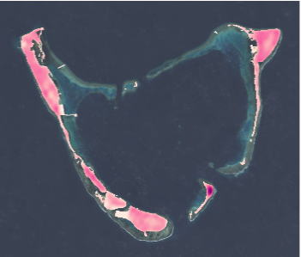
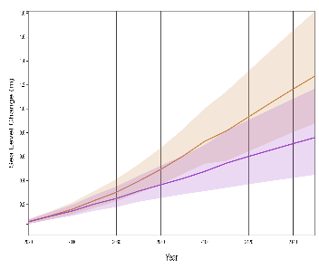
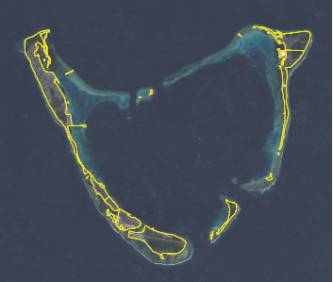
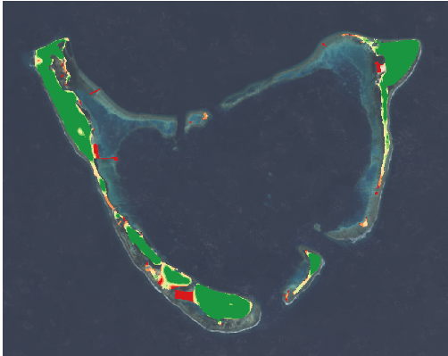
Methodology: Coastal Flooding
In a Bathtub Model, inundation risk is identified where:
Digital
Elevation
Model
Sea Level
Projection
Scenarios
Coastline Vector
Inputs
Elevation < Shoreline water level
Using uBTM in Google Earth Engine Terres de Lima et al. (2021)
Identify Error Range for DEM and Projection
Elevation Classification by Sea Level
Processes
Incorporates vertical uncertainty of DEM and SLR projection
Produce Coastal Flood Risk Map
Hydrostatic methods can overpredict flood risk, but limits inputs and compute power
Output
Notes:
The next step was to complete a sea level rise inundation mapping. To do so, we utilized a hydrostatic approach termed the "bathtub model." Instead of attempting to simulate water motion dynamics, like tides and wave activity, we identify inundation zones based on elevations that are below the projected sea levels. This simpler approach can overpredict flood risk, but saves on the amount of inputs and compute time required.
To compensate for the uncertainty in the inputs, both in terms of vertical bias from the DEM and in the range of values from the sea level rise projection, we use what's called a modified deterministic method. Specifically, we adapted the uncertainty bathtub model (uBTM) from Terres de Lima et al. (2021), which uses the root mean square error of each to calculate a range of potential values – thusly mapping flood risk from 0% of flooding, to 100% chance of flooding.
------------------------------Image Information Below ------------------------------
Image Credits: Microsoft Icons and Maldives Climate Team

Slide 14
Methodology: Coastal Flooding
In a Bathtub Model, inundation risk is identified where:
Digital
Elevation
Model
Sea Level
Projection
Scenarios
Coastline Vector
Inputs
Elevation < Shoreline water level
Using uBTM in Google Earth Engine Terres de Lima et al. (2021)
Identify Error Range for DEM and Projection
Elevation Classification by Sea Level
Processes
Incorporates vertical uncertainty of DEM and SLR projection
Produce Coastal Flood Risk Map
Hydrostatic methods can overpredict flood risk, but limits inputs and compute power
Output
Notes:
The next step was to complete a sea level rise inundation mapping. To do so, we utilized a hydrostatic approach termed the "bathtub model." Instead of attempting to simulate water motion dynamics, like tides and wave activity, we identify inundation zones based on elevations that are below the projected sea levels. This simpler approach can overpredict flood risk, but saves on the amount of inputs and compute time required.
To compensate for the uncertainty in the inputs, both in terms of vertical bias from the DEM and in the range of values from the sea level rise projection, we use what's called a modified deterministic method. Specifically, we adapted the uncertainty bathtub model (uBTM) from Terres de Lima et al. (2021), which uses the root mean square error of each to calculate a range of potential values – thusly mapping flood risk from 0% of flooding, to 100% chance of flooding.
------------------------------Image Information Below ------------------------------
Image Credits: Microsoft Icons and Maldives Climate Team

Slide 15
Methodology: Coastal Flooding
In a Bathtub Model, inundation risk is identified where:
Digital
Elevation
Model
Sea Level
Projection
Scenarios
Coastline Vector
Inputs
Elevation < Shoreline water level
Using uBTM in Google Earth Engine Terres de Lima et al. (2021)
Identify Error Range for DEM and Projection
Elevation Classification by Sea Level
Processes
Incorporates vertical uncertainty of DEM and SLR projection
Produce Coastal Flood Risk Map
Hydrostatic methods can overpredict flood risk, but limits inputs and compute power
Output
Notes:
The next step was to complete a sea level rise inundation mapping. To do so, we utilized a hydrostatic approach termed the "bathtub model." Instead of attempting to simulate water motion dynamics, like tides and wave activity, we identify inundation zones based on elevations that are below the projected sea levels. This simpler approach can overpredict flood risk, but saves on the amount of inputs and compute time required.
To compensate for the uncertainty in the inputs, both in terms of vertical bias from the DEM and in the range of values from the sea level rise projection, we use what's called a modified deterministic method. Specifically, we adapted the uncertainty bathtub model (uBTM) from Terres de Lima et al. (2021), which uses the root mean square error of each to calculate a range of potential values – thusly mapping flood risk from 0% of flooding, to 100% chance of flooding.
------------------------------Image Information Below ------------------------------
Image Credits: Microsoft Icons and Maldives Climate Team

Slide 16
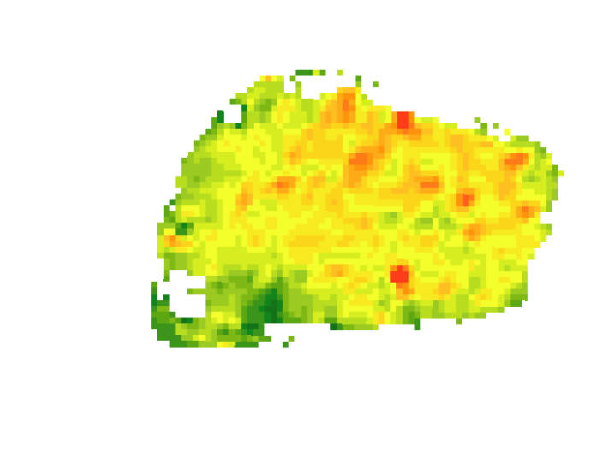
DEM Elevation
Vertical Bias
SRTM
7m
Forest canopy
Urban Cover
450 m
-2m
18m
N
Data Validation
CoastalDEM
3.52m
711 ground control points across 300 islands
Local RMSE of 1.51m, compared to global RMSE of 6.10m (Kulp et al., 2019)
-0.42m
7.28m
True Elevation: 1.87m
Image credits: NASA
Notes:
Our elevation data comes from the 2001 Shuttle Radar Topographical Mission, which mapped the elevations of most of the world's surface at 30m resolution. However, in addition to being rather outdated, missing for example recently reclaimed land in the Maldives, this data product has a significant amount of vertical bias, registering things like the top of tree canopies and dense urban areas.
Our Bathtub model used, instead, the CoastalDEM, which Climate Central kindly gave us a free license for for the purposes of this study. CoastalDEM runs the SRTM through a machine learning process with 21 different filtering inputs, such as vegetation, population density, etc, to help correct for some of the vertical bias, especially in low lying coastal areas.
As the Bathtub Model is heavily reliant on the elevation data used, we attempted to validate it using hundreds of ground control points collected by the Maldives Land and Survey Authority. This is compared to a global RMSE of 6.10, as determined by Kulp et al. using 10,000 IceSat-2 measurements.
------------------------------Image Information Below ------------------------------
Image Credits: Microsoft Icons and Maldives Climate Team
SRTM Credits: NASA
CoastalDEM Credits: Climate Central

Slide 17
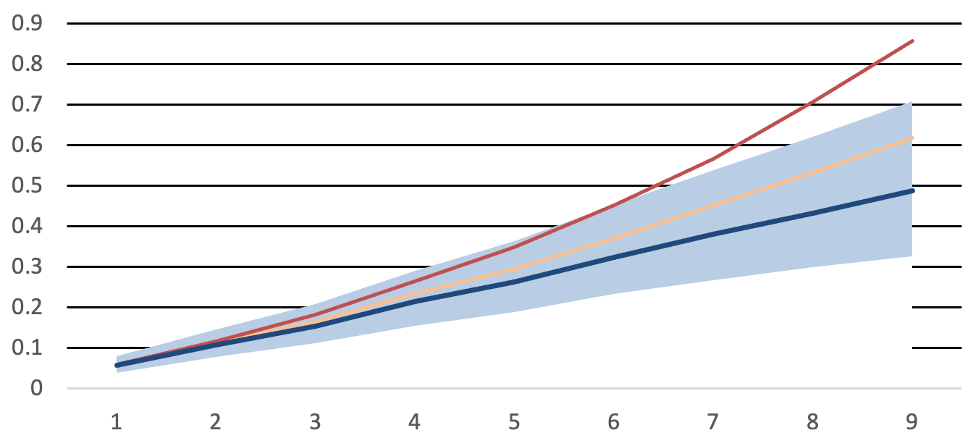
Sea Level Rise Scenarios
Methodology: Sea Level Rise
SSP1-2.6
SSP2-4.5
SSP5-8.5
Reaching Net Zero emissions by 2050​
In line with Nationally Determined
Contribution (NDCs) ​
High reference scenario with no additional climate policy​
0.9
0.9
1.2
Mean Sea Level (m)
Mean Sea Level (m)
Mean Sea Level (m)
0.6
0.6
0.8
0.3
0.3
0.4
2050
2100
2050
2100
2050
2100
1.8°C by 2100
2.7°C by 2100
4.4°C by 2100
Image credit: Wikimedia
Notes:
Sea Level Rise Projections were taken from the NASA AR6 Sea Level Rise Modelling Tool based on the IPCC AR6 Shared Socio-Economic Pathways (SSP) SSP1-2.6, SSP2-4.5, and SSP5-8.5. We chose these scenarios to offer our partners a low, intermediate and high emissions scenarios. We also calculated rough estimates of the standard deviations of each scenario, based on the likely range (17th percentile to 83rd percentile).
------------------------------Image Information Below ------------------------------
Background Image Credit: Wikimedia user Gzzz https://commons.wikimedia.org/wiki/File:Bathala_%28Maldives%29_6.jpg
Licensed under the Creative Commons Attribution-Share Alike 4.0 International
Graph image credit: Maldives Climate team, using data from NASA. (n.d.). IPCC AR6 Sea Level Projection Tool. NASA Earthdata.

Slide 18
Sea Level Rise Scenarios
Methodology: Sea Level Rise
SSP1-2.6
SSP2-4.5
SSP5-8.5
Reaching Net Zero emissions by 2050​
In line with Nationally Determined
Contribution (NDCs) ​
High reference scenario with no additional climate policy​
0.9
0.9
1.2
Mean Sea Level (m)
Mean Sea Level (m)
Mean Sea Level (m)
0.6
0.6
0.8
0.3
0.3
0.4
2050
2100
2050
2100
2050
2100
2050: 0.21m +/- 0.05m
2100: 0.49m +/- 0.13m
1.8°C by 2100
2.7°C by 2100
4.4°C by 2100
Image credit: Wikimedia
Notes:
The first scenario occurs if we reach net zero emissions by 2050. Following this scenario would result in an estimated 0.21 meter rise in sea level by 2050 and 0.49 meter rise by 2100.
------------------------------Image Information Below ------------------------------
Background Image Credit: Wikimedia user Gzzz https://commons.wikimedia.org/wiki/File:Bathala_%28Maldives%29_6.jpg
Licensed under the Creative Commons Attribution-Share Alike 4.0 International
Graph image credit: Maldives Climate team, using data from NASA. (n.d.). IPCC AR6 Sea Level Projection Tool. NASA Earthdata.

Slide 19
Sea Level Rise Scenarios
Methodology: Sea Level Rise
SSP1-2.6
SSP2-4.5
SSP5-8.5
Reaching Net Zero emissions by 2050​
In line with Nationally Determined
Contribution (NDCs) ​
High reference scenario with no additional climate policy​
0.9
0.9
1.2
Mean Sea Level (m)
Mean Sea Level (m)
Mean Sea Level (m)
0.6
0.6
0.8
0.3
0.3
0.4
2050
2100
2050
2100
2050
2100
2050: 0.23m +/- 0.05m
2100: 0.62m +/- 0.14m
1.8°C by 2100
2.7°C by 2100
4.4°C by 2100
Image credit: Wikimedia
Notes:
The second sea level rise scenario reflects a scenario in which CO2 emissions stay around their current values and then start to decline by about 2050, which is roughly in line with the current commitments made in Nationally Determined Contributions (NDCs) per the 2015 Paris Agreement. In this scenario, there is around a projected 0.23 meter rise in sea level in the region around Malé by 2050, and by 2100 there is a projected 0.62 meter rise in sea level.
------------------------------Image Information Below ------------------------------
Background Image Credit: Wikimedia user Gzzz https://commons.wikimedia.org/wiki/File:Bathala_%28Maldives%29_6.jpg
Licensed under the Creative Commons Attribution-Share Alike 4.0 International
Graph image credit: Maldives Climate team, using data from NASA. (n.d.). IPCC AR6 Sea Level Projection Tool. NASA Earthdata.

Slide 20
Sea Level Rise Scenarios
Methodology: Sea Level Rise
SSP1-2.6
SSP2-4.5
SSP5-8.5
Reaching Net Zero emissions by 2050​
In line with Nationally Determined
Contribution (NDCs) ​
High reference scenario with no additional climate policy​
0.9
0.9
1.2
Mean Sea Level (m)
Mean Sea Level (m)
Mean Sea Level (m)
0.6
0.6
0.8
0.3
0.3
0.4
2050
2100
2050
2100
2050
2100
2050: 0.26m +/- 0.05m
2100: 0.86m +/- 0.17m
1.8°C by 2100
2.7°C by 2100
4.4°C by 2100
Image credit: Wikimedia
Notes:
The last sea level rise scenario that we looked at reflects a scenario in which CO2 emissions continue to increase as they have been without human intervention to cut greenhouse gas emissions, and with global development continuing to be powered by fossil fuels. In this scenario, there is around a projected 0.26 meter rise in sea level in the region around Malé by 2050, and by 2100 there is a projected 0.86 meter rise in sea level.
------------------------------Image Information Below ------------------------------
Background Image Credit: Wikimedia user Gzzz https://commons.wikimedia.org/wiki/File:Bathala_%28Maldives%29_6.jpg
Licensed under the Creative Commons Attribution-Share Alike 4.0 International
Graph image credit: Maldives Climate team, using data from NASA. (n.d.). IPCC AR6 Sea Level Projection Tool. NASA Earthdata.

Slide 21
Results: Land Classification
Land Classes
Shallow Water
Deep Water
Landsat 8
Sentinel 2
PlanetScope
Vegetation
Urban
Barren
500 meters
N
Overall Accuracy:
91.00%
Overall Accuracy:
93.58%
Overall Accuracy:
92.66%
Image credits: Includes copyrighted material of Planet Labs PBC. All rights reserved.
Notes:
We created land classification maps using four different satellite datasets and were able to compare the results produced from each. To compare the results, we used an error matrix and calculated the overall accuracy of each classifier. Landsat 7 and Landsat 8 imagery has a 30 meter resolution, which is the lowest resolution data that we used. The low resolution classification was still accurate, with a 91% overall accuracy. We primarily used Landsat for conducting historical analyses from 2000 to 2016, but there is Landsat data through the present day. Sentinel-2 allowed us to create 10m-resolution classification maps for 2016 through the present and had the highest overall accuracy at 93.58%. PlanetScope data had the highest resolution at 3m and provided data for 2017 through the present day and had an overall accuracy of 92.66%. The lower accuracy of PlanetScope may be due to the fact that the Planet Dove series sensors do not pick up as many frequency bands as Landsat and Sentinel-2, which affects the ability of the algorithm to classify pixels.
PlanetScope Image Credit: Includes copyrighted material of Planet Labs PBC. All rights reserved.

Slide 22
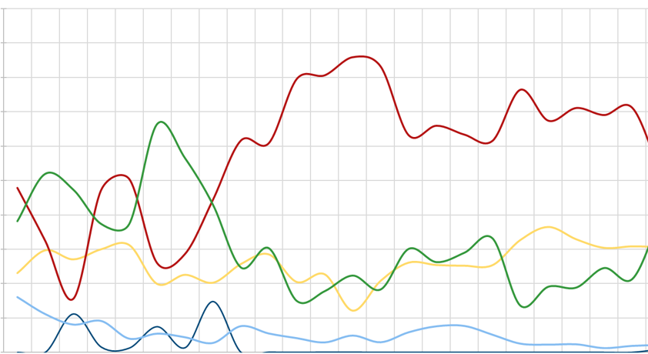
Results: Land Classification Time Series
2
1.8
1.6
1.4
1.2
1.0
0.8
0.6
0.4
0.2
0.0
Land Classes
Shallow Water
Deep Water
Vegetation
Urban
Barren
Surface Area (${\text{km}}^{2}$)
2000
2002
2004
2006
2008
2010
2012
2014
2016
2018
2020
2022
Year
Notes:
The chart visualizes the change in land class for Kulhudhuffushi from 2000 through 2023 using Landsat imagery. The most notable trends are visible between the vegetation and urban land classes. Generally, we see an increase in urban areas while vegetation appears to be decreasing. We will dive deeper in the years 2000, 2016, and 2022 and see how land cover has shifted since the construction of the airport.

Slide 23
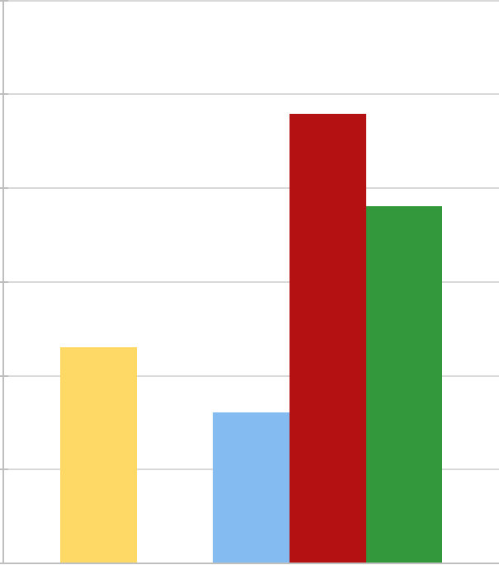
Results: Land Classification and Time Series
2000
Land Classes
Shallow Water
Deep Water
Vegetation
Urban
Barren
2016
1.2
1.0
0.8
0.6
0.4
0.2
0.0
2022
Surface Area (${\text{km}}^{2}$)
Kulhudhuffushi
500 meters
N
2000
Notes:
We were able to pair our time series analyses with our land cover maps to observe the changes on each of the islands. This is the classified map of Kulhudhuffushi and the surface area of each of the classes from 2000. We will now look at Kulhudhuffushi in 2016, after a major land reclamation project in the west.

Slide 24
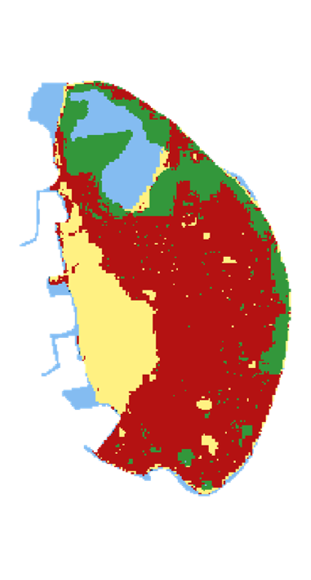
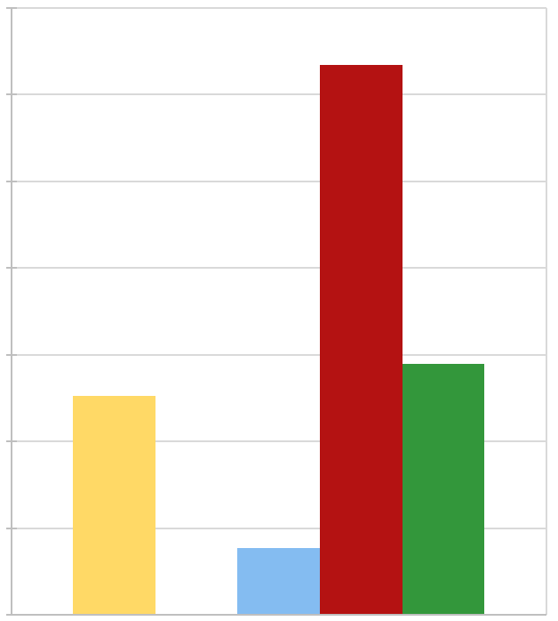
Results: Land Classification and Time Series
2000
Land Classes
Shallow Water
Deep Water
Vegetation
Urban
Barren
2016
1.4
1.2
1.0
0.8
0.6
0.4
0.2
0.0
2022
Surface Area (${\text{km}}^{2}$)
Kulhudhuffushi
500 meters
N
2016
Notes:
Here we can see the classified map of Kulhudhuffushi and the surface area of each of the classes from 2016. As we mentioned, you can see the area in the west change from shallow water to barren environment as the result of land reclamation. The shift is reflected in the time series analysis graph. We will now look at Kulhudhuffushi in 2022, after a major airport construction in the north.
Image derived from Sentinel 2

Slide 25
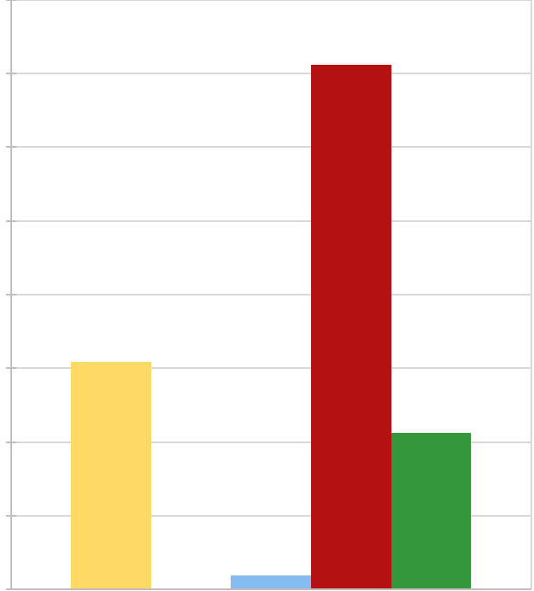
Results: Land Classification and Time Series
2000
Land Classes
Shallow Water
Deep Water
Vegetation
Urban
Barren
2016
1.6
1.4
1.2
1.0
0.8
0.6
0.4
0.2
0.0
2022
Surface Area (${\text{km}}^{2}$)
Kulhudhuffushi
500 meters
N
2022
Notes:
Here we can see the classified map of Kulhudhuffushi and the surface area of each of the classes from 2022. As we mentioned, you can see the area in the north changed from being entirely forest to now having some urban land because of the airport construction. The shift is reflected in the time series analysis graph.
Image derived from Sentinel 2

Slide 26
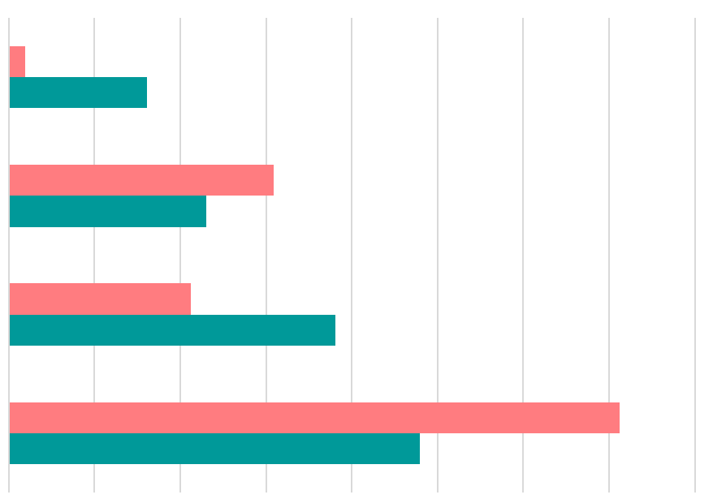
Results: Comparing Land Classes for Kulhudhuffushi
-88%
Shallow Water
2022
2000
34%
Barren
-44%
Vegetation
49%
Urban
0
0.2
0.4
0.6
0.8
1.0
1.2
1.4
1.6
Surface Area (${\text{km}}^{2}$)
Notes:
This chart compares the change in shallow water, barren, vegetation, and urban land cover between 2000 and 2022. Shallow water appeared to show the largest decrease from 2000. Vegetated areas also revealed a decrease by 44%. Meanwhile, both barren and urban land cover increase by 34% and 49%, respectively.

Slide 27
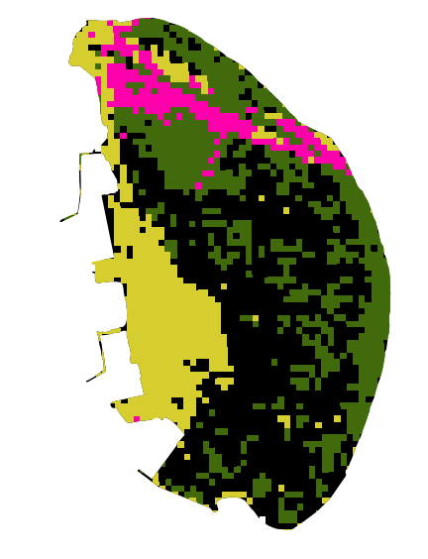
Results:
Land Use Classification
Change detection
Kulhudhuffushi 2017-2019
Change detection can be used between years to show the difference between land classes over a given period.
Land Classes
N
Forest
500 meters
Barren
In the figure shown on the right, the change shown can map the construction of the Kulhudhuffushi Airport, which was built in 2019.
Change
Other
Change detection from Forest to Barren
Image credits: Photo by Shifaaz shamoon on Unsplash
Notes:
This is a change detection map that highlights the change between two classes from differing years. In this example the green represent the forest pixels from 2017 and the yellow represents the barren pixels from 2019. We can see from the highlighted pink, the overlap of the two classes where one changed into the other.
Image derived from Landsat 8.
------------------------------Image Information Below ------------------------------
•Image Credit: Photo by Shifaaz shamoon on Unsplash
•Image Source: https://unsplash.com/photos/AAFH_AADpRg (CC0 license)

Slide 28
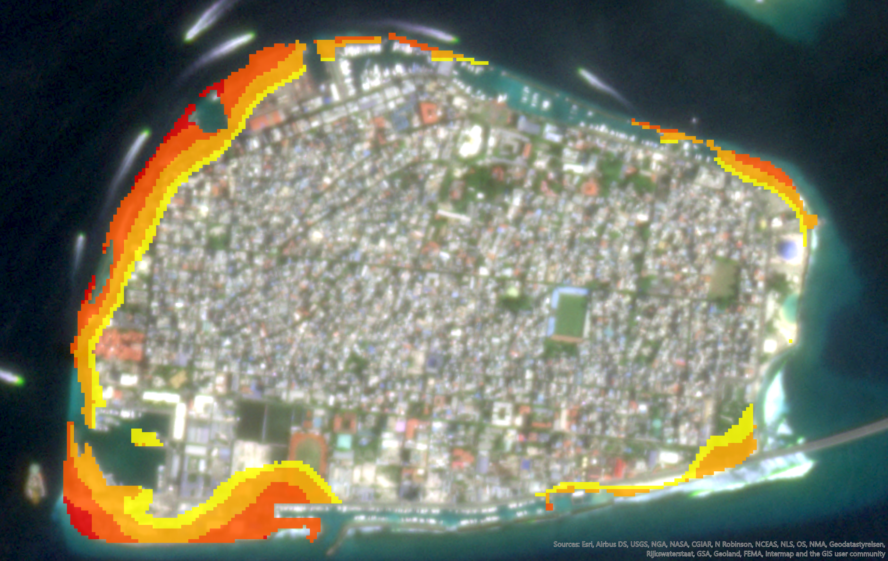
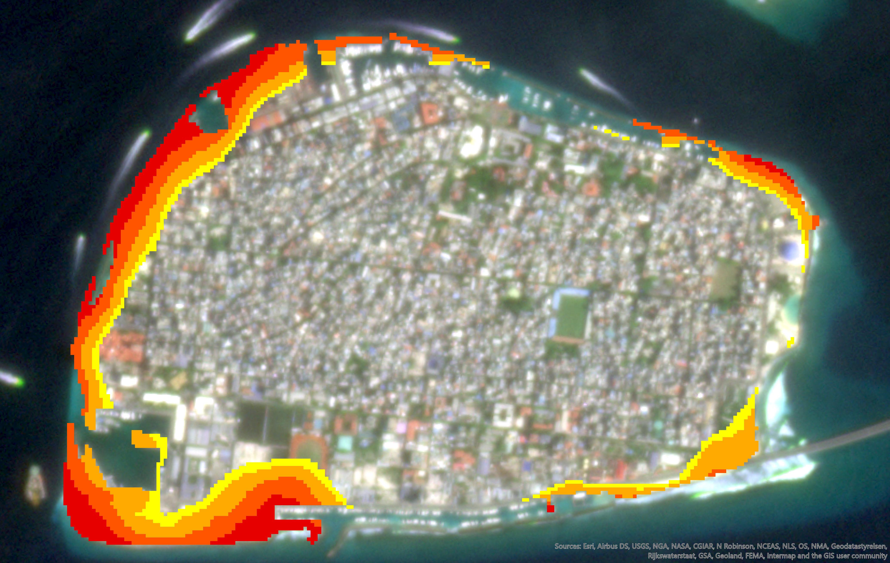
Results – Sea Level Projection for Malé
SSP1-2.6 (0.49m SLR)
SSP5-8.5 (0.86m SLR)
Probability of Coastal Flooding
300 m
N
≤ 12.5%
≤ 37.5%
≤ 62.5%
≤ 87.5%
Notes:
We were able to create sea level rise inundation maps of each of our study islands to show the probability of each part of an island flooding as a result of sea level rise. Here we can see the capital, Malé, under two different shared socioeconomic pathways and associated levels of sea level rise. The image on the left shows the regions of Malé that are likely to flood with 0.49 meters of sea level rise, with each color representing a different probability of flooding. On the right you can see the flood inundation map of Malé with 0.86 meters of sea level rise. As one may expect, the areas further inland have a lower probability of flooding. Additionally, the coastlines do not all flood equally, and those at higher elevations tend to have a lower probability of flooding with sea level rise.

Slide 29
Results – Mapping Flood Risk for Urban Areas in Thuraakunu
35
32.9 ${\text{km}}^{2}$
9.8 ${\text{km}}^{2}$
30
25
15.8 ${\text{km}}^{2}$
20
Urban Area (${\text{km}}^{2}$)
15
10
8.8 ${\text{km}}^{2}$
Basemap: 2022 PlanetScope Imagery
5
0
≤ 12.5%
≤ 37.5%
≤ 62.5%
≤ 87.5%
Probability of Flooding with 0.86m SLR
Probability of Coastal Flooding with 0.86m SLR
250 meters
N
≤ 12.5%
≤ 37.5%
≤ 62.5%
≤ 87.5%
Image credits: Includes copyrighted material of Planet Labs PBC. All rights reserved.
Notes:
Once we had flood inundation data for each of the islands, we were able to overlay that data with our land use maps to see how each individual land class would be affected under each of the different sea level rise scenarios. Here we see Thuraakunu, where we classified the urban land on the island and plotted the probability of each urban pixel being affected by sea level rise. From that data, we were able to extract the amount of land, in square kilometers, that is at risk of flooding based on the sea level rise projection data, as seen in the graph on the right.
For left image:
Basemap: PlanetScope Imagery
Top Layer: Model derived from SRTM and Sentinel-2
© Planet Labs PBC {2022}. All rights reserved.

Slide 30
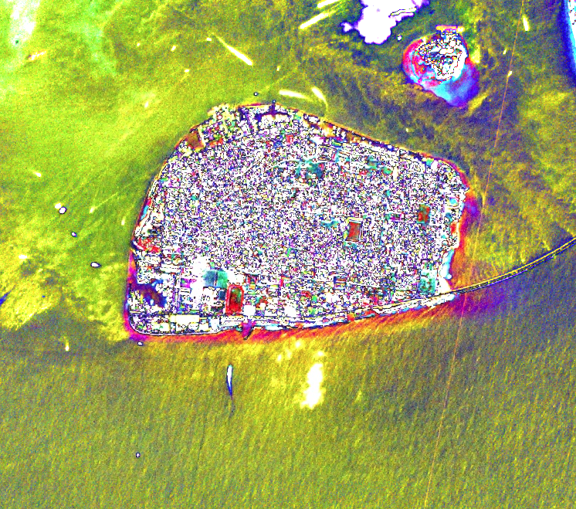
Conclusions
Supervised land classification can be an efficient, accurate alternative to manual island classifications
Bathtub modeling can be an effective way to screen and plan for future coastal flooding risks
Image credits: Includes copyrighted material of Planet Labs PBC. All rights reserved.
Notes:
In conclusion, we found that it was possible to conduct supervised land classifications in small island nations, such as the Maldives, with 30 meter resolution imagery and higher resolution imagery. We found some limitations in data availability; however, the process works for most of our study period and provides an efficient alternative to manually classifying the land on each island. Additionally, we found that bathtub modeling can be an effective way to plan for future coastal flooding risks, and this model can be enhanced with more elevation data and sea level rise projection data. These tools will help the Republic of Maldives use remote sensing for their current and future environmental monitoring projects.
Image derived from PlanetScope Imagery.
Includes copyrighted material of Planet Labs PBC. All rights reserved.

Slide 31
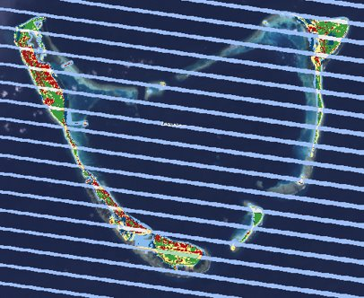
Errors and Uncertainties:
Land Classification
Limited Earth Observation data
Low resolution of satellite imagery prior to 2016
Lack of in situ data for validation
Notes:
Many of the errors and uncertainties associated with our land classification were based on a limited amount of satellite data of the Maldives. We originally planned to conduct land classification studies going back to 1984 using Landsat 5; however, there was not sufficient imagery of the region to train and apply a classification algorithm. Additionally, many of the datasets that we had were missing years of data or fully composed of cloudy imagery. For example, there is no Sentinel-2 data for certain islands in the Maldives between 2017 and 2020, which results in a large gap in our analyses. Furthermore, all of the imagery that we had of the Maldives prior to 2016 is 30 meter resolution, which makes for coarse land classification. Lastly, we did not have any up-to-date in situ data for the Maldives to compare our land classifications to, which made it difficult to check for accuracy beyond what we could do using satellite data.

Slide 32
Errors and Uncertainties:
Sea Level Rise
Vertical bias in DEM products
Low spatial resolution of DEMs (30m)
Doesn’t account for hydrodynamics (i.e tides)
Inherent uncertainty in SLR projection scenarios
Notes:
The sea level rise analysis involved many uncertainties, as it is difficult to be precise when making predictions about future climate pathways. With these climate predictions, there is the inherent uncertainty of whether or not the sea level rise will match the value predicted by the sea level rise tool. Additionally, the data points used in our model of the Maldives came from just two islands, as those were the only locations in the country where there was projection data. Another uncertainty that we faced was the low spatial resolution of the DEMs that were available for the region. The highest resolution DEM that we had available for the region was 30 meters which does not allow for much precision, especially when dealing with coasts of small islands. Additionally, the DEM data that we had came from the SRTM in 2000, which means it does not account for the new reclaimed land areas in the Maldives and thus we did not have elevation data for those reclaimed areas. Furthermore, the DEM data that we did have had some vertical biases from trees and buildings, which we attempted to resolve by using groundtruthing points, but ultimately they still affected the elevation levels that we were doing calculations with. Lastly, the bathtub model that we were using for creating projected flood inundation maps is a relatively simple model that does not account for hydrodynamics and other factors—such as the effect of climate change on tidal patterns and how reef destruction affects coastal erosion.
Image Source: Microsoft Icons

Slide 33
Future Work
Classify subclasses—such as mangrove wetlands—using additional satellite data
Compare historic rates of land reclamation and urbanization to projected rates of sea level rise
Incorporate additional hazards, such as storm surge and groundwater intrusion
Predict future shoreline changes using historical patterns
Notes:
Future work may include enhancing our land classifications by classifying subclasses, such as mangroves, and incorporating additional satellite data [may want to expand what type of satellite data]. It would also be interesting to compare historic rates of land reclamation and urbanization to projected rates of sea level rise. Further incorporation of additional hazards may include storm surge and groundwater intrusion. Lastly, historical patterns may be utilized to predict future shoreline changes.
------------------------------Image Information Below ------------------------------
Image Credit: Microsoft Icons

Slide 34
Lisa Tanh (NASA Ames Research Center)
Dr. Juan Torres-Pérez (NASA Ames Research Center)
Britnay Beaudry (NASA Ames Research Center)
Partners
Maldives Ministry of Environment, Climate Change and Technology
U.S. Department of State, Bureau of South and Central Asian Affairs, Office of Bangladesh, Nepal, Sri Lanka, Maldives, and Bhutan
USAID, Maldives Office
Past Contributors
Aidan Harvey, Daniel Lopez, Derek Chin, Mitch Porter
Data provided by Dr. Scott Kulp, Climate Central.
This material contains modified Copernicus Sentinel data (2016-2022), processed by ESA.
This work utilized data made available through the NASA Commercial Smallsat Data Acquisition (CSDA) program.
Notes:
This project would not have been possible without the help from Lisa Tanh, Dr. Juan Torres-Pérez, and Britnay Beaudry throughout the course of the term.
We would also like to acknowledge our partners including the
Maldives Ministry of Environment, Climate Change and Technology
U.S. Department of State, Bureau of South and Central Asian Affairs, Office of Bangladesh, Nepal, Sri Lanka, Maldives, and Bhutan
USAID, Maldives Office

