Slide 1
Southern Idaho
Health & Air Quality II
Evaluating Atmospheric Mixing Height Estimations in the Western United States
Dean Berkowitz, Jukes Liu, Lauren Mock, Chris Wright
Idaho - Pocatello

Slide 2
Motivations & Community Concerns
Wildfires are increasing in frequency and intensity.
Smoke pollution harms human health.
Prescribed burns are often vetoed due to potential smoke hazards.
There are inconsistencies in smoke forecasting across public agencies.
GOES-17 satellite view of smoke plumes from the 2020 California & Oregon wildfires
Icon Credit: Microsoft PowerPoint ClipArt
Image Credit: National Weather Service
Notes:
Over the past 60 years, wildfire frequency and intensity in the western United States have continually increased, with 2020 breaking historic records for both number of fires and total acreage burned. Smoke pollution from these fires detrimentally impacts human health in nearby areas as well as locations downwind of fire events, as combusting fuels generate harmful gases such as ozone precursors and fine particulate matter like PM2.5, which can travel deep into the lungs and bloodstream.
In order to reduce wildfire intensity, land managers conduct what are known as prescribed burns, which are intentionally set fires that clear excess fuel build-up like brush and debris from forests. While the benefit of prescribed burns for fire management is well understood, they are often vetoed due to potential downwind smoke hazards. Currently, there is no standardized method across public agencies such as the National Weather Service to predict the movement and dispersal of wildfire smoke plumes, leading to forecasting inaccuracies and confusion. This is critical knowledge for warning the public of air quality hazards as well as informing prescribed burn decisions.
------------------------------Image Information Below ------------------------------
•Image Credit: National Weather Service
•Image Source: https://commons.wikimedia.org/wiki/File:GOES17_geocolor_Western_US_2020-09-09_1100AM.jpg (Public Domain CC0)
Icon Credit: Microsoft PowerPoint ClipArt

Slide 3
Fires & Mixing Height
Mixing height estimations inform:
High Mixing Height
Low Mixing Height
Air quality forecasts
Prescribed burn decisions
Estimation Methods:
Balloon soundings
Mixing height acts as a lid on smoke pollution.
Models
Earth observations
Icon Credit: Microsoft PowerPoint ClipArt
Notes:
0.5 min
Mixing height is one important factor in predicting smoke dispersal. It's determined by atmospheric temperature and acts as a lid on smoke and other aerosols. This means that lower mixing heights often trap pollutants closer to the ground, leading to poor air quality. These estimations are important in determining air quality at the surface, and helping land managers decide whether or not it is safe to conduct a prescribed burn.
The mixing height over a given location at a given time can be estimated with in-situ measurements in the atmosphere, models with meteorological inputs, or satellite observations.
The NWS Fire Weather Program has not determined a national standard for calculating mixing heights because there is little to no validation of the accuracy of different mixing height estimation models. Lack of research in this area results in inconsistencies in smoke forecasting between agencies and across Western US state boundaries.
------------------------------Image Information Below ------------------------------
•Image Source: Lauren Mock (DEVELOPer)
•Flame Credit: Microsoft PowerPoint Icons

Slide 4
Project Partners
NOAA's National Weather Service Fire Weather Program
Bureau of Land Management National Interagency Fire Center
National Park Service Fire Management Program Center
Notes:
We worked with partners in the NWS, BLM and NPS. The NWS is looking to understand systematic bias in mixing height estimation. The BLM and NPS are looking for more insight into which mixing height estimation method is most accurate in order to authorize prescribed burns, which are deliberate fires that play a vital in reducing the fuel load of wildfires.

Slide 5
Objectives
Determine mixing heights over wildfire smoke plumes in the Western US utilizing NASA Earth Observations
Compare with mixing heights forecasted by the National Weather Service
Icon Credit: ProSymbols and Creative Stall from The Noun Project
Notes:
0.5 min
Our two main objectives for the project were to utilize NASA Earth Observations to calculate the height of the mixing layer over wildfire smoke plumes over the western US and to compare those to and validate the mixing heights forecasted by the National Weather Service. We pulled the mixing heights from the forecasts where available on the Iowa State National Weather Service text product archive.
Icon citations:
- Satellite by ProSymbols from The Noun Project (https://thenounproject.com/term/satellite/)
- Statistics by Creative Stall from The Noun Project (https://thenounproject.com/term/statistics/)

Slide 6
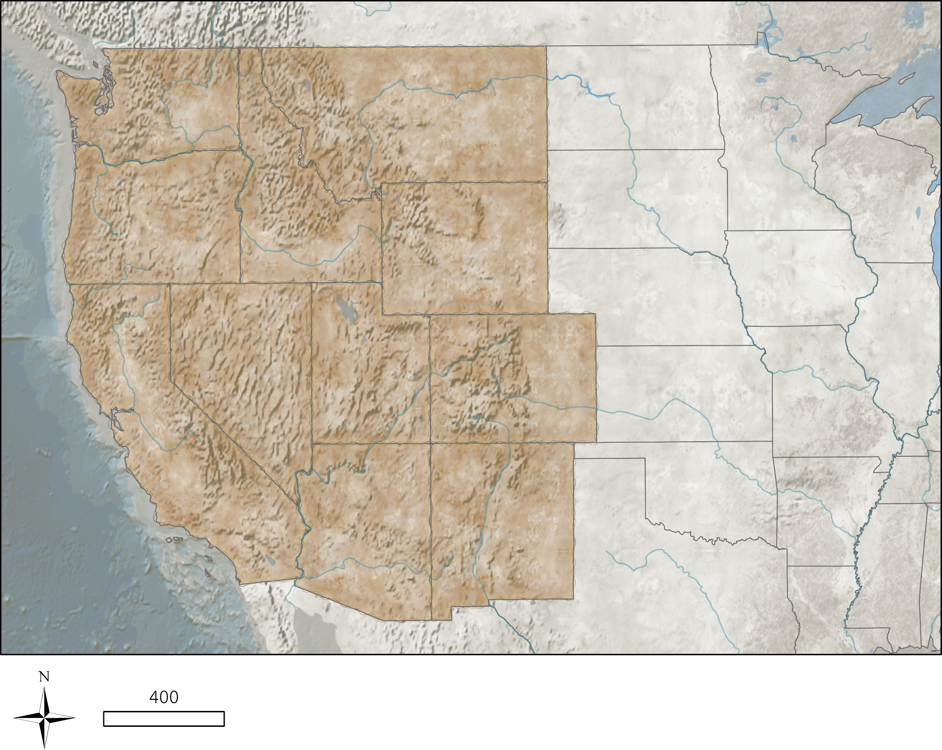
Study Area & Time Period
WA
MT
Western United States
2006-2020
July–September
OR
ID
WY
NV
UT
CO
CA
AZ
NM
N
400
Kilometers
Notes:
Originally this project focused on wildfire events in Southern Idaho, however our team expanded the study area to the entire western United States in order to increase the likelihood of CALIPSO transects intersecting smoke plumes. Upscaling the sample size also enabled us to conduct more rigorous statistical validations of our analyses. We mainly focused on August and September but expanded the monthly scope when wildfire data was limited.

Slide 7
NASA Satellites & Sensors
CALIPSO CALIOP
Aqua MODIS
Vertical and horizontal distribution of cloud and aerosol layers
Terra MODIS
Active fire boundary and smoke imagery
Suomi NPP VIIRS
Vertical water vapor gradient and smoke imagery
Historic fire approximation
Image Credit: NASA
Notes:
We used CALIPSO LiDAR vertical feature masks data to determine land, aerosol and cloud features. Terra MODIS , Aqua MODIS and VIIRS were used to identify fire boundary, smoke plume trajectory, and CALIPSO flight path. Terra MODIS was also used to determine mixing height via water vapor gradient shifts.
Image Credit: NASA

Slide 8
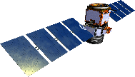
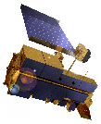
Approach
Identify Plumes
Data Acquisition
NWS Forecasts
AWIPS Model Output
Balloon Soundings
CALIOP
Aerosol Layer
Processing
Forecaster Intervention
MODIS
Water Vapor
Intercomparison
Statistical Evaluation of Systematic Bias
CALIPSO CIMSS
Image Credit: NASA
Notes:
1) We identified large plumes from 2006-2020 in the western US using EOS Worldview.
2) We used CALIOP and MODIS observations transecting those plumes to calculate mixing height.
3) We compared data to several other mixing height estimations:
- Forecaster estimations based on Stull models and balloon soundings
- CALIPSO CIMSS mixing height estimations using alternative CALIPSO products (level 1).

Slide 9
Mixing Heights from CALIPSO CALIOP
A-SMOKRE
L2 Vertical Feature Masks
Feature Classification Flags
CALIPSO-CIMSS
L1B Calibrated lidar backscatter
Wavelet covariance transform
Height of smoke aerosols
Height of Surface Attached Aerosol Layer (SAAL)
Image credit: NASA
Notes:
1 min
For our validation, we use two datasets derived from the CALIPSO CALIOP lidar instrument. The first dataset is produced by our DEVELOP team's tool A-SMOKRE, which has been the main focus of our work. The automated tool uses the Level-2 Vertical Feature Masks from CALIPSO, which contains feature classification flags including aerosol, cloud, etc. And aerosol type, such as smoke, etc. Our A-SMOKRE tool processes the Feature Classification Flags from this data product to determine the maximum height of the aerosols, which is assumed to be the maximum height of the mixing layer.
In addition, there is a sparser dataset produced by the University of Wisconsin-Madison's Cooperative Institute for Meteorological Satellite Studies. They analyzed certain CALIPSO Level-1B calibrated backscatter transects using a wavelet covariance transform, which they used to identify the height of the Surface Attached Aersool Layer (SAAL), a proxy for the planetary boundary layer height or mixing layer height. Both of these datasets were used in our comparison and validation.
Image credit: NASA

Slide 10
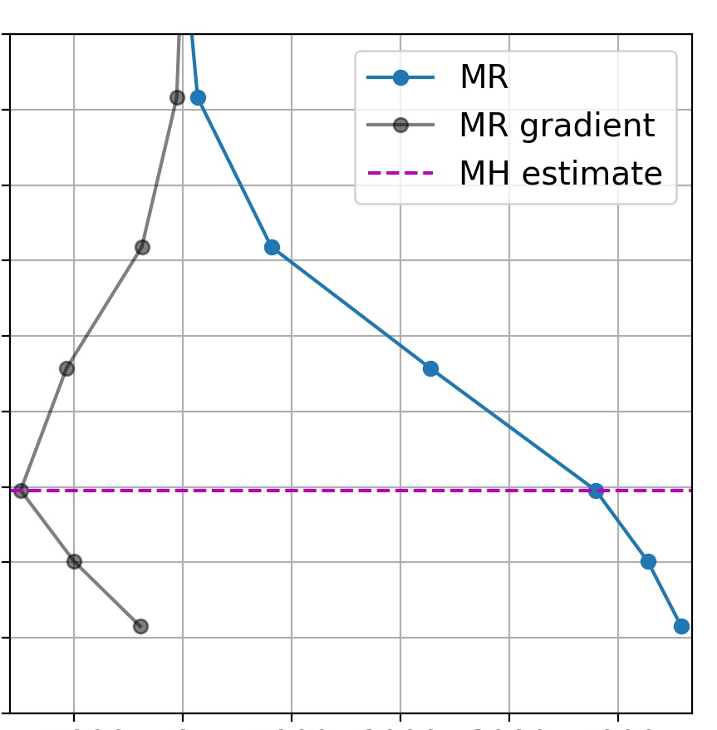
Mixing Heights from MODIS Profiles
Followed radiosonde-validated method from Feng et al. (2015)
MR gradient (g/kg/km)
Advantages
Spatial coverage
Temporal resolution
Limitations
Cannot resolve below 1km
Temporal coverage
Vertical resolution
Missing values
10
9
8
7
6
5
4
3
2
1
MR
MR gradient
MH estimate
Altitude (km)
-1 0 1 2 3 4
MR (g/kg)
MODIS atmospheric profile over Elk Complex fire on Aug. 13, 2013.
Notes:
1.5 min
We explored using the MODIS vertical moisture profiles to determine mixing heights using a method from a 2015 paper by Feng and others. They used the gradient in the water vapor mixing ratio to identify where there was an abrupt change in mixing ratio, which coincided with mixing heights they determined using radiosonde data. Our team developed an automated script to pull these vertical profiles that overlap our smoke events of interest, visualize the water vapor mixing ratio (shown here in blue), calculate the gradient in the mixing ratio (shown here in grey), and automatically identify the point of abrupt change, producing a mixing height estimate.
Given that our analysis for estimating mixing height from the water vapor profile only relies on the relative change of water vapor mixing ratios, we omitted the x-axis units for clarity and instead titled it “Water Vapor Coordinate”, with the x-axis units scaled to represent relative changes. By “water vapor coordinate,” we are referring to how the MODIS atmospheric profile demonstrates relative changes in the mixing ratio which we are using to estimate mixing height. So, this unitless coordinate merely represents the location in the water vapor profile gradient where this inflection point occurs that indicates the mixing height layer
We investigate this method due to some of the advantages of using MODIS data compared to CALIPSO. With gridded data from MODIS, we have greater spatial coverage compared to the CALIPSO transects. In addition, there are multiple overlapping MODIS scenes per day, increasing our temporal resolution. And the vertical profiles cover from 2000 – present day with no delay in data release, so the increased temporal coverage is also an advantage. On the other hand, with these vertical profiles resolved at 20 discrete pressure levels, we are limited to the vertical resolution of the profile. There are only several data points in the lower portion of the atmosphere where mixing heights would exist. These profiles do not extend below 1km above ground level. And there are sometimes missing values in the profile and entire grid cells.
Despite some of these limitations, the sheer amount of data available and coverage from MODIS made this an attractive option, so we compare the mixing heights from this method to our CALIPSO-derived mixing heights and the NWS forecasts.

Slide 11
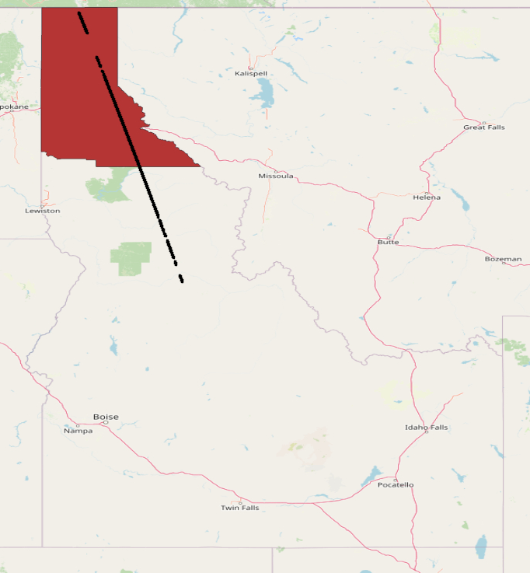
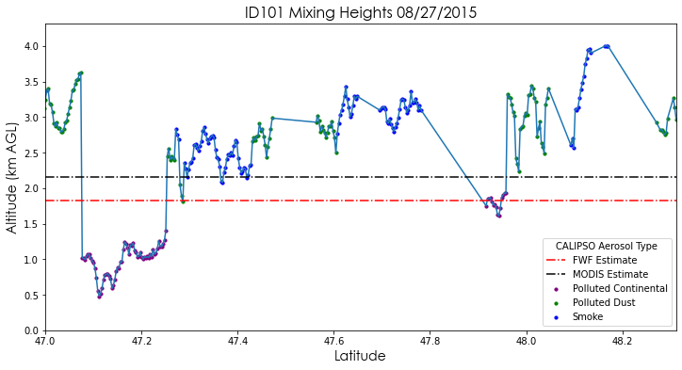
Case Study
Mixing heights on Aug. 27, 2015 in fire weather zone ID101
A'
A
A'
4.0
3.5
3.0
2.5
2.0
1.5
1.0
0.5
0.0
ID101
Mixing height (km)
A
Idaho
NWS Fire Weather Forecast
MODIS
A-SMOKRE: Polluted Continental
A-SMOKRE: Polluted Dust
A-SMOKRE: Smoke
47 47.2 47.4 47.6 47.8 48.0 48.2
Latitude along CALIPSO transect
Notes:
1 min
Case study for Fire Weather Zone (FWZ) ID101 in Northern Idaho for August 27,2015 using 3 different data sources to estimate MH (2 remote sensed datasets to evaluate NWS Fire Weather Forecast)
Large smoke plume event with fires burning in Idaho, across the Pacific Northwest and BC
The NWS Fire Weather Forecast (FWF) underestimates mixing height compared to CALIPSO CALIOP and MODIS, which was indicated in the literature (Fearon et al. 2015)
True mixing height for this case study is hypothesized to lie somewhere between the NWS value and the upper bound of CALIPSO [1.5km - 4km]
Plot is symbolized by VFM aerosol subtype.
Polluted Continental subtype performed poorly and is not necessarily an accurate indicator of mixing height.
Note that despite the lines connecting A-SMOKRE points, there are data gaps between A-SMOKRE points.

Slide 12
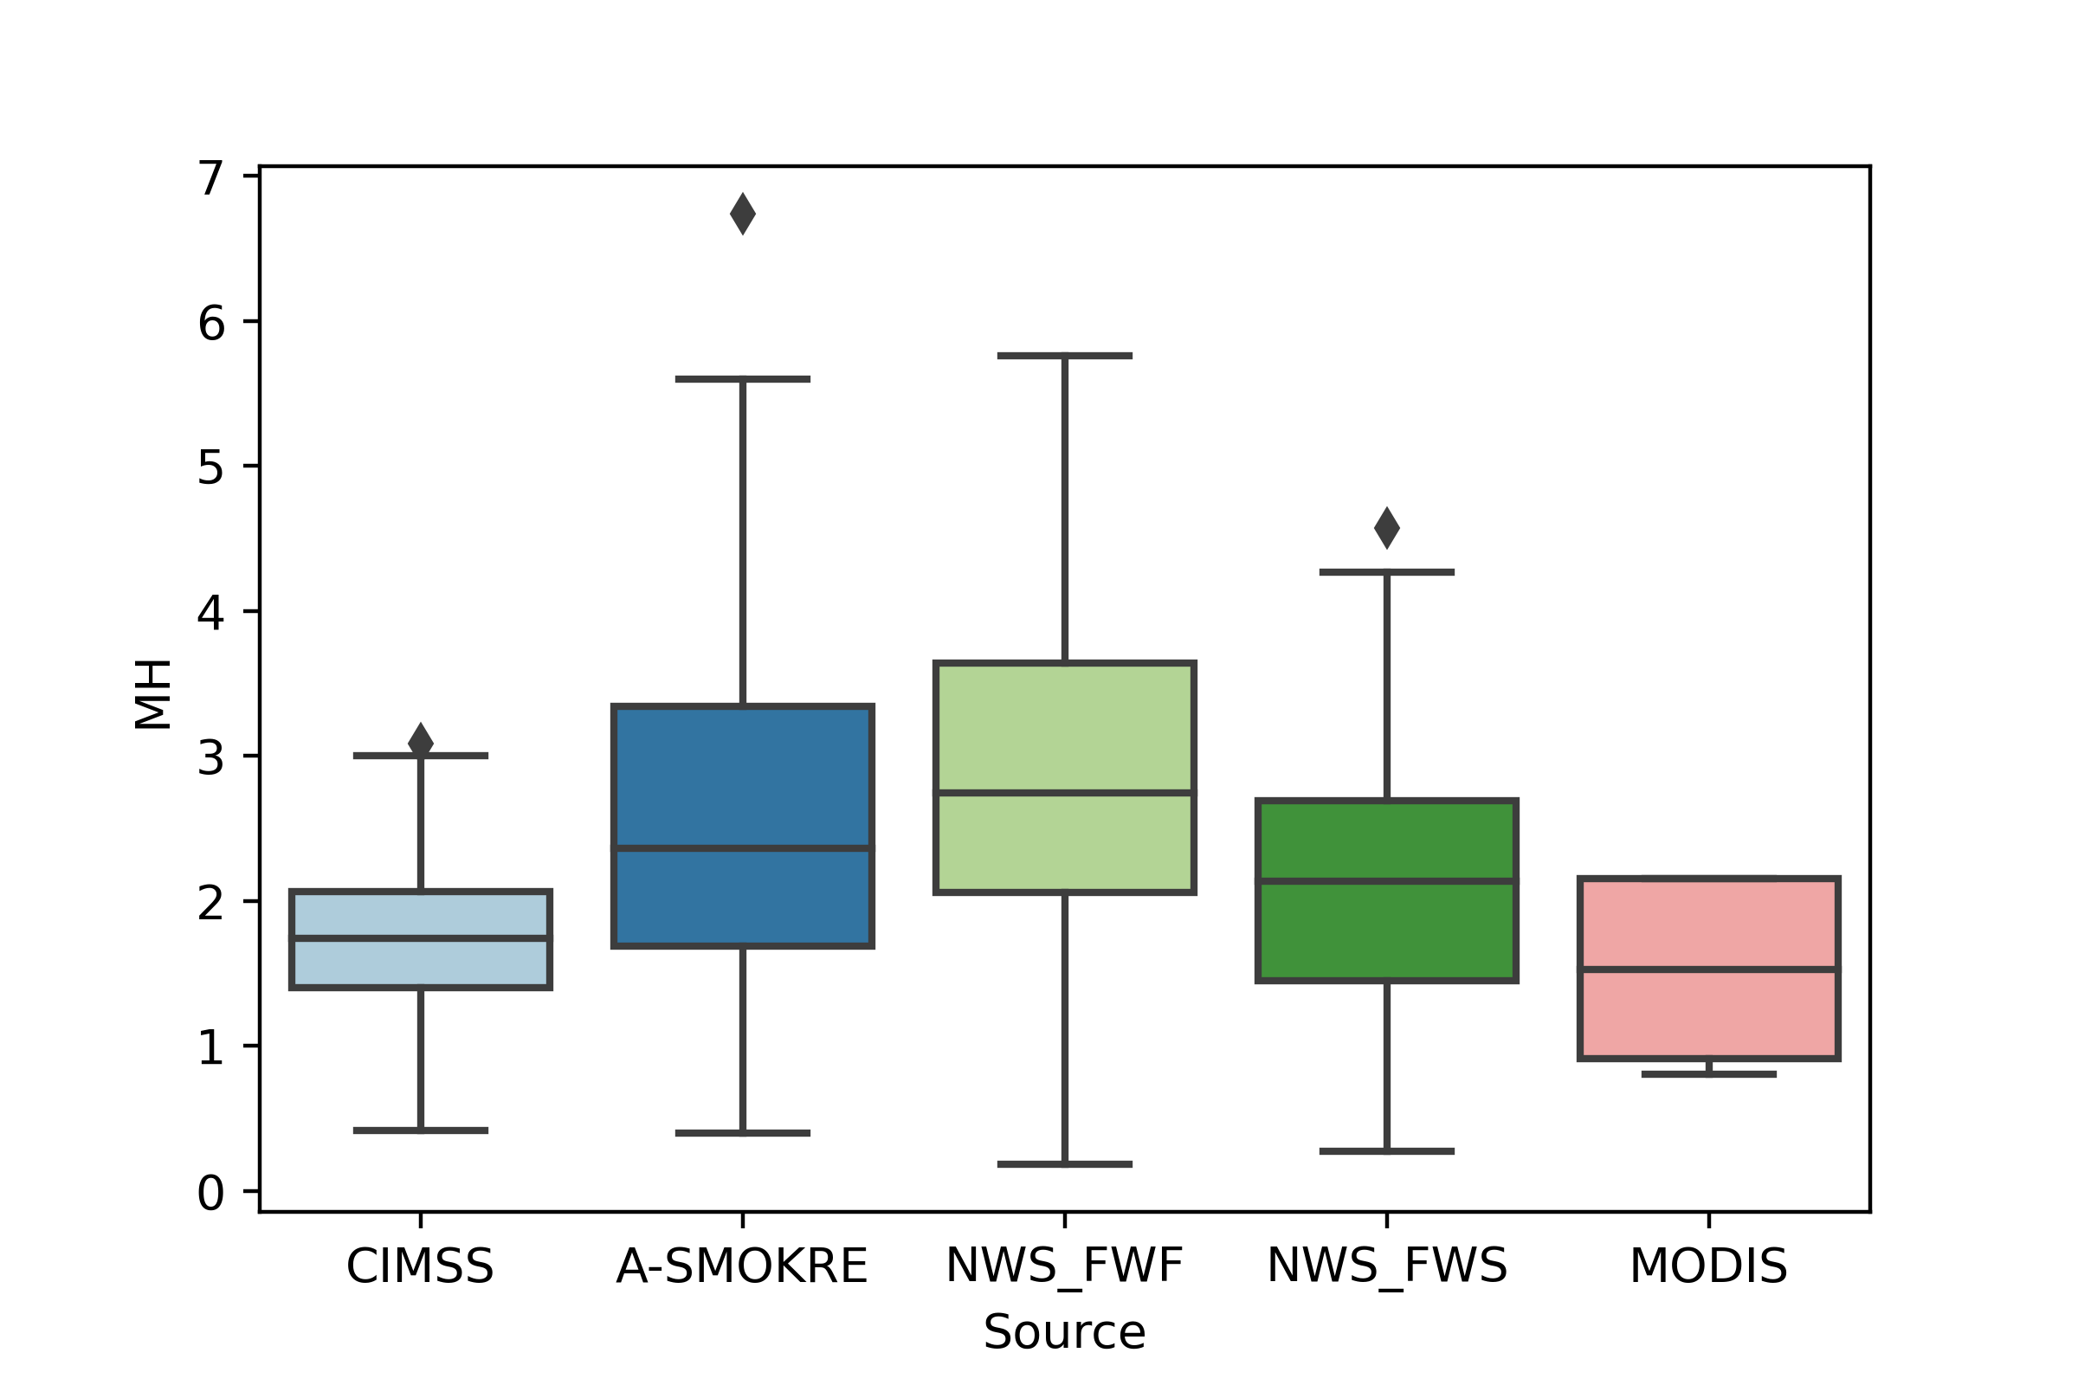
Mixing Heights by Data Source
7
N = 387
N = 1186
6
5
N = 156
Mixing Height (km)
4
N = 913
3
N = 612
2
1
0
CALIPSO (CIMSS)
CALIPSO
(A-SMOKRE)
NWS Fire Weather Forecast
NWS Spot Forecast
MODIS
Data Source
Notes:
1 min
This box plot summarizes the distribution of mixing height estimations that were collected with each method. The boxes show the 25th quartile, median, and 75th quartile. The upper whisker extends to the last point within the 75th quartile + (1.5 * IQR), and the lower whisker extends to the last point within the 25th quartile - (1.5 * IQR). IQR (inter-quartile range) is the range within the box. Any points that do not fall within this range are considered outliers and are represented as diamonds.
- There is a clear difference in the distributions of the two CALIPSO datasets. CIMSS has a much narrower spread than A-SMOKRE, and also has no predicted mixing heights above 3 km.
- The NWS fire weather forecasts seem to be higher on average than the NWS spot forecasts.
- MODIS has very little spread due to its poor vertical resolution, and its values are also low relative to the other methods.

Slide 13
Comparison to NWS Forecasts
Fire Weather Forecasts
Spot Forecasts
N =145
N = 48
N = 131
6
5
6
5
5
4
4
4
3
NWS Forecasts (km)
3
3
2
2
2
1
1
1
0
0
0
0 1 2 3 4 5 6
0 1 2 3 4 5
0 1 2 3 4 5 6
A-SMOKRE Mixing Heights (km)
CALIPSO-CIMSS Mixing Heights (km)
MODIS Mixing Heights (km)
Notes:
1 min
MODIS strategy only calculated lower mixing heights.
NWS forecasts actually overestimate mixing heights based on the CIMSS dataset and MODIS dataset.
It's tough to tell what the relationship is between NWS forecasts and the A-SMOKRE results, to be addressed in a few slides.

Slide 14
Comparison to CALIPSO
N = 103
N = 65
N = 159
6
7
5
5
6
4
5
4
3
4
A-SMOKRE MH (km)
A-SMOKRE MH (km)
CALIPSO-CIMSS MH (km)
3
3
2
2
2
1
1
1
0
0
0
0 1 2 3 4 5 6
0 2 4 6
0 1 2 3 4 5
CALIPSO-CIMSS Mixing Heights (km)
MODIS Mixing Heights (km)
MODIS Mixing Heights (km)
Aerosol Type:
Smoke
Polluted Dust
Continental
Undetermined
Notes:
1 min
It seems as if the A-SMOKRE mixing height is further from the CIMSS estimates when the dominant aerosol type is smoke. This would indicate one of two things, that the VFM smoke aerosol classifications are not very accurate, OR the CIMSS dataset only accurately predicts mixing height for non-smoke aerosols.
CIMSS and MODIS data seem to predict lower mixing heights in general compared to NWS and ASMOKRE.

Slide 15
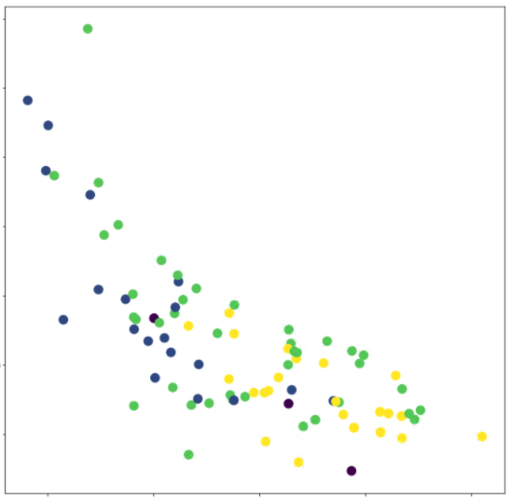
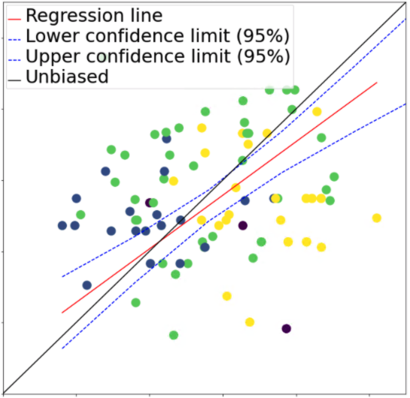
Comparison to NWS Forecasts
N = 96
N = 93
ODR line
Lower confidence limit (95%)
Upper confidence limit (95%)
Unbiased
200
200
150
100
1
2
3
4
5
FWF Mixing Heights (km)
FWF Relative Error (% above A-SMOKRE)
50
0
Slope: 0.75
-50
Regression SE: 0.96 km
1
2
3
4
5
1
2
3
4
5
Aerosol Type:
A-SMOKRE Mixing Heights (km)
A-SMOKRE Mixing Heights (km)
Smoke
Polluted Dust
Continental
Undetermined

Slide 16
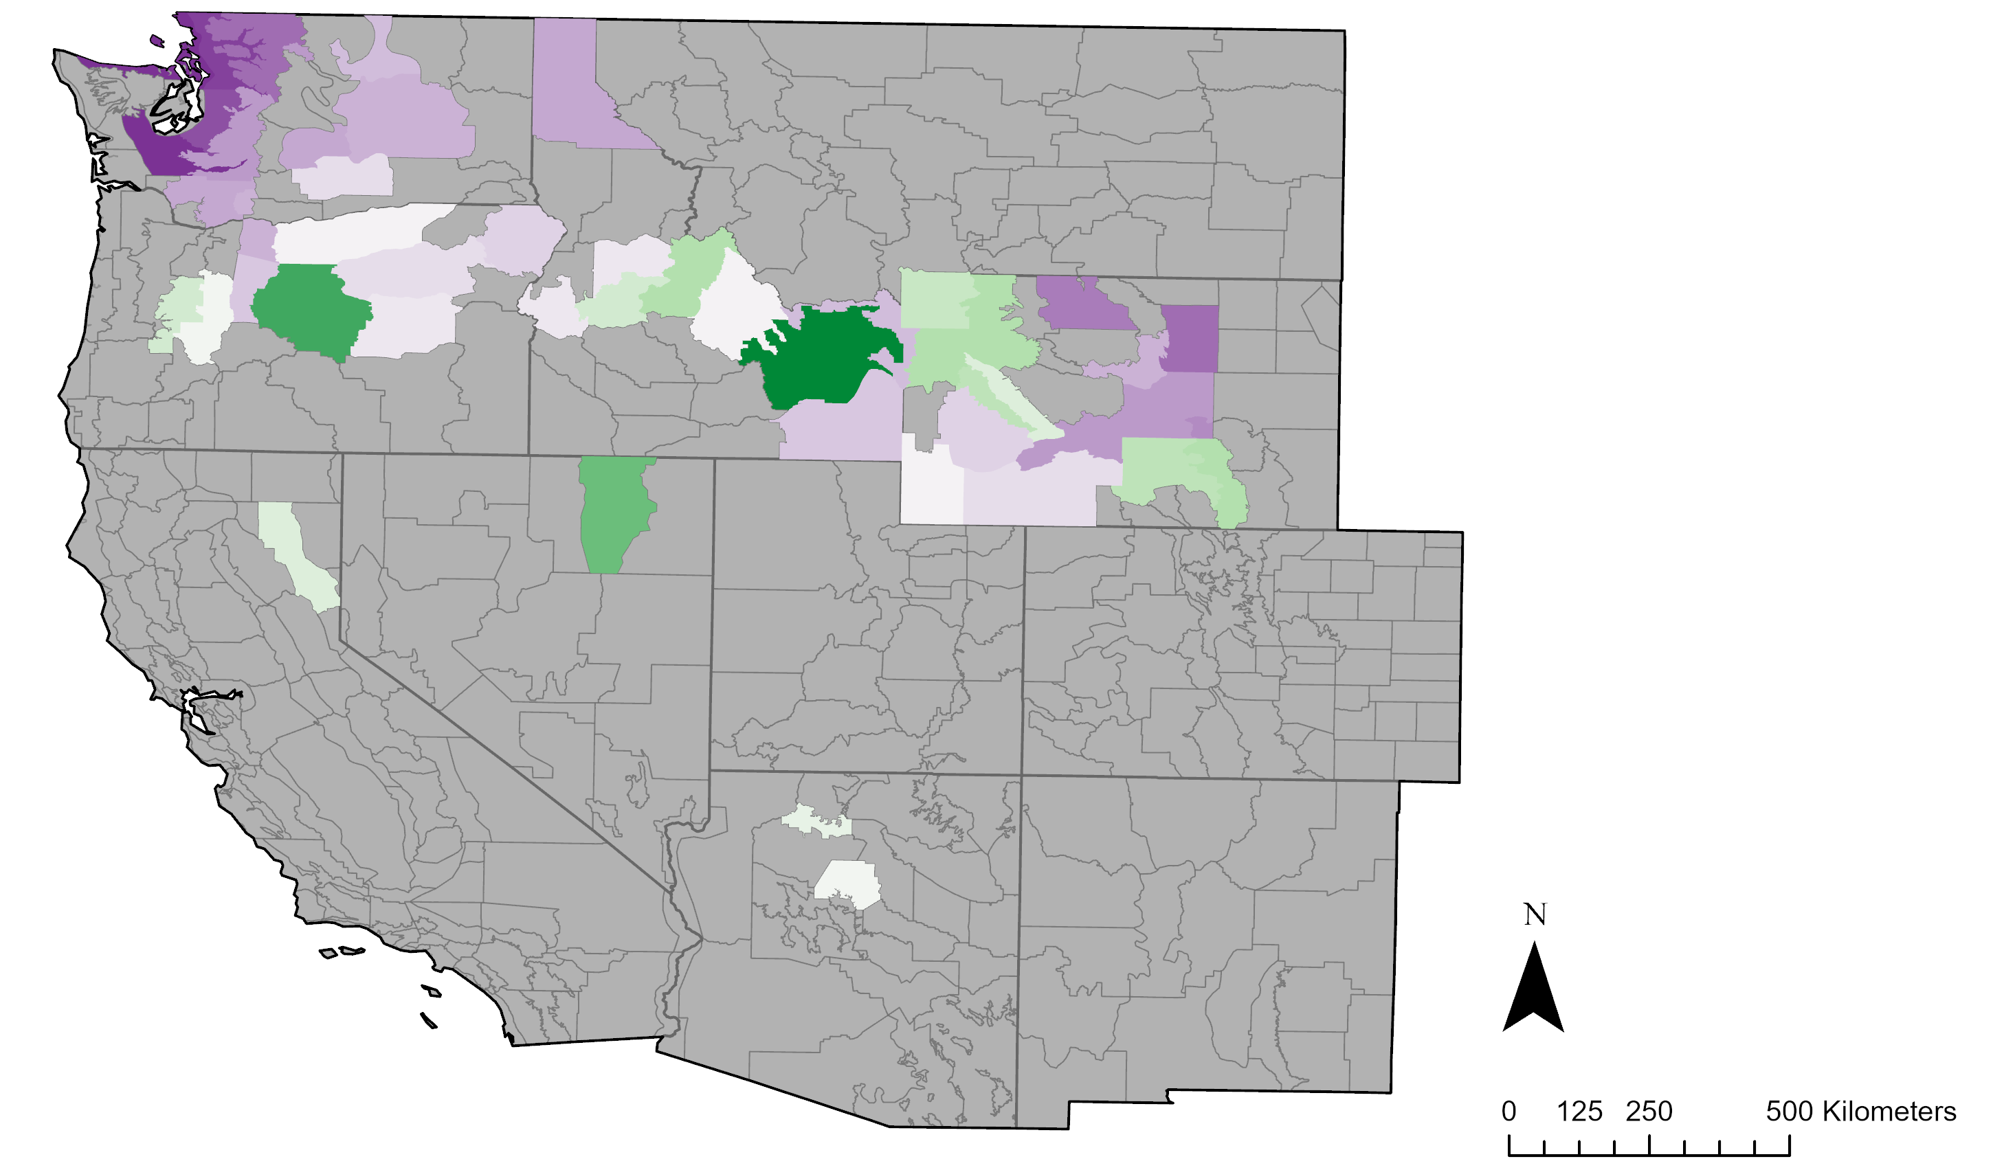
FWF Relative Error Across Study Area
FWF Relative Error (% above A-SMOKRE)
-85 0 141
N
0 125 250 500 kilometers
N
Notes:
FWF Relative Erro mapped Across Study Area, with CALIOP MHs computed as zonal means across FWZ
We have data for 51 Fire Weather Zones, out of the 411 across the Study Area (just 12% coverage)
-due to the fact that not every state calculates MH for FWZ, inability to scrape all spot forecasts, and the fact that CALIPSO transects with 16day temporal res make it unlikely to intersect smoke plumes across every FWZ
Purple indicated underestimates compared to CALIPSO CALIOP (A-SMOKRE output), Green over estimates, white neutral (similar estimates)
Wide range of variation, from –85% to +141%
Apparent clustering of underestimates in Washington, Central Wyoming
"" overestimates in NW wyoming, central ID
Unclear whether this is a general trend that holds true across space, and what the reason could be

Slide 17
Preliminary Conclusions
NWS fire weather forecasts generally align with A-SMOKRE outputs
MODIS vertical profile resolutions are too coarse for meaningful comparison
CIMSS mixing heights are different from A-SMOKRE outputs
NWS fire weather forecasts are different from NWS spot forecasts
Notes:
1 min
1. NWS Fire Weather Forecasts generally align with A-SMOKRE for MH below 75km
1a. Lower mixing height values are associated with much larger discrepancies between the two data sources (between 500% to 1,500% relative error)
2. The poor vertical resolution of MODIS makes it difficult to compare with other methods.
3. CIMSS mixing heights are different from A-SMOKRE outputs.
4. NWS fire weather forecasts are different from NWS spot forecasts.

Slide 18
Future Work
Identify additional wildfire smoke events for validation
Explore alternative satellite products for comparison
Investigate variation between NWS FWF and FWS
Icon Credit: Microsoft PowerPoint ClipArt
Icon Credit: ProSymbols from The Noun Project
Notes:
0.5 min
FWS - Fire Weather Spot Forecast
Expand the time period to include the entire wildfire season each year.
Future directions for this work include identifying additional wildfire smoke events for validation and exploring how the MODIS strategy for deriving mixing heights from water vapor profiles work in dry versus wet climates. In addition, one could expand the analysis to investigate how mixing height changes and influences smoke dispersion using nighttime data.
Icon credits:
Microsoft PowerPoint ClipArt
Satellite by ProSymbols from The Noun Project
Source: (https://thenounproject.com/term/satellite/)

Slide 19
Acknowledgements
DEVELOP Fellow:
Brandy Nisbet-Wilcox
Past Contributors:
Ella Griffith, Ashwini Badgujar, Sean Cusick, Patrick Giltz
Science Advisors:
Keith Weber (Idaho State University GIS Training and Research Center)
Dr. Kenton Ross (NASA Langley Research Center)
Dr. Travis Toth (NASA Science Directorate)
Project Partners:
Heath Hockenberry, Robyn Heffernan (National Weather Service, Fire Weather Program)
Mark Fitch (National Park Service, Fire Management Program Center)
Bureau of Land Management, National Interagency Fire Center: Dave Mueller
Notes:
0.5 min

Slide 20
References
SA/LARC/SD/ASDC. (2010). CALIPSO Lidar Level 2 Vertical Feature Mask data, Validated Stage 1 V3 -01. NASA Langley Atmospheric Science Data Center DAAC, accessed 8 February 2021. Retrieved from https://doi.org/10.5067/CALIOP/CALIPSO/CAL_LID_L2_VFM-VALSTAGE1-V3 -01_L2-003.01
Borbas, E. E., S. Seemann, Z. Li, J. Li, A. Kern, & Menzel, W.P. (2016). MODIS Atmosphere Profiles Product (07_L2). NASA MODIS Adaptive Processing System, Goddard Space Flight Center, accessed 8 February 2021. http://dx.doi.org/10.5067/MODIS/MOD07_L2.006 (Terra), http://dx.doi.org/10.5067/MODIS/MYD07_L2.006 (Aqua)
Cooperative Institute for Meteorological Satellite Studies (2011). CALIPSO-CIMMS Surface Attached Aerosol Layer product. University of Wisconsin-Madison Space and Engineering Center, accessed 8 February 2021. http://cimss.ssec.wisc.edu/calipso/
Fearon, M. G., T. J. Brown, & G. M. Curcio (2015). Establishing a national standard method for operational mixing height determination. J. Operational Meteor., 3(15), 172-189. http://dx.doi.org/10.15191/nwajom.2015.0315.
Feng, X., Wu, B., & Yan, N. (2015). A Method for Deriving the Boundary Layer Mixing Height from MODIS Atmospheric Profile Data. Atmosphere, 6, 1346-1361. doi:10.3390/atmos6091346

