Slide 1
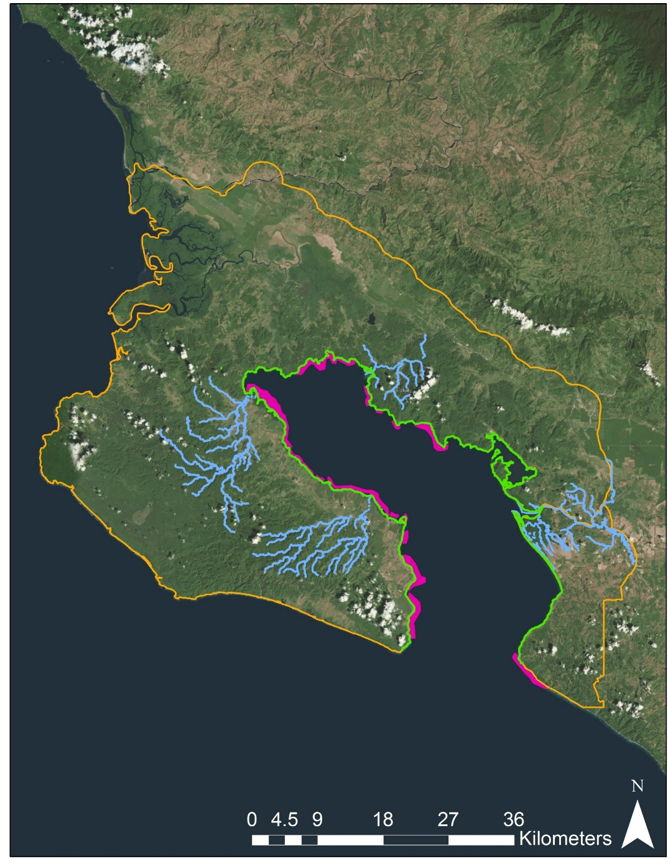
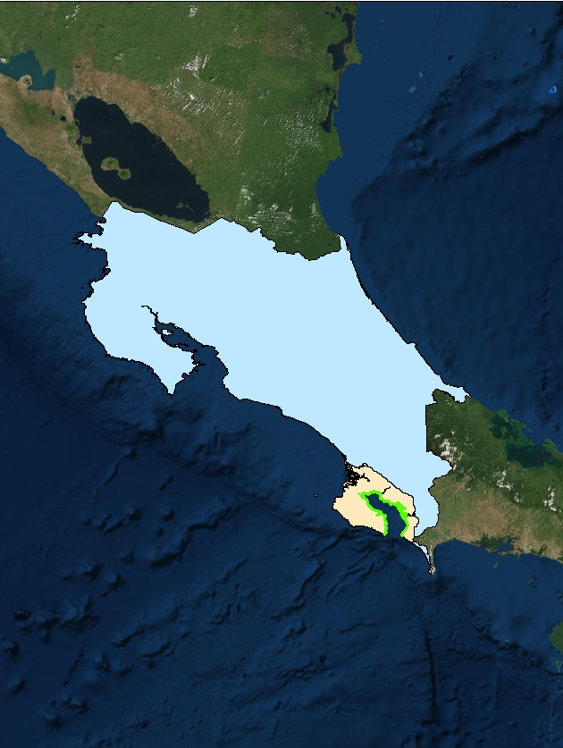
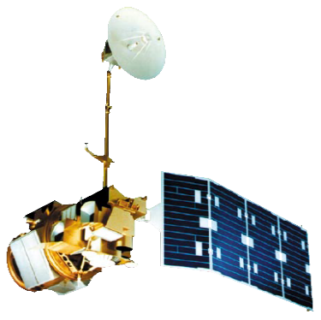
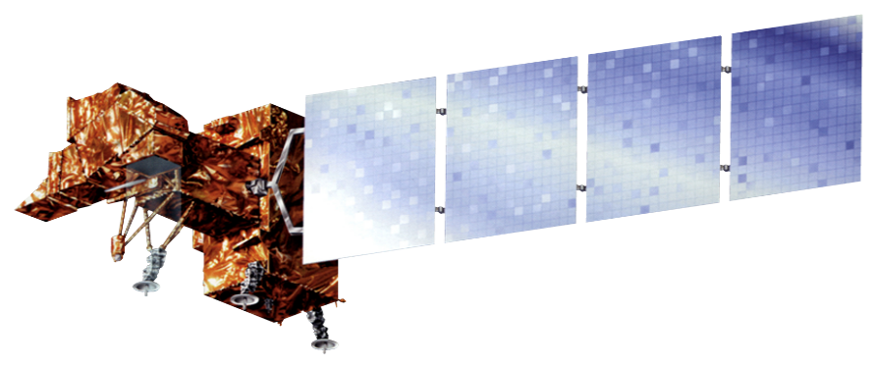
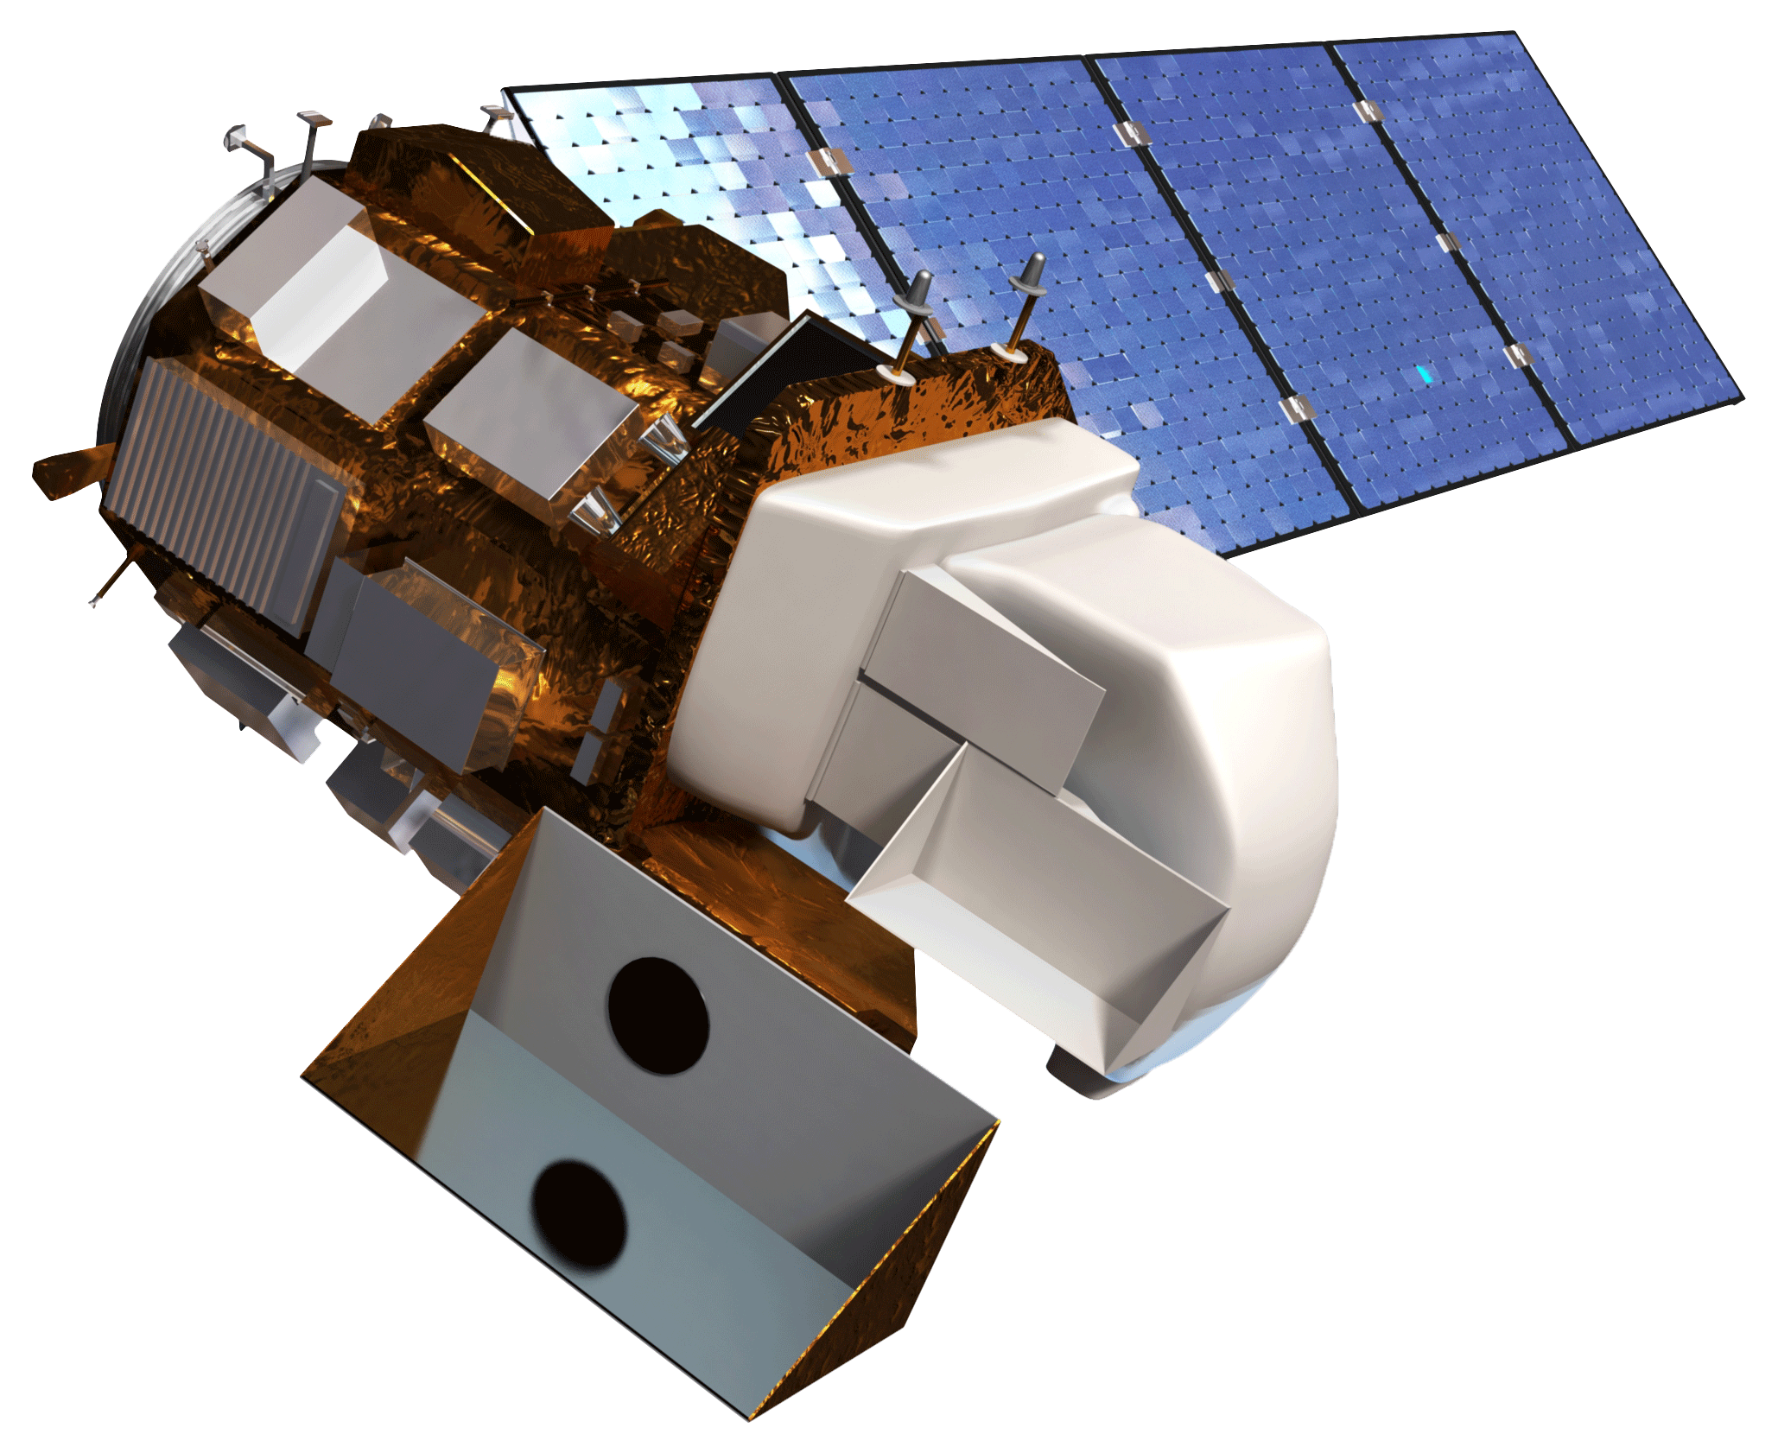
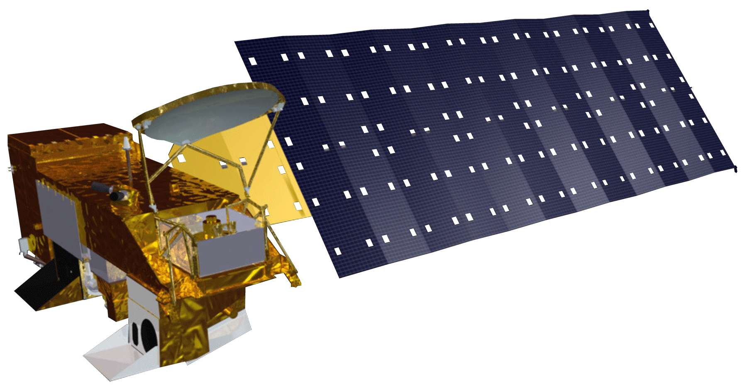
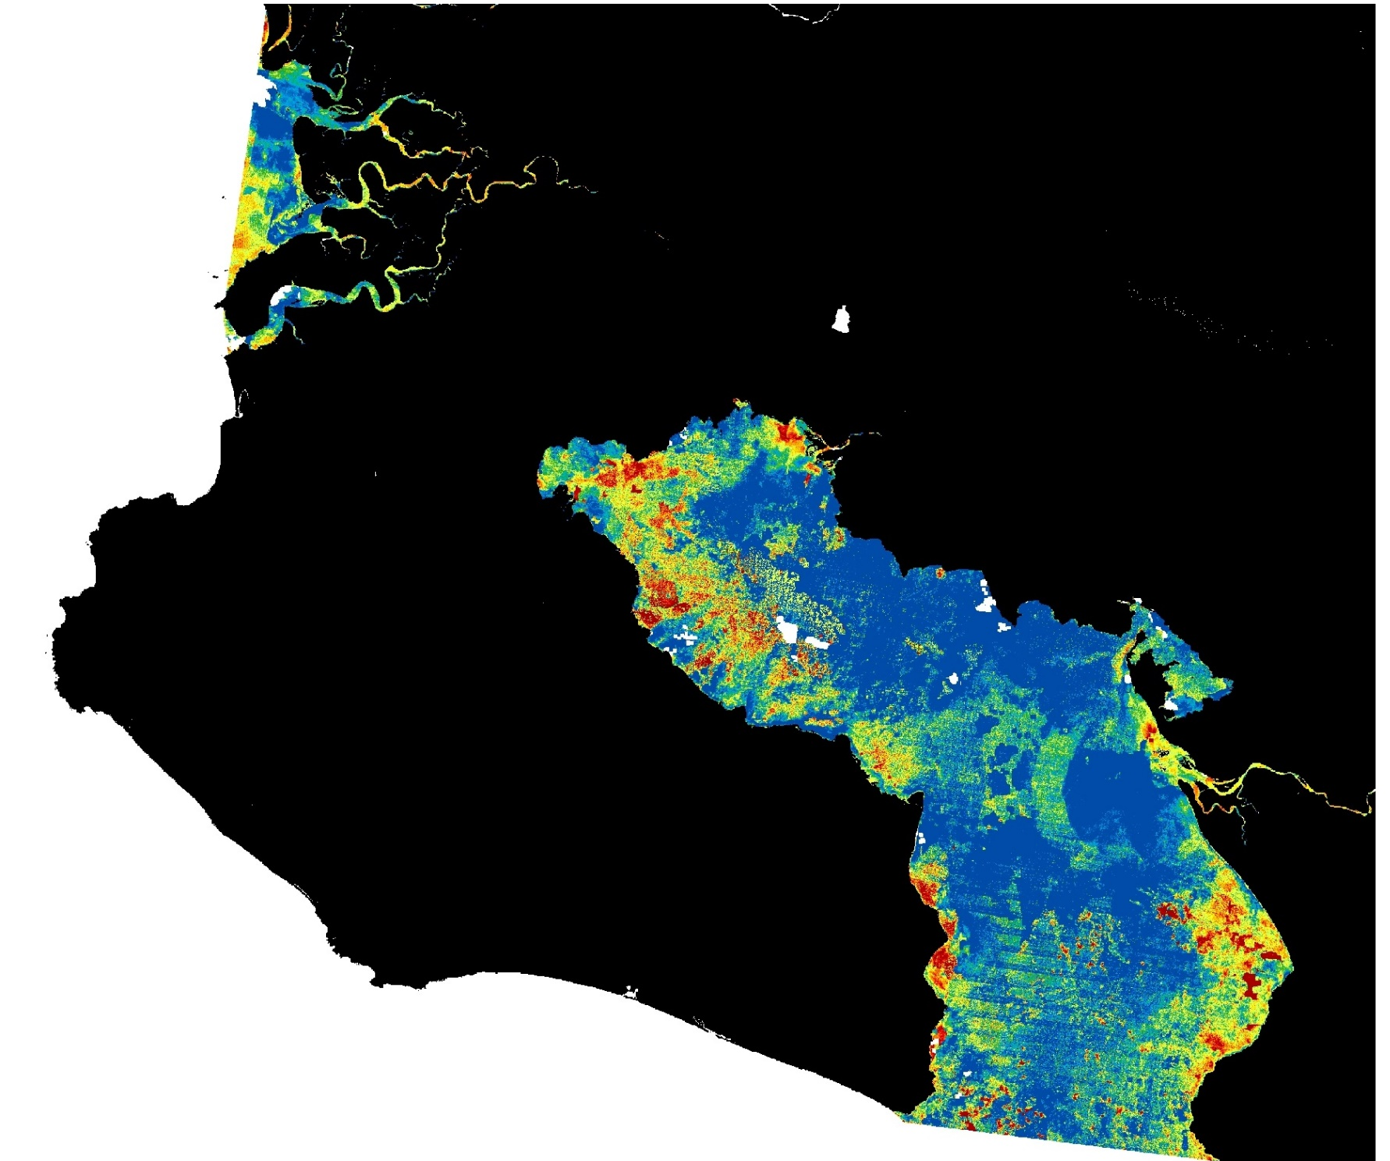
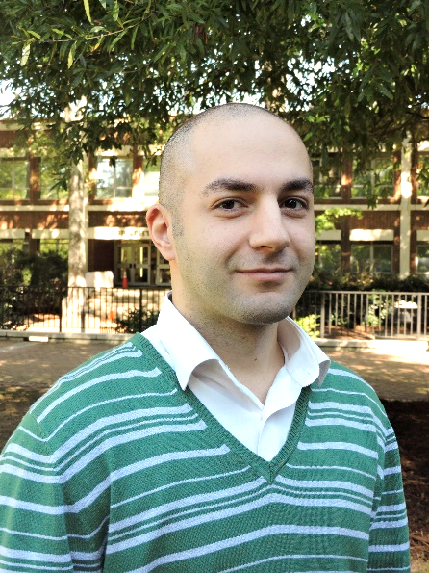
Evaluating Potential Sites for Coral Reef Restoration in the Golfo Dulce, Costa Rica Based on Turbidity and Sea Surface Temperature
Abstract
Objectives
The Osa Peninsula, located in the southern region of Costa Rica’s Pacific coast, is one of the most biologically diverse places on Earth. NASA DEVELOP partnered with Osa Conservation to analyze the impact of human activity on vital water resources, with a focus on determining suitable locations for coral reef restoration in the Golfo Dulce. Coral reefs play a crucial role as a habitat provider, an ecosystem stabilizer, and as food security for marine and terrestrial communities; however, they are highly sensitive to changes in aquatic conditions, which can lead to bleaching and slowed reef accretion. This project used Landsat 5 Thematic Mapper (TM), Landsat 7 Enhanced Thematic Mapper Plus (ETM+), Landsat 8 Operational Land Imager (OLI), and Aqua Moderate Resolution Imaging Spectroradiometer (MODIS) satellite imagery to investigate turbidity and sea surface temperature (SST). These data were compiled into time series maps to assess variability within a season and over the years. The variability data were used to evaluate sites for coral restoration and provide insight into the connections between land use, river health, and fluctuations in water quality within the gulf.
Produce time series maps for median annual turbidity from 1986 to 2016
Produce maps of seasonal differences in median turbidity and average SST (February-May and August-November) for 2015 to 2017
Investigate river deltas in the Golfo Dulce and assess turbidity change per season
Identify areas of the Golfo Dulce most suitable for coral restoration
Create a correlation chart for the relationship between turbidity and SST
Produce a bivariate change in SST and turbidity map to identify areas in the Golfo Dulce most suited for coral restoration
Produce an interactive SST map tool for 2002 to 2018
Methodology
Project Partner
Landsat 5 TM
1986 1991 … 2016
NDTI annual time series
Osa Conservation
Landsat 7 ETM+
Study Area
Landsat 8 OLI
2015 2016 2017
NDTI seasonal time series
Coral restoration suitability map
Landsat 8 OLI
SST seasonal time series
Aqua MODIS
2002 to 2018
2015 2016 2017
Earth Observations
Costa Rica
Study Area
Coral
Focal Rivers
Landsat 5 TM Landsat 7 ETM+ Landsat 8 OLI Aqua MODIS
Golfo Dulce
N
Results
NDTI
Change
SST
Change
N
N
Change in median Normalized Difference Turbidity Index (NDTI) in the Golfo Dulce for 1996 to 2016
Coral restoration suitability bivariate map using average SST and NDTI fluctuations for coral restoration suitability
Median SST and NDTI time series in the Golfo Dulce
Conclusions
There is a noticeable decrease in NDTI over the gulf from 1996 to 2016. A potential reason may be the extensive reforestation efforts after Forest Law 7575 of 1996.
Rio Coto, the largest river delta, shows little fluctuation in NDTI over the past 20 years. However, the mouth feeding into the gulf is a highly turbid area.
Minimal fluctuations in NDTI and SST are seen in the northwest region of the gulf. With the sensitive nature of coral, this area is the most suitable for their restoration.
NDTI and SST do not show strong correlations. However, median SST in the gulf has continually increased over the past 15 years while NDTI is variable with a downward trend.
Acknowledgements
Team Members
Dr. Sergio Bernandes and Dr. Marguerite Madden, University of Georgia, Center for Geospatial Research (Science Advisors)
Hilary Brumberg, Mónica Espinoza Miralles, and Dr. Noelia Hernandez from Osa Conservation
Previous team members and contributors: Marie Bouffard, Tanner Johnson, John Langstaff, Candice Lee, Emily Pauline, Taufiq Rashid, Suravi Shrestha, and Sam Tingle
Hikari Murayama
Project Lead
McKenna Barney
Soroush Esmaeili Neyestani
Samuel Furey
Osa Peninsula Water Resources III
Georgia – Athens | Fall 2018

