Slide 1
DEVELOP National Program
Alabama Ecological Forecasting
NASA Marshall Space Flight Center
SPRING 2016
Imagery Gallery

Slide 2
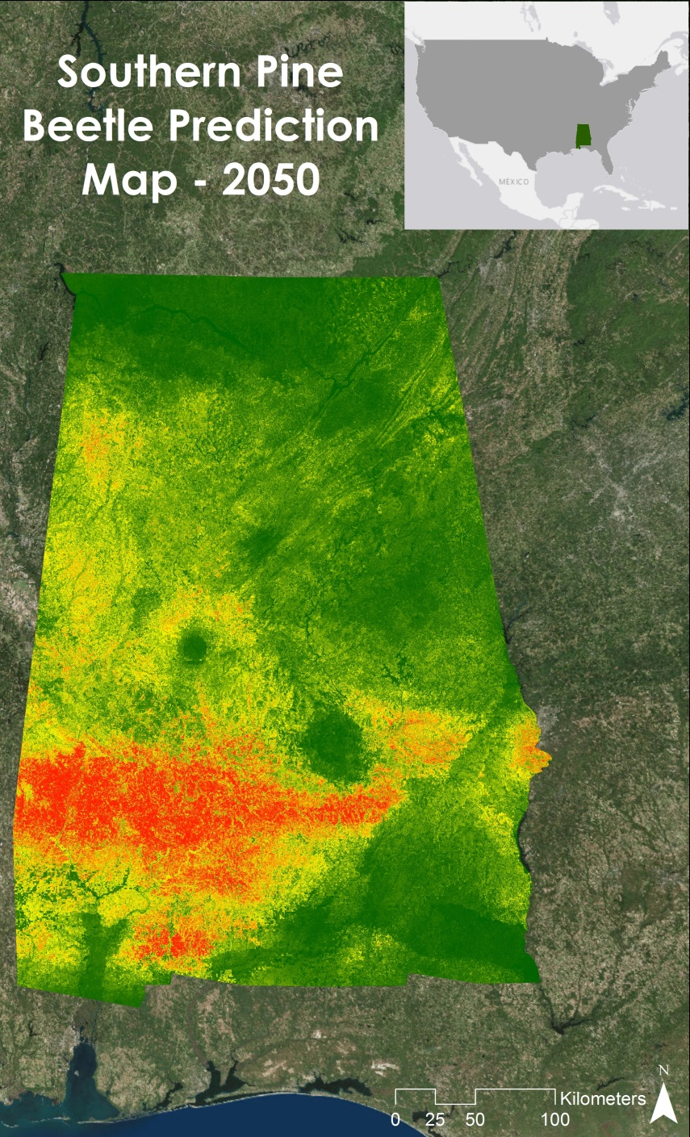
NASA Marshall Space Flight Center
Alabama Ecological Forecasting
Southern Pine Beetle Prediction Map for 2050 using the Princeton University Maximum Entropy Model. Landsat 5 Thematic Mapper, Landsat 8 Operational Land Imager, and Shuttle Radar Topography Mission Version 2 were used to create this map. This helped project partners decide where to focus mitigation efforts to attempt to reduce or even prevent future Southern Pine Beetle outbreaks.

Slide 3
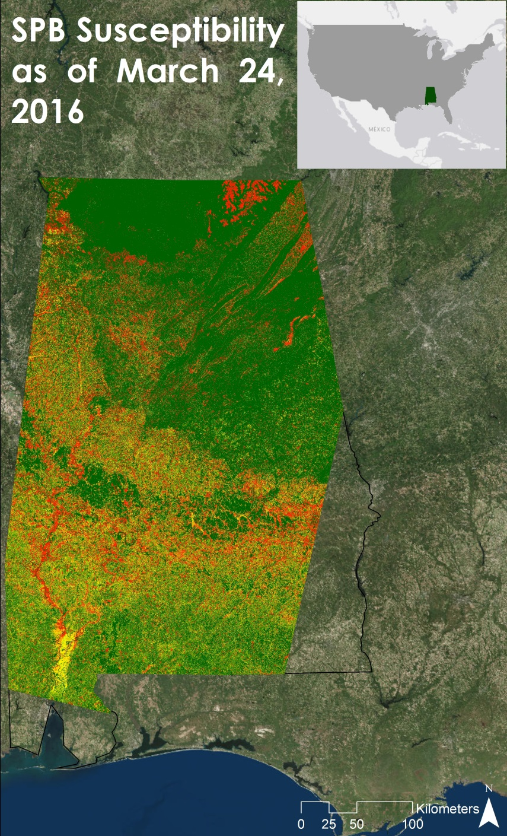
NASA Marshall Space Flight Center
Alabama Ecological Forecasting
Near Real-Time Southern Pine Beetle Susceptibility Model for March 24, 2016. Landsat 8 Operational Land Imager was used to create this model. This helped project partners decide where to focus mitigation efforts to attempt to reduce or even prevent future Southern Pine Beetle outbreaks.

