Slide 1
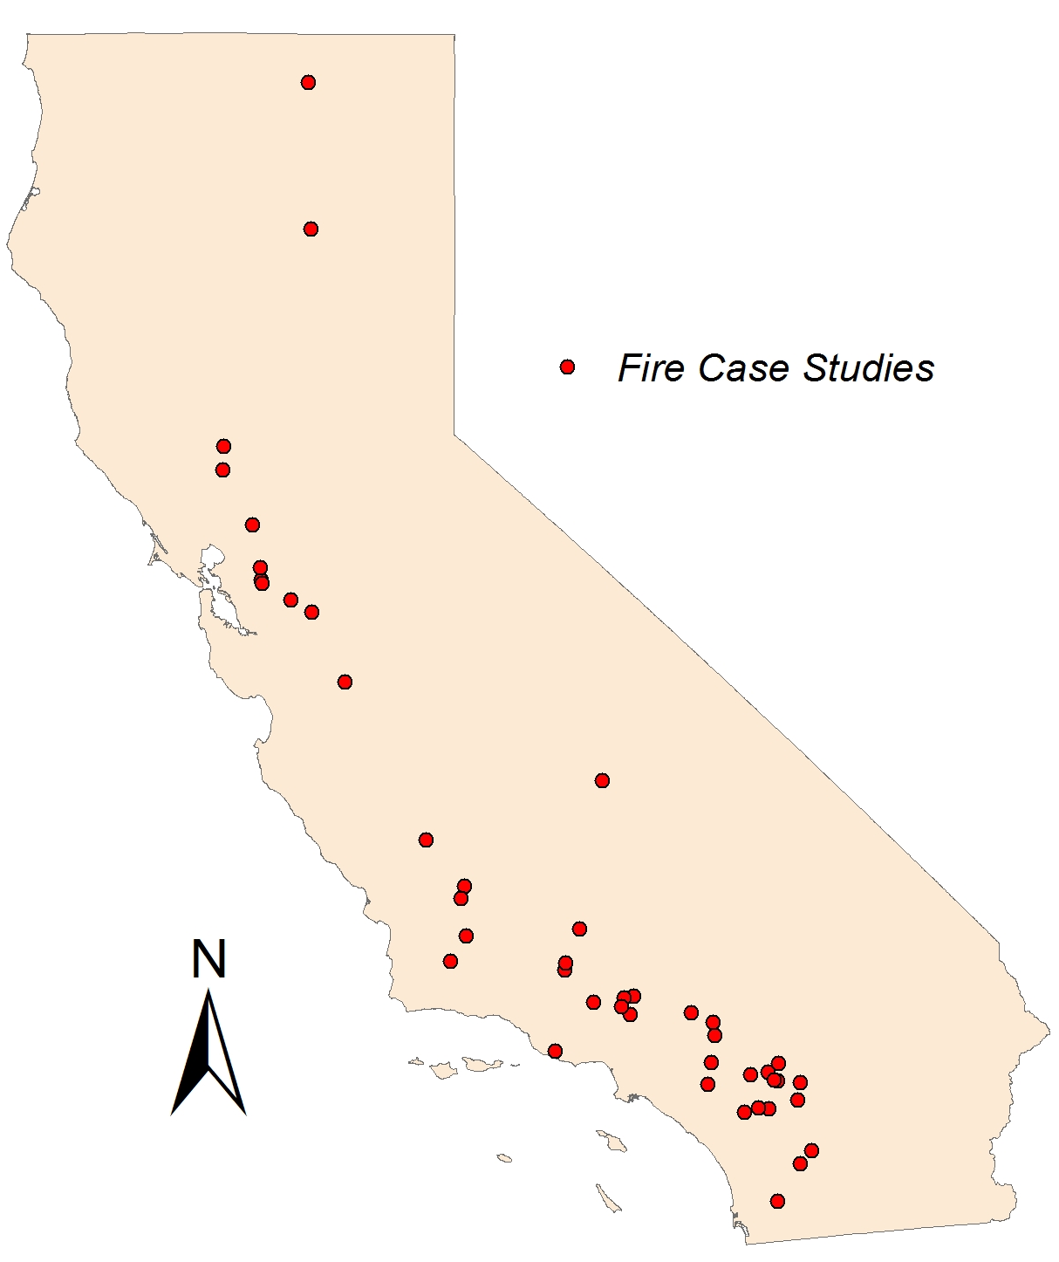
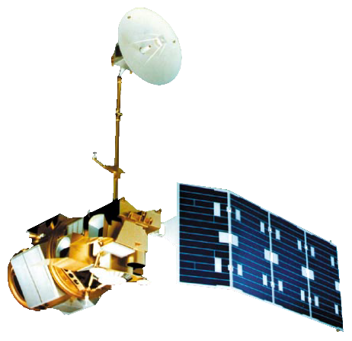
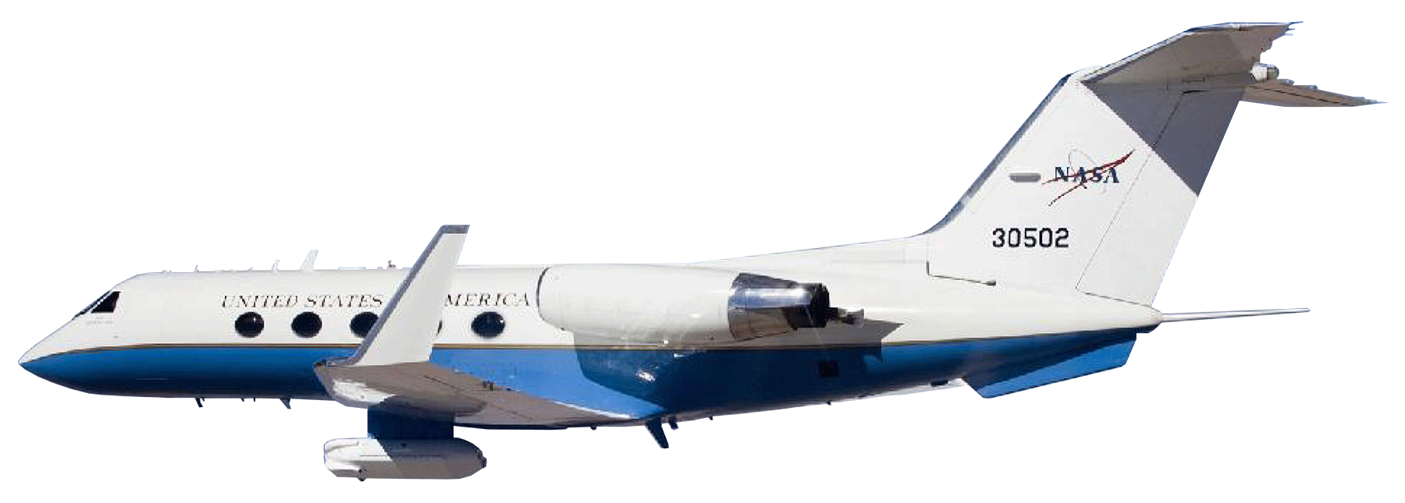
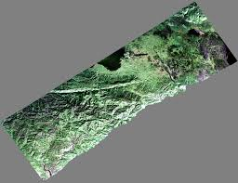
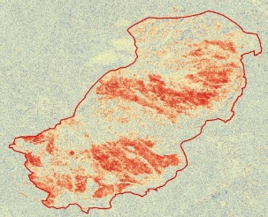
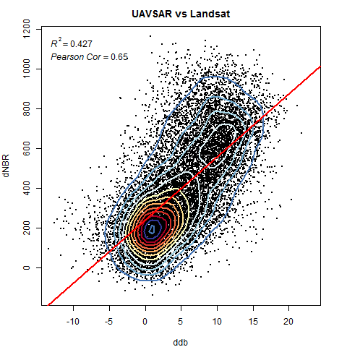
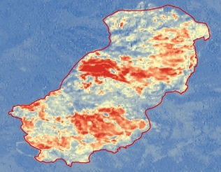
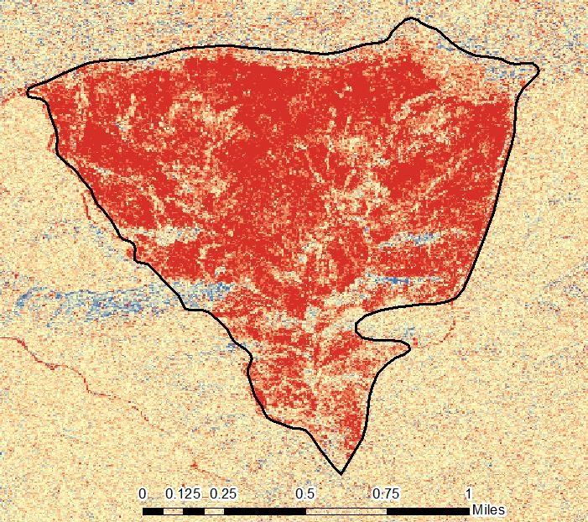
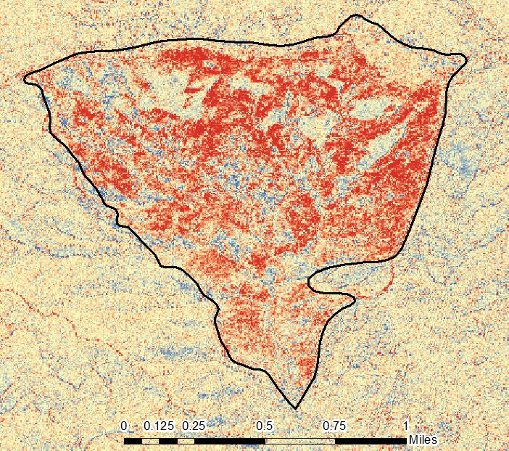
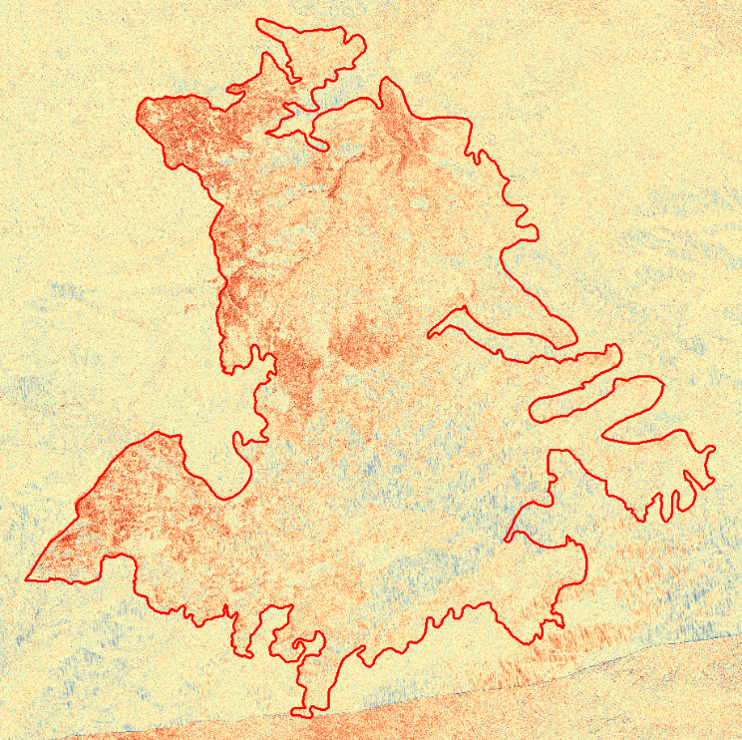
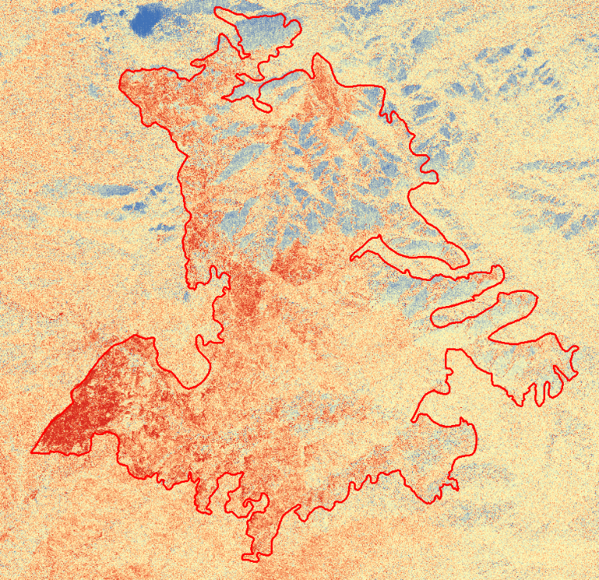
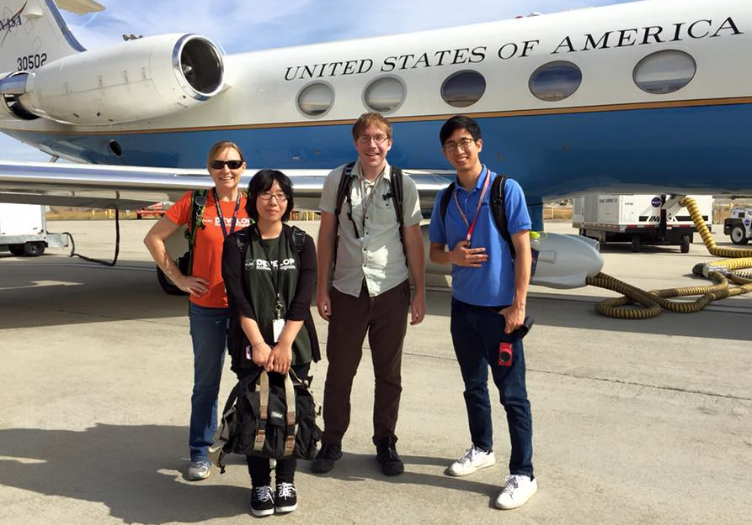
California Disasters II
A New Method for Providing Near-Real-Time Active-Fire Support to Fire Responders Using NASA’s Uninhabited Aerial Vehicle Synthetic Aperture Radar (UAVSAR)
Jerry Heo (Project Lead), Christine Rains, Erika Higa, Mark Barker
NASA DEVELOP National Program
Study Area
Objectives
Earth Observations
Process all fire case studies from 2009-present and provide a comprehensive list of these fires with associated R² and Pearson correlation values between our dCBB versus the Landsat derived dNBR products
Capture data of fire in progress for data during a wildfire occurrence
Analyze field data and correlate it with the UAVSAR output (dCBB)
Provide a list of case studies to project partners and other end users as a means of using our data for future research.
Landsat 5 TM
Landsat 8 OLI
UAVSAR on Gulfstream III
Methodology
Conclusions
UAVSAR
BEFORE (dB)
AFTER (dB)
Radar Difference Map
Use bullets.
Use complete sentences with periods.
Words
The bird
Is the word
Bird bird bird.
Landsat 5 & 8
BEFORE (NBR)
AFTER (NBR)
dNBR Map
Results
Correlation graph(s) will be here…
And other imagery of case studies
UAVSAR derived dCBB product of the Mint fire with different look directions of the sensor. The image on the left is North looking while the image on the right is South looking.
dCBB of the Eagle Fire with the image on the left as North looking while the image on the right is South looking.
Team Members
Project Partners
Acknowledgements
California Department of Forestry and Fire Protection (CAL FIRE)
U.S. Forest Service
Dr. Sang-Ho Yun (NASA JPL) – Science Advisor
Dr. Mark Simons and Brent Minchew (Caltech) – Science Advisors
Yunling Lou (NASA JPL)
Naiara Pinto (NASA JPL)
Natasha Stavros (NASA JPL)
Sander Veraverbeke (UCI)
Benjamin Holt (NASA JPL) – DEVELOP Mentor
Gwen Miller – DEVELOP Center Lead
From left to right: Christine Rains, Erika Higa, Mark Barker, and Jerry Heo
Jet Propulsion Laboratory

