Slide 1
Texas Disasters
Utilizing NASA Earth Observations to Assist the Texas Forest Service in Mapping and Analyzing Fuel Loads and Phenology in the Texas Grasslands
Ben Beasley
Alex Holland
Kristen Kelehan
Notes:
Hello,
My name is Ben Beasley
This project is entitled Texas Disasters:
Utilizing NASA Earth Observations to Assist the Texas Forest Service in Mapping and Analyzing Fuel Loads and Phenology in the Texas Grasslands.
Team Members: Alex Holland
Kristen Kelehan
Next……………

Slide 2
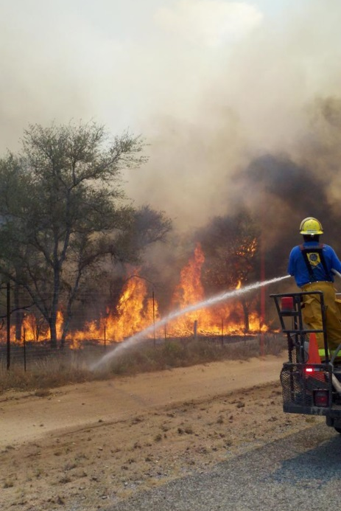
Community Concerns
Wildfire risk has increased due to climate change and recent urbanization
Texas grasslands are highly susceptible to wildfires especially during drought years
In 2011 wildfires in Texas scorched 4,000,000 acres and destroyed nearly 3,000 homes
Source:”
Image: NOAA
Notes:
Wildfire risk in Texas has increased due to climate change and recent urbanization
Texas grasslands are highly susceptible to wildfires especially during drought years
In 2011, the state of Texas declared a state of emergency due to the increase in wildfires that burned nearly 4,000,000 acres of Texas and destroyed nearly 3,000 homes.
Image source:
http://www.crh.noaa.gov/bro/?n=2011event_smacfirephotogallery
.

Slide 3
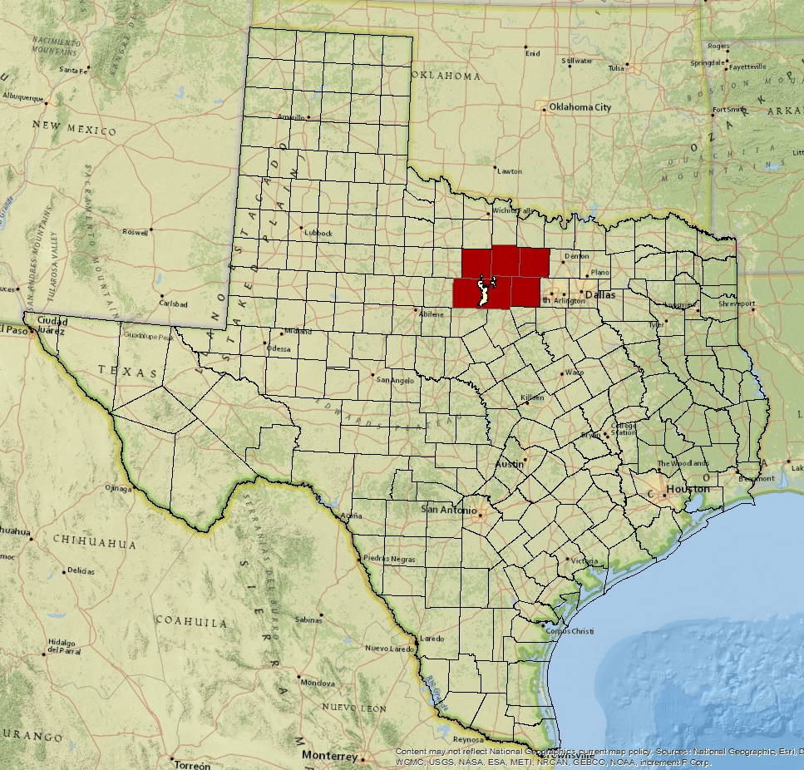
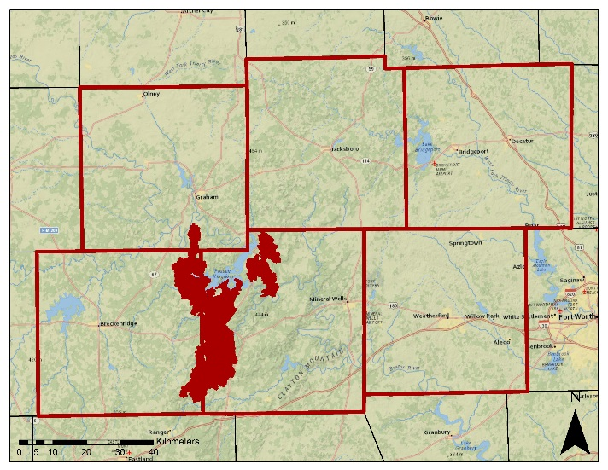
Study Area
The study covers the State of Texas with a case study of the Possum Kingdom Complex wildfires which burned ~150,000 acres in 2011.
Notes:
The study covers the entire State of Texas with a case study of the
Possum Kingdom Complex wildfires,
just west of Fort Worth,
which destroyed approximately 150,000 acres in 2011.

Slide 4
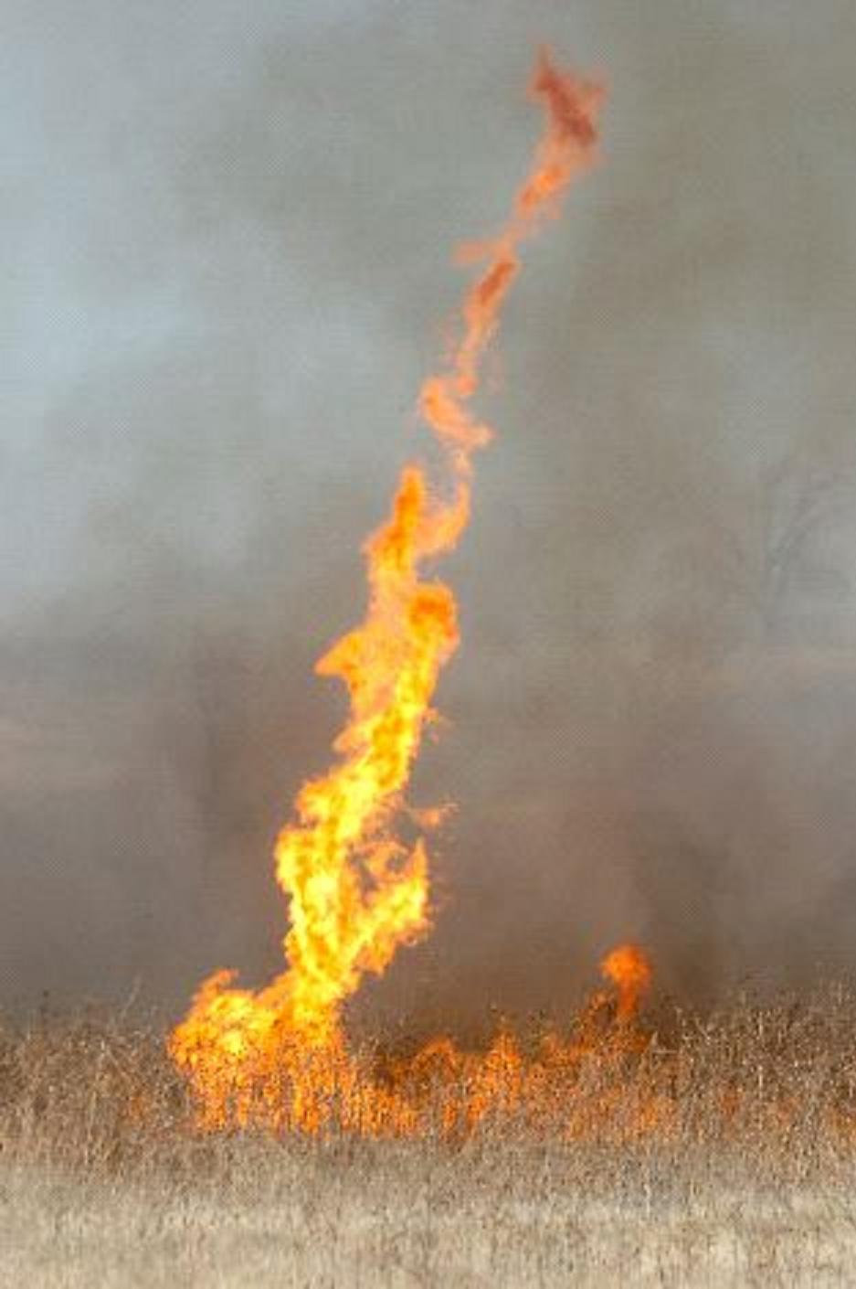
Project Partners
Texas A&M Forest Service –
Objectives:
Assessment of wildfire risk
Monitoring of vegetative fuel loads
Calculating fire behavior
Image: NOAA
Notes:
The partners for this project were the Texas Forest Service who have partnered with DEVELOP for several projects in the past.
They are tasked with evaluating potential fire risk in order to manage and allocate resources for the prevention and containment of wildfires across the State.
A key component for assessing fire risk is the classification and monitoring of vegetative fuel types and fuel loads and to model fire behavior based on the characteristics of each fuel.
They currently use comprehensive fuel mapping techniques using Landsat data but do not have a method to adjust these models to seasonal changes.
Next………………………………………..
Image source:
http://www.srh.noaa.gov/ama/?n=fire_weather

Slide 5
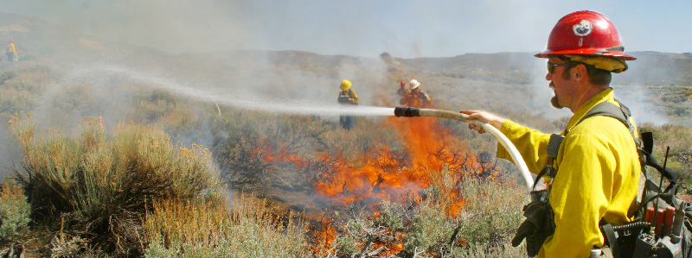
Image: USGS
Objectives
Enhance current fuel mapping capabilities using NASA Earth observation data
Use and demonstrate NASA data to help assess seasonal variations in fuel loads
Compile up-to-date fuel load maps that depict fuel conditions
Notes:
The Objectives for this project were to:
Enhance current fuel mapping capabilities using NASA Earth observation data
Use and demonstrate NASA data to help assess seasonal variations in fuel loads
Compile up-to-date fuel load maps that depict fuel conditions
To provide additional tools and information for wildfire fuel modeling and risk assessment.
Next…………………………………..
Image source:
http://www.werc.usgs.gov/OLDsitedata/fire/lv/fireandinvasives/photo_gal.htm

Slide 6
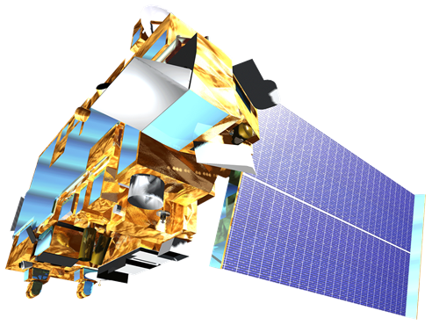
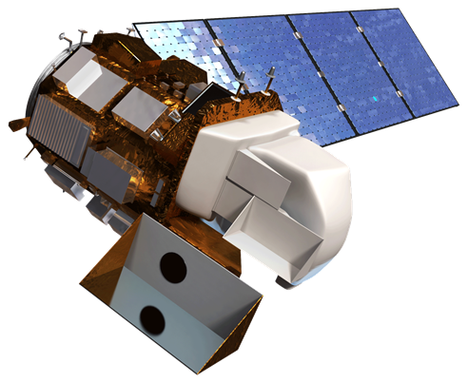
NASA Satellites/Sensors
Sensor | Spatial Resolution | Temporal Resolution
MODIS (Terra and Aqua) Moderate Resolution Imaging Spectroradiometer | 250 m (bands 1-2) 500 m (bands 3-7) 1000 m (bands 8-36) | 1 Day
Landsat 8 OLI Operational Land Imager | 30 m | 16 Days
Notes:
NASA Earth Observations provide a good platform for evaluating wildfire fuel across varied temporal and spatial scales.
For this project the temporal advantages of daily pass MODIS data were combined with spatial advantages of 30-meter Landsat products.
Next………………………………….

Slide 7
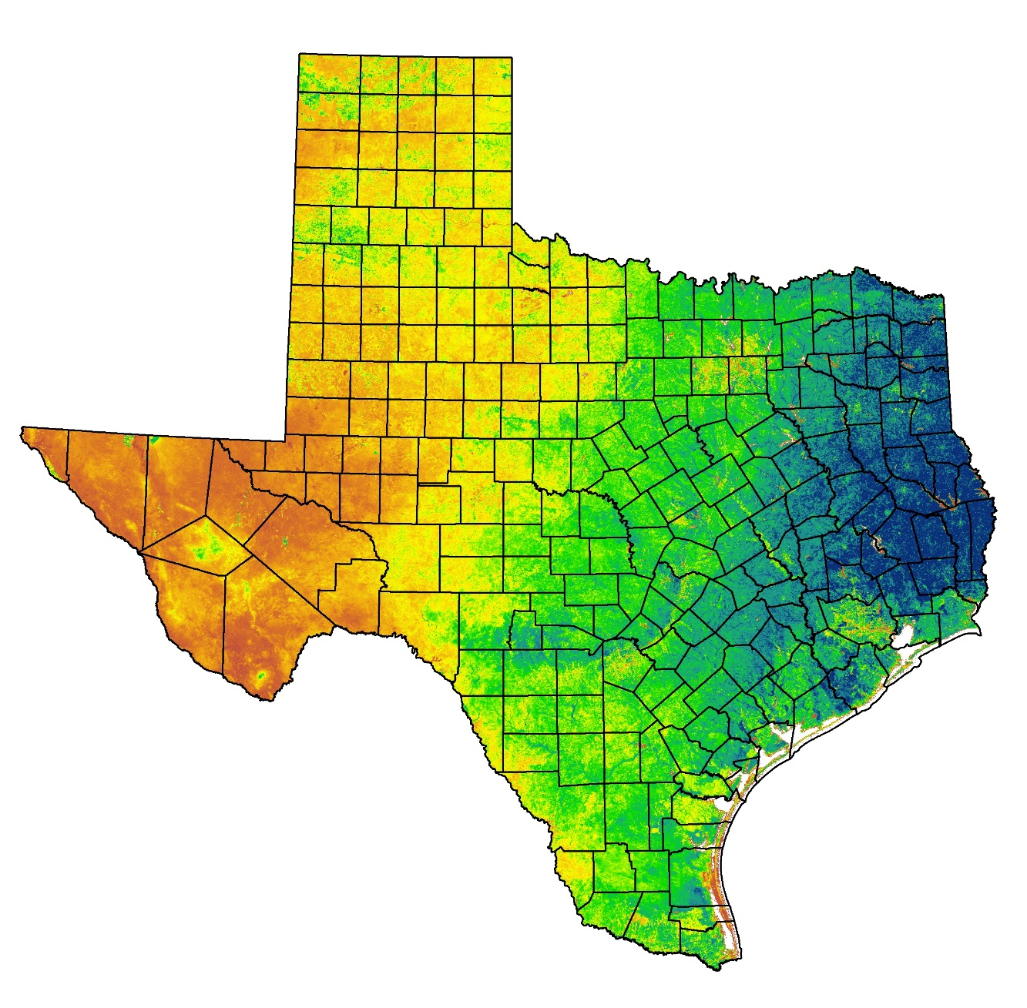
NDVI
2014
Cumulative
NDVI
Normalized
Difference
Vegetation
Index
NDVI = (NIR-VIS/NIR+VIS)
Can measure annual plant productivity based on the density of greenness of vegetation
Data Source: USFS ForWarn EWS
Notes:
In order to make these fuel maps sensitive to seasonal fluctuations, NDVI was utilized.
NDVI (Normalized Difference Vegetation Index) measures the density of the greenness of vegetation and is commonly used as a proxy for plant productivity.
Next………………………..
In order to make these fuel maps sensitive to fluctuations NDVI was utilized.
NDVI (Normalized Difference Vegetation Index) is commonly used as a proxy for plant productivity based on the density of the greenness of vegetation.

Slide 8
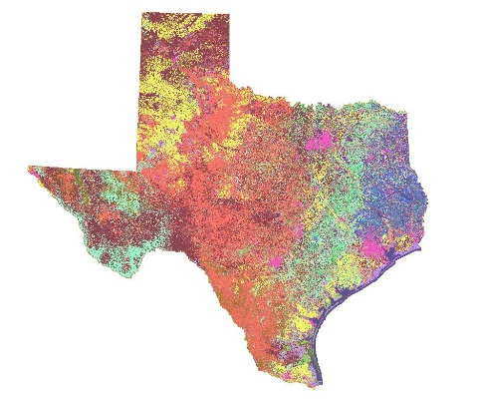
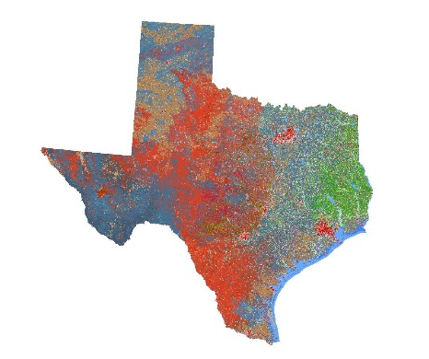
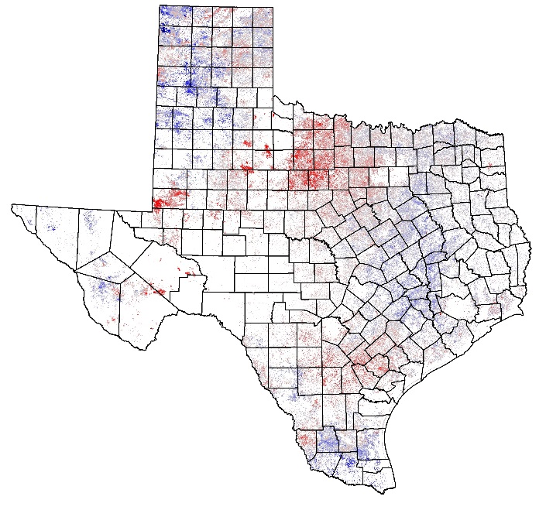
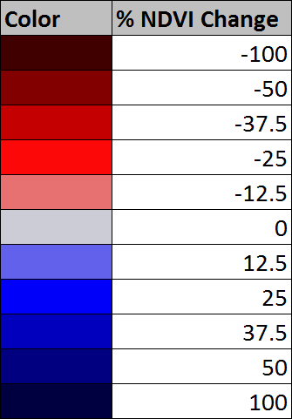
Methodology
Surface Fuel Types
Vegetation
Types
Combined
Fuels and Vegetation
Grassland Annual
Relative Fuel Load
NDVI
2000-2014
NDVI
15 Year Average
NDVI
Annual
Notes:
NDVI was incorporated into the fuel maps by:
Fuel Types
First, Surface Fuel Maps were collected from the Texas Forest Service.
These maps classify the type of fuel that will drive a wildfire and the intensity that it will burn.
They were combined with Vegetation Type Maps were also collected to allow for the investigation of areas where the fuel expected to drive a wildfire and the dominant vegetation cover are not the same.
NDVI
Next, MODIS derived annual cumulative NDVI was compiled from 2000-2014 from the USDA Forest Service Forwarn Early Warning System .
The 15-year average was computed and compared to each annual cumulative NDVI to calculate the percent change form the mean.
This was then combined with fuel and vegetation map to highlights areas within each fuel type that are above and below average for a particular year
Since NDVI is used to measure plant productivity, this indicates the amount of relative biomass accumulation or relative fuel load.
Next……………………..

Slide 9
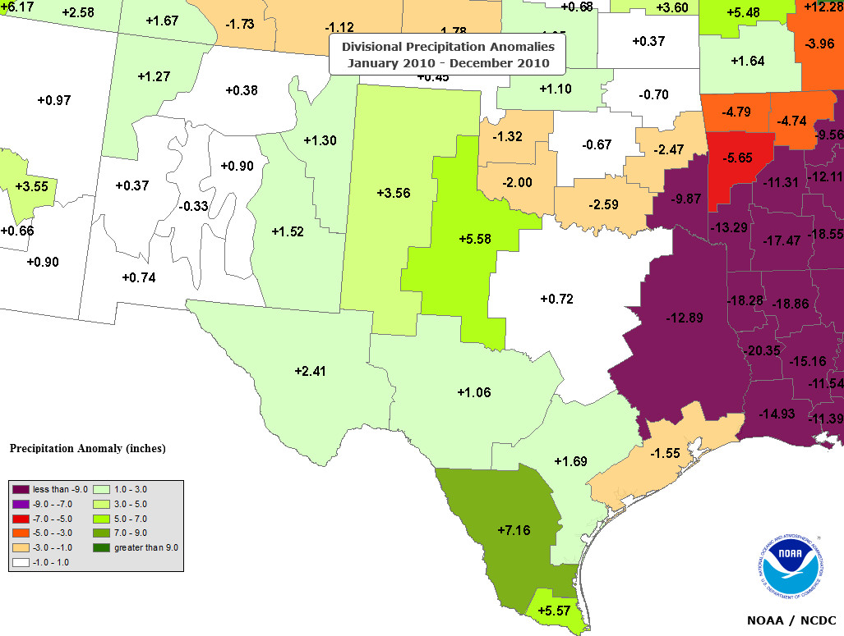
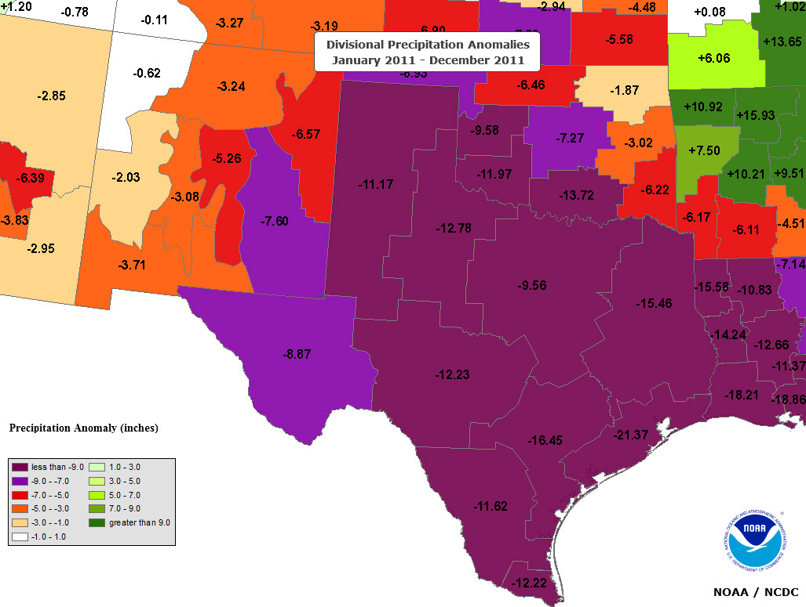
Annual Precipitation
2010 (Wet Year)
2011 (Drought Year)
2010
Relative Precipitation – These maps compare the annual precipitation to the average annual precipitation. The green areas depict above average and the red and purple depict areas below average.
Notes:
One of the main influences on vegetation productivity is precipitation.
These maps produced by the NOAA indicate the annual precipitation relative to the average annual precipitation.
The green areas depict above average and the red and purple depict areas below average.
So as you can see
This shows that 2010 was an abnormally wet year and 2011 was considered a drought year.
It is well known that drought contributes in to increased wildfire risk, but wetter growing seasons prior to drought years may also play a role.
Next…………………
One of the main influences on vegetation productivity is precipitation.
These maps produced by the National Climate Data Center
indicate the annual precipitation relative to the average annual precipitation.
The green areas depict above average and the red and purple depict areas below average.
So as you can see
This shows that 2010 was a abnormally dry year and 2011 was abnormally dry year.
So how does this translate into fuel loads?
Source:
Image source: http://gis.ncdc.noaa.gov/map/cag/#app=cdo

Slide 10
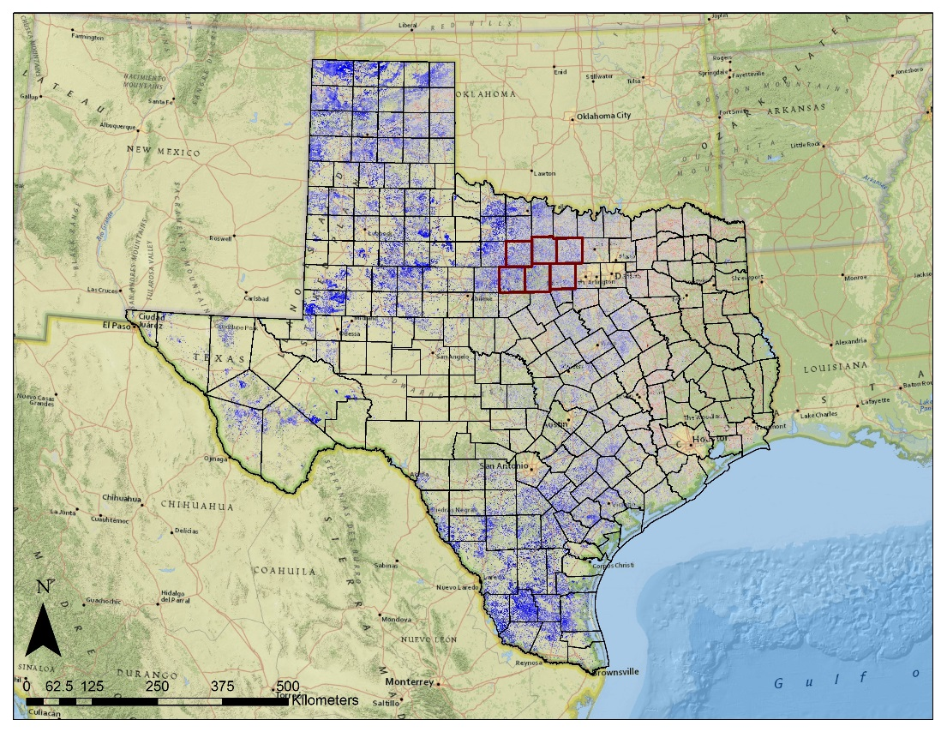
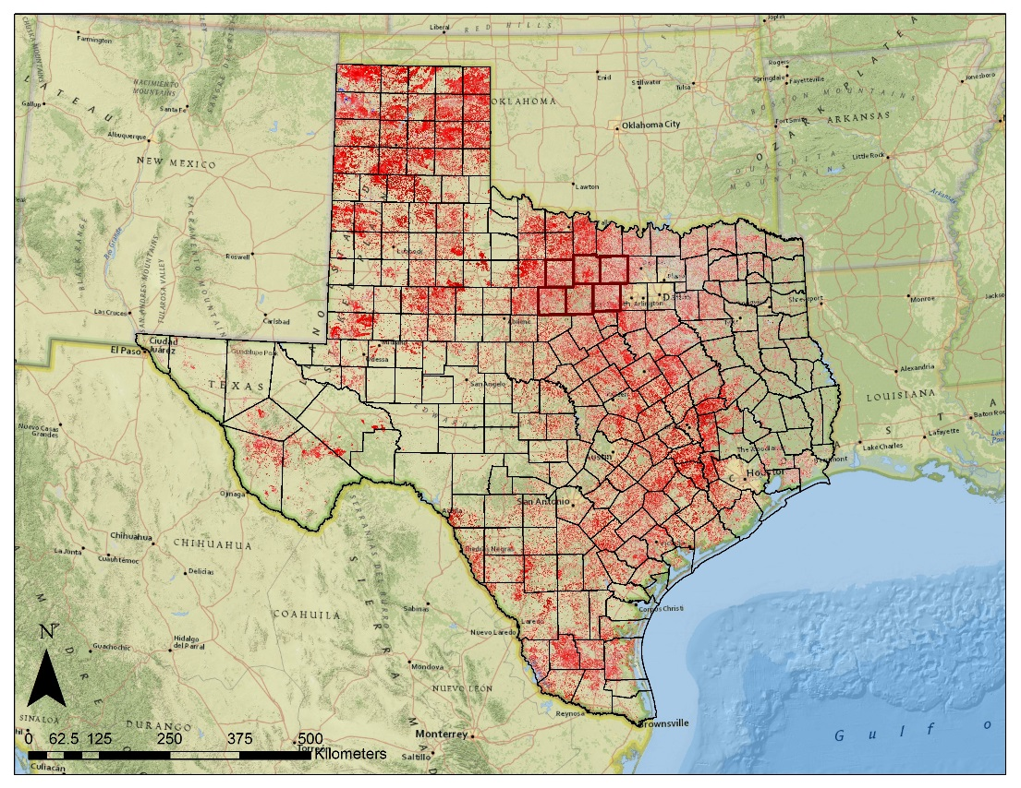
Results - Texas
2010 (Wet Year)
2011 (Drought Year)
2010
Grassland Relative Fuel Loads – Comparison of annual NDVI to 15 year average NDVI. Blue tones = higher and red tones = lower than average cumulative NDVI.
Notes:
This effect is evident in these statewide maps produced for 2010 and 2011.
They depict the percent change in mean annual cumulative NDVI of grassland fuels.
The deeper blues represent greater than average and deeper reds represent less than average NDVI response.
So as expected, there was an increase in vegetation productivity in the wetter 2010 and a decrease in the much dryer 2011.
This increased the amount of grass available as fuel and which then dried out in 2011 contributing to more intense wildfires.
Next………………………………..

Slide 11
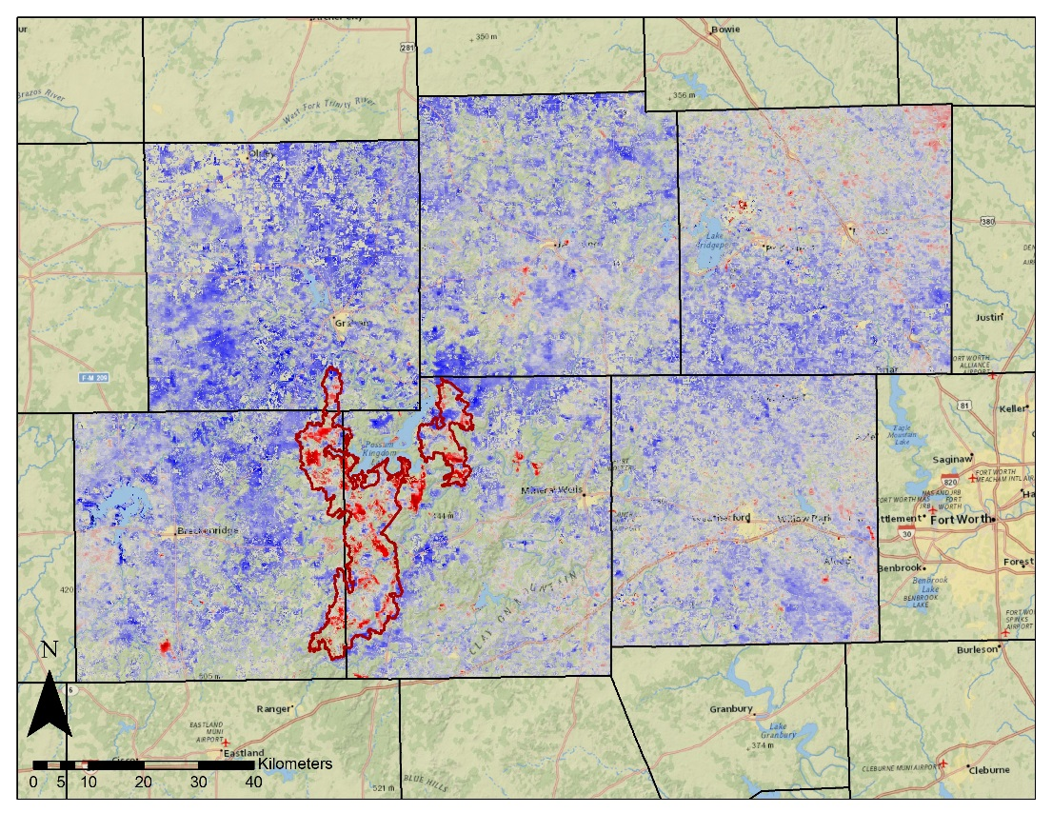
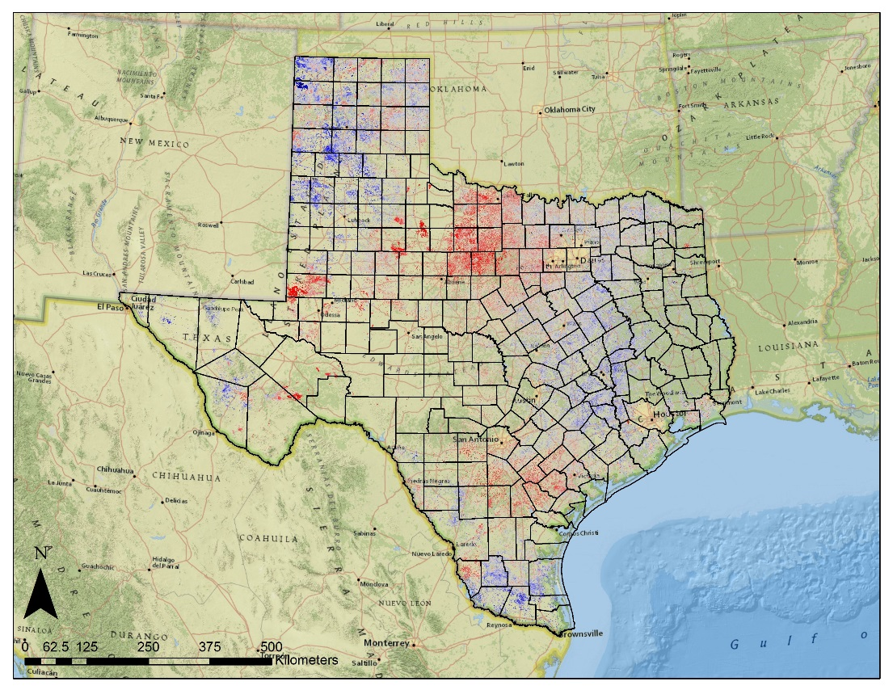
Results
2012 (Post Fire)
2014
Grassland Relative Fuel Loads – Comparison of annual NDVI to 15 year average NDVI. Blue tones = higher and red tones = lower than average cumulative NDVI.
Notes:
These maps show the sensitivity of these products.
The 2012 map on the left indicates the vegetation productivity was greater than average with the exception within the footprint of the Possum Kingdom Complex wildfires of 2011.
This statewide 2014 map shows how the results can vary throughout the State with some areas showing an increase in grassland productivity and others showing a decrease.
This type of product works well to understand how much areas have grown relative to the average growth rates in that area.
Next…………………………….

Slide 12
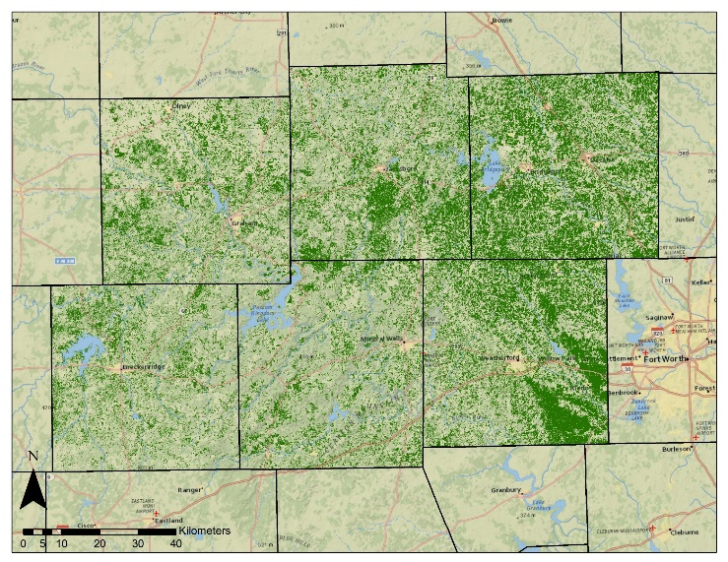
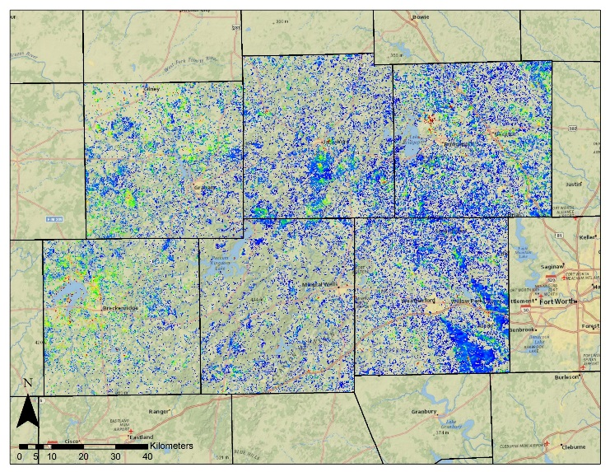
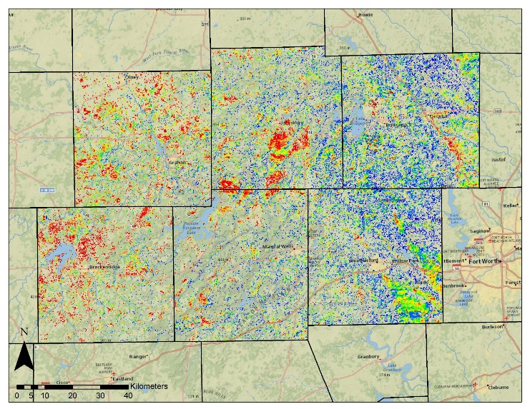
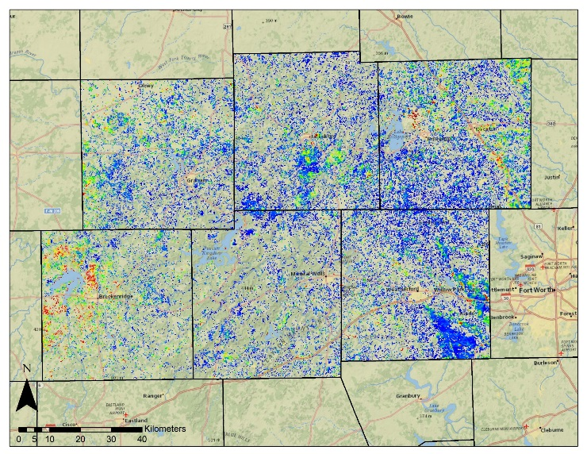
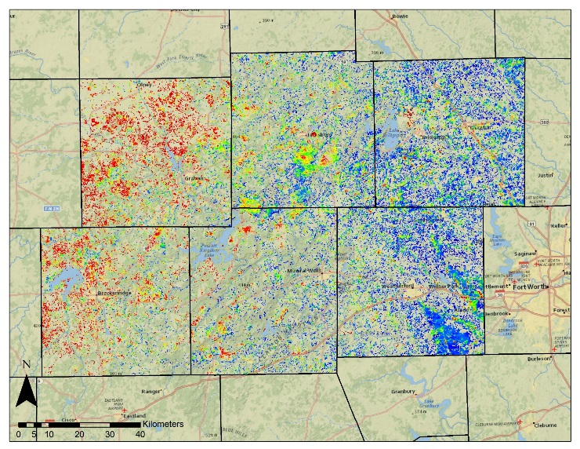
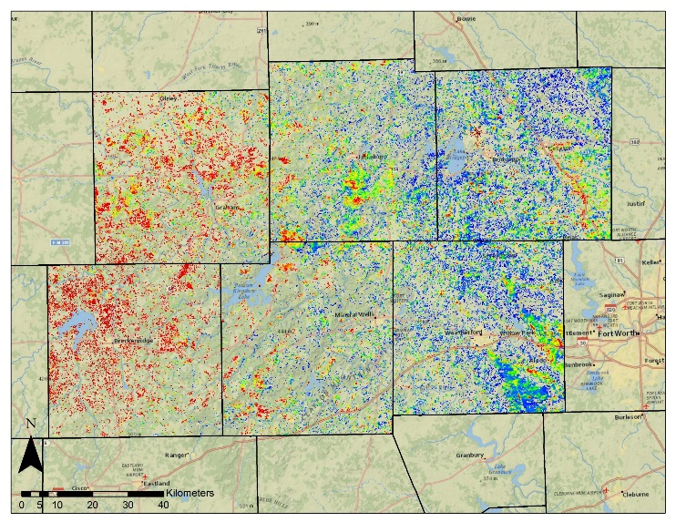
Results
TFS (Gr2)
2010
2011
TFS (Surface Fuels)
2014 (Relative Fuels)
2012
2013
2014
Fuel Type Maps – The Surface Fuels map was adapted from the Texas Forest Service (TFS) of Gr2 fuel. 2010-2014 maps show change in annual cumulative NDVI compared to zonal mean for Gr2.
Notes:
Another way that these MODIS derived cumulative NDVI products were used was to calculate zonal means or an average NDVI value for each type of fuel.
The Surface Fuel map on the top- left represents the type of map currently used by the forest service.
Here showing only Grass Fuel Type 2 or Gr2.
The 2010-2014 maps, were created by comparing the annual cumulative NDVI for each year to the zonal mean for the gr2 fuel type.
This method showed temporal variations within this fuel type as related to the average NDVI for this particular fuel type.
The blue tones represent above average NDVI and the red tones represent below average.
This method illustrates another way to analyze relative fuel loads based on vegetation characteristics.
Next……………………….

Slide 13
Conclusions
Fuel Loads
Geospatial information on grassland fuel loads are important for assessing wildfire risk
MODIS NDVI
Annual cumulative MODIS NDVI offers a means to monitor relative fuel loads
Fuel Models
Such MODIS NDVI products can serve as inputs to fuel load models
Notes:
Geospatial information on grassland fuel loads are important for assessing wildfire risk
Annual cumulative MODIS NDVI offers a means to monitor relative fuel loads
Such MODIS NDVI products can serve as inputs to fuel load models to assist the Texas Forest Service in wildfire risk assessment.
Future work:
This project is planned to be continued in the next term and the methodology explored during this term can be expanded upon by:
Computing seasonal averages to compliment the annual average computed for this project
Explore other data fusion techniques
Do phenology studies on grasslands to pinpoint green up and brown down timeframes.
Relative fuel loads based on MODIS NDVI is a good tool to assess fluctuations in grassland fuels.
Provides wildfire risk managers a new method for adjusting fuel model according to the actual changes grassland growth rates.
Using MODIS data to detect seasonal changes in the Texas Grasslands is a crucial step in moving towards real-time assessment in fuel loads.
The Texas Forest Service can use this data in the future to better assess the wildfire risk based on recent observations rather than using a static fuel model.

Slide 14
Joseph Spruce (Senior Scientist and Lead Science Advisor at NASA SSC)
James “Doc” Smoot (Senior Scientist and Assistant Science Advisor at NASA SSC)
Dr. Kenton Ross (NASA DEVELOP National Science Advisor, LaRC
Advisors
Partners
Texas Forest Service; Tom Spencer and Curt Stripling- Predictive Services
USDA Forest Service; William “Bill” Hargrove- PI for the ForWarn Early Warning System
Trade names and trademarks are used in this report for identification only.
Their usage does not constitute an official endorsement, either expressed or implied, by the National Aeronautics and Space Administration.
Notes:
We would like to thank our science advisors as well as our project partners at the Texas Forest Service as well as the USDA Forest Service.

Slide 15
Notes:
Thank you

