Slide 1
Texas Disasters
Utilizing NASA Earth Observations to Assist the Texas Forest Service in Mapping and Analyzing Fuel Loads and Phenology in the Texas Grasslands
Ben Beasley
Alex Holland
Kristen Kelehan
Notes:
*Introduce ourselves*
And our project is Texas Disasters:
Utilizing NASA Earth Observations to Assist the Texas Forest Service in Mapping and Analyzing Fuel Loads and Phenology in the Texas Grasslands.

Slide 2
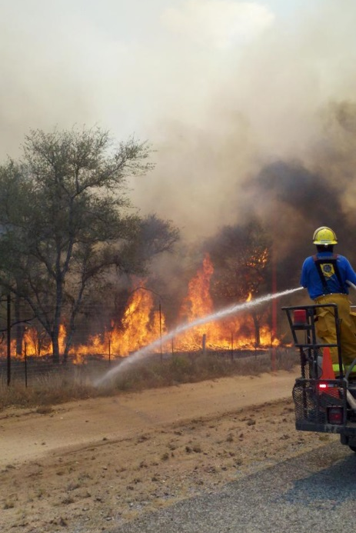
Community Concerns
Wildfires risk has increased due to climate change and recent urbanization
Texas grasslands are highly susceptible to wildfires especially during drought years
In 2011 wildfires in Texas scorched 4,000,000 acres and destroyed nearly 3,000 homes
Source:”
Image: NOAA
Notes:
Wildfires risk has increased due to climate change and recent urbanization
Texas grasslands are highly susceptible to wildfires especially during drought years
In 2011, the state of Texas declared a state of emergency due to the uproar of wildfires that scorched nearly 4,000,000 acres of Texas grasslands, forests, and urban areas and destroyed nearly 3,000 homes.
In recent years, the risk of severe wildfires has been increasing due to weather phenomena such as sequences of wet years and
drought years making recent urban expansion into woodland areas vulnerable to wildfire.
During the year 2010, Texas experienced higher amounts of rainfall, which produced more fuel for fires in the following year.
Image source:
http://www.crh.noaa.gov/bro/?n=2011event_smacfirephotogallery
.

Slide 3
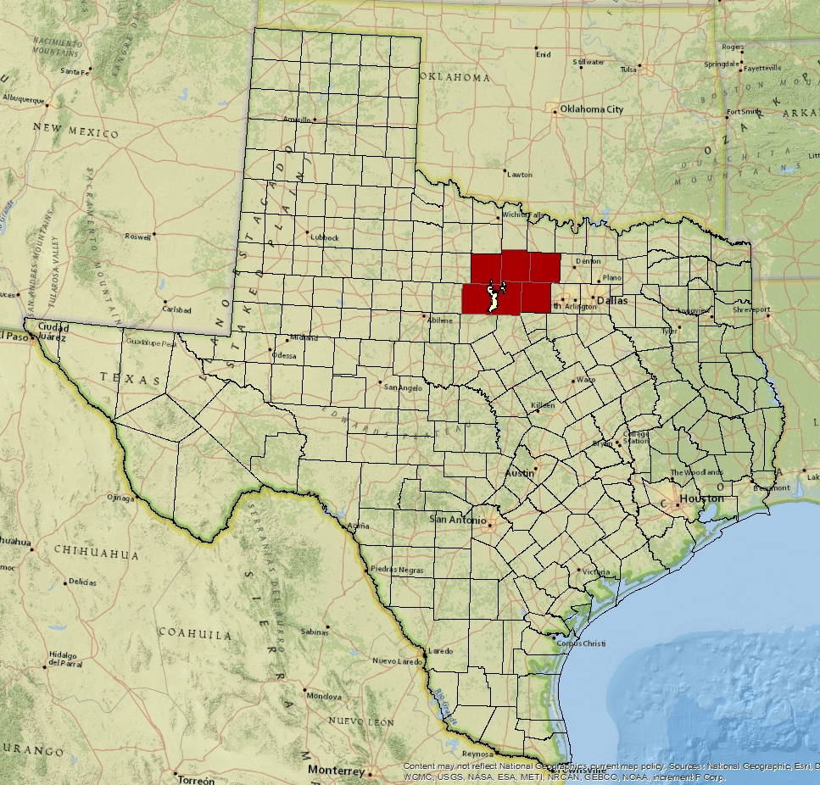
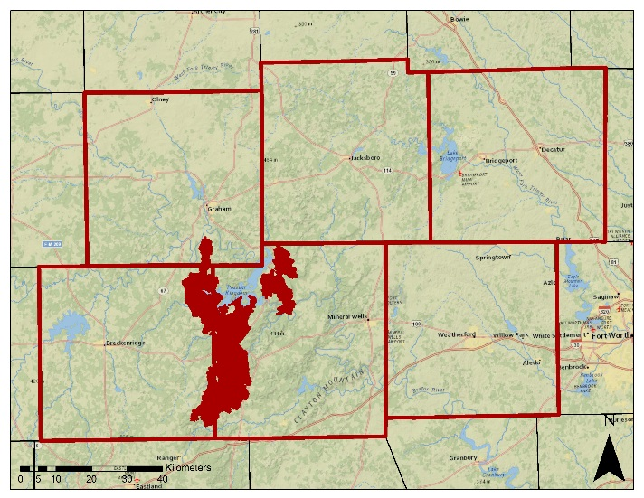
Study Area
The study covers the State of Texas with a case study of the Possum Kingdom Complex wildfires (upper right image) which burned approximately 150,000 acres in 2011.
Notes:
The study covers the entire State of Texas with a case study of the
Possum Kingdom Complex wildfires,
just west of Fort Worth,
which destroyed approximately 150,000 acres in 2011.

Slide 4
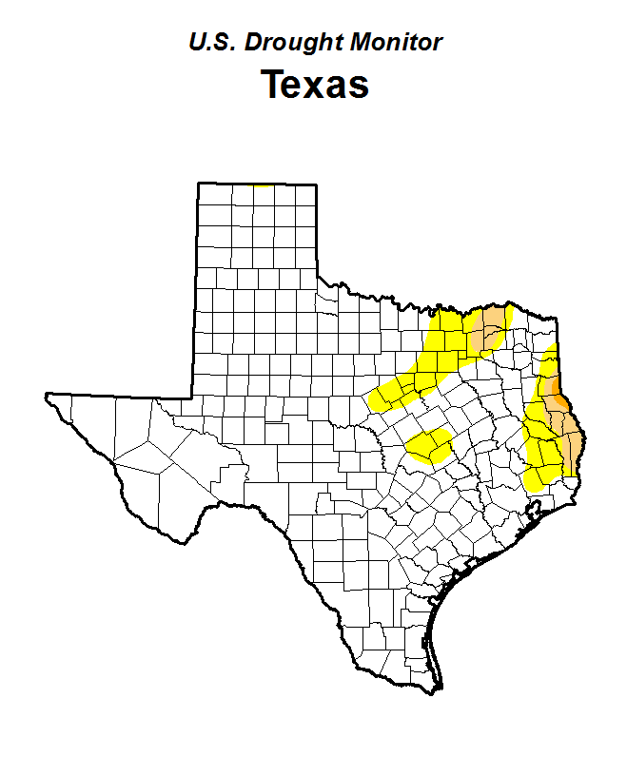
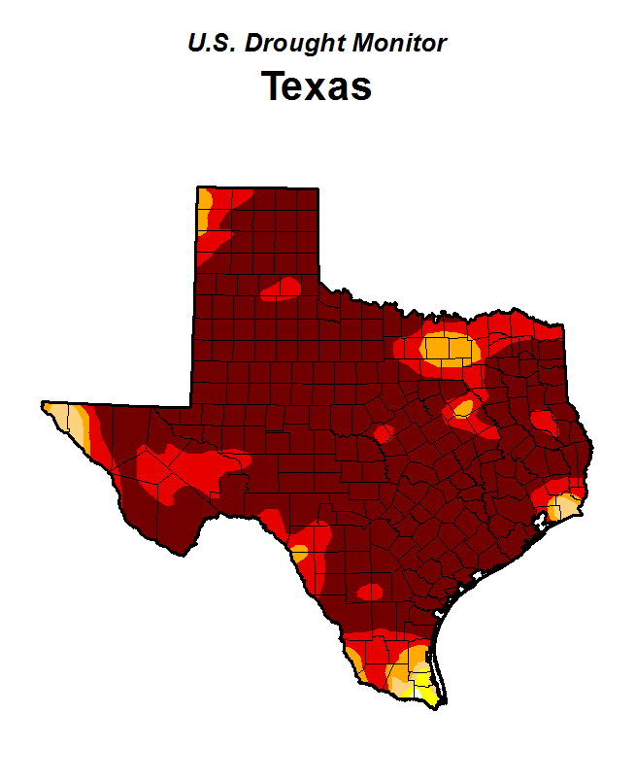
Why 2010-2011?
2010 (Wet Year)
2011 (Drought Year)
Drought Monitor– These maps show the intensity of the 2011 drought across Texas compared to the 2010 drought monitor
Notes:
2010 was an abnormally wet year for Texas and was followed by a historic drought in 2011.
These maps produced by the USDA and NOAA in conjunction with the University of Nebraska-Lincoln
Source:
Image source: http://droughtmonitor.unl.edu/MapsAndData/MapArchive.aspx

Slide 5
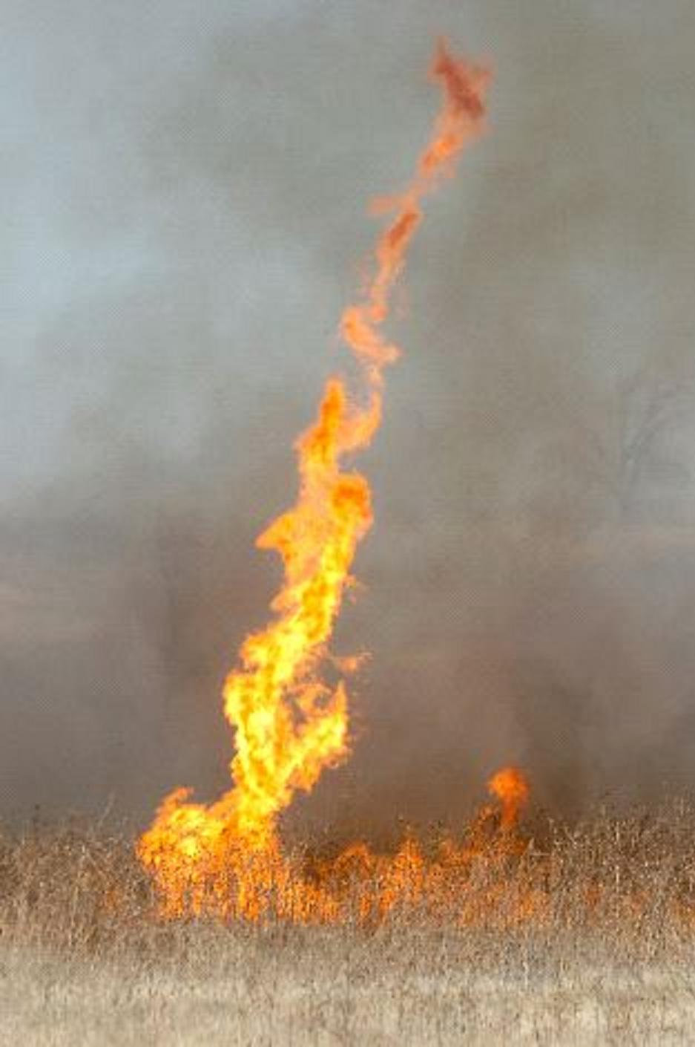
Project Partners
Texas A&M Forest Service –
Partner Objectives:
Assessment of wildfire risk
Monitoring of vegetative fuel loads
Calculating fire behavior
Image: NOAA
Notes:
The partners for this project were the Texas Forest Service who have partnered with DEVELOP for several projects in the past.
They are tasked with evaluating potential fire risk in order to manage and allocate resources for the prevention and containment of wildfires across the State.
A key component for assessing fire risk is the classification and monitoring of vegetative fuel types and fuel loads and to model fire behavior based on the characteristics of each fuel.
They currently use comprehensive fuel mapping techniques using Landsat data but do not have a method to adjust these models to seasonal changes.
Next………………………………………..
Image source:
http://www.srh.noaa.gov/ama/?n=fire_weather

Slide 6
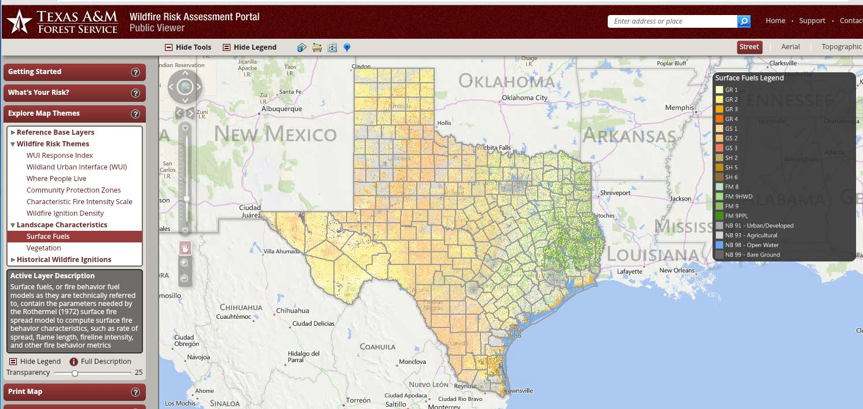
Texas Wildfire Risk Assessment
Fuel mapping – Landsat based 30m maps of vegetative fuels
Weather monitoring – weather patterns and drought indices
Source: Texas Forest Service
Notes:
Methods for wildfire management have typically relied on models based on Landsat data to produce comprehensive fuel load and fuel type maps at 30 meter resolution.
This approach works well in relatively stable forested areas, but does not have the capability to accurately
depict seasonal changes in more dynamic fuel types such as grasslands.
The monitoring and forecasting of weather patterns, especially drought, is also an important component in used predicting fire behavior,
but drought is a cause of increased risk and is hard to quantify the actual response of fuel types on a large scale.
Image source: www.texaswildfirerisk.com

Slide 7
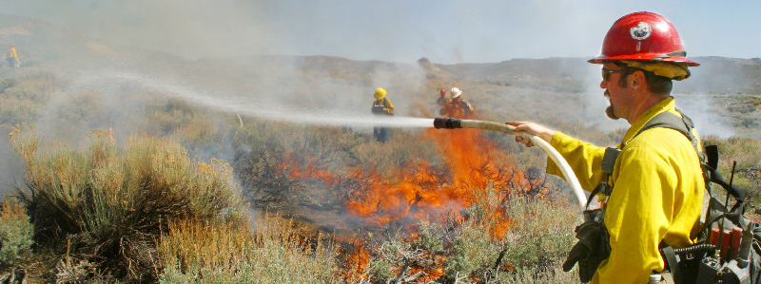
Image: USGS
Objectives
Enhance current fuel mapping capabilities using NASA Earth observation data
Use and demonstrate NASA data to help assess seasonal variations in fuel loads
Compile up-to-date fuel load maps that depict fuel conditions
Notes:
Enhance current fuel mapping capabilities using NASA Earth observation data
Use and demonstrate NASA data to help assess seasonal variations in fuel loads
Compile up-to-date fuel load maps that depict fuel conditions
To provide additional tools wildfire management and fuel modeling.
Image source:
http://www.werc.usgs.gov/OLDsitedata/fire/lv/fireandinvasives/photo_gal.htm

Slide 8
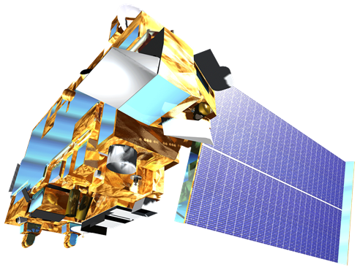
NASA Satellites/Sensors
Sensor | Spatial Resolution | Temporal Resolution
MODIS (Terra and Aqua) Moderate Resolution Imaging Spectroradiometer | 250 m (bands 1-2) 500 m (bands 3-7) 1000 m (bands 8-36) | 1 Day
Landsat 8 OLI Operational Land Imager | 30 m | 16 Days
Notes:
NASA Earth Observations provide a good platform for evaluating wildfire fuel across varied temporal and spatial scales.
For this project the temporal advantages of daily pass MODIS data were combined with spatial advantages of 30-meter Landsat products.
Next………………………………….

Slide 9
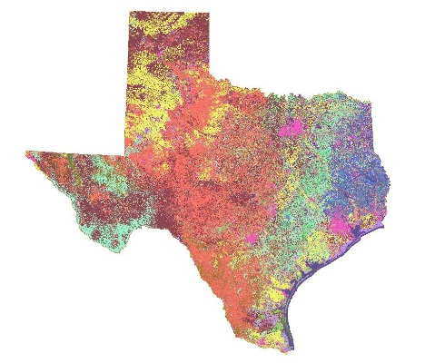
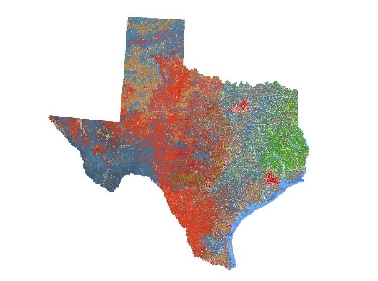
Methodology
Surface Fuel Types
Vegetation
Types
Combined
Fuels and Vegetation
Notes:
Fuel Types
First, Surface Fuel Maps were collected from the Texas Forest Service. These maps indicate the type of fuel that will drive a wildfire and the intensity that it will burn.
Next, Vegetation Type Maps were also collected. These maps depict the dominant vegetation in each area.
These two types of maps were hybridized to create a map that combined the surface fuel and vegetation cover.
This allowed for the investigation of areas where the dominant vegetation cover and the main fuel expected to drive a wildfire are no the same.

Slide 10
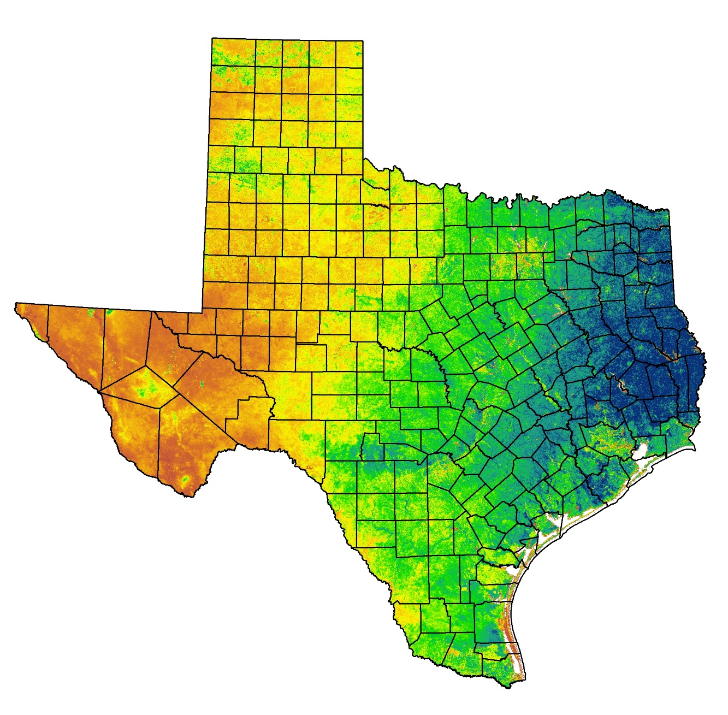
NDVI
2014
Cumulative
NDVI
Normalized
Difference
Vegetation
Index
NDVI = (NIR-Red/NIR+Red)
Measure plant productivity based on the density of greenness of vegetation
Data source: USFS ForWarn
Notes:
In order to make these fuel maps sensitive to fluctuations NDVI was used.
NDVI
(Normalized Difference Vegetation Index) which is useful for quantifying the greenness of vegetation by comparing the amount visible and infrared wavelengths reflected back from the Earth to a satellite sensor.

Slide 11
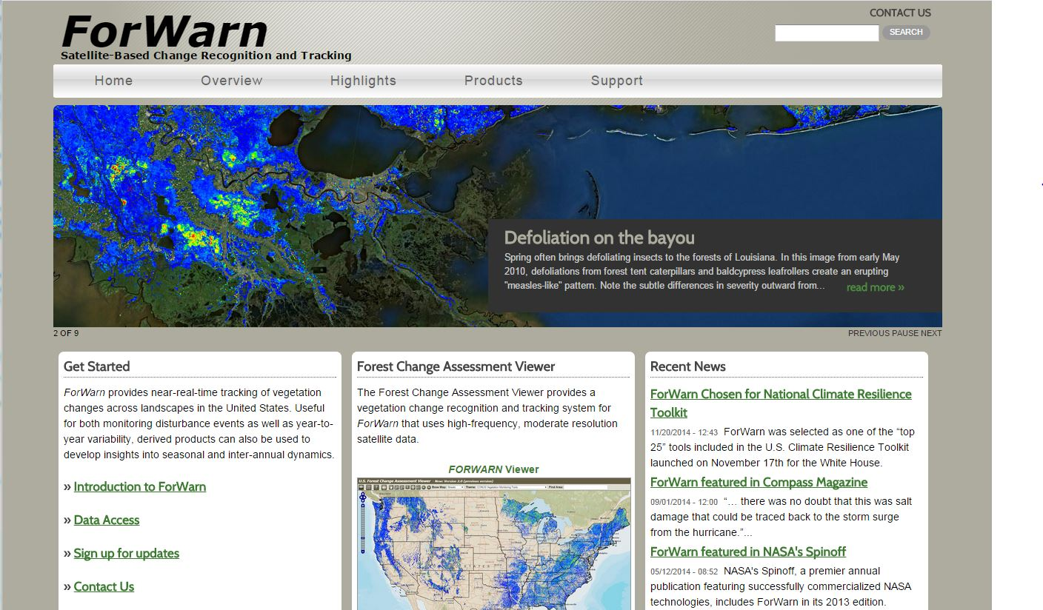
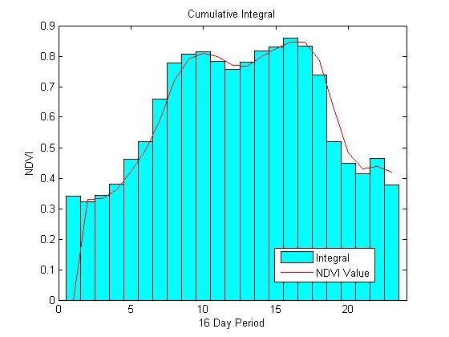
Cumulative NDVI

Slide 12
Methodology
Annual NDVI
2000-2014
Annual NDVI
15 Year Average
NDVI
2014
Notes:
NDVI
First, NDVI (Normalized Difference Vegetation Index) which is useful for quantifying the greenness of vegetation, was compiled from 2000-2014.
By accumulating and combining 8 day NDVI composites for an each year, the build-up of greenness throughout the year was used as a corollary for annual vegetation productivity.
The 15 year average was calculated to provide an annual biomass accumulation baseline for each class.
This was then compared to each annual cumulative NDVI

Slide 13
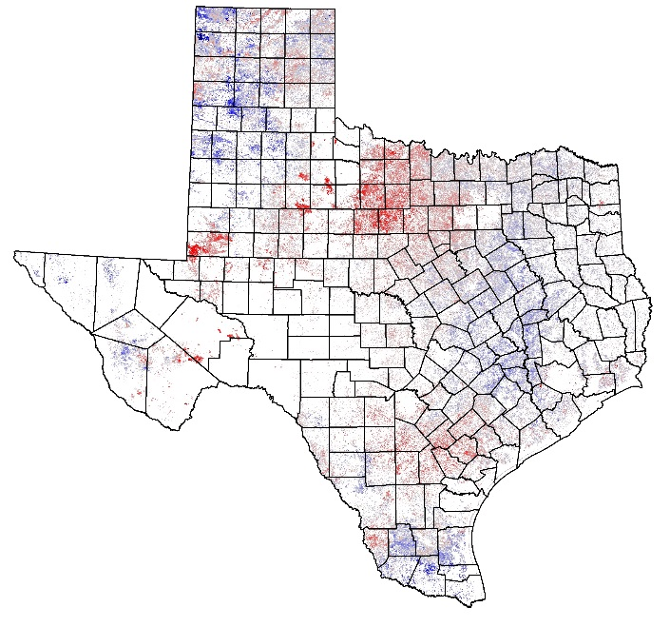
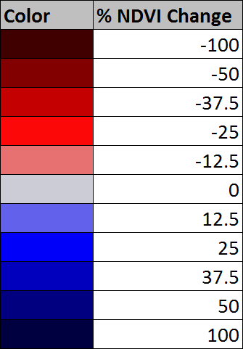
Methodology
Surface Fuel Types
Vegetation
Types
Combined
Fuels and Vegetation
Grassland Annual
Relative Fuel Load
Annual NDVI
2000-2014
Annual NDVI
15 Year Average
NDVI
2014
Notes:
This was then compared to each annual cumulative NDVI to calculate the percent change in mean annual cumulative NDVI or the relative biomass accumulation.
This highlights areas within each fuel type that are above and below average for a particular year.
So how does this translate into the real world?

Slide 14
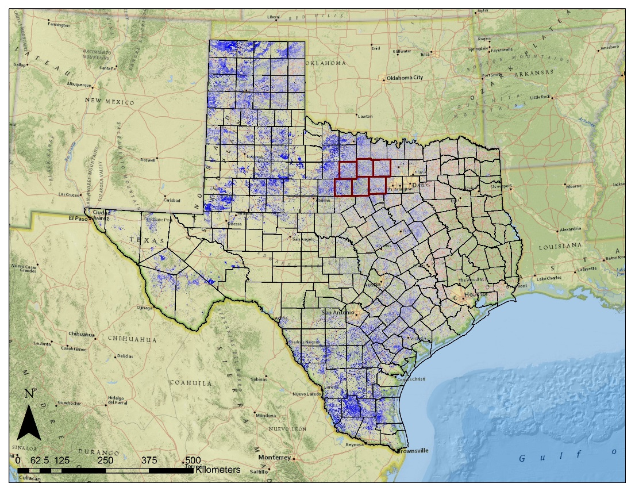
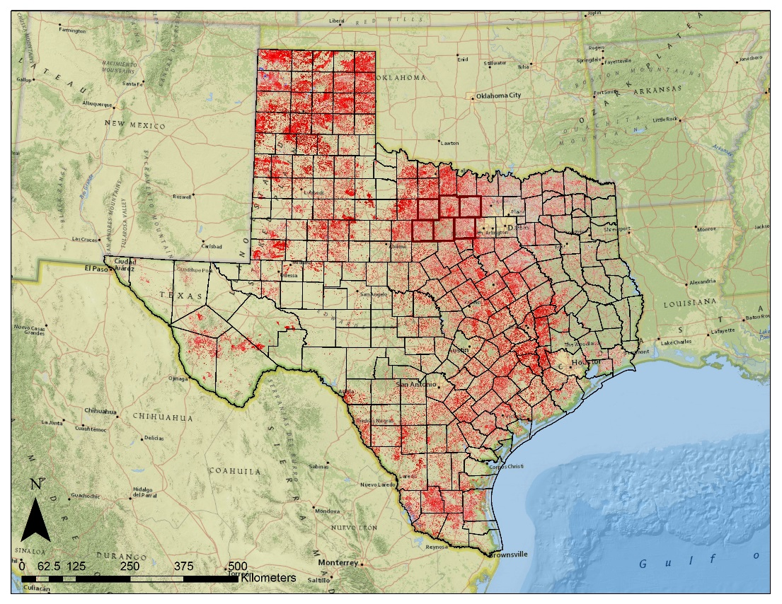
Results - Texas
2010 (Wet Year)
2011 (Drought Year)
2010
Grassland Relative Fuel Loads – Comparison of annual NDVI to 15 year average NDVI for all grass fuel types. Blue tones = higher and red tones = lower than average cumulative NDVI.
Notes:
This effect is evident in these statewide maps produced for 2010 and 2011.
They depict the percent change in mean annual cumulative NDVI of grassland fuels.
The deeper blues represent greater than average and deeper reds represent less than average NDVI response.
So as expected, there was an increase in vegetation productivity in the wetter 2010 and a decrease in the much dryer 2011.
This increased the amount of grass available as fuel and which then dried out in 2011 contributing to more intense wildfires.
Next………………………………..

Slide 15
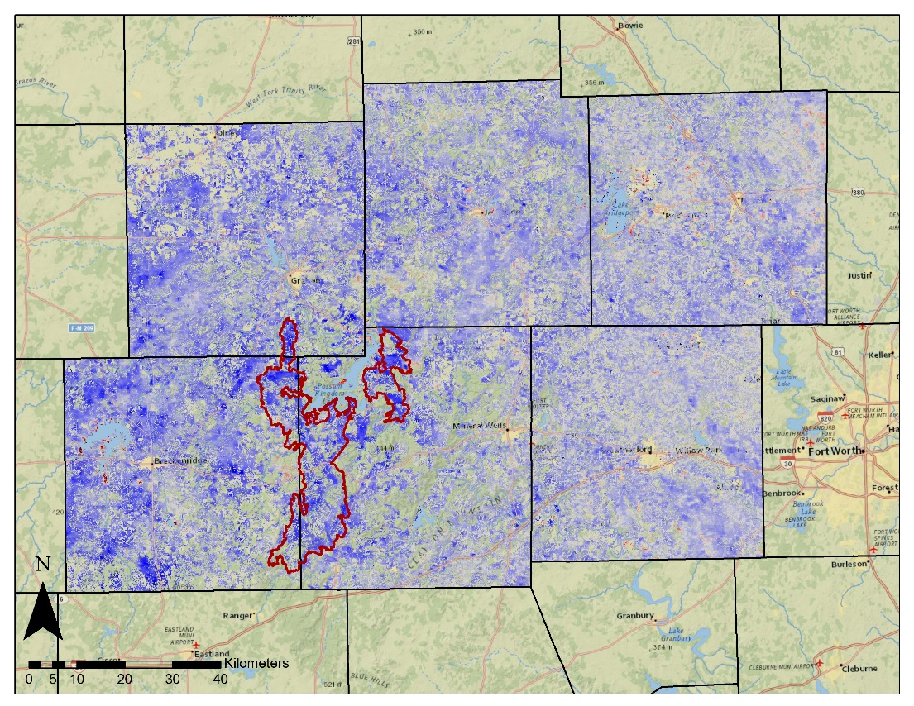
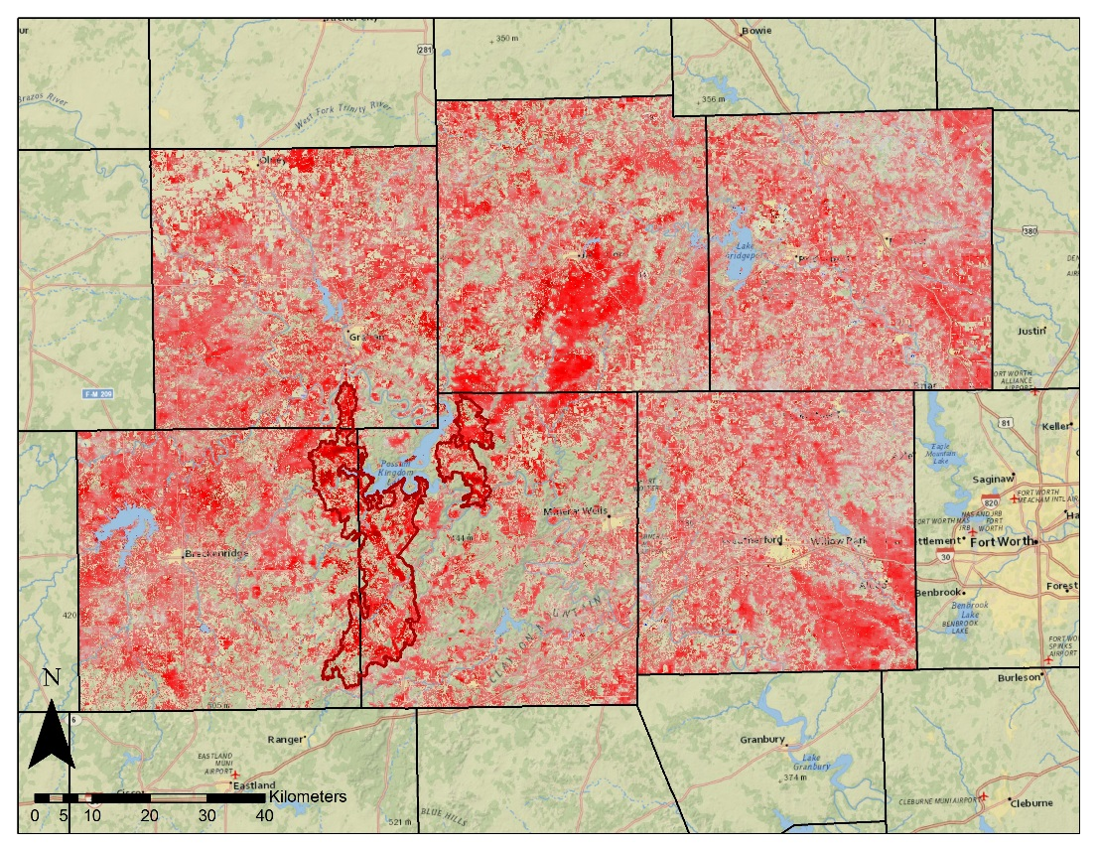
Results – PK Complex
2010 (Wet Year)
2011 (Drought Year)
Grassland Relative Fuel Loads – Comparison of annual NDVI to 15 year average NDVI for all grass fuel types. Blue tones = higher and red tones = lower than average cumulative NDVI.
Notes:
These maps are of the case study of the Possum Kingdom Complex wildfires of 2011.
The increase in vegetation productivity increased the amount of grass available as fuel and then in
2011 that greater biomass dried out resulting in a fire season that had grassland fuel that contained greater biomass than normal which contributed to the intensity and speed of the fires.
Outlined is the perimeter of the largest fire
One of the main drivers of the wildfire was the increase in grassland fuels in 2010 followed by the drying out of the grass in 2011.
The 2011 fire season was particularly bad due to an abnormally wet year in 2010 that caused an increase in biomass growth.
This was followed by an abnormally dry year in 2011.
Using NDVI as a proxy for biomass, it is clear that the extra biomass growth in 2010 was a primary factor in the severity of the 2011 fire season.

Slide 16
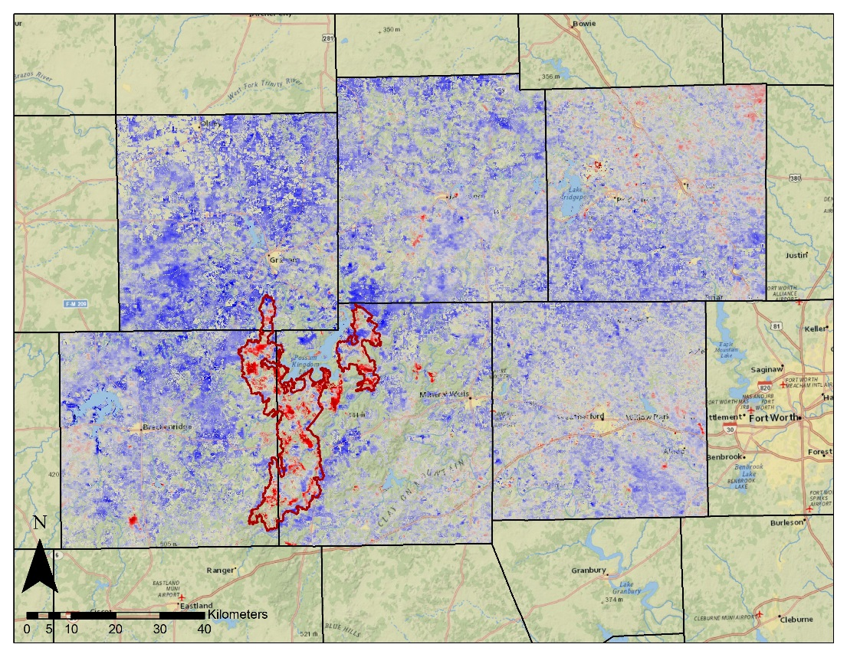
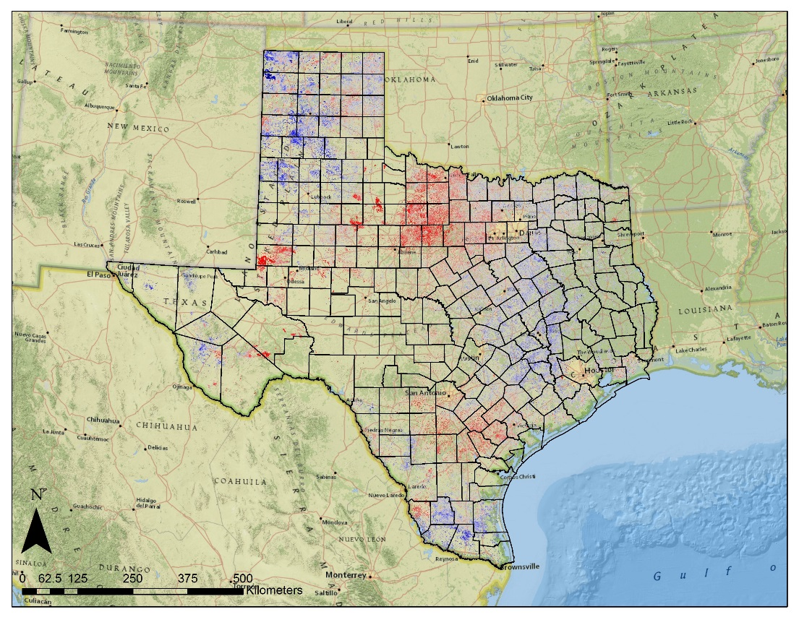
Results
2012 (Post Fire)
2014
Grassland Relative Fuel Loads – Comparison of annual NDVI to 15 year average NDVI for all grass fuel types. Blue tones = higher and red tones = lower than average cumulative NDVI.
Notes:
The following year in 2012 the vegetation productivity was greater than average with the obvious exception within the footprint of the fires.
This was likely due to the burning of large quantities of grass during the fires.
This statewide 2014 map shows how the percent change in cumulative NDVI can vary throughout the state with some areas showing increased productivity and others showing a decrease.
These products are useful in depicting the relative fuel load to quantify the amount difference in vegetation growth.
This type of product works well to understand how much areas have grown relative to the average rates for that area.
This is especially useful for understanding “fuel loading” or the extra amount of biomass that can build up in an area like it did in 2010.
This provides fire risk mangers with additional information of relative growth within a to adjust models based on actual amount of

Slide 17
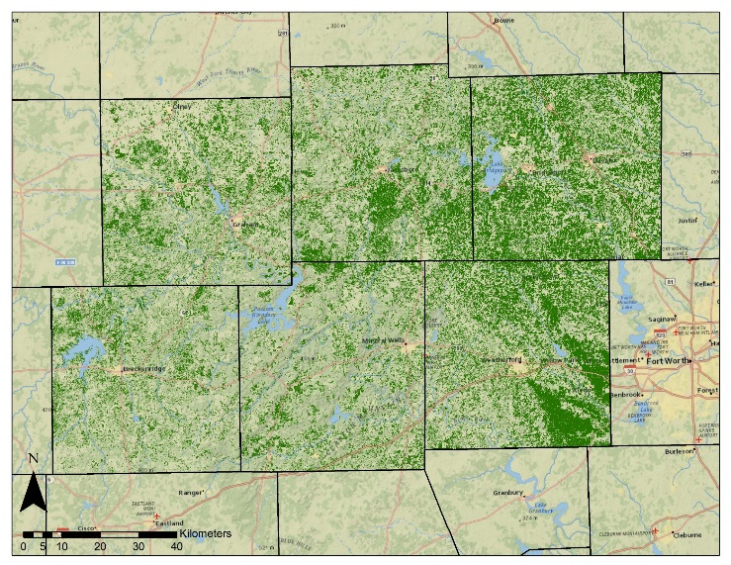
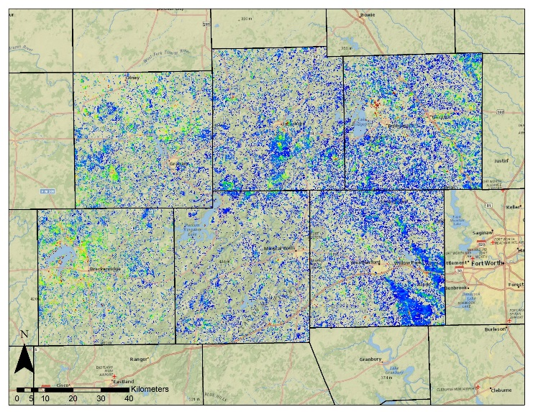
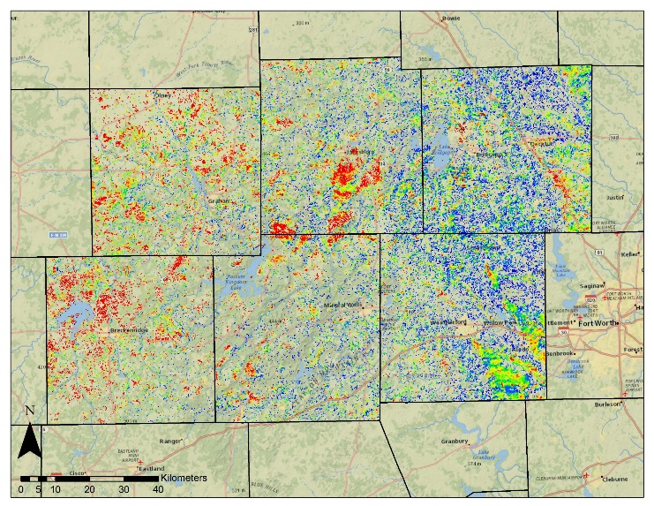
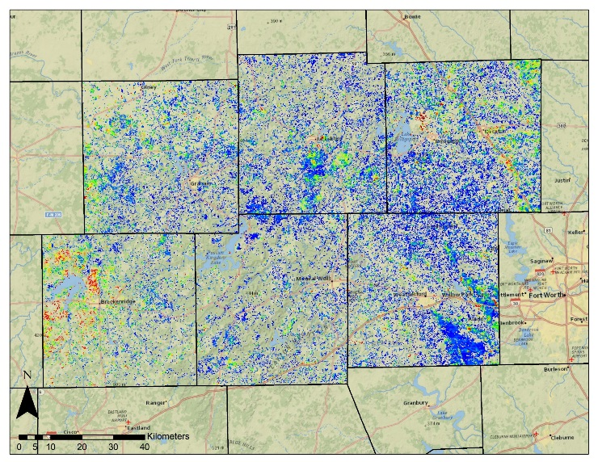
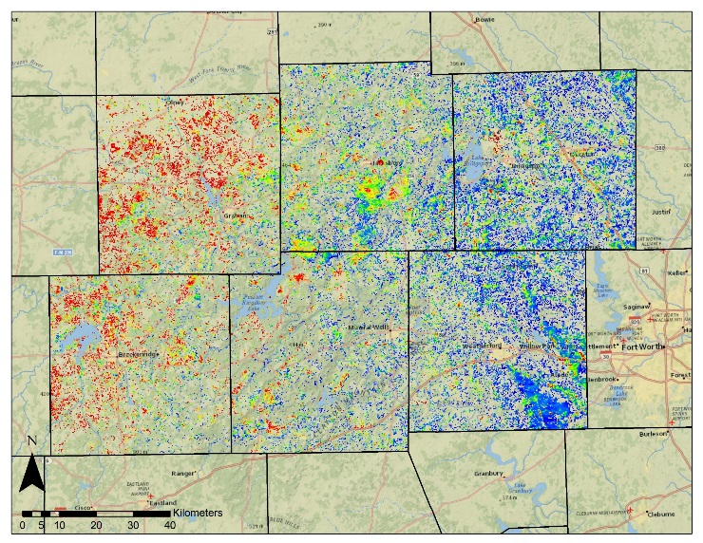
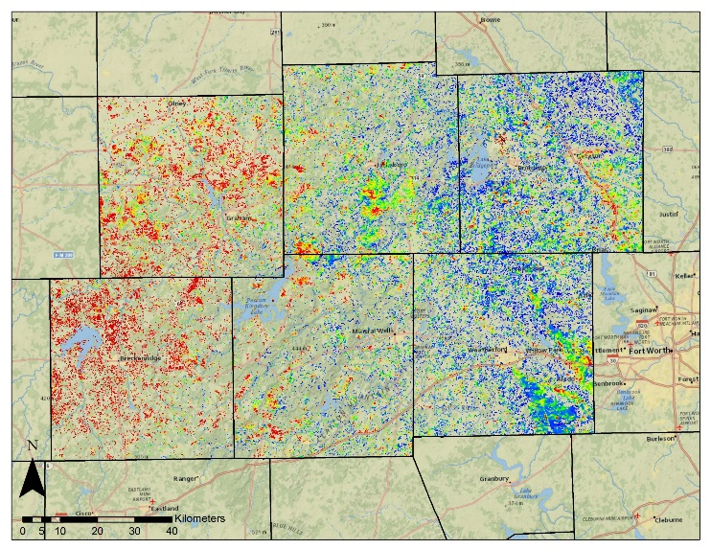
Results
TFS (Gr2)
2010
2011
TFS (Surface Fuels)
2014 (Relative Fuels)
2012
2013
2014
Fuel Type Maps – The Surface Fuels map was adapted from the Texas Forest Service (TFS) of Gr2 fuel. 2010-2014 maps show change in annual cumulative NDVI compared to zonal mean for Gr2.
Notes:
Another way that these MODIS derived cumulative NDVI products were used was to calculate zonal means or an average NDVI value for each type of fuel.
The Surface Fuel map on the top- left represents the type of map currently used by the forest service.
Here showing only Grass Fuel Type 2 or Gr2.
The 2010-2014 maps, were created by comparing the annual cumulative NDVI for each year to the zonal mean for the gr2 fuel type.
This method showed temporal variations within this fuel type as related to the average NDVI for this particular fuel type.
The blue tones represent above average NDVI and the red tones represent below average.
This method illustrates another way to analyze relative fuel loads based on vegetation characteristics.

Slide 18
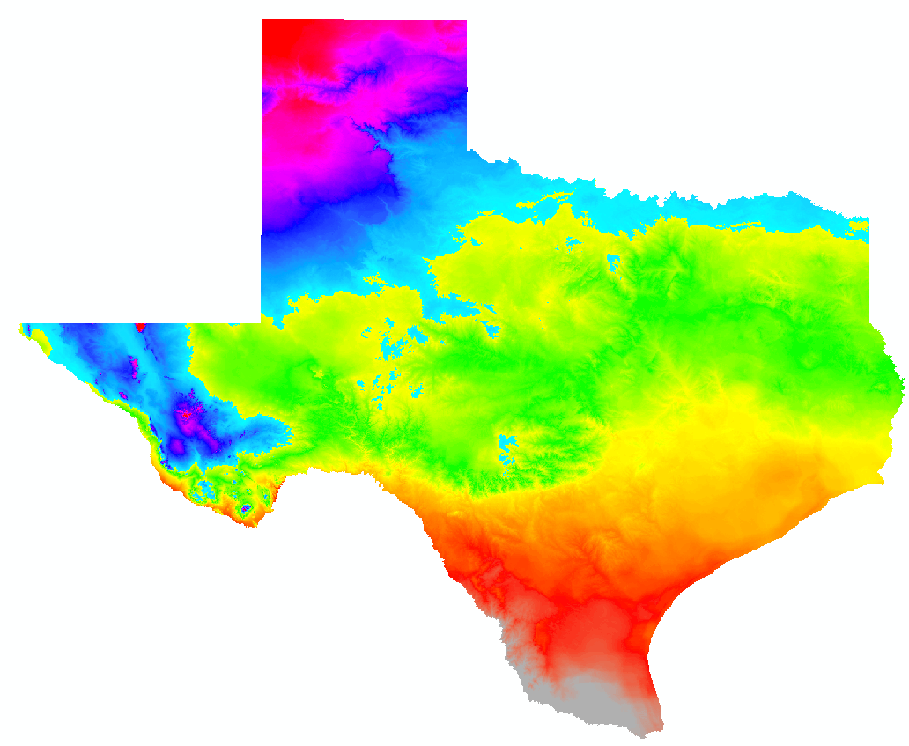
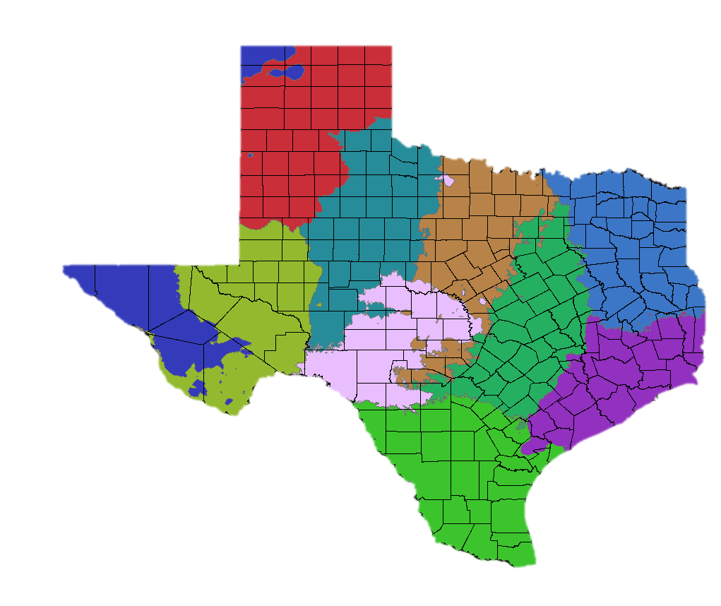
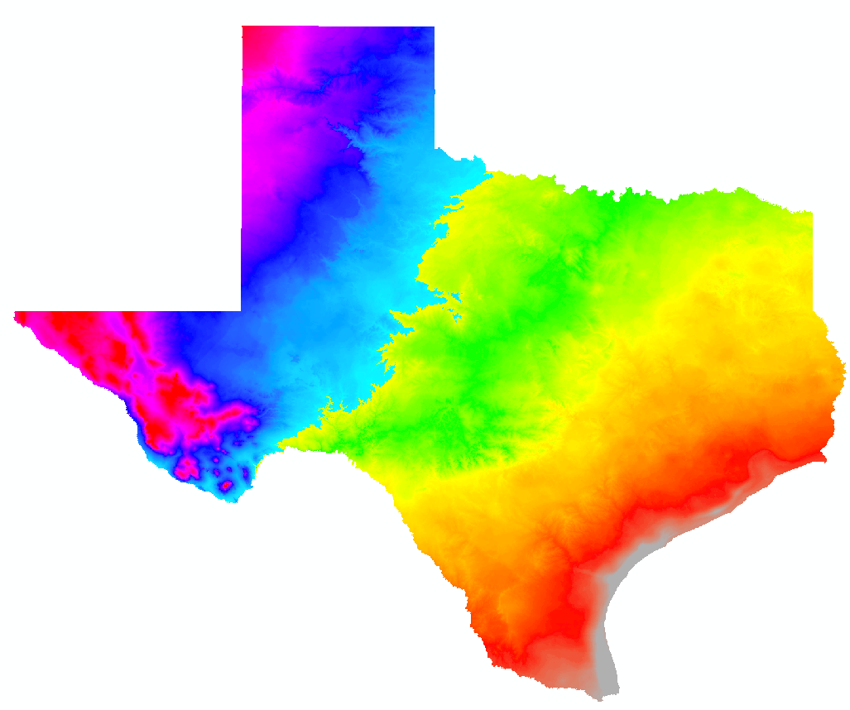
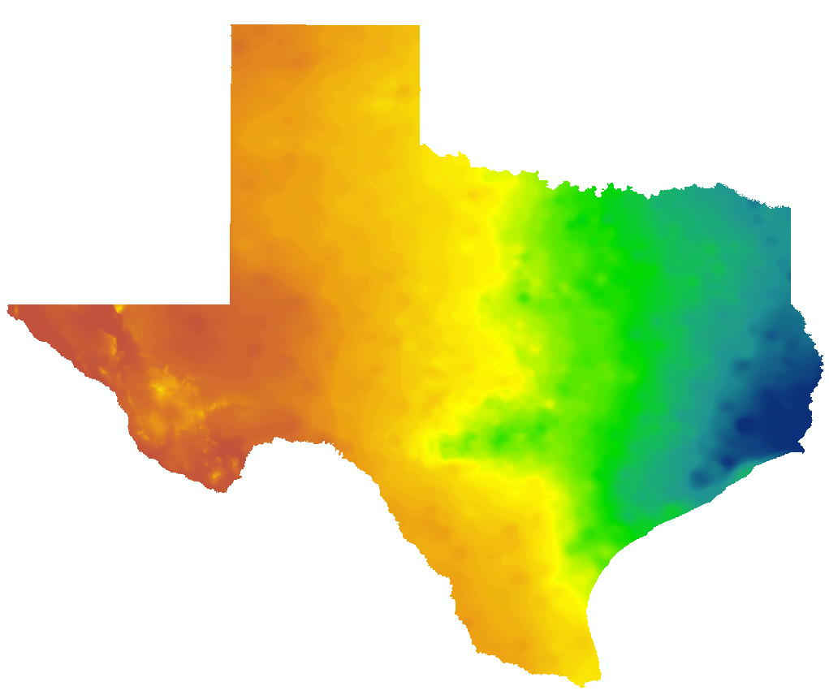
Methodology
30 Year Average Temperature
30 Year Average Dewpoint
30 Year Average Precipitation
Climate Zones
Notes:
The problem is that Texas is a large state. So we separated it into 10 climate zones so that
To create the climate zones, an unsupervised classification was run on the 30 year averages for temperature, dewpoint temperature, and annual precipitation. We then clipped the land cover data to the climate zones. The land cover types were then used as zones to run zonal statistics.

Slide 19
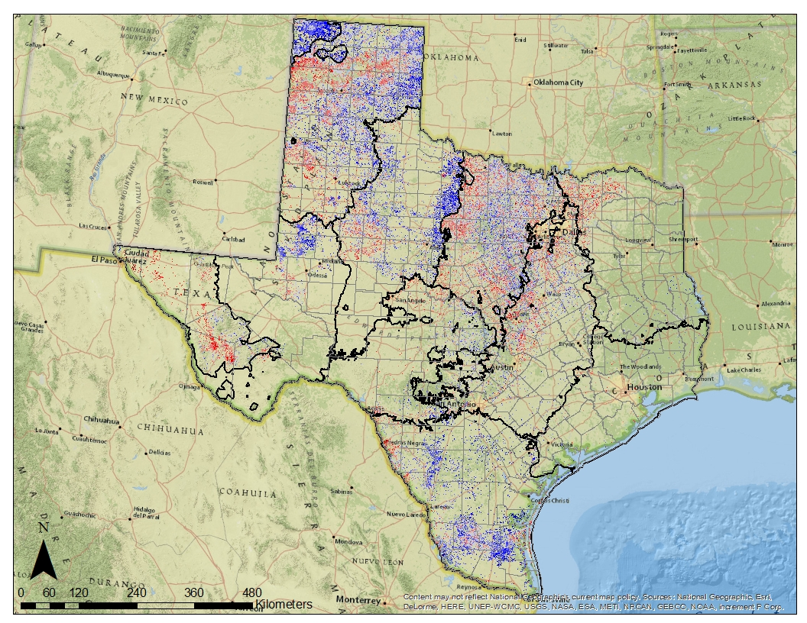
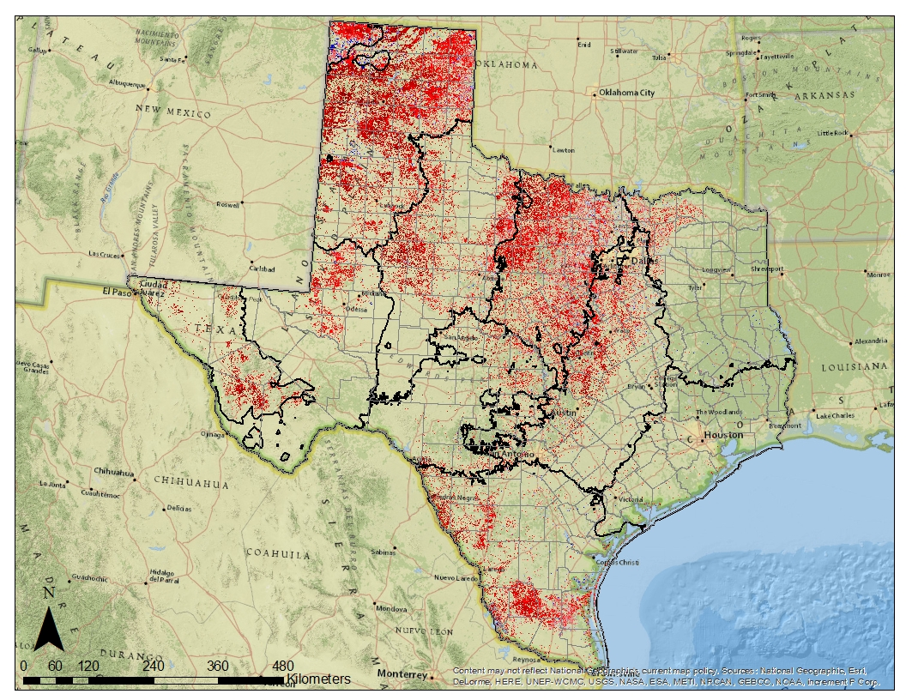
Results - Texas
2010 (Wet Year)
2011 (Drought Year)
2010
Grassland Relative Fuel Loads – Comparison of annual NDVI to 15 year average NDVI for all grass fuel types. Blue tones = higher and red tones = lower than average cumulative NDVI.
Notes:
This effect is evident in these statewide maps produced for 2010 and 2011.
They depict the percent change in mean annual cumulative NDVI of grassland fuels.
The deeper blues represent greater than average and deeper reds represent less than average NDVI response.
So as expected, there was an increase in vegetation productivity in the wetter 2010 and a decrease in the much dryer 2011.
This increased the amount of grass available as fuel and which then dried out in 2011 contributing to more intense wildfires.
Next………………………………..

Slide 20
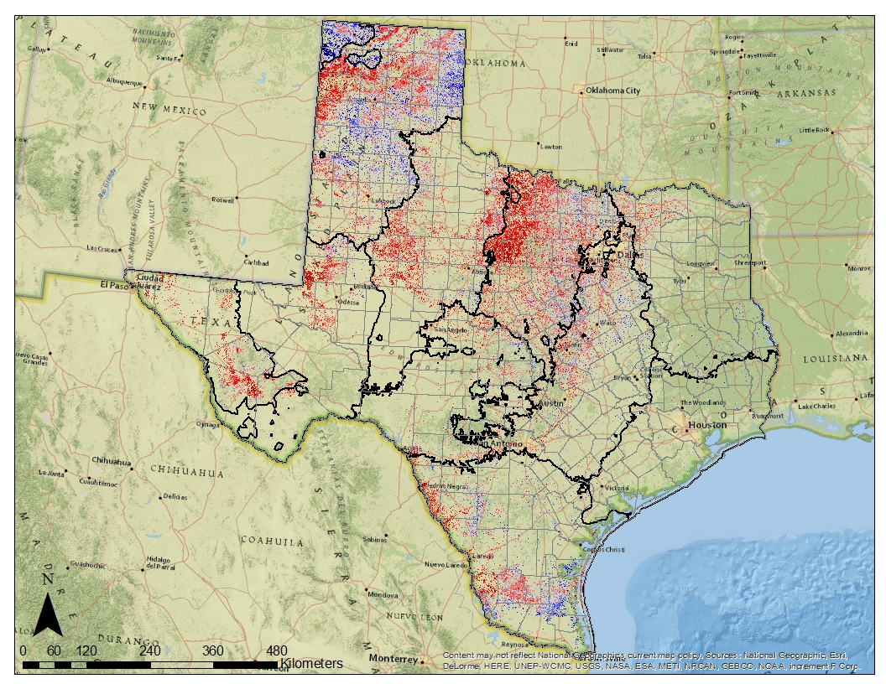
Results - Texas
2014
Grassland Relative Fuel Loads – Comparison of annual NDVI to 15 year average NDVI for all grass fuel types. Zonal mean for each fuel and climate zone. Blue tones = higher and red tones = lower than average cumulative NDVI.
Notes:
This effect is evident in these statewide maps produced for 2010 and 2011.
They depict the percent change in mean annual cumulative NDVI of grassland fuels.
The deeper blues represent greater than average and deeper reds represent less than average NDVI response.
So as expected, there was an increase in vegetation productivity in the wetter 2010 and a decrease in the much dryer 2011.
This increased the amount of grass available as fuel and which then dried out in 2011 contributing to more intense wildfires.
Next………………………………..

Slide 21
Conclusions
Fuel Loads
Geospatial information on grassland fuel loads are important for assessing wildfire risk
MODIS NDVI
Annual cumulative MODIS NDVI offers a means to monitor relative fuel loads
Fuel Models
Such MODIS NDVI products can serve as inputs to fuel load models
Notes:
Geospatial information on grassland fuel loads are important for assessing wildfire risk
Annual cumulative MODIS NDVI offers a means to monitor relative fuel loads
Such MODIS NDVI products can serve as inputs to fuel load models
Relative fuel loads based on MODIS NDVI is a good tool to assess fluctuations in grassland fuels.
Provides wildfire risk managers a new method for adjusting fuel model according to the actual changes grassland growth rates.
Using MODIS data to detect seasonal changes in the Texas Grasslands is a crucial step in moving towards real-time assessment in fuel loads.
The Texas Forest Service can use this data in the future to better assess the wildfire risk based on recent observations rather than using a static fuel model.

Slide 22
Future Work
Seasonal
Adjust model to reflect specific points in the growing season
Phenology
Investigate timing of growing season of certain species
Data Fusion
Explore other methods of combining MODIS and Landsat data, such as STAR FM

Slide 23
Dr. Kenton Ross (NASA DEVELOP National Science Advisor, LaRC)
Joseph Spruce (Senior Scientist and Lead Science Advisor at NASA SSC)
James “Doc” Smoot (Senior Scientist and Assistant Science Advisor at NASA SSC)
Advisors
Partners
Texas Forest Service; Tom Spencer and Curt Stripling- Predictive Services
USDA Forest Service; William “Bill” Hargrove- PI for the ForWarn Early Warning System
Trade names and trademarks are used in this report for identification only.
Their usage does not constitute an official endorsement, either expressed or implied, by the National Aeronautics and Space Administration.

Slide 24
Questions?
Notes:
Questions?

