Slide 1
SOUTHEAST MICHIGAN
Health & Air Quality
Identifying Trends of Ground-level Ozone Precursors in Southeast Michigan
Mariam Moeen (Project Lead), Helen Turvene, Yuan Lin & Albert Kodua
Virginia – Langley
Notes:
Hi everyone! My name's Mariam Moeen and I'm the project lead for the SMHAQ project this fall at the Virginia-Langley DEVELOP node. Before I get started, I wanted to go ahead and introduce the rest of the team which included (**Everyone wave when their name is called**) Helen Turvene, Yuan Lin and Albert Kodua.
Today, our team's going to be giving a brief overview of what our project entailed. We assessed and visualized the distribution of three pollutants in southeast Michigan and northern Ohio over a 3-year time period to aid our project partners which (**insert name**) will talk about in the next slide.

Slide 2
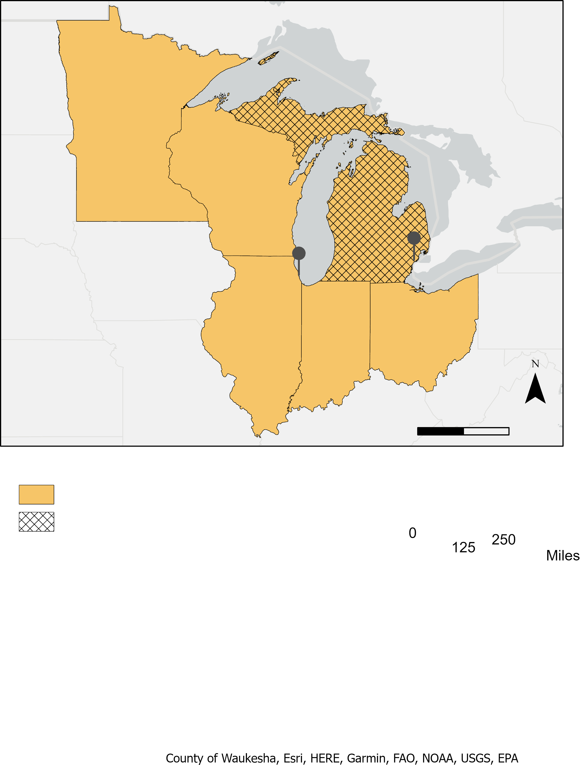
PARTNERS
Michigan Department of Environment, Great Lakes, and Energy's (EGLE)Air Quality Division
Lake Michigan Air Directors Consortium (LADCO)
Chicago
Detroit
Jurisdiction
LADCO
EGLE
0 125 250
Notes:
DEVELOP involves cooperation between participants and partners to address environmental issues of interest to the partners.
Our project partnered with two organizations. The first was the Air Quality Division of the Michigan Department of Environment, Great Lakes, and Energy or EGLE. The mission of the Air Quality division of EGLE is to monitor air quality and to meet Environmental Protection Agency (EPA) standards. As a Michigan government department, EGLE's jurisdiction is the state of Michigan, but it also collaborates with nearby states and provinces to address air quality concerns. Our second partner was the Lake Michigan Air Directors Consortium or LADCO. LADCO works with public agencies within the states colored orange in the map by providing technical support on air quality related issues.
LADCO and EGLE mainly use intricate computer models and in situ data to guide air quality improvement efforts in the region. However, our partners are interested in applying Earth Observations in their decision-making processes and our team helped bring insight into the utility of Earth Observations in air quality monitoring.

Slide 3
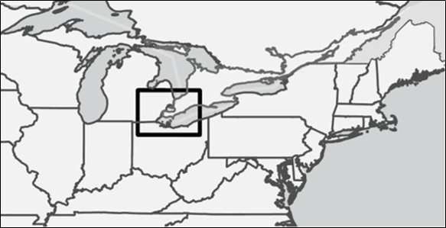
STUDY AREA
0 12.5 25 50
Sarnia
Detroit
STUDY PERIOD
May through September
of 2019-2021
Cleveland
Notes:
After consulting with our partners, our study area focused on a subset of the great lakes region. This area encapsulated industrial centers of interests to our partners which included: Detroit, Michigan; Sarnia, Ontario and Cleveland, Ohio. Additionally, there is a located map in the top right corner which shows the eastern united states and Canada with our study area enclosed in the thick, black bounding box.
*Click for animation*
Our study period ran from May through September of 2019-2021. We looked at only these 5 spring/summer months as opposed to all months because cloud cover is less prevalent over the area in the spring and summer. Cloud cover can obstruct the signal of Earth Observation instruments. Additionally, many pollutants are formed more readily through UV-ray exposure. Since sun rays are more powerful in our study area in the spring and summer months, pollutant trends will be more distinct.

Slide 4
COMMUNITY CONCERNS
Industrialized
regions
Ground-level ozone
Ground-level ozone
=
public health hazard
Health disparities exist between different demographic groups
Image credit: Unsplash
Notes:
Here's an image of downtown Detroit. Areas such as this, with heavy industrialization, tend to have high levels of pollutants which lead to the production of ground-level ozone. (**Click next for first textbox**) While ozone in the upper-atmosphere protects earth from harmful UV rays, ground-level ozone can adverse health effects. Ground-level ozone results from certain anthropogenic pollutants reacting with sunlight. (**Click next for second textbox**) Ground-level ozone can exacerbate respiratory health issues like asthma and congestion. For example, asthma is the leading cause of school absences in Detroit. Even more severe issues can occur to humans depending on the level of ozone exposure, including death. (**Click next for the third textbox**) Another factor that influences the level of ozone exposure to humans is not felt equally as those living in impoverished and disenfranchised neighborhoods have shown to be more affected by poor air quality. An example of this disparity would be that the rate of asthma hospitalizations for black residents of Detroit is 30% higher in comparison to white residents.
I'll hand it off to (**name**) to describe our project objectives.
------------------------------Image Information Below ------------------------------
•Image Credit: Creative Hina By.Queelen
•Image Source: (https://images.unsplash.com/photo-1612095547899-899b4159ef53?ixid=MnwxMjA3fDB8MHxwaG90by1wYWdlfHx8fGVufDB8fHx8&ixlib=rb-1.2.1&auto=format&fit=crop&w=1289&q=80)

Slide 5
OBJECTIVES
Acquire
data from two satellite sensors: Sentinel-5P TROPOMI and Aura OMI
Generate
trend maps of atmospheric gas’ distribution (NO2, CH4, HCHO)
Assess
spatio-temporal variation of gases
Notes:
While our partners have experience with in situ monitoring of air quality, It's difficult to measure ground-level ozone through satellites due to the layer of ozone in the upper-atmosphere. However, satellites can identify the concentrations of pollutants that contribute to ground-level ozone precursors. The ozone precursors our project focuses on include: nitrogen dioxide, formaldehyde and methane. Our first objective was to acquire data from two satellite sensors: ESA's Sentinel-5p TROPOMI and NASA's Aura OMI for 5 months (May-September) for 3 years (2019-2021). Second, we generated trend maps of the ozone precursors' distributions. Lastly, we assessed the spatio-temporal variation of gases which will be used for further work by our partners.

Slide 6
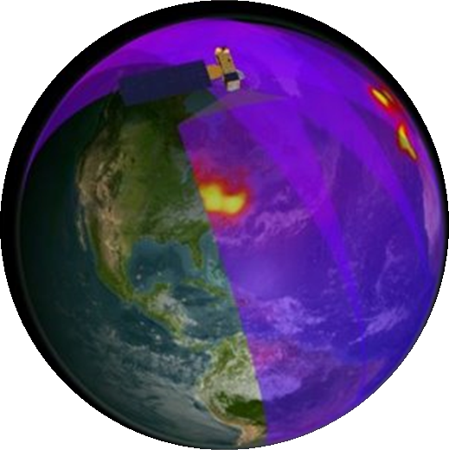
Satellites & Sensors Used
OMI
Aura (2004, NASA)
NO₂
Yearly maps
TROPOMI
Sentinel-5p (2017, ESA)
NO₂, HCHO, CH₄
Monthly and yearly maps
Image credit: ESA (left), NASA (right)
Notes:
We compared data from two satellites for our project. For all three gases, we analyzed data from TROPOMI aboard the Sentinel-5p satellite of the European Space Agency, and for nitrogen dioxide we used data from OMI aboard NASA's Aura satellite. TROPOMI, which is a newer instrument, has the advantage of higher resolution and less noise in its data, so we were able to make both monthly and yearly maps for its data, while having only yearly ones for OMI.
Left image: found on DEVELOPedia - ESA image, Link:https://www.esa.int/ESA_Multimedia/Videos/2017/08/Tropomi_unfolds
Right image: NASA – OMI, Link: https://svs.gsfc.nasa.gov/2948

Slide 7
METHODOLOGY
Download
ESA TROPOMI & OMI Data from NASA Earth Data
Re-grid & Average
Daily and Monthly Oversampled Files
Display
The Resulting Oversampling Files in ArcGIS
Notes:
For our methodology, developing an iterative methodology was an efficient way in processing our data. Firstly, we downloaded Level 2 ESA TROPOMI and NASA OMI satellite data from the NASA Earth Data website for each pollutant. After compiling the data, we utilized programs in the IDL programming language to re-grid and generate averages of the daily observations into monthly and yearly temporal ranges. Finally, using ArcPy we gave each file a spatial reference and outputted it as a .tif file so it could be visualized into ArcGIS software for analysis.

Slide 8
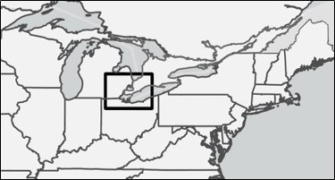
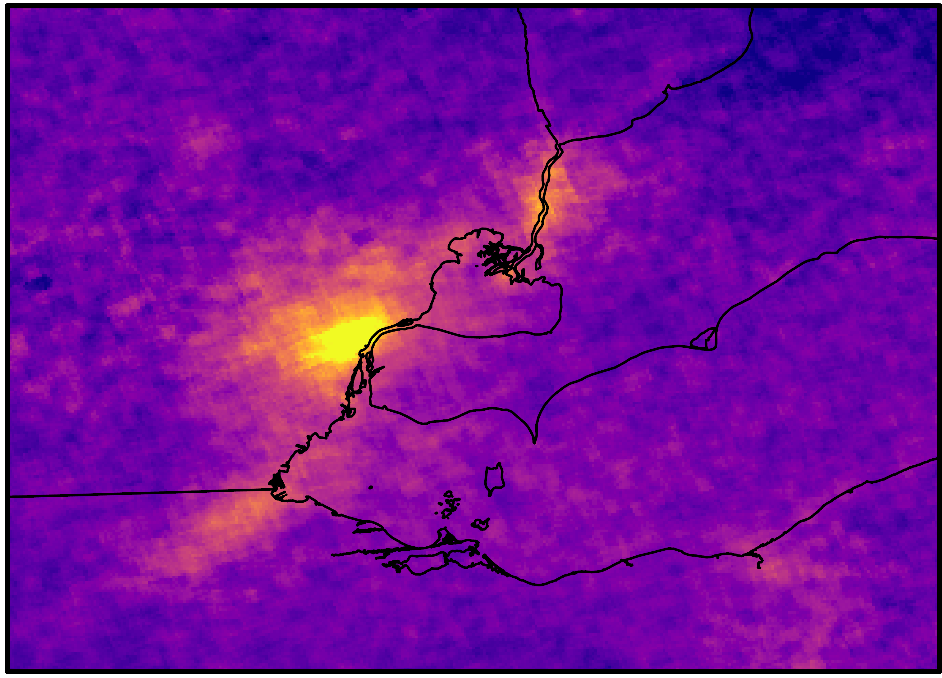
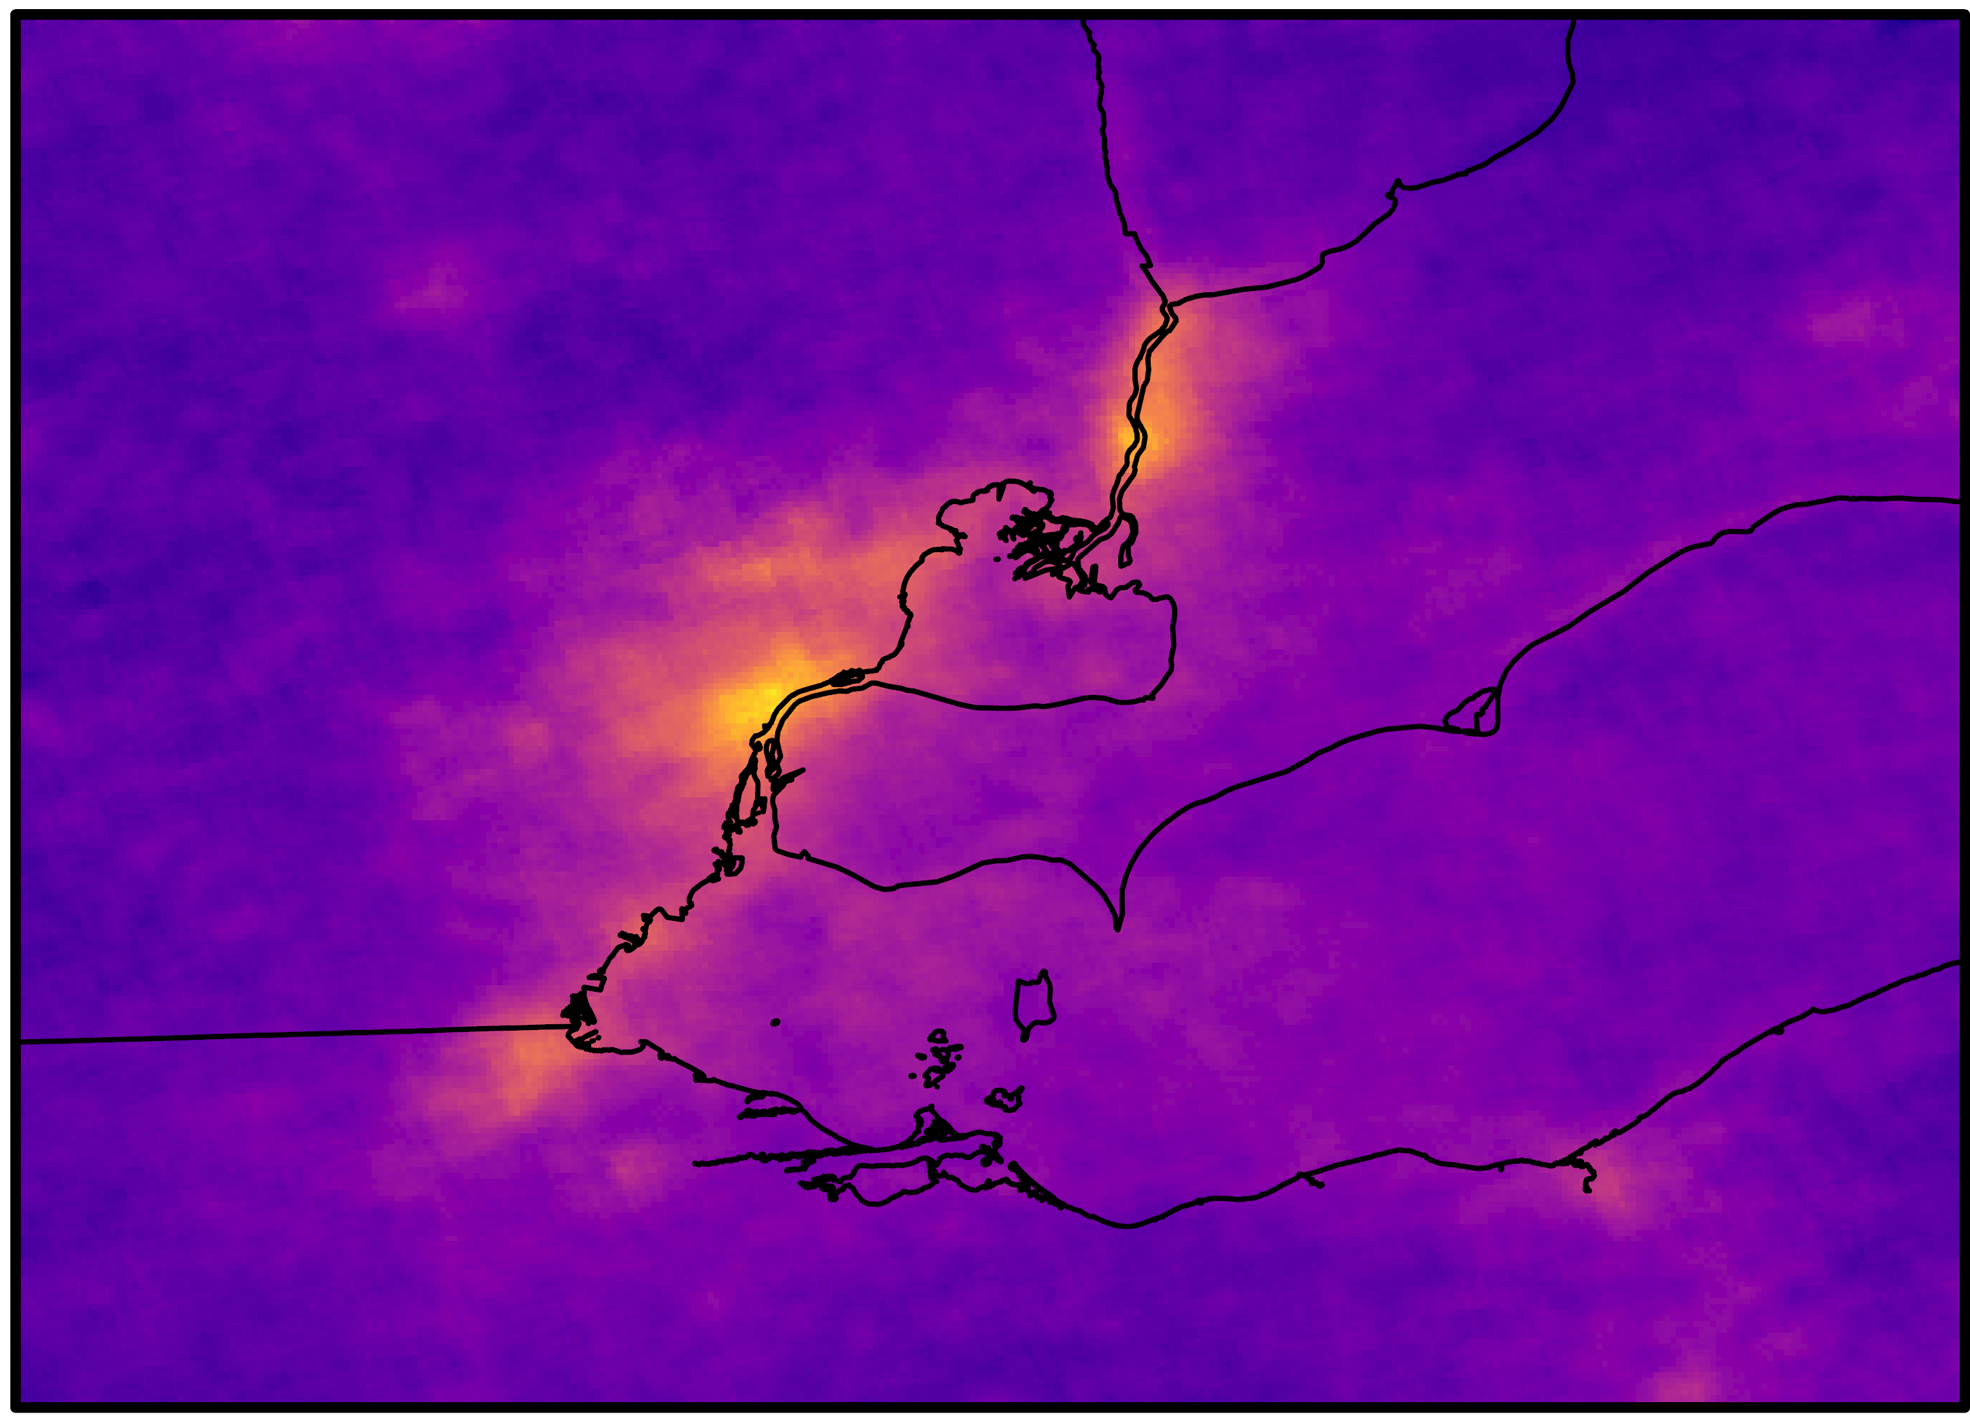
RESULTS – NITROGEN DIOXIDE
September
2021
Year
2021
Molecules/cm²
5e15
0 12.5 25 50
9e14
Notes:
The first gas we applied our methodology to was nitrogen dioxide. On the left hand side, you can see the monthly average for September and on the right hand side is the yearly (May through September) average of 2021. By utilizing the legend in the bottom-right hand corner of the page, we see that the closer the colors on the map are to yellow the higher the NO2 concentration. The closer the colors are to dark purple, the lower the NO2 concentration. We can observe that higher concentrations of NO2 are seen in proximity to urban areas (particularly areas such as Detroit, Michigan, and Sarnia, Canada), and lower concentrations are visible in more rural locations.

Slide 9
RESULTS – FORMALDEHYDE
September
2021
Year
2021
Molecules/cm²
2e16
0 12.5 25 50
2e15
Notes:
In comparison to NO2 data, formaldehyde is noisier (or not representative of that gas) and therefore more difficult to use in hotspot identification. These results are expected since formaldehyde tends to have a less distinct characterization which makes it difficult to separate from background attributes (such as land or air molecules). In the averaged September 2021 image, it's difficult to make out any trends or patterns. These kinds of averages don't necessarily reflect air quality data accurately and can give a false sense of where higher concentrations are located. The yearly average reflects the data in a similar manner. However, looking at this data shows that even after data is averaged/oversampled, it still doesn't compensate for overtly noisy data (at least at the monthly or yearly time scales). Averaging over greater temporal time scales, however, may help work around noise in data, but that would depend on the kind of imagery and the level of noise.

Slide 10
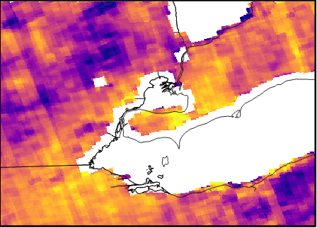
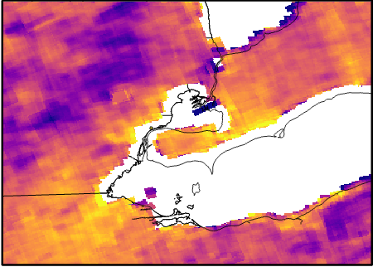
RESULTS – METHANE
September
2021
Year
2021
Parts per billion (ppb)
1.9e3
1.8e3
0 12.5 25 50
Notes:
Lastly, these maps show the monthly distribution for methane in September (on the left) and the yearly average (on the right). Right of the bat, you'll notice a huge portion of the data is missing and this is due to the manner Earth Observations measure methane. Methane measurements over dark areas like water bodies and cities is quite noisy which is why it isn't included in the final data products. In the monthly map, we see that there are clearer areas of high/low methane concentrations, but the yearly average is much clearer and helps solidify the areas in which those trends are visible.

Slide 11
RESULTS – OMI NO₂
Year
2021
4e15
0 12.5 25 50
7e14
Notes:
We wanted to compare some of our outputs from TROPOMI to the OMI satellite, and were only able to compare data for NO2 since the noise was overwhelming the majority of the data for formaldehyde and methane is undetectable by the OMI satellite. Here you see the NASA OMI NO2 data averaged for the year 2021 (May-September). The larger pixel sizes on the map (compared to the previous slides) reflect OMI's lower spatial resolution. We observed that most of the hotspots are clearly concentrated northeast of Detroit, but it is still difficult to tell where the other areas of high versus low concentrations are due to OMI poor resolution.

Slide 12
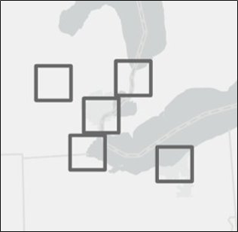
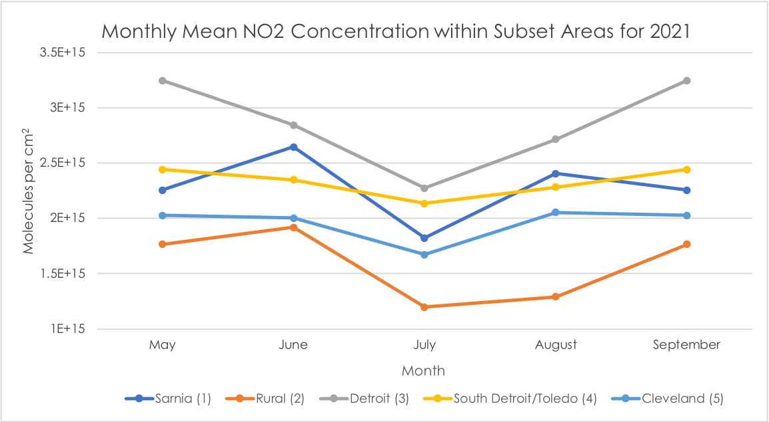
RESULTS – ZONAL STATISTICS
Notes:
In addition to creating maps, we calculated some quantitative metrics. The graph above shows average monthly NO2 for the year 2021 within 5 subset areas that are mapped out in the corner of the slide. The graph indicates the seasonality of NO2 in 2021. Interestingly the lowest NO2 measurements for all subsets was in July. Other than the month of July, there are no other obvious seasonality trends present in all subsets. Additionally, the graph also shows the relative magnitude of NO2 in the subset areas. As to be expected the area encapsulating Detroit has the highest measurements and the rural has the lowest.

Slide 13
CONCLUSIONS
NO₂ can be effectively monitored from space
Oversampling is an effective technique, but comes with limitations
As the successor of OMI, TROPOMI improves on many of OMI's drawbacks​
Notes:
Firstly, nitrogen dioxide concentration can be effectively monitored from space. We know this because the NO2 data from both sensors visually illustrated hotspots. However, CH4 and especially HCHO tended to be more noisy and less representative of actual pollutant concentrations hinting that CH4 and HCHO monitoring from space has less utility than NO2 monitoring until further technological advancement.
Additionally, oversampling proved to be an effective technique for increasing spatial resolution and lowering noisiness, however oversampling, unless on very long time scales, cannot compensate for overtly noisy data such as HCHO data measured by TROPOMI.
Lastly, our study looked at both OMI and TROPOMI measurements. While OMI data is valuable, TROPOMI allows for a much higher spatial resolution and less noisiness. In fact, OMI data was so noisy that we were not able to utilize OMI HCHO measurements in our study. Additionally, while TROPOMI data can be displayed using monthly oversampling, OMI is only effectively displayed with yearly oversampling, therefore not allowing for depiction of seasonality. Additionally, TROPOMI can monitor methane, a gas that OMI cannot measure. Lastly, OMI experienced a row anomaly shortly after launch, making a lot of it's data unusable.

Slide 14
FUTURE WORK
PROBLEMS
POTENTIAL SOLUTIONS
HCHO data is too noisy to interpret
Average data over a larger amount of time
OMI row anomaly develops over time
Further study of which pixels or data to remove
OPPORTUNITIES FOR FUTURE WORK
Accuracy Assessments
Accuracy Assessments
Use New Satellite Sensor Launches (TEMPO & Geocarb) to Acquire Better Data
C
Ratio Maps That Compare High Resolution Data Distributions Between Gases
Analyze More Gases
(CO, CO2)
Notes:
A number of problems that we encountered through our project could be addressed in future work. As seen earlier, the formaldehyde data from even the higher-resolution TROPOMI was too noisy to interpret, and this could be solved by averaging data over a longer time period. For the OMI nitrogen dioxide maps, the row anomaly problem with the instrument has progressed over time. More study would be needed to determine what OMI data to remove.
Additional opportunities for future work include taking advantage of data from instruments aboard satellites to be launched in the near future, considering more air pollutants for study, more accuracy assessments of the data, and making NO2-HCHO ratio maps for high-ozone days to help understand the main source of ozone.

Slide 15
Meet Our Team:
(NASA LaRC)
Zac Adelman (LADCO)
Jay Olaguer
(EGLE)
Dr. Kenton Ross
(NASA LaRC)
Dr. Laura Judd
(NASA LaRC)
Dr. Daniel Goldberg
(George Washington University)
Lauren Childs-Gleason
(NASA LaRC)
Mariam Moeen
(Texas A&M University)
Helen Turvene
(McGill University)
Yuan Lin
(UC Berkeley)
Adriana Le Compte
(NASA LaRC)
Albert Kodua
(Virginia Tech)
This material contains modified Copernicus Sentinel data (2019, 2020, 2021), processed by ESA.
Notes:
Before we end, we'd like to give a sincere shoutout and thank our project partners for collaborating with us. Specifically, Zac Adelman from the Lake Michigan Air Directors Consortium (LADCO) and Jay Olaguer from the Air Quality Division of the Michigan Department of Environment, Great Lakes, and Energy (EGLE). We would also like to thank our wonderful group of science advisors Dr. Kenton Ross, Dr. Laura Judd, Dr. Daniel Goldberg and Lauren Childs-Gleason for all of their guidance and contribution. Finally, a huge thank you to our wonderful fellow, Adriana Le Compte for supporting us throughout this term, and making our time with DEVELOP enjoyable and memorable. We couldn't have gotten through this project without the help of all these people. There expertise was extremely valuable to us and we really appreciate everything that they did.
And that's all, thank you so much for listening. We'll take any questions!

