Slide 1
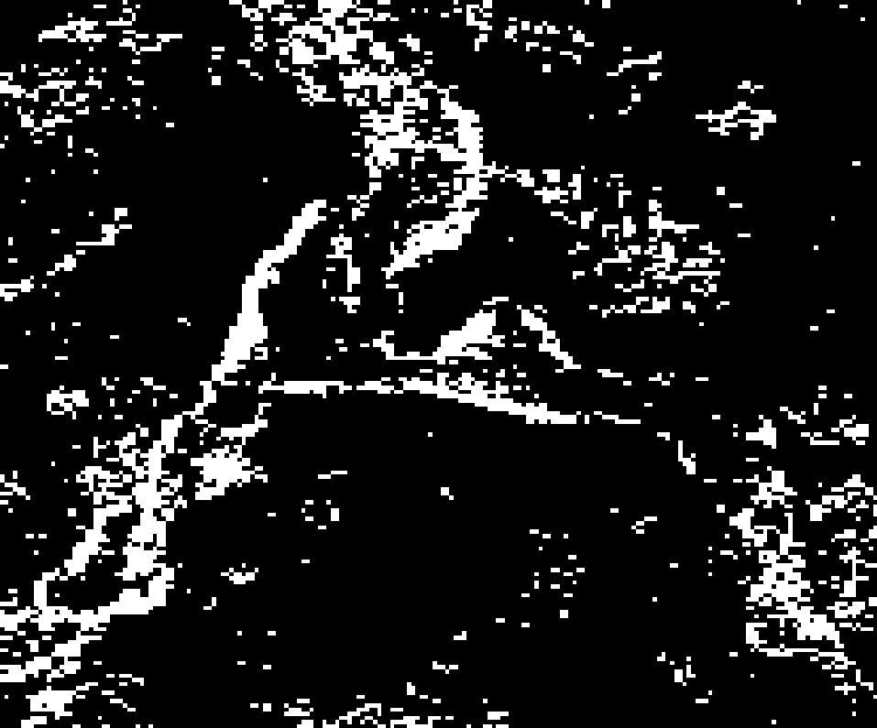
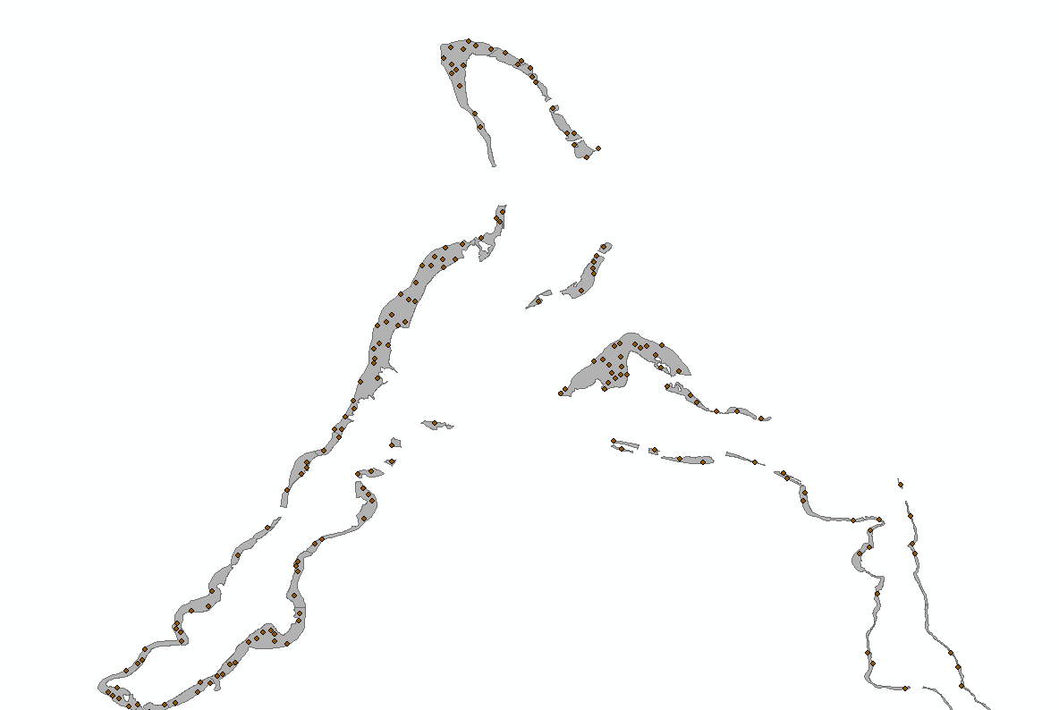
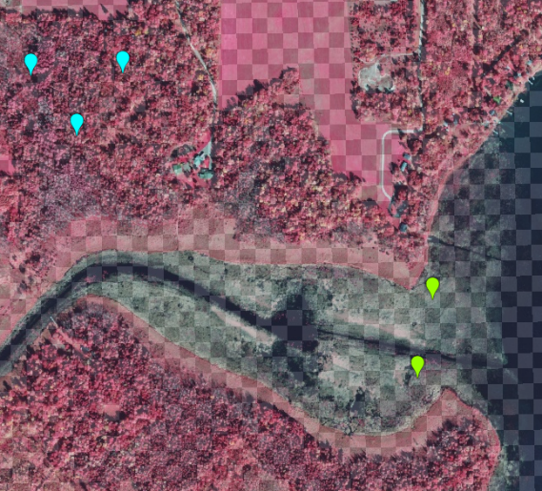
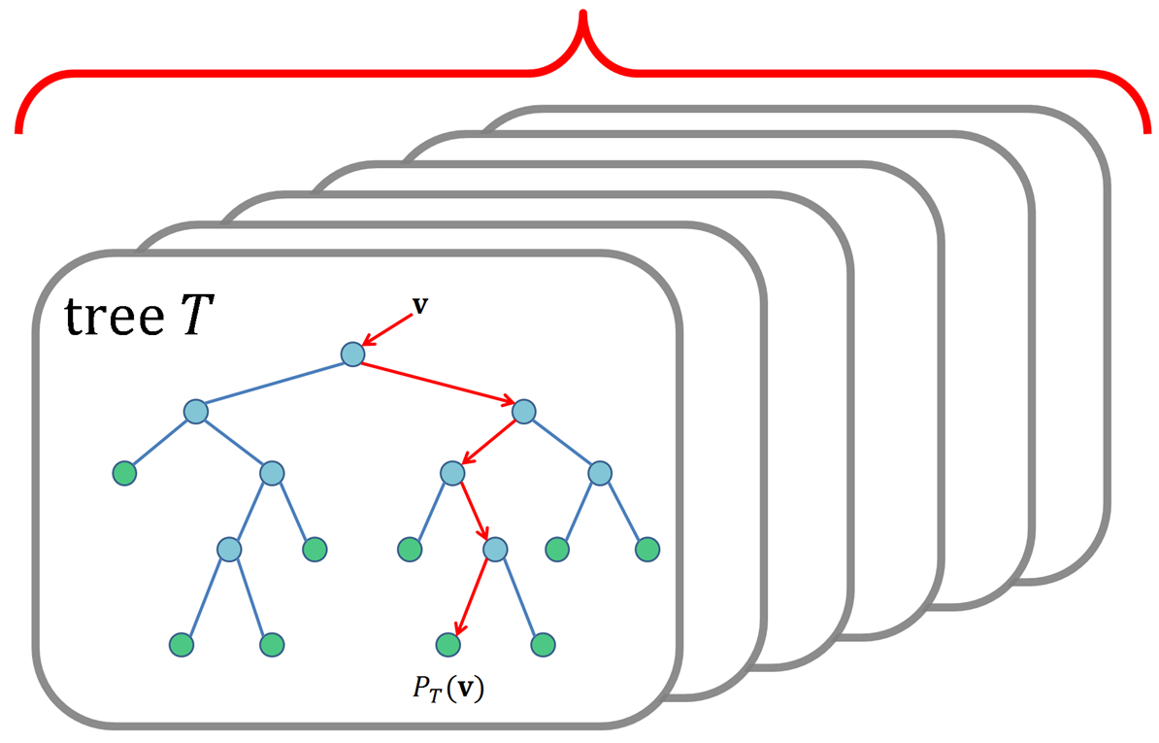
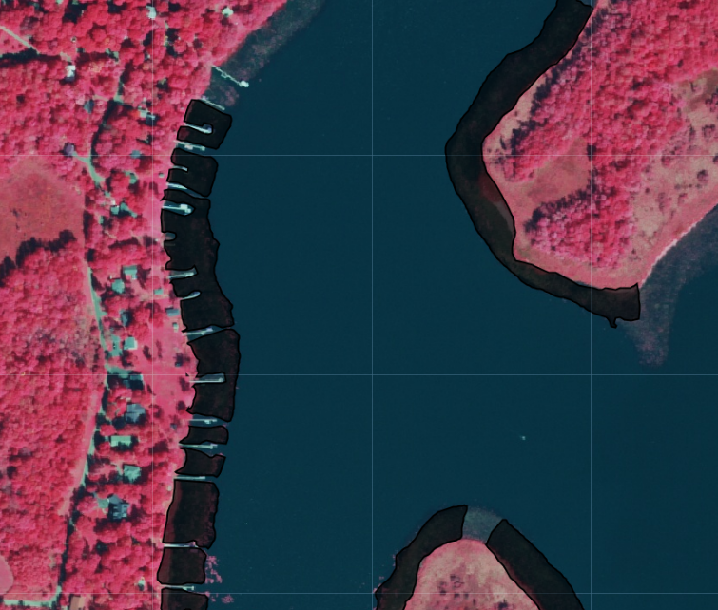

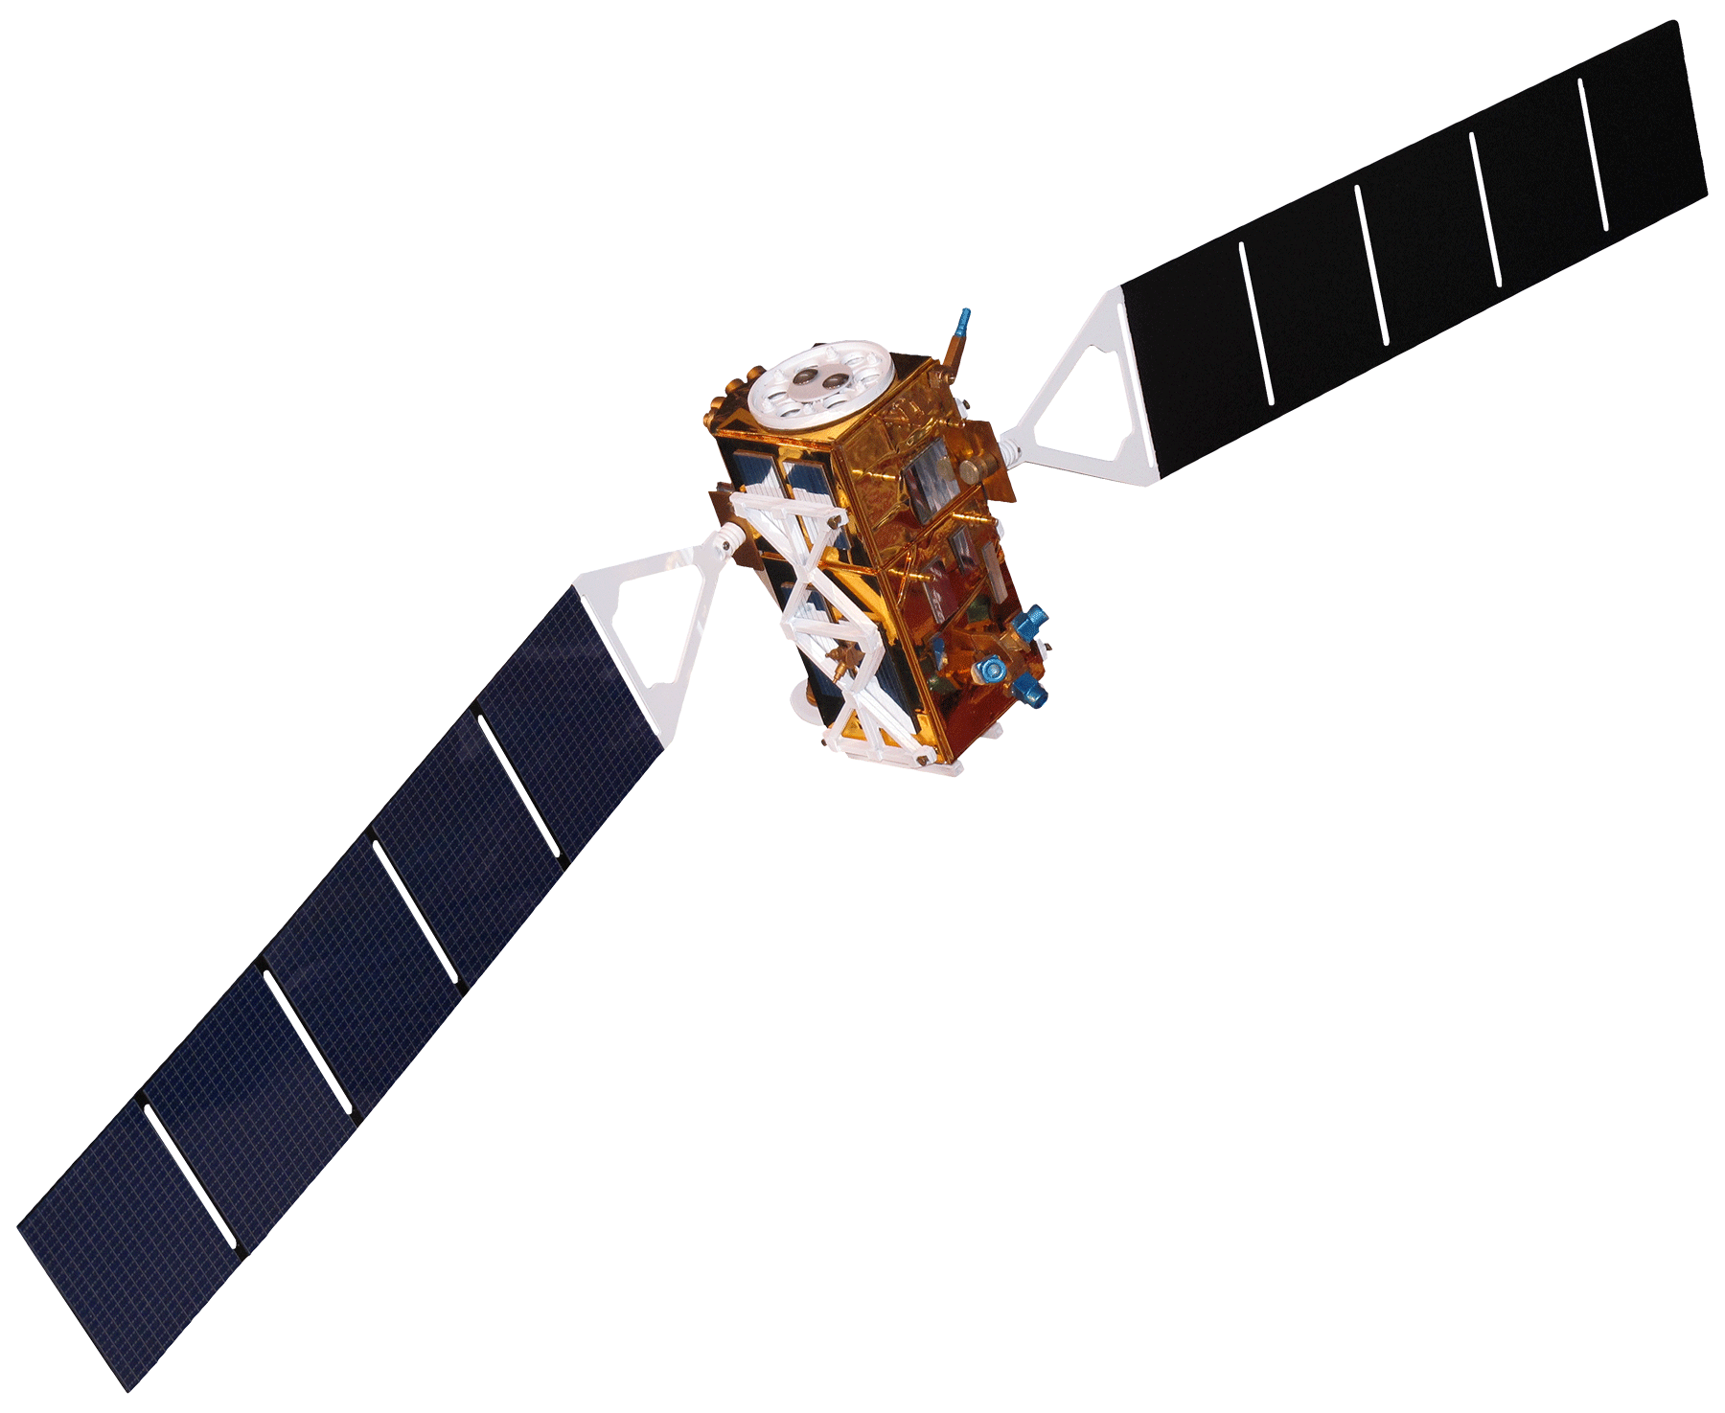
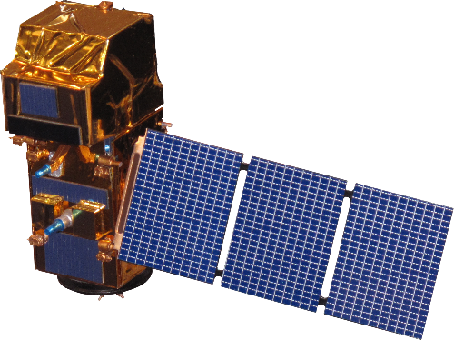
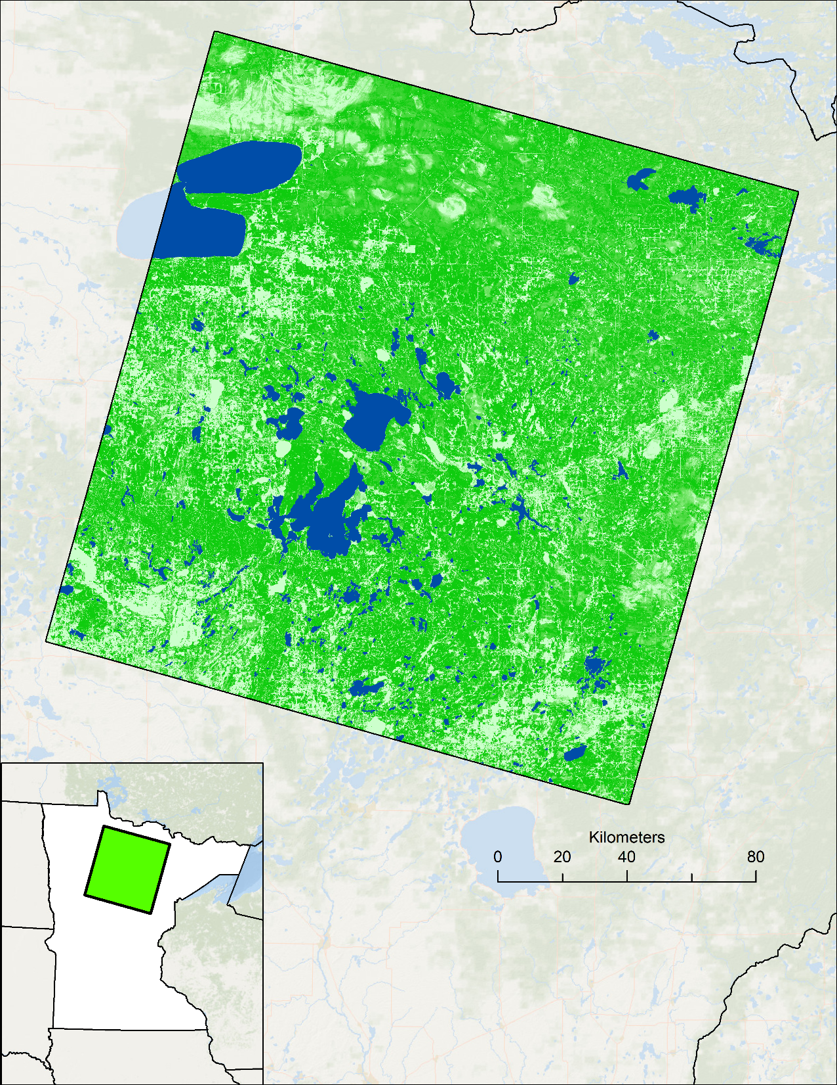








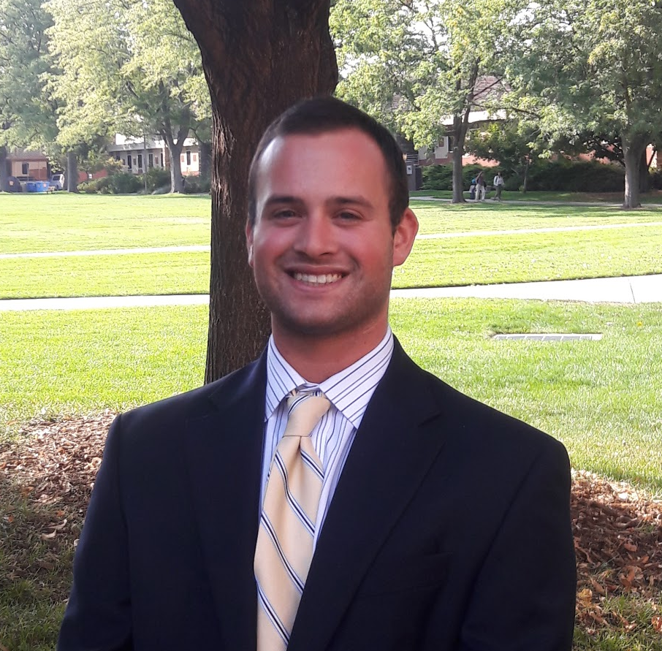
Implementing NASA Earth Observations to Validate Spectral Detection Models of Northern Wild Rice
Abstract
Methodology
Crop wild relatives (CWRs) are genetically related to cultivated crops and function as repositories for genetic diversity. These plants have the potential to improve the yield, nutritional value, and resilience of crops, thereby buffering against widespread crop failure and supporting rural economic productivity. Our partners at the United States Department of Agriculture, Agricultural Research Service, National Plant Germplasm System (USDA ARS NPGS) are tasked with preserving CWRs, such as northern wild rice (Zizania palustris L.) in Minnesota. Additional partners at the Minnesota Department of Natural Resources (MN DNR) monitor wild rice and other aquatic vegetation by conducting annual field surveys. Currently, the NPGS relies primarily on habitat distribution modeling to predict suitable habitats for CWRs, while the MN DNR relies on its field surveys. This project focused on validating a digital ocular sampling (DOS) method for wild rice detection with the intention of improving habitat distribution modeling and facilitating wild crop monitoring. Previous NASA DEVELOP research incorporated Sentinel-1 C-band Synthetic Aperture Radar and Landsat 8 Operational Land Imager data into a DOS approach, which was subsequently validated in this project with in situ data collected by the MN DNR. Results confirmed that models trained with MN DNR field data, as well as a combination of spectral and radar variables, outperformed other model iterations and are highly accurate in their classification of rice. We also found that DOS is not suitable for training models to distinguish between different aquatic vegetation types. These insights will provide end users with an improved framework for integrating remote sensing into their wild rice monitoring processes.
Validation of Spring 2018 Model
Generating Points Over Aquatic Vegetation DNR Polygons
Predicted Class
Raw Model Output
P
N
P
True Positives (TP)
False Negatives (FN)
Actual Class
False Positives (FP)
True Negatives (TN)
N
Objectives
Refining Modeling Methodology
Digital Ocular Sampling
Derive Predictor Variables from
VSURF & Random Forest
Validate digital ocular sampling methods used to create emergent aquatic vegetation models, including for northern wild rice, with in situ data collected by NASA DEVELOP and the Minnesota Department of Natural Resources
Refine detection modeling process by comparing DOS-trained models with in situ data-trained models
Landsat 8 OLI
Sentinel-1 C-SAR
Earth Observations
Sentinel-2 MSI
Wild Rice Presence
Point Sampling from DNR Survey
Wild Rice Absence
Landsat 8 OLI
Sentinel-1 C-SAR
Sentinel-2 MSI
Results
Study Area
Minnesota Agriculture & Food Security
Study Period: 2015 to 2017 (June to September)
Landscape: Mixed spruce and pine forest with vast river/lake networks
Known as the “Land of 10,000 lakes”
Wetland habitats across the state of Minnesota create ideal growing conditions for emergent vegetation such as wild rice
In situ data clustered in this scene
Digital ocular sampling from Phase I also present in this scene
DOS-trained Model (Spring 2018)
DNR-trained Model
(30 m Spectral and Radar)
DNR-trained Model
(10 m Radar Only)
% Wild Rice Correctly Classified | 68%
% Other Vegetation Misclassified | 46%
% Wild Rice Correctly Classified | 81%
% Other Vegetation Misclassified | 22%
% Wild Rice Correctly Classified | 67%
% Other Vegetation Misclassified | 25%
ND
P 28
R 27
CAN
Kilometers
Conclusions
Study Area
SD
MN
WI
State Boundaries
Not all emergent aquatic vegetation (EAV) is distinguishable using high resolution (1 m) NAIP imagery.
Bulrushes and waterlilies are commonly misclassified as wild rice due to their spectral similarities.
Training a model with digital ocular sampling was not optimal for distinguishing EAV.
Radar range outperformed radar variance as a detection filter.
While rice has a unique and reliable radar signature, we can detect rice with higher accuracy by combining spectral and radar variables, rather than employing radar exclusively.
Higher resolution variables do not necessarily result in higher detection accuracy of EAV.
Rice Lakes Identified by DNR
100% Forest Cover
IA
0% Forest Cover
Project Partners
University of Minnesota
Minnesota Department of Natural Resources
USDA, Agricultural Research Service, National Plant Germplasm System
Team Members
Acknowledgements
The Minnesota Agriculture & Food Security team would like to thank our partners at the USDA ARS, the MN DNR, and the University of Minnesota for engaging with NASA DEVELOP to make this research possible.
A special thanks to Kristen Dennis (Colorado – Fort Collins Node Acting Center Lead), Tony Vorster (Science Advisor), and Dr. Colin Khoury (USDA ARS) for working closely with our team throughout this research project.
This material contains modified Copernicus Sentinel data (2015-2017), processed by ESA.
Vanesa Martín
Project Lead
Kristen Dennis
Leorah McGinnis
Eli Simonson
Colorado – Fort Collins| Spring 2019

