Slide 1

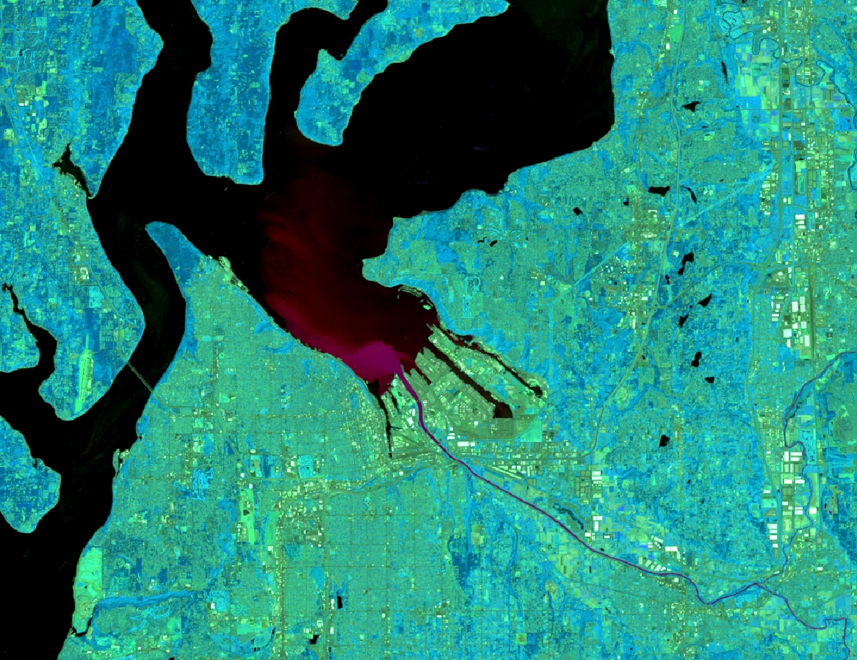

Puget Sound Water Resources
Evaluating Methods for Identifying and Monitoring Factors in the Puget Sound that Indicate Eutrophication and Hypoxia
Emily Kinkle
Helen Baldwin
Christine Evans
Yu Han
Alabama – Marshall
Spring 2018

Slide 2
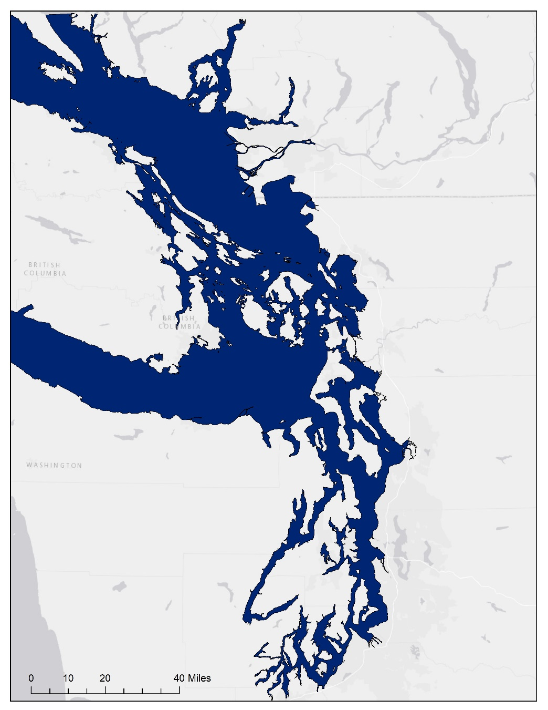
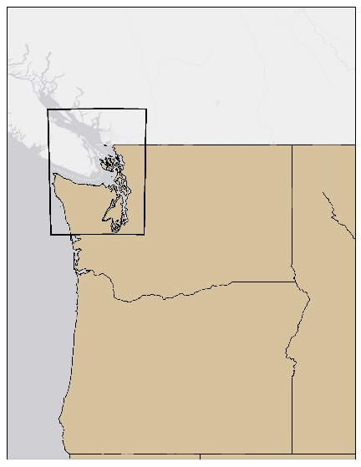
Overview
  Study Area:
  Puget Sound, WA
  Study Period:
  2013 – 2017 (May – October)
  Objectives:
  Identify factors indicative of harmful algal blooms in the Puget Sound
  Determine if ACOLITE and NASA Earth Observations can be used for monitoring eutrophication in Puget Sound
Bellingham
Canada
Mt Vernon
WA
Puget Sound
OR
ID
Seattle
Notes:
Emily – The Puget Sound is a diverse estuary located in Northwestern Washington. The waters are home to a wide variety of aquatic organisms and the shoreline is home to two-thirds of Washington’s population. Our study uses in situ data collected from buoys and cruise ships within the sound, along with NASA Earth Observation images. The data used were collected between May 2013 through October 2017. The objectives for this project is to identify factors indicative of eutrophication using Earth Observations. We then determined if ACOLITE and NASA Earth Observations can be used for monitoring eutrophication in Puget Sound.
Map made in ArcMap by Christine Evans

Slide 3
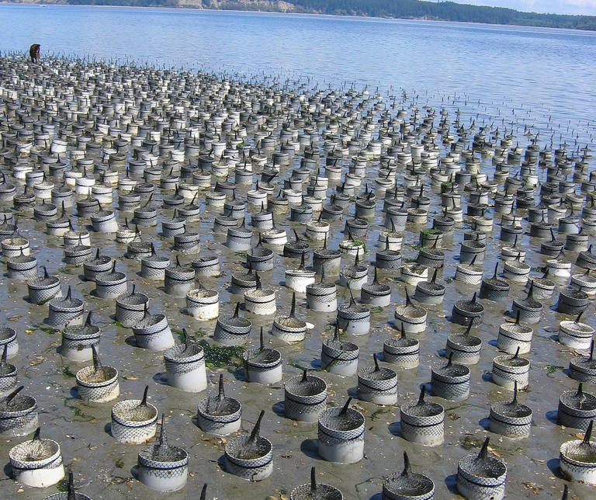
Community Concerns
  Declining dissolved oxygen (DO) levels since 2000 due to eutrophication
  Negative impact on local economy
  Increased potential for fish kill events
  Domoic Acid
    Produced by Pseudo-nitzchia
Image Source: Wikimedia Commons
Notes:
Christine –
Dissolved Oxygen levels have been declining in the Puget Sound since 2000. This decrease in dissolved oxygen are due to eutrophic and hypoxic waters. This hypoxia is directly reducing the populations of sessile organisms, like geoducks, that are important to the local economy. In 2015, the geoduck economy profited $75.8 million. With an increase in eutrophication and hypoxia, fish kill events have also been increasing, having a negative impact on the mobile species in the sound. The algal blooms have begin to rapidly growing from this eutrophication have been producing toxins that are impacting the health of the locals.
Image Source: https://commons.wikimedia.org/wiki/File:Geoduck_Farm_on_Hartstine_Island.jpg

Slide 4
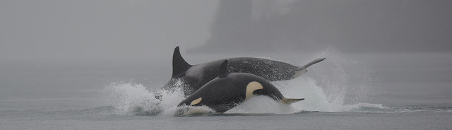

Pacific States Marine Fisheries Commission,
Habitat Program
Image Credit: Monet
  Partners with local government and organizations to maintain water quality and preserve watershed and estuaries on the West Coast
  Advises the Pacific Fishery Management Council on protection of essential fish habitats
  Provides water quality management advice to communities and organizations
  Currently monitors eutrophication and hypoxia with seaplanes, ferries, and moored instruments
Notes:
Christine – The habitat program supports fish habitat conservation and restoration of watersheds and estuaries over 5 states, including the Puget Sound. They provide water quality management advice to organizations. Monitoring of eutrophication and hypoxia is being done with seaplanes, ferries, and moored instruments.
Image Source: https//www.flickr.com/photos/mikecharest/16040662956

Slide 5
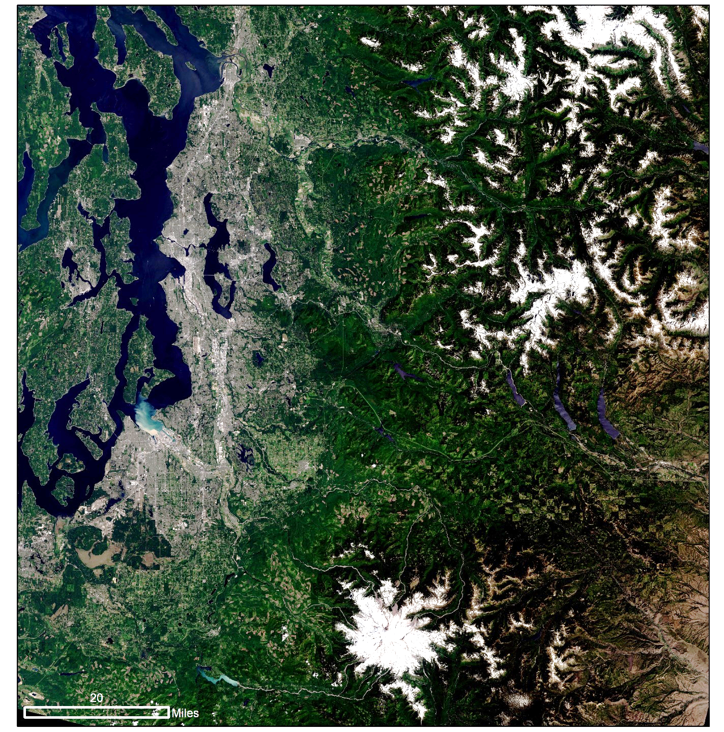
End Products
Chlorophyll & Turbidity Time Series Analysis
  Identify factors indicating eutrophication according to algorithms within ACOLITE
Buoy Interpolation & ACOLITE Analysis Maps
  Provide assessment of utility of algorithms processed through ACOLITE
ACOLITE Tutorial
  Illustrate method implemented in ACOLITE to provide reference for future work
Notes:
Helen –
The following end products were developed to meet the objectives of the project.
The chlorophyll & turbidity time series analysis was created using landsat-8 data processed through ACOLITE using the ?? For turbidity And ?? For chlorophyll algorithms. This analysis will give the partner more information about identifying where these two indicators of HABs tend to occur according to the algorithms used within ACOLITE by showing how HAB suitability parameters change geographically within the Puget Sound.
The Buoy Interpolation and ACOLITE Analysis maps were created using Landsat 8 OLI an dSentinel-2 MSI. This analysis will provide the partner with an assessment of the utility of algorithms processed through ACOLITE along with other GIS techniques for filling in spatial gaps in in situ data.
The ACOLITE Tutorial will show the project partner the method that was used within ACOLITE. This will allow the project partner to recreate what was done and potentially change setting within ACOLITE for more accurate results in the future.

Slide 6
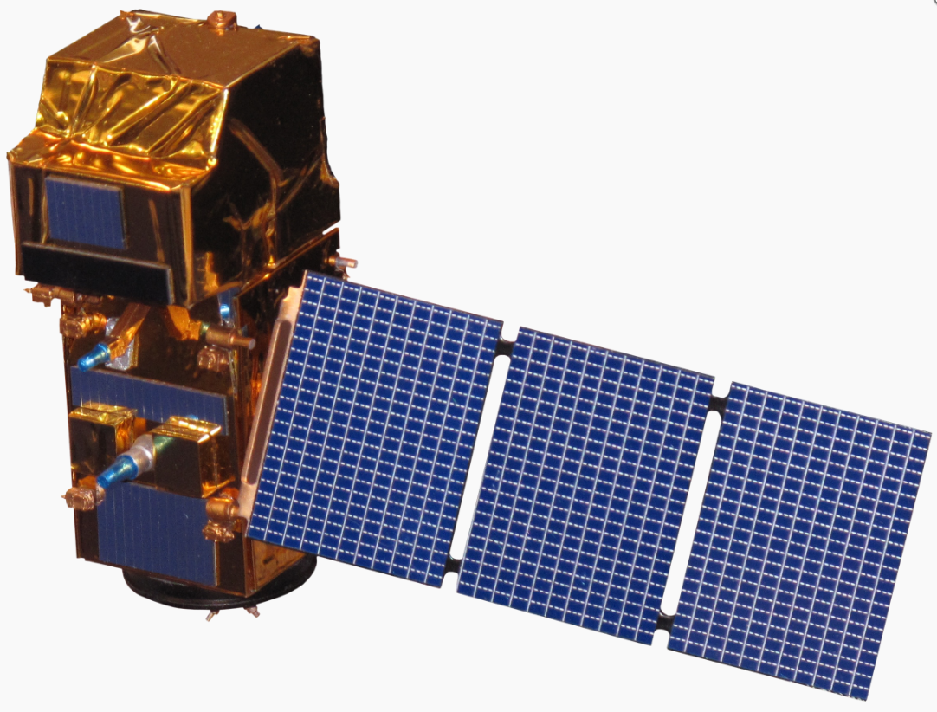
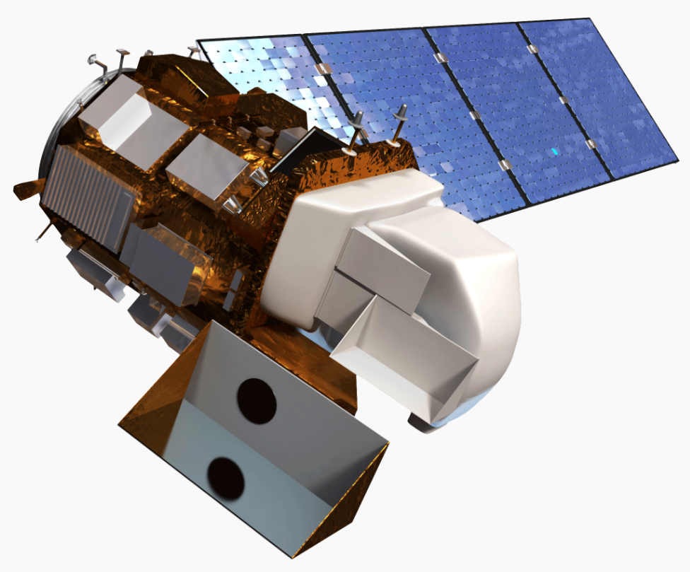
Sensors Used
Image Credit: Monet
Sentinel-2 MSI
  Spatial Resolution: 10m, 20m, 60m
  Temporal Resolution: 10 days
Landsat 8 OLI
  Spatial Resolution: 30m
  Temporal Resolution: 16 days
Image Credit: NASA
Notes:
Emily –
Two Earth Observations will be used throughout the project. ESA’s Sentinel-2 Multispectral Imager (MSI), which launched in 2015, will be used to identify chlorophyll concentrations and turbidity. The level-3 product was downloaded from Earthexplorer. The temporal resolution of Sentinel-2 is 10 days. Different bands are in different spatial resolutions, specifically, Band 1,9,10-60 meters; Band 2,3,4,8-10 meters; Band 5,6,7,8a,11-20 meters.
NASA’s Landsat 8 Operational Land Imager (OLI) will be used to identify chlorophyll concentration and turbidity. The Landsat 8 satellite payload consists of two science instruments—the Operational Land Imager (OLI) and the Thermal Infrared Sensor (TIRS). These two sensors provide seasonal coverage of the global landmass at a spatial resolution of 30 meters (visible, NIR, SWIR); 100 meters (thermal); and 15 meters (panchromatic) and the temporal resolution is 16 days.
http://www.devpedia.developexchange.com/dp/index.php?title=List_of_Satellite_Pictures

Slide 7
Buoy Data
In situ Chlorophyll concentration and Turbidity
State of Washington Department of Ecology
NOAA National Data Buoy Center
King County Mooring
Notes:
Christine –
In situ buoy data were downloaded from multiple sources in order to have an adequate number of points for validation. 37points were downloaded from the State of Washington Department of Ecology, 6 points were downloaded from King County Mooring, and 9 points were downloaded from NOAA’s National Data Buoy Center.

Slide 8
Methodology
Data
ACOLITE Processing
Statistical Analysis
  Landsat 8 OLI
  Sentinel-2 MSI
  In situ
  Landsat 8 OLI: 2 Chlorophyll algorithms, 5 turbidity algorithms
  Sentinel-2 MSI: 4 Chlorophyll algorithms, 5 turbidity algorithms
  Pearson Correlation
  Analysis of Variance (ANOVA)
  Tukey’s HSD Analysis
Notes:
Emily –
Landsat 8 OLI and Sentinel-2 MSI data were downloaded from the USGS EarthExplorer portal with both being restricted to scenes with less than 10 percent cloud cover. This yielded 25 dates of data from Landsat 8 OLI and 7 dates of data for Sentinel-2 MSI over the course of the study period. Landsat 8 OLI and Sentinel-2 MSI data were processed using ACOLITE to determine Chlorophyll concentration and turbidity. Four algorithms were used to determine chlorophyll with two being only for Sentinel-2 MSI data. 5 algorithms were used to test for turbidity. Each of these algorithms was then tested by using the “extract to point” tool in ArcMap to compare with in situ data by using an ANOVA statistical analysis. Exploratory regression analysis was also used to compare data with a recent HAB event.

Slide 9
Statistical Analysis
Pearson Correlation
ANOVA
Tukey’s HSD
  Correlation between in situ data
  and data derived from satellite
  through ACOLITE
  Analyze the differences among
  the algorithms of chlorophyll and
  the algorithms of turbidity
  Find out which specific
  algorithms’ means are
  different
Notes:
Hannah –
We used three statistical methods to conduct our analysis.
Pearson correlation was used to see which algorithm aligns in situ data best.
Tukey’s HSD was used to better understand how these algorithms are different from each other.

Slide 10
Results(Correlation&ANOVA-Sentinel2)
Algorithms |  | Correlation Coefficient |  |  | ANOVA
Abbreviation | Full name | r | P-value | N | F value | P-value
CH2 | CHL_OC2 | 0.25 | 0.362 | 15 | 2.269 | 0.082
CH3 | CHL_OC3 | 0.19 | 0.508 | 14
GON | CHL_RE_GONS | -0.26 | 0.377 | 14
MO | CHL_RE_MOSES3B | -0.25 | 0.392 | 14
T | T_DOGLIOTTI | 0.25 | 0.631 | 6 | 75.400 | 0.000
TNIR | T_DOGLIOTTI_NIR | -0.47 | 0.350 | 6
TRED | T_DOGLIOTTI_RED | -0.03 | 0.958 | 6
TGAR | T_GARABA_645_LIN | 0.26 | 0.620 | 6
TNEC | T_NECHAD_645 | 0.25 | 0.631 | 6
  No correlation(P>0.05) between algorithms data and in-situ data
  No significant difference(P>0.05) among algorithms of chlorophyll
  Significant difference among algorithms of turbidity
Notes:
Correlation Coefficient: This table explains correlations between in-situ data and the data obtained through different algorithms for Sentinel-2 MSI data after ACOLITE correction. All P-values<0.05, which means we couldn’t prove there was any correlation between in-situ data and the data derived from ACOLITE correction.
ANOVA: We performed ANOVA among algorithms of chlorophyll (green)and algorithms of turbidity (blue). No significant difference was evident among algorithms of chlorophyll (P>0.05) and significant difference was evident among algorithms of turbidity (P<0.05).

Slide 11
Results(Tukey’s HSD Analysis-Sentinel-2)
Algorithms | Mean difference | 95% Confidence Interval |  | P-value
 |  | Lower Bound | Upper Bound
CH3-CH2 | -0.013 | -339.60 | 339.57 | 1.000
GON-CH2 | 18.893 | -320.69 | 358.48 | 0.999
MO-CH2 | -272.232 | -611.82 | 67.35 | 0.164
GON-CH3 | 18.906 | -320.68 | 358.49 | 0.999
MO-CH3 | -272.219 | -611.81 | 67.37 | 0.164
MO-GON | -291.125 | -630.71 | 48.46 | 0.121
TGAR-T | -0.579 | -1.99 | 0.84 | 0.794
TNEC-T | 0.026 | -1.39 | 1.44 | 1.000
TNIR-T | 6.771 | 5.36 | 8.19 | 0.000*
TRED-T | -0.474 | -1.89 | 0.94 | 0.888
TNEC-TGAR | 0.605 | -0.81 | 2.02 | 0.766
TNIR-TGAR | 7.350 | 5.93 | 8.77 | 0.000*
TRED-TGAR | 0.104 | -1.31 | 1.52 | 1.000
TNIR-TNEC | 6.745 | 5.33 | 8.16 | 0.000*
TRED-TNEC | -0.501 | -1.31 | 0.92 | 0.867
TRED-TNIR | -7.246 | -8.66 | -5.83 | 0.000*
  Chlorophyll: no significant difference (P>0.05)
  Turbidity: significant difference (P<0.05)
Notes:
As you see we used Tukey’s HSD analysis to better understand the difference between each pair of the algorithms. This slide tells the results of comparison of algorithms of turbidity for sentinel-2 data. The picture shows the differences in mean levels of algorithms of chlorophyll and turbidity. When P>0.05, then no significant difference was evident and vise versa. So from the picture on the right, we found the all algorithms of chlorophyll were similar to each other; the algorithm T_DOGLIOTTI_NIR was significantly different from T_DOGLIOTTI, T_GARABA_645_LIN, T_NECHAD_645 and T_DOGLIOTTI_RED; no significant difference was found between these pairs: TGAR-T,TNEC-T,TRED-T, TNEC-TGAR, TRED-TGAR, TRED-TNEC.

Slide 12
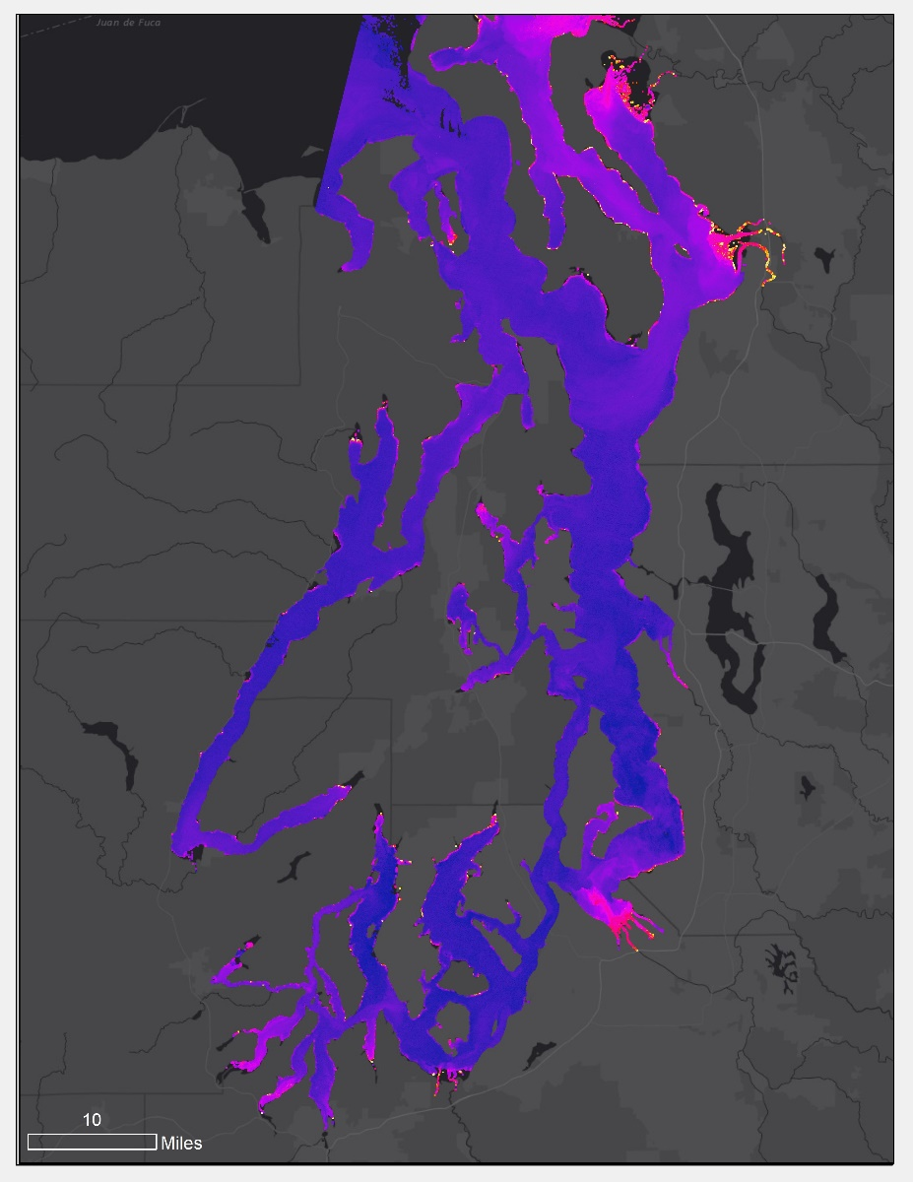
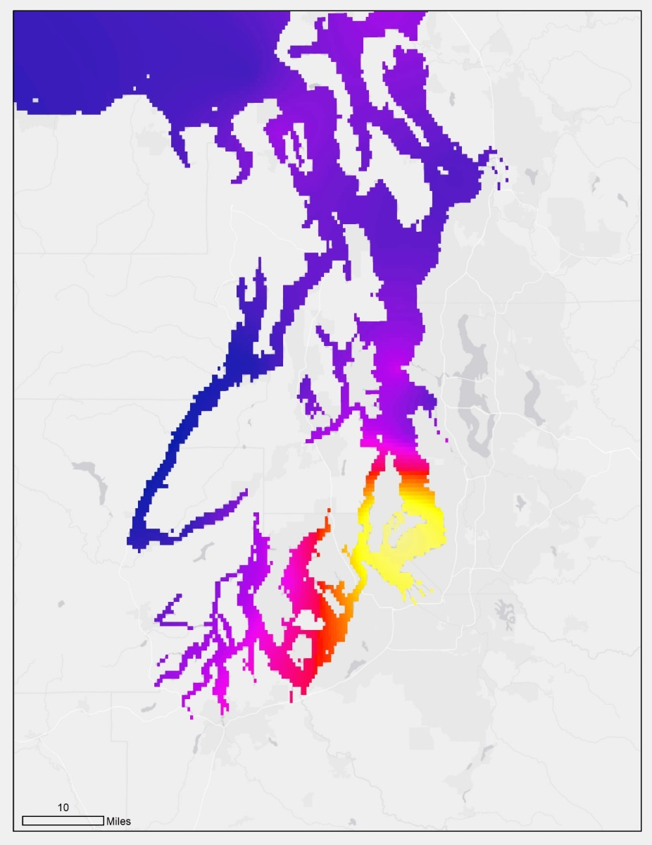
Results – ACOLITE Analysis and Buoy Interpolation Maps
ACOLITE Analysis
Buoy Interpolation
Interpolation date: August 20, 2013
ACOLITE algorithms: CHL_OC2
Areas identified by the interpolation and the processed satellite data to have high indications of HABs were similar
Chlorophyll Concentration (ug/L)
Chlorophyll Concentration (ug/L)
High
High
Low
Low
Notes:
Christine
If you compare these to the chlorophyll concentration interpolation map, you can see that the areas identified as having high indicators are similar on both the buoy interpolation map and the ACOLITE analysis map. We interpolated data from two dates: August 20, 2013 and July 09, 2015, these dates has the greatest number of chlorophyll concentration measurements from buoys.

Slide 13
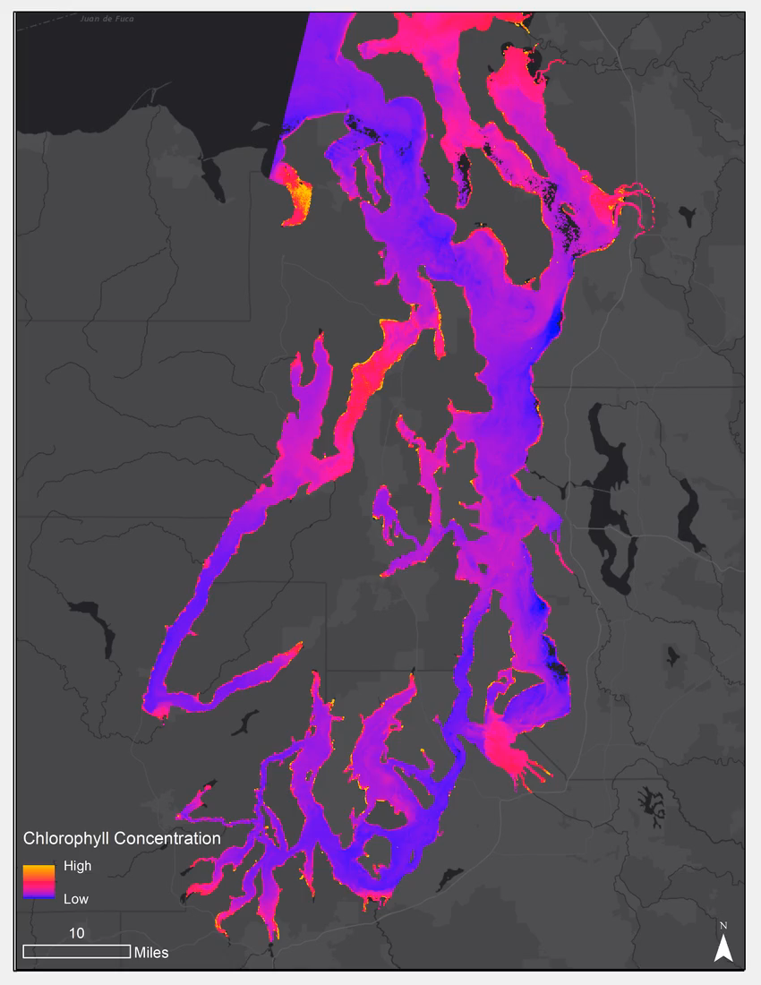
Results – Time Series Analysis
Areas identified by the time series as having high indications of HABs repeat throughout the series
Notes:
Christine
Throughout the time series analysis of chlorophyll concentration, the areas identified as having high indicators of HABs are consistent. The time series analysis includes chlorophyll concentration derived from ACOLITE using the CHL_OC2 algorithm for 24 dates within the study period.

Slide 14
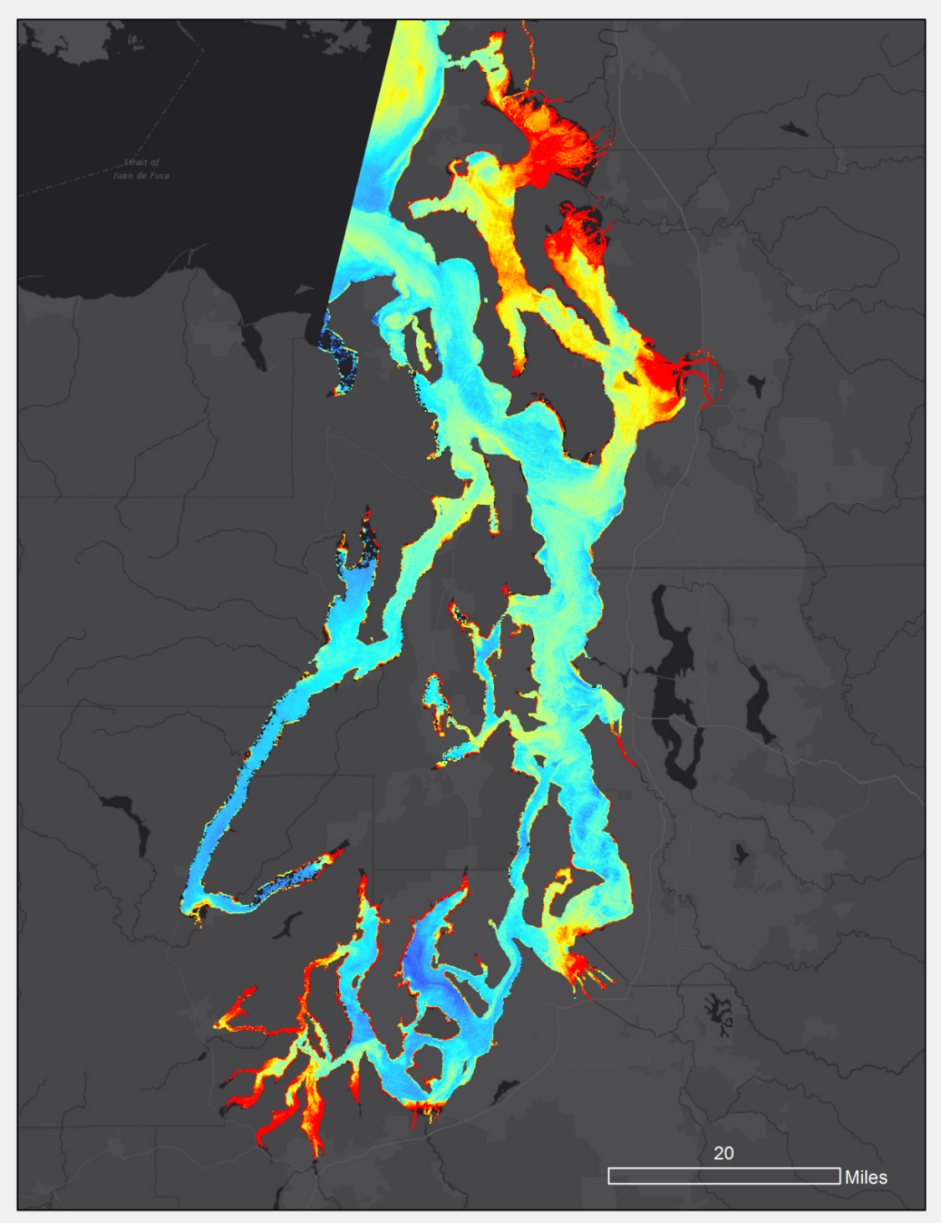
Conclusions
ACOLITE algorithm
Chlorophyll is highest within and along inlets
Areas highlighted by time series analysis need further monitoring
The algorithms determining chlorophyll were similar
The majority of turbidity algorithms were similar
Landsat 8 OLI and Sentinel-2 MSI imagery processed through ACOLITE are not the most ideal for monitoring eutrophication and HABs in the Puget Sound
Chlorophyll
Concentration (ug/L)
High
Low
Notes:
Emily –
We tested all of the algorithms available for use in ACOLITE and none of these produced verifiable results, therefore this method is not ideal for monitoring eutrophication and harmful algal blooms in the Puget Sound. However, the time series analysis There is still a need for remotely sensed monitoring in this area, but other methods may be more feasible. Applying atmospheric corrections, alternative algorithms, and other methods would be better suited for this area.
By looking at this map I can make inferences to where high chlorophyll concentrations are, make that a conclusion! What did the time series show you? Make that a conclusion! Yeah it all has to taken with a grain of salt, but those are still conclusions.
Chlorophyll concentration derived from ACOLITE, June 23 2015

Slide 15
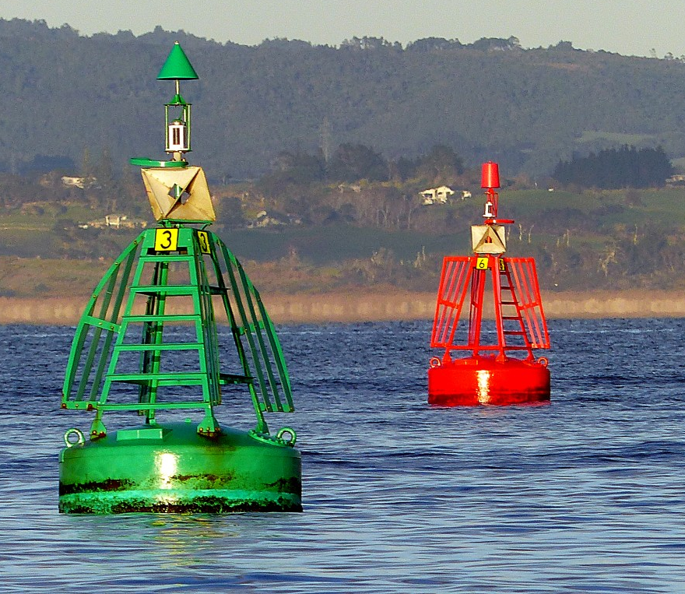
Limitations
Depth of measurements
  Buoy: 1.5 m
Timing of data collection
  Buoy: 15 minute intervals
    Daily average
  Sentinel-2: once every 10 days
  Landsat 8 OLI: once every 16 days
In situ data
  Low correlation between turbidity & chlorophyll
  Inconsistencies
Missing pixels after ACOLITE processing
  Focal Statistics tool
Image Source: pxhere
Notes:
Image source: https://pxhere.com/en/photo/341265
Not all buoy data has a time stamp. Buoy measured at different increments, some as often as every 15 minutes.
Inconsistencies: units, parameters differ (some collect turbidity other collect percentage of light transmission)
From Manual: CHL_OC2, CHL_OC3: blue-green ratio chlorophyll algorithm using bands 483-561 (OC2) and bands 443-483-561 (OC3). Algorithm coefficients provided by the OBPG (http://oceancolor.gsfc.nasa.gov/). This type of algorithm should be used with caution in turbid waters, and the performance of the OLI chlorophyll product has not been evaluated. Use with caution.
T_DOGLIOTTI: blended turbidity from (Dogliotti et al., 2015) using the 645/859 nm setting from their paper with the OLI 655/865 nm bands or the MSI 664/865 nm bands. “RED” turbidity is used for ρw 655/664 < 0.05, “NIR” turbidity for ρw 655/664 > 0.07, with linear blending for ρw 655/664 between 0.05 and 0.07.

Slide 16
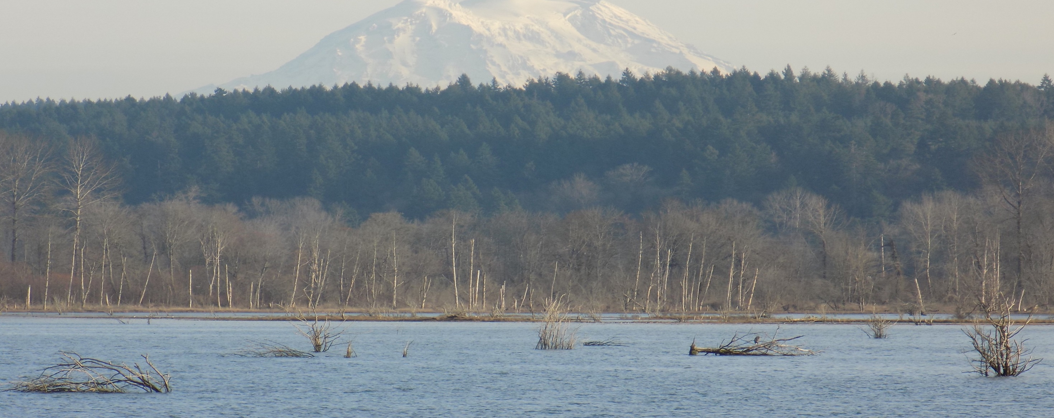
Future Work
Image Credit: Skylar Edwards
  Investigate ACOLITE Advanced Settings
  Test alternative algorithms
  Incorporate atmospheric correction
  Include more indicators
Notes:
Investigate ACOLITE Advanced Settings (research more about what types of settings are available for presentation)
Incorporate atmospheric correction (Ben Page’s work)
Include more indicators of HABs. After comparing the in situ data, it was determined that there doesn’t seem to be a correlation between chlorophyll-a and turbidity in the Puget Sound. In the future, other factors could be considered in order to conduct a more in depth analysis such as salinity and sea surface temperature. (ask the team what the comparison was conducted between turbidity and chlorophyll)

Slide 17
Acknowledgements
  Dr. Jeffrey Luvall (NASA Marshall Space Flight Center)
  Dr. Robert Griffin (University of Alabama in Huntsville)
  Dr. Juan L. Torres-Pérez (Bay Area Environmental Research Institute, NASA Ames Research Center)
  Leigh Sinclair (University of Alabama in Huntsville/Information Technology and Systems Center)
  Maggi Klug (University of Alabama in Huntsville)
  Fran Recht (Pacific States Marine Fisheries Commission, Habitat Program Manager)
  Benjamin Page (NASA SERVIR)

Slide 18
ACOLITE Algorithms
Algorithm Name | Parameter | Sensor
CHL_OC2 | Chlorophyll | Landsat 8 OLI Sentinel-2 MSI
CHL_OC3 | Chlorophyll | Landsat 8 OLI Sentinel-2 MSI
T_DOGLIOTTI | Turbidity | Landsat 8 OLI Sentinel-2 MSI
T_DOGLIOTTI_RED | Turbidity | Landsat 8 OLI Sentinel-2 MSI
T_DOGLIOTTI_NIR | Turbidity | Landsat 8 OLI Sentinel-2 MSI
T_GARABA_645_LIN | Turbidity | Landsat 8 OLI Sentinel-2 MSI
T_NECHAD_645 | Turbidity | Landsat 8 OLI Sentinel-2 MSI
CHL_RE_GONS | Chlorophyll | Sentinel-2 MSI only
CHL_RE_MOSES3B | Chlorophyll | Sentinel-2 MSI only
Notes:
Emily –
4 chlorophyll algorithms were tested with 2 of them only having been tested on Sentinel-2 MSI. 5 turbidity algorithms were tested on both Landsat 8 OLI and Sentinel-2 MSI.

