Slide 1
Performing a Fuzzy Logic Analysis in ArcMap
A Tutorial
Leigh Sinclair (Project Lead)
Tyler Finley
Padraic Conner (Co-Project Lead)
Jeanné le Roux

Slide 2
Background
Fuzzy logic is an approach to computing based on "degrees of truth" rather than the usual "true or false" (1 or 0) Boolean logic on which the modern computer is based. The idea of fuzzy logic was first advanced by Dr. Lotfi Zadeh of the University of California at Berkeley in the 1960s.
Membership Function
Membership Function
1
1
^{O}C
-10 Cold 0 Cool 10 warm 20 hot 30
-10 Cold 0 Cool 10 warm 20 hot 30
Bivariate sets to characterize room temperature
Fuzzy sets to characterize room temperature

Slide 3
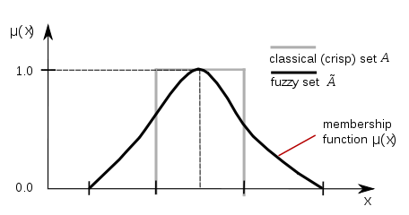
Background
Credit: B. Jankuloski
In Fuzzy Logic, values of a dataset are between 0 and 1 based on how well the values can be described by a certain field.
The higher the value, the more accurate the description and the more likely that value fits into that particular group.
Notes:
http://help.arcgis.com/en/arcgisdesktop/10.0/help/index.html#//009z000000rv000000.htm

Slide 4
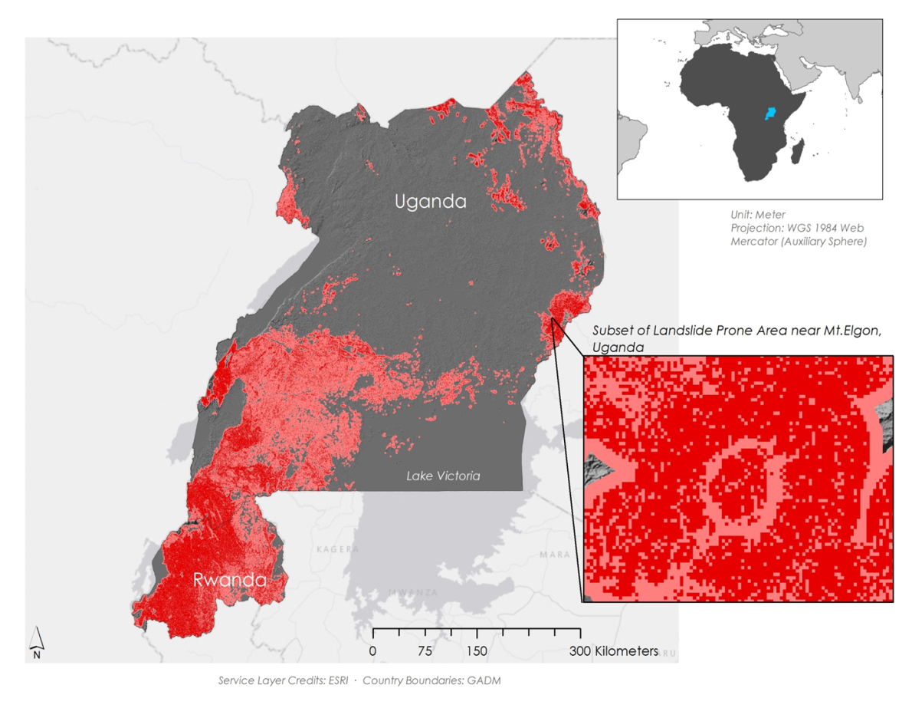
Background
This project employed a fuzzy logic overlay to develop a Landslide Susceptibility Map for Rwanda and Uganda. The following slides describe how apply fuzzy logic in ArcMap to accomplish this.
Area Susceptible to Landslides
Within 1km of Susceptible Area

Slide 5
Step 1: Identify Problem and Define Variables
First, a problem needs to be identified and input variables to be included in the model need to be selected. This can be accomplished by conducting a thorough literature review. Once inputs are decided they need to be download or derived.
Variables Selected
Elevation
Slope
Plan Curvature
Profile Curvature
Distance from Roads
Distance from Streams
Distance from Ridge
Terrain Roughness
Depth to Bedrock
Topographic Wetness Index (TMI)
Problem: Landslides threaten lives and infrastructure.
What do areas that are prone to landslides have in common?
What geographic variables can cause landslides?

Slide 6
Step 2: Download and Derive Data
DEM: SRTM-V2
USGS website
International Soil Reference and Information Centre website
Data Sources
Depth to Bedrock Data
Socioeconomic Data and Applications Center website
Roads Shapefile
ArcMap was used to derive elevation, slope, plan curvature, profile curvature, distance from roads, distance from streams, distance from ridge, terrain roughness, topographic wetness index, and depth to bedrock.
Notes:
USGS website: http://earthexplorer.usgs.gov/
International Soil Reference and Information Centre website: http://www.isric.org/content/african-soilgrids-250m-geotiffs
SEDAC: http://sedac.ciesin.columbia.edu/data/set/groads-global-roads-open-access-v1

Slide 7
Step 3: Assign Fuzzy Membership
After variable layers are derived, fuzzy memberships need to be assigned to each layer. Some of this information comes from literature review, but presence points can be used to get a better idea of the values that are appropriate for the study area.
Type | Value(s) Designated as 1 | Value(s) Designated as 0
Gaussian | Midpoint of input dataset | Values of input furthest from midpoint
Small | Smallest value of input dataset | Largest value of input dataset
Large | Largest value of input dataset | Smallest value of input dataset
Near | Midpoint of input dataset | Values of input furthest from midpoint
Linear | User-specified maximum value and all larger input values | User-specified minimum value and all smaller input values
Fuzzy memberships were assigned using the “Fuzzy Membership” tool in ArcMap.

Slide 8
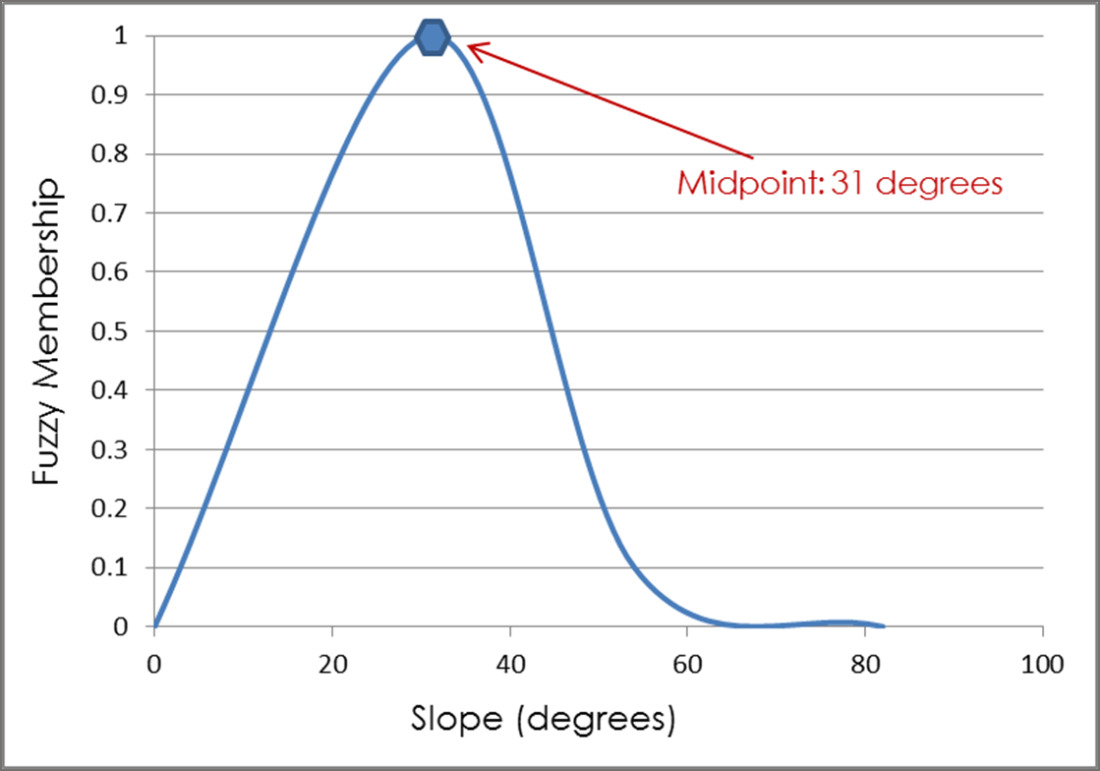
Step 3: Assign Fuzzy Membership
Presence points for the study area were used in the “Extract Value to Points” tool to determine the range of values for each variable at known landslide locations. These values were used to decide which membership type to assign and where to set parameters, such as midpoint.
Notes:
Example: slope. From a literature point of view, it is known that the types of landslides common in Uganda and Rwanda (debris flow, mudflows), typically occur on slopes of 20 – 50 degrees, so not too shallow and not too steep (expert opinion). Next we tailored this known threshold to our study area. We did so by overlaying 56 historically known landslide locations with the slope raster to see the range of slopes covered by the landslide points. It was revealed that the known landslide locations fell on slopes ranging from 11 – 51 degrees (the entire study area had slopes ranging from 0 to 82 degrees). In order to capture this trend with the fuzzy membership tool, the slope raster was assigned a fuzzy membership type of “Near.” The midpoint was assigned a fuzzy membership of 1 and the values gradually decreased to zero the further away from the midpoint.

Slide 9
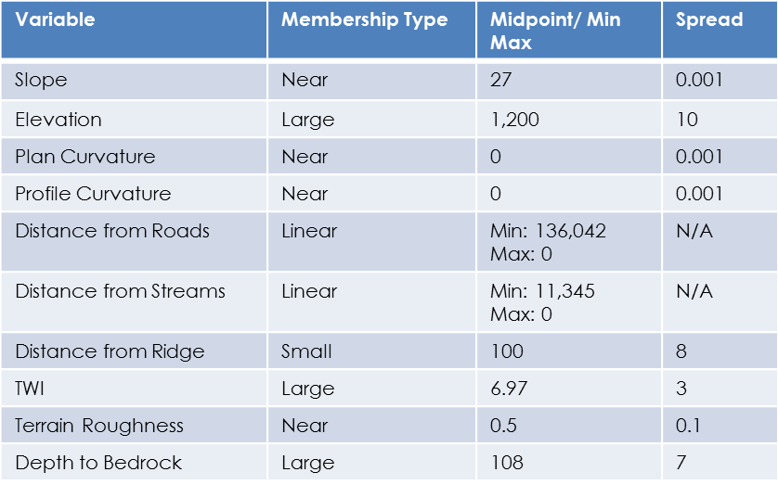
Step 3: Assign Fuzzy Membership
Membership parameters for this example were as follows:

Slide 10
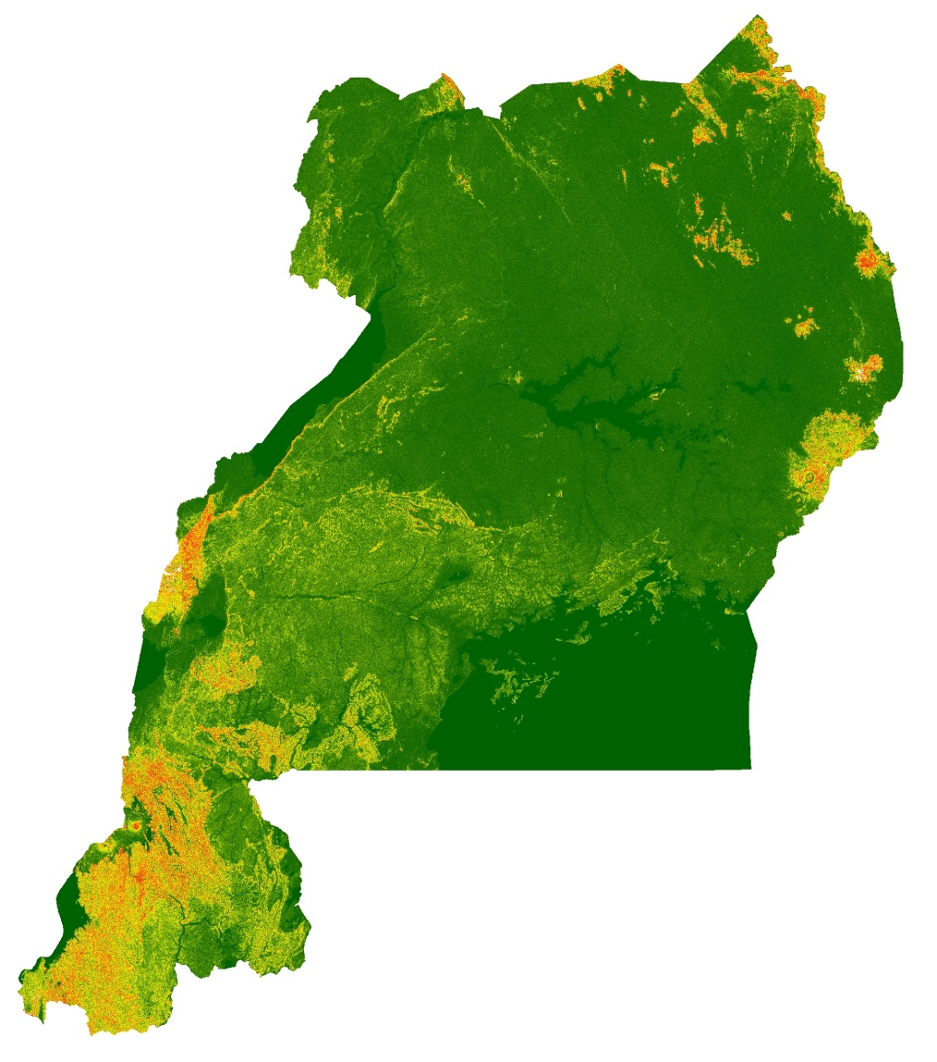
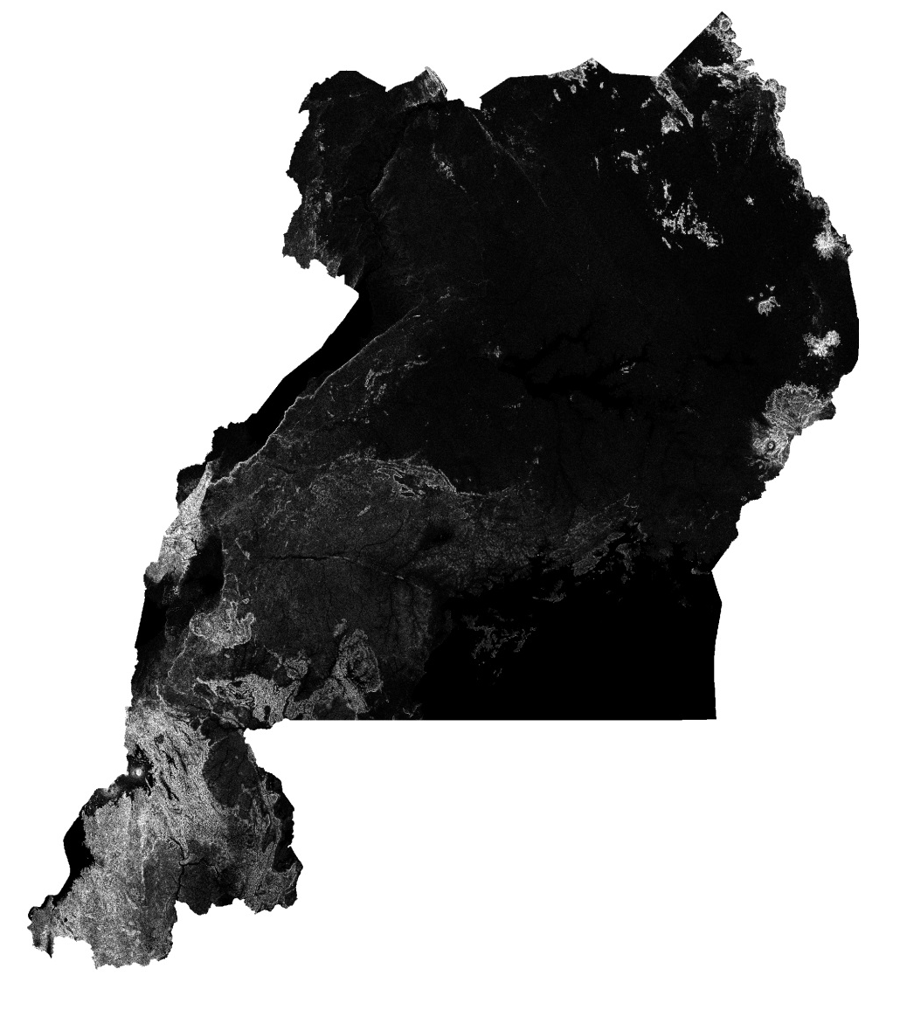
Step 3: Assign Fuzzy Membership
Example: Slope
Slope Fuzzy Membership Layer
Slope Raster Layer

Slide 11
Step 4: Fuzzy Overlay
Next, all fuzzy membership layers need to be combined. This can be accomplished with the “Fuzzy Overlay” tool. This tool computes the possibility of a phenomenon belonging to multiple sets in a multicriteria overlay analysis.
Fuzzy Overlay Operators:
Fuzzy And
The Fuzzy And overlay type will return the minimum value of the sets the cell location belongs to. This technique is useful when you want to identify the least common denominator for the membership of all the input criteria. For example, in a housing suitability model, you may only want to select locations that have at least a 0.5 or greater possibility of being suitable for all the criteria.
Fuzzy And uses the following function in the evaluation:
Fuzzy Or
The Fuzzy Or overlay type will return the maximum value of the sets the cell location belongs to. This technique is useful when you want to identify the highest membership values for any of the input criteria. For example, in a housing suitability model, you may want to identify all locations that have at least one of the criteria being fully in the suitable set, a value of 1.
Fuzzy Or uses the following function in the evaluation:
Fuzzy Product
The Fuzzy Product overlay type will, for each cell, multiply each of the fuzzy values for all the input criteria. The resulting product will be less than any of the input, and when a member of many sets is input, the value can be very small. It is difficult to correlate the product of all the input criteria to the relative relationship of the values. The Fuzzy Product option is not used often.
Fuzzy Product uses the following function in the evaluation:
Fuzzy Sum
The Fuzzy Sum overlay type will add the fuzzy values of each set the cell location belongs to. The resulting sum is an increasing linear combination function that is based on the number of criteria entered into the analysis.
Fuzzy Sum is not an algebraic sum and should not be confused with the additive approach used in the Weighted Overlay and Weighted Sum tools. These two overlay approaches assume that the more favorable input, the better. To add all the membership values in a Fuzzy Sum analysis does not necessarily mean the location is more suitable. The Fuzzy Sum option is not used often.
Fuzzy Sum uses the following function in the evaluation:
Fuzzy Gamma
The Fuzzy Gamma type is an algebraic product of Fuzzy Product and Fuzzy Sum, which are both raised to the power of gamma. The generalize function is as follows:
µ(x) = (FuzzySum)^{γ} * (FuzzyProduct)^{1-γ}
* Source: http://resources.arcgis.com/en/help/main/10.1/index.html#/How_Fuzzy_Overlay_works/009z000000s0000000/
Notes:
http://resources.arcgis.com/en/help/main/10.1/index.html#/How_Fuzzy_Overlay_works/009z000000s0000000/

Slide 12
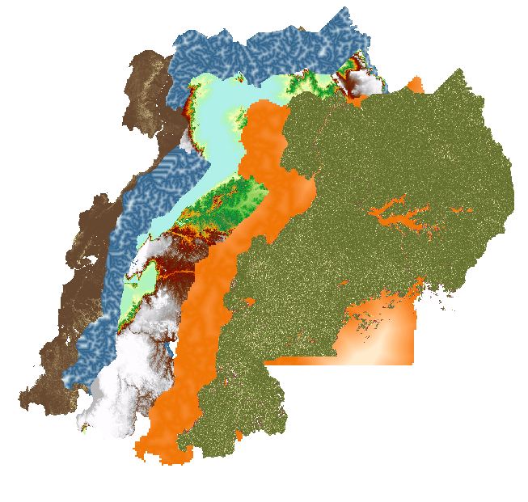
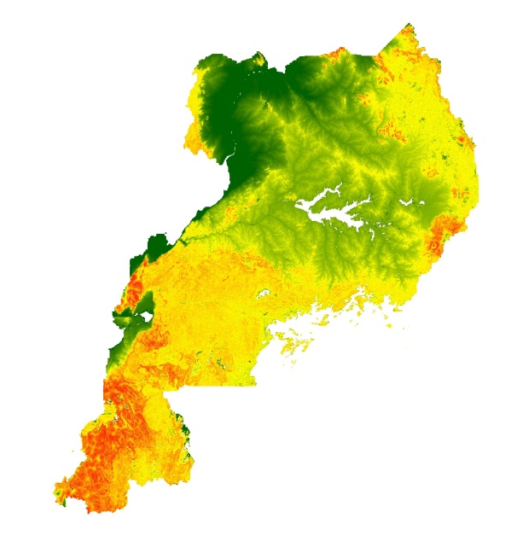
Step 4: Fuzzy Overlay
For this study the AND operator was chosen to combine the fuzzy membership layers since this operator considered the combined input of all variables when assigning pixel values. Pixels were assigned the lowest value from the corresponding pixels of the input layers. The result was one raster layer with values ranging from 0 to 1, where pixels closer to zero represented low susceptibility to landslides and pixels closer to 1 represented high susceptibility to landslides.
Fuzzy Membership Layers
Fuzzy Overlay (Landslide Susceptibility Map)
Notes:
http://help.arcgis.com/en/arcgisdesktop/10.0/help/index.html#//009z000000rv000000.htm

Slide 13
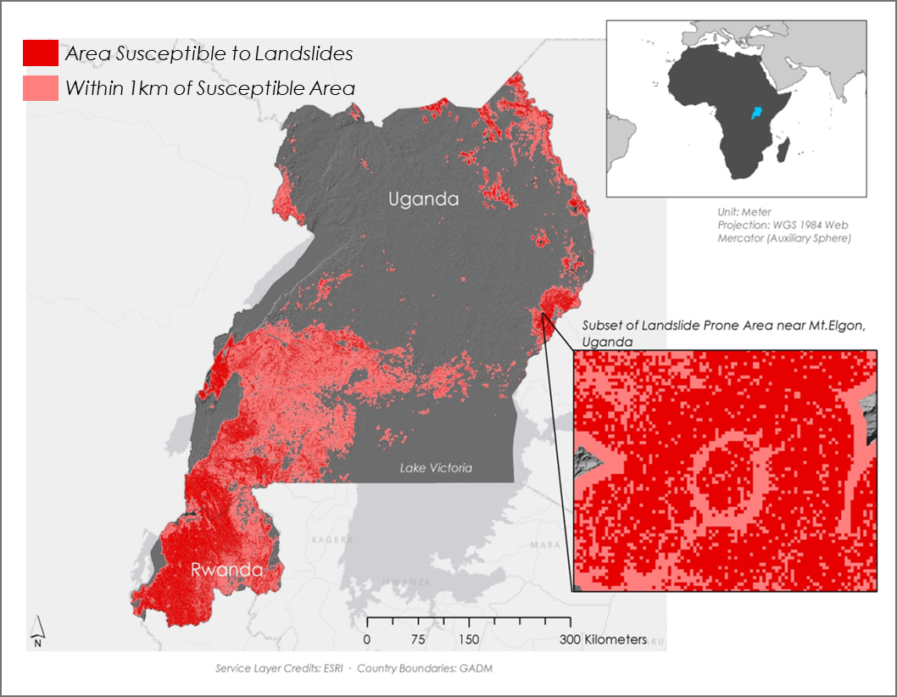
Final Susceptibility Map
The final map (right) was reclassified to show only areas with a fuzzy membership of 0.5 or greater (red). Buffers of 1km were placed around these areas (pink) to account for possible landslide inundation zones.
Notes:
http://help.arcgis.com/en/arcgisdesktop/10.0/help/index.html#//009z000000rv000000.htm

