Slide 1
Ocmulgee
Ecological
Forecasting II
Utilizing NASA’s Earth observations for Forecasting Land Use Change and Wildlife Disturbances Along the Ocmulgee River Corridor
Christopher Cameron (Project Lead)
Ayn Remillard
Andrew Herring
Zhan Shi
Notes:
This is a multi-term project with the Georgia Department of Natural Resources (Wildlife Resources Division) to produce updated an land cover map and ecological forecast for threatened species in the study area.

Slide 2
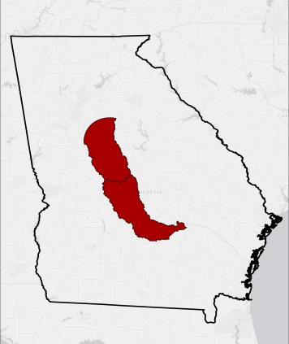
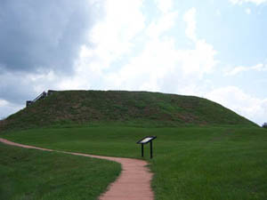
Study Area: The Ocmulgee River
Eco-recreation and preservation
Home to critical keystone species
Georgia’s largest collection of National Register of Historic Places
Georgia
Ocmulgee River
Credit: National Park Service
Notes:
Located in the heart of Georgia’s Piedmont and Coastal Plain region, the head waters of the Ocmulgee River begin just south of the city of Atlanta and flow for 180 miles until it joins the Oconee River to form the Altamaha.
This study focused on the portions of the Ocmulgee watershed which fall within 40 kilometers of the river itself, resulting in a total study area of approximately 11468 km2.
Great Temple Mound at Ocmulgee National Monument.
Photo by Wayne Hsieh, Flickr
http://www.nps.gov/nr/travel/cultural_diversity/photos/Ocmulgee1.jpg

Slide 3
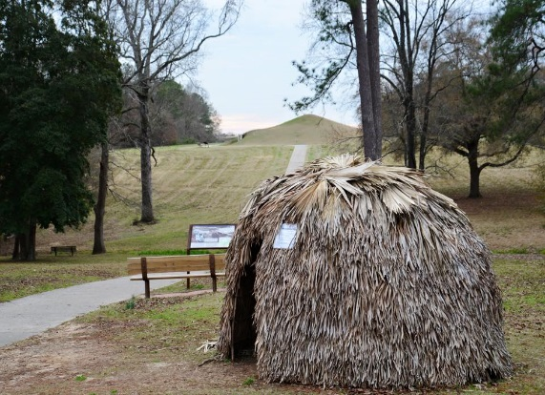
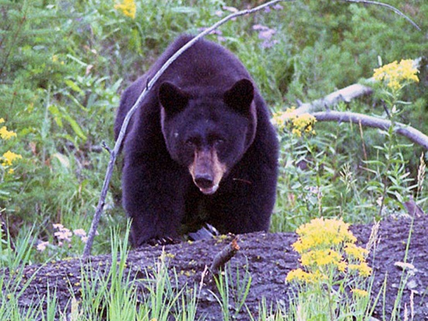
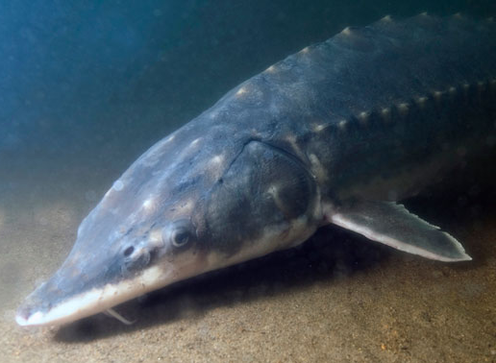
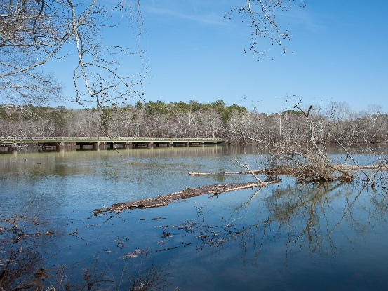
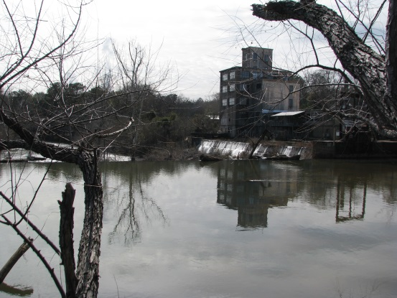
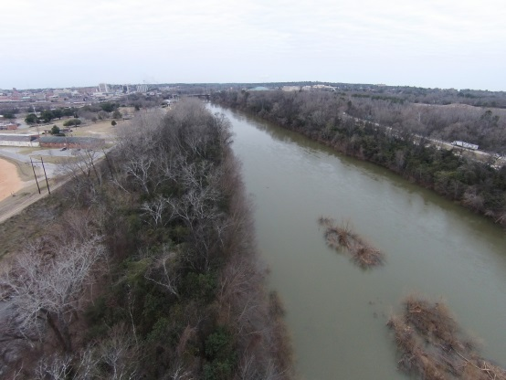
Community Concerns
High-priority landscape in Georgia’s 2005 Wildlife Action Plan
Habitat becoming fragmented due to urban sprawl
Threat to endangered species
Credit: NPS website
Credit: Ocmulgee Eco Team
Notes:
The Ocmulgee River corridor is inhabited by several federally protected endangered species- including the Atlantic sturgeon and Short nosed sturgeon. Other species which rely on the Ocmulgee are the black bear and many types of migratory birds. The primary concern for this study area is habitat fragmentation due to increasing urbanization.
https://www.facebook.com/ocmulgeenps
Photograph by Terry Spivey, USDA Forest Service
http://www.georgiaencyclopedia.org/articles/geography-environment/blue-ridge-mountains
Robert Michelson
http://www.nmfs.noaa.gov/stories/2012/01/31_atlantic_sturgeon.html

Slide 4
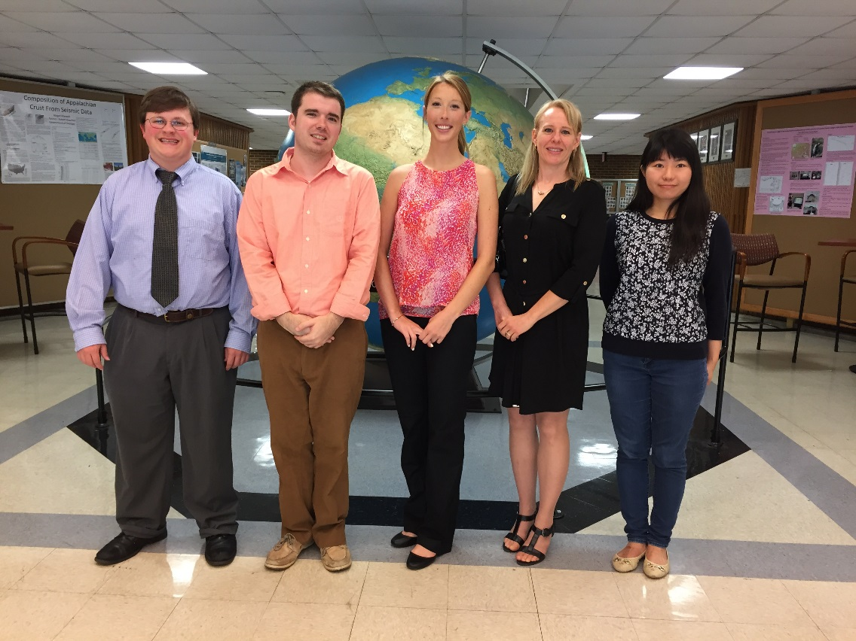
Project Partners
Georgia Department of Natural Resources
Credit: Ocmulgee Eco Team
Notes:
Our NASA DEVELOP team worked with partners from The Georgia Department of Natural Resources to conduct a land cover change study with the goal of predicting future land use trends in the Ocmulgee River corridor.
Andrew Herring, Christopher Cameron, Ayn Remillard, Melanie Riley (GA DNR), Zhan Shi

Slide 5
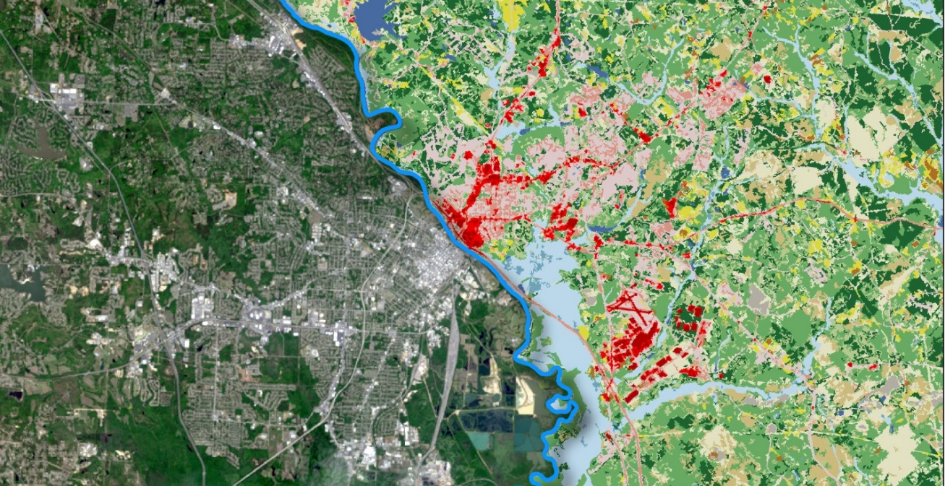
Objectives
Produce a 2014 land cover dataset using Landsat 8 imagery
Quantify land cover change in the Ocmulgee River Valley
Assess historic trends in land cover from 2001 to 2014
Predict land cover changes within the Ocmulgee Corridor
Model effects of land cover change on ecological habitats
Identify priority wildlife conservation areas for state agencies
Credit: Ocmulgee Eco Team
Notes:
The image on this slide shows a comparison of how the Ocmulgee River Corridor near Macon, GA looks across Landsat 8 and 2011 NLCD

Slide 6
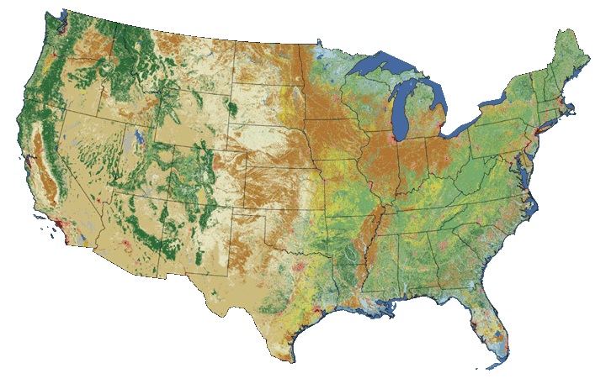

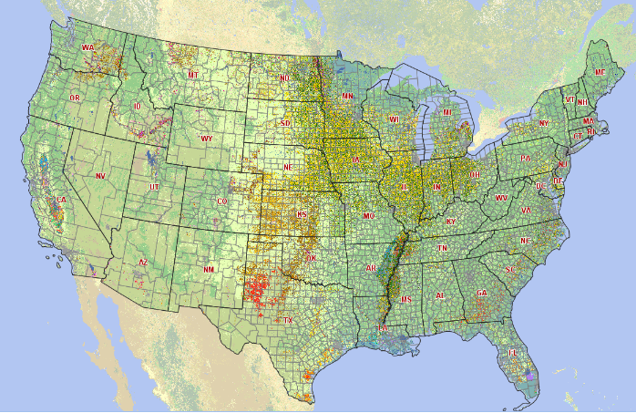
Data Sources
Landsat 8, OLI
  2014 satellite imagery
U.S. Geologic Survey (USGS)
  National Land Cover Dataset (NLCD): 2001, 2006, and 2011
U.S. Department of Agriculture (USDA)
  CropScape Data Layer: 2008-2014
Credit: NASA
Credit: USGS
Credit: USDA
Notes:
This project used Landsat 8 imagery to classify the study area. Landsat 8 is NASA’s eighth satellite in the Landsat series focusing on earth-observations. Landsat 8 produces approximately 400 images a day of the Earth’s surface at a resolution of 15 to 100 meters across a variety of spectral bands. This data can be used to determine land cover conditions.

Slide 7
Project Methodology
DATASETS
ANALYSIS
PRODUCTS
2014 Land Cover Supervised Classification
Land Cover Change Predictions
Landsat 8 Imagery
Historic Land Cover (NLCD)
Ecological Forecasting
Land Cover Change Detection
Threat and Opportunity Assessment
Ecology and Wildlife
Notes:
The process of classification involves the comparison of multiple Landsat 8 images through the use of software like ERDAS IMAGINE, ArcGIS, and ENVI to detect changes in land cover.

Slide 8
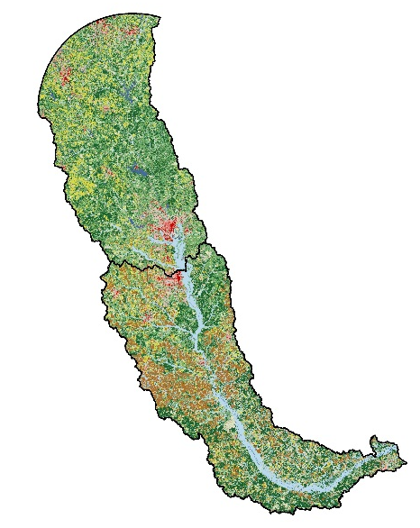
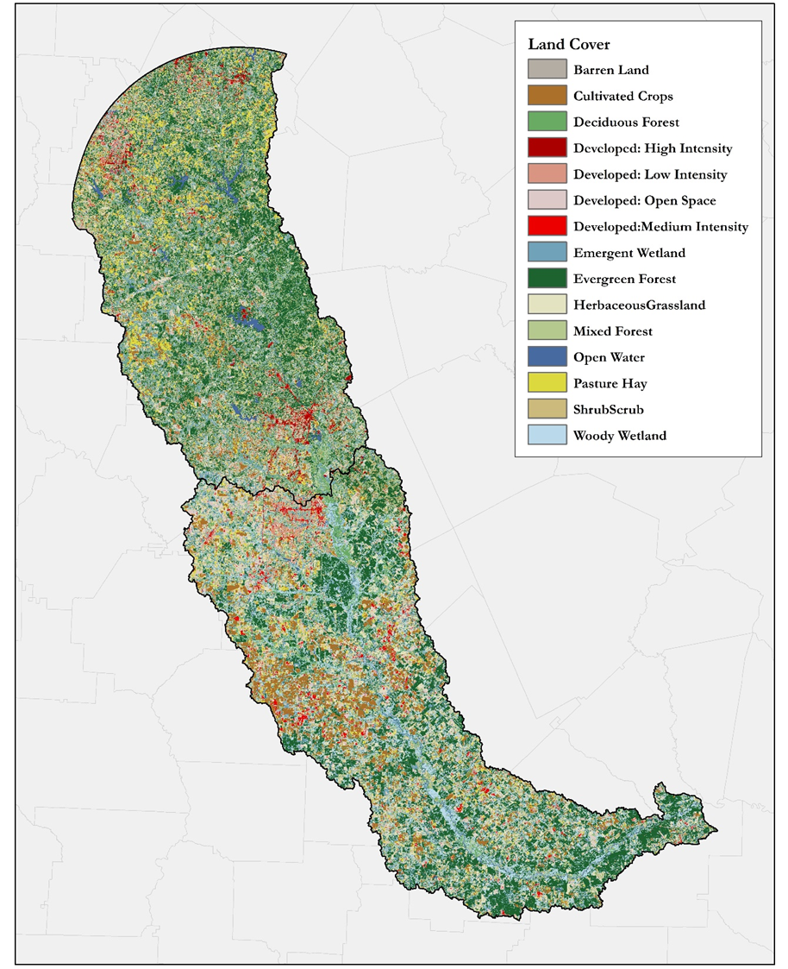


Results: 2001-2014 Land Cover
2014 Land Cover
2001 NLCD
2006 NLCD
2011 NLCD
Credit: NLCD
Credit: Ocmulgee Eco Team
Notes:
The team utilized historic national land cover datasets from the years 2001, 2006, and 2011. They created a 2014 land cover classification to analyze the effects of changing environmental conditions on wildlife in the Ocmulgee River valley.

Slide 9
Results: Land Cover Classification
Area (km²)
Notes:
2001,2006, and 2011 data displayed here are all from the NLCD datasets. The 2014 data is based on the team’s supervised classification.

Slide 10
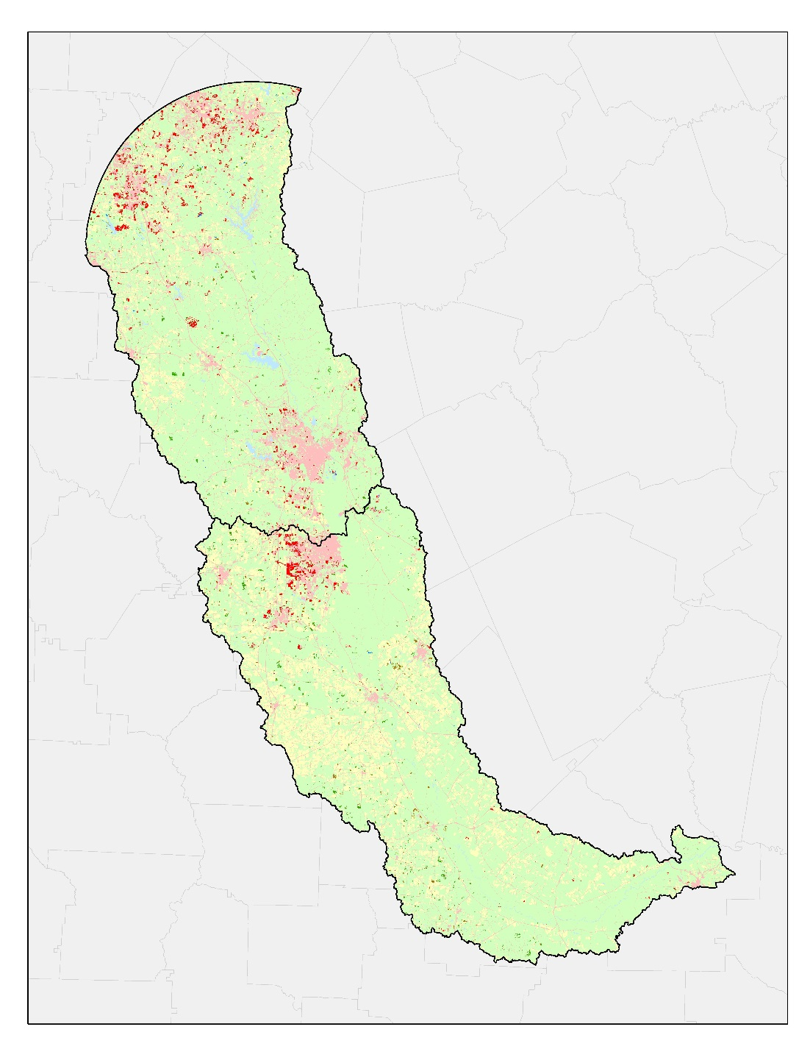
Results: Land Cover Change
Change Detection: 2001 – 2006
Agriculture
Vegetation
Development
Water
New Vegetation
New Agriculture
New Development
New Water
Percent of Total Area
98.2%
Percent of Changed Area
Credit: Nation Land Cover Database, Ocmulgee Eco Team
Notes:
Total area: Change 1.8%
Percent changed area: Developed 62.7%, Agriculture 10.5%, Water 1.9%, Vegetation 24.9%

Slide 11
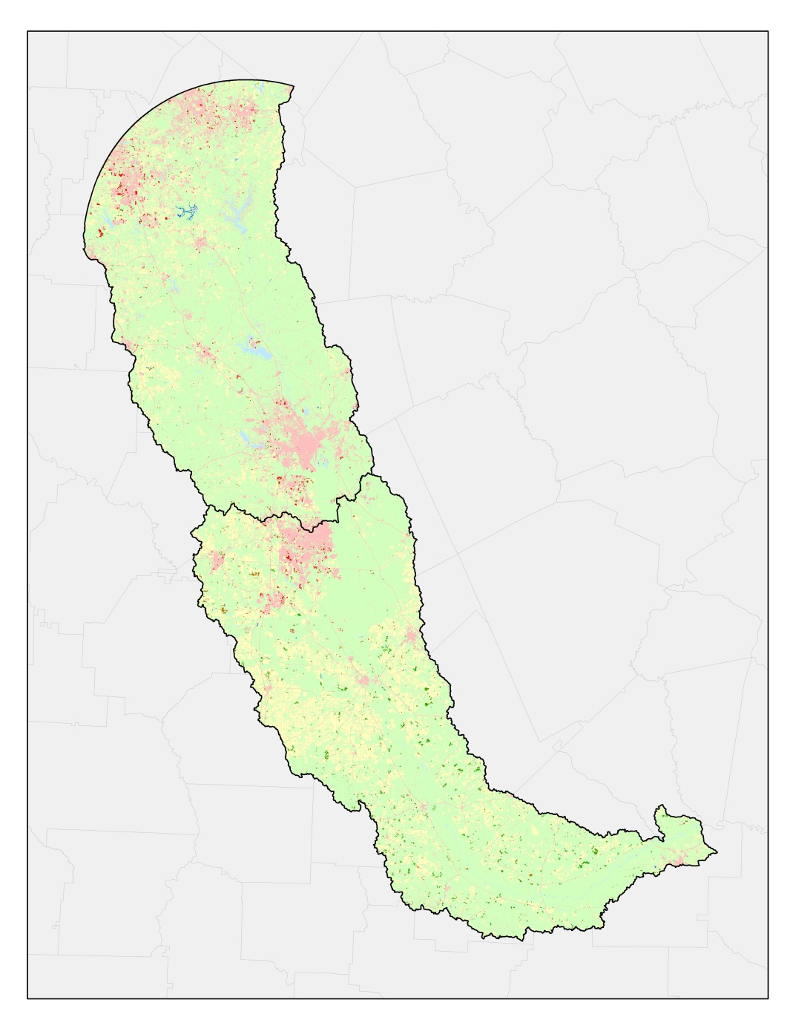
Results: Land Cover Change
Change Detection: 2006 – 2011
Agriculture
Vegetation
Development
Water
New Vegetation
New Agriculture
New Development
New Water
Percent of Total Area
98.9%
Percent of Changed Area
Credit: Nation Land Cover Database, Ocmulgee Eco Team
Notes:
Total area: Change 1.1%
Percent changed area: Developed 30.1%, Agriculture 17.3%, Water 4.4%, Vegetation 48.2%

Slide 12
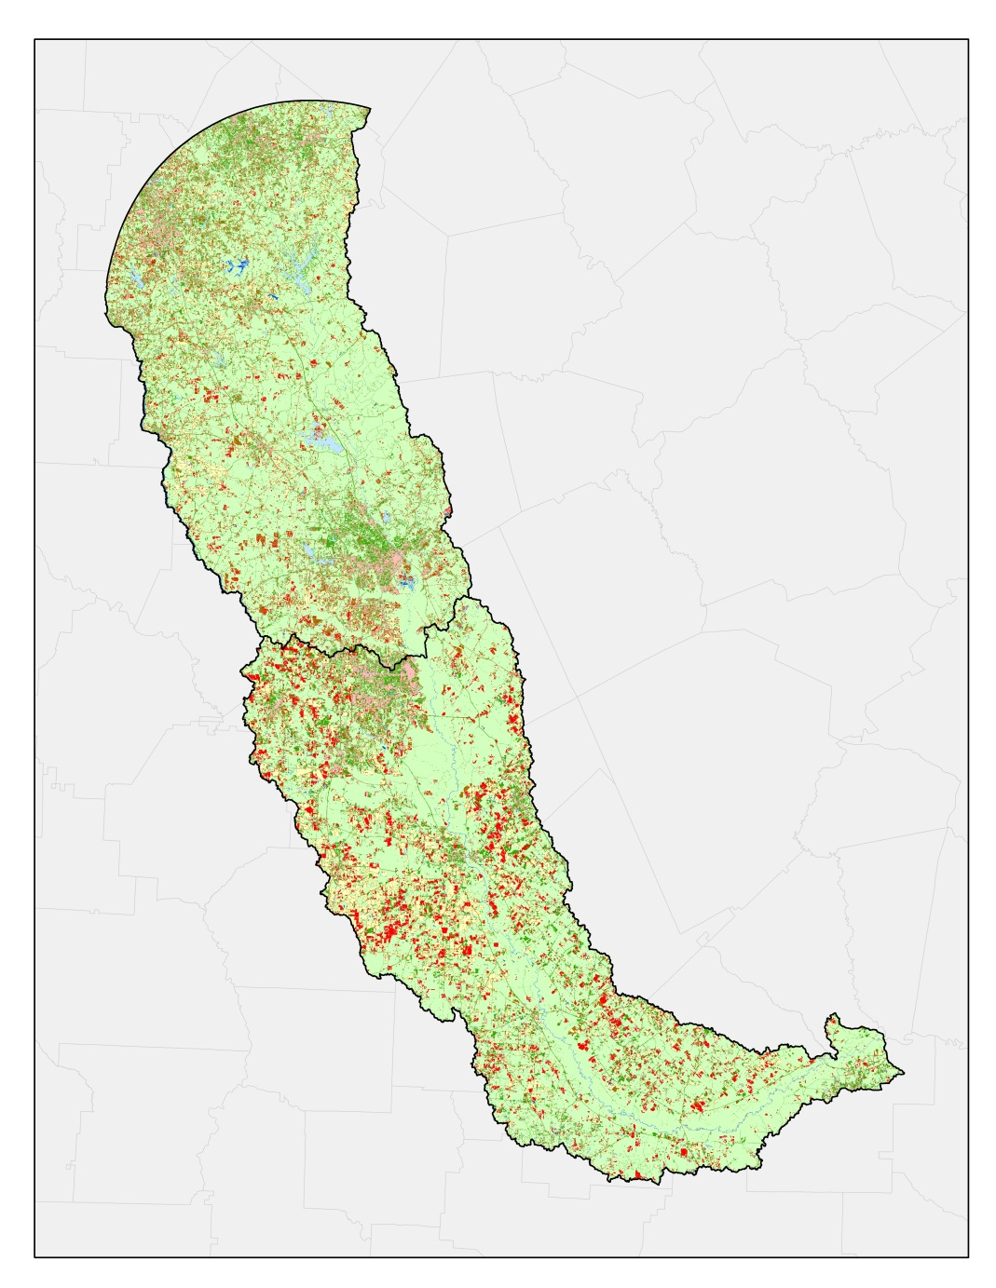
Results: Land Cover Change
Change Detection: 2011 – 2014
Agriculture
Vegetation
Development
Water
New Vegetation
New Agriculture
New Development
New Water
Percent of Total Area
78.8%
Percent of Changed Area
Credit: Nation Land Cover Database, Ocmulgee Eco Team
Notes:
Total area: Change 21.2%
Percent changed area: Developed 31.1%, Agriculture 17.2%, Water 3.7%, Vegetation 48.0%

Slide 13

Results: Land Cover Change
Change Detection: 2001 – 2014
Agriculture
Vegetation
Development
Water
New Vegetation
New Agriculture
New Development
New Water
Percent of Total Area
77.9%
Percent of Changed Area
Credit: Nation Land Cover Database, Ocmulgee Eco Team
Notes:
Total area: Change22.1%
Percent changed area: Developed 33.0%, Agriculture 16.1%, Water 3.8%, Vegetation 47.1%

Slide 14
Results: Land Cover Trends
Area(km²)
If observed land cover trends continue, we predict a 7.3% increase in development and 3.6% increase in agriculture by 2027.
Notes:
The graphic here shows land cover trends over time for given time periods.

Slide 15
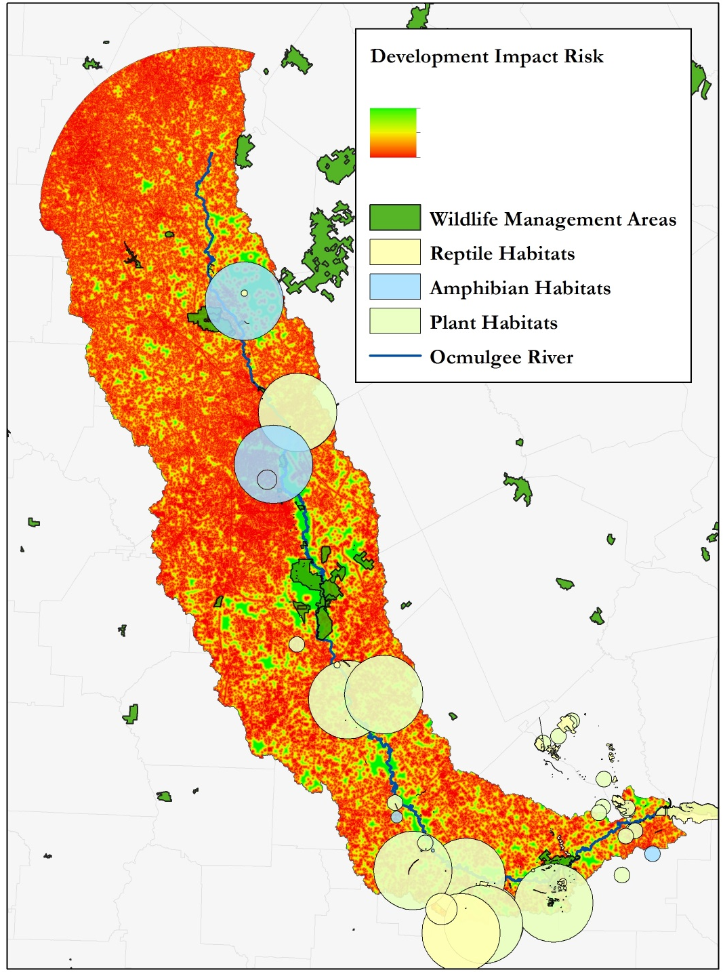
Results: Urbanization Impacts
-Low Risk
-High Risk
Ecological habitats and GA DNR wildlife management sites in relation to risk from urban encroachment.
Credit: Ocmulgee Eco Team
Notes:
Although some of the GA DNR wildlife management areas do fall within the low risk zones there are many low risk zones that could be considered for future wildlife management areas.

Slide 16
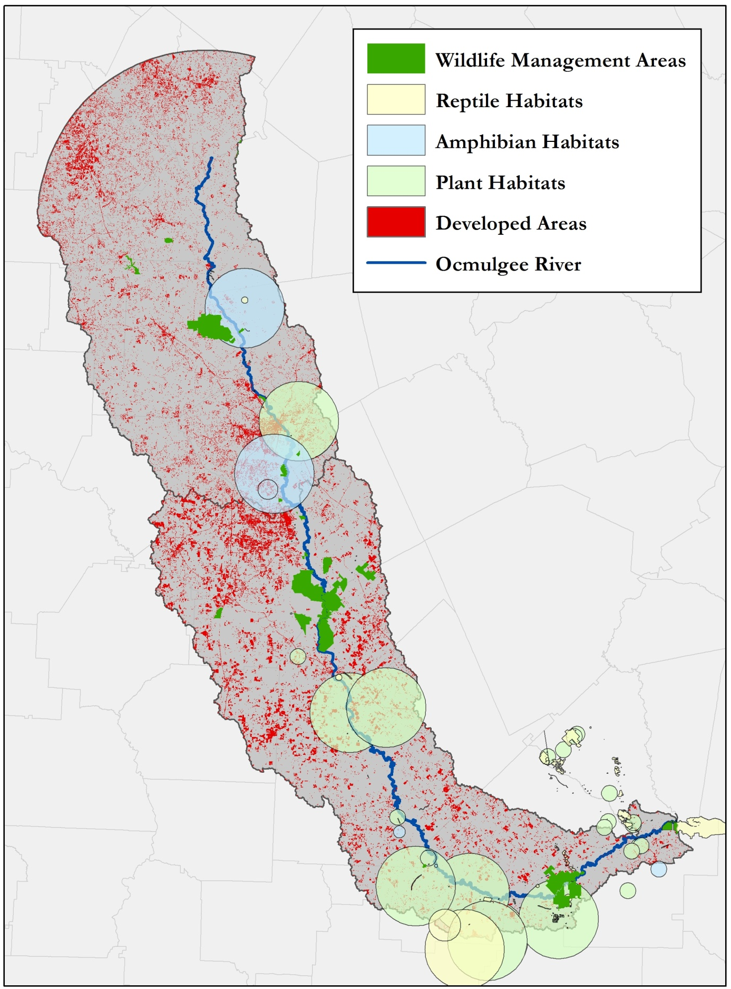
Results: Ecological Disturbances
Ecological habitats and GA DNR wildlife management sites in relation to urban areas
Credit: Ocmulgee Eco Team
Notes:
In the future it would be beneficial to create more wildlife management areas within the known ecological habitats present, while avoiding developed areas.
Ecological habitats and GA DNR wildlife management sites in relation to urban areas

Slide 17
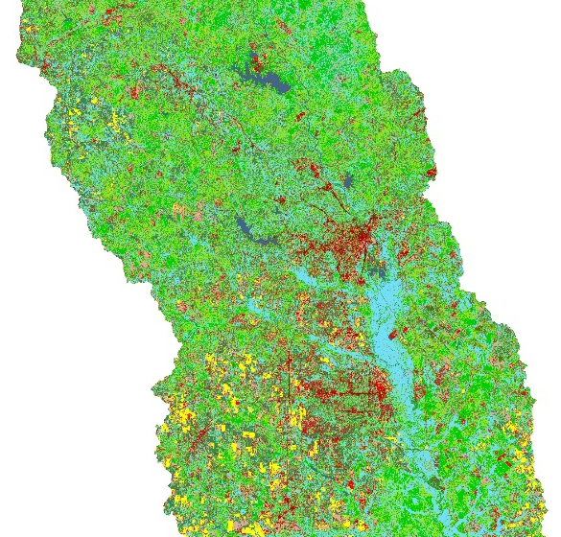
Conclusions
Land cover change (2001-2014) showed increasing developed areas coinciding with urban sprawl
Rare plant, amphibian, and reptile communities appear to be the most sensitive to increasing development based on proximity to urban areas
Existing wildlife management areas are situated in locations that would allow GA DNR to expand their conservation efforts to include these habitats
Supervised classification proved more accurate for land cover mapping
Credit: Ocmulgee Eco Team
Unsupervised Land Cover Results
Supervised Land Cover Results
Notes:
Unsupervised Classification results are from the first term of this this project (Spring 2015)

Slide 18
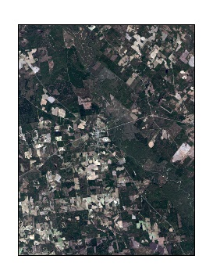
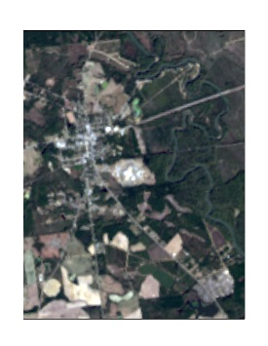
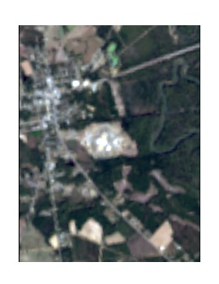
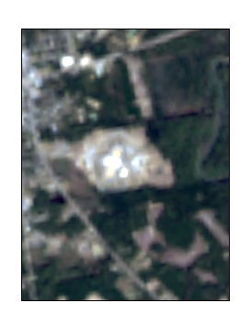
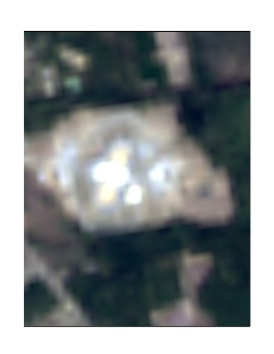
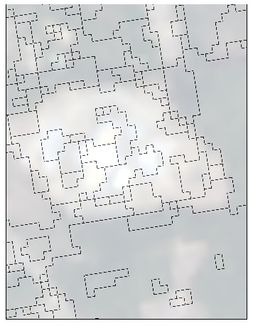
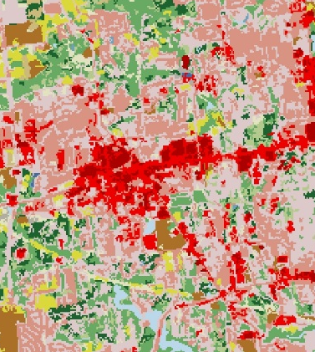
Errors and Uncertainties
Classification Errors
  Data Limitations
    30-meter resolution of Landsat 8 Imagery
    Overlapping pixel values for land cover classes
    Diversity of classes present within urban landscapes
  Misinterpretation of Imagery
    Subjective differences in individual visual analysis for training sets
30-meter resolution segmentation within an urban area.
Urban landscape along the Ocmulgee river.
Credit: Ocmulgee Eco Team, Landsat 8 Imagery
Notes:
One of the largest limitations of Landsat 8 Imagery is it’s 30-meter resolution which is course enough to represent the heterogeneous land cover but not detailed enough to capture the desired classification, specifically within urban areas.

Slide 19
Future Considerations
Using ecological forecasting modelers to better predict future land use conditions
  Clark Labs geospatial software system - TerrSet
    Land Change Modeler
    Habitat and Biodiversity Modeler
When classifying the land cover, using a combined spectral and spatial approach may be useful for mapping urban features - particularly those with low spectral values
Using smaller portions of the study area with higher resolution imagery to get a more accurate classification, especially for urban features

Slide 20
Advisors
Dr. Thomas Jordan, University of Georgia- Center for Geospatial Research
Dr. Marguerite Madden, University of Georgia- Center for Geospatial Research
Partners
Thom Litts, Georgia Department of Natural Resources
Melanie Riley, Georgia Department of Natural Resources
Past Contributors
Peter Hawman, DEVELOP
Gail Miller, DEVELOP
Caren Remillard, DEVELOP
Simmone Simpson, DEVELOP
Steve Padgett-Vasquez, DEVELOP

