Slide 1
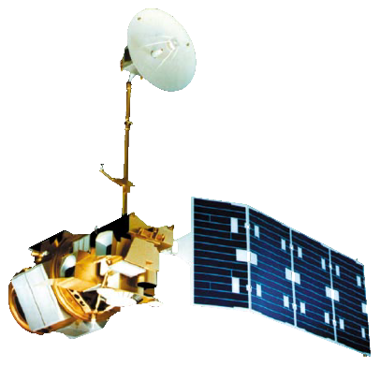
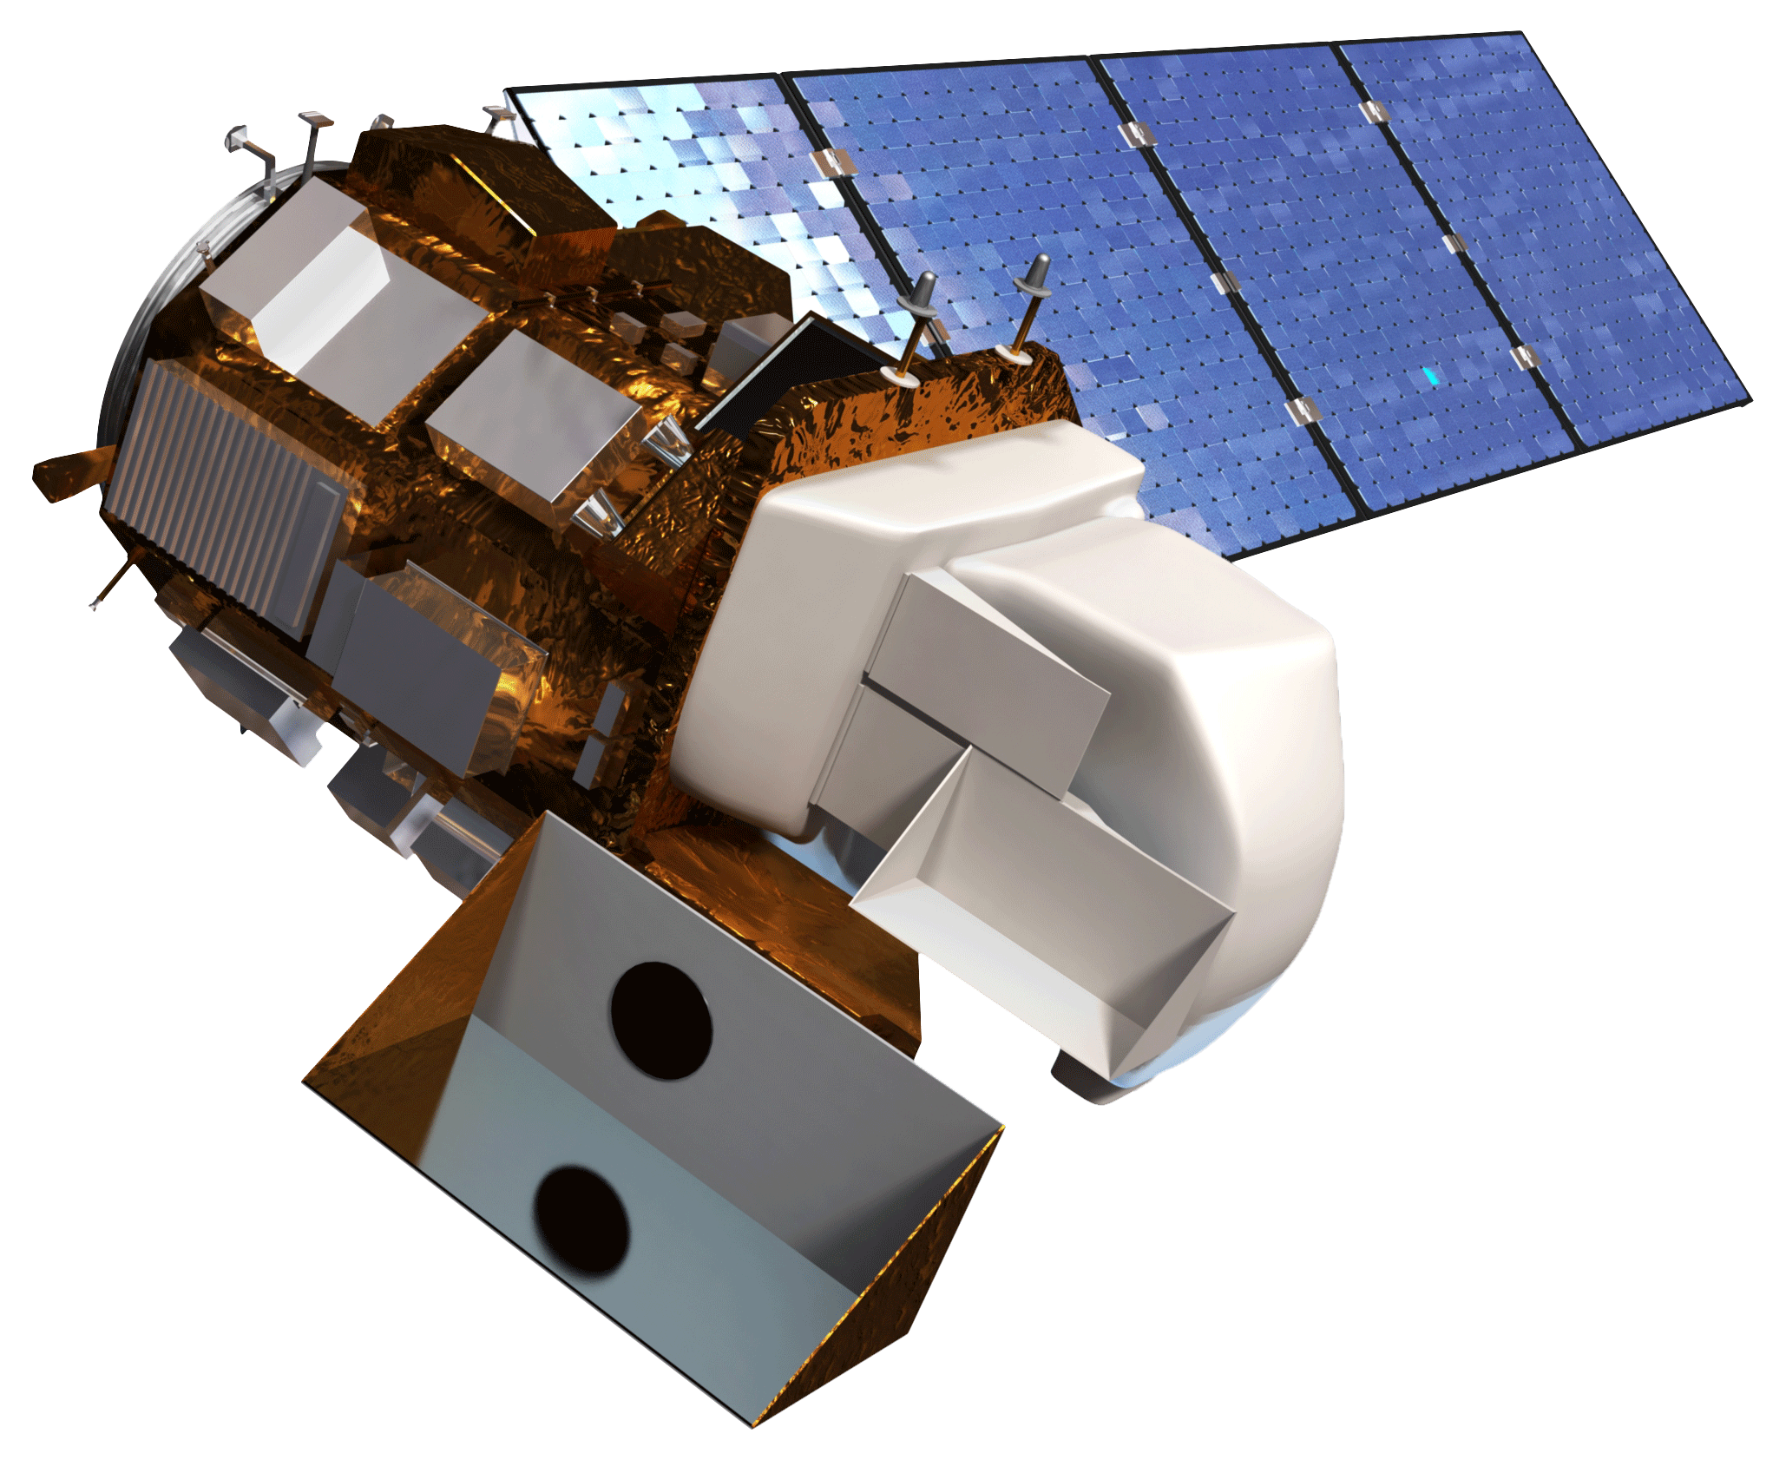
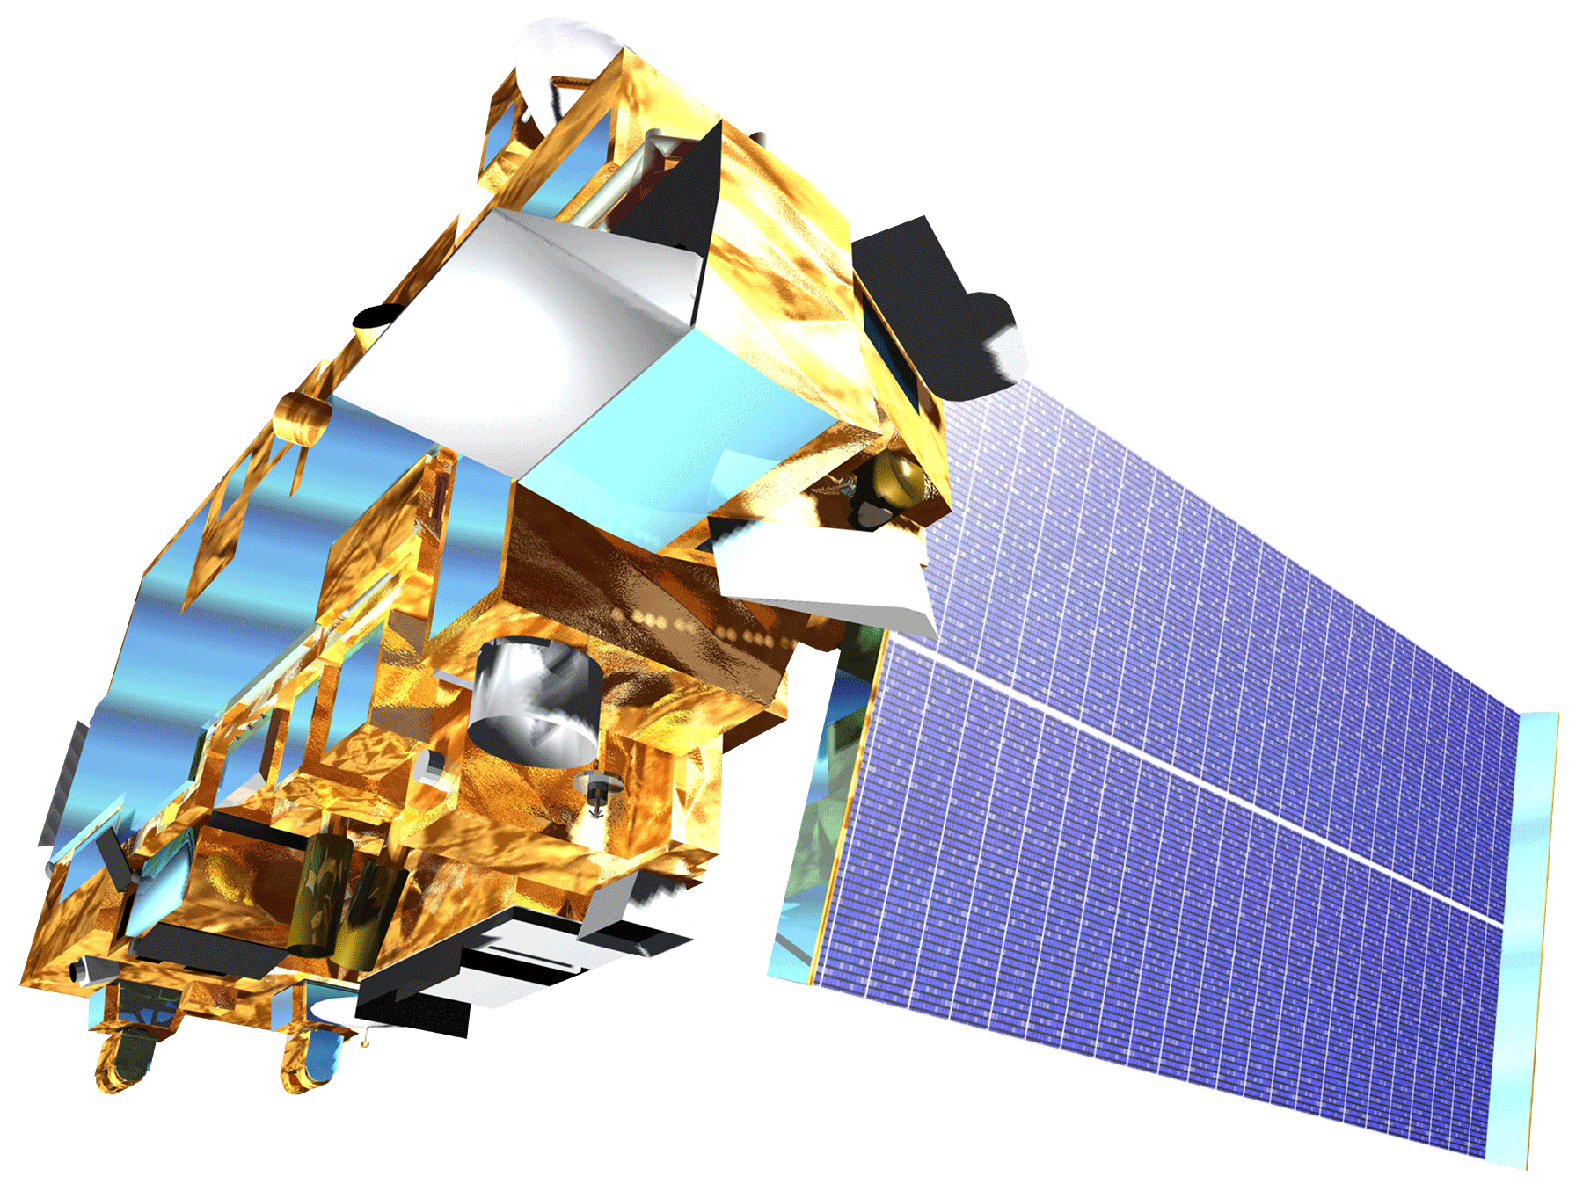
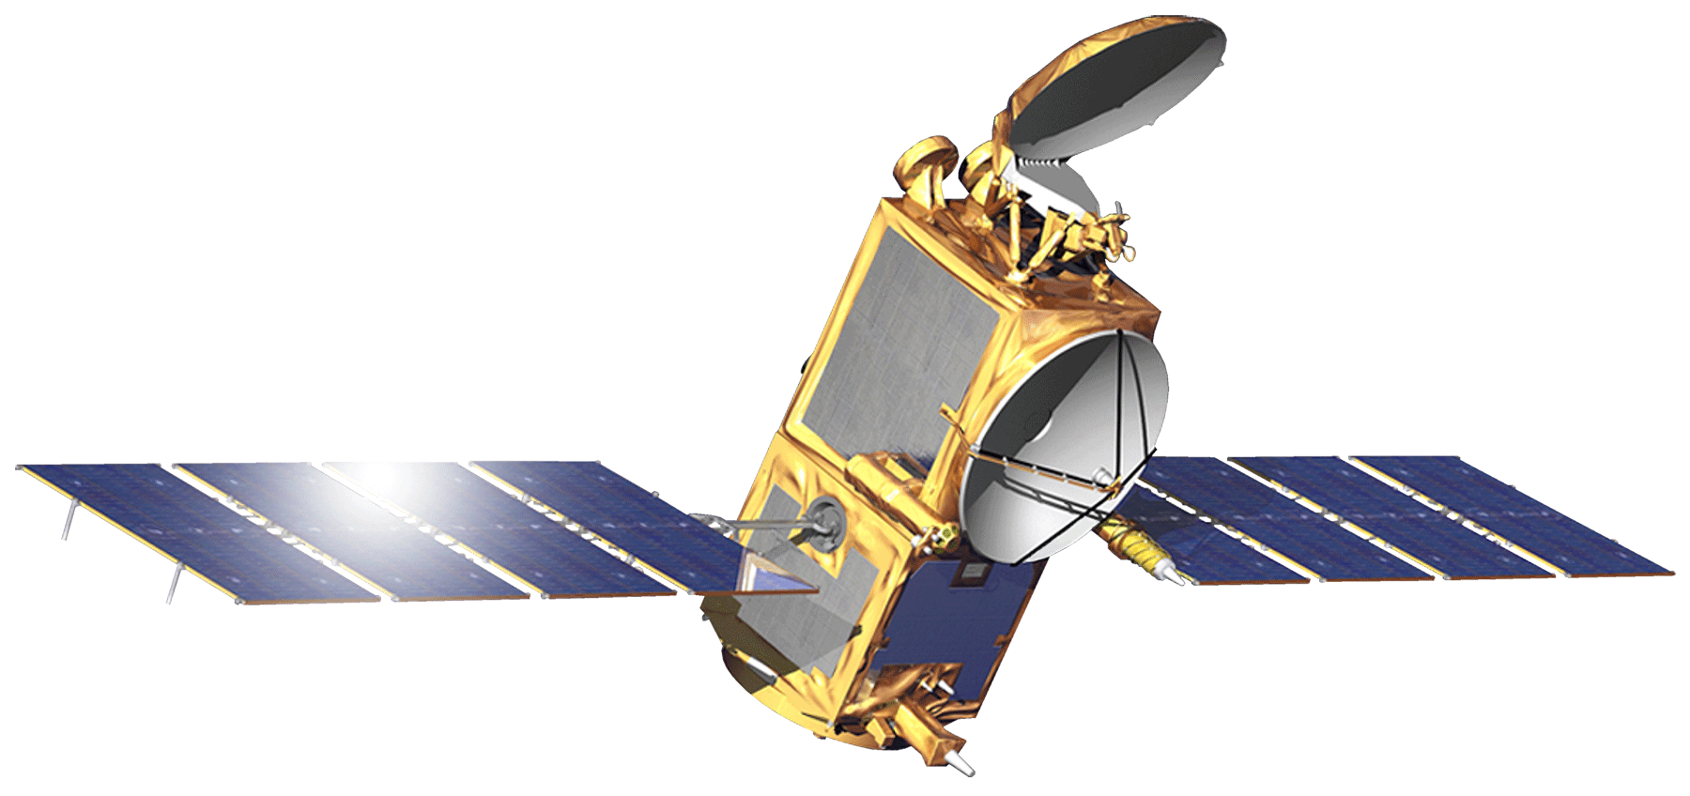
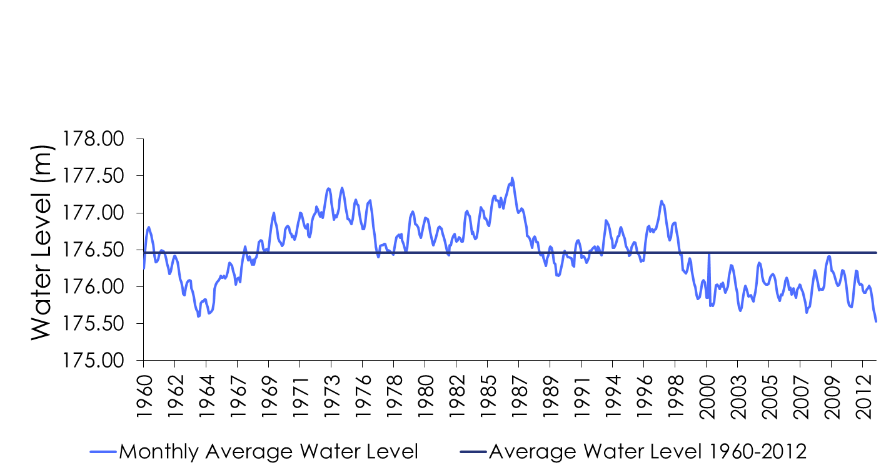
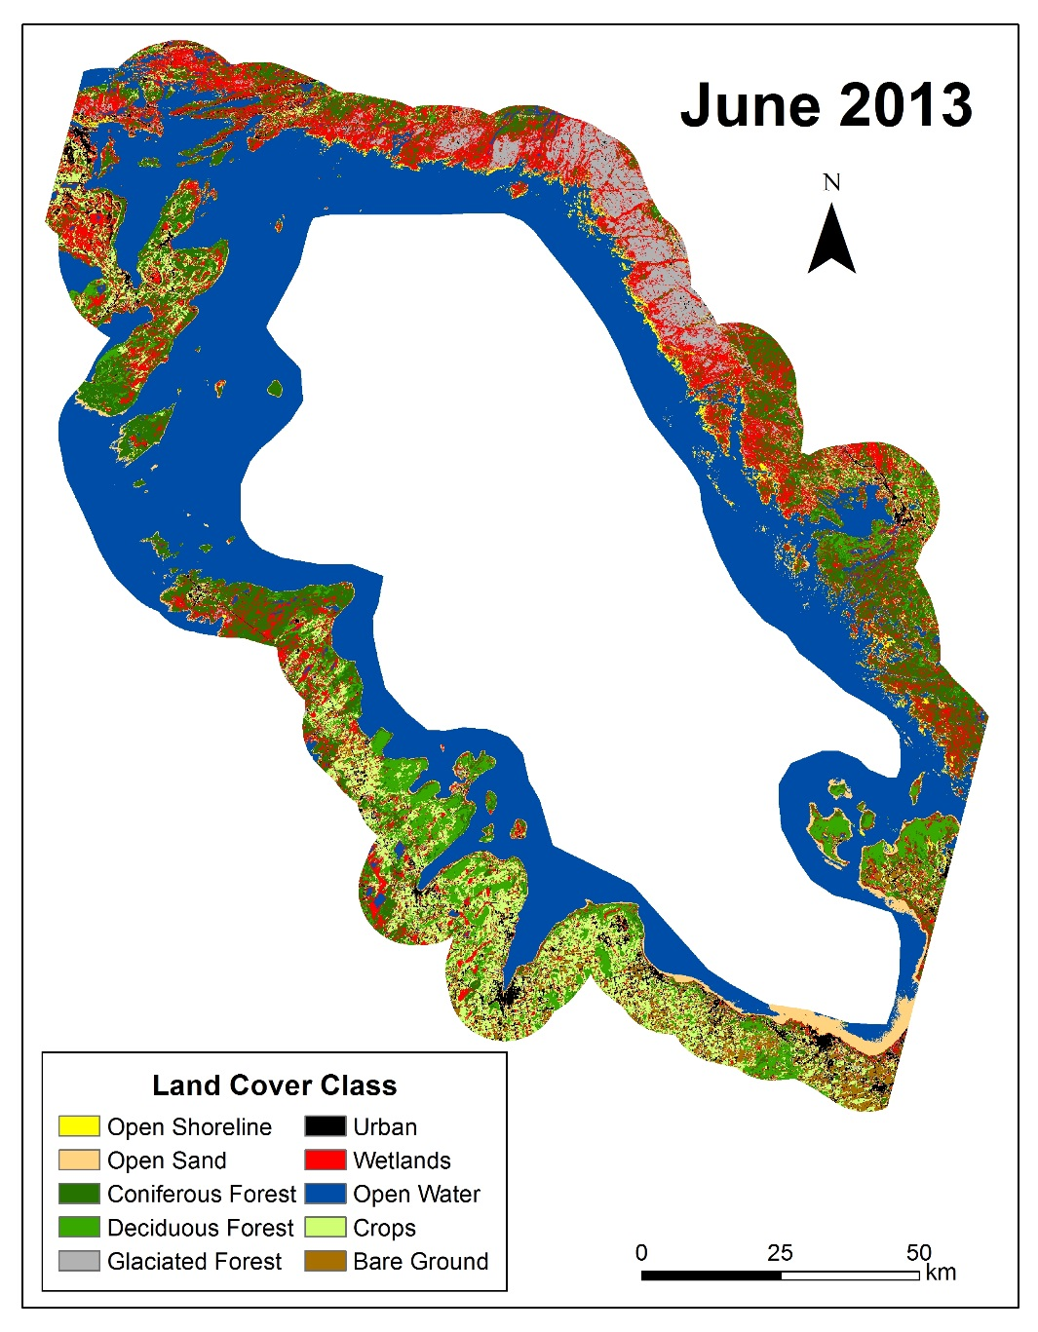
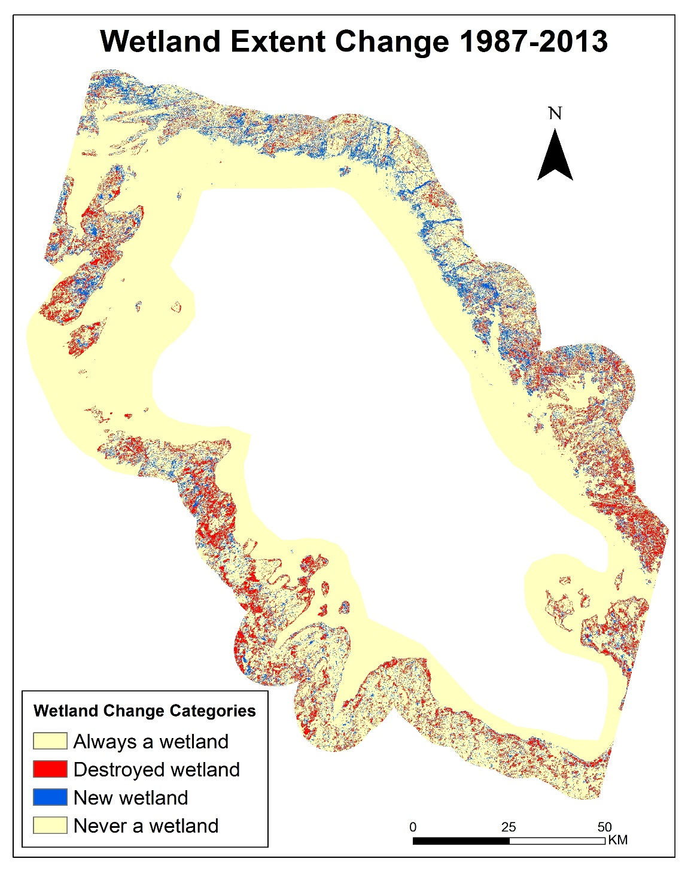
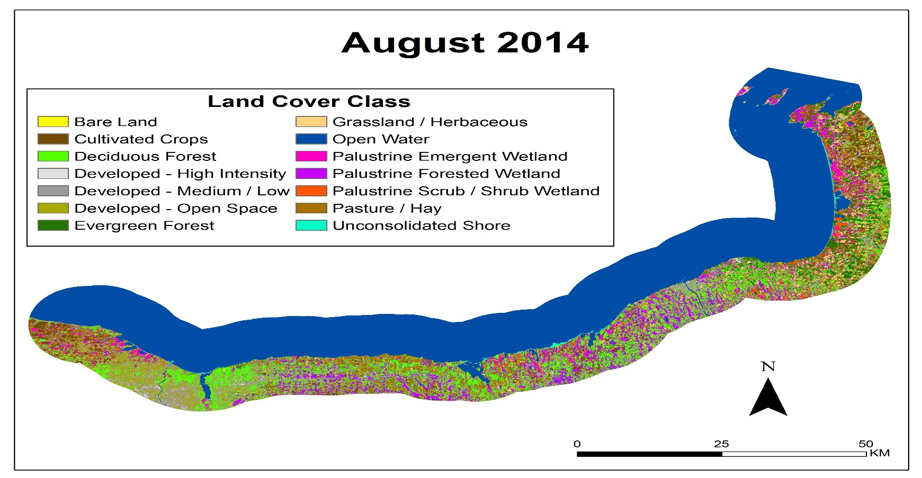
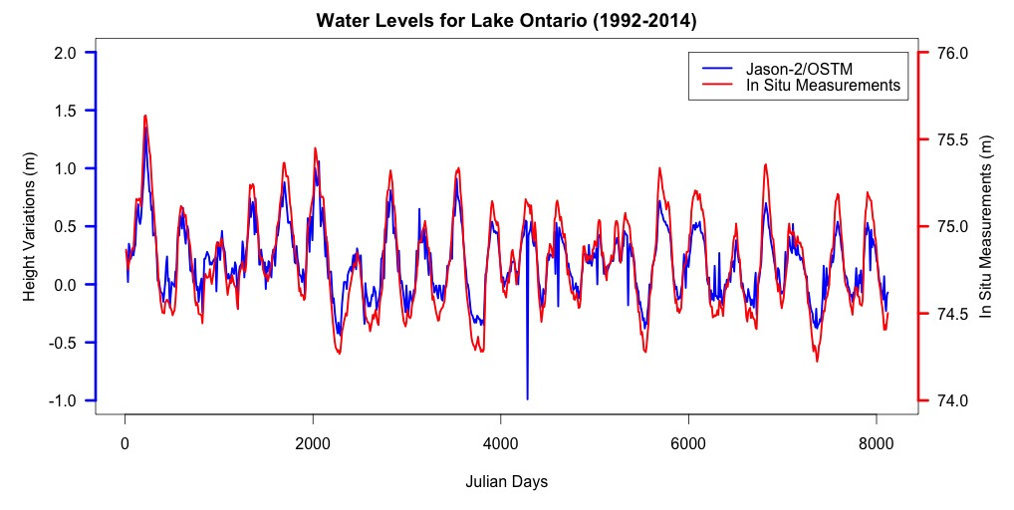
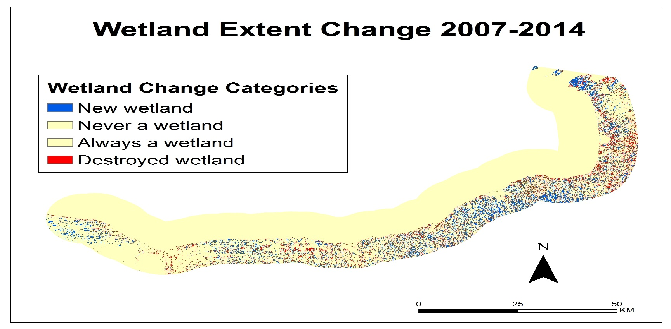
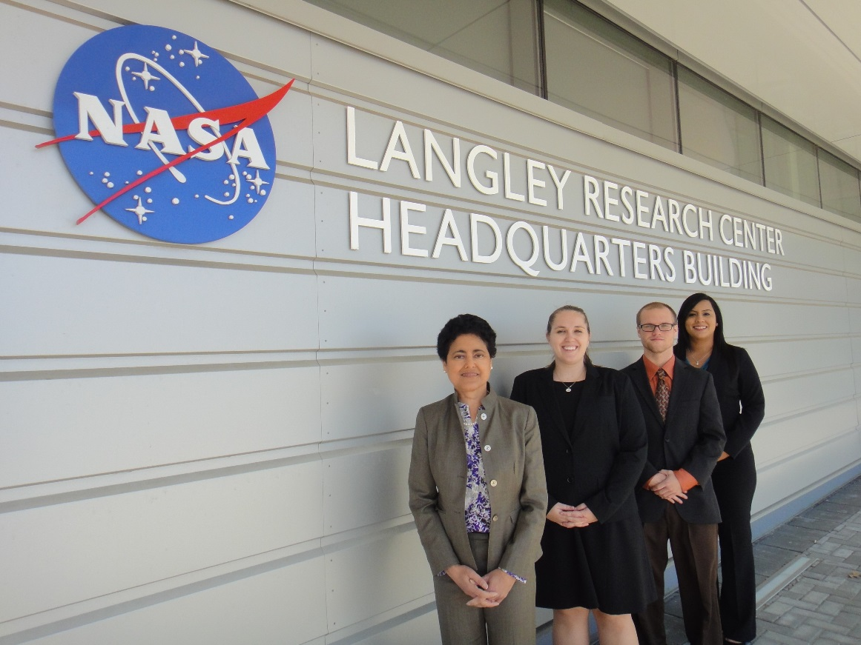
Great Lakes climate ii
Monitoring the Impacts of Climate Change and Decreasing Water Levels on Wetlands in the Great Lakes Region of North America
Emily Adams (Project Lead), Idamis Del Valle Martínez, Miriam Harris, Rodney Meyer, Stephen Zimmerman
NASA Langley Research Center
The Laurentian Great Lakes region of North America includes several types of coastal wetlands (e.g., swamps and marshes) that support a high diversity of biota. The health of these ecosystems is very important for ecological communities and economic industries, which benefit from fisheries and tourism. Great Lakes wetlands have been estimated to provide over 10,000 US dollars per acre in economic and ecosystem services. The effects of climate change, including variations in temperature, precipitation, and evapotranspiration, could impact the water level of the Great Lakes directly, and therefore, the development and survival of coastal wetlands. Increasing environmental pressures from rising populations, invasive species, and pollution will also negatively affect these wetlands if they are not managed appropriately. An updated land cover classification was developed, using a Random Forest classification method, to evaluate and monitor changes in the wetlands around Georgian Bay and the southern portion of Lake Ontario. NASA Earth Observations System (EOS) data from Landsat 5 Thematic Mapper (TM) and Landsat 8 Operational Land Imager (OLI) provided historical images and current images to classify land cover. Terra Advanced Spaceborne Thermal Emission and Reflection Radiometer data provided digital elevation model data from which slope was calculated. Resultant land cover classifications were validated with ground truth data. Additionally, TOPEX/Poseidon Jason-1 and Ocean Surface Topography Mission (OSTM)/Jason-2 radar altimeters and in -situ water gauge data served as a resource for tracking water levels over time. This methodology offers a more cost-effective approach to monitoring wetlands in the region.
Create historic and current land cover classification maps for Georgian Bay, ON and the southern portion of Lake Ontario including Rochester, NY
Produce wetlands extent change maps
Generate time series of wetland extent
Data Acquisition
Data Processing
Data Analysis
Landsat 5
TERRA
Land Cover for Georgian Bay
Landsat 5 (July 1987)
Landsat 8 (June 2013)
ASTER DEM
Top of Atmosphere Corrected
Training Site
Selection
Landsat 8
OSTM/Jason-2
Land Cover for Southern Lake Ontario
Landsat 5 (June 1987)
Landsat 8 (June 2014)
ASTER DEM
Mosaicked Landsat Scenes
Random Forest Land Cover Classification Script (R)
Incorporation of thermal band, DEM and slope greatly reduced random forest error rate
Over a 20 year period wetland extent has decreased 4% for Georgian Bay shoreline
Over a 7 year period there is negligible change in wetland extent for Southern Lake Ontario shoreline
Random Forest Classification error calculated to approximately 2%
Cost effective methodology for creating classified land cover and wetland extent change maps
Accuracy assessment in progress
Water Levels
TOPEX/Jason-1
OSTM/Jason-2
In situ water level gauges
Study area defined by 10 km buffer around shoreline
Validation and Accuracy
Assessment
Water Level
Georgian Bay (Top), Lake Ontario (Bottom)
(L to R): Miriam Harris, Emily Adams, Stephen Zimmerman, and Idamis Del Valle Martínez
Great Lakes and St. Lawrence Cities Initiative
David Ullrich
Executive Director
Georgian Bay Forever
David Sweetnam
Executive Director
Ontario Ministry of Natural Resources
Mike Robertson
Imagery Project Manager
Dr. Kenton Ross
NASA DEVELOP National Program
Science Advisor
James Favors
NASA DEVELOP National Program
International Lead
Jeff Ely
NASA DEVELOP
Fall 2014 Great Lakes Climate I

