Slide 1
Los Angeles Oceans
Using Remotely Sensed Observations to Detect Wastewater Plumes and Assess Their Impact on Public Water Quality in Los Angeles County, California
Rebecca Trinh (Project Lead)
Lindsay Almaleh
Mark Barker
Notes:
Hello. My name is Rebecca, Lindsay, Mark. And we are the NASA, JPL Los Angeles Oceans Team. Today we will be taking to you about sewage, where it goes, and how it affects the ocean.

Slide 2
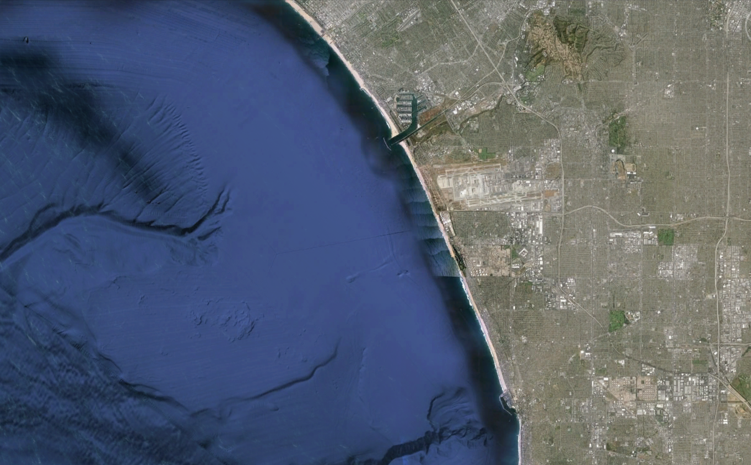

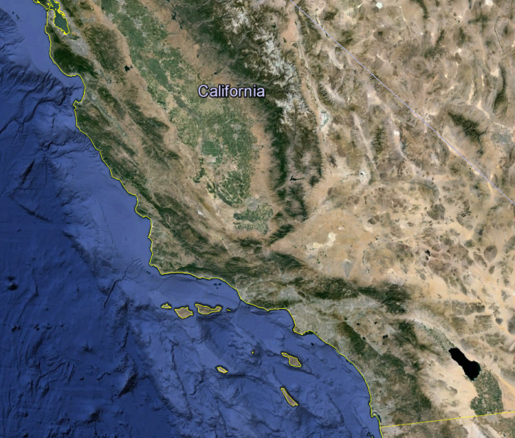
Study Area
Marina Del Rey
Santa
Monica
Bay
LAX
California
Los Angeles
Redondo Beach
Notes:
Our project takes place in Los Angeles, California, focusing on the waters of Santa Monica Bay. The location is south of Malibu, West of Marina Del Rey, and North of the Palos Verdes Peninsula. The Santa Monica Bay is an ecologically important marine habitat and a valuable resource in terms of commercial and recreational fishing and tourism.

Slide 3
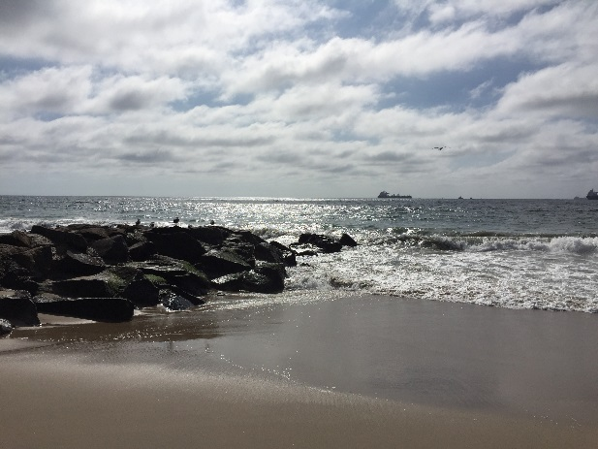
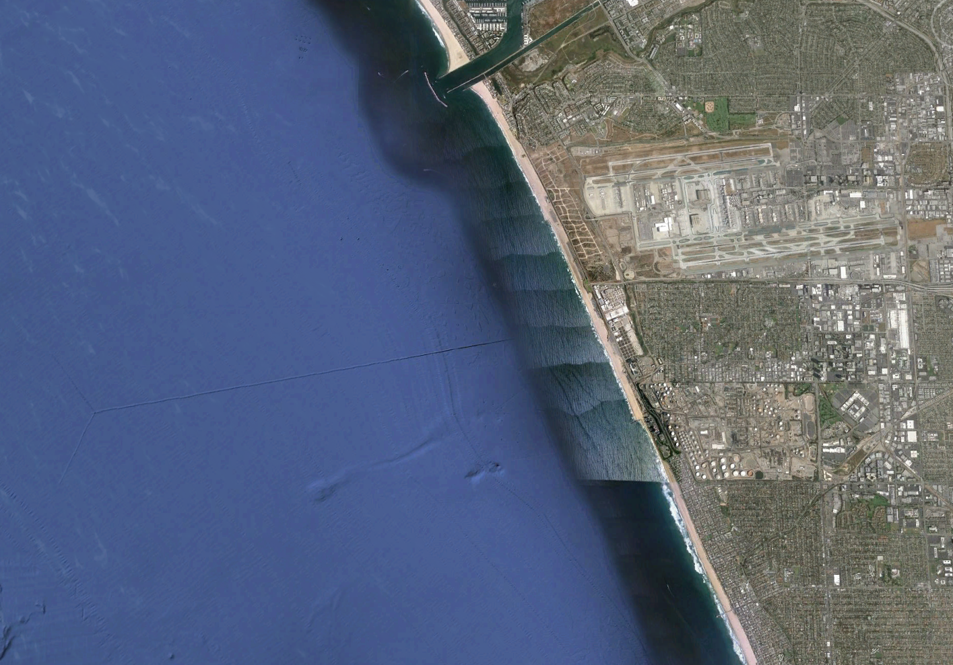
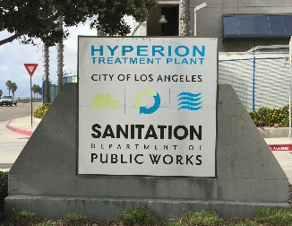
Hyperion Treatment Plant (HTP)
362 Million Gallons/Day
5-mile pipe
  57m deep
  Wastewater dilutes
Repair = DIVERSION
to 1-mile pipe
  15m deep
  Wastewater can reach surface
Marina Del Rey
Santa
Monica
Bay
LAX
Hyperion
5-Mile Outfall
1-Mile Outfall
Image Credits: Mark Barker
Notes:
Hyperion Treatment Plant is a wastewater treatment facility located adjacent to the coast and just south of Los Angeles’s major airport, LAX.
Hyperion is one of the largest wastewater plants on the west coast of the United States. They release an average of 362 million gallons of treated sewage per day into the Santa Monica Bay.
In normal operation, they release treated wastewater, also called effluent, into the ocean through a 5-mile-long outfall pipe where it is pumped 57m deep into the head of the marine canyon. The effluent mixes with the seawater, which dilutes it before it can reach the surface.
In the rare instance that they need to do maintenance or repair the 5-mile pipe, they have to divert all the effluent to a backup 1-mile long pipe that is only 15m deep.
This event is called a DIVERSION.
Hyperion conducted a similar diversion in 2006, and they have done it again this year to make repairs to their system.

Slide 4
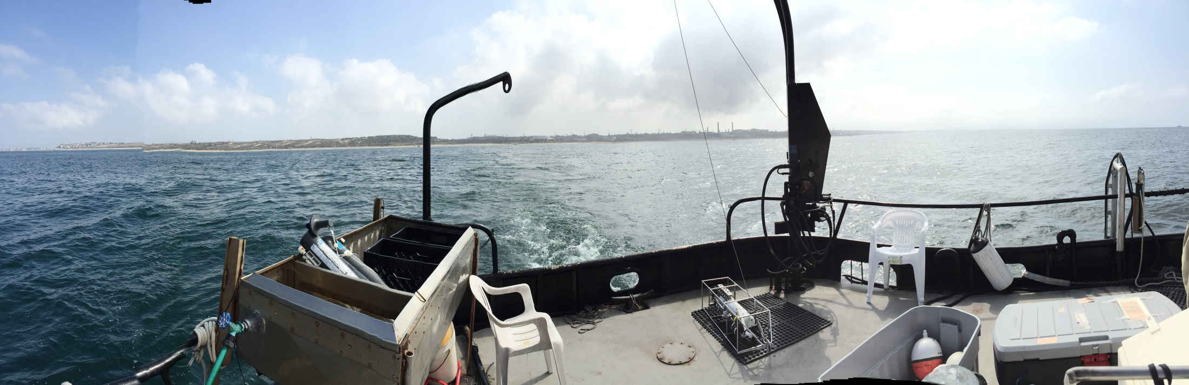
Study Period
DIVERSION
Before
After
8/30
9/21
11/2
11/19
Image Credit: Ben Holt, JPL
Notes:
The diversion just so happened to coincide with our DEVELOP term.
We processed satellite imagery from August 30th to Septemer 20th to get a pre-diversion baseline of what the ocean signatures around Hyperion’s outfall looked like.
On September 21st Hyperion’s diversion was under way, and from then until November 2nd , we analyzed all the signatures from the effluent that was being emitted from the 1 mile outfall.
After November 2nd until the end of the term, we analyzed imagery post-diversion to monitor ocean restoration and detect any long-term effects.
Pre-Diversion: Aug 30-Sept 20, 2015
Diversion: Sept 21-Nov 2, 2015 (12:01 am)
Post-Diversion: Nov 2-Nov 19, 2015

Slide 5
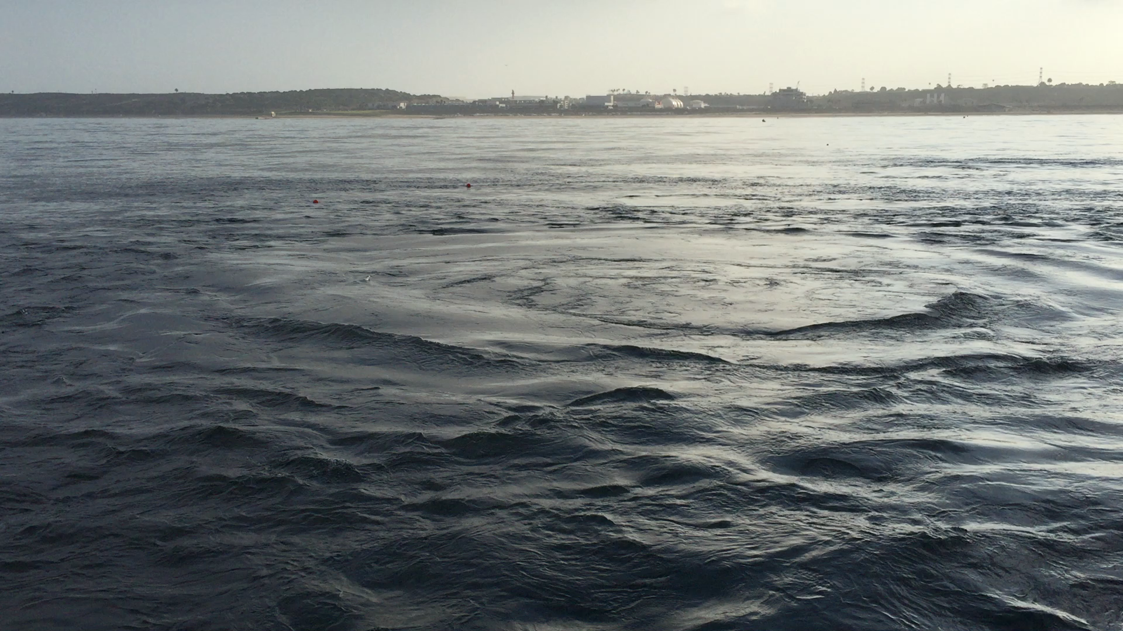
Wastewater Plume at the Ocean Surface
Video Credit: Ben Holt, JPL
Notes:
This is a video of the treated wastewater percolating up to the surface at the 1-mile outfall during the diversion.
The water is colder than the ambient water, contains nutrients and oils, and is freshwater.
Under normal treatment operations, the wastewater does not get a chance to reach the surface like this.

Slide 6
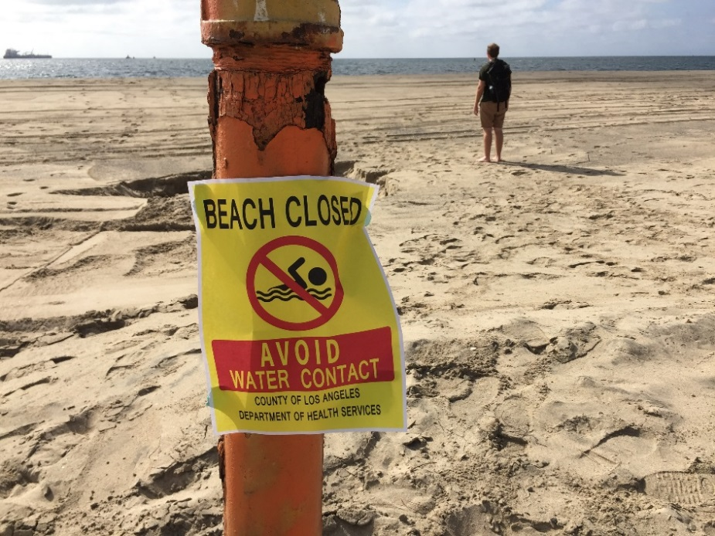
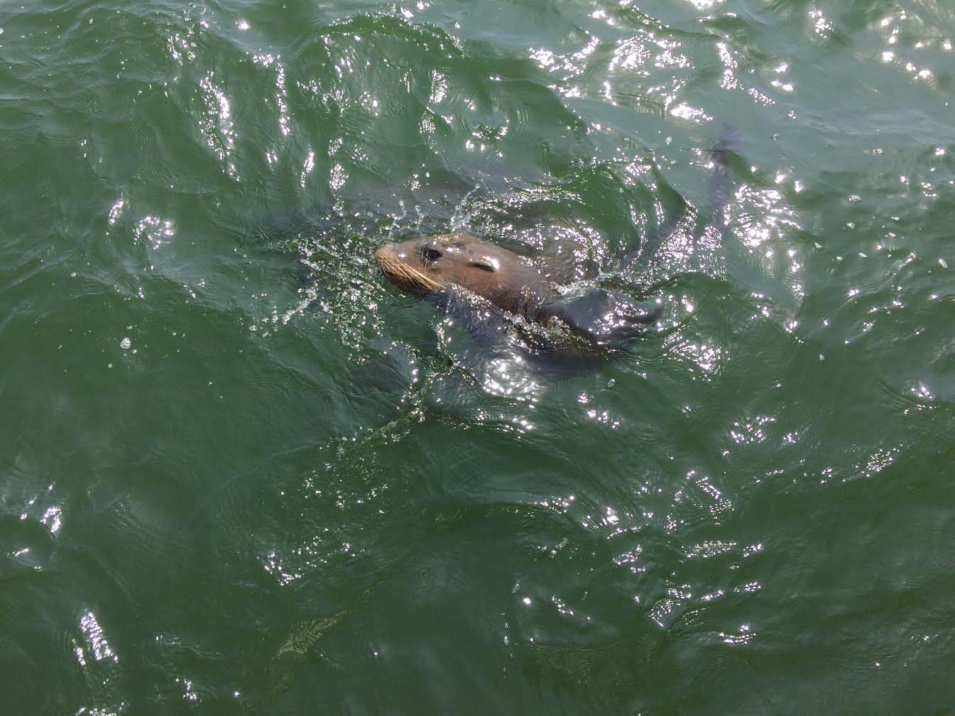
Community Concerns
Humans
Ecosystem
Commercial fishing
Tourism/Recreation
Polluted water for beachgoers
Media
Algal blooms
Depleted oxygen levels, increased temperature, oil slicks
Disrupted food web
Image Credits: Mark Barker
Notes:
This event has raised public concerns. In terms of human impacts, commercial fishing patterns could change, tourists may be discouraged from visiting the beaches, and beachgoers may be exposed to harmful contaminants. The news media has taken a strong hold of this issue and has put pressure on scientists to analyze the diversion’s impacts.
In terms of ecosystem health, algal blooms may occur due to the increased oxygen and nutrient levels that the effluent puts into the sea water, this may lead to depleted oxygen levels, and light attenuation which may harm organisms. There will also be an increased presence of oils and organics in the ocean’s surface. And, the water temperature around the 1-mile outfall is cold because the fresh water being released is colder than ambient seawater. All these factors may disrupt the local food web in Santa Monica Bay.

Slide 7
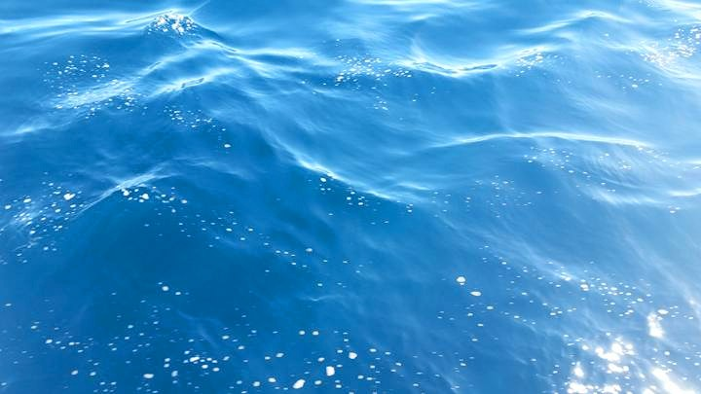
Objectives
Process & Analyze
Coordinate & Compare
Investigate
Remote sensing data
Our data with in situ data from other agencies
Ecosystem impacts (present and future)
Notes:
The objectives of this study are to: (1)process and analyze plume signatures, using remote sensing techniques, from HTP’s 5 week planned effluent diversion, (2) coordinate with Hyperion and other institutions to compare the results of processed satellite imagery to measurements of in situ data, and (3) investigate potential ecosystem impacts of this diversion event and future effects.

Slide 8

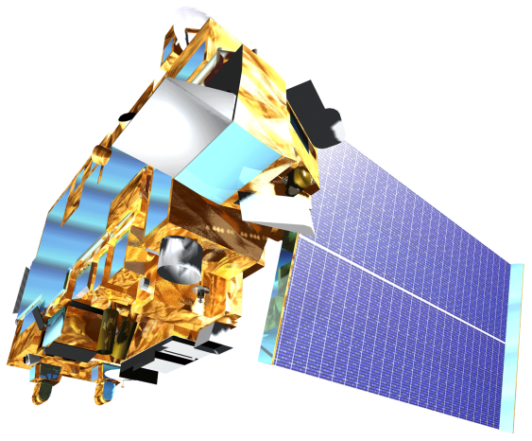

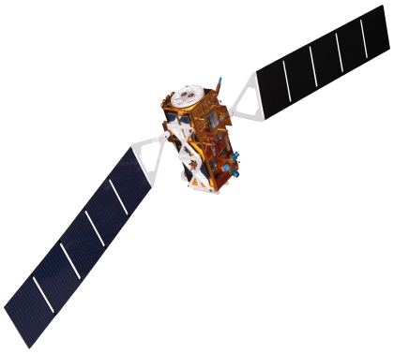
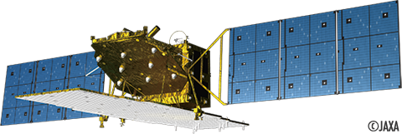
Instruments Utilized
Remote Sensing
Landsat 8
NASA
Terra-ASTER
NASA
Aqua – MODIS
NASA
Sentinel – 1
ESA
ALOS – 2
JAXA
Notes:
Field measurements are often very labor-intensive, expensive, and limited in spatial and temporal coverage.
We have the benefit of using satellites to do Remote sensing. It is relatively inexpensive and provides much greater spatial coverage.
However, remote sensing only captures images at the surface of the sea, versus the ability to obtain data at depth when gathered in situ.
We used multiple sensors on multiple satellites to determine the best techniques of imaging the extent of these surfaced wastewater plumes. Each sensor has its own benefits an limitations, which we explored in our images.

Slide 9
Satellites and Sensors
Satellite | Instrument | Sensor | Resolution | Acquisition | Detection
Sentinel-1 | SAR | Radar | 100 m | 6 days | Sea surface roughness
ALOS-2 | PALSAR-2 | Radar | 10 m | 46 days | Sea surface roughness
Terra | ASTER | Thermal Infrared | 90 m | 16 days | Sea surface temperature
Aqua | MODIS | Optical | 250 m | Daily | Sea surface temperature Chlorophyll-a Particulate reflectance
Landsat-8 | TIRS | Thermal Infrared | 30 m | 16 days | Sea surface temperature Chlorophyll-a Particulate reflectance Turbidity
Notes:
This table shows the spatial and temporal resolution of the different sensors on each satellite used to provide the most coverage of Santa Monica Bay during the diversion.
There are pros and cons to each sensor.

Slide 10
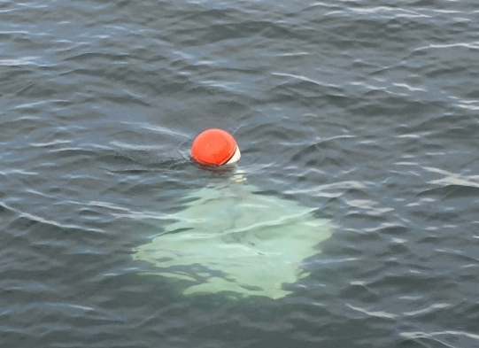
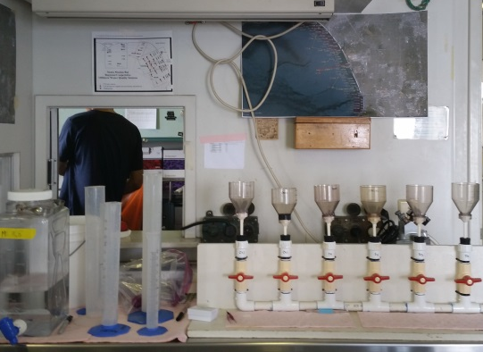
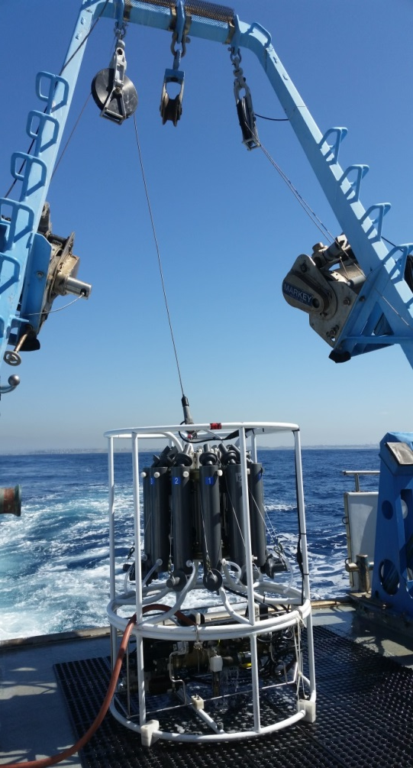
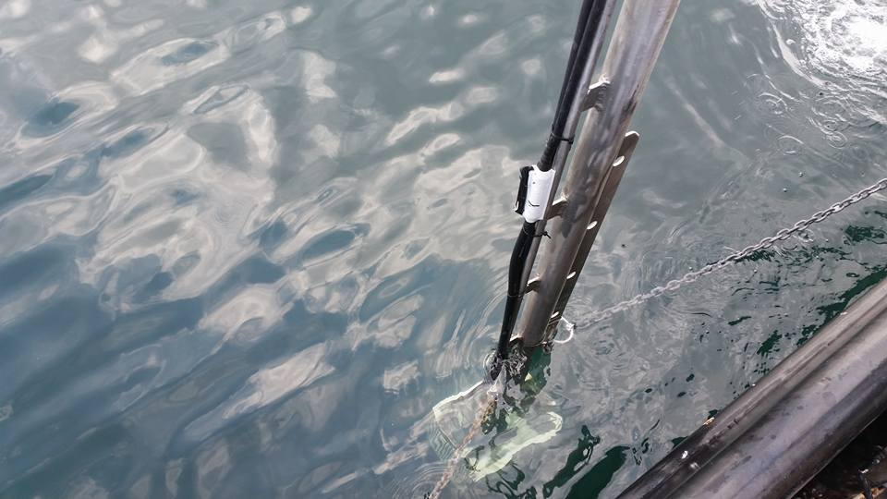
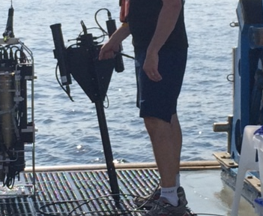
Instruments Utilized
In Situ Data Verification
Lagrangian Drifters
UCSB
Phytoplankton Water Chemistry
USC
CTD Sensor
City of LA
YSI Sensor
City of LA
Hyperspectral Instrument
JPL/NASA
Image Credits: Rebecca Trinh
Notes:
Hyperion has invited us to come aboard their 2 City of Los Angeles owned boats.
Many collaborators go out into the Santa Monica Bay several times a week to take in situ measurements of the diversion plume.
Some of the instruments used are:
Hyperion’s CTD, which stands for and measures Conductivity, Temperature, and Depth.
Hyperion’s YSI Sensor takes surface measurements such as temperature, dissolved oxygen, turbidity, and pH.
University of California Santa Barbra has installed GPS drifters in the ocean to track the plume’s movement over time.
University of Southern California uses laboratory methods to test the sea water for phytoplankton levels.
A collaborator at JPL uses his hyperspectral instrument to measure reflectance, Absorbance, chlorophyll, and CDOM.
We have access to all the results found in the field via a shared information website, and we can compare their in situ results to our remote sensing results to validate our conclusions.

Slide 11
Project Methodology
NASA Earth observations:
Landsat-8, TIR
Aqua, MODIS
Chlorophyll-a
Surface Sediment
Turbidity
Effluent
impact
on local
plant
and wildlife
Spatiotemporal
Analysis of combined
datasets
Terra, ASTER
Sea Surface Temperature
Partner Agency SAR Data:
ALOS – 2 (JAXA)
Sentinel – 1 (ESA)
Sea Surface Roughness
In Situ Measurements
Notes:
The general signatures we are looking for in our processed satellite imagery are 1) chlorophyll-a , 2) Sea surface temperature 3) turbidity, 4) suspended solids, and 5) sea surface roughness.
Both LANSAT-8 and MODIS can detect chlorophyll, sediment, and sea surface temperature. Landsat can also detect turbidity. ASTER can also detect sea surface temperature. We used Synthetic Aperture Radars (SAR) on ALOS-2 and Sentinel-1 to give us sea surface roughness data, but the signatures were not present.
We collected and have access to in situ data to cross-reference our satellite imagery data in time and space.
Ultimately, this analysis should give us a solid platform to answer our questions and address public and ecological concerns.

Slide 12
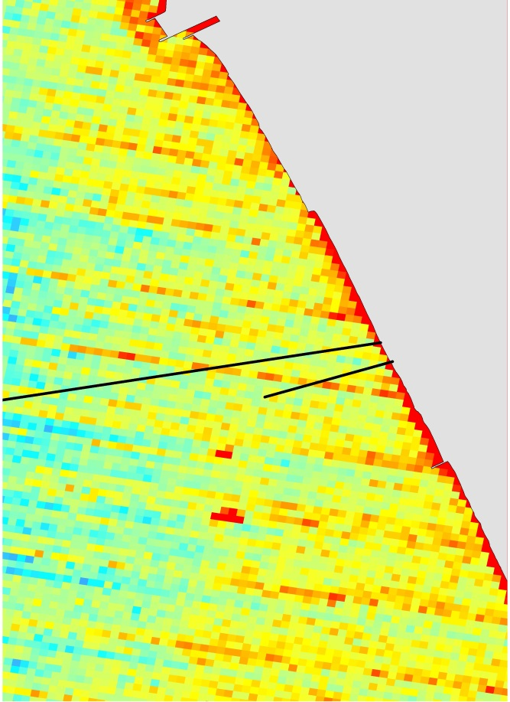
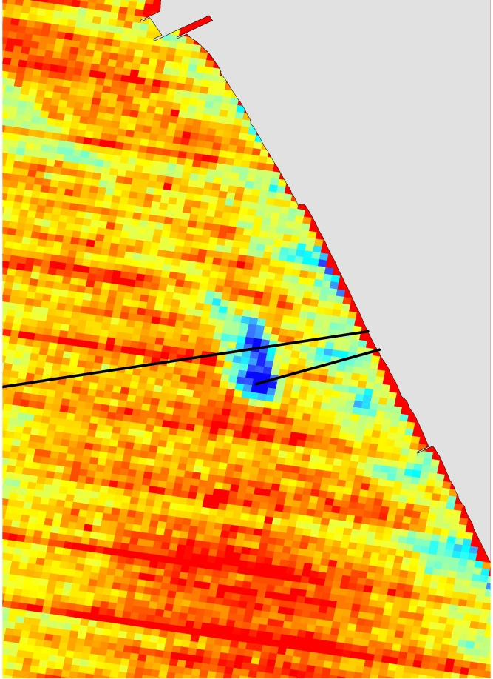
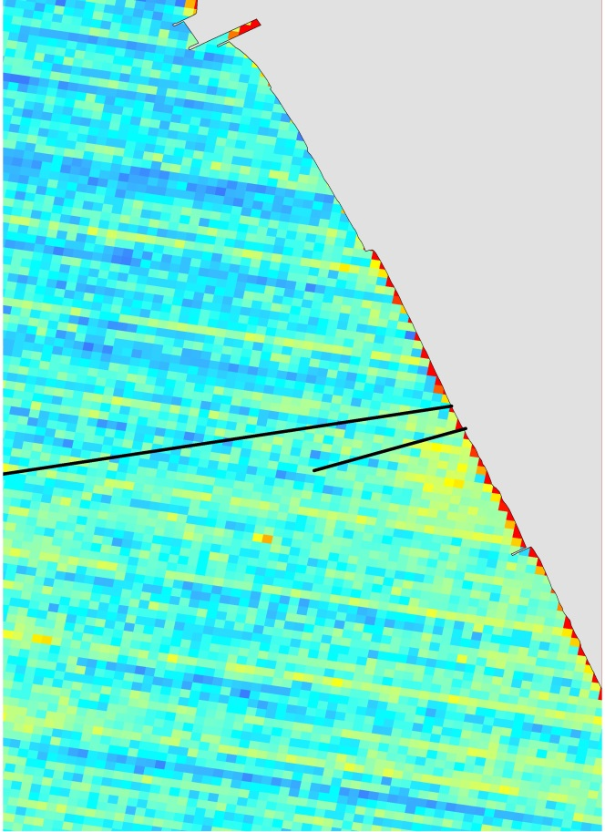
ASTER Sea Surface Temperature
Before
During
After
September 16, 2015
18:46:29 UTC
11:46:29 PDT
October 2, 2015
18:46:07 UTC
11:46:07 PDT
November 3, 2015
18:46:31 UTC
10:46:07 PST
Notes:
These are ASTER sea surface temperature images from before, during, and after the diversion. You can see that the before and after have no signature around the 1-mile pipe, but the during image has a very clear localized signature around the pipe outfall. These maps are very zoomed in because the signature does not get a chance to spread before it dissipates into ambient sea temperature levels.

Slide 13
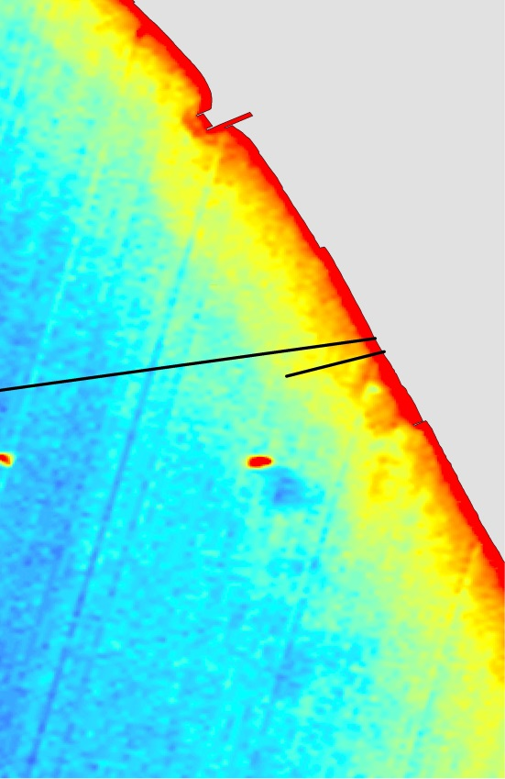
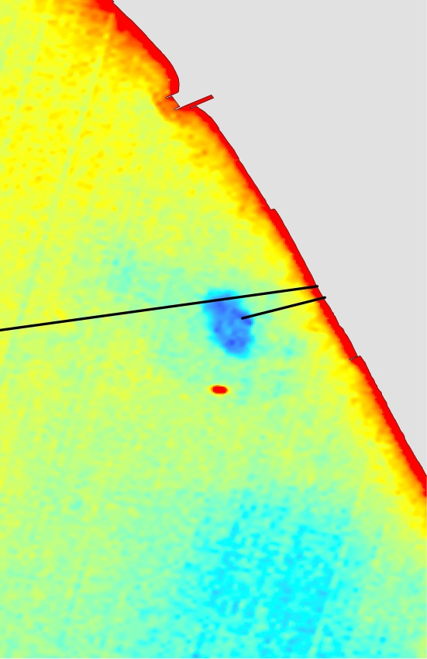
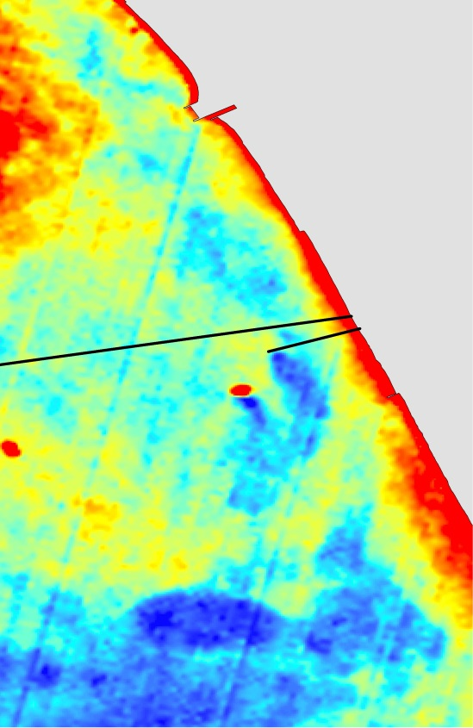

Landsat-8 Sea Surface Temperature
Before
During
After
Landsat-8 TIRS instrument error as of Nov. 3, 2015
September 8, 2015
18:27:56 UTC
11:27:56 PDT
September 24, 2015
18:28:03 UTC
11:28:03 PDT
October 10, 2015
18:28:05 UTC
11:28:05 PDT
November 11, 2015
18:28:105 UTC
10:28:10 PST
Notes:
Landsat captures similar images of sea surface temperature, but with better resolution. Again, the localized cold signature can bee seen at the end of the 1 mile pipe during the diversion, and is not present before or after the diversion.

Slide 14
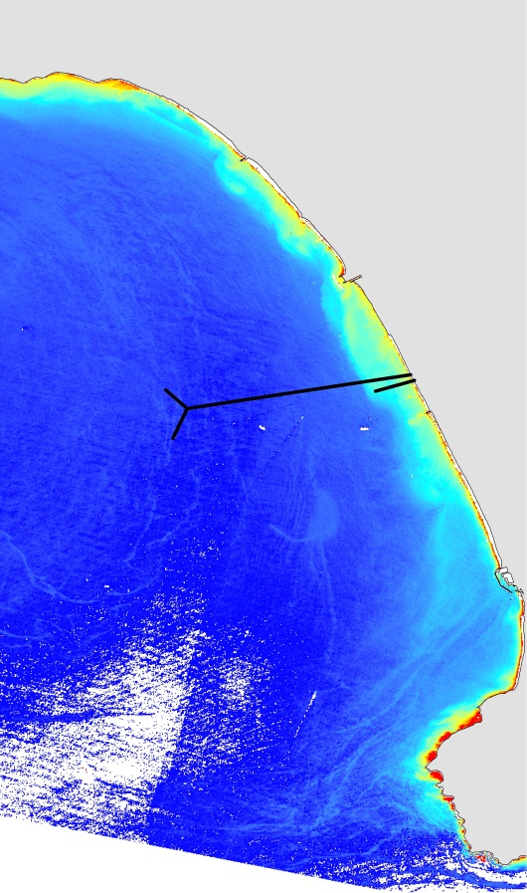
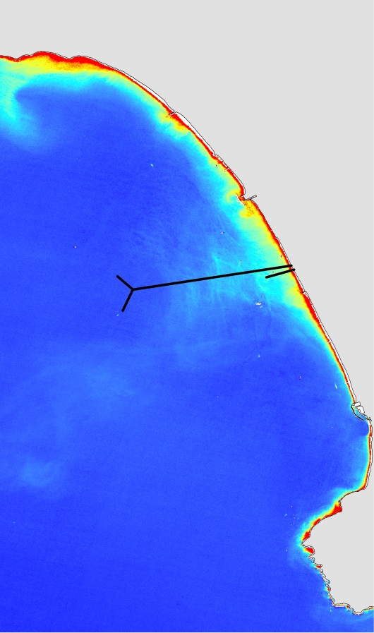
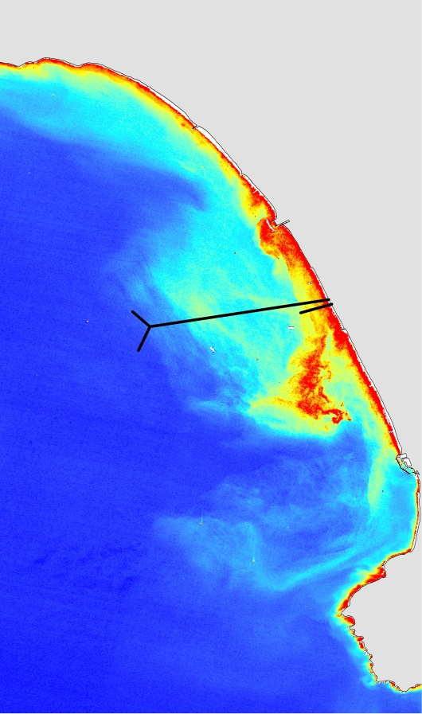
Landsat-8 Chlorophyll-a
Before
During
After
Landsat-8 TIRS instrument error as of Nov. 3, 2015
September 8, 2015
18:27:56 UTC
11:27:56 PDT
September 24, 2015
18:28:03 UTC
11:28:03 PDT
October 10, 2015
18:28:05 UTC
11:28:05 PDT
November 11, 2015
18:28:105 UTC
10:28:10 PST
Notes:
Lansat-8 is also able to capture high resolution chlorophyll-a signatures. The added nutrients from the effluent, in conjunction with warm waters, and high amounts of available sunlight, stimulated large phytoplankton blooms that spread with prevailing currents. These algael blooms may be harmful to humans, because they are associated with bacteria. They are also harmful to marine life because algae removes oxygen from the water and obscures light attenuation. This can choke out animals and disrrupt the fragile food web. If this happens, recreational and commercial fishing may be affected as well. You can see that algeal blooms begin to worsen as the diversion progresses. Algal blooms proliferate and drift. In situ measurements were taken to monitor the currents and drift of these blooms. There is ala

Slide 15
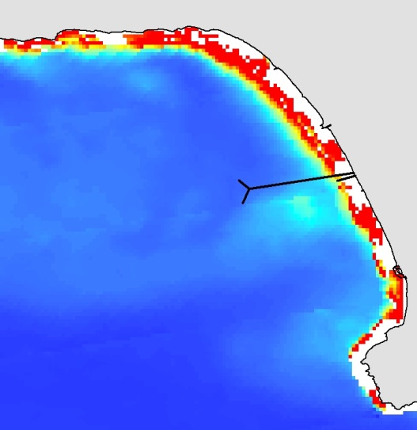
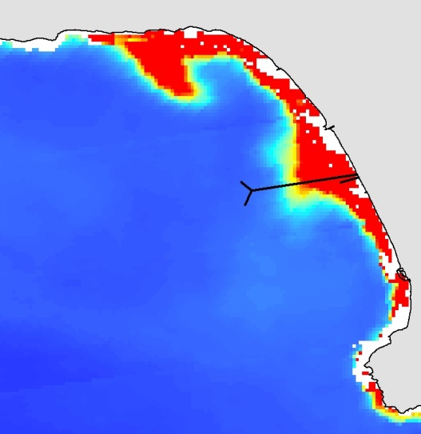
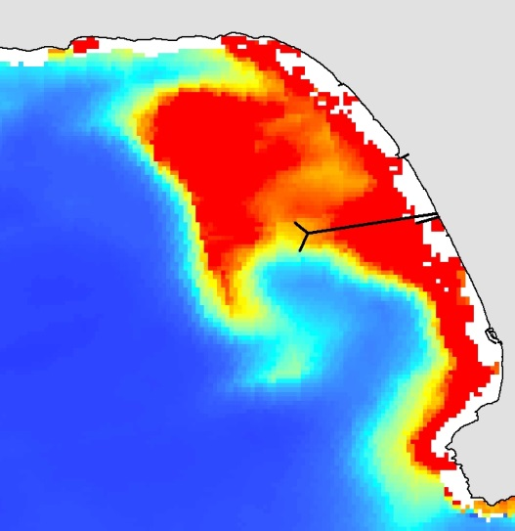
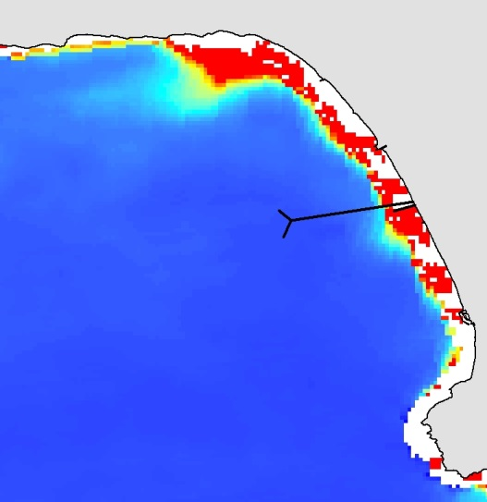
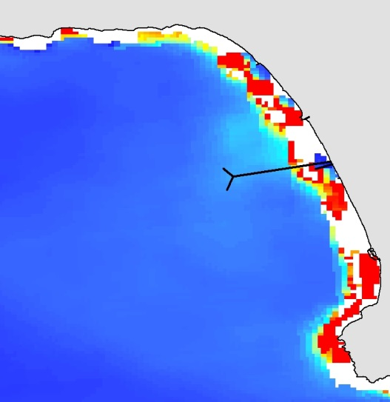
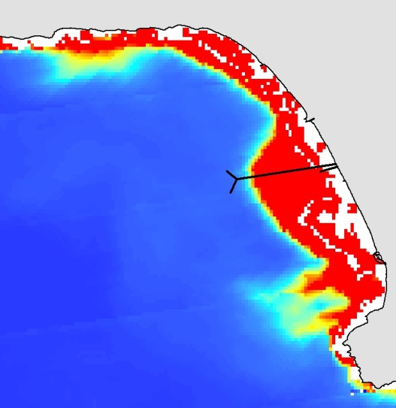
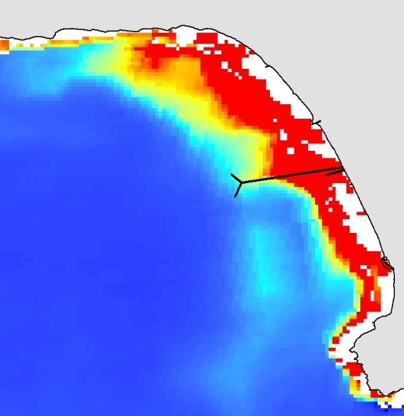
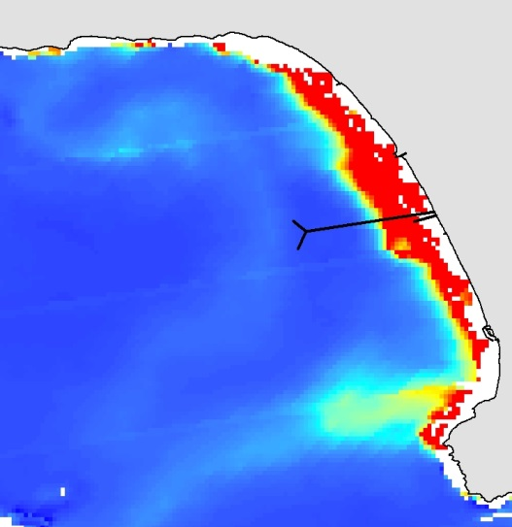
Aqua Modis Chlorophyll-a
Before
During
After
September 17, 2015
21:06:01 UTC
September 24 2015
20:40:33 UTC
October 30, 2015
20:46:44 UTC
November 4, 2015
21:05:15 UTC
September 20, 2015
21:35:40 UTC
October 10, 2015
21:11:05 UTC
October 30, 2015
21:30:10 UTC
November 9, 2015
21:23:28 UTC
Notes:
MODIS images were processed nearly every day to monitor chlorophyll levels as well, although the resolution is not as fine as Lansat-8. It is clear that algal blooms continued to proliferate around the outfall during the diversion. And began to die down shortly after the diversion ended.

Slide 16
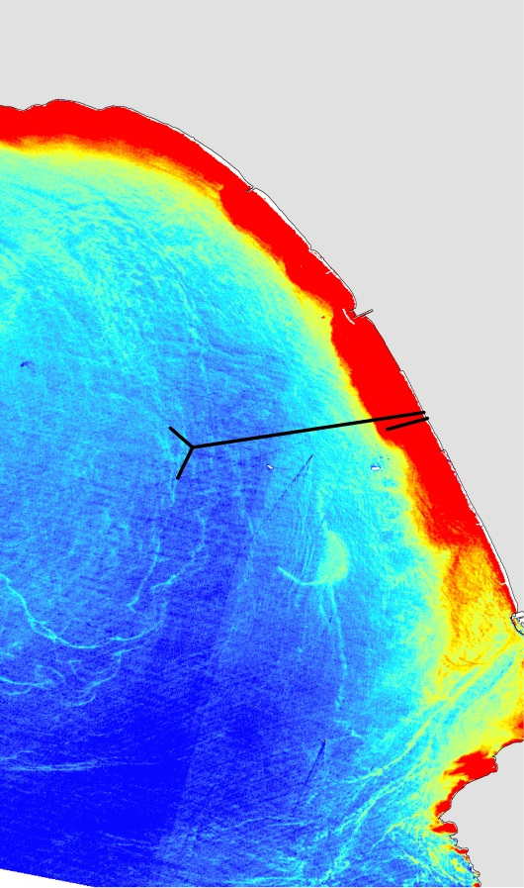
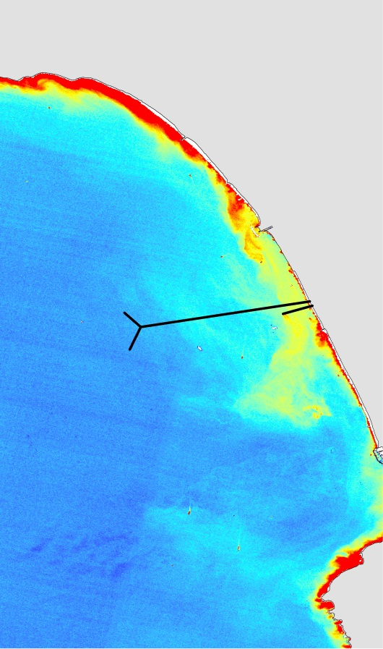
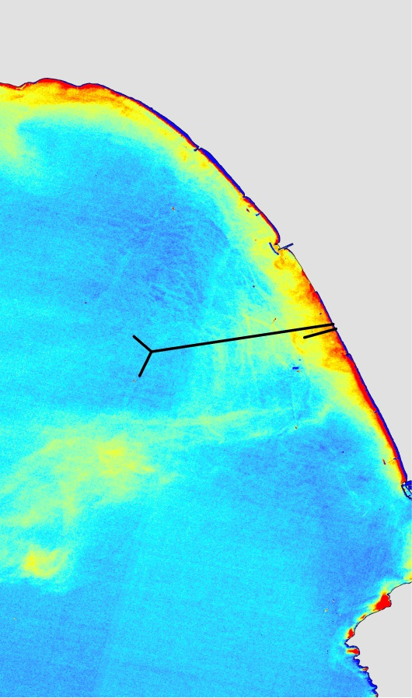
Landsat-8 Total Suspended Matter
Before
During
After
Landsat-8 TIRS instrument error as of Nov. 3, 2015
September 8, 2015
18:27:56 UTC
11:27:56 PDT
September 24, 2015
18:28:03 UTC
11:28:03 PDT
October 10, 2015
18:28:05 UTC
11:28:05 PDT
November 11, 2015
18:28:105 UTC
10:28:10 PST
Notes:
Similar to chlorophyll, Total Suspended Matter is a gauge of ocean health, because it plays an important role in determining light attenuation at depths. The more suspended matter, the less light can penetrate the ocean. The suspended matter in the effluent is released at the 1 mile pipe and spreads further out into the ocean.

Slide 17
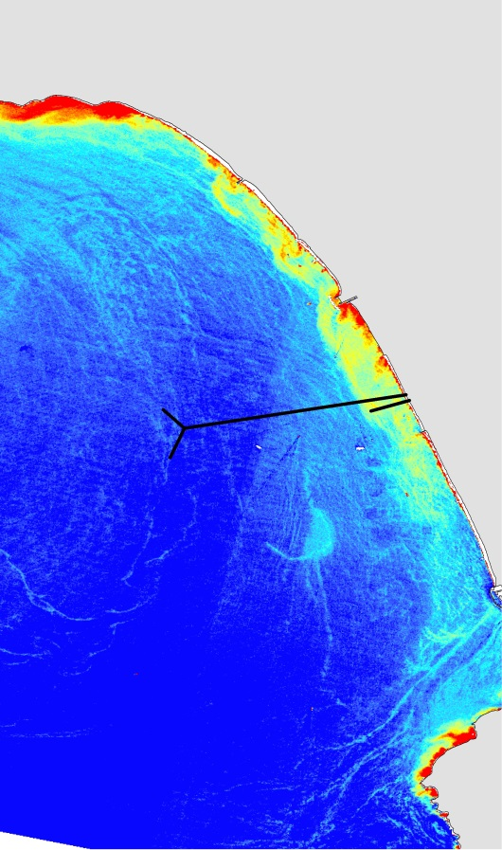
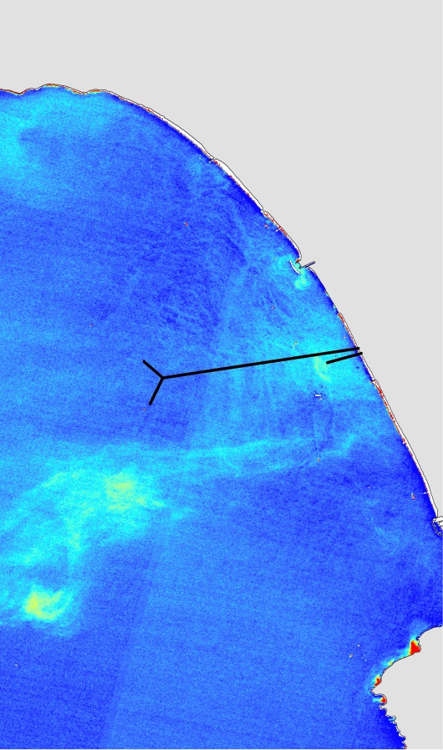
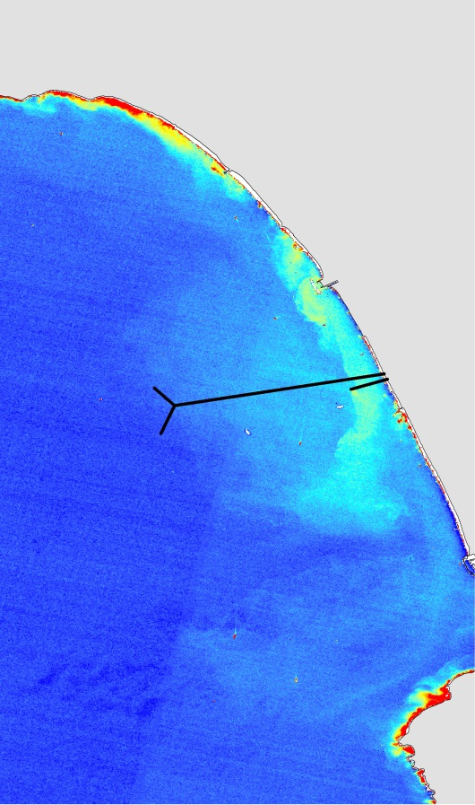
Landsat-8 Turbidity
Before
During
After
Landsat-8 TIRS instrument error as of Nov. 3, 2015
September 8, 2015
18:27:56 UTC
11:27:56 PDT
September 24, 2015
18:28:03 UTC
11:28:03 PDT
October 10, 2015
18:28:05 UTC
11:28:05 PDT
November 11, 2015
18:28:105 UTC
10:28:10 PST
Notes:
Turbidity measurements from Landsat-8 can also be used to help track the effluent

Slide 18
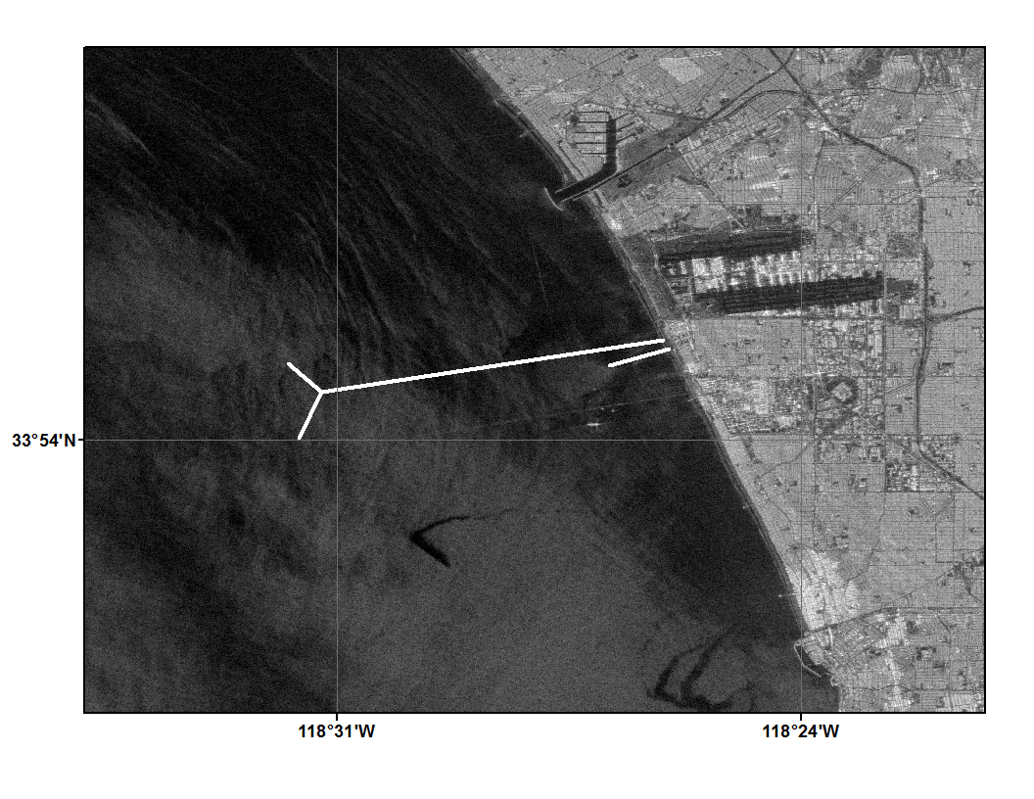
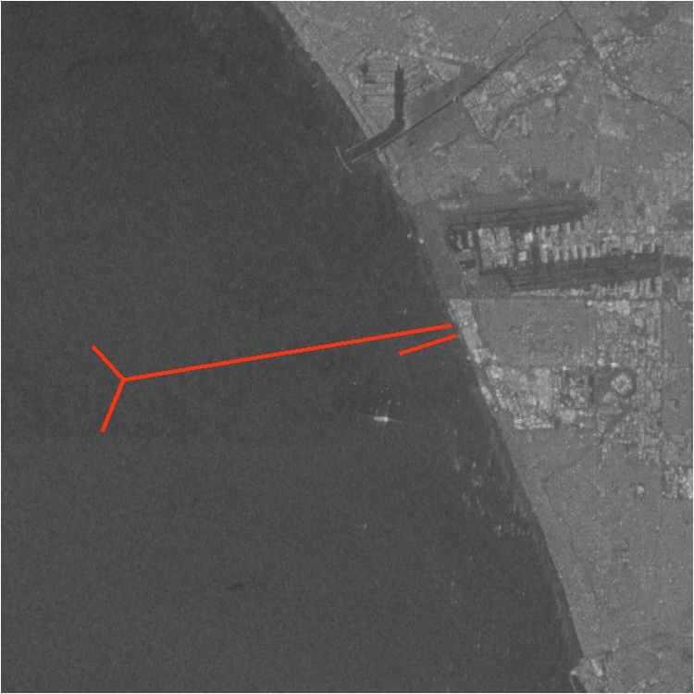
ALOS-2 PALSAR-2 Sentinel-1
During
Sentinel – 1
10-5-15
0
6 Km
1.5
3
Notes:
Wind conditions were not optimal the night of the ALOS-2 acquisition. Sentenl-1’s low resolution was unable to pick up any prominent plume surface signatures.

Slide 19
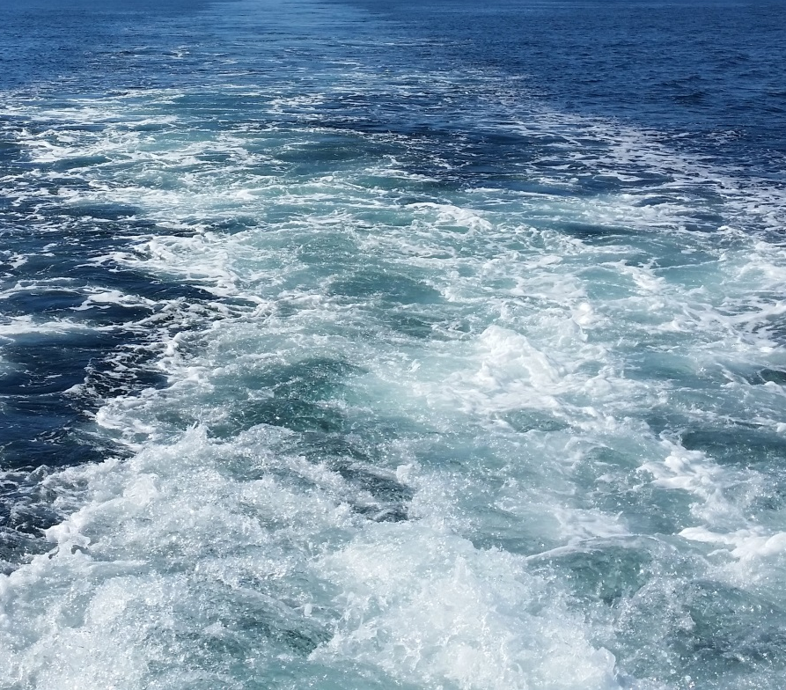
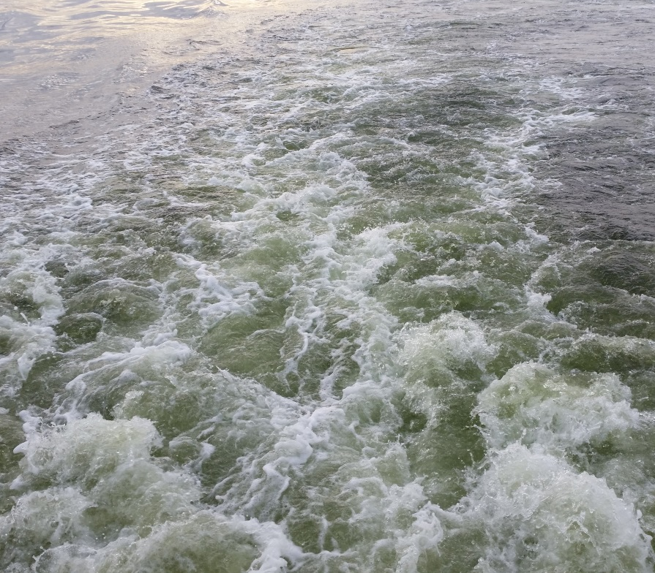
Results
Pre Diversion
  Normal sea states in Santa Monica Bay
  No signatures from effluent
During Diversion
  Biological responses
  Algal blooms spread
  Cold SST signature
  No SAR signature due to winds and low resolution
  High levels of suspended sediment
  Turbulent mixing
Post Diversion
  Algal blooms continue
  Cold SST signatures disappear
Image Credit: Rebecca Trinh
Notes:
Prior to the diversion, waters in Santa Monica Bay were primarily blue, there were no anomalous sea surface temperature anomalies associated with either the 5-mile or 1-mile pipe, no anomalous algal blooms, or surface signatures.
During the diversion, we were able to track the evolution of the biological response to the added nutrients being discharged by the 1-mile pipe.
After the diversion ended, we continued to monitor the waters in Santa Monica Bay, both via satellite and shipboard measurements. Algal blooms persisted for a few weeks post diversion
The cold sea surface temperature signature was the first to dissipate after the effluent was redirected to the 5-mile pipe

Slide 20

Conclusions
Remote sensing techniques CAN detect wastewater diversion signatures
Chlorophyll-a signature spread throughout Santa Monica Bay
Cold SST signature localized only around the pipe
Landsat- 8
September 24, 2015
18:28:03 UTC
11:28:03 PDT
Notes:
This study showed that satellite remote sensing can indeed be used to track surfaced effluent plumes.
By using multiple sensors and satellites, as well as field measurements, we were able to provide a comprehensive overview of what was happening in Santa Monica Bay in relation to this diversion event.
Landsat-8 had the highest spatial resolution and was able to pick up fine grain details missed by ASTER SST and MODIS ocean color.
There was a time lag in the response of phytoplankton growth as the diversion began. Blooms grew and died down and new ones formed over time due to multiple factors such as winds, currents, cloud cover and available sunlight.
Sea surface temperature signatures were localized around the terminus of the 1-mile pipe as the discharged effluent entrained colder water at depth and brought it to the surface, where it eventually mixed with warmer ambient sea water.

Slide 21
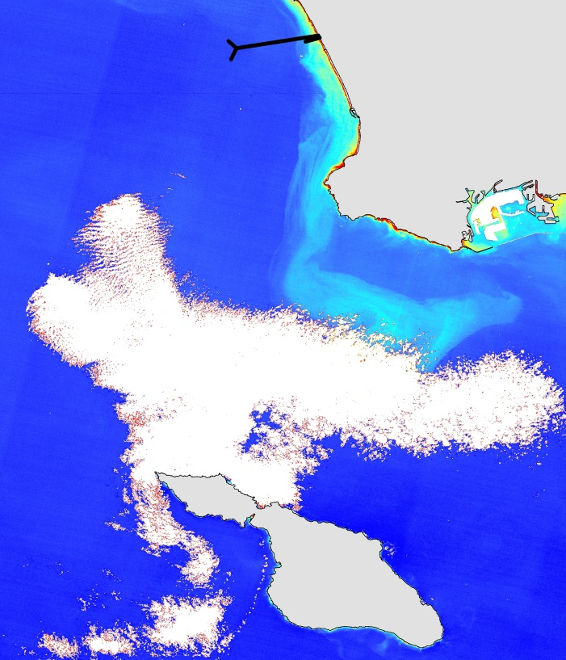
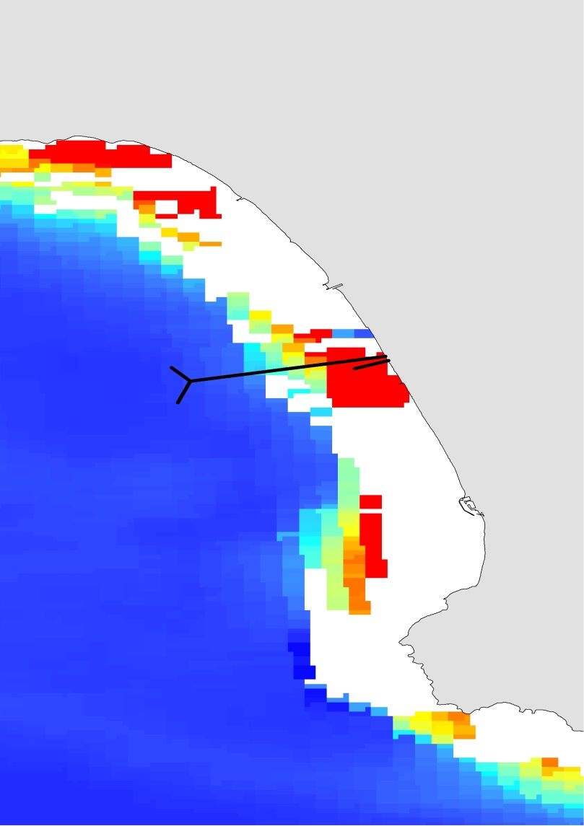
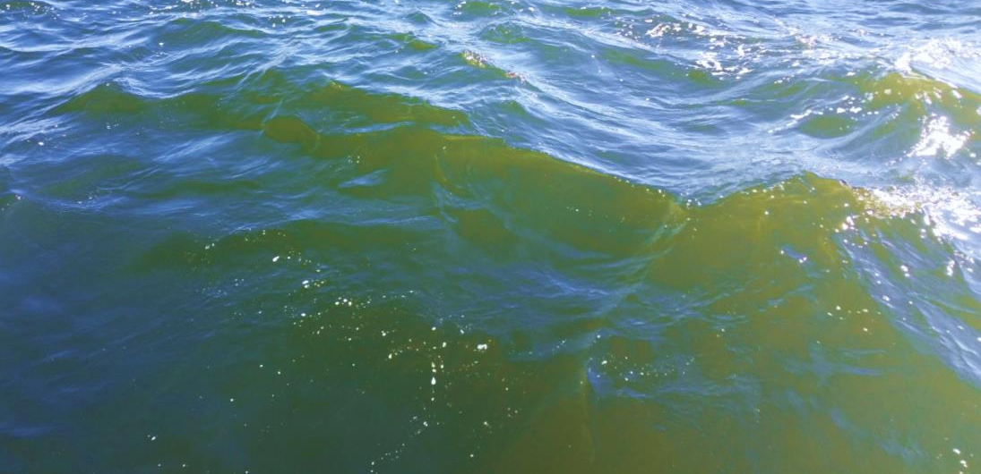
Errors & Uncertainties
Rain storms/stormwater
Low resolution data
Cloud cover
2D surface readings
Ambient phytoplankton
Notes:
Rainstorms and every day runoff causes stormwater to be expelled into the ocean at Marina Del Rey via Ballona Creek. The stormwater is untreated, releasing nutrients that may cause algal blooms. It also has a unique temperature signature. Data processed from Earth Observing Systems is not always reliable. Cloud cover can obscure or make the data completely unusable. Aqua-Modis has a daily repeat cycle, giving us daily readings, but the drawback is the resolution of the data is very low, pixilated, and sometimes does not capture our region of interest. The earth observing systems we use only take surface readings of the ocean, so we are not able to extrapolate data points at depth, like in situ instruments can. Finally, ambient plankton is always present and algal blooms can happen at any point in time regardless of point sources.

Slide 22
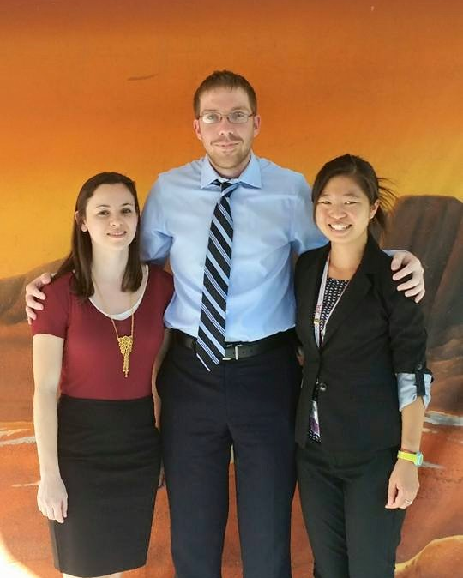
Future Work
Spring 2016
Continued monitoring of post-diversion using NASA Earth Observing Systems
Further analysis of in situ data
Continued collaboration with City of LA and other institutes
Published Paper
DEVELOP Los Angeles Oceans Team, JPL: (from left to right) Lindsay Almaleh, Mark Barker, Rebecca Trinh (Team Lead)
Notes:
Our project has been proposed to continue for a second term here at NASA DEVELOP at JPL. We plan to continue our methods to monitor the region post-diversion. Our next term will focus primarily on comparing in situ data with remote sensing data, using programs like Matlab. City of LA and other collaborators will continue to monitor the area and take in situ readings year round. The ultimate goal is to publish a paper in a journal about this major diversion event at Hyperion.

Slide 23
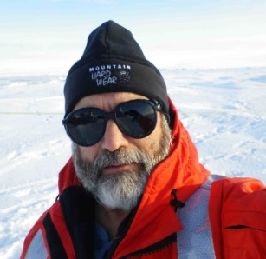






Advisors
Ben Holt & Michelle Gierach of NASA, Jet Propulsion Laboratory
Partners
Curtis Cash, Ashley Booth, & Mas Dojiri of Los Angeles City Hyperion Treatment Plant
Past Contributors
Christine Rains & Jack Pan of NASA DEVELOP
Notes:
We would like to thank our advisors, Ben and Michelle.
Our partners Curtis, Ashley, and Mas from Hyperion.
And past contributors of the project, Christine and Jack.

Slide 24

Questions?
Notes:
Thank you for your time. Any questions?

