Slide 1
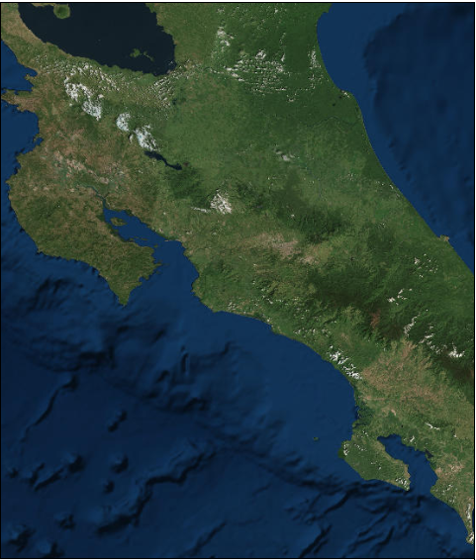
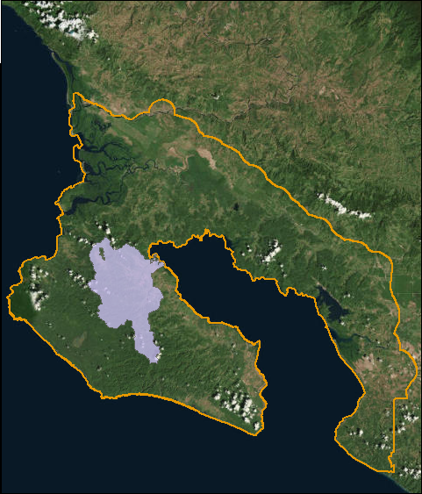


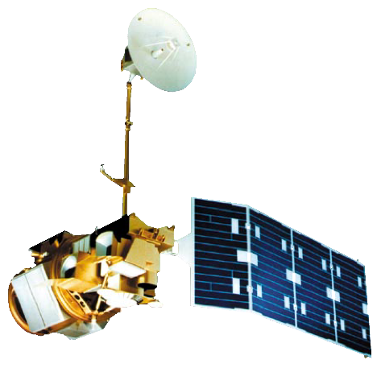

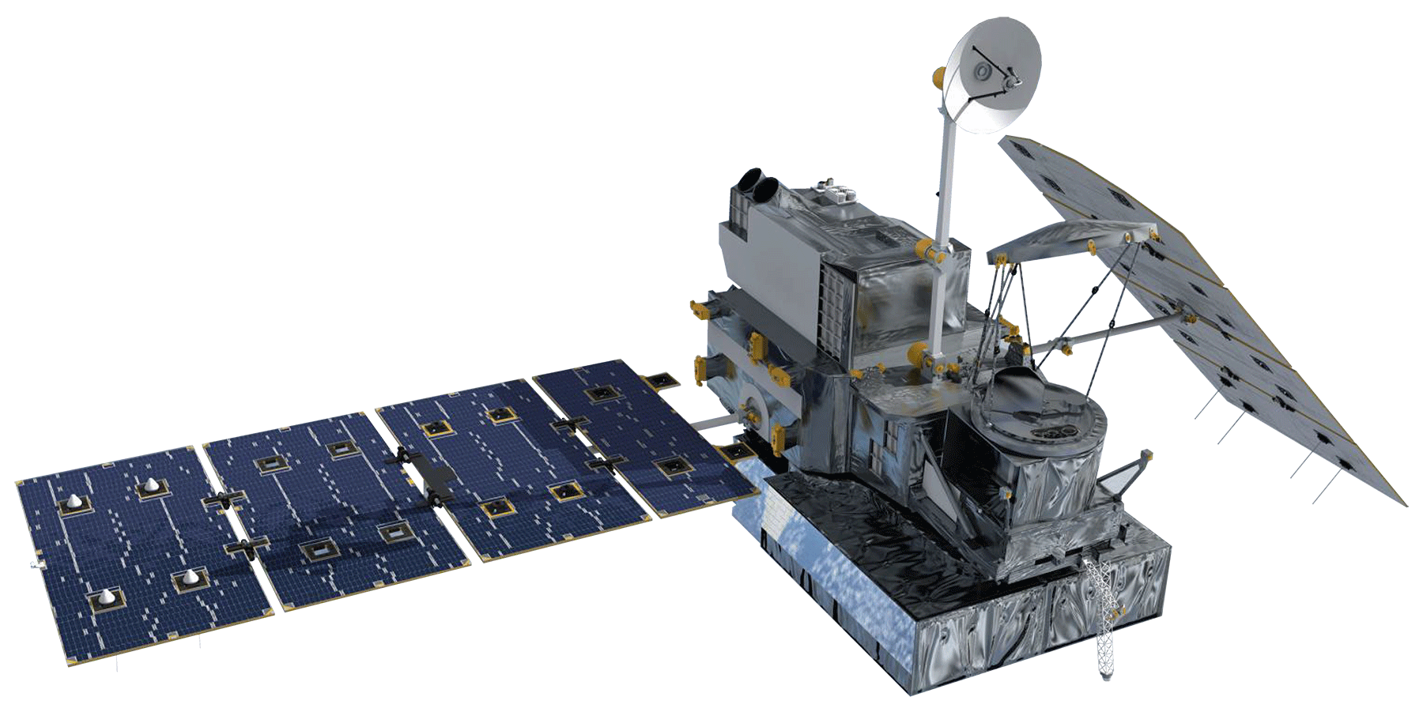
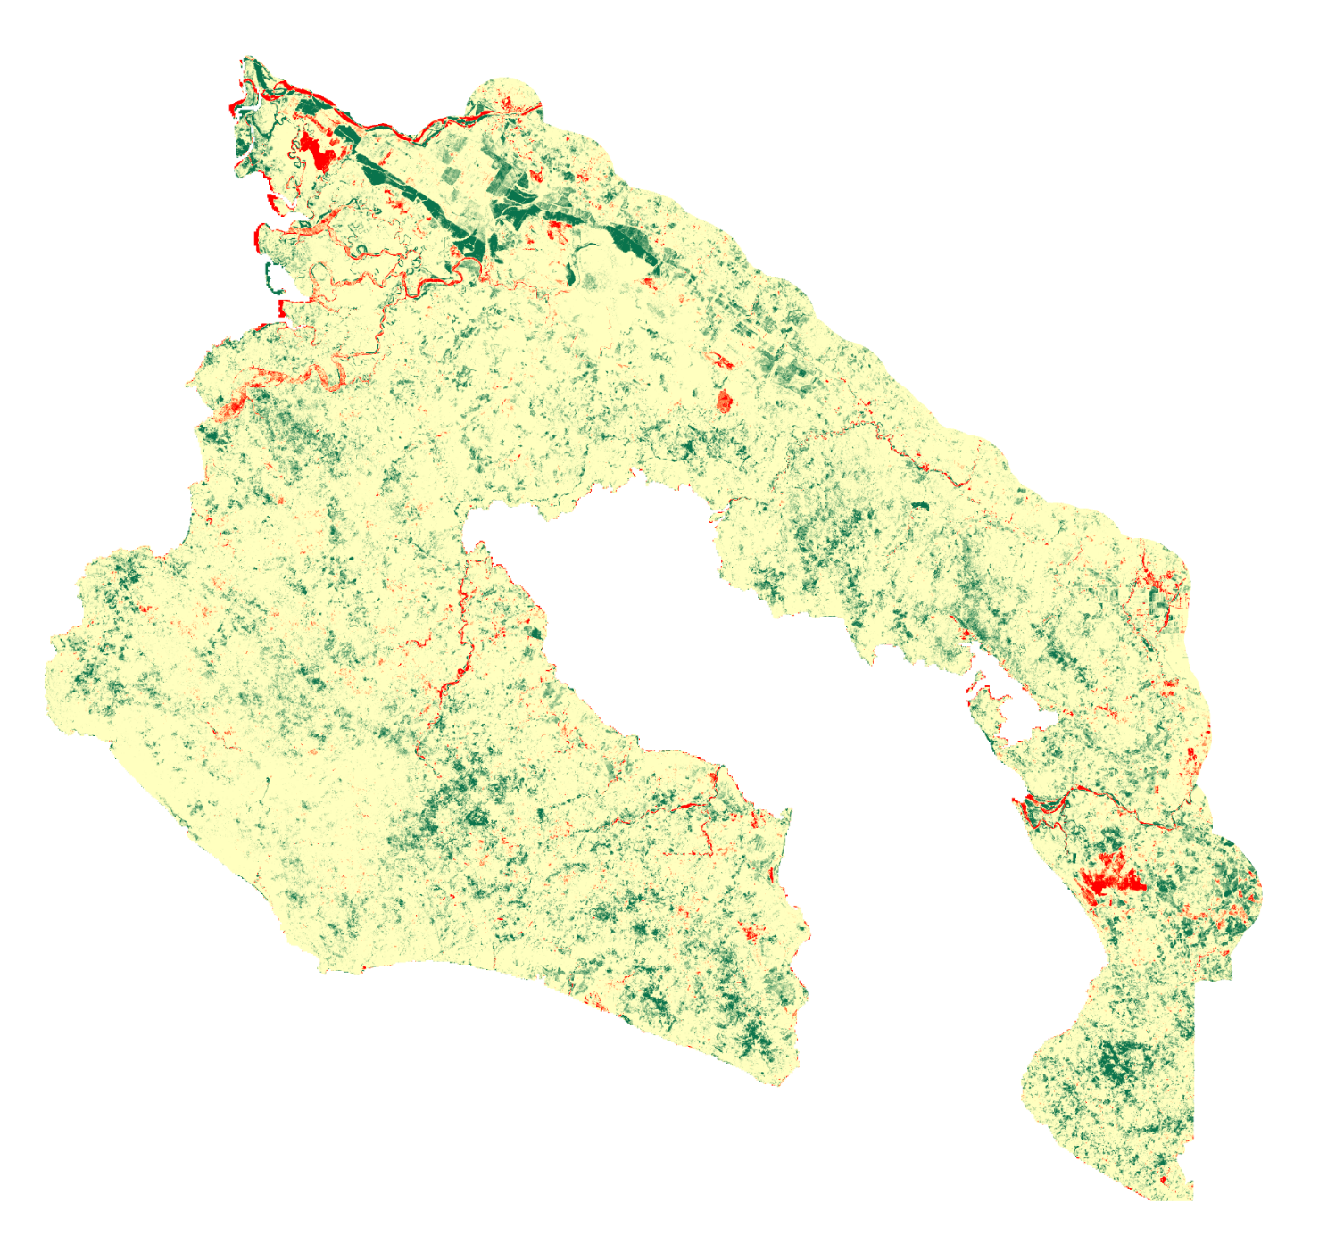
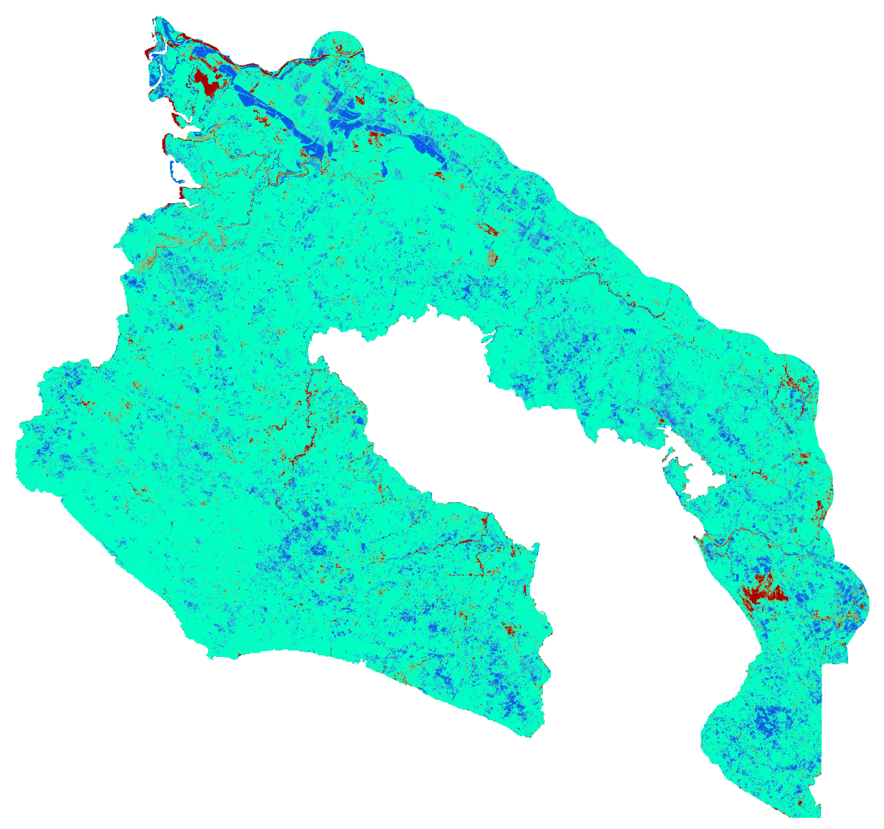
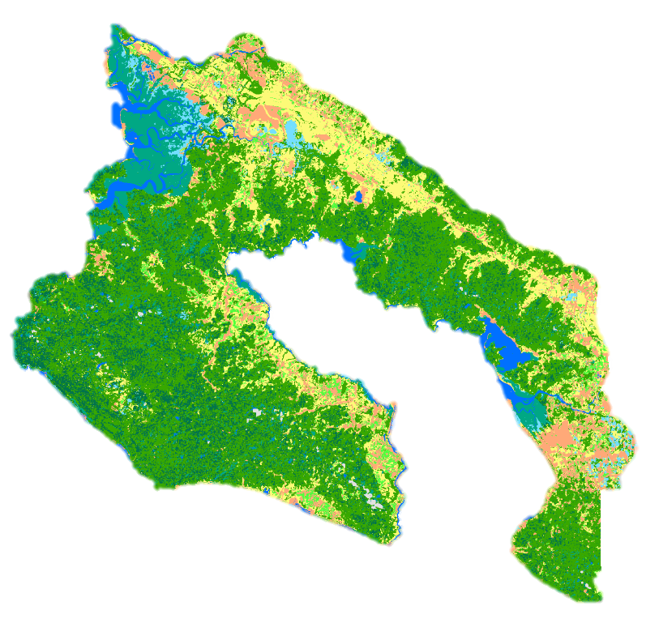


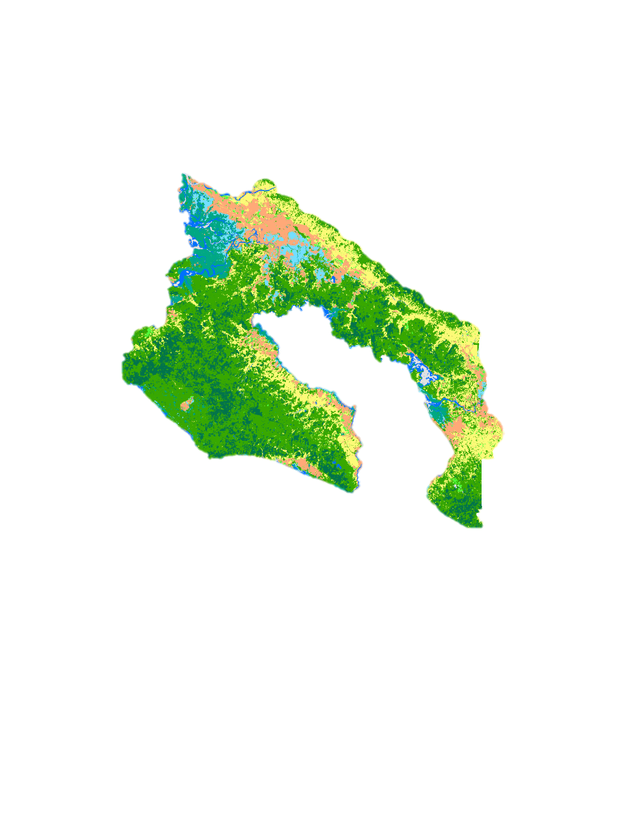

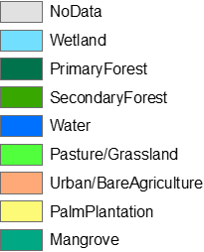





Utilizing NASA Earth Observations to Evaluate Effects of Land Use Change on Watershed Health and Carbon Sequestration in the Osa Peninsula
Abstract
Objectives
The Osa Peninsula, located in the southern region of Costa Rica’s Pacific Coast, is one of the most biologically-diverse places on Earth and a popular ecotourism destination. Previous work through NASA DEVELOP showed positive trends in land use since the implementation of the 1996 Forest Law legislation which supported reforestation and riparian health. However, the area still faces watershed degradation and loss of biodiversity due to deforestation, pollution from agriculture, and human settlement. NASA DEVELOP partnered with Osa Conservation to analyze land cover change in the peninsula to better understand threats to river water quality and watershed health. This project used Landsat 5 Thematic Mapper (TM) and Landsat 8 Operational Land Imager (OLI) to create land use maps, which were used to analyze change in riparian case study areas. Additionally, a Soil Water Assessment Tool (SWAT) model was created to predict the effects of riparian restoration on river water quality, and the model predictions were visualized. The model examines Terra Advanced Spaceborne Thermal Emission and Reflection Radiometer (ASTER) elevation data, and Global Precipitation Measurement (GPM) Dual-frequency Precipitation Radar (DPR) data, soil data, and land use data. In situ water quality data provided by the partners were used for model calibration and validation. The partners will use and distribute results of this project to the National System of Conservation Areas (SINAC), Ministry of Environment and Energy (MINAE), and local communities to inform land management decisions, policy enforcement, education and outreach initiatives, and watershed restoration and monitoring.
Evaluate the land use change in riparian zones of Osa Peninsula since 1987
Predict how riparian restoration affects sediment and nutrient levels in the Rincon Watershed using the SWAT model
Produce high resolution land use maps of the Osa Verde and Hacienda Rio Oro properties to serve as baselines for ongoing restoration efforts
Create accessible public outreach materials to inform the local community on the benefits of sustainable practices
Study Area
Costa Rica
Figure 1. Study area map. The Osa Peninsula is on Costa Rica’s southern Pacific coast. The Rincon watershed is an important biological corridor
Methodology
Landsat 5
Random forest classification
Land Cover Time Series
Landsat 8
Rincon Watershed
Osa Peninsula
Terra
SWAT model
Predictive Hydrologic Model
Earth Observations
GPM
Project Partners
Osa Conservation
  Hilary Brumberg, Rios Saludables Program Coordinator
  Dr. Andy Whitworth, Science Director
Landsat 8 OLI
Landsat 5 TM
Terra ASTER
GPM DPR
Results
1987-2017
1987-2017
1987
2017
Decrease in NDVI
No Change
Increase in NDVI
Decrease in EVI
No Change
Increase in EVI
Less Vegetation
Wetland
Primary Forest
Pasture/Grassland
Secondary Forest
Figure 2. Change in Normalized Difference Vegetation Index (NDVI) from 1987 to 2017
Figure 3. Change in Enhanced Vegetation Index (EVI) from 1987 to 2017
Figure 4. Land Cover Classification
Water
Urban/Bare
Palm Plantation
No Data
Mangrove
Conclusions
The NDVI and EVI maps, created from yearly composites, show that these parameters have increased across much of the study area which an indicates an overall growth in vegetation.
The land cover maps illustrate that forest regeneration is taking place on land that was previously grassland. Both palm and forest increased in area between 1987 and 2017, while grassland decreased. Wetland area decreased while mangrove forest remained relatively constant. Osa Conservation can use these maps to identify vulnerable watersheds.
Acknowledgements
Team Members
Dr. Marguerite Madden, University of Georgia, Director of Center for Geospatial Research (Science Advisor)
Previous team members and contributors: Marie Bouffard, Candice Lee, Emily Pauline, Sam Tingle, and Dr. Sergio Bernardes (University of Georgia, Associate Director of Center for Geospatial Research)
Caren Remillard, Center Lead
Austin Stone, Communications Fellow
EXAMPLE
Suravi Shrestha
Project Lead
Tanner Johnson
John Langstaff
Taufiq Rashid
Osa Peninsula Water Resources II
Georgia – Athens| Summer 2018

