Slide 1
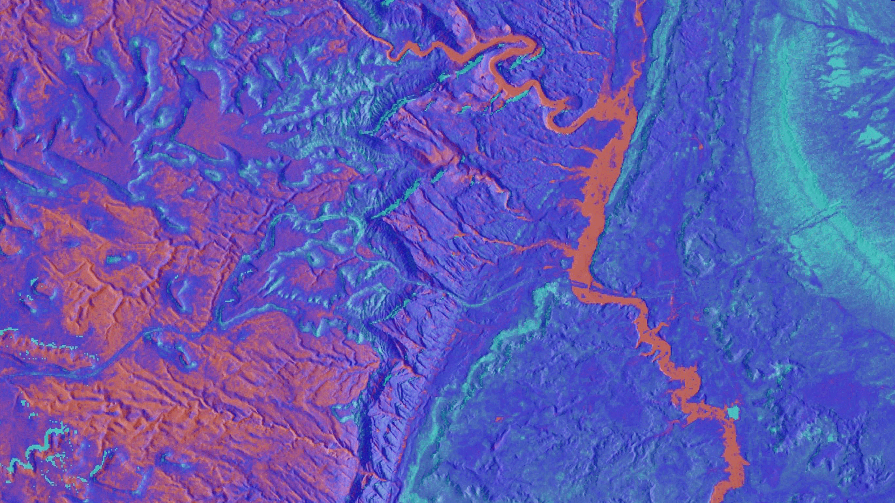
Utah Water Resources
Utilizing Landsat to Detect Ephemeral Water Sources in Support of a USGS Feasibility Assessment and Management Strategy of Equids
Kristen Dennis
Anson Call
Timothy Mayer
Gary Olds

Slide 2
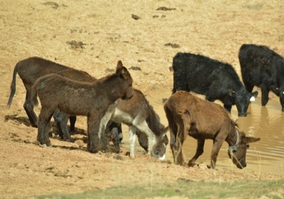
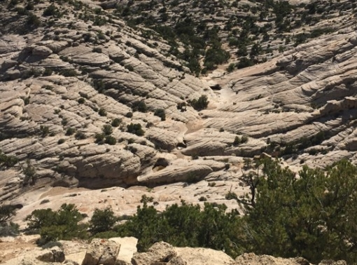
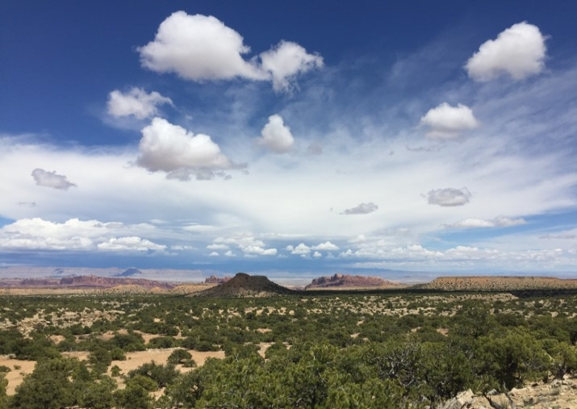
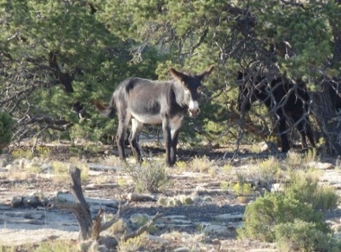
Overview
Wild horses and burros are cultural icons of the American West
Effective management requires understanding of environmental factors such as cover, forage, and water
Management areas are located in semi-arid environment
Surface water in this location is ephemeral
Goal: Employ NASA Earth observations to identify smaller scale surface water sources
The Sinbad HMA, Utah.
(Image credit: Sarah King, Savannah Summers, Tessa Roos)
Notes:
Why does this project matter? People care about wild horses and burros. We want healthy populations of these wild animals to persist.
To manage these animals, we must understand their biology. We need to know what types of habitat and resources the animals require. We also need to track those resources to ensure that population sizes match the level of resources available.
Surface water is important to horses and burros, but most wild horse and burro rangelands are arid or semi-arid. The little water that is available is usually found in small ponds, puddles, catchment basins, and tinajas (rock tanks). These ponds can be wet one day and dry the next. This makes tracking water availability extremely difficult on these remote landscapes.
We want to use NASA EO to track water availability in these small ponds and catchments throughout time.
Image Sources: Dr. Sarah King and Colleagues Savannah Summer & Tessa Roos.

Slide 3
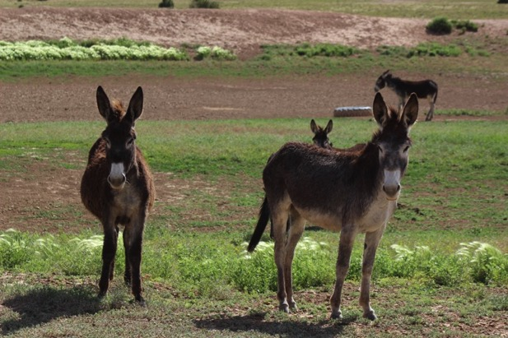
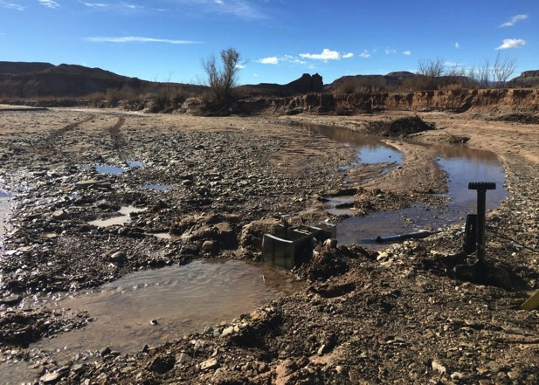
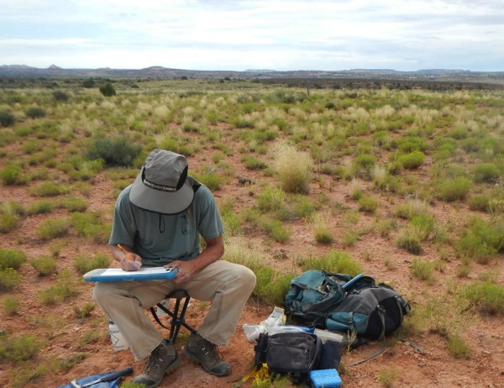
Community Concern
Information is needed for the BLM and USGS to enact informed and effective management
decisions.
Wild burros on the Sinbad HMA, Utah.
(ImageCredit: Savannah Summers)
Shallow ponds in Emery County, Utah.
(Image credit: Michael Freeman, USGS)
Federal agencies support healthy populations of free-roaming burros on the rangelands.
Information regarding water resources for equids in semiarid ecosystems is limited.
USGS researcher in Utah.
(Image credit: Jessica Mikenas, USGS)
Notes:
Federal agencies are responsible for managing healthy, sustainable populations in federally-designated Herd Management Areas
Agencies need information on animal habitat to understand the animal’s biology and to manage the animals correctly.
Water is an important resource, but researchers just don’t know exactly when and where water can be found on the landscape. If they could find out, they could better understand burro biology and make better management decisions.
Image sources: <Colleague of Dr. Sarah King>, Savannah Summers, <https://www.usgs.gov/products/multimedia-gallery/images>; Jessica Mikenas, USGS; Michael Freeman, USGS

Slide 4
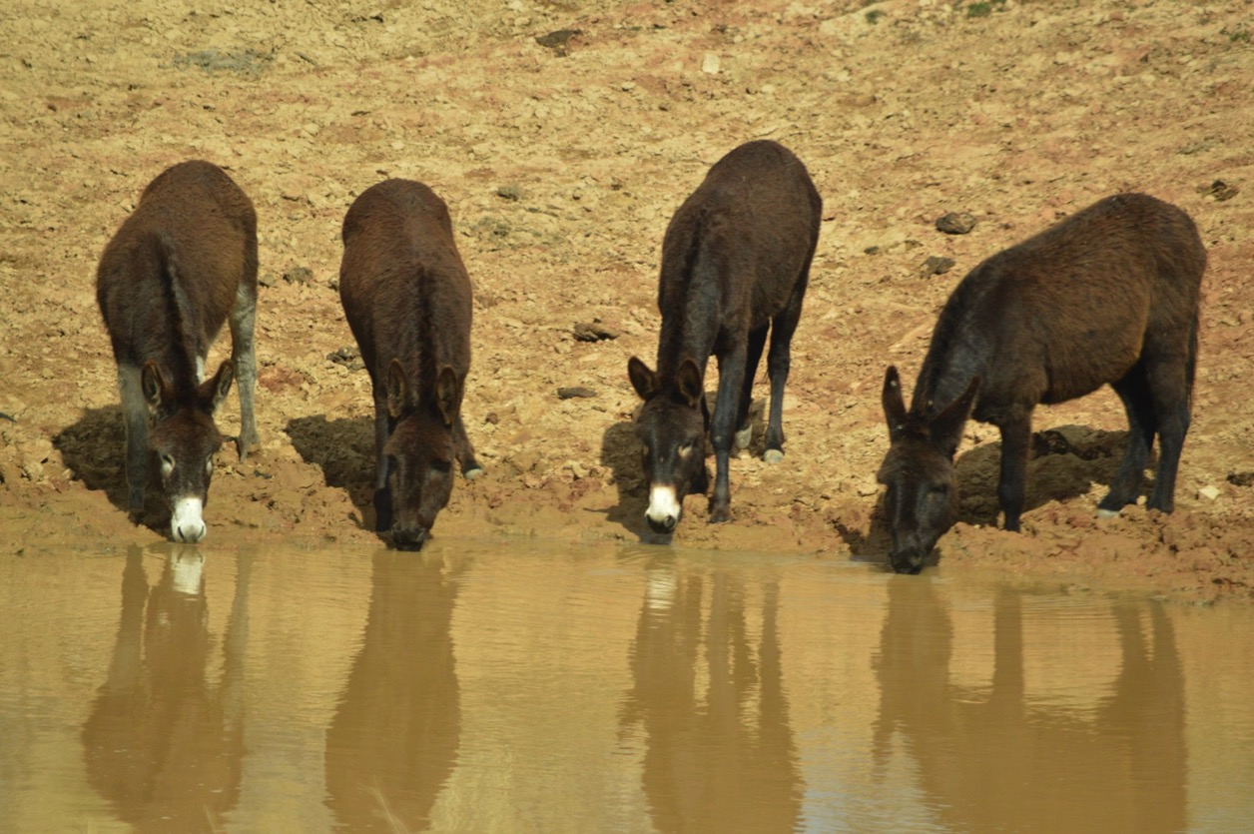
Partners
USGS
Dr. Kate Schoenecker, ecologist
BLM
Gus Warr, BLM Program Manager
BLM and USGS partnered to study habitat selection of burros on the Sinbad Herd Management Area
Burros at a watering hole in Sinbad HMA, Utah. (Credit: Savannah Summers)
Notes:
Kate was the main point of contact. schoeneckerk@usgs.gov
Image Sources: <Colleague of Dr. Sarah King>, Savannah Summers

Slide 5
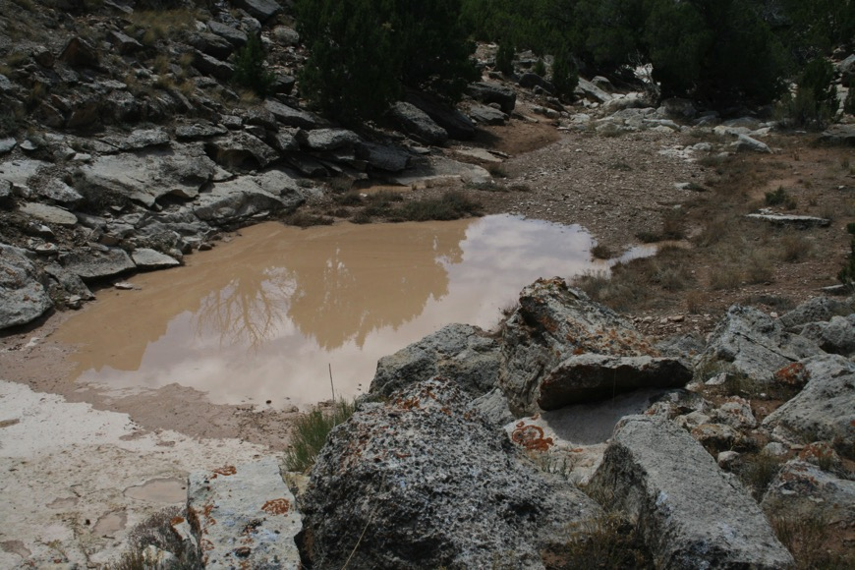
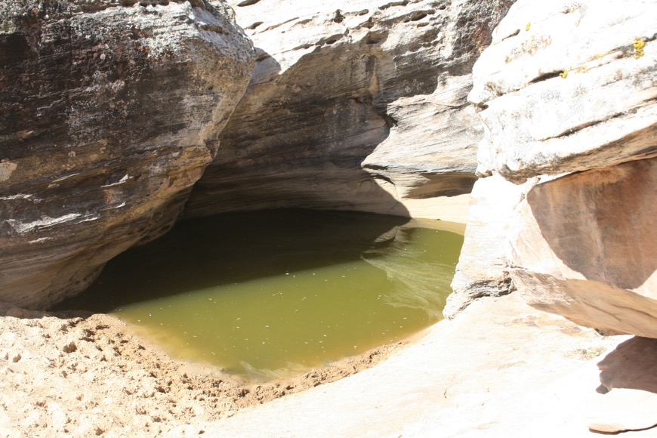
Objectives
Our study objectives include:
1)Testing the feasibility of using NASA earth observations to detect surface water at small scales
2) Determining the seasonality of the available surface water
3) Up-scaling the methods by creating a toolset and tutorial for use in other regions and organizations
Credit: Mike Tweddell, BLM
Image credit: Mike Tweddell, BLM
Notes:
Basically, the goal was to use EO to say when and where water is available for burros. We wanted to create a series of maps that reflected seasonal change in surface water, as well as a tool to map surface water at any given time in the past.
Our study focused on one study area – the Sinbad HMA in southern Utah (see next slide).
We wanted to create a repeatable workflow that could be used to apply our method to other rangelands.

Slide 6
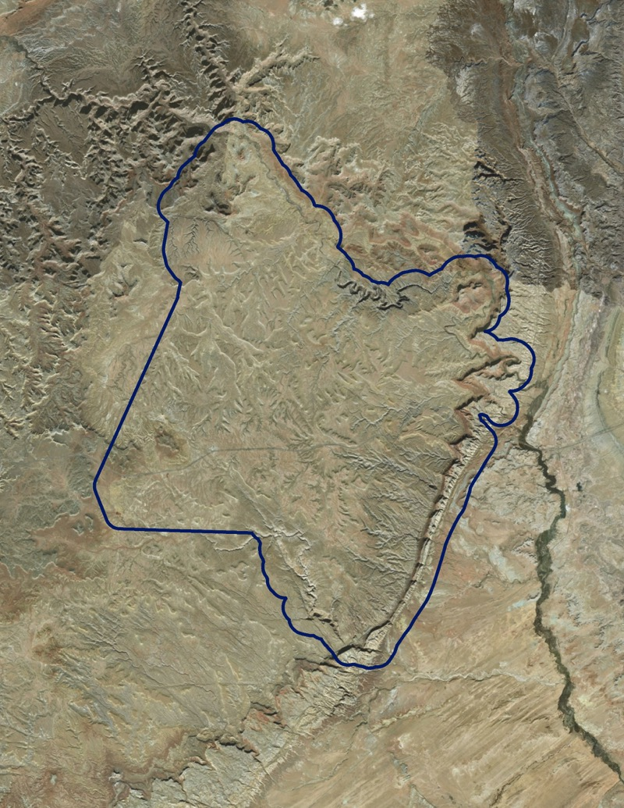
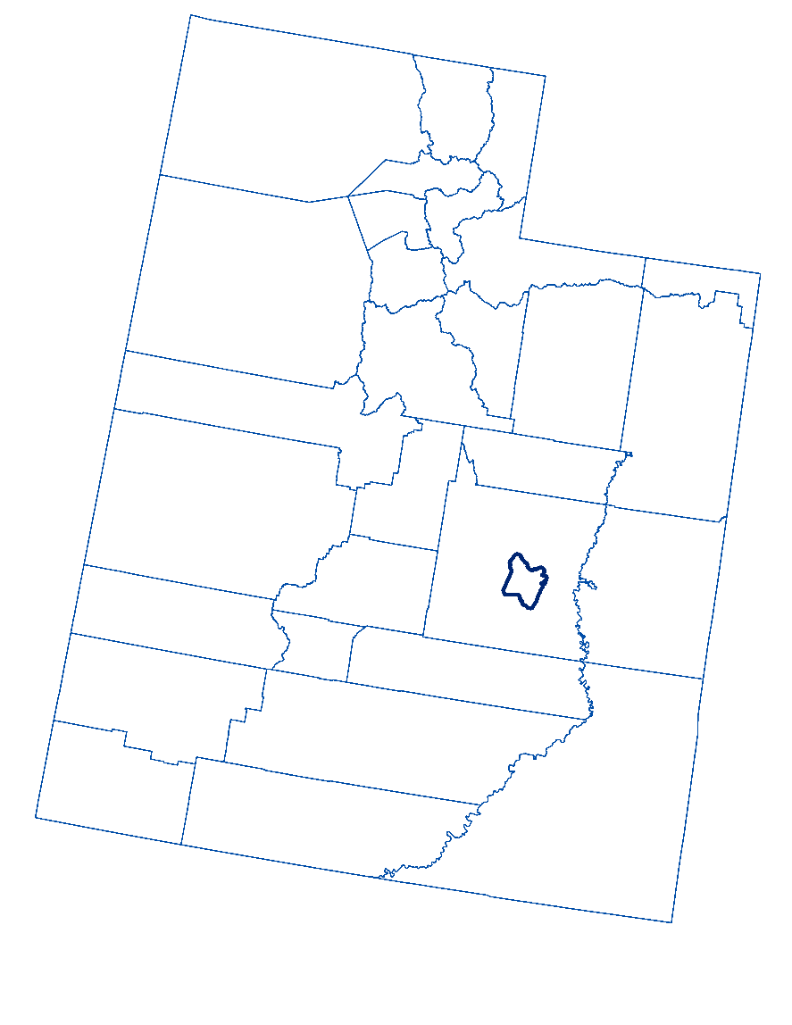
Study Area
Sinbad HMA and surrounding area
Emery County, Utah
61,126 ha / 875,071 Landsat pixels
Semi-Arid with bimodal precipitation regime
Image credit: ESRI Baselayer
Notes:
Climate: Semi-arid. Snow is usually present from November to March (burros can eat snow for water content).
Dry season is April – July. Monsoon season starts in July ends in October.

Slide 7
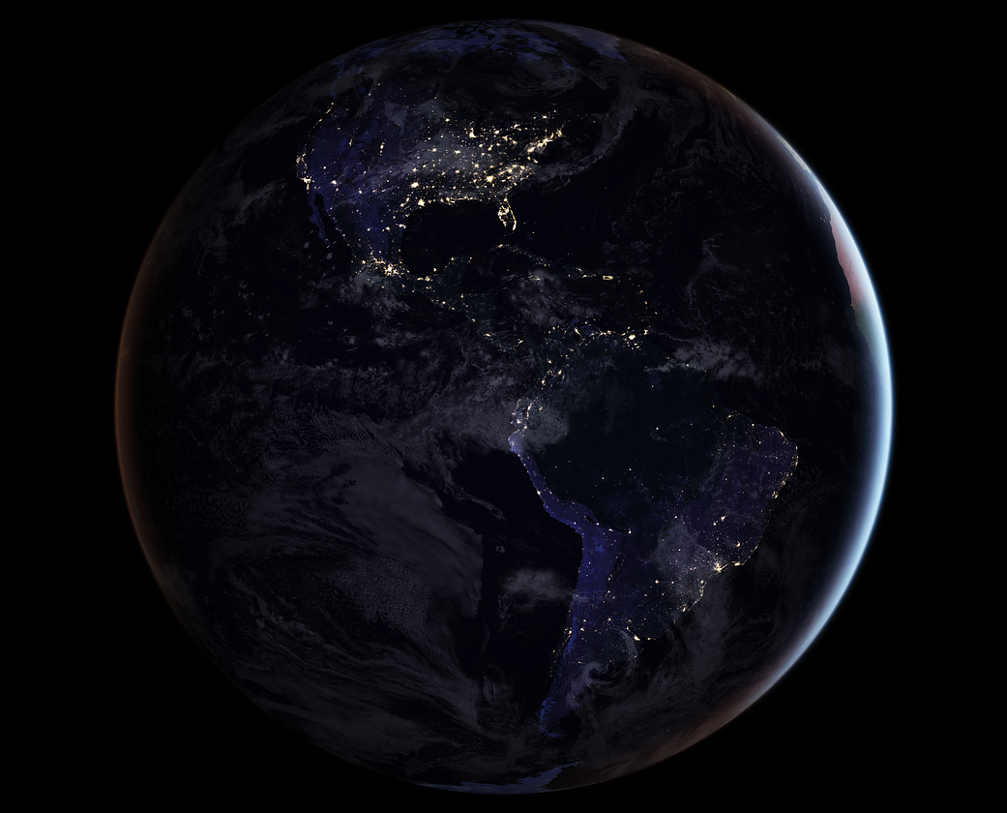
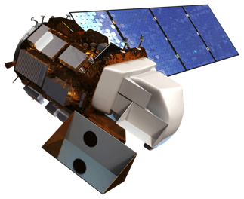
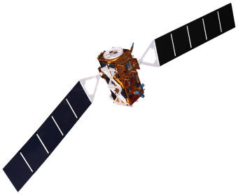
Satellites & Sensors
Landsat 8 OLI
Sentinel-1 SAR
Platform and Sensor | Data Product | Dates/ Availability | Acquisition Method
Landsat 8 OLI | Collection 1, Tier 1 Raw and TOA Reflectance (Orthorectified) scenes | April 2013 - present | Google Earth Engine
Sentinel-1 SAR | C-band Synthetic Aperture Radar Ground Range Detected, Level-1C | October 2014 - present | Google Earth Engine
STRM | Digital Elevation and Topography Models | June 2015 - present | Google Earth Engine
Shuttle Radar Topography Mission
Image Credit: NASA
Notes:
We only attempted to map water during times for which Landsat 8 imagery was available. Our method could be extended to use older Landsat sensors. Sentinel is used to supplement Landsat and increase our ability to detect water, especially water sources that are smaller than a single Landsat pixel.

Slide 8
Digital Sampling in Earth Engine
Two Sampling Efforts
Used NAIP imagery to create training data
15M: 299 “dry” points, 242 “wet” points
30M: 226 “dry” points, 206 “wet” points
Sampling criteria: ocularly survey a single Landsat pixel, estimating cover of 5 different land classes:
15M Sampling (Panchromatic)
30M sampling
Water
Vegetation
Bare ground
Shadow
Other
Notes:
High-res NAIP imagery was used to create training data.
287 points randomly scattered within already-mapped water features
Points must be 30m apart (each point is unique landsat pixel). Would have liked to make more points, but area was too small!
1000 points randomly scattered throughout the entire study area
Digital Point Sampling criteria
Water = Surface water
Vegetation= pinyon, juniper, shrubs, and/or grasses
Bare Ground = rocks, dirt including dirt roads, and dead or senescent grass
Other = paved roads and urban
Shadow

Slide 9
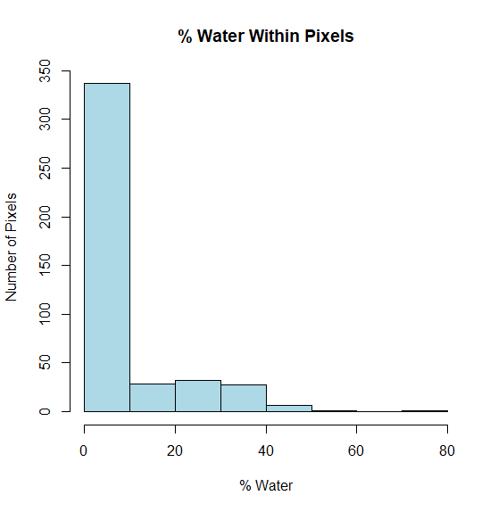
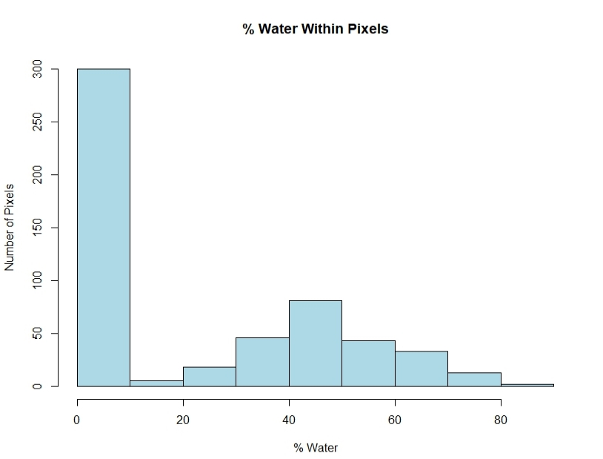
Digital Sampling Effort
Two Sampling Efforts
Observed 30M Dataset
Highly skewed: few pixels have >40% water
Observed 15M Dataset
Still skewed, but includes more pixels with high percentage of surface water
% Water Within Pixels
30M Dataset
% Water Within Pixels
15M Dataset
Notes:
High-res NAIP imagery was used to create training data.
287 points randomly scattered within already-mapped water features
Points must be 30m apart (each point is unique landsat pixel). Would have liked to make more points, but area was too small!
1000 points randomly scattered throughout the entire study area
Digital Point Sampling criteria
Water = Surface water
Vegetation= pinyon, juniper, shrubs, and/or grasses
Bare Ground = rocks, dirt including dirt roads, and dead or senescent grass
Other = paved roads and urban
Shadow

Slide 10
Methodology
NASA Earth Observations
Landsat 8
STRM
Senintel-1 SAR
R
Random Forest
PRISM Climate Data
Google Earth Engine
Ocular Digital Survey Data
Water Presence Map
Field Data
Sensor Input
Data
Software
Algorithm
Output
1
2
3
4
5
Notes:
General work flow depicting the overall process- acquiring imagery and ancillary data, processing and modeling in Google Earth Engine and R, and outputting water presence maps.
Utilized imagery from Landsat 8 OLI and SRTM as well as Sentinel 1 SAR, combined with information from field data, ocular digital survey, and climate data. Spectral indices and other variables from these data sources were processed in Google Earth Engine, and were then run through a Random Forest classification model in R to create a model for water detection. This model provided a final output of water presence maps.

Slide 11
MODELING WORKFLOW
CLOUD-FREE LANDSAT MOSAIC
CLIP TO STUDY AREA
EXTRACT DATA TO POINTS (WET & DRY)
COMBINE CSVs & CREATE THRESHOLD COLUMNS
RUN RANDOM FOREST IN R
MAKE MODEL & OUTPUT TIFF
SENTINEL -1 C-SAR
RESAMPLE & CLIP TO STUDY AREA
MERGE
NDVI/NDWI
CLIP TO STUDY AREA
EXPORT TO TIFF
OTHER PREDICTOR INDICES
CLIP TO STUDY AREA
Notes:
Model work flow implemented to generate the final model and Tiff

Slide 12
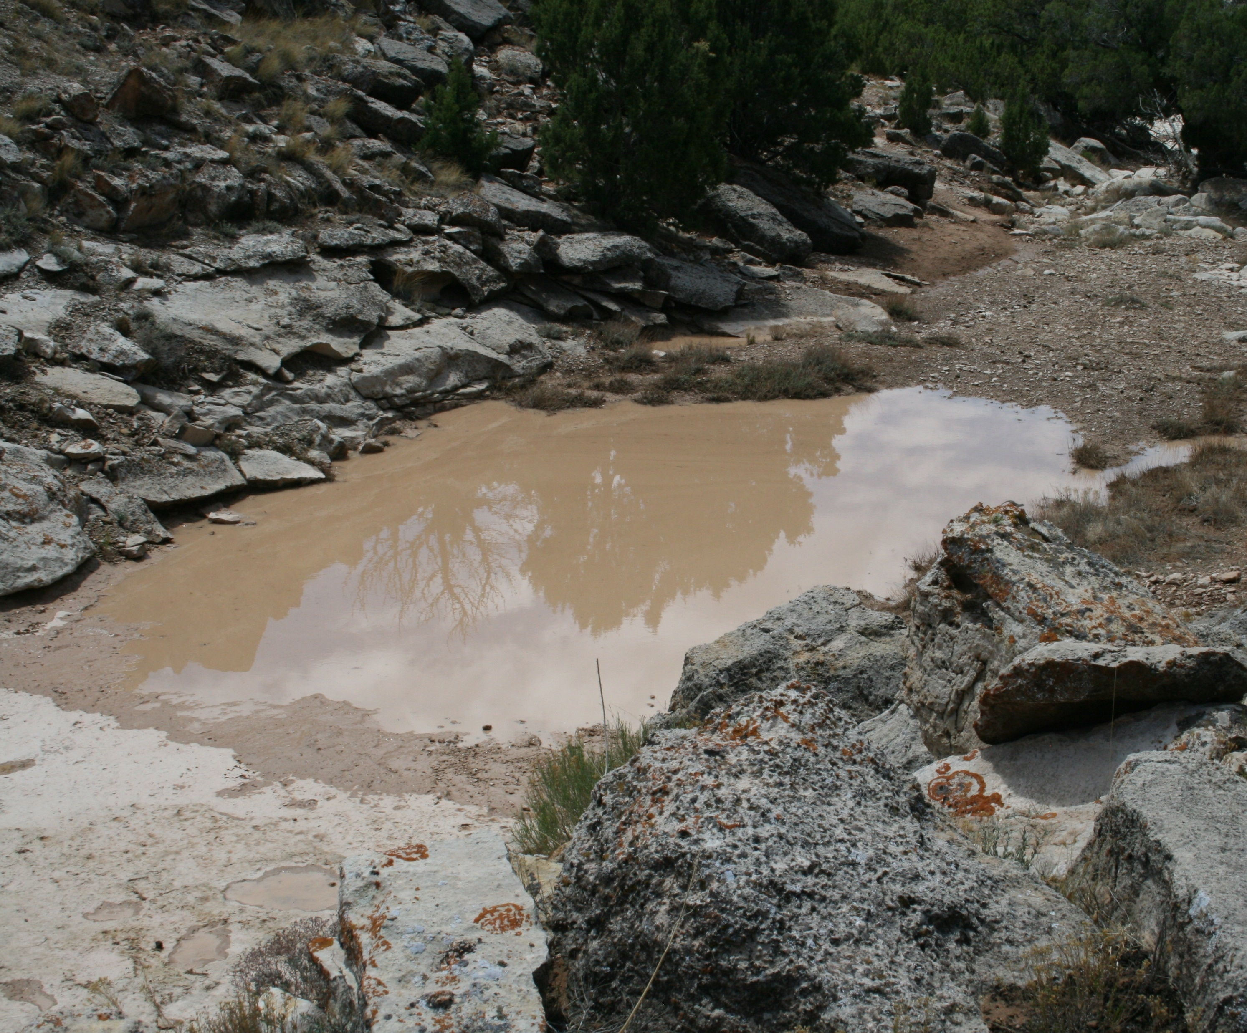
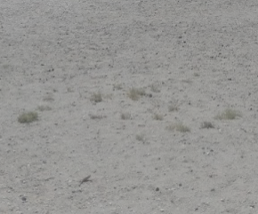
Random Forest
Process
Rank variables using VSURF
Covariate correlation plot
Criteria for Removing Variables
Correlated above 0.8
Remove least-predictive first
Explanatory Variables
BLUE | SWIR 1 | NBR | Sentinel-1 VV
GREEN | SWIR 2 | Tassled Cap B,G,W | Slope
RED | NIR | NDMI | Eastness
PAN | NDVI | GRVI | Northness
Presence
Absence
Notes:
RF modeling process, Key elements such as vsurf was used in the variable selection process. Correlated variables were removed if above 0.8

Slide 13
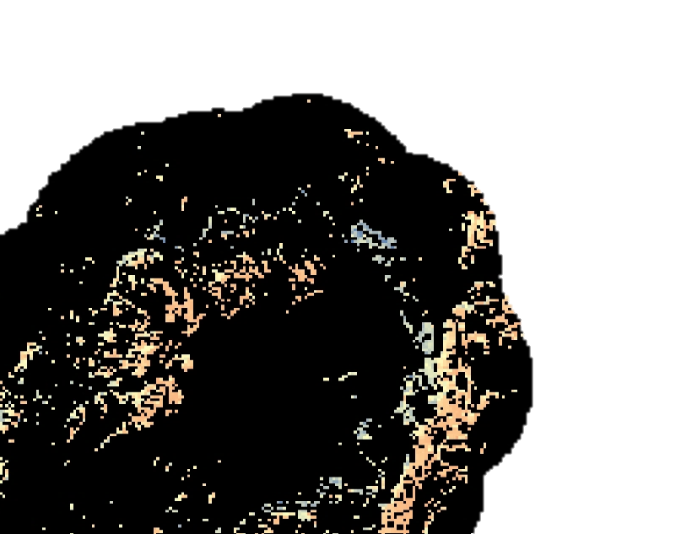
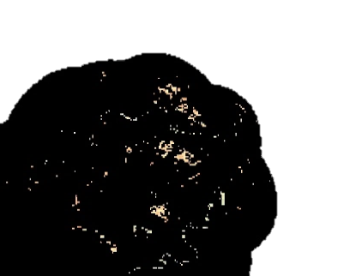
Results:
Wet Season
Dry Season
Landsat 30m Model
Two Step Classification models
Evaluation Metrics
Kappa: 0.3284
AUC: 0.6347
Model Accuracy: 90.7407%
Users Accuracy: 30.0%
Producer’s Accuracy: 50.0%
Specificity: 0.3
Sensitivity: 0.9694
More wet
More dry
Notes:
Landsat 30m model looking at the “wet” and “dry” seasons. Models produced provided a relatively accurate assessment of percent cover class of water within the landscape.
The model Dry model was applied to a wet landsat scene and we, through visual assessment, observed more potential surface water

Slide 14
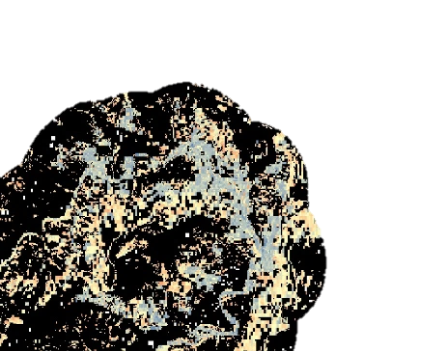
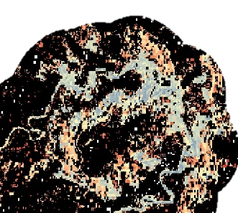
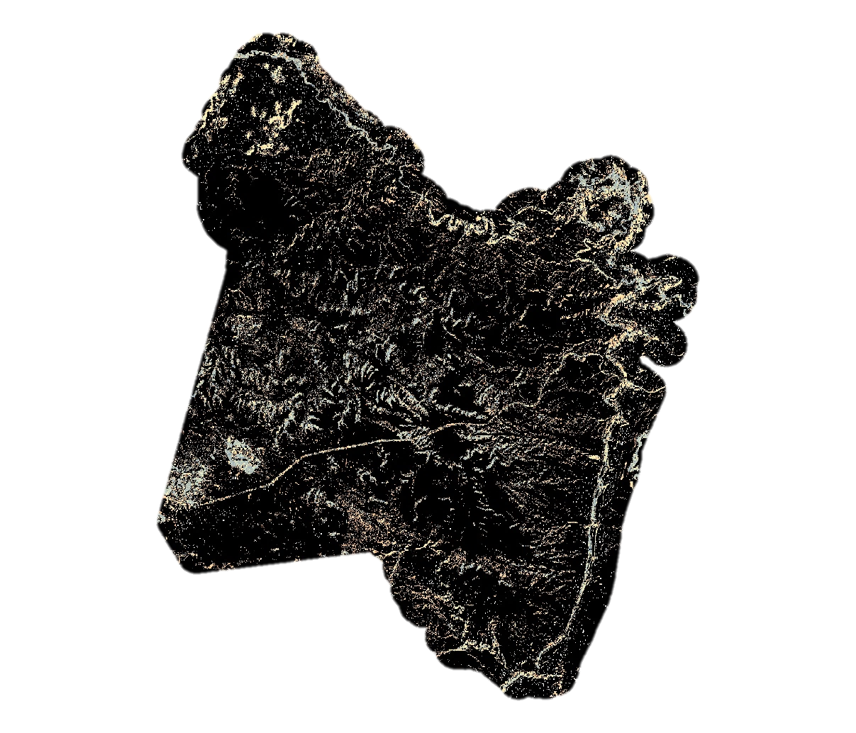
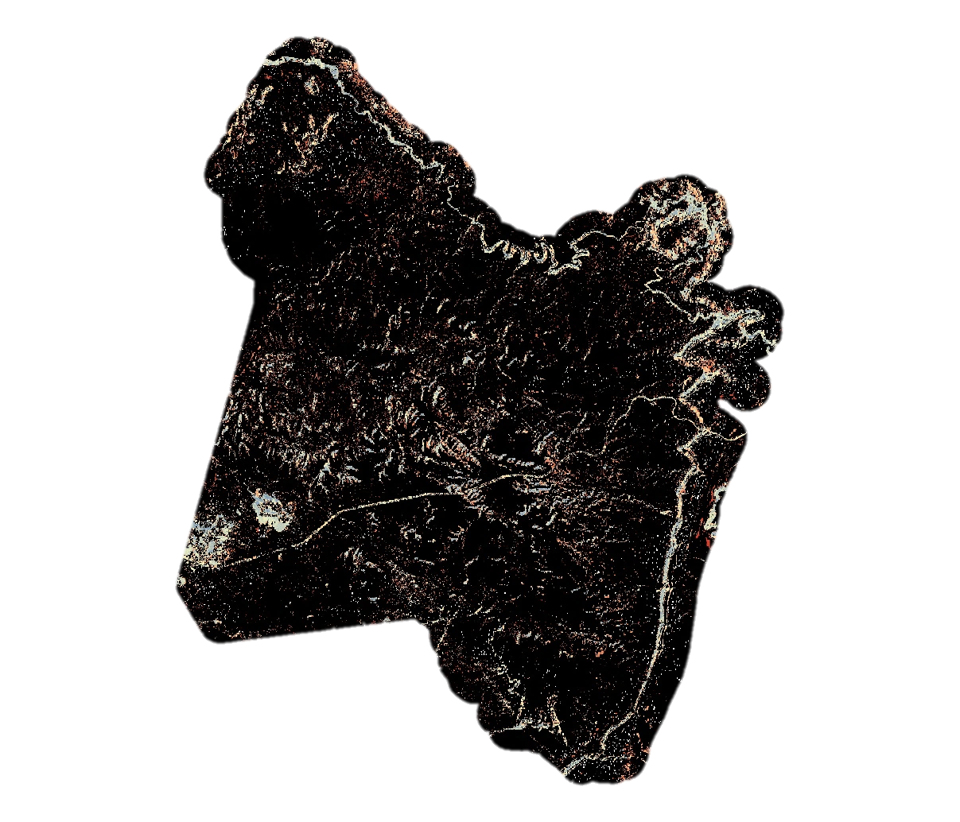
Results:
Wet Season
Dry Season
Landsat 15m Panchromatic Model
Two Step Classification models
Evaluation Metrics
Kappa: 0.8803
AUC: 0.7655
Model Accuracy: 94.0850%
User’s Accuracy: 94.5%
Producer’s Accuracy: 92.2%
Specificity: 0.9454
Sensitivity: 0.9373
More wet
More dry
Notes:
Landsat 15m panchromatic model looking at the “wet” and “dry” seasons. Models produced provided a relatively accurate assessment of percent cover class of water within the landscape.
The model Dry model was applied to a wet landsat scene and we, through visual assessment, observed more potential surface water
We observed a drastic increase in percent cover class of surface water with the improved resolution in the 15m model

Slide 15
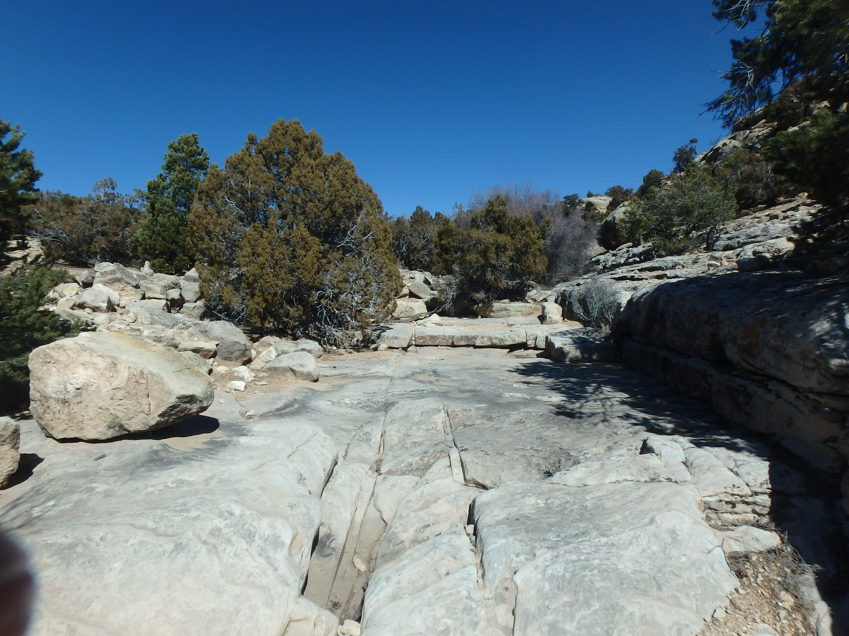
Conclusions
Panchromatic model:
Higher Resolution
Improved training effort
Provided markedly improved reflectance models
More accurately displays ephemeral surface water in distinct seasons
This may be employed to inform habitat selection models
Image credit: Anson Call
Notes:
The percent cover of ephemeral water sources at 30M2 resolution and 15M2 will aid our partners at the USGS and BLM in identifying locations of critical habitat and potential habitat use for wild horses and feral burros.
The Panchromatic model produced a
These maps are key to future management efforts. This project also expands upon the scale of previous work. We generated a modeling technique in a region with a high level of variability. This project employed a scalable methodology utilizing NASA Earth Observations and Google Earth Engine which can be replicated on an annual basis to provide managers with an up-to-date dataset and the most informed models possible.
The 15m model was an improvement over the traditional 30m model. We would recommend using this approach in the future. However this does require a significant effort to produce a pan. Model series of resampling efforts must be enacted to achieve the required results

Slide 16
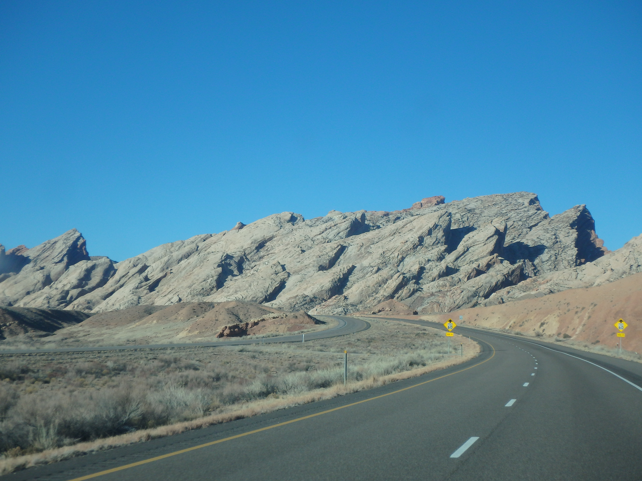
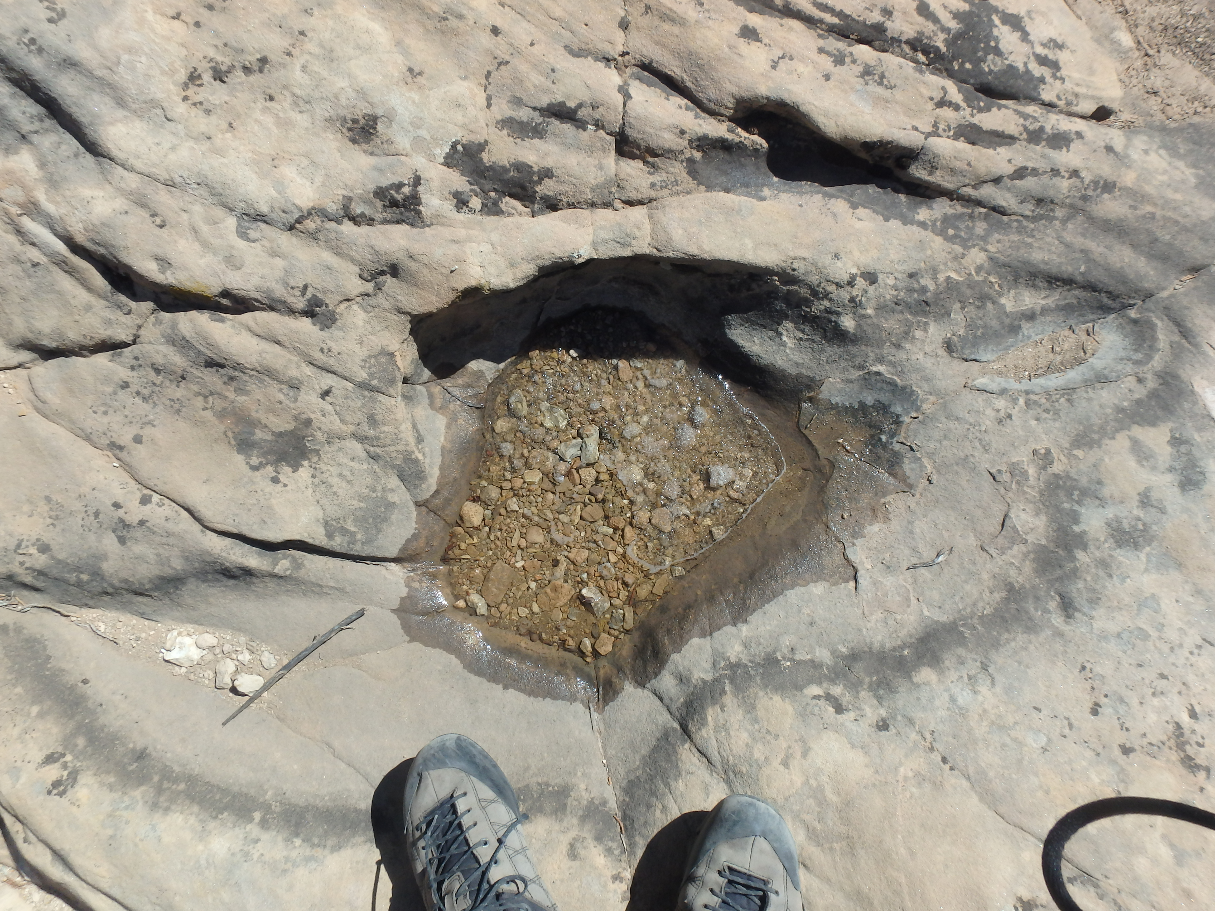
Errors and Uncertainties
Potential significant influence of mixed pixel training data set
Misclassified pixels could result in skewed model results
NAIP availability resulted in training data sets from the “Dry” season
Model was projected to a typical “Wet” season scene
Credit: Anson Call
Notes:
This project had several caveats and limitations. We performed ocular surveys of 1000 points for the 30M² Landsat Model and XXXX for the 15M² Panchromatic Landsat Model across an area of 61,126 hectares. This study may have been hindered by the inherent mixed pixel stemming from the low number of percent cover of water training plots. Overall due to the low number of input data, as well as the low proportion that exhibited a high, >50%, percent cover of water this potentially significantly influenced the model. Potentially misclassified quadrat plots could significantly affected the modeling efforts of the project due to the limited sample size of input training data and percent cover distribution previously discussed. As a result of the sparse nature of surface water in this semi-arid area, a majority of sampled presence points came from the river and may not be completely reflective of water found in ponds and tinajas.
chnange
add
correct?

Slide 17
Future Work
Explore more predictor variables
Potentially expand the study area to include more HMA’s
Collection of Remote Sensing oriented in-situ data by teams in the field
For “Wet” and “Dry” periods
Sentinel-2 cross sensor implementation for increased resolution
Focusing on locations with ample LiDAR data may be useful as well
Credit: Savannah Summers
Notes:
With future work, this project would be able to explore more predictor variables, and potentially expand the study area to include more HMA’s. We recommend the collection of Remote Sensing oriented in situ data by wild horses and feral burro survey teams in the field. The implementation of specific field data collected with Remote Sensing application is critical for improving modeling efforts. Training data complete with attribute description of water sources is essential for further refining the seasonality of ephemeral water sources in semi-arid landscapes.

Slide 18
Acknowledgements
Dr. Paul Evangelista (Natural Resource Ecology Laboratory, Colorado State University)
Dr. Catherine Jarnevich (USGS, Fort Collins Science Center)
Nick Young (Natural Resource Ecology Laboratory, Colorado State University)
Dr. Kate Schoenecker (USGS, Fort Collins Science Center)
Dr. Sarah King (Ecosystem Science and Sustainability, Colorado State University)
This material contains modified Copernicus Sentinel data (2017), processed by ESA
Notes:
These notes should be thorough enough for someone not familiar with the project to clearly present the material.
NOTE: For every image on the slide include an image source in the speaker notes (ex. URL; Name, Affiliation, etc.)
Image Source: http://commons.wikimedia.org/wiki/File:Claude_Monet_-_The_Magpie_-_Google_Art_Project.jpg

Slide 19
References
Baig, M. H. A., Zhang, L., Shuai, T., & Tong, Q. (2014). Derivation of a tasselled cap transformation based on Landsat 8 at-satellite reflectance. Remote Sensing Letters, 5(5), 423-431. doi:10.1080/2150704x.2014.915434
Breiman, L. (2001). Random forests. Machine Learning, 45(1), 5-32. doi:10.1023/a:1010933404324
Brown, B. T., & Johnson, R. R. (1983). The distribution of bedrock depressions (tinajas) as sources of surface water in Organ Pipe Cactus National Monument, Arizona. Journal of the Arizona-Nevada Academy of Science, 18(2), 61-68.
Drake, J. C., Jenness, J. S., Calvert, J., & Griffis-Kyle, K. L. (2015). Testing a model for the prediction of isolated waters in the Sonoran Desert. Journal of Arid Environments, 118, 1-8. doi:10.1016/j.jaridenv.2015.02.018
European Space Agency. (2013-2017). Sentinel Data, processed by ESA.
Genuer, R., Poggi, J.-M., & Tuleau-Malot, C. (2015). VSURF: An R package for variable selection using random forests. R Journal, 7(2), 19-33.
Jurgens, C. (1997). The modified normalized difference vegetation index (mNDVI) - a new index to determine frost damages in agriculture based on Landsat TM data. International Journal of Remote Sensing, 18(17), 3583-3594. doi:10.1080/014311697216810
Ko, B. C., Kim, H. H., & Nam, J. Y. (2015). Classification of potential water bodies using Landsat 8 OLI and a combination of two boosted random forest classifiers. Sensors, 15(6), 13763-13777. doi:10.3390/s150613763

Slide 20
References
NASA Jet Propulsion Laboratory (JPL). (2013-2017). NASA Shuttle Radar Topography Mission Global 1 arc second [Data set]. NASA EOSDIS Land Processes DAAC. doi:10.5067/MEaSUREs/SRTM/SRTMGL1.003
Olthof, I. (2017). Mapping seasonal inundation frequency (1985-2016) along the St-John River, New Brunswick, Canada using the Landsat archive. Remote Sensing, 9(2). doi:10.3390/rs9020143
Rotz, J. D., Abaye, A. O., Wynne, R. H., Rayburn, E. B., Scaglia, G., & Phillips, R. D. (2008). Classification of digital photography for measuring productive ground cover. Rangeland Ecology & Management, 61(2), 245-248. doi:10.2111/07-011.1
U.S. Geological Survey Earth Resources Observation and Science Center. (2013-2017). Provisional Landsat OLI Surface Reflectance, TOA, 32-day NDVI, and 32-day NDMI. US Geological Survey. https://doi.org/10.5066/F7KD1VZ9
Wild Horse Annie Act - Public Law 86-234 (1959)
Zhou, Y., Dong, J., Xiao, X., Xiao, T., Yang, Z., Zhao, G., . . . Qin, Y. (2017). Open surface water mapping algorithms: a comparison of water-related spectral indices and sensors. Water, 9(4). doi:10.3390/w9040256

