Slide 1
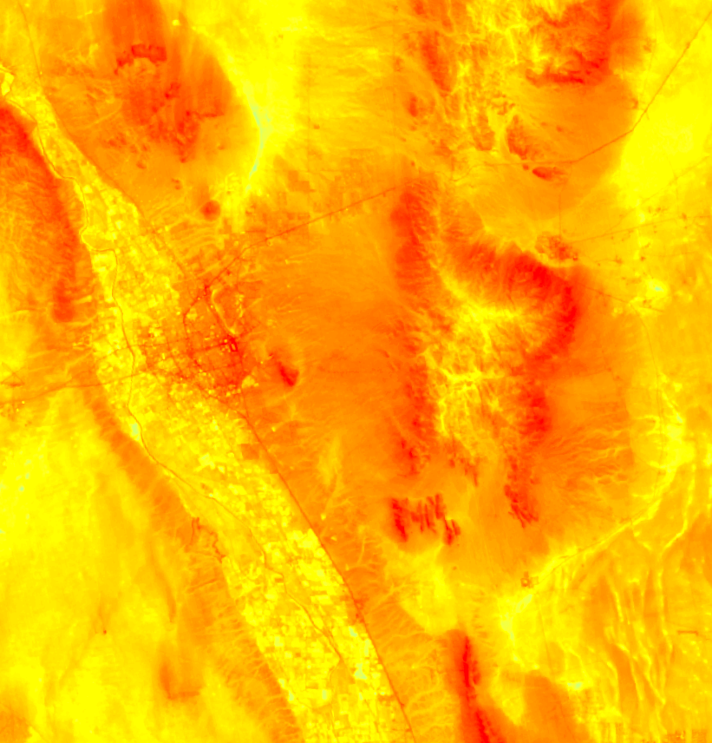
LAS CRUCES HEALTH & AIR QUALITY
Assessing Urban Heat as it Relates to Social Vulnerability and Land Cover Changes in Las Cruces, New Mexico
Jonathan O’Brien
Rebia Khan
Fanqi Jia
Christopher Wilson
Maricopa County Department of Public Health and Arizona State University
2017 Summer

Slide 2
Background
Image Source: CLIMAS
Located just 50 miles North of the Mexican border, the city of Las Cruces is the 2nd largest city in New Mexico. The city has experienced rapid urban growth, and in the last 20 years the population has risen in tandem with the temperatures.
Notes:
Located just 50 miles North of the border with Mexico, and just Northwest of El Paso, Las Cruces is the 2nd largest city in the state of New Mexico. It has seen some very rapid growth in the last 20 years, especially in the early 2000’s. Since then, both the population and the temperatures in the city have risen.
Image Source: Sarah Leroy & Dr. Gregg Garfin, Climate Assessment for the Southwest (CLIMAS).

Slide 3
Background
This rapid urban growth has caused an increase in impervious surfaces such as concrete and a lack of vegetation, making the city even hotter. Aside from the heat, many residents struggle with poverty, health problems, and sub-standard living conditions.
Image Source: Pixabay
Notes:
All of this urban growth typically means less trees and more impervious surfaces like pavement, which has been the case for Las Cruces. Impervious surfaces like concrete and pavement are known to heat up much more than vegetated areas, and they also retain their heat at night, preventing the city and the people in it from being able to cool down. Aside from the heat, there are many residents living in poverty, with serious medical conditions, and sub-standard living conditions. All of these things can put people in situations where they are much more vulnerable to the heat than they would be otherwise. For example, people with diabetes have trouble coping with extreme heat because of their medical condition, and many people living in poverty don’t have air conditioning. When more than one of these factors come together, mixed with extreme heat, it can be deadly.
Image Source: https://pixabay.com/en/usa-road-america-straight-asphalt-2125138/

Slide 4
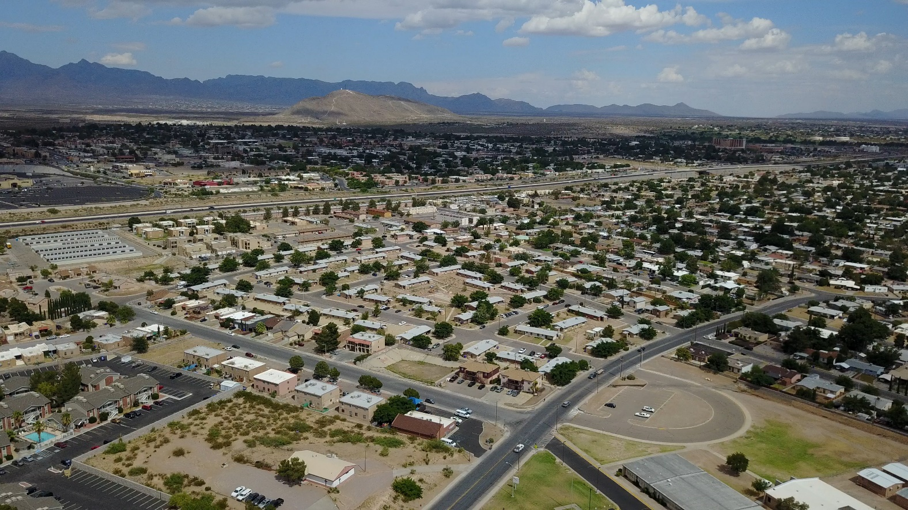
Community Concerns
There have been five years where the city experienced more than 30 consecutive days 100 °F+ (LeRoy and Garfin, 2017).
At risk populations include: minorities, those with poor health, people that are socially isolated, the elderly, and the poor.
Less than 4.5% tree canopy coverage exists throughout the city.
Decision Points:
Identify areas to implement greening and the development of “Cool Corridors”.
Quantify the percentage of tree canopy cover, vegetation, and impervious surface to reduce surface temperature
Image Source: City of Las Cruces
Notes:
Las Cruces is the 2nd largest in New Mexico and has experienced rapid urbanization over the past 30 years. On record, the city has experienced 5 years with more than 30 consecutive days with temperatures in excess of 100 F. The city is expected to experience an increase in the number of 100 degree days moving forward. Populations at risk of heat related illness often include, ethnic minorities, those with poor health, socially isolated, and low income. Increasing vegetation and tree canopy coverage is one adaptation method, which can ameliorate extreme temperatures. However, estimates show tree canopy coverage is less than 4.5% for the city. This project will help identify areas to implement several adaptation strategies including greening and establishing cool corridors. Second, quantify the percentage of tree canopy cover, vegetation, and impervious surfaces’ influence on LST.
Shade canopy can be an effective way to reduce exposure to extreme heat for pedestrians. City of Las Cruces urban tree canopy is limited to 4.5%. Many low-income neighborhoods have minimal green space.
Shade canopy is limited to 4.5% of the city and many low-income neighborhoods have minimal green landscaping.
There have been five years in which Las Cruces experienced more than 30 days with 100+ degree temperatures.
Identify areas to implement greening development of “Cool Corridors”. Implement green projects in parts of the city most vulnerable to extreme heat.
Quantify the percentage of tree canopy cover, vegetation, and impervious surface to reduce LST.

Slide 5
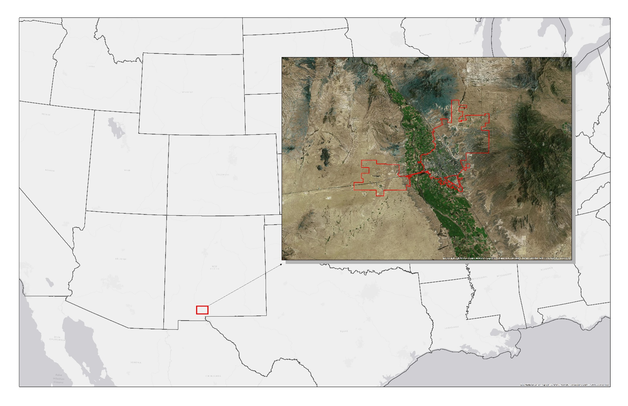
Study Area and Study Period
Our Study Area consisted of the city limits for the City of Las Cruces.
In order to capture the massive urban growth that took place in the early 2000’s, our Study Period was from 1999 to 2016, and included the months from May to September.
City of Las Cruces
New Mexico
1999
2016
Notes:
For our study area we used the city limits for the city of Las Cruces. The irregular shape you see jutting out to the bottom-left is Las Cruces International Airport. The Northeastern parts of the city are mostly residential, and the bottom-left portion of the actual city itself is known as the Infill District, which consists of mostly residential and industrial properties. The Infill District was mentioned in particular as a problem area. Most of the urban growth occurred in the early 2000’s, so in order to see that change and the changes leading to present day our study period includes data from 1999 to 2016.

Slide 6
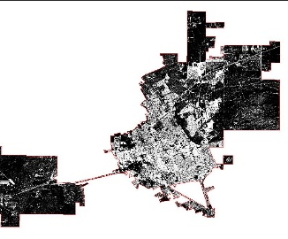
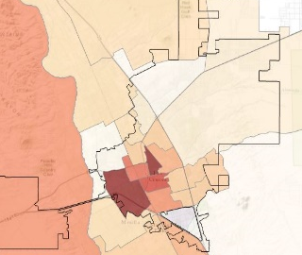
Objectives
Define the morphology of the urban heat island in Las Cruces
Assess patterns of social vulnerability and land cover within the city
Compare land cover and social vulnerability to the urban heat profile
Locate intersections of social vulnerability and extreme heat
Inform heat mitigation strategies and green infrastructure implementation
Notes:
Our first objective was to DEFINE the morphology (aka the shape) of the urban heat island.
Second was to ASSESS patterns of social vulnerability and land use and land cover (like residential versus commercial and trees versus pavement respectively).
Third was to COMPARE land use and social vulnerability profiles to the heat profile.
Fourth was to use this comparison to LOCATE areas where vulnerability and extreme heat intersect.
Finally, all of this will be used to INFORM those in charge of implementing strategies to reduce the heat.

Slide 7
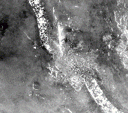
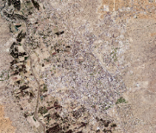
Overview
Landsat 5, Landsat 8
NAIP Aerial Imagery
American Community Survey & CDC
Data
Sources
Social
Vulnerability
Tree Canopy
Layers
Surface
Temperature
Impervious
Surfaces
Result
Heat Vulnerability Analysis
Notes:
The data that we used for this project came from multiple sources, but our satellite imagery, which played a key role in the project, came from the Landsat 5 and Landsat 8 satellites. Landsat 5 was launched in 1984, and Landsat 8 was launched much more recently in 2013. The Landsat 5 data covered the timespan from 1999 to 2011 and the Landsat 8 data covered from 2013 to 2016. Both were used to estimate land surface temperature, which we then used to estimate the shape and intensity of the urban heat island.

Slide 8
Overview
Landsat 5, Landsat 8
NAIP Aerial Imagery
American Community Survey & CDC
Data
Sources
Social
Vulnerability
Tree Canopy
Layers
Surface
Temperature
Impervious
Surfaces
Result
Heat Vulnerability Analysis

Slide 9
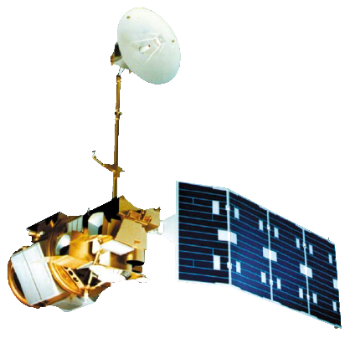
Earth Observations
Launch Date: March 1st, 1984
Data Used: Thematic Mapper (TM)
Purpose: Estimating Land Surface Temperature (LST)
Landsat 5 and Landsat 8 images were used to estimate land surface temperature (LST) in Las Cruces.
These data serve as an indicator of the shape and intensity of the urban heat island.
Landsat 5
1999
2011
Launch Date: February 11th, 2013
Data Used: OLI and TIRS
Purpose: Estimating Land Surface Temperature (LST)
Landsat 8
2013
2016
Notes:
The data that we used for this project came from multiple sources, but our satellite imagery, which played a key role in the project, came from the Landsat 5 and Landsat 8 satellites. Landsat 5 was launched in 1984, and Landsat 8 was launched much more recently in 2013. The Landsat 5 data covered the timespan from 1999 to 2011 and the Landsat 8 data covered from 2013 to 2016. Both were used to estimate land surface temperature, which we then used to estimate the shape and intensity of the urban heat island.

Slide 10
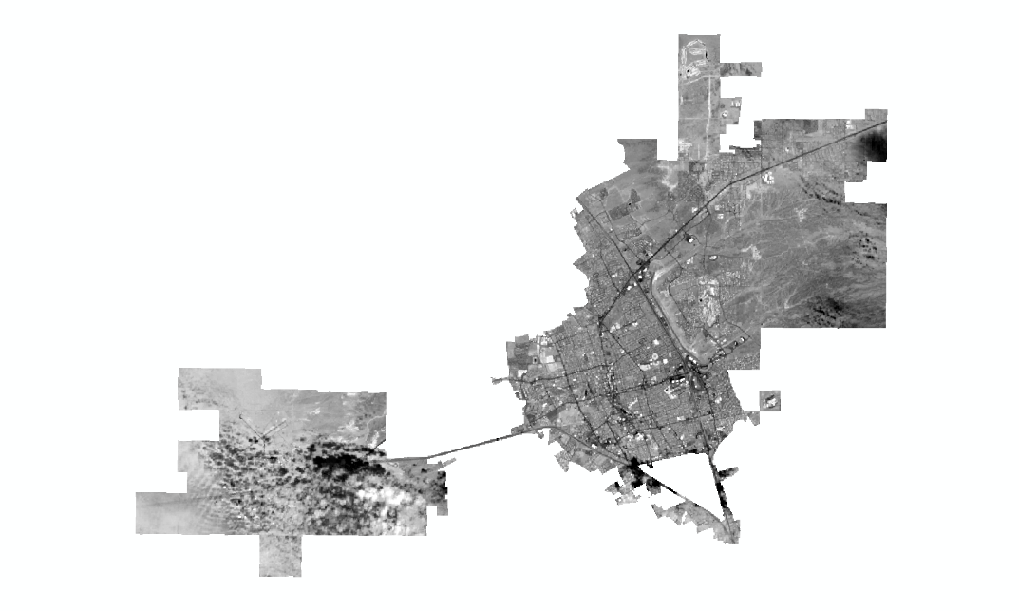
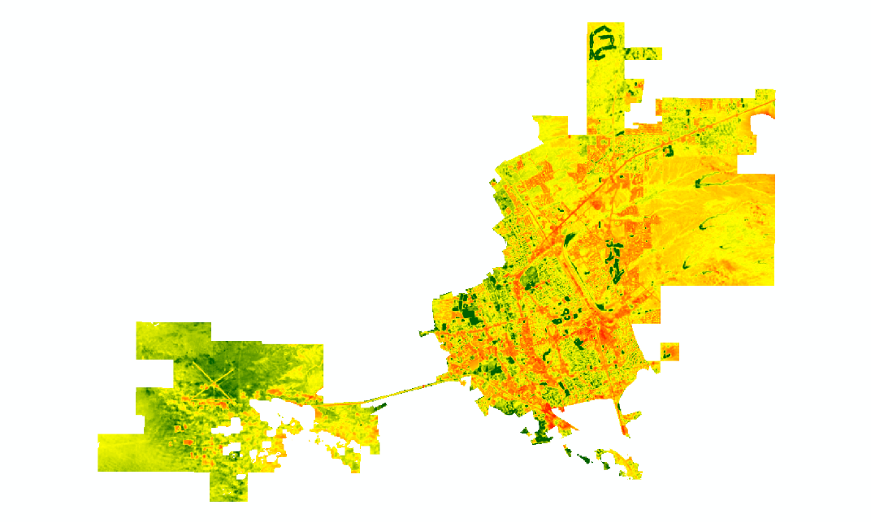
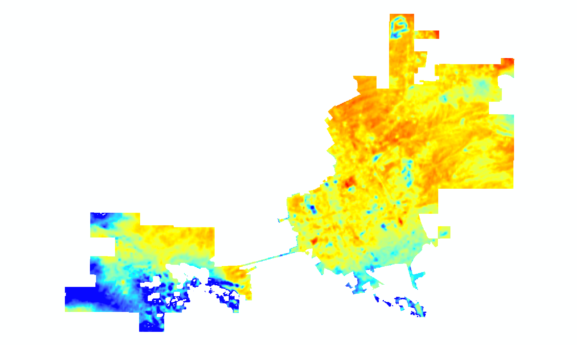
Calculating Land Surface Temperature
Raw
Image
Vegetation
Index
Cloud
Detection
Land Surface Temperature
Notes:
In order to derive usable surface temperature values for our study area, multiple stages needed to be addressed. First, a cloud cover mask was applied from the quality assessment band of each image. Once the clouds were removed from the equation, multiple calculations were done in order to brightness temperature, part of which included a Normalized Differential Vegetation Index (NDVI). This index shows the scale of healthy vegetation prevalence in our study area. Land surface temperature values could then be calculated using conversion constants provided in the metadata of each downloaded image. This process was completed for 92 total images in our study timeline.

Slide 11
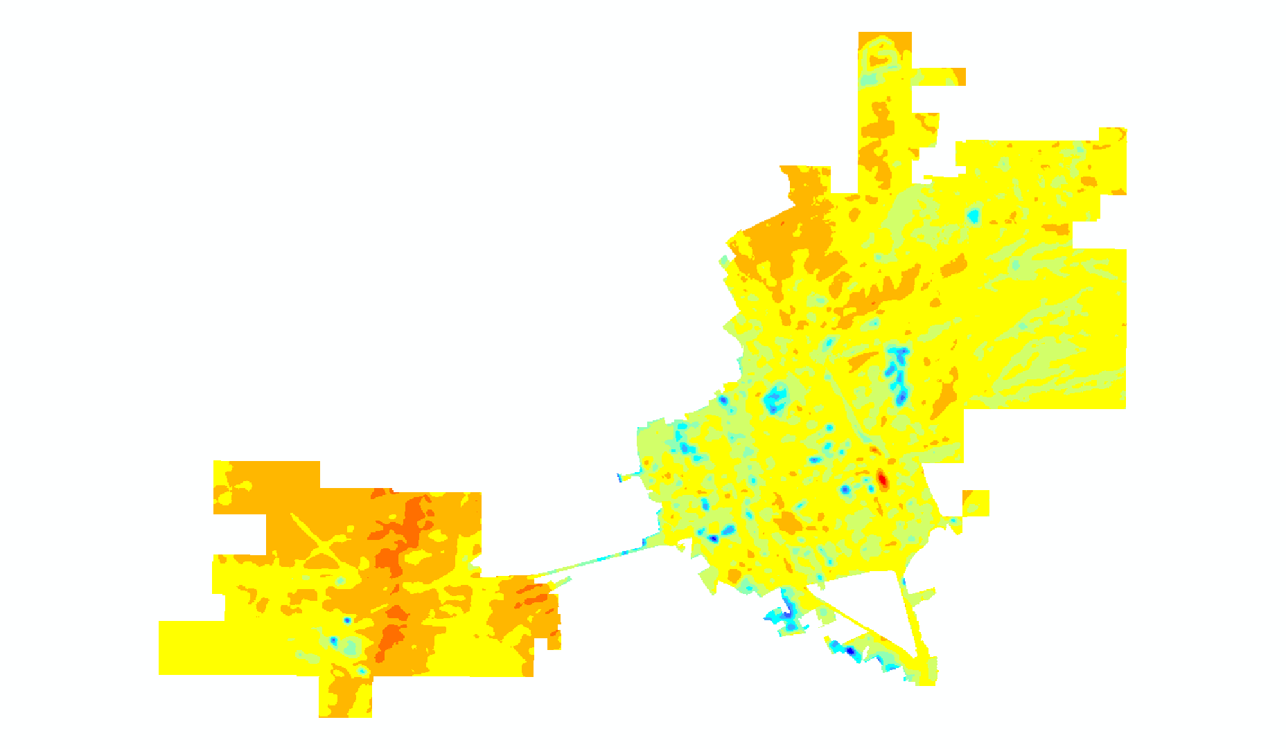
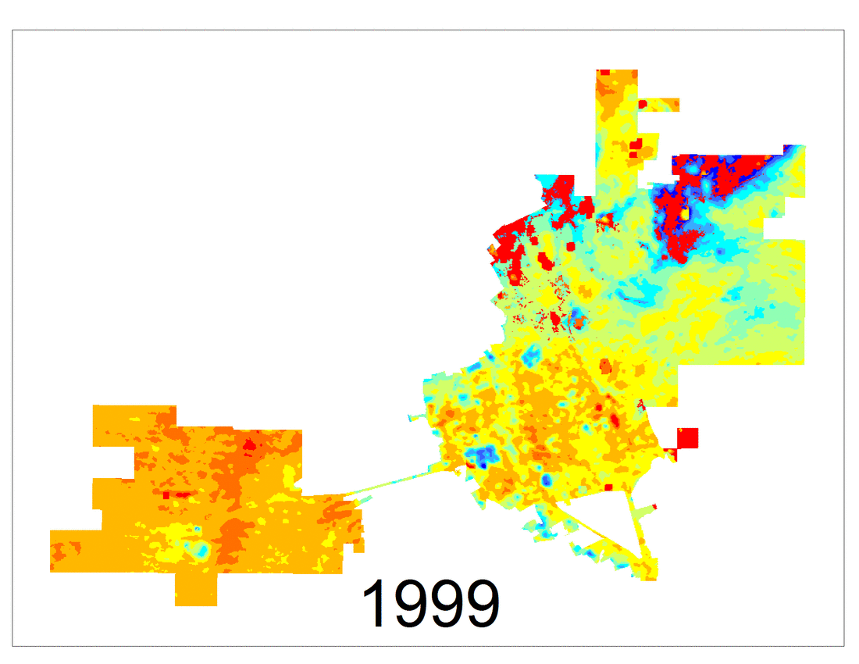
Surface Temperature Assessment

Slide 12
Overview
Landsat 5, Landsat 8
NAIP Aerial Imagery
American Community Survey & CDC
Data
Sources
Social
Vulnerability
Tree Canopy
Layers
Surface
Temperature
Impervious
Surfaces
Result
Heat Vulnerability Analysis

Slide 13
Overview
Landsat 5, Landsat 8
NAIP Aerial Imagery
American Community Survey & CDC
Data
Sources
Social
Vulnerability
Tree Canopy
Layers
Surface
Temperature
Impervious
Surfaces
Result
Heat Vulnerability Analysis

Slide 14
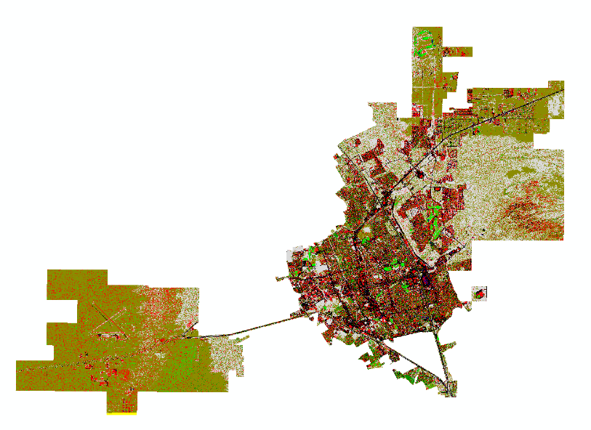
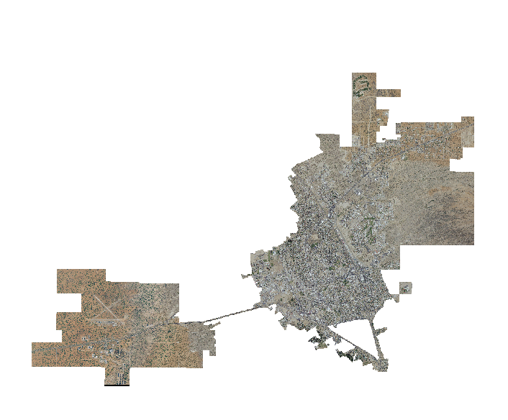
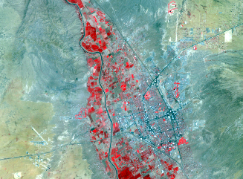
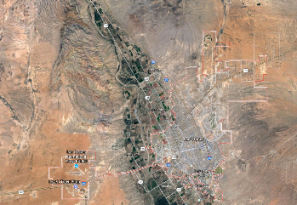
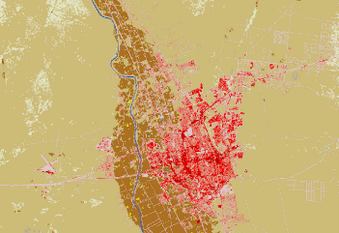
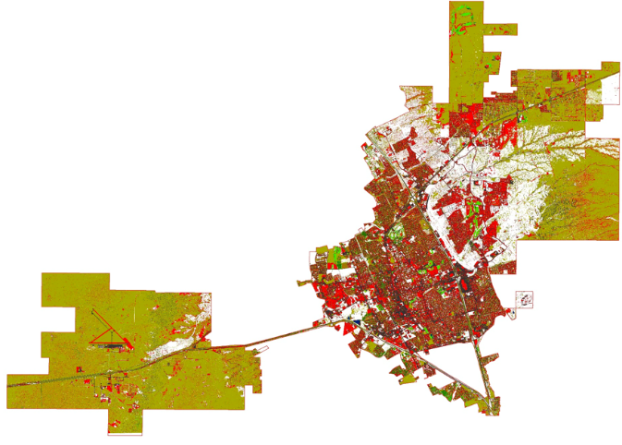
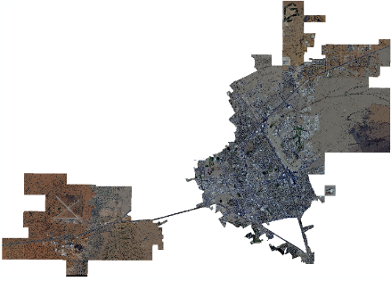
Land Cover Classification
How does land cover influence the urban heat island effect?
Collect Training Sites
Supervised Classification
Object-based Classification
NAIP Imagery
False-Color Image
Google Earth
NLCD
Notes:
To estimate the influence of land cover on urban heat island effect, we used high-resolution NAIP imagery processing land cover classification. We assign each pixel with a specific class by collecting training sites, representative samples for each land cover class. We referred the false-color image, Google Earth satellite image, and NLCD, National Land Cover Database, to maximize the accuracy of training sites. Then, we used two different methods to classify land cover, supervised classification and object-based classification.

Slide 15
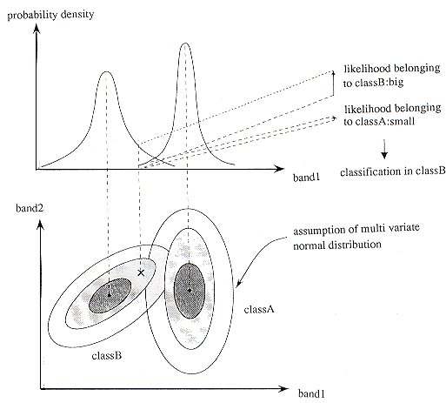
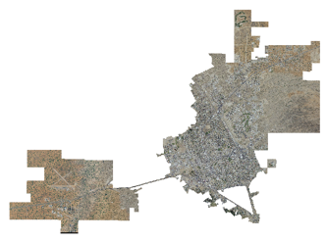
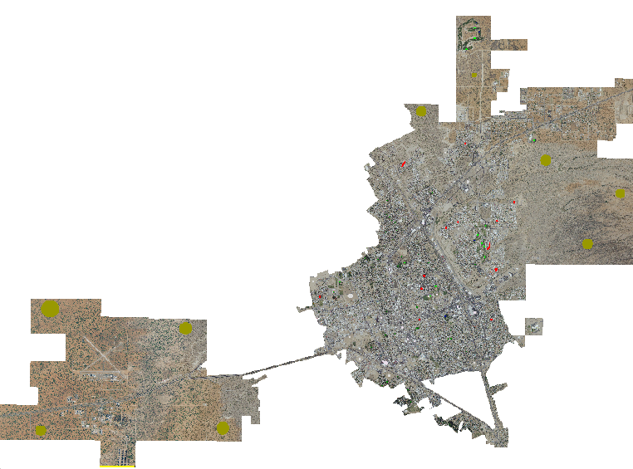
Land Cover Classification
Supervised Classification
Source: Japan Association of Remote Sensing, 1996
NAIP Imagery
Collecting Training Sites
Maximum Likelihood Algorithm
Object-based
Classification
Segmentation
Output
Notes:
The difference between supervised classification and object-based classification is that the latter one requires image segmentation, a process of grouping pixels that share a homogeneous spectral similarity into segments or objects with different shape and scale.
We used maximum likelihood algorithm for both methods. This algorithm will assign each pixel to the class that has the highest probability according to the calculation based on the training sites.
Image Source: http://wtlab.iis.u-tokyo.ac.jp/~wataru/lecture/rsgis/rsnote/cp11/cp11-7.htm

Slide 16
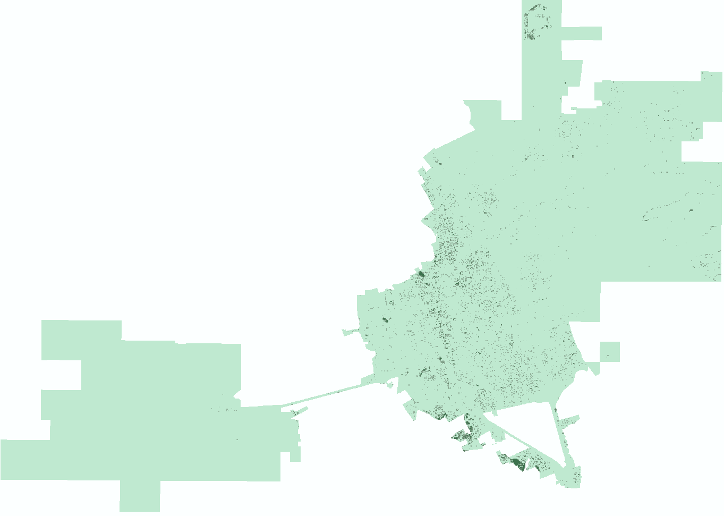
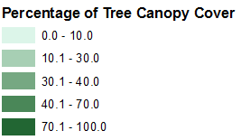
Urban Tree Canopy Cover
Urban Tree Canopy helps offset the urban heat island effect. More trees are associated with lower temperatures.
Combine Classes
Compute Statistics
Notes:
Urban tree canopy cover corresponds to “green trees” class of the classification results. Estimating the tree canopy throughout the city is important because trees could offset urban heat island effects by providing shades and cooling surrounding areas through transpiration.

Slide 17
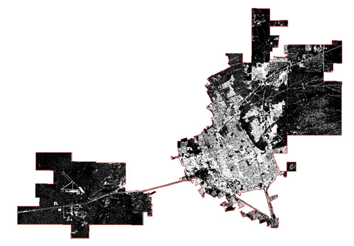
Impervious Surfaces
Some impervious surfaces could absorb more radiance. Such radiance will be re-emitted into the atmosphere, increasing the temperature and contributing to the urban heat island effect.
Combine Classes
Compute Statistics
Notes:
Impervious surface includes “built-up” class and “open area” class in the results of classification. Here, “open area” class includes parking lots and roads.
Some impervious surfaces could intensify the effects of heat island. Understanding the density and distribution of impervious surfaces and tree canopy cover will help predict the high-temperature area.

Slide 18
Overview
Landsat 5, Landsat 8
NAIP Aerial Imagery
American Community Survey & CDC
Data
Sources
Social
Vulnerability
Tree Canopy
Layers
Surface
Temperature
Impervious
Surfaces
Result
Heat Vulnerability Analysis

Slide 19
Overview
Landsat 5, Landsat 8
NAIP Aerial Imagery
American Community Survey & CDC
Data
Sources
Social
Vulnerability
Tree Canopy
Layers
Surface
Temperature
Impervious
Surfaces
Result
Heat Vulnerability Analysis

Slide 20
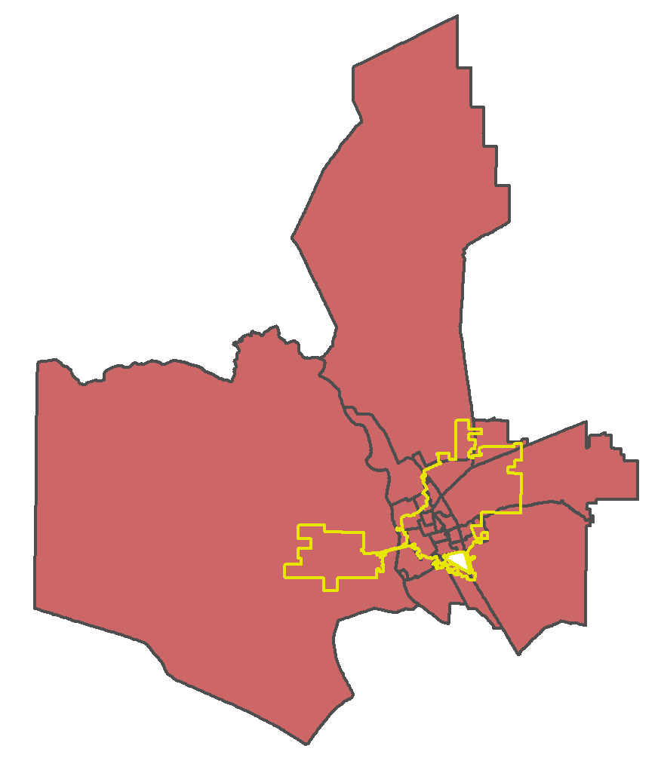
Creating Vulnerability Index
Data sources:
American Community Survey (2015 5-YR)
CDC Behavioral Risk Factors, NM Cities, 2013-2014
25 Census Tracts
Notes:
Vulnerability was calculated on a census tract level. There are 25 census tracts in Las Cruces. As you can see, a few of them extend far beyond the city limits, which is important to consider when looking at the final clipped results.
Our data sources were the American Community Survey from the Census Bureau and a CDC study from 2013-2014 that mapped out various health risks in census tracts in Las Cruces.

Slide 21
Creating Vulnerability Index
Relevant ACS and Health variables selected through literature review:
Vulnerability Variables
% over 65
% under 5
% single parent
% mobile homes
% limited English
…
THEME 1 – HOUSEHOLD COMPOSITION
THEME 2 – MINORITY STATUS
THEME 3 – ECONOMIC STABILITY
THEME 4 – TRANSPORTATION AND HOUSING
THEME 5 – HEALTH
filtered by partners
grouped by theme
Notes:
We did a literature review to compile a list of socioeconomic and health variables that previous studies had shown were contributors to heat vulnerability. These variables encompassed information on age, education, and information about housing. The variables we could choose were limited by what we could get from the ACS and health data that we had.
After we compiled a long list of possible variables, we sent the list to our partners to get their input on which variables they found important for decision making. This was an important step because we wanted to make the final product useful for them, so it was good to get their feedback early on. Also, while we could look at previous studies for guidance on which variables to choose, their advice from the ground was invaluable in making the indicators useful in Las Cruces.
We then grouped the variables by theme. Our final themes were: Household composition, which included variables such as % over 65 and % single parent, minority status, which included race percentages and English speaking ability, economic stability, which included variables such as % under the poverty level and education level, transportation and housing, which included % mobile homes and % walk to work, and health, which included existing conditions such as diabetes and obesity, which can increase risk of heat illness.
Our goal was to calculate a vulnerability score, or index, for each of these themes

Slide 22
Creating Vulnerability Index
Calculating Theme Score (CDC Method):
THEME 1- HOUSEHOLD COMPOSITION
Census Tract | % rank over 65 | % rank under 5 | % rank single parent | % rank 65 alone
1 | 1 | 1 | .75 | 1
2 | .75 | .75 | 1 | .5
3 | .5 | .5 | .5 | .75
4 | .25 | 0 | .25 | .25
5 | 0 | .25 | 0 | 0
SUM THEME 1 | THEME 1 % RANK
3.75 | 1
3 | .75
2.25 | .5
.75 | .25
.25 | 0
Notes:
There are many ways to calculate a vulnerability index. We decided to adopt a similar method to the one the CDC uses, which calculates scores by themes using percentile rank values. As with other social index scores, the higher the value, the higher the vulnerability.
Here is an example of those calculations for theme 1 – household composition. For simplicity, we are pretending we only have 5 census tracts to work with. The four variables that go into theme1 are the % of people over 65, % under 5, % single parents, and % over people who are over 65 and living alone, which is all information we got from the census. But instead of using the actual percentages for the calculations, the CDC uses the percentile rank. Percentile rank shows how each census tract compares to the other census tracts, 1 being the highest and 0 being the lowest. So in our example, Census 3 has a value of .25, which means its in the 25th percentile for people over 65. This means that the percent of people 65 and over in that census tract is higher than 25% of other tracts, which in this case means it is higher than only 1 of the 4 other census tracts. In the real calculations, we ranked each census tract in Las Cruces against the 25 other census tracts in las cruces. And we did that for each variable. Then to calculate the theme score, we first added those values together for each census tract to get the sum. And then we percentile ranked the sum to get the final score – which is a value from 0-1, and can also be considered as the percentile for theme 1. So here, census tract 2 has a score of .75, and can be said to be in the 75th percentile when it comes to Household composition vulnerability.

Slide 23
Creating Vulnerability Index
Calculating Theme Score (CDC Method):
THEME 1- HOUSEHOLD COMPOSITION
Census Tract | % rank over 65 | % rank under 5 | % rank single parent | % rank 65 alone
1 | 1 | 1 | .75 | 1
2 | .75 | .75 | 1 | .5
3 | .5 | .5 | .5 | .75
4 | .25 | 0 | .25 | .25
5 | 0 | .25 | 0 | 0
SUM THEME 1 | THEME 1 % RANK
3.75 | 1
3 | .75
2.25 | .5
.75 | .25
.25 | 0
Notes:
There are many ways to calculate a vulnerability index. We decided to adopt a similar method to the one the CDC uses, which calculates scores by themes using percentile rank values. As with other social index scores, the higher the value, the higher the vulnerability.
Here is an example of those calculations for theme 1 – household composition. For simplicity, we are pretending we only have 5 census tracts to work with. The four variables that go into theme1 are the % of people over 65, % under 5, % single parents, and % over people who are over 65 and living alone, which is all information we got from the census. But instead of using the actual percentages for the calculations, the CDC uses the percentile rank. Percentile rank shows how each census tract compares to the other census tracts, 1 being the highest and 0 being the lowest. So in our example, Census 3 has a value of .25, which means its in the 25th percentile for people over 65. This means that the percent of people 65 and over in that census tract is higher than 25% of other tracts, which in this case means it is higher than only 1 of the 4 other census tracts. In the real calculations, we ranked each census tract in Las Cruces against the 25 other census tracts in las cruces. And we did that for each variable. Then to calculate the theme score, we first added those values together for each census tract to get the sum. And then we percentile ranked the sum to get the final score – which is a value from 0-1, and can also be considered as the percentile for theme 1. So here, census tract 2 has a score of .75, and can be said to be in the 75th percentile when it comes to Household composition vulnerability.

Slide 24
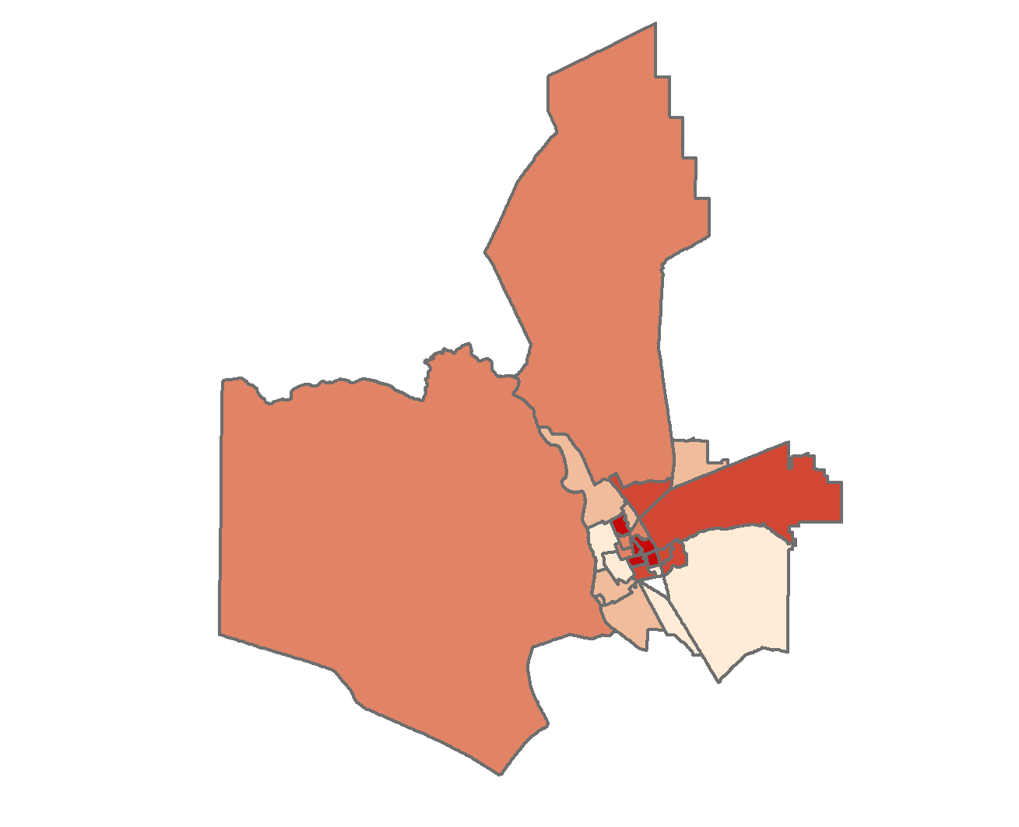
Creating Vulnerability Index
THEME 1 – HOUSEHOLD COMPOSITION
Notes:
This gave us our final social vulnerability map, which shows the spatial variation in vulnerability by theme. These 5 maps, one for each theme, could then be converted to a raster format to be used in further analysis.

Slide 25
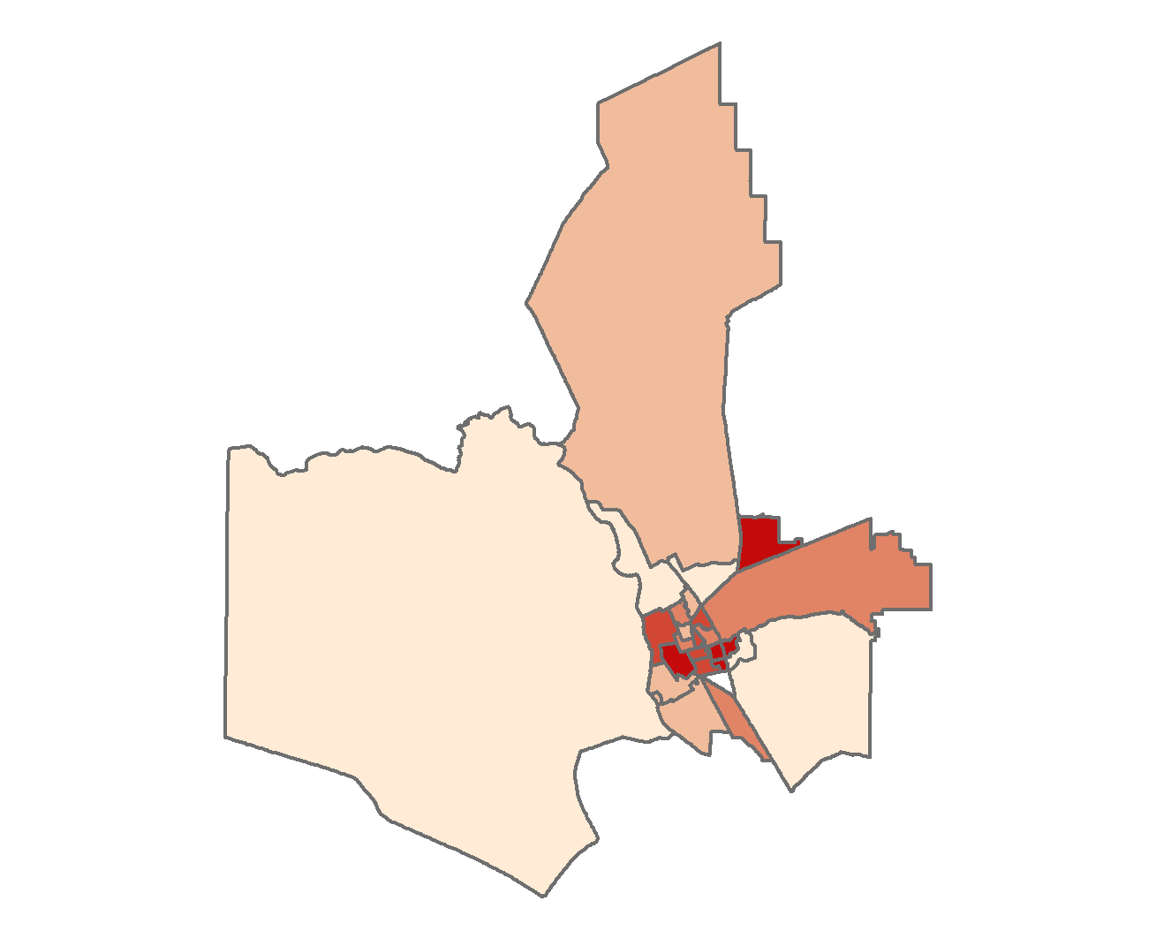
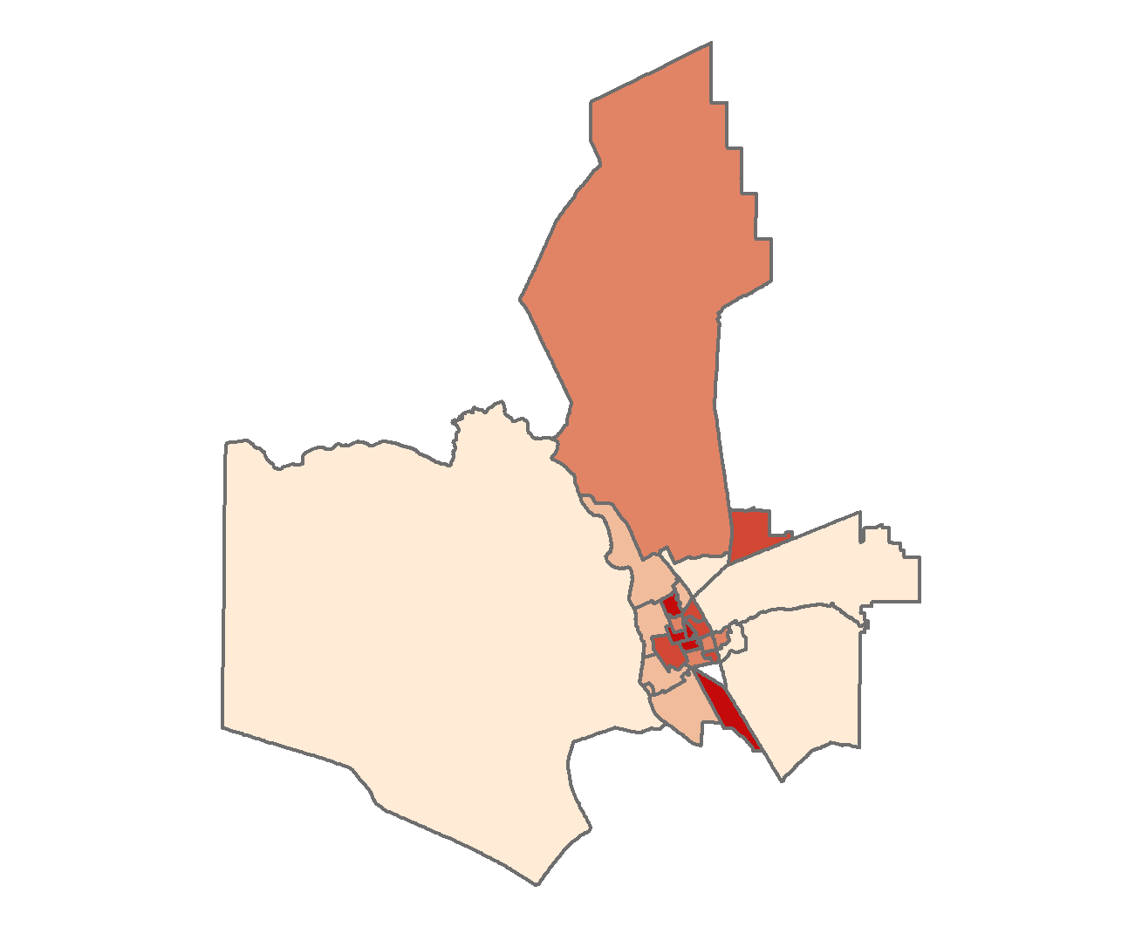
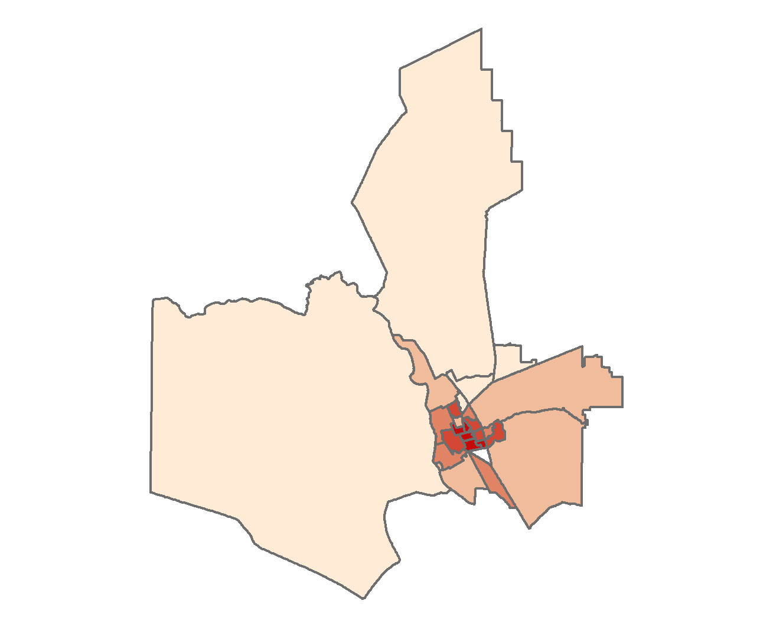
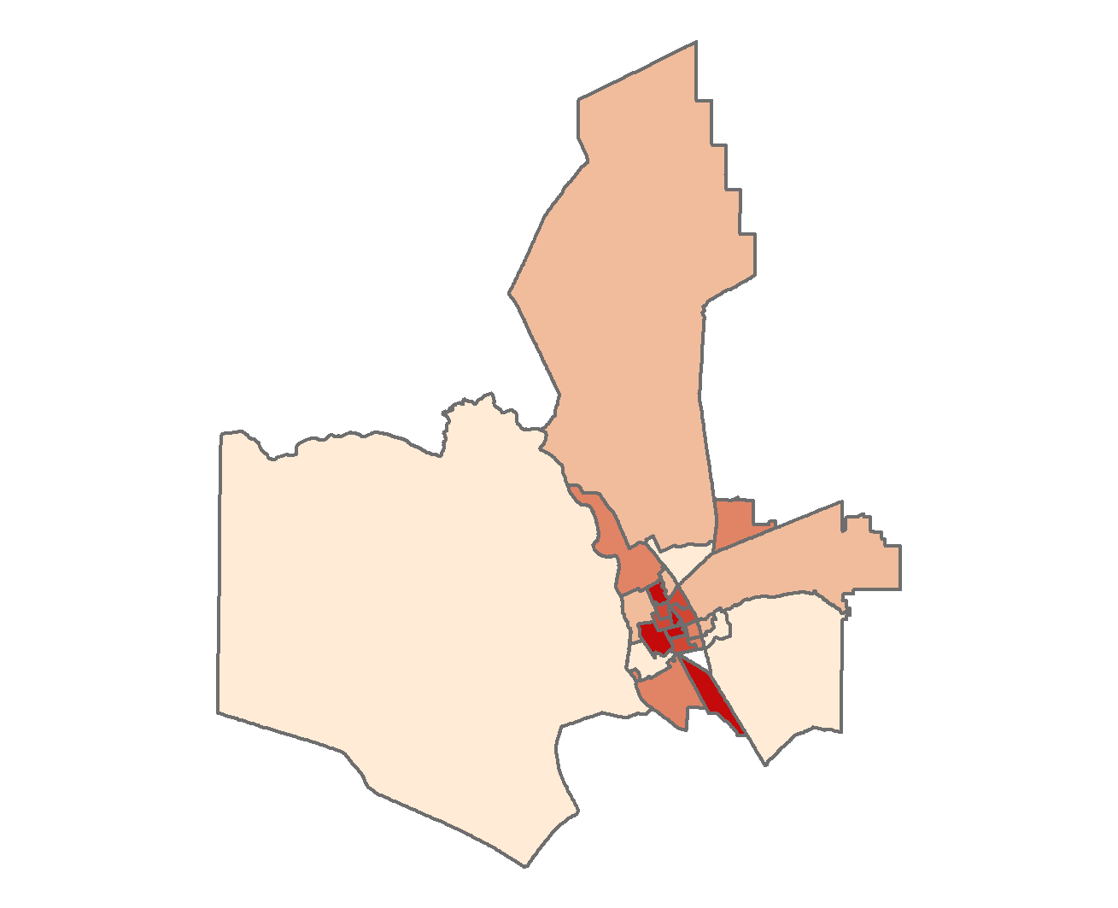
Creating Vulnerability Index
HOUSEHOLD COMPOSITION
MINORITY STATUS
ECONOMIC STABILITY
TRANSPORTATION & HOUSING
HEALTH
Notes:
This gave us our final social vulnerability map, which shows the spatial variation in vulnerability by theme. These 5 maps, one for each theme, could then be converted to a raster format to be used in further analysis.

Slide 26
Overview
Landsat 5, Landsat 8
NAIP Aerial Imagery
American Community Survey & CDC
Data
Sources
Social
Vulnerability
Tree Canopy
Layers
Surface
Temperature
Impervious
Surfaces
Result
Heat Vulnerability Analysis

Slide 27
Overview
Landsat 5, Landsat 8
NAIP Aerial Imagery
American Community Survey & CDC
Data
Sources
Social
Vulnerability
Tree Canopy
Layers
Surface
Temperature
Impervious
Surfaces
Result
Heat Vulnerability Analysis

Slide 28
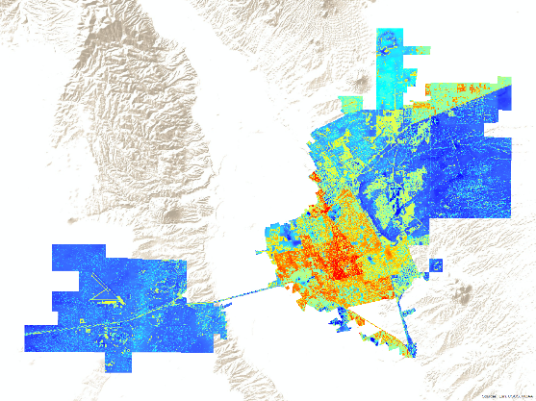
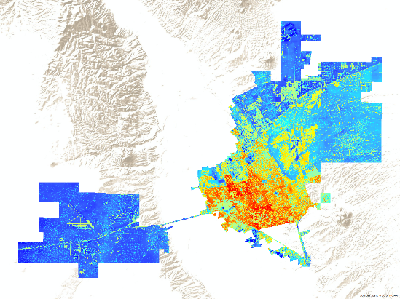
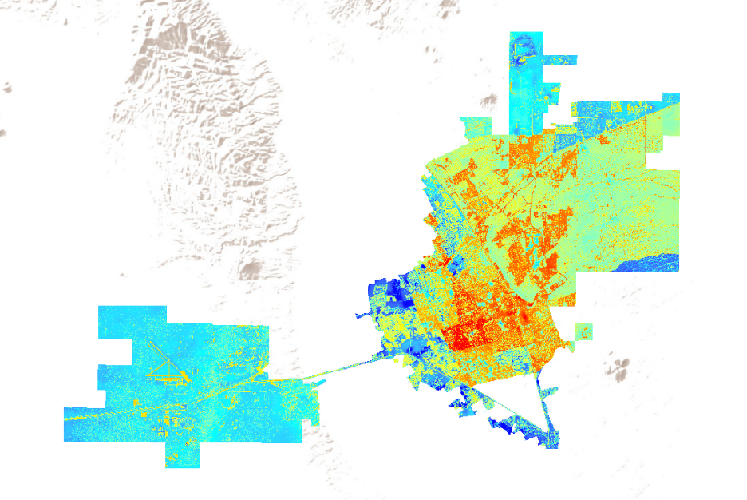
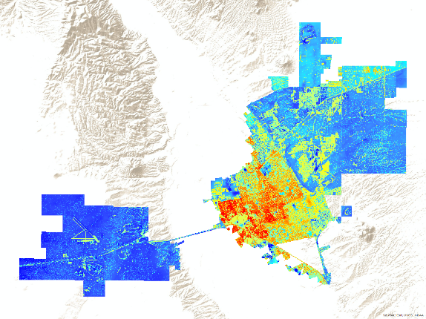
Heat Vulnerability Analysis
Land Surface Temperature
Social Vulnerability
Economic Stability
Percent Impervious
1 - Percent Tree Canopy
Housing & Transportation
Heat Vulnerability
Health Status
Notes:
We conducted a heat vulnerability analysis for 2011, 2014, and 2016. With input from our partners the American Community Survey and CDC Health data were used to produce a 5 social vulnerability layers describing economic stability, housing & transportation, minority status, household composition, and health status. These 5 layers were then combined with standardized LST, Percent impervious, and to produce the heat vulnerability for each theme. The maps to your right depict vulnerability to heat for 3 of the 5 themes.

Slide 29
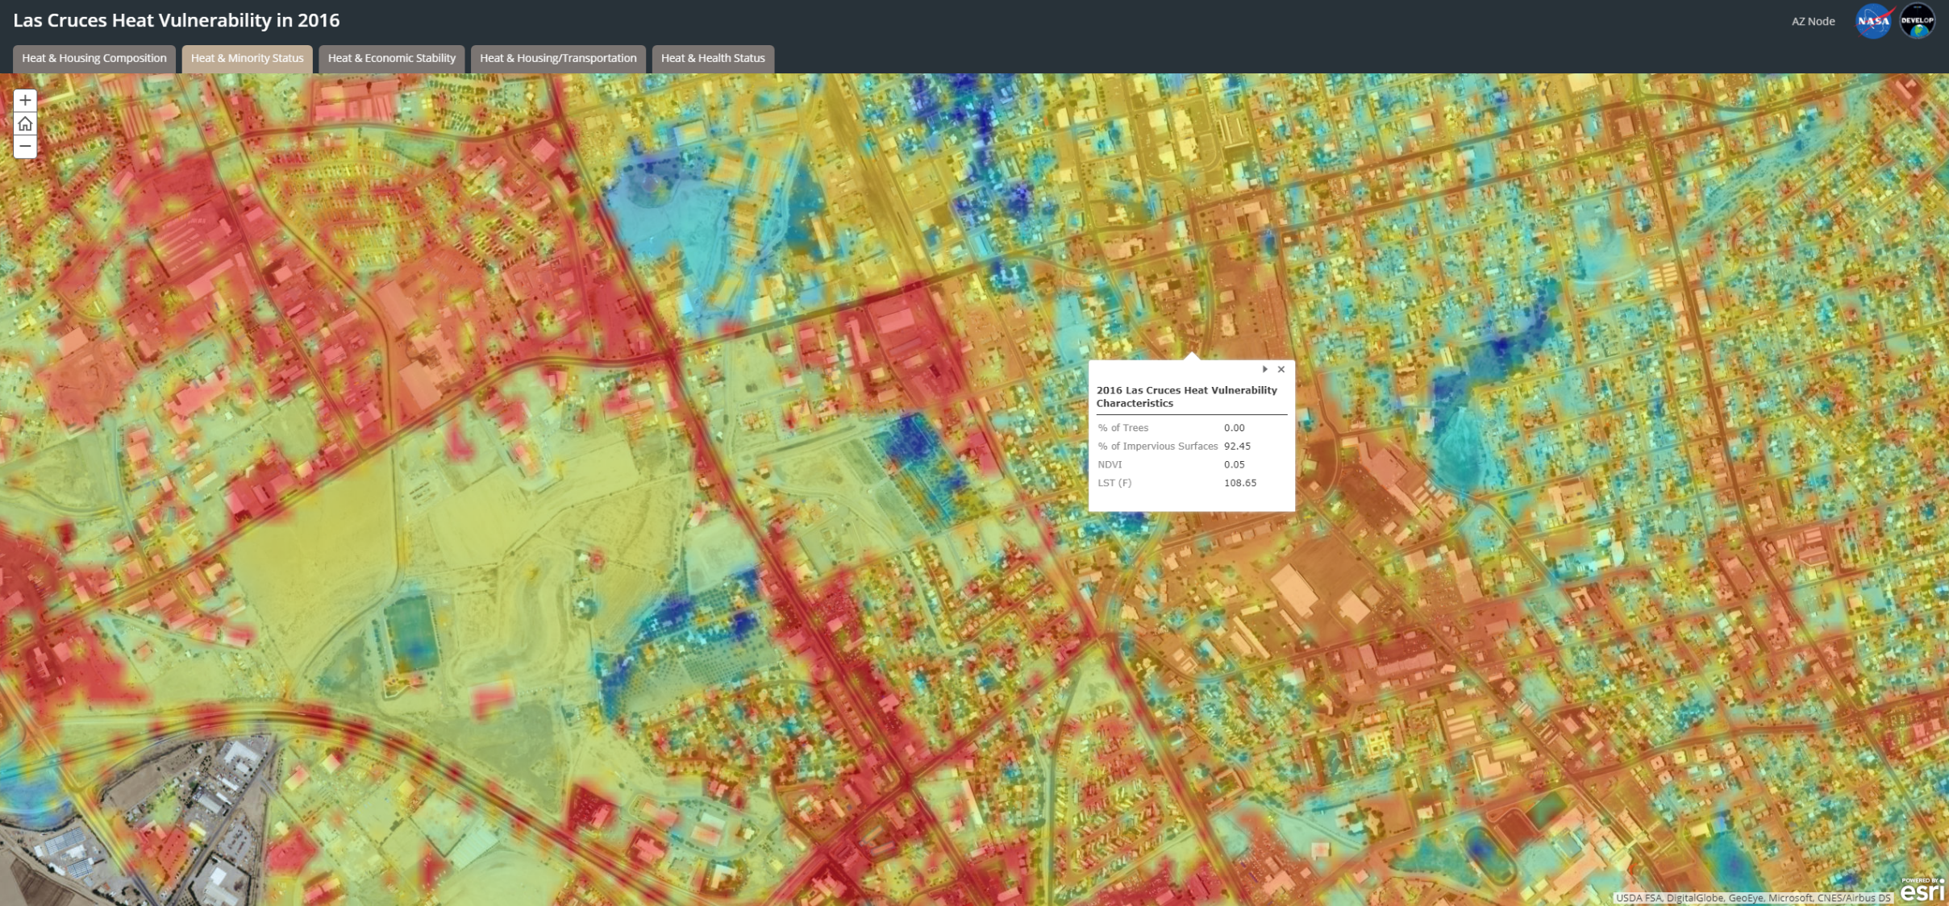
Web App
Notes:
As an additional step we calculated the percentage of NAIP based estimates of urban tree canopy, impervious surface, and vegetation prevalence, summarized in look up tables that can be displayed in Google Earth. This provides an interactive display which partners can use to assess the surface conditions at specific locations within each census tract.
The resulting layers show the intersection of social vulnerability and physical landscapes. Our partners can utilize these layers in deciding where to implement a variety of adaptations from increased tree planting to community based intervention.

Slide 30
Future Work
The City of Las Cruces Sustainability Office plans to undertake projects in order to better understand and mitigate the urban heat island effect
The data we produce may inform their decisions and guide policy change regarding where to introduce mitigation techniques, such as green stormwater infrastructure and urban shade canopies
Notes:
In the near future, the City of Las Cruces Sustainability Office has plans to implement something called Green Stormwater Infrastructure, or GSI. GSI is a cost-effective method to reduce the overall heat of an urban area, and once in place is largely self sustaining. This infrastructure will provide shade and cooling benefits to some of Las Cruces’ most vulnerable residents. The Sustainability Office will use the information and methodology we have provided when deciding where to introduce this infrastructure, making sure that it is added where it is needed most.
Image Source: https://pixabay.com/en/planting-environment-nature-botany-1898946/

Slide 31
Acknowledgments
Lisa LaRocque, Sustainability Officer – City of Las Cruces Sustainability Office
Dr. Gregg Garfin, Associate Professor – Climate Assessment for the Southwest (CLIMAS)
Sarah Leroy, Research Staff – Climate Assessment for the Southwest (CLIMAS)
Lance Watkins, Center Lead – NASA DEVELOP, Maricopa County Department of Public Health & Arizona State University
Dr. David Hondula, Science Advisor – Arizona State University
Team Members
Jonathan O’Brien
Team Lead
Fanqi Jia
Rebia Khan
Christopher Wilson

