Slide 1
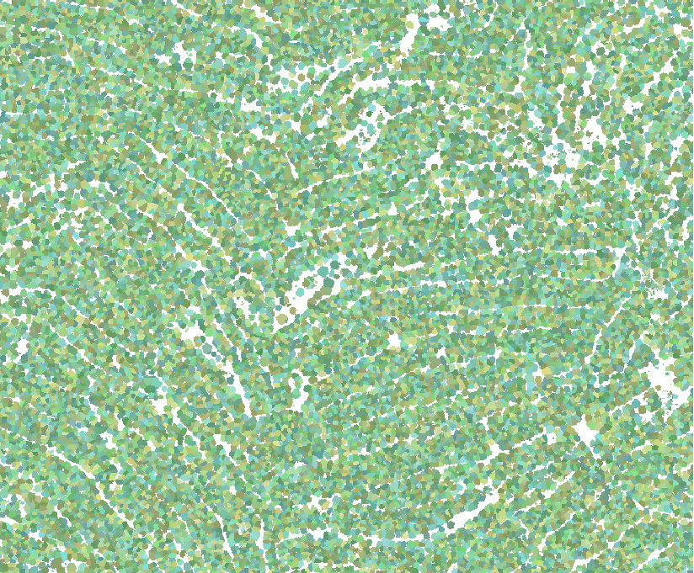


Lassen Volcanic National Park Disasters II
Evaluating Fuel Loading at a Landscape Scale in High Elevation Alpine Forests of Lassen Volcanic National Park
Anna McGarrigle
Heather Myers
Andrea Ferrer
Peter Norton
California – Ames
Fall 2017
Notes:
Image Source: 2015 Badger LiDAR Lassen National Forest and Arcmap

Slide 2

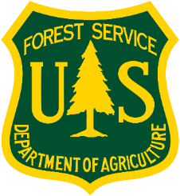
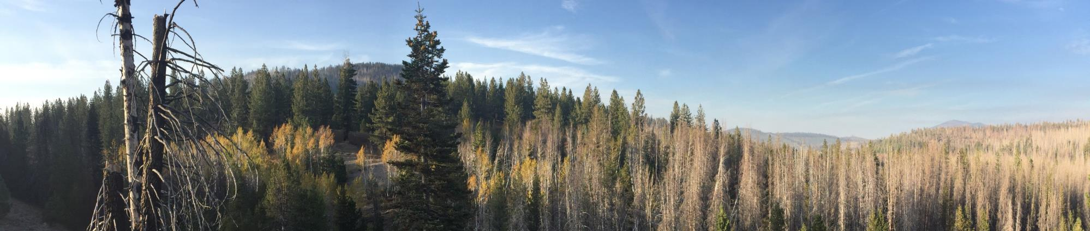
Partners
Lassen Volcanic National Park
Lassen National Forest
End user
Collaborator
Image Credit: Andrea Ferrer
Notes:
We continued working with our partners at Lassen Volcanic National Park this term, and also included neighboring Lassen National Forest as a collaborator.
Image Source: Andrea Ferrer (team member)

Slide 3
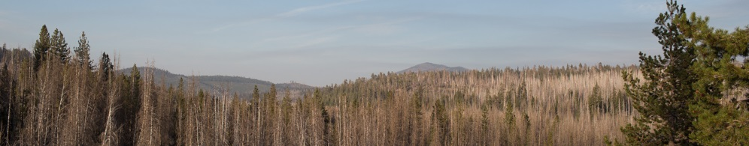
Community Concerns
Fuel loads
Landscape-scale
Resilience
Fire suppression, drought, and changing climate increase tree mortality, compounding fuel loads
Decisions affect stakeholders downstream, need transparent data and interagency collaboration
Land managers want to use wildfire for resource benefits
Image Credit: Anna McGarrigle
Notes:
The need for this project comes from three main elements: fuel loads, the landscape scale, and forest resilience.
Heavy fuel loads in Lassen increase the risk of large-scale fires. Unnaturally high fuel loads exist as a consequence of fire suppression policy, compounded by changing climate conditions and drought.
Land managers need to understand a landscape-scale view of Lassen. Stakeholders downstream from one vested manager are affected by decisions made by others. Transparency with data would aid their landscape-scale assessments. Therefore, interagency collaboration is imperative.
Finally, we want to plan for resilience. Wildland fire use for resource management benefits can take place in a forest with safe fuel loads – land managers should be able to assess whether to let low intensity high frequency fires burn safely.
Image: Anna McGarrigle (team member)

Slide 4
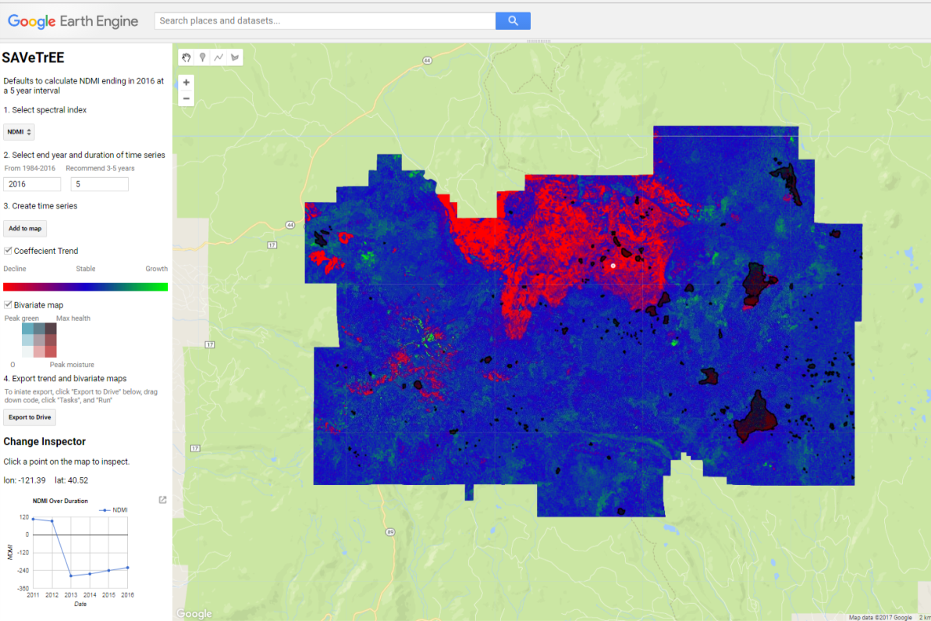
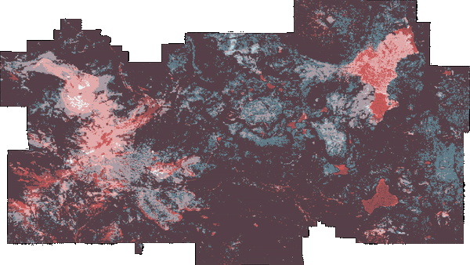
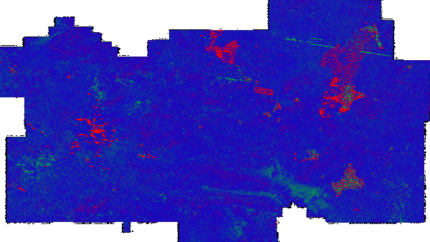
Previous Work
SAVeTrEE
  Simple Analysis of Vegetative Trends in Earth Engine
  Maps trends in tree mortality
  Bivariate plot shows moisture and greenness
  Cloud-based
  Landsat data at 30m
  **In NASA software release process, not yet available to distribute
Notes:
This project began in June of 2017 as a 10 week project. The team created 3 main data products that are important to introduce before this work.
SAVeTrEE is our historical tree mortality product.
It maps historical trends in tree mortality using Landsat data, going back to 1984.
It is built in Google Earth Engine, which is a cloud computing platform. Basis in GEE means all data, processing is hosted on GOOGLE’s servers. This circumvents the costly aspects of analyzing remotely sensed imagery, like processing time and technician’s time, expensive software, the need for high power computers, and need for lots of hard drive space to store imagery.
In the tool we built, the user selects the spectral index, end year, and duration of trend. Growth is green and mortality is red.
It also produces a bivariate plot showing the variation in moisture and healthy vegetation
On click you can see how the value of one pixel has changed over time

Slide 5
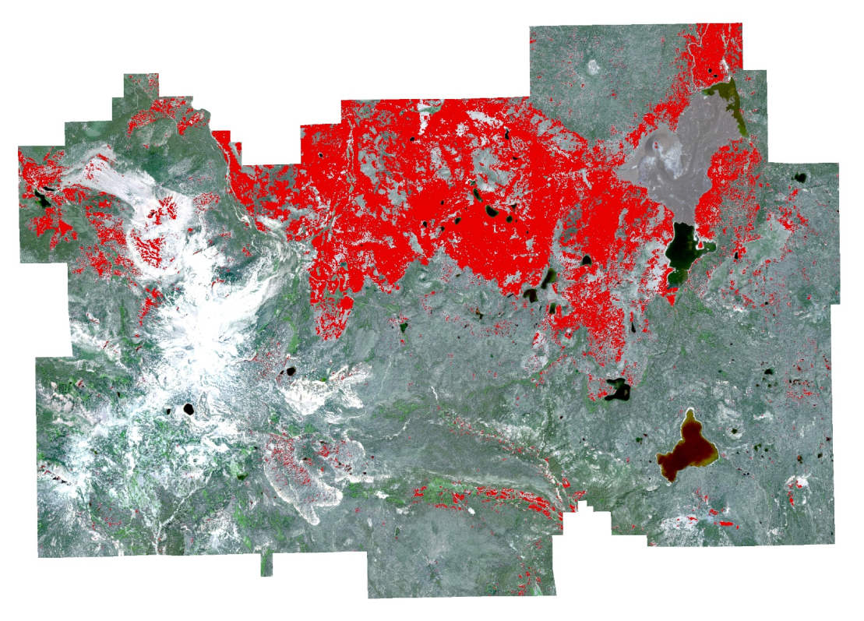
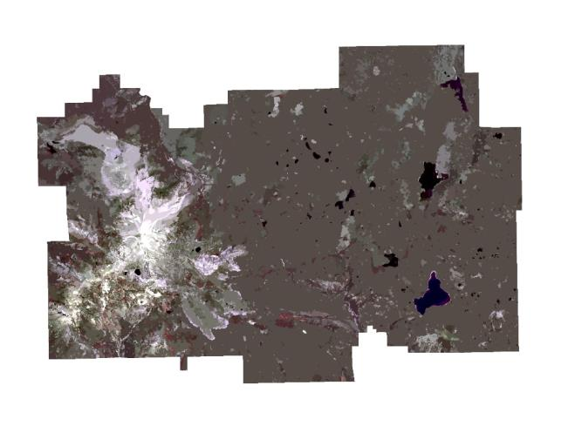

Previous Work
Sentinel-2 Present Mortality Classification
  10m Resolution
  Began 2015, ESA
  Limited data archive
Mortality
Notes:
To map present day tree mortality, we used imagery from Sentinel-2, which is a freely available European Space Agency satellite.
It has a 10m resolution, but was only launched in 2015 so can’t do historic analysis
Detailed methods if interested:
The sentinel 2 a imagery provides a higher resolution depiction of mortality in the park and is trained using the output of the GEE.
The training stack that was most successful used the Sentinel2 imagery, SRTM DEM, and NDMI
The SVM classification had a cross validation rate of 0.82,
These methods can be applied as needed to analyze mortality in greater resolution

Slide 6
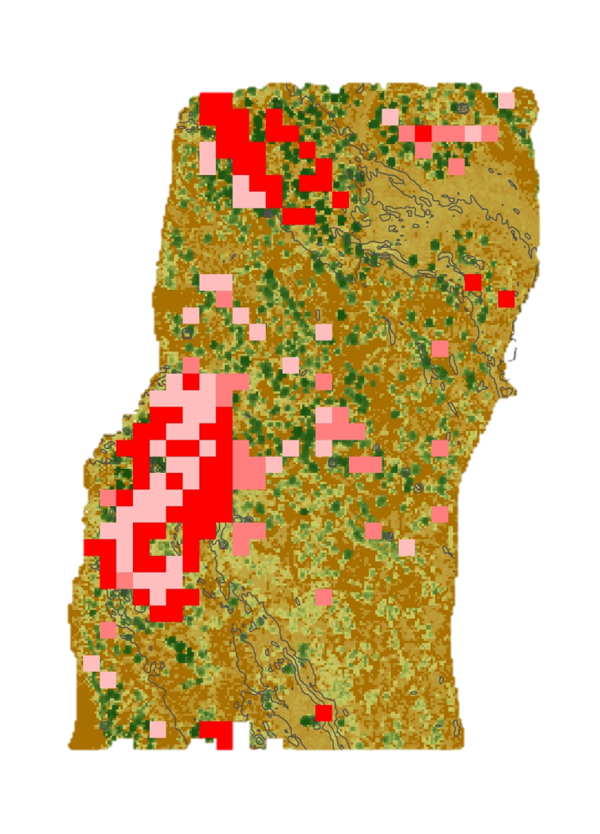
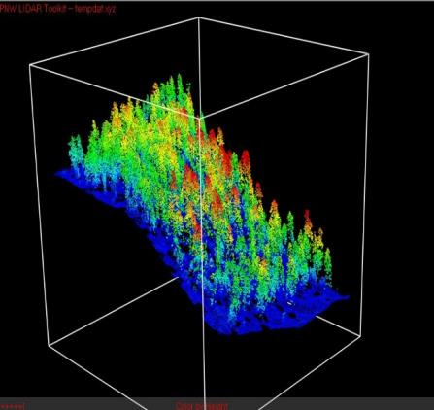


Previous Work
  LiDAR Feasibility
  Finer level of detail in LiDAR data
  Canopy Height
  Canopy Cover
  Vertical Stratification
  Estimate Fuel Heavy Areas
  Uncertainties
Steep Slope with High Crown and Understory Vegetation Density
High Crown Density and Understory Vegetation
High Crown Density
0 75 150 300 m
High: 45m
Low: 0m
Notes:
LiDAR offers many benefits to forest management due to the finer level of detail it can produce in booth 2D images and using 3D structures.
We did a feasibility study for using LiDAR to map fuel loads. This analysis aided the park in getting funding to LiDAR over the entire park.
More detail
Here we can see a sample of an estimate of fuel heavy areas overlaid on the Canopy height model. Light pink shows where there is both a high density of canopy cover and forest
The darker pink showing areas where there is also high understory vegetation
And the Darkest red showing where is additionally a slope steeper than 20 degrees (which makes fire spread faster)

Slide 7
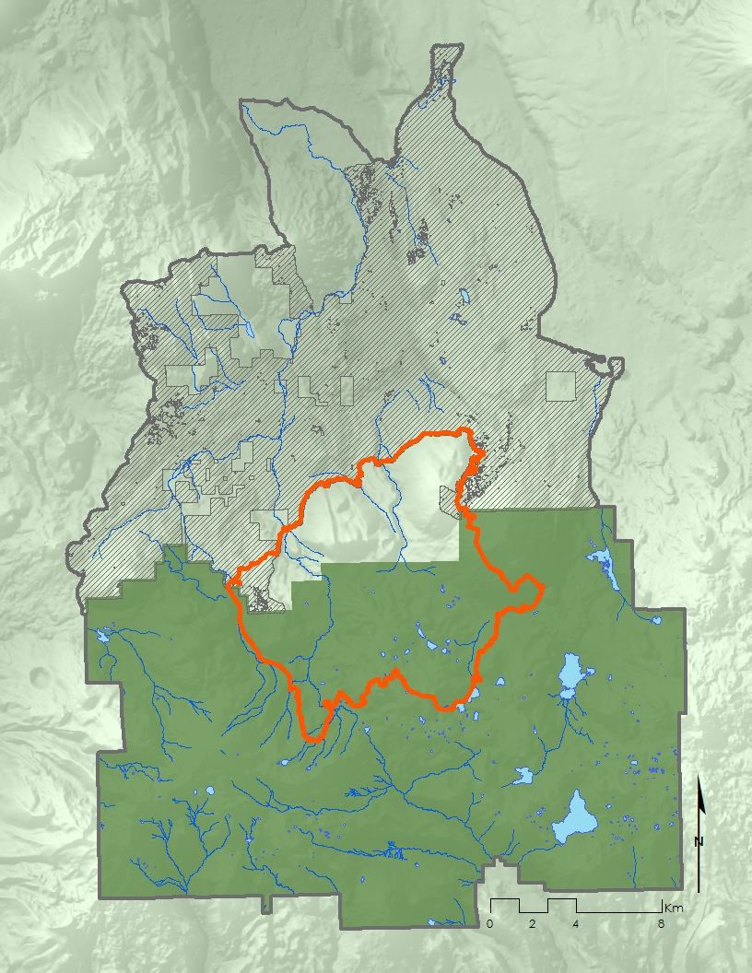
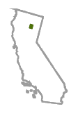


Study Area
  Badger Planning Area
Lassen Volcanic National Park
Lassen National Forest
  Reading Fire
Waterbodies
2012 Reading Fire Boundary
LiDAR Coverage
  LVNP
Total Study Area
Data: NPS, USFS
NAD 1983 UTM Zone 10
  LNF
Notes:
Lassen Volcanic National Park is the rectangular area in dark green.
It is surrounded on all sides by Lassen National Forest
Two features we’re interested in are the Reading Fire, which you see in Orange across the Park and Forest boundary, and the Badger Planning Area which is in gray to the North.
The Badger Planning Area is defined by the surrounding watersheds. There is LiDAR coverage in this area.
The red element is the Reading Fire, which crosses the administrative boundary.
Data Source: NPS and USFS

Slide 8
Objectives
  Identify continuous fuel structures using LiDAR in the Badger Planning Area
  Quantify recovery from the 2012 Reading Fire with land cover change
  Expand capabilities of the SAVeTrEE tool to map historic tree mortality in Google Earth Engine
Notes:
We identified three objectives to address our partners’ needs using NASA Earth Observations.
First, to identify continuous fuel structures using LiDAR in the Badger Planning Area by producing per acre stem density and high-risk canopy data
Second, we wanted to map recovery from the 2012 Reading Fire, which burnt around 28,000 acres and cost $17 million.
Lastly, we watned to build upon the software developed in term one to expand its applications for mapping historic tree mortality

Slide 9

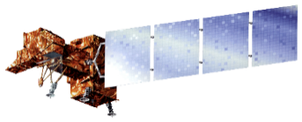

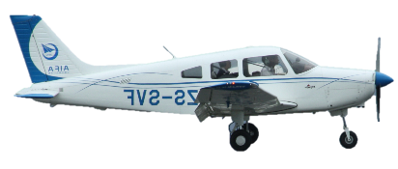
Earth Observations
USFS LiDAR, Partenavia P68C, Leica ALS70,
<15cm Spatial Resolution,
2015
USDA Farm Service Agency’s National Agriculture Imagery Program (NAIP),
1m Spatial Resolution
2012, 2014, 2016
Landsat 5 TM
30m Spatial Resolution
16 Day Revisit
1984 - 2013
Landsat 7 ETM+
30m Spatial Resolution
16 Day Revisit
1999 - Present
Landsat 8 OLI
30m Spatial Resolution
16 Day Revisit
2013 - Present
Notes:
5 sensors were used to address these objectives.
The Landsat series was used for the 30 year time series to predict historical mortality, specifically Landsat 5 TM, 7 ETM+, 8 OLI
For the LiDAR portion, we used USFS LiDAR data from 2015.
NAIP from 2012, 2014, 2016
Images Source: http://www.devpedia.developexchange.com/dp/index.php?title=List_of_Satellite_Pictures; Public Domain
Piper Image Source: https://upload.wikimedia.org/wikipedia/commons/b/b5/AIFA_%28AVIC%29_Piper_PA-28-161_Cherokee_Warrior_ZS-SVF_%2815471693972%29.jpg; Bob Adams;

Slide 10
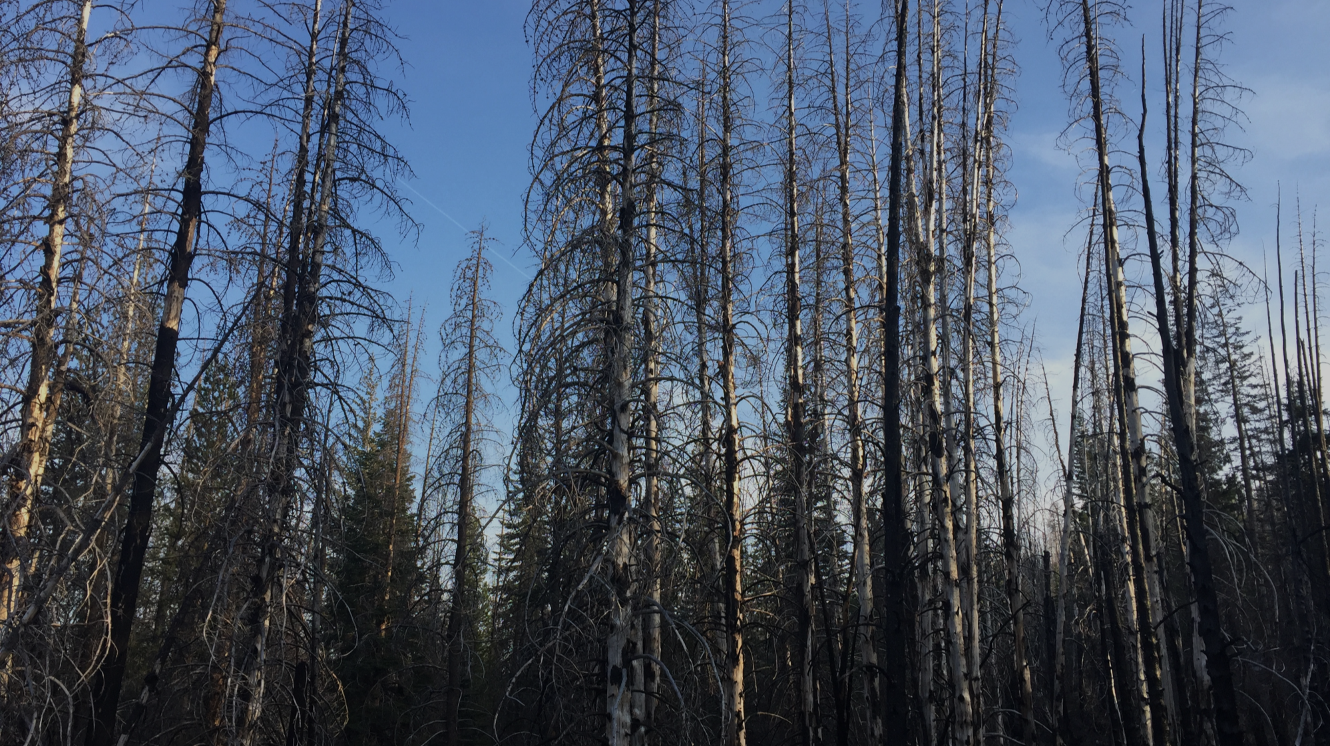
Badger Planning Area LiDAR Case Study
1
Notes:
First, we analyzed the LiDAR from the Badger Planning Area north of the Park to perform a landscape-scale assessment of the forest, and more specifically the fuel load
Image Source: Heather Myers

Slide 11
Methods
Badger Planning Area LiDAR Case Study
Acquire Data
Density
LNF 2015 Badger LiDAR
Stems per acre
Segment
Thiessen polygons to segment individual canopies
Process
Process
Canopy Height Model (CHM)
Canopy Cover (CC)
Canopy Base Height (CBH) for all trees
Notes:
The two inputs to the LiDAR case study was the LiDAR and corresponding plot data, provided by the Forest.
The first piece of data derived was heights.
Then we ran an algorithm to segment individual tree canopies and locate tree trunks. This also provides Canopy Base Height and Canopy Cover
We also identified ladder fuels, which was used to identify priority treatment areas so that our partners know where areas vulnerable to large scale fires are.

Slide 12
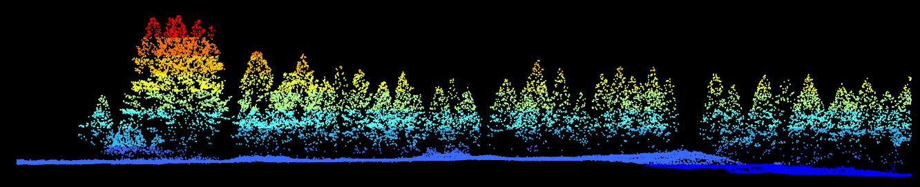
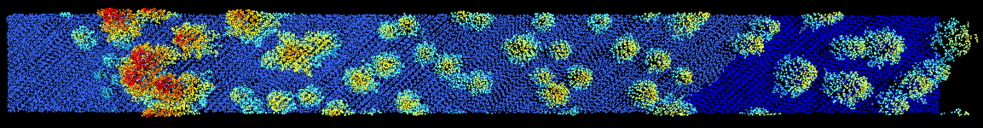
Results
37 m
Max height
141 m
Notes:
To test methods for the LiDAR data, we picked an arbitrary sample area in the Badger area that also included plot data and processed a sample.
The first metric derived was heights
Data source: 2015 Badger LiDAR

Slide 13
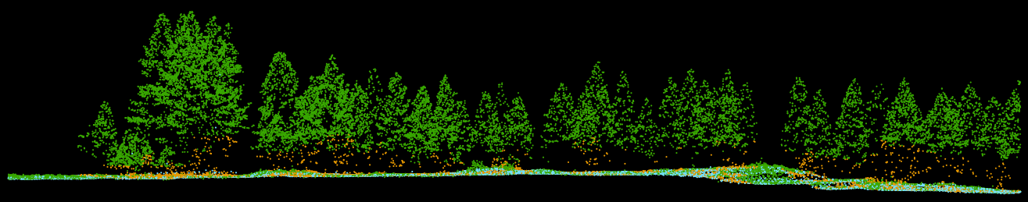
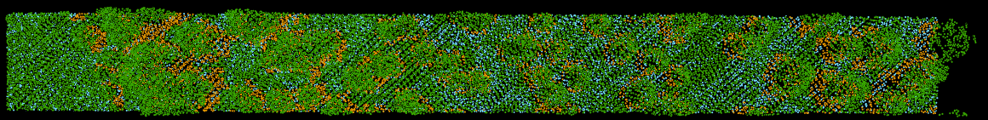
Results
Ladder fuel
37 m
Max height
141 m
Notes:
With the heights, canopy cover and tree trunk locations, we can extract ladder fuels
Data source: 2015 Badger LiDAR

Slide 14
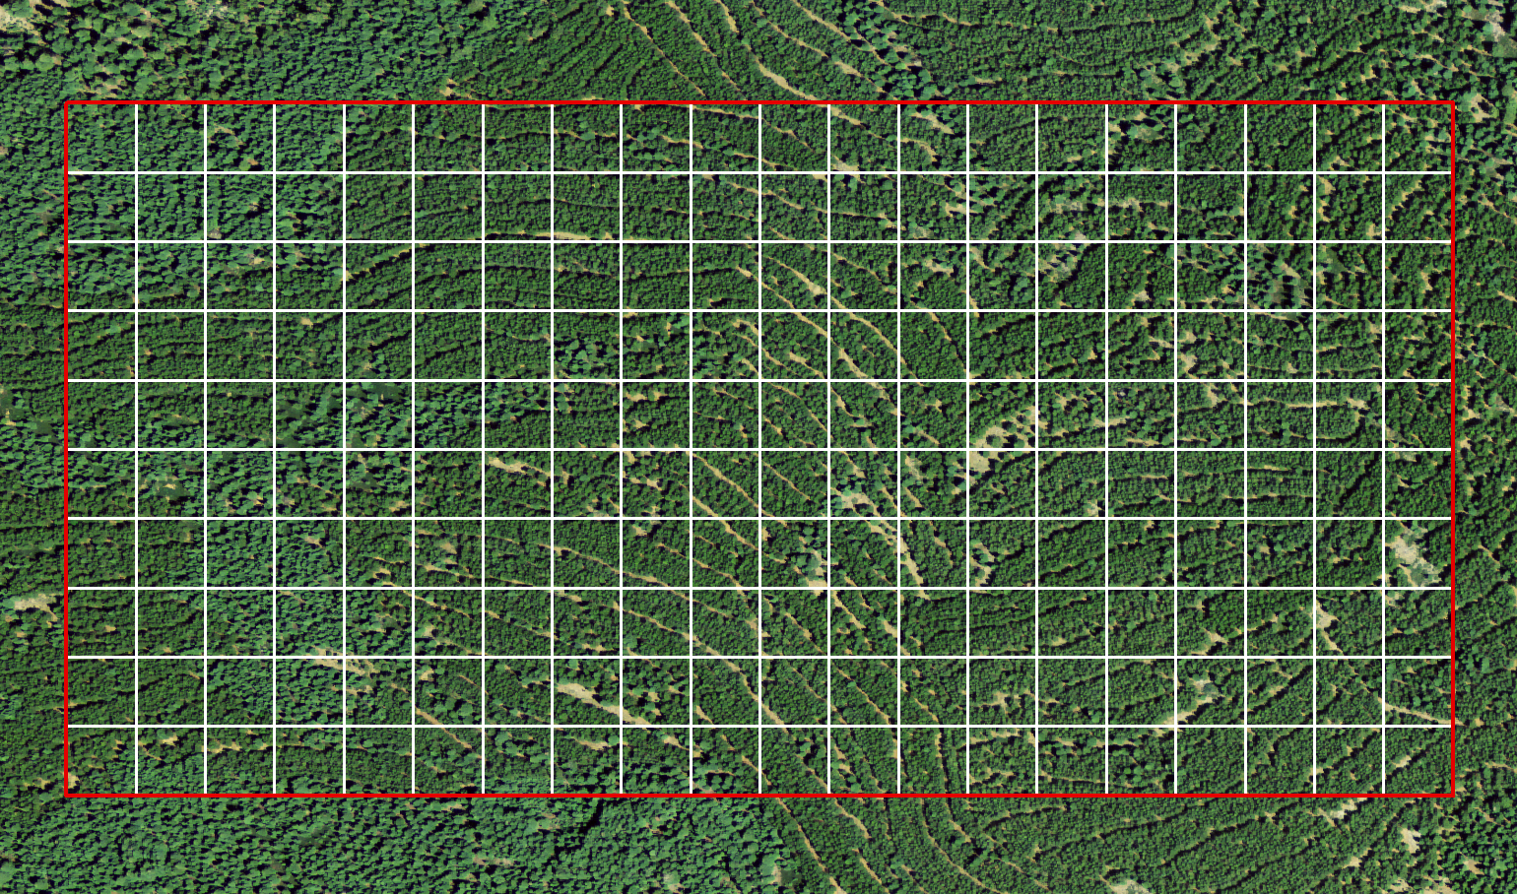
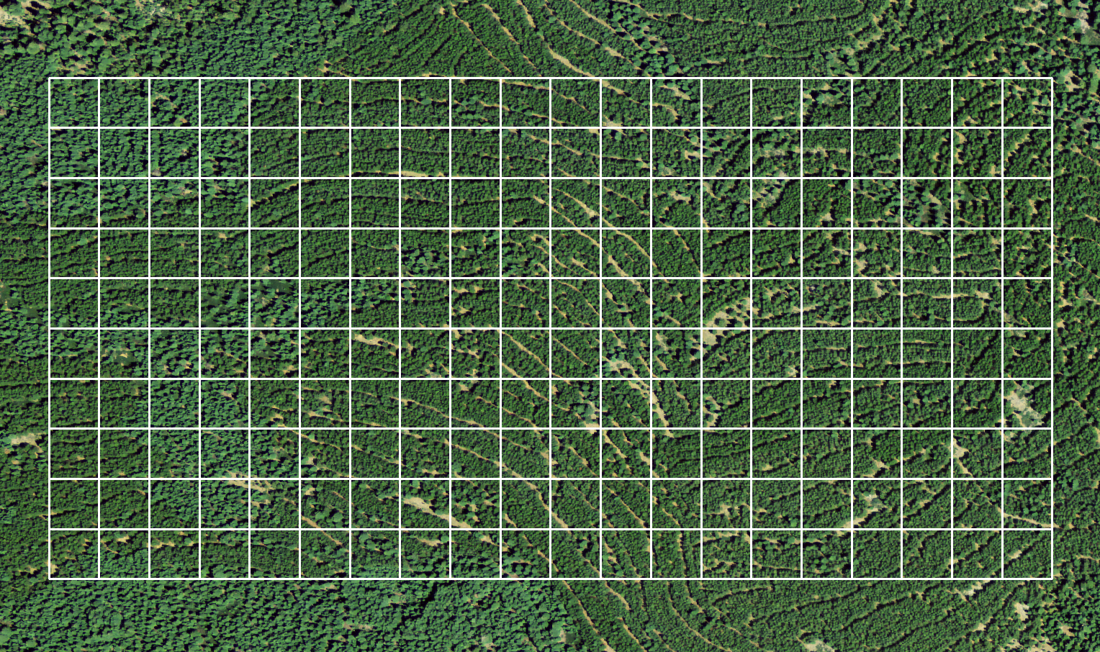

Results – ROI within Badger Planning
200
Acres
Notes:
This 200 acre site was selected within the Badger Planning Area, Lassen National Forest. These 200 acres are planted trees, hence the wavy pattern.

Slide 15
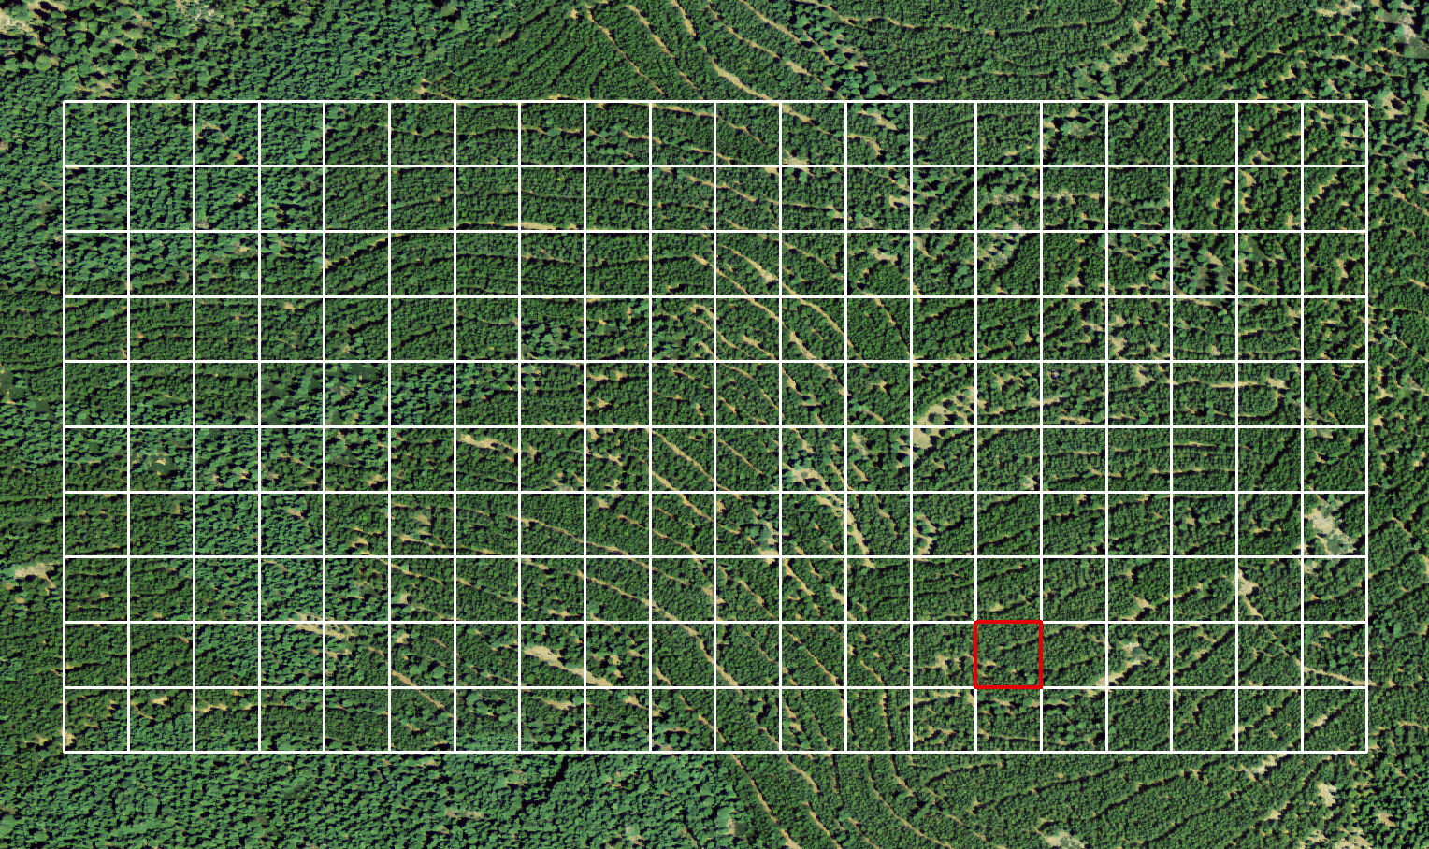
Results – ROI within Badger Planning
1
Acre
Notes:
For higher resolution demonstration purposes, this square acre was selected to show results at a finer scale.

Slide 16
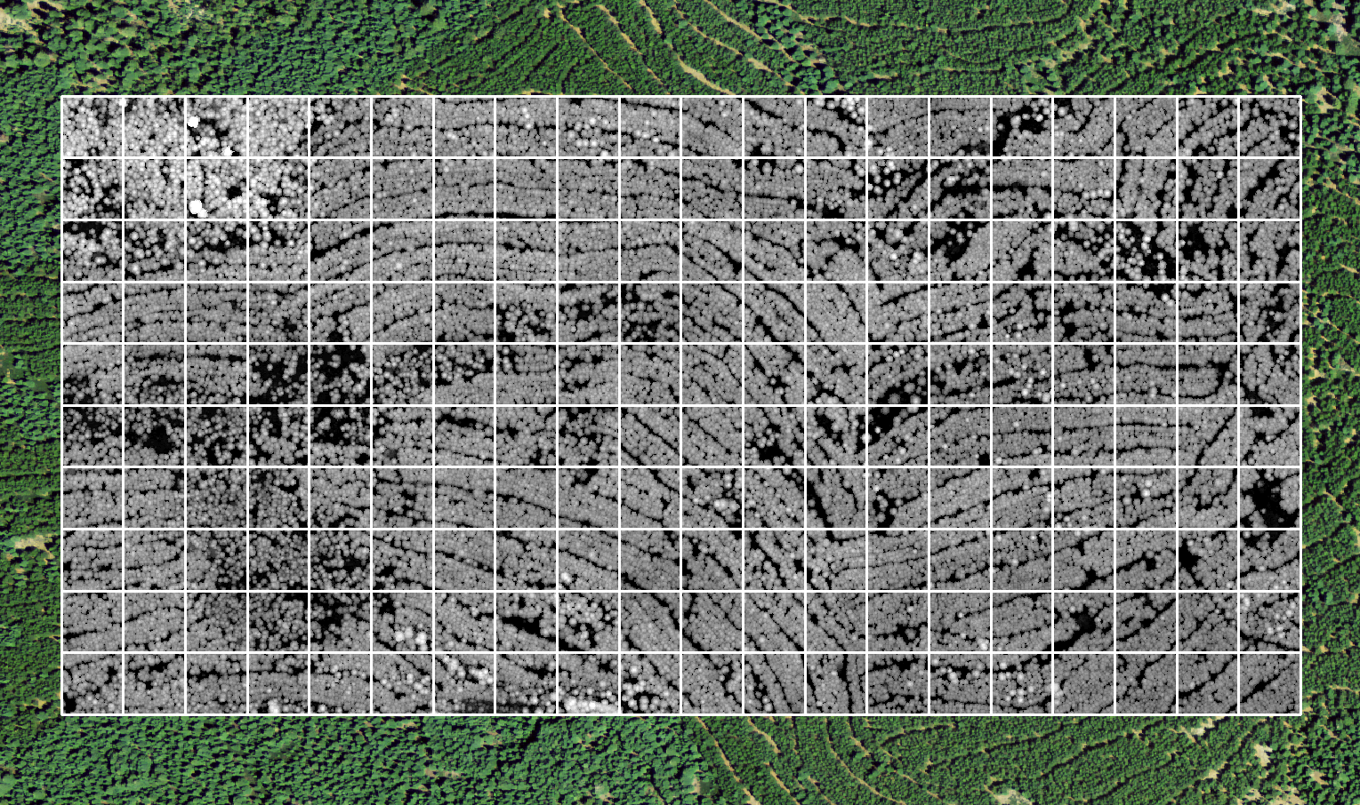
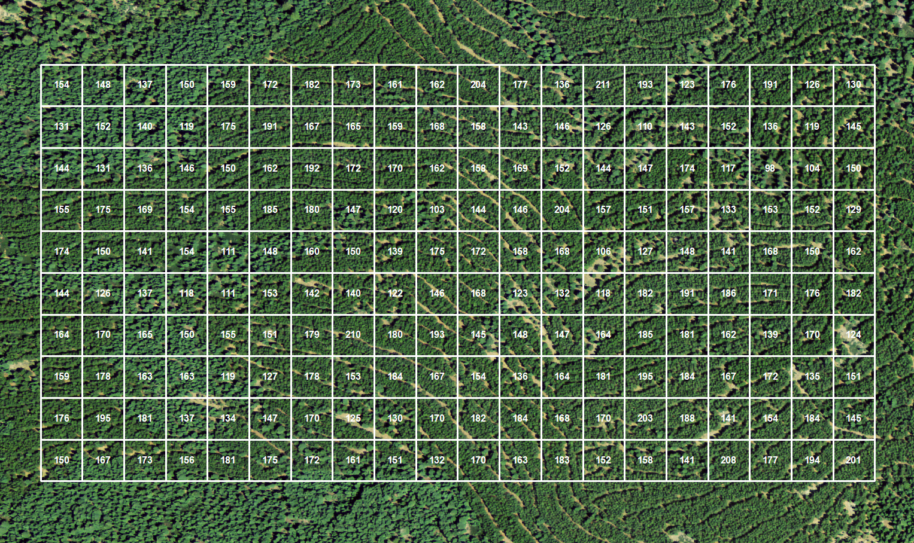

Results – Canopy Height Model
Height (m)
58
0
Notes:
This is the high resolution Canopy Height Model (CHM) created from the LiDAR points, which captures the heights of all trees at 1m horizontal resolution.

Slide 17
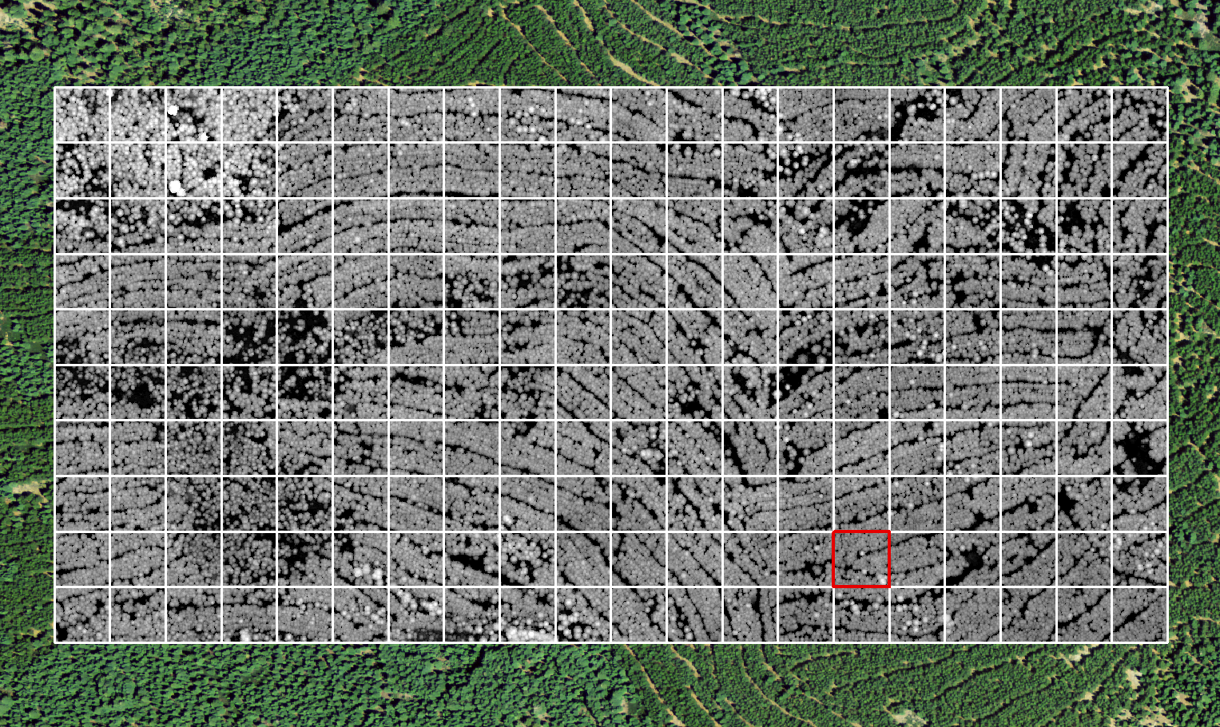
Results – Canopy Height Model
Height (m)
58
0
Notes:
It this scale, individual trees are difficult to identify, so zooming in to the square acre will help explain the canopy segmentation process.

Slide 18
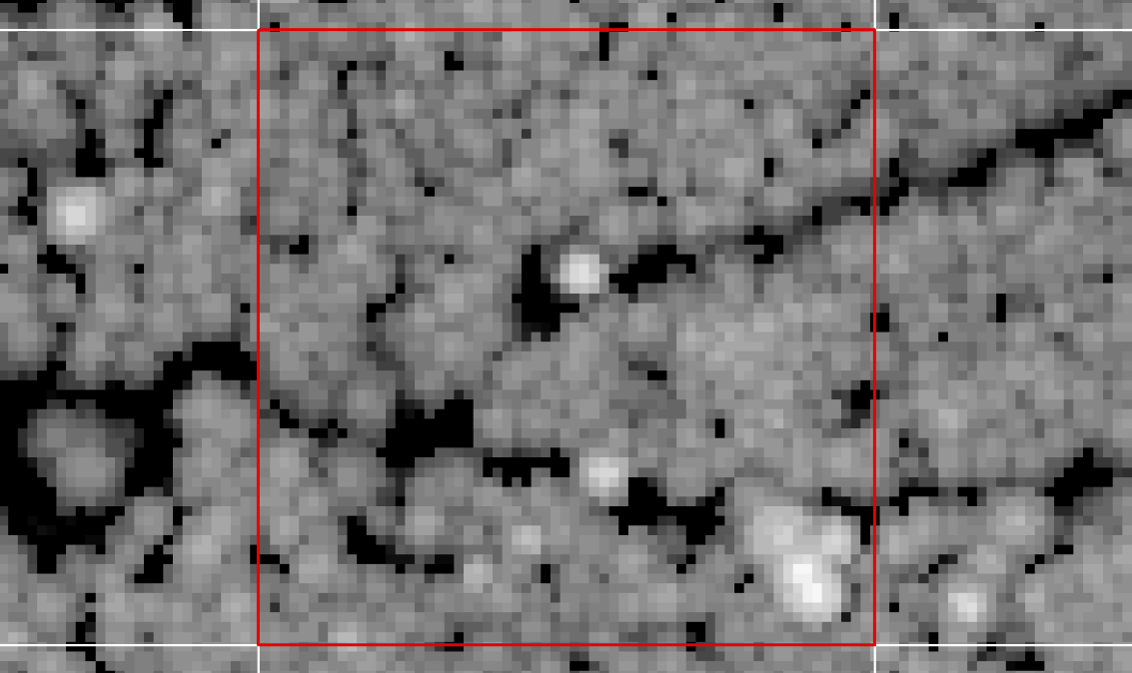
Results – Canopy Height Model
Height (m)
58
0
Notes:
It this scale, individual trees are difficult to identify, so zooming in to the square acre will help explain the canopy segmentation process.

Slide 19
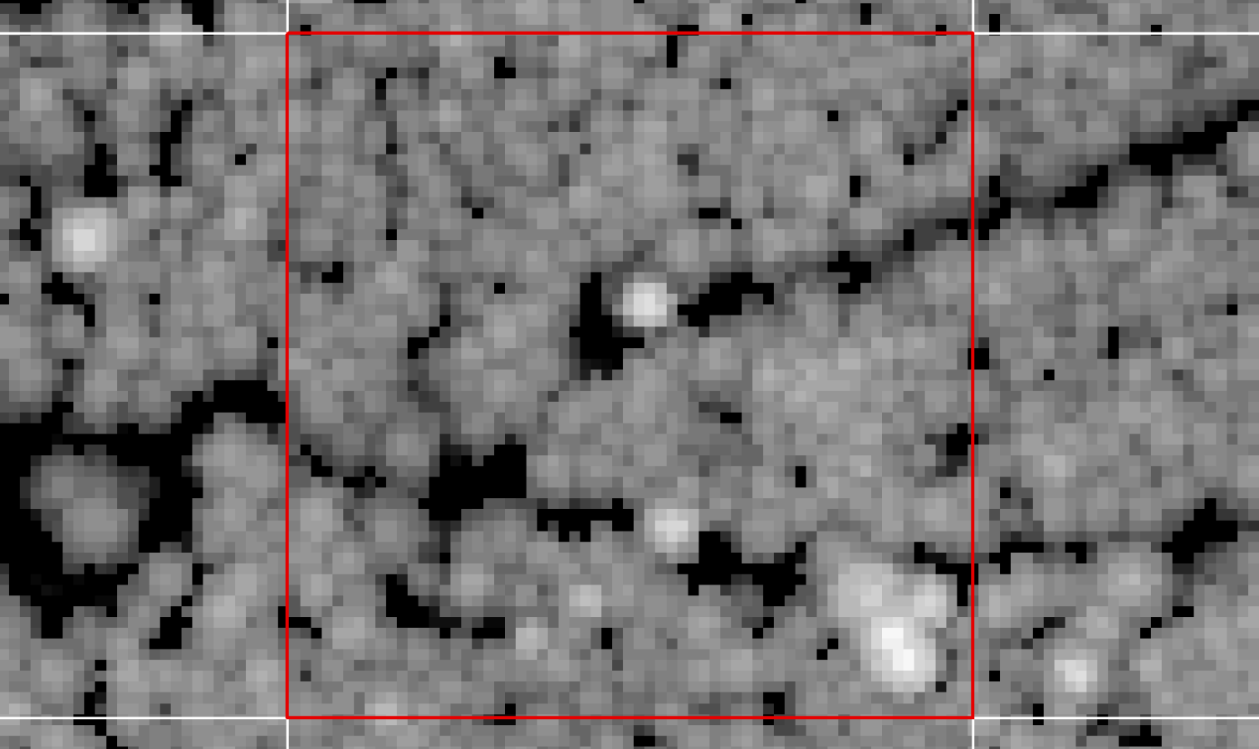
Results – Canopy Height Model
Height (m)
30
0
Notes:
At this scale, the boundaries of individual tree can be identified.

Slide 20
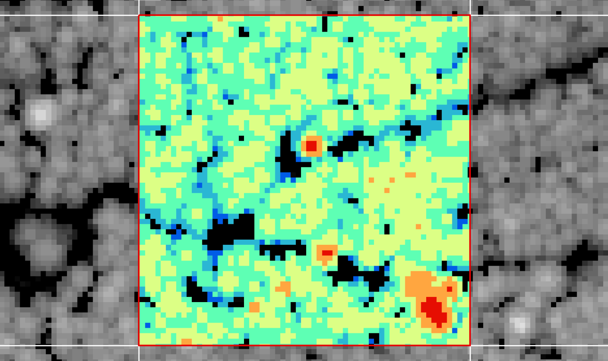

Results – Canopy Height Model
Height (m)
25-30
20-25
15-20
10-15
6-10
1-5
Notes:
Color help display the heights, which visually helps differentiate the dominant trees from co-dominant trees.

Slide 21
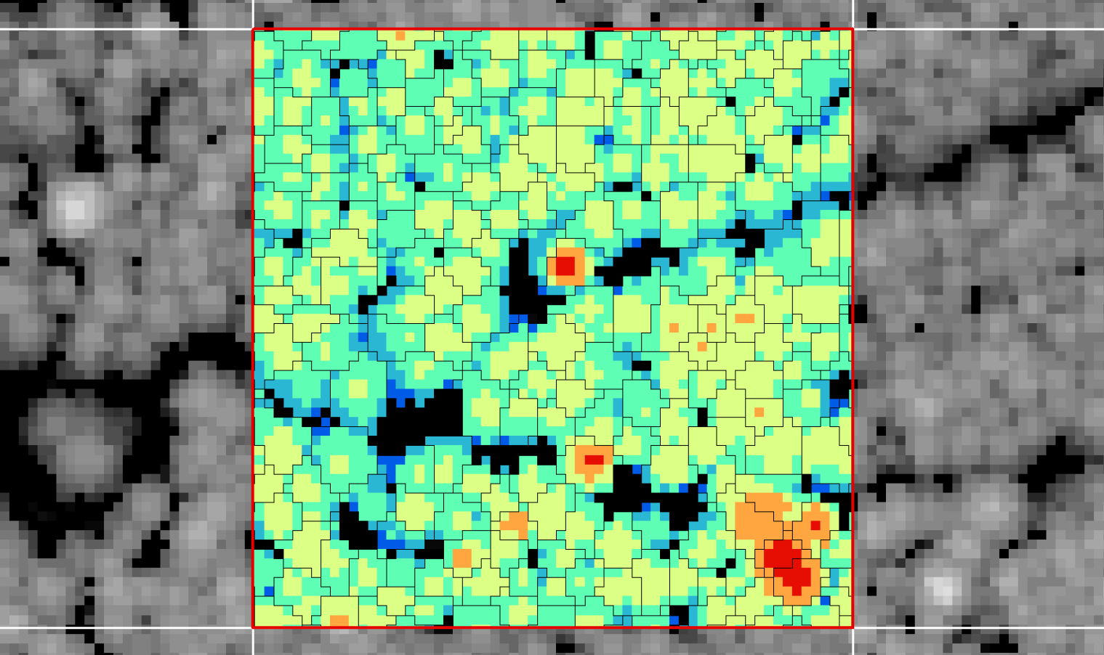

Results – Canopy Segmentation
canopy
Height (m)
25-30
20-25
15-20
10-15
6-10
1-5
Notes:
Canopies are segmented with an algorithm that segments the heights raster vertically and finds new relative maxima for each binned height slice. This is an iterative process for the entire heights raster, finding the relative maximum heights across the landscape at 1m vertical slices. When all maximum heights are found, Thiessen Polygons are created, then clipped by the canopy cover boundary.

Slide 22


Results – Stem Locations
Stem
Canopy
Height (m)
25-30
20-25
15-20
10-15
6-10
1-5
Notes:
The centers of the Thiessen Polygons are useful representations of stem locations. This square acre has 203 stems identified.

Slide 23
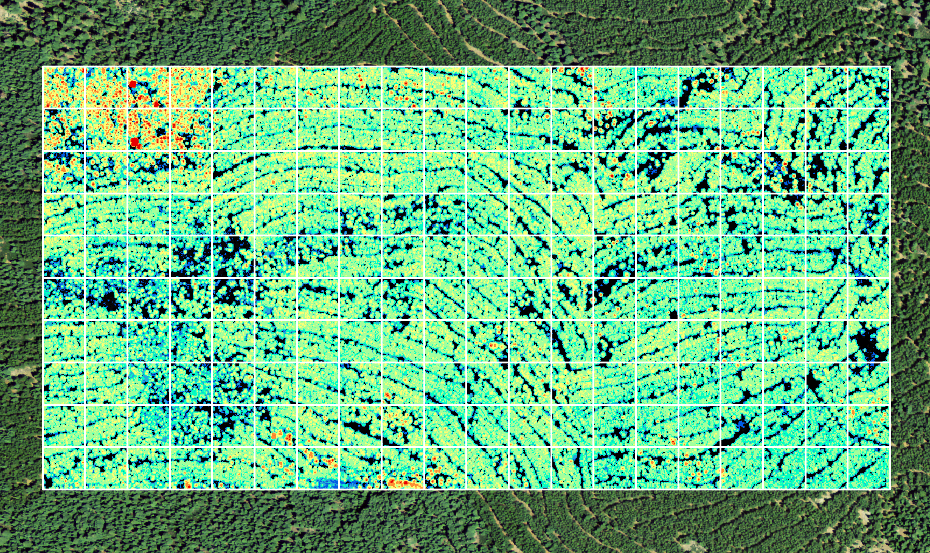
Results – Canopy Height Model
Height (m)
25-50
20-25
15-20
10-15
6-10
1-5
Notes:
Color help display the heights, which visually helps differentiate the dominant trees from co-dominant trees for the 200 acres.

Slide 24
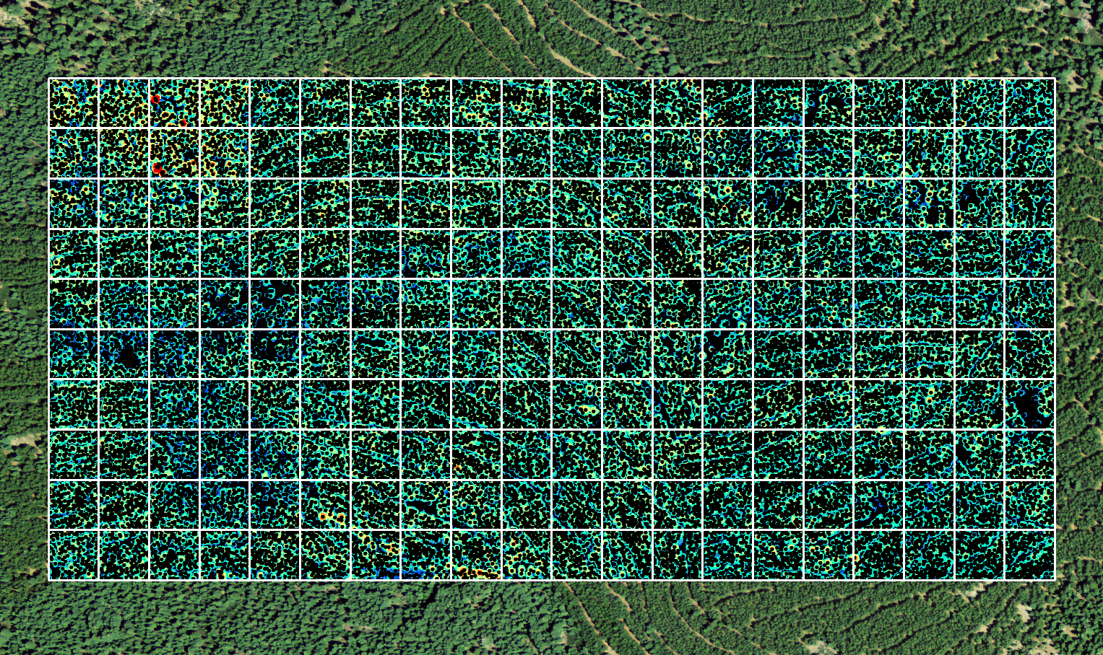
Results – Stem Locations
Stem
Height (m)
25-50
20-25
15-20
10-15
6-10
1-5
Notes:
Stem centers for 200 acres were calculated and shown. Visual display is funny and requires coarsening of data visualization.

Slide 25
Results – Stem Density/Acre
Notes:
This diagram shows stem counts within each acre as a measure of stem density.

Slide 26
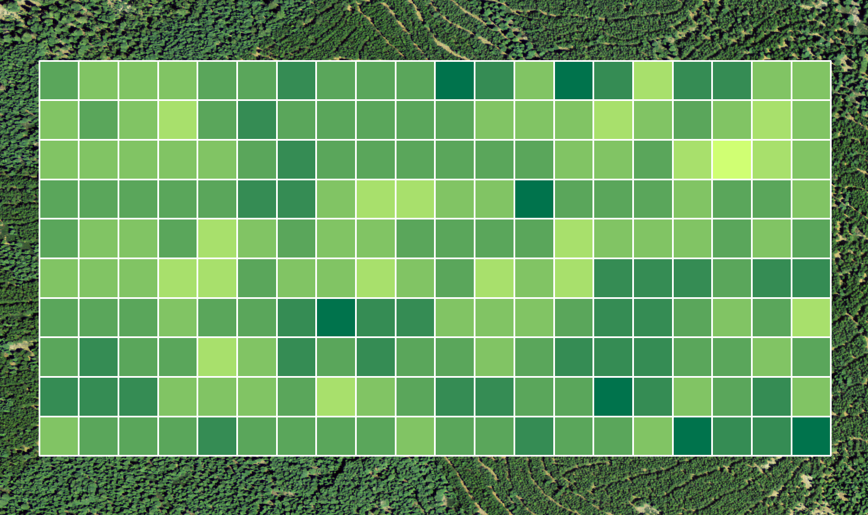

Results – Stem Density/Acre
# Stems
225
200
175
150
125
100
Notes:
This diagram shows stem density colored for quick visual assessment of densest areas within 200 acres. Areas in darker green have higher densities of trees and thus higher fuel loads. Fuel managers should see these areas to prioritize fuel treatments in order to reduce risks of high intensity fires.

Slide 27
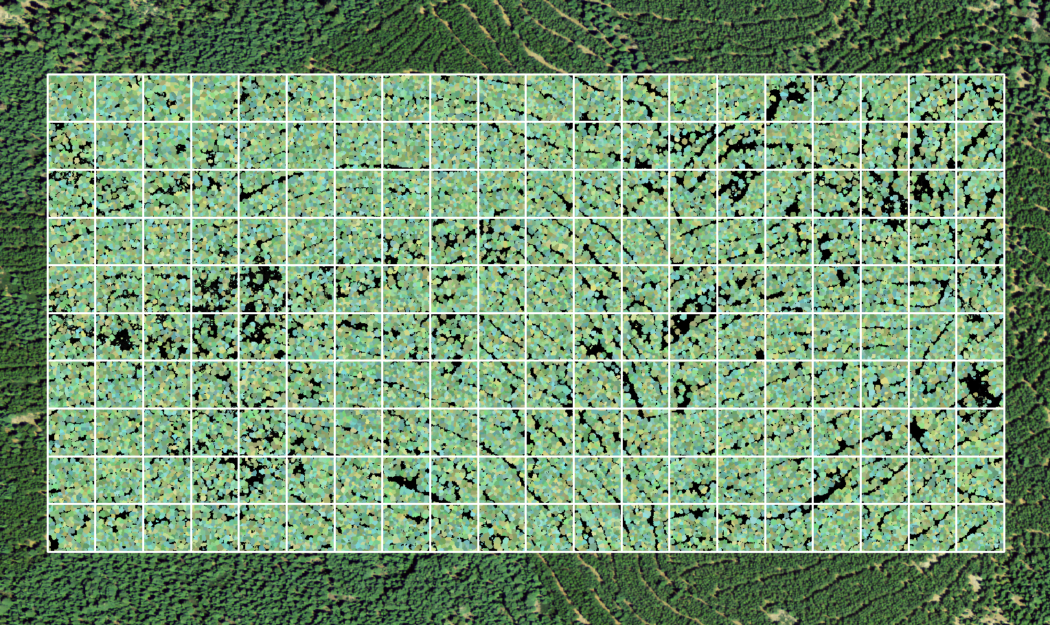
Results – Canopy Segmentation
Canopy
Notes:
This diagram shows each tree canopy colored with a unique color.

Slide 28
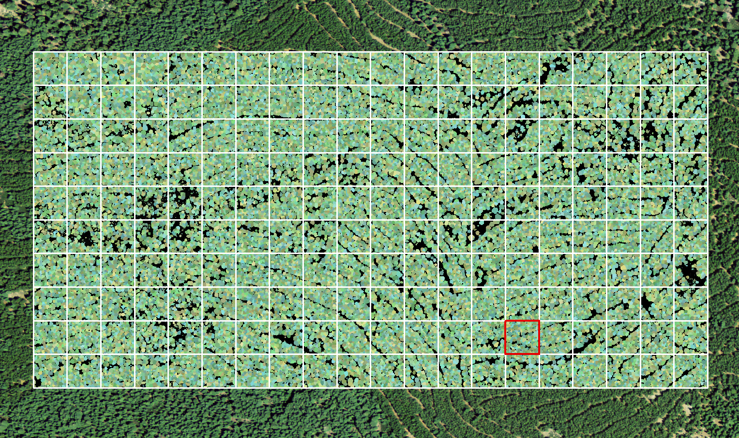
Results – Canopy Segmentation
Canopy
Notes:
Zoom in to 1 acre

Slide 29
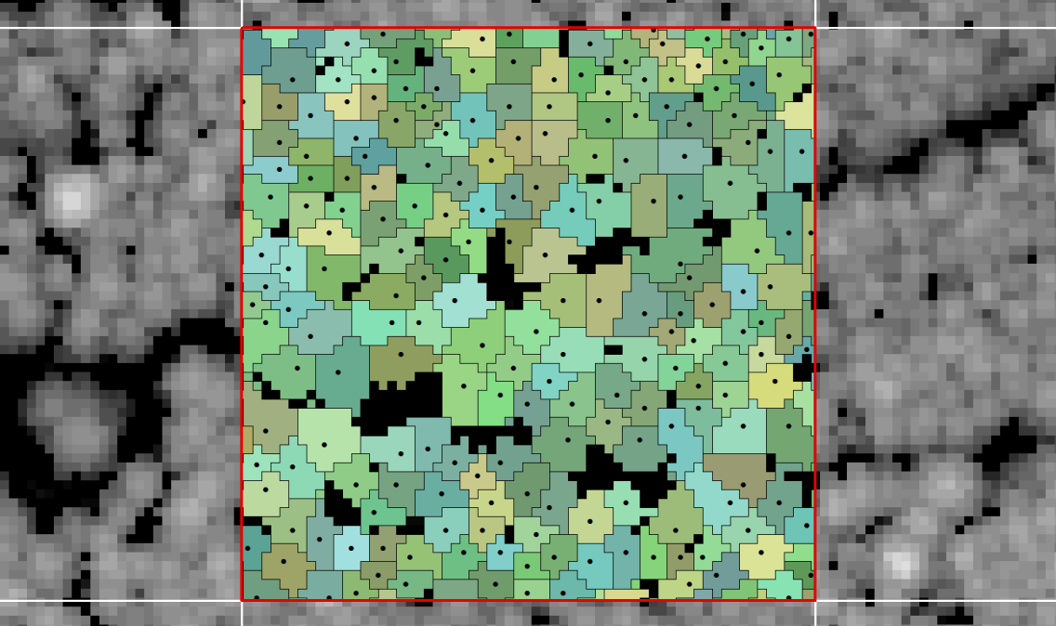
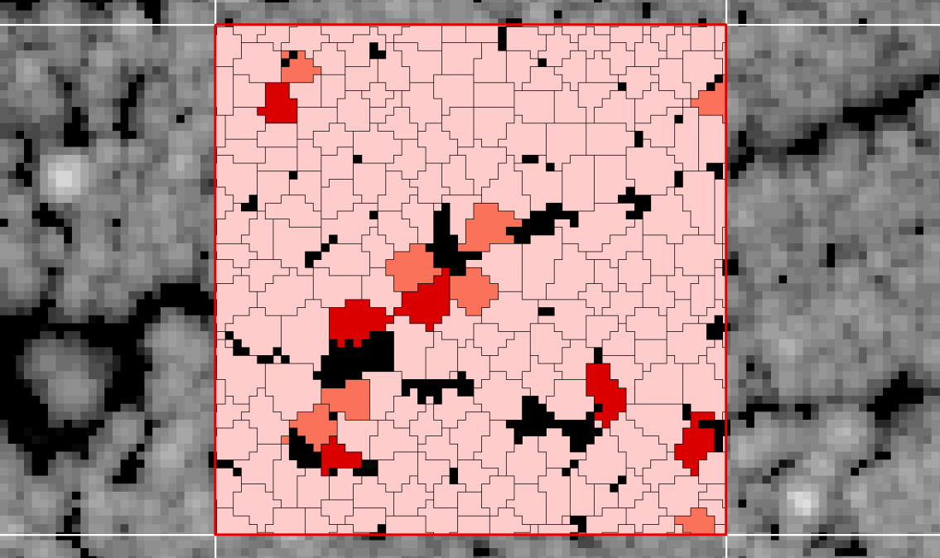
Results – Canopy Segmentation
Stem
Canopy
Notes:
Zoom in to 1 acre

Slide 30
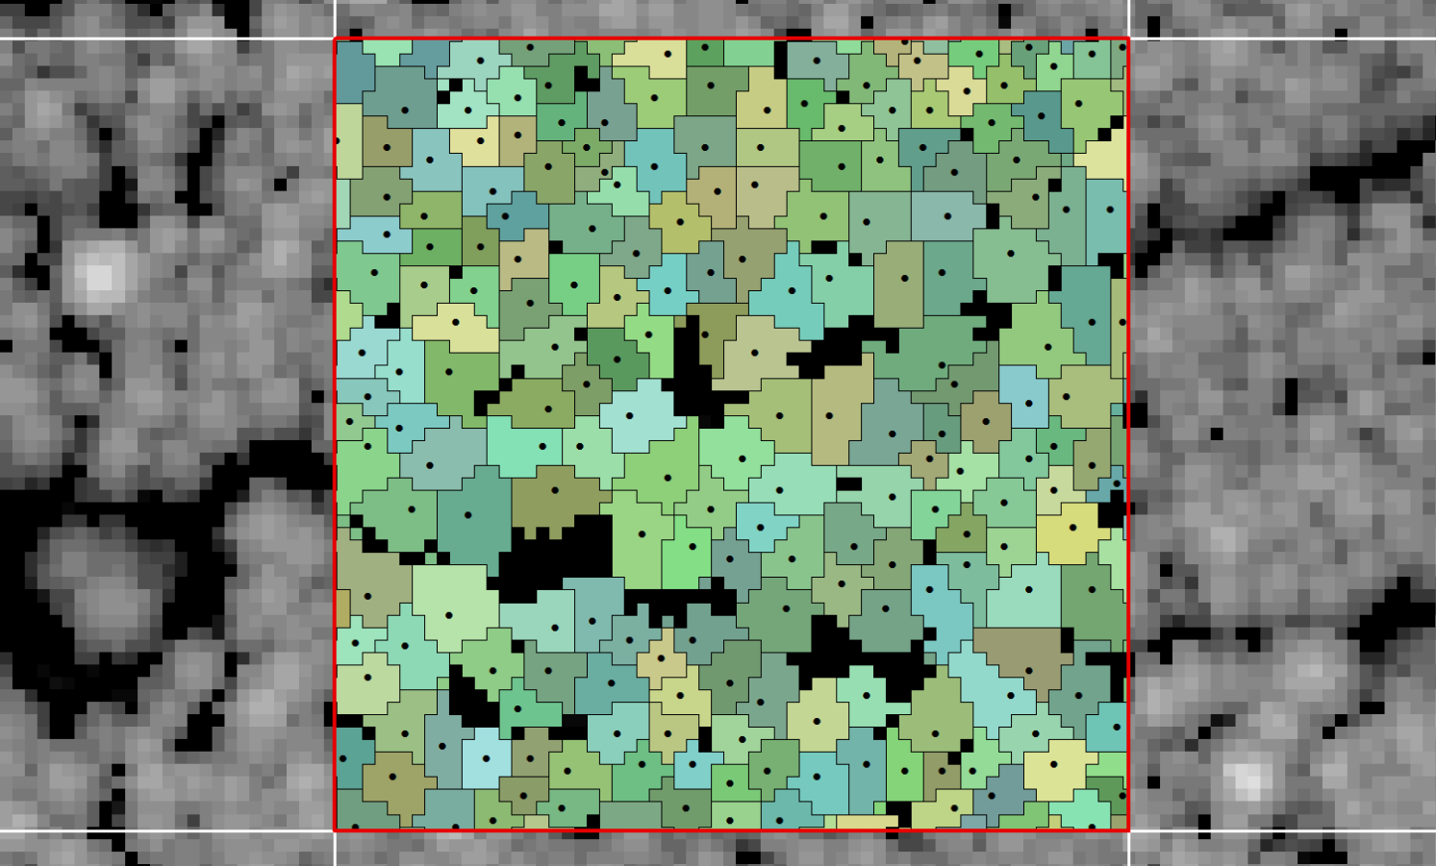
Results – Canopy Segmentation
Stem
Canopy
Notes:
At this scale, the density of trees is made more clear. Yes, this is 203 trees.

Slide 31



Results – Canopy Base Heights
Height (m)
4+
2-4
0-2
Notes:
The minimum height for each canopy segment was used as a proxy for each tree’s canopy base height. This is the distance from the ground to the trees lowest hanging branch. Trees with low canopy base heights increase the risks of canopy fires since surface fires can easily spread into canopies when vegetation understories touch a canopy’s base.

Slide 32
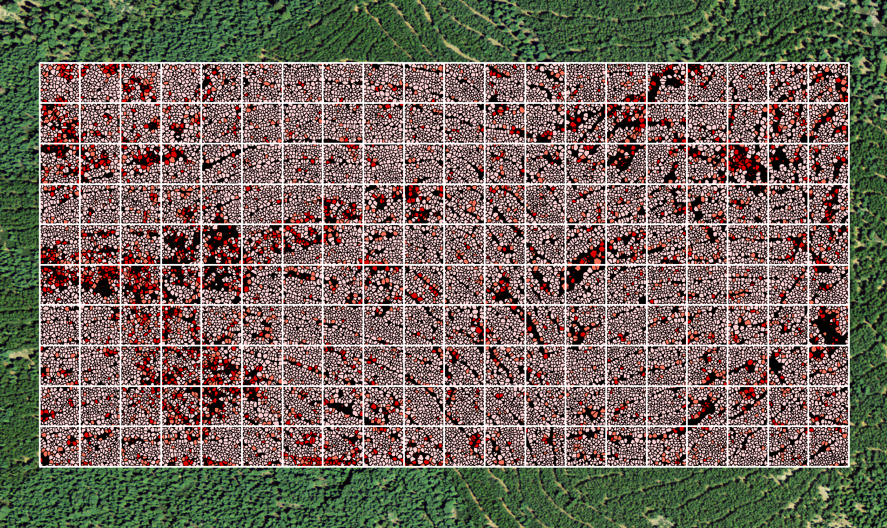
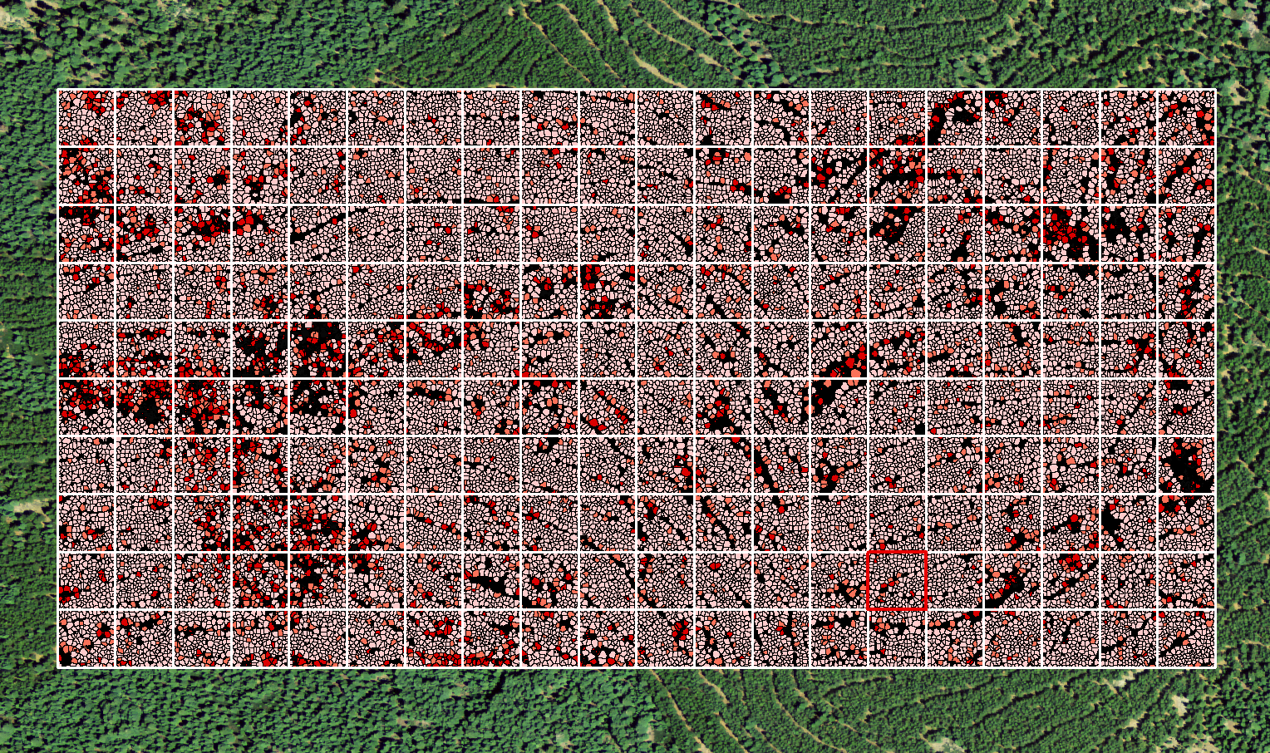
Results – Canopy Base Heights
Height (m)
4+
2-4
0-2
Notes:
The canopy base heights was calculated for all 200 acres. Focus your attention on areas with a high density of trees with low canopy base heights located around black (grassland) patches. These areas are at a higher risk of starting canopy fires because the grassland-forest interface has a higher diversity of grasses and shrubs that act as ladders into canopies.

Slide 33
Results – Canopy Base Heights
Height (m)
4+
2-4
0-2
Notes:
The canopy base heights was calculated for all 200 acres. Focus your attention on areas with a high density of trees with low canopy base heights located around black (grassland) patches. These areas are at a higher risk of starting canopy fires because the grassland-forest interface has a higher diversity of grasses and shrubs that act as ladders into canopies.

Slide 34
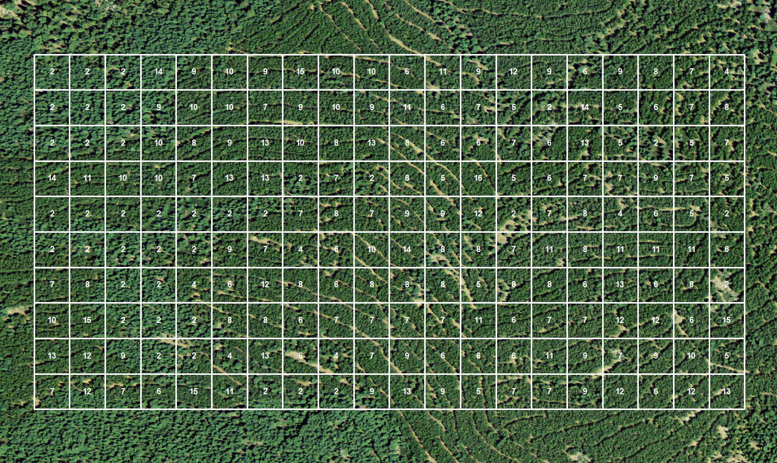
Results – Mean Canopy Base Heights
Notes:
This diagram visualized the mean canopy base height for each acre.

Slide 35
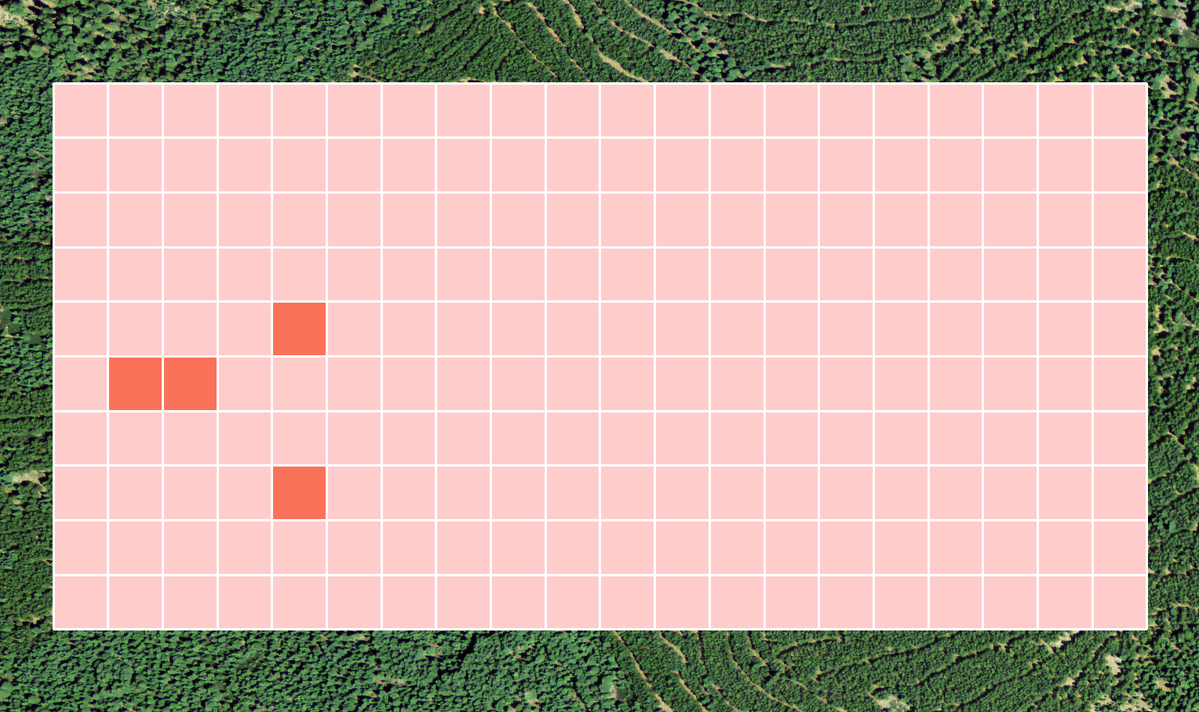
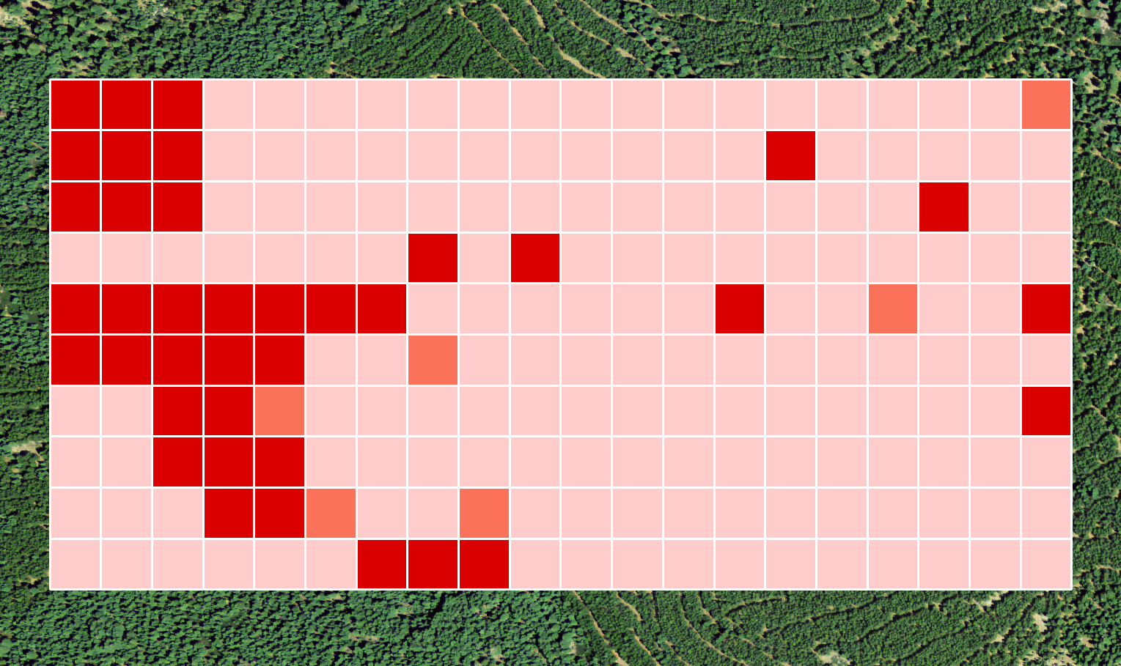
Results – Mean Canopy Base Heights
Height (m)
4+
2-4
0-2
Notes:
This diagram can be used to identify areas useful for fuel treatments. These areas have a high density of low canopy base height trees, which are candidates for hazardous fuel structures.

Slide 36
Results – Understories and Edge Effects
Edge effects on surface fire spread at forest-grassland interface
High canopy understories increase risks of canopy fires due to continuous surface fuels created from ladders
  Surface fuels in conifer forest patches are primarily needles and timber litter, which have low rates of spread
  Surface fuels in grasslands have high rates of spread
Fuel treatments at these interfaces will reduce risks to entire forest patches
Notes:
The forest-grassland interface is a an area where surface fires can spread into canopies easily. The edge effects of these forest and grassland patch dynamics produce habitats that are more suitable for diverse grasses and shrubs. By creating clear fuel breaks in these interface areas and removing understories from low canopies, fuel managers can reduce the risks of catastrophic wildfire events resulting from surface fire spread (and not crown spotting).

Slide 37
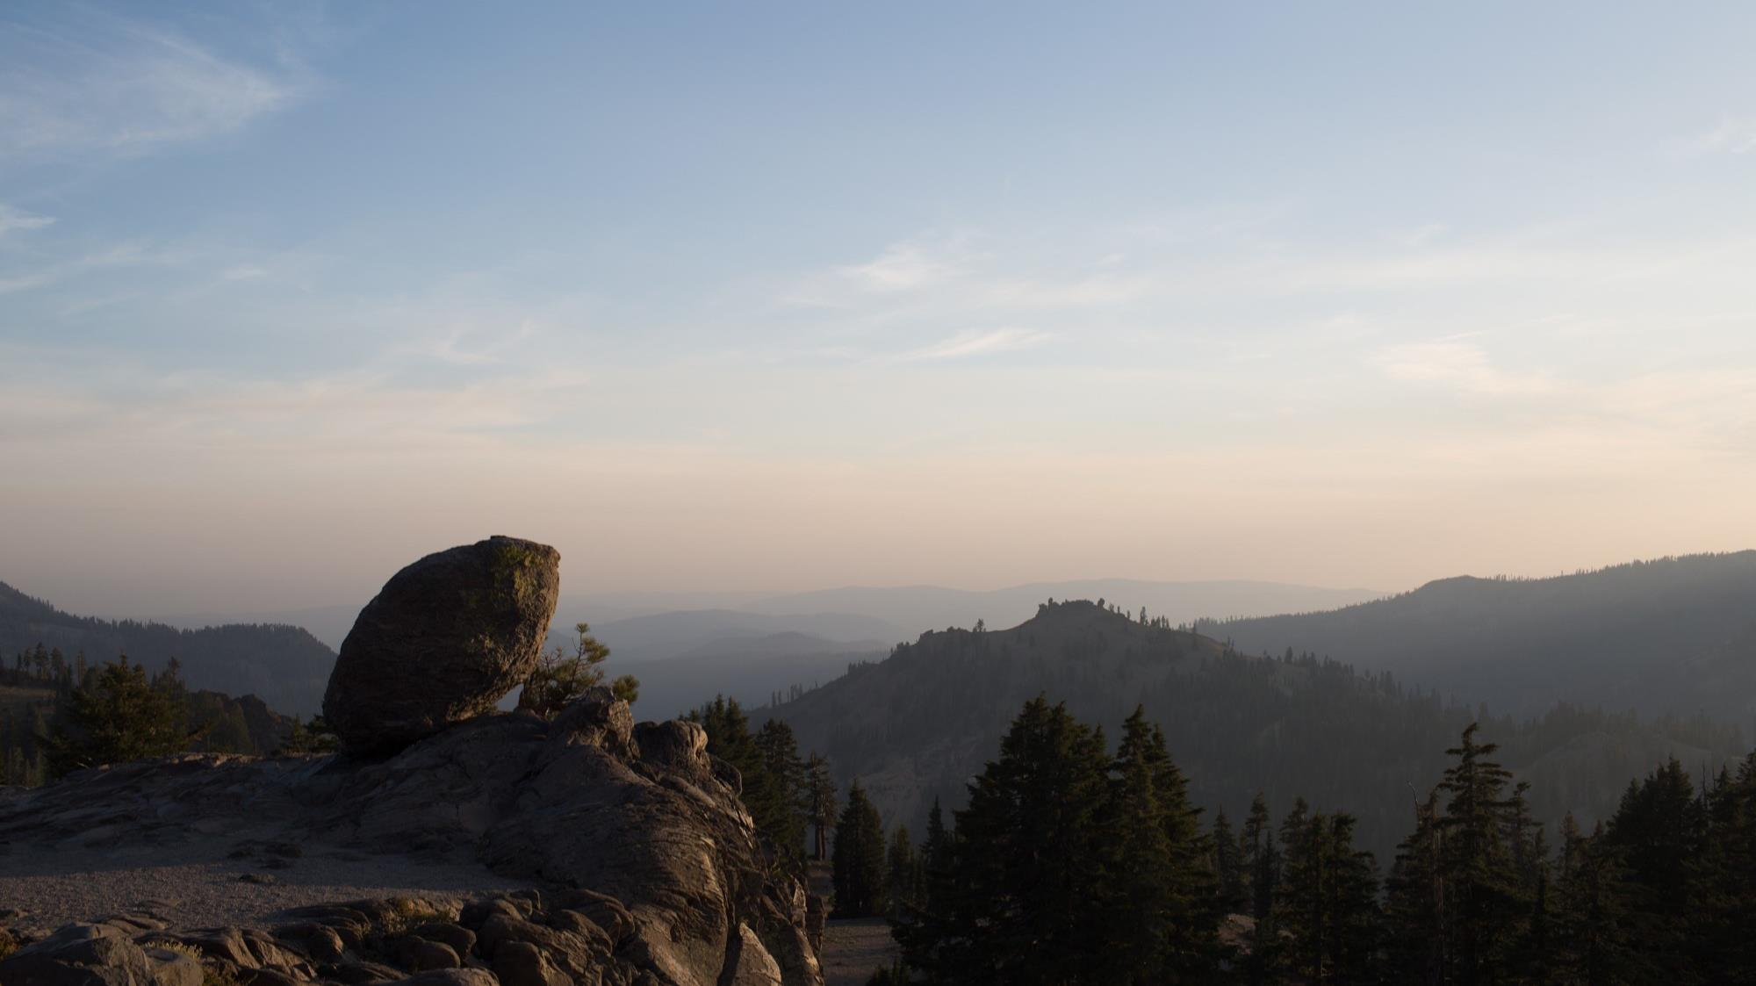
SAVETREE 2.0
2
Notes:
Image Source: Anna McGarrigle (team member)

Slide 38
Methods
SAVeTrEE 2.0
Acquire
Google Earth Engine
LNF and Badger Planning Area boundaries
FRAP CA historic fire perimeters
Enable user uploaded AOIs
Drape documented fuel treatments over detected mortality trend
Notes:
For the updates to SAVeTrEE, we acquired additional shapefile boundaries to expand areas of interest, and fire history data from FRAP
In GEE, we added functionality for the user to upload their own area of interest, and add fire history to the map

Slide 39
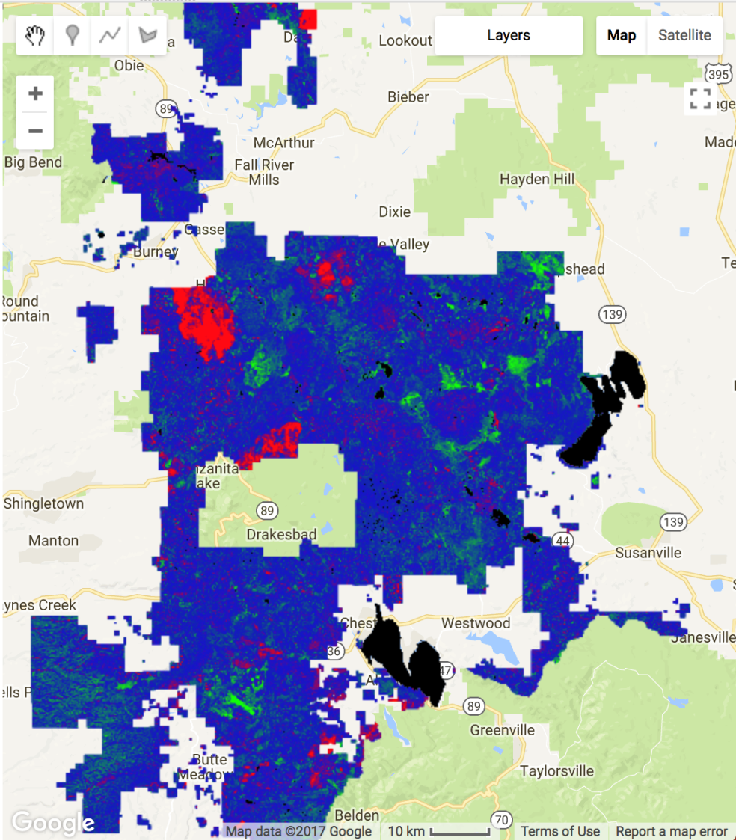
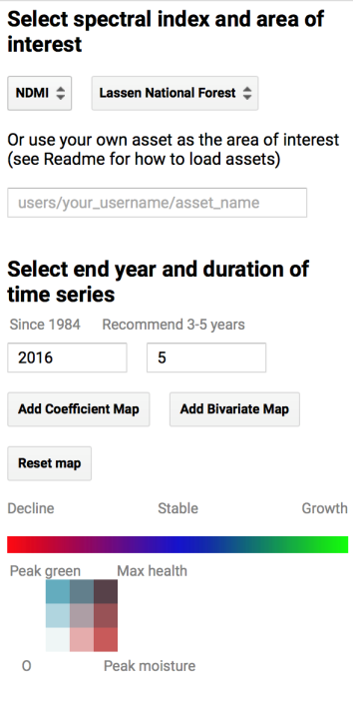
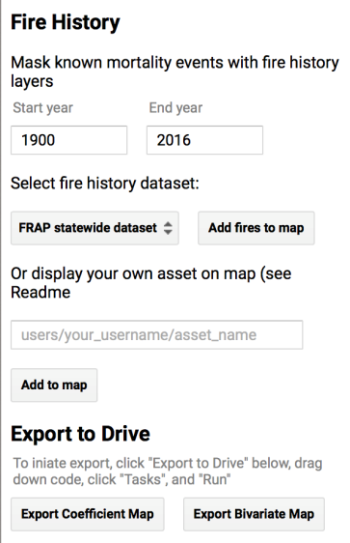
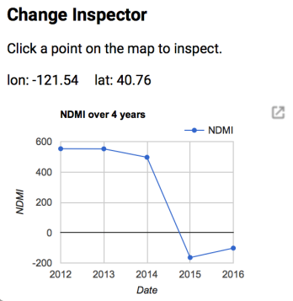
Results
Generalized code, allowing users to easily customize map
Added historical fire data for users to differentiate between prescription fires and other kinds of tree mortality
Improved interface by adding layers one at a time
Opened code up to other shapefiles and fusion tables outside of area of interest
Notes:
The user interface of SAVETREE has been expanded with future use in mind. By allowing the user to input their own asset, the analyses can be run on any shapefile they want, including shapefiles of future fires. Future fire history data can also be added to the map.
Image Source: Google Earth Engine. Data: Lassen National Forest

Slide 40
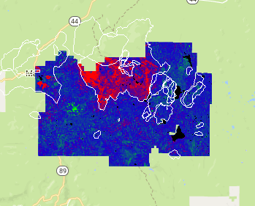
Results
Historic fire data
  FRAP CA statewide fire history: wildfire, treatments, prescriptions
  Mask known mortality events
  Can supply own shapefile
Expands landscape-scale analysis
  More options for areas of interest
  Lassen National Forest, Badger Planning Area
Increased flexibility
  User supplied area of interest and fire assets
Improved interface
  Add one layer at a time
  Streamlined interaction with UI design
Notes:
By adding historic fire data, we can now differentiate between apparent tree mortality that can be attributed to wildfires, fire treatments, and mechanical thinning, and tree mortality that does not appear to have a known cause.
Thus, forest managers can hone in on areas experiencing high rates of tree mortality with no known cause, and watch the progression of tree recovery in areas that have experienced mortality events.
By increasing the capabilities of the user interface we have made a tool which will be useful to the LVNP for many years and over the course of many future fire events.
Image source: Google Earth Engine. Data: FRAP CA Statewide Fire Perimeters and Lassen Volcanic National Park boundary, freely available

Slide 41
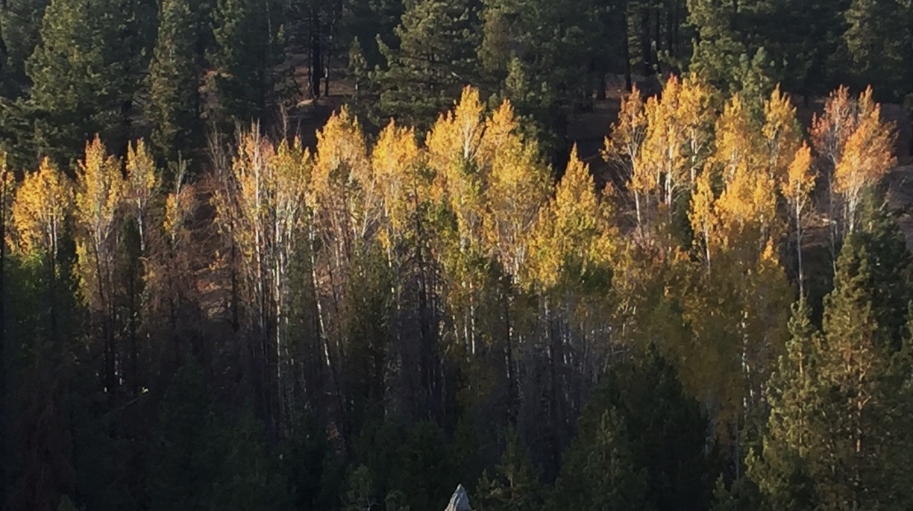
Reading Fire Recovery
3
Notes:
We also analyzed land cover within the Reading Fire perimeter to see how it’s recovering
Image Source: Heather Myers (team member)

Slide 42
Methods
Reading Fire Recovery
Acquire
Classify
Change Analysis
NAIP 2012, 2014, 2016
LNF planting points
Supervised classification: bare earth, grass, tree
State of ecosystem recovery post-Reading Fire
Process in ArcMap
Mean NDVI
Change Analysis
Mosaic quadrangles
Calculate NDVI
At planting points in LNF
At random points in LVNP
Compare recovery across boundary
Notes:
-USDA NAIP is flown every two years, so we acquired images for 2012-a pre-fire image, 2014-as a post-fire image, and 2016- as a recovery image
-We looked at recovery in two ways: by doing a land cover classification and by analyzing NDVI
-ArcMap was used to run a supervised classification using a support vector machine. We classified each year’s image into- bare earth, grass, and tree. Lakes were masked out of each image before performing the classification.
-Using raster calculator, we calculated how each pixel has changed over the three images, which gives us an estimate on how the Reading Fire area is recovering
-We were given planting points from LNF and we created planting points on the LVNP side of the fire
-Using google earth engine, we calculated mean NDVI for each image and compared the values at the points to compare recovery across the boundary

Slide 43


Results
2012
Bare earth: 30.5%
Grass: 42.1%
Tree: 27.4%
2012 | Bare | Grass | Tree | User’s accuracy (%)
Bare | 50 | 0 | 0 | 100
Grass | 0 | 34 | 5 | 87.18
Tree | 0 | 16 | 45 | 73.77
Producer’s accuracy (%) | 100 | 68 | 90 | 86
Kappa statistic | 0.79
Bare Earth
Grass
Tree
Notes:
-The 2012 NAIP image was taken right before the fire and it shows that the area is about 30% bare earth and 70% vegetation
-An accuracy assessment was done for the land cover classification, all three being in the 80% range
Image Source: NAIP, ArcMap

Slide 44

Results
2014
Bare earth: 63%
Grass: 17.4%
Tree: 19.5%
2014 | Bare | Grass | Tree | User’s accuracy (%)
Bare | 47 | 2 | 1 | 94
Grass | 3 | 38 | 14 | 69.09
Tree | 0 | 10 | 35 | 77.78
Producer’s accuracy (%) | 94 | 76 | 70 | 80
Kappa statistic | 0.7
Bare Earth
Grass
Tree
Notes:
-The 2014 image was two years after the fire so it’s exactly a post-fire image but it’s what we used as our post-fire imagery.
-The area of bare earth doubled from 2012, at around 63%
-The areas of vegetation could be either areas of regrowth or areas that weren’t adversely affected by the fire. More analysis using the fire severity layers would help determine the status of those areas
Image Source: NAIP, ArcMap

Slide 45

Results
2016
Bare earth: 45.2%
Grass: 25.5%
Tree: 29.3%
2016 | Bare | Grass | Tree | User’s accuracy (%)
Bare | 48 | 0 | 0 | 100
Grass | 0 | 45 | 20 | 69.23
Tree | 2 | 5 | 30 | 81.08
Producer’s accuracy (%) | 96 | 90 | 60 | 82
Kappa statistic | 0.73
Bare Earth
Grass
Tree
Notes:
-The 2016 image is what we used for our recovery state
-More vegetation has grown in since the 2014 image was taken, there’s about 55% vegetation but still large areas of bare earth that are showing no signs of recovery
Image Source: NAIP, ArcMap

Slide 46
Results
16,309 acres were not adversely affected
6,844 acres have not recovered
2,460 acres have fully recovered to their pre-fire state
1,374 acres are a new vegetation cover
952 acres are in a transition state to their pre-fire state
Notes:
Of the 27,939 acres burned by the 2012 Reading Fire,
16,309 acres (58%) were not adversely affected by the fire. This includes areas of vegetation as well as bare earth.
6,844 acres (25%) of vegetation experienced mortality from the fire and have not begun to recover.
2,460 acres (9%) of vegetation experienced mortality and have made a full recovery to their pre-fire state. Full recovery meaning it was classified as a tree, not necessarily a full sized tree
1,374 acres (5%) of vegetation recovered from the fire as a new vegetation cover i.e. it was grass in 2012 and tree in 2016.
952 acres (3%) of vegetation are in a state of transition to their pre-fire state.
Image Source: PowerPoint

Slide 47

Results
Distribution of points used
Evaluating planting activity
LNF planting points (9,299)
LVNP random samples (9,000)
Notes:
We did an evaluation of planting activity on the forest side of the fire perimeter compared to random points on the park side.
The forest began replanting after the fire in 2012
In the chart on the left you can see that the park had over 50% healthy before the fire, and the forest had about 75%. As expected, both dropped to below 10% in 2014. And, both increased approximately the same amount by 2016.
On the right you can see the distribution of points on either side of the administrative boundary
Introduces error from where the points are: LNF ones are placed intentionally in areas that might need the extra push, or where only forest was before, LVNP ones are randomly distributed so might pick up bare earth, rock, grass, etc.
Image Source: ArcMap. Data: Lassen National Forest

Slide 48
Results
Distribution of vegetation health within the Reading Fire
HEALTHY VEGETATION RANGE
LASSEN VOLCANIC NATIONAL PARK,
Sample Points
LASSEN NATIONAL FOREST,
Planting Activity
Distribution of vegetation health within the Reading Fire
Distribution of vegetation health within the Reading Fire
Distribution of vegetation health within the Reading Fire
Distribution of vegetation health within the Reading Fire
Distribution of vegetation health within the Reading Fire
Distribution of vegetation health within the Reading Fire
LASSEN VOLCANIC NATIONAL PARK,
Sample Points
LASSEN VOLCANIC NATIONAL PARK,
Sample Points
LASSEN VOLCANIC NATIONAL PARK,
Sample Points
LASSEN VOLCANIC NATIONAL PARK,
Sample Points
LASSEN VOLCANIC NATIONAL PARK,
Sample Points
LASSEN VOLCANIC NATIONAL PARK,
Sample Points
LASSEN NATIONAL FOREST,
Planting Activity
LASSEN NATIONAL FOREST,
Planting Activity
LASSEN NATIONAL FOREST,
Planting Activity
LASSEN NATIONAL FOREST,
Planting Activity
LASSEN NATIONAL FOREST,
Planting Activity
LASSEN NATIONAL FOREST,
Planting Activity
Notes:
The blue range is the healthy vegetation range, which is an NDVI between .2 and .8
In green you see that on both sides, the maximum frequency is in the healthy range
In red in 2014, the max is at -.1, and the points are normally distributed
Two years later in 2016, the points shift about .2 or two tenths towards healthy. The majority of both sides are still not healthy, but are moving towards it.

Slide 49

Results
Healthy vs not healthy points, 2016
Mean Δ NDVI
LVNP: +.249
LNF: +.216
Not healthy, NDVI<.2
Healthy, .2>NDVI>.8
Notes:
Healthy and not healthy pixels are smattered throughout the fire perimeter in this map from 2016. It is difficult to distinguish much difference visually.
However, the mean change in NDVI was .249 for the park and .216 for the forest, so theres not a substantial difference detected from satellite imagery with the recovery of vegetation health.
NDVI values from 2016
LNF side: 17.44% healthy, LVNP side: 25.66% healthy[5:48] 9000 random samples, 9299 planting points
Image source: ArcMap

Slide 50

Conclusions
In the Badger Planning Area, mean of 157 stems per acre
Canopies with low base heights along the forest-grassland interface are high-priority locations for treatments
Within Reading Fire perimeter:
  9% full recovery
  3% transitioning to pre-fire state
  25% no change
No significant vegetation growth (∆NDVI) from satellite imagery at planting activity
  More analysis needs to be done
Include fire history in analysis with SAVeTrEE tool
Image Credit: Library of Congress
Notes:
From these results we can draw several conclusions.
First, in the Badger Planning Area, the mean stem density is 157 per acre.
Continuous fuel structures exist on the forest-grassland interface with low canopy base heights. These should be high priority locations for fuels treatment due to the increased risk of spreading a crown fire.
In the Reading Fire perimeter, 25% has not changed, 9% has returned to what it was pre-fire, and 3% is in transition.
From satellite imagery, we are unable to detect significant differences in vegetation health between passive and active management areas. More analysis needs to be done here.
The historic fire history analysis enables further analysis.
Image Source: Library of Congress (Public Domain)

Slide 51

Errors and Uncertainties
LiDAR
Discrepancy between LiDAR and field data
Over-segmentation, tree may have multiple relative maximum
Under-segmentation, canopies of dominant and co-dominant trees overlap and younger trees are masked in the lidar points
Reading Fire Recovery Map
Temporal resolution misses immediate post-fire
Random sampling vs. sampling at known vegetation
SAVeTrEE
Simple Linear Regression can normalize extreme events
Software release process limits validation
Variable growing seasons in drought years
Imagery
  Spectral enhancements: snow, ice, water
  Cloud coverage
  Artifacts in composites
Image Credit: Library of Congress
Notes:
We found major errors with field data collected to validate the LiDAR data, so were not able to produce an accuracy assessment.
If a tree has multiple relative maximums, our algorithm might double count it, thus introducing error by over-segmenting
Alternatively, if canopies overlap, the they might get under segmented.
With the Reading Fire Recovery map, we traded off high spatial resolution with 1m NAIP with high temporal resolution. Therefore, although we have imagery from weeks before the fire, we do not have imagery right after the fire.
With the planting points evaluation, the points created on the Park side were randomly distributed whereas the Forest points were captured at places with known vegetation
In SAVeTrEE, a simple linear regression is used to calculate the trend map. This can normalize extreme events depending on the duration.
Also, since the tool is in software release process at the time of writing, partners have not been able to use the tool and provide feedback on errors and uncertainties
Drought and climate change affects when the growing season occurs. This is difficult to capture for our composite images
Finally, there are errors in the imagery from spectral enhancements, cloud coverage and artifacts
Image Source: Library of Congress (Public Domain)

Slide 52

Future Work
Image Credit: Heather Myers
Process LiDAR acquired by LVNP
Calculate biomass using terrestrial LiDAR-derived diameter breast height
Assess accuracy of mortality trends
Develop SAVeTrEE with NAIP imagery to create bi-annual trends at 1m spatial resolution since 2002 to capture drought
Leverage high temporal frequency sources like Planet Rapideye SR data
Map aspen post-fire and revisit planting points
Notes:
Future work in this region is limitless.
First and foremost, future work is to process the LiDAR that LVNP will acquire within the next year.
And, if they acquire terrestrial LiDAR, biomass calculations can be done by diameter breast height measurements
More work on assessing accuracy in SAVeTrEE would be helpful
Adding high resolution spatial data from NAIP into SAVeTrEE would be helpful in assessing the drought in California
Leveraging daily imagery like Planet’s Rapideye imagery would take the tool to new heights
To map recovery, identifying aspen as an indicator species and revisiting the planting points would be an interesting analysis.
Image Source: Heather Myers (team member)

Slide 53

Questions?
Notes:
From left to right: Heather Myers, John Dilger, Andrea Ferrer, Anna McGarrigle, Peter Norton at Lassen Volcanic National Park
Image source: Team

Slide 54
Acknowledgements
Jenna Williams, NASA Ames Research Center DEVELOP Center Lead
Steve Buckley, National Park Service
Elizabeth Hale, National Park Service
Juan Torres-Perez, Bay Area Environmental Research Institute
Vince Ambrosia, California State University - Monterey Bay
John Dilger, DEVELOP Geoinformatics Fellow and Previous Contributor
Joshua Verkerke, Previous Contributor
Amber Wittner, Lassen National Forest

