Slide 1
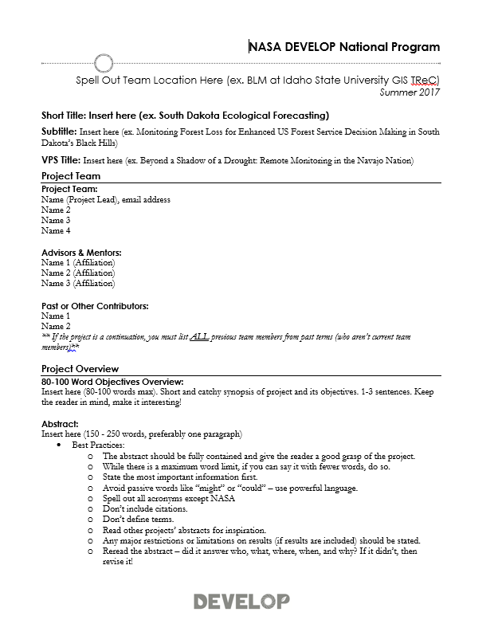
Deliverables: Project Summary
What it is: The Project Summary provides a short overview of project information in one place.
Why it matters:
The content in this document is compiled for reporting to NASA HQ –project indicators and tracking metrics, annual reports, quarterly program reviews, monthly status reports, etc.
Future teams will refer to this document.
Project Summaries are commonly shared when project information is requested (ex. Legislative Affairs, Partners, etc.).
How to make it work for you:
This is where the abstract “lives” – you will iterate with the PC team in this file. Don’t put the abstract on other deliverables until it’s finalized here.
Use the Project Summary content to fill in the sections of the DEVELOPedia page and poster.
Use this document in the future when you need to share information about the project you worked on.
Project Summary: http://www.devpedia.developexchange.com/dp/index.php?title=Project_Summary

Slide 2
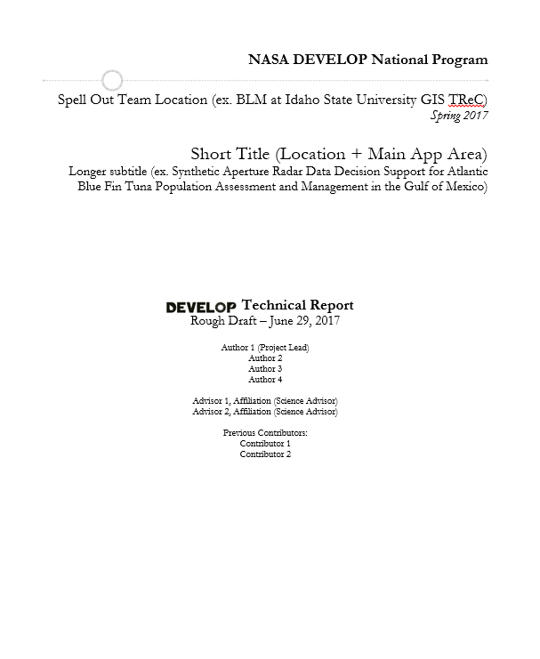
Deliverables: Tech Paper
What it is: The Tech Paper provides a synopsis of the project with technical details for partners and future DEVELOP teams to replicate and understand.
Why it matters:
Tech papers are the foundation for all future publications relating to the project.
Tech papers are commonly shared with project partners.
Methods are a large focus of the paper and should assist others in replicating your work.
How to make it work for you:
Develop your technical writing skills by working on the tech paper.
Use content from the tech paper in the video, poster, and presentation.
When you are applying to jobs and schools – this can be shared as a writing sample.
Tech Paper: http://www.devpedia.developexchange.com/dp/index.php?title=Tech_Paper

Slide 3
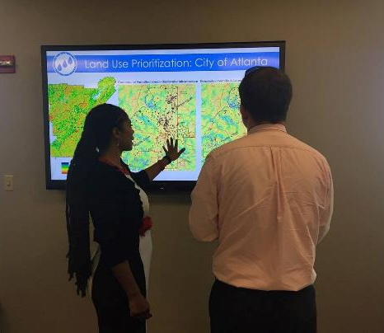
Deliverables: Presentation
What it is: the “story” of your project laid out in a slide by slide progression. It should speak to all aspects of your project.
Why it matters:
Presentation skills are fundamental to effective communication of science.
Presentations are commonly presented at the end-of-term node close out events.
Content from presentations are often repackaged for recruiting presentations, conference presentations.
This deliverable will be shared with project partners.
Presentation content is commonly used in recruiting presentations to inform potential partners and participants about the type of projects we conduct.
Presentations are used to report to NASA HQ in ASP Program Reviews and SMD Monthly Status Reviews.
How to make it work for you:
Presentation skills are critical – having good content to practice those skills helps!
The ability to craft a good PowerPoint presentation is important. Chartsmanship counts!
Presenting your work at a conference, in a classroom, or other events is fun and builds your skills and network.
Important to Know:
Some teams will be presenting a version of the presentation during Applied Science Week to NASA HQ.
The template's layout is a guide, feel free to amend it to fit your project. A good practice is to have the presentation flow through the following: what was the problem, what did you do about it, and what is/will be the benefit and outcome.
Presentation: http://www.devpedia.developexchange.com/dp/index.php?title=Presentation

Slide 4
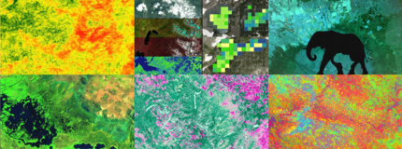
Deliverables: Website Image
What it is: The web image is a processed Earth observation image of your study area. The image must use NASA Earth observations and must include some kind of processing (it cannot simply be a true color image or a false color composite).
Why it matters:
These images are used for website project pages, graphic design elements, social media, and the ASP website.
How to make it work for you:
The ability to make effective visualizations of your work can increase the resonance of your project and attract viewers.
Important to Know:
The website image should not have any text on the image as it will be viewed at multiple scales and it would be distorted.
The website image comes in early in the term so that NPO has time to build project web pages.
Imagery: http://www.devpedia.developexchange.com/dp/index.php?title=Website_and_Technical_Imagery

Slide 5
Deliverables: Study Area Shapefile
What it is: The shapefile outlines the study area and is used for the creation of impact maps and congressional district maps.
Why it matters:
This deliverable allows us to show how our program benefits the taxpayer, giving insight into where we are increasing workforce development and building capacity to use NASA Earth observations.
Maps will be used by NASA's Applied Sciences when reporting to members of Congress, and it is thus extremely important that these maps accurately reflect the extent of our projects’ impact.
This shapefile is used in the creation of impact maps and the new interactive web mapper to discern project study areas.
How to make it work for you:
The ability to package shapefiles and share is helpful and you can reuse this shapefile in the future.
Important to Know:
Your shapefile must match the study area listed on your project summary.
Create a polygon shapefile of your study area, containing only one feature.
Attribute table should contain a “project” field where your project short title is listed.
The shapefile must be zipped and saved using standard file nomenclature.
Coordinate system: GCS_WGS_1984
If through the course of the project, your study area changes to include additional states/countries not originally listed, ALL deliverables must be updated to reflect that change (even after a FD has been submitted).
Shapefile: http://www.devpedia.developexchange.com/dp/index.php?title=Study_Area_Shapefile

Slide 6
Deliverables: DEVELOPedia Project Page
What it is: Each project has a page on DEVELOPedia that is accessible to future DEVELOPers.
Why it matters:
DEVELOPedia serves as the most complete project archive available – this is a resource to everyone in the program.
How to make it work for you:
You can refer back to this page at anytime as DEVELOPers get to keep their accounts for eternity.
After a final NPO review, a final, archival set of deliverables are posted and you can access as needed.
DEVELOP Website Project Pages
Project pages are posted near the end of term on the NASA DEVELOP website. Feature your experiences and project pages on LinkedIn.

Slide 7
Deliverables: Feedback Form
What it is: The newest deliverable is in response to NASA Headquarters’ request that we increase our collection and reporting of feedback relating to three things: 1) NASA Earth observation data (accessibility, processing, and use), 2) research questions surfaced by application projects (what do the feasibility study results lead our partners to pursue next), and 3) partner engagement. Headquarters is also collecting information relating to answering the question “what is your success rate?” driving DEVELOP to increase its reflection on and assessment of projects and resources expended. With this in mind, DEVELOP has created a simple template that collects information regarding the above topics, along with team and advising relating to each project.
Why it matters:
Headquarters is looking for the wealth of knowledge rapidly gained in DEVELOP projects to feed into Science Teams
How to make it work for you:
Team discussion relating to the challenges and data use is a great exercise for the team to pursue. Follow up with project partners is also an important facet to the relationships built.

