Slide 1
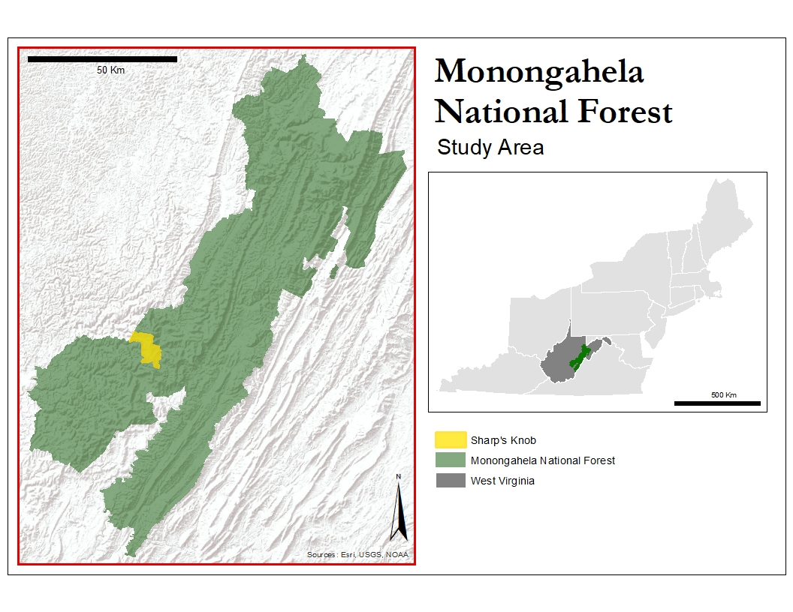



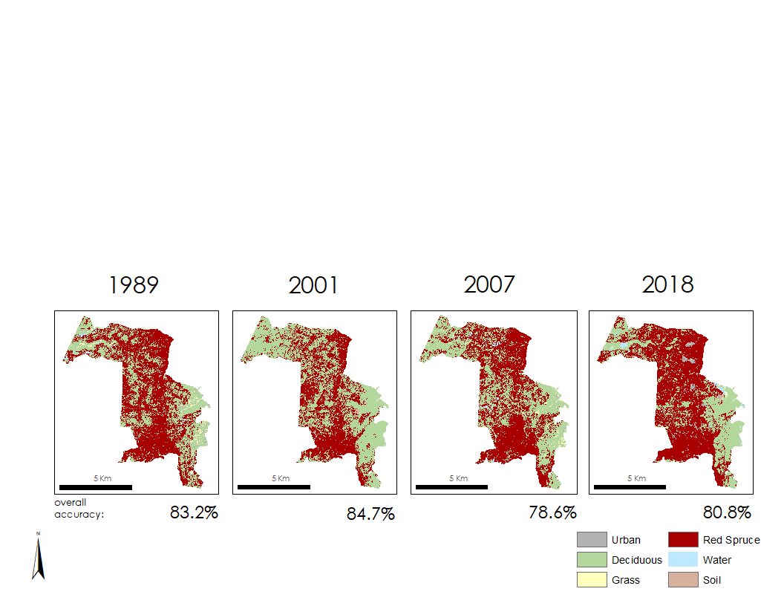
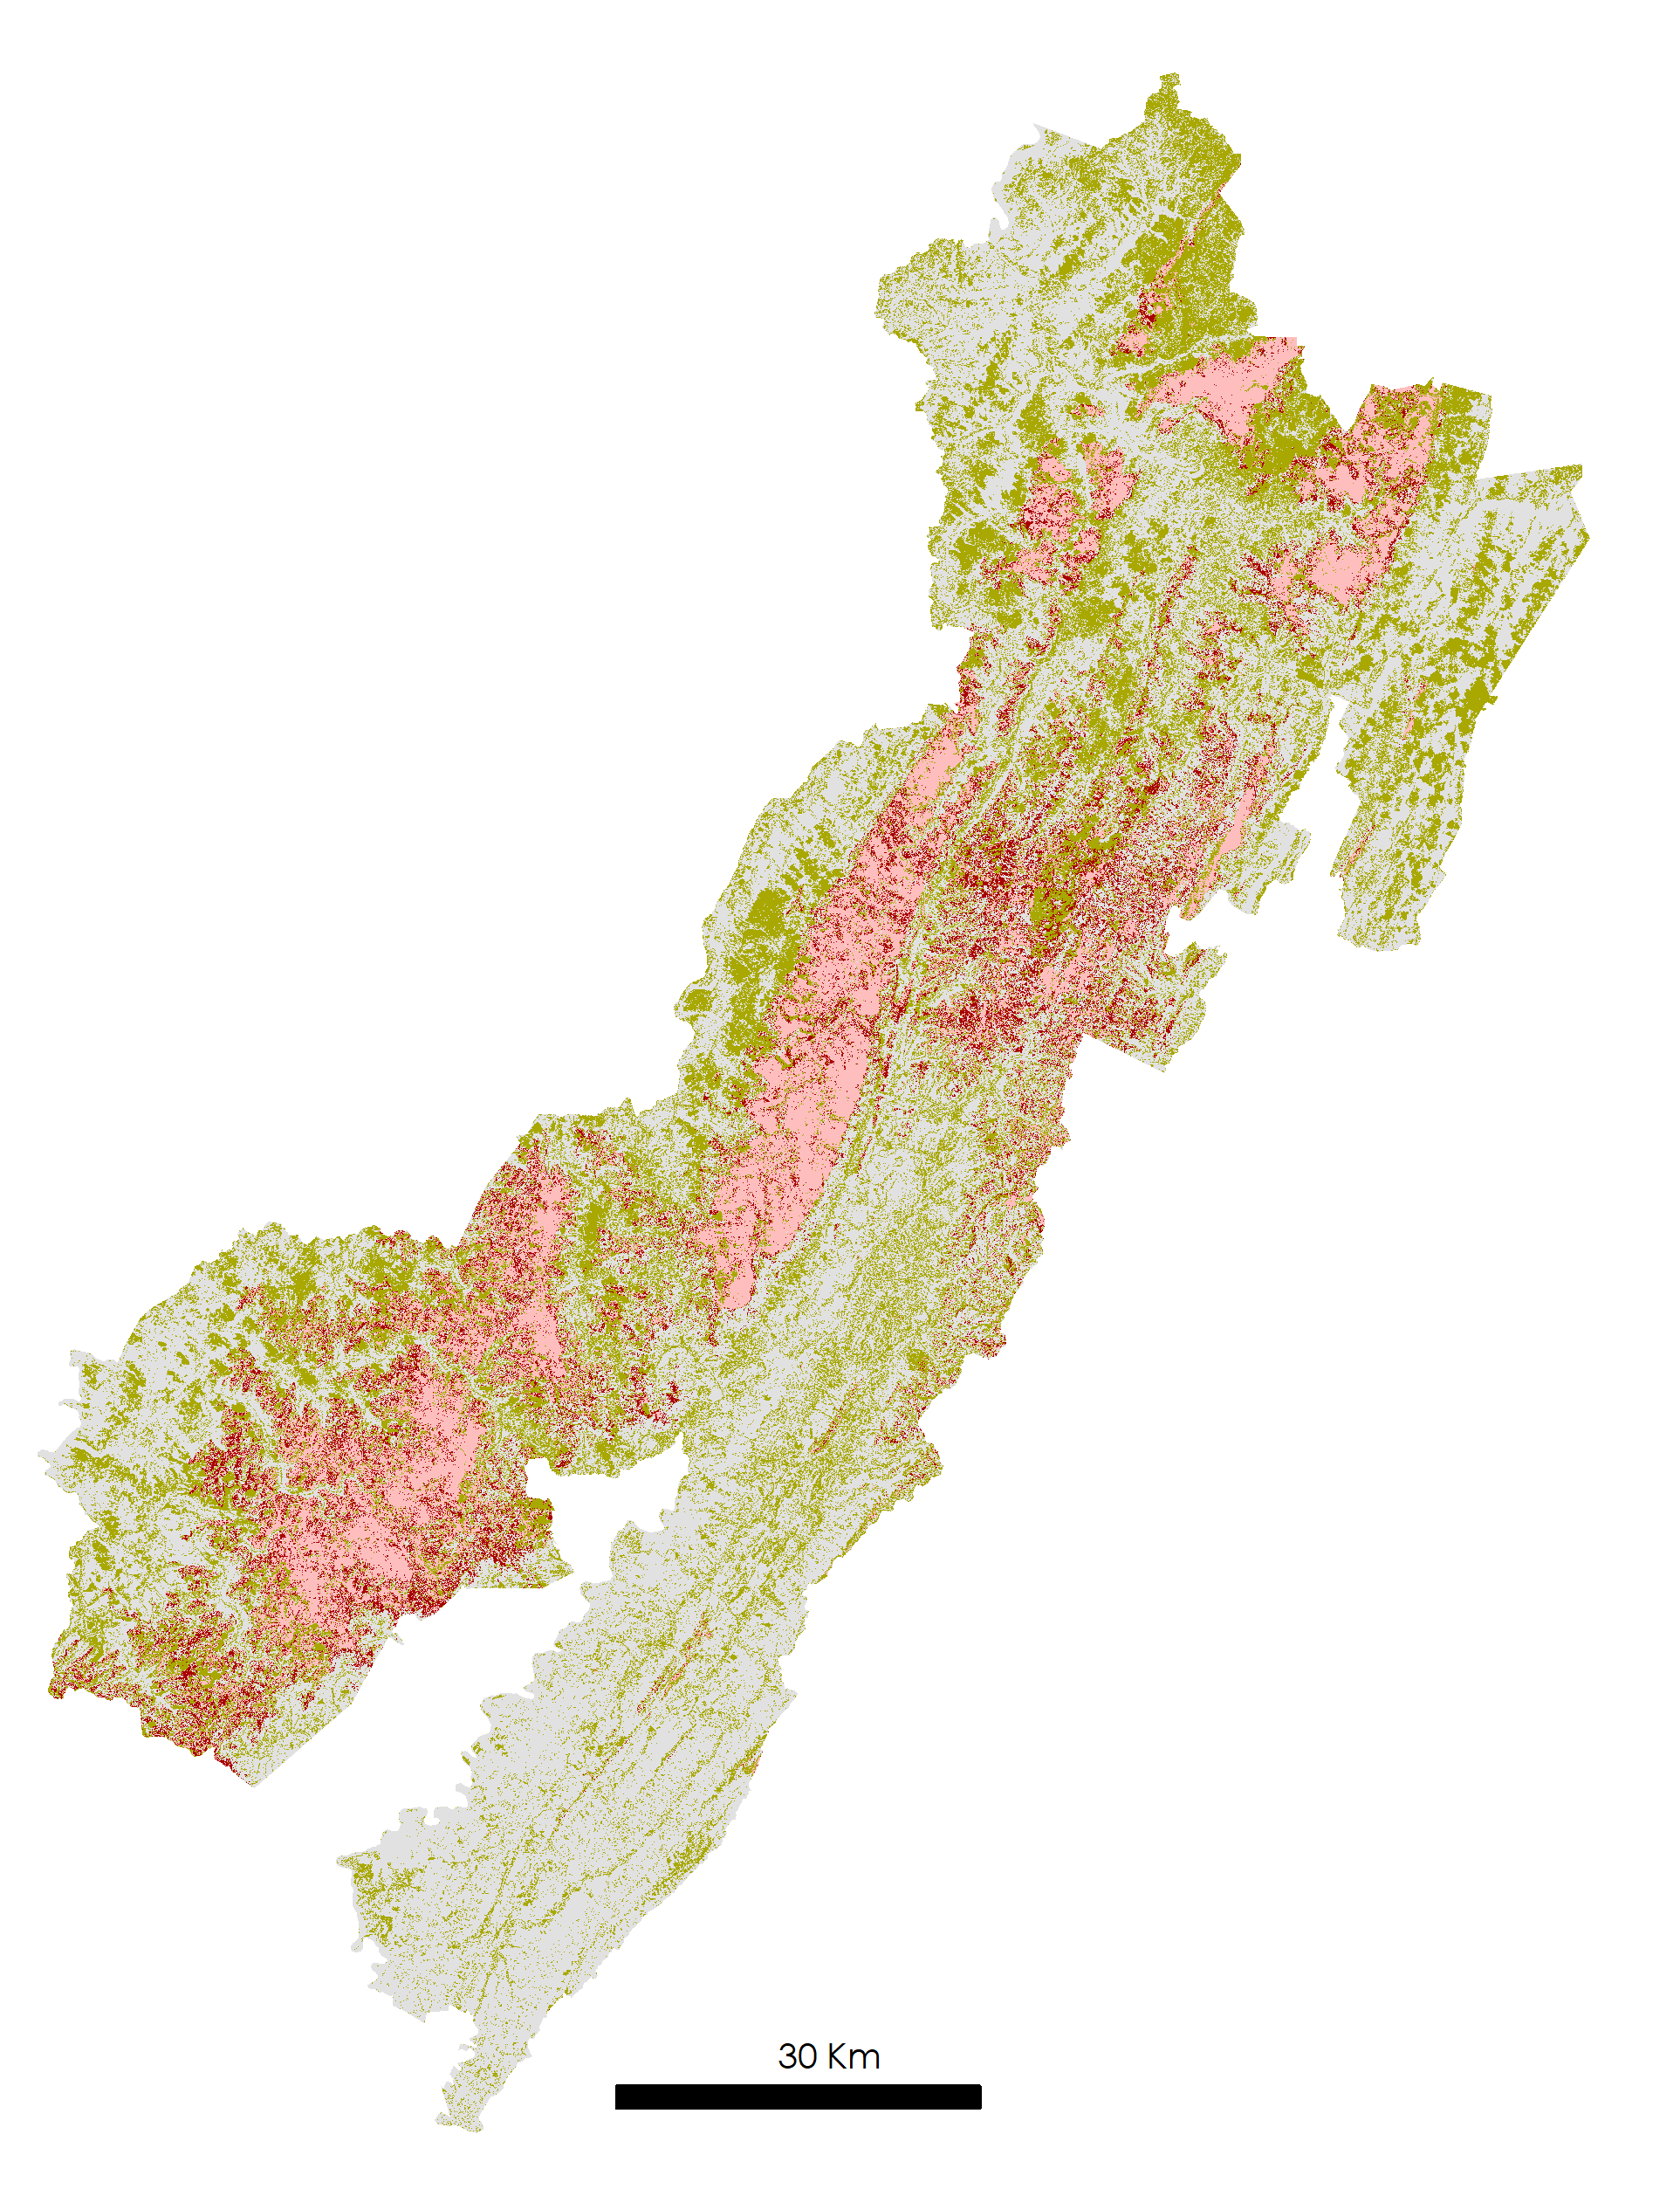
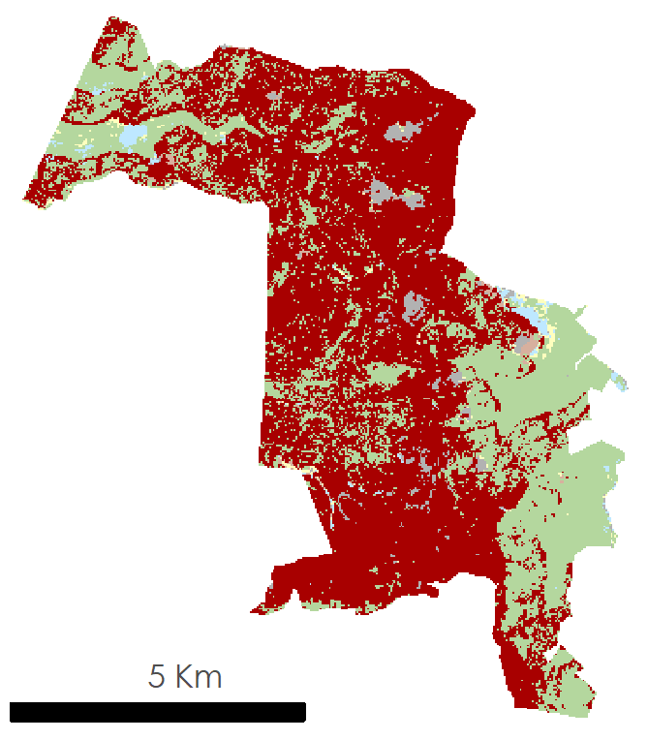
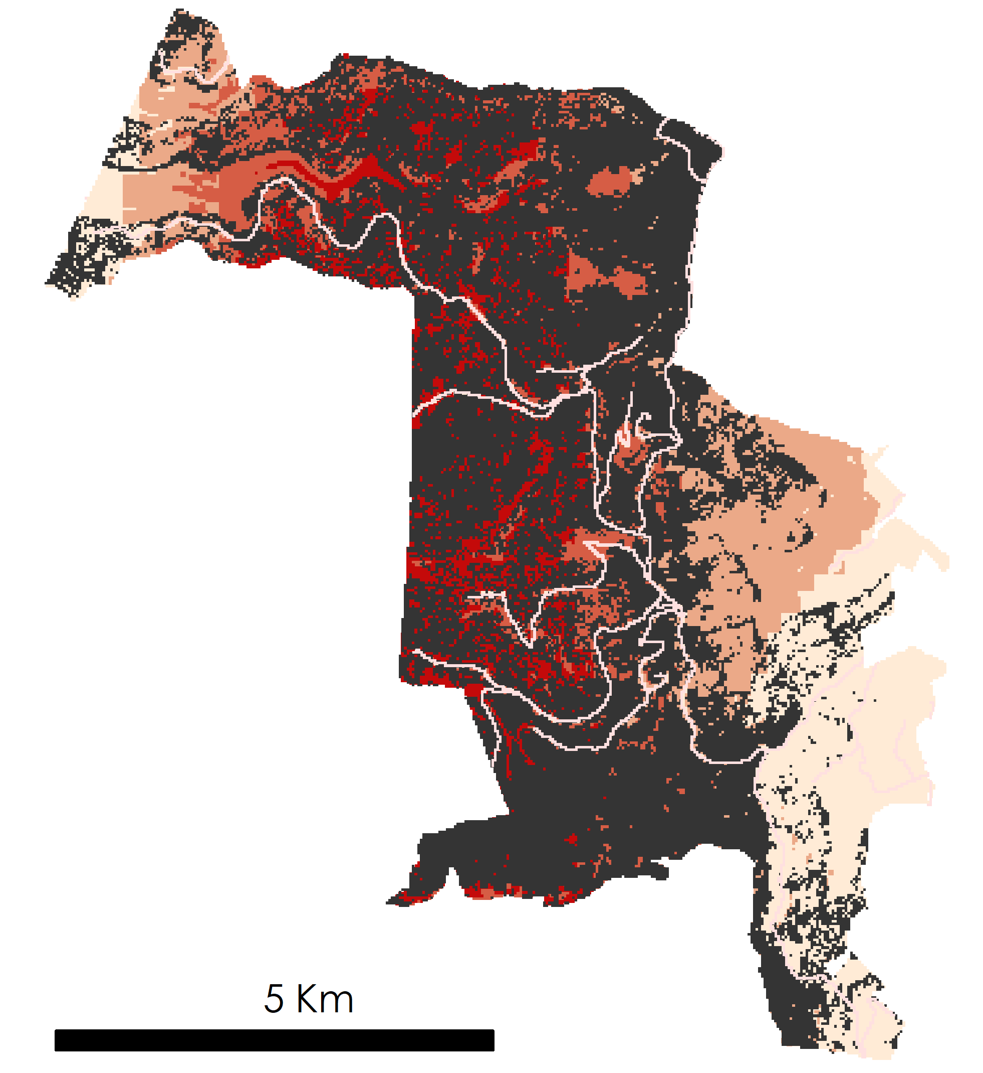


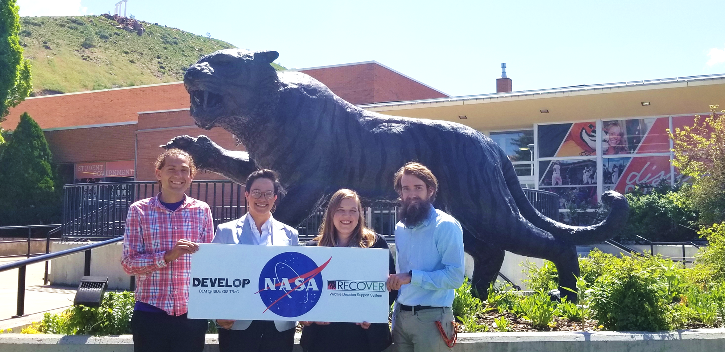

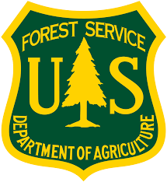
Forecasting Red Spruce Restoration Using NASA Earth Observations to Support the USFS Monongahela National Forest
Abstract
Objectives
Study Area
Monongahela National Forest Ecological Forecasting
Within the Monongahela National Forest (MNF), situated in the Allegheny Highlands of West Virginia, extensive logging and mining practices have significantly altered the structure and composition of flora and fauna over the past two centuries. Of particular concern to MNF land managers are red spruce (Picea rubens) stands, which provide shelter and food to several endangered and threatened species. To aid red spruce restoration, this study mapped current and historical stands and identified non-native stands with suitable habitats for red spruce in the Sharp Knob Red Spruce Restoration Area. Data from Landsat 5 Thematic Mapper (TM), Landsat 8 Operational Land Imager (OLI), and Shuttle Radar Topography Mission (SRTM) were input into classification tree and fuzzy logic algorithms. Furthermore, 2018 classification maps were utilized in the TerrSet Land Change Modeler to forecast red spruce extent up to 2040. As a product of these analyses, we produced three sets of maps: four time series maps of red spruce stands from 1989 to 2018, a map that identifies suitable stands for future restoration efforts, and a red spruce land cover change map up to 2040. Our results indicate that 562 hectares are suitable for future restoration in Sharp’s Knob, with an 8% gain in red spruce stands from 1989 to 2018. However, forecasting results indicate that management intervention will be necessary for this trend to continue.
Identify red spruce extent for 4 years between 1989 and 2018
Map suitable locations and corridors for current red spruce restoration efforts
Forecast red spruce canopy cover for 2040
Produce tutorial for partners to reproduce methods throughout Monongahela National Forest
Sharp’s Knob
Monongahela NF
Methodology
West Virginia
Step 1: Classification
Forest Cover Identification:
Classification Tree Algorithm (TerrSet)
Data Collection:
SRTM
Landsat 5 TM
Landsat 8 OLI
Image Derivatives:
NDVI, NDMI, Elevation, Slope, Aspect, and PCA band 1
Step 2: Forecasting
Earth Observations
Inputs:
Forest classifications (CTA output) from 1989 and 2018, roads, elevation, aspect, and slope
Projected Land Cover Change from 2018 to 2040:
Land Change Modeler (TerrSet)
Step 3: Site Suitability
Red spruce suitability variables:
Elevation, slope, frost days, growing degree days, distance to roads, annual temperature, and annual precipitation
Fuzzy Membership Assignment:
Linear, small, and large
Suitability Map:
Fuzzy Overlay (ArcMap)
Landsat 5 TM
Landsat 8 OLI
SRTM
Results
Classification
Forecasting to 2040
Site Suitability
Change to spruce
No change
Persistent spruce
Red spruce
Change other
Suitability
Water
Low
Soil
Moderate
Urban
High
Deciduous
Very high
Grass
Roads
Red spruce extent
Conclusions
Team Members
Medium resolution, multispectral imagery from Landsat can be successfully used to identify and classify red spruce stands in the Monongahela National Forest.
Red spruce extent has increased by 17,777 hectares (12.7%) from 1989 and 2018 across the entire National Forest and 238 hectares (8%) in Sharp’s Knob.
562 hectares were not classified as red spruce by our model but were classified as either very high or high suitability, suggesting these areas are suitable for future restoration projects.
According to the forecasting model, without active management practices red spruce stands will not continue to reclaim historical extent.
John Dialesandro
Project Lead
Mason Bull
Tia Francis
Katy Yut
Acknowledgements
Project Partners
We would like to thank our partners at the Monongahela National Forest, Stephanie Connolly, Amy Coleman, and Sam Lammie. In addition, we appreciate the advice and expertise of our science advisors, Keith Weber (Idaho State University, GIS TReC), Joseph Spruce (Science Systems and Applications, Inc.) and Dr. Catherine Jarnevich (USGS Fort Collins Science Center), along with the Colorado Center Lead, Kristen Dennis.
USDA, US Forest Service, Monongahela National Forest
USDA, US Forest Service, Northern Institute of Applied Climate Science
Idaho – Pocatello| Summer 2019

