Slide 1
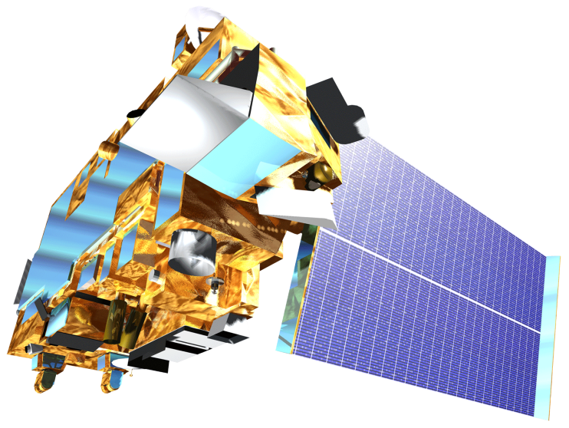
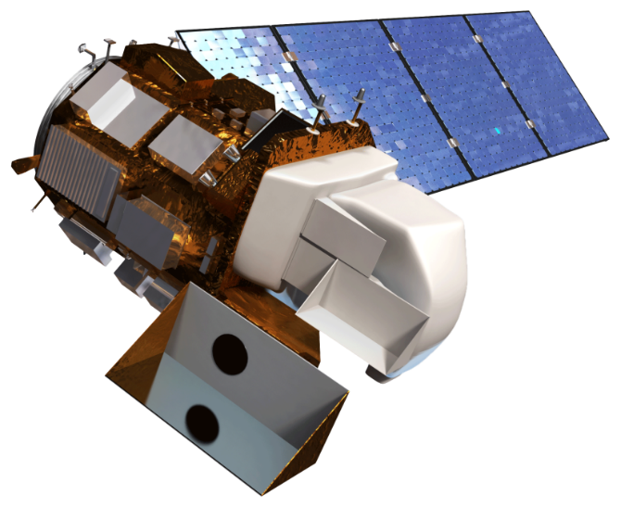
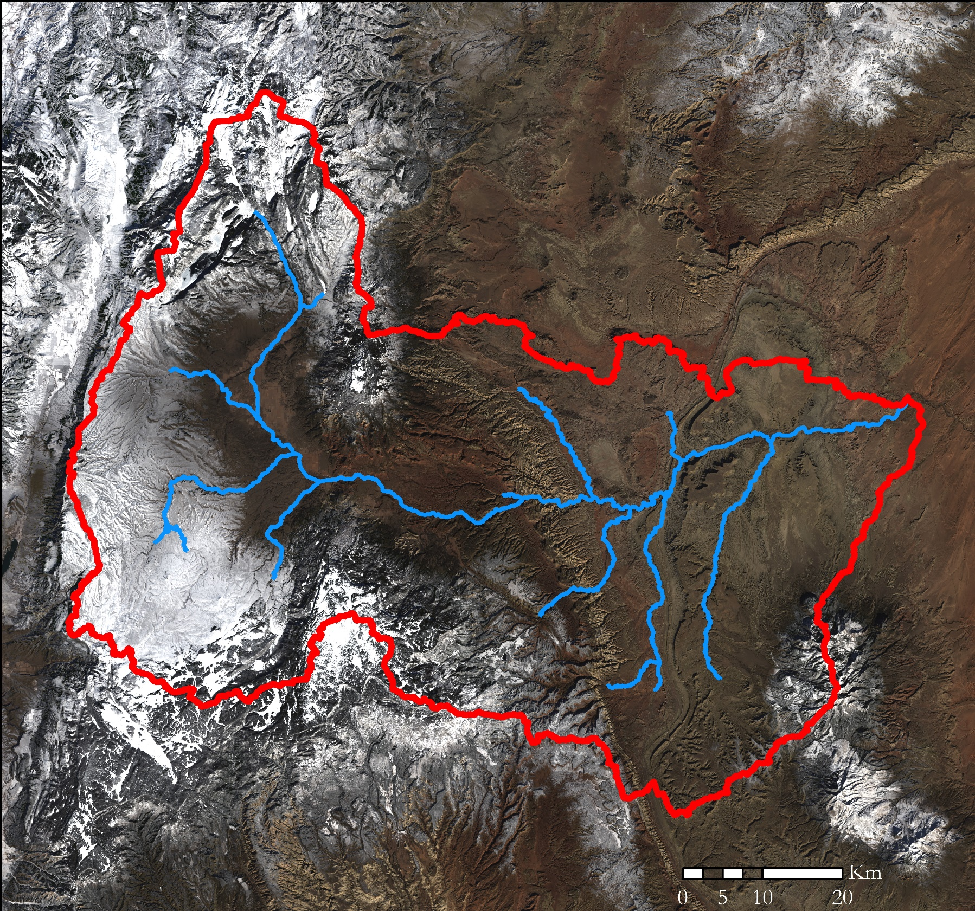
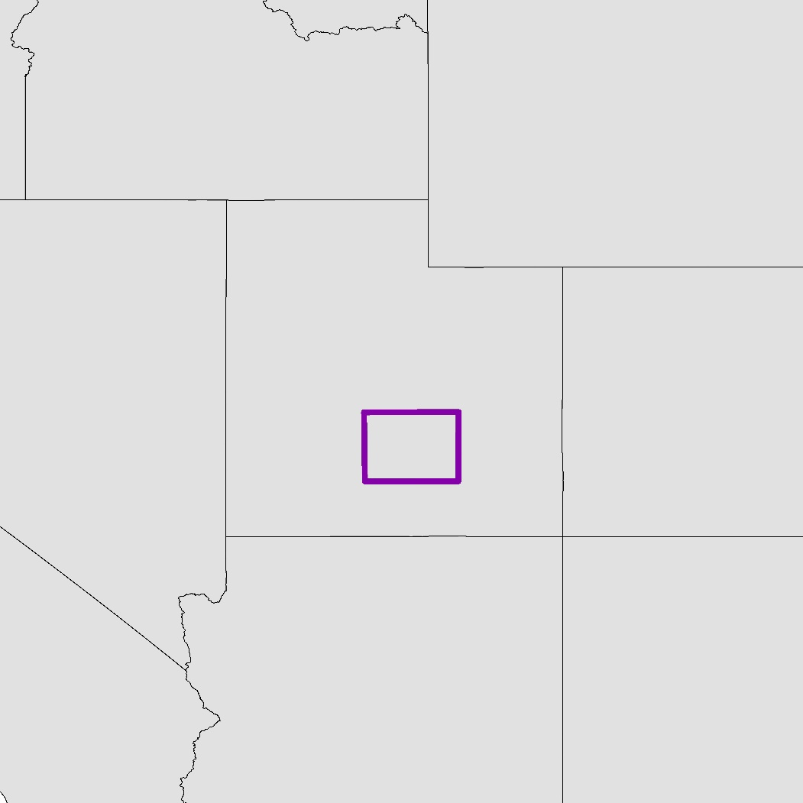
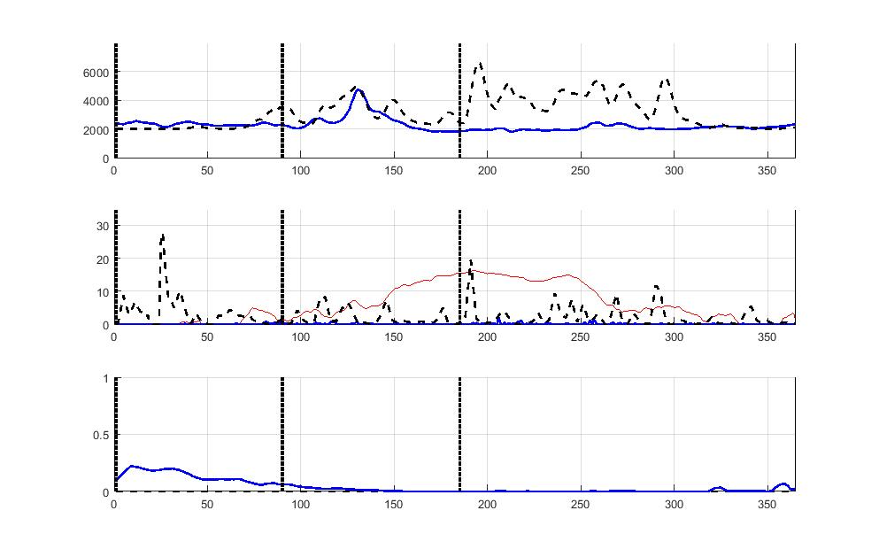
Assessment of Annual Snowpack and Its Effect on Water Availability in the Fremont River Basin
Abstract
Objectives
The Fremont River in Utah provides water for wildlife, riparian habitats, and irrigation for approximately 16,000 acres of agricultural lands, which includes the historic orchards and pastures maintained by Capitol Reef National Park. Annual snowmelt is recognized as the primary water source within the Fremont River Basin. However, the predictions of seasonal water availability within the basin from in situ snowpack measurements have proven unreliable in the past. For this reason, a more robust method was required to provide accurate estimates. For better predictions of annual water resources from snowmelt, the team utilized daily Normalized Difference Snow Index (NDSI) snow cover data and daily Land Surface Temperature (LST) data from the Terra Moderate Resolution Imaging Spectroradiometer (MODIS). The team also integrated daily precipitation data from the Precipitation Estimation from Remotely Sensed Information using Artificial Neural Networks - Climate Data Record (PERSIANN - CDR). These datasets were incorporated into the SNowmelt Observational Watershed Model (SNOW-M) with in situ data, creating two graphical outputs that reveal the changes in snowmelt between 2000 and 2017. These graphical outputs included the actual flow versus the simulated water flow per annum and the snow covered area per annum. Furthermore, this model simulated the projected water flow for three months based on snow covered areas. Complementing the SNOW-M, monthly Terra MODIS NDSI snow cover data were utilized to produce maps displaying the change in snow cover extent. Capital Reef National Park will employ these products to further predict the seasonal water availability for irrigation.
Derive the Snowmelt Observational Watershed Model (SNOW-M) from the Modified – Snowmelt Runoff Model (M-SRM)
Detect snow cover from NASA Earth observations
Model and Predict water flow
Earth Observations
Study Area
Terra MODIS
Landsat 8 OLI
Methodology
1/3 Arc Sec LiDAR DEM
ArcSWAT Watershed Delineation
ID
WY
Landsat 8 OLI
MODIS NDSI
MODIS
LST
PERSIANN Precipitation
In situ SNOTEL Data
In situ Stream Gauge Data
Elevation Zones
NV
UT
CO
Validate Snow Cover
SNOW-M
CA
AZ
NM
Fremont River Watershed
Snow Maps
Validation Table
Actual vs Simulated Flow Plot
Snow Cover Area Plot
Fremont River & Tributaries
Results
In Situ Flow vs. Simulated Flow: 2017
In Situ
Difference in 2016-2017 Snow Cover from 2000-2010 Snow Cover
Flow (L/s)
Simulated
% Difference
Precipitation vs. Temperature: 2017
4.7 - 6.3
Precipitation (cm/day)
Temperature (C)
Temperature
3.2 - 4.7
Precipitation (in situ)
1.6 - 3.2
Precipitation (PERSIANN)
0 - 1.6
-2.5 - 0
Snow Covered Area: 2017
-5.1 - -2.5
Low Elevations
-7.6 - -5.1
Fractional Area
High Elevations
-9.6 - -7.6
Landsat 8 OLI Natural Color Imagery
Project Partners
Conclusions
National Park Service, Northern Colorado Plateau Network
Capitol Reef National Park
The preliminary snow cover change map for the 2016 to 2017 water year shows less snow cover.
The SNOW-Model was written and adapted from M-SRM to fit the Fremont River Basin.
The project resulted in the development of the SNOW-Model.
Acknowledgements
Team Members
Joseph Spruce, Lead Science Advisor for NASA DEVELOP VA – Wise County
Dr. L. DeWayne Cecil, Chief Climatologist at NOAA National Centers for Environmental Information and Program Manager of Global Science & Technology, Inc.
Annette Hollingshead, Senior Scientist at Global Science & Technology, Inc.
Bob VanGundy, Geology Instructor at The University of Virginia’s College at Wise
Dr. Kenton Ross, Lead Science Advisor for NASA DEVELOP National Program
Katherine Cavanaugh, Geoinformatics Fellow at NASA DEVELOP, Jet Propulsion Laboratory
Eric White, Center Lead at NASA DEVELOP Wise County Clerk of Circuit Court’s Office
Brooke Colley, Assistant Center Lead at NASA DEVELOP Wise County Clerk of Circuit Court’s Office
The team would also like the acknowledge the Chile Water Resources teams from Fall 2013 and Spring 2014 at the Langley Research Center for the creation of the Modified Snowmelt-Runoff Model (M-SRM) utilized in our project.
Margaret Mulhern
Project Lead
Manda Au
Nolan Barrette
Austin Counts
Fremont River Basin Water Resources
Virginia – Wise | Spring 2018

