Slide 1

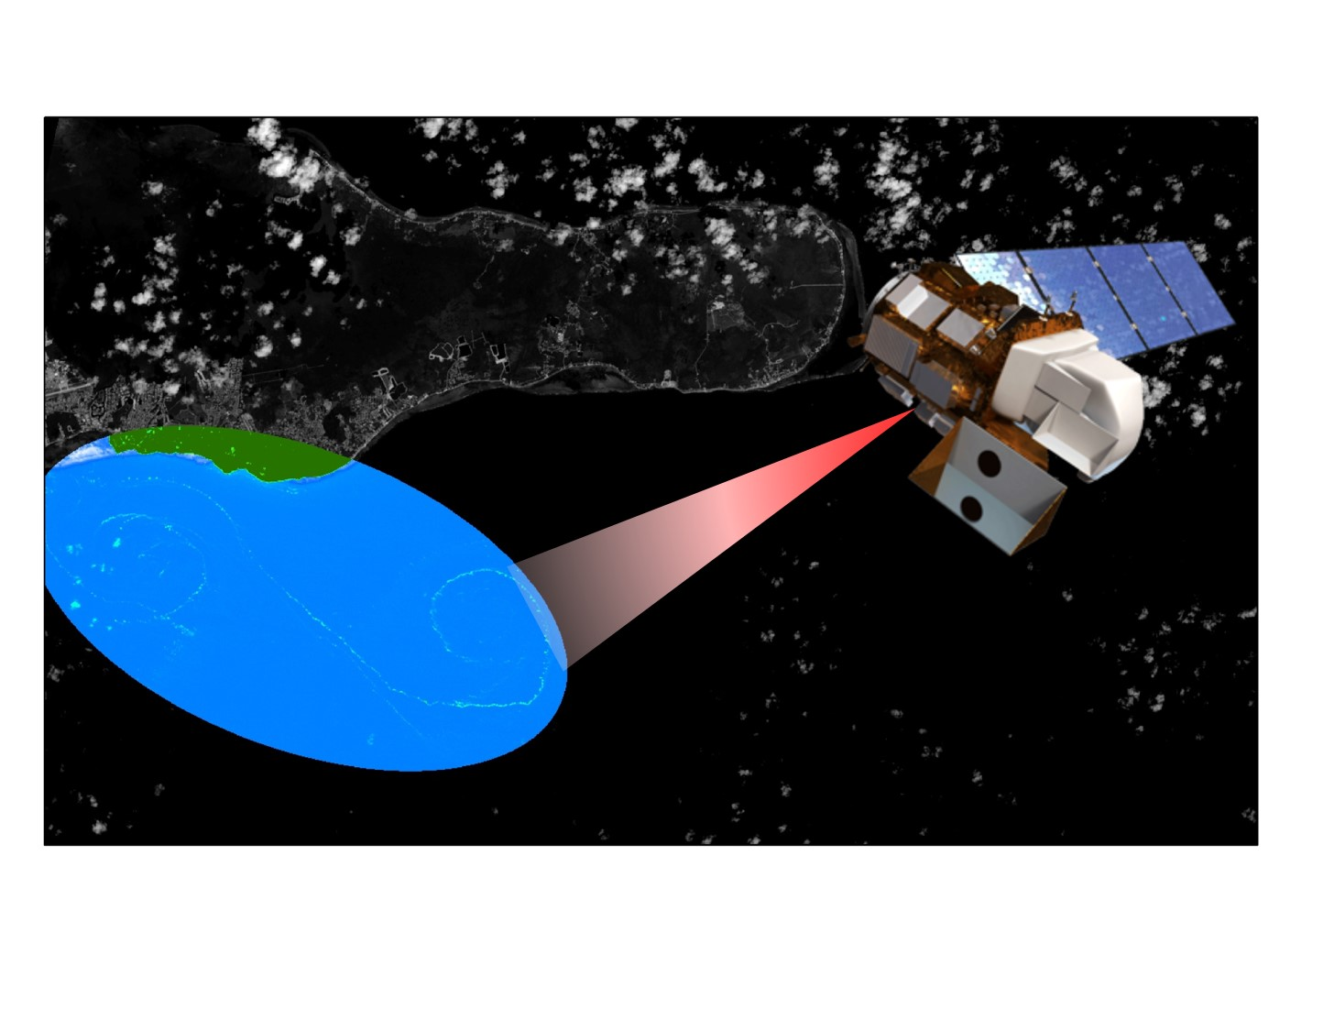
Caribbean Oceans II
Jordan Ped
Investigating Inundation Events: A Study of Remote Sensing Techniques and Novel Data Sources for Sargassum Detection and Quantification in the Caribbean Sea
Maria Lopez-Peña
Emma Accorsi
Notes:
[MARIA]
Hello everyone!
I am Maria Lopez-Peña from the Metropolitan University of Puerto Rico and I am Emma Accorsi from Emory University. We are the Caribbean Oceans DEVELOP team at the NASA Ames Research Center in Mountain View, CA, and today we will be speaking about utilizing NASA Earth Observations to detect Sargassum and to model its relationship between oceanic variables in the Caribbean Sea in response to unprecedented Sargassum inundation events.

Slide 2
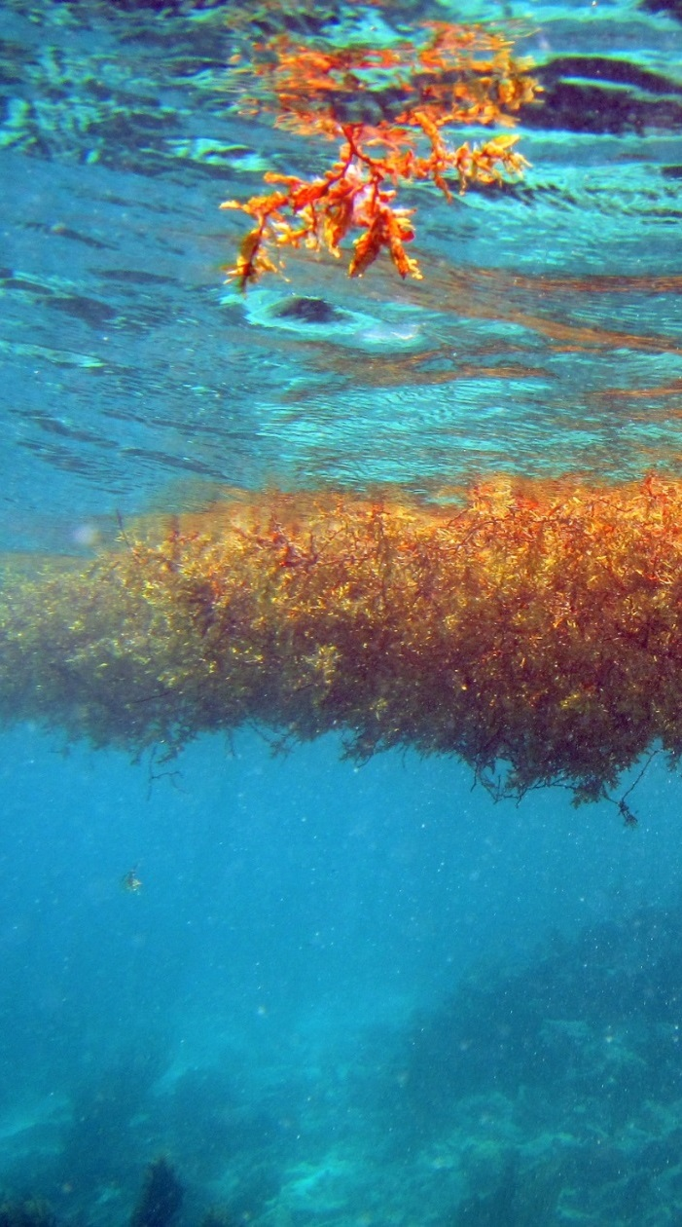
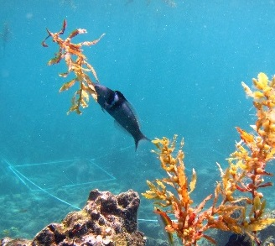
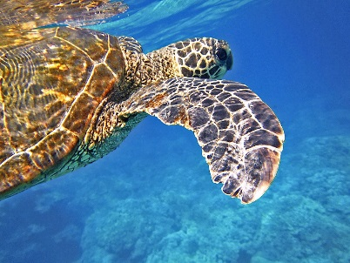
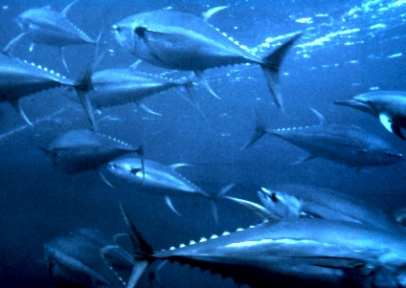
What is Sargassum?
Sargassum - genus of pelagic brown macro algae
  Holopelagic:
  Sargassum fluitans and Sargassum natans
Significant ecosystem services:
Ocean nutrient cycling
Food Source
Nursery
Habitat
Source: Dr. Juan Torres-Perez
Source: Pixabay
Source: Wikipedia
Helps Promote Biodiversity
Image Credit: Dr. Juan Torres-Perez
Notes:
So what is Sargassum?
Sargassum is a holopelagic brown seaweed that spends its entire life cycle floating in the upper-most part of the water column and plays a vital role in the marine ecosystem.
Many of the ecosystem services that these floating mats provide include: food source and habitat for endemic and migratory species such as the Sargassum Anglerfish and juvenile sea turtles, fish nursery, and nutrient cycling.
These services can promote biodiversity and sustain unique marine communities to flourish in the open ocean.
Image URL:
Turtle: https://pixabay.com/static/uploads/photo/2014/11/27/02/55/sea-turtle-547163_960_720.jpg
Tuna: https://en.wikipedia.org/wiki/Yellowfin_tuna

Slide 3
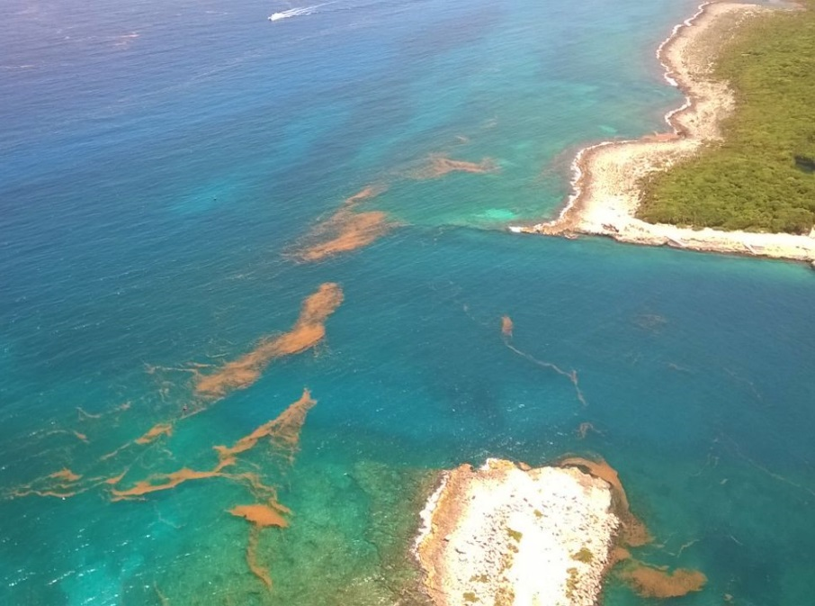
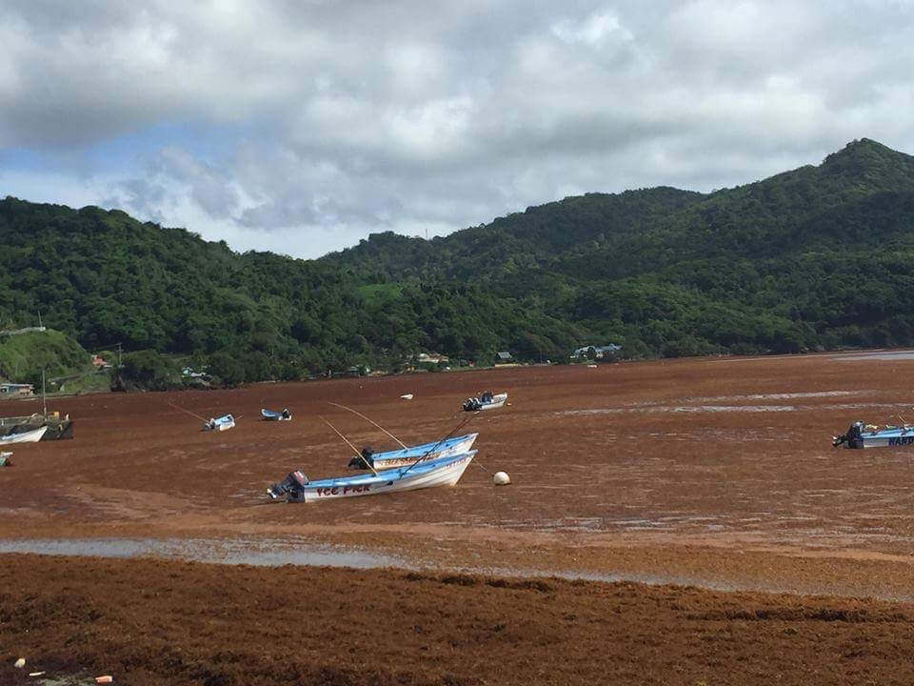
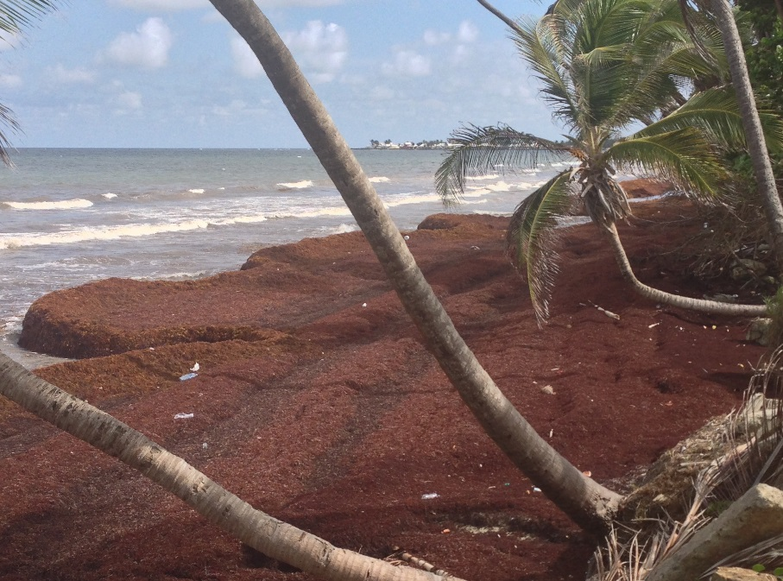
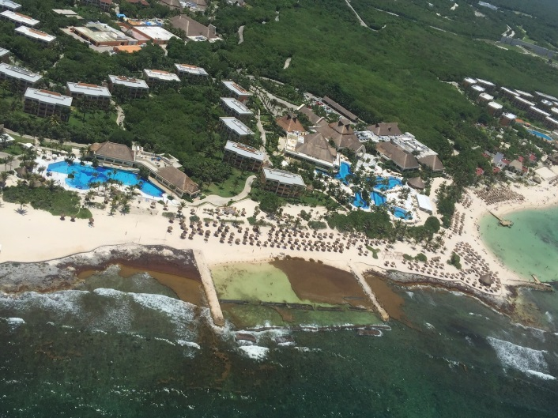
Caribbean Influx
Community Concerns
Environmental
Economic
+
Image Credit: Roy Armstrong
Image Credit: Roy Armstrong
Significant influx in Caribbean in 2011, 2014, 2015
Growing concern from Caribbean Nations
Notes:
The nations of the Caribbean face both economic and environmental concerns from Sargassum inundation events.
Including: harm to near shore-ecosystems from block sunlight to coral reefs and hypoxia for fish populations, compressed sand for sea turtle nests. Reduction in tourism from lack of beach access and putrid smell
Inundation occurred in 2011, 2014, and 2015 prompting significant investigation into the reasons for these events

Slide 4
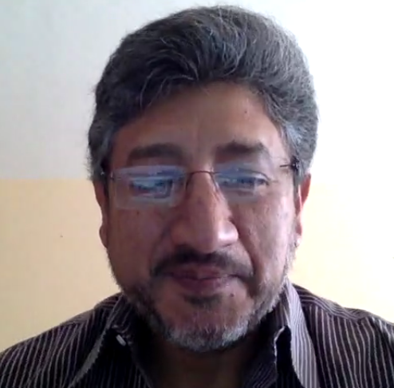
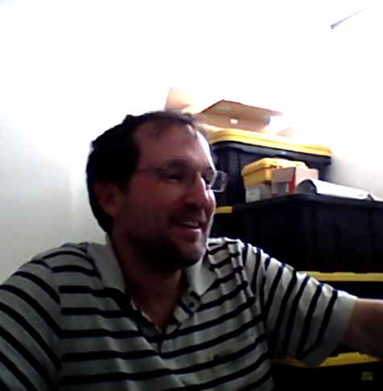
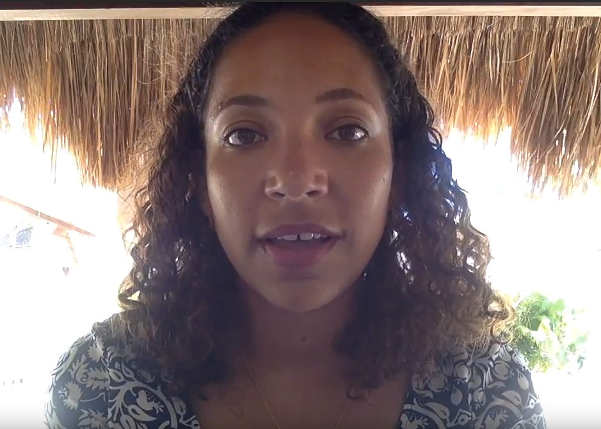
Partnerships
Dr. Porfirio Alvarez Torres, Executive Secretary at CiiMarGoMC
Dr. Sergio Cerdeira, CONABIO
Frederique Fardin,
Project Coordinator on Sargassum Issues at SPAW-RAC
A 2016 survey of 45 marine researchers showed that 80% (36/45) agreed that the amount of Sargassum in the Caribbean in 2015 was significantly higher than in previous years.
Notes:
Our project partners included:
Dr. Porfirio Alvarez from Consorcio de Instituciones de Investigación Marina del Golfo de México y del Caribe (CiiMar-GoMC) who brought our attention to the Project
Dr. Sergio Cerdeira from Comisión Nacional para el Conocimiento y Uso de la Biodiversidad (CONABIO) who helped us with technical specifications
Frederique Fardin from the UN’s Regional Activity Center for Specially Protected Areas and Wildlife (SPAW-RAC) helped us coordinate with other researchers

Slide 5
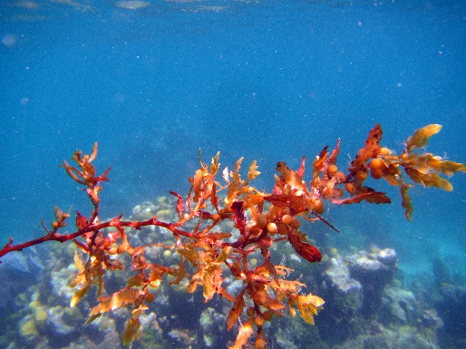
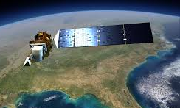

Objectives
Detect Sargassum
Image Credit: Dr. Juan Torres-Perez
Compare Indices and Sensors
NASA Earth Observations
Asses accuracy of Instagram
Ground truth data
Notes:
Detect Sargassum inundation events in the Caribbean region:
-Compare indices and sensors available through NASA EOS for Sargassum detection
-Assess the accuracy of Instagram as a proxy for ground truth data
Images:
https://www.nasa.gov/content/goddard/nasa-usgs-landsat-8-satellite-celebrates-first-year-of-success/#.V6u7GvkrLX4
http://www.forbes.com/sites/fruzsinaeordogh/2016/05/12/love-it-or-hate-it-instagrams-new-logo-is-so-internet-right-now/#c33f4cc6923c

Slide 6
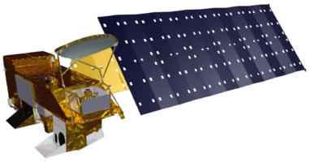
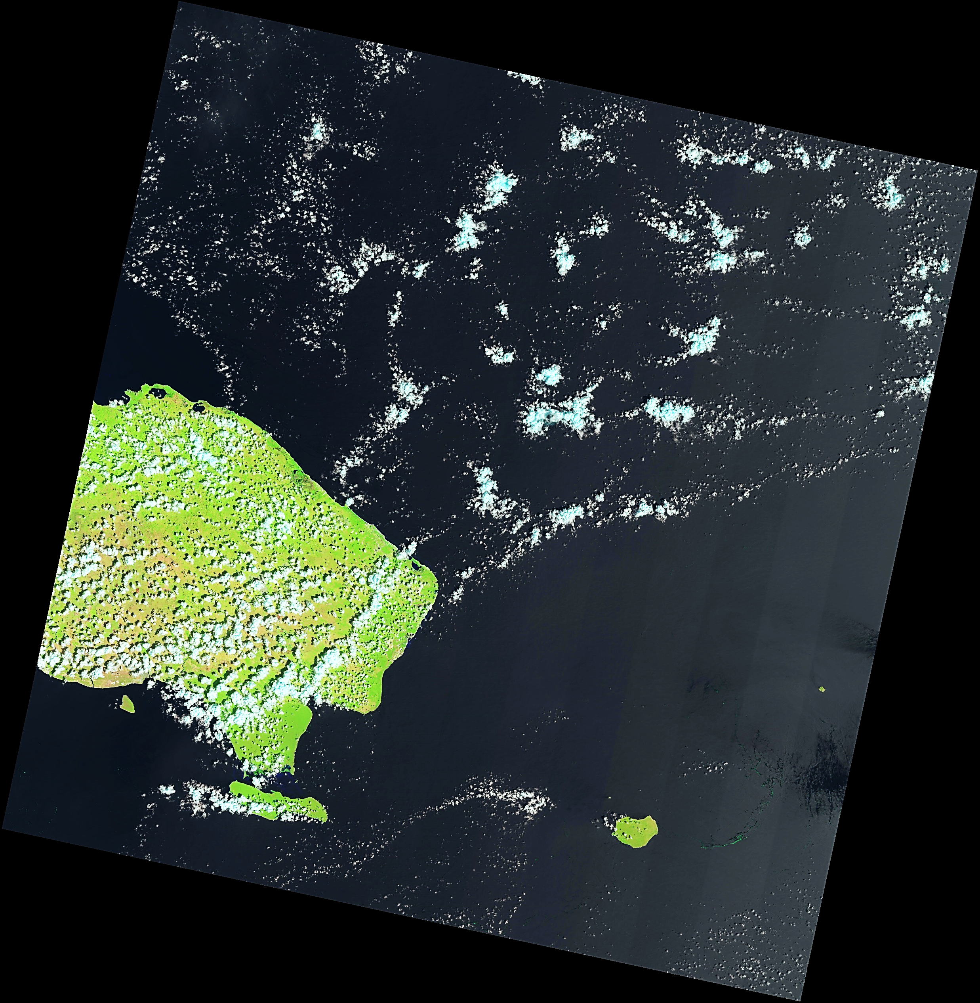
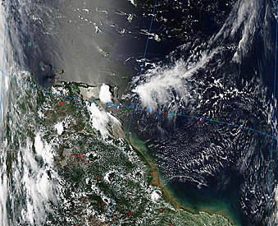
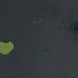
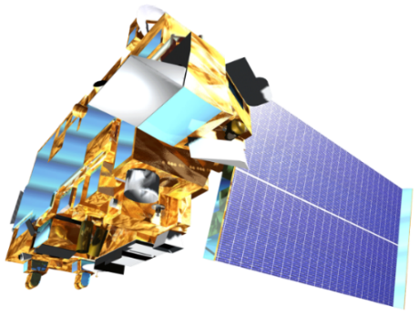
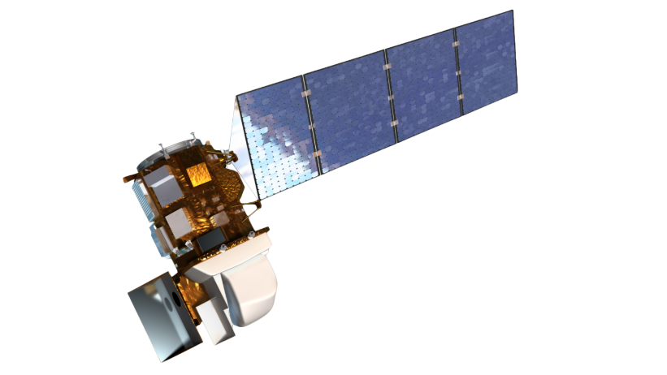
Data Acquisition I
Aqua MODIS
Terra MODIS
Landsat 8 OLI
GLOVIS Earth Explorer Ocean Color Web
glovis.usgs.gov earthexplorer.usgs.gov oceandata.sci.gsfc.nasa.gov
Notes:
We used Aqua, Terra, and Landsat 8 downloaded from Glovis, Earth Explorer, and Ocean Color web. Landsat has higher spatial resolution and MODIS has higher temporal resolution.
Images:
http://landsat.gsfc.nasa.gov/?p=3186
http://earthobservatory.nasa.gov/Features/Terra/
http://earthobservatory.nasa.gov/Features/Water/page4.php

Slide 7


Data Acquisition II
Stakeholder and Community Survey:
45 responses
Topics addressed: Sargassum sighting locations, 2015 Sargassum levels, year-to-year differences, removal strategies, future research, Sargassum seasonality, environmental concerns
Notes:
Our second source of data acquisition was the STAKEHOLDER AND COMMUNITY SURVEY, which was carried out with 45 marine researchers and addressed topics such as:
Sargassum siting locations
2015 Sargassum levels
Year to year differences
Removal strategies
Future research
Sargassum seasonality
Environmental concerns
The survey was made available through the BASECAMP forum. BASECAMP is a Sargassum-related scientific forum, where discussions and collaborations are made available for the Sargassum research community worldwide.
Images:
https://signalvnoise.com/posts/3791-basecampy

Slide 8
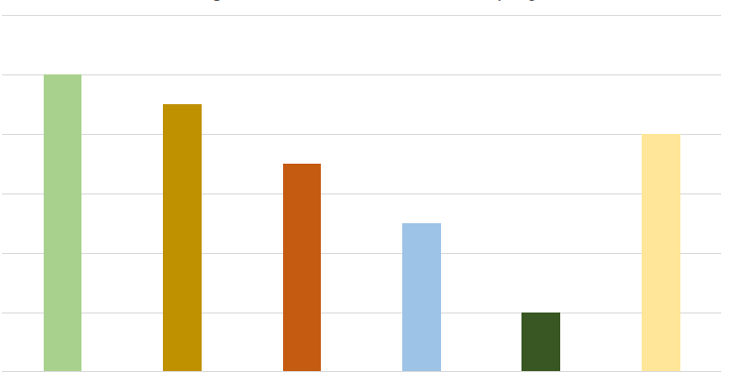
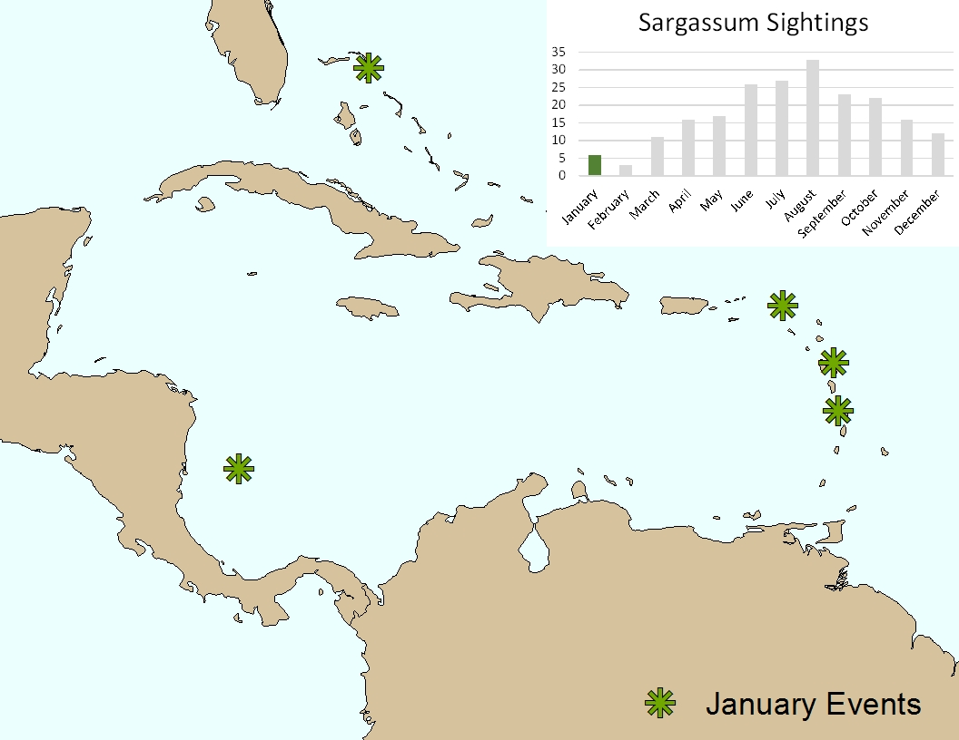
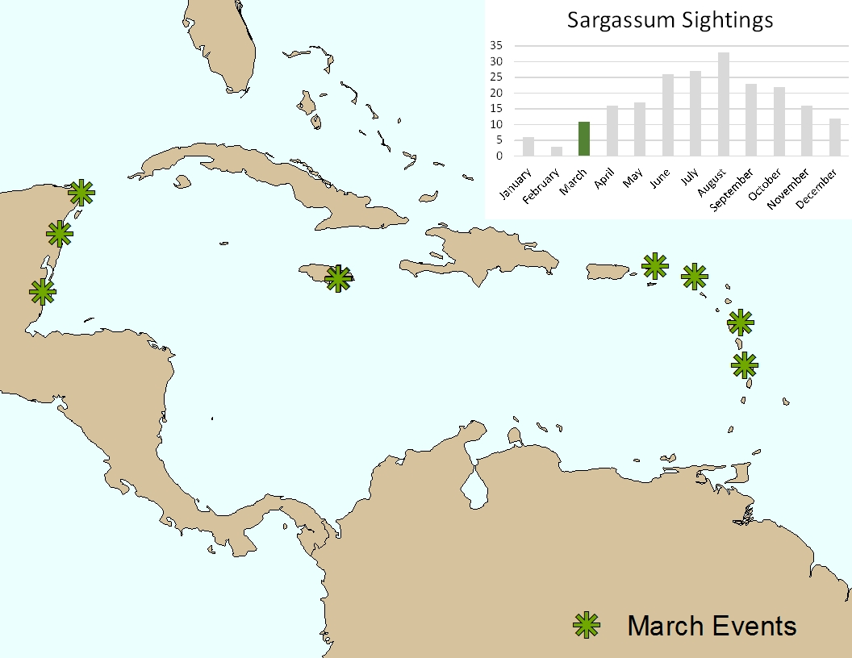
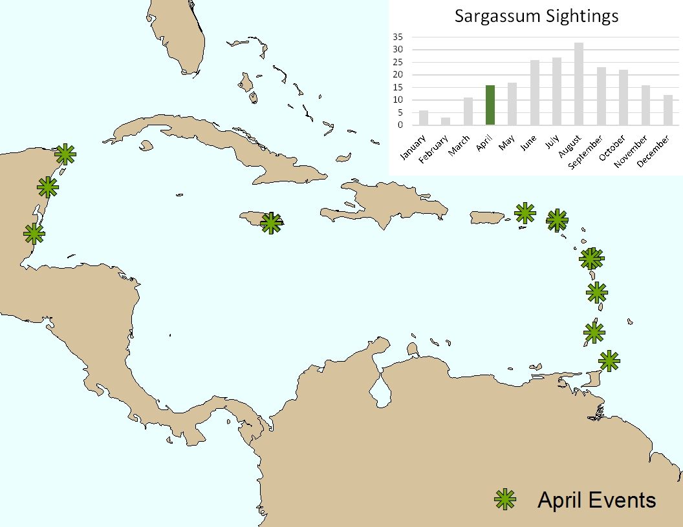
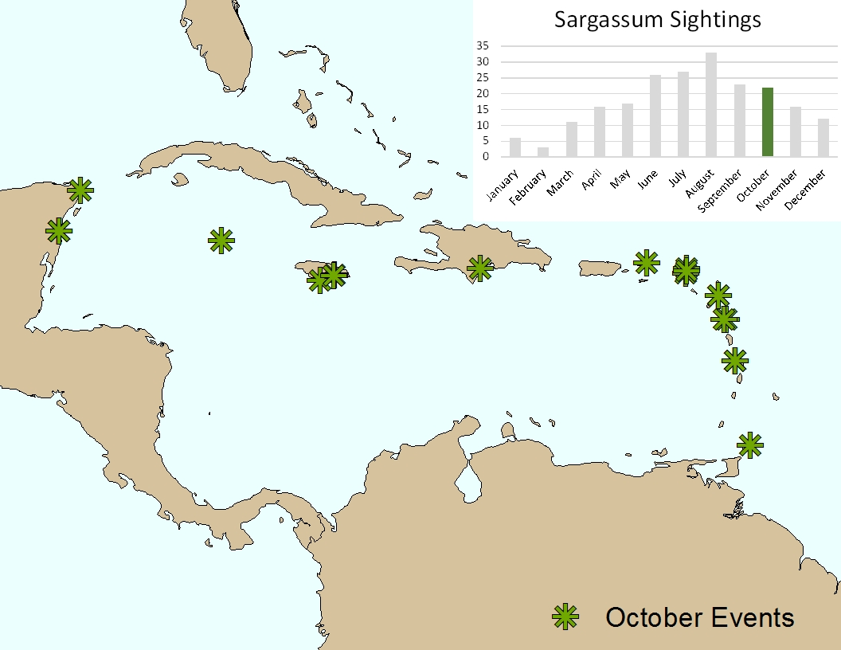
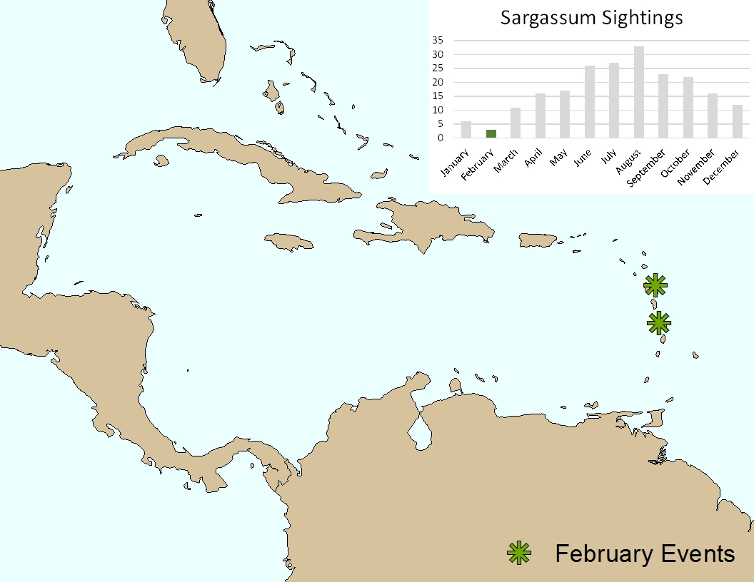
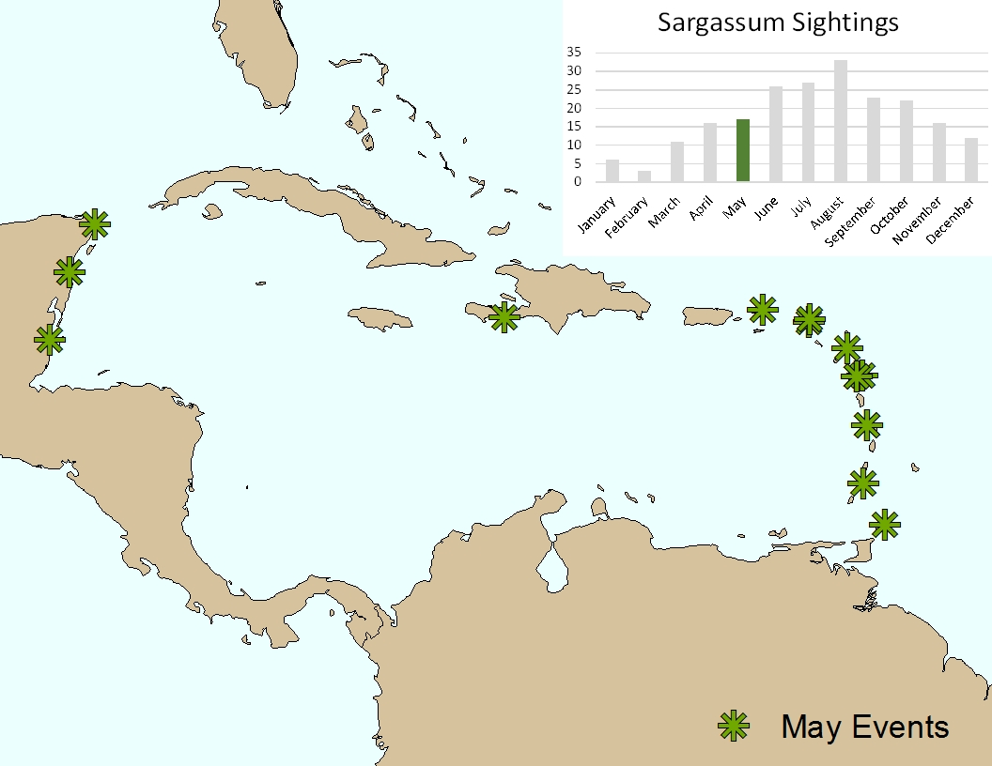
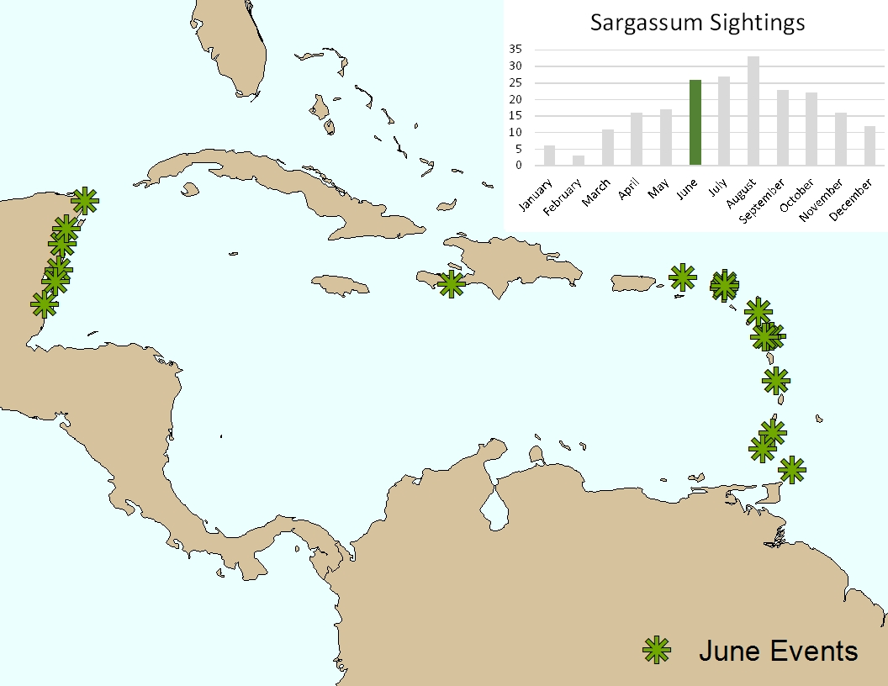
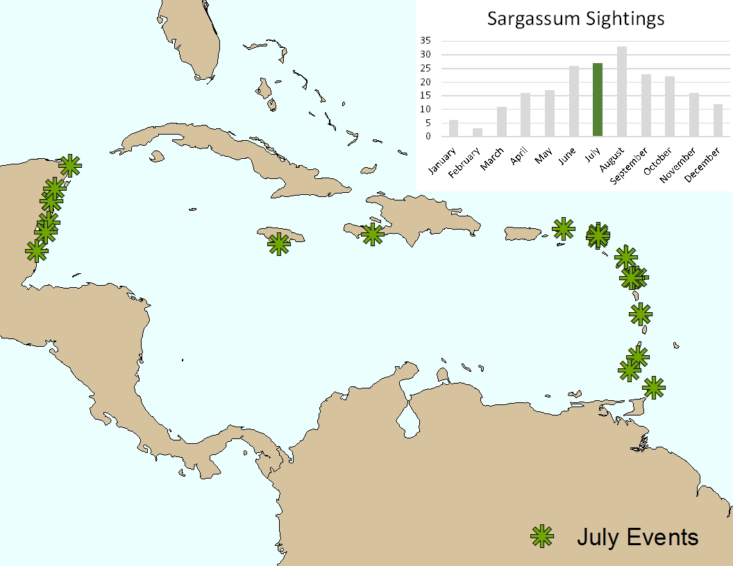
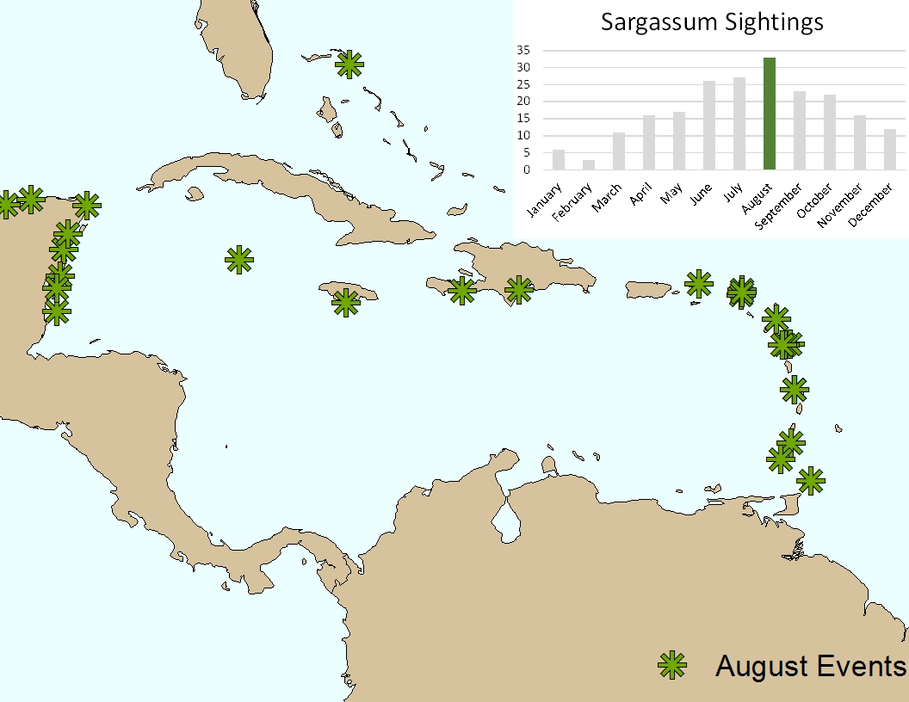
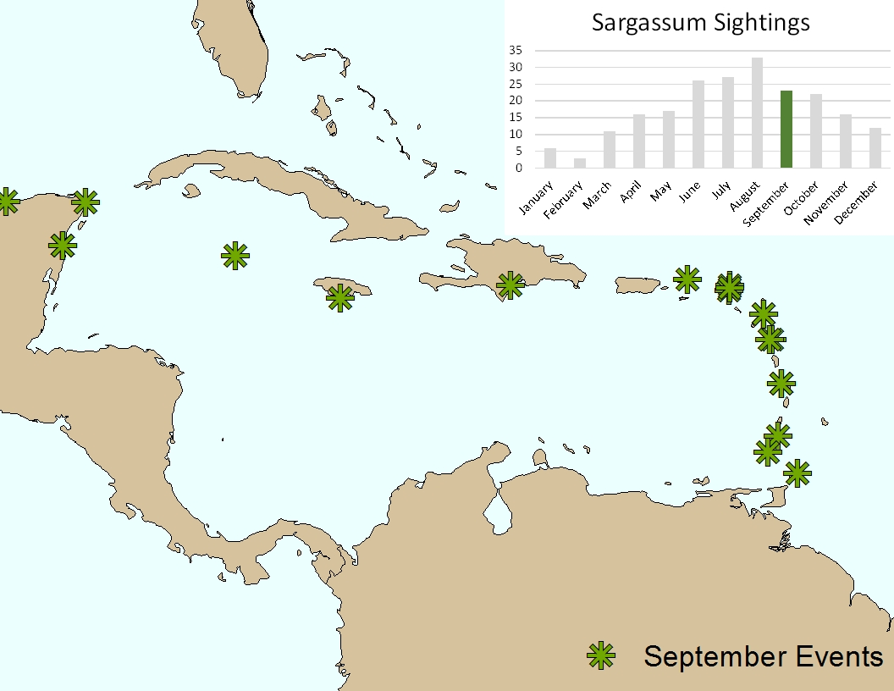
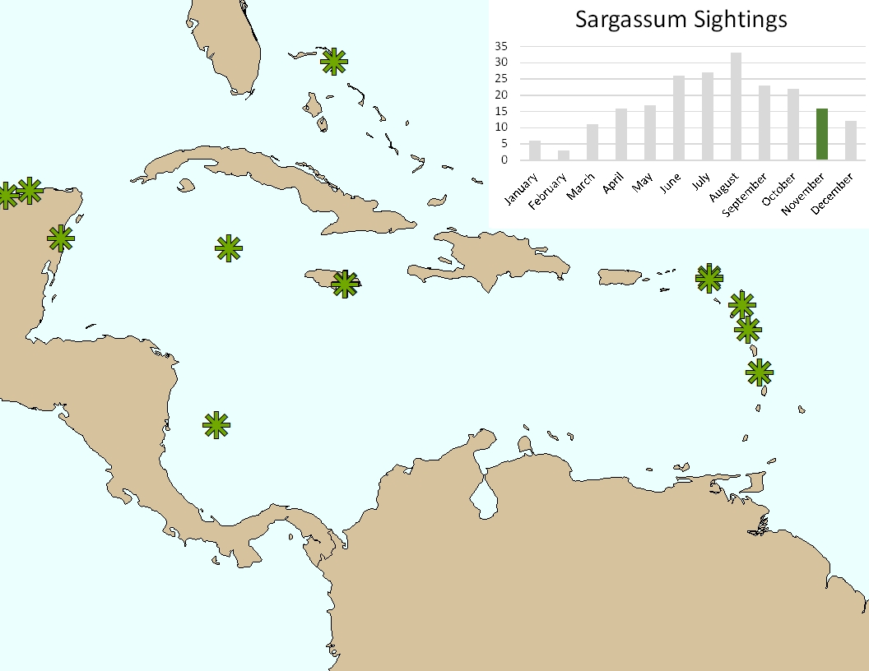

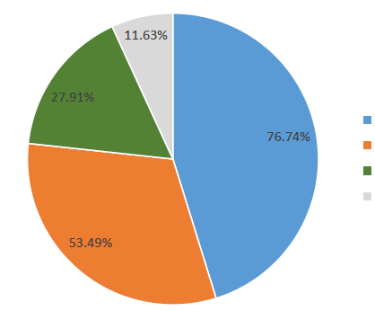
Data Acquisition II
Main categories of environmental problems caused by Sargassum influx
What time of the year do you observe Sargassum?
12
10
8
6
Total Responses
4
2
0
Sea Turtles
Fisheries
Decomposition
Coral Reefs
Coastal Trees
Beaches
How is Sargassum most commonly removed from the shoreline?
11.63%
27.91%
Hand Removal
76.74%
Heavy Machinery
No Removal
Other
53.49%
Notes:
Next we analyzed the survey data,
Survey data showed strong seasonality
We also collected information on the context of the problem – such as the main environmental concerns and the most common removal strategies
We have a document summarizing the survey data that we can share if anyone is interested

Slide 9

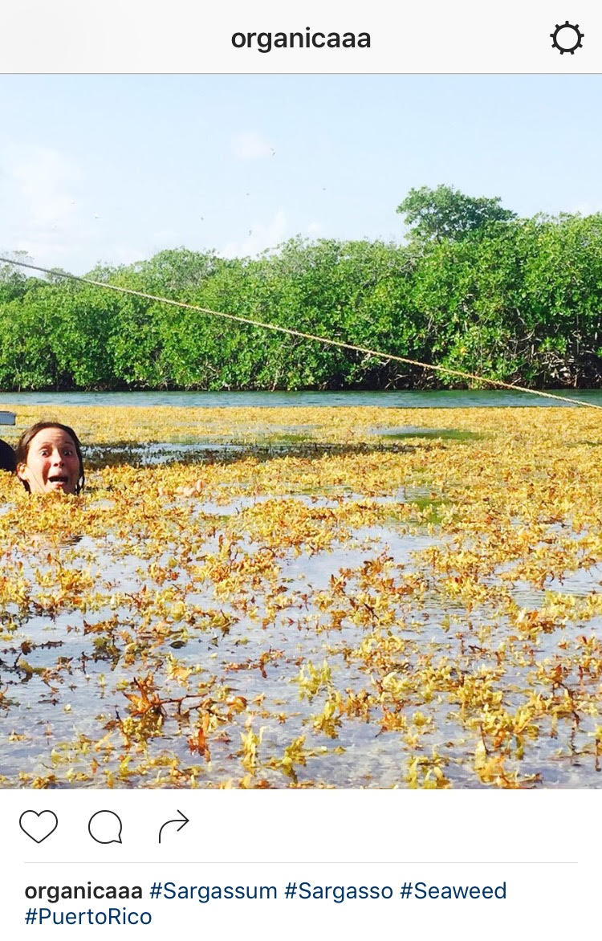
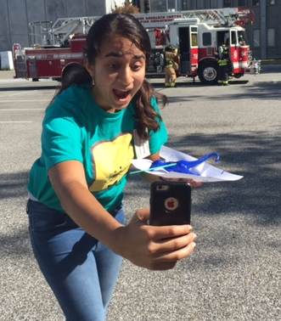
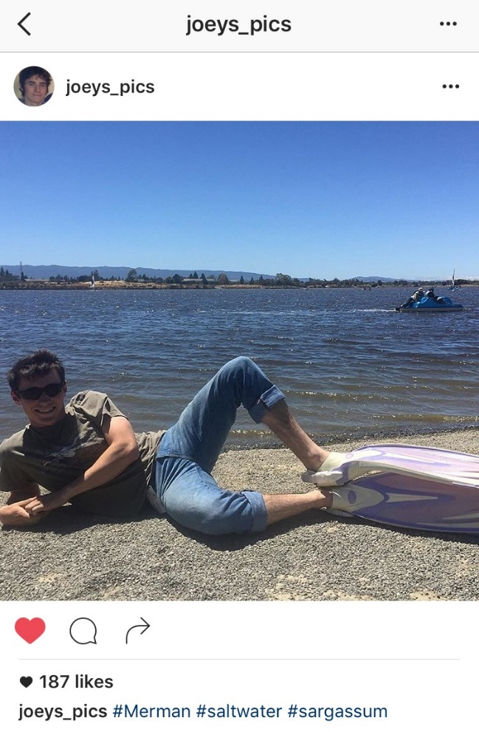
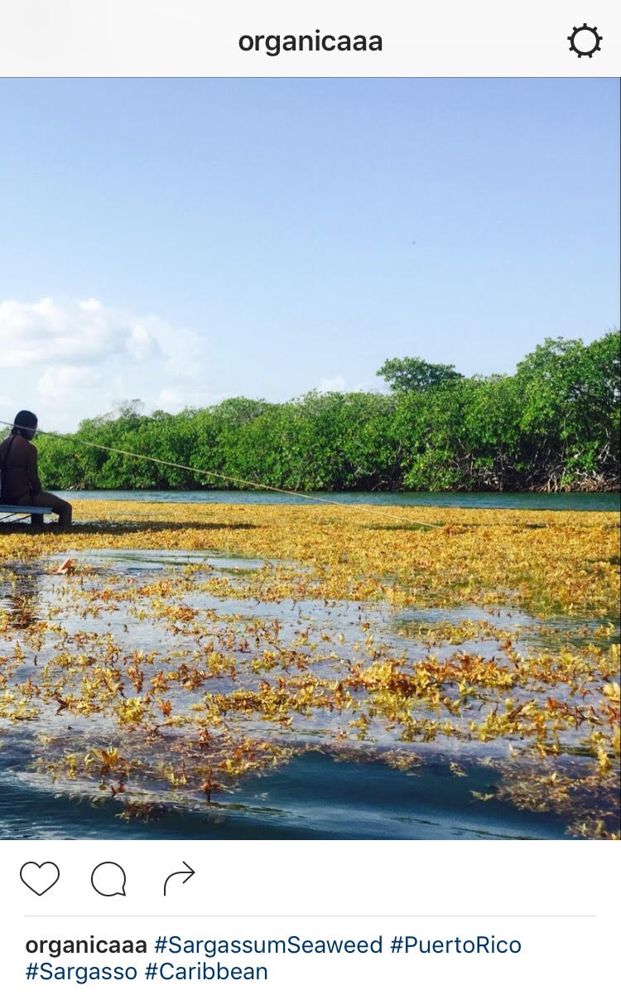
Data Acquisition III
#Sargassum
#Sargassumseaweed
Notes:
In 2015, users of the social media site Instagram uploaded roughly one hundred images of Sargassum sightings.
Our first goal was to assess the reliability of these reports as a source of ground truth data.
Images:
http://www.forbes.com/sites/fruzsinaeordogh/2016/05/12/love-it-or-hate-it-instagrams-new-logo-is-so-internet-right-now/#c33f4cc6923c

Slide 10
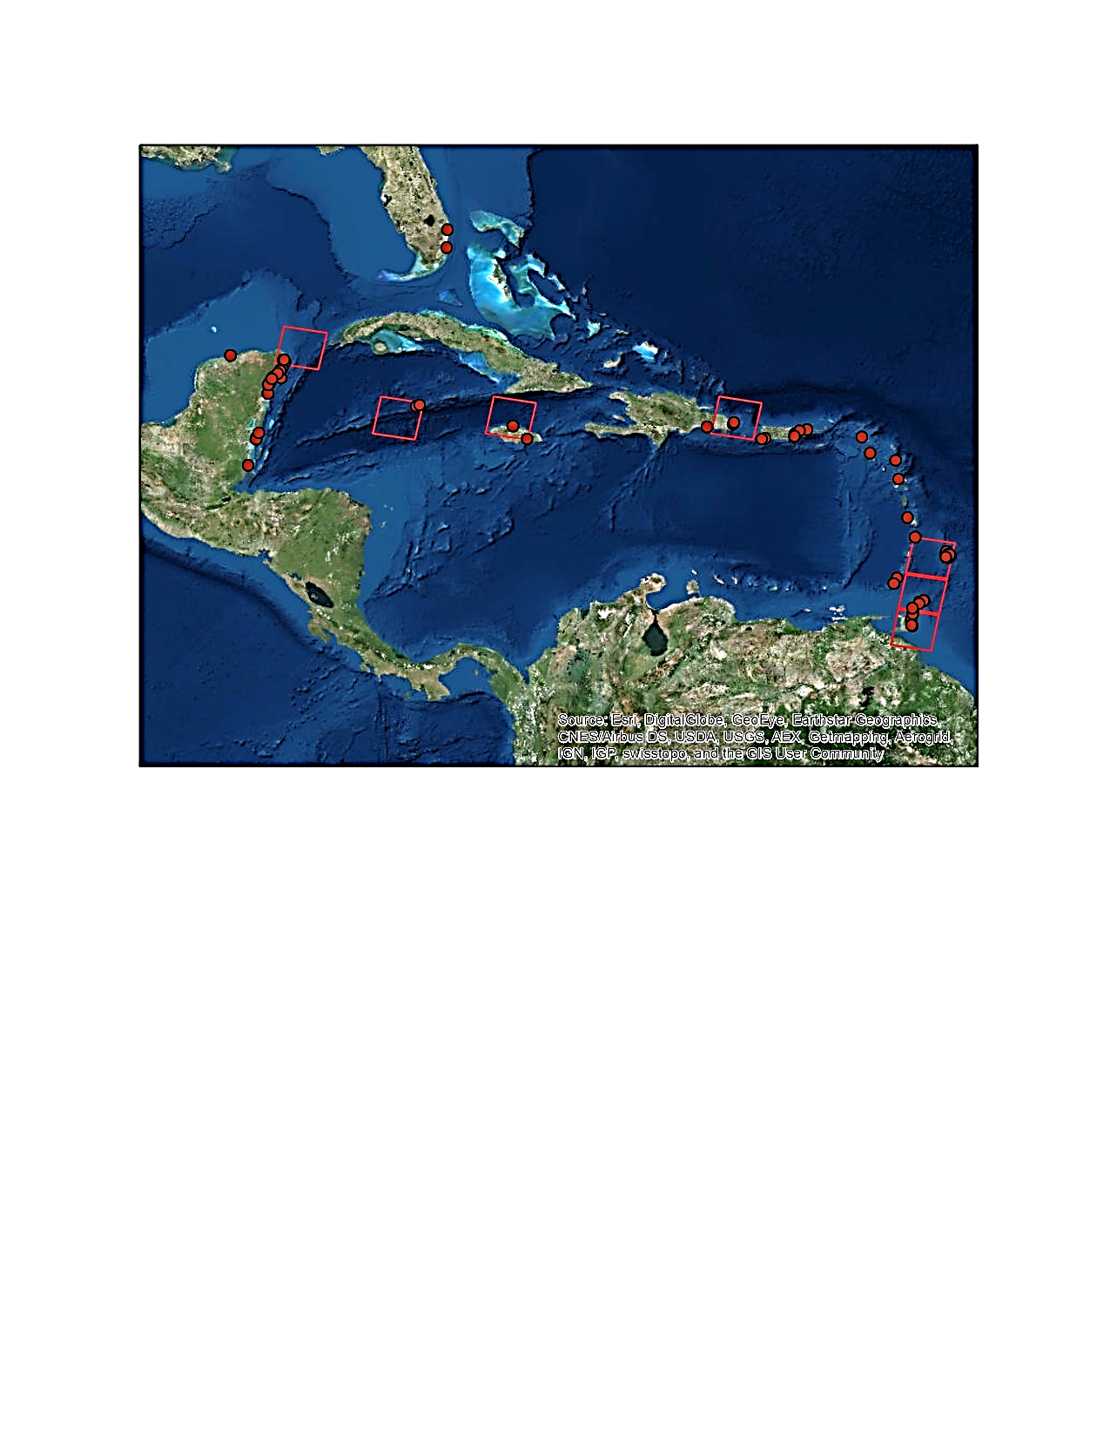
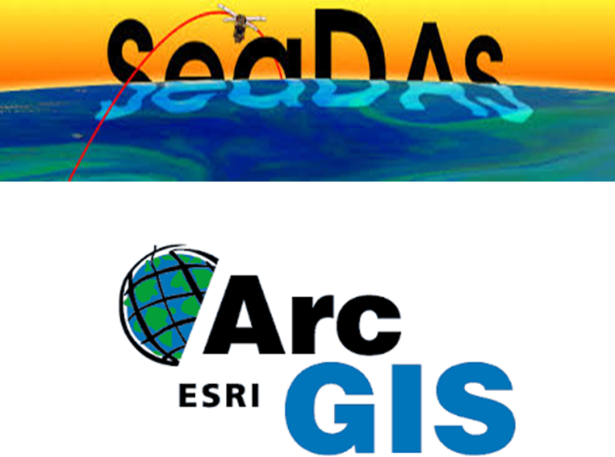
Methods Overview
Imagery Analysis
  Sargassum Identification
  Pre-processing
  Application of Indices
Instagram Assessment
  Database Geolocation
  Accuracy Estimate
Notes:
Overview:
-Image analysis: identification of Sargassum, preprocessing and applying indices using SeaDas and ArcGis.
-Instagram accuracy assessment by performing database geolocation and accuracy estimate.
Images:
http://seadas.gsfc.nasa.gov/
http://prehnit.hr/index.php/education-and-training/esri/

Slide 11
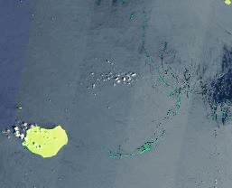
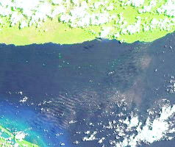
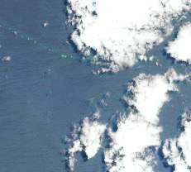
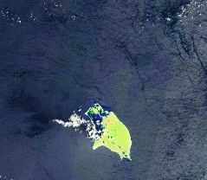
Methods: Image Analysis
Notes:
Ideal Sargassum sites were identified based on typical patterns of Sargassum distribution and then corrected using seadas before the application of the ndvi fai and afai imagery. Finally the iamges were classified using arcmap to identify pixels most likely to be Sargassum
FAI and AFAI are similar indicies, but using different MODIS bands the second NIR modis band has lower resolution, but also lower noise creating an index that can be more accurate in some instances

Slide 12

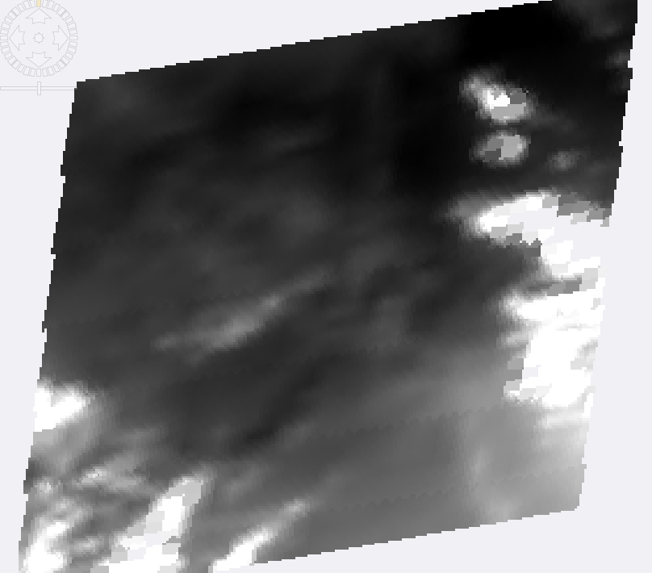
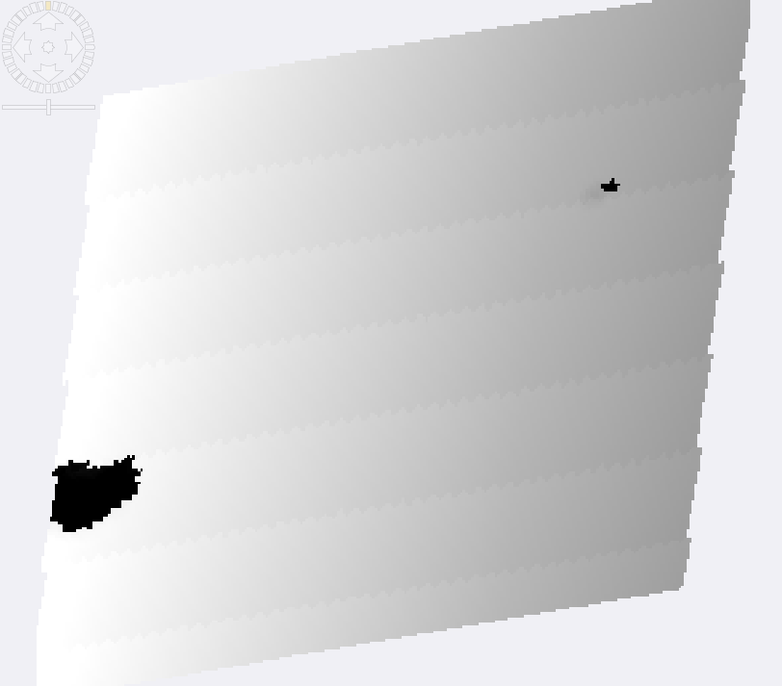


Methods: Image Analysis
NDVI = $\frac{RrcNIR −RrcRED}{RrcNIR+RrcRED}$
FAI = Rrc_{NIR} – $\left[RrcRED+\left(RrcSWIR−RrcRED\right) × \frac{λNIR −λRED}{λSWIR −λRED}\right]$
AFAI = Rrc_{NIR} – $\left[RrcRED+\left(RrcNIR2−RrcRED\right) × \frac{λNIR −λRED}{λNIR2−λRED}\right]$
Aqua MODIS
Landsat 8 OLI
Geolocation
Level 2 Product
Level 1B Product
Level 2 Product
Top of Atmosphere Radiance (Lt)
Top of Atmosphere Rayleigh Radiance (Lr)
Solar Zenith Angle (ϴ_{s})
Rayleigh Reflectance per Band = π / µ0 / cos (ϴ_{s}) * (Lt-Lr)
NDVI
AFAI
FAI
Notes:
Processing of imagery using SeaDas included: generation of Level 1 and Level 2 products for MODIS imagery and Level 2 product for Landsat 8 OLI imagery.
All bands for both sensor images were atmospherically corrected to obtain: Top of Atmosphere Radiance, Top of Atmosphere Rayleigh Radiance and Solar Zenith Angle.
Resulting imagery were then, reprojected, collocated and processed for each of the indices.

Slide 13
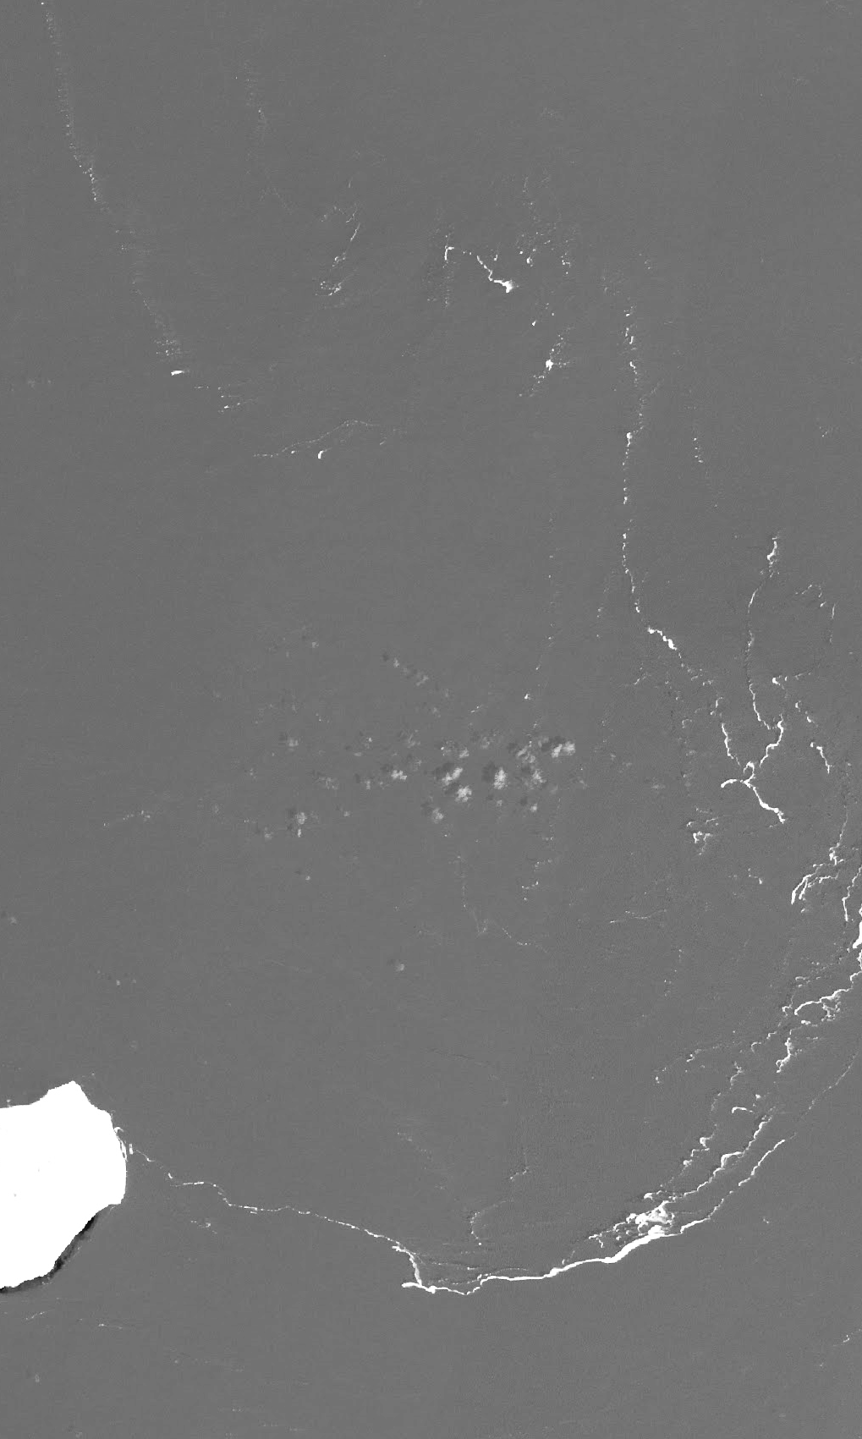
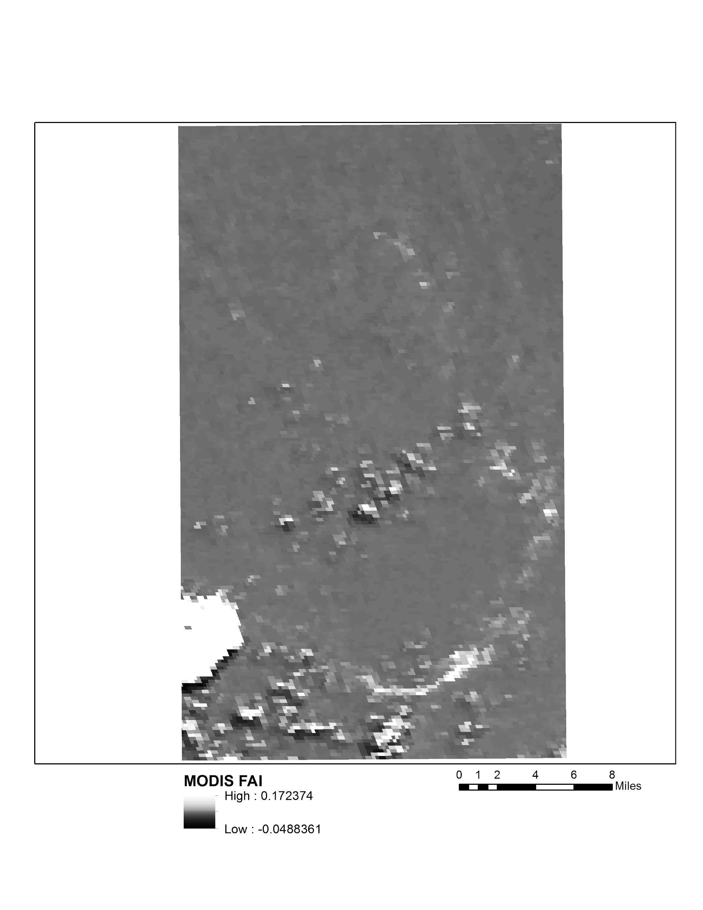
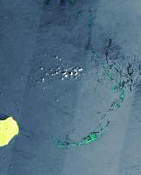
Results: Image Analysis
Landsat 8 FAI
MODIS FAI
Landsat True Color (RGB)
Notes:
Ideal Sargassum sites were identified based on typical patterns of Sargassum distribution and then corrected using seadas before the application of the ndvi fai and afai imagery. Finally the iamges were classified using arcmap to identify pixels most likely to be Sargassum
FAI and AFAI are similar indicies, but using different MODIS bands the second NIR modis band has lower resolution, but also lower noise creating an index that can be more accurate in some instances

Slide 14
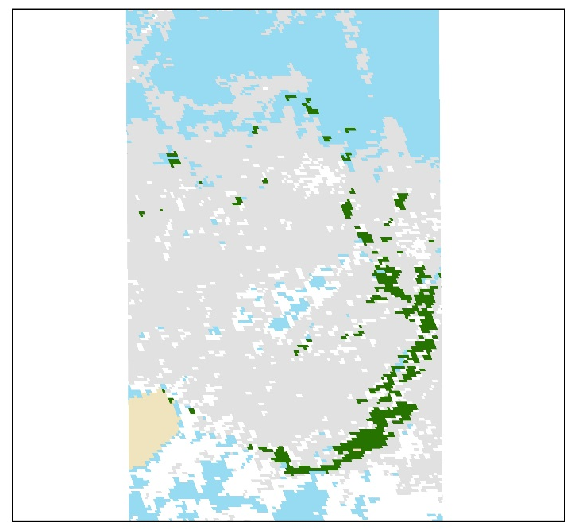



Results: Image Analysis
MODIS FAI
MODIS NDVI
Landsat FAI
Landsat NDVI
Mona Island, Puerto Rico
21.55 mi²
29.59 mi of Sargassum
Notes:
The results indicated that Sargassum can be best identified with landsat fai and our complete results will estimate the difference in amount of Sargassum identified. This is an example from September 19th 2015 near the coast of Isla De Mona in the Dominican republic

Slide 15



Methods: Instagram Assessment
Totals:
103 Instagram reports
128 Landsat images
Database
Notes:
We created a database of their reports with date and location and visually assessed Sargassum presence in the corresponding Landsat 8 OLI images.
Images:
http://www.forbes.com/sites/fruzsinaeordogh/2016/05/12/love-it-or-hate-it-instagrams-new-logo-is-so-internet-right-now/#c33f4cc6923c

Slide 16

Results #Instagram
79% of images contained Sargassum
Notes:
The results indicate that Sargassum Instagram is a better predictor of Sargassum in landsat imgery when the flyover and posting dates are closer
Additionally as the number of sightings increase Instagram because a better indicator, with all sightings more than 6 being identifiable in a landsat scene
The x-axis in the second graph gives the difference between the Instagram date and landsat fly over in bins of several days. Negative values represent landsat flyovers proceeding Instagram posting.

Slide 17





Conclusions:
NASA Earth Observations detect Sargassum in the Caribbean Sea
Instagram can be used as novel data source for hypothesis generation
#Sargassum
#SargassumSeaweed
Image Credit: Roy Armstrong
Image Credit: Roy Armstrong
Notes:
MODIS imagery likely misidentifies large areas, Landsat imagery performs well with FAI, Stronger conclusions cannot be made without a more comprehensive ground truth survey
Posts with the hashtag can provide researchers initial coverage, Imagery and sightings are more highly correlated at matching flyover dates, Instagram is not a substitute for validation
Images:
http://www.hdwidewallpaper.com/caribbean-beach-wide-high-definition-wallpaper-download-pictures/

Slide 18
Advisors
Dr. Sherry Palacios, Bay Area Environmental Research Institute
Dr. Juan Torres-Pérez, Bay Area Environmental Research Institute
Partners
Dr. Porfirio Alvarez Torres, Consorcio de Instituciones de Investigación Marina del Golfo de México y del Caribe (CiiMarGoMC)
Dr. Roy A. Armstrong, Bio-optical Oceanography Laboratory University of Puerto Rico, Department of Marine Sciences
Dr. Sergio Cerdeira, Marine Monitoring Coordinator at Comisión Nacional para el Conocimiento y Uso de la Biodiversidad (CONABIO)
Dr. Amy Siuda, Dr. Deb Goodwin, Dr. Jeff Schell Sea Education Association
Frederique Fardin, SPAW-RAC
Others
Chippie Kislik (NASA Ames DEVELOP Center Lead)
Victoria Ly (NASA Ames DEVELOP Assistant Center Lead)
Erica Scaduto (DEVELOP Alumna)
Notes:
Thanks to our Advisors, Partners and everyone involved in the progress of our project.

Slide 19

Questions?
Contact:
emma.k.accorsi@nasa.gov
maria.c.lopez-pena@nasa.gov
jordan.w.ped@nasa.gov
Source: Dr. Juan Torres-Perez

