Slide 1
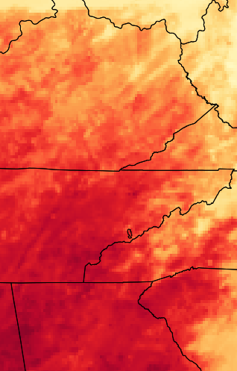
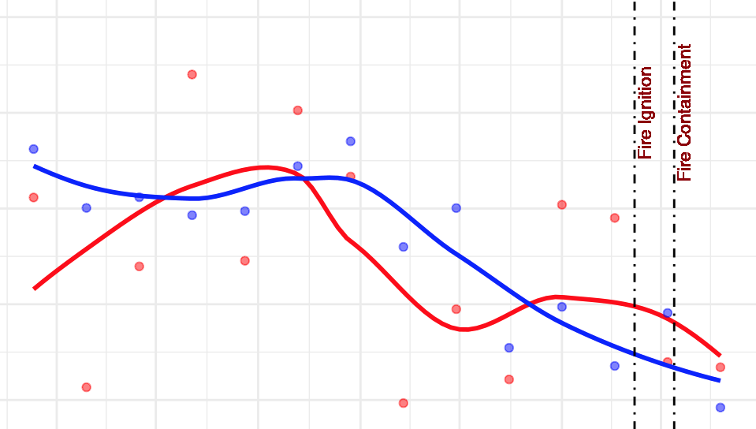
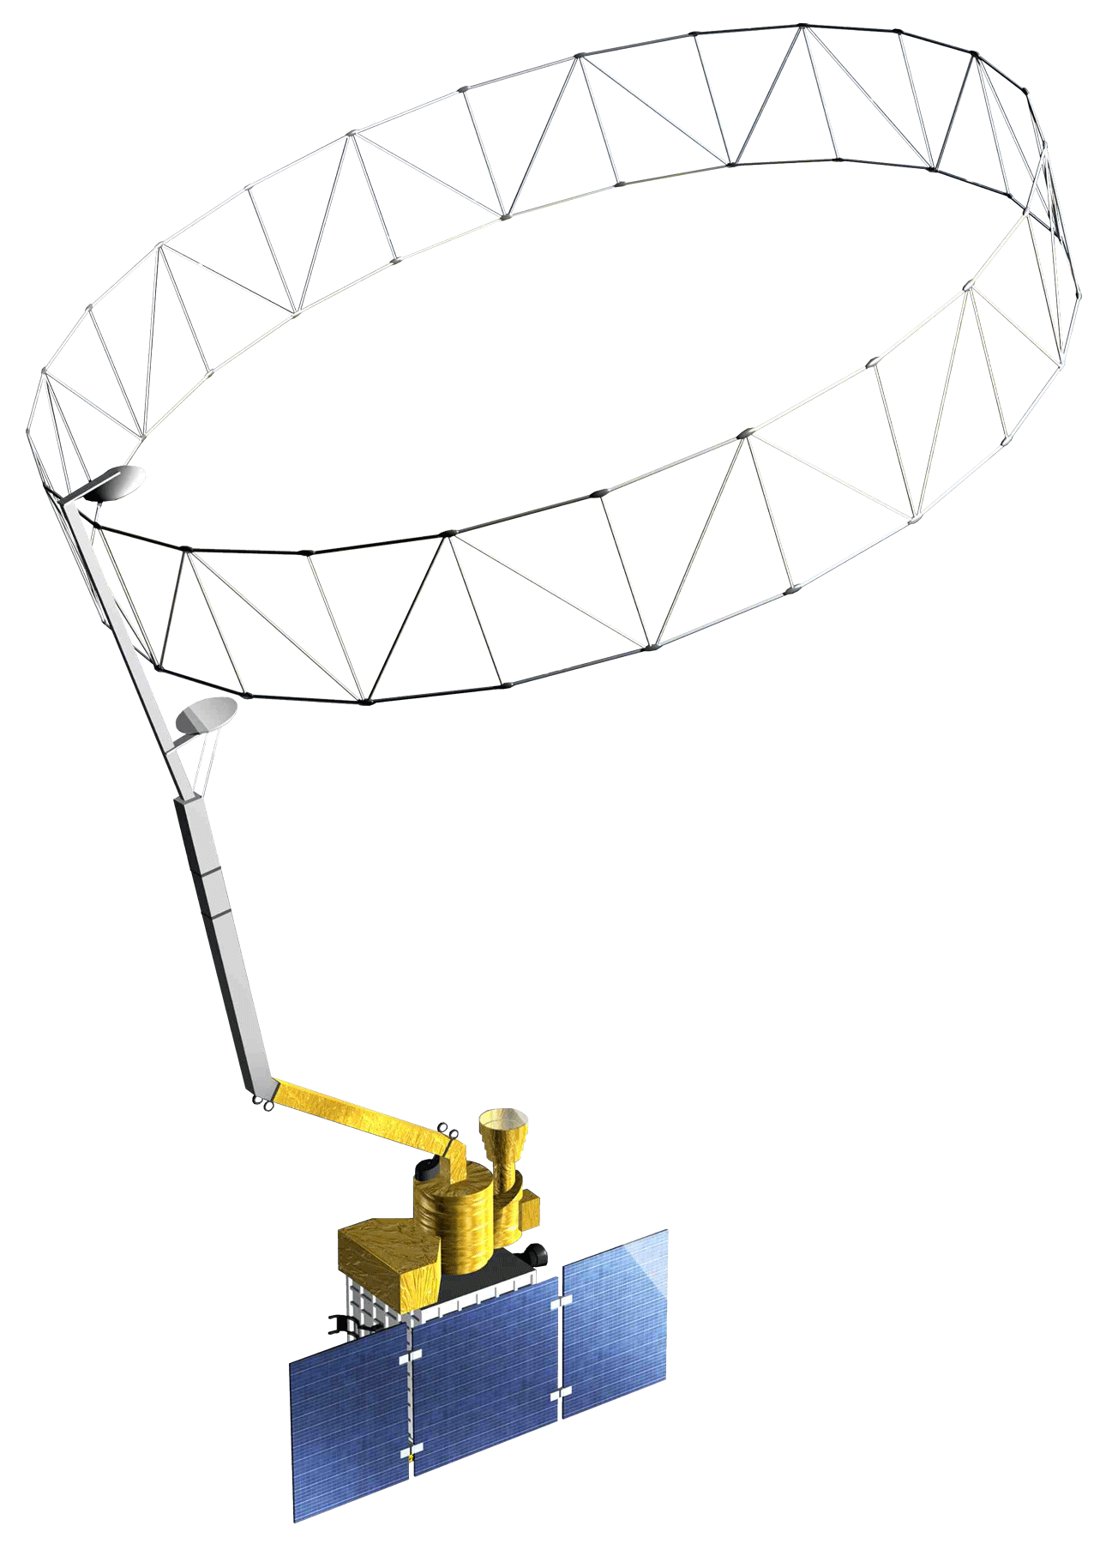
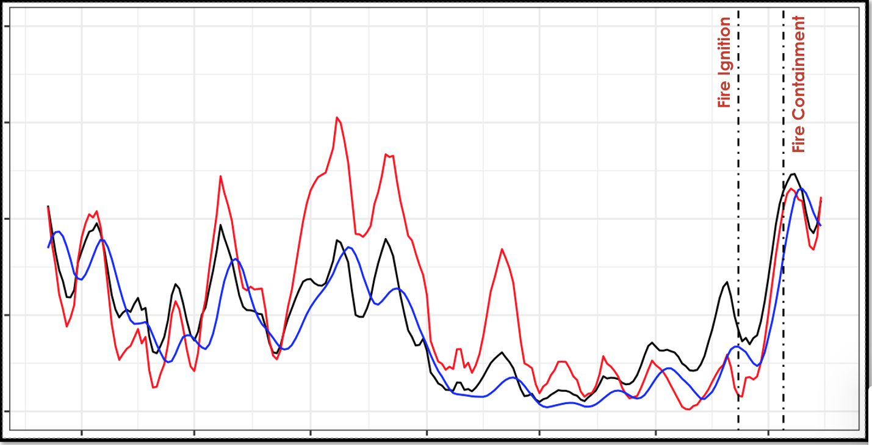
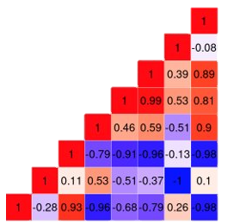
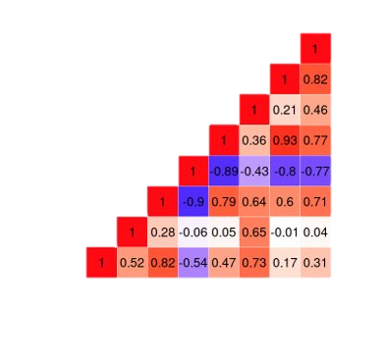
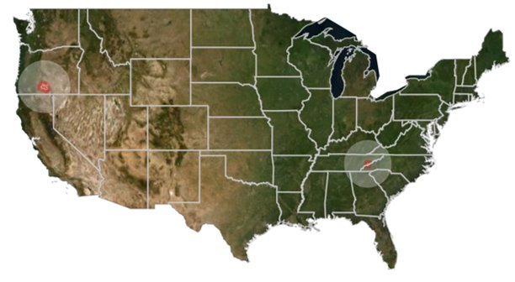
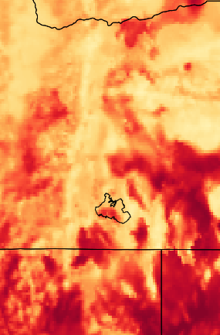
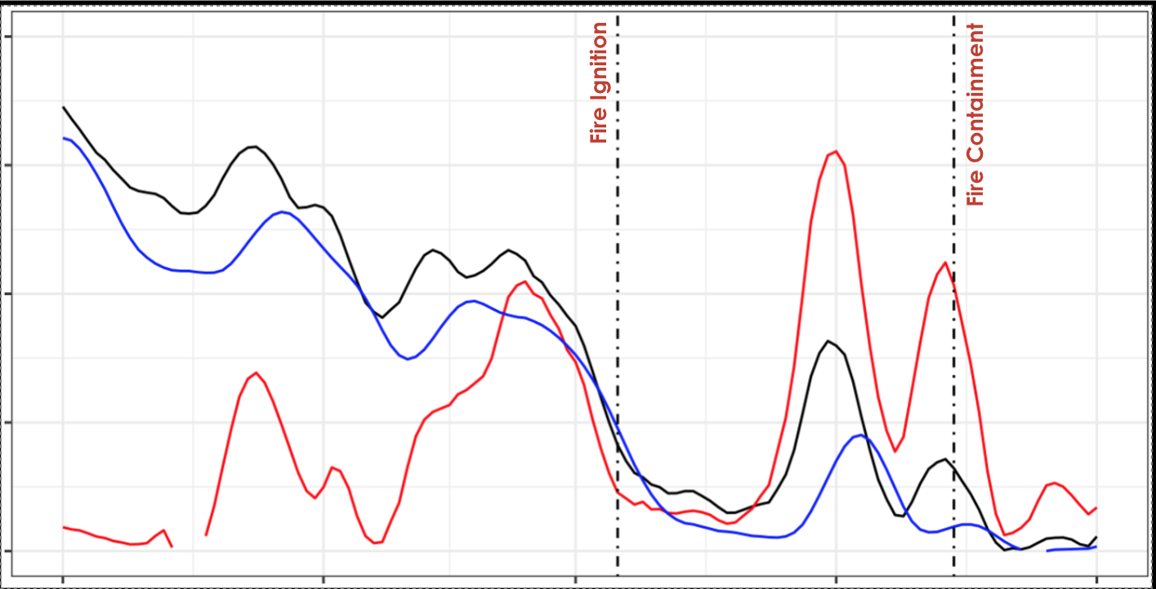
Evaluating the Role of Soil Moisture in Determining Vegetation Health, Fuels Loads, and Wildfires in the Gatlinburg and Beatty Fires
Abstract
Objectives
Gatlinburg & Beatty Wildfires
Wildfire potential monitoring, an increasingly vital effort under climate change-induced droughts, could be improved through the incorporation of remotely-sensed soil moisture data. To better understand the connections between soil moisture and vegetation health, stakeholders are interested in using soil moisture data in the development of fire-related indices. NASA DEVELOP partnered with the Desert Research Institute’s Western Regional Climate Center (WRCC), NOAA’s National Integrated Drought Information System (NIDIS), the North Carolina State Climate Office, and Oklahoma State University to evaluate how measures of remotely-sensed standardized soil moisture compare to vegetation health and fire fuel indices using a case study of two fire events: the 2016 Chimney Tops 2 fire near Gatlinburg, Tennessee and the 2021 Bootleg fire near Beatty, Oregon. To do this, the team visualized vegetation change six months prior to each event using spectral vegetation indices observed by the Moderate Resolution Imaging Spectroradiometer (MODIS) aboard NASA’s Terra satellite, as well the Keetch-Byram Drought Index (KBDI). These visualizations were then compared to soil moisture data from European Space Agency's (ESA) Soil Moisture Climate Change Initiative (CCI) project, which were collected in part by the Soil Moisture Active Passive (SMAP) satellite and standardized utilizing three different methods: Interannual Standardized Anomaly, Period of Record Percentiles, and Fraction of Available Water (FAW). Overall, period of record percentiles and fraction of available water standardizations correlated stronger with fuel load and vegetation indices, indicating their utility for fire potential monitoring. Although extreme drought conditions preceded both fire events, soil moisture conditions remained exceptionally dry for several months before the Chimney Tops 2 fire, whereas drought conditions only intensified immediately prior to the Bootleg fire. This indicates greater sensitivity to drought conditions under western fire regimes.
Produce fuel load maps and a spatially-averaged time-series utilizing vegetation indices and KBDI
Analyze soil moisture conditions preceding both fire events across three standardization approaches
Assess the relationship between vegetation health, soil moisture conditions, and fuel load for correlations with fuel buildup six months prior to both fire events
Results
0.8
VEGETATION ANALYSIS
0.4
0.0
-0.4
NDVI
EVI
Earth Observations
-0.8
Jun 1
Jul 1
Aug 1
Sep 1
Oct 1
Nov 1
Dec 1
Terra MODIS
SMAP
1.00
SOIL MOISTURE
Methodology
0
800 km
0.75
KBDI
800
0
0.50
ESA CCI Soil Moisture
Interannual Standardized Anomaly
Time Series
Correlation Analysis
CHIMNEY TOPS 2
0.25
SMA
FAW
VSM
Period of Record Percentiles
0.00
Jun 1
Jul 1
Aug 1
Sep 1
Oct 1
Nov 1
Dec 1
FAW
Pearson Correlation
NDVI_anom
Pearson Correlation
Terra MODIS
NDVI
NDVI_anom
NDVI
NDVI
-1.0
-0.5
0.0
0.5
-1.0
-0.5
0.0
0.5
EVI_anom
1.0
EVI
EVI_anom
1.0
EVI
EVI
KBDI
KBDI
KBDI
FAM
FAM
SMA
Study Area
SMA
VSM_pst
VSM_pst
SMA
KBDI
NDVI
VSM_pct
FAW
EVI_anom
KBDI
EVI_anom
EVI
NDVI_anom
FAW
NDVI
SMA
Beatty, Oregon: Bootleg Fire burned from July 6th to Aug 15th
Study period: January 2021 – July 2021
Gatlinburg, Tennessee: Chimney Tops 2 Fire burned from Nov 23rd to Dec 13th
Study period: June 2016 – November 2016
VSM_pct
EVI
NDVI_anom
BOOTLEG
1
VEGETATION ANALYSIS
NDVI
EVI
KBDI
0
-1
Jan 1
Feb 1
Mar 1
Apr 1
May 1
Jun 1
Jul 1
Aug 1
Sep 1
Bootleg Fire Footprint
SOIL MOISTURE
Team Members
1.00
Chimney Tops 2 Fire Footprint
0.75
0.50
0.25
SMA
FAW
VSM
0
800 km
Kelli Roberts
Project Lead
Will Hadley
Technical Lead
Dan Littleton
0.00
May 1
Jun 1
Jul 1
Aug 1
Sep 1
Acknowledgements
Conclusions
Corey Davis
Dr. Sheila Saia
Dr. Timothy Brown
Britt Parker
Marina Skumanich
Dr. Tyson Ochsner
Ronnie Leeper
Molly Woloszyn
Kathryn Caruso
Strong evidence of low soil moisture conditions immediately before the Bootleg fire contributing to the fire event.
Analysis shows longer term drought influence on the Chimney Tops 2 fire.
NDVI, EVI, and KBDI are all good indicators for wildfires in the Eastern region of the country.
North Carolina – NCEI

