Slide 1
Technical Imagery Spring 2019
Project Short Title
DEVELOP Node Name (Ex. Virginia – Langley)

Slide 2
Technical Image: Purpose & Overview
This image should be composed of attractive, processed imagery of your study area that displays your project results. This image will be used on your project’s page of the DEVELOP website and any future purposes for which visual results are needed (like DEVELOP marketing materials or social media).
Delete this slide before submission.

Slide 3
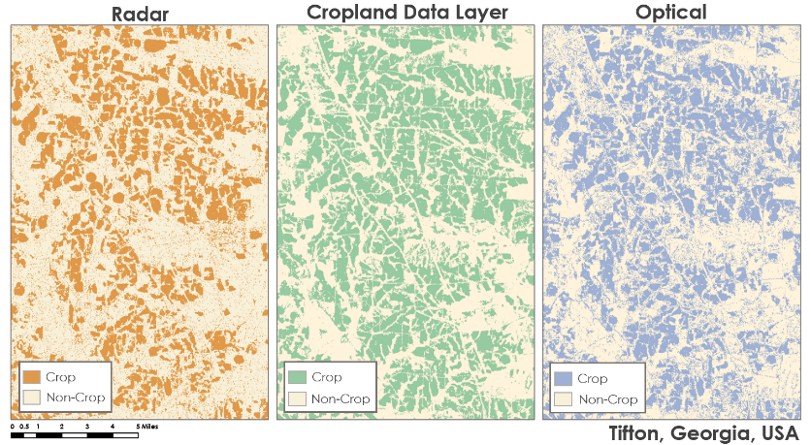
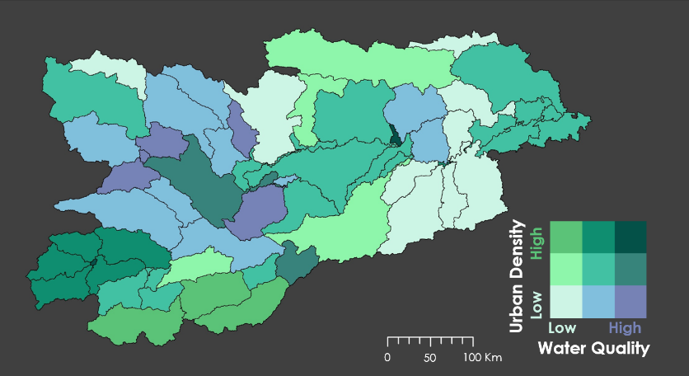
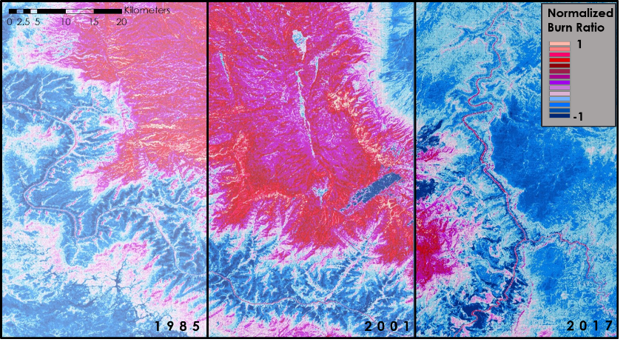
Technical Image: Requirements
High-resolution: 1920 x 1080 (300+ dpi), landscape orientation
You can use an online resizer like this one → http://resizeimage.net/
Saved as a JPEG or PNG
At least one image provided is derived from recent data (2018 to 2019)
Image is derived from NASA sensor data
Not from an outside source
Not a photograph of the team or a landscape
Why? DEVELOP is a NASA-funded program that is focused on highlighting NASA data applications.
Some kind of processing has taken place
The team actually created the image
Not just a raw satellite image or simple re-order of spectral bands (false color composite)
A north arrow, scale bar, and legend are included
Delete this slide before submission.

Slide 4
Technical Image: Tips
Make sure that all text is legible (meaning not too small) and separate/editable.
You can include inset maps to give a greater context of where your study area is in the United States or the world.
Use descriptive, well thought out legends not titled “Legend”.
If you were to read the legend without the visual map, you should still be able to understand what information is being presented.
Picking your symbology wisely
Be thoughtful when choosing color schemes.
Avoiding bad color combinations
Designing for color blindness
Be careful about your scale bars.
You can import the scale bar as part of the image, but the numbers/unit text must separate/editable.
Do not include metadata on the image (datasets, map authors, projection type)
Consider the scale/shape of the image: feel free to zoom in to a particularly interesting part of the study area or duplicate the image to make a time series
Before submission, have multiple people look at the imagery with a critical eye
There are more map resources available on DEVELOPedia
Delete this slide before submission.

Slide 5
Technical Image: Caption Examples
You need to include what NASA satellite/sensor from which the image is derived. You should also include what date image was captured, what it is (EX: NDVI), and how it can be used for decision making. Here are some good examples:
“The extent of riparian vegetation (black) and probability map of the extent of tamarisk cover, with high probability (red) to low probability (dark blue), in the Green River watershed in 2016.”
“Average turbidity across the San Francisco Bay-Delta derived from Landsat 7 data (2016). Turbidity concentrations can be used to track Delta smelt throughout the region.”
“Sea level anomaly from Jason 2 satellite altimeter. The Republic of the Marshall Islands Exclusive Economic Zone is shaded blue. Sea level anomaly heights range from low (dark blue) to high (dark orange).”
Delete this slide before submission.

Slide 6
Delete this box and place image here.
In the case you’d like to submit more than one image, duplicate this slide.
Project Short Title Here
Caption: Make sure to include what NASA satellite/sensor and date from which the image is derived. You should also include what the image is (EX: NDVI) and how it can be used for decision making. 75 word limit.
Metadata Tags: List any keywords or project participant names that you would like to be included in the photo’s metadata.

