Slide 1
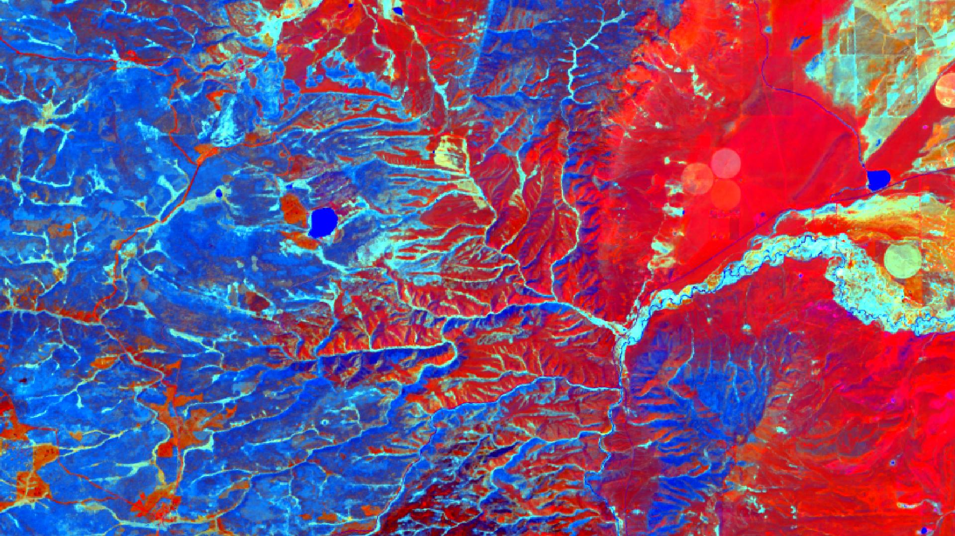
MEDICINE BOW DISASTERS
Utilizing Remote Sensing to Evaluate Herbicide Treatment Efficacy on Invasive Cheatgrass in Medicine Bow National Forest, Wyoming
Chiara Phillips
Stacy Armbruster
Forrest Corcoran
Byron Schuldt
Colorado – Fort Collins | Fall 2019
Notes:
Speaker Notes:
Hello everyone! We’re the Medicine Bow Disasters team. Our project focused on evaluating the efficacy of aerial herbicide application on invasive cheatgrass populations by mapping their extent in 2019, 3 years post-treatment. [Introduce yourselves].
Image Credit: Tasseled Cap multiband image of study area- NASA DEVELOP

Slide 2
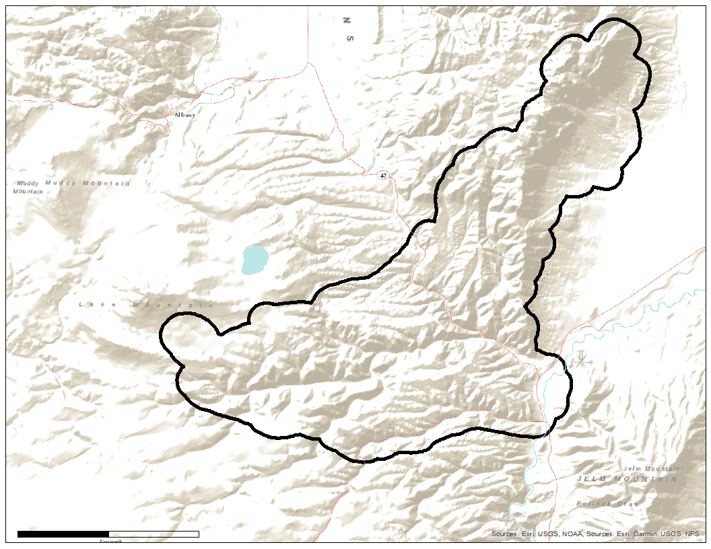
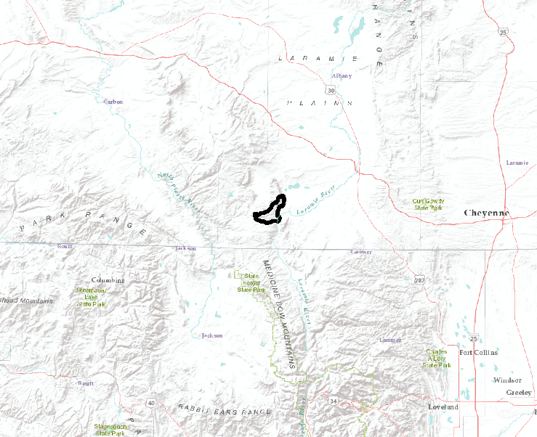
STUDY AREA/PERIOD
Medicine Bow National Forest, WY
Squirrel Creek Fire Boundary
May 2019 to October 2019
= Study Area
WYOMING
Cheyenne
Squirrel Creek Fire
Boundary
Columbine
COLORADO
0 1.5 3
N
km
Notes:
Speaker Notes: (STACY)
The study area for this research was the boundary of the Squirrel Creek Fire in the Medicine Bow National Forest in Wyoming.
In June of 2012, the Squirrel Creek Fire began and was contained within 10 days, (burned nearly 11,000 acres), with burn severity categorized as low to moderate. Essentially, after that event, cheatgrass then became a problematic invasive species in the burned area.
In the Fall of 2015, the Wyoming Ecological Forecasting DEVELOP Team created an accurate map of cheatgrass distribution in a post-wildfire area for targeted aerial herbicide spraying.
This map was used for targeted aerial herbicide treatment for cheatgrass in 2016 with aerial spraying and then most recently on August 16-26, 2019, as treatment is applied every 3 years for a 9-year period.
After treatment, there have been a small number of point-sample efforts to monitor treatment effectiveness and a need to map cheatgrass across the study area, but a larger scale analysis is needed to understand the overall effectiveness of the treatment. This project will build off of methods first explored by the Fall 2015 DEVELOP team and the publication by West et al. (2017) and explore how cheatgrass has responded to the herbicide treatment by looking at its lifecycle from May to October of 2019 with remotely sensed data and machine learning methods.
Image Credit: NASA DEVELOP

Slide 3
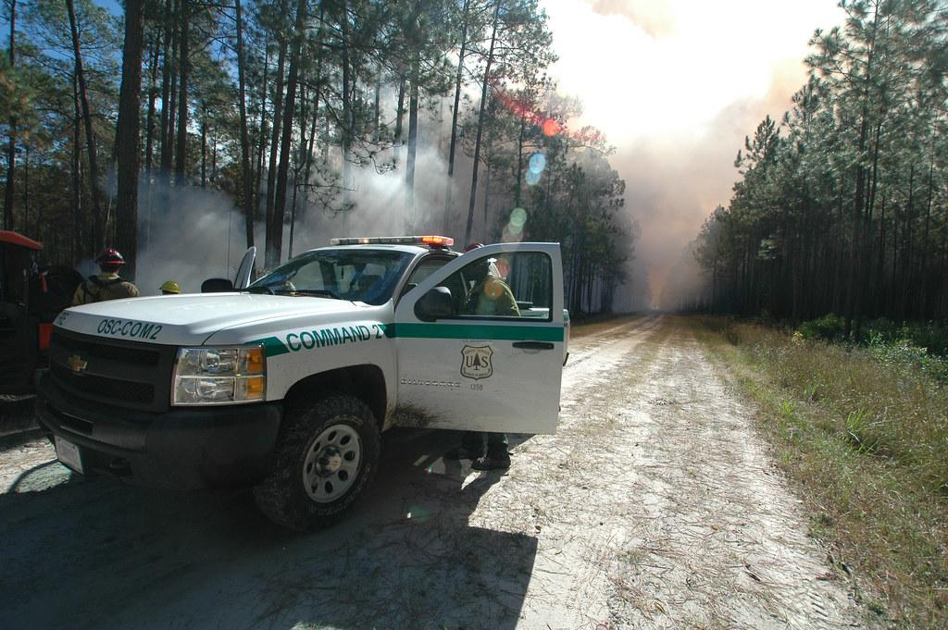
PARTNERS
US Forest Service
Federal agency responsible for managing US national forests and grasslands.
Image Credit: US Forest Service; US Forest Service - Southern Region
Notes:
Speaker Notes: (STACY)
The end user for our project was the US Forest Service. They are an agency part of the US government that is responsible for managing the nation’s national forests and grasslands.
Image Credit:
USFS Logo: https://commons.wikimedia.org/wiki/File:Logo_of_the_United_States_Forest_Service.svg, Public domain
Truck Image: https://search.creativecommons.org/photos/d20d68ff-a710-4f3b-aed1-e1dcff5df622 CC BY-SA 2.0

Slide 4
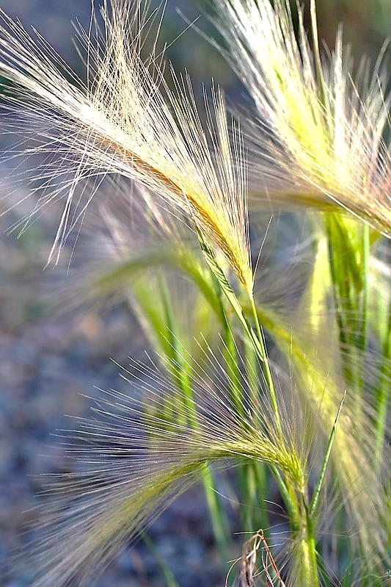
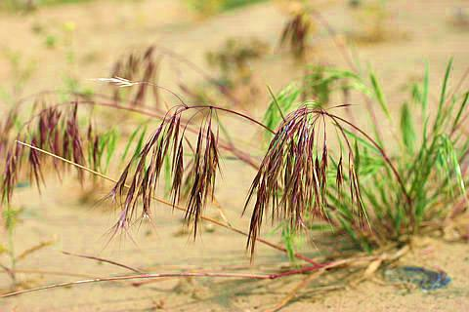
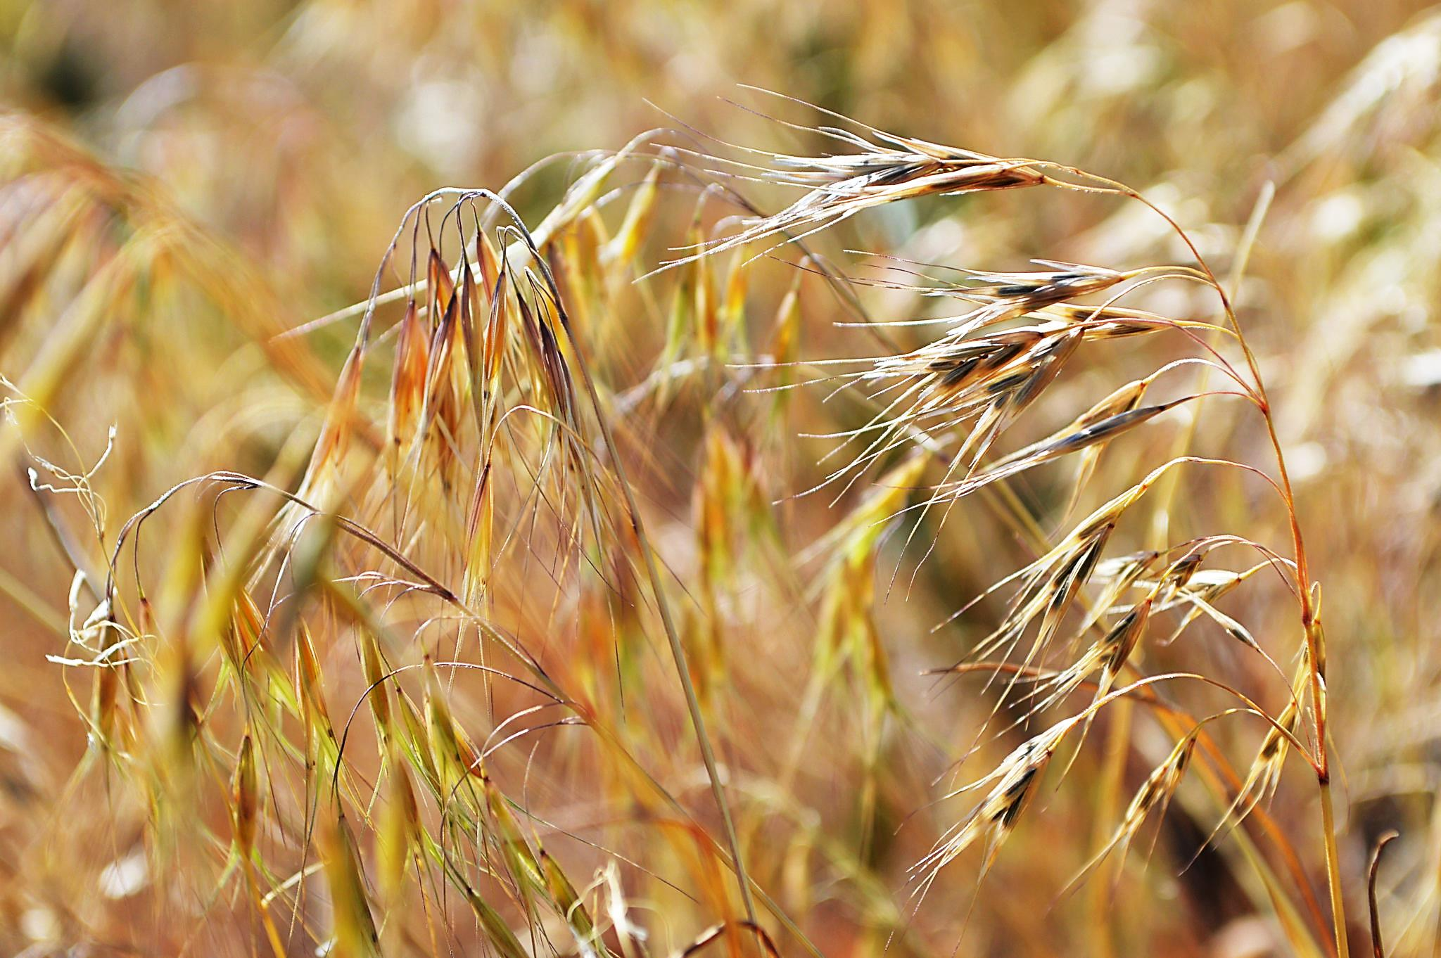
Emergence Stage
Maturation Stage
Senescence Stage
COMMUNITY CONCERN
Cheatgrass (Bromus tectorum):
Invasive annual grass, three life stages
Outcompetes native grasses (forage)
Germinates in fall
Alters hydrologic/nutrient regimes
Produces hundreds of seeds
Grows in most soil conditions
Increases fire continuity
Colonizes in disturbed areas
Image Credit: Flickr
Notes:
Speaker Notes: (STACY)
Cheatgrass is an invasive annual grass, meaning it must grow from a seed and die every year. It grows in three stages, the emergence stage, which shows green shoots in early spring, the purple/red stage where it matures and sets seed, and senescence, when it dies in late summer and turns brown, creating an increased amount of potential, seasonal fuel for fires.
Cheatgrass can outcompete native grasses that serve as forage for mule deer and elk.
Multiple reasons why it can outcompete native grasses for example, it germinates in the fall and develops its lateral and vertical root systems throughout the winter so that when warmer temperatures arrive in spring, it is already ahead of native species that begin germination at that time.
Its roots are very efficient in extracting water from the soil since they have many root hairs, depriving other species of water and changing the makeup of the soil.
Cheatgrass is a prolific seed generator, with one plant being able to produce around 500 seeds. those seeds can stay viable for 2-3 years in the field if conditions are not favorable for germination.
Cheatgrass can grow in most soil conditions and alters fire regimes because it creates drier soils and contributes to more ground litter and potential fuel for fire when fires do occur, cheatgrass is then especially able to colonize in these new disturbed areas better than other species it creates so many seeds that some are bound to slip in cracks and be untouched by fires, and when more seeds grow in untouched areas, we have more cheatgrass.
Image Credit:
Emergence: https://www.flickr.com/photos/carfull/18749468183/in/photolist-uyPVEP-e6R3Ew-2eCK6wW-ULyu8p-nFXRe8-o6jAQF-aBb7ZR-asTrtr-at74tT-LHKuhA-asVzA7-9uTbdF-e6Kp96-9YaD6a-9Ye7v6-Uas2b5-asTr7t-e6R3Fb-bKjooH-bKjnLt-cg8Um-Xgv6Wf-9UJpr9-vWbYRG-2sS7Xj-o1eT8H-enckTx-2cFHN1F-81ofBh-NcQRAd-ACcp7y-Uz3eXx-tUYriR-ULwjEC-48LNA-rNgjU2-nYkQmj-dDhdYp-WUf4Q7-bwpzf9-48LNz-9UtEa4-uQEdRf-YhgeDb-2h3gCRD-W8H2rB-qStQ7y-mAe58n-V9q1NC-W8GRY8 CC BY-NC-ND 2.0
Maturation: https://www.flickr.com/photos/pnnl/3366200490/in/photolist-68sE8u-owxiEv-tFJPfX-uyPVEP-e6R3Ew-2eCK6wW-ULyu8p-nFXRe8-o6jAQF-aBb7ZR-asTrtr-at74tT-LHKuhA-asVzA7-9uTbdF-e6Kp96-9YaD6a-9Ye7v6-Uas2b5-asTr7t-e6R3Fb-bKjooH-bKjnLt-cg8Um-Xgv6Wf-9UJpr9-vWbYRG-2sS7Xj-o1eT8H-enckTx-2cFHN1F-81ofBh-NcQRAd-ACcp7y-Uz3eXx-tUYriR-ULwjEC-48LNA-rNgjU2-nYkQmj-dDhdYp-WUf4Q7-bwpzf9-48LNz-9UtEa4-uQEdRf-YhgeDb-2h3gCRD-W8H2rB-qStQ7y CC BY-NC-SA 2.0
Senescence: https://www.flickr.com/photos/usfwsmtnprairie/36275047894/in/photolist-Xgv6Wf-9UJpr9-vWbYRG-2sS7Xj-o1eT8H-enckTx-2cFHN1F-81ofBh-NcQRAd-ACcp7y-Uz3eXx-tUYriR-ULwjEC-48LNA-rNgjU2-nYkQmj-dDhdYp-WUf4Q7-bwpzf9-48LNz-9UtEa4-uQEdRf-YhgeDb-2h3gCRD-W8H2rB-qStQ7y-mAe58n-V9q1NC-W8GRY8-SGL8Ww-259WfYt-2apkKx3-qe1rRT-Yhgetb-raFZBn-2fy8YEo-YhgepU-k5UNQs-pTtu56-27TgBZx-27TgEVT-27TgCFH-255pMFi-XvyZwE-M8szih-qYzSi4-4EyZdY-27TgCcB-nk1mDm-M8sz9j CC BY 2.0

Slide 5
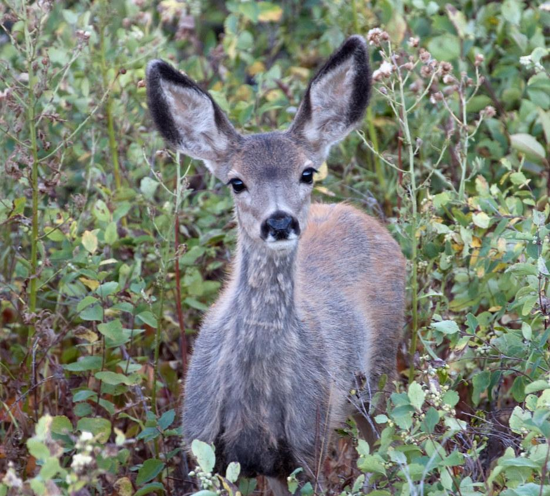
CURRENT DECISION MAKING
Current Mitigation Strategy
Chemical (USFS- Imazapic, $37/acre)
U.S. Forest Service has already spent over $100,000 treating thousands of affected acres in the Medicine Bow National Forest
Image Credit: Creative Commons
Notes:
Speaker Notes: (STACY)
The U.S. Forest Service is currently applying an aerial herbicide called Imazapic to seeds that have already dropped to prevent germination with the cost amounting about $37/acre the forest service has already spent over $100,000 treating thousands of acres of land in the medicine bow national forest, so our work is necessary in evaluating the effectiveness of their current management strategies.
Image Credit:
Mule deer: https://search.creativecommons.org/photos/86874d7b-7229-46a6-8855-0a70ff730300 CC BY 2.0
Cheatgrass: https://search.creativecommons.org/photos/35d38437-5b68-465a-a6bb-182407ba70dc CC BY 2.0
Helicopter Man: https://search.creativecommons.org/photos/8ba1bd76-2f79-4b4e-aa88-f05cdbf745e6 CC PDM 1.0

Slide 6
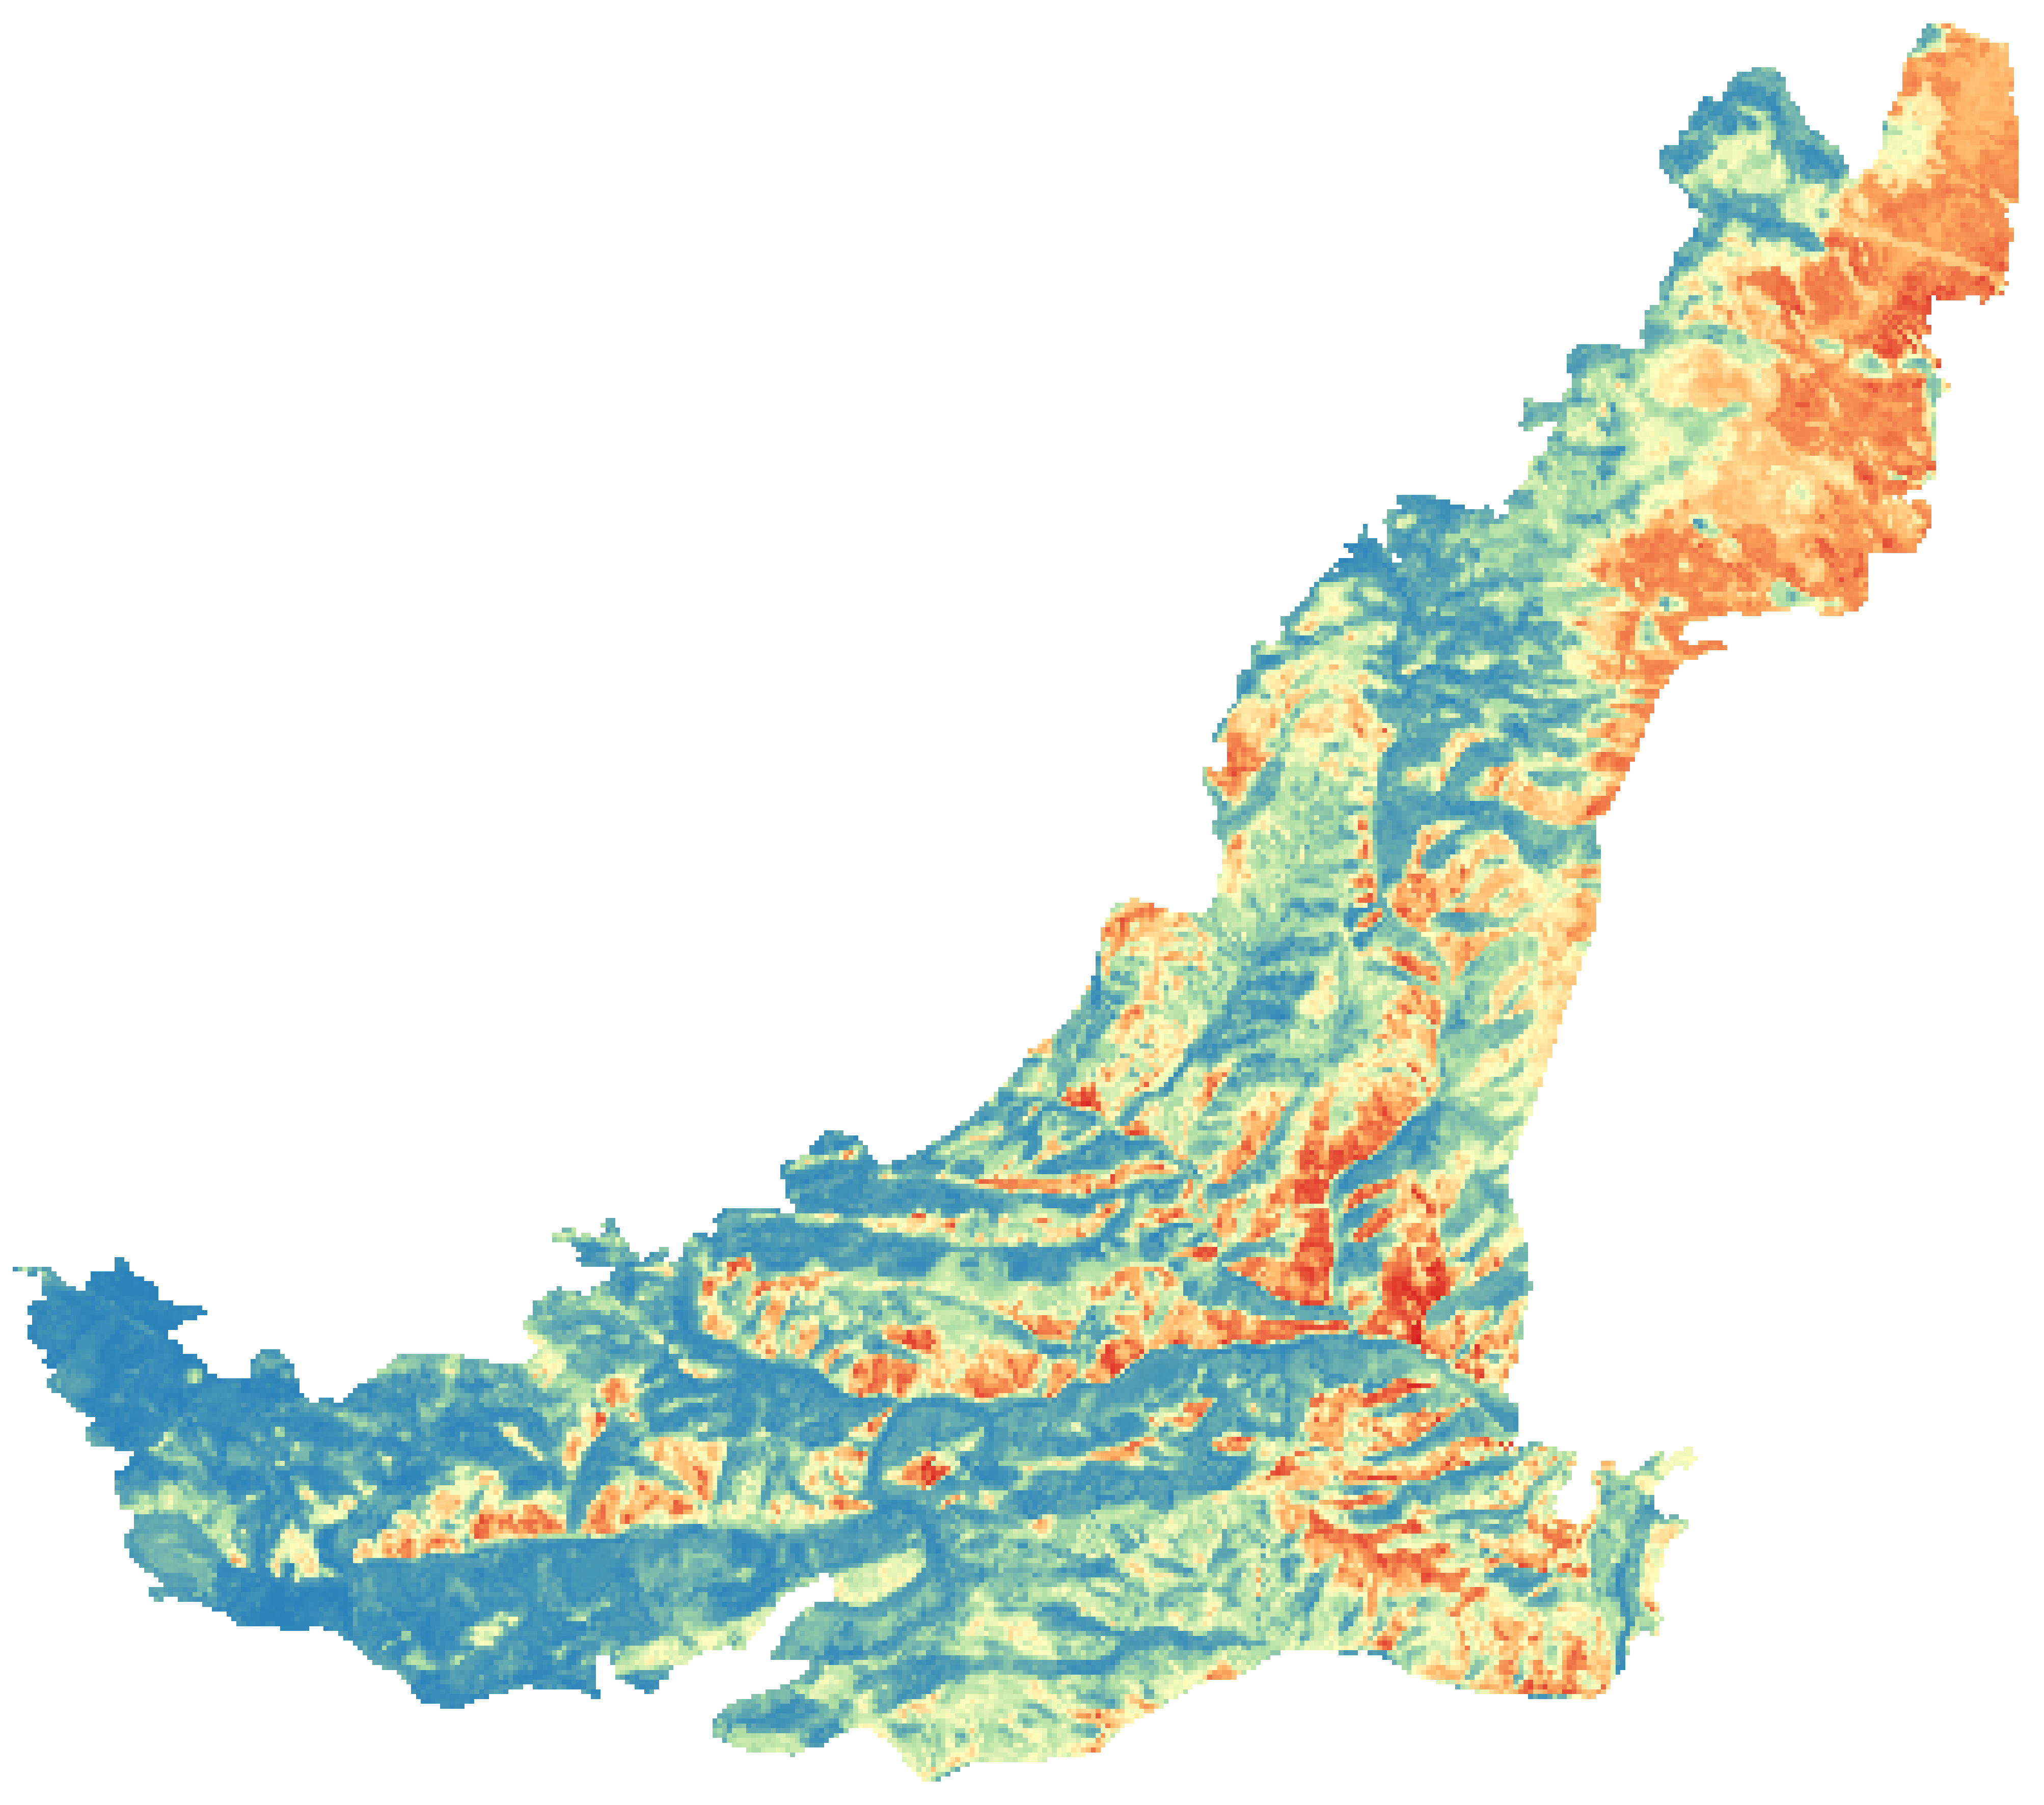
OBJECTIVES
Generate a probabilistic cheatgrass occurrence map for 2019
Analyze the effectiveness of aerial herbicide spraying on cheatgrass populations
2014 Probability of >= 40% Cheatgrass Map
Low High
Image Credit: NASA DEVELOP
Notes:
Speaker Notes: (CHIARA)
Main Objectives:
The two main objectives for our project were first to monitor cheatgrass re-establishment since the 2016 treatment by using machine learning models to create a 2019 probabilistic cheatgrass map. Second, we aimed to summarize the effectiveness of that 2016 treatment by comparing the 2015 map produced by Amanda West (shown here) that 2019 cheatgrass extent map.
Because it is difficult to determine the exact percentage of cheatgrass across each location of a landscape, they instead chose to map the probability at each location of cheatgrass cover being greater than or equal to 40%. The 40% threshold was chosen because the US Forest Service considers 40% cheatgrass presence sufficient for treatment.
Image Credit:
Made by a DEVELOPer

Slide 7
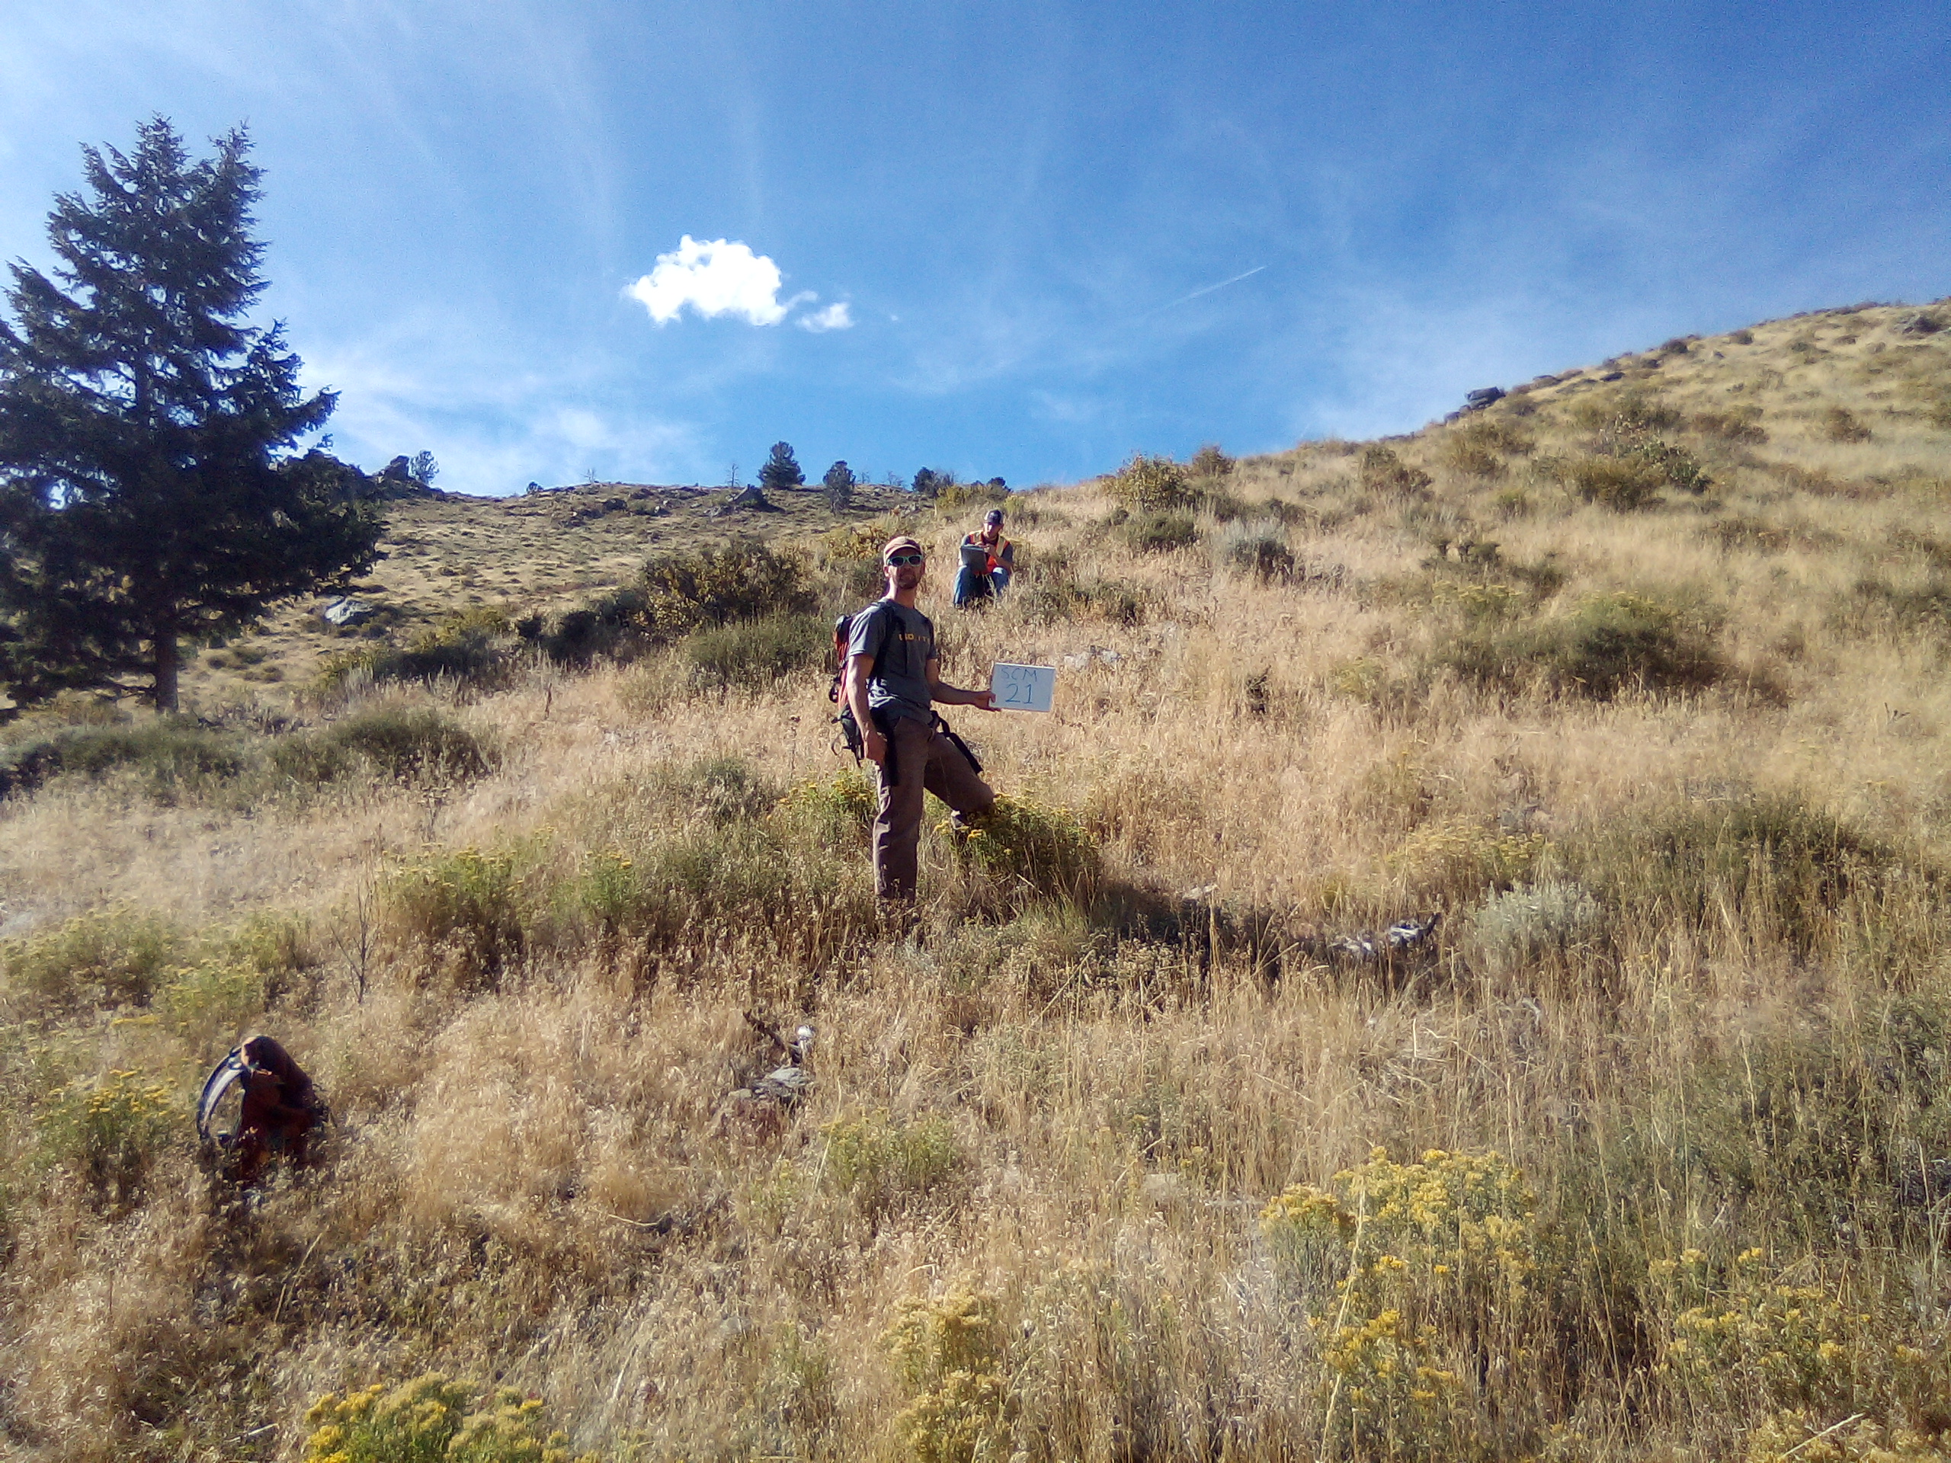
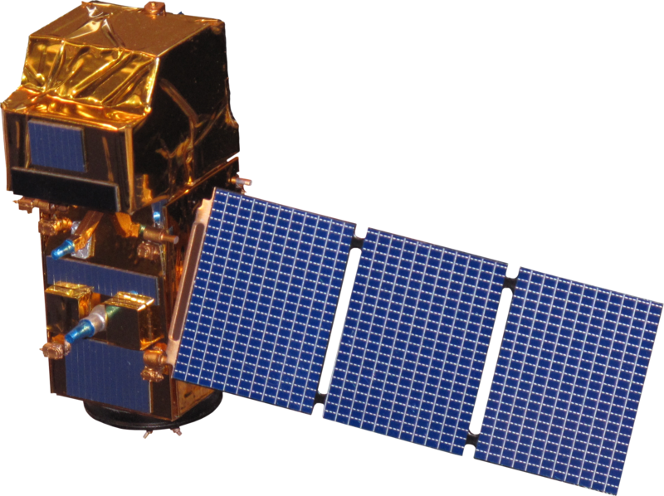
ANCILLARY DATA, SATELLITES, & SENSORS
Ancillary Data
Squirrel Creek Fire Boundary data
Imazapic Spray Boundary data
2014 Probabilistic Cheatgrass Map
In situ field samples
Landsat 8 Operational Land Imager
Surface Reflectance Tier 1
16-day return
30-meter resolution
Sentinel 2-MultiSpectral Instrument
Surface Reflectance Level 1C
5-day return
10-meter resolution
Image Credits: NASA DEVELOP
Notes:
Speaker Notes: (CHIARA)
For this project, we used ancillary data from the USFS and the CSU Natural Resource Ecology Lab including shapefiles of the squirrel creek fire boundary and the Imazapic spray boundary, the raster of the 2014 probabilistic cheatgrass map and in-situ field samples of cheatgrass presence and absence. Additionally, we used Landsat 8 OLI Surface Reflectance Tier 1 data and Sentinel 2-MSI Level 1C data downloaded from Google Earth Engine.
Image Credit:
Field: NASA DEVELOP
Landsat: http://www.devpedia.developexchange.com/dp/index.php?title=File:03_Landsat8.png
Sentinel: http://www.devpedia.developexchange.com/dp/index.php?title=File:24_Sentinel2.png

Slide 8
METHODOLOGY
Gather in situ absence and presence data
Compile satellite imagery from May to October 2019
Data Acquisition
Calculate spectral indices on imagery using Google Earth Engine
Execute machine learning models using in situ data and predictor variable raster images in Software for Assisted Habitat Modeling (SAHM)
Data Processing
Analyze AUC/ROC, Correlation Matrices, Calibration plots from SAHM
Compare model outputs to treatment polygons and West et al. 2017 map
Data Analysis
2019 Probabilistic Cheatgrass Map
Summary of Treatment Efficacy
End Products
Notes:
Speaker Notes: (CHIARA)
To model cheatgrass occurrence using remote sensing techniques within Google Earth Engine and the Software for Assisted Habitat Modeling aka SAHM. There were essentially three main steps to this process:
1. The first is data acquisition.
- We gathered in situ absence and presence data in-person by establishing 7m radius plots and estimating what percent of that plot was cheatgrass. We gathered over 50 plots and also received additional plot data collected by our partners at the USFS. Across all of the plots we sampled, there were plots with low cheatgrass, with high cheatgrass, and everything in between.
Then, we also gathered satellite imagery from May to October 2019 over our study area.
2. The next step was data processing. After masking out any cloud cover on our satellite images, we calculated a suite of spectral indices over each image. The resulting rasters were used as predictor variables in our machine learning models within the Software for Assisted Habitat Modeling (SAHM). We ran four models, which included boosted regression tree, generalized linear model, multi-adaptive regression splines, and the random forest model.
3. After executing these models, we analyzed their results using SAHM’s built in model evaluation metrics to understand the model accuracy and compared model outputs to the areas where the USFS sprayed imazapic in 2016 and also to the probabilistic map Amanda West published in 2017 in order to have control values over areas that were unsprayed.
As such, the final end products were the 2019 probabilistic cheatgrass map and the summary of the efficacy of the herbicide treatment.

Slide 9
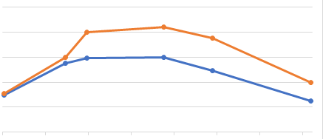
PREDICTOR VARIABLES
NDVI
EVI
SAVI
NBR
PSRI
NMBDI
NDWI
MNDWI
Tasseled Cap
Brightness
Greenness
Wetness
Tasseled Cap Wetness
1000
980
960
940
920
900
26-Jun
10-Jul
24-Jul
7-Aug
21-Aug
4-Sep
18-Sep
2-Oct
> 40% Cheatgrass
< 40% Cheatgrass
Notes:
Speaker Notes: (BYRON)
NDVI - Normalized Difference Vegetation Index
EVI - Enhanced Vegetation Index
NBR - Normalized Burn Ratio
SAVI - Soil Adjusted Vegetation Index
PSRI - Plant Senescence Reflectance Index
NMBDI - Normalized Multiband Drought Index
NDWI - Normalized Difference Water Index
MNDWI - Modified Normalized Difference Water Index
Tasseled Cap - Linear Transformation of the bands into their principle components
Wetness - First principle component
Greenness -Second principle component
Wetness - Third principle component
In places where the rate of change of an index differed for cheatgrass presence points and cheatgrass absence points, the difference between those values (i.e. rasters) was calculated in order to capture that distinction.

Slide 10
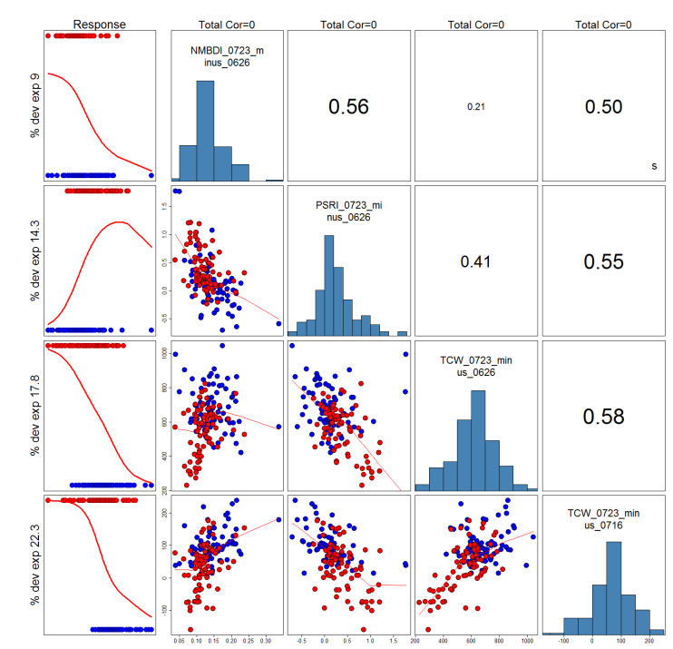
VARIABLE SELECTION & VALIDATION
Response
Predictor Variables chosen based on:
Correlation
Deviance explained
Validation:
Confusion Matrices
Calibration Plots
AUC of ROC
Covariate Importance Plots
NMBDI (0723 - 0626)
% dev exp
9.0
0.56
0.21
0.50
PSRI
(0723 - 0626)
% dev exp 14.3
0.41
0.55
TCW (0723 - 0626)
% dev exp 17.8
0.58
TCW (0723 - 0716)
% dev exp 22.3
Notes:
Speaker Notes: (BYRON)
Predictor Variables: The predictor variables are independent variables used provide information useful to the modeling algorithms for classifying the presence/absence of the response variables.
During the variable selection phase, the number of predictor variables was pruned down based on their correlation with each other such that only those variables with low correlation between each other were used. If a pair of predictors were correlated at or above 70%, the variable that explained more of the data was chosen. This minimized the amount of overlapping information contained by the predictor variables as a whole.
Response Variable: The response variable represents the property predicted by the model. In order to “supervise” the training of the binary classification models, a data set of known presence/absence points is required. For this project, the sample plots taken in Medicine Bow National Forest were used as the response variable for the training data.
Model Validation: Validation is the process by which the accuracy of the model output is determined. This is done by withholding a subset of the original training data, known as the test or validation data, from the model training. Once the model is trained, it is applied to the test data to generate predicted values of the response variable. These predictions can then be compared to the known values of the test data response variable and statistical analysis can be performed to determine the accuracy of the overall model. In K-Fold Cross Validation, the training data is stratified into K subsets and the model is trained K times, leaving one of the subsets out on each round sequentially. This method is more robust for validation because it reduces the likelihood of a significant pattern being excluded from the training data due to the partitioning of the data into training and test sets. For this project, four different metrics were used to evaluate the accuracy of the model output:
Confusion Matrices:
Matrix containing the number of True Positives, False Positives, True Negatives, and False Negatives.
Calibration Plots:
Plot of the percent of positive values vs the probability of those pixels being positive if 80% of pixels with a 80% probability of being positive are positive, the model is well calibrated.
The Area Under the Curve of the Receiver Operating Characteristic graph:
Compares the False Positive Rate and the True Positive Rate of test data predictions for several binary splitting thresholds
“threshold independent” metric because it analyzes the accuracy of the model at several thresholds.
Covariate Importance Plots:
Plot of the change in the AUC of the ROC for each predictor variable when that variable is permuted.

Slide 11
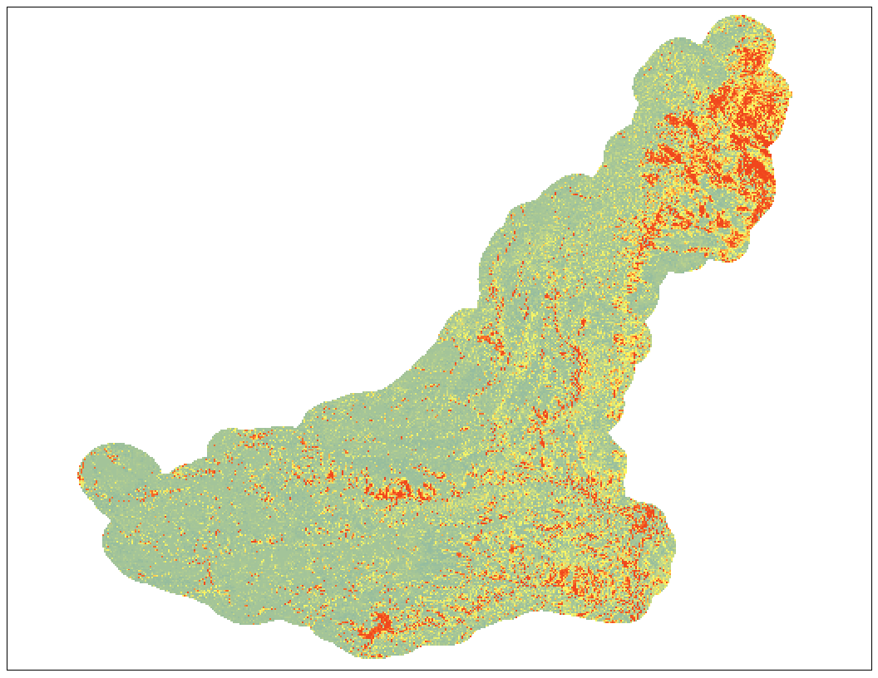
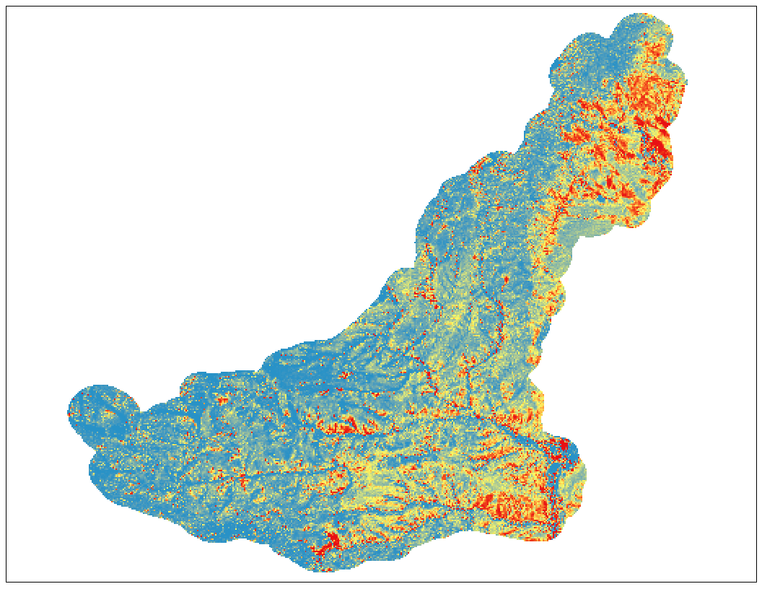
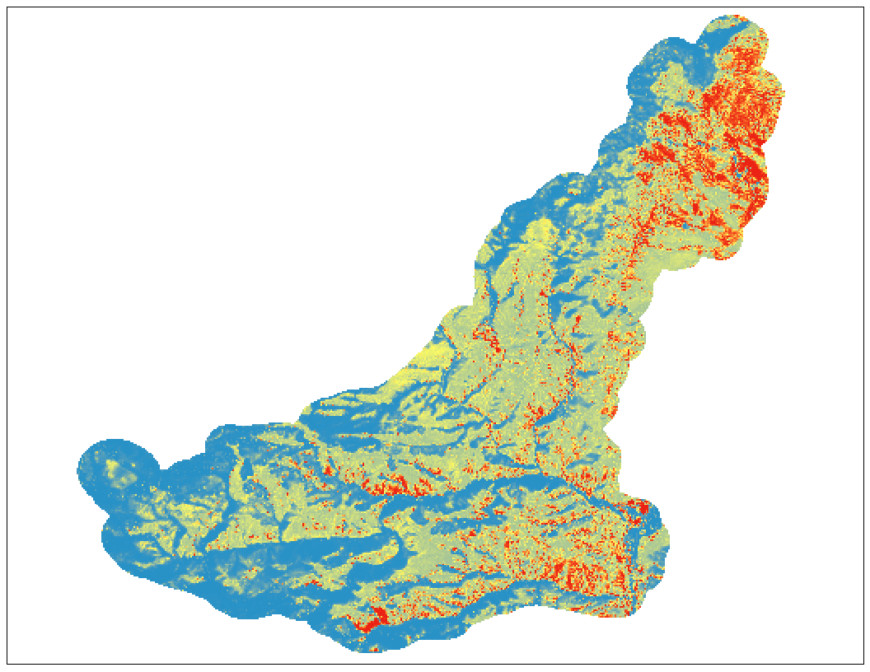
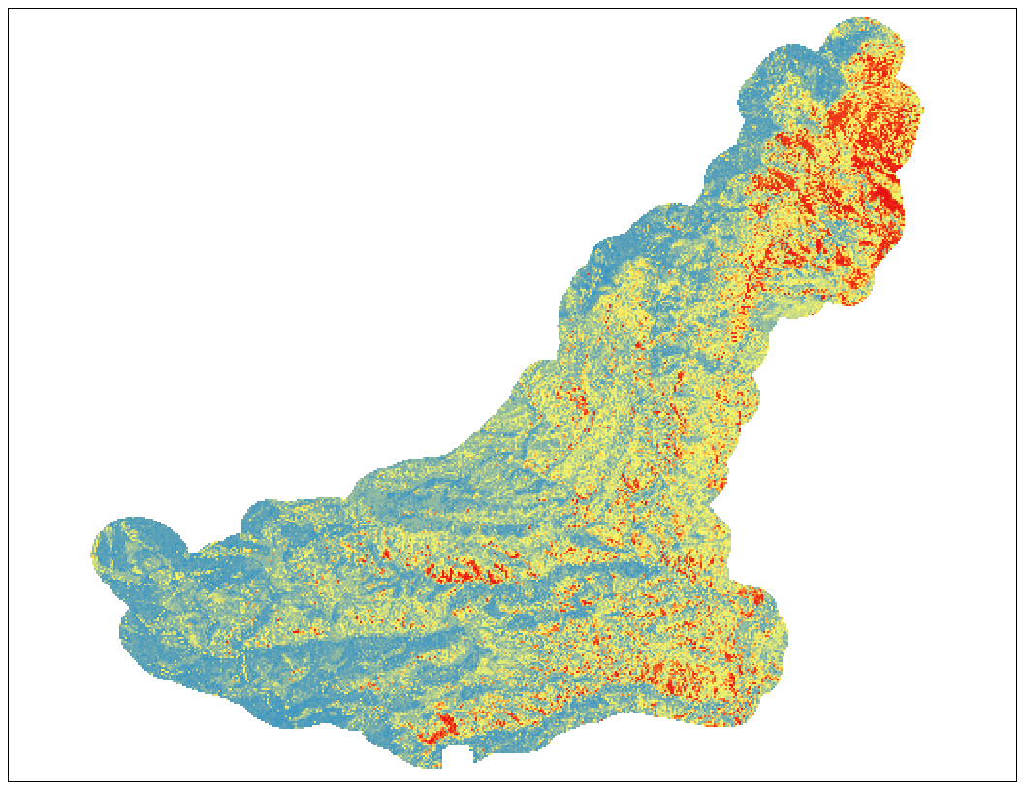
RESULTS
Boosted Regression Tree | Generalized Linear Model | Multi-Adaptive Regression Splines | Random Forest
Training Split AUC = 0.890 CV Mean AUC = 0.791 Variable # = 2 | Training Split AUC = 0.865 CV Mean AUC = 0.838 Variable # = 4 | Training Split AUC = 0.844 CV Mean AUC = 0.820 Variable # = 2 | Training Split AUC = 0.738 CV Mean AUC = 0.715 Variable # = 5
* Probability of >= 40% Cheatgrass Maps
Notes:
Speaker Notes: (BYRON)
CV Mean AUC indicates the mean score of model output across K-folds of cross validation
Training Split AUC indicates the score of the model output when applied to the data with
held from the training stage (i.e. test data).
BRT, GLM, and MARS all contain methods for “pruning” (i.e. removing) variables from the model based on metrics for the importance of each variable to the output. (Example: Percent of variance explained by each variable).
Image Credit: NASA DEVELOP

Slide 12
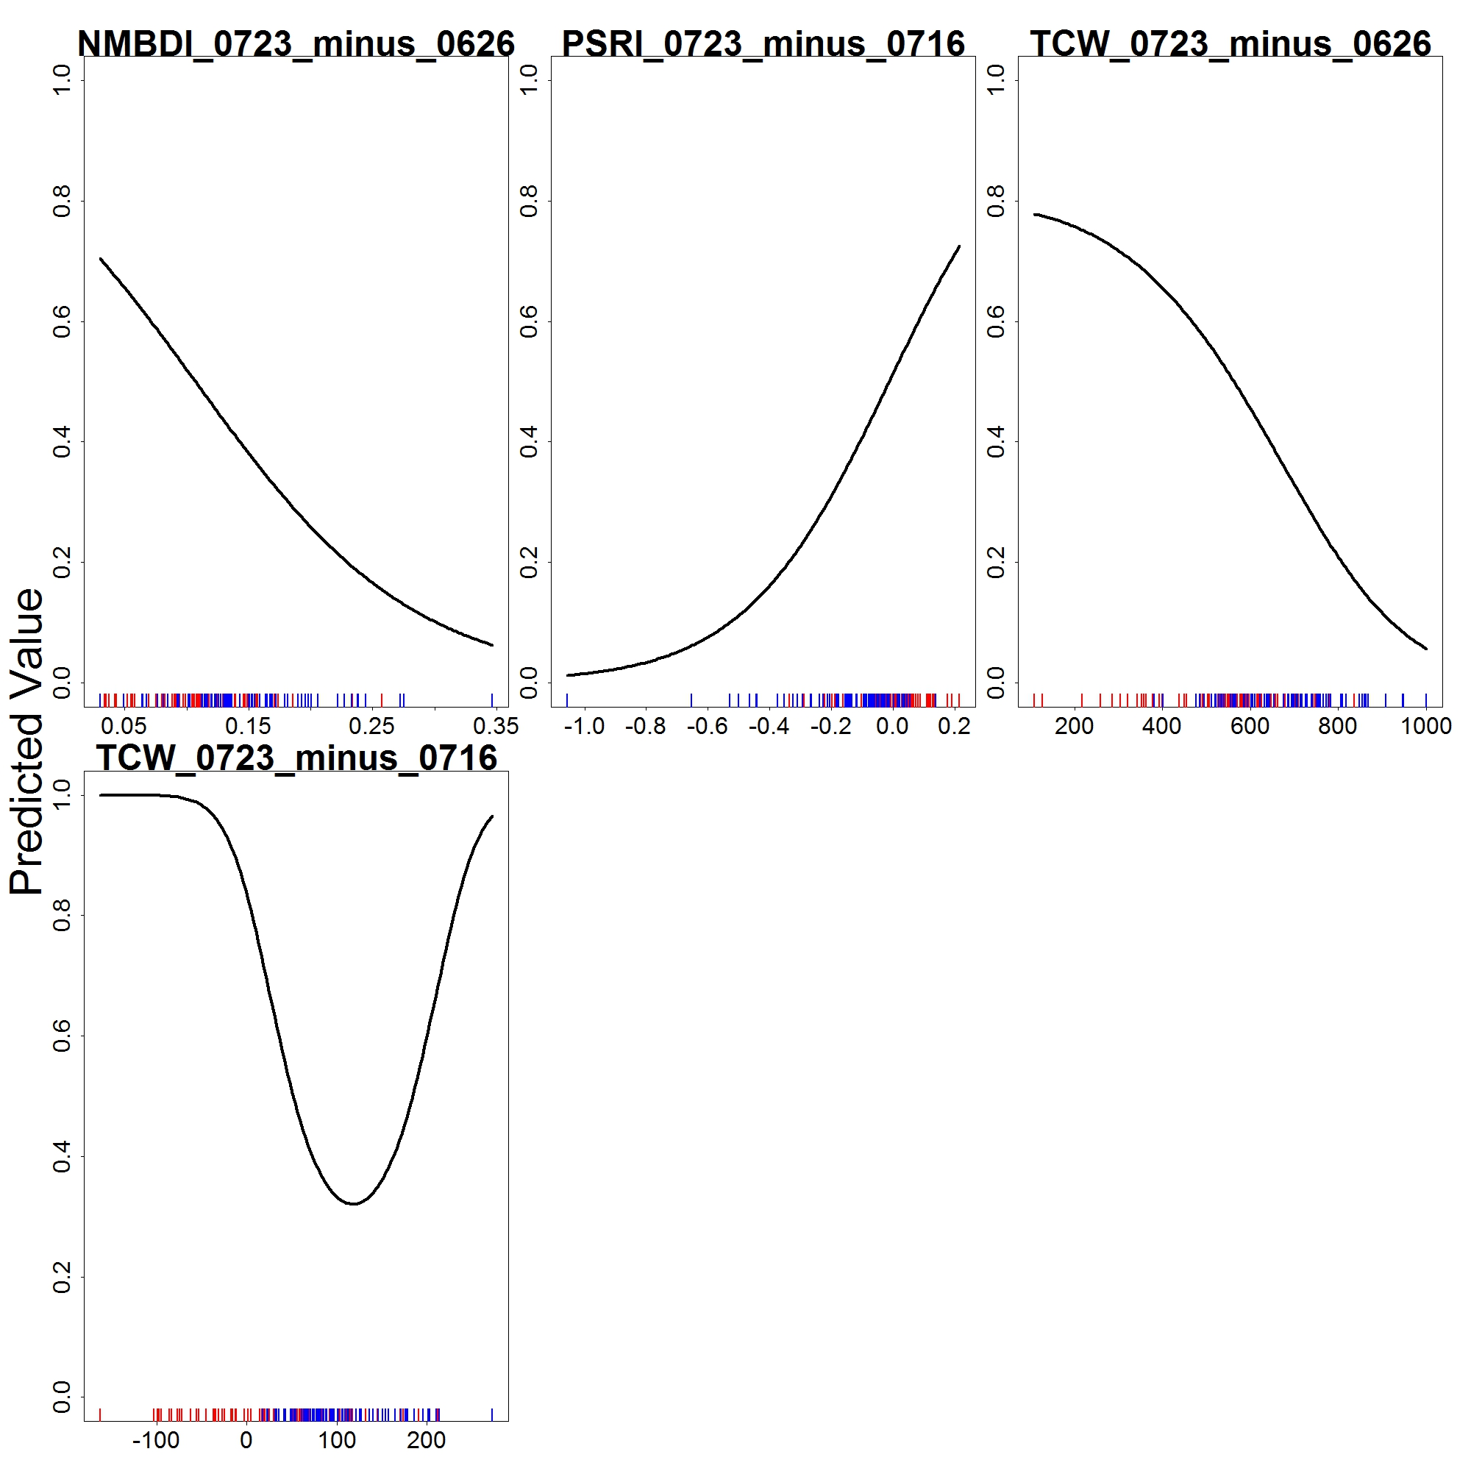
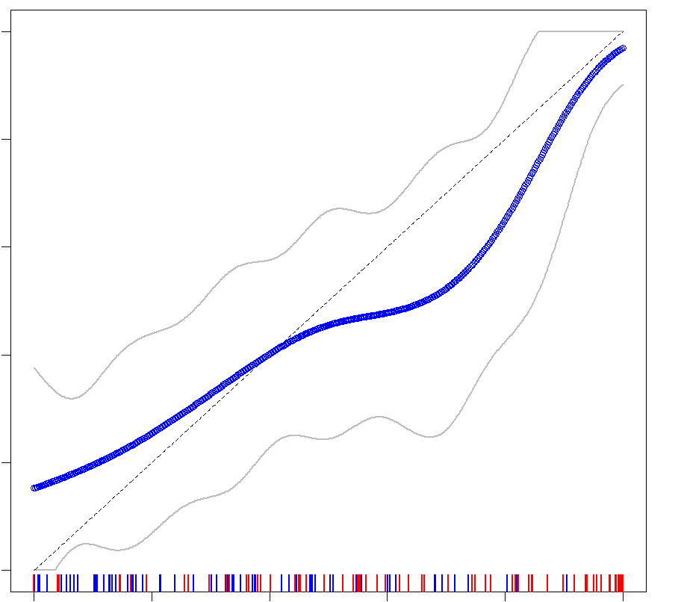
RESULTS: GLM
Calibration Plot for Cross Validation Split
NMBDI (07/23 – 06/26)
PSRI (07/23 – 07/16)
TCW (07/23 – 06/26)
Probability of Presence
0.0
0.2
0.4
0.6
0.8
1.0
Predicted Value
TCW (07/23 – 07/16)
0.0
0.2
0.4
0.6
0.8
1.0
Predicted Probability of Presence
Notes:
Speaker Notes: (BYRON)
The calibration plot (left) shows how the predicted probability (x-axis) compares with the true probability (y-axis). A perfectly calibrated model (line with slope of 1 and intersect of 0 – dotted line) would indicate that the model is perfectly predicting the probability of >= 40% cheatgrass for all pixels.
The response curves (right) show the shape of the decision function for each variable, assuming all other variables are held constant. The response curves can be used to understand the complexity of the trained model. This is important because an overly complex (i.e. overfit) model will not be able to generalize to new data, and thus not make accurate predictions, while an oversimplified model (i.e. underfit) will not have sufficient complexity to differentiate properly between different classes. (think goldilocks)
Image Credit: NASA DEVELOP

Slide 13
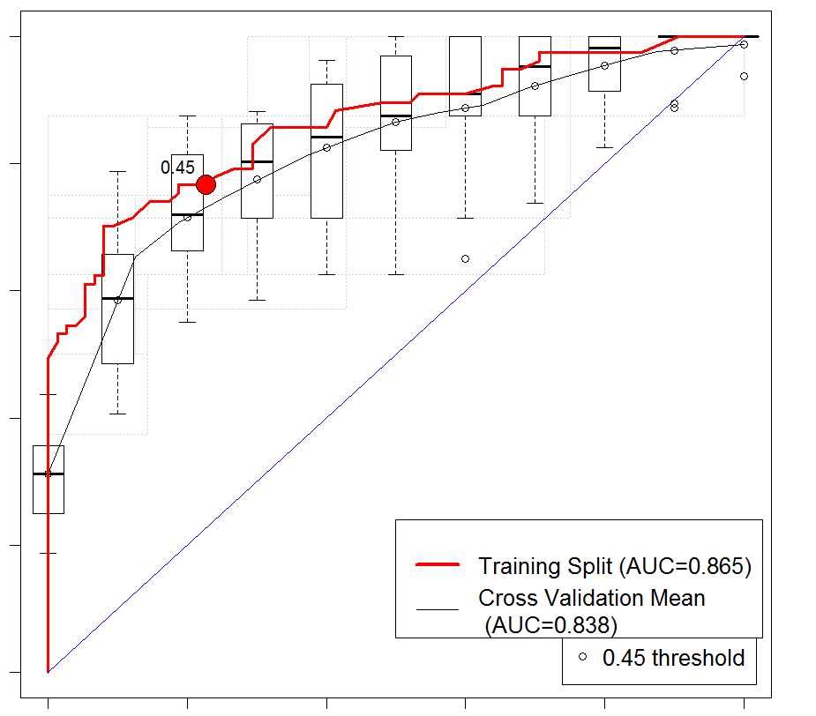
RESULTS: GLM
ROC Plot for Cross-Validation
Accuracy Summary
 | Predicted | Total | % Correct
Presence | 59 | 77 | 76.6%
Absence | 58 | 75 | 77%
0.0
0.2
0.4
0.6
0.8
1.0
Sensitivity (True Positive)
Training Split (AUC-0.865) Cross Validation Mean
(AUC=0.838)
0.45 threshold
0.0
0.2
0.4
0.6
0.8
1.0
Specificity (False Positive)
Notes:
Speaker Notes: (BYRON)
The ROC Plot (left) shows the True Positive Rate vs the False Positive Rate for the model. Each point represents a different threshold value. The threshold value is the probability of being >=40% cheatgrass value above which pixels are considered positive and below which pixels are considered negative. Because the curve represents all possible thresholds, this metric is considered “threshold independent”. An accuracy value between 0% and 100% can be calculated by taking the area under the ROC curve.
The model predicted presence points with a 76.6% accuracy and absence points with a 77% accuracy.
Image Credit: NASA DEVELOP

Slide 14
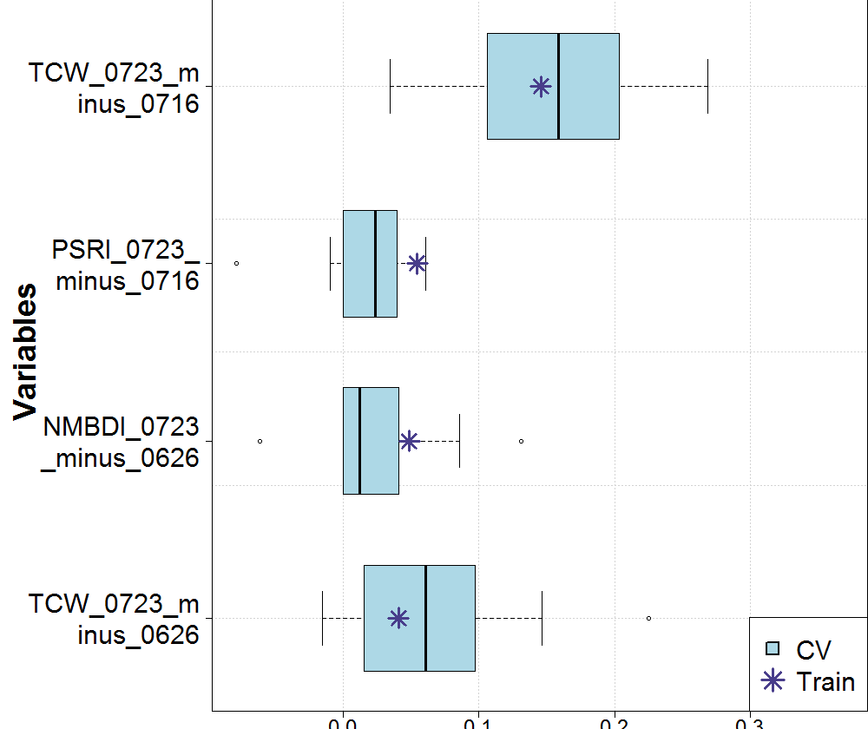
RESULTS: GLM
Importance using the change in AUC when each predictor is permuted
Final variables were all differenced raster images
June/July time period
TCW/NMBDI: water availability
PSRI: Cheatgrass senescence?
TCW
(07/23 – 07/16)
PSRI
(07/23 – 07/16)
Variables
NMBDI
(07/23 – 06/26)
TCW
(07/23 – 06/26)
CV
Train
0.0 0.1 0.2 0.3
Importance
Notes:
Speaker Notes: (BYRON)
The covariate importance plot shows the change in the AUC of the ROC curve when each predictor variable is permuted. The dark lines indicate the mean change in AUC for all cross validation folds, the box indicated the standard deviation in change of AUC for all cross validation folds, and the whiskers show the outlying values for change in AUC for the cross validation folds. The stars indicate the change in AUC for the training data when the variable is permuted.
Our final variables were all differenced raster images either between the end of June to the end of July or mid July to the end of July. This indicates that something significant was happening either with the climate or within the cheatgrass lifecycle within this time period. Three of the four final variables evaluate wetness, which suggests that water availability is of high importance for cheatgrass. The last was the plant senescence reflectance index, which may suggest that cheatgrass senescence began during this period.
Lastly, all of these indices make use of other bands in addition to NIR and Red, which are used in many vegetation health indices. This indicates that perhaps vegetation health is not the best way to distinguish cheatgrass from other plants in the area.
Image Credit: NASA DEVELOP

Slide 15
RESULTS: GLM
 | Treated Areas | Untreated Areas
Cheatgrass Before | 59% | 17.5%
Cheatgrass After | 23% | 23%
% Change | -36% | +5.5%
2014 Probability >= 40% Cheatgrass Map
2019 Probability >= 40% Cheatgrass Map
Notes:
Speaker Notes: (BYRON)
Results of the GLM Model show that the percent of pixels with greater than or equal to 40% cheatgrass coverage has decreased from 59% to 23% in areas treated with the herbicide. In contrast, the percent of pixels with greater than or equal to 40% cheatgrass coverage has increased from 17.5% to 23% for untreated areas.
Image Credit: NASA DEVELOP

Slide 16
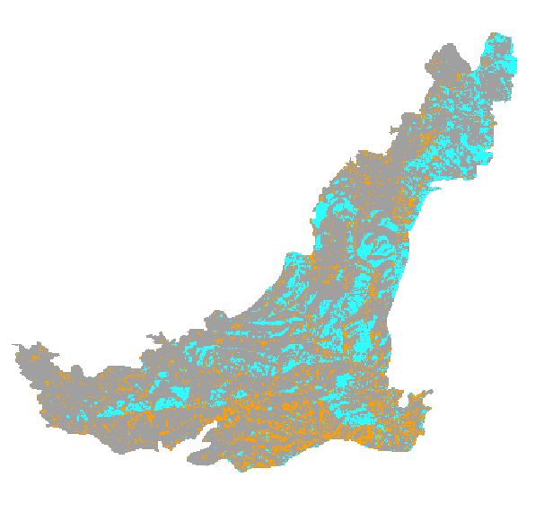
CONCLUSIONS
2015/2019 Cheatgrass Change Map
GLM best models Cheatgrass populations
Best calibrated model
Visual patterns match field observations
Larger range of probabilities
Highest AUC Scores, within 0.05 of each other
2016 Imazapic Treatment was effective
36% Decrease in Treated Areas
5.5% Increase in Untreated Areas
= No Change
= Cheatgrass Increase
= Cheatgrass Decrease
Notes:
Speaker Notes: (FORREST)
Our final conclusions are that GLM best models cheatgrass populations. First, the model was the best calibrated. Also, besides having the highest AUC score of the models, we felt the GLM model output best approximated the patterns we saw in the field, specifically the tendency of cheatgrass to grow on south facing slopes.. Additionally, the GLM results showed the closest fit between the Cross Validation AUC and the Training Split AUC, indicating the least amount of overfitting.
Based on our models, we conclude that the 2016 imazapic treatment was effective, as there was a 36% reduction of cheatgrass in treated areas compared to a 6% increase in untreated areas.

Slide 17
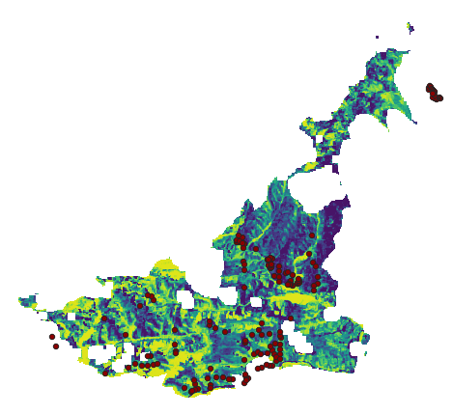
LIMITATIONS
Fewer in situ data points in the Northeastern part of the study area
Lack of clear imagery during 2019 emergence stage for Sentinel and Landsat 8
Striping over study area with Terra ASTER and Landsat 7
Detecting with models
May 13th, 2019 Landsat 8 Plant Senescence Reflectance Index
May 12th, 2019 Landsat 7 Red Band
Notes:
Speaker Notes: (FORREST)
There were multiple limitations for this project. The first limitation was that there was fewer in situ data points in the Northeastern part of the study area. In addition, we were unable to find sufficient cloud-free imagery during the emergence stage of the cheatgrass lifecycle for 2019, which was during May and June. We tried to acquire imagery for these months from other satellites and sensors such as Terra ASTER and Landsat 7, but both had striping that severely compromised the extent of the image. Lastly, any time you try to detect plant cover with modelling, there is bound to be error, so no model can be 100% accurate.
Image Credit:
NASA DEVELOP team

Slide 18
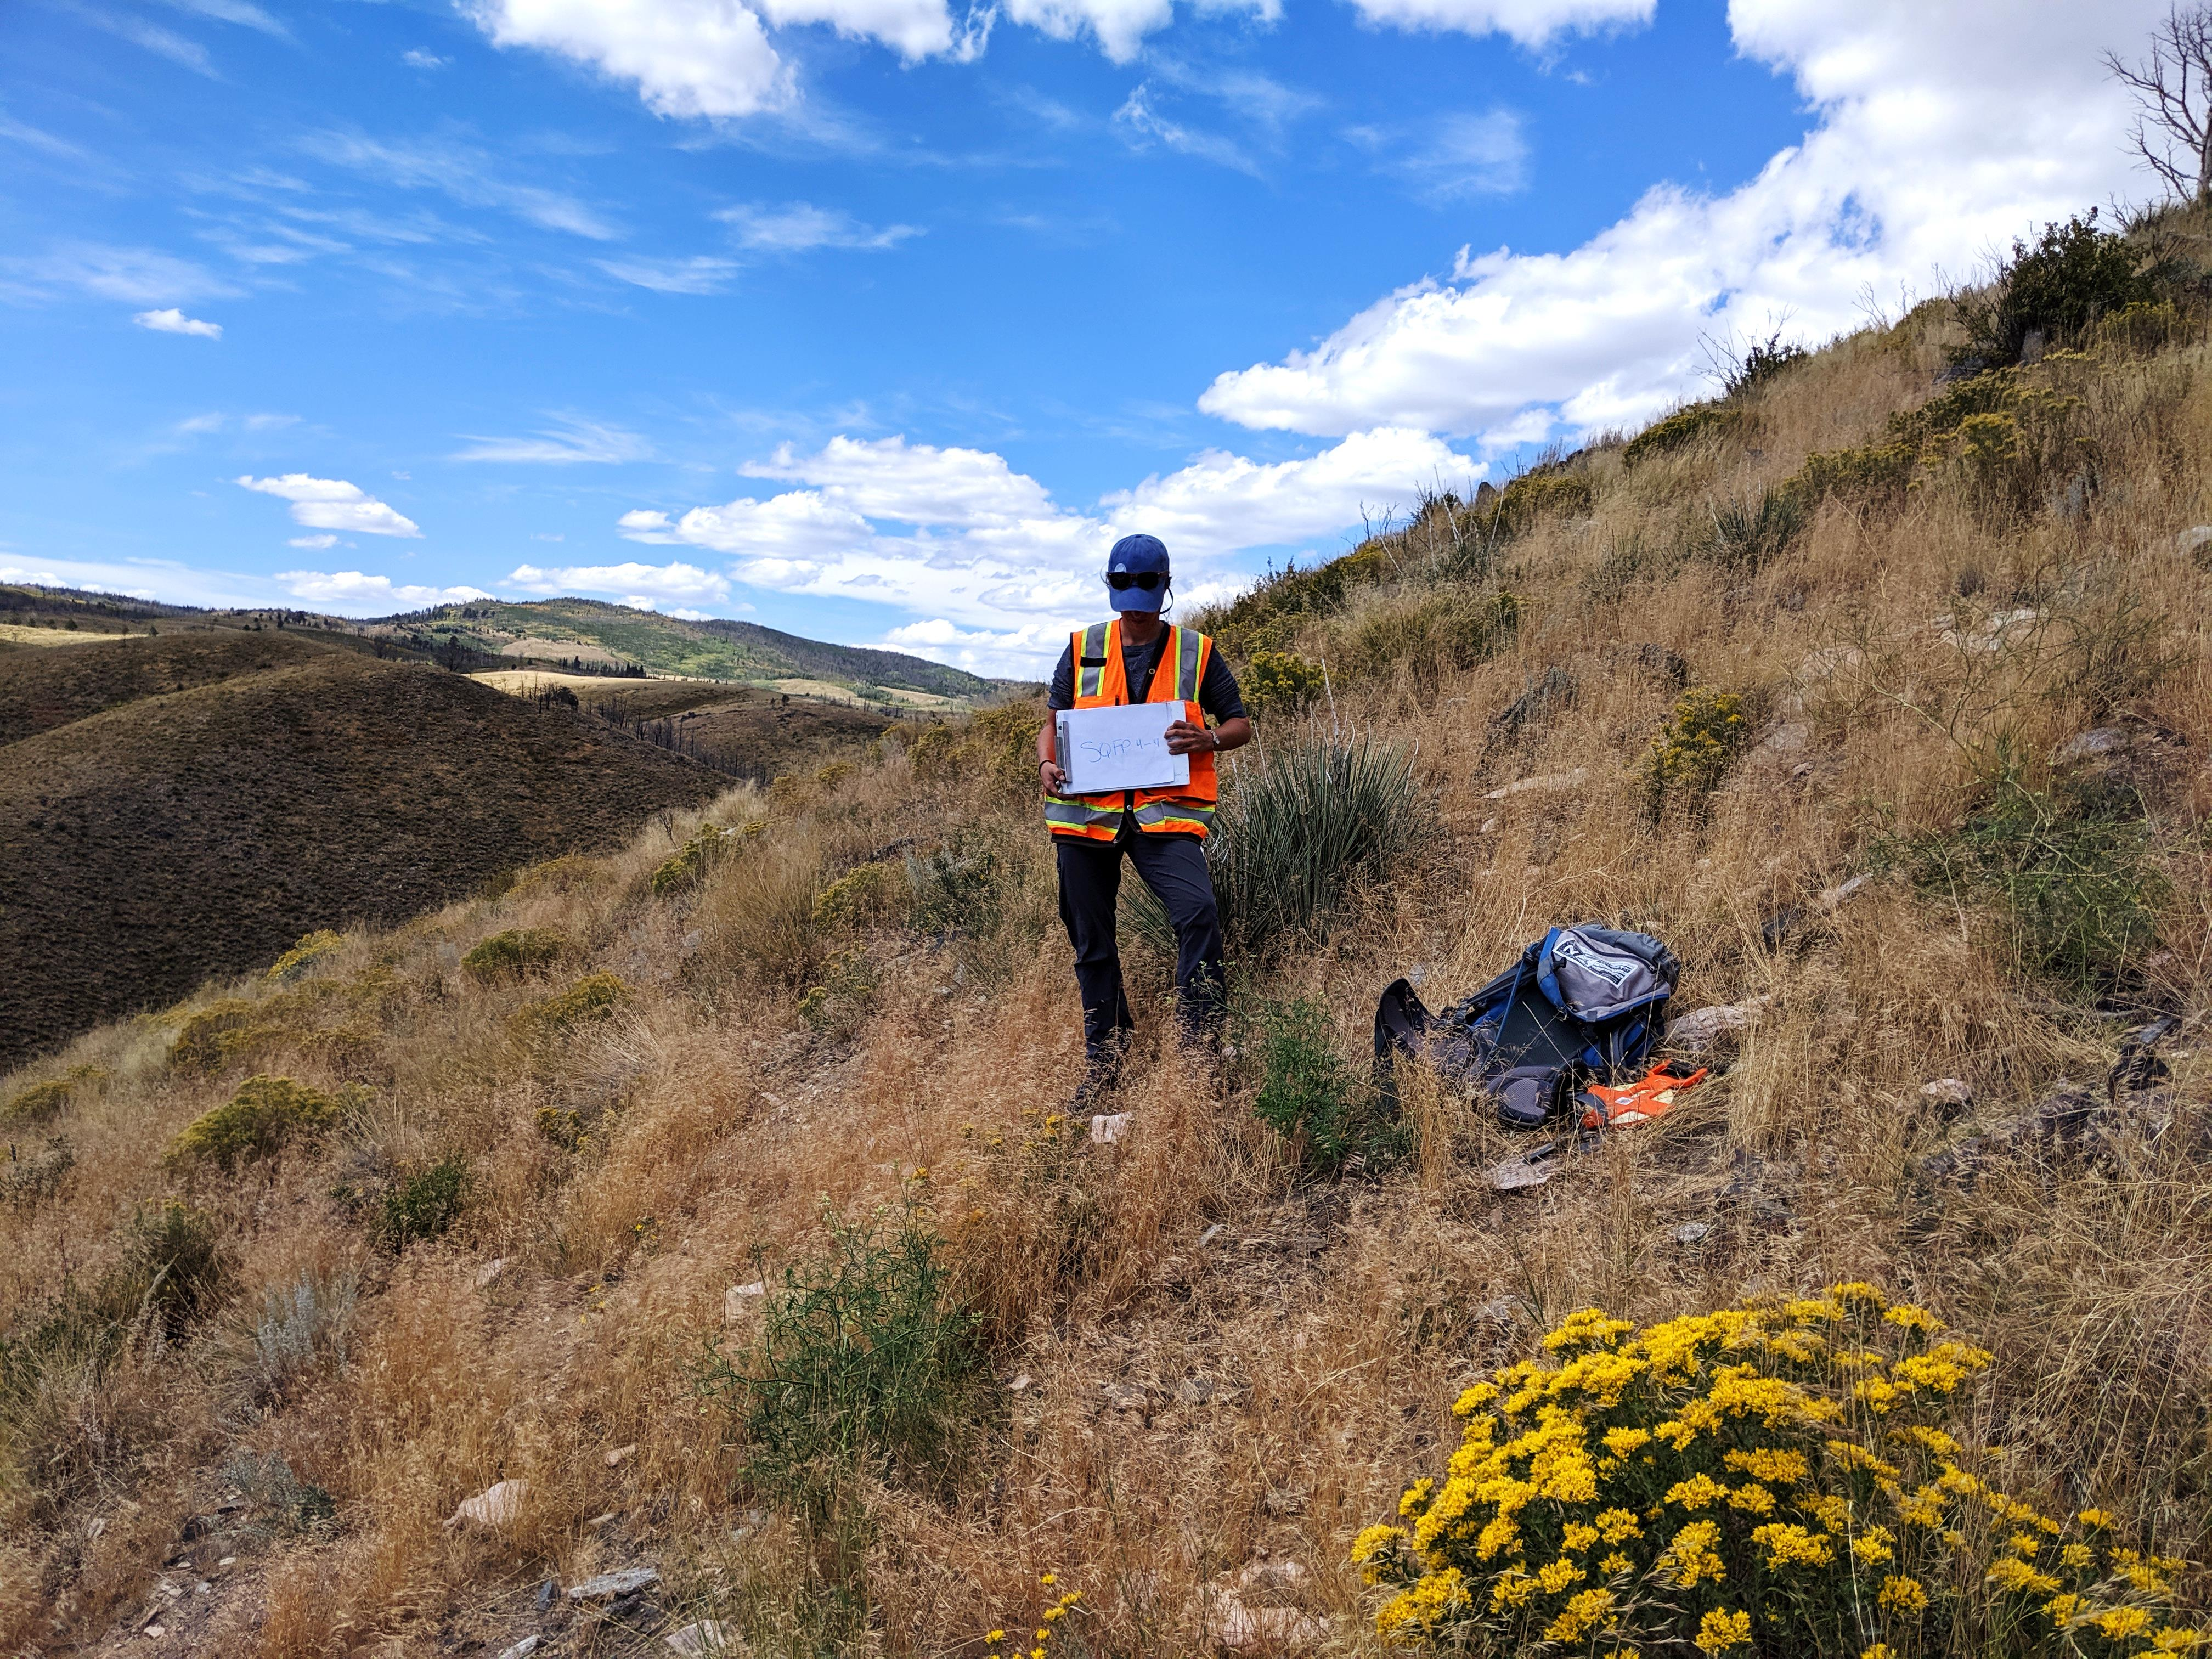
FUTURE WORK
Evaluate August 2019 and 2022 treatment
Continue field data collection
Analyze the effect of Imazapic on native plants
Image Credit: Medicine Bow Disasters Team
Notes:
Speaker Notes: (FORREST)
Future work should include evaluating the recent treatment in August of 2019 and the future treatment in 2022. To do this, the USFS should continue field data collection annually. Additionally, the effect of Imazapic on native plants should be researched, because even though Imazapic seems to be effective in reducing cheatgrass populations, the goal of the USFS is to foster an environment for increased forage for mule deer and elk. If native plants are not growing back after treatment, this mitigation strategy may not be as useful as we think.
Image Credit:
NASA DEVELOP team

Slide 19
ADVISORS & MENTORS
CSU Natural Resource Ecology Laboratory
Dr. Paul Evangelista
Peder Engelstad
Nicholas Young
Tony Vorster
USGS, Fort Collins Science Center
Dr. Catherine Jarnevich
NASA DEVELOP
Kristen Dennis
PARTNERS
USDA, US Forest Service
Jacquilyn Roaque
Katie Haynes
Wyatt Good
John Kenney
This material contains modified Copernicus Sentinel data 2019, processed by ESA.
Notes:
Speaker Notes: (FORREST)
We would like to thank our advisors, DEVELOP leadership, and partners for their ongoing support throughout the term. Questions?

