Slide 1
2018 Fall | Maryland – Goddard
CHESAPEAKE BAY AGRICULTURE II
Operational Analysis of Winter Cover Crop Environmental Performance throughout the State of Maryland
Logan Kline
Julio Peredo
Diane Portillo
Benjamin Whong
Notes:
(Ben)
We are the Chesapeake Bay Agriculture II team at Goddard Space Flight Center. We are Logan Kline, Benjamin Whong, Julio Peredo, and Diane Portillo.
For our project this Fall 2018 term, we continued the work of a previous DEVELOP team to analyze winter cover crops in Maryland and their benefits for the Chesapeake Bay.

Slide 2
The Chesapeake Bay
Largest estuary in the United States
Inhabited by more than 3,600 species
Important economic resource for Maryland
Image Credit: Matt Rath / Chesapeake Bay Program
Notes:
(Ben)
The Chesapeake Bay is one of the Earth’s most important natural resources. It is the largest estuary in the nation and home to thousands of species of plants and animals including fish, seagrass, crustaceans, and mollusks. Its watershed spans six states and is a valuable source of economic productivity throughout the Mid-Atlantic. Conserving the Bay is of chief ecological importance for both the state of MD and the entire US.
Economic importance (fishing and boating) ← Let’s time ourselves first, then see if we can add this in
Image URL: https://flic.kr/p/8SbgP3

Slide 3
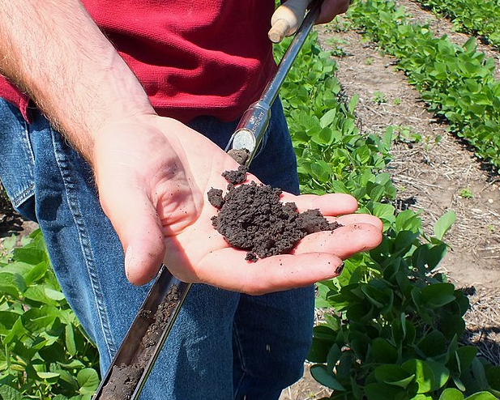
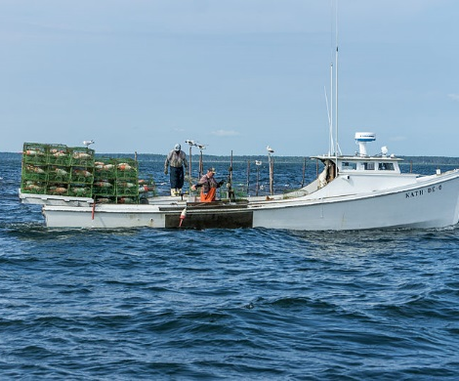
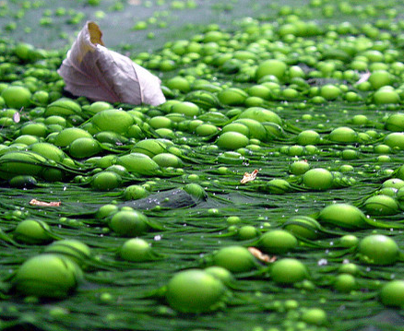
Community Concerns
Agricultural Runoff & Water Quality
Biodiversity
Soil Health
Economic Benefits
Image Credit (Left to Right): USDA NRCS South Dakota, F. Lamiot, Peretz Partensky, Will Parson (Chesapeake Bay Program)
Notes:
(Ben)
Community and ecological concerns around the Bay are often linked. Soil health and nutrient retention influences agricultural runoff and eutrophication, which alter the overall water quality of the Bay. Excess nutrients within soil can result in algal blooms, draining oxygen and light reaching the Bay’s deeper waters. When water quality is lowered by these threats, economic benefits and biodiversity decrease; oyster and fish hauls, recreational activities, and commercial ventures may suffer from nutrient-polluted waters.
Eutrophication image: https://www.flickr.com/photos/48722974@N07/4464986156
Belted kingfisher image: https://flic.kr/p/oJGyX9
Crab pots image: https://commons.wikimedia.org/wiki/File:Setting_out_Crab_Pots_on_the_Chesapeake_(7315909698).jpg
Healthy soil image: https://commons.wikimedia.org/wiki/File:Soybean_Field_with_Healthy_Soil_(9316804120).jpg

Slide 4
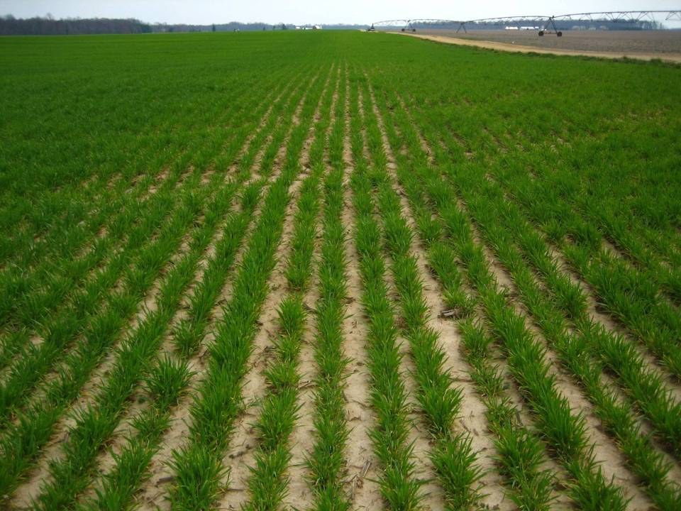
Cover Crops
Crops grown between growing seasons to manage soil erosion and fertility while promoting a healthier ecosystem
Maryland Agricultural Water Quality Cost-Share Program
Cover crop enrollment program
Image Credit: Dean Hively (USGS)
Notes:
(Ben)
One effective strategy for promoting Bay health is by using winter cover crops. These are crops planted outside of typical growing seasons during the winter months, whose primary purpose is to absorb excess nutrients, particularly nitrogen, from the soil so that they do not enter the Bay. Cover crops are thus important for preventing soil erosion and eutrophication. The Maryland Agricultural Water Quality Cost-Share Program, or MACS, was initiated by the Maryland Department of Agriculture and oversees a program that incentivizes winter planting of cover crops to ensure these benefits are maximized. In the spring, farmers who kill off (not harvest!) their crops are financially rewarded for their efforts to return the nutrients to the soil. Thus, the soil and the Bay both stay healthy.
Image URL: https://commons.wikimedia.org/wiki/File:Grain_Crop_(Unsplash).jpg

Slide 5
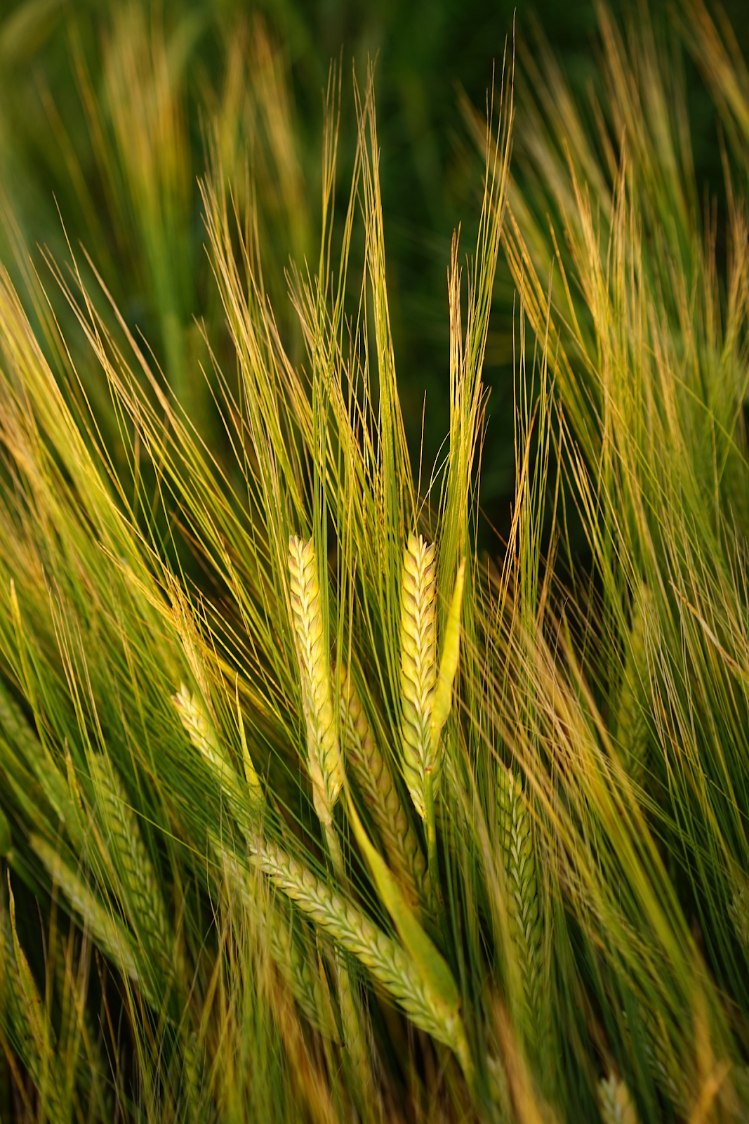
Partners
Maryland Department of Agriculture, Office of Resource Conservation
USDA, Agricultural Research Service
USGS, Eastern Geographic Science Center
US EPA, Chesapeake Bay Program
Image Credit: Hans Braxmeier
Notes:
(Diane)
Our project focuses on using remote sensing data to analyze the benefits of these winter cover crops. We are partnered with the USDA-ARS, the USGS, and the EPA Chesapeake Bay Program to provide a tool to our end users at the Maryland Department of Agriculture.
The MDA provided shapefiles of enrolled counties and will receive the scripts created from this project.
The USDA-ARS provided calibration data from 2006-2012.
The USGS provided the scientific basis and inspiration for the project.
The Chesapeake Bay Program provided support as a boundary organization and will help disseminate the results of this project.
Image URL: https://pixabay.com/en/barley-field-spike-grain-cereals-1117283/

Slide 6
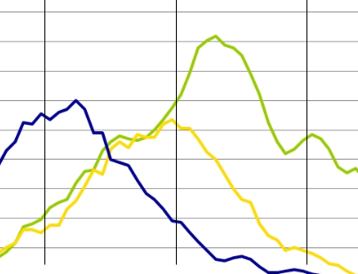
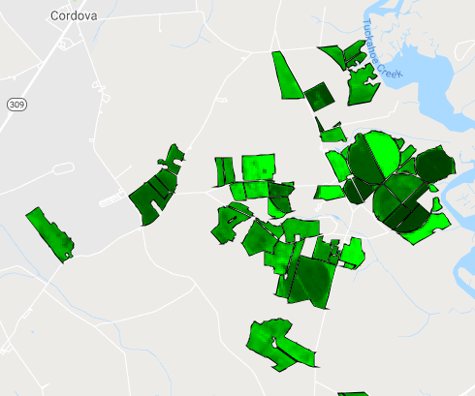
Objectives
Implement code and research into a Google Earth Engine GUI
Visualize performance of fields in winter cover crop program
Facilitate regular analysis of cover crops
Image Credit (Left to Right): Christiaan Colen, Dean Hively (USGS), NASA DEVELOP
Notes:
(Diane)
Our overall objective for this project was to reduce the need for costly, labor-intensive in situ spot-checking of fields to verify their performance in the cover crop program. By helping the MDA use remotely sensed data, we can help them achieve their long-term goal of eliminating spot-checking.
To help us reach this goal, we set out to:
1. Update the previous team’s work and streamline it into an easy-to-use GUI for the MDA.
2. Analyze input data and process it into meaningful graphs and tables to make it easier to spot patterns in performance.
3. Provide the GUI to the MDA so they can analyze performance based on planting date, plant type, planting method, county, and more.
Code image: https://www.flickr.com/photos/christiaancolen/20445410340
Graph image: Provided by Dr. Dean Hively of USGS
GEE image: NASA DEVELOP team

Slide 7
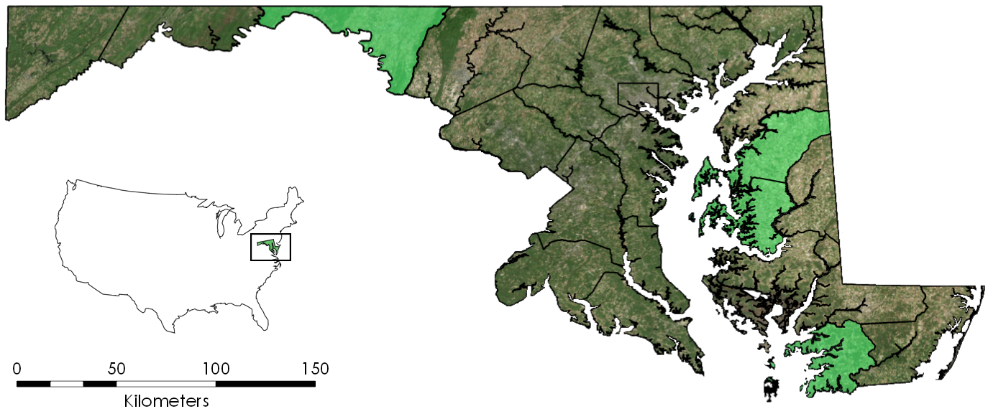
Project Areas of Interest
1
Maryland Counties
2
1 – Washington
2 – Queen Anne’s
3 – Talbot
4 – Somerset
3
4
Study period: winter (December 15 – January 31) and spring (March 1 – April 15) from 2006 - 2018
Notes:
(Diane)
Here we display the region we focused on for this project.
Data were provided for four Maryland counties: Washington, Queen Anne’s, Talbot, and Somerset, as seen on the map.
The entire study period for this project ranges from 2006 through 2018. We broke this study period into two components:
Calibration data collected from 2006 to 2012 that was used to create NDVI-correlated biomass and percent ground cover predictions
Full winter cover crop program enrollment data collected between 2014 to 2018. Although we focused on the four counties shown here, we did receive data from all counties for 2017 and 2018; this was not used in the development of our GUI but was used to test our analysis.
Within our study period, we specifically looked at times between growing seasons: December 15 – January 31 for winter, and March 1 – April 15 for spring.
Base layer source: Maryland iMap (2018) detailed county boundaries (http://data.imap.maryland.gov/datasets/maryland-physical-boundaries-county-boundaries-detailed). Raster image is ArcGIS World Imagery basemap (Sources: Esri, DigitalGlobe, GeoEye, i-cubed, USDA FSA, USGS, AEX, Getmapping, Aerogrid, IGN, IGP, swisstopo, and the GIS User Community).

Slide 8
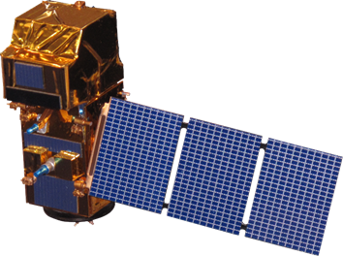
Satellites Used
Landsat 5
Thematic Mapper
Landsat 8
Operational Land Imager
Sentinel-2
MultiSpectral Instrument
Notes:
(Diane)
Staying consistent with the previous DEVELOP team, we are using NASA Landsat 5 and Landsat 8 imagery. We are also implementing a script that was written for ESA Sentinel-2, as it has now been sufficiently integrated into Google Earth Engine. Landsat 5 images are applicable from 2006-2013 while Landsat 8 images are applicable from 2013-2018. Sentinel-2 images can be used from 2015 onward to supplement data-poor Landsat images – for example, those with high cloud cover.

Slide 9
Methodology
NDVI
Calculate NDVI for enrolled fields using Google Earth Engine
Performance Metrics
Analysis
Generate histograms and summary tables to analyze data
Percent ground cover
Biomass
Image Credit (Left to Right): NASA DEVELOP Team, Alan Manson (Wikimedia), NASA DEVELOP Team
Notes:
(Diane)
The steps we took to carry out our analysis were:
Calculating NDVI values for fields based on winter or springtime
Applying calibration equations formulated by the spring 2017 team in order to calculate biomass and percent ground cover based on NDVI
Analyzing data filtered on user-selected agricultural parameters through histograms and tables that display biomass and percent ground cover estimates
A major goal of our GUI was to have these actions performed directly within Google Earth Engine, without using programs such as R or Excel. Each methodology listed here was thus coded and performed within the functioning capabilities of our GUI.
Crop shapefile image: NASA DEVELOP team
Image URL: https://commons.wikimedia.org/wiki/File:2004_0609_Italian_ryegrass_cover_crop.jpg
Histogram image: NASA DEVELOP team

Slide 10
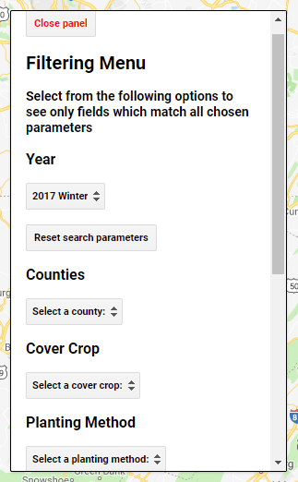
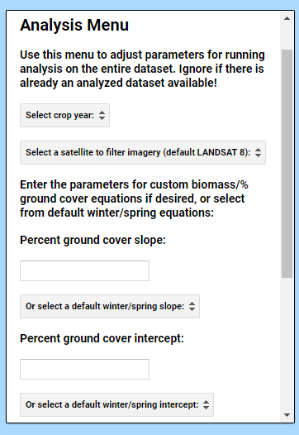
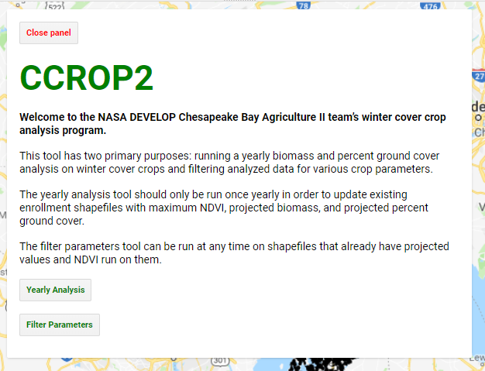
GUI Functionality
Notes:
(Julio)
Here we have a snapshot of the GUI our team created. Upon running the program, an initial welcome screen appears that describes the two separate tools contained in this GUI.
[click for Yearly Analysis] The first tool, Yearly Analysis, is run only once per year when new cover crop enrollment data is collected. Using this tool allows the user to select the planting year and satellite imagery as well as input calibration data for generating biomass and percent ground cover. When the analysis is run, average maximum NDVI, biomass, and percent ground cover is generated for each field listed in that enrollment year. This is then exported as a shapefile and set up to be re-imported into GEE.
[click for Filter Parameter] Our filtering parameters tool can be utilized at any time and is run on the re-imported shapefiles that have NDVI, biomass, and percent ground cover. On this menu, the user can run analyses on certain counties, select a cover crop to analyze, and adjust various other parameters.

Slide 11
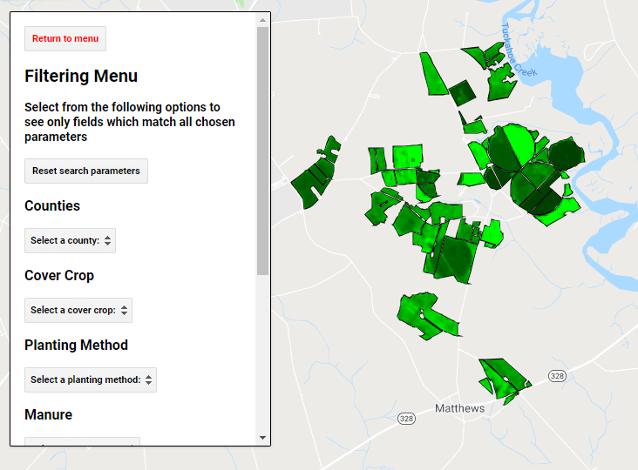
Example GUI Output
Notes:
(Julio)
Here is an example of how our GUI filtering menu looks with crop fields displayed. The user sees these fields and can select from the parameters we have provided (such as planting method, irrigation, and planting date). This snapshot displays NDVI overlaid on a subset of our crop fields.

Slide 12
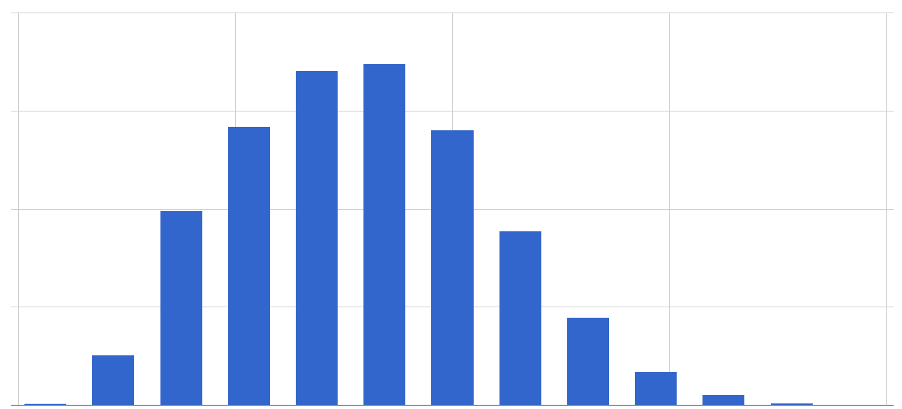
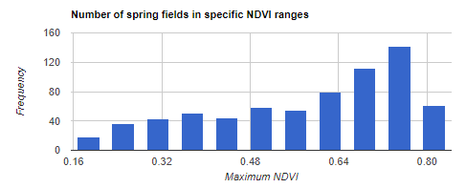
Results: Histograms
Satellite: Landsat 8
Season: Spring
Cover Crop: Wheat
Satellite: Landsat 8
Season: Spring
Cover Crop: Triticale
Number of Wheat Fields by NDVI Range
Number of Triticale Fields by NDVI Range
3000
2250
1500
750
0
160
120
80
40
0
Frequency
Frequency
0.1 0.3 0.5 0.7 0.9
0.16 0.32 0.48 0.64 0.80
Maximum NDVI
Maximum NDVI
Notes:
(Julio)
Our calculated performance metrics can then be used to analyze cover crop effectiveness based on the selected parameters. The GUI generates histograms showing the distribution of fields based on NDVI, which represents the overall health of the filtered region. These histograms can be used to compare variables of interest, such as the overall performance of one cover crop type compared to another.
For example, in this histogram we can see that wheat’s peak NDVI is around 0.4, while triticale’s peak NDVI is closer to 0.7. This allows us to hypothesize that in spring of the analyzed year, triticale was performing more efficiently than wheat. These graphs enable the MDA to visually interpret performance metrics and make more informed decisions on agricultural management.

Slide 13
Results: Histograms
Satellite: Landsat 8
Season: Spring
Planting Month: September
Satellite: Landsat 8
Season: Spring
Planting Month: November
Number of Fields by NDVI Range
Number of Fields by NDVI Range
2000
1500
1000
500
0
1000
750
500
250
0
Frequency
Frequency
0.1 0.3 0.5 0.7 0.9
0.15 0.30 0.45 0.60 0.75
Maximum NDVI
Maximum NDVI
Notes:
(Julio)
The MDA could also use our GUI to analyze the performance of cover crops depending on planting month. The histogram on the left displays the maximum NDVI of all fields planted in September while the right displays the maximum NDVI of those planted in November. It is easy to see how planting month influences NDVI; here, September plants have an average of 15% higher NDVI. This type of data can be used in developing planting protocols for the winter cover crop program.

Slide 14
Results: Summary Table
Tabular output summarizing NDVI, biomass, and percent ground cover
Easy comparison between agronomic factors
Notes:
(Julio)
Our GUI also has the capability to produce summary tables for the four counties in our study area. These tables summarize NDVI, biomass, and percent ground cover for the counties. This tabular output allows for easy comparison between agronomic factors.
Looking at this table, we can clearly see the two trends we just discussed: September planted fields have higher average NDVI than November planted fields, and triticale has a higher average than wheat. Our partners can use these tables to examine the data on a broad scale and look for other patterns.

Slide 15
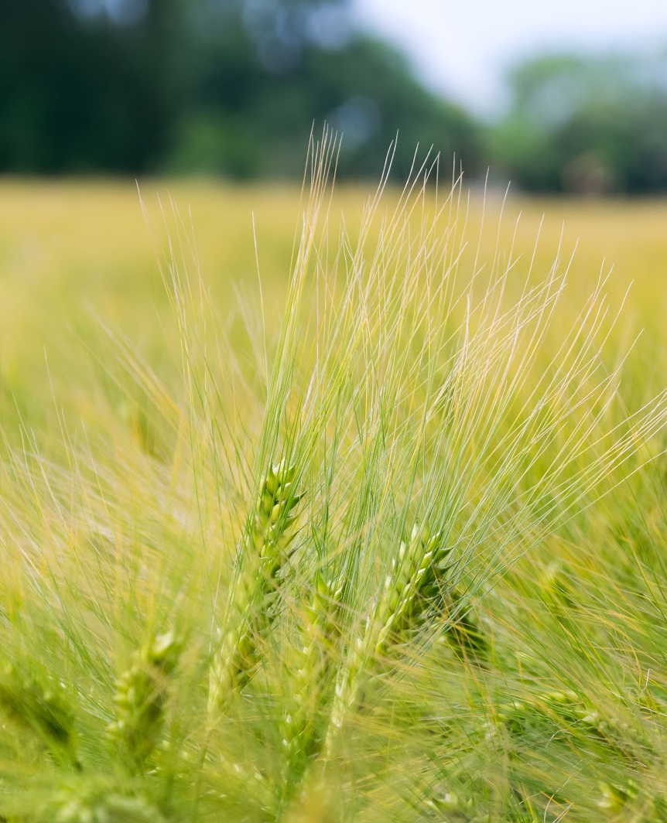
Conclusions
Visualized and interactively filtered cover crop enrollment
Correlated NDVI with performance metrics
Established foundation to assess correlations and make analyses
Early planting > late planting
Triticale > wheat
Previous crops influence productivity
Image Credit: J. Triepke
Notes:
(Logan)
Through our work on this project, we were able to:
-Visualize and interactively filter cover crop enrollment across Maryland
-Correlate NDVI with plant performance metrics in biomass and percent ground cover
-Establish the foundation for identifying and analyzing patterns in crop performance.
For instance, we found that early planting is more effective then late planting,
triticale is generally more effective than wheat,
and cover crop efficiency is influenced by the previous crop planted in the field.
Image URL: https://flic.kr/p/uWY2yj

Slide 16
Errors & Uncertainties
Cloud cover, atmospheric errors
Calibration equation errors
NDVI comparisons between days
Satellite comparisons
Data gaps
Image Credit: David Stewart
Notes:
(Logan)
Errors and uncertainties for our project include the following:
Certain fields may lack applicable images for NDVI analysis due to cloud cover or other atmospheric limitations.
The calibration equation inputted to the GUI will not be perfect for every image and NDVI value. Furthermore, the calibration equations given to us do not fit well to data from larger grains, so our more accurate measurements are limited to wheat, rye, triticale, and barley.
Since images vary across days due to atmospheric changes and other variables, NDVI comparisons between days have error that is difficult to quantify.
For instance, a field which had its max NDVI on January 12th is not directly comparable to one whose max NDVI occurred on December 19th
Google Earth Engine has not yet calibrated Sentinel-2 NDVI measurements with Landsat 8 measurements, so values calculated from Landsat 5 and 8 are not directly comparable to Sentinel-2 values.
Fields with no planting dates had to be removed from our datasets for GEE compatibility. We also lost the geometry of fields with a radius less than 15 m in our buffering process. Thus, we lost metric predictions for these fields.
Image URL: https://flic.kr/p/28ZRuTq

Slide 17
Future Work
Image Credit: Pexels
Incorporate other spectral indices: red edge, EVI, SAVI…
Calculate vegetation index values on a per pixel basis
Expand analysis to all Maryland counties
Optimize the MDA Cover Crop Program by greatly reducing the need for spot-checking
Notes:
(Logan)
Future work on this project would largely include addressing the limitations we’ve just expressed. Particularly, we could incorporate other spectral indices – such as Sentinel-2 red edge – in order to enhance our vegetation biomass and percent ground cover predictions. We could also calculate vegetation index values – and thus our performance metrics – on a per pixel basis, allowing farmers to identify particular problem sections within individual fields. A long term goal of this project is to expand winter cover crop analysis to all Maryland counties in order to evaluate performance statewide. Finally, all past, present, and future work done on this project will be pushing toward reducing the need for in situ spot-checking, saving time, effort, and money for our partners at the MDA.
Image URL: https://pixabay.com/en/agriculture-countryside-crop-1867864/

Slide 18
Acknowledgements
Past Contributors
Dr. Sunita Yadev
Alison Thieme
Sean McCartney
Perry Oddo
John Fitz
Advisors
Dr. W. Dean Hively
USGS Eastern Geographic Science Center
Dr. Greg McCarty
USDA Agricultural Research Service
Dr. Kristofer Lasko
ERDC Geospatial Research Laboratory
Rich Batiuk
EPA Chesapeake Bay Program
Dr. John Bolten
NASA Goddard
End User
Jason Keppler
Maryland Department of Agriculture
Center Lead
Victor Lenske
Notes:
(Logan)
Thanks to the Spring 2017 DEVELOP team for their preliminary work on this project. Thanks to our advisors and our end user, Jason Keppler, for scientific advice and project support. Thanks to our center lead, Victor Lenske, for general support and leadership.

