Slide 1
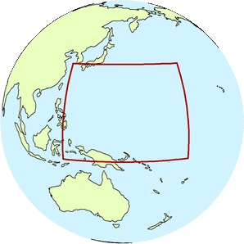
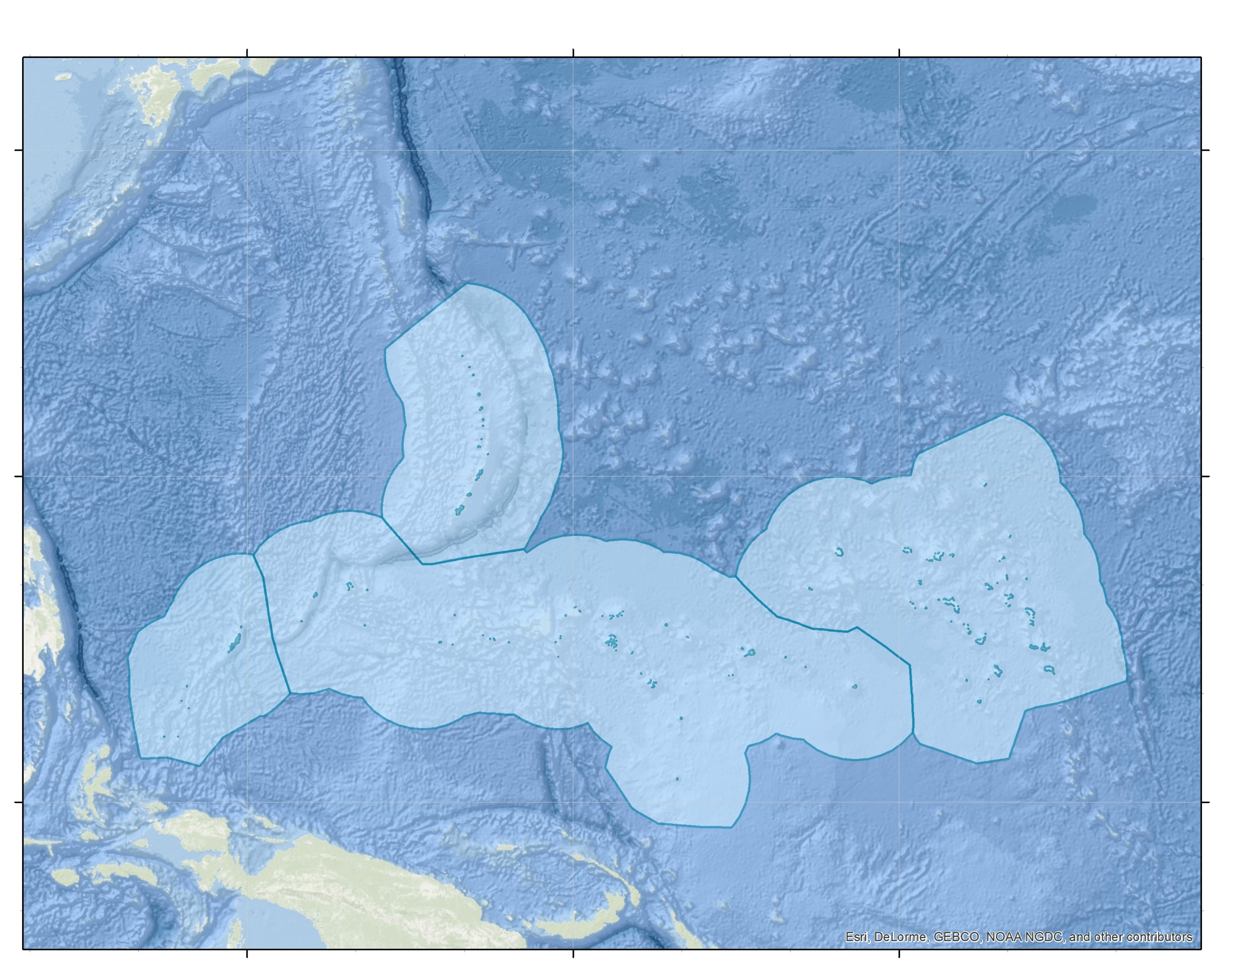
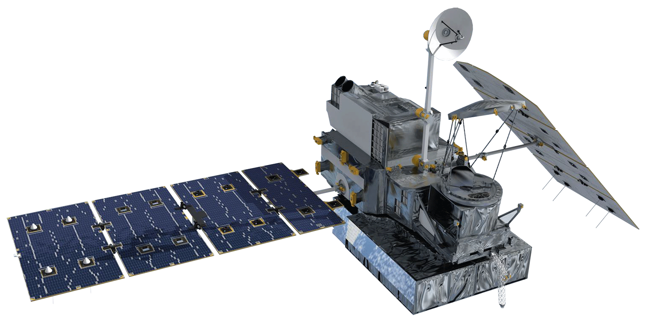
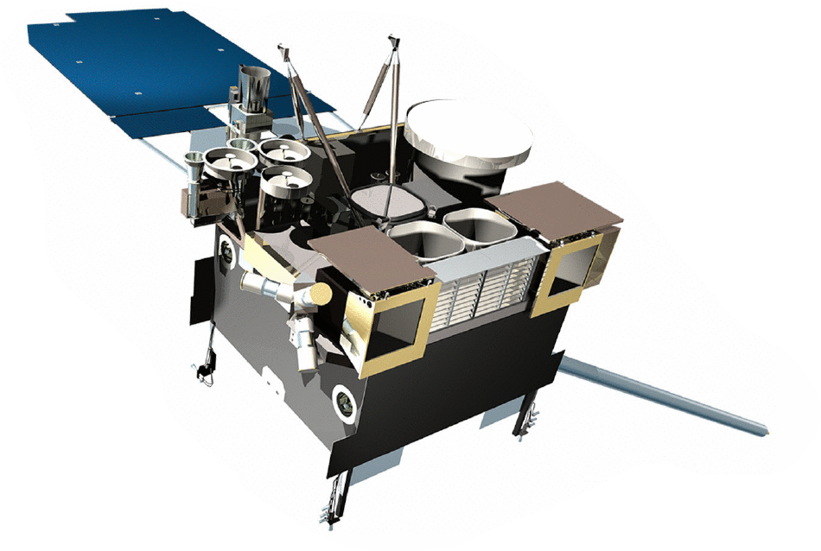
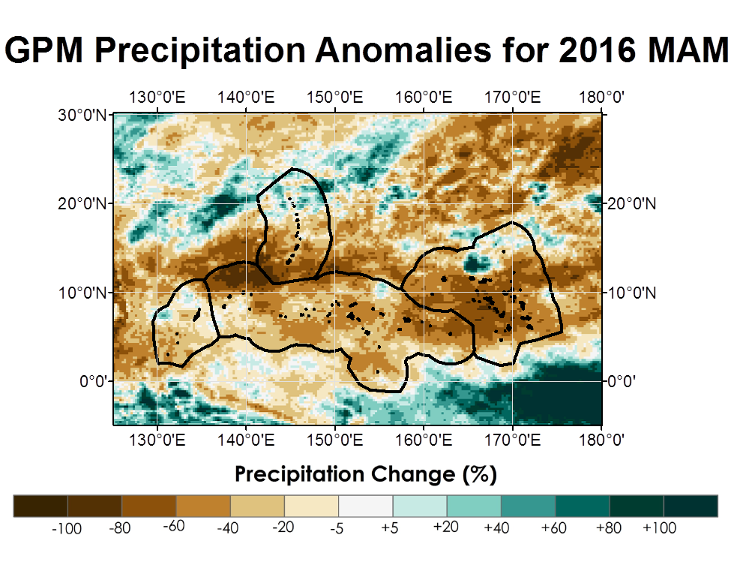
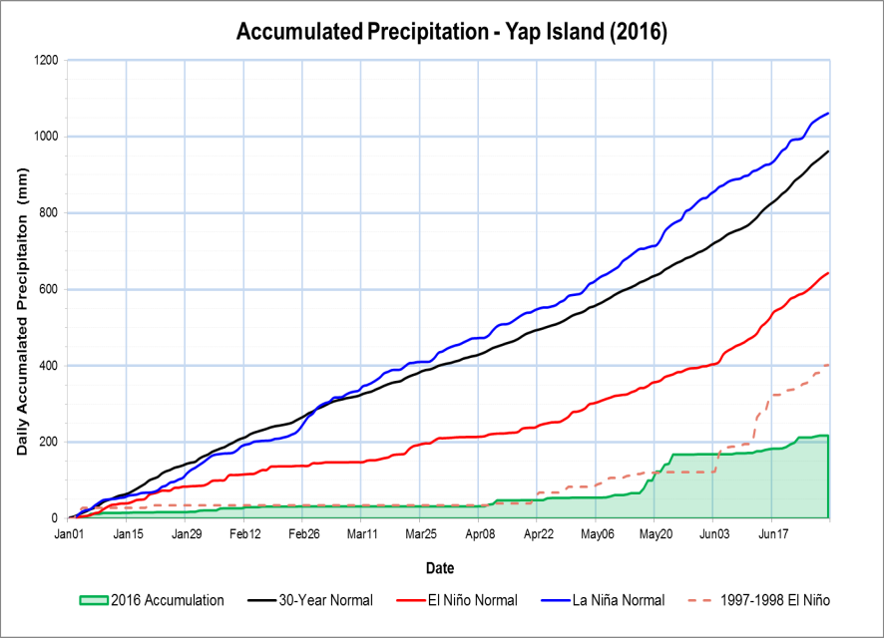
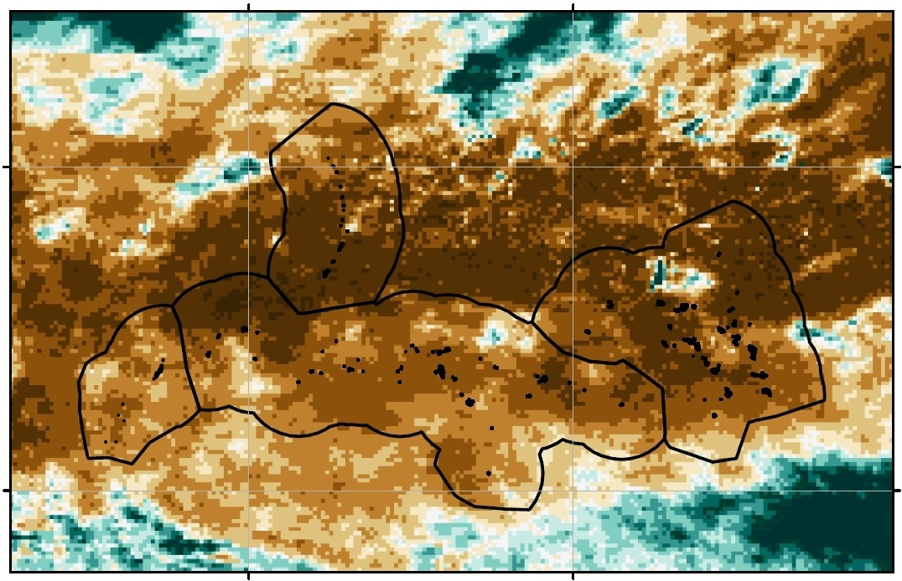
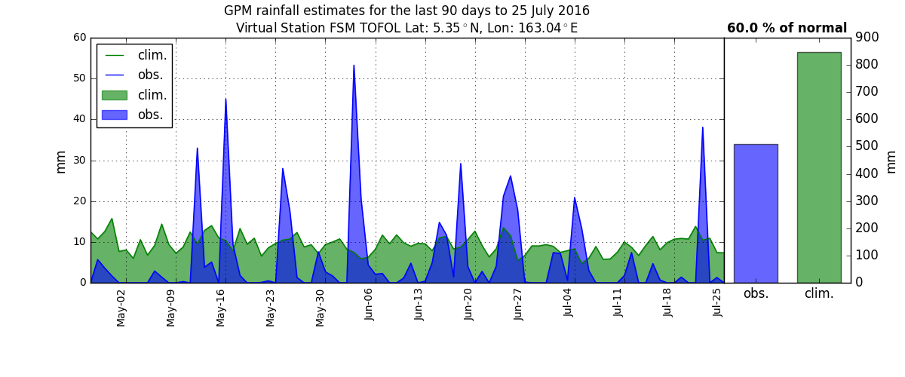
Enhancing Decision Making to Help Manage Freshwater Resources: Using NASA Earth Observations and NOAA CDR’s to Provide Near Real-Time Precipitation Estimates for Forecasters in the U. S. Affiliated Pacific Islands
Abstract
Objectives
The United States Affiliated Pacific Islands (USAPI) are extremely vulnerable to precipitation shifts associated with the El Niño Southern Oscillation (ENSO). In the past, scientists in the region utilized a spatially-limited, in situ-based, ENSO climatology to inform their seasonal precipitation outlooks. To fill this spatial gap, the Pacific Water Resources I team successfully delivered an updated, ENSO-based precipitation climatic reference atlas derived primarily using remotely-sensed data. While the atlas has been heavily utilized by scientists in the region, it is somewhat limited in that it does not provide near real-time precipitation estimates. The Pacific Water Resources II project filled this limitation through the utilization of near real-time precipitation data from NASA’s Global Precipitation Measurement (GPM) mission which provides 30-minute rainfall estimates at 0.1° spatial resolution. To fully understand whether satellite-derived rainfall estimates from GPM can be used operationally in a near-real-time anomaly product, an analysis comparing the satellite products (PERSIANN-CDR, GPM) to 27 Global Historical Climate Network Daily (GHCN-D) stations in the west Pacific was completed. Results suggest that daily trends in raw station values and satellite-derived rainfall estimates were consistent. Therefore, results herein confirm the usefulness of using GPM precipitation estimates to accurately capture the recent seasonal precipitation trends found across the USAPI. The end results from this project provided a suite of near real-time precipitation estimate tools that can be used by decision makers in the region to mitigate and adapt to ongoing and future water resource emergencies.
Create a suite of near real-time precipitation climate monitoring tools using remotely sensed data from the NOAA PERSIANN-CDR and NASA Global Precipitation Measurement (GPM) products.
Enhance short-term water resources decision making by forecasters, emergency managers, and disaster managers in the U.S. Affiliated Pacific Islands as it relates to the mitigation and adaptation to ongoing and future water resources emergencies.
Study Area
135° 0’ 00’
150° 0’ 00’
165° 0’ 00’
30° 0’ 00’
Commonwealth
of the Northern
Mariana Islands
15° 0’ 00’
Republic of the
Marshall Islands
15° 0’ 00’
Earth Observations
Federated States
of Micronesia
NASA GPM
microwave sensor
Spatial resolution:
0.1° (~11 km)
Temporal resolution:
30 minute
NOAA PERSIANN-CDR primarily infrared product
Spatial resolution:
0.25° (~27km)
Temporal resolution:
Daily
Republic of
Palau
0° 0’ 00’
0° 0’ 00’
Methodology
Data Collection:
Convert to Raster
Aggregate & Sum
Clip to extent
135° 0’ 00’
150° 0’ 00’
Visualization:
165° 0’ 00’
Processing:
Compilation:
Extract Raster to Station Points
GPM
TRMM
PERSIANN
GHCN
Pacific Water Resources II
Results
GPM Precipitation Anomalies for 2016 MAM
140°0’E
160°0’E
20°0’N
20°0’N
Daily Accumulated Precipitation (mm)
0°0’
0°0’
Figure 1 (left): Precipitation anomalies at 0.25° resolution for the 2016 March-May season. Precipitation estimates from the GPM-IMERGDE were used to generate the seasonal real-time estimates and are compared against precipitation estimates from the NOAA PERSIANN-CDR 30-year seasonal normal climate atlas.
Figure 3 (top): Time-series comparison of precipitation estimates derived from GHCN station observations, the PERSIANN-CDR, and GPM-IMERGDE for the Yap Island station.
Figure 4 (left): Virtual station plot for Yap Island. The green shaded area represents the daily normal precipitation derived from the 30-year PERSIANN-CDR. The blue shaded area represents real-time precipitation estimates from the GPM-IMERGDE satellite product.
140°0’E
160°0’E
Figure 2 (right): Satellite-derived accumulated precipitation for the Yap Island station through June 30, 2016. The 2016 Accumulation line was obtained using daily precipitation estimates from the GPM-IMERGDE satellite product. The remaining lines were derived using precipitation estimates from the PERSIANN-CDR
Project Partners
Conclusions
Acknowledgements
Earth Resources Technology (ERT)
National Centers for Environmental Information, Regional Climate Services Director, Pacific Region
PERSIANN – CDR and GPM tend to underestimate raw station daily precipitation observations.
PERSIANN – CDR and GPM do follow wet and dry daily trends, and therefore can be used in a near-real time product.
Output generated by the tools confirm the crippling effects of the strong 2015 – 2016 El Niño event.
The tools are fully operational for future use by our project partners.
We would like to thank our Center Lead Alec Courtright and science advisor Michael Kruk for their help and guidance in this project. We also would like to acknowledge:
Previous contributors: Jessica Sutton, Ethan Wright, & Nick Luchetti, and the NASA DEVELOP National Program Office
Team Members
Emma Baghel
James Potemra
Ryan Berkheimer
Tom Burnet
John Marra
Nicolas Fauchereau
James Adams
NCEI Employees
DEVELOP National Program Office
Nicholas Luchetti
Project Lead
Zachary Vozzelli
Kyle Jones
Any opinions, findings, and conclusions or recommendations expressed in this material are those of the author(s) and do not necessarily reflect the views of the National Aeronautics and Space Administration. This material is based upon work supported by NASA through contract NNL11AA00B and cooperative agreement NNX14AB60A.
NOAA National Centers for Environmental Information – Summer 2016

