Slide 1
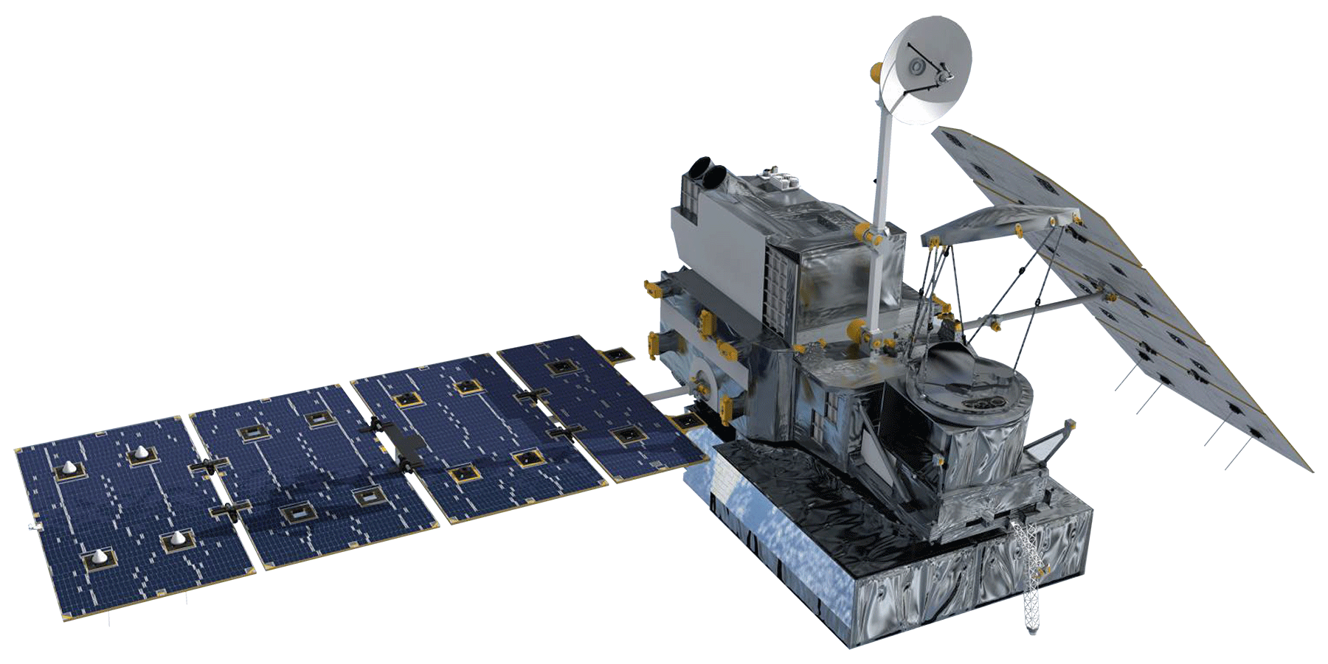
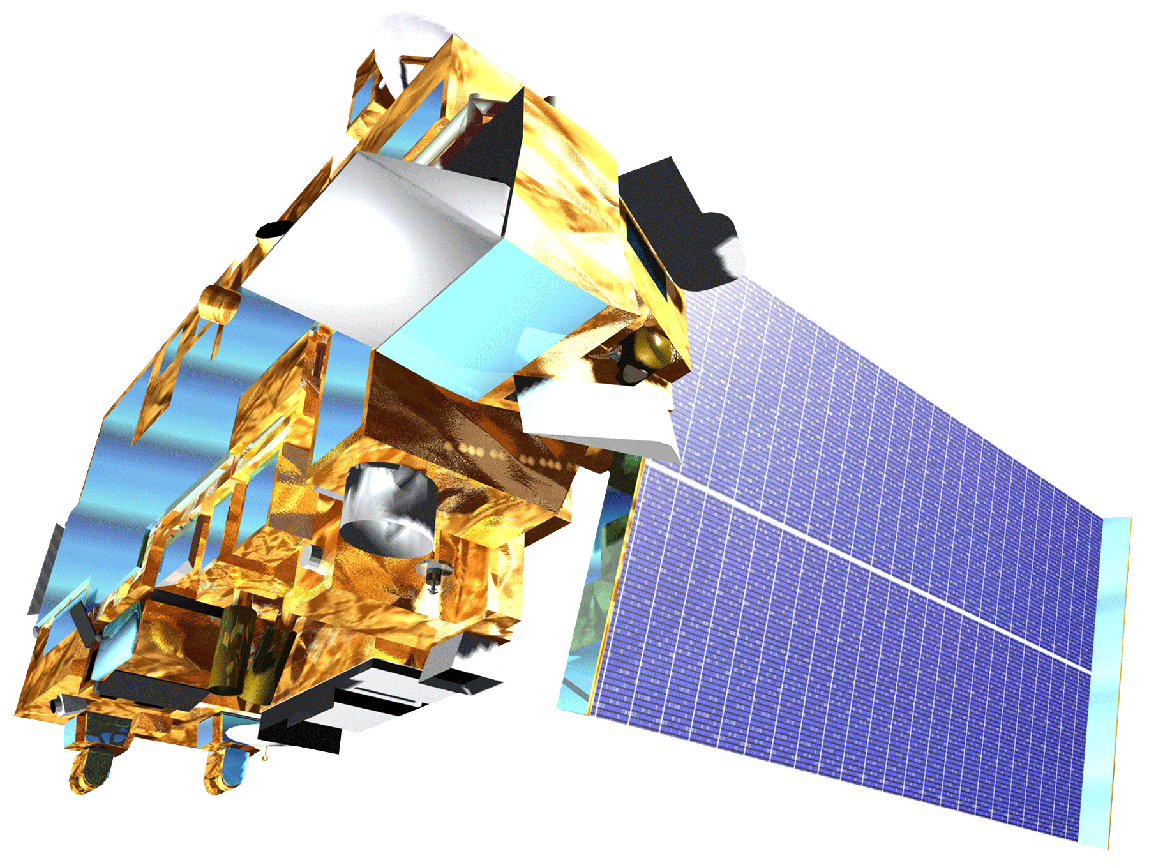
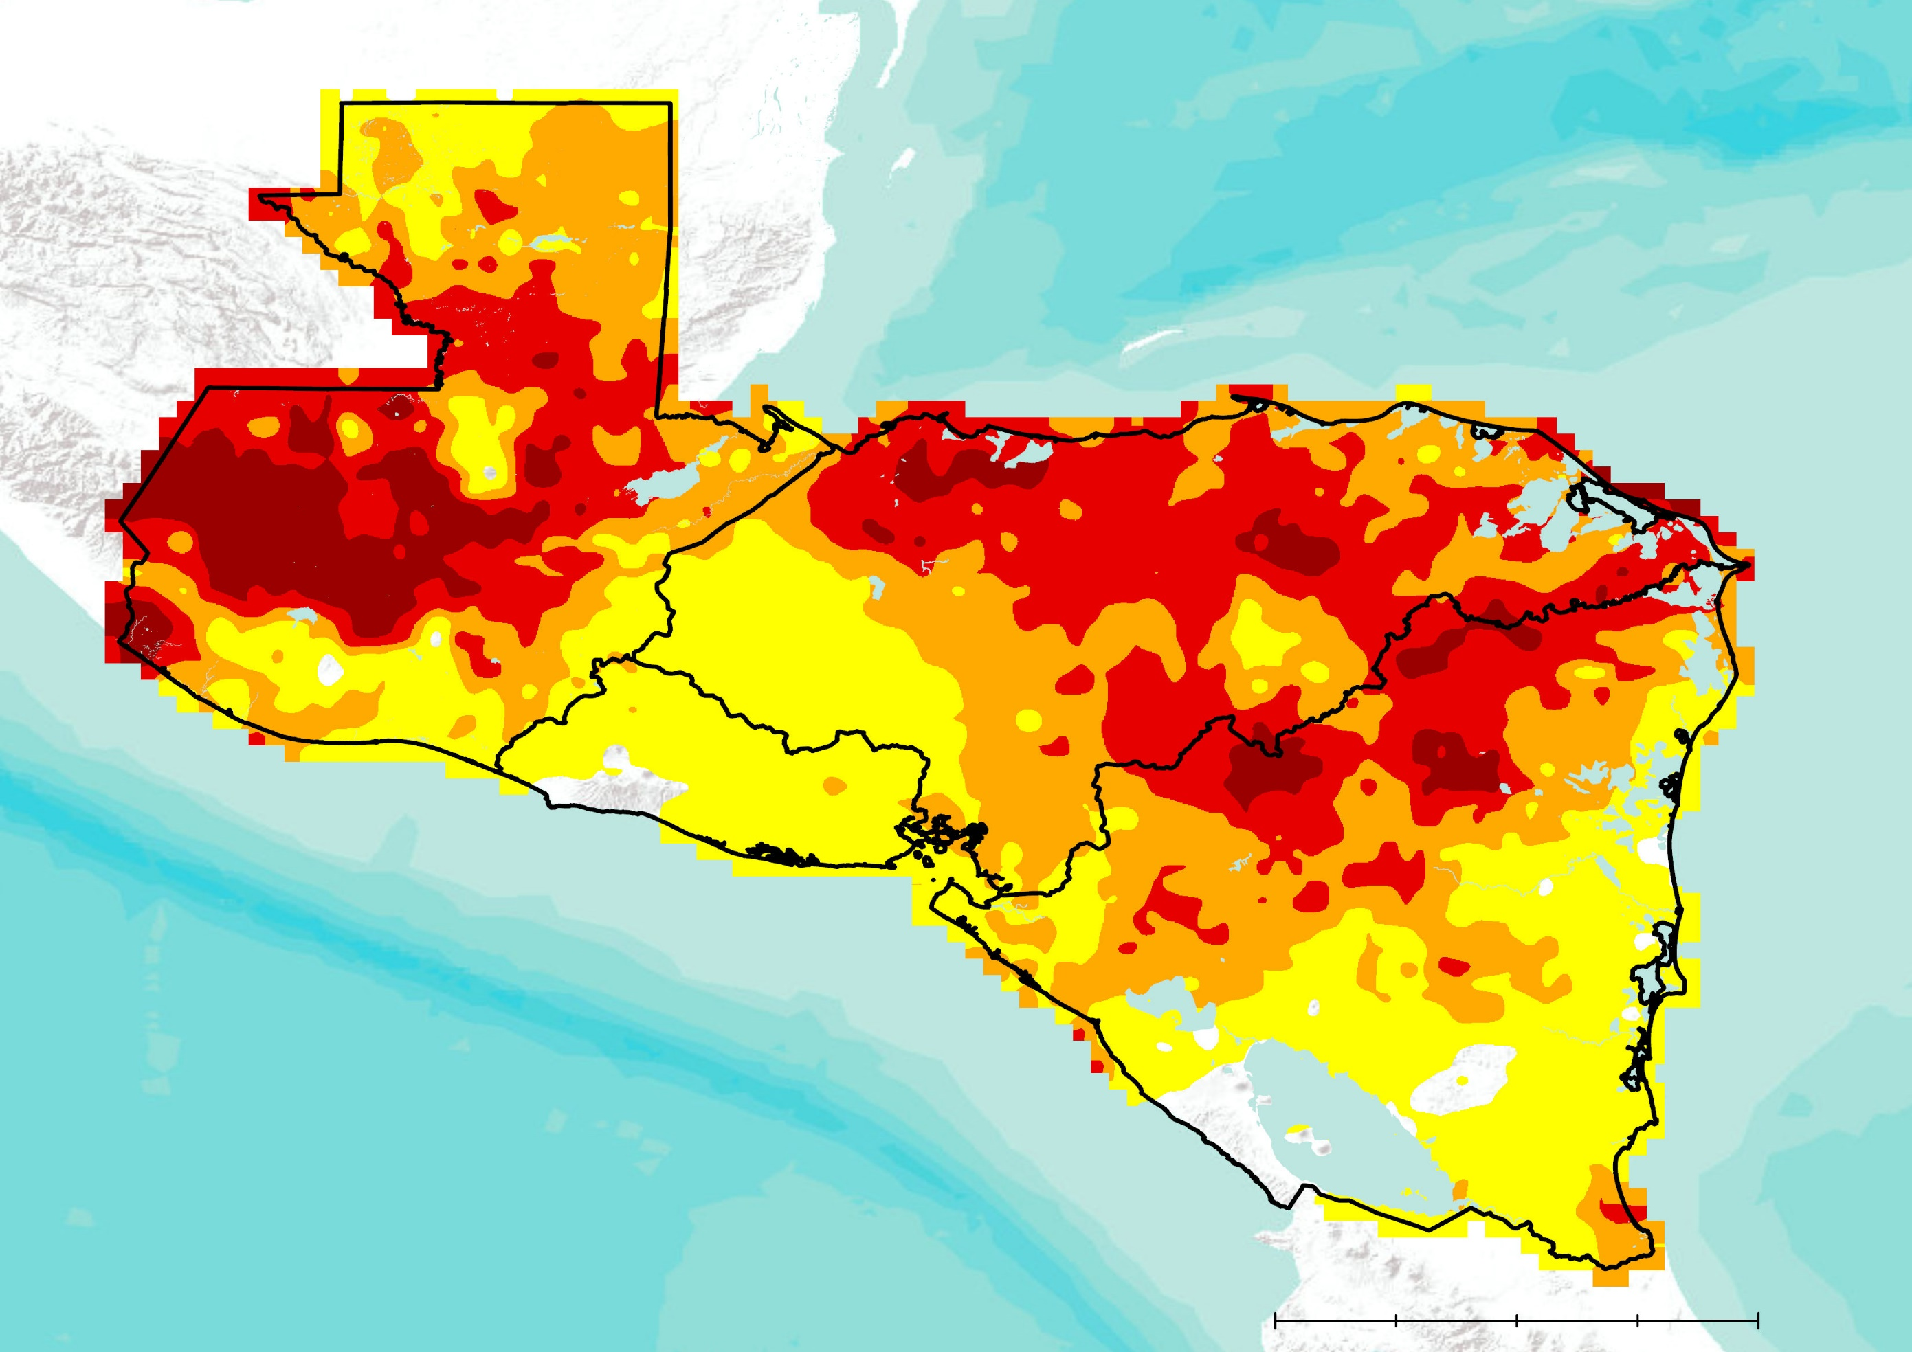
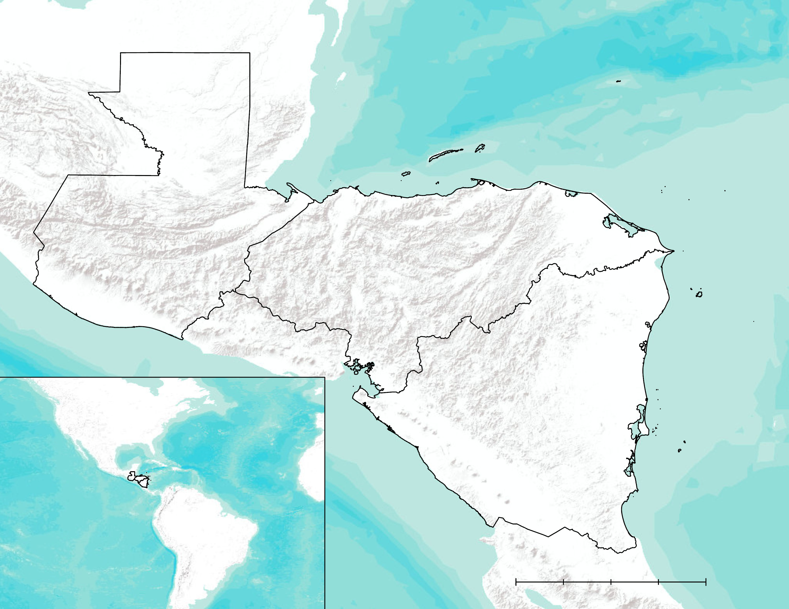
Assessing Vegetation Response to Remote Sensing Drought Indices within the Dry Corridor of Central America Using NASA Earth Observations
Abstract
Objectives
Central America Agriculture & Food Security
The dry corridor resides primarily in the pacific region of Central America, which experiences severe drought during the El Niño Southern Oscillation cycle. El Niño causes severe climate variances in Central America that impact agriculture, livelihoods, and hydrological cycles. The region is rich with cash crops, including bananas, plantains, corn, sugar, and coffee, that are at risk during El Niño events. The region is also home to many subsistence farmers who rely on rainfed agriculture. These climate anomalies can lead to loss of livelihood and regional food insecurity. The team used remote sensing data from Global Precipitation Measurement (GPM) mission Integrated Multi-satellite Retrievals for GPM (IMERG) and Terra Moderate Resolution Imaging Spectroradiometer (MODIS) to generate Normalized Difference Vegetation Index and Standard Precipitation Index data to identify regions that have been negatively impacted by past El Niño events in the dry corridor of Guatemala, Honduras, and Nicaragua. The project identified the historic areas of socioeconomic vulnerability during the onset of El Niño related drought. Team members worked with Universidad del Valle de Guatemala to provide information regarding regional drought to the Nicaragua Ministry of Agriculture and Forestry and the Honduran Ministry of Agriculture and Livestock. The project concluded that there is an increase in the area of severe and extreme drought during El Niño events in the Central American dry corridor, and the team provided time series maps that visually demonstrated the progression of drought in the region.
Create a protocol to calculate and display SPI from GPM IMERG precipitation data
Teach project partners how to calculate SPI for GPM IMERG and other NASA Earth Observation datasets
Calculate long term vegetation averages and determine seasonal anomalies from NDVI data derived from NASA’s Terra MODIS
Investigate the impacts of ENSO events on NDVI and SPI in the study area
Earth Observations
Methodology
Results
GPM IMERG
TERRA MODIS
GPM IMERG Data
6 month SPI from June 2019, showing the extreme drought that was a result of the 2018/2019 El Niño
Much of Guatemala, Honduras, and Nicaragua are in severe to extreme drought
Converted to CSV in ArcMap
TERRA MODIS Data
SPI Calculate in R
Scaled and calculated Data in ArcMap
June 2019
Displayed in ArcMap
Displayed in ArcMap
Comparison of SPI, NDVI, and ENSO events
Study Area
Extreme Drought: ≤ -2
Severe Drought: -1.5 to -2
Moderate Drought: -1 to -1.49
Kilometers
Mild Drought: 0 to -0.99
0
150
300
Guatemala
Conclusions
Honduras
Standard Precipitation Index values were calculated from the GPM IMERG data.
There were extreme levels of drought during El Niño years, but no clear trend in what areas got less rain.
A comprehensive tutorial was created so the project partners could calculate SPI based on GPM IMERG data and view vegetation anomalies using MODIS data.
Future work will investigate the movement of drought throughout the region for various phases of the ENSO phases and compare the droughts impact on NDVI.
Nicaragua
Project Partners
0
150
300
Kilometers
Nicaragua Ministry of Forestry and Agriculture (Ministerio Agropecuario y Forestal)
Honduras Ministry of Agriculture and Livestock (Secretaría de
Agricultura y Ganadería - Gobierno de la República de Honduras)
Guatemala Valley University -(Universidad del Valle de Guatemala)
Team Members
Acknowledgements
We would like to thank our Science Advisor for the project Olivier Pratt & (North Carolina Institute for Climate Studies, NOAA National Centers for Environmental Information) and our fellow Andrew Shannon (NASA National Aeronautics and Space Administration DEVELOP, NOAA National Centers for Environmental Information) for their help and guidance on the project. Additionally we would like to thank Sean McCartney (Goddard Space Flight Center, NASA National Aeronautics and Space Administration) and SICA for logistical support and Emil Cherrington (Marshall Space Flight Center, NASA National Aeronautics and Space Administration) for translation services. We would also like to thank Ronald Leeper (North Carolina Institute for Climate Studies, NOAA National Centers for Environmental Information), the employees from NCEI, NOAA, NCICS, our project partners, and the NASA DEVELOP fellows for their time and support over the course of this project.
Adelaide Schmidt
Project Lead
Cade Justad-Sandberg
Jared Kelly
North Carolina – NCEI| Fall 2019

