Slide 1
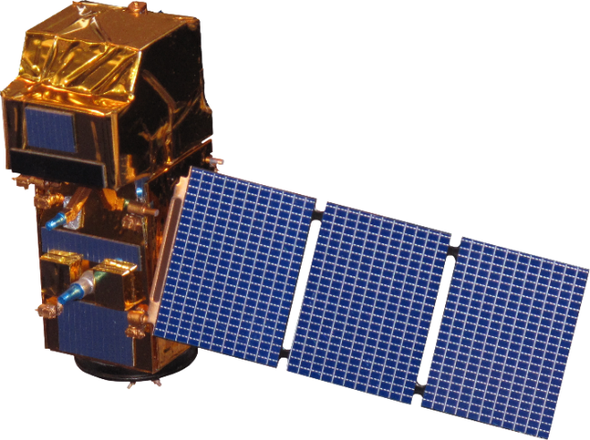
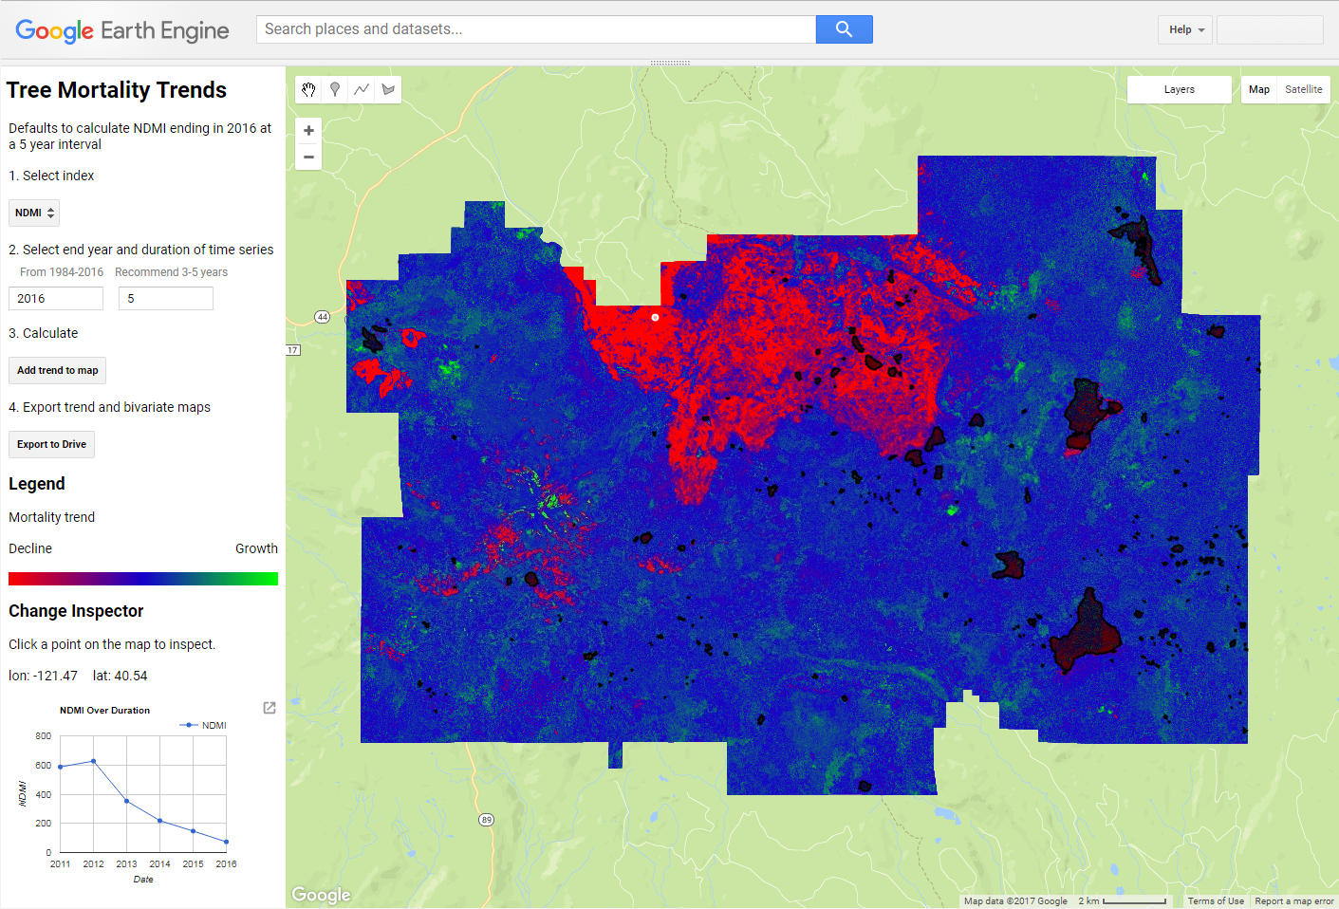
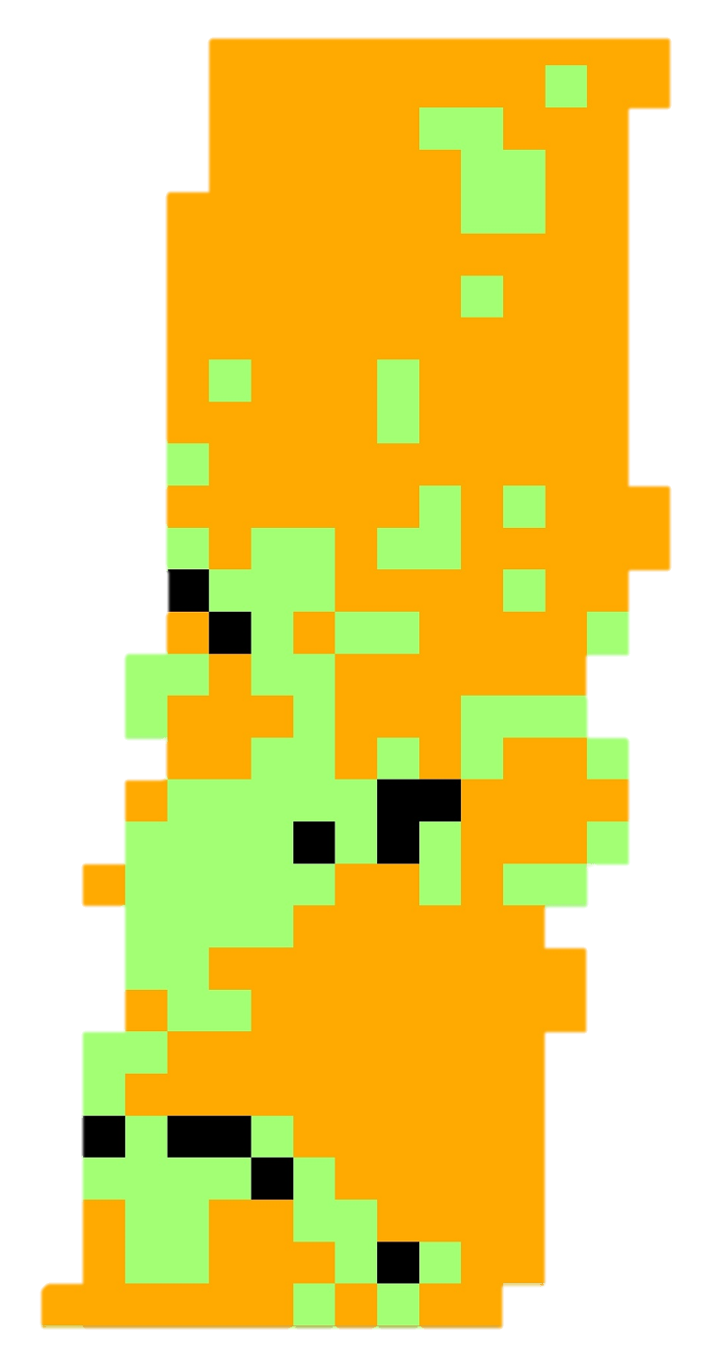
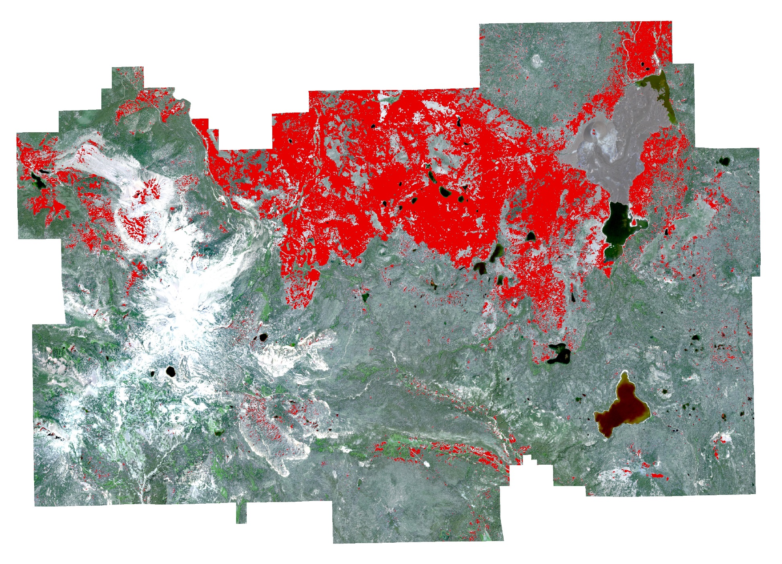
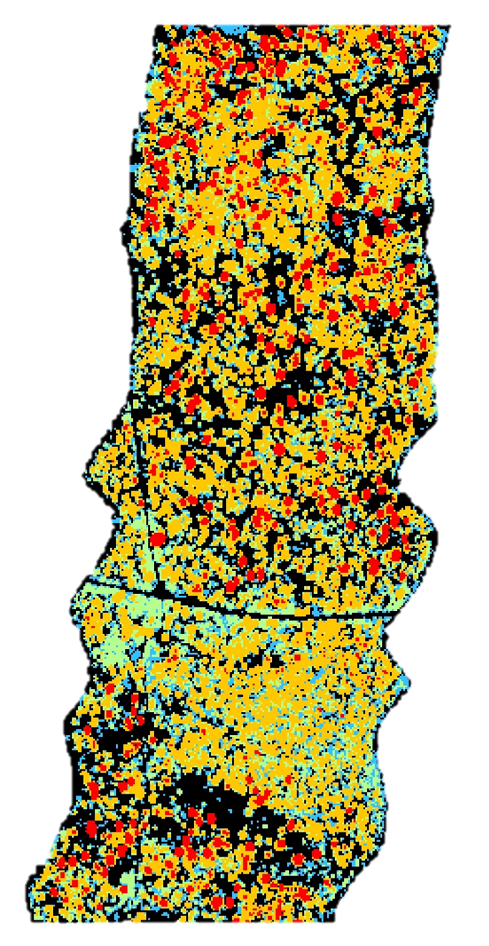
Understanding Fuel Loading in Lassen Volcanic National Park Through Earth Observation to Manage Wildland Fire Risk
Abstract
Landsat 5 TM
Methodology
Nearly three quarters of Lassen Volcanic National Park (LVNP) is designated as Wilderness under the Wilderness Act of 1964, meaning it is to be managed “to preserve its natural conditions… with the imprint of man’s work substantially unnoticeable.” This prevents land managers from clearing excess vegetative fuels that have accumulated due to fire suppression policy. Therefore, LVNP must rely on fire to restore healthy levels of vegetation. Devastation following the 2012 Reading Fire demonstrated the strength of accumulated fuel loads. Detailed cataloguing of fuel loads is necessary to predict the behavior and severity of any fire allowed to burn in LVNP. To provide these estimates, NASA Earth observations were used to generate maps of historical and present-day tree mortality, and to evaluate advantages in using LiDAR data to obtain detailed fuel load measurements. We estimated tree mortality using a linear trend regression analysis implemented in Google Earth Engine (GEE), to process time series of multispectral data from Sentinel-2 and the Landsat series (TM, ETM+, OLI). LiDAR data were related to spatial layers of species coverage and other environmental factors to estimate fuel loads. These products will help partners at LVNP to periodically update their mortality maps and fuel loading estimates in their ongoing efforts to maintain a healthy and safe Wilderness.
Historical Tree Mortality
Filter GEE Cloud Repository
Create Growing Season Composite
Calculate Linear Trend
Landsat 7 ETM+
Year
Growing Season (Mid-May ➔ Mid-Aug)
Study Area
Highest NDVI per pixel across Growing Season
Removes clouds, phenological variation
ρ = β₀ + β₁t + e_{t}
Best fit line of spectral value over time period
Landsat 8 OLI
Generate Spectral Indices
Generate Mortality Classification
NDVI
NDMI
Repeat for each year in 5-year period
+β₁ = Growth
̶ β₁ = Mortality
β₁≈0 = Stable
Study Area
Earth Observations
Present Day Tree Mortality
Preprocess Sentinel-2
Train Classification
Generate Mortality
Sentinel-2
Acquire growing season scene
Processing in STEP: Terrain & Atmospheric Correction
Support Vector Machine
Train on recent tree mortality classification
Environmental factors input
Fit classification on Sentinel-2 high resolution imagery
Protected Wilderness
Lassen Volcanic National Park
SRTM V3
LiDAR Feasibility
Roads
Acquire Data
Process Models
Generate Areas Of Interest
Goddard’s LiDAR, Hyperspectral & Thermal Imager
Download in LAS format
Canopy Height
Bare Earth
Canopy Closure
Understory Binning
Combine with environmental parameters
Calculate weighted fuel loadings
Lassen Volcanic National Park Disasters
Objectives
G-LiHT (Airborne Lidar)
Create a tool for quickly classifying vegetation condition (growing, stable, declining) from satellite imagery time series based on user-input year
Analyze the utility of LiDAR for mapping fuel loads within LVNP
Conclusions
Results
Cloud-based computing with Google Earth Engine enables rapid mapping of tree mortality over a 30+ year time series of Landsat imagery. This provides Park managers insight to historic forest conditions impacting fuel build up.
Classification of present-day tree mortality from 10 meter resolution Sentinel-2 imagery is possible using vegetation and environmental data as inputs to a Support Vector Machine. This gives an up-to-date detail of tree health throughout the entire forest.
LiDAR provides finer spatial resolution and information about vertical structure of a forest that is missing from satellite multispectral imagery. This finer level of detail allows for more accurate understanding of fuel loads.
LANDFIRE 2012 Canopy Height Model
+ β₁
β₁≈0
Project Partners
̶ β₁
National Park Service,
Lassen Volcanic National Park
Non-Forested
1m < CH < 5m
5m <= CH < 10m
10m <= CH < 25m
25M <= CH < 50m
Team Members
Earth Engine 5 year time series linear regression trend for NDMI values 2012-2016
10m present-day tree mortality based on SRTM and Sentinel-2 Multispectral Data, using a Support Vector Machine Classifier
Joshua Verkerke
(Project Lead)
Anna McGarrigle
John Dilger
Acknowledgements
Mortality
Juan Torres-Perez, Bay Area Environmental Research Institute
Vince Ambrosia, NASA Applied Science Wildfire Program
Cindy Schmidt, Bay Area Environmental Research Institute
Keith Weber, GIS Training and Research Center
NASA G-LiHT Airborne Imager
NASA Ames Research Center – Summer 2017

