Slide 1
CALIPSO Cross-Cutting
Interfacing CALIPSO data through a graphical user interface
Grant Mercer (Team Lead)
Nathan Qian

Slide 2
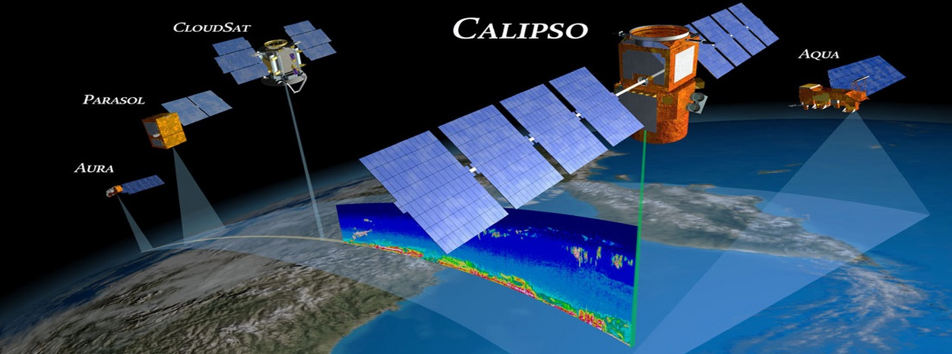
NASA Langley Research Center
Background
Cloud-Aerosol Lidar and Infrared Pathfinder Satellite Observation (CALIPSO)
Collects aerosol data
Viewed with an Interactive Data Language (IDL) program
Notes:
CALIPSO is an Earth observation that measures aerosol data in the Earth’s atmosphere. Earth scientists use CALIPSO data to analyze aerosols’ impact on Earth’s climate. To view CALIPSO data, researchers use a program written IDL.
Image source: http://www.nasa.gov/images/content/329173main_CALIPSO-a-train-full.jpg

Slide 3
Community Concerns
Aerosols
Affects Earth’s climate
Largest unknown variable in climate models
Negative health effects
IDL Program
Proprietary
Obscure
Difficult to update
Notes:
Aerosols have a major impact on the environment and human health. Aerosols can influence cloud formation and cloud radiative properties, affecting both the water cycle and radiative heating. Additionally, aerosols can be detrimental to air quality, causing adverse health effects to people. While the IDL program was written to help scientists identify aerosols’ environmental impact, IDL is a proprietary and obscure language, which makes it difficult to update and meet the researchers’ needs.

Slide 4
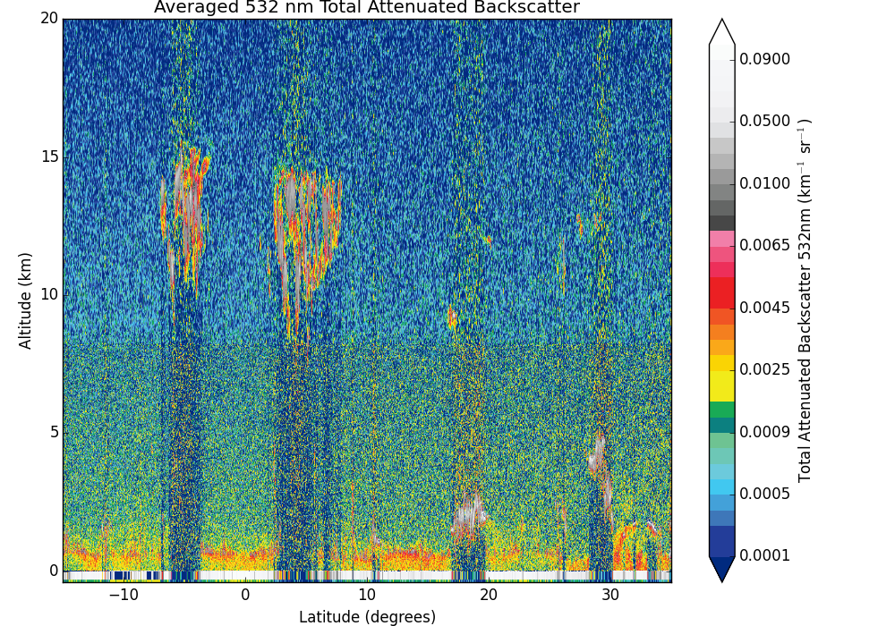
Objectives
Create a visualization tool in Python
Add data analysis and sharing features
Open source software release
CALIPSO Data
Notes:
Aerosols have a major impact on the environment and human health. Aerosols can influence cloud formation and cloud radiative properties, affecting both the water cycle and radiative heating. Additionally, aerosols can be detrimental to air quality, causing adverse health effects to people. While the IDL program was written to help scientists identify aerosols’ environmental impact, IDL is a proprietary and obscure language, which makes it difficult to update and meet the researchers’ needs.
Image source: http://reverb.echo.nasa.gov/

Slide 5
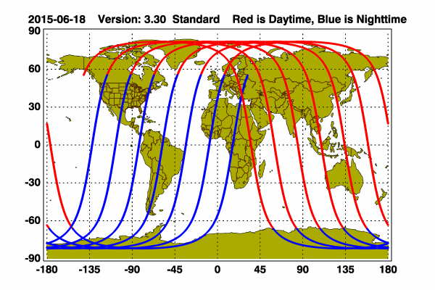
Study Area
CALIPSO Image Viewer
Study Period
CALIPSO data: May 2006 – Today
Project Partner
CALIPSO Science Team
Dr. Charles Trepte
Dr. Amber Soja
Notes:
Our study area spans the globe, and our study period includes all data sets collected by CALIPSO since its launch in May 2006. Our project partner and end user is the CALIPSO science team. Dr. Charles Trepte and Dr. Amber Soja were our point of contacts.
Image source: http://www-calipso.larc.nasa.gov/data/BROWSE/production/V3-30/2015-06-18/2015-06-18_V3.30_name_map.png

Slide 6
Methodology
Calipso
Displays Interface
ShapeManager
Holds list of PolygonDrawers
Handles shape manipulations requests
DatabaseManager
Creates and maintains the database
ShapeReader
Reads shapes from JSON
Shape
Draws shape
Store shapes’ internals
DatabasePolygon
Converts shape into database entry
Legend
Association
Aggregation
Composition
Notes:
The Calipso class is responsible for displaying the interface for the Python CALIPSO visualization tool. The Calipso class has a PolygonList which handles shape manipulation requests. PolygonList holds several PolygonDrawers and sends the drawing request to the appropriate PolygonDrawer to update the shape. To read shapes saved on the local file directory, PolygonList has a PolygonReader, which parses JavaScript Object Notation (JSON) file and reads the shape files. When PolygonList receives a request to save or load a shape from the database, it signals DatabaseManager to carry out the appropriate operation. For saving shapes into the database, DatabaseManger has a dbPolygon, whose responsibility is to convert a shape into a database entry.

Slide 7
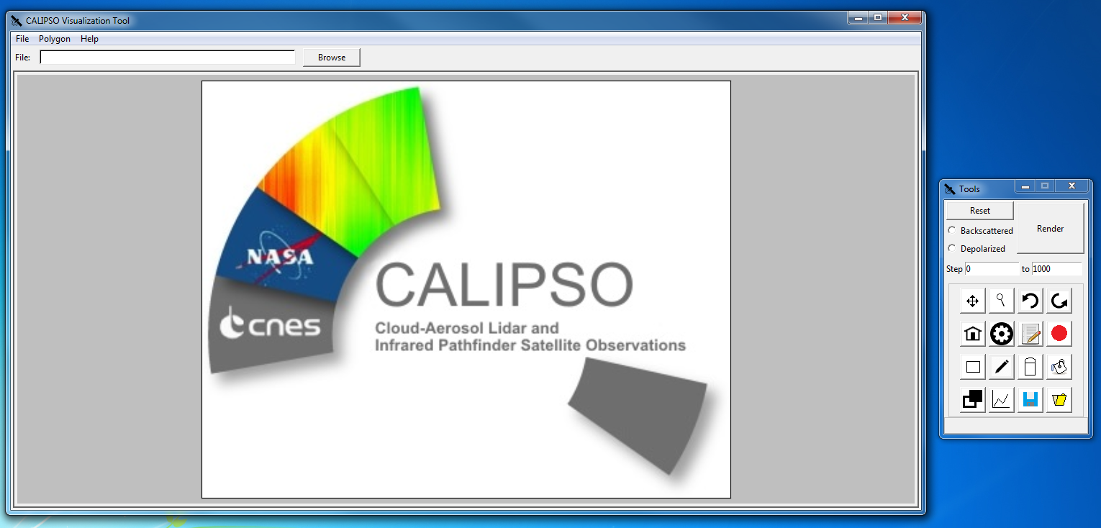
Results
Program Start
Notes:
The Python CALIPSO visualization tool starts with an empty screen, until the user loads a CALIPOS Hierarchical Data Format (HDF) file and selects a plot type.

Slide 8
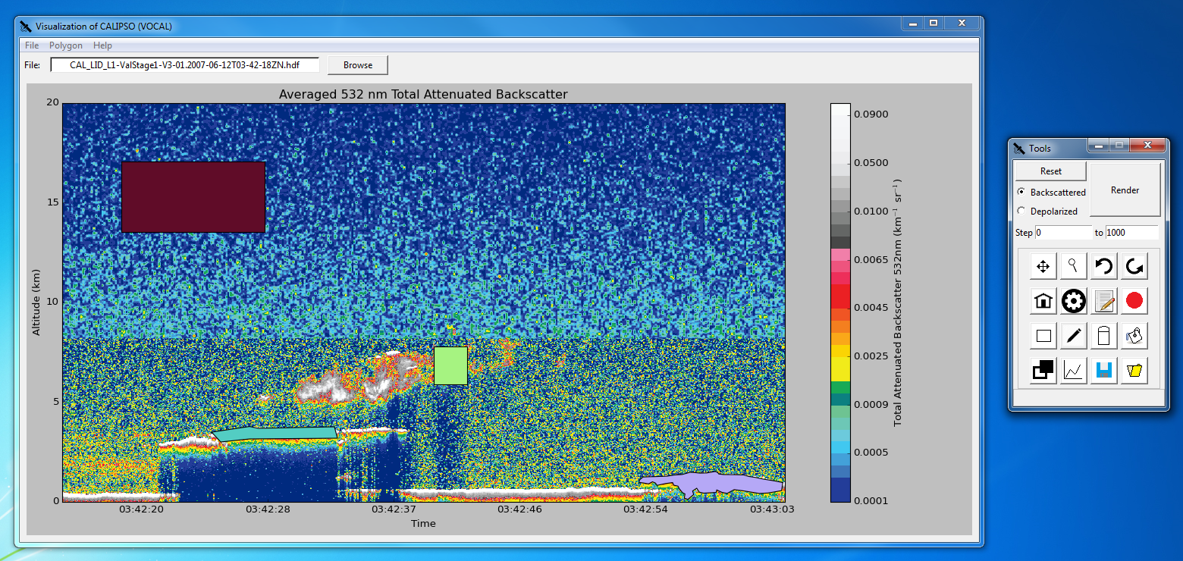
Results
Shape Drawing

Slide 9
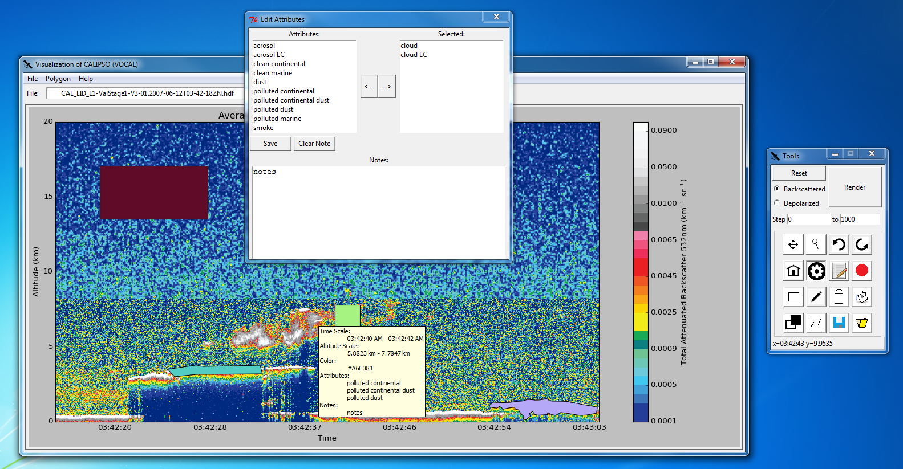
Results
Assigning Attributes

Slide 10
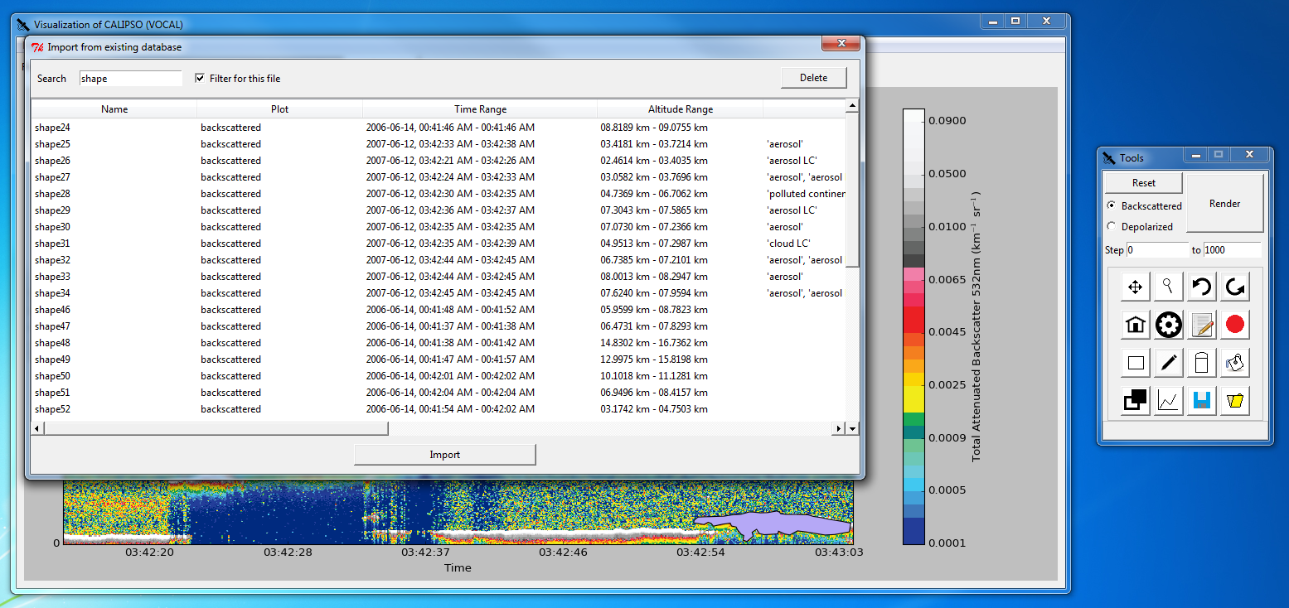
Results
Database Import

Slide 11
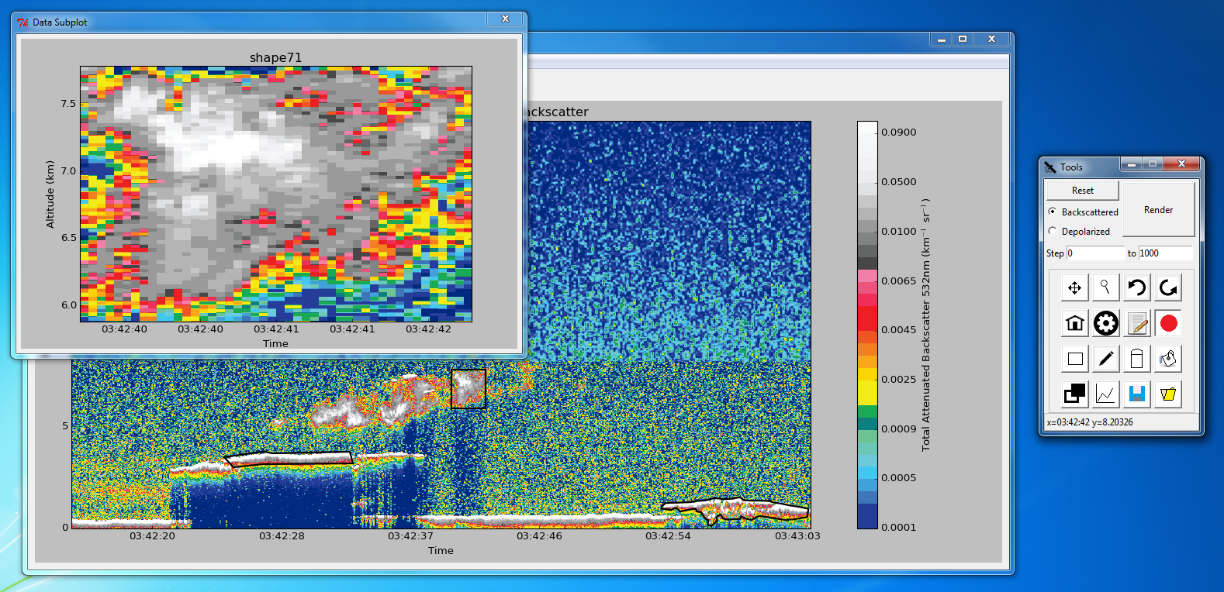
Results
Shape Data Subview

Slide 12
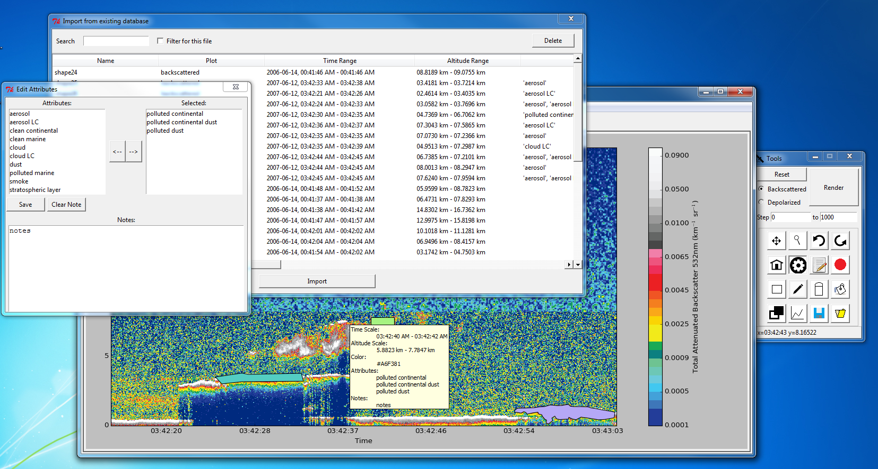
Conclusion
Allows Earth scientists to better identify, analyze, and track the characteristics of aerosols.
Enables researches to work on collaborative efforts.
Notes:
With the Visualization of CALIPSO tool, Earth scientists have a software that can help them identify, analyze, and track aerosols by supplying new features that were absent in the old IDL tool. Additionally, with the database and JSON saving support, researchers can more easily collaborate with each other remotely. These new features will help scientists understand how aerosols affect the global climate and its impact on human health.

Slide 13
Advisors
Jeffry Ely, NASA DEVELOP National Program
Dr. Kenton Ross, NASA DEVELOP National Program
Partners
Dr. Chris Trepte, CALIPSO Science Team
Dr. Amber Soja, CALIPSO Science Team

