Slide 1
MAIPO RIVER VALLEY
Agriculture
Determining Crop Coefficients
Using Remote Sensing
for the Maipo River Valley Basin in Chile
Benjamin Goffin
Duncan Srsic
Rishudh Thakur
Sarah Da Conceição Carlos
Pop-Up Project – PUP
Notes:
Hello, this project focused on the agricultural sector of the Maipo River Valley of Central Chile. Our team consisted of Benjamin Goffin, Duncan Srsic, Rishudh Thakur, and Sarah Da Conceicao Carlos. We aimed to study the irrigation needs of a region that experiences extreme water stress by determining crop coefficients using remote sensing tools.

Slide 2
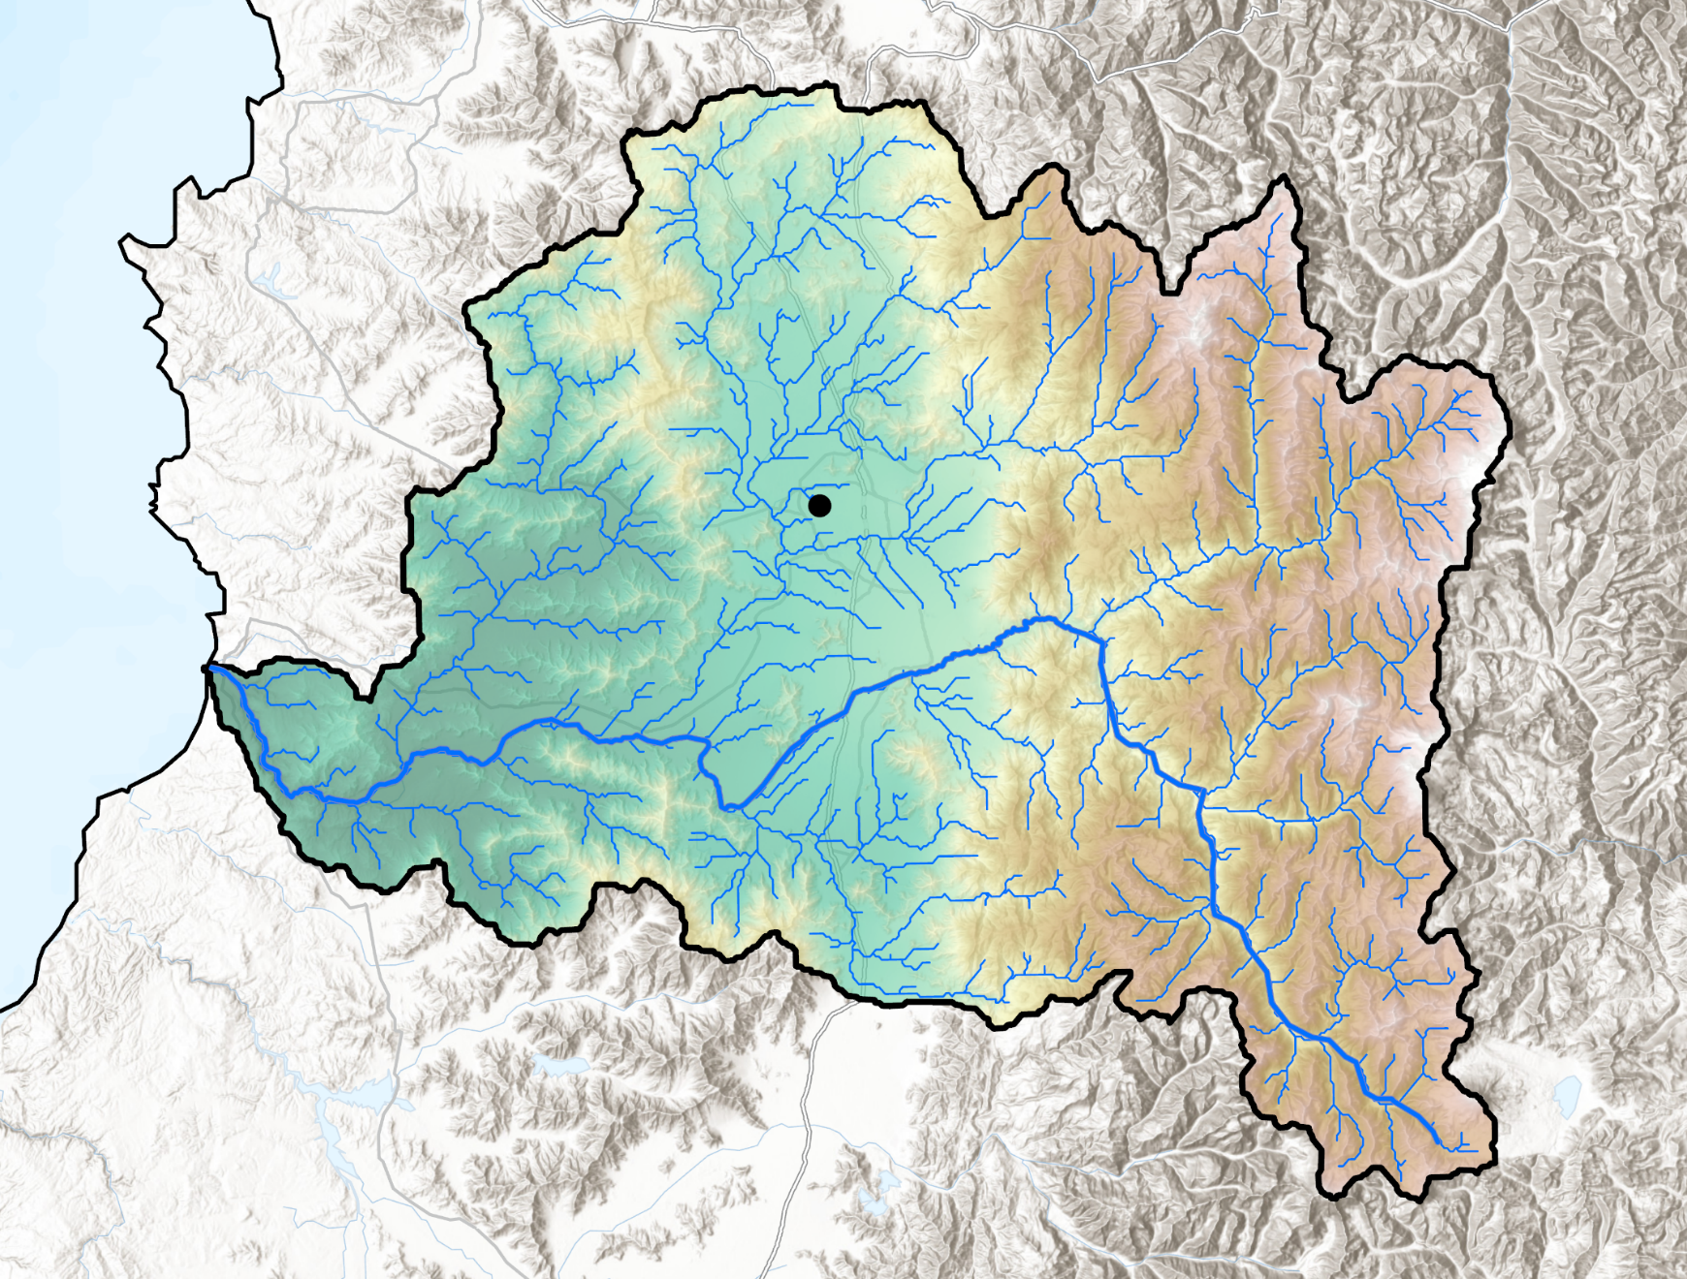
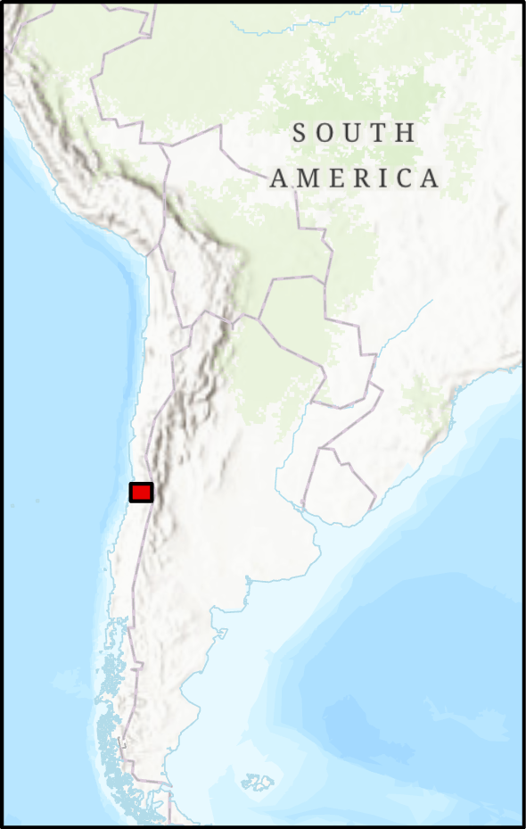
COMMUNITY CONCERNS
The Maipo River Basin provides livelihood to
7M inhabitants, and
contributes 44% of Chile’s GDP
The region is experiencing
climate change,
a mega-drought, and
extreme water scarcity
putting irrigated agriculture at risk!
Santiago
Pacific Ocean
Maipo River
Andes
Mountains
Maipo Basin Elevation
6560m
-4m
Basin Streams
Maipo River
0 12.5 25 50 75 100km
Maipo River Basin
Sources: CIREN, FAO, NOAA, USGS, Esri, HERE, Garmin, Foursquare, METI/NASA, CGIAR
Notes:
The Maipo River in Central Chile stretches over 250 km from the Andes Mountain to the Pacific Ocean. Its watershed provides livelihood to nearly 7 million inhabitants and contributes 44% of Chile's Gross Domestic Product. With its Mediterranean climate, the region is an agricultural hub.
But the region has been impacted by climate change with lower precipitations and a decrease in glacier runoff, coupled to an increase in temperatures and evapotranspiration. In addition to these changes in the water balance, the area has undergone a mega-drought since u2010 and experienced severe water scarcity.
The limited water availability and present competition for water withdrawal in the Maipo River Valley puts irrigated agriculture at risk and calls for more accurate irrigation management and decision-making practices in the region.
Basemap credits/sources: CIREN, Esri, NASA, METI, NGA, USGS, HERE, Garmin, Foursquare, FAO via ArcGIS Pro

Slide 3
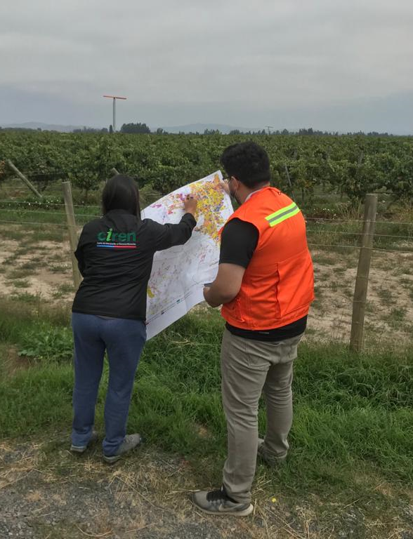
PARTNERS
Centro de Información
de Recursos Naturales (CIREN)
Embassy of Chile,
Agricultural Office
Image Credit: Felipe Arróspide (CIREN)
Notes:
The team partnered with the Centro de Informacion de Recursos Naturales (CIREN) and the Embassy of Chile, Agricultural Office, aimed to expand beyond reference crop coefficients (Kc) and assess actual irrigation needs across the region. CIREN works to ensure high-quality planning, decision-making, and the design of productive development and land use policies in Chile. Currently, the organization contributes to the decision-making in resolve the impacts of water scarcity on agriculture. In this project, CIREN contributes greatly with the in-situ data and their local knowledge about the region. Additionally, the Embassy of Chile agricultural Office is also a key partner on this project.
Image Credit/Source: Felipe Arróspide (partner CIREN) via email | with permission from partner
CIREN description source: https://www.ciren.cl/quienes-somos/

Slide 4
TEAM
Benjamin Goffin
Rishudh Thakur
Maipo River Valley Agriculture
NASA Earth Science
Duncan Srsic
Sarah Carlos
Notes:
A DEVELOP project was initiated in support of our partner's objectives. Our team is made up of Benjamin Goffin (in the role of the project lead) and Rishudh Thakur, Duncan Srsic, and Sarah Carlos. Based on inputs from our partners on our ground, the team aimed to analyze irrigation needs and maximize the efficiency of water usage in crop production.

Slide 5
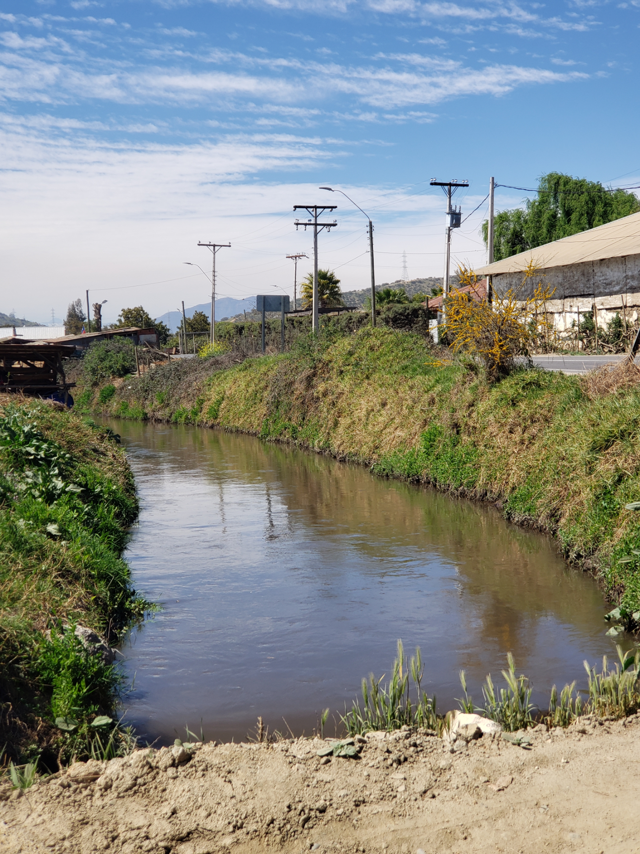
OBJECTIVES
Obtain crop coefficients (Kc) specific to Maipo's
Geography
Climate
Compare techniques & confirm Kc estimates
Between crop types
Through the growing seasons
Across the region
Assess agricultural water demand based on
Remote sensing
Image Credit: Felipe Arróspide (CIREN)
Notes:
In support of their work, we obtained crop coefficients (Kc) specific to the geography and Climate of the Maipo River Valley. In addition, we compared techniques and confirmed Kc estimates between crop types, through the growing seasons, and across the region. Ultimately, this project will serve as a foundation to assess agricultural water demand based on remote sensing and meteorology.
Image Credit/Source: Felipe Arróspide (partner CIREN) via email | with permission from partner

Slide 6
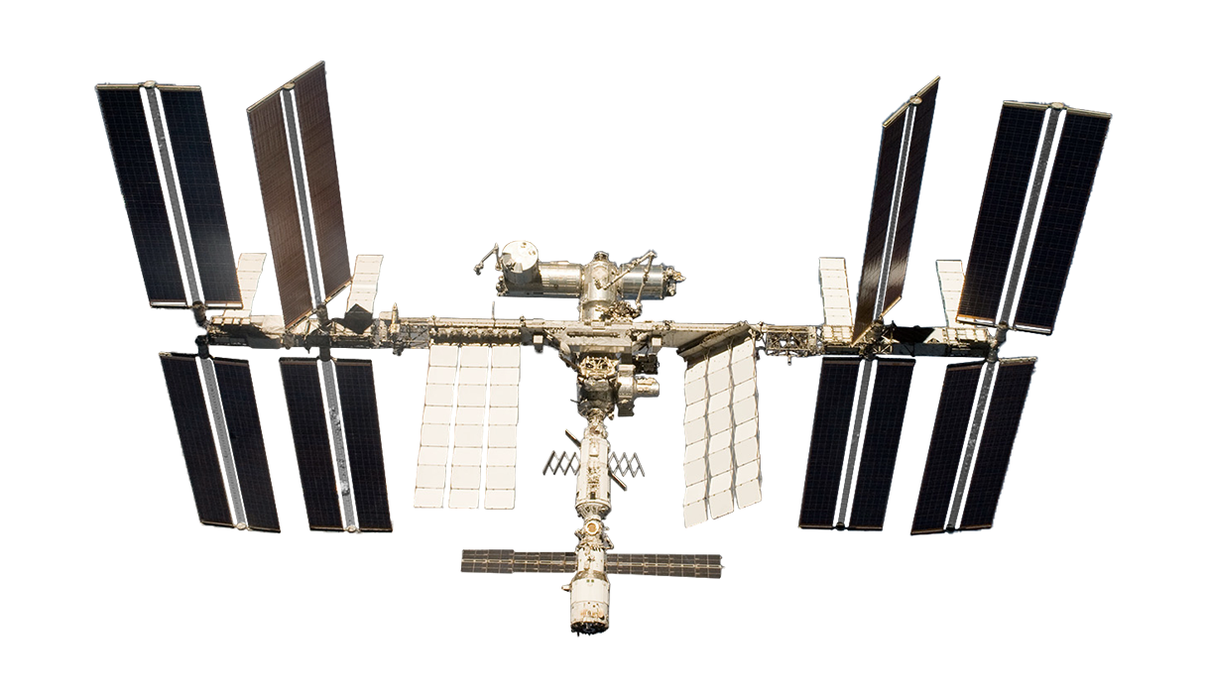
NASA SATELLITES AND SENSORS USED
Landsat 8 OLI
Terra MODIS
ISS ECOSTRESS
Image Credit: NASA
Notes:
To meet our project goals, we used data from several NASA programs among which Operational Land Imager (OLI) on Landsat-8, the Moderate Resolution Imaging Spectroradiometer (MODIS) aboard Terra, and NASA's Ecosystem Spaceborne Thermal Radiometer Experiment on Space Station (ECOSTRESS)
Landsat 8 image source: https://www.devpedia.developexchange.com/dp/index.php?title=List_of_Satellite_Pictures
Terra image source: https://www.devpedia.developexchange.com/dp/index.php?title=List_of_Satellite_Pictures
ECOSTRESS source: https://www.jpl.nasa.gov/missions/ecosystem-spaceborne-thermal-radiometer-experiment-on-space-station-ecostress

Slide 7
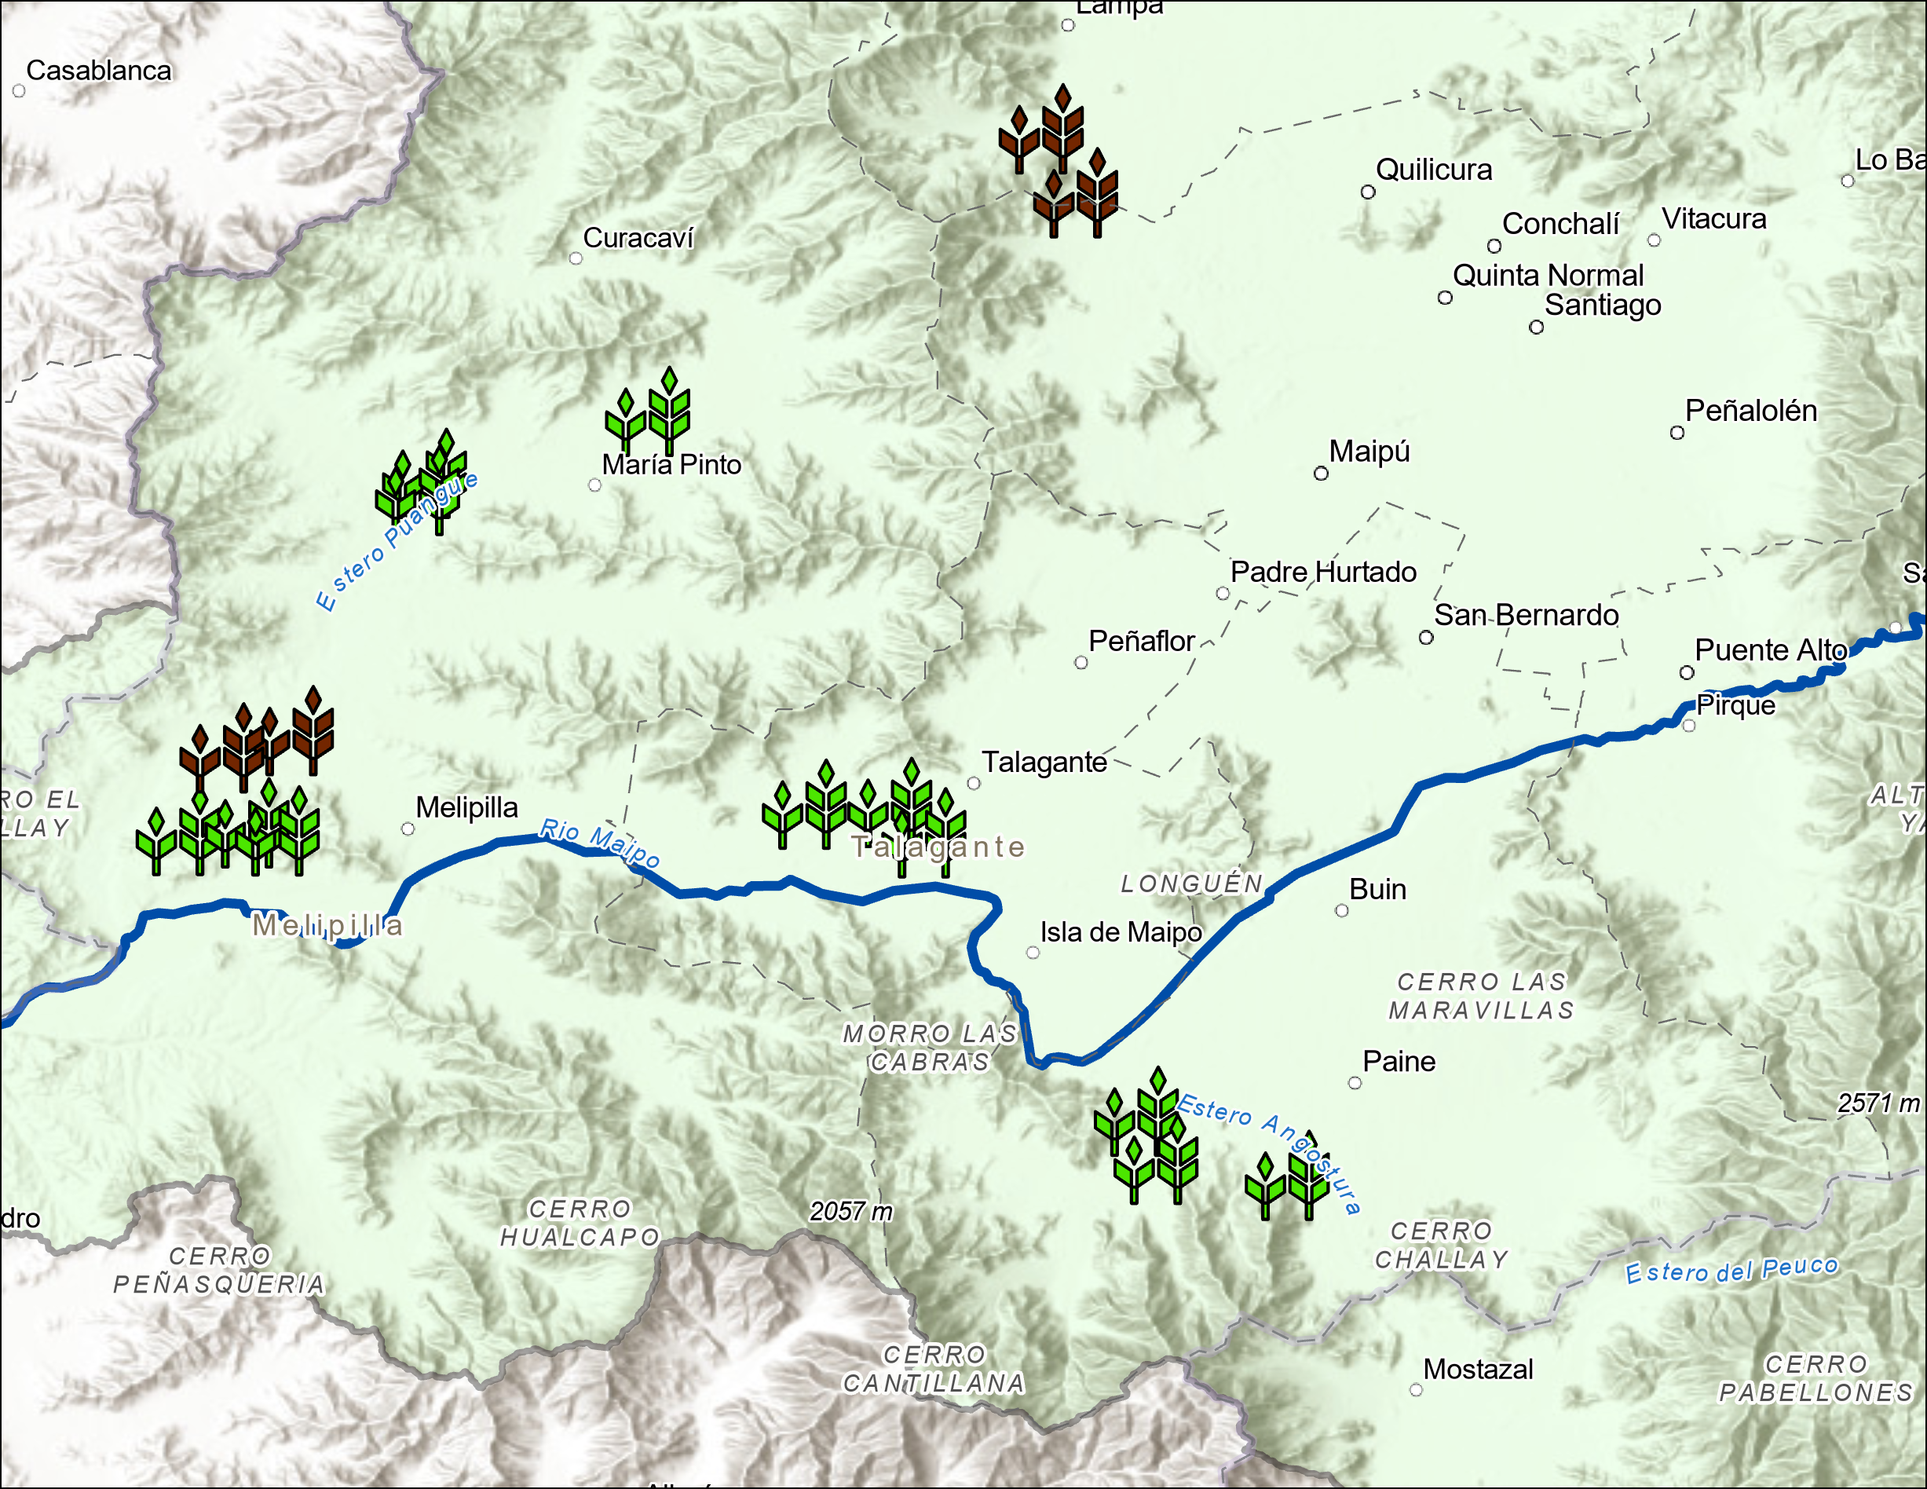
STUDY SITES
Site characteristics:
Removed 50-m. buffer
Retained parcels with min. 30 pixels (>3 ha.)
2 crop types:
Walnut
Corn
12 fields & 4 orchards:
Capturing both consistent + variable growing conditions
WA-HI- 101 &102
CO-LO- 104 → 106
WA-LO- 101 &102
CO-HI- 101 → 103
CO-LO- 101 → 103
CO-HI- 104 → 106
Study Sites
Corn
Walnut
Maipo River
0 10 20 30 40 50
Basin Boundary
Kilometers
Basemap: CIREN, Esri, HERE, Garmin, Foursquare, FAO, METI/NASA, USGS, CGIAR
Notes:
To inform our site selection, our partners provided us with geospatial information pertaining to field extents and crop types. We removed a 50-meter buffer around each parcel to reduce contamination from nearby pixels and potential edge effect within an agricultural field. The resulting parcels were filtered for individual areas greater than roughly 3 hectares with at least 30 pixels of size 30m by 30m.
For this feasibility project, two types of crops were considered with corn as an annual crop and walnut as a perennial one.
Four fields and four orchards were selected for each crop type capturing similar and different geographic and climatic conditions. These sites covered a wide elevation range from 0 to 600 m with annual precipitation between 200 and 500 mm.
Sites for Corn (“Maiz”) and Walnut (“Nogal”) were labeled with M and N, respectively. Sites at Lower and Higher elevations included the letter L or M. These locations were spread over a large spatial distribution from the vicinity of Melipila to the Santiago metropolitan area.
Basemap credits/sources: CIREN, Esri, NASA, METI, NGA, USGS, HERE, Garmin, Foursquare, FAO via ArcGIS Pro

Slide 8
STUDY SITES – Corn Field Locations
Elevation Range (m) | Nearby Locality | Site Designation | Parcel Size (ha)
100–200 | Melipilla | CO-LO-101 CO-LO-102 CO-LO-103 | 77 62 103
100–200 | Maria Pinto | CO-LO-104 CO-LO-105 CO-LO-106 | 13 27 12
300–400 | Talagante | CO-HI-101 CO-HI-102 CO-HI-103 | 4 4 3
300–400 | Laguna Aculeo | CO-HI-104 CO-HI-105 CO-HI-106 | 7 8 6
Notes:
The table shows the selected corn fields for the project. We selected 6 fields from the lower elevation, with 3 in the vicinity of Melipilla and 3 more near Maria Pinto. We also identified 6 sites at a relatively higher elevation, with 3 near Talagante and 3 near Laguna Aculeo. The close proximity of 3 sites should provide redundancy and consistency in our findings while the geographic spread across the region should provide a range in geographic and meteorologic conditions.

Slide 9
STUDY SITES – Walnut Orchard Locations
Elevation Range (m) | Nearby Locality | Site Designation | Parcel Size (ha)
100–200 | Melipilla | WA-LO-101 WA-LO-102 | 28 17
400–500 | Lampa | WA-HI-101 WA-HI-102 | 125 23
Notes:
Similarly to the corn fields selection, we also diversify our collection for Walnut sites with 2 lower elevation sites near Melipilla and 2 sites at relatively higher elevation near Lampa.

Slide 10
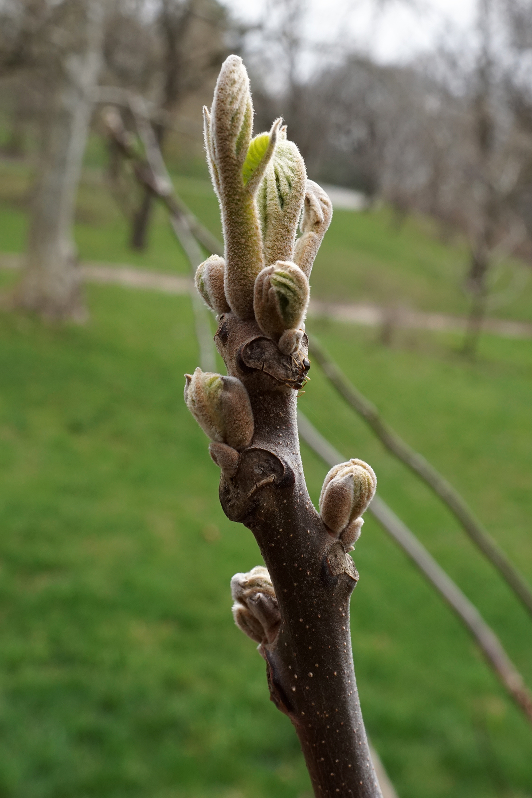
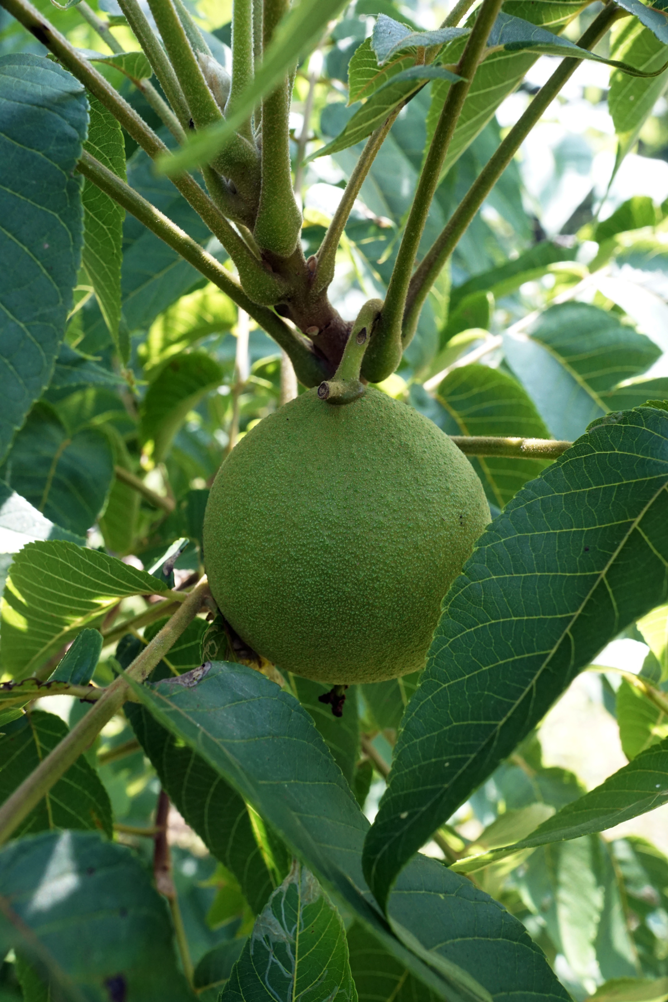
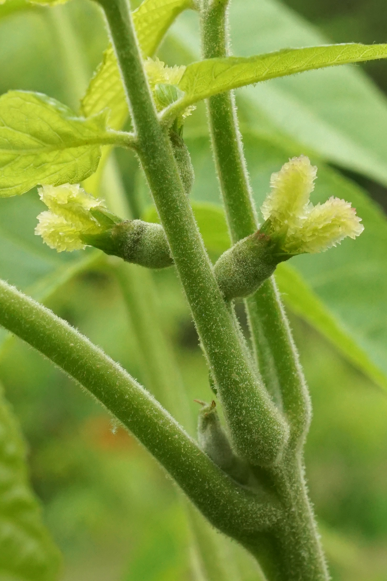
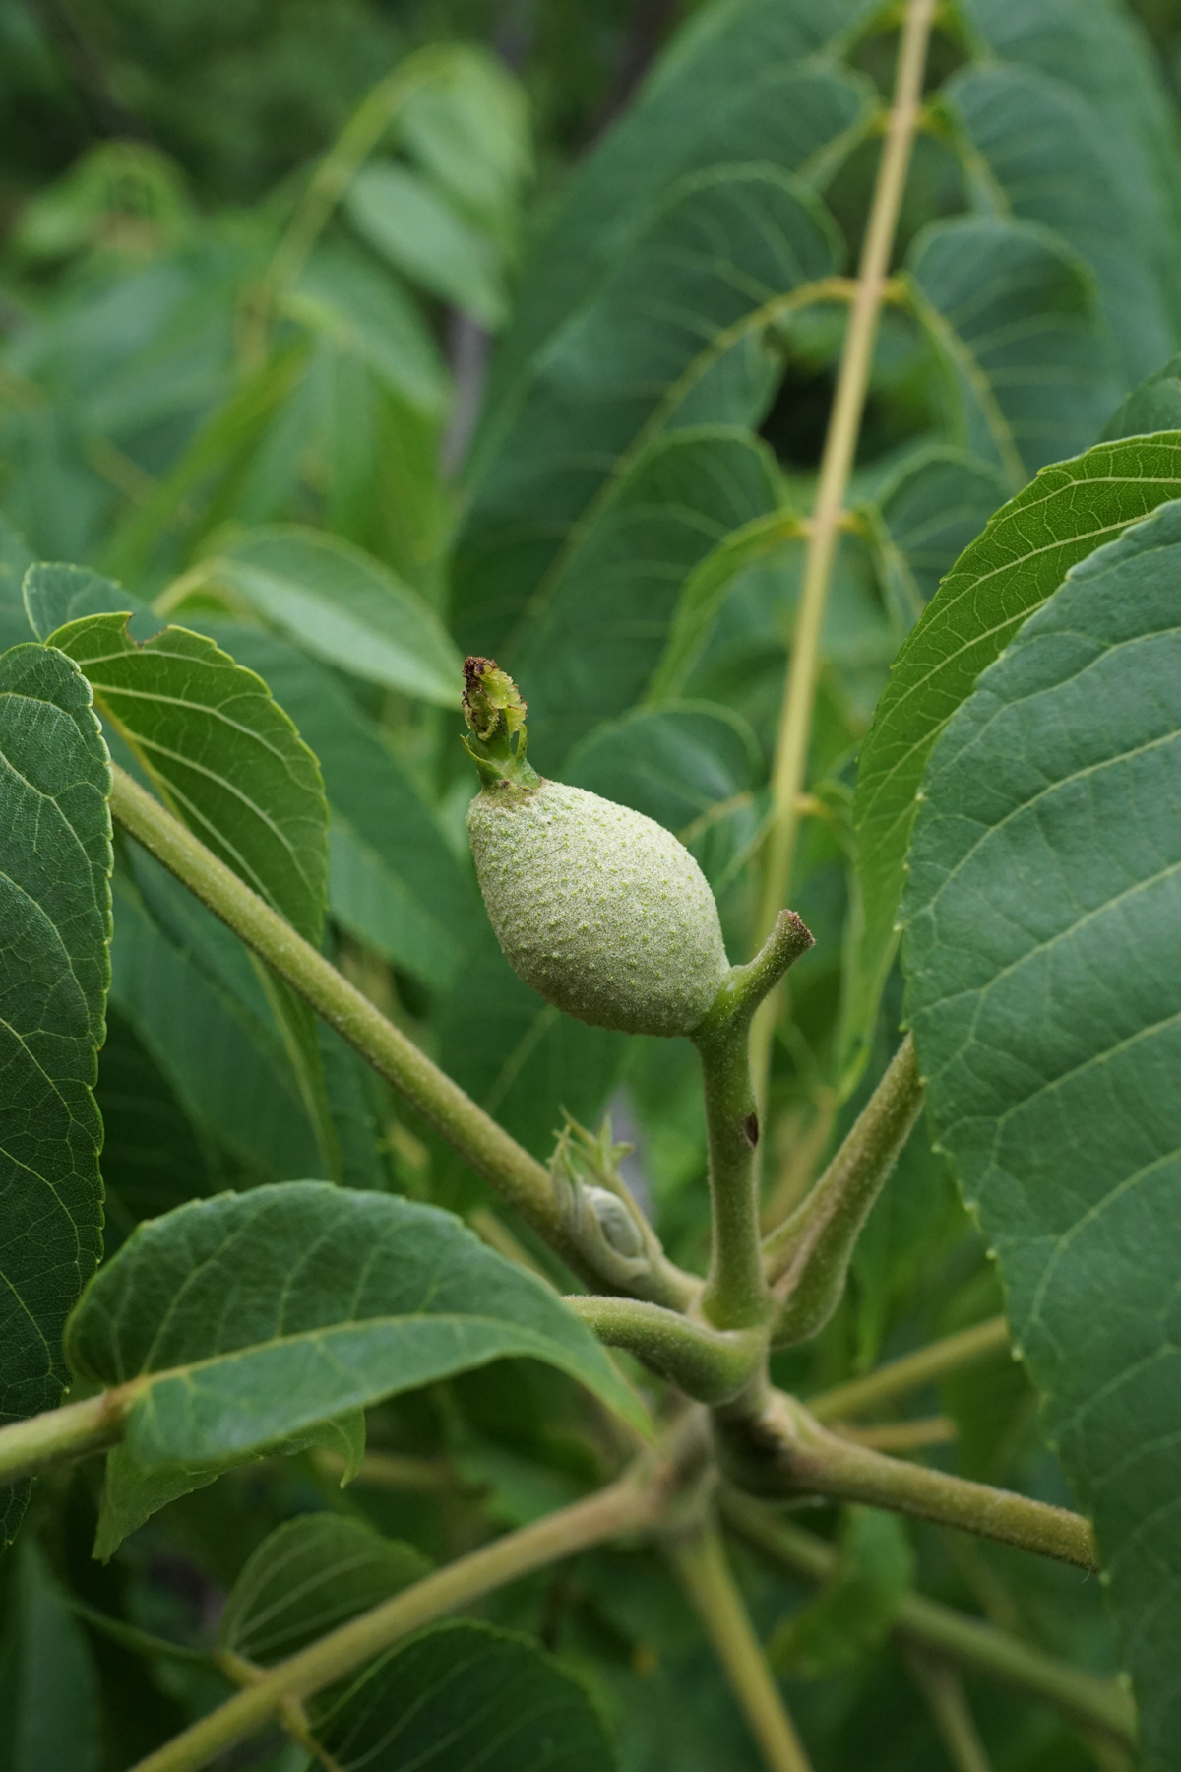
STUDY PERIOD
Three growing seasons (September to May) between 2019 & 2022
Image Credit: Plant Image Library
Notes:
We explored trends during the successive growth stages (September to May) of consecutive growing seasons between 2019 and 2022.
Image1 credit/source: Plant Image Library on Flickr via https://flic.kr/p/UMtSkQ Attribution-ShareAlike 2.0 Generic (CC BY-SA 2.0) / Attribution-ShareAlike 4.0 International (CC BY-SA 4.0)
Image2 credit/source: Plant Image Library on Flickr via https://flic.kr/p/SLvMzE Attribution-ShareAlike 2.0 Generic (CC BY-SA 2.0) / Attribution-ShareAlike 4.0 International (CC BY-SA 4.0)
Image3 credit/source: Plant Image Library on Flickr via https://flic.kr/p/ULhSW1 Attribution-ShareAlike 2.0 Generic (CC BY-SA 2.0) / Attribution-ShareAlike 4.0 International (CC BY-SA 4.0)
Image4 credit/source: Plant Image Library on Flickr via https://flic.kr/p/YoYVK9 Attribution-ShareAlike 2.0 Generic (CC BY-SA 2.0) / Attribution-ShareAlike 4.0 International (CC BY-SA 4.0)

Slide 11
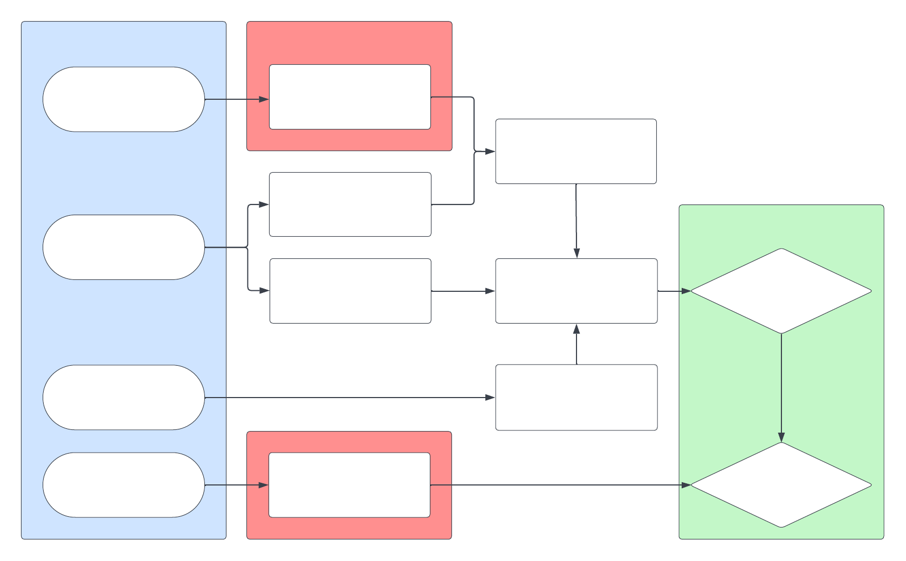
METHODOLOGY #1 – NDVI-based Kc
SOURCES
E.O
Landsat 8 OLI
RED & NIIR (30m)
Site-specific NDVI
Field inventory & study sites
END PRODUCT
CIREN
Phenological Calendar
Linear Regression
Site-specific Kc
FAO
Reference Kc
Terra MODIS
PET (500m)
Estimated ET
Notes:
In our Normalized Difference Vegetation Index technique, we acquired the red and near-infrared (NIR) bands of Earth observations from Landsat-8 OLI. The red and NIR parameters were used to calculate NDVI for specific sites. Based on FAO guidelines and the phenological calendar from our partners at CIREN, we derived a linear regression between calculated NDVI and the reference crop coefficients, which resulted in new Kc values specific to our study sites. With Potential Evapotranspiration from Terra MODIS and site-specific Kc, we computed estimates of actual ET at each site.

Slide 12
DATA – Corn NDVI through time
Sep-25
Oct-11
Oct-27
Nov-12
Nov-28
Dec-14
NDVI
0.5
0.4
Dec-30
Jan-31
Mar-20
0.3
Jan-15
Feb-16
Mar-04
0.2
0.1
Corn Site CO-LO-101 (77 ha.) during Growing Cycle 2021–2022
Notes:
NDVI signals of a corn field are shown through the growth stages during last year's season. The range of NDVI values throughout the growing cycle is very wide, allowing for interpretation of the growth stages. For instance, it takes roughly 6 weeks from planting for the NDVI to increase. The values peak around December 14th and remain that way until the end of January. They start going down around mid February, prior to harvesting.

Slide 13
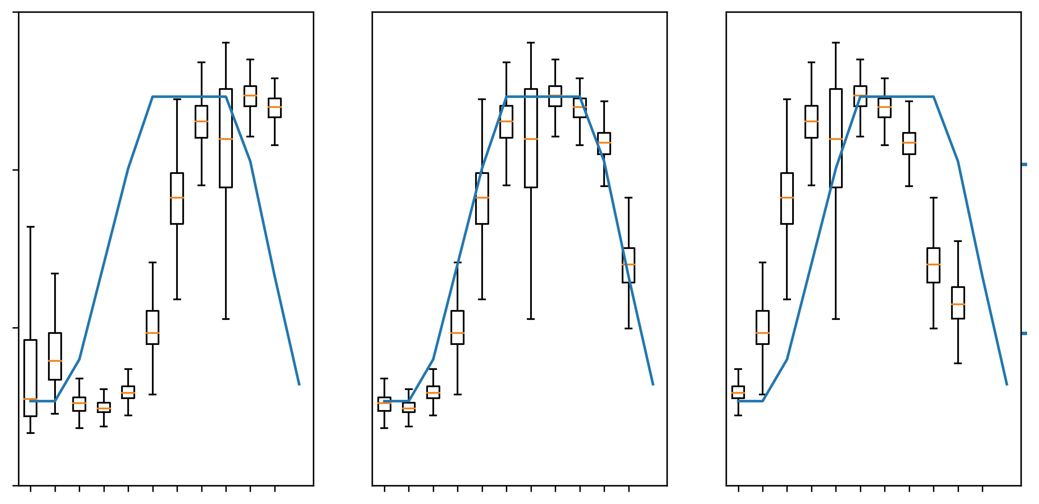
DATA – Corn NDVI for Assumed Day of Planting
DAP ~Aug 24, 2021
DAP ~Sep 25, 2021
DAP ~Oct 27, 2021
0.6
0.4
1.0
Reference Kc
NDVI
0.2
0.5
0.0
5 37 69 101 133 165
5 37 69 101 133 165
5 37 69 101 133 165
Days after Planting
Corn Site CO-LO-101 during Growing Cycle 2021–2022
Notes:
Next, we performed some data review and iterative work to determine the day of planting for each site and season. We aimed to best match our data curve with the typical growth stages per the FAO reference. In this case, we found that September 25 seemed to be the best fit. On the left plot with an earlier assumed day of planting, we see that the NDVI signals peak late after being planting. On the contrary, on the right plot with a later assumed day of planting, we find that the vegetation produced NDVI signals that peak shortly after planting.

Slide 14
DATA - Corn Growing Cycles
Assumed Day of Planting
 | 2019–2020 | 2020–2021 | 2021–2022 | Analysis
CO-HI-101 | Oct-22 | N/A | Oct-27 | Model Fitting
CO-HI-102 | Sep-04 | Oct-08 | Sep-25 | Validation Only
CO-HI-103 | Sep-04 | N/A | Sep-09 | Model Fitting
CO-HI-104 | Sep-04 | Sep-06 | N/A | Model Fitting
CO-HI-105 | Sep-20 | Sep-22 | Sep-09 | Validation Only
CO-HI-106 | Sep-04 | Sep-22 | Sep-09 | Model Fitting
CO-LO-101 | Sep-04 | Sep-06 | Sep-25 | Model Fitting
CO-LO-102 | Sep-20 | Sep-06 | Sep-25 | Validation Only
CO-LO-103 | Sep-20 | Sep-06 | N/A | Model Fitting
CO-LO-104 | Oct-22 | Oct-08 | Oct-11 | Model Fitting
CO-LO-105 | Oct-22 | Oct-08 | Oct-11 | Validation Only
CO-LO-106 | Sep-04 | Sep-06 | N/A | Model Fitting
Notes:
This chart displays the starting date of growing cycle we found for each corn site across 3 seasons between 2019 and 2022. Based on insight from our partners at CIREN, the day of planting is generally comprised between the beginning of second week of September and the end of second week of October. N/A denotes a mismatch in NDVI signals we observed and the phenology calendar we were handed by our partners. It is likely the result of crop rotation with another crop on a different cycle being present at the site. After determination of the day of planting, corn sites were divided into two categories, with two thirds used for model fitting, and one third of the sites left aside for subsequent validation.

Slide 15
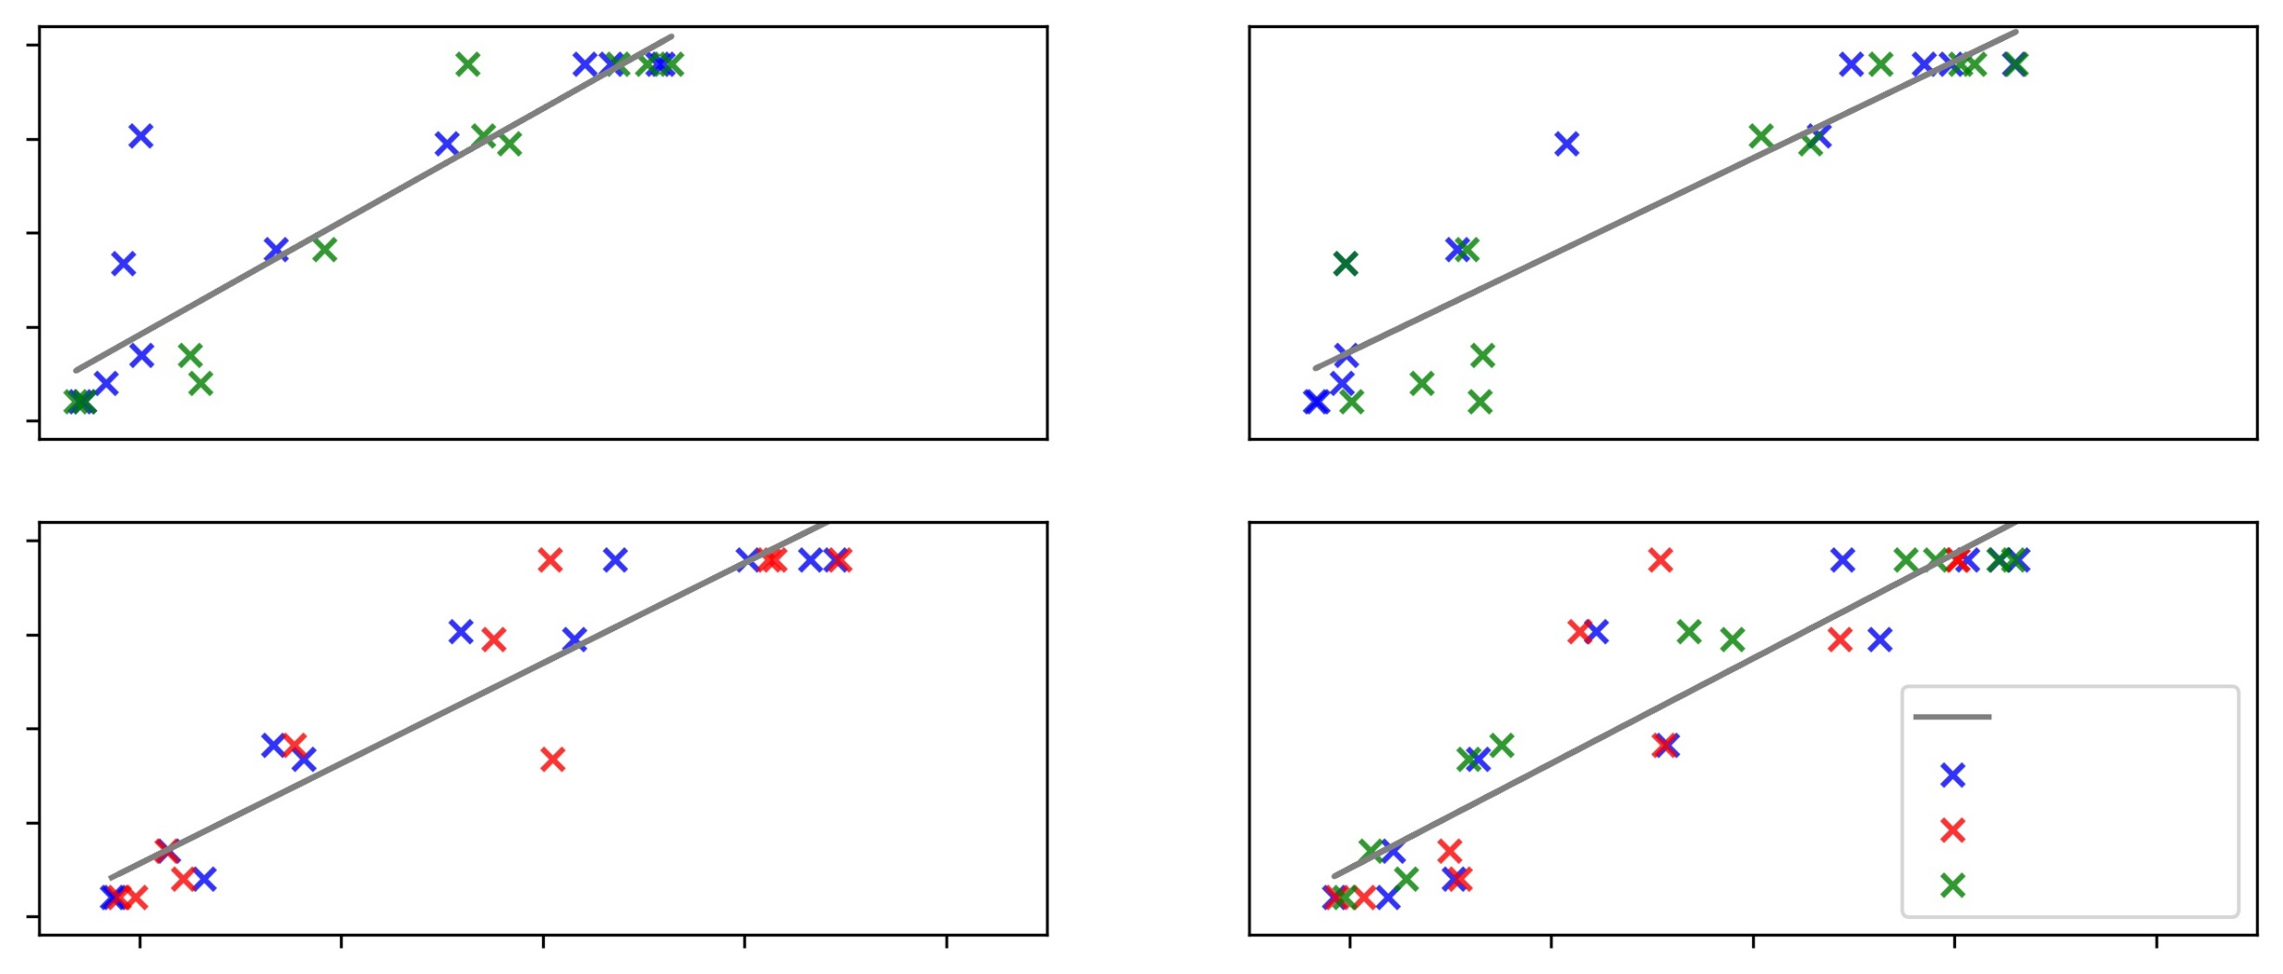
RESULTS – NDVI-Kc Model Fitting
CO-HI-101
CO-HI-103
1.25
Slope: 3.01
Intercept: 0.176
r2 score: 0.84
Slope: 2.58
Intercept: 0.174
r2 score: 0.85
1.00​
0.75​​
0.5​​​
Kc
​0.25​
CO-HI-104
CO-HI-106
1.25
Slope: 2.67
Intercept: 0.123
r2 score: 0.89
Slope: 2.79
Intercept: 0.098
r2 score: 0.85
1.00​
0.75​​
Linear Fit
9/2019-4/2020
0.5​​​
9/2020-4/2021
​0.25​
9/2021-4/2022
0.1 0.2 0.3 0.4 0.5
0.1 0.2 0.3 0.4 0.5
NDVI
Linear Regressions at Corn Sites (high el.)
Notes:
These graphs show the linear regressions between the FAO kc and NDVI for corns sites in the higher elevation range. From these four sites, the good fits indicate that the FAO Kc and NDVI have a strong correlation with r-square values consistently around 0.8. Similarly, the slopes of these four linear regressions have similar coefficients.

Slide 16
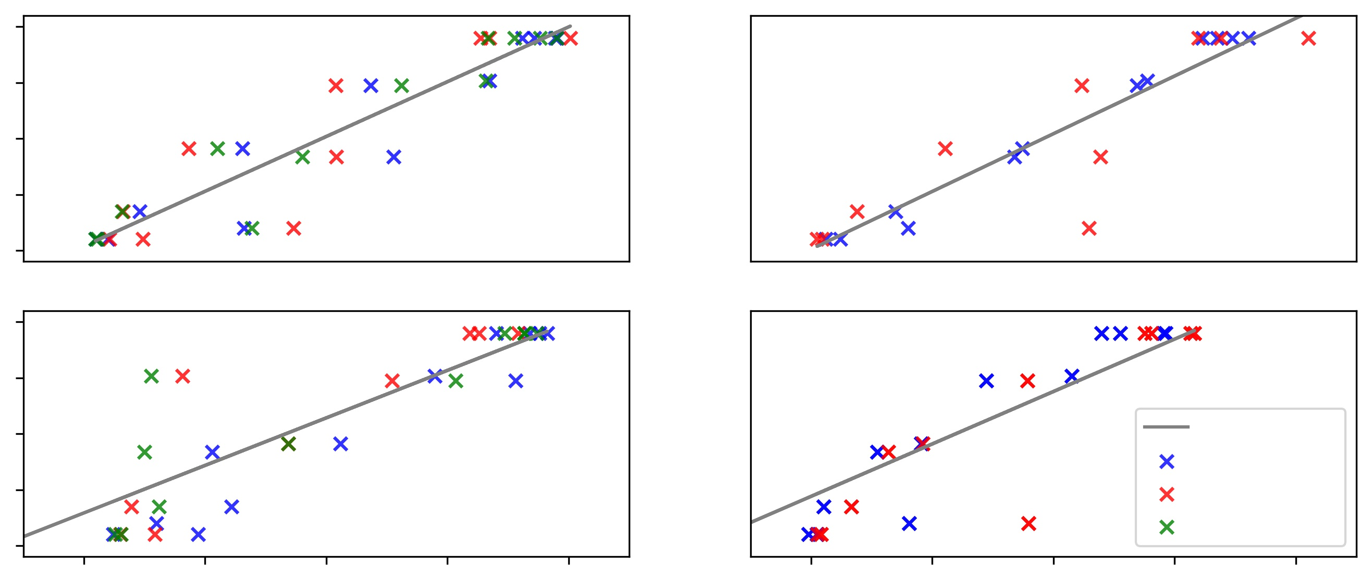
RESULTS – NDVI-Kc Model Fitting
CO-LO-101
CO-LO-103
1.25
Slope: 2.45
Intercept: 0.024
r2 score: 0.88
Slope: 2.58
Intercept: -0.003
r2 score: 0.86
1.00​
0.75​​
0.5​​​
Kc
​0.25​
CO-LO-104
CO-LO-106
1.25
Slope: 2.12
Intercept: 0.184
r2 score: 0.74
Slope: 2.34
Intercept: 0.0236
r2 score: 0.61
1.00​
0.75​​
Linear Fit
9/2019-4/2020
0.5​​​
9/2020-4/2021
​0.25​
9/2021-4/2022
0.1 0.2 0.3 0.4 0.5
0.1 0.2 0.3 0.4 0.5
NDVI
Linear Regressions at Corn Sites (low el.)
Notes:
In comparison to the high elevation, the linear regression at the lower elevation sites showed slightly lower r-square values. However, the correlation we found are still strong and produced slope coefficient and intercept similar to the prior.

Slide 17
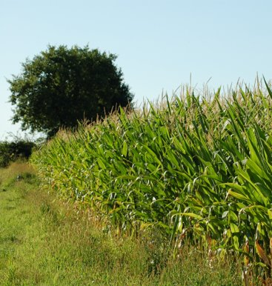
RESULTS – NDVI-Kc Ensemble Model
Based on regressions at 8 sites,
We developed a regional ensemble model with
Slope of 2.57
Intercept of 0.13
Image Credit: Alex Lomas (Wikicommons)
Notes:
A single ensemble equation was developed by taking the mean of slope and intercept of the NDVI-Kc equation developed individually for the 8 model fitting sites. The mean ensemble equation was also compared with the ensemble equations obtained by taking median and averaging by weighted r-square. The three estimates were almost identical to each other and thus, the analysis was further advanced with the formula of mean ensemble.
Image credit: Alex Lomas
source: Wikicommons via https://commons.wikimedia.org/wiki/File:Zea_mays_(2943636083).jpg
(This file is licensed under the Creative Commons Attribution 2.0 Generic license.
This image was originally posted to Flickr by alexlomas at https://flickr.com/photos/51464530@N00/2943636083. It was reviewed on 24 October 2015 by FlickreviewR and was confirmed to be licensed under the terms of the cc-by-2.0.)

Slide 18
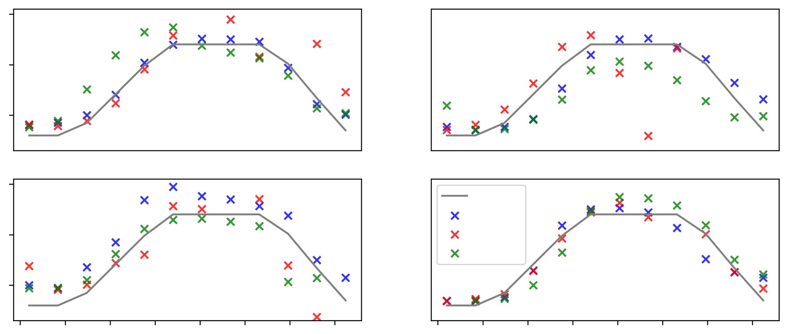
RESULTS – NDVI-Kc Ensemble Validation
CO-LO-102
CO-HI-102
1.5
​1.0​
0.5
Kc
Co-lo-105
Co-hi-105
CO-LO-105
CO-HI-105
1.5
FAO
2019-2020
​1.0​
2020-2021
2021-2022
0.5
0 25 50 75 100 125 150 175
0 25 50 75 100 125 150 175
Days after Planting
Linear Modeling through Growing Cycles
Notes:
This graphic shows the robustness of the NDVI-Kc ensemble equation across the four validation sites. Here we have two sites at lower elevations and two at higher elevation. The different marker colors shows the scatter for the different years. For each of the plot the FAO-Kc and the estimated Kc from the ensemble equation has been plotted against the days after planting. The estimated Kc’s are in agreement with the FAO-Kc curve. Therefore, the ensemble equation does a good job in estimating Kc’s across the basin and accounts for the geographic/climatic variability across the sites.

Slide 19
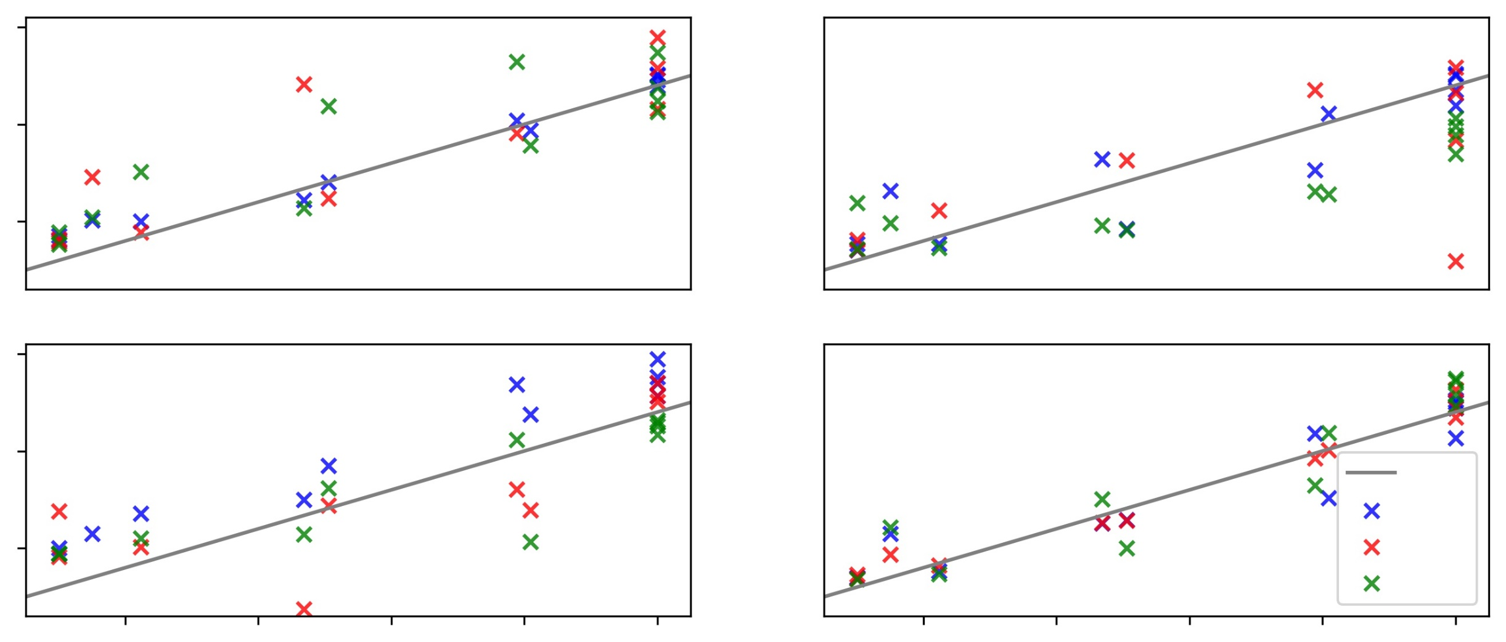
RESULTS – NDVI-Kc Ensemble Validation
CO-LO-102
CO-HI-102
1.5
r2 score: 0.75
rmse: 0.033
r2 score: 0.56
rmse: 0.060
​1.0​
0.5
Ensemble NDVI-KC
CO-LO-105
CO-HI-105
1.5
r2 score: 0.65
rmse: 0.044
r2 score: 0.90
rmse: 0.012
​1.0​
1:1 line
2019-20
0.5
2020-21
2021-22
0.4 0.6 0.8 1.0 1.2
0.4 0.6 0.8 1.0 1.2
FAO Kc
Linear Modeling against Reference
Notes:
Here the correlation of ensemble Kc with the FAO-Kc for four validation sites have been estimated for the period of analysis between 2019-2022. The different marker colors shows the scatter for the different years. The correlation between the ensemble equation and the FAO-kc is high and thus it shows that the ensemble equation can be relied upon to calculate crop coefficients for corn sites across the basin.

Slide 20
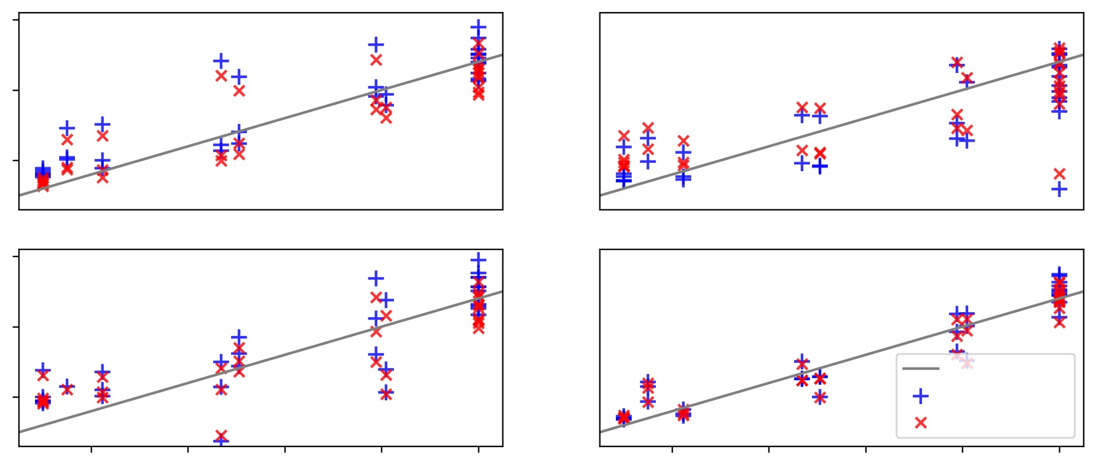
RESULTS – Performance of NDVI-Kc Ensemble
CO-LO-102
CO-HI-102
1.5
Ensemble r2: 0.75
Best-fit r2: 0.81
Ensemble r2 score: 0.56
Best-fit r2 score: 0.60
​1.0​
0.5
NDVI-KC
CO-LO-105
CO-HI-105
1.5
Ensemble r2 score 0.65
Best-fit r2 score: 0.71
Ensemble r2 score: 0.90
Best-fit r2 score: 0.91
​1.0​
1:1 line
0.5
Ensemble
Site-specific regr.
0.4 0.6 0.8 1.0 1.2
0.4 0.6 0.8 1.0 1.2
FAO Kc
Linear Modeling against Best Possible Fit
Notes:
Also, the correlation between the ensemble equation and site specific NDVI-Kc equation across the validation sites have been calculated. It can be seen that the performance of ensemble r2 and best fit r2 is very similar to each other. This shows that ensemble equation does a pretty good job in capturing site response and an equation specifically developed at the site does not add much value. Therefore, reinstating that our model can be further used to determine crop coefficients for corn across the basin.

Slide 21
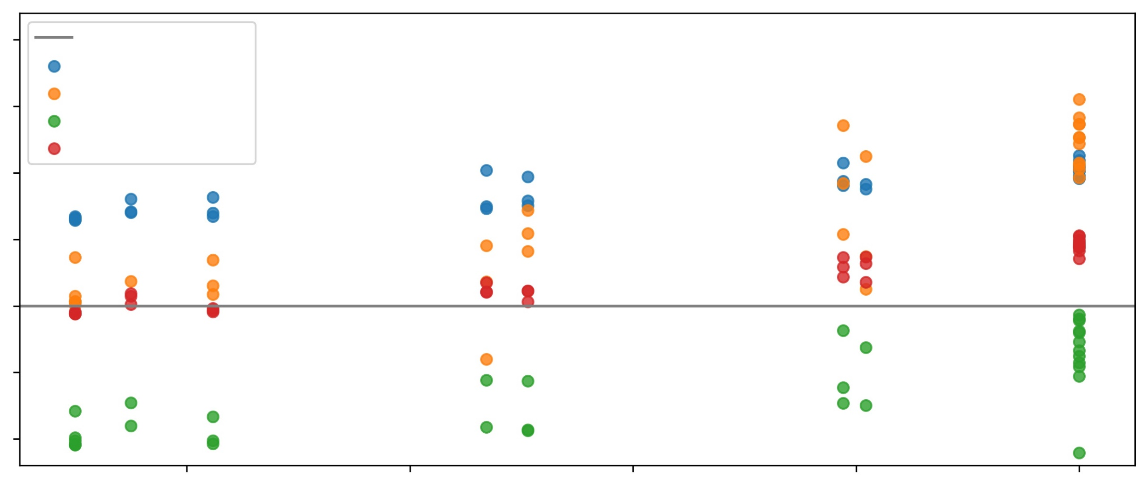
RESULTS – Potential Bias in NDVI-Kc Ensemble
0.20
y=0
CO-LO-102
0.15
CO-LO-105
CO-HI-102
CO-HI-105
0.10
Kc from ensemble model minus Kc from site-specific region
0.05
0.00
-0.05
-0.10
0.4 0.6 0.8 1.0 1.2
FAO Kc
Notes:
Here, we subtracted the Kc estimates obtained with the ensemble equation or using the best-fit specifically developed at a site. When subtracting these two, we see a slight overestimation of the ensemble for the blue dots at site CO-LO-102 while there appears to be a slight underestimation for site CO-HI-102 shown in green. Overall, the residuals appear to balance out and do show a particular trend. With no particular pattern observed, we concluded that there was no obvious bias and did not further tune our ensemble model parameters.

Slide 22
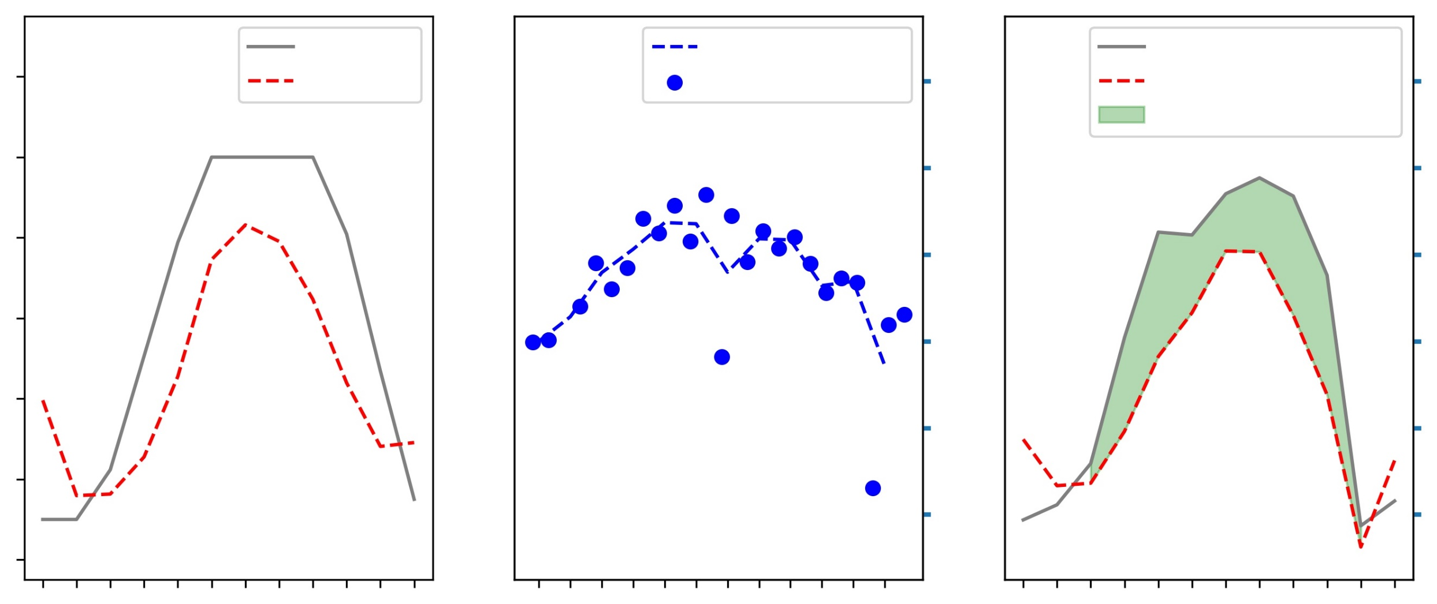
RESULTS – Applications of Ensemble Kc Model
FAO Kc
Interpolated PET
ET based FAO
1.4
NDVI Kc
Observed PET
12
ET based NDVI
Prior overestimation
1.2
10
1.0
8
0.8
Crop coefficient
Evapotranspiration
6
0.6
4
0.4
2
0.2
9/25 10/27 11/28 12/30 1/21 3/04
9/25 10/27 11/28 12/30 1/21 3/04
9/25 10/27 11/28 12/30 1/21 3/04
Day after Planting (mm/dd)
Corn Site CO-HI-102 during Growing Cycle 2021–2022
Notes:
The ensemble model was derived from the FAO reference and NDVI patterns for the region. As such, it captured unique vegetation response at validation site CO-HI-102 during the growing season 2021-22 (on the left). We acquired potential evapotranspiration data from Terra MODIS and interpolated it for the days at which we modeled Kc (in the middle). We multiplied PET by modeled Kc to estimate evapotranspiration. Our ensemble model plots below the FAO estimates which, indicates a potential overestimation of irrigation needs per the FAO reference alone (on the right).

Slide 23
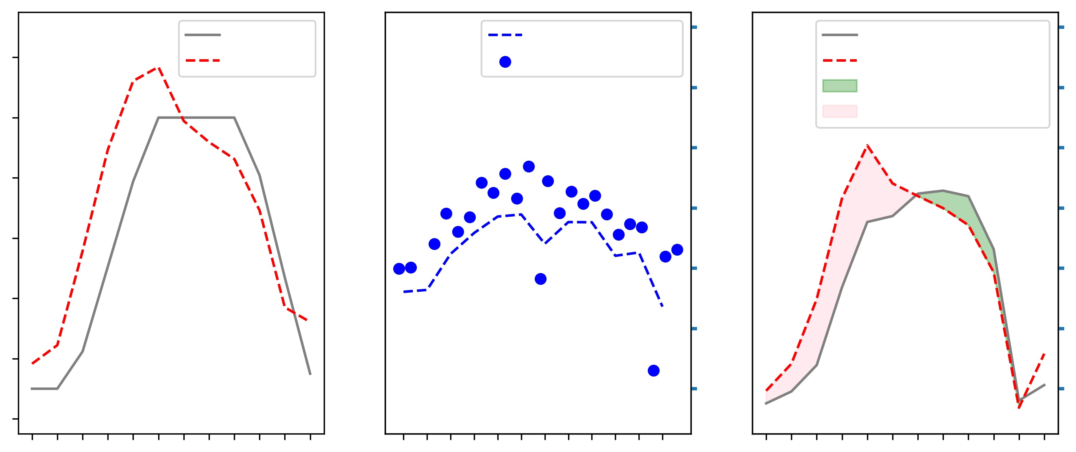
RESULTS – Applications of Ensemble Kc Model
FAO Kc
Interpolated PET
14
1.4
ET based FAO
NDVI Kc
Observed PET
ET based NDVI
Prior overestimation
12
1.2
Prior underestimation
10
1.0
8
0.8
Crop coefficient
Evapotranspiration
6
0.6
4
0.4
2
0.2
9/25 10/27 11/28 12/30 1/21 3/04
9/25 10/27 11/28 12/30 1/21 3/04
9/25 10/27 11/28 12/30 1/21 3/04
Day after Planting (mm/dd)
Corn Site CO-LO-102 during Growing Cycle 2021–2022
Notes:
For another site, the findings of our approach are more nuanced and indicate both a prior underestimation of water requirements in the first half of the season (red shade) combined with possible overestimation by FAO in the second half of the season (green shade) and of water requirements.

Slide 24
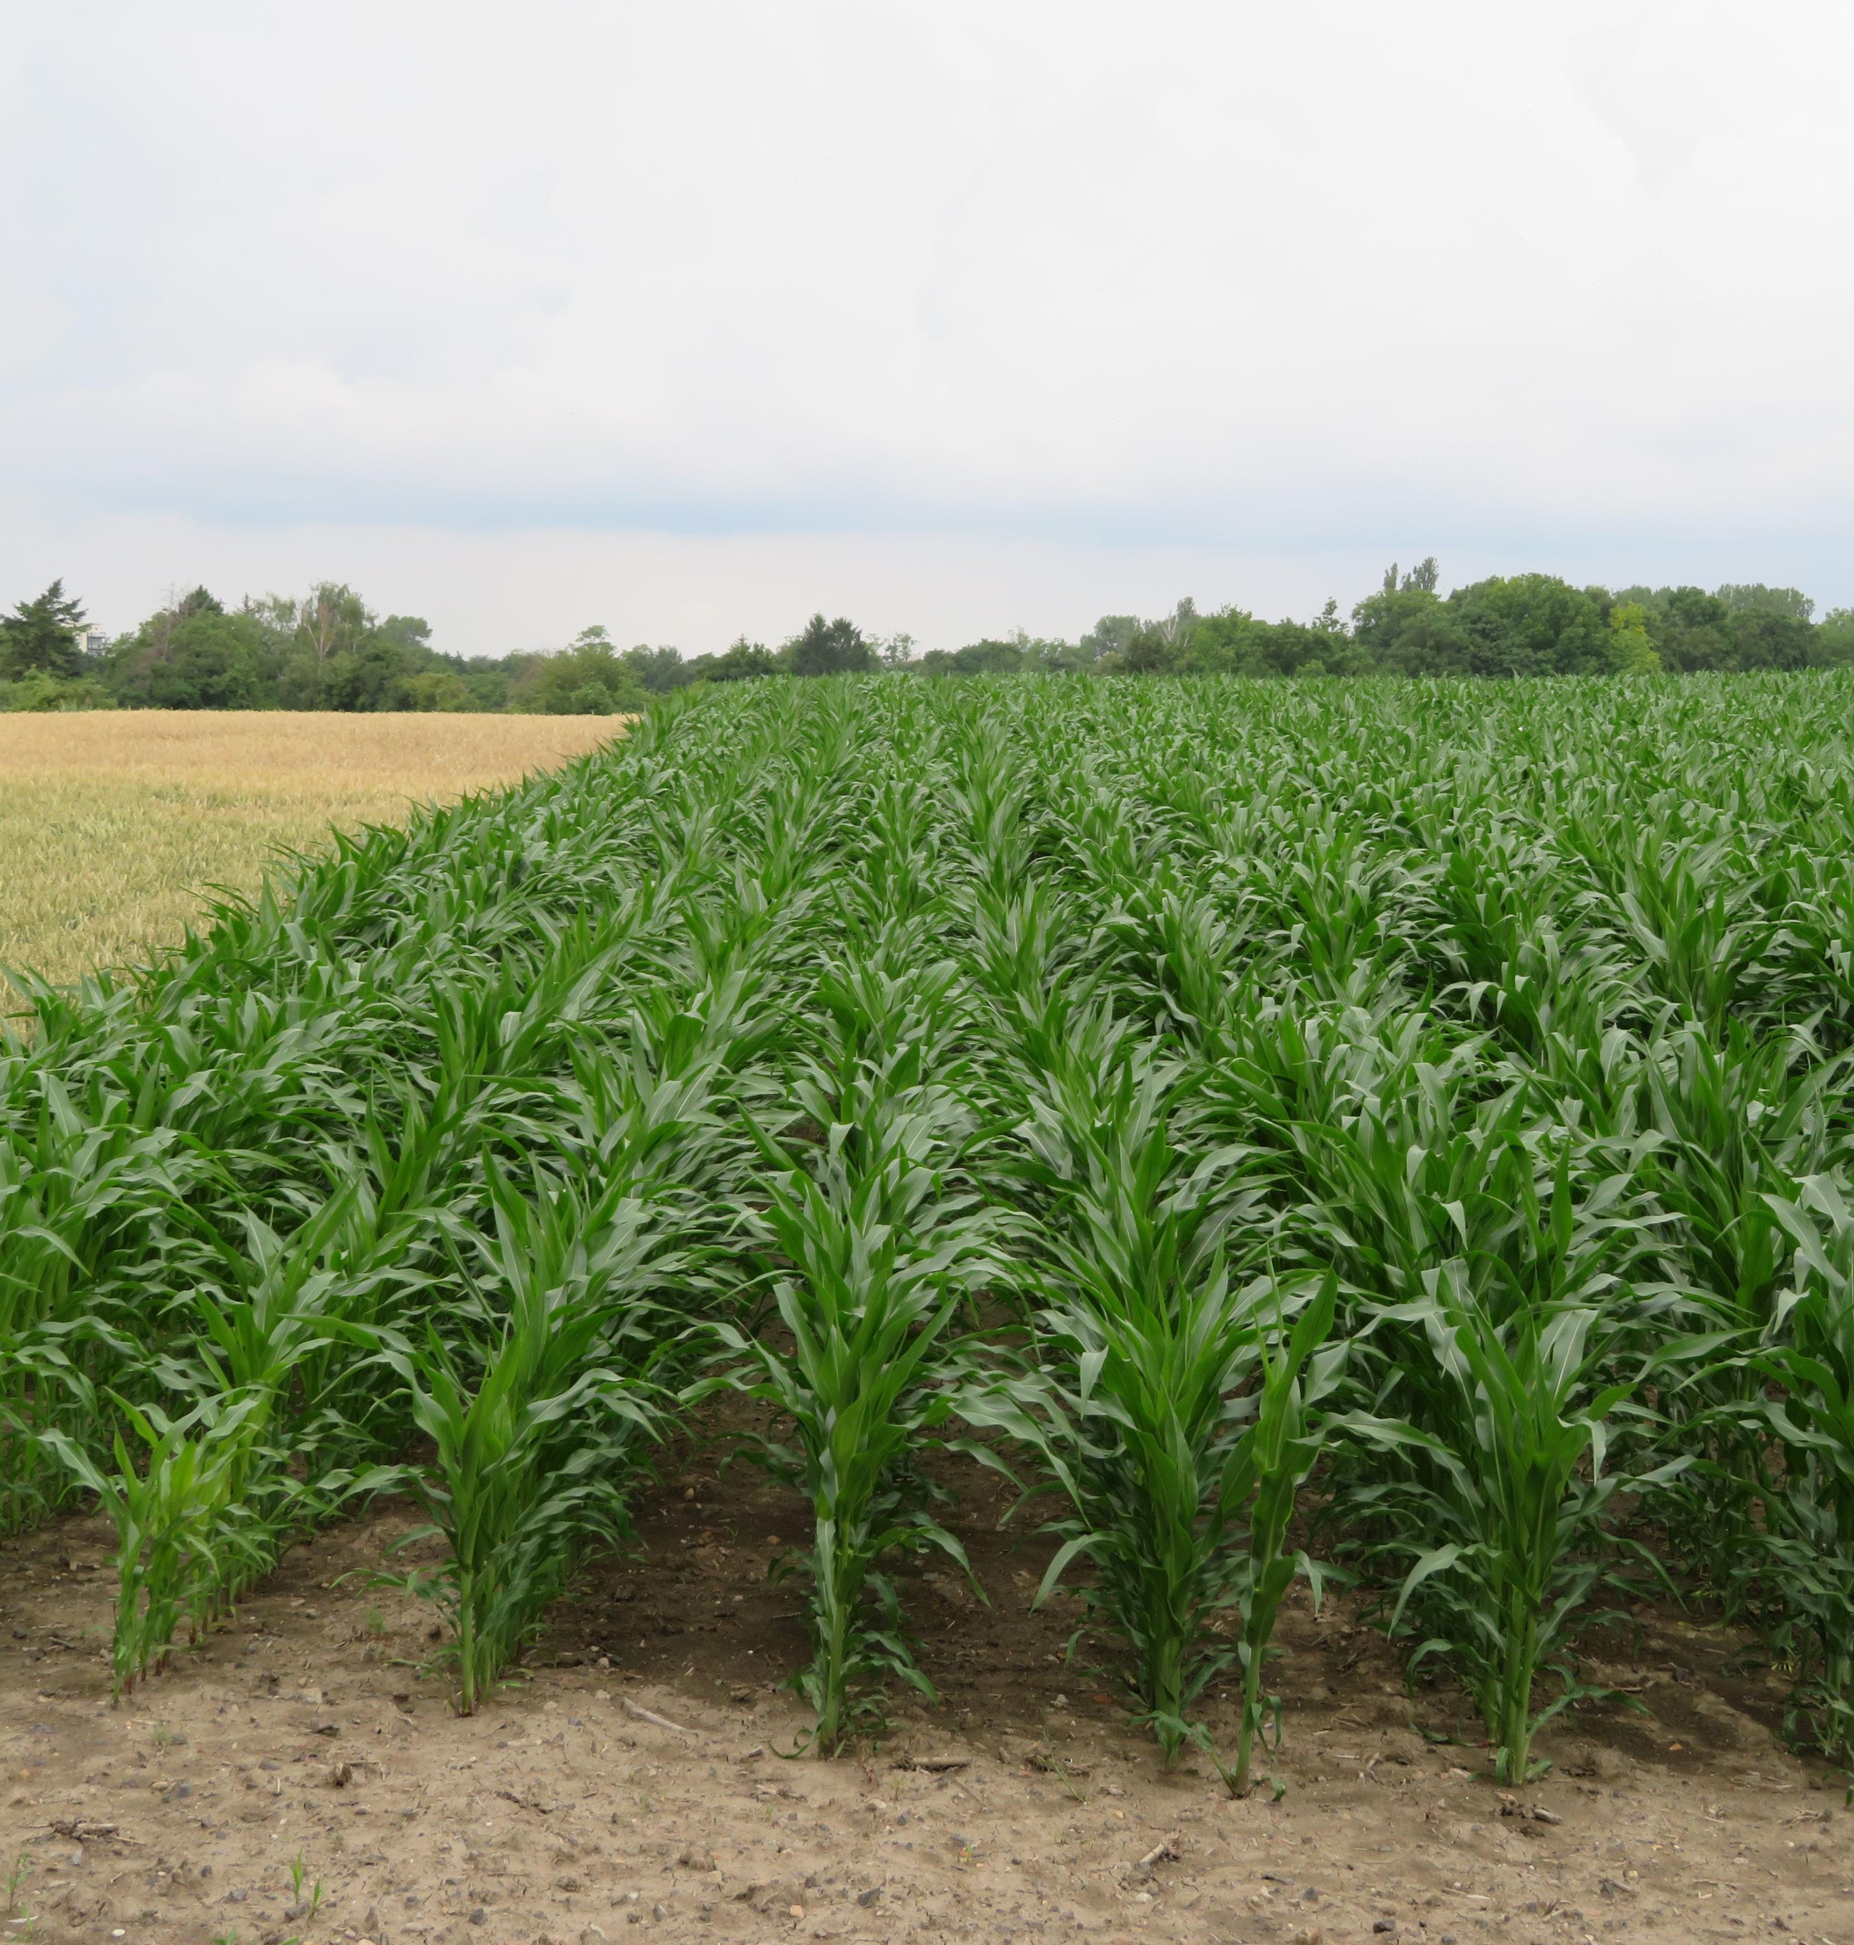
Key FINDINGS from Corn NDVI
Studied the relationship between
Kc and NDVI at 8 sites
Produced 1 regional model, which was validated at 4 locations
This method followed typical growth stages and captured unique vegetation responses at each site
Assessed actual crop water requirements
Image Credit: Sciencia58 (Wikicommons)
Notes:
Our team studied the relationship between Kc and NDVI at 8 sites. We then produced 1 regional model, which followed overall growth stages. This method also captured unique vegetation response at each site. As such, our approach was able to assess actual crop water requirements
Image Credit/Source: Sciencia58 on Wikicommons via https://commons.wikimedia.org/wiki/File:Maisfeld_-_Zea_mays_1.jpg (This file is licensed under the Creative Commons Attribution-Share Alike 4.0 International license.)

Slide 25
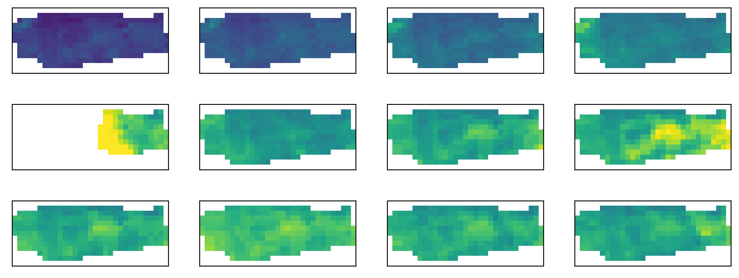
DATA – Walnut NDVI through time
Sep-20
Oct-06
Oct-22
Nov-07
NDVI
0.16
0.14
Nov-23
Dec-09
Dec-25
Jan-10
0.12
0.10
Jan-26
Feb-11
Feb-27
Mar-14
0.08
0.06
Walnut Site WA-LO-101 (28 ha.) during Growing Cycle 2019–2020
Notes:
Looking at the spatial distribution of NDVI values across the season, we see a narrow range of values, relatively lower than those of corn. We see a slight progressive increase beginning in October through November. Values thereafter are somewhat stagnant and do not allow for meaningful interpretation of the time of flowering, harvest, and leaf fall.

Slide 26
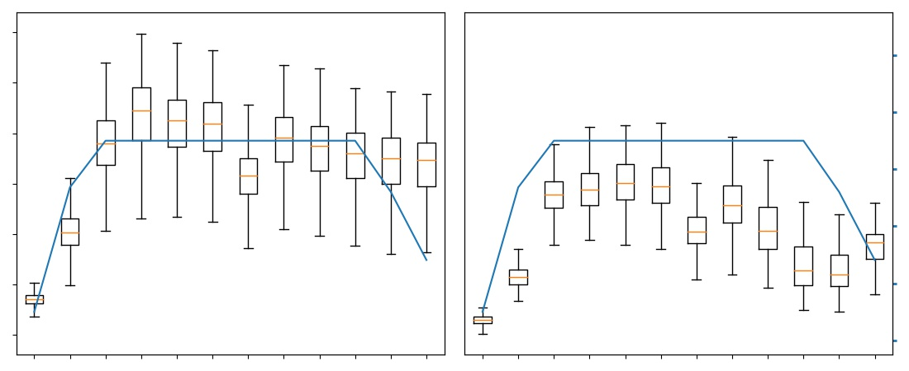
DATA – Walnut NDVI for Assumed DAP
0.40
1.4
0.35
1.2
0.30
1.0
NDVI
0.25
Reference Kc
0.8
0.20
0.15
0.6
0.10
0.4
12 28 44 60 76 92 108 124 140 156 172 188
12 28 44 60 76 92 108 124 140 156 172 188
Walnut Sites WA-HI-101 & 102 during Growing Cycle 2019–2020
Notes:
Here we are showing the pixel distribution across time for two walnut sites at high elevation. We would expect them to behave similarly. From these boxplots, a sharp uptake can be noticed when leaves are likely forming across the orchard. A plateau appears to be reached in the mid season. The subsequent growth stages are then harder to decipher. In the case of Site 101 (on the left), the season appears to extend beyond the FAO reference curve, while Site 102 (on the right) seems to have a shorter growing cycle with a noticeable decline initiated around Day 124. This makes the process of relating NDVI with FAO Kc more difficult and has resulted in weak correlations to date, motivating us to explore an alternative methodology.

Slide 27
METHODOLOGY #2 – ET-based Kc
Satellites & Sensors
E.O
END PRODUCT
ET (70m) = ETc
ISS ECOSTRESS
Site-specific Kc
PET (70m) ≈ ETr
Notes:
For our ET-approach, we used ET and PET observations from the ECOSTRESS mission aboard the International Space Station at 70 m resolution. These datasets have a fine resolution with 70-m pixels. ET was divided by PET to get an approximation of Kc at a site. These estimates from the second methodology were helpful to confirm our prior results and fill in blanks left by our first methodology.

Slide 28
DATA – Walnut ECOSTRESS ET through time
Sep-17
Oct-25
Nov-15
Nov-28
Dec-24
Jan-06
Jan-22
Jan-29
ET
250
200
150
Feb-24
Mar-03
Mar-07
Mar-15
Mar-24
Apr-22
Apr-30
May-4
100
50
W/m²
Walnut Site WA-HI-101 (125 ha.) during Growing Cycle 2021–2022
Notes:
ECOSTRESS ET snapshots are shown here for the growing season of walnuts for the year 2021 – 2022. As can be seen in the image, the ECOSTRESS ET is not available for a fix revisit period leading to temporally inconsistent sampling. While we expect some patterns in evapotranspiration throughout the growth stages, no prominent trend and no clear indication of flowering and harvest of walnuts can be inferred from these snapshots in time of ET.

Slide 29
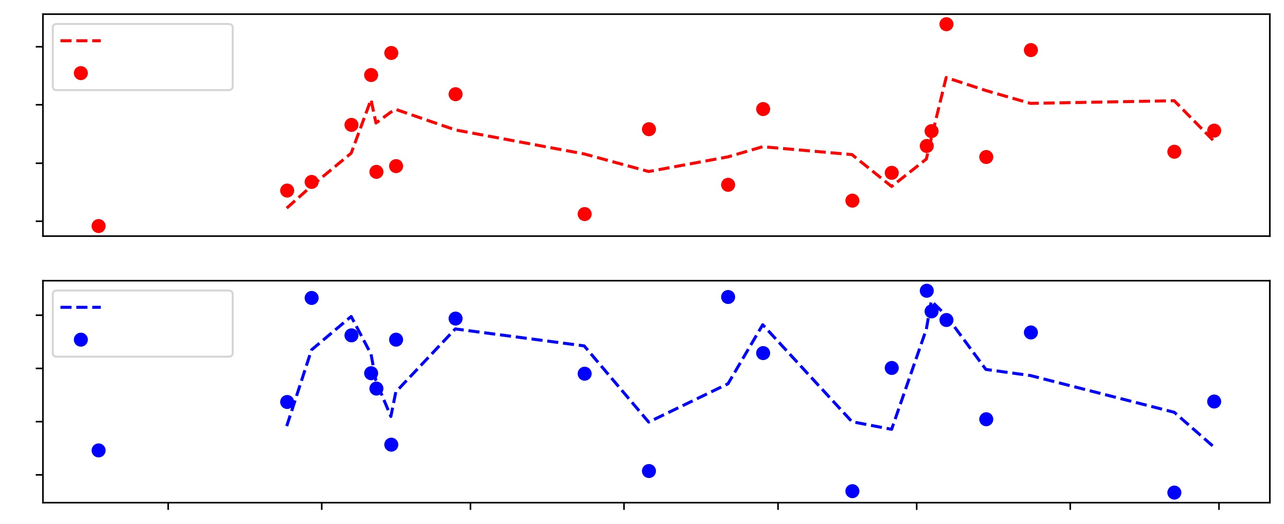
RESULTS – ECOSTRESS ET-PET trends
8
Moving Avg
Observed ET
6
ET (mm)
4
2
8
Moving Avg
6
Observed PET
PET (mm)
4
2
10/2021 11/2021 12/2021 01/2022 02/2022 03/2022 04/2022 05/2022
mm/year
Walnut Site WA-HI-101
Notes:
The mean of observed ET and PET value across the growing season have been plotted. To account for the inconsistency in the data, the moving average of ET and PET across the growing season has been calculated and plotted, making it easier to observe the trends in ET and PET. It can be seen that both ET and PET are highly variable across the season.

Slide 30
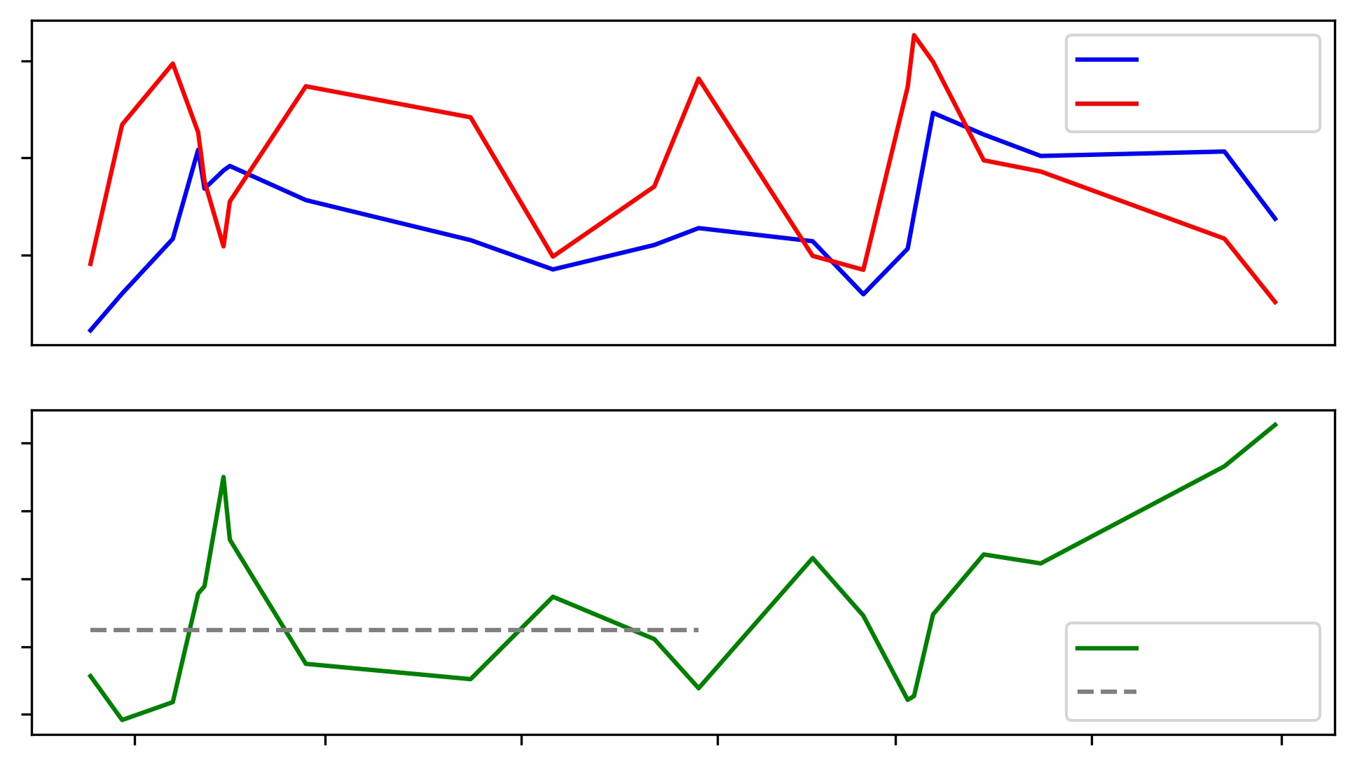
RESULTS – ECOSTRESS Kc trend
8
ET
PET
6
ET (mm)
4
1.50
Kc
1.20
1.00
0.75
Kc
0.50
Dev. Stage Kc
11/2021 12/2021 01/2022 02/2022 03/2022 04/2022 05/2022
mm/year
Walnut Site WA-HI-101 during Growing Cycle 2021–2022
Notes:
Using the ET and PET derived from moving average, the Kc for development stage (~DAP 40 to ~ DAP 140) has been calculated. The development stage for walnuts is very long, and the water requirement during this stage is high. The calculated Kc value for the development stage can be reported for use by our partners. During the development stage, the ET and PET plots show that there is a potential underestimation of crop irrigation requirements when the green line dips below the gray dashes.

Slide 31
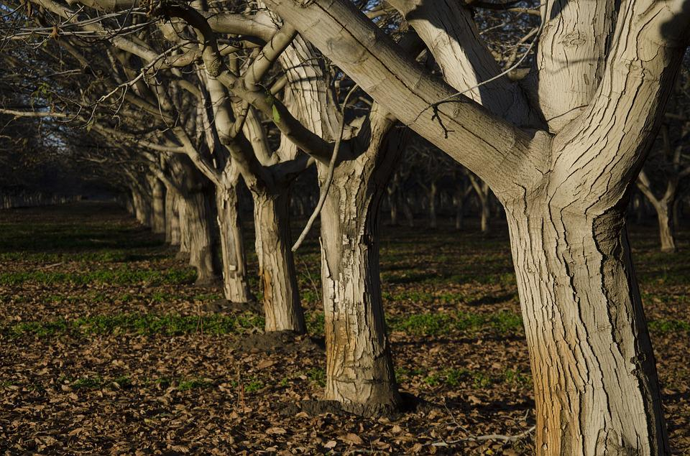
Key FINDINGS from Walnut ECOSTRESS
ET & PET for walnut appeared to be influenced by:
Undergrowth
irrigation patterns
weather conditions
Kc in the development stage of walnut was identified as ~0.80
Image Credit: Sierrasue7 (Pixabay)
Notes:
ET and PET for walnut appeared to be influenced by the floor vegetation, irrigation patterns and weather conditions. Nevertheless, we identified Kc in the development stage of walnut to be around 0.80
Image Credit/Source: Sierrasue on Pixabay via https://pixabay.com/photos/orchard-trees-walnut-nuts-nature-1149536/ (Pixabay License Free for commercial use No attribution required )

Slide 32
ERRORS AND UNCERTAINTIES
Did not account for the effect on NDVI and ET of:
Weather (e.g. trends in temperature, precipitation amount)
Variations in irrigation practices
Resulting changes in undergrowth
Limited NDVI data points available for regression model due to:
Longer revisit period of the Landsat 8
Cloud cover on Earth observations
Crop rotation and mismatch in crop inventory/calendar
Incomplete capture of ET and PET variability from ECOSTRESS due to:
Irregular data acquisition with no fixed revisit period
Notes:
The influence of floor vegetation, weather and irrigation patterns on NDVI and ET has not been accounted. This can lead to an uncertainty in the estimates of Kc for both corn and walnut. Limited data points were available for fitting a regression between NDVI and FAO Kc due to the longer revisit period of the Landsat-8 OLI. Further, some Earth observations were impacted by cloud cover and could not be considered. Similarly, the selected parcels showed NDVI signals for certain seasons that did not align with the phenological information from our partner and had to be disregarded. Irregularity in data acquisition (i.e. no fixed revisit time) from ECOSTRESS does not capture the variability of ET and PET across the growing season of corn and walnut. This hampers our ability to report different Kc values through growth stages.

Slide 33
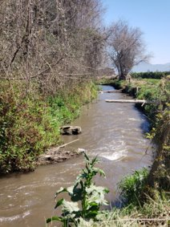
CONCLUSIONS
Leveraged NASA E.O.
Developed & validated a regional Kc model
Through the growing cycle of corn
Estimated typical Kc values
For the development stage of walnut
Captured overall trends and
site-specific signals in vegetation health
Showed the potential to:
Estimate actual crop water requirements
Assess irrigation needs
Inform water management
Image Credit: Felipe Arróspide (CIREN)
Notes:
We leveraged NASA Earth observations and developed regional model of Kc through the growing cycle of corn. We also estimated Kc values for the development stage of walnut. As such, our study captured overall trends and site-specific signals. Overall, this work showed the potential to estimate actual crop water requirements, assess irrigation needs, and inform water management.
Image Credit/Source: Felipe Arróspide (partner CIREN) via email | with partner permission

Slide 34
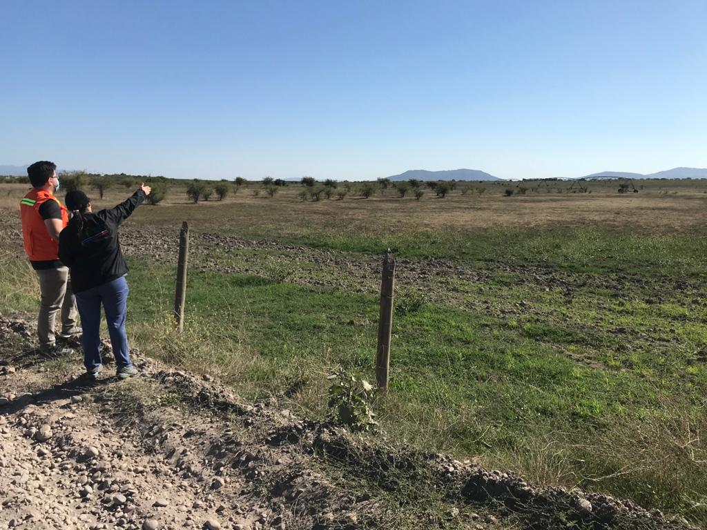
FUTURE WORK
Further data cleaning
Draw additional comparison for PET from MODIS and ECOSTRESS
Incorporate weather data to calculate PET
Expand work to more sites and crop types
Image Credit: Felipe Arróspide CIREN)
Notes:
Further data cleaning could improve our NDVI approach. In addition, more comparisons could be drawn for PET from MODIS and ECOSTRESS. Weather data could also be incorporated to calculate PET. Last, this work could be expanded to account for other sites and crop types.
Image Credit/Source: Felipe Arróspide (partner CIREN) via email | with partner permission

Slide 35
Partners
Centro de Información de Recursos Naturales (CIREN)
Embassy of Chile, Agricultural Office
DEVELOP Science Advisors
Dr. Venkataraman Lakshmi (University of Virginia)
Dr. Kenton Ross (NASA Langley Research Center)
DEVELOP Fellow
Caroline Williams (Pop Up Projects)
Maps throughout this work were created using ArcGIS® software by Esri. ArcGIS® and ArcMap™ are the intellectual property of Esri and are used herein under license. All rights reserved.
Notes:
We would like to acknowledge other contributors to our project: CIREN, Embassy of Chile, Agricultural Office, Dr. Kenton Ross(NASA Langley Research Center), Dr. Venkataraman Lakshmi(University of Virginia), and our DEVELOP Fellow Caroline Williams.

Slide 36
Supplemental Slides

Slide 37
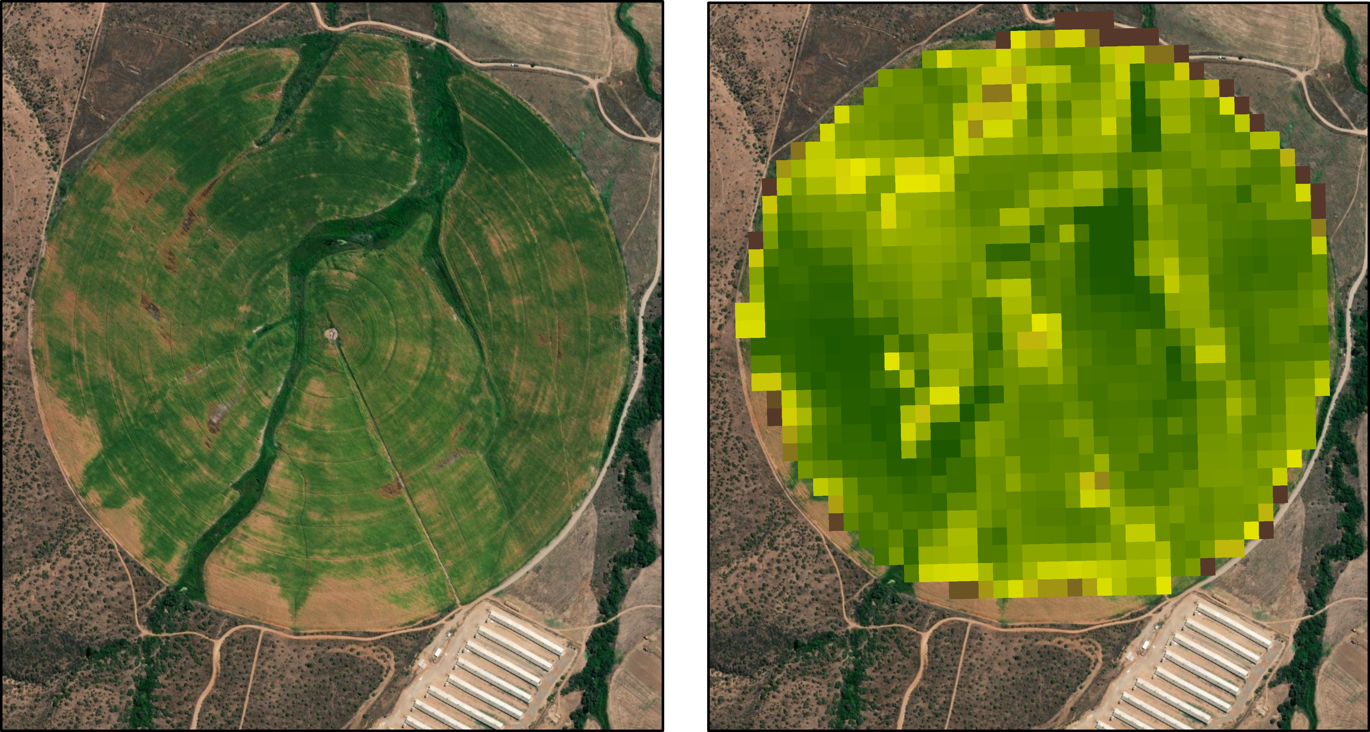
DATA – Corn NDVI
NDVI
0
0.25
0.50
Image & Basemap Credits: Ciren, Esri, Maxar, NASA
Notes:
Large corn circle to demonstrate the concept of using a site specific NDVI. Note: some variation and relatively high resolution.
Citations/Sources: Ciren, Esri, Maxar, NASA (Maxar in this case is a part of the Esri autogenerated basemap credits)

Slide 38
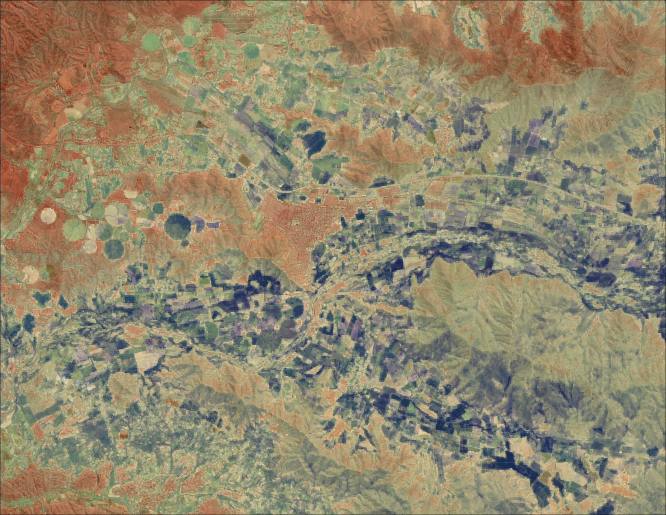
DATA – ECOSTRESS ET
ECOSTRESS
Median ET
9.8
mm/day
2.2
mm/day
0 2.5 5.0 7.5 10.0
Kilometers
Basemap: Ciren, Esri, Maxar, NASA
Notes:
Map of ECOSTRESS median ET Daily on a given day. Note the large ranges between the city/mountains and the fields in terms of ET. The fields have a much higher ET daily value shown in blue, when compared to the ET daily values of the city and mountains.
Citations/Sources: Ciren, Esri, Maxar, NASA (Maxar in this case is a part of the Esri autogenerated basemap credits)

