Slide 1
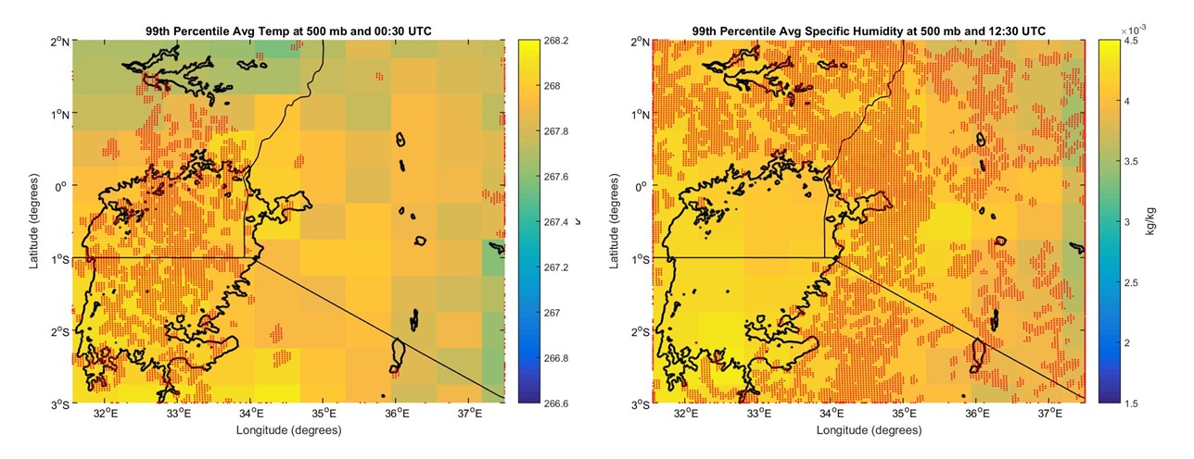
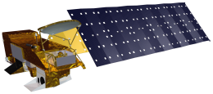
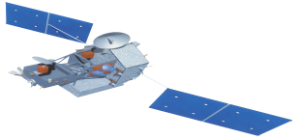
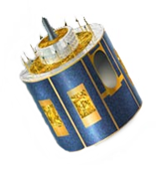
Wise County Clerk of Court’s Office
Weather
Identifying Indicators to Help Predict Deadly Storms over the African Great Lakes
Authors: Annabel White (Project Lead), Jakub Blach, Megan Buzanowicz, Michael Brooke, Rajikishan Rajappan, Kathy Dooley, Ryan Umberger
Plots of Lake Victoria and the surrounding region showing 30 day 500 mb average temperature at 00:30 UTC (left) and specific humidity at 12:30 UTC (right) for days experiencing severe storms. Overshooting top data shows that the storms mainly occur over Lake Victoria at night and over the land surrounding the lake during the day. As indicated by the figure on the right, high amounts of specific humidity provide fuel for severe storms to occur.
Concern
Severe storms develop suddenly over the African Great Lakes, creating dangerous conditions for residents. As there is no effective early warning system, which is partly due to an incomplete understanding of which climatic variables produce inclement weather in this region, thousands of residents die each year.
This study was conducted to provide the Kenyan Meteorological Department with information regarding what composition of climatic variables precede the formation of overshooting tops, which we use as an indicator for severe storms.
Case Study
To identify potential storm indicators in the Lake Victoria region, 30 days of average weather were compared to 30 days of severe storm weather. Severe storms typically occur over land during the day and over Lake Victoria at night. Maps of the region showing meteorological conditions, derived from the Modern-Era Retrospective Analysis for Research and Applications (MERRA), at day and at night were produced for the 30 days of average weather and 30 days of severe storm weather.
Also, Skew-T/Log-P plots typically represented what is expected to be seen in cases of severe weather during the day. At night, key common meteorological factors that typically indicate severe weather were absent, indicating that atypical factors produce and drive the storms over the lake.
Decision Support
This project created multiple maps of meteorological parameters over the Lake Victoria region. These parameters are commonly assessed when forecasting severe storms. Furthermore, plots from AIRS indicated that atypical factors drive the storms that occur over the lake at night. This information will aid the Kenya Meteorological Department in furthering their understanding of weather over the African Great Lakes.
DEVELOP Location
Wise County Clerk of Court’s Office – Wise, Virginia
Earth Observations
Aqua – AIRS
Meteosat - SEVIRI
TRMM – LIS
MERRA
Partners
Kenya Meteorological Department
Advisors
Dr. Kenton Ross [NASA Langley Research Center], Kristopher Bedka [NASA Langley Research Center], Dr. DeWayne Cecil [NOAA - NCEI, Ashville],
Robert VanGundy [The University of Virginia’s College at Wise]

