Slide 1
Bolsa Chica Ecological Forecasting
Analyzing the Success of the Bolsa Chica Wetland Restoration Using Multi-spectral NASA Earth Observations
Christine Elowitt (Project Lead)
Steven Kerns
Nick Rousseau

Slide 2
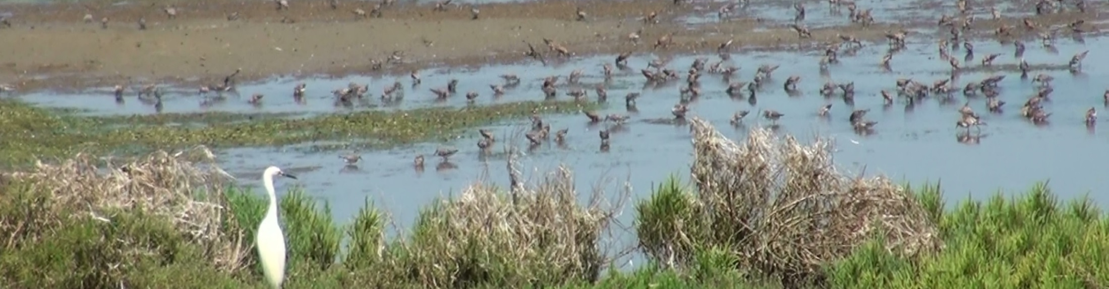
Introduction
During the last two centuries, the contiguous United States has lost over half of its wetland habitats.
California leads the nation in this historic loss of wetlands, sustaining as much as 91% of environmental degradation.
Southern California and the San Franscisco Bay area lead the state in percentage of wetlands habitat lost.
Credit: Nick Rousseau
Notes:
During the last two centuries, the contiguous United States has lost over half of its wetland habitats; averaging a rate of 60 acres lost per hour (Dahl 1990). California leads the nation in this historic loss of wetlands, sustaining as much as 91% of environmental degradation and human–induced changes to wetland habitats (Zedler 1996). The San Francisco Bay and the southern regions of the state are home to the most significant losses in wetland habitats (Larson 2001, Goodwin et al. 2001).

Slide 3
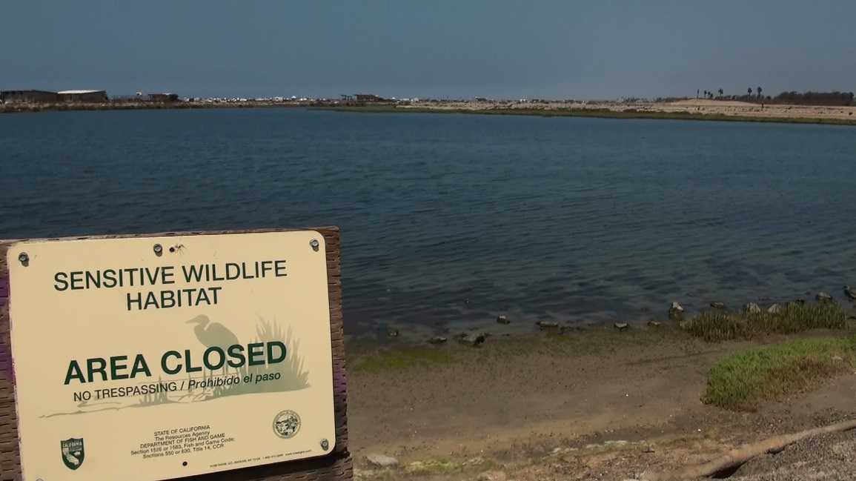
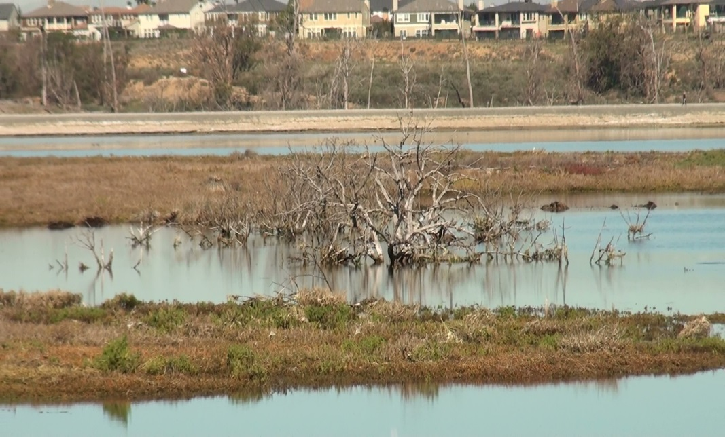
Introduction
The Bolsa Chica Wetlands provide critical habitat for migratory and endangered avifauna.
Given the dramatic drop in avifauna population, wetlands such as Bolsa Chica serve an increasingly important role in the sustainment of migratory bird populations along the Pacific Flyway.
Formerly the site of an oil drilling operation, the wetlands at Bolsa Chica were acquired by the state of California in 1997 and is now managed by the California Department of Fish and Wildlife.
Credit: Nick Rousseau
Notes:
Migratory birds traveling along the Pacific Flyway were once estimated to be 60 million in number but now oscillate between 2-4 million waterfowl and 1-2 million shorebirds (Bryant 2003, Larson 2001). Given the dramatic drop in avifauna population, wetlands such as Bolsa Chica serve an increasingly important role in the sustainment of migratory bird populations along the Pacific Flyway.

Slide 4
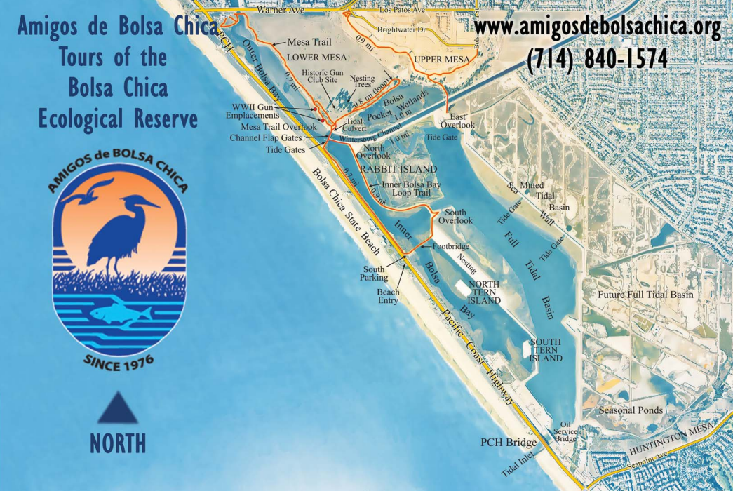
Introduction
Since the state acquired the site, there has been an effort to restore native vegetation and tidal flows.
Amigos de Bolsa Chica
Non-profit volunteer
advocacy group
Started in 1976 - 40 years of conservation efforts pre-dating the state’s acquisition of the site
One of two non-profit groups affiliated with the site that give input and feedback to the state
Amigos prioritize community involvement and education through activism and advocacy
Notes:
In an effort to mitigate wetland loss in the Bolsa Chica Ecological Reserve, several conservation and restoration projects have been created. The wetlands of Bolsa Chica is an endangered ecoregion in Southern California that has been steadily increasing in size and provides a large number of ecosystem services (Noss 1995).
Efforts in management and maintenance practices of the wetlands have achieved vast improvements since the efforts began in 1976, however, no attempt has been made to develop a qualitative assessment of the extent of restoration efforts or whether the restoration has been truly successful
This project is of interest to the Amigos as it allows them to better inform the public on the wetland’s restoration success, as well as, expand their citizen scientist education program. The Amigos will decide how to best implement our end products into their education programs and public outreach campaigns. Findings will be shared with the CA Department of Fish and Wildlife, the management organization responsible for the Bolsa Chica Ecological Reserve. The Amigos will directly benefit from being provided with NASA remote sensing data, enabling them to better understand, share, and protect the Bolsa Chica Ecological Reserve.

Slide 5
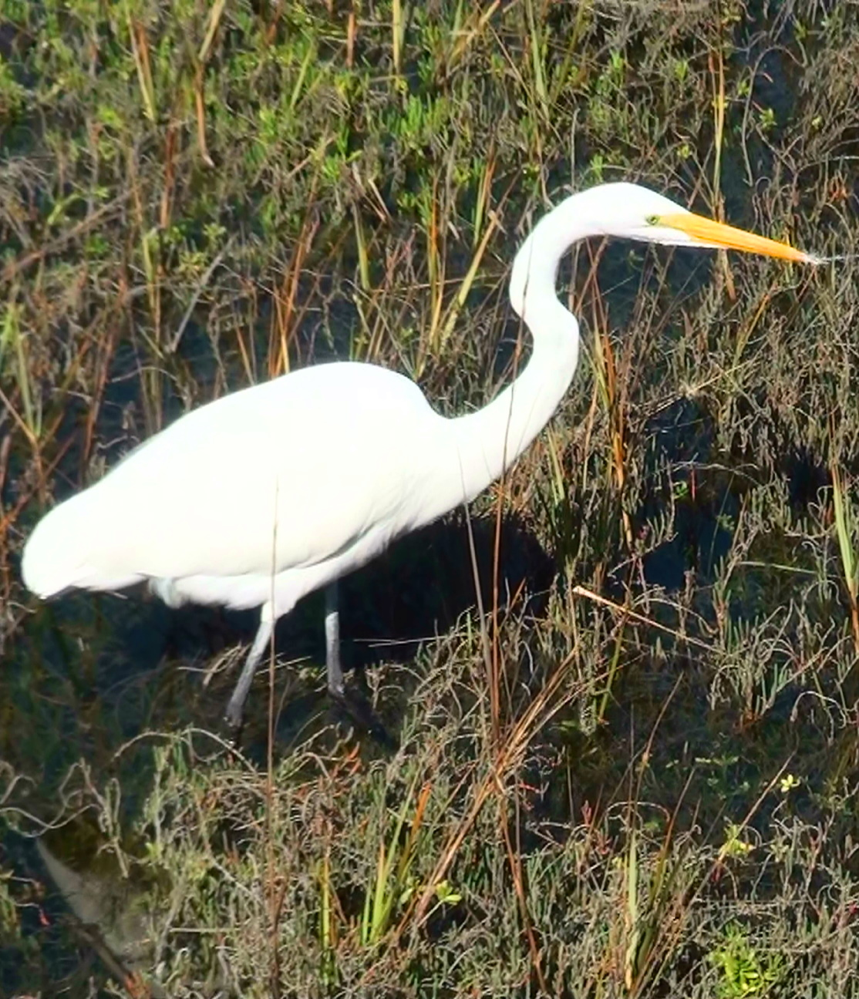
Objectives
Create a time-series analysis to demonstrate Bolsa Chica wetland restoration success from 1984-2015.
Determine the location of different vegetation types and water extent throughout the site using NASA remote sensing technologies.
Expand the Amigos de Bolsa Chica’s education and outreach program by creating an interactive online map resource for the public using project outputs and satellite images.
Credit: Nick Rousseau

Slide 6
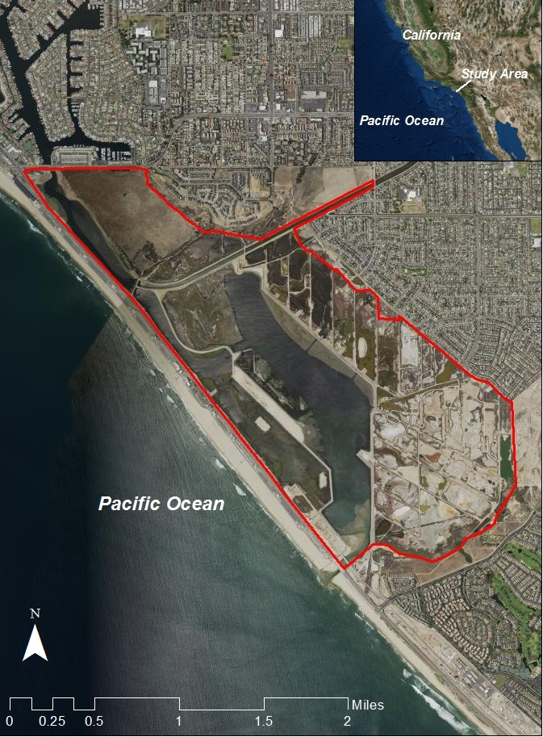
Study Period
and Area
Location:
Bolsa Chica Ecological Reserve
Huntington Beach, CA
Study Period: 1985-2015

Slide 7
Community Concerns
The impacts on the wetlands of past human and oil extraction activities
Providing habitat for endangered species and other wildlife
Gauging the success of restoration
Demonstrating that the use of tax dollars has been valuable in the restoration efforts to date
Notes:
This needs a background picture

Slide 8
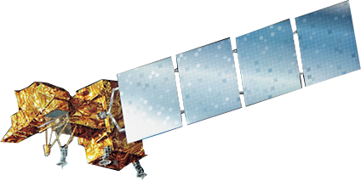


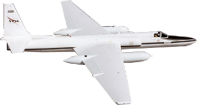
NASA Sensors
Landsat 7 ETM+
Landsat 8 OLI
Landsat 5 TM
ER-2 AVIRIS

Slide 9
Project Methodology
Acquire Analyze Produce
AVIRIS Imagery (2014 and 2015)
Classify land cover types (ENVI)
Detailed Current Land Cover Map
Landsat Imagery (1984, 2002, and 2015)
Calculate NDVI and WRI indices (ArcGIS)
Time Series Maps
(changes in water extent and vegetation)
Pan-sharpen (ArcGIS)
NAIP Imagery (2005 and 2014)
Create vegetation and water extent vector layers (ArcGIS)
NOAA Coastal Change Analysis (1996 to 2010)
Interactive Web Map

Slide 10
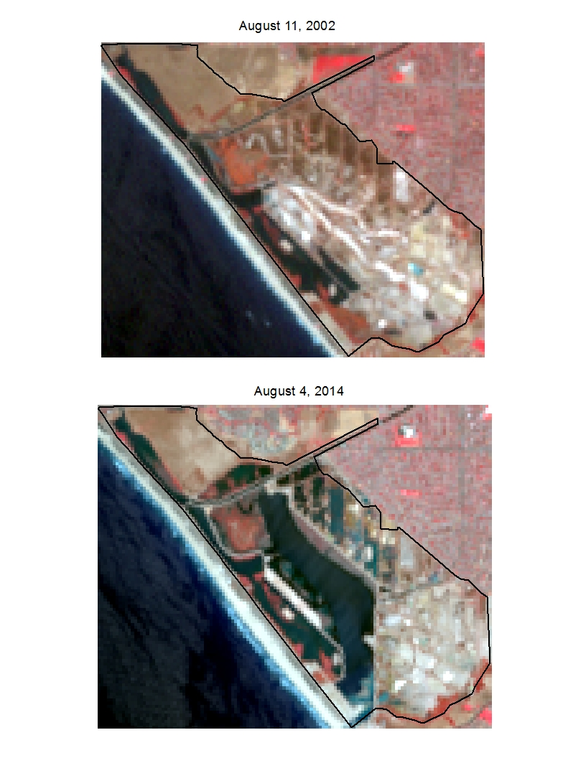
Project Methodology

Slide 11
Project Methodology
Acquire Analyze Produce
AVIRIS Imagery (2014 and 2015)
Classify land cover types (ENVI)
Detailed Current Land Cover Map
Landsat Imagery (1984, 2002, and 2015)
Calculate NDVI and WRI indices (ArcGIS)
Time Series Maps
(changes in water extent and vegetation)
Pan-sharpen (ArcGIS)
NAIP Imagery (2005 and 2014)
Create vegetation and water extent vector layers (ArcGIS)
NOAA Coastal Change Analysis (1996 to 2010)
Interactive Web Map

Slide 12
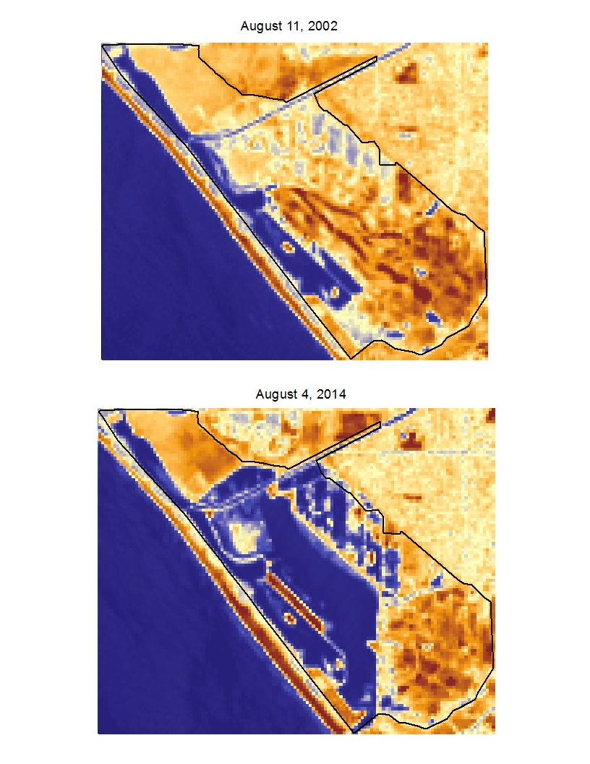
Project Methodology

Slide 13
Project Methodology
Acquire Analyze Produce
AVIRIS Imagery (2014 and 2015)
Classify land cover types (ENVI)
Detailed Current Land Cover Map
Landsat Imagery (1984, 2002, and 2015)
Calculate NDVI and WRI indices (ArcGIS)
Time Series Maps
(changes in water extent and vegetation)
Pan-sharpen (ArcGIS)
NAIP Imagery (2005 and 2014)
Create vegetation and water extent vector layers (ArcGIS)
NOAA Coastal Change Analysis (1996 to 2010)
Interactive Web Map

Slide 14
Results
TBD

Slide 15
Errors and uncertainties
TBD

Slide 16
Conclusion
TBD

Slide 17
Advisor
Cedric Fichot, NASA Jet Propulsion Laboratory
Partners
Joana Tavares-Reager, Vic Leipzig, Jerry Donohue, Amigos de Bolsa Chica
Others
Benjamin Holt, NASA Jet Propulsion Laboratory
Bruce Chapman, NASA Jet Propulsion Laboratory
David Thompson, NASA Jet Propulsion Laboratory

Slide 18
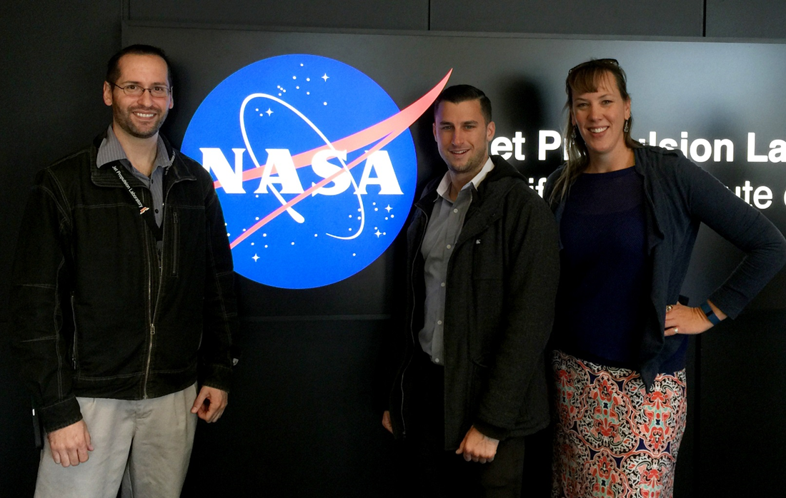
Questions?
Bolsa Chica Ecological Forecasting Team, Spring 2016
From left to right: Nick Rousseau, Steven Kerns, Christine Elowitt

