Slide 1
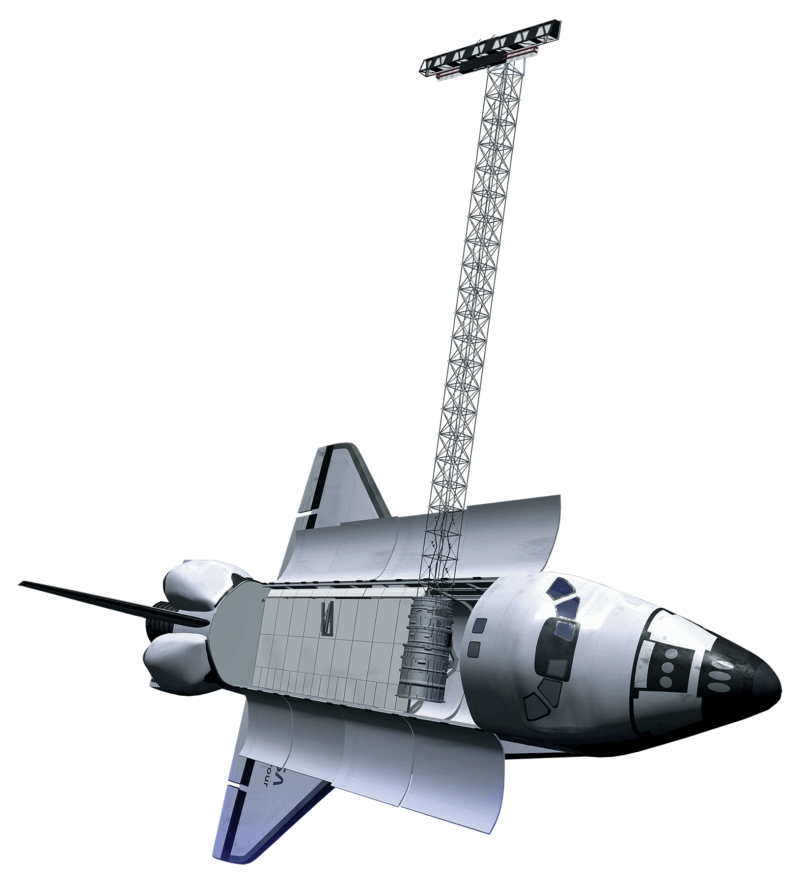


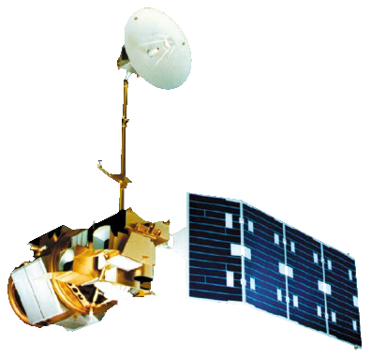
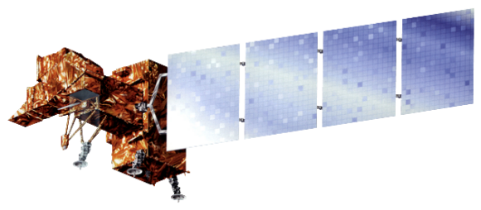

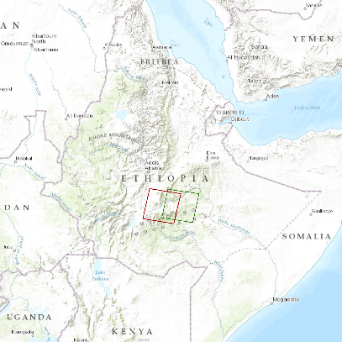


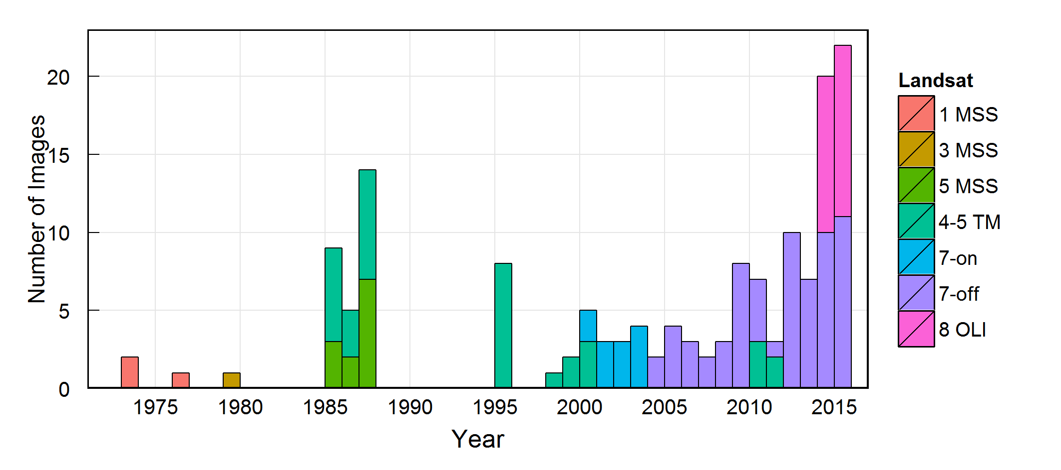
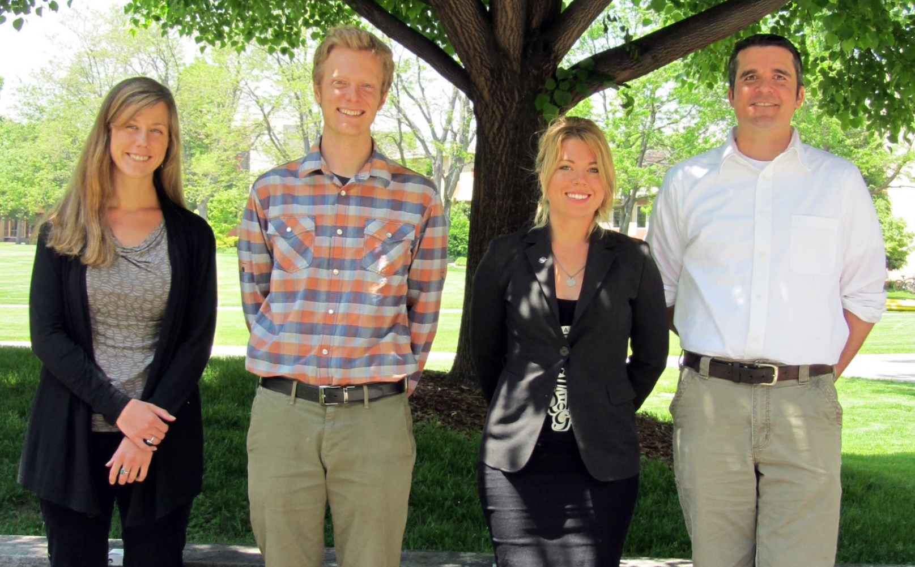
Ethiopia Ecological Forecasting
Mapping four decades of fire history for targeted conservation in the south-central highlands of Ethiopia
Stephen Chignell, Chandra Fowler, Kelly Hopping, Darin Schulte
NASA DEVELOP National Program
Abstract (text included for spacing pusposes)
The Bale-Arsi massif of south-central Ethiopia comprises one of the largest and least studied mountain systems in Africa. An internationally recognized biodiversity hotspot, the region is home to Bale Mountains National Park and the Sanetti Plateau, which provide critical alpine habitat for numerous endemic and endangered species such as the Mountain Nyala. Ethiopian agro-pastoralists in the region practice intentional burning to clear land for grazing and planting; however, pressures related to climate change and increasing populations have made understanding the frequency and extent of burning a top data need for conservationists and park managers seeking to balance conservation goals with the needs of local communities. We quantified historical fire occurrence and extent in the unique, high-altitude Ericaceous shrublands of Bale, using 42 years (1973-2015) of Landsat data. Multispectral images were spatially and spectrally linked within the LandsatLinkr R package, masked for clouds using a 30m Shuttle Radar Topography Mission digital elevation model, and subsequently analyzed using the LandTrendr disturbance algorithm. The resulting fire extents we revalidated using the Moderate Resolution Imaging Spectroradiometer Burned Area product, as well as ancillary field records compiled from the literature. Maps and spatial data of fire date and extent were disseminated to project partners working in Bale. These will enable targeted conservation efforts in the park, and inform management approaches that ensure the preservation of the region's natural resources and the social-ecological systems they support.
.
Objectives
Study Area
Earth Observations
Quantify fire extent and distribution on the Bale-Arsi massif over a 42 year time period
Provide the most current and complete record of fires to land managers in the region
Compare spatial and temporal patterns of burning to observed land changes
Demonstrate a novel and reproducible methodology for application in Ethiopia and around the globe
Shuttle Radar Topography Mission (SRTM)
Terra - Moderate Resolution Imaging Spectroradiometer (MODIS)
Aqua - Moderate Resolution Imaging Spectroradiometer (MODIS)
Bale Mountains National Park
Landsat 1,3,4,5 – Multispectral Scanner (MSS), Thematic Mapper (TM)
Landsat 7 ETM+
Landsat 8 - Operational Land Imager (OLI)
WRS1 Path180 Row 55
WRS2 Path 167 Row 55
High
Low
Map projection: WGS84 UTM Zone 37N. Elevation data source: SRTM 1-arc second global. Locater data source: Esri base maps
Elevation
Methodology
Results
Data Processing
LandsatLinkr
Aggregation & Sampling
Calibration
Data Acquisition
MSS, TM, ETM+
SRTM 30m
MODIS Burn Area
OLI
Analysis
LandTrendr
NBR
Results
Historical Disturbance, Magnitude & Year
Validation
Recent
Disturbances
(Left) Will insert description of flowchart in final draft.
Coming Soon!
(Left): Summary of Landsat scenes and sensors acquired over the study period.
Conclusions
Team Members
Project Partners
Coming Soon!.
The Murulle Foundation
Natural Resource Ecology Laboratory at Colorado State University
Acknowledgements
We would like to thank Dr. Paul Evangelista and Nicholas Young (Natural Resource Ecology Laboratory, Colorado State University) for their guidance and support throughout this project. Special thanks to Justin Braaten (Oregon State University) and Brian Woodward (DEVELOP) for their considerable support with LandsatLinkr and LandTrendr.processing.
Team members (Left to Right): Kelly Hopping, Stephen Chignell, Chandra Fowler, Darin Schulte
USGS at Colorado State University

