Slide 1
Thailand Agriculture
Monitoring Food Crop Health and Stress Due to Changing Climate for Enriched Agricultural Land Management
Tim Klug (Project Lead)
Arom Boekfah
Chayanit Choonwattana
Komsan Rattanakijsuntorn
Watanyoo Suksa-ngiam
Atipat Wattanuntachai

Slide 2
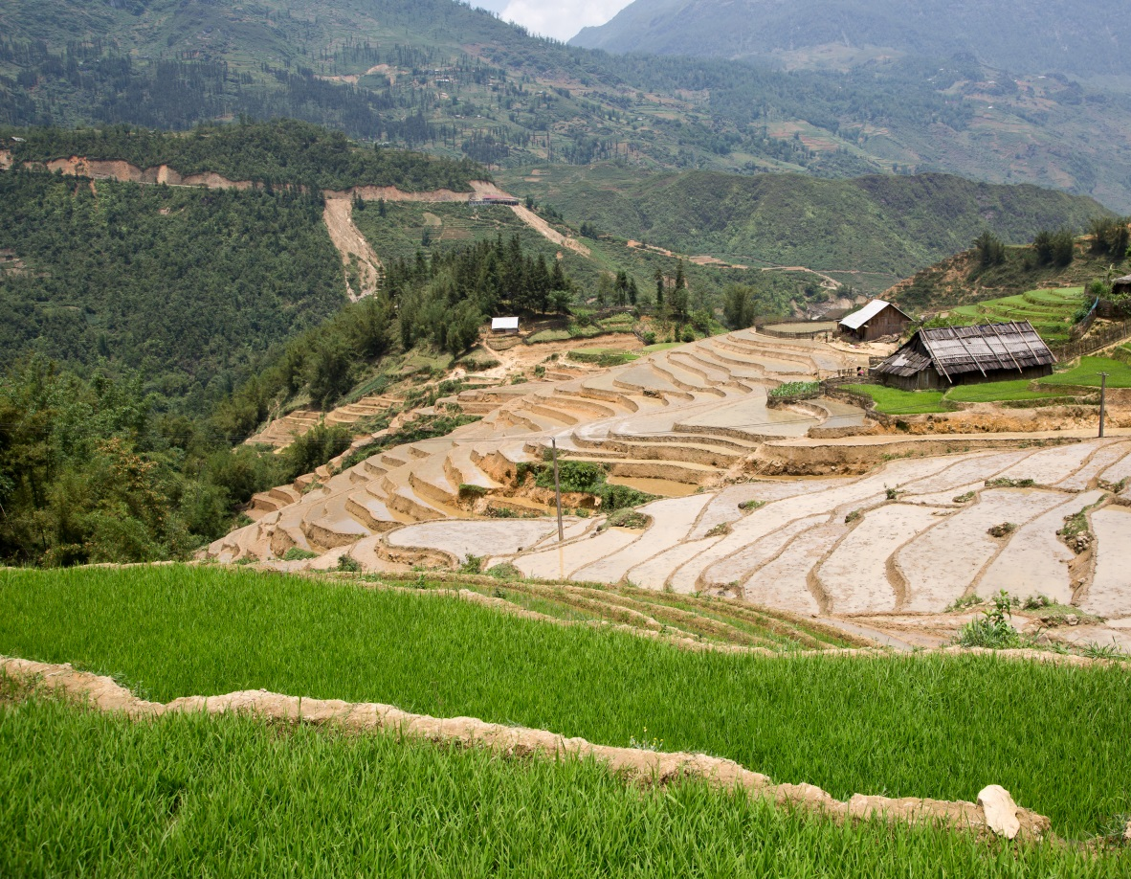

Background
Thailand is one of the world’s largest exporters of rice.
Unlike other areas in Thailand, the majority of the northeastern region’s crops are rain-fed.
Source: Y Nakanishi
Notes:
Corner rice plant logo designed by DEVELOP participant Komsan Rattanakijsuntorn at NASA MSFC

Slide 3
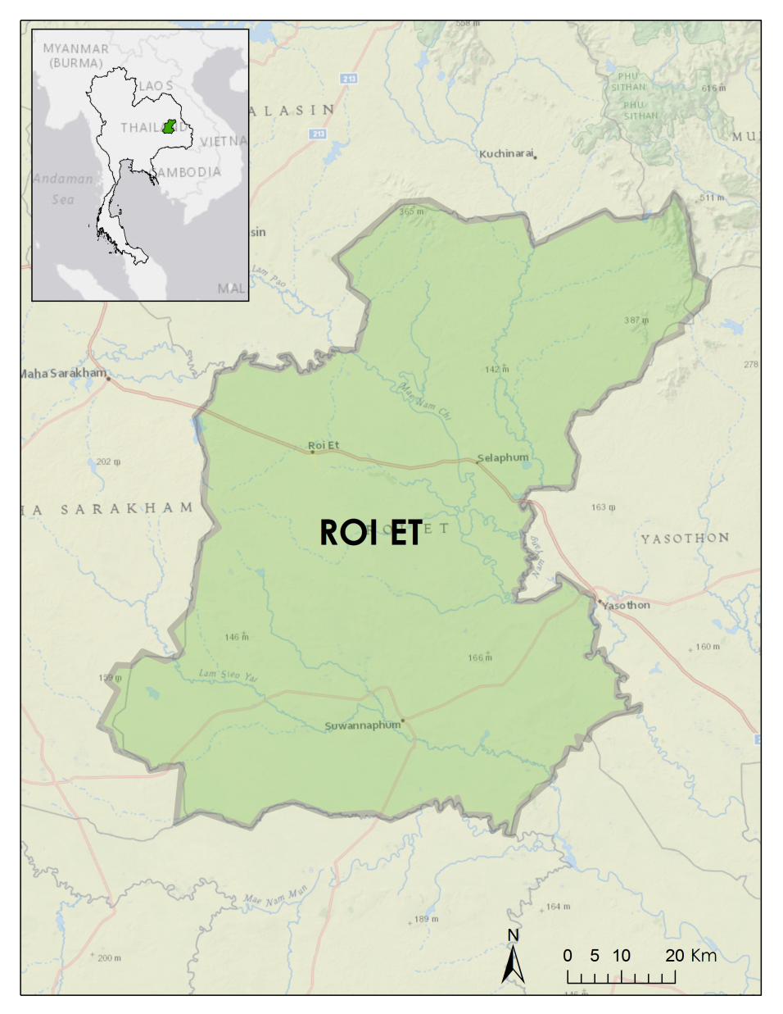
Study Area
The province of Roi Et is located in the northeastern region of Thailand.
Roi Et is known for producing large quantities of Jasmine rice.
Notes:
Roi Et is located on a plateau in northeastern Thailand. Because the rice paddies in this region are primarily rain-fed, rice crops are only grown in this region during the wet seasons. Jasmine rice is a premium product in this region and plays a large role in the Thai economy.

Slide 4
Community Concerns
Agriculture plays a large role in the economy of Thailand.
Because the rice fields in Roi Et are primarily rain-fed, rice is only grown during the wet season.
These crops’ dependence on rain leaves the region vulnerable to climate change.

Slide 5
Objectives
To monitor agricultural lands under the change of environmental variables
To improve the understanding of agricultural lands under changing climate patterns

Slide 6
Project Partners
Royal Thai Embassy
SERVIR Mekong

Slide 7

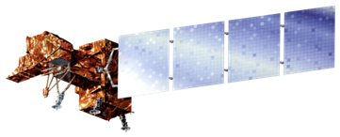


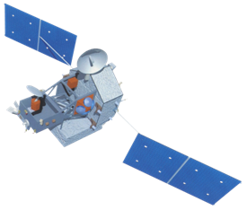
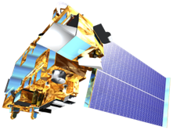


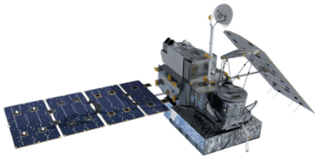
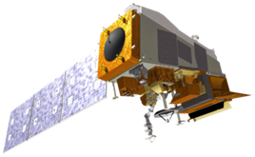



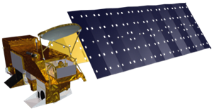


NASA Earth Observations
Landsat 5, 7, 8: Land cover classifications, vegetation indices, and land surface temperature
Terra/Aqua MODIS: land surface temperature
Suomi NPP VIIRS: land surface temperature and vegetation indices
TRMM and GPM: precipitation

Slide 8
Methodology
[TBD]

Slide 9
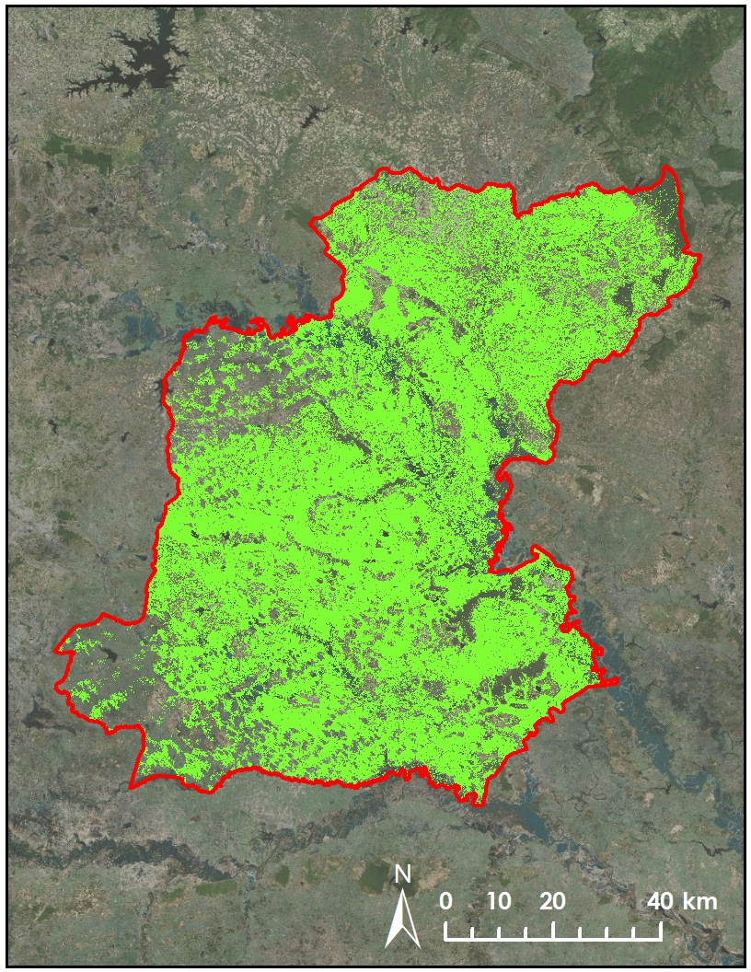
Land Cover Classification (LCC)
Supervised LCC was used to estimate possible area of rice fields

Slide 10
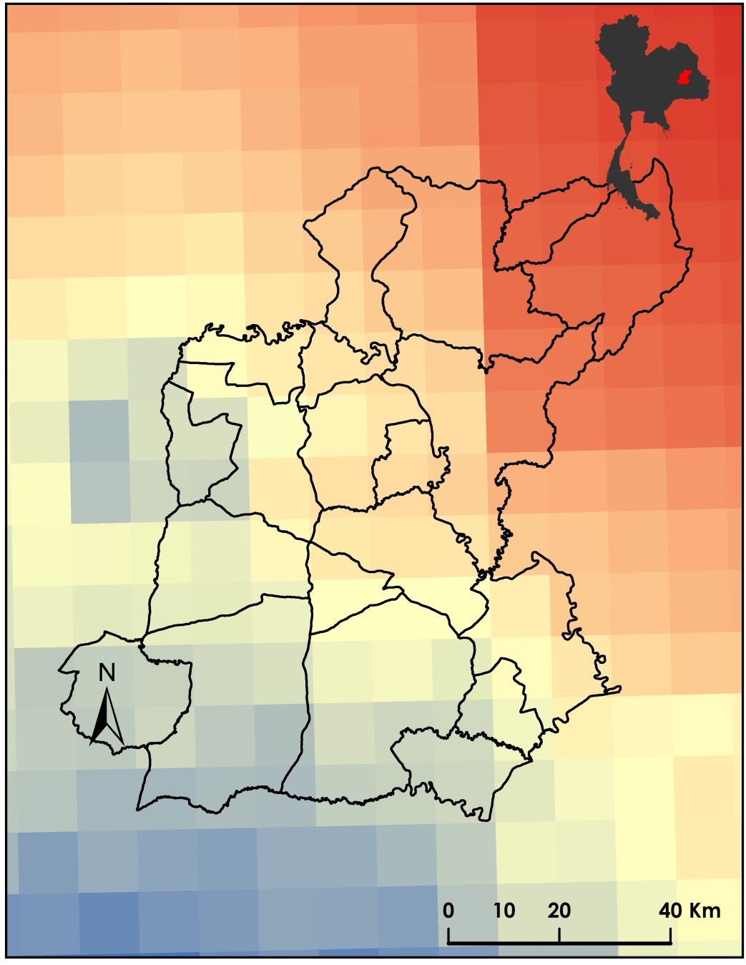
Precipitation Data
Monthly precipitation data was processed from TRMM and GPM.
Units were returned in mm/hour at 11km resolution for GPM imagery.

Slide 11
Land surface temperature data
[TBD]

Slide 12
Models used
[TBD]

Slide 13
Errors and Uncertainty
[TBD]

Slide 14
Conclusions
[TBD]

Slide 15
Advisors
Dr. Jeffrey Luvall (NASA at National Space Science and Technology Center)
Dr. Robert Griffin (University of Alabama in Huntsville)
Partners
Gam Raksaphaeng (Royal Thai Embassy)
Bill Crosson (SERVIR Mekong)
Peter Cutter (SERVIR Mekong)

Slide 16
Questions?

