Slide 1
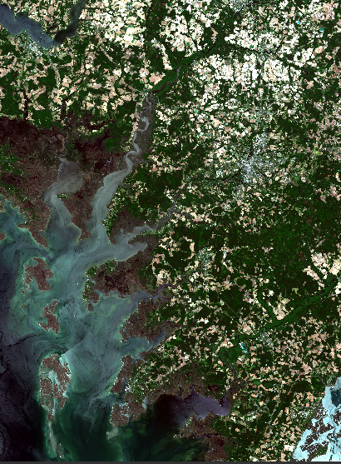
CHESAPEAKE BAY ECOLOGICAL FORECASTING
Utilizing NASA Earth Observations to Monitor Marsh Health in the Chesapeake Bay to Support the Maryland Department of Natural Resources Coastal Resiliency Assessment
Victor Lenske
Sean McCartney
John Fitz
Helen Plattner
Sara Lubkin, PhD
NASA Goddard Space Flight Center
2017 Summer
Notes:
Victor: Good morning everyone, thank you for joining us today. My name is Victor Lenske and I am the Project Lead for the Chesapeake Bay Ecological Forecasting Team.
John: Hi everybody I’m John Fitz.
Sara: I’m Sara Lubkin.
Helen:– And I’m Helen Plattner. Our project utilized NASA Earth observations to evaluate and forecast marsh health on Maryland’s Chesapeake Bay.

Slide 2
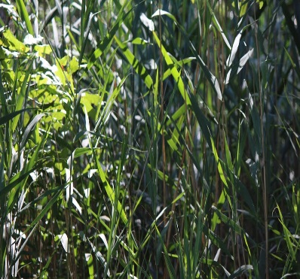
Maryland Marshes
Wetland ecosystem
Low lying land that is flooded some or all of the time
Dominated by grasses and other herbaceous plants
Image Credit: U. S. Fish and Wildlife Service
Insets - Helen Plattner, NASA DEVELOP
Notes:
Helen: Tidal wetlands, such as marshes and swamps, are among the Chesapeake Bay’s most important natural features. Not only do wetlands provide vital ecological services such as breeding grounds and water purification, but wetlands also deliver direct benefits to coastal communities through water absorption, wave attenuation, and sediment stabilization. Marshes differ from swamps because they are dominated by grasses, reeds and herbaceous plants, whereas swamps are primarily dominated by trees.
Image Credits: U. S. Fish and Wildlife Service - Northeast Region [CC BY 2.0 (http://creativecommons.org/licenses/by/2.0) or Public domain], via Wikimedia Commons
Helen Plattner, NASA DEVELOP

Slide 3
Maryland Marshes
Fish and wildlife habitat
Shoreline stabilization
Flood Protection
Nutrient Recycling
Carbon sequestration
Groundwater recharge and stream flow maintenance
Recreational Activities
Image Credit: The Nature Conservancy
Notes:
Helen: Marsh plants stabilize shorelines, increasing flood protection for coastal communities. They also filter and recycle excess nutrients from their surroundings, providing natural and efficient water purification systems while simultaneously sequestering carbon from the environment. Healthy marshes support groundwater recharge and stream flow maintenance along with offering many excellent recreational opportunities for people of all ages to enjoy. (click)
Image Credit: U. S. Fish and Wildlife Service - Northeast Region [CC BY 2.0 (http://creativecommons.org/licenses/by/2.0) or Public domain], via Wikimedia Commons
Helen Plattner, NASA DEVELOP

Slide 4
Community Concerns
Population density in vulnerable coastal communities is growing rapidly
Healthy wetlands offer protection from coastal erosion, coastal flooding and severe storms
Protecting and restoring wetlands promotes clean water, healthy habitats and a restored Chesapeake Bay
Image Credit: U.S. Navy
Notes:
Helen: Marshes also offer protection to coastal communities.
More than two-thirds of Maryland’s population lives in coastal communities. Between 1980 and 2016, more than 41 billion dollars was spent on flooding and other natural disasters affecting Maryland’s coasts. The frequency of these events are expected to increase. Yet, Maryland’s coastal population also continues to increase annually, expanding the need to protect vulnerable coastal populations. Wetlands are an important first line of defense for these communities.
This is an image of a flooded parking lot at the US Naval Academy in Annapolis, MD after Hurricane Isabel in 2003. As you can see, severe storms can be extreme and destructive, which is why it is imperative that we support natural methods of damage mitigation.
Image Source: https://commons.wikimedia.org/wiki/File:US_Navy_030919-O-0000X-004_Flood_and_wind_damage_from_hurricane_Isabel_aboard_U.S._Naval_Academy.jpg

Slide 5
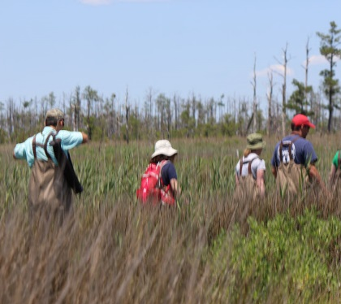
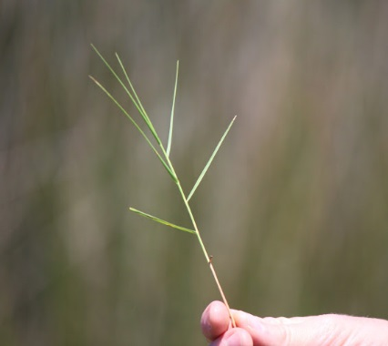
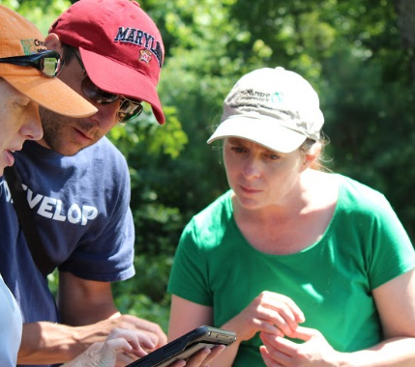
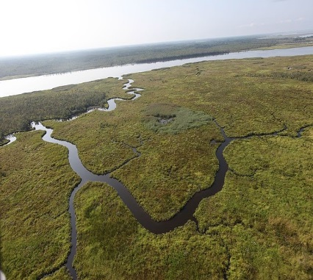
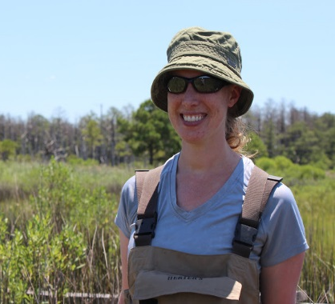
Partner Organizations
Maryland Department of Natural Resources (MD DNR)
The Nature Conservancy (TNC)
Maryland Coastal Resiliency Assessment
Image Credit: Helen Plattner, NASA DEVELOP
Notes:
Helen: We partnered with (click) the Maryland Department of Natural Resources and (click) The Nature Conservancy to support their recently completed (click) Coastal Resiliency Assessment.
Image Credit: Helen Plattner, NASA DEVELOP

Slide 6
Maryland Coastal Resiliency Assessment
Purpose: To identify the areas where natural habitats provide the greatest potential risk reduction for shoreline communities
Image Credit: Helen Plattner, NASA DEVELOP
Notes:
Sara: The Coastal Resiliency Assessment identifies where natural habitats provide the greatest potential risk reduction for coastal communities. The assessment included calculation of indices for shoreline hazards, an estimation of the relative exposure to coastal hazards in Maryland, and identified coastal community flood risk regions and priority shoreline areas. (click)
Image Credit: Helen Plattner, NASA DEVELOP

Slide 7
Marsh Protection Potential Index (MPPI)
Five Criteria
Ability of marsh to reduce coastal hazards
Proximity of marsh to areas threatened by coastal hazards
Human population protected by the marsh
Proximity of marsh to other protective habitats
The likelihood that the marsh will persist in the face of rising sea levels
Image Credit: The Nature Conservancy
Notes:
Sara: The assessment also included the development of The Marsh Protection Potential Index (MPPI) which ranks Maryland’s coastal marshes by their ability to protect vulnerable communities from coastal hazards based on five criteria: 1. The ability of the marsh to reduce the impact of coastal hazards; 2. The proximity of the marsh to areas threatened by coastal hazards; 3. Human population protected by the marsh; 4. The proximity of the marsh located to other protective habitats; 5. And the likelihood that the marsh will persist in the face of rising sea levels. (click)
Image Credit: The Nature Conservancy

Slide 8
Marsh Protection Potential Index (MPPI)
Marsh health?
Notes:
Sara: What the Marsh Protection Potential Index did not consider was the health of Maryland’s marshes. The Index assumed that the marshes are healthy and working at optimal capacity. But, are all the marshes healthy? Our study sought to address this question.

Slide 9
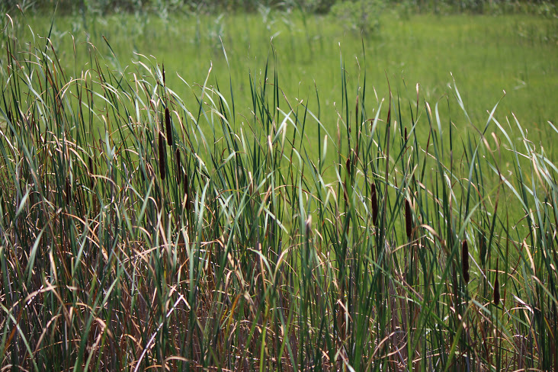
Healthy
Unhealthy
Image Credit: Helen Plattner, NASA DEVELOP
Notes:
Sara: Healthy marshes are characterized by areas of contiguous dense vegetation with little to no areas of continuously standing water.
Whereas unhealthy marshes consist of vast areas of continuously standing water, which limit nutrient uptake by plants and, in turn, create more areas of standing water. If ponding such as this persists for a long enough period of time, the entire marsh eventually becomes degraded and, in turn, unable to provide the important ecological services that healthy marshes provide. (click)
Image Credit: Helen Plattner, NASA DEVELOP

Slide 10
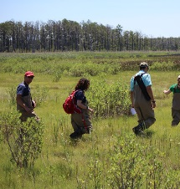
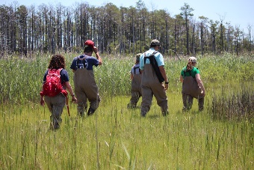
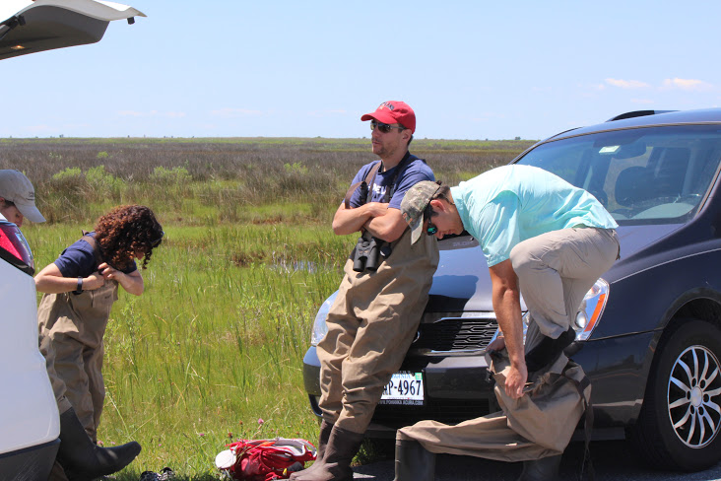
Study Area
78,500 hectares of coastal marshes identified by the MD DNR’s Coastal Resiliency Assessment
Image Credit: Helen Plattner, NASA DEVELOP
Notes:
John: Our study area included 78,500 hectares of coastal marshes within the Chesapeake Bay that were identified by the Maryland DNR’s Coastal Resiliency Assessment. Baltimore City and Maryland’s 16 counties surrounding the Chesapeake Bay are shown in green with the marsh areas of our study area highlighted.
Image Credit: Helen Plattner, NASA DEVELOP

Slide 11
Objectives
Analyze trends in marsh health (1984 to 2017)
Measure current marsh extent and health(2015 to 2017)
Forecast marsh health (2017 to 2030)
Image Credit: The Nature Conservancy
Notes:
John:
We sought to analyze trends in marsh health using NASA Earth observations for the period of 1984 to the present.
We then evaluated recent and current marsh health using spectral indices derived from Sentinel-2 data.
And lastly, we sought to forecast marsh health within the study region to the year 2030.
Image Credit: The Nature Conservancy

Slide 12
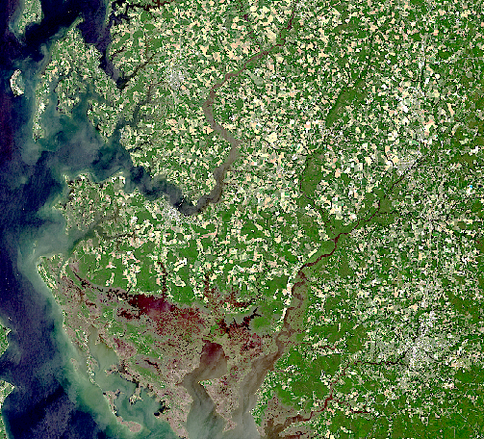
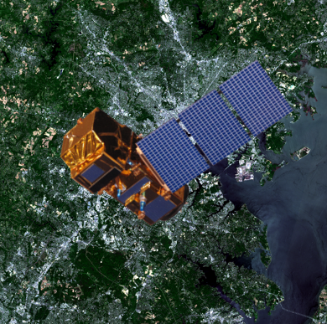
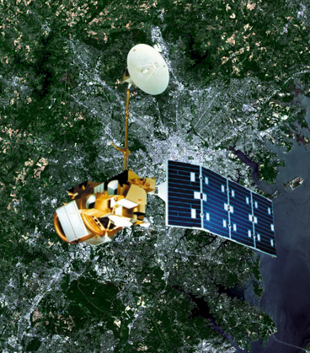
Earth Observations
Landsat 8
(2013 – Present)
Landsat 5
(1984 – 2013)
Sentinel – 2
(2015-Present)
Notes:
John: In order to accomplish our objectives, we utilized imagery collected from Sentinel-2, Landsat 5, and Landsat 8. Due to its 10-meter resolution, we utilized Sentinel-2 imagery to create a current day map of marsh extent and health.
In order to analyze trends in marsh health, we utilized NASA Earth observations collected from Landsat 5 and Landsat 8. Imagery from these satellites was also used to forecast future marsh health.

Slide 13
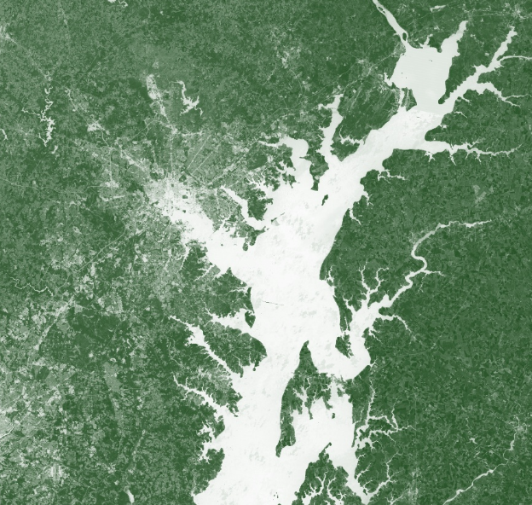
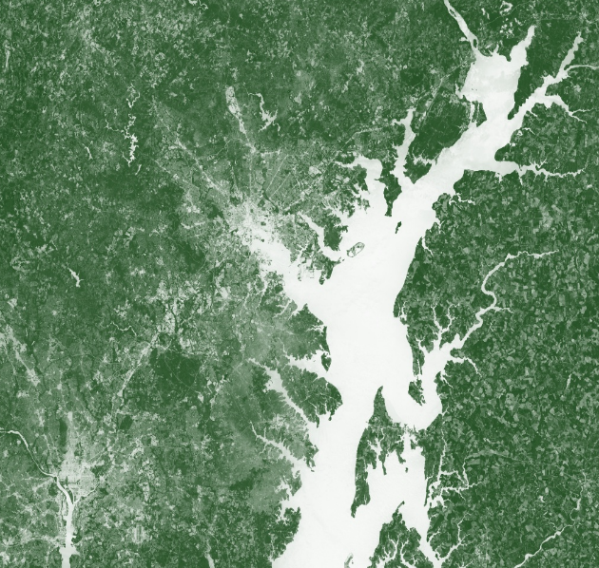
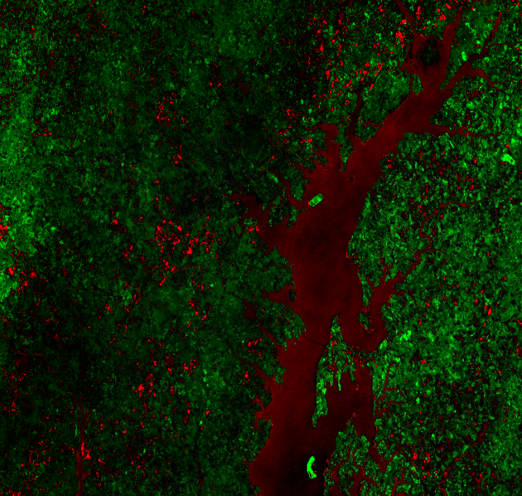
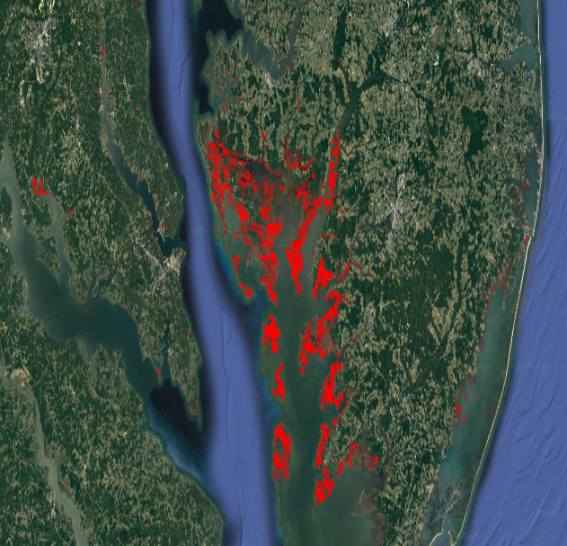
Methodology – Trends
NDVI1984
NDVI2017
Change
NDVI
Extent 2000
Extent 2015
Notes:
John: In order to analyze trends in marsh health, we utilized Earth observations collected from Landsat 5 and Landsat 8. We leveraged the computing power of Google Earth Engine to perform an analysis showing the average values of NDVI, or Normalized Difference Vegetation Index, for the period of 1984 to 1995. After creating this baseline, we calculated anomalies in NDVI from 1996 to 2017.
Google Earth Engine was also used to classify images and calculate marsh extent for the years of 2000 and 2015.

Slide 14
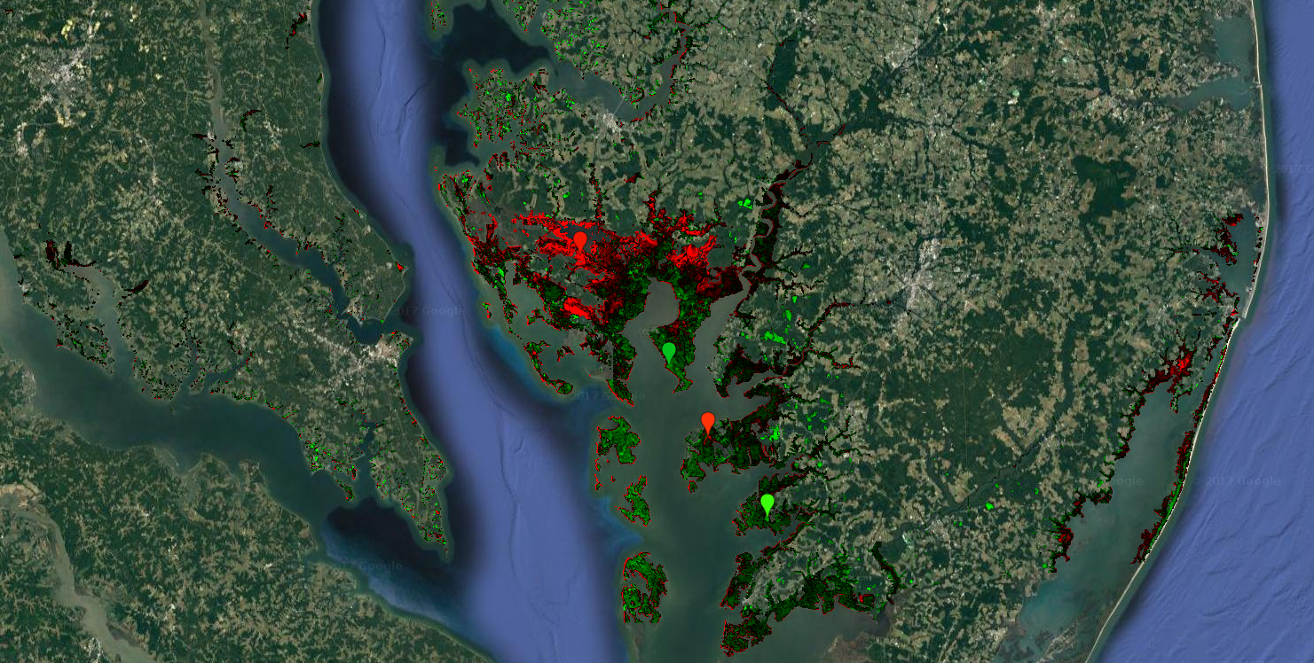
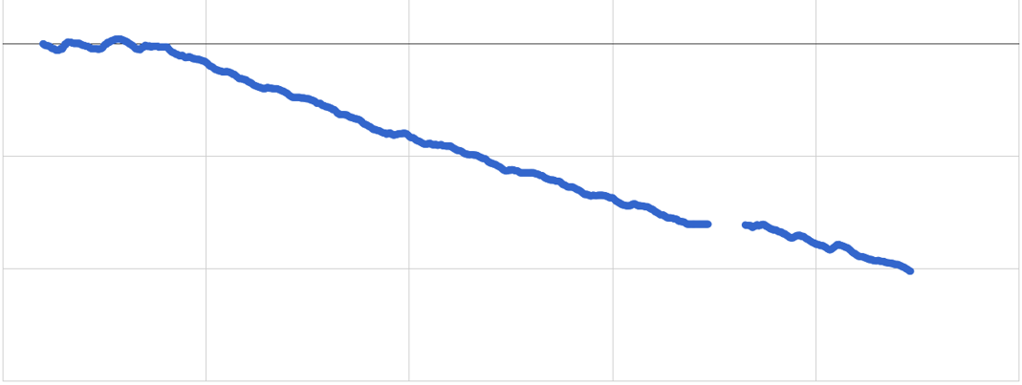
Results
NDVI Values in Different Regions Over Time
0
Relative NDVI value
-20
-40
-60
1995
2000
2005
2010
2015
2020
Year
Notes:
John: Preliminary historical analysis shows hotspots of both positive and negative NDVI change.
This graph shows the average change in NDVI values across the four points of interest and you’ll notice that greenness has decreased over time from 1996 to 2017…
Image Credit: Helen Plattner, NASA DEVELOP

Slide 15
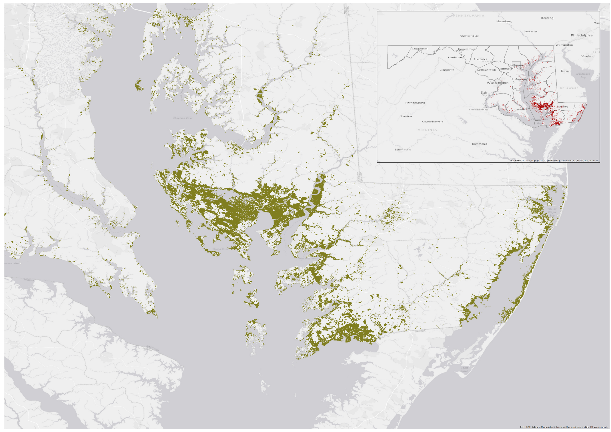
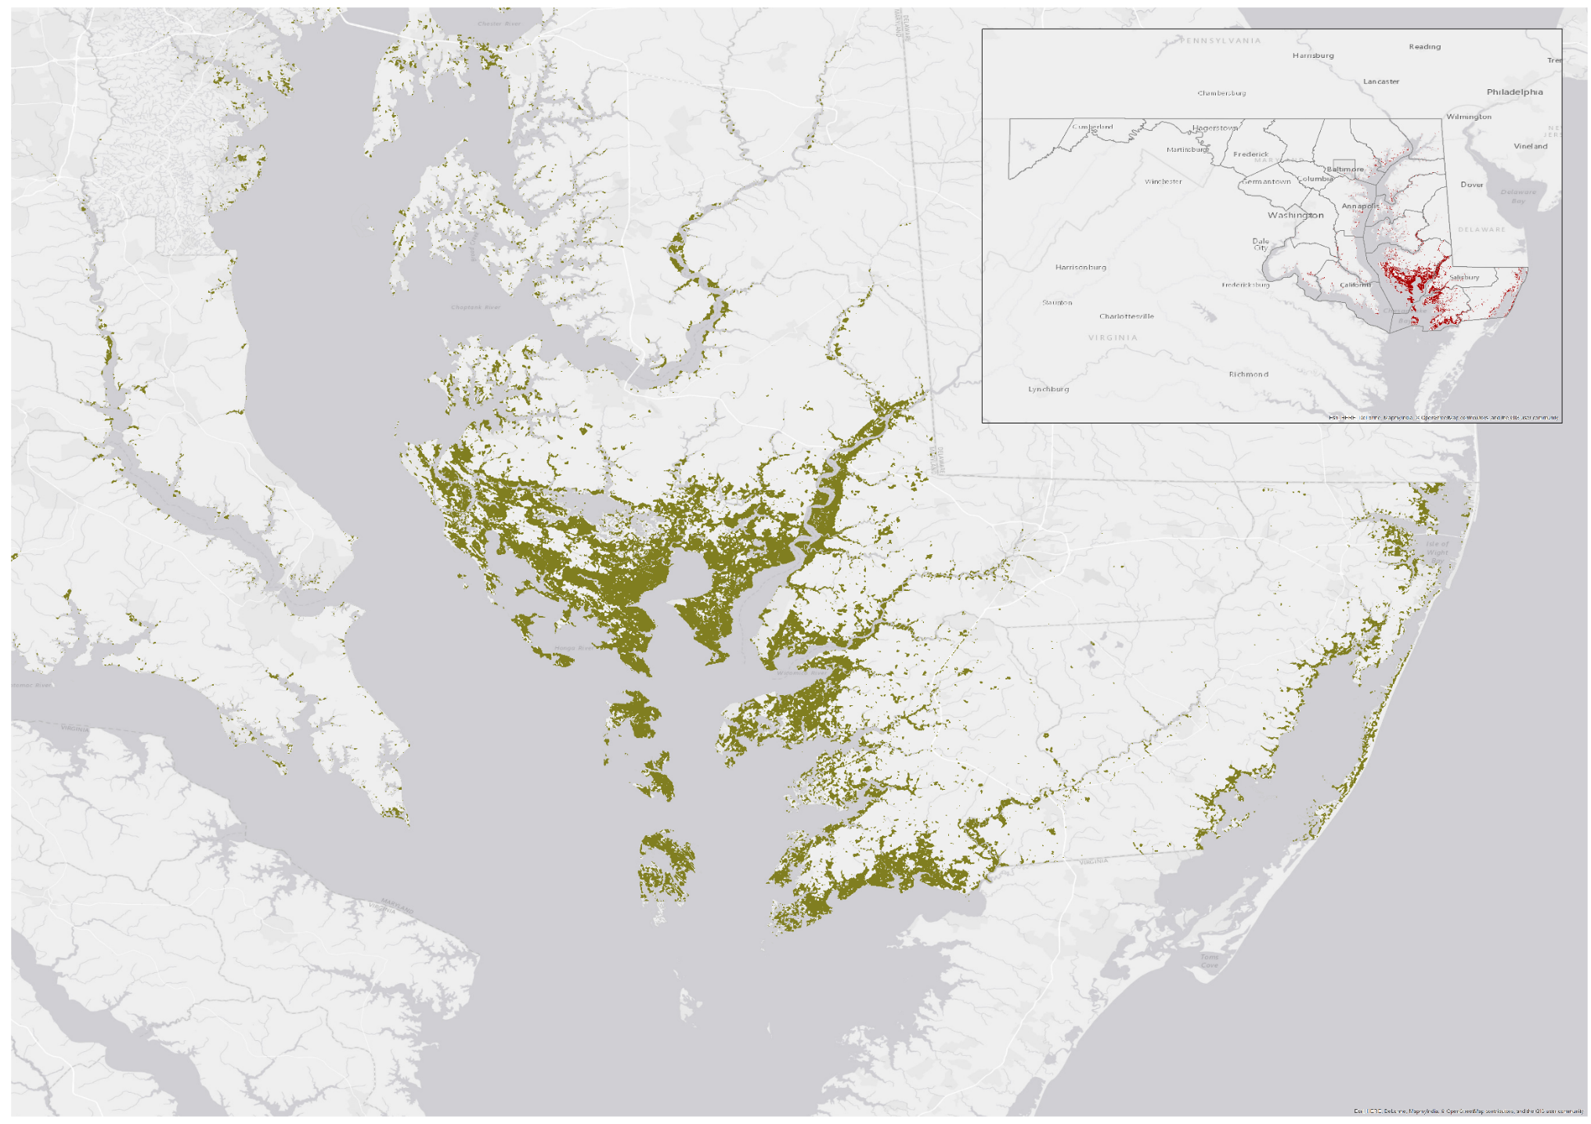
Marsh Extent for Year 2000
Marsh Extent for Year 2015
±
Value
±
Value
Marsh Extent
Marsh Extent
0
5
10
20
30
40
Miles
Notes:
John:
Marsh extent maps were generated in Google Earth Engine scripts for user-selected years. Years 2000 and 2015 were shown as an example.
Image Credit: Helen Plattner, NASA DEVELOP

Slide 16
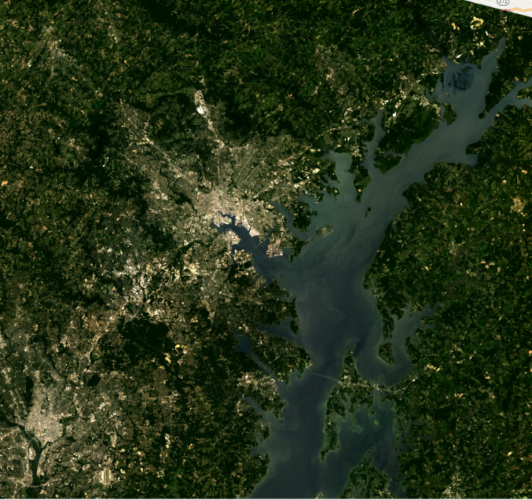
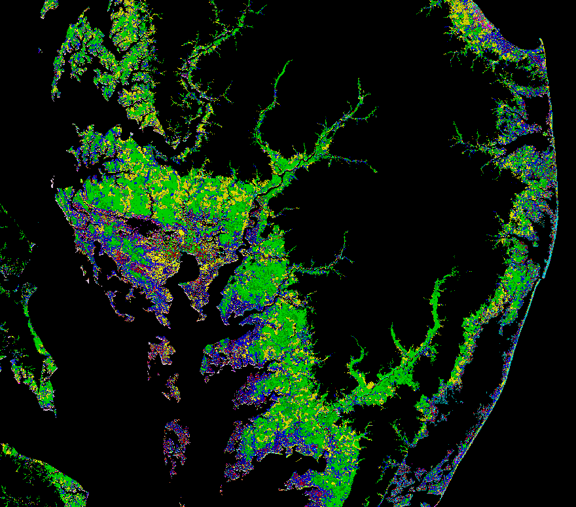
Methodology – Extent
NDVI
Composite
NDSI
NDWI
Classified
Notes:
Sara: Our second goal was to create a map of current marsh extent and health using Sentinel-2 imagery due to its higher spatial resolution. We derived a Water index, Soil index, and Vegetation index which were then combined in a false–color composite used to analyze and classify current marsh health.

Slide 17
Results
Notes:
Sara
The first image is a ten meter resolution false color composite of NDWI, NDSI, and NDVI. Water is red, soil and urban areas are green, and vegetation is blue. The second image shows the results of a classification of the false color imagery using a 10 meter elevation mask. The marshes are easy to see as the purple-blue areas. But, when we zoom in, we can see that these areas are not homogenous. Marsh health can be depicted as patchiness.
Image Credit: Helen Plattner, NASA DEVELOP

Slide 18
Results
Composite image?
10-m resolution classification maps with zoom on monie
Notes:
Sara
The first image is a ten meter resolution false color composite of NDWI, NDSI, and NDVI. Water is red, soil and urban areas are green, and vegetation is blue. The second image shows the results of a classification of the false color imagery using a 10 meter elevation mask. The marshes are easy to see as the purple-blue areas. But, when we zoom in, we can see that these areas are not homogenous. Marsh health can be depicted as patchiness.
Image Credit: Helen Plattner, NASA DEVELOP

Slide 19
Results

Slide 20
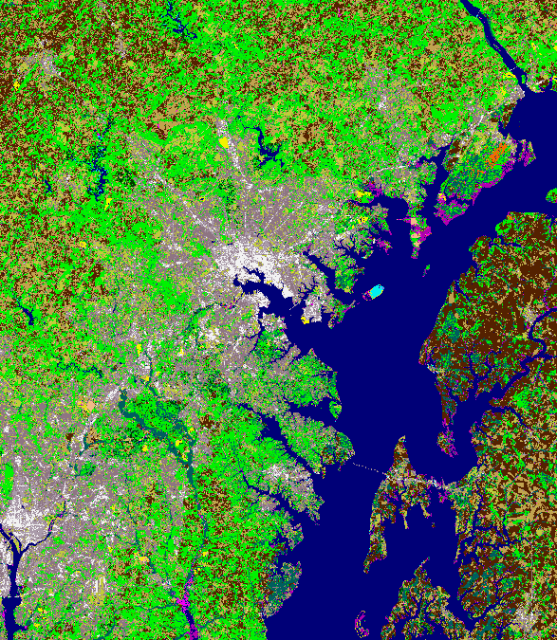
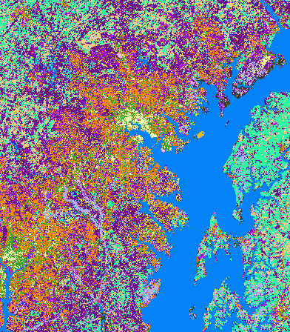
Methodology - Forecasting
LULC1992
LULC 2010
2030
LULC2001
Notes:
Victor: NOAA’s Coastal Change Analysis Program, or C-CAP, LULC data was downloaded and imported to TerrSet in order to model changes in Maryland marsh distribution to 2030. LULC data for (click) 1992 was compared against LULC data for (click) 2001 to illustrate the change in land cover and use between those years. The transitions from ’92 to 2001 were then planned to be extrapolated to predict and map future changes to (click) 2030. The latest NOAA C-CAP LULC data for (click) 2010 was chosen to validate predicted changes.

Slide 21
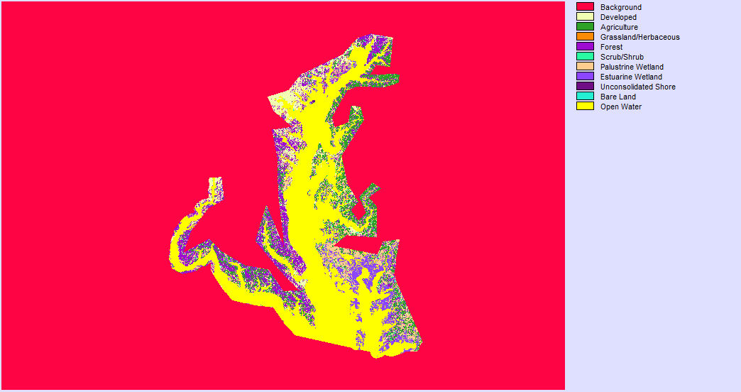
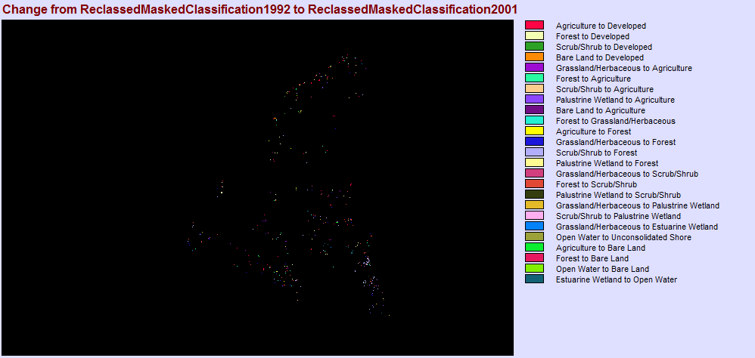
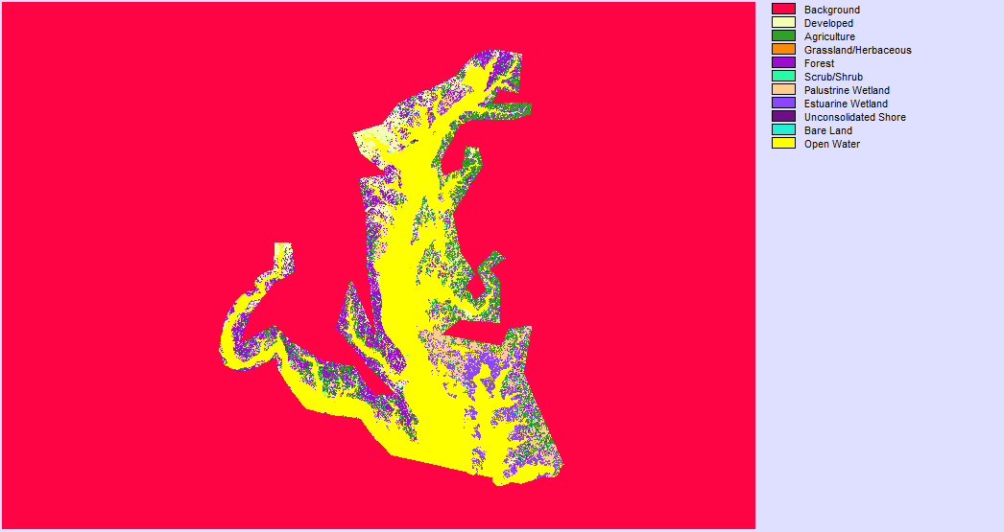
Results
LULC1992
LULC2001
Notes:
Victor: Transitions in LULC were successfully displayed using TerrSet’s Land Change Modeler. (click x2) Unfortunately, further work needs to occur to accurately determine and acquire useful data on the driving factors behind the transitions. Once this data is acquired, it can then be incorporated into the Land Change Modeler to predict change into the future.
Image Credit: Helen Plattner, NASA DEVELOP

Slide 22
Conclusions
Preliminary historical analysis shows hotspots of both positive and negative NDVI change.
Sentinel-2 imagery was successfully used to create a baseline of current marsh health.
Trends in marsh health show overall degradation.
Image Credit: The Nature Conservancy
Notes:
Victor:
(click)Preliminary historical analysis shows hotspots of both positive and negative NDVI change throughout Maryland’s Chesapeake Bay. Blackwater National Wildlife Refuge, one of the largest contiguous blocks of salt marsh along the Northeast Atlantic Coast, has experienced dramatic loss in vegetation over the study period. (click)
Sentinel-2 imagery was successfully used to create 10-meter resolution baseline maps of Maryland marsh health. (click)
Maryland’s marshes are trending towards degradation and, if all contributing factors persist, will continue to degrade over time. It is our hope that these analyses will assist the Maryland Department of Natural Resources and The Nature Conservancy in identifying and restoring areas of marshland that provide the greatest risk reduction for coastal communities. (click)
Image Credit: The Nature Conservancy

Slide 23
Future Work
Image Credit: The Nature Conservancy
Explore high/low marsh classification of Landsat imagery
Verify marsh classifications
Automate map making processes
Repeat classifications on 5-year intervals to further guide restoration efforts
Incorporate elevation, precipitation, slope, sea-level rise, and distance data into marsh health forecasting
Notes:
Victor:
Future analyses should consider implementing marsh classifications between high and low marsh areas.
Data validation should include ground truthing and an accuracy assessment of marsh classifications to confirm accuracy of our analyses.
Different indices can be applied to the areas of interest and an automation of the Sentinel analysis processes could be beneficial to maximize analytical capabilities.
Classifications should be repeated on 5-year intervals to continue efficiently guiding restoration efforts.
Current elevation, slope, precipitation, and sea-level rise data should be implemented into future forecasting efforts to ensure accuracy and distance to things like roads, open water, & agriculture should be considered as well.
Image Credit: The Nature Conservancy

Slide 24
Acknowledgements
Advisors
Dr. David Lagomasino, Universities Space Research Association, GSFC
Jenny Allen, Chesapeake Bay National Estuarine Research Reserve, MD DNR
MD DNR
Nicole Carlozo, Natural Resources Resiliency Planner, Chesapeake Coastal Service
Rachel Marks, GIS Analyst and Ecological Modeler
The Nature Conservancy
Michelle Canick, GIS Project Manager
Image Credit: The Nature Conservancy
Notes:
Victor: We would like to thank our incredible science advisors and wonderful project partners for all of their continuous support and enthusiasm throughout the duration of this project. Additionally, this project would not have happened without the amazing people working within the NASA DEVELOP National Program, so our thanks go out to them as well. We want to thank you all for coming and if anyone has any questions or comments, please feel free to ask them now/after the next presentation.
Image Credit: The Nature Conservancy

