Slide 1
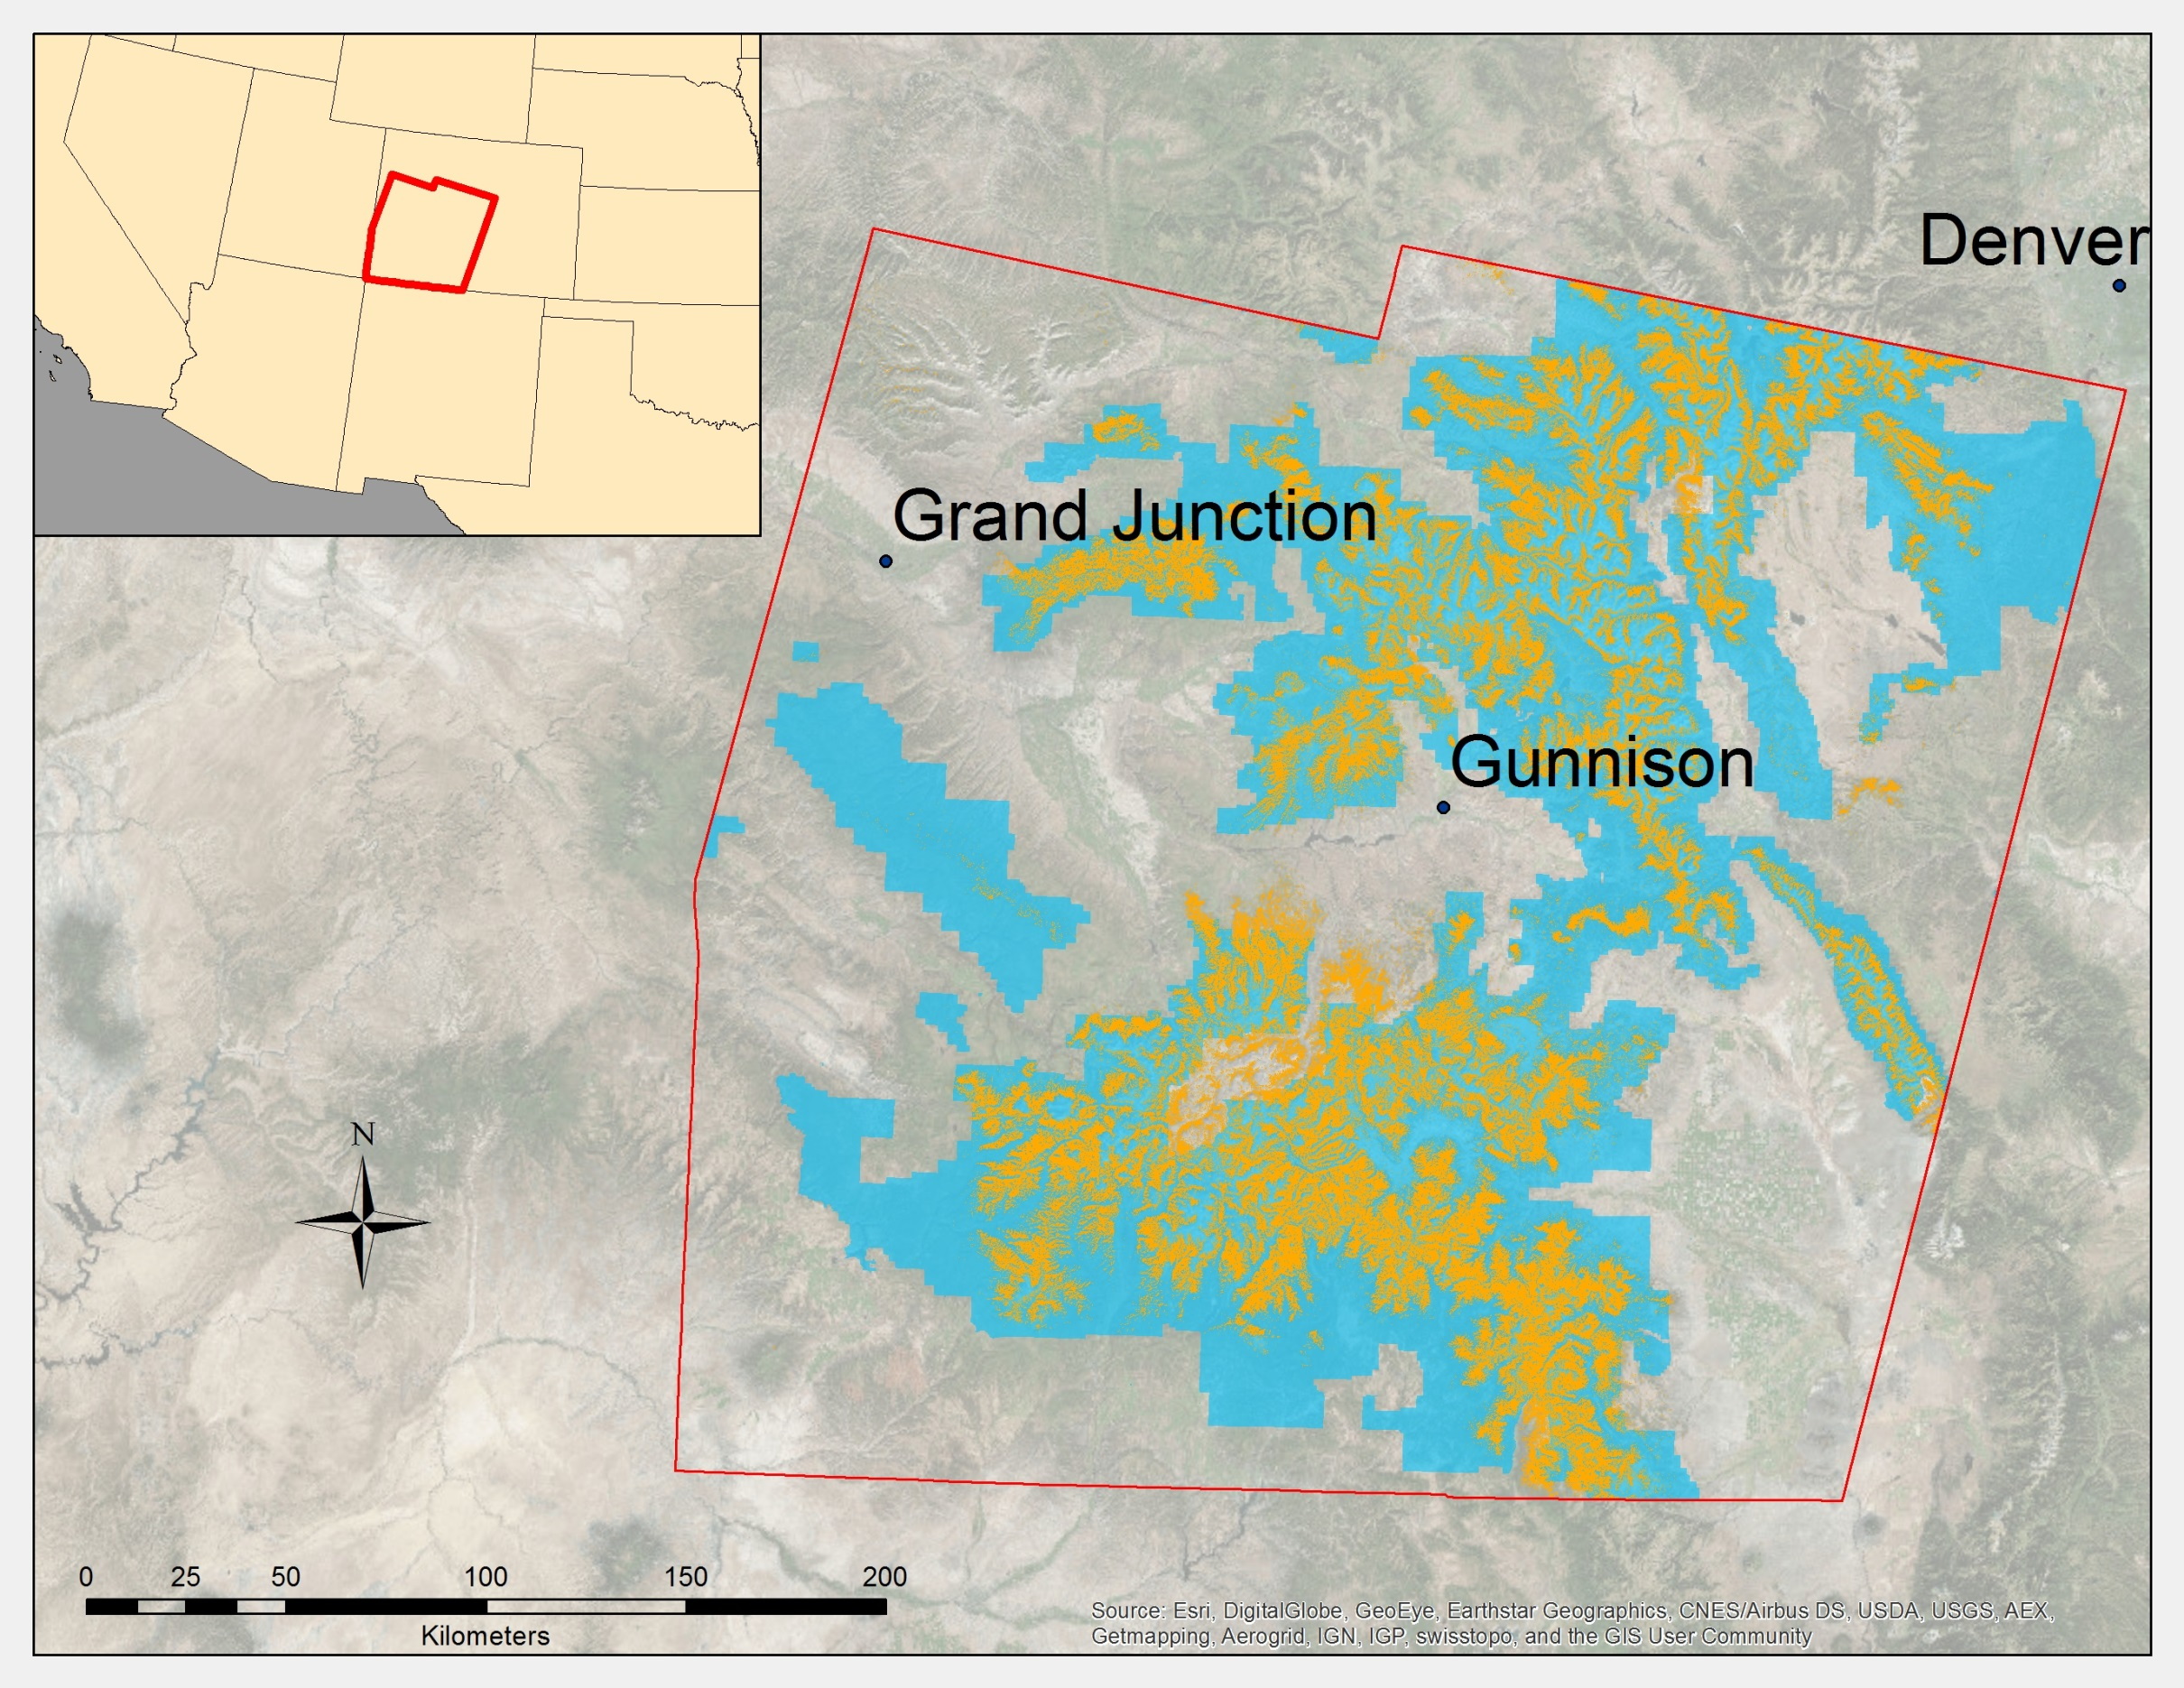
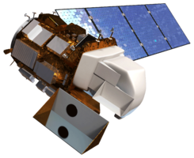

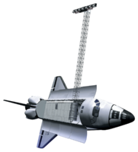
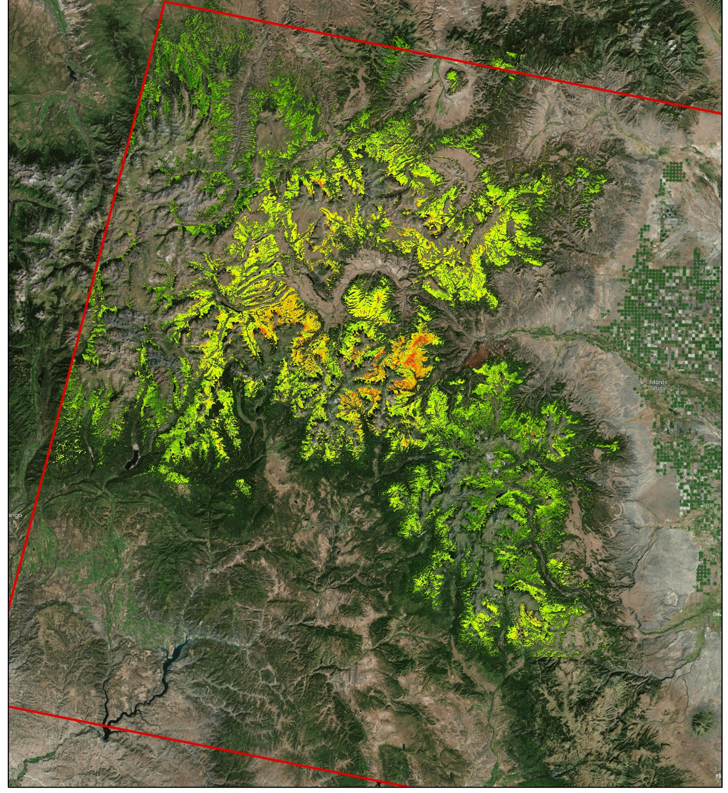
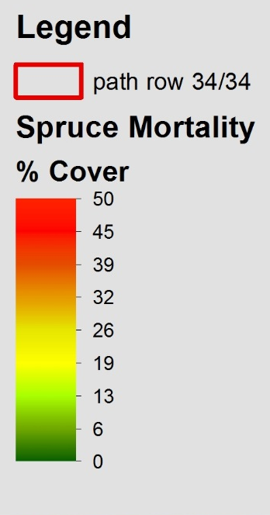
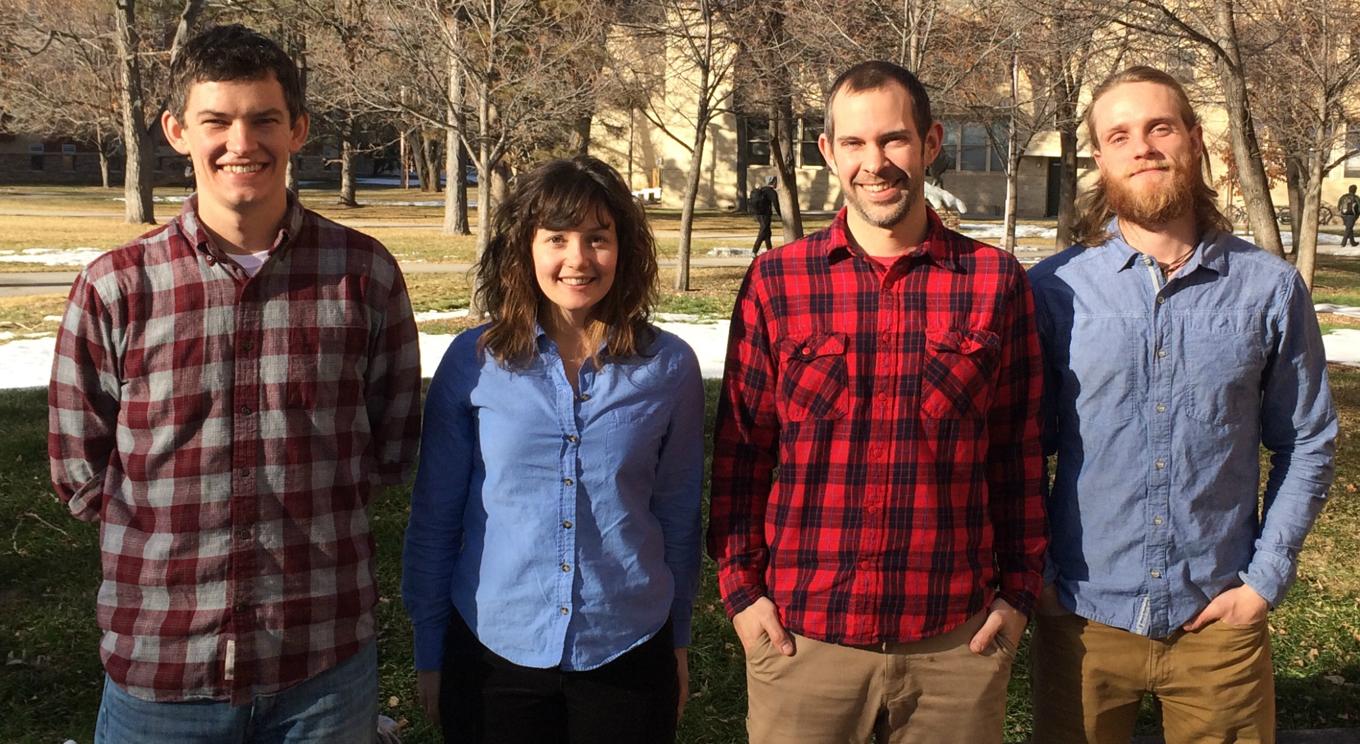
Gunnison National Forest Agriculture
Mapping spruce beetle outbreak severity and distribution in Gunnison National Forest using Landsat and integrative spatial modelling
Eric Rounds (Project Lead), Sarah Carroll, Oliver Miltenberger, Peder Engelstad
DEVELOP National Program at USGS at Colorado State University, Fort Collins
Abstract
Objectives
Create reference data using a novel data collection methodology
Produce fine scale maps of spruce mortality in southwest Colorado
Inform forest management plans that address wildlife habitat analyses and biomass estimation
Study Area
Methodology
Reference Data
Classify Land Cover (live/dead trees) within 30m pixels using 1m resolution imagery
Calculate percent mortality of trees for each randomly selected pixel
Reference Data Creation
Imagery Processing
Model Processes
Inputs
Outputs
Creating Model Inputs
Imagery Processing
Stack 2006/13 & 2015 imagery separately and clip to study area
Extract spectral values of stack layers that correspond to each reference data point
Model Step 1
Binary classification
Presence = 1
Absence = 0
Binary map of study area
Percent Mortality & Spectral Values of reference points
Combine outputs to create final map of spruce mortality in southwest Colorado
Earth Observations
Model Step 2
Continuous classification of study areas for each species
Continuous Map of Study Area
Results
Landsat 8 OLI & TIRS
Landsat 5 TM
Shuttle Radar Topography Mission (SRTM)
Conclusions
Coming soon…
Team Members
Project Partners
Acknowledgements
Bioenergy Alliance Network of the Rockies (BANR)
Spatial Sciences Center, Montana State University
Natural Resource Ecology Laboratory
USFS, Gunnison District
USFS Rocky Mountain Research Station
This project was made possible through the support and mentorship of select individuals and organizations. We extend a kind thanks to the following:
Dr. Paul Evangelista, Colorado State University (CSU), Natural Resource Ecology Laboratory (NREL)
Tony Vorster, CSU, NREL, Bioenergy Alliance Network of the Rockies (BANR)
Brian Woodward, DEVELOP - Fort Collins Center Lead
Shannon Savage, Spatial Sciences Center of Montana State University (MSU)
(Left to Right): Eric Rounds, Sarah Carroll, Peder Engelstad, and Oliver Miltenberger
NASA DEVELOP National Program USGS at Colorado State University

