Slide 1
ENVIRONMENTAL JUSTICE NEEDS ASSESSMENT
Disasters
Assessing the Landscape and Capacity of Organizations & Communities Working Towards Environmental Justice with Potential to Use NASA Earth Observations to Support Equitable Disaster Management and Risk Reduction
Julianne Liu
Emma Cooper
Natasha Johnson-Griffin
Keegan Kessler
Virtual Environmental Justice
Notes:
Hello, my name is _____, and I’m part of DEVELOP’s Disasters Needs Assessment team and part of the first cohort of Environmental Justice projects.

Slide 2

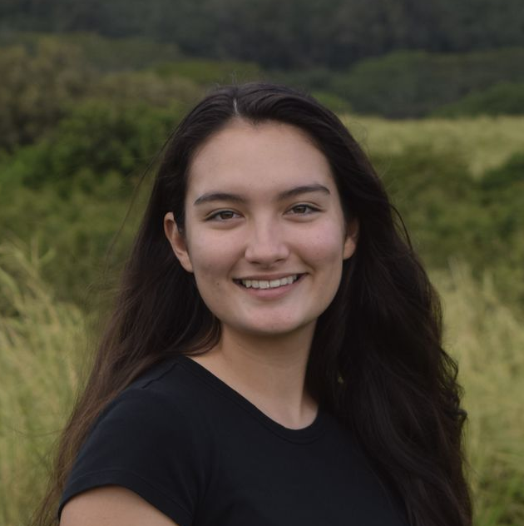
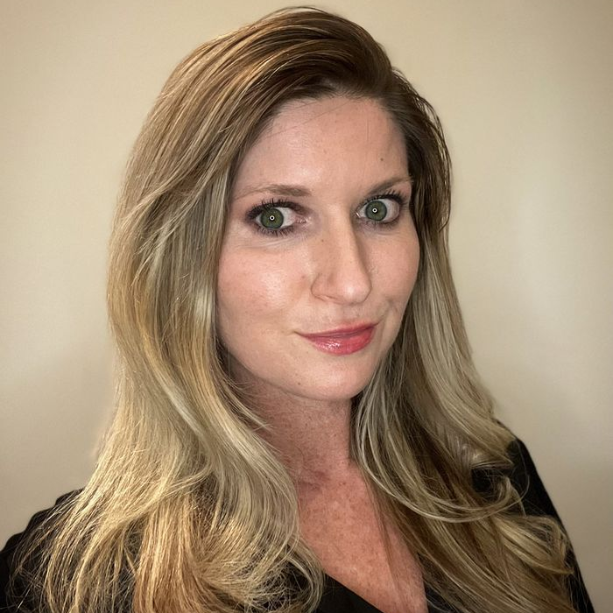
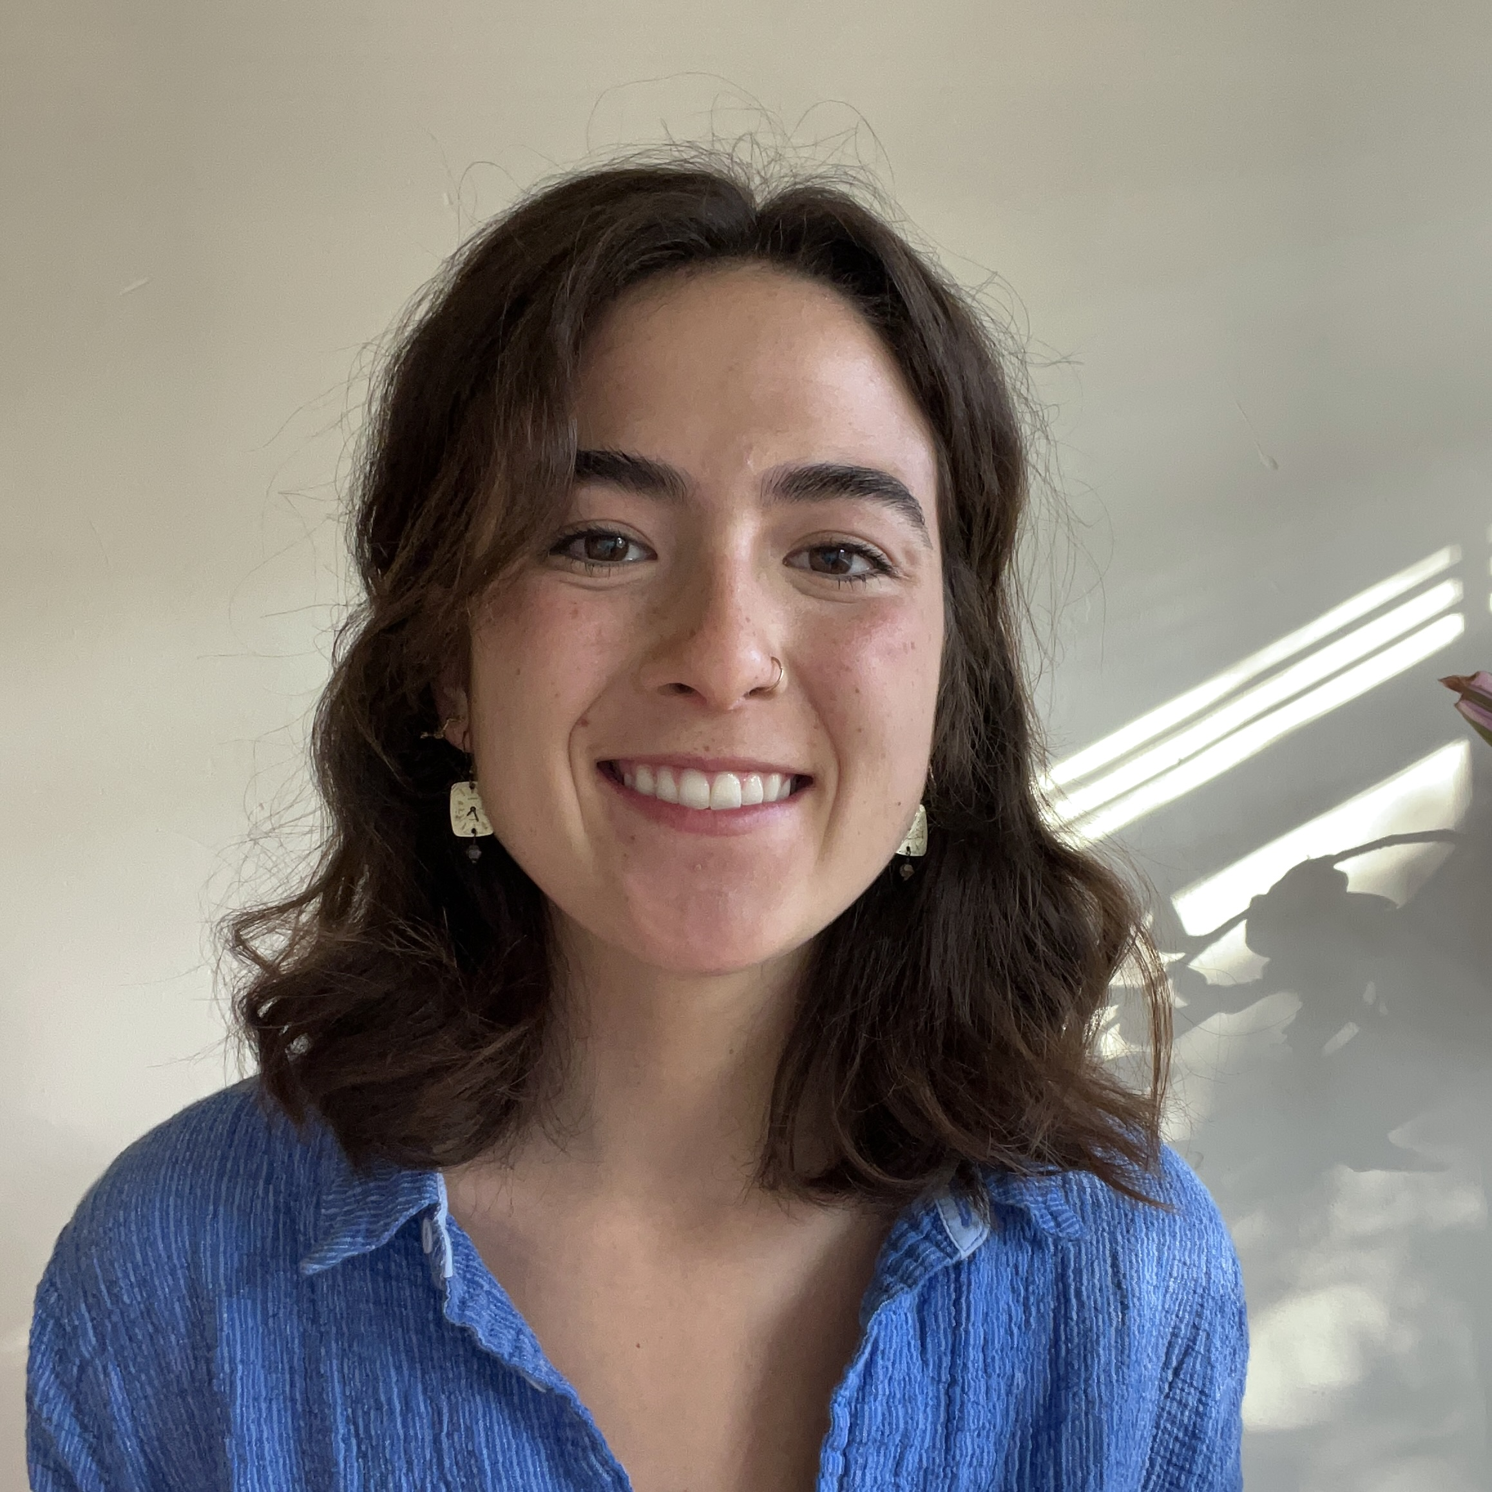
Our Team
Julianne
Liu
Keegan Kessler
Natasha Johnson
Emma Cooper
Notes:
I’m joined by my teammates: [unmute and say names so video appears on people’s screens now]. Over 10 weeks, we explored the landscape of organizations working in environmental justice and disasters to help DEVELOP assess the geospatial needs in these areas and identify possible projects for the future.

Slide 3
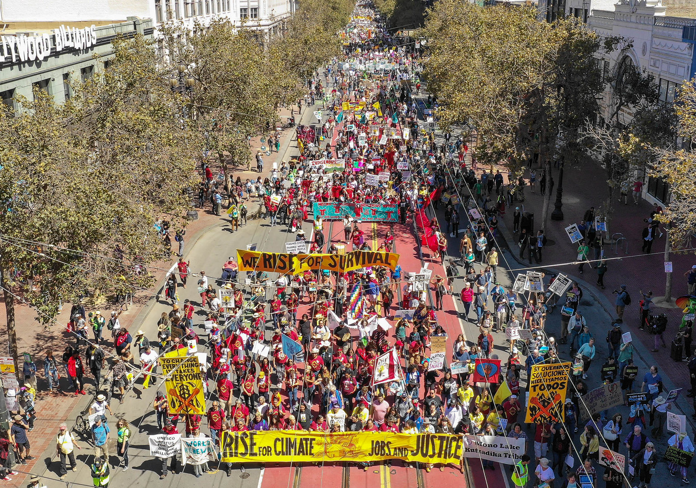
Environmental Justice
Charles Lee's Proposed New Working Definition (2021):
“the fair treatment and
meaningful involvement of
all people regardless of race, color, national origin, or income, with respect to the development, implementation, and enforcement of laws, regulations, and policies that affect the environment and/or public health."
Image Credit: Anesti Vega
Notes:
We’ll begin by discussing Environmental Justice, which we will refer to as EJ in this presentation.
The formal EJ Movement began in the second half of the 20th century and continues to this day as marginalized communities work to regain autonomy over their health and environment. EJ recognizes the joint exploitation of people and land, and it also recognizes how systemic discrimination and disproportionate exposure to environmental hazards primarily affect communities of color and communities who are low-income and linguistically isolated.
Charles Lee, a trailblazer in the EJ Movement, has critically examined the EPA’s EJ definition and proposed these changes to center justice, rather than equity. His definition continues to also say EJ works to prioritize communities experiencing the greatest inequities, disproportionate impacts, and unmet needs, as well as works to prevent and mitigate environmental harms and burdens and eliminate systemic barriers to the achievement of healthy and sustainable communities for all people.
--
Image Credit: Anesti Vega
Image Source: https://www.flickr.com/photos/25654955@N03/43651206615 (CC BY-NC-SA 2.0)
New Working Definition: Lee, C. (2021). Evaluating Environmental Protection Agency’s Definition of Environmental Justice. Environmental Justice, 14(5), 332–337. https://doi.org/10.1089/env.2021.0007

Slide 4
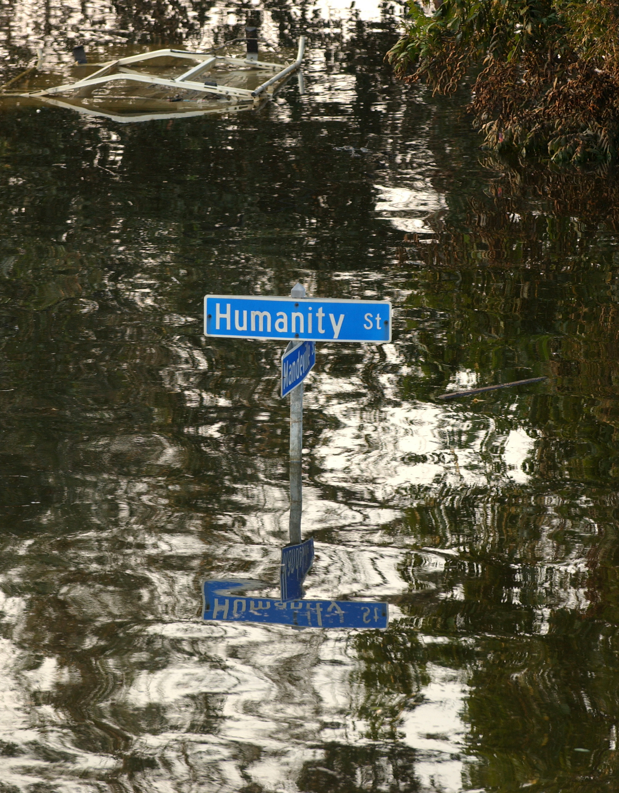
Disasters &
Environmental (In)Justice
Environmental Injustices
Disproportionate Disaster Impacts
Lack of Equitable Disaster Response
Community Vulnerability
Barriers to Recovery
Image Credit: Jocelyn Augustino
Notes:
In disasters, historical and contemporary disenfranchisement, disinvestment, and discriminatory policies have contributed to marginalized communities being disproportionately located in the areas most affected by disasters. They bear an unequal burden of disaster impacts and are pushed into a further cycle of injustice as disaster management and response plans often do not address their needs or include them in decision making. This leads to more barriers to recovery and a heightened vulnerability and susceptibility to EJ issues. This is an ongoing and dangerous cycle that emphasizes the need for equitable disaster management, and it was a topic DEVELOP was interested in learning more about.
This dangerous cycle was clearly seen in New Orleans during Hurricane Katrina, represented by the image of flooding on this slide. This event and others still today emphasize the need for equitable disaster management, and this is an area DEVELOP is interested in learning more about.
--
Image Credit: Jocelyn Augustino
Image Source: https://commons.wikimedia.org/wiki/Hurricane_Katrina (Public Domain)
Provided by FEMA

Slide 5
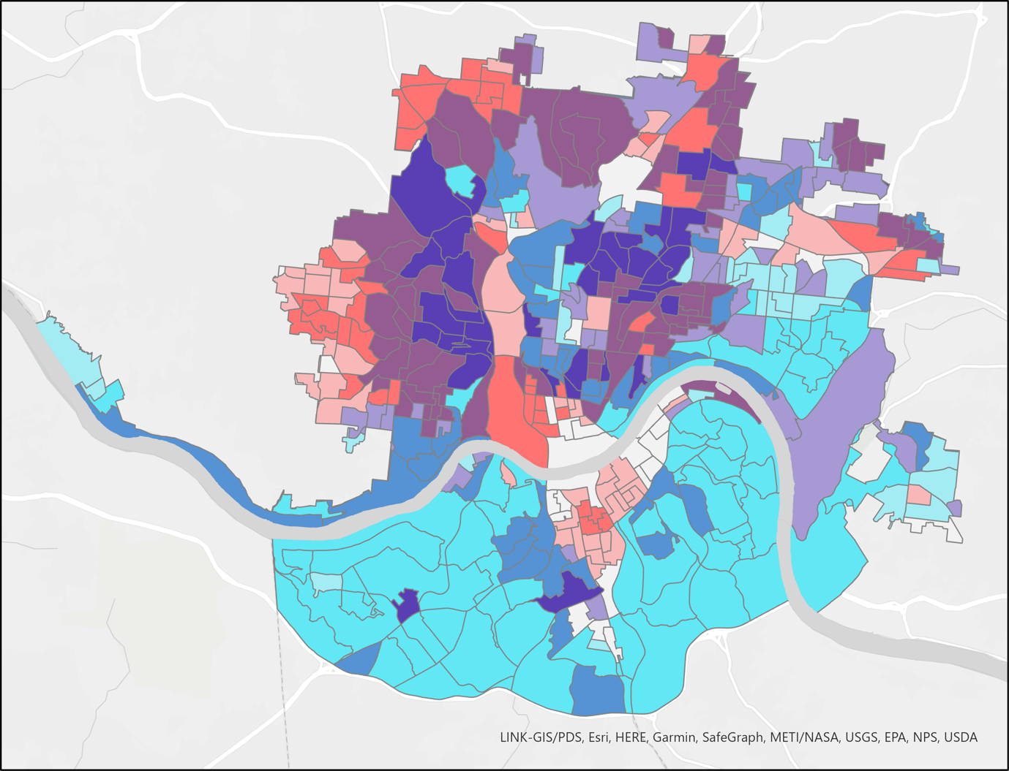
Background
High
Landslide Susceptibility
Low
NASA DEVELOP and
NASA Applied Sciences
Low
High
Vulnerable Groups Population Density
  NASA Earth observations and geospatial tools in EJ
  Relationships with local disaster-EJ organizations
  Community-led research and disaster management
LINK-GIS/PDS, Esri, HERE, Garmin, SafeGraph, METI/NASA, USGS, EPA, NPS, USDA
Image Credit: NASA DEVELOP Cincinnati and Covington II Urban Development Project (Summer 2021)
Notes:
DEVELOP recently launched an initiative to strengthen their action in EJ. This led to the creation of the Virtual Environmental Justice office and our disasters project.
With NASA DEVELOP and NASA Applied Sciences as our partners, our project explored how NASA Earth observations and geospatial science can be used to support research on disasters and EJ. We also began the process of building relationships with local organizations focusing on disasters and EJ and followed the lead of communities in research and disaster management.
The image on this slide is from a DEVELOP project last summer and shows populations most vulnerable to landslides. By comparing landslide susceptibility and social vulnerability markers like race, age, and poverty levels, they found that the areas in dark purple were at disproportionate risk. This is an example of how geospatial data has been used to identify vulnerabilities to disaster, and our project sought to strengthen the acknowledgement and inclusion of EJ in future DEVELOP projects – which ______ will discuss next.
--
Image Credit: Paxton LaJoie, Edward Cronin, John Perratti, Erin Shives, Sophie Webster
Image
Source: https://www.devpedia.developexchange.com/dp/index.php?title=Cincinnati_%26_Covington_Urban_Development_II_MA_Summer_2021

Slide 6
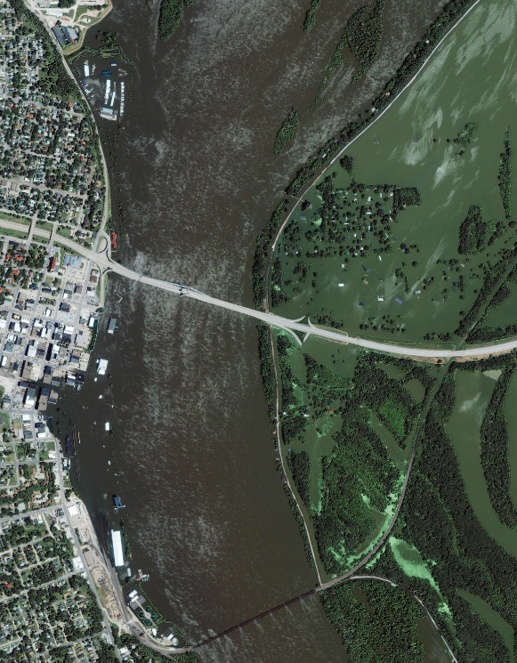




Objectives
Identify intersections between EJ, disasters, and geospatial science
Assess how EJ and disaster organizations can be supported by remote sensing and geospatial tools
Increase public awareness of geospatial data, tools, and software trainings
Support the continued integration of EJ at DEVELOP
Image Credit: NASA
Notes:
We were guided by these objectives.
First, to identify the intersections between EJ, disasters, and geospatial science, we conducted a literature review and connected with researchers with expertise in these areas.
Second, to assess how remote sensing data and geospatial tools could support EJ, we interviewed EJ and disaster organizations.
Third, to increase public awareness of open-source geospatial data, tools, and software trainings, we created a resource list shared with our contacted organizations.
And fourth, throughout this whole process, we supported the continued integration of EJ at DEVELOP. With our compiled list of potential partner organizations and project ideas, DEVELOP can take steps to better support the meaningful inclusion of disproportionately affected communities in reducing the risk of disasters.
-- Image Credits
Image Credit: NASA
Image Source: https://earthobservatory.nasa.gov/images/8862/mississippi-river-floods-gulfport-illinois (Public Domain)

Slide 7

Guiding Principles
Transparency
Accessibility
Reciprocity
Sensitivity
Awareness
Notes:
Additionally, our team deeply reflected on the work we were doing and spaces we were entering, and we guided our project by these principles, inspired by the 17 Principles of EJ created during the first People of Color Environmental Leadership Summit in 1991.
Transparency came from the recognition of historical and contemporary trauma inflicted by federal institutions on marginalized communities. We were always clear about where data came from and where information was going.
Reciprocity stemmed from wanting to show that we valued the time of our interviewees through efficient and meaningful communication.
Accessibility was important to us because of geospatial jargon so we used more familiar language to introduce concepts and build capacity.
Moreover, we were sensitive to the media included in this presentation and other materials. We didn’t want to tokenize marginalized communities or re-invoke trauma from a vulnerable time in someone’s life from a stock image.
This was part of an overarching principle of cultural awareness and respecting the diversity of backgrounds and familiarities represented in our project.
I’ll now turn it over to _____ to talk about our methodology and how we put these principles into action.
----Image / Icon Credits----
1. Microsoft PowerPoint

Slide 8




Methodology - Overview
Research
Literature Review
Outreach
Landscape Analysis
Community Engagement
Needs Assessment
Analysis
Results & Recommendations
Notes:
We created a framework for future DEVELOP needs assessment projects with our 4-phase process of research, outreach, interviews, and analysis.
We began our research by conducting a literature review to explore how EJ and disasters intersect. We also consulted researchers with expertise in environmental justice, disaster science, and geospatial analysis to inform our project methodology.
----Image / Icon Credits----
1-4. Microsoft PowerPoint

Slide 9
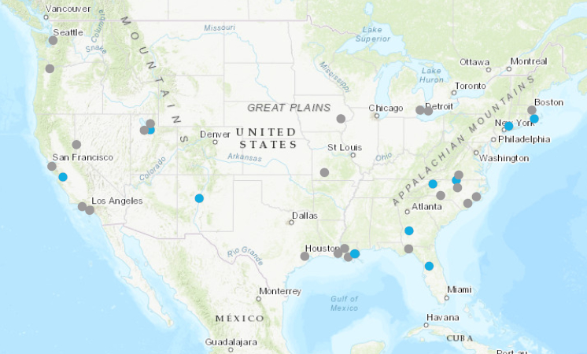
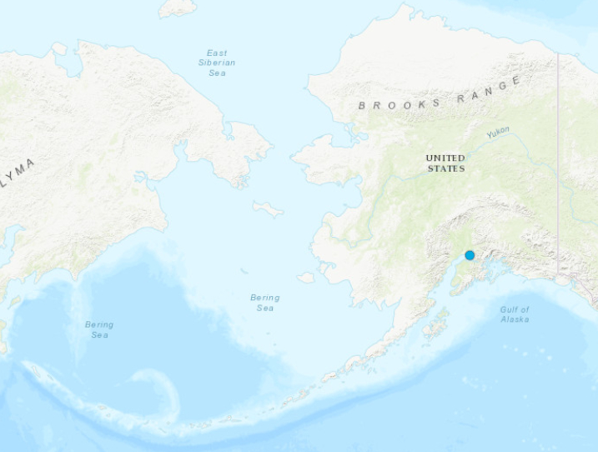

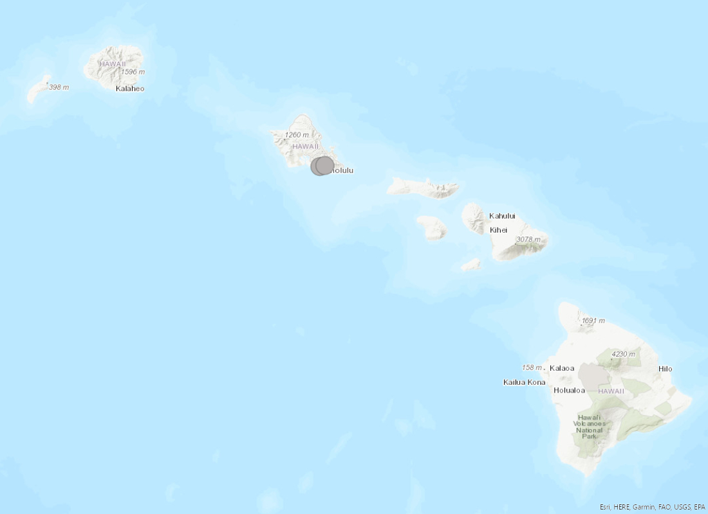
Outreach
Organization Outreach
Engaged
Contacted
500 km
500 km
150 km
Basemap Attribution: ESRI, HERE, Garmin, FAO, NOAA, USGS, EPA
Notes:
We created a framework for future DEVELOP needs assessment projects with our 4-phase process of research, outreach, interviews, and analysis.
We began our research by conducting a literature review to explore how EJ and disasters intersect. We also consulted researchers with expertise in environmental justice, disaster science, and geospatial analysis to inform our project methodology.
----Basemap Credits----
1. Esri
Sources: ESRI, HERE, Garmin, FAO, NOAA, USGS, EPA

Slide 10
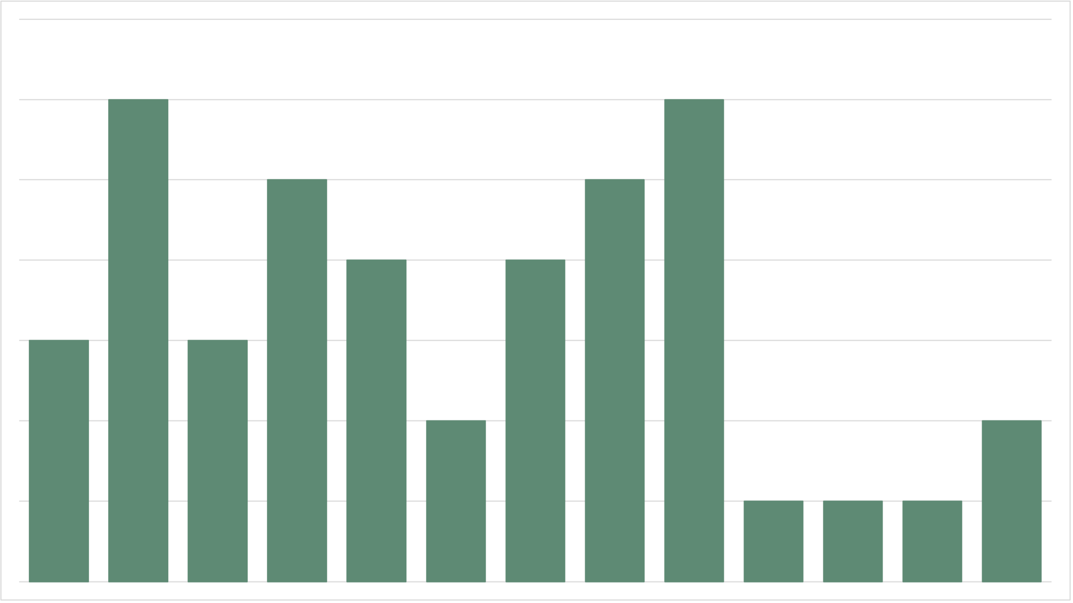
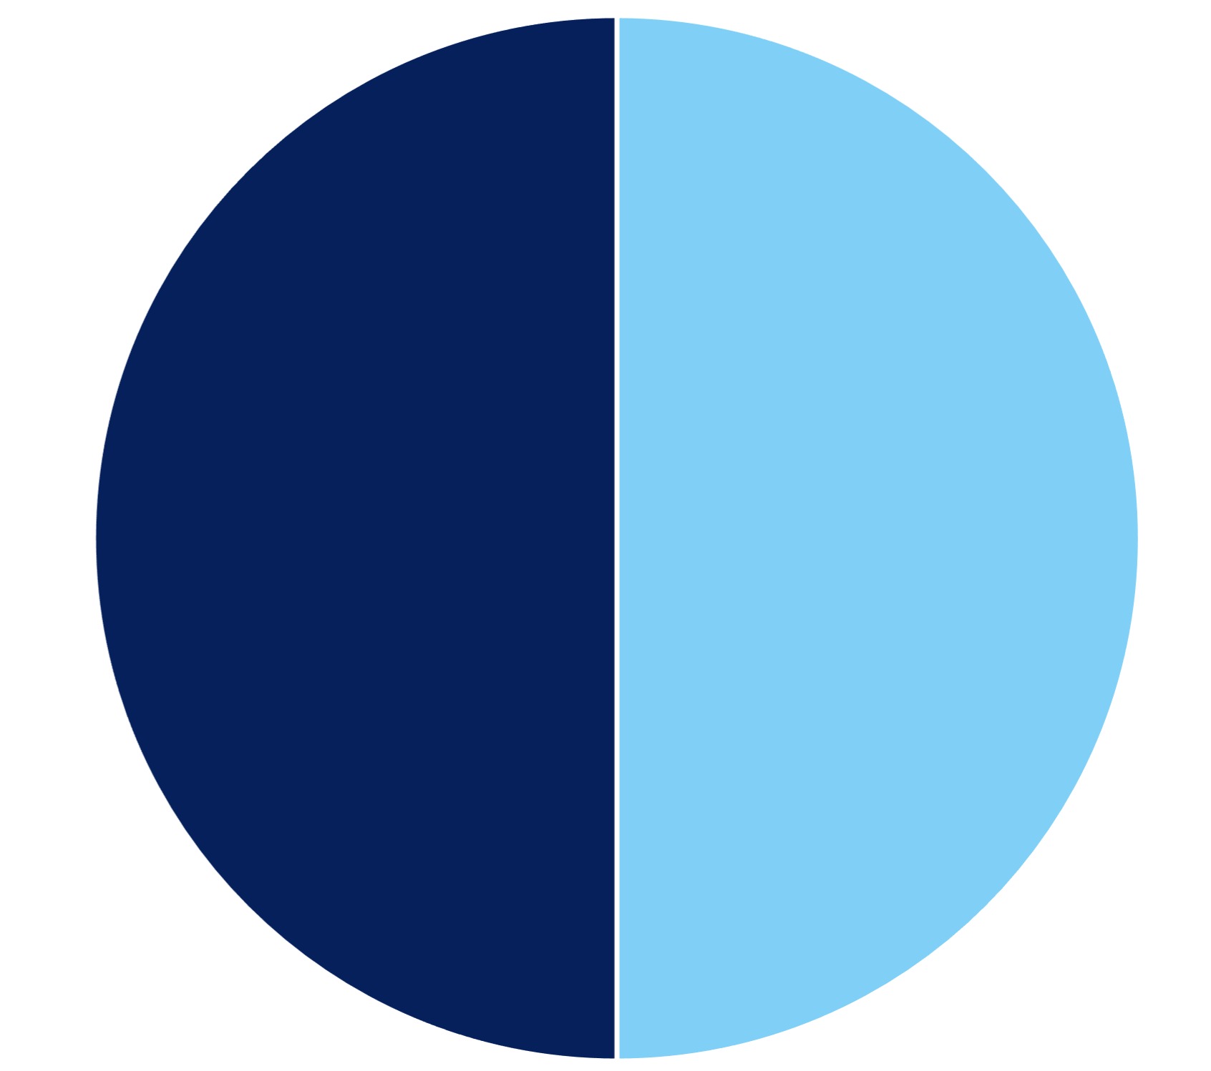
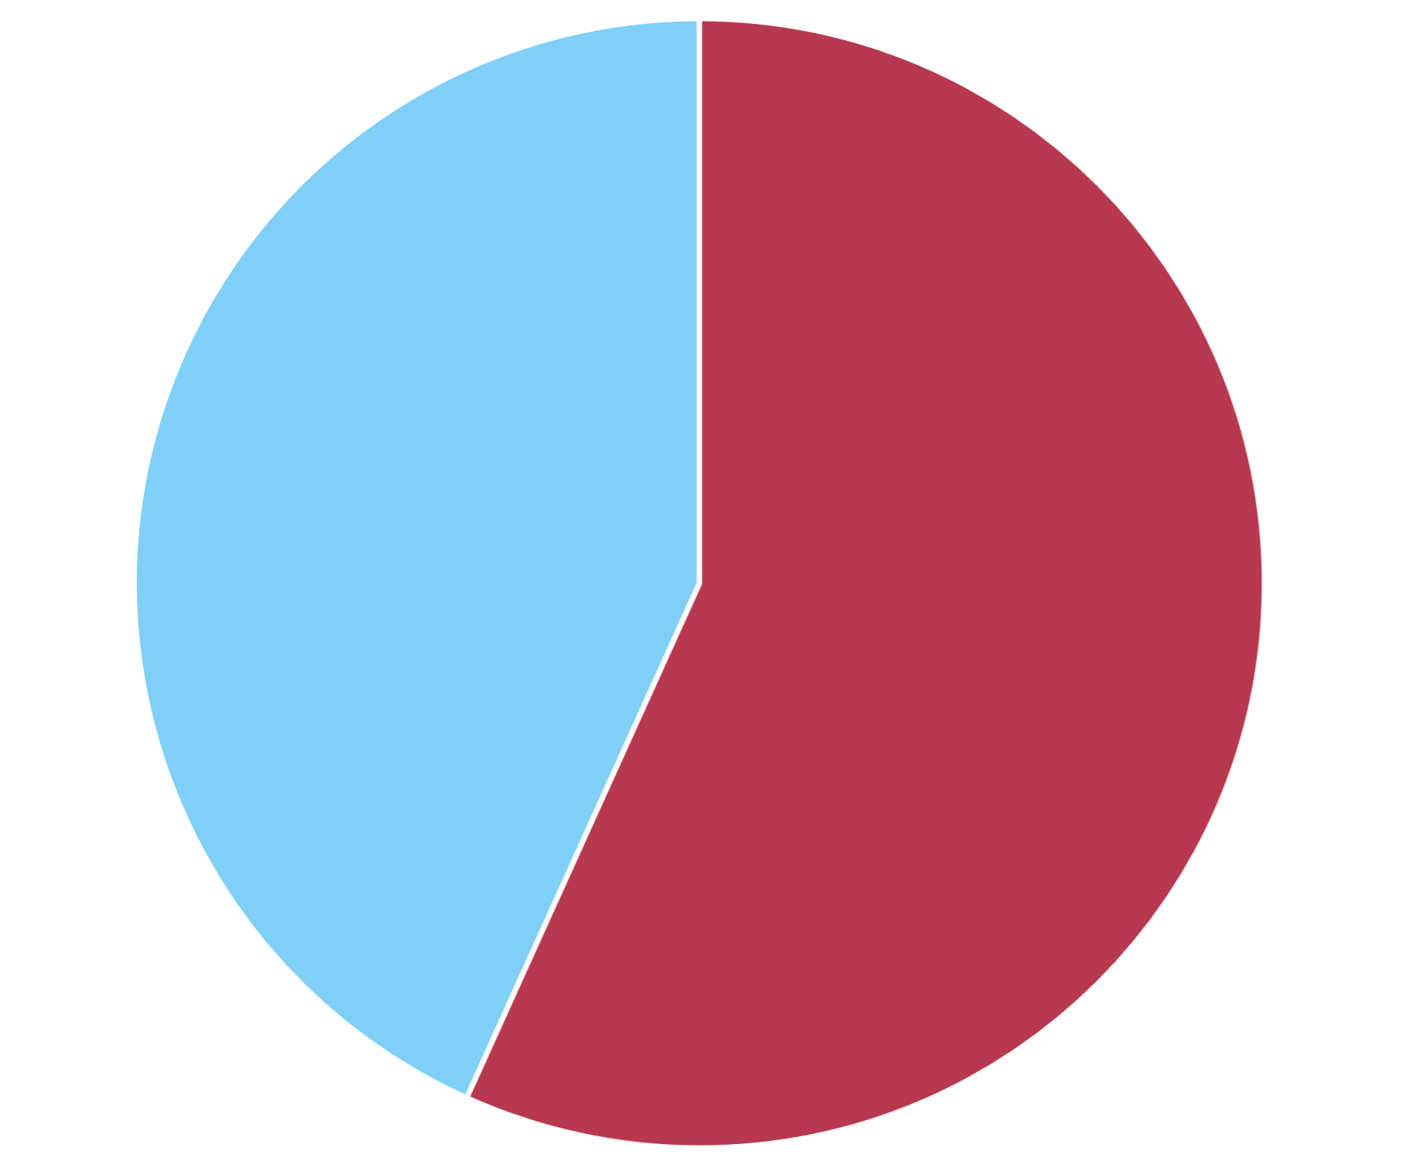
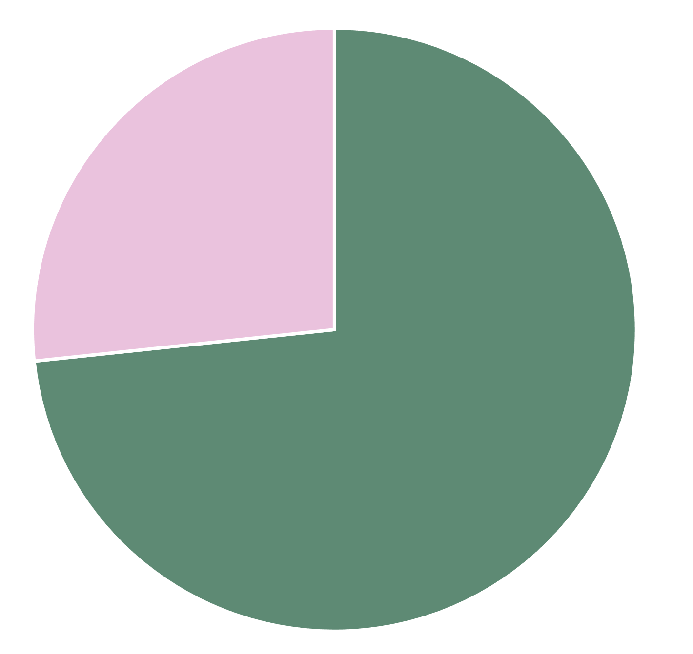
Results
Prior Experience with Mapping Software and/or Satellite Imagery
Outreach Success Rate
Disaster Types
6
No Response
57%
Yes
50%
No
50%
5
Yes
50%
No
50%
4
Responded
43%
Frequency
3
Frequency
2
27%
1
73%
0
Other
Floods
Hurricanes
Tornadoes
Severe Storms
Wildfires
Drought
Extreme Heat
Earthquakes
Tsunamis
Engaged
Not engaged
Coastal Hazards
Volcanoes
Landslides/Mudslides
Contacted, No Response
Responded
Notes:
Out of the 37 organizations contacted, about 40% responded to us. From these 16, 10 agreed to an interview where we learned more about their organizations and their needs. We found that many organizations were engaged with multiple types of disasters, and work concerning extreme heat, drought, and flooding were the most frequent. We also identified that half of the organizations have experience with geospatial tools and analyses, and the other half were interested after learning some of the applications.

Slide 11
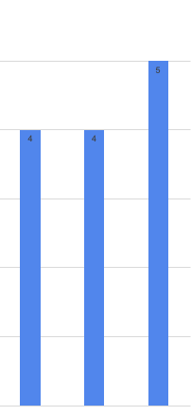
Analysis
Resource Requests
Priorities
5
  Community involvement
  Sustainability
  Holistic justice
4
Geospatial Needs
  Identify disparities and vulnerabilities
  Show changes over time
  Quantify and visualize impacts of their work
3
2
Challenges
DEVELOP Project
Educational Materials
Grant Resources
  Staffing capacity
  Funding needs
  Software access
1
0
Notes:
Based on our analyses at the time this presentation was created, the following themes emerged about EJ and disaster organizations’ needs.
Organizations prioritized community involvement, sustainable workloads and project impact, as well as approaching justice holistically and directing attention to social and economic justice alongside EJ. These are important to include in addressing their needs.
Among organizational challenges and needs, many spoke to the limited human power with staffing and volunteer capacity, as well as time constraints, which prevent them from participating in trainings to learn how to use mapping technology. For organizations with technical abilities, they have barriers to accessing data and software, be it from time constraints, lack of know-how, or unaffordability. Additionally, an overarching challenge and need was funding for both organizations and the populations they aim to support.
These challenges and organizational needs informed their geospatial needs. Groups are seeking maps which show disparities and changes over time to help with decisions such as policy making and resource distribution. They are also interested in using geospatial tools to quantify and visualize their impact to help with grant writing. Overall, the most requested resources included educational materials, information about geospatial and EJ grant opportunities, and an interest in a potential future project with DEVELOP.
I will now pass it over to ____ to discuss the takeaways of our project.

Slide 12
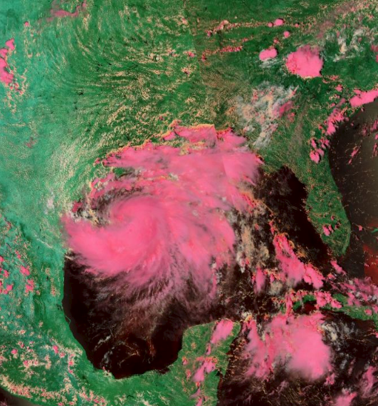
Conclusions
  Takeaways
  EJ takes time
  Capacity-building challenges
  Active participation in science
  Pathway Forward
  Emphasize relationship building and inter-term continuity of contact
  Transparency, reciprocity, accessibility, sensitivity, and awareness
  Connecting with new organizations
  Creating DEVELOP project opportunities
Basemap Attribution: ESRI, NASA VIIRS / Suomi-NPP
Notes:
Through this project, we identified crucial points to consider in bringing together EJ, disasters, and remote sensing work.
First, EJ takes time. Many organizations emphasized the importance of time to build strong and trustworthy relationships throughout communities.
Second, there are challenges to capacity building within communities as marginalized groups often can’t dedicate extra time or resources to finding and learning geospatial software and tools. Without this knowledge, communities may not be able to participate in decision-making processes in their region.
Third, it is critical that projects at the intersection of EJ, disasters, and remote sensing are community-led. As scientists, science communicators, and community outsiders, we need to listen to community and organizational experiences and needs. This will allow us to gain a deeper understanding of barriers in order to effectively contribute to building community capacity.
Organizations expressed a lot of interest in collaborating and learning how to use NASA data to empower their communities through DEVELOP and beyond the scope of a project. DEVELOP and NASA Applied Sciences have an opportunity to bring underserved communities into the landscape of remote sensing. In addressing environmental problems, it is important to ensure the diversity of voices affected by EJ is meaningfully represented.
Sustained engagement with organizations that can have the most direct impact in these communities is an essential step in making sure these voices and concerns are heard.
As we move forward, the use of EJ principles is paramount in building strong relationships with communities and organizations. Continuing communication and relationship building with the organizations we have contacted can introduce future DEVELOP project opportunities to communities across the US and bridge an accessibility gap for groups that may not be as familiar with the extensive capabilities and applications of GIS.
Team-created map. NASA data.
----Basemap Credits----
1. Esri
Sources: Esri, DigitalGlobe, GeoEye, i-cubed, USDA FSA, USGS, AEX, Getmapping, Aerogrid, IGN, IGP, swisstopo, and the GIS User Community

Slide 13
DISASTER AND EJ ORGANIZATIONS
Alaska
Alaska Institute of Justice – Robin Bronen
Gulf Coast
Imagine Water Works – Klie Klibert & Miriam Belblidia
Seeds of Resistance – Guadalupe de la Cruz
SBP – Elizabeth Egle & Reese May
West Coast
Depave – Katya Reyna
East Coast
All Hands and Hearts – George Hernandez Mejia
Americares – Diana Maguire & Kristin Stevens
The Fuller Center for Housing – Stacey Driggers
NC Climate Justice Collective – Jodi Lassetter & Connie Leeper
Intermountain West
Save Our Great Salt Lake – Chandler Rosenberg
Friends of Great Salt Lake – Lynn de Freitas
Valle de Oro National Wildlife Refuge – Jennifer Owen-White; Katie McVey, & Xavier Barraza
Notes:
We’d like to thank all of the organizations for their impactful work, engaging conversations, and enthusiasm about our project.

Slide 14
Project Partners
NASA DEVELOP
NASA Applied Sciences
Science Advisor
Lauren Childs-Gleason
DEVELOP Fellow
Marco Vallejos
EJ and Disaster Experts
Dr. Sara Grineski & Dr. Tim Collins (University of Utah, Center for Natural and Technological Hazards)​
Dr. Jennifer Pipitone (College of Mount Saint Vincent)​
Dr. Lori Peek (University of Colorado Boulder, Natural Hazards Center)
Notes:
We’d also like to thank our support system at DEVELOP and the researchers who shared their expertise and contributed to the success of our project.
Maps throughout this work were created using ArcGIS® software by Esri. ArcGIS® and ArcMap™ are the intellectual property of Esri and are used herein under license.

