Slide 1
Indonesia Agriculture
Identifying Current Areas of Palm Oil Production and Modeling a Risk Map for Future Expansion in Central Kalimantan, Indonesia
Kyle Peterson (Project Lead)
Abigail Childs
Michael Riedman
Notes:
Kyle:
Hello my name is Kyle Peterson and I am the team lead
Abigail:
I am Abigail Childs
Michael:
I am Michael Riedman and we are the Indonesia Agriculture team

Slide 2

Project Motivation
Problem: Indonesia is currently experiencing rapid unsustainable growth in palm oil plantations
Objective: To develop geospatial mapping layers and associated metrics that identify areas of palm oil production at the district-level in Central, Kalimantan, Indonesia
Why: Difficult to map palm oil plantations using traditional remote sensing techniques
Notes:
Slide 3 - Study Period
Abby:
Our project utilized data collected over a 16 year study period from January 2000 – January 2016.
This image shows areas of forest loss in Central Kalimantan within our study period.
There has been considerable forest loss region particularly in the southwest portion of the province. Most of this can be attributed the expansion of palm oil plantations which have been steadily increasing by 120,000 – 140,000 hectares per year since 2000.
------------------------------------------------------------------------------------------------------------------------------------------------------------------------------------
Our project utilized data over a 16 year study period from January 2000 – January 2016.
*CLICK
This image shows areas of forest loss in Central Kalimantan between 2000-2014, collected over 14 years using Landsat imagery
There was considerable forest loss in this region over that 14 year period, particularly in the southwest portion of the province. Most of this loss is estimated to have come from the increase in palm oil plantations- palm oil plantations in Central Kalimantan have increase by 120,000 – 140,000 hectares per year since 2000.
Citation
Yayu Ramdhani and R. Kiki Taufik, Land Suitability Analysis for Sustainable Oil-palm Plantations in Kalimantan using Fuzzy Weighted Linear Combination on Multi Criteria- Spatial Decision Support System
Hansen/UMD/Google/USGS/NASA ->Forest loss data: http://earthenginepartners.appspot.com/science-2013-global-forest/download_v1.2.html
ESRI Basemap :World Imagery provides one meter or better satellite and aerial imagery in many parts of the world and lower resolution satellite imagery worldwide. The map includes 15m TerraColor imagery at small and mid-scales (591M down to 72k) and 2.5m SPOT Imagery (288k to 72k) for the world, and USGS 15m Landsat imagery for Antarctica. The map features 0.3m resolution imagery in the continental United States and 0.6m resolution imagery in parts of Western Europe from Digital Globe. Recent 1m USDA NAIP imagery is available in select states of the US. In other parts of the world, 1 meter resolution imagery is available from GeoEye IKONOS, Getmapping, AeroGRID, IGN Spain, and IGP Portugal. Additionally, imagery at different resolutions has been contributed by the GIS User Community. For more information on this map, including the terms of use, visit us online at http://goto.arcgisonline.com/maps/World_Imagery

Slide 3
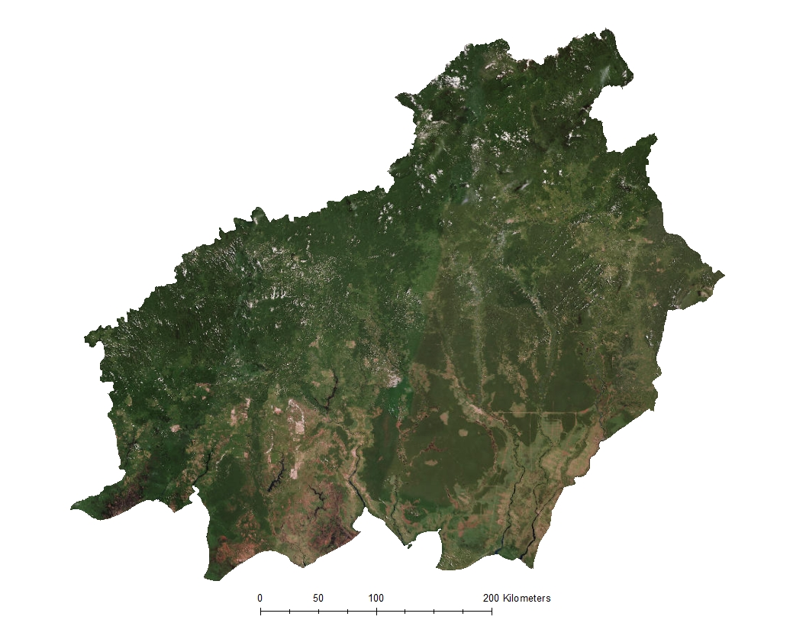
Study Area
Central Kalimantan,
Indonesia
Notes:
Michael:
Central Kalimantan, Indonesia is located in Southeast Asia, on the island of Borneo, the third largest island in the world.
Central Kalimantan is a remote province that is home to natural rainforests, peatlands, and many endangered species, such as orangutans, pygmy elephants.

Slide 4
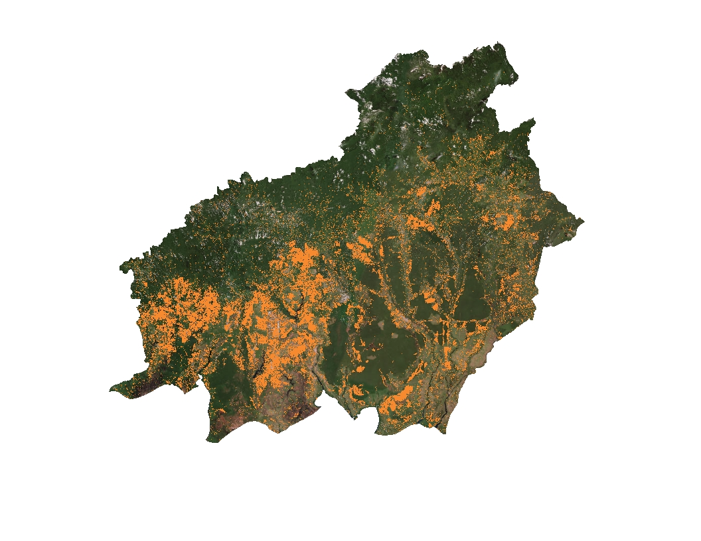
Study Period
January 2000 – January 2016
Palm oil plantations expanded by 120,000-140,000 ha/yr since 2000
Loss of Forest, 2000-2014
Image Credit: Hansen/UMD/Google/USGS/NASA
Notes:
Slide 3 - Study Period
Abby:
Our project utilized data collected over a 16 year study period from January 2000 – January 2016.
This image shows areas of forest loss in Central Kalimantan within our study period.
There has been considerable forest loss region particularly in the southwest portion of the province. Most of this can be attributed the expansion of palm oil plantations which have been steadily increasing by 120,000 – 140,000 hectares per year since 2000.
------------------------------------------------------------------------------------------------------------------------------------------------------------------------------------
Our project utilized data over a 16 year study period from January 2000 – January 2016.
*CLICK
This image shows areas of forest loss in Central Kalimantan between 2000-2014, collected over 14 years using Landsat imagery
There was considerable forest loss in this region over that 14 year period, particularly in the southwest portion of the province. Most of this loss is estimated to have come from the increase in palm oil plantations- palm oil plantations in Central Kalimantan have increase by 120,000 – 140,000 hectares per year since 2000.
Citation
Yayu Ramdhani and R. Kiki Taufik, Land Suitability Analysis for Sustainable Oil-palm Plantations in Kalimantan using Fuzzy Weighted Linear Combination on Multi Criteria- Spatial Decision Support System
Hansen/UMD/Google/USGS/NASA ->Forest loss data: http://earthenginepartners.appspot.com/science-2013-global-forest/download_v1.2.html
ESRI Basemap :World Imagery provides one meter or better satellite and aerial imagery in many parts of the world and lower resolution satellite imagery worldwide. The map includes 15m TerraColor imagery at small and mid-scales (591M down to 72k) and 2.5m SPOT Imagery (288k to 72k) for the world, and USGS 15m Landsat imagery for Antarctica. The map features 0.3m resolution imagery in the continental United States and 0.6m resolution imagery in parts of Western Europe from Digital Globe. Recent 1m USDA NAIP imagery is available in select states of the US. In other parts of the world, 1 meter resolution imagery is available from GeoEye IKONOS, Getmapping, AeroGRID, IGN Spain, and IGP Portugal. Additionally, imagery at different resolutions has been contributed by the GIS User Community. For more information on this map, including the terms of use, visit us online at http://goto.arcgisonline.com/maps/World_Imagery

Slide 5
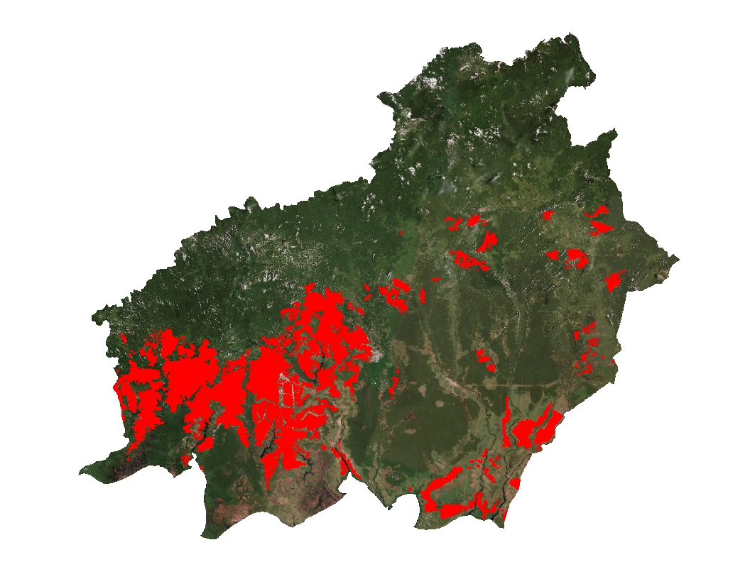
Current Plantations
Indonesia has set a goal to expand palm oil plantations by 20 million ha by 2020
Plantation Locations
Data from: World Wildlife Fund and Global Forest Watch
Notes:
Slide 4 - Current Plantations
Abby:
Our project utilized data collected over a 16 year study period from January 2000 – January 2016.
This image shows areas of forest loss in Central Kalimantan within our study period.
There has been considerable forest loss region particularly in the southwest portion of the province. Most of this can be attributed the expansion of palm oil plantations which have been steadily increasing by 120,000 – 140,000 hectares per year since 2000.are likely increase their plantation sizes in the near future since these areas have existing infrastructure making the relative cost of growth and expansion inexpensive.
Citations: Data layers obtained from Global Forest Watch (http://data.globalforestwatch.org/datasets/baae47df61ed4a73a6f54f00cb4207e0_5) and provided by World Wildlife Fund
ESRI Basemap: World Imagery provides one meter or better satellite and aerial imagery in many parts of the world and lower resolution satellite imagery worldwide. The map includes 15m TerraColor imagery at small and mid-scales (591M down to 72k) and 2.5m SPOT Imagery (288k to 72k) for the world, and USGS 15m Landsat imagery for Antarctica. The map features 0.3m resolution imagery in the continental United States and 0.6m resolution imagery in parts of Western Europe from Digital Globe. Recent 1m USDA NAIP imagery is available in select states of the US. In other parts of the world, 1 meter resolution imagery is available from GeoEye IKONOS, Getmapping, AeroGRID, IGN Spain, and IGP Portugal. Additionally, imagery at different resolutions has been contributed by the GIS User Community. For more information on this map, including the terms of use, visit us online at http://goto.arcgisonline.com/maps/World_Imagery

Slide 6
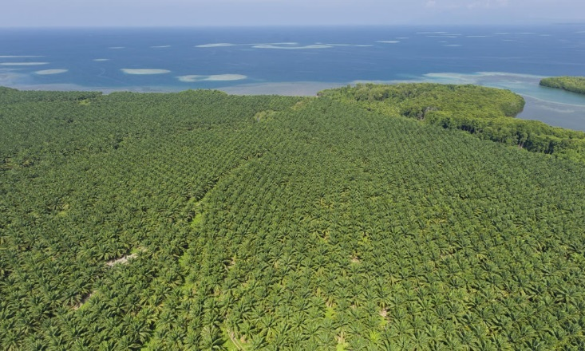

Objectives
Identify current palm oil plantations in Central Kalimantan, Indonesia using Maxent
Generate a likelihood assessment map of future palm oil plantations based on identified plantations
Enhance World Wildlife Fund’s ability to combat deforestation using NASA Earth observations
Image Credit: World Wildlife Fund
Don’t destroy my home!!!
Image Credit: Flickr (Restless Mind)
Notes:
Slide 5 - Objectives
Kyle:
There were two primary objectives for this project:
1.The first objective was to create a model that identifies the probability of current palm oil plantations in Central Kalimantan, based on in situ data provided by the World Wildlife Fund, data obtained from NASA satellites, and other ancillary data.
2. The second objective was to generate a likelihood of expansion map based on WWF in situ data combined with deforestation data.
Both objectives used Maxent to model the presence of palm oil plantations in Central Kalimantan
Both end products will be used by WWF to combat deforestation in specific provinces and to protect virgin rainforest, peatlands, and biodiversity.
Image Link:
http://www.worldwildlife.org/photos/sustainably-produced-palm-oil
https://www.flickr.com/photos/restless_mind/2318914518/sizes/l

Slide 7
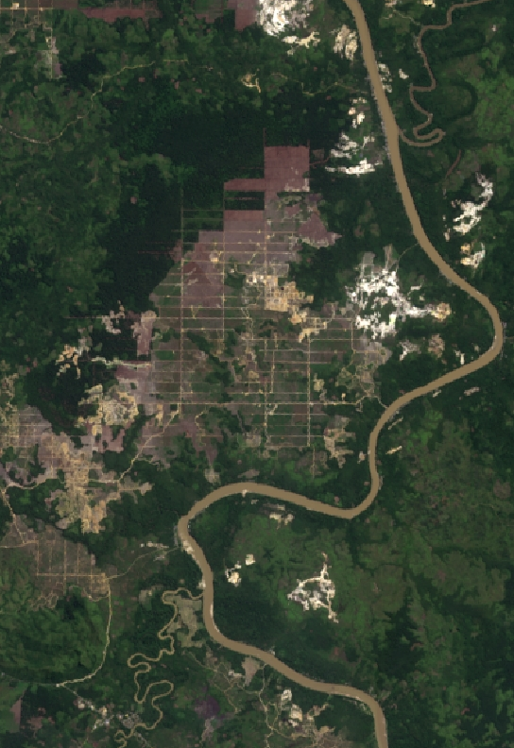
Community Concerns
Deforestation
Increasing CO₂ emissions
Rainforest and biodiversity loss
Image Credit: Landsat 8
Notes:
Slide 6 - Community Concerns
Michael:
The most cost effective way of of converting land into palm oil plantations is to burn the existing forests and peatlands.
This deforestation and burning has been recognized as one of the leading drivers of CO2 emissions, greatly impacting the carbon cycle.
The biodiverse forests of Central Kalimantan, are home to endangered orangutans and elephants. Palm oil has become an integral ingredient in everyday consumer products, from ramen noodles to girl scout cookies, from toothpaste to cosmetics
Palm oil is a leading driver of deforestation in Indonesia.

Slide 8
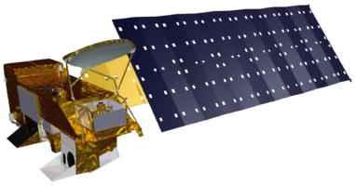
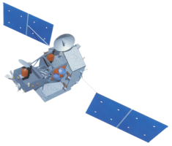
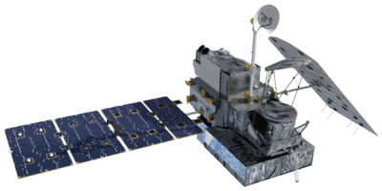
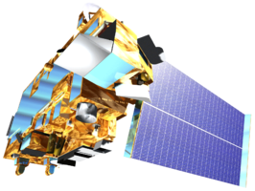
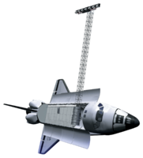
Data Acquisition
NASA Earth Observations:
  Giovanni Data Portal
  USGS Earth Explorer
Ancillary Data:
  DIVA GIS
  WORLDPOP.org
  Global Forest Watch
  World Resource Institute
WWF Field Data:
  WWF Indonesia
Aqua MODIS
TRMM TMI
GPM GMI
Terra MODIS
SRTM IFSAR
Notes:
Slide 7 - Data Acquisition
In order to create these end products we utilized free and open source data. NASA Earth observation data was gathered using USGS Earth Explorer and the Giovanni data portal. The ancillary data data was acquired from a number of sources including worldpop.org, global forest watch, and the world resource institute.

Slide 9
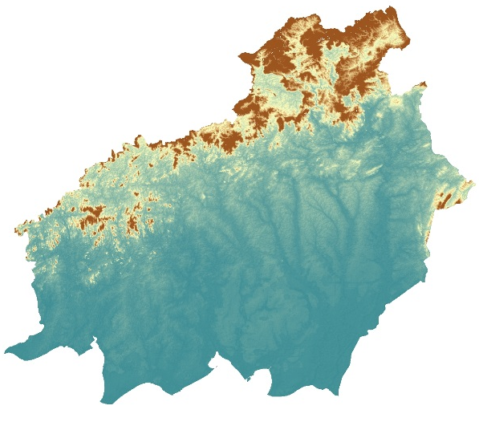
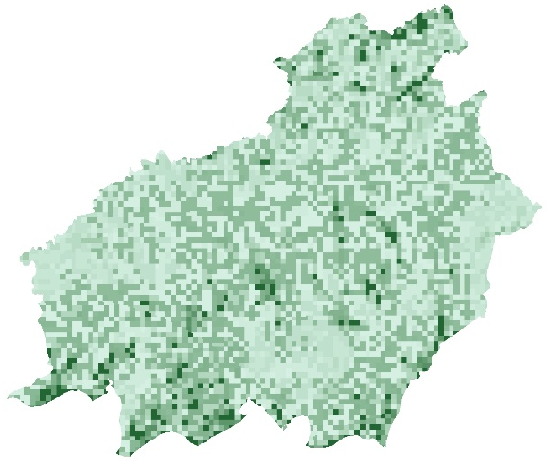
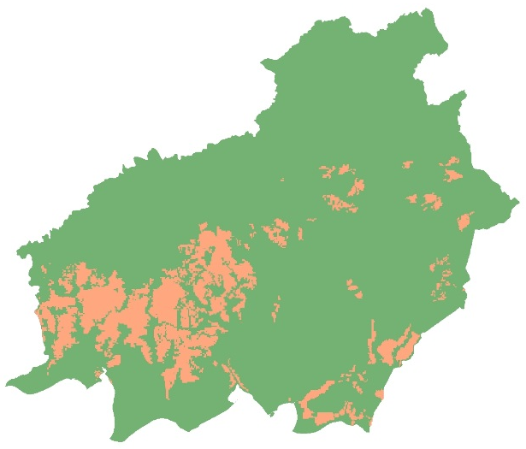
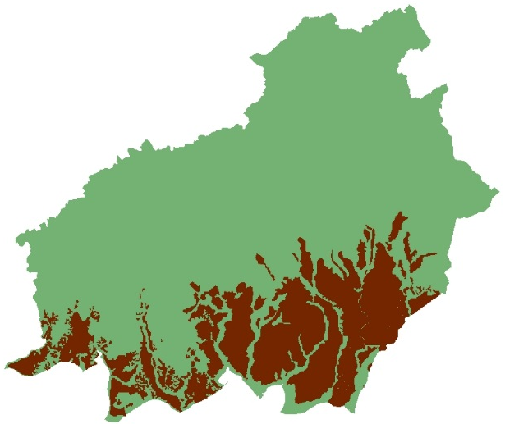
Data Acquisition
NASA Earth Observations:
  Precipitation
  Relative Humidity
  NDVI
  EVI
  Surface Temperature
  Elevation/Slope
Ancillary Data:
    Roads
    Administrative Boundaries
    Water
    Settlements
    Population
    Protected Areas
    Soil Type
    Peatlands
    Plantations
    Concessions
Notes:
Slide 8 - Data Acquisition
There were a wide range of datasets acquired. Utilizing NASA Earth observations information such as vegetation indexes, climatic conditions, and elevation were readily available. Ancillary datasets included roads, boundaries, peatlands, conservation areas, and palm oil concessions.

Slide 10
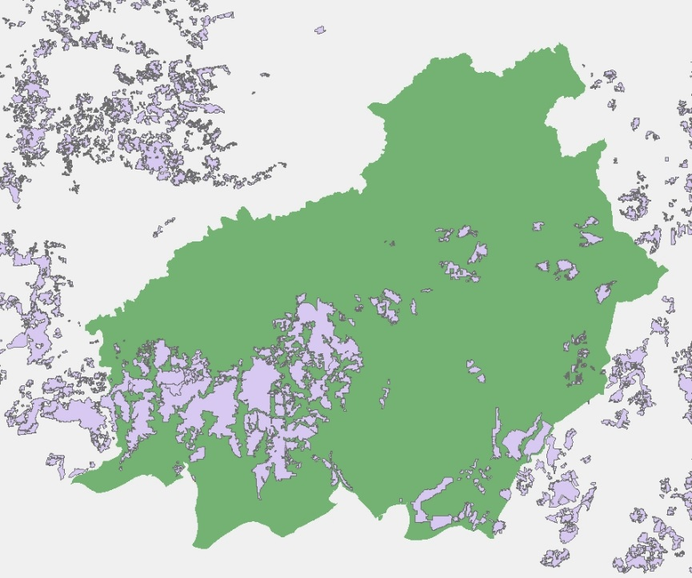
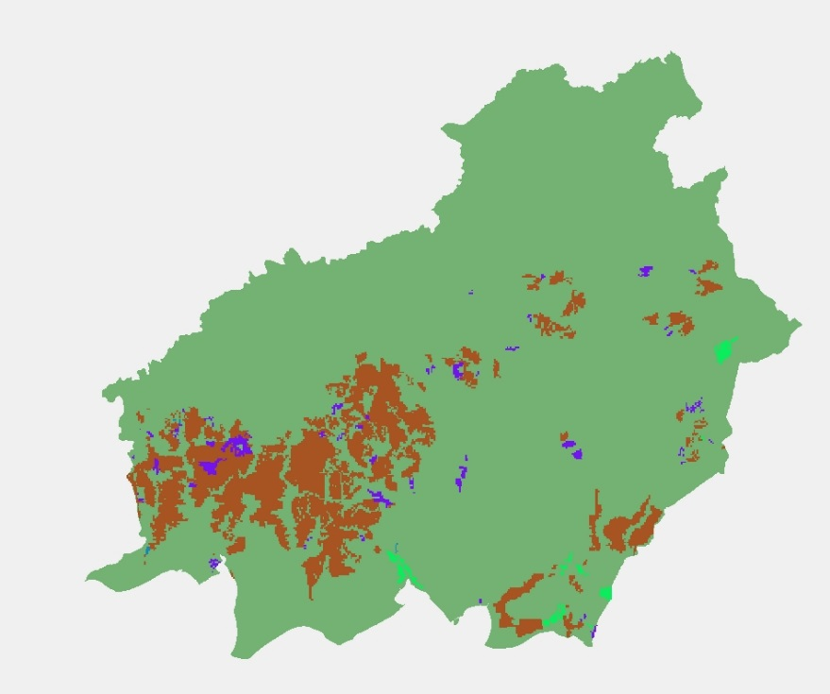

Data Processing
Python Script:
  Convert vector data to raster
  Project to WGS1984_UTM_ZONE_50_N
  Resolution:100x100 meters
  Consistent extent between layers
  Convert file format to ASCII
Notes:
A condition of Maxent is that all input data must have the same cell size, spatial resolution, and extent for Maxent to process and model the data. Both vector and raster data were processed using a python program to make the resampling of input data streamlined and uniform. The program pulled files from a folder, converted vectors to rasters, changed files to have a cell size of 1 hectare, matched extent and number of rows and columns for all rasters, clipped the rasters to the study area, and converted the outputs into ASCII files that could be entered into the Maxent
Image source: python.org
--------------------------------------------------------------------------------------------------------------------------------------------------------------------------------------------
A condition of Maxent is that all input data must have the same cell size and resolution for Maxent to process and effectively model the data. Both vector and raster data were processed using a python program to make the resampling of input data more streamlined. The program pulled files from a folder, converted vectors to rasters, changed files to have a cell size of 1 hectare, a matching extent and number of rows and columns, then clipped the rasters to the study area, and converted the outputs into ASCII files that could be entered into the Maxent
Image source: python.org

Slide 11
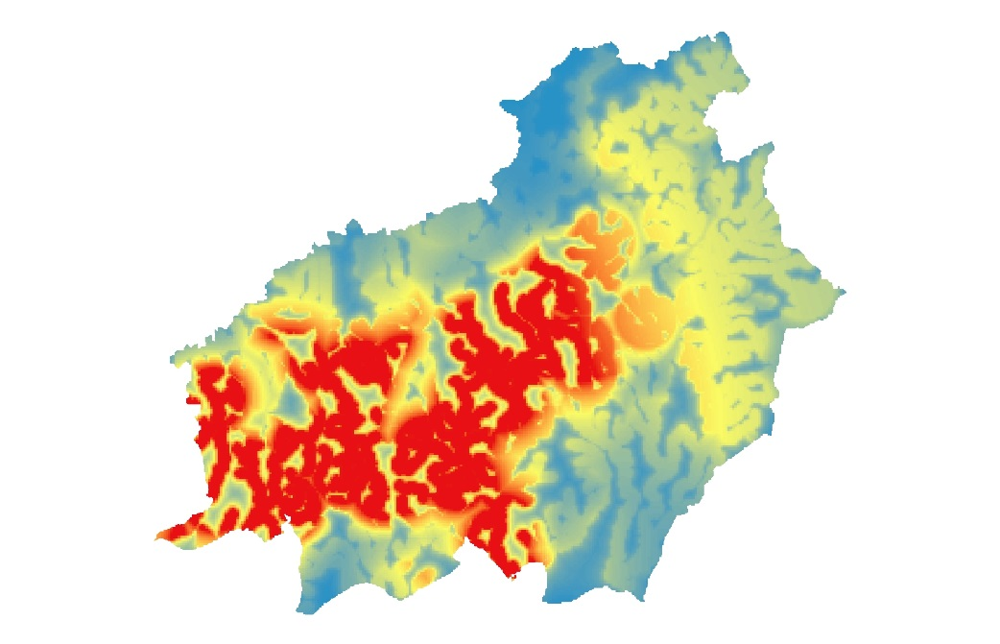
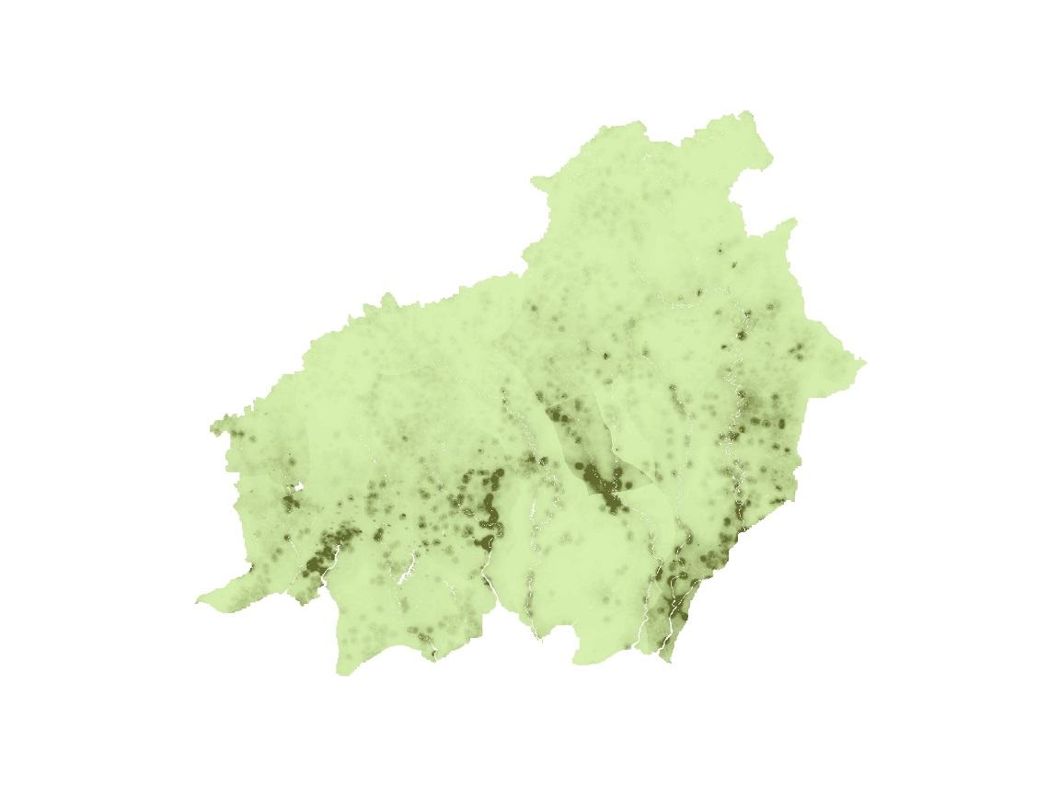
Data Processing
Accessibility Index
  Combination of Palm Oil Mill Locations, Roads, Water, Settlements
    Generated Euclidean Distance for each layer
    Assigned a Fuzzy Membership value between 0-1
    Combined using Fuzzy Overlay
Population Trends
  Population data from 2010 and 2015
    Pop2015 - Pop2010 = Population Change
    Neighborhood Analysis
Notes:
Slide 10 - Data Processing
Accessibility: The accessibility layer is a combination of vector inputs such as sustainable palm mill locations, roads, water, and settlements. A Euclidean distance was generated for each layer and each layer was assigned a fuzzy membership value between 0 and 1. These layers were then combined using a fuzzy overlay.
Population Trends: The population trends layer used worldpop estimates for 2010 and 2015. To gauge the overall change we subtracted the 2010 data from year 2015 and used a neighborhood analysis to assign mean values.
----------------------------------------------------------------------------------------------------------------------------------------------------------------------------------

Slide 12
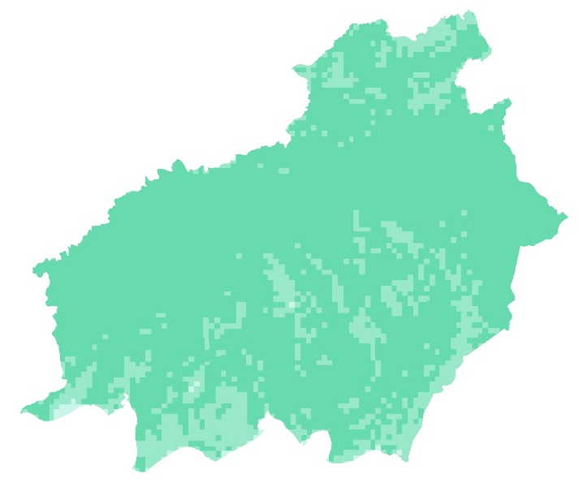
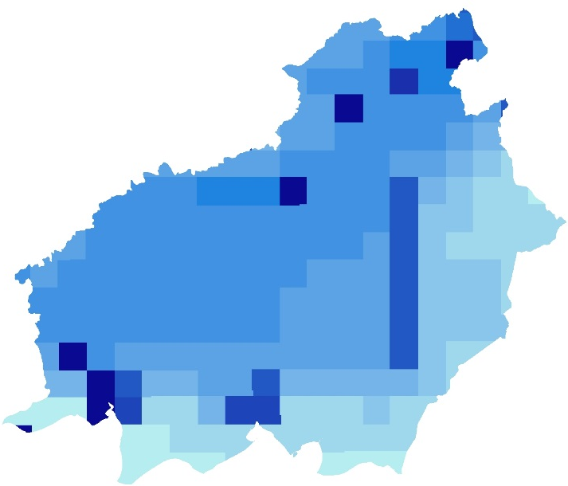

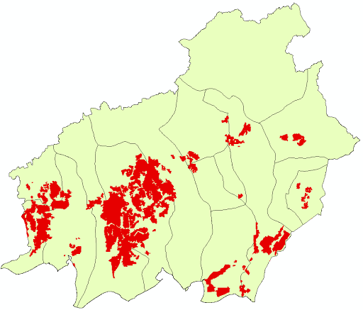

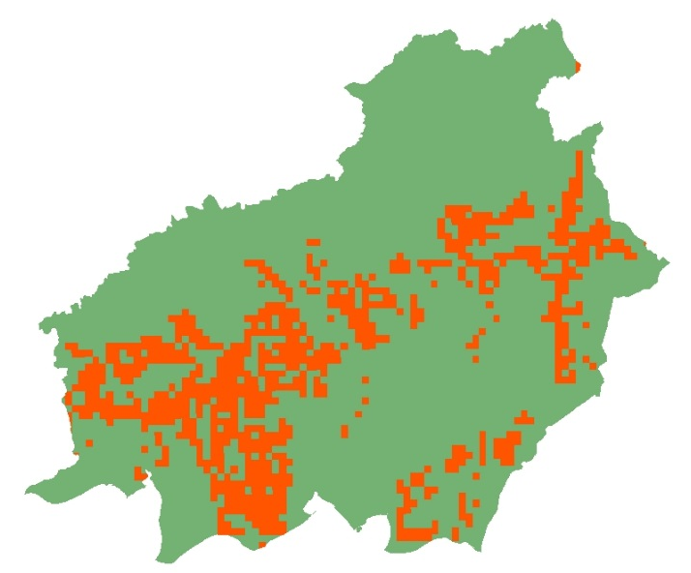


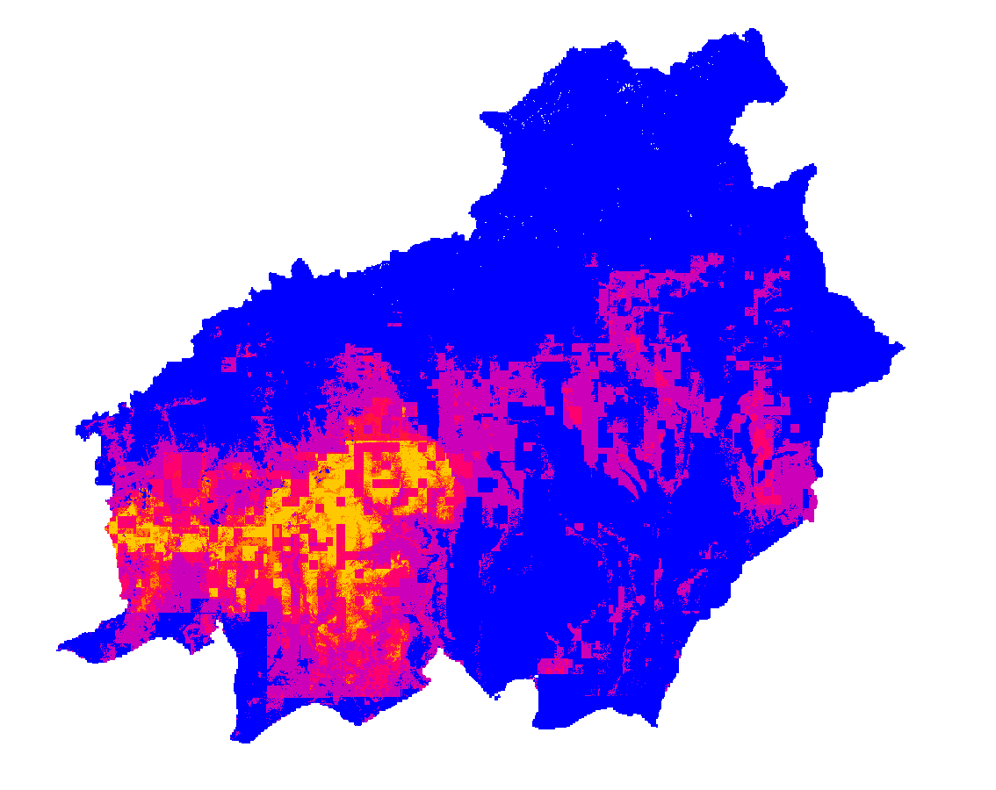

Methodology
NASA Earth Observations
Training Data
MAXENT
Ancillary Data
Potential Locations
Notes:
Slide 11 - Methodology
After all of our data were acquired and processed they were then ready to be loaded into the Maxent modeling software.
Within Maxent we used both NASA EO’s and ancillary data as environmental variables.
We then added known palm oil plantation data provided by WWF, as the training data for Maxent. Sample points from the polygon layer were created using a random sample generator to randomly select 500 points, greater than 500 meters apart, in known palm oil plantation locations.
The known locations information was used as the input into Maxent and the environmental variables were tested against the training data to predict areas where other palm oil plantations may exist.
These data layers were entered into the maxent model and produced a map of potential palm oil locations based on the inputs.
-----------------------------------------------------------------------------------------------------------------------------------------------------------------------------------

Slide 13
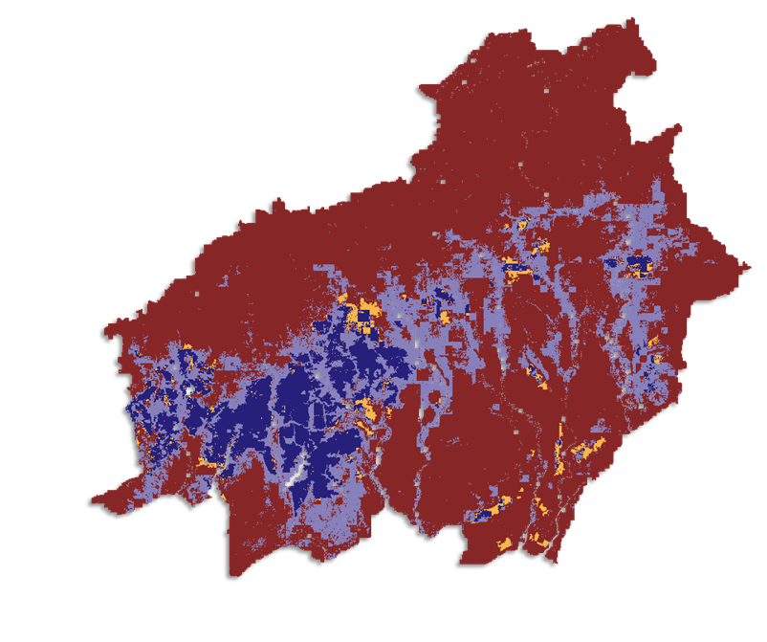
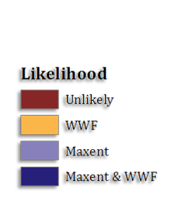
Results:
Probable Current Palm Oil Locations
AUC=0.835
Stdv= 0.024
n = 704
% Total Ha
70%
1.6%
60% threshold
19.45%
8.82%
Notes:
Slide 12- Results
Abby:
Our results determined that the most probable locations for palm oil plantations are in the southwestern portion of Central Kalimantan.
Our maxent prediction model was strong, with a mean area under the curve score of 0.835 and a standard deviation 0.024, meaning that our model was significant. Palm oil concessions, elevation, and accessibility were the main drivers of the model.
Compared with known palm oil plantation locations, our model did well in predicting current palm oil plantation locations, as well as identifying previously unknown plantation locations. This map highlights the overlap and differences between our findings and WWFs data.

Slide 14
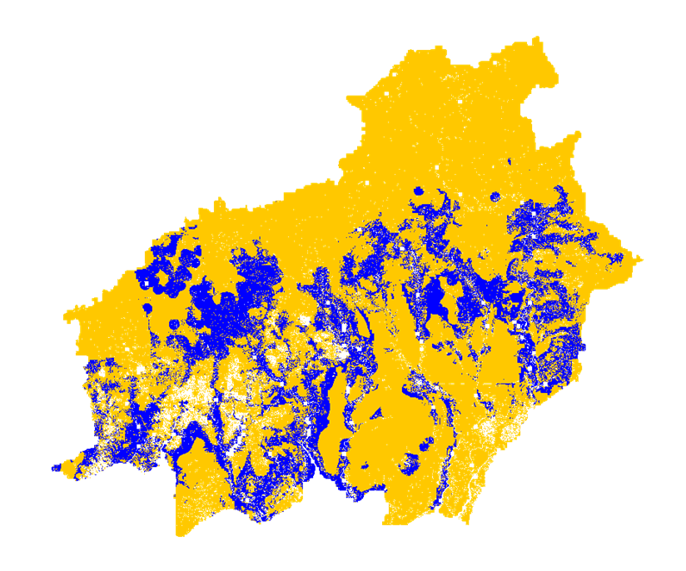
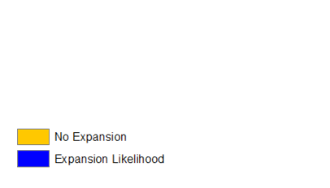
Results:
Likelihood of Conversion
AUC=0.713
Stdv= 0.047
n = 234
3,442,325 ha
40% threshold
Notes:
Slide 13- Results
Abby:
The second run of Maxent was to model likelihood for palm oil plantation expansion in Central Kalimantan. The input data for this model was a combination of known palm oil plantation locations and forest loss from 2000-2016 throughout the region. Environmental variables were accessibility, population growth from 2015-2020, provinces, primary forest, peatlands, and conservation areas. The AUC score was 0.713 with a standard deviation of 0.047. While not as strong as our palm oil prediction locations model, this model is still significant.

Slide 15
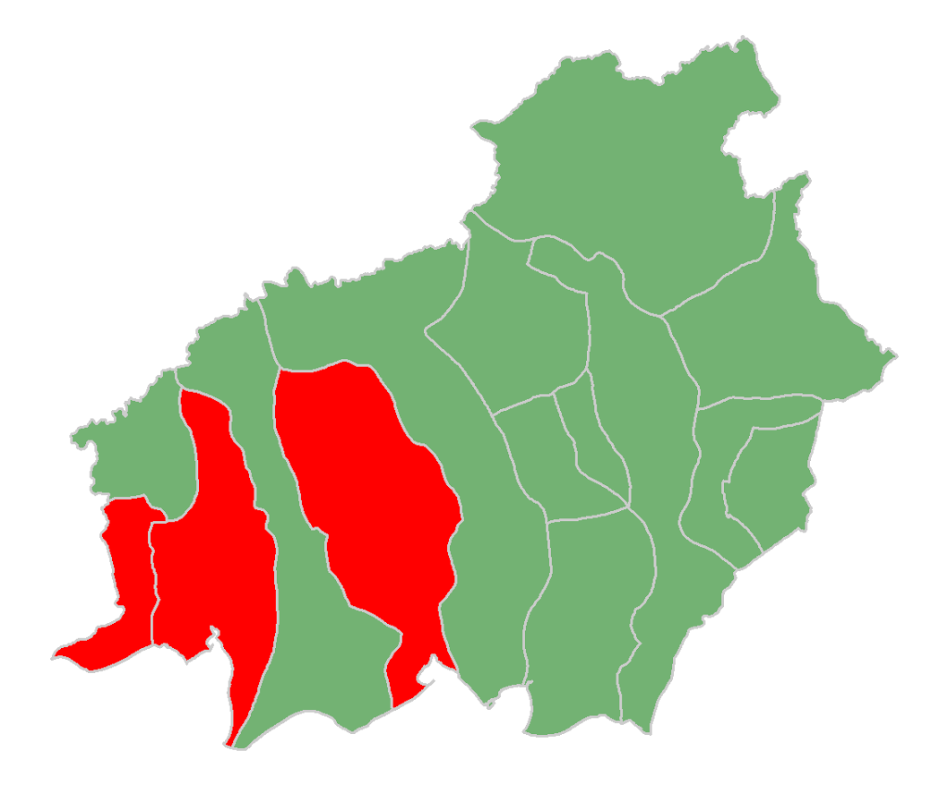
Conclusions
Most plantations occur and are likely to expand in southwestern Central Kalimantan
Conservation areas and peatlands were not substantial contributors to the likelihood model
These results will allow decision makers to see what districts are at greatest likelihood of expansion into forested areas
3
1
2
Regencies Most at Risk:
Sukamara
Kotawaringin Barat
Kotawaringin Timur
Flickr: RestlessMinds
Notes:
Slide 15 - Conclusions
Kyle:
By using this soft approach we were able to predict palm oil plantations accurately enough to provide decision makers with important information that can be used to combat issues raised by the palm oil industry in Indonesia.

Slide 16
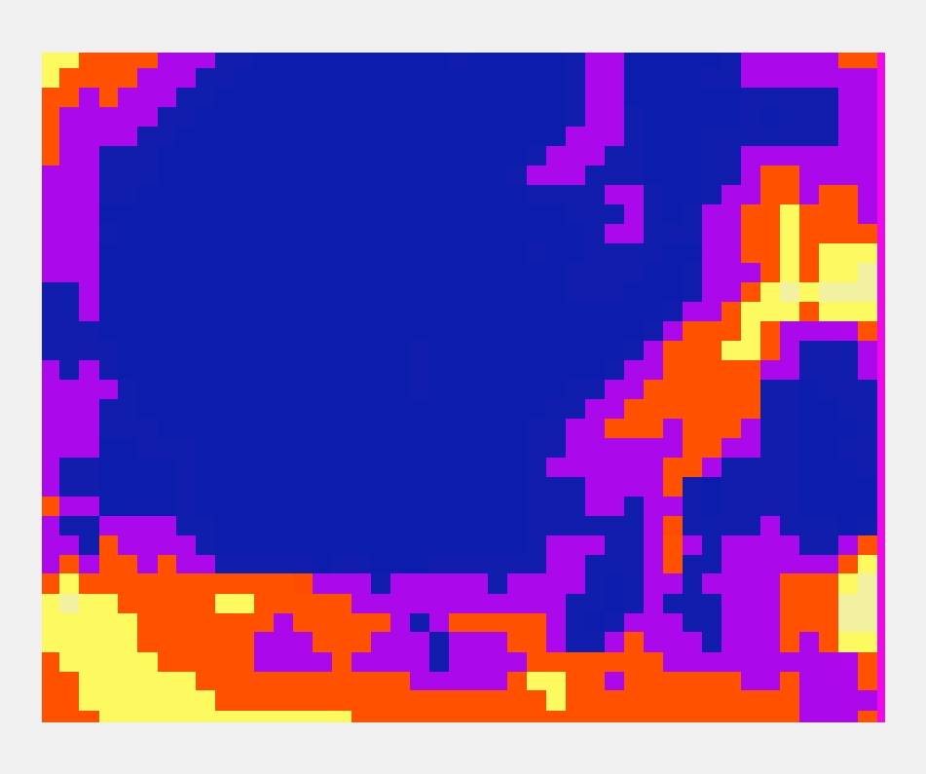
Errors & Uncertainties
Datasets omitted
  EVI
  Soil Types
  Climatic Variables
  Slope
Possible spatial autocorrelation from training data
Lack of current data from Indonesia
Notes:
Slide 16 - Errors and Uncertainty
Michael:
It is important to remember that this project is a work in progress and that statistical modeling is an imperfect science.
Potential errors could be linked to issues with data, coarse resolution, and a lack of current information in Central Kalimantan.
Multiple layers were omitted/excluded from our models along the way.
-EVI, Soil types, climatic variables, slope, Land use change
Much work is still left to be done.

Slide 17
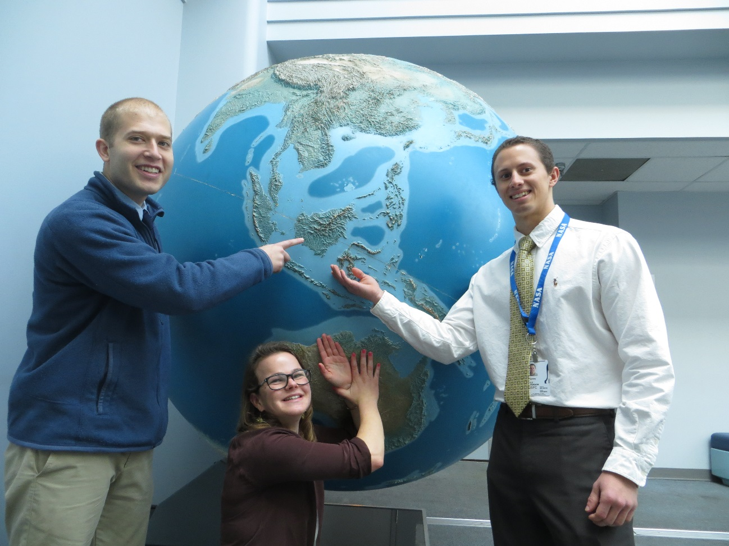
Future Work
Expand scope of work to all of Kalimantan
Other countries experiencing palm oil production growth
Expand model to incorporate future projections
Notes:
Slide 16 - Future Work
Abby:
We hope that future work can expand on our project and extrapolate our findings to the entire region of Kalimantan, Indonesia. By using our results to model current locations of palm oil plantations in Kalimantan, WWF and other NGOs can better target their resources over a wider range, thus curbing deforestation of conserved areas and reducing biodiversity loss.
Expand model to incorporate future projections of deforestation and land cover change.
-deforestation estimates for:
-5 years
-10 years
-15 years etc.
Add Land use change and land classification to the model

Slide 18
Advisors
Dr. Naikoa Aguilar-Amuchastegui, WWF (Science Advisor)
Aakash Ahamed, USRA/GSFC (Science Advisor)
Partners
World Wildlife Fund
World Wildlife Fund Indonesia
DEVELOP Staff
Sean McCartney, SSAI/GSFC (DEVELOP Center Lead)
Notes:
Slide 17 - Acknowledgments
Kyle:
We would like to acknowledge both Dr. Naikoa Aguilar-Amuchastegui and Aakash Ahamed for their advice and guidance over the course of this project.
We would also like to thank World Wildlife Fund for partnering with NASA DEVELOP to bring this project to life and for advising us throughout the project.
Lastly, we would like to thank Sean McCartney at DEVELOP his help and guidance throughout the course of this project.

