Slide 1
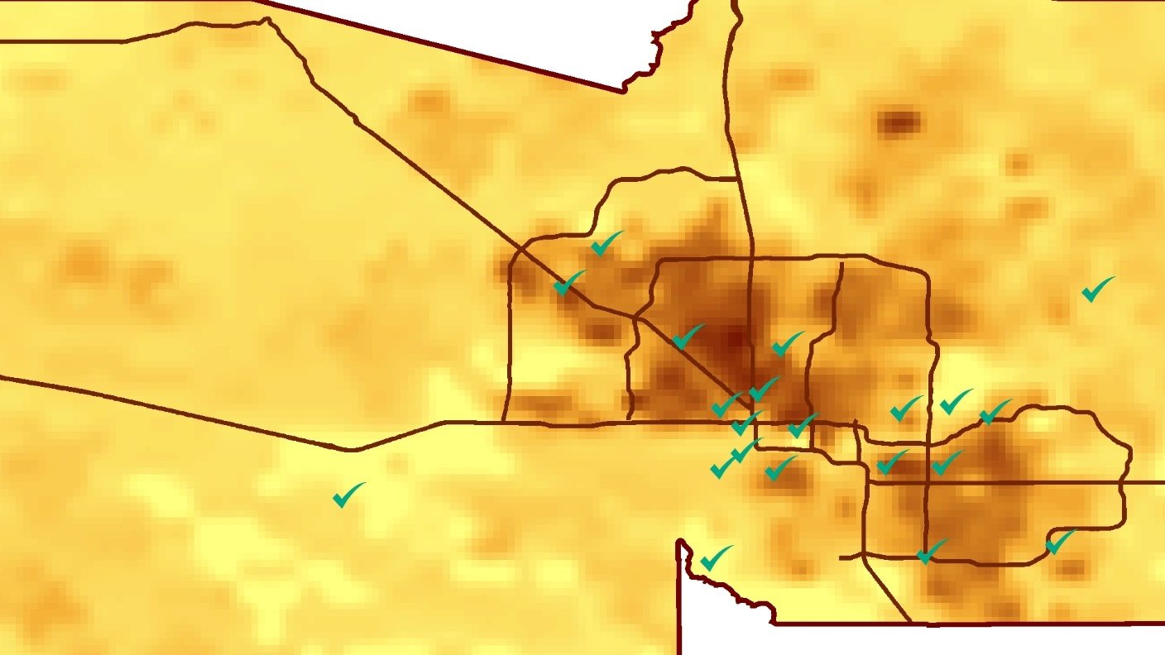
MARICOPA COUNTY HEALTH & AIR QUALITY II
Tamara Dunbarr (Project Lead)
Modeling a Decade of PM10 Concentrations in Maricopa County, Arizona for Air Quality and Epidemiological Analysis
Michael Pechacek
Jayanth Serla
Parul Singh
Notes:
Thank you for joining us today. Our team represents the Maricopa County Health and Air Quality project for NASA DEVELOP. Today we will be talking about studying particulate matter in a semi-arid desert region.

Slide 2
Background
Particulate matter <10 µm in aerodynamic diameter
PM10 is a large contributor of air pollution in Urbanized areas
Semi arid regions are particularly vulnerable due to dust storms
Excessive human exposure to PM10 can result in respiratory and cardiovascular disease
Image Credit: Mircea
Notes:
PM 10 is particulate matter measuring 10 micrometers or less in aerodynamic size PM10 is a concern because it is pollution
Deserts have a lot of PM10
PM10 can cause health problems
Image Source: http://commons.wikimedia.org/wiki/File:Claude_Monet_-_The_Magpie_-_Google_Art_Project.jpg

Slide 3
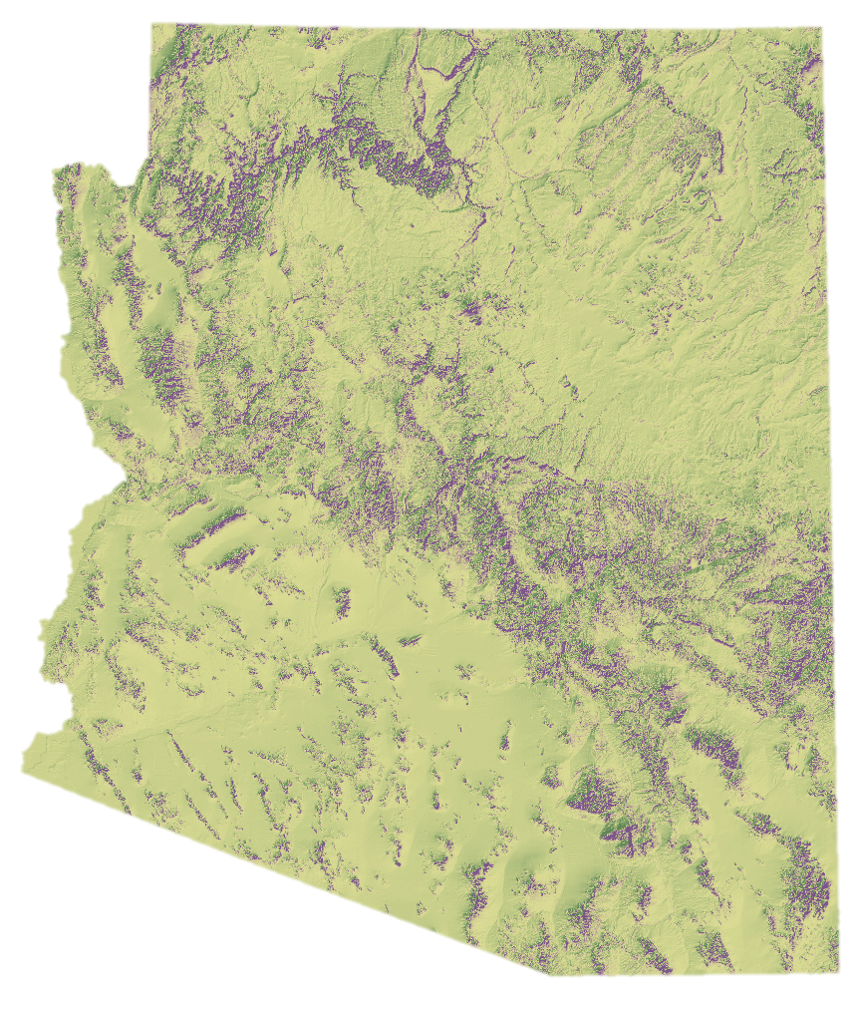
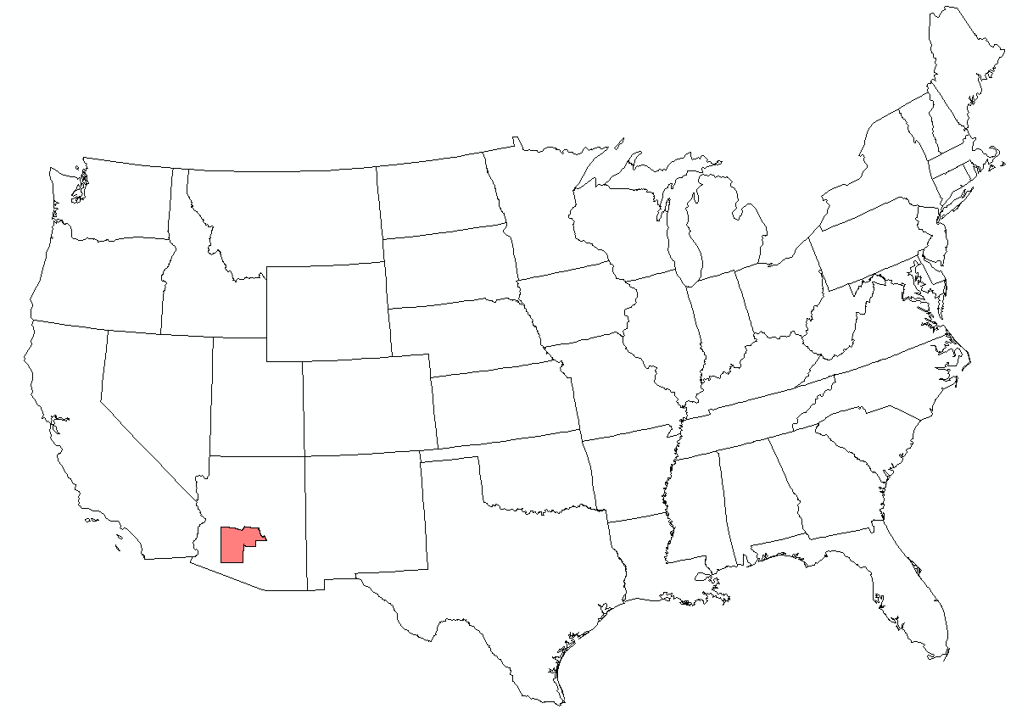
Study Area
Maricopa County, Arizona
9224 square miles
4.1 million people (US Census 2010)
Large population living in the Phoenix metropolitan area
Maricopa
County
Notes:
The study area is Maricopa County, Arizona. This area houses the Phoenix Metro area, and comprises a population of approximately 4.1 million people and covers over 9 thousand square miles

Slide 4
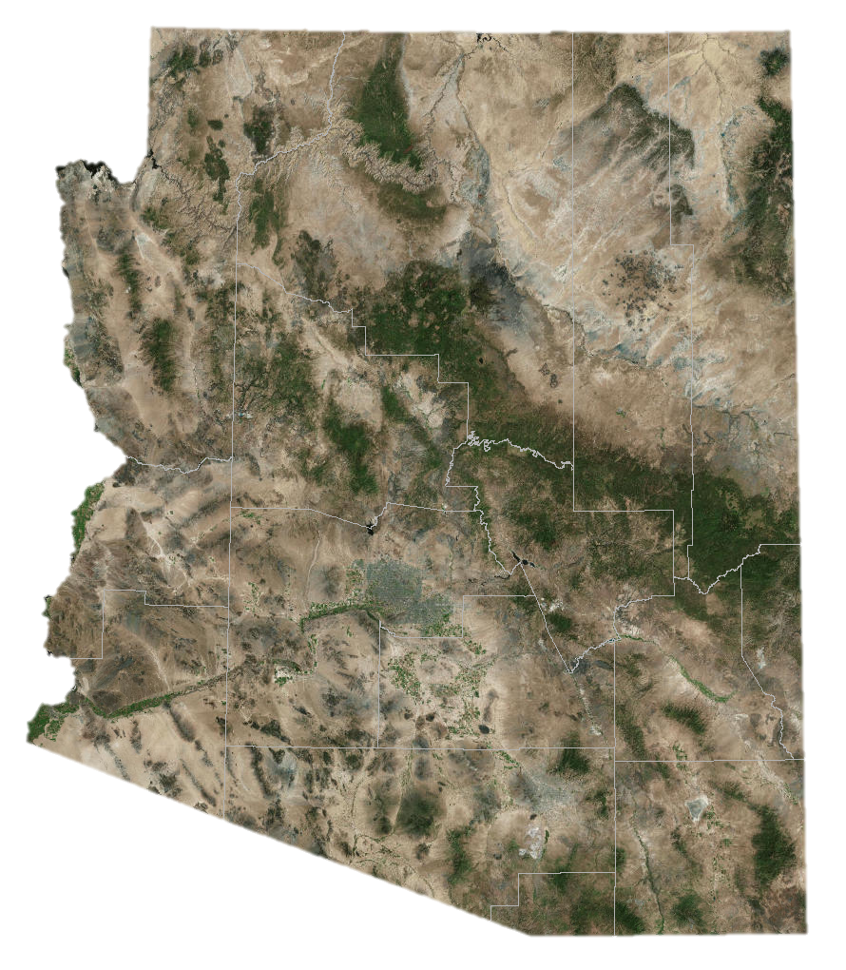
Study Period
Global sub-tropical high pressure zone
Very hot, dry summer, mild winters and significant dust storm events
Study Period – 1st January 2006 – 31st December 2016
Study Period – 1st January 2006 – 31st December 2016
Maricopa County
Notes:
Maricopa county is located at approximately 33 degrees north, which is in a global high-pressure band. The area is categorized by hot, dry summers and mild winters. It is a semi-arid desert, and is subjected to numerous dust events.
Image Source: http://commons.wikimedia.org/wiki/File:Claude_Monet_-_The_Magpie_-_Google_Art_Project.jpg

Slide 5
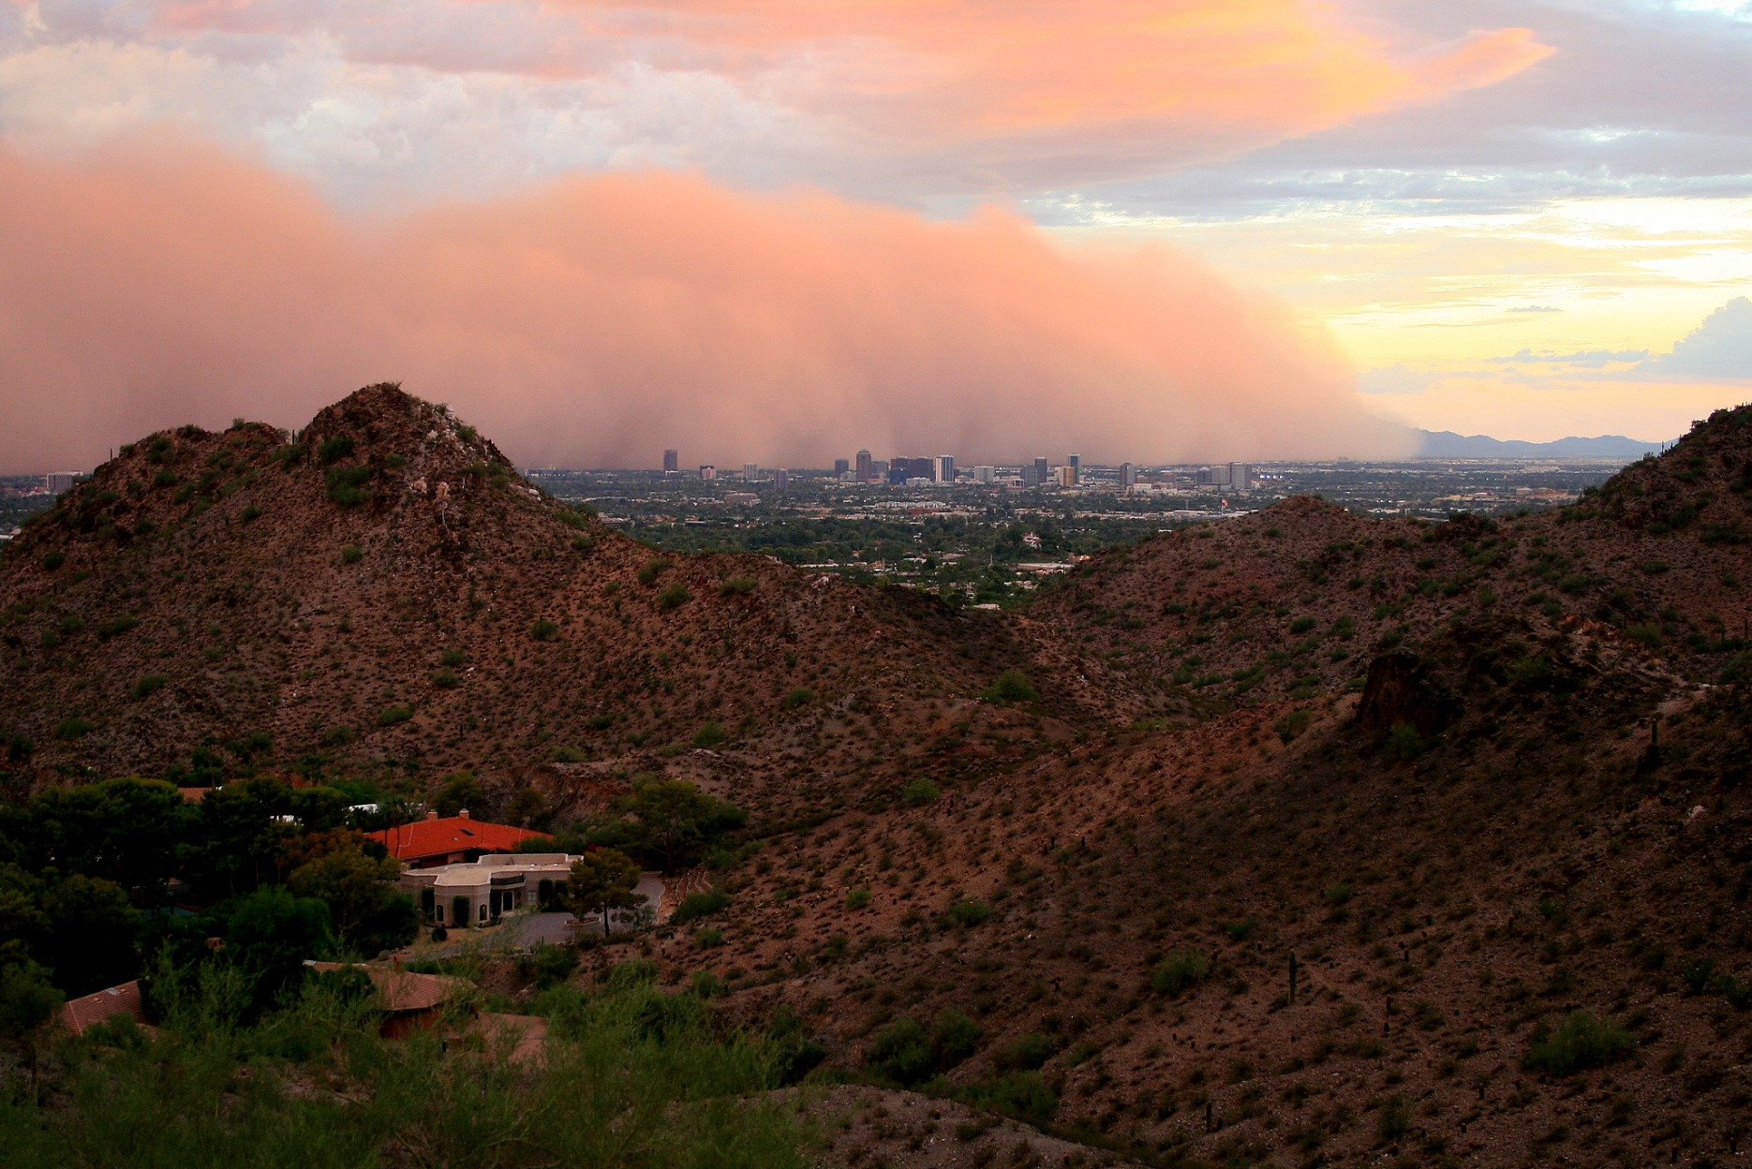
Partner Organizations
Maricopa County Department of Public Health
Maricopa County Air Quality Department
Image Credit:SD Anderson
Notes:
The study was done in collaboration with the epidemiology department at the Maricopa County Department of Public Health and the Maricopa County Air Quality Department’s monitoring division.
Image Source: https://www.flickr.com/photos/19442067@N00/14976727247/in/gallery-flickr-72157647117951140/

Slide 6
Community Concerns
PM 10 microns or less in size is epidemiologically significant to all population but especially a concern for susceptible groups with pre existing lung and heart disease
Particulate matter contributes to poor visibility in the valley which is responsible for “Valley Brown Cloud”
EPA designated Maricopa County as “Serious non-attainment” of PM10 standards.
Image Credit: 3TV Phoenix
Notes:
PM 10 can penetrate deeply into the lungs, so it is a danger to susceptible groups. PM 10 incorporates measurements of PM 2.5, which is a danger to all people living with higher than normal exposure. It contributes to a visible brown cloud that hangs over the metro area, and has contributed to non-attainment of EPA standards.
Image Source: https://pbs.twimg.com/media/CtZ5iAEVUAANxf8.jpg:large

Slide 7
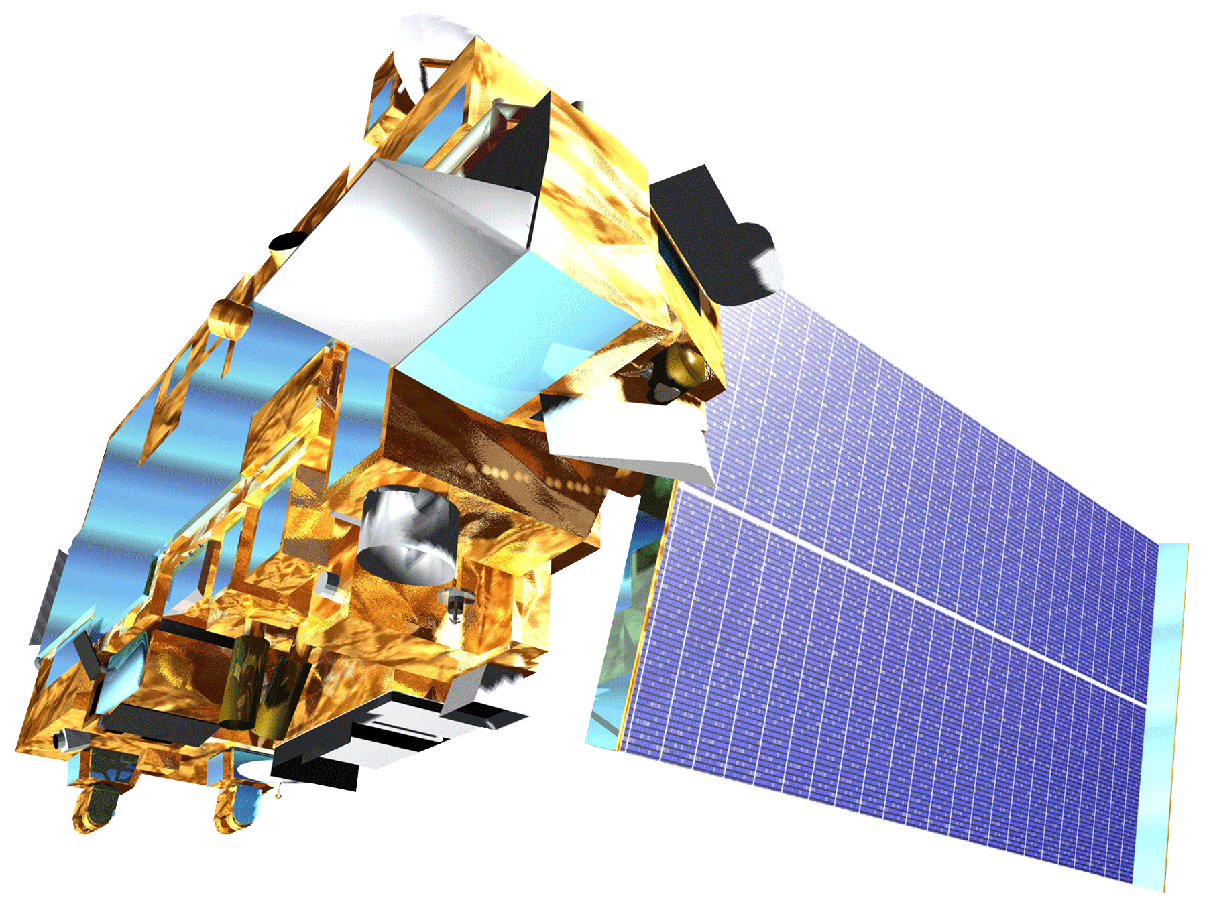
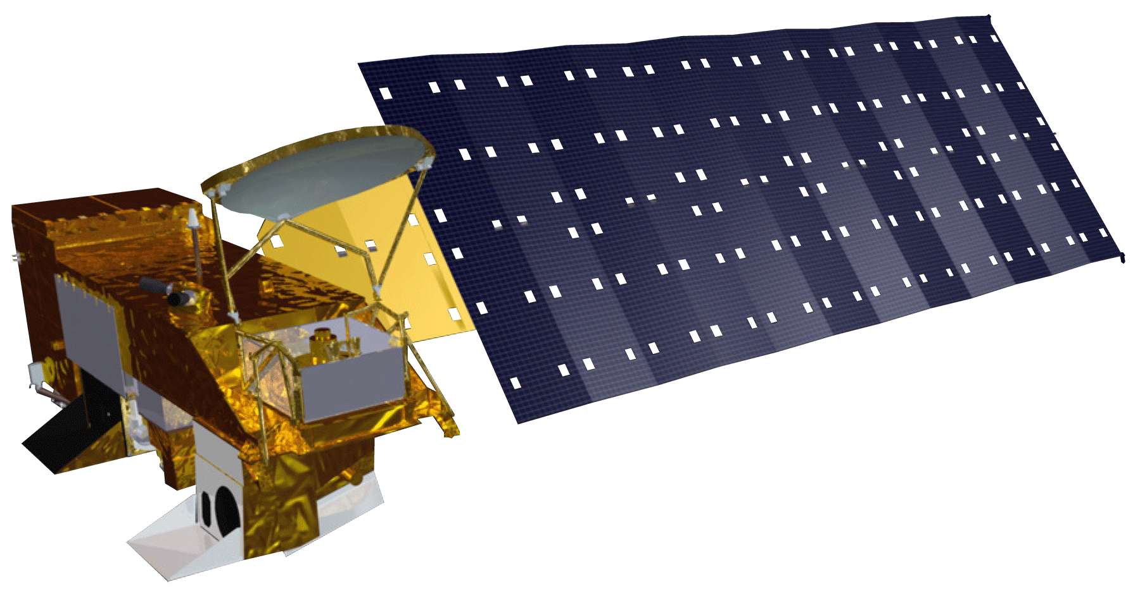
Earth Observations
Terra Satellite
MODIS
MODerate resolution Imaging Spectroradiometer
Provides aerosol optical depth (AOD) data at a 3 km spatial resolution
Aboard the Terra and Aqua satellites (Earth Observing System)
Aqua Satellite
Notes:
Our Aerosol optical depth (AOD) measurements were obtained from the MODIS instrument aboard the Aqua and Terra satellites over a 10 year period.
Image Source: http://commons.wikimedia.org/wiki/File:Claude_Monet_-_The_Magpie_-_Google_Art_Project.jpg

Slide 8
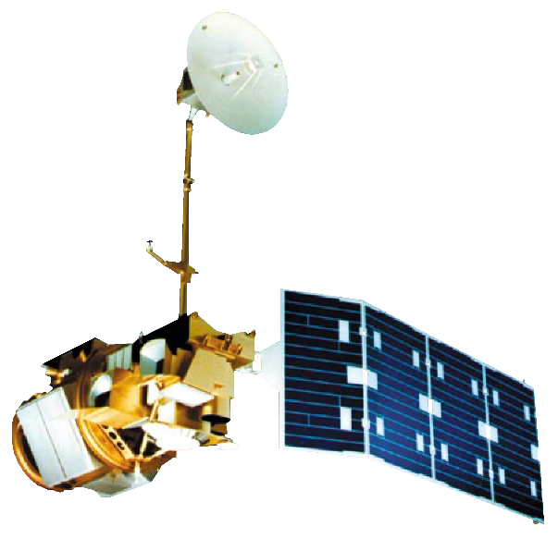
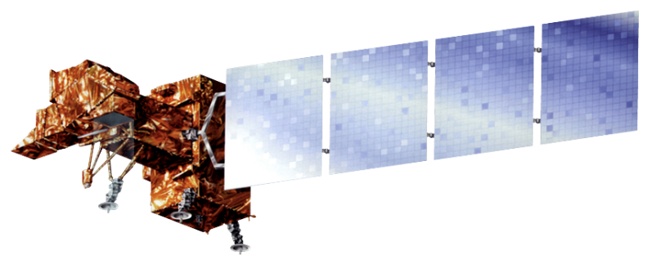
Earth Observations
Landsat 5 – Thematic Mapper
Used by the USGS National Land Cover Database (NLCD) 2011
Incorporated into this study to determine percent of open space via land cover data
Landsat 7 – EMT+
To see the correlation between the thermal data and the observed PM10 values
Notes:
Additional inputs included infrared data from Landsat 7 EMT+ and percentage of open space provided byt the USGS National Land Cover Database in 2006 and 2011 and interpolated for years between.
Image Source: http://commons.wikimedia.org/wiki/File:Claude_Monet_-_The_Magpie_-_Google_Art_Project.jpg

Slide 9
Methods
PM₁₀ Land Use Regression Model
Satellite Data (MODIS, Landsat 7 ETM+)
County Lane Data (TIGER/ Line Repository)
Meteorological Data (Daymet)
Transportation (TIGER/ Line & Maricopa Air Quality Department Repository)
Elevation (National Elevation Database – USGS)
Land Cover (Landsat 5)
Notes:
All layers were output in dialy tabular format and run through a model in R studio, which then gave an output of correlation between AOD and PM10 values, which is then used to apply to cells lacking PM10 inputs.
Image Source: http://commons.wikimedia.org/wiki/File:Claude_Monet_-_The_Magpie_-_Google_Art_Project.jpg

Slide 10
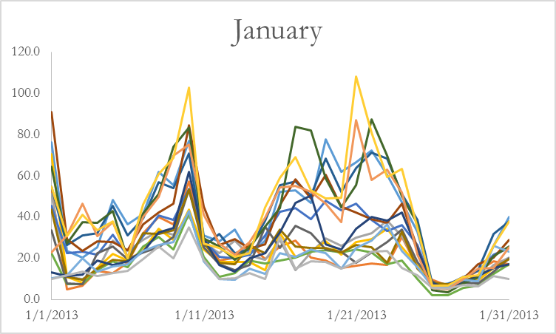
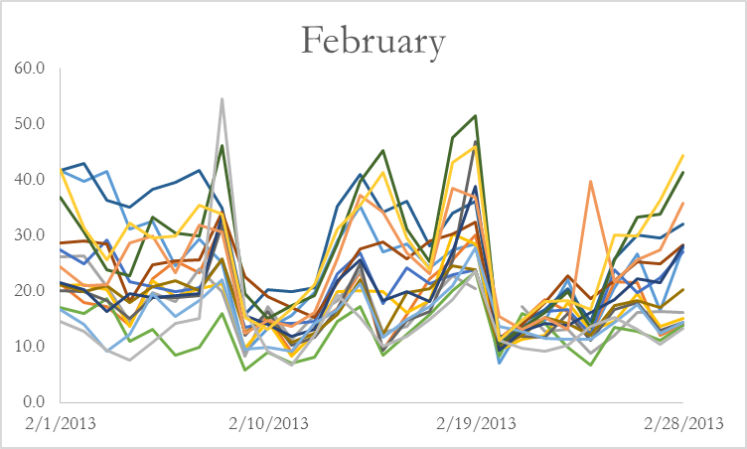
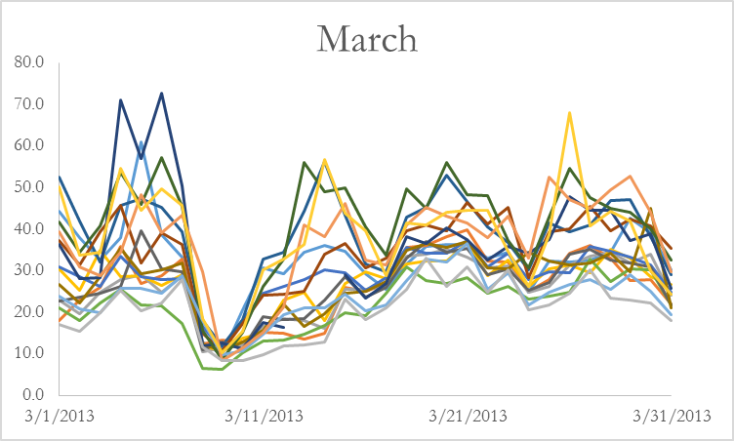
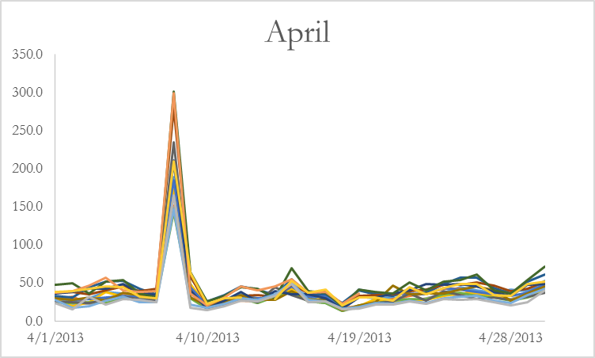
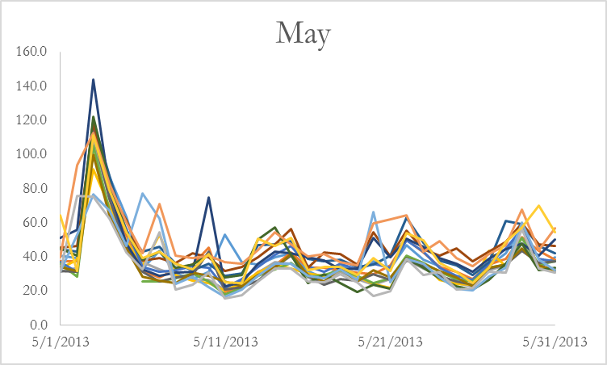
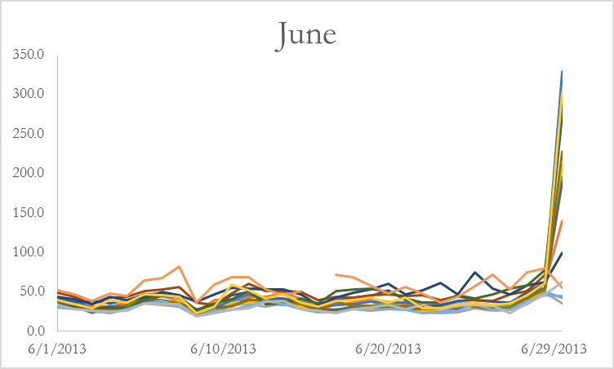
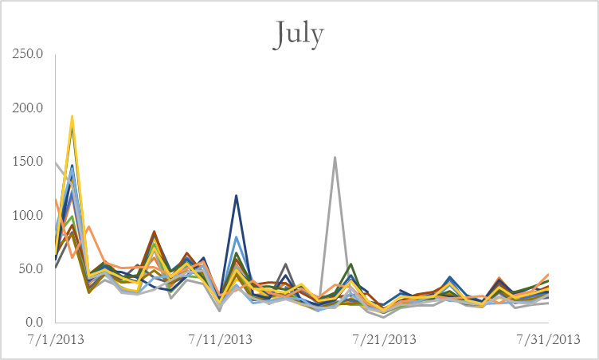
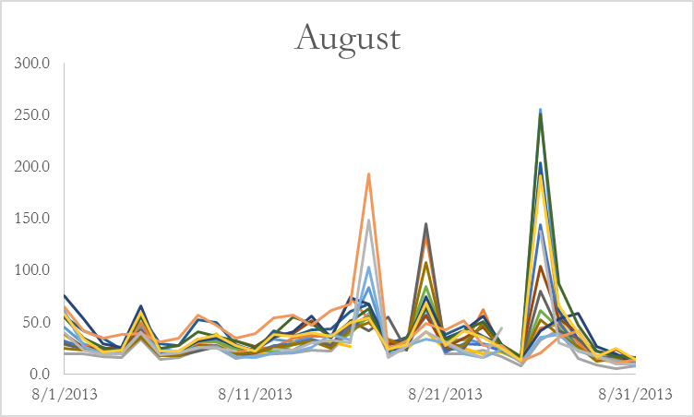
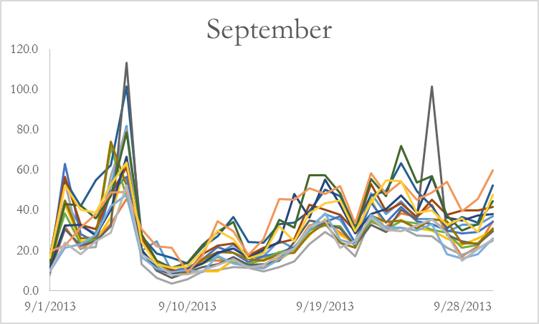
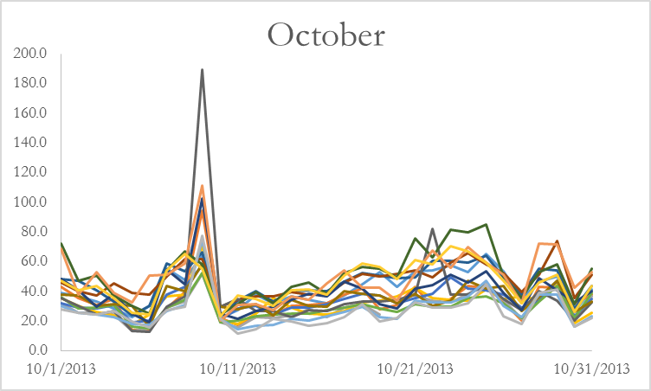
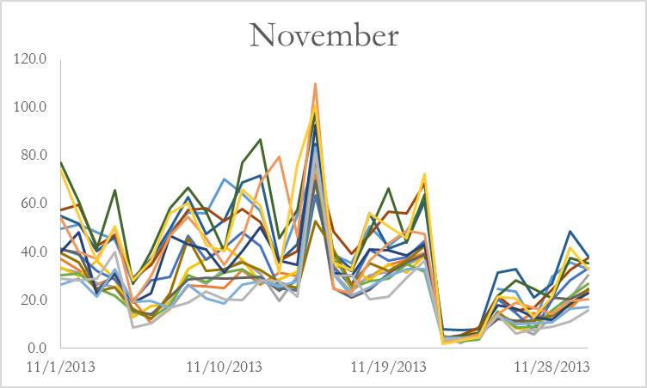
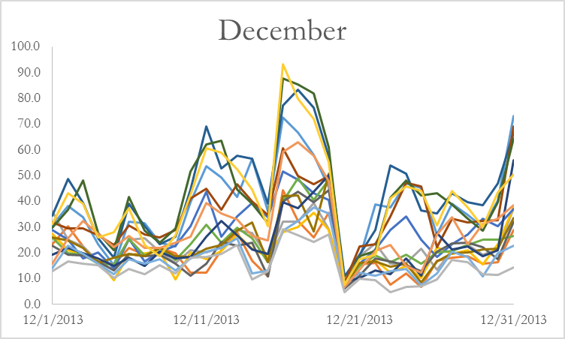
Results – Daily average of PM10 values for the year 2013
Notes:
This data represents a year of average daily PM 10 values over 2013, to show the patterns of PM 10 in the Maricopa County Area. Each of the lines on each graph represents an individual PM10 monitor. You can see that while there are some region-wide trends, often there are also events that only effect a couple of monitors at a time.

Slide 11
Conclusions
Satellite data helps to pinpoint potential particulate matter issues to a specific geographic area and provides an easily interpretable graphic view to enhance decision-making for health and air quality thereby aiding epidemiological studies
Inclusion of additional model variable like thermal infrared (TIR) data and Daymet data refine the model and improve correlation in desert regions that are a particular challenge to analyze using satellite data due to the high amount of reflection of the surface
Since the diurnal changes in the concentration of PM10 are considerable, having a day to day time frame increases the efficiency of the model and adds confidence to the results
Image Source: Parul Singh
Notes:
Using multiple inputs to model AOD against PM10 is necessary for a useable correlation between variables. By using a shorter temporal or spatial resolution, we are able to get a more defined result. Using other datasets in the future, such as infrared, as a refinement can help increase the correlation values. Daily monitoring also allows for variability at a finer scale than monthly.
Image source: Parul Singh

Slide 12
Advisor
Dr. Dave Hondula, Arizona State University, Assistant Professor
Partners
Maricopa County Department of Public Health:
Kate Goodin, Epidemiologist and Data Services Program Manager
Vjollca Berisha, Senior Epidemiologist
Maricopa County Air Quality Department:
Ronald Pope, Atmospheric Scientist
Ira Domsky, Planning Consultant
School of Geographical Sciences & Urban Planning at Arizona State University
Other Support
Dr. Itai Kloog, Ben-Gurion University of the Negev, Senior Lecturer
Other Support
We would also like to acknowledge the contributors of the Maricopa County and Air Quality I team: Jason Hodgson, Leslie Araujo and Tamara Dunbarr
Notes:
Just read the slide.

