Slide 1
2024 Spring Calendar
Week 1 | Week 2 | Week 3 | Week 4 | Week 5
Submit Entrance Personal Growth Assessment (PGA) (1/22) DEVELOPedia Profile (1/25) | Study Area Shapefile (2/1) | Creative Communication Form (2/8) *Presentation CP1 (2/8) | *Tech Paper CP1 (2/15) | Creative Communication Video CP1 (2/22) *Poster CP1 (2/22)
Week 6 | Week 7 | Week 8 | Week 9 | Week 10
*Tech Paper CP2 (2/29) *Presentation CP2 (2/29) *Tutorial CP1 (2/29) | Website Image (3/7) *GitLab Code CP1 (3/7) *Creative Communication RD (3/7) | Presentation FD (3/14) Poster FD (3/14) | Creative Communication FD (3/21) Project Summary (3/21) DEVELOPedia Page (3/21) **Tech Paper RD (3/21) | Submit Exit PGA (3/25) Project Feedback form (3/28) Tech Paper FD (3/29) Tutorial FD (3/29) Gitlab Code FD (3/29)

Slide 2
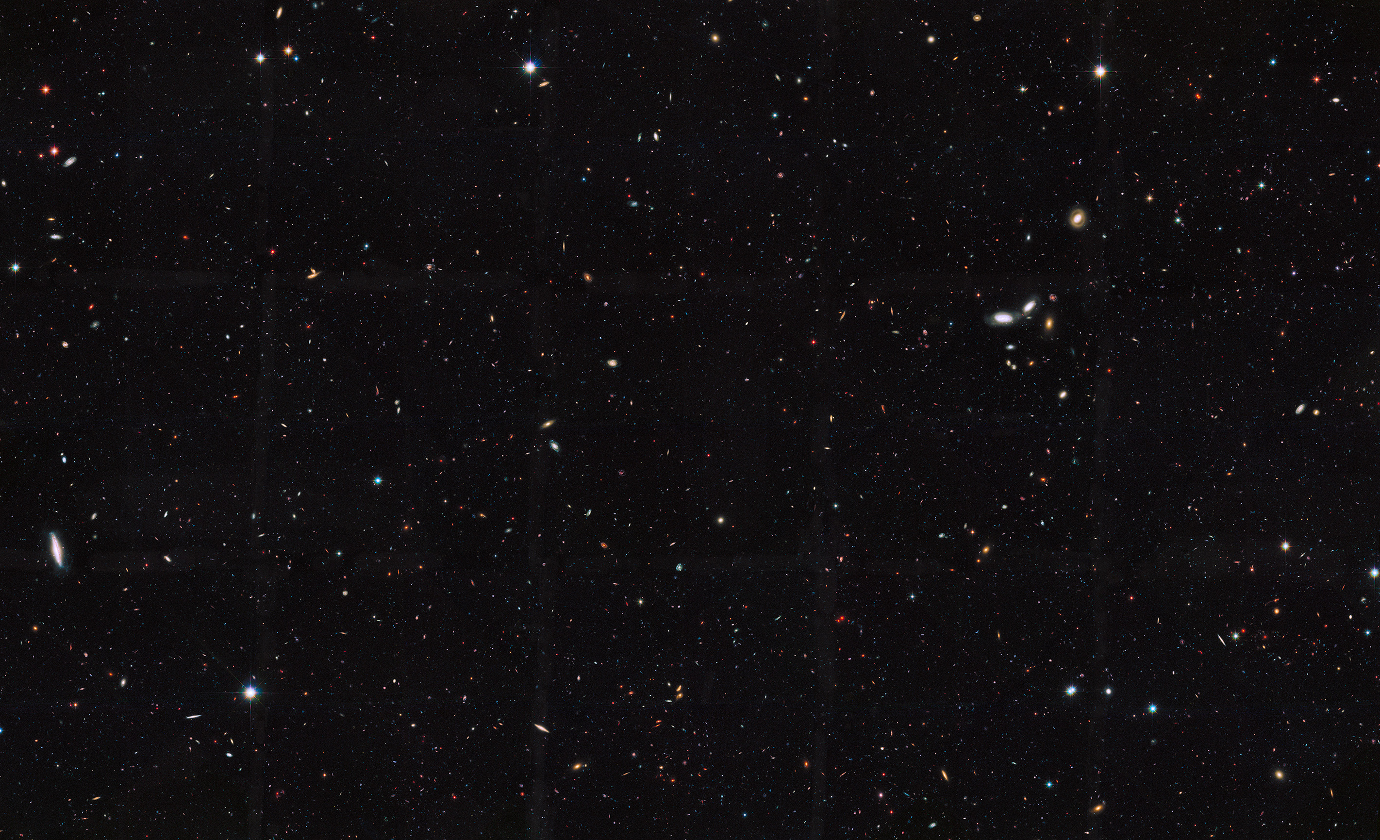
Calendar Notes:
All checkpoints and deliverables are due on Thursday, close of business (local time), unless otherwise noted. *Checkpoints are denoted with a star on the deliverable calendar.
**For the Tech Paper Rough Draft, you must have your science advisor review your tech paper prior to submission on Thursday, close of business, of Week 9. This deliverable will only be reviewed by the node Lead.
Creative communication deliverables are optional. However, the checkpoints must be submitted if your team is participating in the creative communication deliverable.
Tutorial Checkpoint 1 is only required for code tutorials. It is not required for GIS tutorials.
Please note that the Exit Personal Growth Assessment is due Monday of Week 10.

