Slide 1
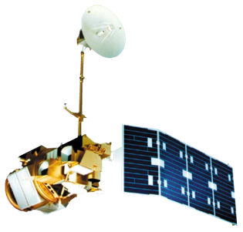
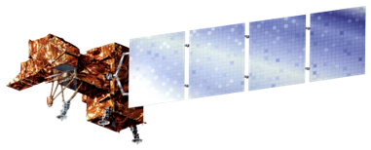
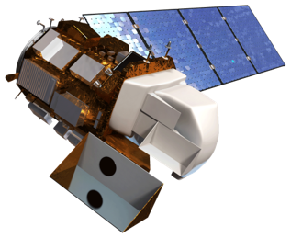
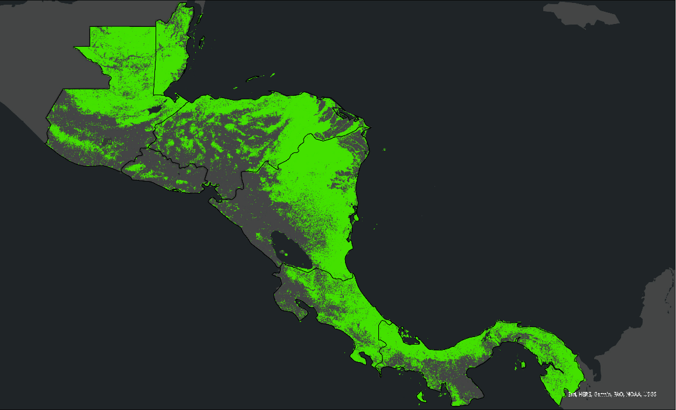
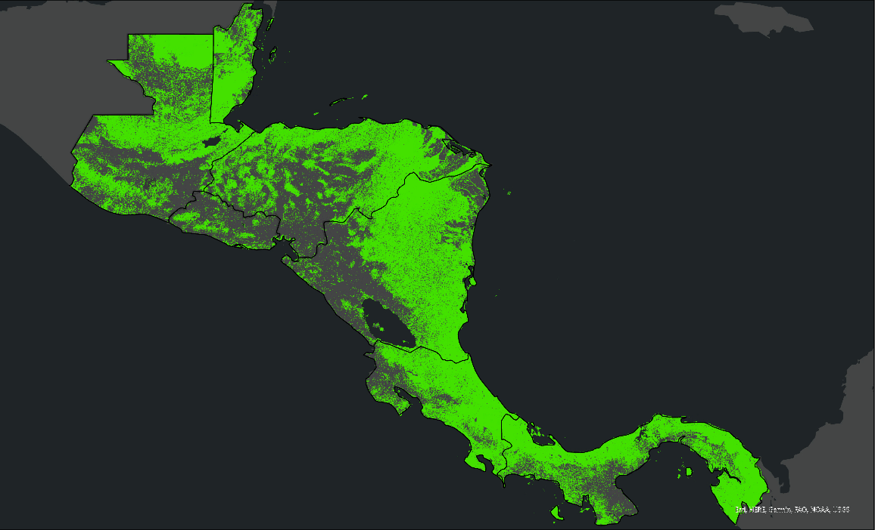
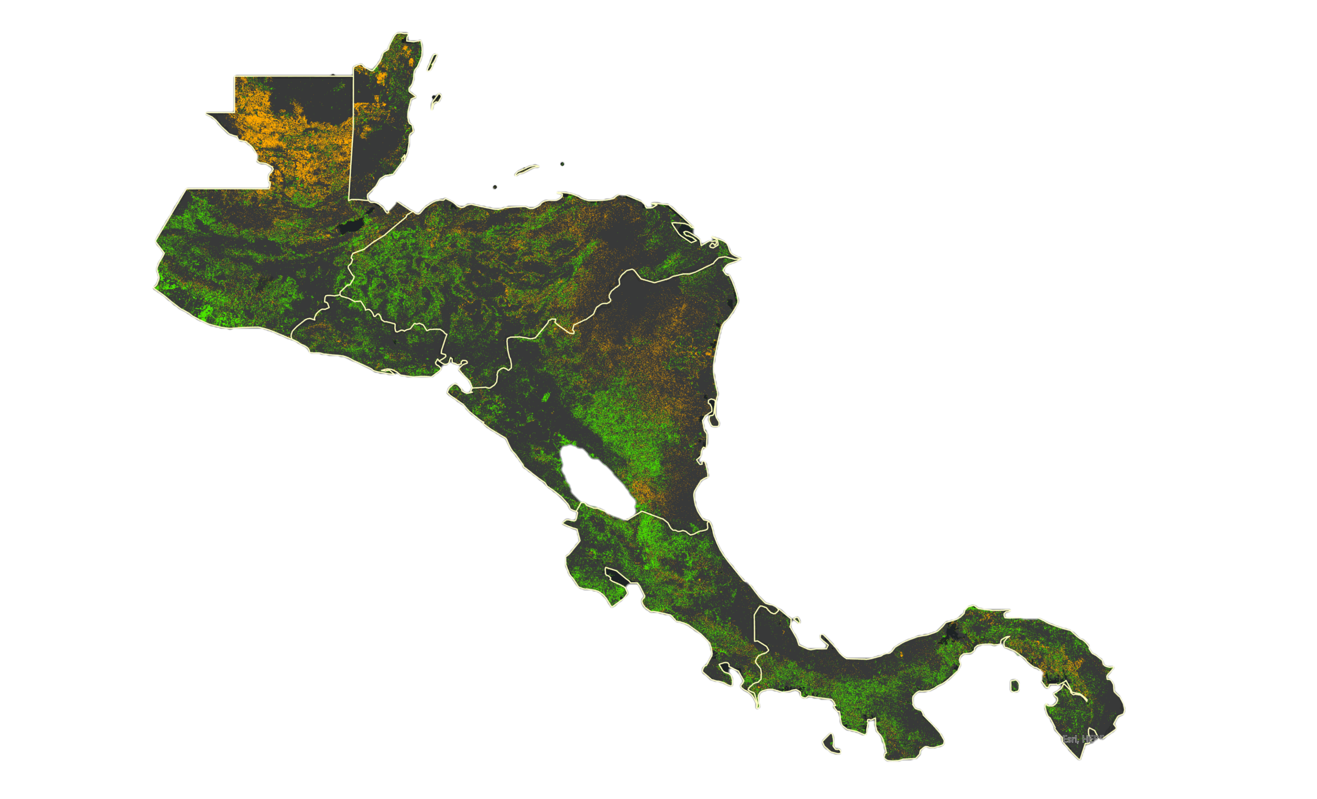
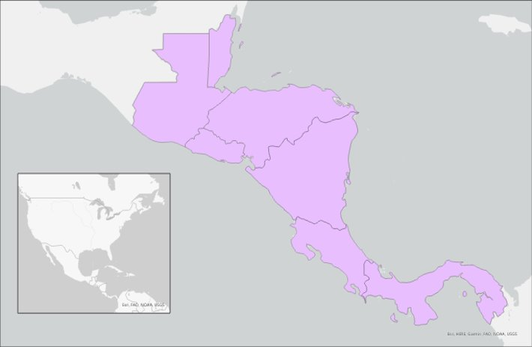
Assessing Land Cover Change to Inform Management Planning for the Mesoamerican Biological Corridor
Abstract
Objectives
Mesoamerica Ecological Forecasting
In 1992, Central America and Mexico drew up an agreement to establish the Mesoamerican Biological Corridor (MBC) which defines natural corridors to connect nearly 600 protected areas. The MBC is home to 9% of the world's terrestrial species on 0.7% of the world's landmass, yet this biodiverse area has been impacted by great levels of deforestation. The MBC supports protected areas and the important conservation efforts that are tied into the area’s economic and sustainable development. The NASA DEVELOP team partnered with NASA SERVIR, Sistema de la Integración Centroamericana (SICA), Tropical Agriculture Research and High Education Center (CATIE), and Ministries of the Environment for Costa Rica, El Salvador, and Guatemala to assess forest cover change in the MBC. While the southern states of Mexico are included in the MBC, the team excluded Mexico in this study. The team acquired data from Landsat 5 Thematic Mapper (TM), Landsat 7 Enhanced Thematic Mapper Plus (ETM+), Landsat 8 Operational Land Imager (OLI), and Landsat 9 OLI-2 to develop a forest versus non-forest classification. This classification was used to create a Land Use Land Cover Change (LULC) trend map and Deforestation Detection Time Series analysis between 1992 and 2022. The team found that minimum distance classification was the most effective classifier for the project scope. Analysis showed that 6.18% of the study area experience forest loss and 10.99% experienced forest growth. These observations will help partners visualize the evolution and severity of deforestation and allow decision making for future land management and transboundary conservation efforts.
Classify forest and non-forest land cover in the​ MBC by using a Minimum Distance Classifier​
Identify forest cover change in the last 30 years by producing Land Use Land Cover Change (LULC) trend maps of 1992 and 2022
Visualize deforestation at a regional level by generating deforestation time series analysis of the MBC during the study period
Earth Observations
Landsat 7 ETM+
Landsat 9 OLI-2
Landsat 5 TM
Landsat 8 OLI
Results
Annual Forest Cover
Data Acquisition
Landsat-derived
CATHALAC
Data Processing
Sample training
Classify common
Data Analysis
Group Forest
Calculate change
Protected areas,
Ancillary
End Products
Deforestation
Landcover
national borders
30-year change
Time Series
Analysis
in forest extent
and Non-forest
points
landcover types
SERVIR imagery
LULC Map of
Generate cloud-free mosaics
Datasets
1992
2022
Methodology
N
N
0
500km
0
500km
Forest
Non-forest
Forest Cover Change 1992-2022
N
Forest growth
Forest loss
Study Area
No change
Mesoamerican
Biological Corridor
0
250
500 km
Belize
N
Guatemala
Conclusions
El Salvador
Honduras
Accounting for spectral variation in land cover types requires holistic training data.
Training and deploying a Minimum Distance Classification was the most effective method for classifying ​forest and non-forest in the MBC
Analysis showed an overall 6.18% forest loss and a 10.99% forest growth occurred in the MBC between 1992-2022.
Nicaragua
Costa Rica
Project Partners
0
250
500 km
Panama
Sistema de la Integracion Centroamericana (SICA)
Tropical Agriculture Research and High Education Center (CATIE)
Ministry of the Environment & Energy (MINAE) of Costa Rica
Ministry of the Environment & Natural Resources (MARN) of El Salvador
Ministry of the Environment & Natural Resources (MARN) of Guatemala
Base Map: ESRI, HERE, Garmin, FAO NOAA, USGS
Team Members
Acknowledgements
Dr. Robert Griffin (University of Alabama
in Huntsville)
Dr. Jeffery Luvall (NASA Marshall Space
Flight Center)
Betzy Hernandez (NASA SERVIR)
Dr. Emil Cherrington (NASA SERVIR)
Lauren Casey (NASA SERVIR)
Africa Flores (NASA SERVIR)
Sylvia Wilson (USGS SilvaCarbon)
Dr. Kent Ross (NASA Langley)
Brianne Kendall (MSFC Node Fellow)
Hanna Jung
Deliverables Lead
Ross Kalter Technical Lead
Amelia Untiedt
Cristina Villalobos Heredia
Alabama - Marshall

