Slide 1
San Diego
Urban Development
Utilizing NASA Earth Observations to Identify Drivers of Extreme Urban Heat and Generate a High-Resolution Vulnerability Index for Urban Planning and Climate Resiliency in San Diego, California
John Dialesandro, Meryl Kruskopf, M. Colin Marvin, Mireille Vargas
Arizona – Tempe

Slide 2
Project Overview​

Slide 3
Community Concerns
Increasing urban temperatures Increased exposure to heat
Increased exposure disproportionally impact certain demographics
Exposure leads to heat related death/illness, increased energy use,
and loss of work productivity
Icon Credit: Microsoft PowerPoint Clipart​
Notes:
Speaker Notes: Within the City of San Diego there are a number of community concerns. Increasing urban temperatures particularly along the coast where not all residents have access to air conditioners has left many residents exposed to heat. There is a strong thermal inequity between which social demographic groups face the largest burden from heat. This exposure leads to increased heat related death and mortality, as well as a loss of work productivity and increase in energy use.
-----------------------------------------------------------------------------------------------------------------------------------------------------------------------------------------------------------------------------------------------------------------
Icon Credit: Microsoft PowerPoint Clipart

Slide 4
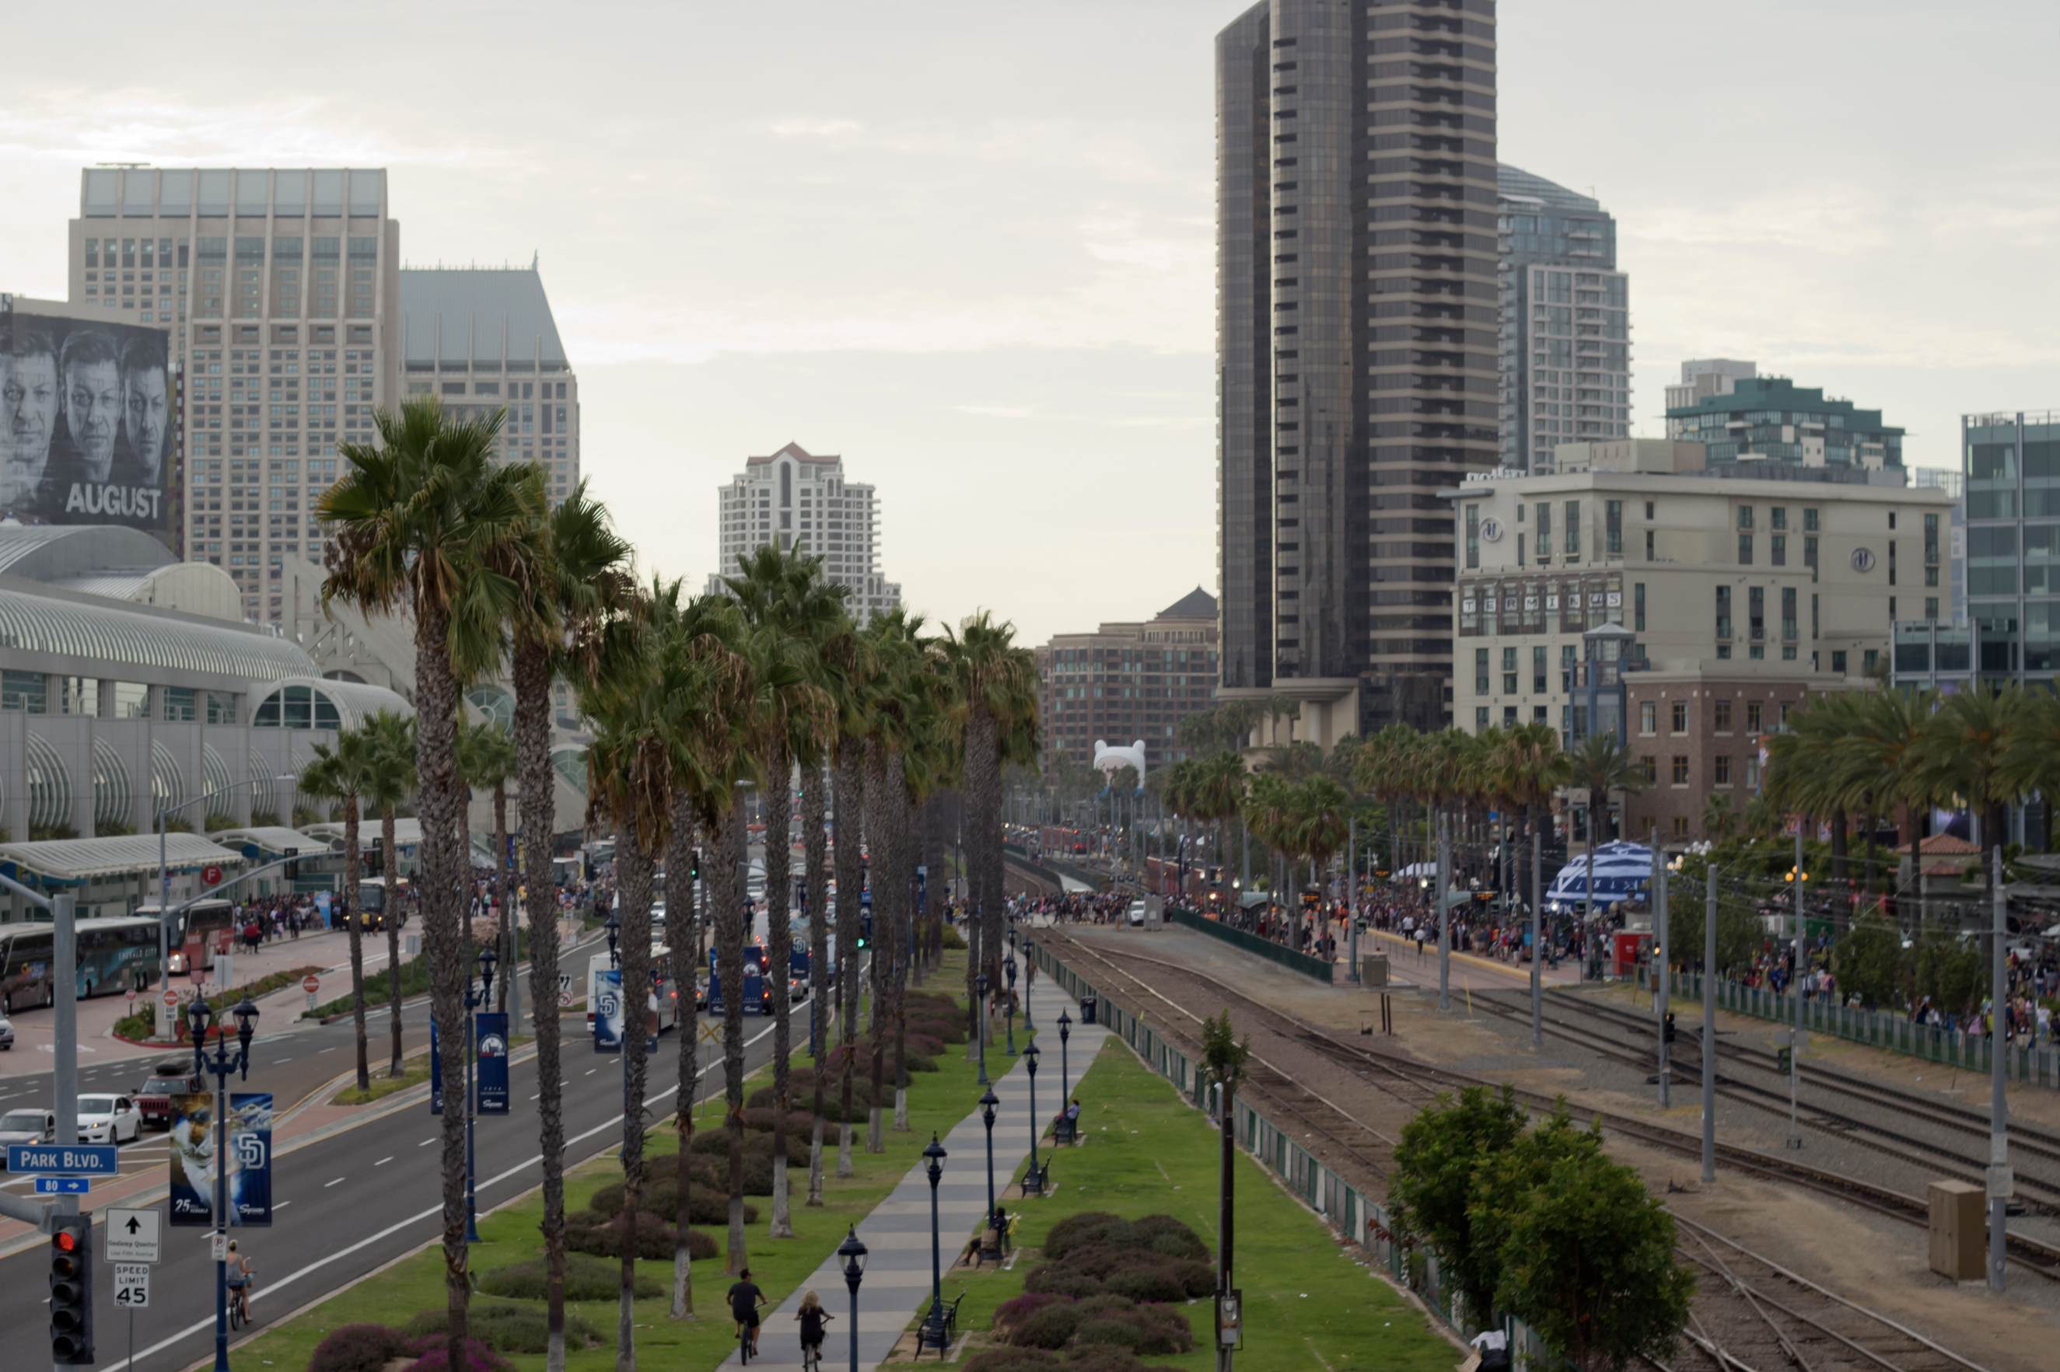
Project Partners
1) City of San Diego, California, Planning Department (End User)
2) American Geophysical Union (AGU) Thriving Earth Exchange (Collaborator)
Credit: vagueonthehow
Notes:
Speaker Notes: "The City of San Diego has a population of 1.4 million, making it the eighth-largest city in the United States. The city is working collaboratively with stakeholders and community members to develop a Climate Adaptation and Resiliency Plan to reduce vulnerability to projected climate changes. One major challenge they are planning for is increased heat. Like many other large urban areas, San Diego has seen an increase in heat-related hospitalizations and morbidity in response to hot-weather episodes. This impact has been especially prominent along the coast where residents may not have air conditioning or be acclimated to the heat. "
-------------------------------------------------------------------------------------------------------------------------------------------------------------------------------------------------------------------------------------------------------------
Image Credit: Vagueonthhow
Image Source: https://www.flickr.com/photos/vagueonthehow/14856602229/in/photolist-oCPYfi-ouwNFk-oM2EHD-KVk879-otnsF2-LPgZgA-KVjTWm-LqZwWQ-omxx3H-LqYYEf-KVaxtq-LGCoBb-xHBJ3m-fiSCwi-fiKQes-fivQ2r-wdoucR-fiSB1k-vgwqZa-wdoEfX-vVLomJ-wcKjVW-LKpByk-KVni9i-LGC9Tj-6KBTWL-6Kyb4i-KVaCps-KVwFaK-a86ANb-KVxcmX-LGCb1j-oTi9Gj-LSinok-KV9DKA-LSu6MD-oCQumG-a86TZy-a86yu1-LPg2xS-KVf6Dt-a83R5g-KVf71a-a848pH-LGUDzf-KVnjZx-LGUXqW-a86UHE-LGCph9-LSttzD (CC BY 2.0)

Slide 5
Project Objectives
Provide data to the city to support the development of the Climate Adapation Plan
Heat Exposure
Heat Vulnerability
Cooling Capacity
Icon Credit: Microsoft PowerPoint Clipart
Notes:
Speaker Notes: The objectives of this project were to generate reproducible methods for the City to use for future surface heat extraction and sociodemographic data acquisition. We also strived to create a geodatabase of urban heat data, generate exposure and heat risk maps. In addition, we plan to provide InVEST model results of heat mitigation, and temperature differences based on modeled tree canopy scenarios.
Icon Credit: Microsoft PowerPoint Clipart

Slide 6
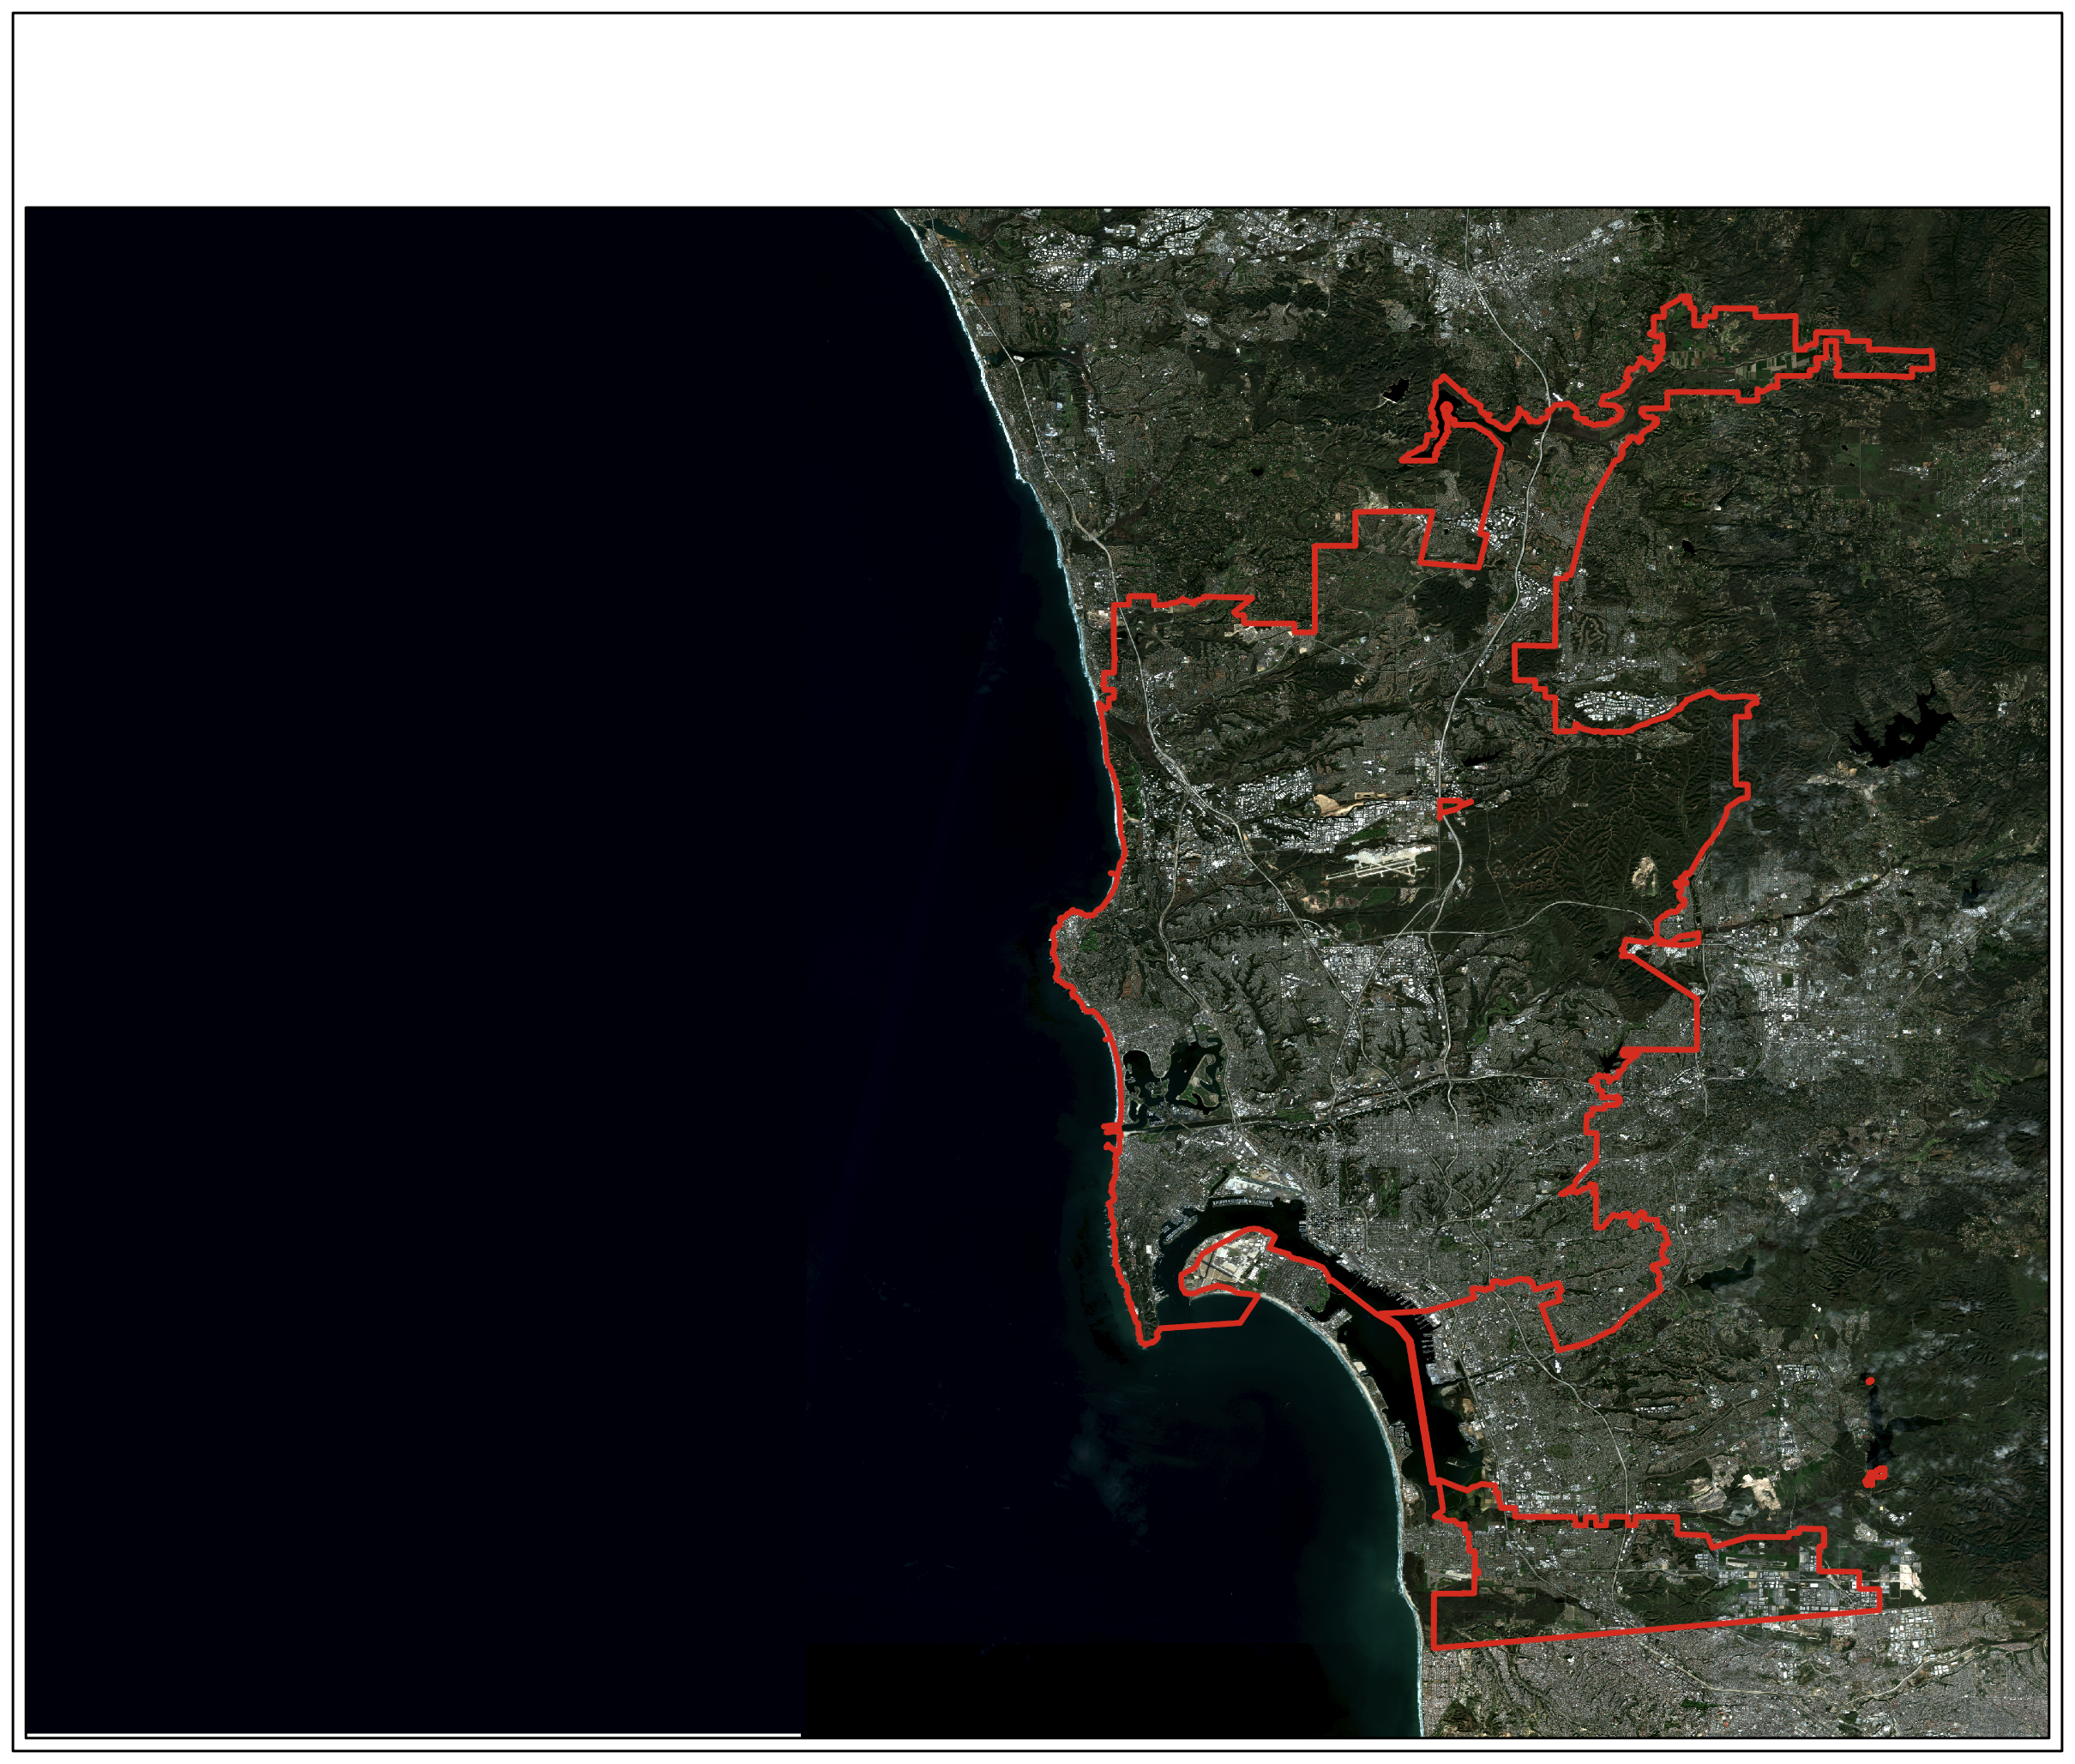
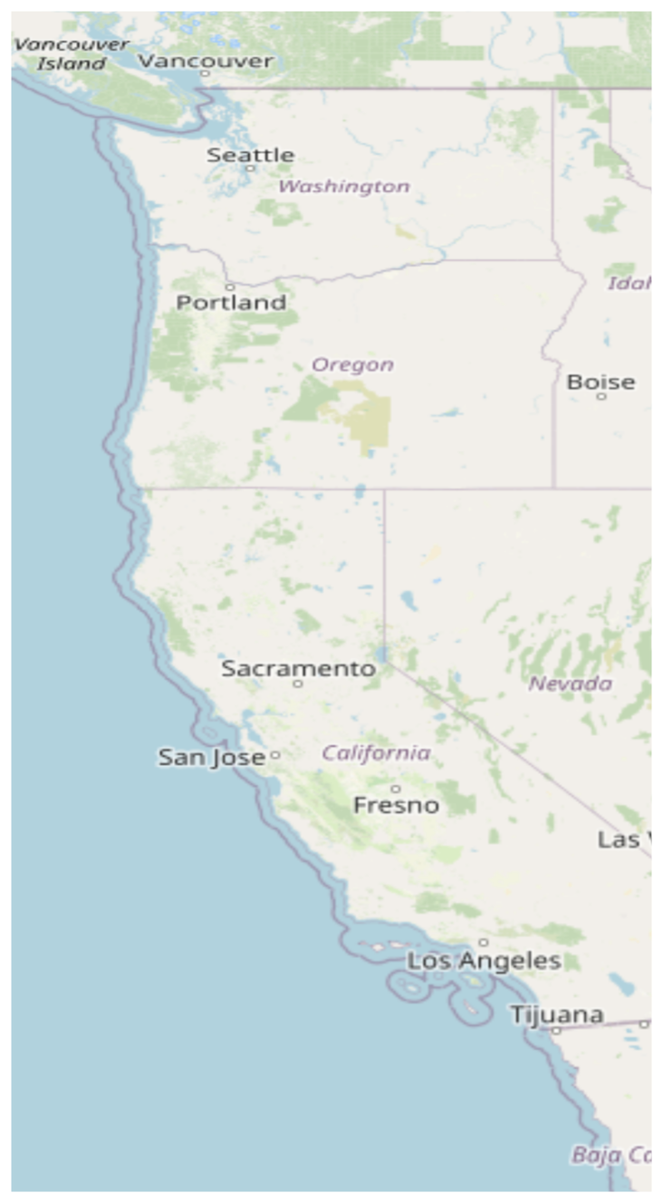
Study Site
Where:
City of San Diego, California Population: 1.4M
City of San Diego, California, USA
Carlsbad
Escondido
When:
Summer, May-September, 2015-2020
Pacific Ocean
Poway
Why:
Climate adaptation
Unique maritime climate
Future applications
La Jolla
Point Loma
Coronado
Chula Vista
Tijuana
Notes:
Speaker Notes: The city proper of San Diego was the examined as opposed to the metropolitan area including adjacent cities and suburbs. The years of 2015-2020 was the time frame of the study but only for the warm season between May 1st, and September 30th. The city receives only 10 inches of rain per year and is the 8th largest city in the US with 1.4 million residents.
-----------------------------------------------------------------------------------------------------------------------------------------------------------------------------------------------------------------------------------------------------------------
Image Credit: Map Generated by DEVELOP team
Basemap: Sentinel-2 Imagery acquired by DEVELOP team through Google Earth Engine

Slide 7
Data and Methods
Notes:
Speaker Notes:

Slide 8
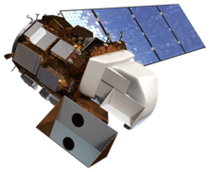
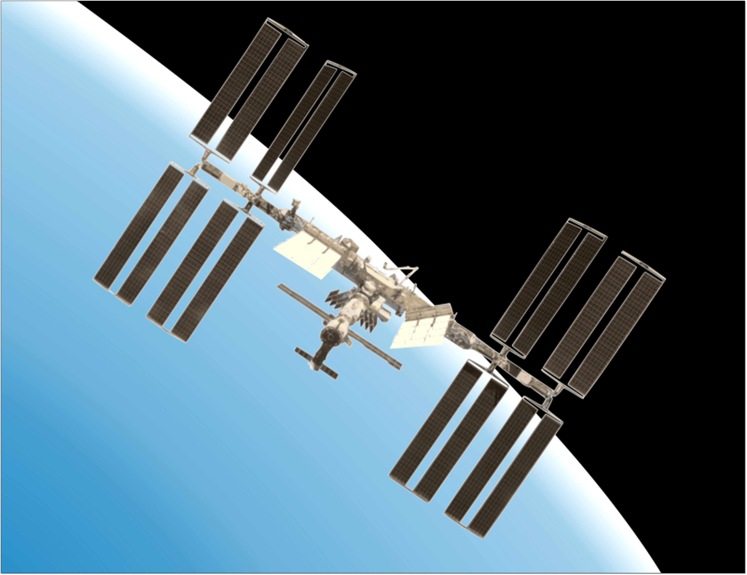
Earth Observations Used
Platform & Sensor | Parameter(s) | Use
Landsat 8 OLI/TIRS | Provisional Surface Temperature product, Albedo | Surface temperature product for calculating daytime surface temperatures
ISS ECOSTRESS | Land Surface Temperature, Evapotranspiration | Nighttime surface temperature and evapotranspiration data
Landsat 8
OLI/TIRS
ISS
ECOSTRESS
Image credit: NASA
Notes:
Speaker Notes: The Earth Observing Satellites that were used included Landsat 8 Observational Land Imager (OLI), and Thermal Infrared Sensor (TIRS) for daytime temperature and albedo, as well as ECOsystem Spaceborne Thermal Radiometer Experiment on Space Station (ECOSTRESS) for nighttime temperature and evapotranspiration rates.
-----------------------------------------------------------------------------------------------------------------------------------------------------------------------------------------------------------------------------------------------------------------
Image Credit: NASA (Public Domain), retrieved from DEVELOPedia

Slide 9
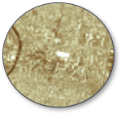
Landsat 8 OLI/TIRS
Red, Green, Blue
Near-Infrared
Shortwave Infrared
Thermal Infrared
Albedo
Emissivity
Landsat 8
OLI/TIRS
Surface Temperature
Image credit: NASA
Notes:
Speaker Notes: The Earth Observing Satellites that were used included Landsat 8 Observational Land Imager (OLI), and Thermal Infrared Sensor (TIRS) for daytime temperature and albedo, as well as ECOsystem Spaceborne Thermal Radiometer Experiment on Space Station (ECOSTRESS) for nighttime temperature and evapotranspiration rates.
-----------------------------------------------------------------------------------------------------------------------------------------------------------------------------------------------------------------------------------------------------------------
Image Credit: NASA (Public Domain), retrieved from DEVELOPedia

Slide 10
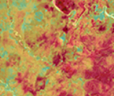
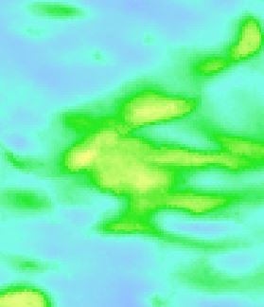
ISS ECOSTRESS
Thermal Bands
ET Product
ISS ECOSTRESS
Image credit: NASA
Notes:
Speaker Notes: ECOsystem Spaceborne Thermal Radiometer Experiment on Space Station (ECOSTRESS) was used for nighttime temperature and evapotranspiration rates. These were both key inputs into the InVEST model for the urban cooling model.
Image credit: NASA (Public Domain), retrieved from DEVELOPedia

Slide 11
Methodology: Raster Collection
Data Acquisition
GEE
AppEEARS
Data Processing
Filter by Study Area
Filter by Study Period
Output
Albedo
Daytime Land Surface Temperature
Select Median per Pixel from Image Collection
Evapotranspiration
Nighttime Land Surface Temperature
Notes:
Speaker Notes: Raster data was acquired using google earth engine as well as NASA Application for Extracting and Exploring Analysis Ready Samples (AppEEARS). We filtered by study area and study period and then took the median pixel from each resulting image collection.
Two of the outputs are used as environmental variables in the PCA and two are used as inputs to InVEST.

Slide 12
Ancillary Data
 | Parameter(s) | Use
 | Land Use/Land Cover | Input for InVEST Urban Cooling Model: Biophysical table properties are per LULC category
 | Percent Tree Canopy | Input for InVEST Urban Cooling Model:Used to derive the percent shade per LULC category
 | Building Footprint | Input for InVEST Urban Cooling Model: Used to derive building intensity per LULC category
 | San Diego Boundary Files | Study Area, block group, and census tract boundaries
Icon Credit: Microsoft PowerPoint Clipart​
Notes:
Speaker Notes: In addition to the remotely sensed data from Landsat and ECOSTRESS, we also used a number of ancillary datasets including, Land Use/Land Cover, and tree canopy cover from the City of San Diego's online GIS repository. Additionally, the team used building footprint data to generate a building Intensity dataset for invest model input from the City.
----------------------------------------------------------------------------------------------------------------------------------------------------------------------------------------------------------------------------------------------------------------
Icon Credit: Micorsoft PowerPoint Clipart

Slide 13
Methodology: Sociodemographic Data
% Ethnic Minority​
% Below Poverty Line​
% Without HS Diploma​
% 65 Years & Older​
% 65 Years Older Living Alone​
% ​Poverty*
% W/O Insurnace*
% LatinX
% Black
% Asian
%Limited English Proficiency
% Asthma Rate
% Diabetes
% Cardiovascular Heart Disease
% Chronic obstructive pulmonary disease (COPD)
% Hypertension
% Obesity
2015-2019 (5-year Estimate)
2019
Notes:
Speaker Notes: We collected social data and health indicator data from the 5 year American Community Survey at the Block Group and Census Tract Level. All variables from the ACS survey were the same for block group and census tract with the exception of percent without health insurance and percent in poverty which were only available at the Census Tract level.
--------------------------------------------------------------------------------------------------------------------------------------------------------------------------------------------------------------------------------------------------------------
Image Credit: US Census Bureau, https://www.census.gov/programs-surveys/acs
Center for Disease Control, https://www.cdc.gov/

Slide 14
Methodology: Vulnerability Assessment
Input Data: Environmental, Health and Social data
Selection based on
the 4 PCAs
Score by Census Tract or Block Group
Icon Credit: Microsoft PowerPoint Clipart​
Notes:
Speaker Notes: Our vulnerability assessment used a Principal Component Analysis, which is also known as a PCA. In short, a PCA takes each variable and combines them into principal components, PCs. These PCs help us inspect the extent to which variables are correlated with each other. It is important all variables were normalized by the standard deviation.
We took the 3 environmental variables (Percent Tree Canopy, Daytime LST, Nighttime LST), and a number of social variables (census tract, and block groups), and health indicators (Census tracts only) and analyzed them using the PCA method. We then selected the 2-4 components that explained at least 80% of the data variation. These components were then used to develop an overall score for each census tract.
Icon Credit: Micorsoft PowerPoint Clipart

Slide 15
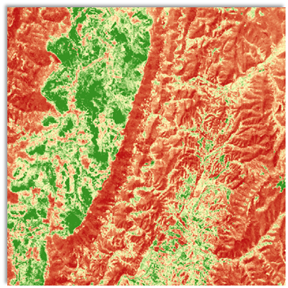
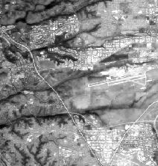
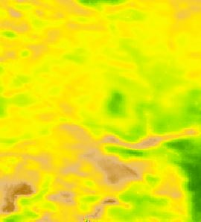
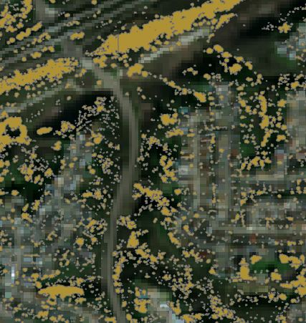
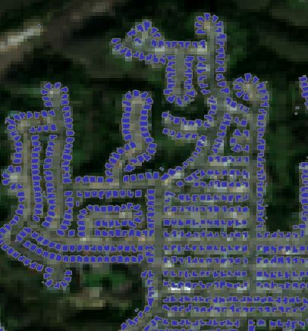
Methodology: InVEST Model
Land Use Land Cover
Land Use Land Cover
Albedo
Evapotranspiration
Shade
Albedo
Green Area
Building Intensity
Tree Canopy
Buildings
Evapotranspiration
Urban Heat Island Magnitude
Rural Reference Temperature
Notes:
Speaker Notes: The InVEST (Integrated Evaluation of Ecosystem Services and Tradeoffs) Urban Cooling Model was created by the Natural Capitol Project based out of Standford University. The model aims to quantify the impacts of green infrastructure and other ecosystem services. The urban cooling model uses land use land cover and the associated properties of shade, albedo, green area and building intensity in addition to evapotranspiration to determine the heat mitigation index of each pixel.
-----------------------------------------------------------------------------------------------------------------------------------------------------------------------------------------------------------------------------------------------------------------
Image Source: Landsat 8 OLI and TIRS data data derived by NASA

Slide 16
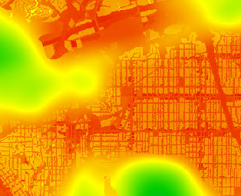
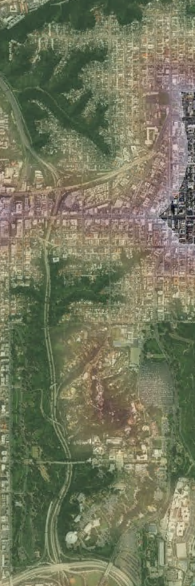
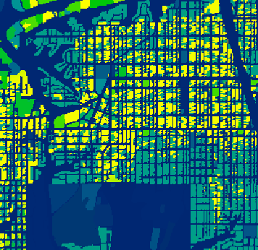
Methodology: InVEST Model
Albedo
Shade
Evapotranspiration
Rural Reference Temperature (Daytime)
Urban Heat Island Magnitude (Daytime)
Daytime Heat Mitigation Index
Greenspace
Cooling
Building Intensity
Rural Reference Temperature (Nighttime)
Urban Heat Island Magnitude (Nighttime)
Nighttime Heat Mitigation Index
Notes:
Speaker Notes: The model is run separately for daytime and nighttime since the heat mitigation is driven by different parameters. During the day, heat is mitigated by albedo, shade, and evapotranspiration. During the night, cooling at a location is driven by building intensity, since building materials are less efficient in giving off heat that was absorbed during the day, thus impeding the ability of highly developed areas to cool down. Both model scenarios take into account the proximity of green areas and use a rural reference temperature to provide a intermediate outputs that describe the cooling capacity of each cell.
----------------------------------------------------------------------------------------------------------------------------------------------------------------------------------------------------------------------------------------------------------------
Image Source: Landsat 8 OLI and TIRS data derived by DEVELOP team

Slide 17
Results
Notes:
Speaker Notes:

Slide 18
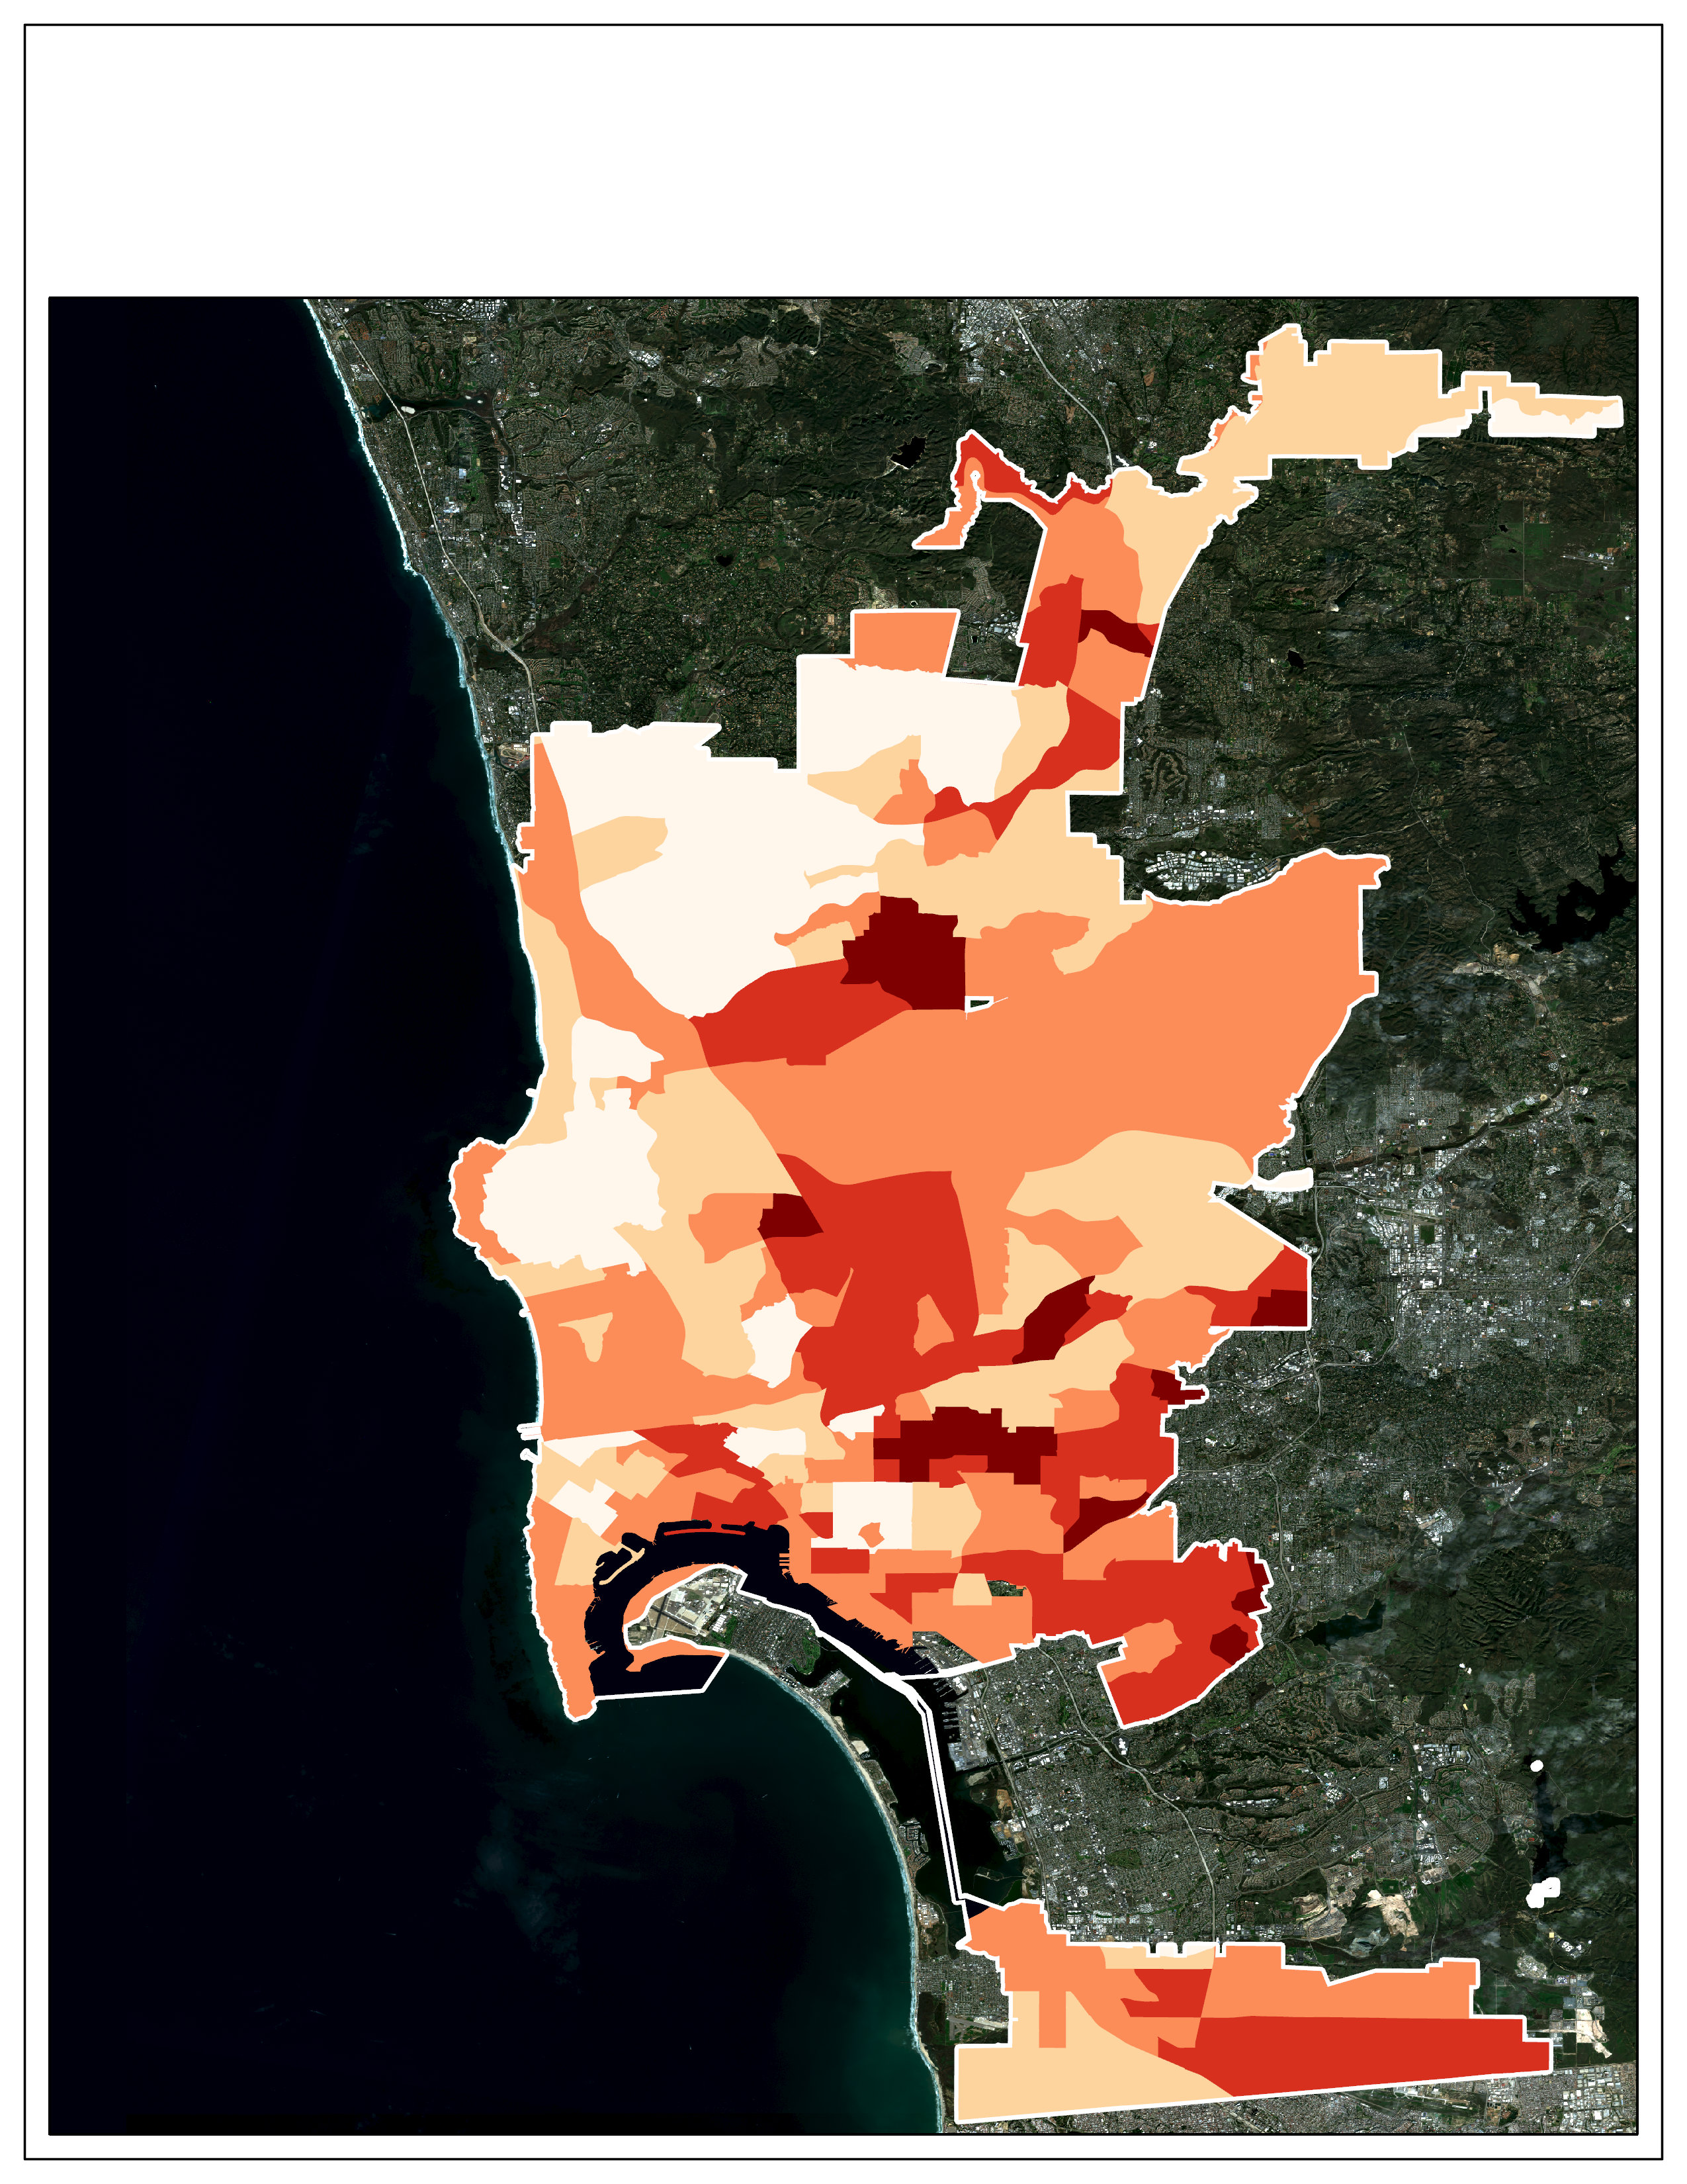
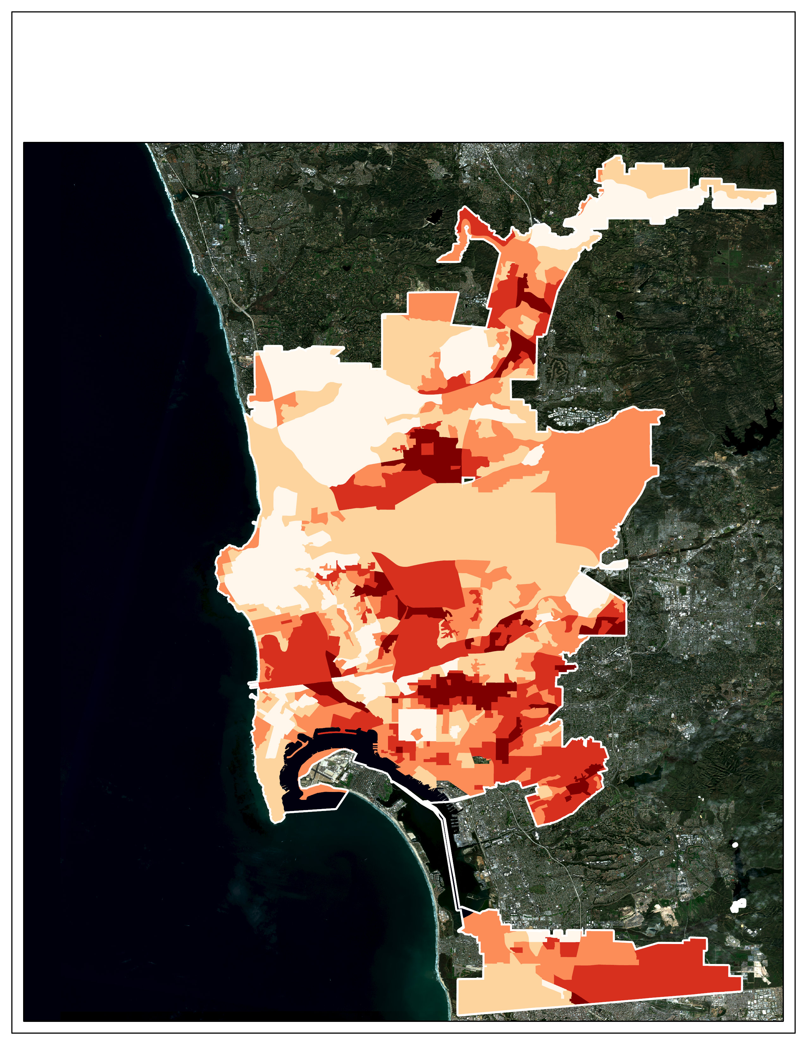
Results: Heat Exposure
Heat Exposure by Census Tract
Heat Exposure by Census Block
Very High
Very High
High
High
Moderate
Moderate
Low
Low
Very Low
Very Low
Notes:
Speaker Notes: Exposure was calculated based on day and nighttime surface temperatures. The equation to calculate exposure weighed nighttime temperature slightly more heavily. The data above is aggregated to the Census Block Group level as well as the Census Tract level. Heat exposure is a direct calculation without the PCA. Areas around the Mid City Normal Heights and University Heights area as well as areas near Mira Mesa in the northern portion of the study area.
----------------------------------------------------------------------------------------------------------------------------------------------------------------------------------------------------------------------------------------------------------------
Basemap info: Sentinel-2 Imagery acquired by DEVELOP team through Google Earth Engine

Slide 19
Results: Heat Vulnerability
Hypertension
COPD
Cardiovascular Health
Asthma
Diabetes
Obesity
High School Education
% Latinx
Insurance Access
English Proficiency
%Poverty
% Non-white
%Asian
%Black
%Over 65
% Living alone & >65
High School Education
% Latinx
English Proficiency
%Asian
% Non-white
% Black
% Over 65
% Living alone & >65
Notes:
Speaker Notes: We used a PCA to generate vulnerability scores for San Diego for both census tract and census block groups.
We took the 16 variables and analyzed them using the PCA method for census tracts and 8 variables for block groups. We then selected the 2-4 components that explained at least 75% of the data variation. These components were then used to develop an overall score for each census tract, and block group.

Slide 20
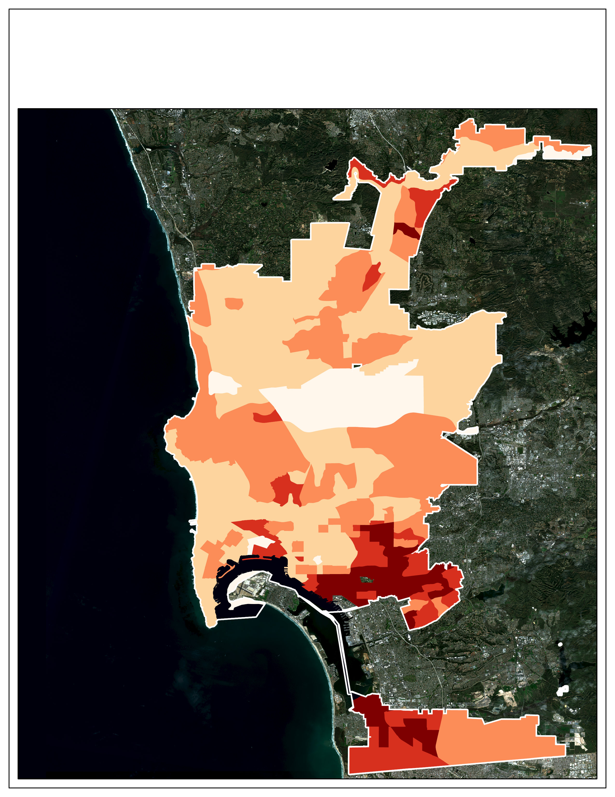
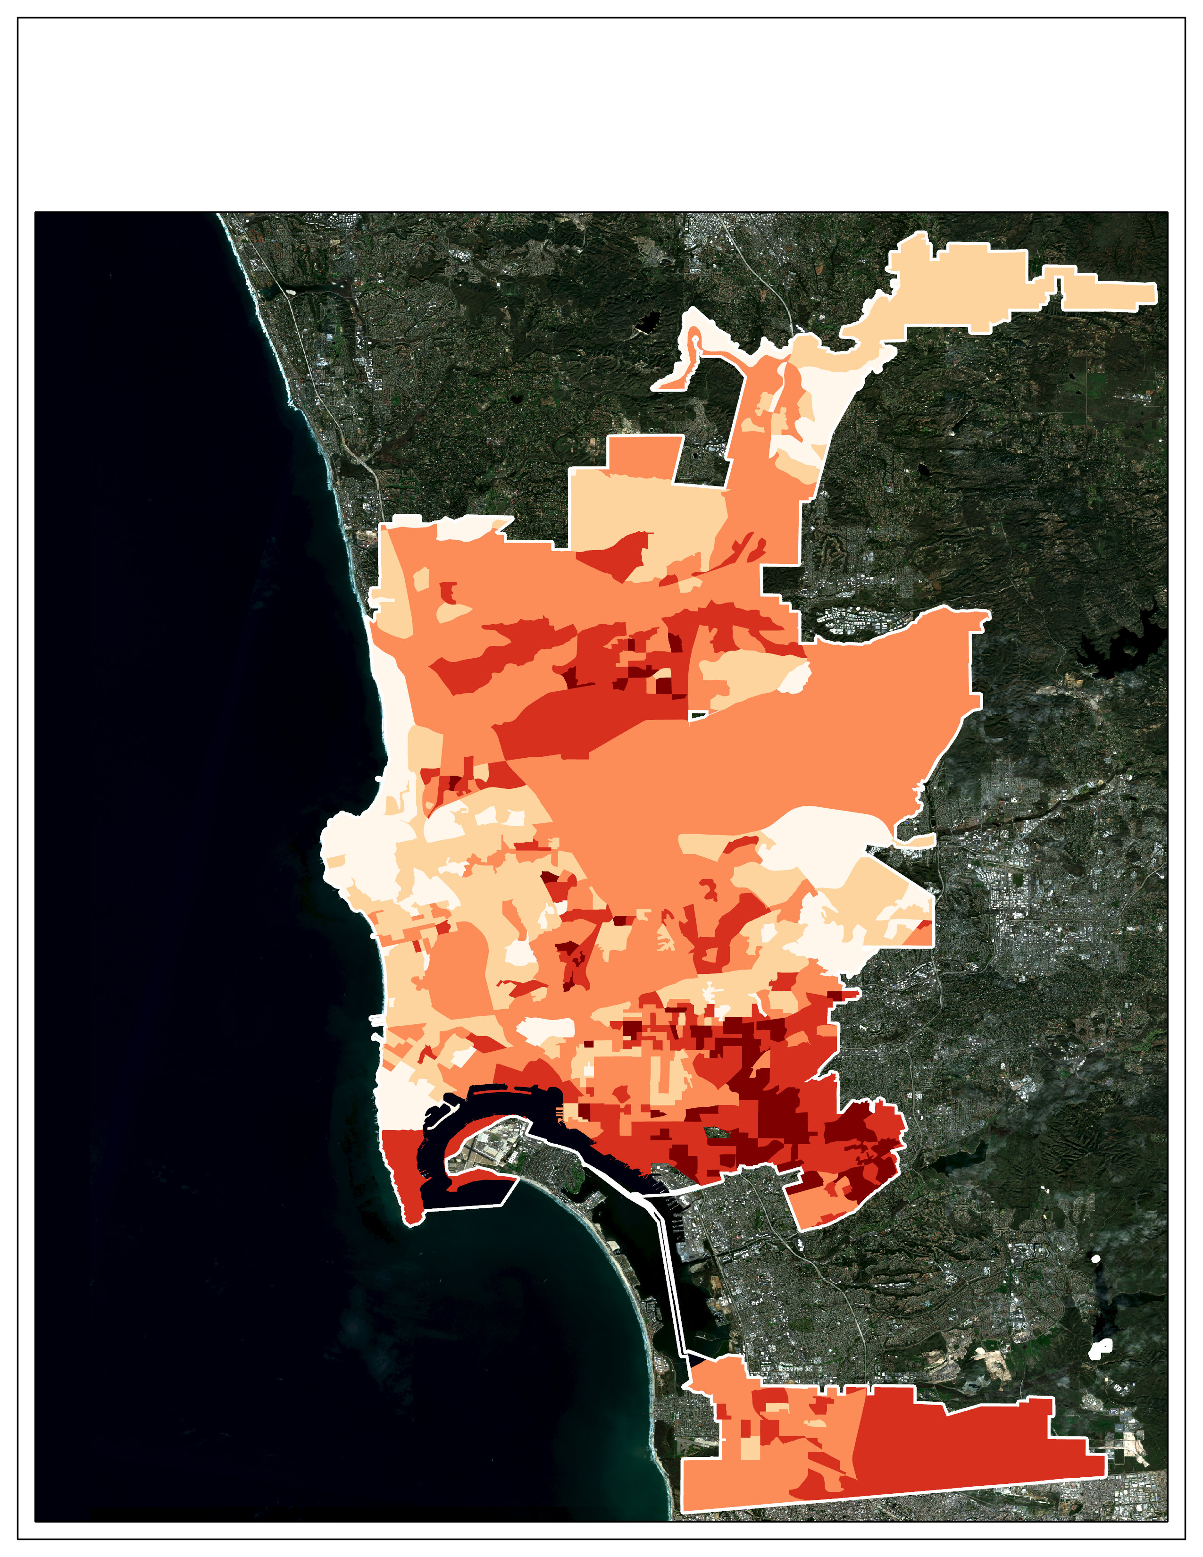
Results: Heat Vulnerability
Heat Vulnerability by Census Tract
Heat Vulnerability by Census Block
Very High
Very High
High
High
Moderate
Moderate
Low
Low
Very Low
Very Low
Notes:
Speaker Notes: The results of our vulnerability analysis show the areas with the highest vulnerability were found near La Mesa, as well as the neighborhoods near Lemon Grove, Encanto, and Lomiya neighborhoods. This was consistent across the both census tracts and census block groups. At the block group resolution another area oh high vulnerability was shown in the Mira Mesa area of San Diego. This was not shown at the census tract level.
----------------------------------------------------------------------------------------------------------------------------------------------------------------------------------------------------------------------------------------------------------------
Basemap info: Sentinel-2 Imagery acquired by DEVELOP team through Google Earth Engine

Slide 21
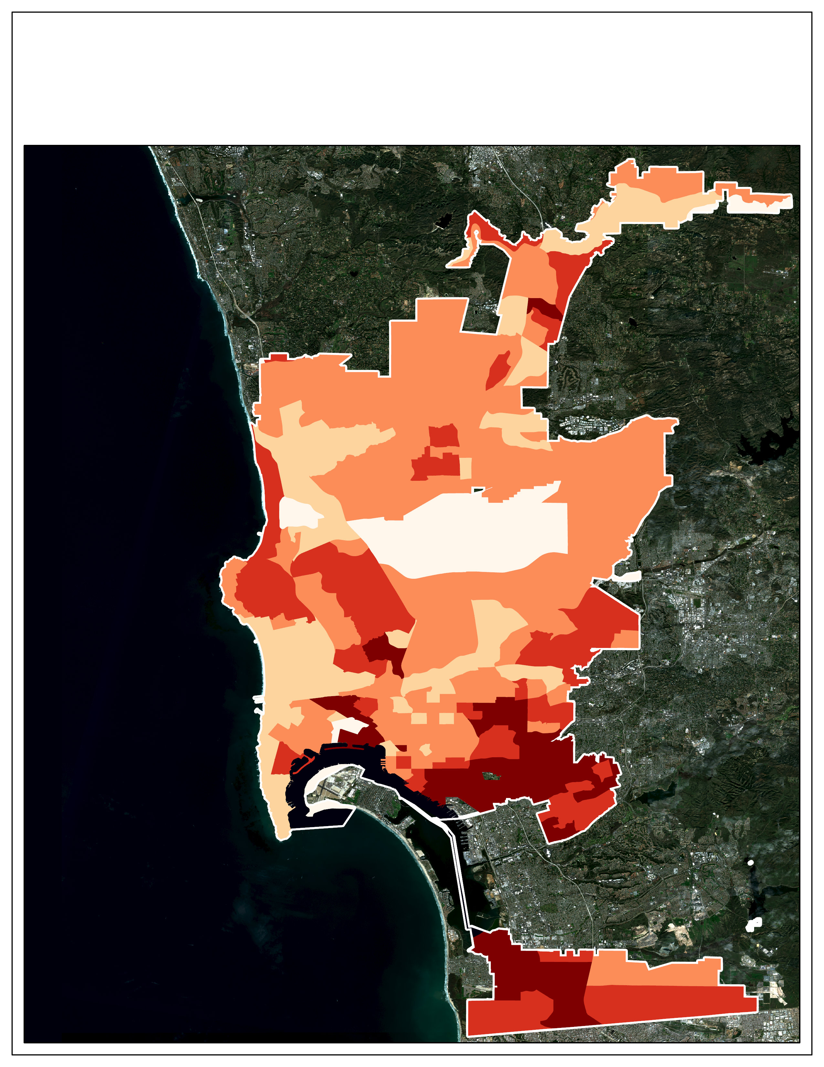
Results: Heat Risk Maps
Heat Risk by Census Tract
Heat Risk by Census Block
Very High
Very High
High
High
Moderate
Moderate
Low
Low
Very Low
Very Low
Notes:
Speaker Notes: Heat risk areas were identified for specific census tracts and census blocks. The difference in resolution produced different results on what areas were highest risk similar to what we found for the vulnerability areas. The highest risk again were found in the neighborhoods that were east of downtown including areas bordering Lemon Grove, Encanto, and Lomita neighborhoods.
----------------------------------------------------------------------------------------------------------------------------------------------------------------------------------------------------------------------------------------------------------------
Basemap info: Sentinel-2 Imagery acquired by DEVELOP team through Google Earth Engine

Slide 22
Results: Heat Risk Maps
Heat Risk by Census Tract
Heat Risk by Census Block
Very High
Very High
High
High
Moderate
Moderate
Low
Low
Very Low
Very Low
Notes:
Speaker Notes: Heat risk areas were identified for specific census tracts and census blocks. The difference in resolution produced different results on what areas were highest risk similar to what we found for the vulnerability areas. The highest risk again were found in the neighborhoods that were east of downtown including areas bordering Lemon Grove, Encanto, and Lomita neighborhoods.
----------------------------------------------------------------------------------------------------------------------------------------------------------------------------------------------------------------------------------------------------------------
Basemap info: Sentinel-2 Imagery acquired by DEVELOP team through Google Earth Engine

Slide 23
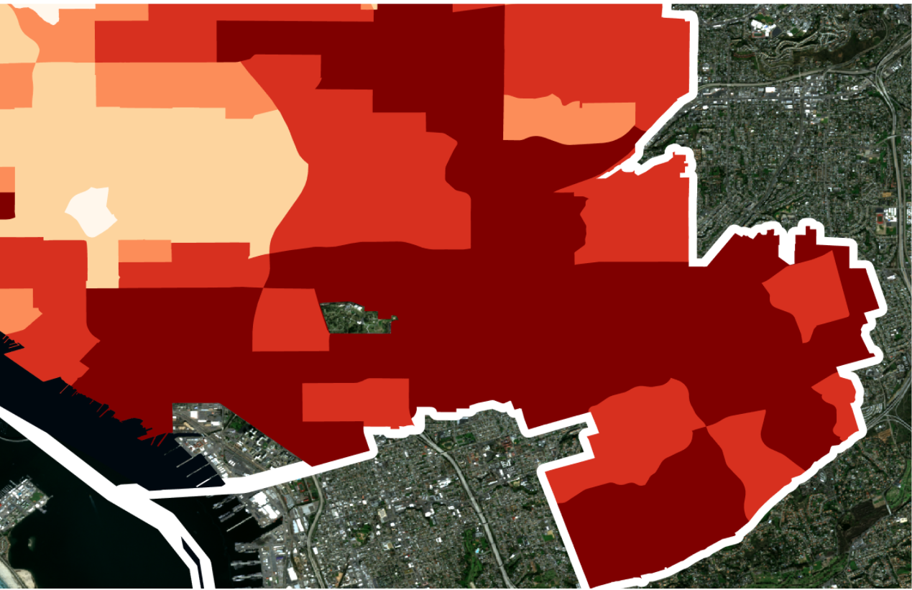
Results: Heat Risk by Neighborhood
Heat Risk by Census Tract
Very High
High
Very High
Moderate
High
Low
Moderate
Very Low
Low
Very Low
Encanto, Skyline-Paradise Hills, Southeastern San Diego
Notes:
Speaker Notes: Heat risk areas were identified for specific census tracts and census blocks. The difference in resolution produced different results on what areas were highest risk similar to what we found for the vulnerability areas. The highest risk again were found in the neighborhoods that were east of downtown including areas bordering Lemon Grove, Encanto, and Lomita neighborhoods. These regions had populations with high health conditions and some census tracts also had high populations of people with no health insurance and in poverty.
----------------------------------------------------------------------------------------------------------------------------------------------------------------------------------------------------------------------------------------------------------------
Basemap info: Sentinel-2 Imagery acquired by DEVELOP team through Google Earth Engine

Slide 24
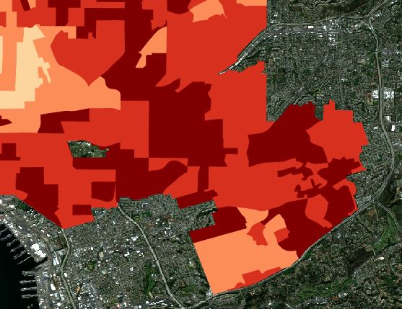
Results: Heat Risk by Neighborhood
Heat Risk by Census Tract
Very High
Very High
High
Moderate
Moderate
Low
Low
Very Low
Very Low
Encanto, Skyline-Paradise Hills, Southeastern San Diego
Notes:
Speaker Notes: Heat risk areas were identified for specific census tracts and census blocks. The difference in resolution produced different results on what areas were highest risk similar to what we found for the vulnerability areas. The highest risk again were found in the neighborhoods that were east of downtown including areas bordering Lemon Grove, Encanto, and Skyline-Paradise neighborhoods. The drivers for this high risk was a large percentage of non white population as well as those living alone and over 65 years old.
----------------------------------------------------------------------------------------------------------------------------------------------------------------------------------------------------------------------------------------------------------------
Basemap info: Sentinel-2 Imagery acquired by DEVELOP team through Google Earth Engine

Slide 25
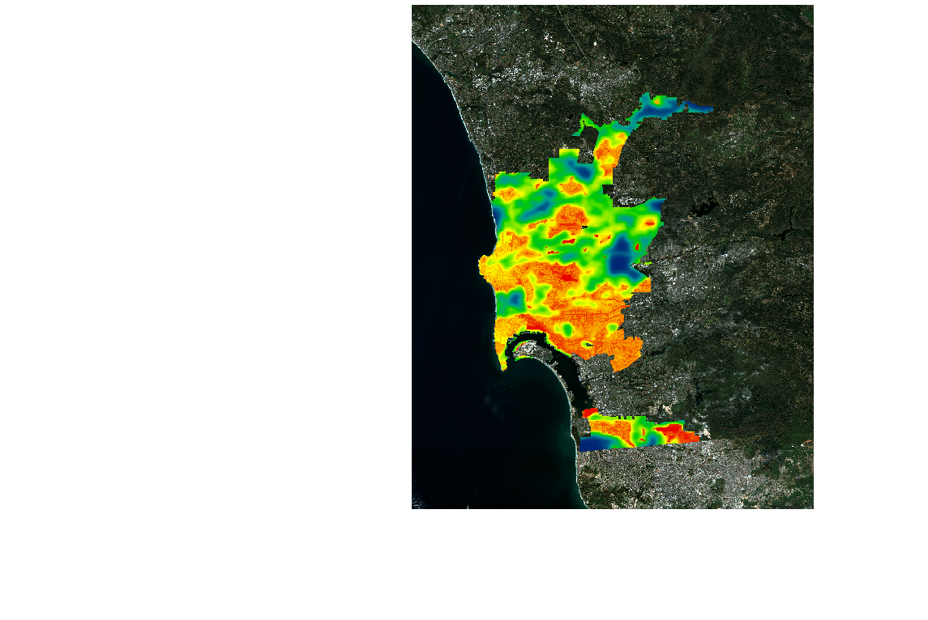
Results: Heat Mitigation Index (HMI)
Daytime HMI
Nighttime HMI
Heat mitigation strongly correlates to the presence of green areas.
1
1
Notes:
Speaker Notes: The heat mitigation index is determined by the parameters discussed previously. If a green area is within a certain distance of the cell then the cooling capacity from that green area is used if it's bigger than the cooling capacity of that cell. The resulting HMI was compared to the locations of parks and there is a clear connection between the presence of vegetation and the HMI for each cell. These HMI maps are outputs from InVEST.
---------------------------------------------------------------------------------------------------------------------------------------------------------------------------------------------------------------------------------------------------------------
Basemap info: Sentinel-2 Imagery acquired by DEVELOP team through Google Earth Engine

Slide 26
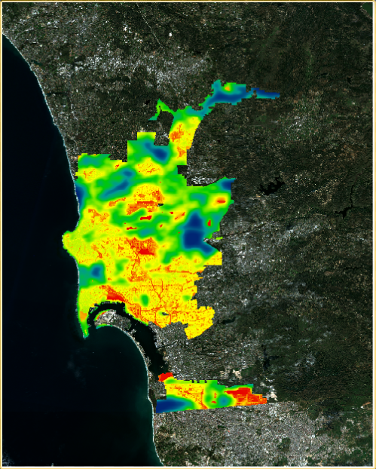
Results: 5% Increase in Tree Canopy
Daytime
A 5% increase in tree canopy showed increased cooling throughout the residential areas of San Diego, particularly in the neighborhoods of Normal Heights, and University Area.
Notes:
Speaker Notes: We ran a 5% tree canopy increase scenario showed cooling potential diffused throughout the City. Tree canopy was increased in areas identified by the City as feasible locations for tree planting. This included road shoulders (city right of way), parks and public spaces, and residential areas as part of a partnership with an NGO that facilitates tree planting for private residents. The result was an overall increase in HMI for these areas. In particular the communities of Normal Heights, University Area, Encanto, and Skyline-Paradise Hills. Remaining areas of low HMI were primarily airports, military bases, and extractive industry.
---------------------------------------------------------------------------------------------------------------------------------------------------------------------------------------------------------------------------------------------------
Basemap info: Sentinel-2 Imagery acquired by DEVELOP team through Google Earth Engine

Slide 27
Conclusions
1. PCA analysis showed
Census tracts: health indicators explained most variance
Census block groups: education, ethnicity, and language proficiency
2. Areas with the highest vulnerability
Near Skyline-Paradise, Encanto, and University Area neighborhoods.
3. Neighborhoods of highest risk reflected those of highest vulnerability.
4. There is considerable overlap between areas of high heat risk and low heat mitigation.
5.InVEST Model showed a substantial cooling potential from an increase of 5% tree canopy.
Icon Credit: Microsoft PowerPoint Clipart​
Notes:
Speaker Notes: The PCA analysis showed that Hypertension, COPD, Cardiovascular Health , Asthma, Diabetes and Obesity explained the most variation in terms of vulnerability at the census tract level, while in the absence of health data at the block group level, high school education, percent latinX, and English language proficiency explained the most variation. The areas with the highest vulnerability were found near Skyline-Paradise, Encanto, and University Area neighborhoods. InVEST Model: Daytime HMI showed areas of low HMI in the vicinity of planning areas Mira Mesa, Mid-City and Otay Mesa-Nestor/San Ysidro. Low Nighttime HMI areas include University and Mid-City and Otay Mesa-Nestor. There is considerable overlap between areas of high heat risk and low heat mitigation.
Icon Credit: Micorsoft PowerPoint Clipart

Slide 28
Errors and Uncertainties
Land Surface Temperature and heat indices are proxies for air temperature
Resolution issues, temporal and spatial
Stationary data
Icon Credit: Microsoft PowerPoint Clipart​
Notes:
Speaker Notes: There were a number of uncertainties in our analysis of San Diego. First and foremost is that LST data was used as a proxy for air temperature or the temperature felt by residents. In addition our analysis does not take into account the movement of people throughout the day such as to work and school. Both our spatial and temporal resolution of our data can be improved due to the images not available everyday and having a moderately coarse resolution. Lastly InVEST as a model involved numerous assumptions including: weighting factors for shade, albedo, and ET, cooling distance for green areas. In addition the model does not account well for cooling due to large water bodies such as the ocean and the bay.
Icon Credit: Micorsoft PowerPoint Clipart

Slide 29
Future Work
Add data from resident surveys that will be completed summer 2021
Use 2020 Census data once it becomes available
Use hospitalization and emergency calls data to analyze the locations of risk
Refine InVEST inputs using up to date data & model validation
Icon Credit: Microsoft PowerPoint Clipart​
Notes:
Speaker Notes: Within the City of San Diego there are a number of community concerns. Increasing urban temperatures particularly along the coast where not all residents have access to air conditioners has left many residents exposed to heat. There is a strong thermal inequity between which social demographic groups face the largest burden from heat. This exposure leads to increased heat related death and mortality, as well as a loss of work productivity and increase in energy use. Additionally this data may be used for the City of San Diego for use with the NIHHIS-CAPA Urban Heat Island Mapping Campaign Application. InVEST: parameters such as building intensity could be improved on using LiDAR or other updated building height data. In addition the LULC table can be refined by merging categories with similar physical parameters to improve accuracy. Further model validation could be done using in-situ temperature measurements.
Icon Credit: Micorsoft PowerPoint Clipart

Slide 30
A special thank you to our Science Advisors and Team Fellow for their direction and support
Dr. David Hondula (Arizona State University, Associate Professor)
Dr. Kenton Ross (NASA Langley Research Center)
Ryan Hammock (NASA DEVELOP, Fellow/Lead)
We would also like to thank our wonderful project partners and collaborators at the City of San Deigo and AGU Thriving Earth Exchange: Julia Chase, Jordan Moore, and Heidi Vonblum of the City of San Diego and Kristen O'Shea of Thriving Earth Exchange
Notes:
Speaker Notes: Our team would like to extend a special thanks to the City of San Diego for partnering with us and their efforts in the project. We would also like to thank Kristen O'Shea who was a great colloborator to work with. We also would like to Thank our NASA DEVELOP fellow Ryan Hammock for all of hie tireless efforts throughout the term. Finally we would like to thank our science advisors Dr. David Hondula and Dr. Kenton Ross.

