Slide 1
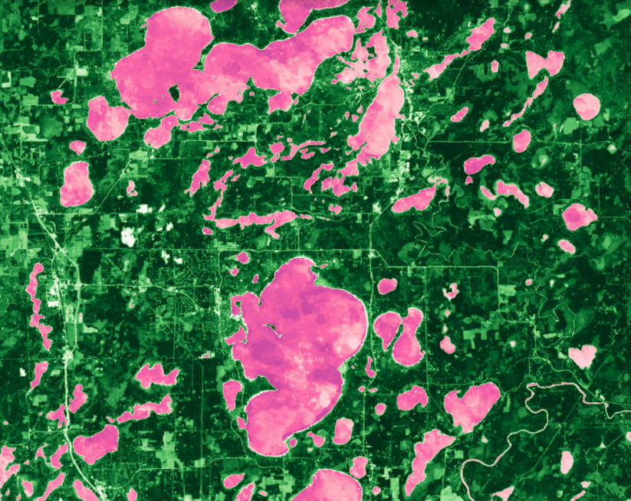
GREAT LAKES WATER RESOURCES
Improving Wetland Change Mapping using Optical and Radar Satellite Sensors to Assess Wetland Gain and Loss Metrics in Minnesota
Erica O’Connor
Melissa Ferriter
Alice Lin
Christopher Notto
California – JPL | Spring 2019
Notes:
The NASA DEVELOP Great Lakes Water Resources team worked in conjunction with end users at wetland agencies in Minnesota and across the nation, to create an automated wetland delineation tool hosted on GEE, called WET (Wetland Extent Tool).

Slide 2
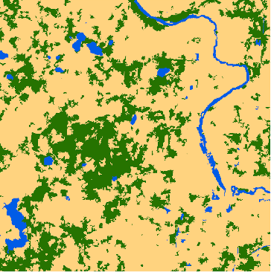
Study Area & Period
Minnesota has a continental climate with cold winters and hot summers
Temperatures frequently dip below freezing, and snow is the main form of winter precipitation
Our study period was the growing seasons of 2017 and 2018, when the area is not frozen
Growing Season: May 21 to September 26
Fond Du Lac Reservation:
2017 Growing Season
N
United States
0 30 60 120 180 240
km
0
3,000 km
1,000
2,000
0
5
10
15 km
Image Credit: Great Lakes Water Resources Team
Notes:
Minnesota’s numerous wetlands provide crucial ecosystem services including flood mitigation, carbon storage, regulation of erosion and water quality, and habitat for rare species.
Despite these benefits, wetlands are facing increasing threats from a variety of sources, including pollution, changing climate, and commercial development.
Our team studied the entirety of the state during the growing season to limit the amount of frozen landscape. The growing season is defined by first and last frost in Northern Minnesota by the Minnesota Department of Natural Resources (MN DNR).
We used a smaller sample area, the Fond Du Lac Reservation, to test our classifications and thresholds. This allowed us to use less processing power and look more closely at an area with a high density of field validation points and a good mix of all three land cover classes of interest.
Image Credit: Spring 2019 Great Lakes Water Resources Team
Image Credit: Esri, DigitalGlobe, GeoEye, Earthstar Geographics, CNES/Airbus DS, USDA, USGS, AeroGRID, IGN, and the GIS User Community

Slide 3
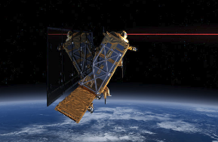
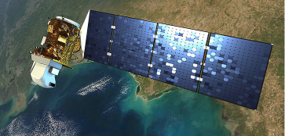
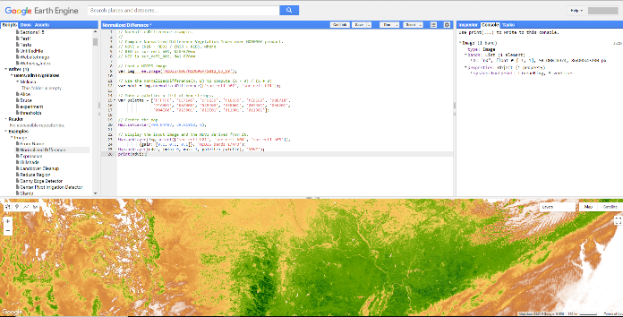
Objectives
Improve wetland change mapping using radar and optical datasets, including NASA EO, to aid end users in assessing wetland gain and loss in Minnesota
Create an automated, multi-satellite, and seasonal tool, called the Wetland Extent Tool, for wetland mapping that can efficiently account for changes in wetland extent
Build our end users’ capacities to utilize radar data and the cloud computing abilities of GEE for wetland mapping
Sentinel-1 C-SAR
Landsat 8 OLI
Google Earth Engine: Wetland Extent Tool
Image Credit: NASA, ESA, Google Earth Engine via Great Lakes Water Resources Team
Notes:
The objective of this project was to improve wetland change mapping using both radar and optical datasets including NASA Earth observations by creating an automated tool in GEE, that we call the Wetland Extent Tool (WET).
This tool utilizes USGS Landsat 8 Operational Land Imager, and ESA Copernicus Sentinel-1 C-band synthetic aperture radar datasets hosted on the cloud to generate classified wetland maps.
The tool also builds and improves our partner’s capacities to use the GEE platform in conjunction with radar imagery and NASA EO data. A host of ancillary datasets, such as a Digital Elevation Model (DEM) and over 7,000 field points used in our classification and validation process.
Ultimately, this automated tool saves time and resources that would otherwise be spent on field surveying and traditional mapping and remote sensing approaches.
Image Credit: NASA DEVELOP
Image Source: http://www.devpedia.developexchange.com/dp/images/c/c2/03_Landsat8.png (public domain)
Image Credit: NASA DEVELOP
Image Source: http://www.devpedia.developexchange.com/dp/images/8/81/23_Sentinel1.png (public domain)
Image Credit: Google Earth Engine
Image Source: https://earthengine.google.com/

Slide 4
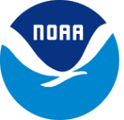
Partners
US Fish and Wildlife Service, National Wetlands Inventory
Minnesota Department of Natural Resources
US Environmental Protection Agency, Office of Research and Development
Ducks Unlimited
University of Minnesota
NOAA Office for Coastal Management
Image Credit: US Fish and Wildlife Service (US FWS), US Environmental Protection Agency (EPA), NOAA
Notes:
The NASA DEVELOP Great Lakes Water Resources team worked with end users at the U.S. Fish and Wildlife Service National Wetland Inventory, Minnesota Department of Natural Resources, Environmental Protection Agency, Ducks Unlimited, the University of Minnesota, and the National Oceanic and Atmospheric Administration Office for Coastal Management.
Image Credit: U.S. Fish and Wildlife Service
Image Source: https://commons.wikimedia.org/wiki/File:US-FWS-logo.png (public domain)
Image Credit: U.S. Environmental Protection Agency
Image Source: https://commons.wikimedia.org/wiki/File:Environmental_Protection_Agency_logo.png (public domain)
Image credit: National Oceanic and Atmospheric Administration
Image source: https://nsd.rdc.noaa.gov/images/NOAA_emblem.png (public domain)

Slide 5
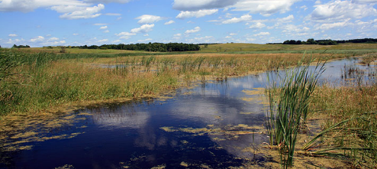
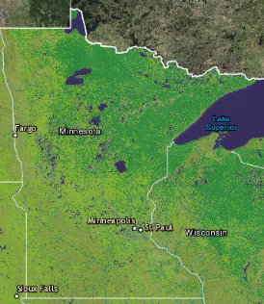
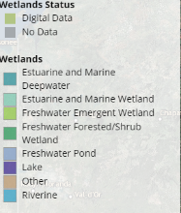
Community Concerns
The Intergovernmental Panel on Climate Change (IPCC) declared wetlands the most vulnerable landscape feature on the planet
Stakeholders need current and accurate wetland maps
Current practices of mapping wetland extent is a time-consuming and labor intensive process
Image Credit: US FWS
Notes:
Wetlands are critical ecosystems that provide services such as water filtration, carbon storage, and habitat to rare species, however, they remain vulnerable to anthropogenic influences.
Minnesota has a ‘no net loss’ policy for wetlands, to ensure the conservation of these important landscapes.
Updated and accurate maps are needed by stakeholders across the spectrum.
Stakeholders in Minnesota particularly use these maps to inform their conservation, home development, transportation infrastructure, and agricultural management decisions.
Traditionally, wetland extent mapping has involved interpretation of aerial orthophotography in conjunction with field data.
Due to the resource intensive nature of conventional wetland mapping methods, it is difficult to consistently update such geospatial inventories in a reliable and comprehensive manner. It requires the participation of multiple agencies in order to be implemented.
As a result, there are still portions of the NWI that have not been updated since the 1970’s.
Image Credit: U.S. Fish and Wildlife Service
Image Source: https://www.fws.gov/midwest/InsideR3/August17Story16.htm (public domain)
Image Credit: U.S. Fish and Wildlife Service
Image Source: https://www.fws.gov/wetlands/data/Mapper.html (public domain)

Slide 6
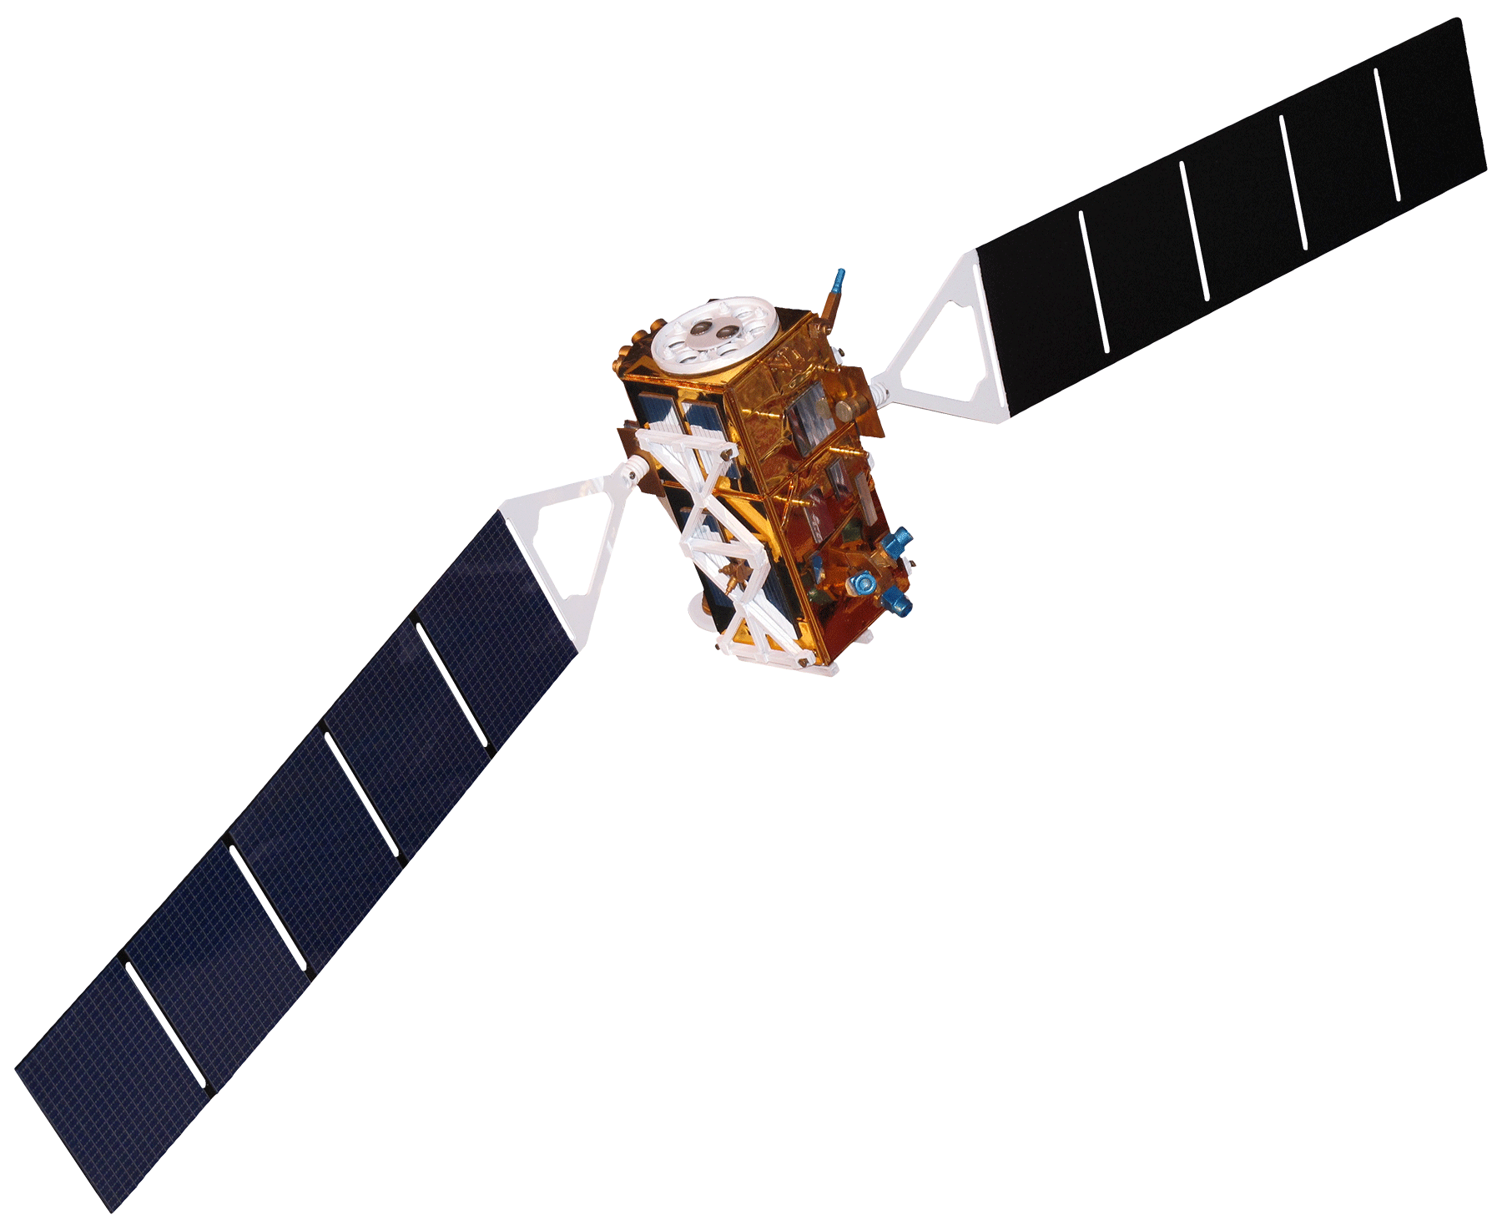
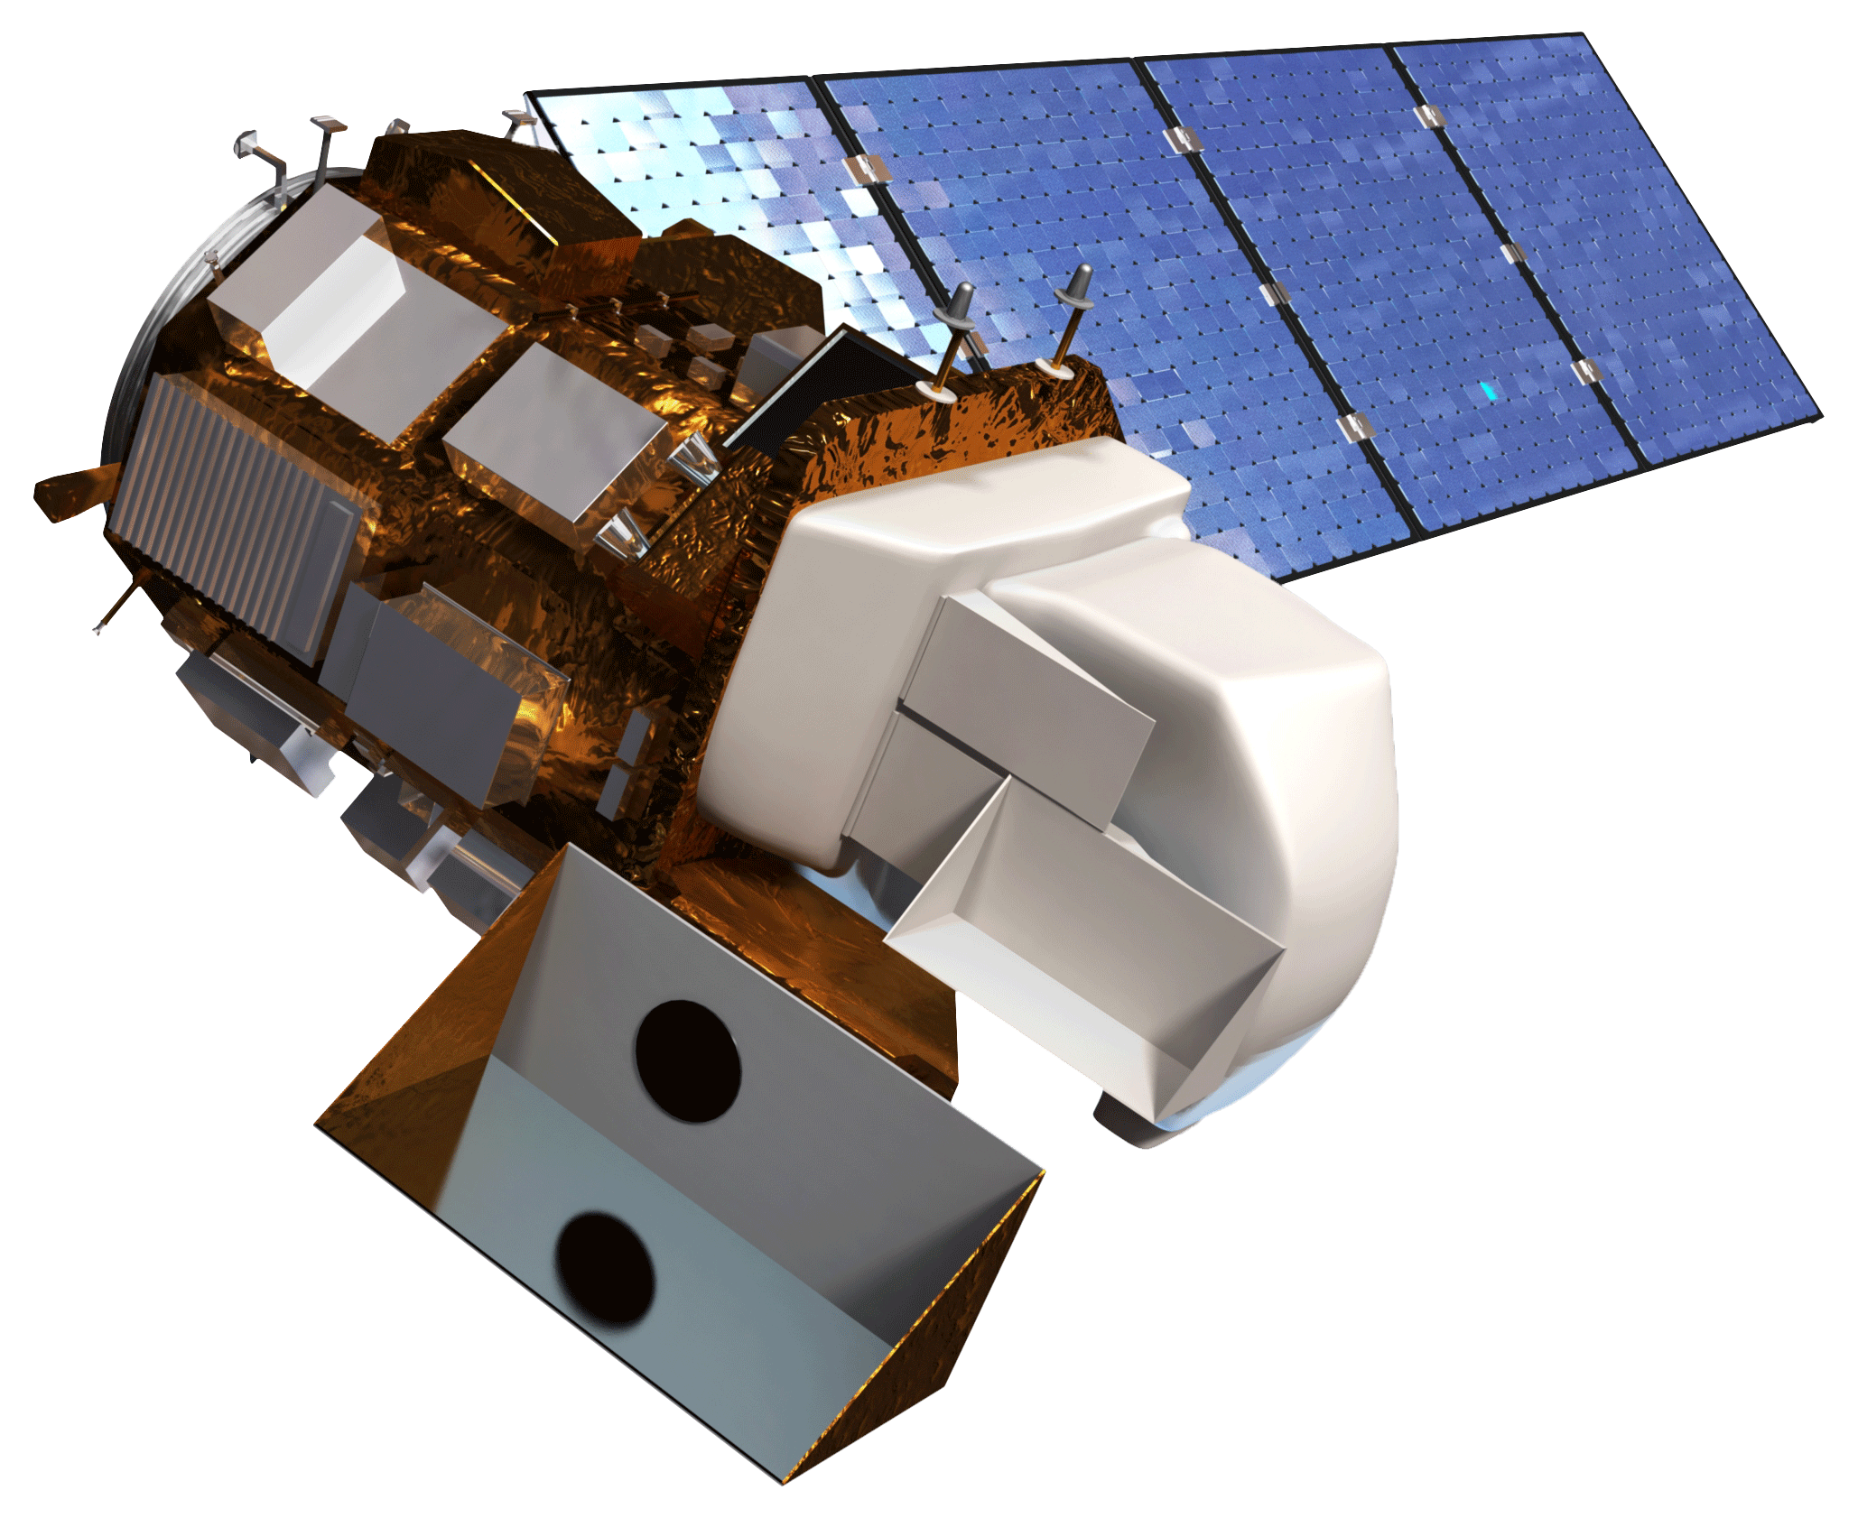
Earth Observations Used
Sentinel-1 C-SAR
Landsat 8 OLI
Backscatter values
6-to 12-day return
10-meter resolution
Surface reflectance
16-day return
30-meter resolution
Image Credit: NASA, ESA
Notes:
NASA Earth observations were used in conjunction with ESA Copernicus Sentinel data.
We used both optical and radar imagery; The sensors utilized were Landsat 8’s Operational Land Imager and Sentinel-1’s C-band synthetic aperture radar.
We chose to use Landsat 8 data, due to the fact that surface reflectance data was accessible on Google Earth Engine.
Image Credit: NASA DEVELOP
Image Source: http://www.devpedia.developexchange.com/dp/images/8/81/23_Sentinel1.png (public domain)
Image Credit: NASA DEVELOP
Image Source: http://www.devpedia.developexchange.com/dp/images/c/c2/03_Landsat8.png (public domain)

Slide 7
Methodology: Wetland Extent Tool (WET)
Filtering
Pre-Processing
Classification
Validation
Change Detection
Cloud mask
Specified thresholds
Landsat 8 OLI
MN State
Date
Cloud Cover
TCWGD, MNDWI
Mean composite
2017 Wetland Map
Preliminary classified wetland map
Sentinel-1 C-SAR
MN State
Date
IW Swath
Border removal
SNIC image segmentation
2018 Wetland Map
Convert to natural values
Image stack
VV,VH
Confusion matrix
Accuracy assessment
Mean composite
(resampled to 30 m)
Random forest classification
Change Detection Map
LiDAR-derived TWI
(resampled to 30 m)
Field data
Notes:
Our Sentinel-1 data was first acquired through the GEE API and then filtered for the state boundary of Minnesota, for the date range of the growing season, and for cloud cover and Interferometric Wide instrument mode.
For the optical imagery, we created a cloud masked Tasseled Cap Greenness Wetness Index (TCGW) and Modified Normalized Difference Water Index (MNDWI) composite mean.
We created a stack that contained the Landsat 8 composites, Sentinel-1 VV and VH backscatter composites, and a LiDar derived Topographic Wetness Index (TWI)
We then took an Object Based Image Analysis (OBIA) by first creating objects through Simple Non-iterative Clustering (SNIC) and then doing two separate classifications using a random forest classifier and manual thresholds
The resulting classification maps were used to generate confusion matrices and change detections maps Image Credit: Spring 2019 Great Lakes Water Resources Team

Slide 8
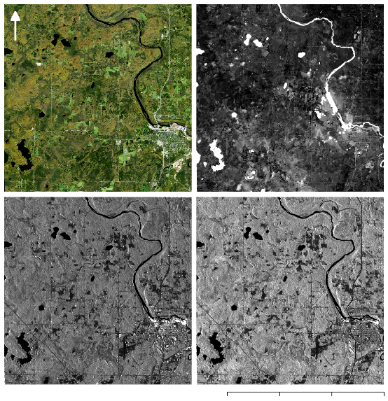
Pre-processing
SNIC Image Objects
NAIP - RGB
Landsat 8 MNDWI
Sentinel-1 VV
Sentinel-1 VH
0
5
10
15 km
0
5
10
15 km
Image Credit: Great Lakes Water Resources Team
Notes:
The SAR scenes hosted by GEE undergo processing by the European Space Agency (ESA) Sentinel–1 toolbox that includes terrain correction using a digital elevation model (DEM), the application of an orbit file, noisy border removal, radiometric calibration, and conversion from natural values to decibels.
For the purposes of this project, we converted dB values back to natural values and removed dark borders from some scenes.
We then created Vertical Vertical and Vertical Horizontal geo-coded backscatter intensity composites for 2017 and 2018
We used created cloud free Landsat 8 Surface Reflectance Tier 1 composites using the Quality Assessment (QA) band.
The tier 1 Landsat collections hosted on GEE are already radiometrically and geometrically corrected so we took no further calibration steps.
In total, 183 and 193 images at 30 m resolution were available for 2017 and 2018 respectively
We carried out an object-based image analysis (OBIA) in a two-stage approach: first segmentation using SNIC and then second a classification using a random forest (RF) classifier and manual thresholds.
We chose to use objects because research suggests object-based image segmentation reduces noise in the final classification while pixel-based classification, relies solely on single pixel values, which results in lower accuracy speckled classification maps.
Image credit: Great Lakes Water Resources Team

Slide 9
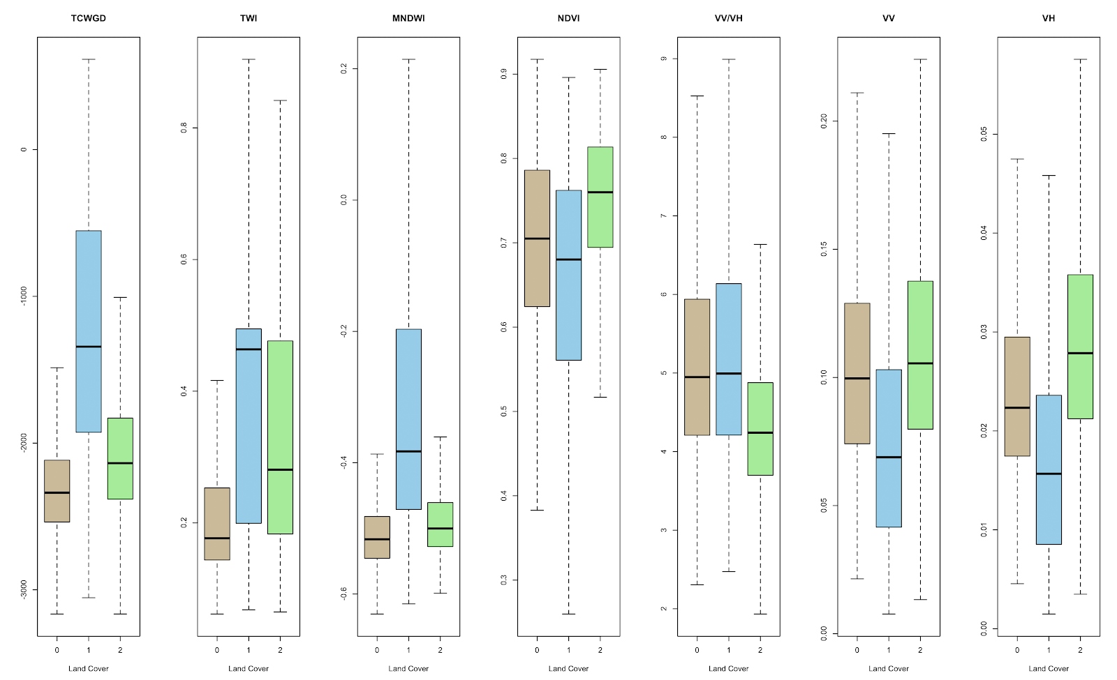
Results: Separability of classes
TCGW TWI MNDWI NDVI VV/VH VV VH
Final inputs are bolded
Outliers omitted from graphs
Upland
Open Water
Wetland
Image Credit: Great Lakes Water Resources Team
Notes:
To reduce computing time, we decided to eliminate inputs that didn’t easily distinguish between classes
We sampled pixel values for each index/band at each field validation point and generated a distribution visualization via box-and-whisker plots
Bolded indices/bands are the ones we put in our final image stack to go into segmentation and subsequent classification
We also have box-and-whisker plots breaking down the wetland classes into four more classes (emergent, shrub, forested, aquatic veg), which could be used during a later term.
Image Credit: Great Lakes Water Resources Team

Slide 10
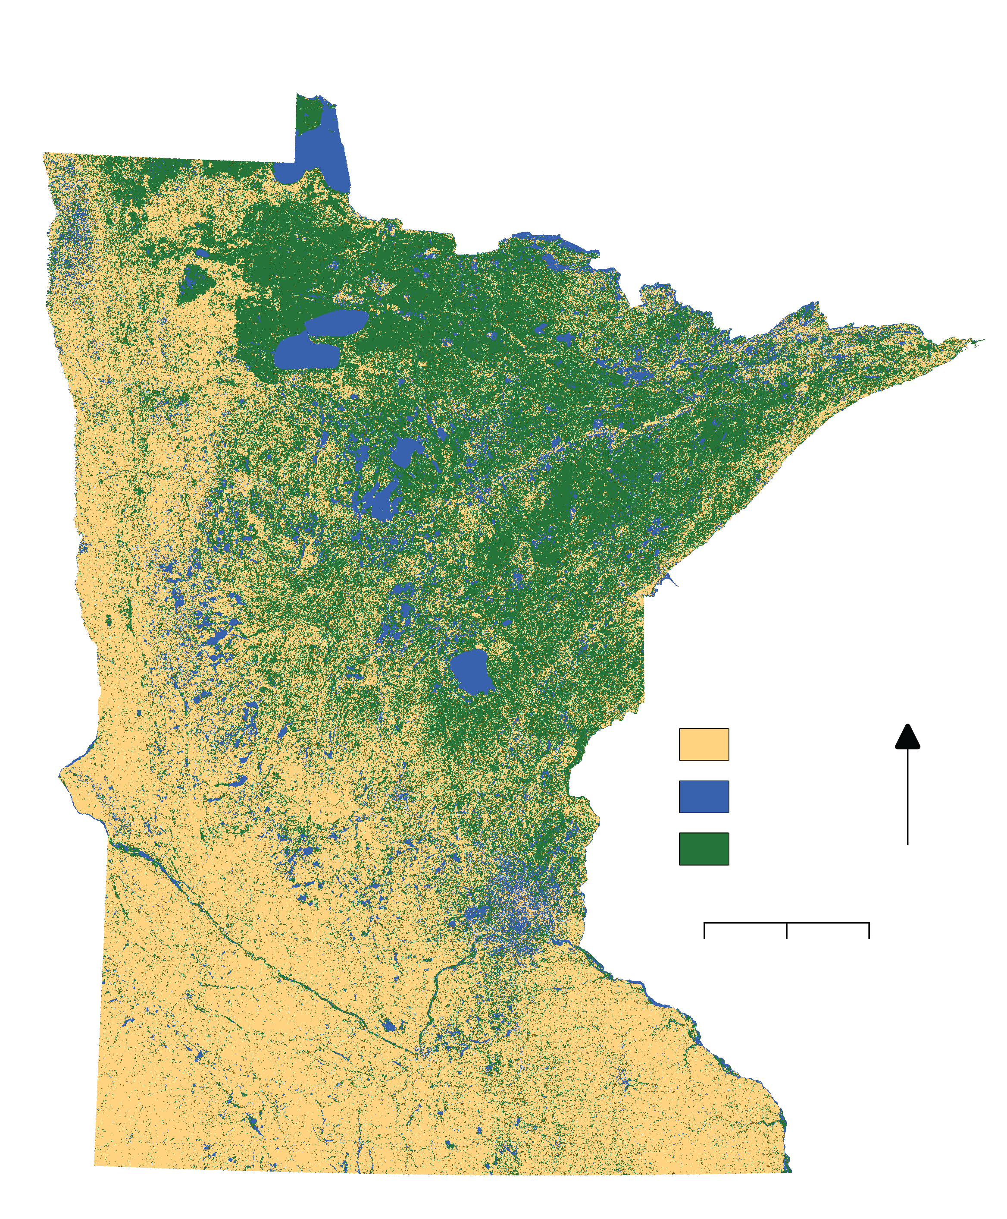
Results
Random Forest Classification Map
An overall classification accuracy of 87% was achieved, when comparing the Random Forest classification to the field data points.
Random Forest Classification:
2017 Growing Season
Accuracy Assessment | Overall Accuracy
Random Forest to Field Data | 87%
Random Forest to NWI | 55%
Threshold Map to Field Data | 49%
Threshold Map to NWI | 44%
Upland
Open Water
Wetland
N
0 25 50 100 150 200
0 500 1000 km
Image Credit: Great Lakes Water Resources Team
Notes:
An overall classification accuracy of 87% was achieved, when comparing the Random Forest classification to the field data points.
Our classification confused upland for open water 15% of the time and wetland for open water 10% of the time.
This suggests that more training data for the open water category is needed
Our second best classification was the random forest compared to the NWI which achieved an overall accuracy of 55% while the Threshold classification achieved a 49% and 44% overall accuracy when compared to the field data and the updated NWI respectively
The threshold map did poorly in differentiating open water from other classes but this could be due to the fact that we used a universal threshold over the entire state
Looking at smaller pilot areas the threshold map was fairly accurate
Image Credit: Great Lakes Water Resources Team

Slide 11
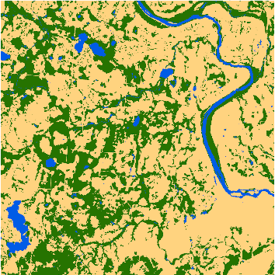
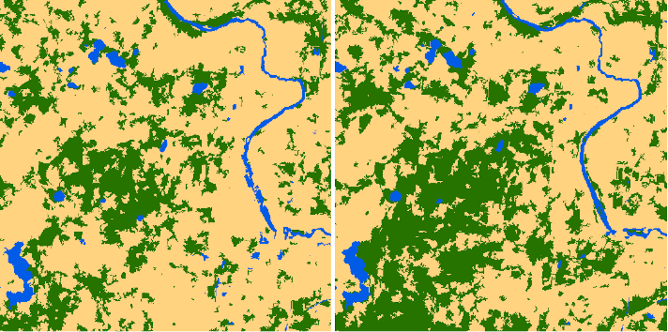
Results: Thresholding
NWI
2017
2018
Upland
Open Water
Wetland
0
2
4 km
Due to disagreement between Random Forest map and NWI, we explored setting threshold rules for each class manually
Adjusted them for Fond Du Lac site until it resembled NWI update (69.5% accuracy)
However, statewide map performed poorly in accuracy assessments (55%)
Image Credit: Great Lakes Water Resources Team
Notes:
We attempted to classify the state through manual thresholding to see if we could generate a map similar to the NWI update provided by partners
Our thresholding rules were based on Modified Normalized Difference Water Index, Topographic Wetness Index, and SAR bands
We adjusted these thresholds for Fond Du Lac reservation until the land cover patterns visually resembled the NWI update
Under the same thresholds, there is a considerable change in the ‘wetness’ of this one site, indicating interyear wetland change can be significant (39% increase from 2017 to 2018)
However, the whole state threshold map performed very poorly in accuracy assessment tests suggesting that more fine tuning of thresholds is needed or spectral signatures for wetlands across MN vary spatially, making it hard to apply one rule to the whole state (at least with current spectral resolution)
Image Credit: Great Lakes Water Resources Team

Slide 12
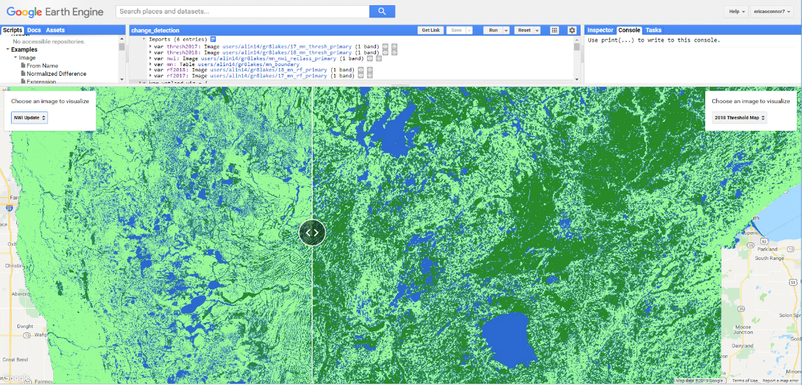
Results: User interface
Wetland Extent Tool
Image Credit: Google Earth Engine via Great Lakes Water Resources Team
Notes:
Our partners will be able to use our WET tool, on Google Earth Engine, a free cloud-computing platform
They will have control over the date range and study area they want to classify, but right now it is set to classify the growing season of the whole state
We also included a slider option user interface that will compare wetland maps side by side
Image source: Google Earth Engine via Great Lakes Water Resources team

Slide 13
Conclusions
The random forest classification map validated against the field points was the most accurate result
Additional field validation points, particularly in the open water class, are needed
Further work can be done to investigate how accuracy changes with the inclusion of additional datasets (soil, Sentinel-2) and classification methods (pixel vs. object)
Image credit: US FWS
Notes:
The Random Forest classification map validated against the field points is the most accurate result by a large margin and approximates the accuracy our partners achieved on their NWI update.
We concluded that additional and more recent field validation points, particularly in the open water class, are needed to strengthen some weak points of the classification
Further work can also be done to investigate how accuracy changes with the inclusion of additional datasets (soil, Sentinel-2) and classification methods (pixel vs. object)
Image Credit: U.S. Fish and Wildlife Service
Image Source: http://www.fws.gov/klamathbasinrefuges/tulelake/tulelake.html (public domain)

Slide 14
Errors & Uncertainties
2017 Random Forest Classification Map vs. Field Data
Spatial resolution for Sentinel-1 data had to be resampled to 30 m
Field data provided by our partners was collected almost ten years ago by multiple researchers and may have classification differences due to individual bias
Tree height and canopy height may be too tall for Sentinel-1 to be able to penetrate through
Overall Accuracy: 87%
 |  | Field Data
 | Upland | Open Water | Wetland
Upland | 87.25% | 7.48% | 7.32%
Open Water | 2.54% | 76.92% | 2.33%
Wetland | 10.21% | 15.60% | 90.35%
2017 Classification Map
 | Producer's Accuracy | User's Accuracy
Upland | 87.25% | 89.49%
Open Water | 76.92% | 87.52%
Wetland | 90.35% | 83.56%
Notes:
Our classified random forest map had an overall accuracy of about 87%, when compared to field data given by our partners, which in some areas has not been update in over 9 years.
Our random forest maps misclassified wetland as upland 3% of the time, and as open water 10% of the time. Also, Upland was misclassified as Open Water 16% of the time.
Further investigation needs to be done to conclude why our maps are over-classifying Open Water, but initial findings suggest that it could be due to the field points or TWI layer
Image Credit: Spring 2019 Great Lakes Water Resources Team

Slide 15
Future Work
Expand classification scheme by including Level–2 classifications of wetlands
Use recent wetland mapping data from Ducks Unlimited to validate the tool
Compare results to seasonal sub-meter optical DigitalGlobe and RADARSAT-2 imagery that has been acquired over 10 pilot sites in Wisconsin and Michigan
Adjust the tool so that it is useable across the Great Lakes area and neighboring regions in Canada
Notes:
Future terms can expand to other Great Lakes states and further classify the wetland class into emergent, forest and shrub wetlands
Work also needs to be done to further calibrate and validate our image segmentation and classification scheme with recent maps and higher resolution imagery

Slide 16
Erika Higa, DEVELOP California – JPL Node (Center Lead)
Neda Kasraee, DEVELOP California – JPL Node (Impact Analysis Fellow & Assistant Center Lead)
Bruce Chapman, NASA Jet Propulsion Laboratory, California Institute of Technology (Science Advisor)
Benjamin Holt, NASA Jet Propulsion Laboratory, California Institute of Technology (Science Advisor)
Brian Huberty, US FWS NWI
Steve Kloiber, MN DNR
Tom Hollenhorst, EPA
Robb Macleod, DU
Joe Knight, UMN
Brandon Krumwiede, NOAA
This material contains modified Copernicus Sentinel data (2017-2018), processed by ESA.

